Slide 1
The Combination therapy in fibrosing ILDs
Venerino Poletti
Dipartimento di Malattie dell’Apparato Respiratorio e del Torace. Azienda USL Romagna
Pneumologia Ospedali Forlì/Ravenna (I)
Department of Respiratory Diseases & Allergy
Aarhus University Hospital (DK)

Slide 2
Conflicts of interest
Boeringher
Roche

Slide 3
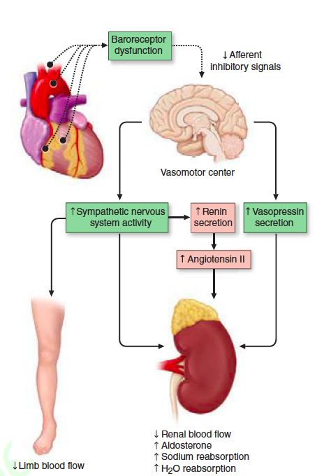
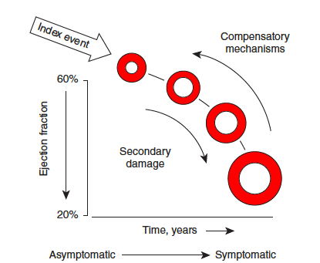

Slide 4
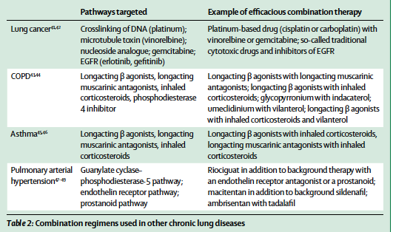

Slide 5
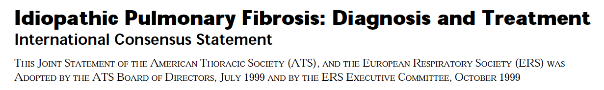

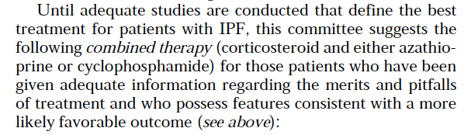

Slide 6
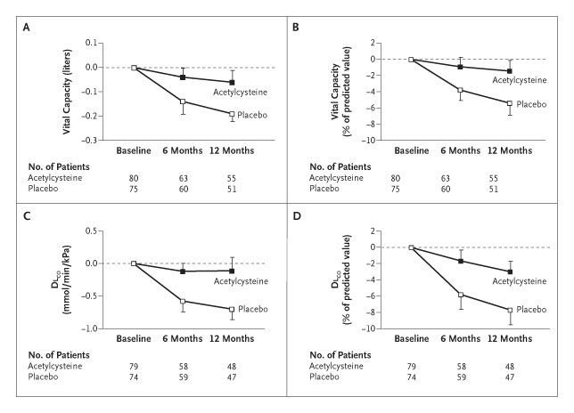
IFIGENIA
NAC slows the rate of decline of lung function in patients treated with prednisone + azathioprine
Δ CV: 180 ml (4,8%) P = 0,017
Δ DLCO : 0,75 (5%) P = 0,003
Mortality : 9% vs 11%
(Demedts, NEJM 2005)

Slide 7
Before 2011,
Prednisone + AZA + NAC
= the therapeutic standard in IPF
Experts (ATS/ERS 2000 consensus)
IFIGENIA study

Slide 8
Before 2011,
Prednisone + AZA + NAC
= the therapeutic standard in IPF
…But No placebo study

Slide 9
PANTHER trial
IPF Network NIH
IPF mild to moderate
(FVC> 50%;DLCO > 30%; Dc <4 years)
Pred + AZA + NAC
Prednisone
0.5→0.15 mg/kg 25wks
Azathioprine : 150 mg/d maxi
NAC : 600 mg x3/d
N=390
60 weeks
NAC
Placebo
(IPFNet, NEJM 2012)

Slide 10
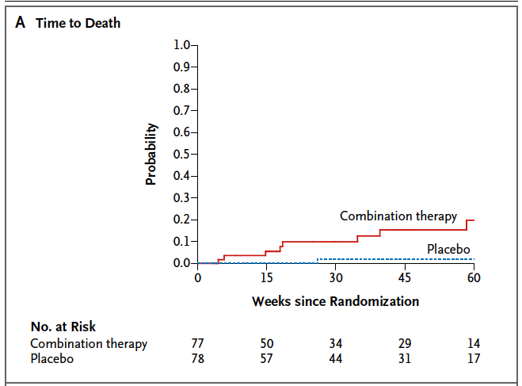
Increased mortality in treated patients
(IPFNet, NEJM 2012)
Notes:
But some questions remain : one question is what is ou what are the stimli responsible for ongoing injury

Slide 11
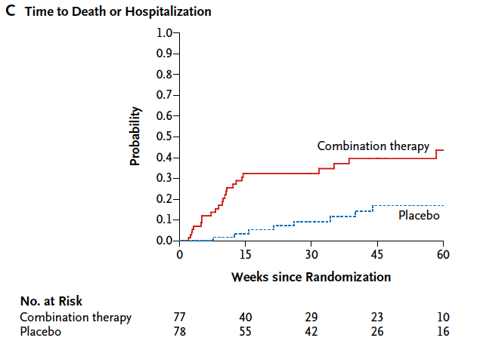
Increased mortality and hospitalization rate
(IPFNet, NEJM 2012)
Notes:
But some questions remain : one question is what is ou what are the stimli responsible for ongoing injury

Slide 12
Pirfenidone: Integrated biological actions
Anti-fibrotic
Inhibits the synthesis and activity of TGF-β, a potent mediator of fibrogenesis^{1,2,4}
Inhibits fibroblast proliferation^{1,2}
Attenuates collagen secretion^{1,2,4,7}
$↓$Expression of pro-fibrotic genes in response to fibrotic stimuli.^{1,4}
Anti-inflammatory
$↓$TNF-α secretion in endotoxin-stimulated cells^{3,5,6}
Prophylactic pirfenidone protects mice from endotoxic shock
  $↓$Pro-inflammatory cytokine levels⁵
  $↑$ Anti-inflammatory cytokine levels.⁵
Anti-oxidant
Potent anti-oxidant and anti-fibrotic activity in experimental cirrhosis.⁸
Although the exact mechanism of action is unclear, evidence from in vitro and in vivo studies suggests that pirfenidone has multiple biological effects.¹⁻⁷

Slide 13
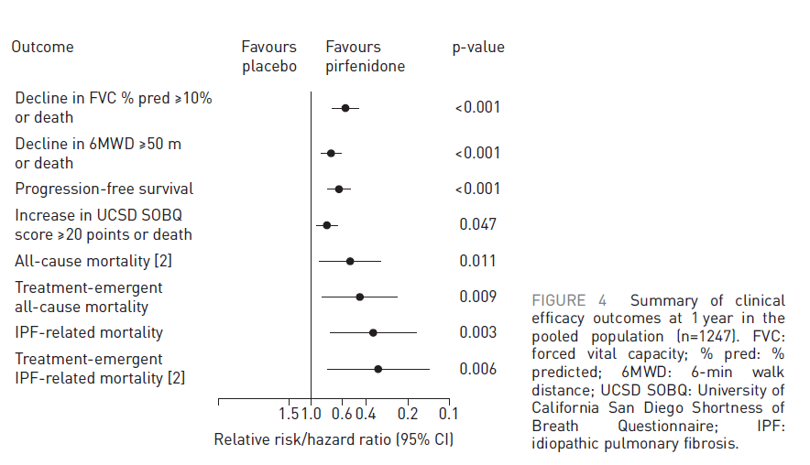
POOLED ANALYSIS: clinical efficacy outcomes at 1 year

Slide 15
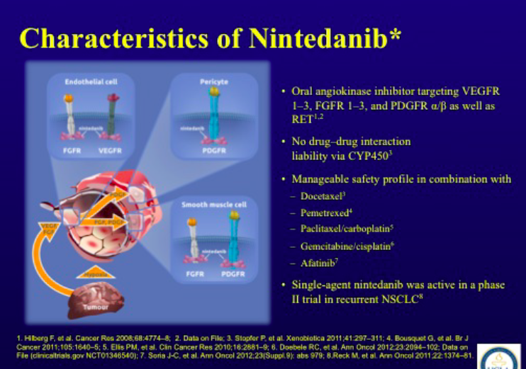

Slide 16
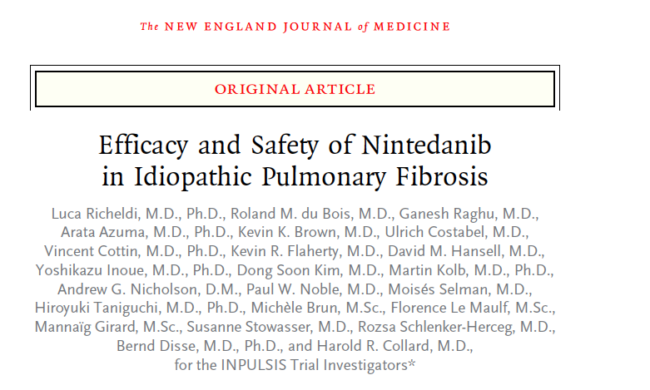

Slide 17
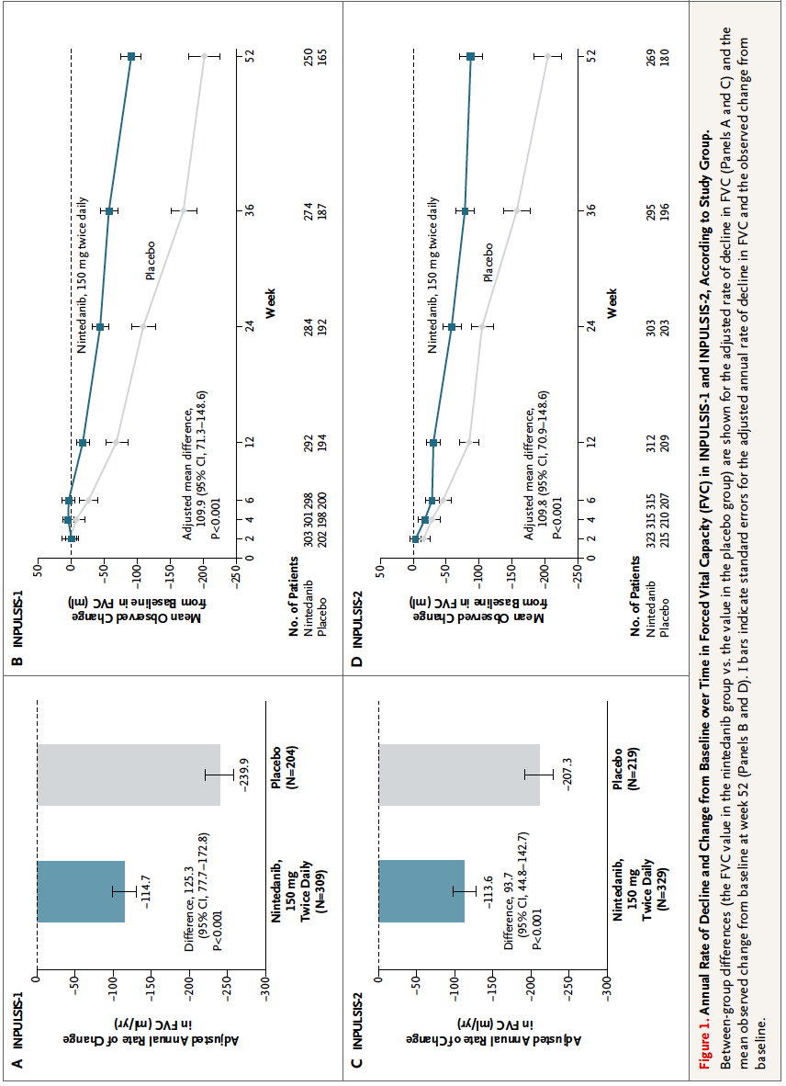

Slide 18
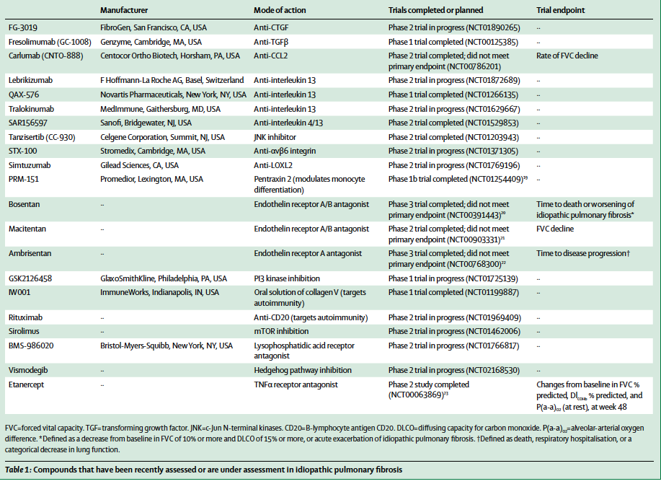

Slide 19
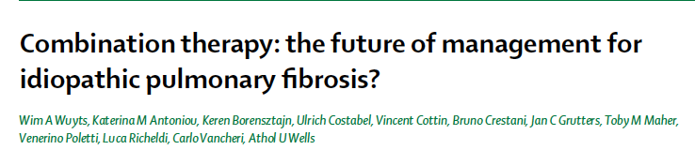

Slide 20
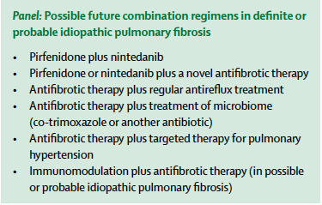

Slide 21
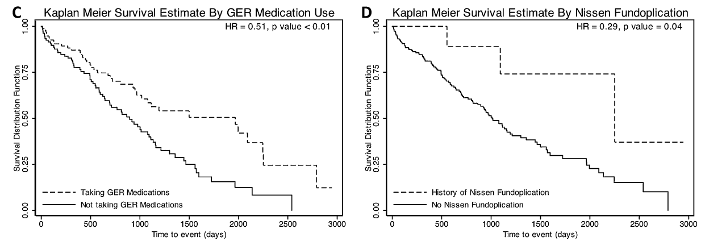
Should we treat GERD ?
Retrospective analysis of 2 IPF cohorts
Prolonged survival associated with :
FVC ↑
DLCO ↑
Anti-GERD Tt
Lee, AJRCCM 2011

Slide 22
Should we treat GERD ?
Kreuter M, et al. Lancet Respir Med , in press
Post hoc analysis study
624 pts , 291 (47%) received antiacid therapy
FVC<70% the overall infections rate and the pulmonary infections rate were higher
A therapeutic trial is needed to answer this question

Slide 23
How to treat cough ?
Affects up to 80% patients
Alters QoL
Predictor of disease progression and death
  Ryerson, Respirology 2011
Difficult to treat
  Search for a cause (GERD, Post nasal drip, ACE inh…)
  Codein and other morphinics are beneficial
    Allen, Palliative Care 2005;19:128-130
  Improved by high doses steroids?
    Hope-Gill, AJRCCM 2003;168:995-1002
  Gabapentine ?
    Ryan, Lancet 2012
  Pirfenidone

Slide 24
How to treat cough ?
Thalidomide
Protective in the Bleo model in mice
Trial 12 weeks double blind cross over (N=24)
  100g mg/d (evening)
  Improved cough, SGRQ
  Adverse effects (75%) :
  Constipation, dizziness, malaise, bradycardia (n=1)
  Collins, PlosOne 2012
  Horton Thorax 2008; 63: 749 ; Horton, Ann Intern Med 2012

Slide 25
Should we treat PHT in IPF ?
  Specific Tts are not recommended
        Hoeper, Int J Cardiol 2011;154S:S45-S53
    Pulmonary edema in case of veno-occlusive component
        Colombat, Hum Pathol 2007;38:60-65
    Ambrisentan increased mortality in a recent trial
        Raghu (ATS 2012)
  Identify the right patient ?
    Sildenafil improves QoL and dyspnea score if RV dysfunction
        IPFNet, NEJM 2010;363:620-8; Han, Chest 2013, on line;
    Riociguat (guanylate cyclase agonist) to be evaluated
        Hoeper, ERJ 2012, on line

Slide 26
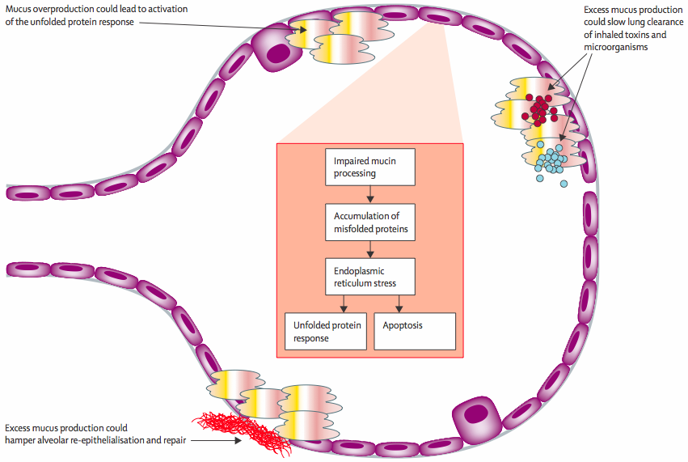
MUC5B and development of pulmonary fibrosis
Spagnolo P et al. Lancet Respir Med 2014; 2: 416-28
Notes:
While the MUC5B rs35705950 SNP is associated with increased MUC5B mRNA expression in lungs of control subjects, MUC5B expression is uniformly increased in lungs of IPF patients compared to controls, regardless of whether the MUC5B SNP is present.
The distal airways are the predominant source of MUC5B expression in IPF lung (Conti et al. AJRCCM 2016). Moreover, Nakano and colleagues have recently shown that the minor T allele enhances MUC5B expression in IPF lungs (Nakano AJRCCM 2016).
MUC5B overexpression may, on the other hand, a) reduce fibrogenic signals; b) reduce alveolar obliteration and collapse by acting as a “secondhand surfactant”; c) help reepithelialize damaged alveolar spaces.

Slide 27
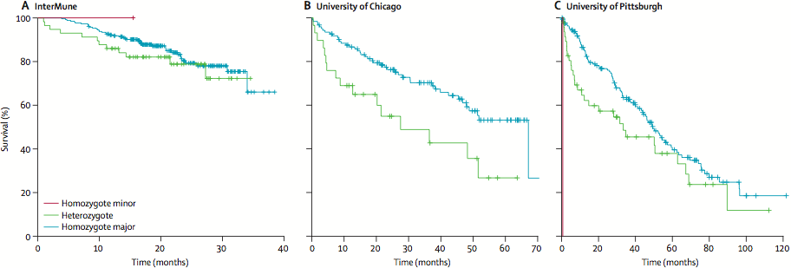
Survival analysis by TOLLIP rs5743890 genotype
Noth I et al. Lancet Respir Med 2013; 1: 309-17
Notes:
TOLLIP is a regulator of innate immune response.
Minor allele of TOLLIP rs5743890 is present in approximately 10% of patients and 16% of controls.
Carriage of TOLLIP SNPs is associated with reduced expression of TOLLIP.
Notably, MUC5B and TOLLIP reside at the same genetic locus. However, they are in only weak LD.

Slide 28

Is bacterial
Infection/colonization
a target in IPF ?
Apoptosis
cotrimoxazole :
960mg x 2/d
Folic acid: 5mg/d
Notes:
28

Slide 29
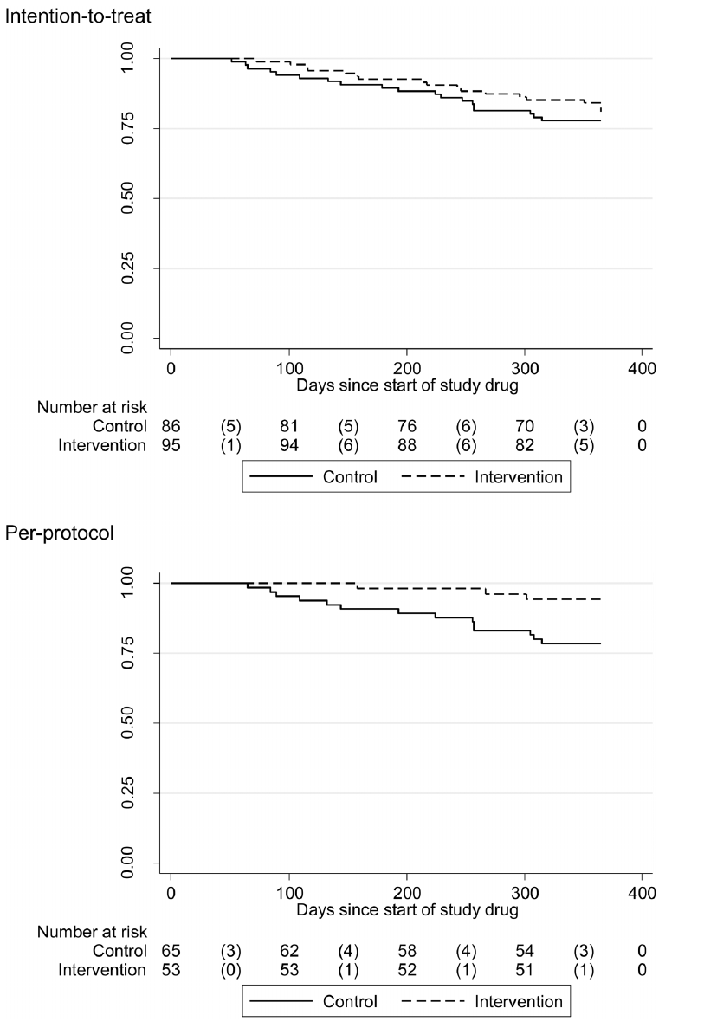
cotrimoxazole
(Shulgina, Thorax 2012; on line First)
No effect on
Lung function
6MWT
Dyspnea (MRC)
Mortality
Improvement of
the SGRQ
-6.88 (-12.06; -1.70)
p=0.009
Survie
NS

Slide 30
cotrimoxazole
(Shulgina, Thorax 2012; on line First)
3/53
Improvement of
mortality in the
per-protocol
population
14/65
Survie
HR: 0.21
(IC95%: 0.06-0.78)
p=0.02

Slide 31
Sleep Med Rev. 2016 Apr;26:57-63.
Sleep and respiratory sleep disorders in idiopathic pulmonary fibrosis.
Milioli G, Bosi M, Poletti V, Tomassetti S, Grassi A, Riccardi S, Terzano MG, Parrino L.
Abstract
Idiopathic pulmonary fibrosis (IPF) is an interstitial lung disease (ILD) characterized by inflammation and progressive scarring of the lung parenchyma. IPF profoundly affects the quality of life (QoL) and fatigue is a frequently disabling symptom. The cause of fatigue is not well understood but patients with IPF often report extremely poor sleep quality and sleep-related breathing disorders (SRBD) that correlate with QoL. IPF patients present alterations in sleep architecture, including decreased sleep efficiency, slow wave sleep and rapid eye movement (REM) sleep, and increased sleep fragmentation. Moreover, sleep related hypoventilation during the vulnerable REM sleep period and obstructive sleep apnea-hypopnea syndrome (OSAHS) are frequent, but remain usually underdiagnosed. These SRBD in IPF are associated with alterations of the sleep structure, reduction of QoL and increased risk of mortality. In the absence of an effective therapy for IPF, optimizing the QoL could become the primary therapeutic goal. In this perspective the diagnosis and treatment of SRBD could significantly improve the QoL of IPF patients.

Slide 32
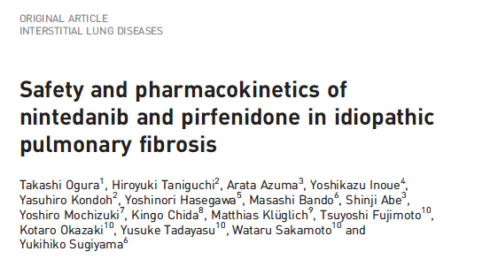

Slide 33
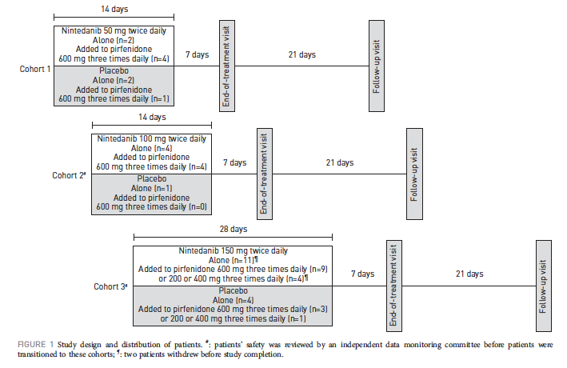

Slide 34
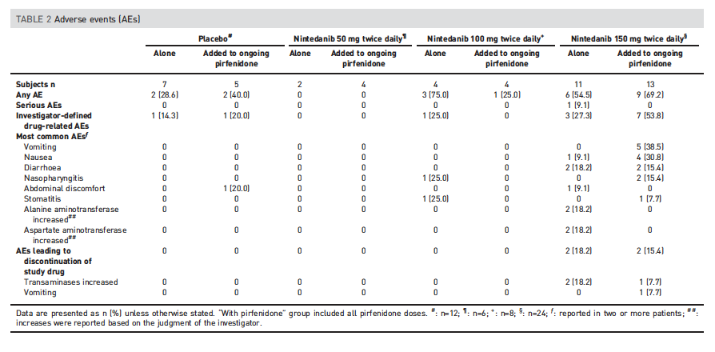

Slide 35
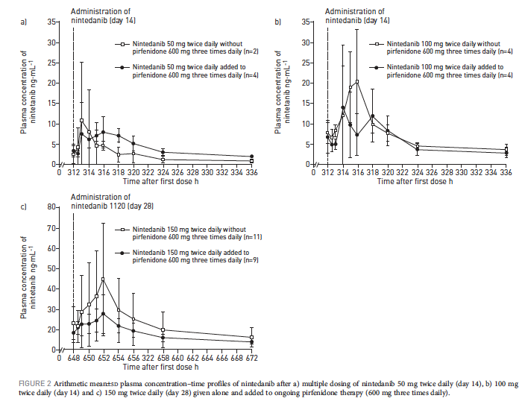

Slide 36
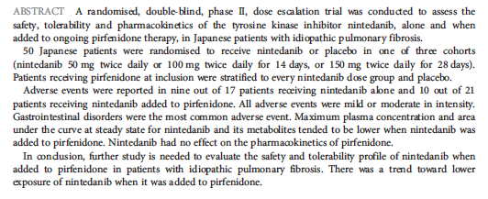

Slide 37
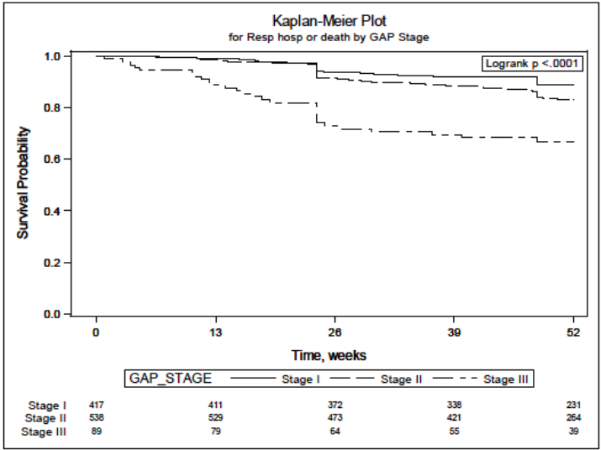

Slide 38
All-cause mortality in IPF: Kaplan–Meier estimates of overall survival*
93.4%
86.3%
N = 622
Week
One- and 2-year mortality rates of 6.6% and 13.7%, respectively¹

Slide 39
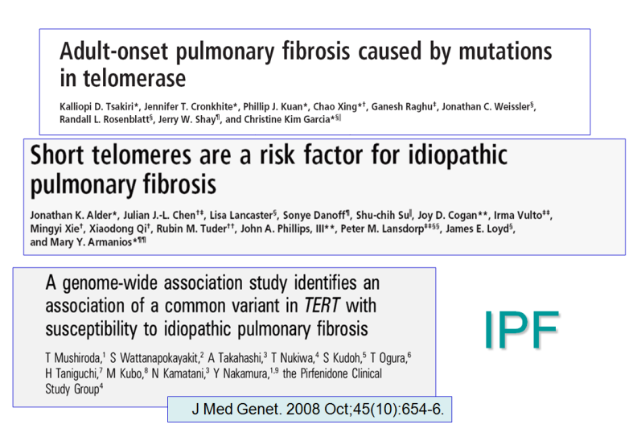
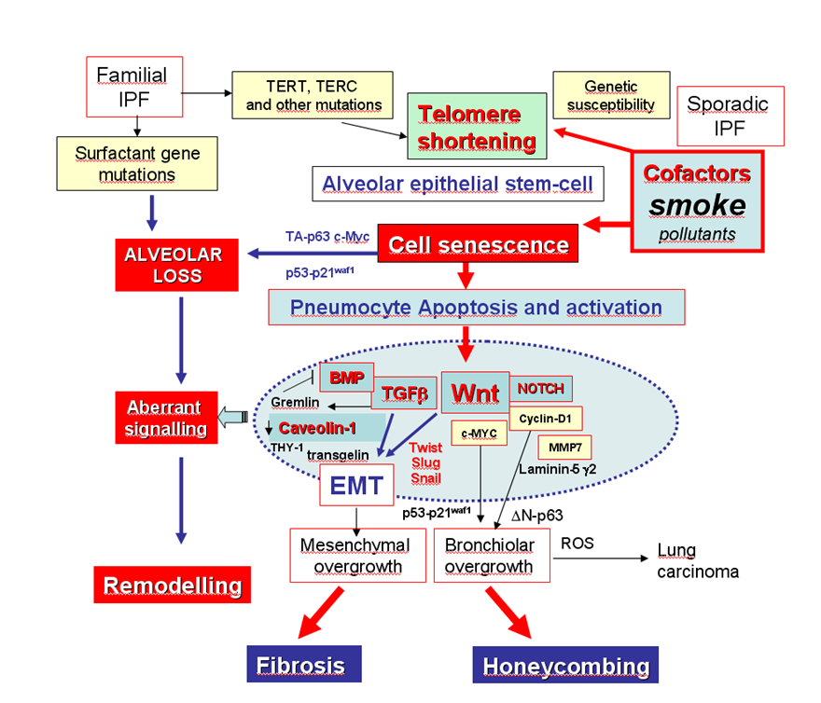
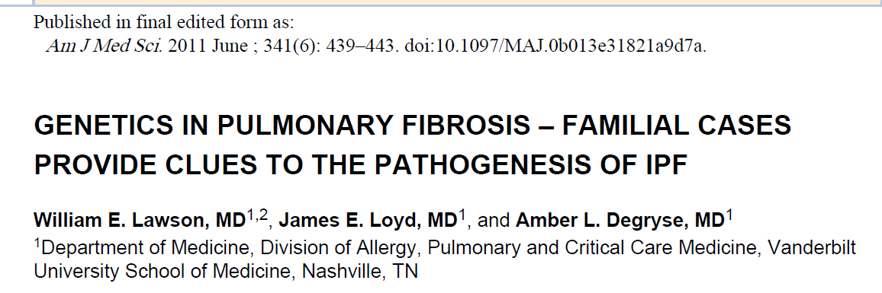
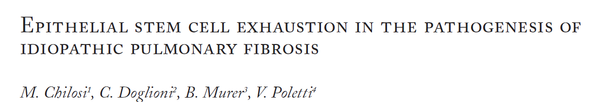
Telomere dysfunction
Endoplasmic reticulum stress (unfolded proteins)
Sarcoidosis Vasc Diffuse Lung Dis. 2010

Slide 40
Combination therapy in fibrosing ILDs: the future
Immunomodulating and «antifibrotic» drugs in chronic HP
Immunomodulating drugs and antibiotics in idiopathic fibrosing NSIP
Stem cells tranplants (alveolar and mesenchimal) in IPF
……

