Slide 1
UIP (IPF) is a Misnomer: Con
Jay H. Ryu
Division of Pulmonary and Critical Care Medicine
Mayo Clinic, Rochester, Minnesota, USA

Slide 2
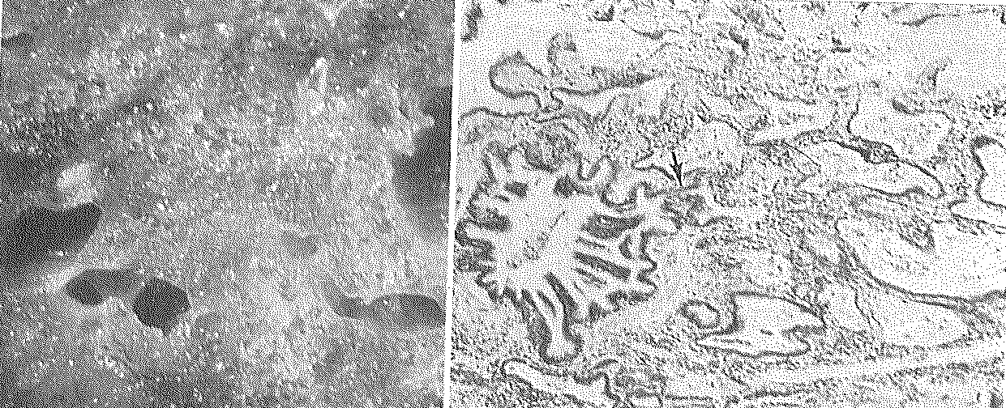
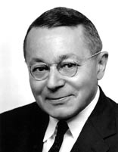
“Definition and Classification of Interstitial Pneumonias in Human Pathology”
AA Liebow. Prog Resp Res 1975
Notes:
UIP end stage with honeycombing
Loss of alveoli and interstitial fibrosis

Slide 3
Interstitial Pneumonias
“Under the present general definition, interstitial pneumonias will be classified on morphological grounds as
(1) classical or ‘usual’ interstitial pneumonia (UIP),
(2) bronchiolitis obliterans with classical interstitial pneumonia (BIP),
(3) desquamative interstitial pneumonia (DIP),
(4) lymphoid interstitial pneumonia (LIP) or
(5) giant cell interstitial pneumonia (GIP).”
“… certain correlates in natural history, radiographic appearance and response to therapy.”
(AA Liebow, Prog Resp Res 1975)
Notes:
Classification based primarily on histological criteria but there are certain correlates in natural history, radiographic appearance and response to therapy.
Types of tissue response with no implication intended that any is pathognomonic for a specific etiological factor.

Slide 4
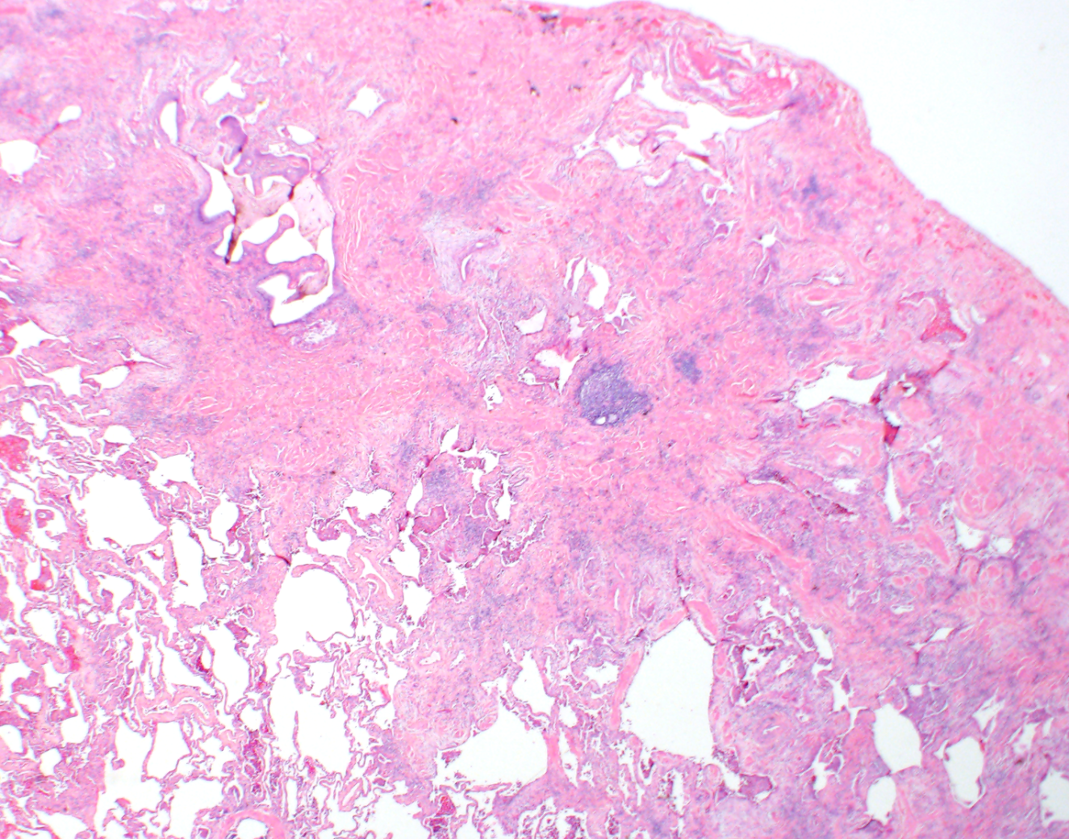
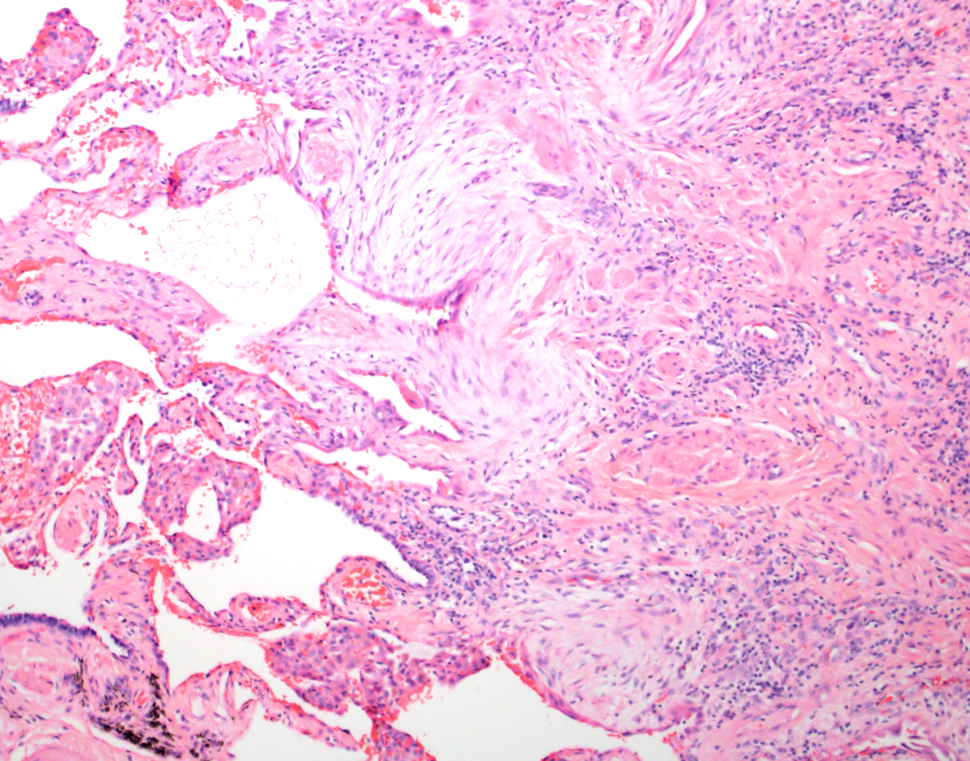
What should we call this IP pattern?
“Classical”?
“Common”?
“Usual” = found most of the time
Notes:
MCP 2014 IPF review – Figure 1A

Slide 5
Idiopathic Pulmonary Fibrosis
1970s – a lung disease of unknown cause characterized by parenchymal inflammation (“alveolitis”) and progressive interstitial fibrosis
1980s-1990s – imaging, histopathologic refinements
2011 consensus statement – “IPF is defined as a specific form of chronic, progressive fibrosing interstitial pneumonia of unknown cause, occurring primarily in older adults, limited to the lungs, and associated with the histopathologic and/or radiologic pattern of UIP.”

Slide 6
Definitions
“name” = a word or phrase that constitutes the distinctive designation of a person or thing

Slide 7
Che cosa dovremmo chiamarlo?
Athol?
Marco?
Sara?
Venerino?
Notes:
What should we call him?

Slide 8
Name: Venerino
Diminutive of: Venerando
Origin: Proto Indo-European / Sanskrit / Latin
Name Root: *Wen > Vanas > Veneris > Venus > Venerabilis
Meaning: This name derives from the Proto indo-european, Sanskrit and Latin root “*wen > vanas > veneris > venus > venerabilis”, meaning “love, sexual desire, loveliness, beauty, charm”.
Venerino spelled backwards is Onirenev.
http://www.name -doctor.com/

Slide 9
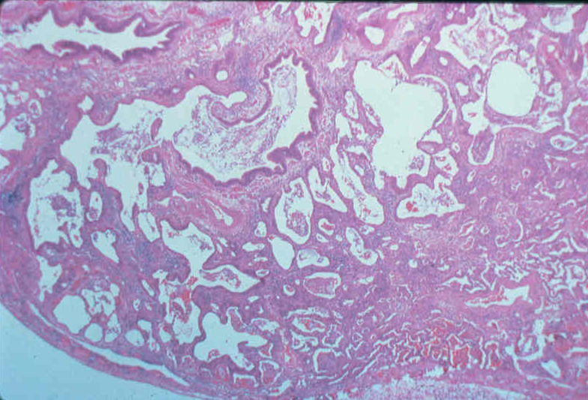
Venerino
Usual IP
If cause unknown = IPF

Slide 10
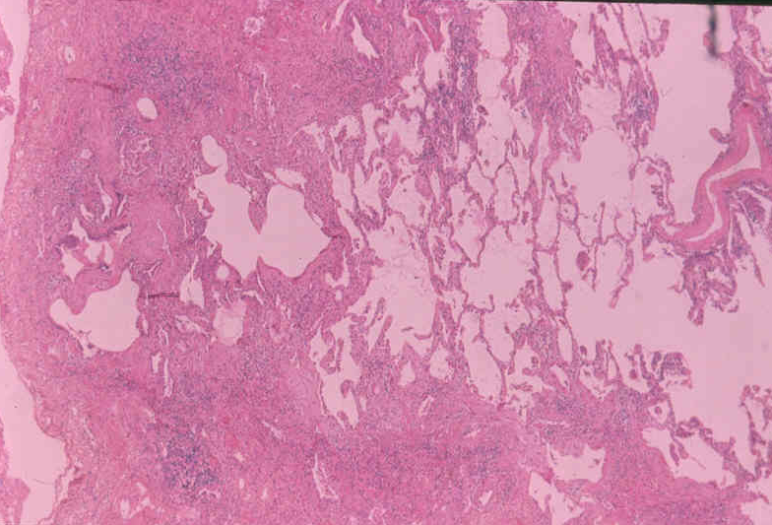
Venerino
UIP
If cause unknown = IPF

Slide 11
Dove si trova Venerino?

Slide 12
Disease
“The name of a disease refers to the sum of the abnormal phenomena displayed by a group of living organisms in association with a specified common characteristic or set of characteristics by which they differ from the norm for the species in such a way as to place them at a biological disadvantage.”
– Scadding 1961

Slide 13
Disease
A disease entity, characterized usually by at least two of these criteria:
a recognized etiologic agent (or agents)
an identifiable group of signs and symptoms
consistent anatomical alterations.

Slide 14
Conclusions
Usual interstitial pneumonia (UIP) is merely a name assigned to a distinctive histopathologic pattern of parenchymal lung injury, commonest (“usual”) form of interstitial pneumonia.
Cause of UIP may be identifiable (e.g., connective tissue disease, drugs, asbestos) or not (“IPF”).

