Slide 1
Pleural Involvement in Diffuse Parenchymal Lung Diseases
Jay H. Ryu
Division of Pulmonary and Critical Care Medicine
Mayo Clinic, Rochester, Minnesota, USA

Slide 2
Diffuse Parenchymal Lung Diseases
Known Cause
CTD-associated
Environmental & occupational (HP, pneumoconiosis)
Drugs & radiation-induced
Smoking-related (RB-ILD/DIP, PLCH, AEP)
Rare forms (LAM, PAP, amyloidosis, heritable disorders, etc.)
Unknown Cause
IPF and other idiopathic interstitial pneumonias
Sarcoidosis
Eosinophilic pneumonias
Vasculitis
Rare forms (IgG4-RD, Erdheim-Chester, etc.)
Notes:
IPF & IIPs – 30%
Sarcoidosis – 20-30%
CTD-associated – 15%
HP – 10%
Drugs & pneumoconioses – 5%
Vasculitis & rare ILDs – 5%
Undefined – 5%

Slide 3
Pleural Involvement in DPLDs
Pleural effusion
Pleural thickening
Pneumothorax

Slide 4
Pleural effusion / thickening in DPLDs
Commonly associated with pleural effusion include CTDs and drug-induced ILDs.
Other ILDs: eosinophilic pneumonias (acute or chronic), asbestos, LAM, amyloid
Also consider processes that mimic ILD: infections, pulmonary edema, lymphoma, lymphangitic carcinomatosis
Commonly associated with pleural thickening include CTDs, drug-induced ILDs, asbestosis, pleuroparenchymal fibroelastosis

Slide 5
Respiratory Manifestations in CTDs
 | RA | PM/DM | SCL | Sjögren | SLE | MCTD
ILD | X | X | X | X | X | X
Airway | X |  | X | X | X | X
Vascular | X | X | X | X | X | X
Pleural | X | X | X | X | X | X
Others | nodules | muscular weak, aspiration | aspiration | lymphoma | diaphr weak | mm weak, aspiration

Slide 6
Pleural Involvement in RA
Pleural disease is common
5-10% on imaging
20-30% pleurisy symptoms
40-70% at autopsy
Spectrum of pleural manifestations
Pleuritis
Pleural effusion (exudative, pseudochylous [cholesterol], empyema)
Pleural thickening ± entrapment
Pneumothorax

Slide 7
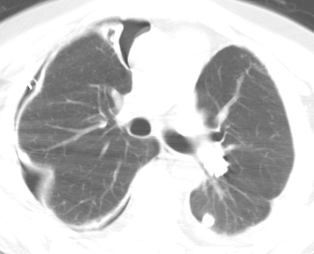
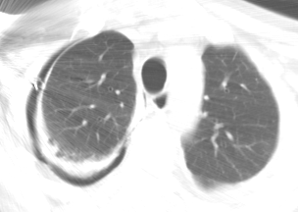
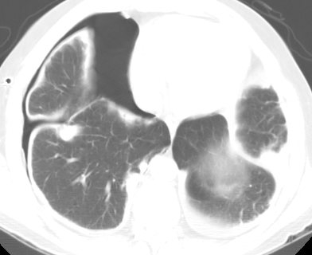
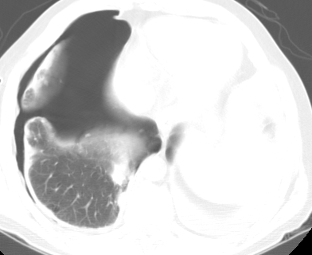
45M Rheumatoid nodules Sept. 2001
Notes:
Pleural disease is common in patients with RA, but is usually subclinical. ^{UpToDate16}
Pleural involvement is found at autopsy in 38-73% of patients although symptomatic pleurisy is less frequent (5-21%) and just over 5% had radiologic evidence of a pleural effusion.
RA-associated pleural abnormalities include exudative “rheumatoid” effusion, drug-induced pleuritis), empyema, bronchopleural fistula, hemopneumothorax, and pyopneumothorax.
Pneumothorax is presumed to be secondary to cavitation of a rheumatoid nodule and can result in a persistent BP fistula.
Pleural effusions are clinically evident in only 5% of patients and may occasionally antedate the onset of articular disease.
Most rheumatoid pleural effusions are small, unilateral, and asymptomatic.
10/1/01 R thoracotomy for persistent pneumothorax (BP fistula) – wedge biopsy shows rheumatoid nodule, chronic pleuritis; decortication performed
12/21/2001 – redo R thoracotomy for recurrent pneumothorax, BP fistula repair

Slide 8
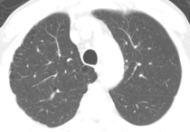
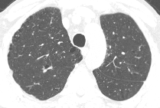
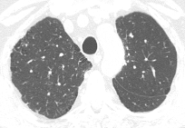
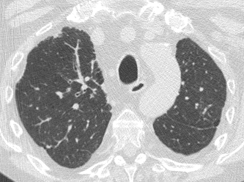
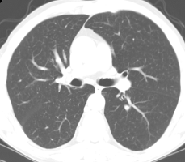
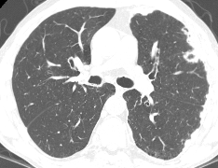
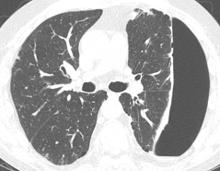
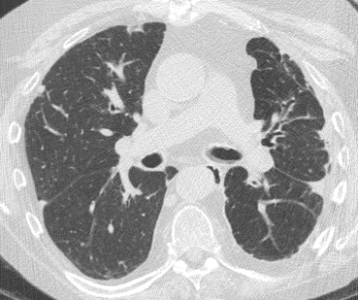
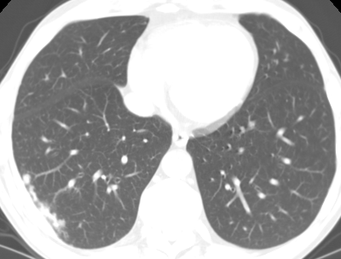
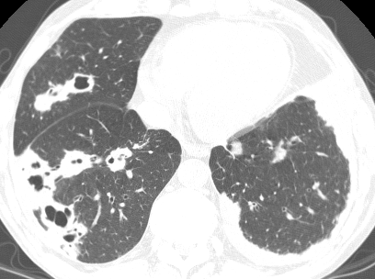
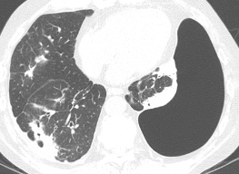
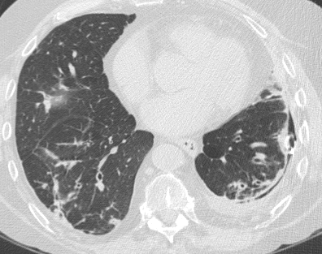
47M
Rheumatoid arthritis
Nov. 2004
Dec. 2005
Apr. 2007
Jun. 2010
Notes:
1/3/2006 recurrent (4th) L pneumothorax; LUL wedge resection – rheumatoid nodule, chronic pleuritis, talc pleurodesis

Slide 9
Drug-Induced Lung Diseases: Patterns
Parenchymal lung disease
Pulmonary edema and/or ARDS
Pulmonary hemorrhage
Airway involvement (central & peripheral)
Pleural and/or pericardial involvement
Pulmonary vasculopathy
Mediastinal involvement
Others – neuromuscular, systemic, etc.

Slide 10
Drug-induced DPLDs with Pleural Disease
Amiodarone
Chemotherapy agents - e.g., methotrexate, gemcitabine
Ergots
Tyrosine kinase inhibitors – e.g., imatinib, gefitinib
Nitrofurantoin
Procainamide
Many others …

Slide 11
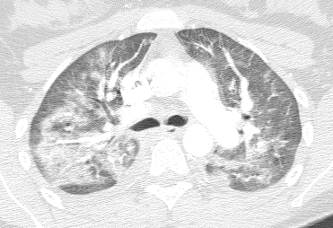
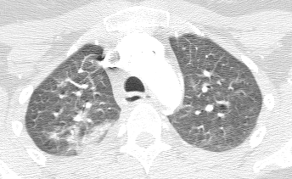
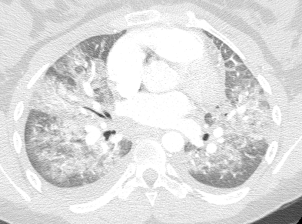
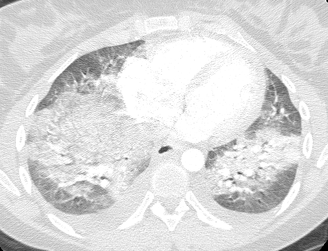
25F Acute NTFN Toxicity
Notes:
Nitrofurantoin-induced lung injury is rare (<1%), although many cases have been reported because the drug is frequently prescribed.
Pulmonary injury from NTFN does not appear to be a dose-related phenomenon.
Acute form of nitrofurantoin-induced lung injury is more common than chronic.
Acute nitrofurantoin-induced lung injury usually occurs within 2 wks of initiation of therapy (mean duration 9 d) and is most consistent with a hypersensitivity reaction, although pulmonary hemorrhage has been reported as a histopathologic finding.
Patients present with fever, dyspnea, cough, and eosinophilia. ^{UpToDate16}
Rash, chest pain, and cyanosis may also be seen.
In most cases, the onset of symptoms is abrupt (80%).
Eosinophilia and leukocytosis are common.
Bilateral parenchymal infiltrates and pleural effusions (more commonly unilateral) are seen.
Prognosis is good with most patients with symptoms resolving within 24-48h after discontinuation of therapy.
11/30/14; begun on nitrofurantoin therapy 11/27/14 for UTI with ureteral stone (stent placed)
Cough, SOB, headaches, hypoxemia – intubated 11/30/14 in ICU; bronchoscopy negative
Begun on Solu-Medrol 250 mg QID on 12/2/14, then prednisone 60 mg/d (extubated prior day)

Slide 12
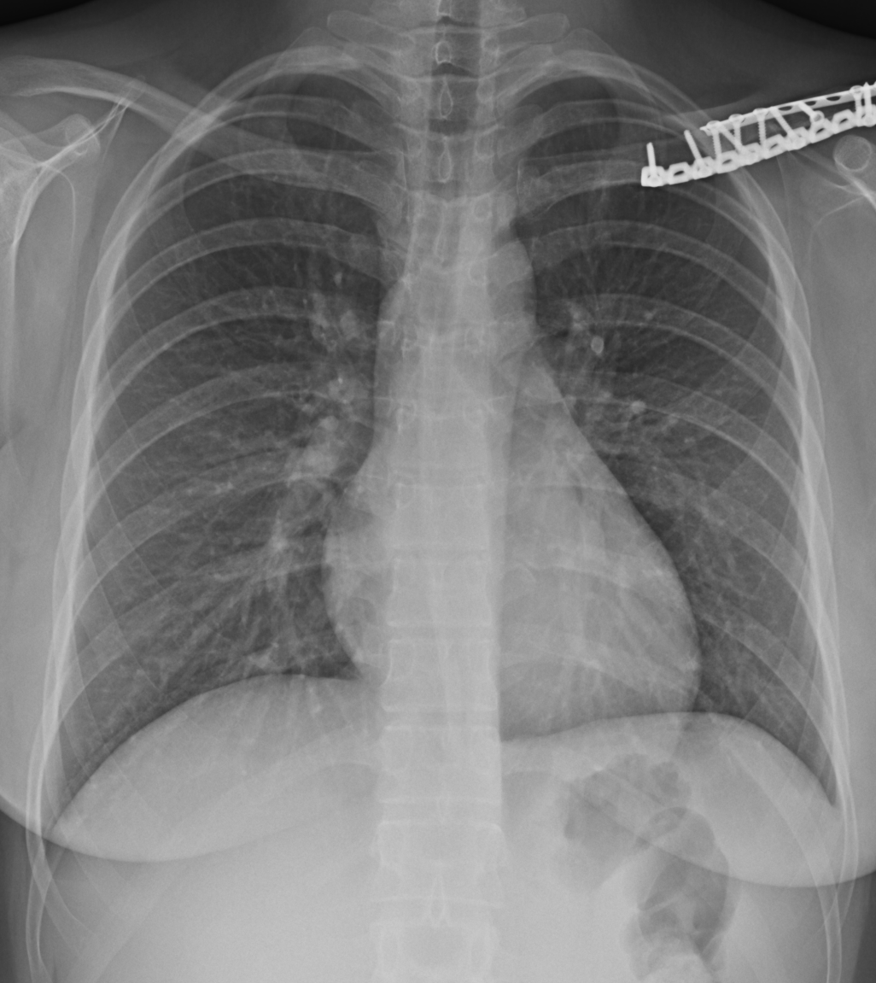
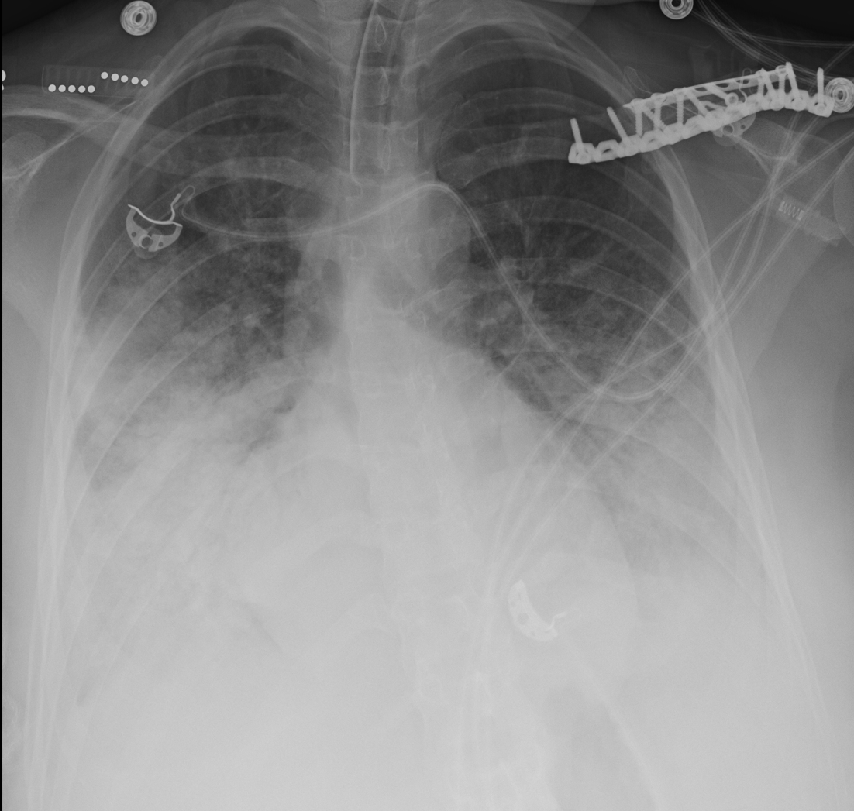
25F Acute NTFN Toxicity
Nov 30
Dec 10
Notes:
11/30/14; begun on nitrofurantoin therapy 11/27/14 for UTI with ureteral stone (stent placed)
Cough, SOB, headaches, hypoxemia – intubated 11/30/14 in ICU; bronchoscopy negative
Begun on Solu-Medrol 250 mg QID on 12/2/14, then prednisone 60 mg/d (extubated prior day)

Slide 13
Eosinophilic Lung Diseases
Acute eosinophilic pneumonia
Chronic eosinophilic pneumonia
Allergic bronchopulmonary aspergillosis (ABPA)
Eosinophilic granulomatosis with polyangiitis (EGPA, Churg-Strauss syndrome)
Hypereosinophilic syndrome
Löffler’s syndrome (simple pulm eosinophilia)
Parasitic (tropical eosinophilia) and other infections, drugs, toxins
Notes:
Asthma
IPF

Slide 14
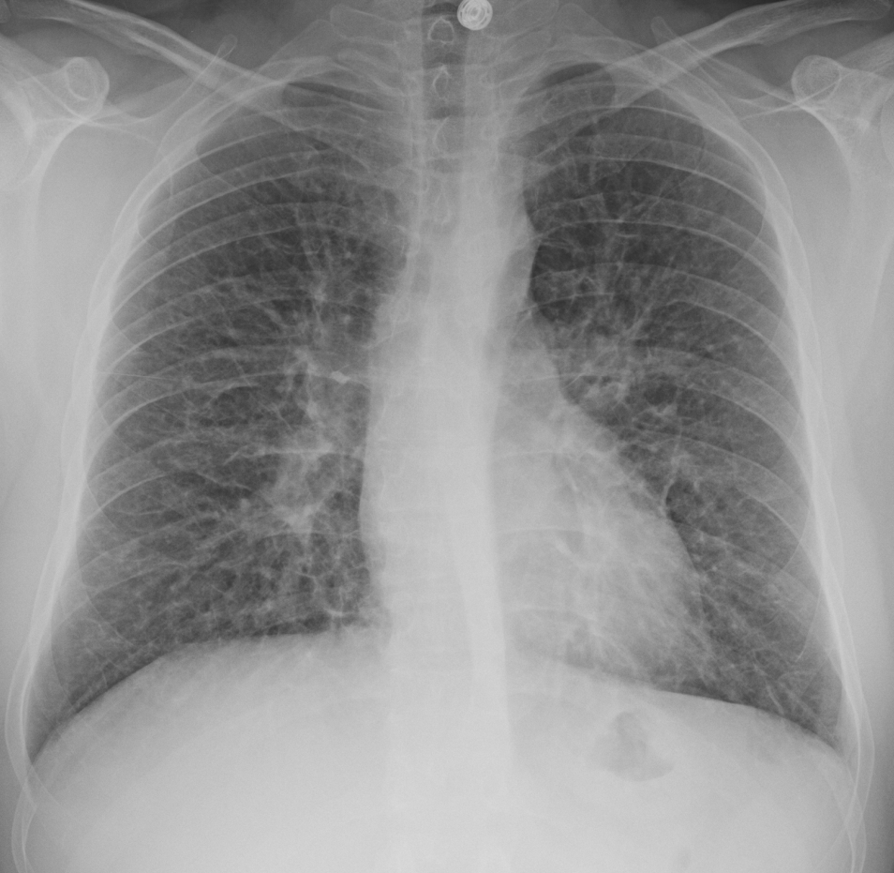
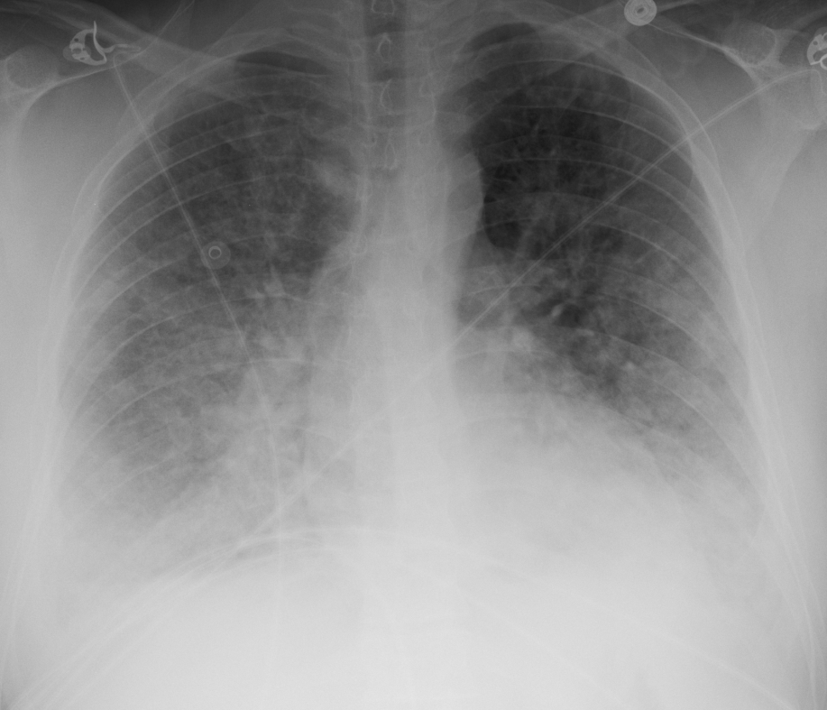
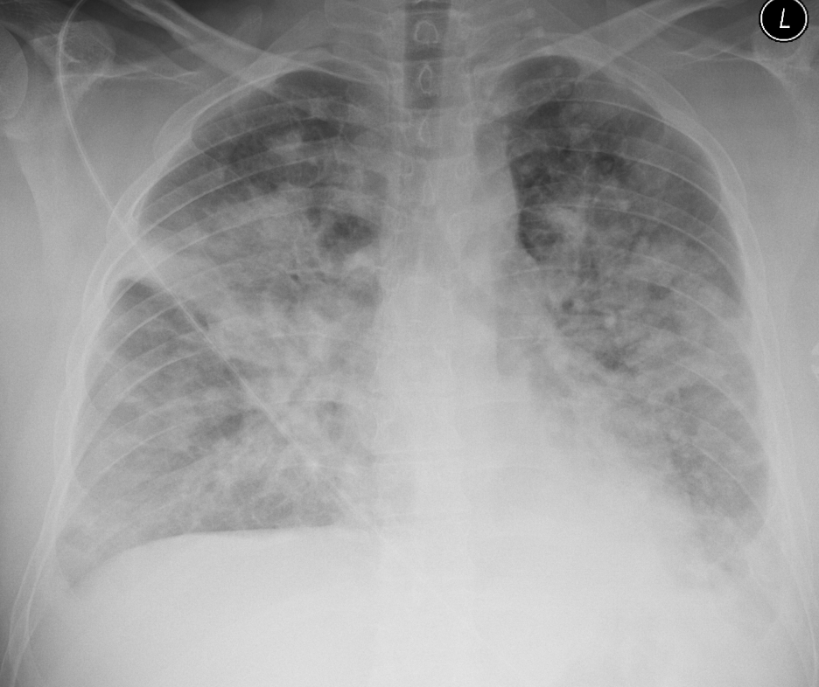
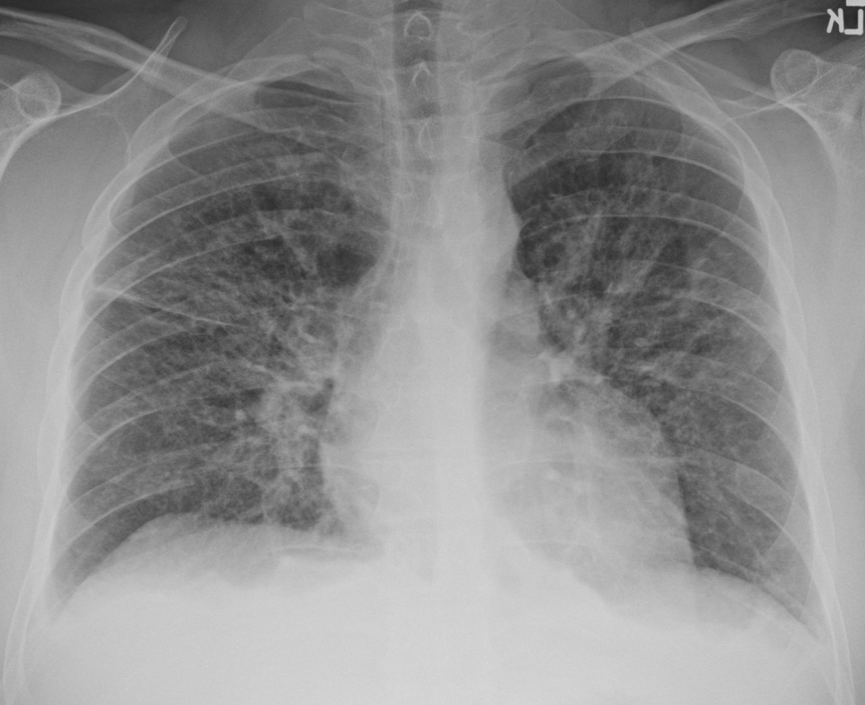
Smoking-related AEP
Dec. 4
Dec. 7
Dec. 9
Dec. 12 (treated)
Notes:
Earlier case reports from Japan
Young adults, acute febrile illness 1-3 weeks after first smoking exposure; dyspnea, hypoxemia, lung infiltrates.
Association with new-onset smoking or change in smoking habit (increased amount) in some cases of AEP.
Imaging: interstitial infiltrates that progress to diffuse alveolar infiltrates (ground-glass attenuation, interlobular septal thickening); pleural effusions common.
Eosinophilia in blood, BAL, pleural fluid or lung tissue.
Treatment: corticosteroids x 4-6 wk, supportive care.
Shorr et al (2004): AEP in 18 military personnel deployed in or near Iraq 2003-04
2/18 died, 67% required mechanical ventilation.
Peripheral eosinophil counts: 12/6 0.20, 12/9 0.91, 12/10 1.31, 12/12 0.10
BAL 12/7/10: 19% M, 35% L, 21% N, 25% E.
Corticosteroids begun 12/10/10 with Solu-Medrol 125 mg BID.
Tapered off over 2 weeks (DM1).
Quit smoking with no recurrence.

Slide 15
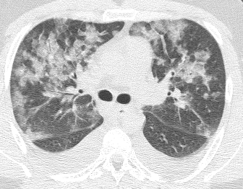
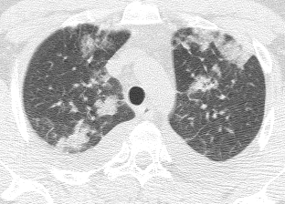
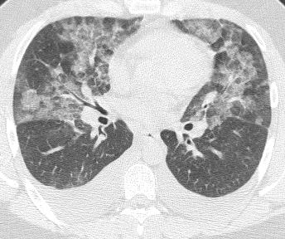
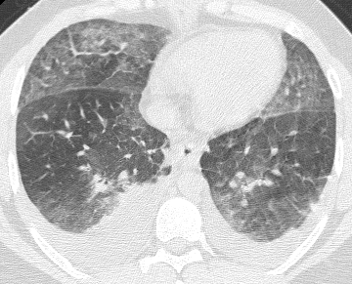
Smoking-related AEP
22M
Dec. 6, 2010

Slide 16
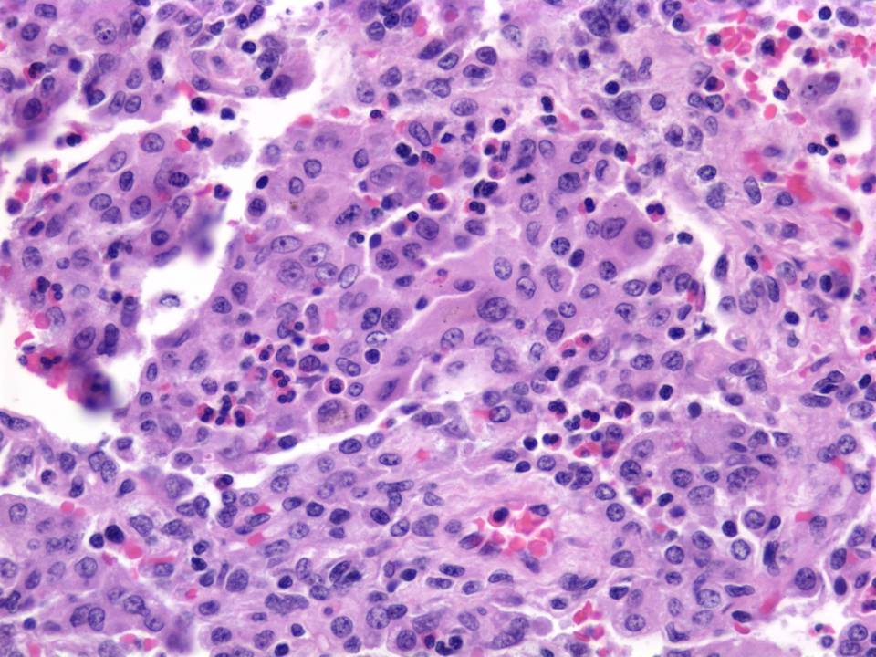
Smoking-related AEP
Notes:
TBLBx

Slide 17
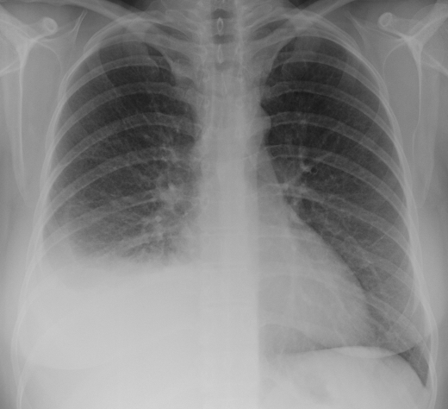
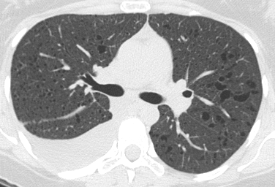
LAM - Chylothorax
30F LAM
Notes:
Highest rate of pneumothorax (60-80%) of all lung diseases.
Recurrence rate (60-70%)

Slide 18
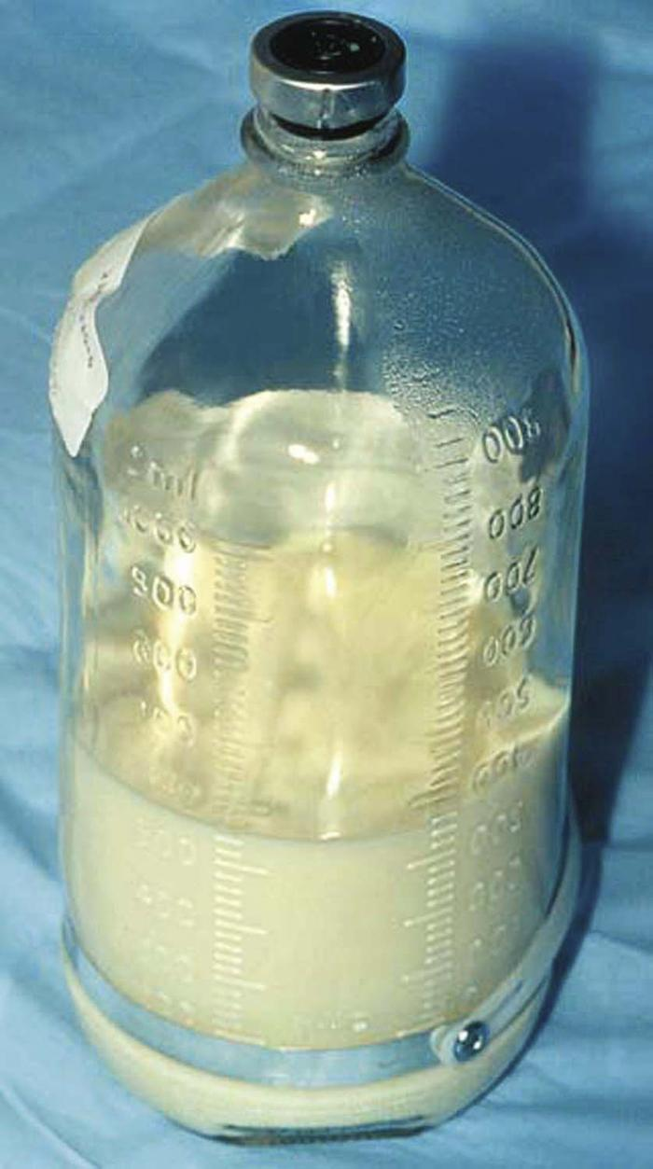
Chylothorax
Notes:
Occurs in 20-40% over the clinical course.
From obstruction/leak of thoracic duct or tributaries, or transdiaphragmatic flow of ascites.
Sometimes, chylous ascites, chyloptysis, chyluria.
Tailor to size of effusion, effects, available expertise & resources
Sirolimus therapy

Slide 19
Pneumothorax in DPLDs
Lymphangioleiomyomatosis (LAM)
Pulmonary Langerhans cell histiocytosis (PLCH)
Birt-Hogg-Dube
Lymphoid interstitial pneumonia
Amyloidosis
Idiopathic pulmonary fibrosis (IPF)

Slide 20
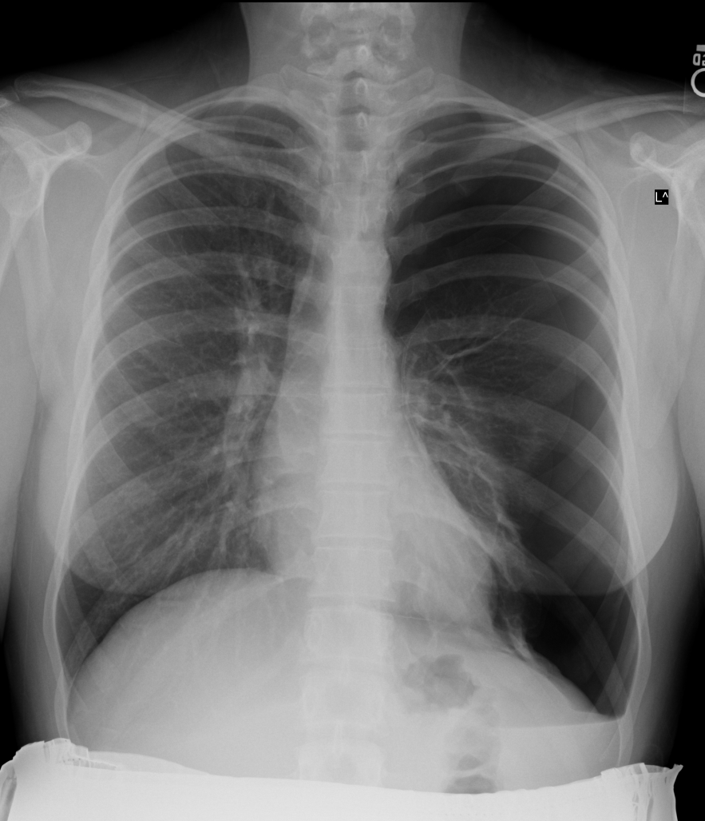
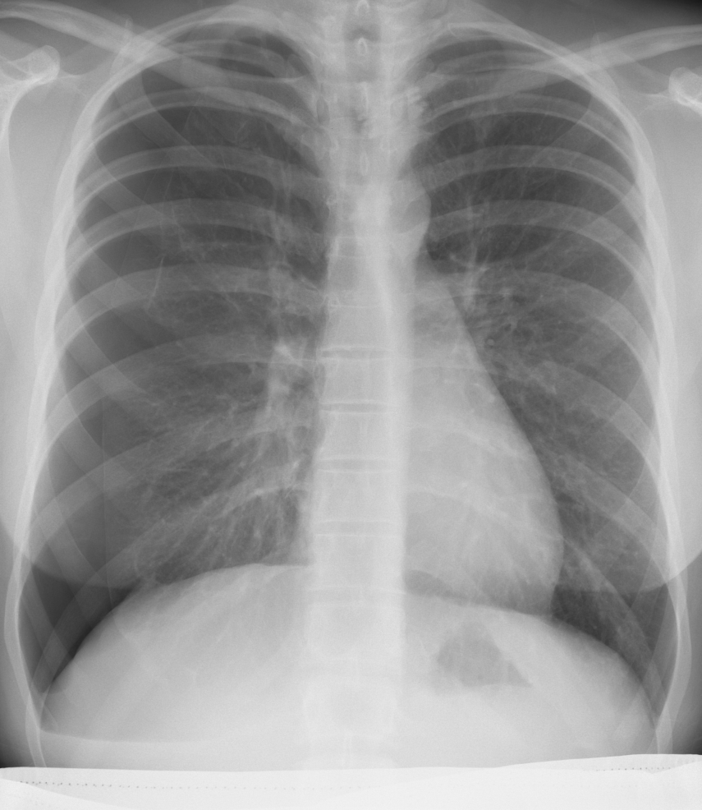
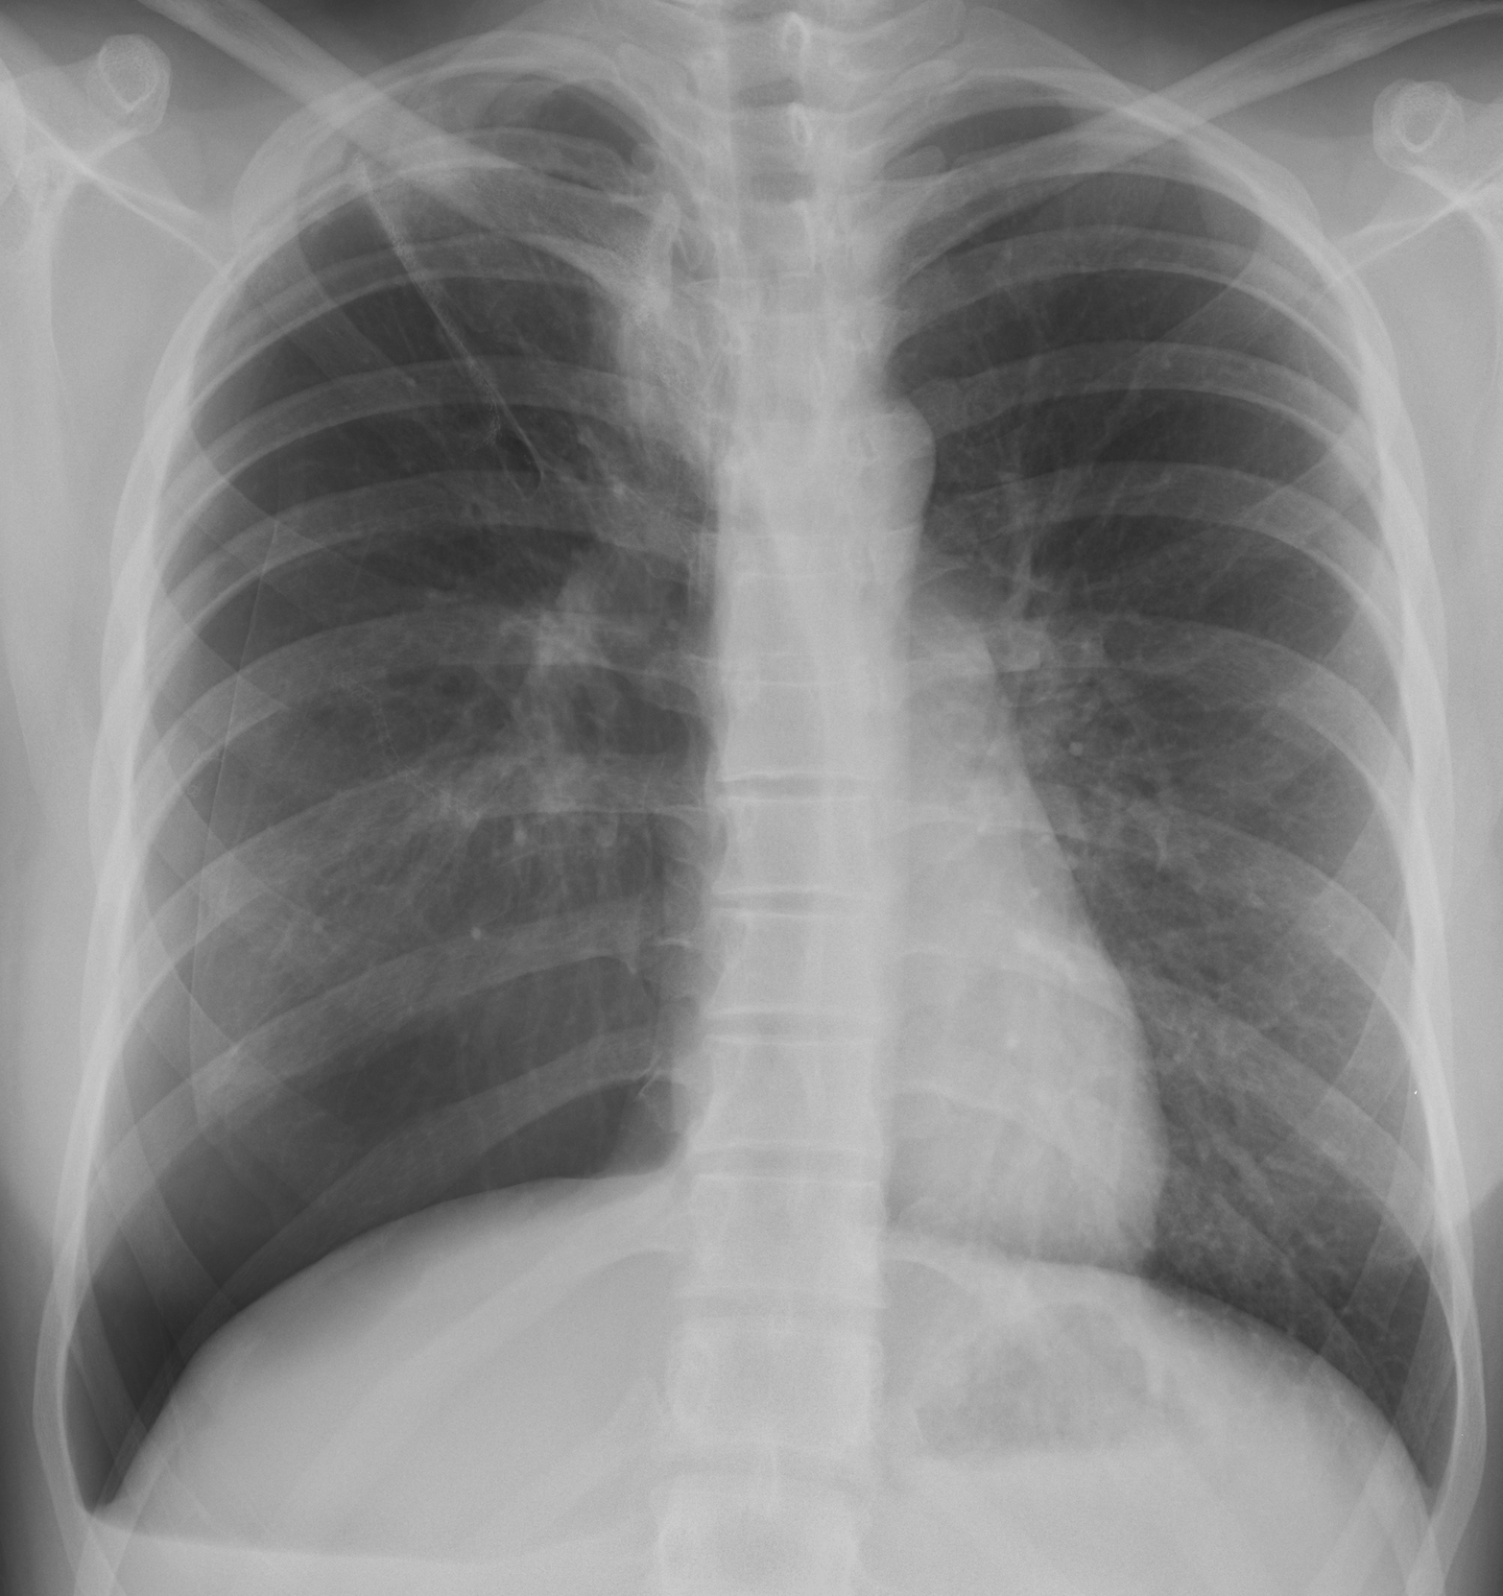
29F LAM
2/28/07 16 wk pregnant
1/15/07 10 wk pregnant
3/14/07 18 wk pregnant
5/3/07 25 wk pregnant
Notes:
Risk of pneumothorax in pregnancy is 10%.
Risk of pneumothorax with air travel: 1-2% per flight.
Pleurodesis is generally recommended for LAM patients to reduce the high risk of recurrence.
In surveys, 56-75% of LAM patients have been pregnant.
15-20% of women with LAM who have been pregnant experienced complications during pregnancy; most commonly pneumothorax.
Many LAM patients feel that pregnancy accelerated the deterioration of their lung disease.
The overall incidence of complications (pneumothorax, chylothorax, surgery) was 11 times higher during pregnancy than at other times. ^{Johnson00}

Slide 21
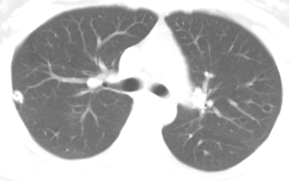
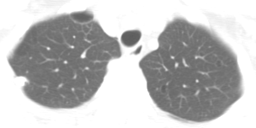
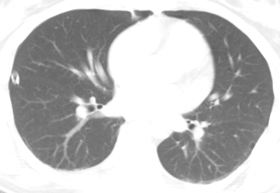
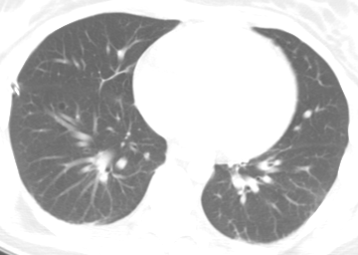
29F LAM
28F 2/28/07 16 wk preg.

Slide 22
LAM
Proliferation of abnormal smooth muscle-like cells (“LAM cells”) resulting in cystic changes of the lung parenchyma.
2 forms: sporadic (S-LAM) and tuberous sclerosis complex-related LAM (TSC-LAM)
Both forms of LAM are caused by mutation in the TSC genes (TSC1 & TSC2)
Highest rate of pneumothorax of all lung diseases; 50-80% in the clinical course.
Risk of pleural complications
Notes:
Primary conditions leading to diagnosis of LAM in the NHLBI Registry were pneumothorax 36%, other pulmonary symptoms 28%, abnormal CXR 20%, others (renal AML, pleural effusion, etc.) 16%.
In TSC, LAM found in 26-81% of women, 38% of men (milder).

Slide 23
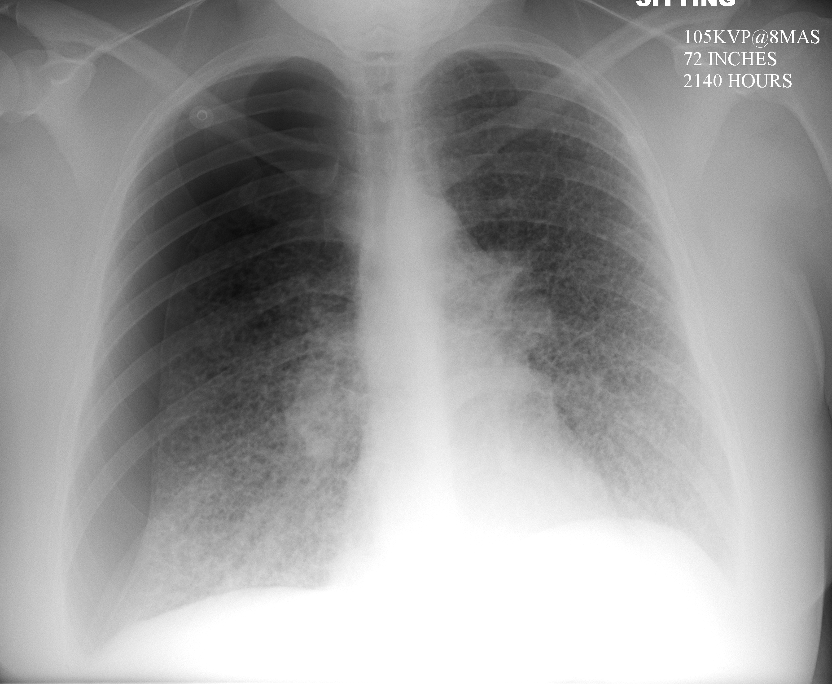
29F PLCH Oct. 2009

Slide 24
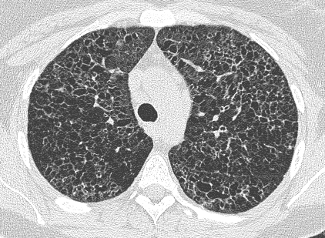
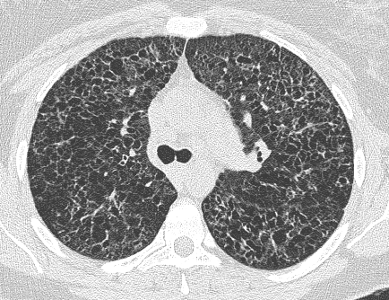
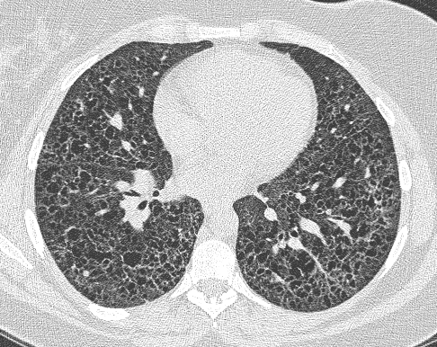
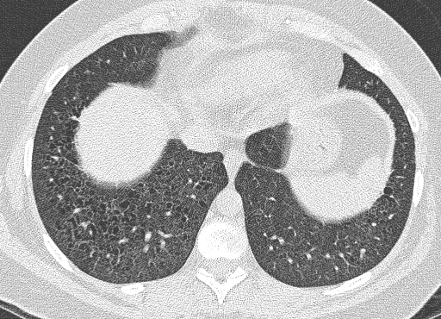
29F PLCH May 2009

Slide 25
Pulmonary Langerhans’ Cell Histiocytosis (PLCH)
Young adults (usually 20-40 yr of age) with smoking history, i.e., smoking-related disease.
Clinical: Pneumothorax (10-15%), bone lesions (10%), diabetes insipidus (<10%), and pulmonary hypertension.
PFT: Obstructive or mixed defect, diffusing capacity usually decreased.
HRCT: Cavitating nodules, irregular cysts with architectural distortion, basilar sparing.
Notes:
HRCT 55-84% correct diagnosis based on HRCT features.

Slide 26
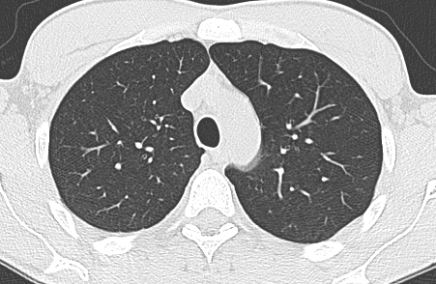
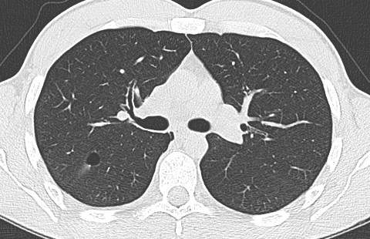
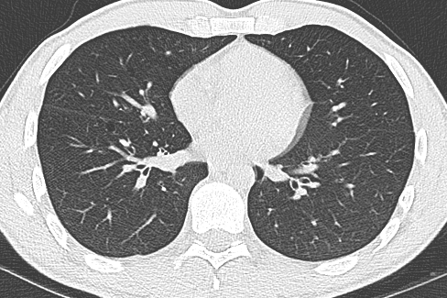
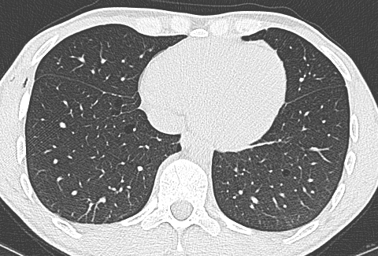
36M Nov. 2013 BHD
Notes:
11/26/2013 OSF
One episode of R pneumothorax, Nov. 2013

Slide 27
72F BHD Sept. 2015
Notes:
72F with BHD, cystic lung disease, R renal tumor, 2/3 sons with BHD

Slide 28
Birt-Hogg-Dubé syndrome
Rare, inheritable disorder (autosomal dominant)
Germline mutations in the BHD (FLCN) gene (chromosome 17); encodes for tumor-suppressor protein, folliculin.
Clinical manifestations:
Fibrofolliculomas
Cystic lung disease (90%) and pneumothoraces (25-40%)
Propensity for renal tumors (5-30%)
Notes:
Skin lesions appear as firm, dome-shaped papules during the 3rd or 4th decade; predominantly face, scalp, neck, upper chest

Slide 30
72M Idiopathic LIP Mar. 2012
Notes:
Mar. 2012

Slide 31
64F 2013 Sjögren-amyloid
Notes:
64F nonsmoker, referred from Hematology for pulmonary amyloidosis, Mar. 2013.
Slowly enlarging pulmonary nodules associated with “blebs”.
TTNA elsewhere 2007 showed amyloid with no evidence of systemic disease.
Trial of Revlimid and dexamethasone for progressive lung disease elsewhere, no benefit.
PMH: Sjögren's syndrome 2003.

Slide 32
Pleural Involvement in DPLDs
Spectrum of pleural manifestations in DPLDs
Pleural effusion
Pleural thickening
Pneumothorax
Commonly associated with pleural effusion include CTDs and drug-induced ILDs.
Commonly associated with pleural thickening include CTDs, drug-induced ILDs, asbestosis, pleuroparenchymal fibroelastosis
Commonly associated with pneumothorax include: LAM, PLCH, BHD, LIP, amyloid, IPF

Slide 33
The End
Thank you

