Slide 1
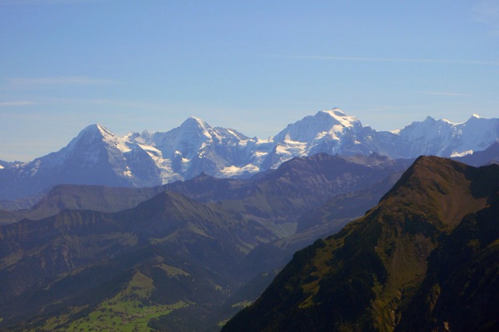
Auguri
dalla Svizzera!

Slide 2
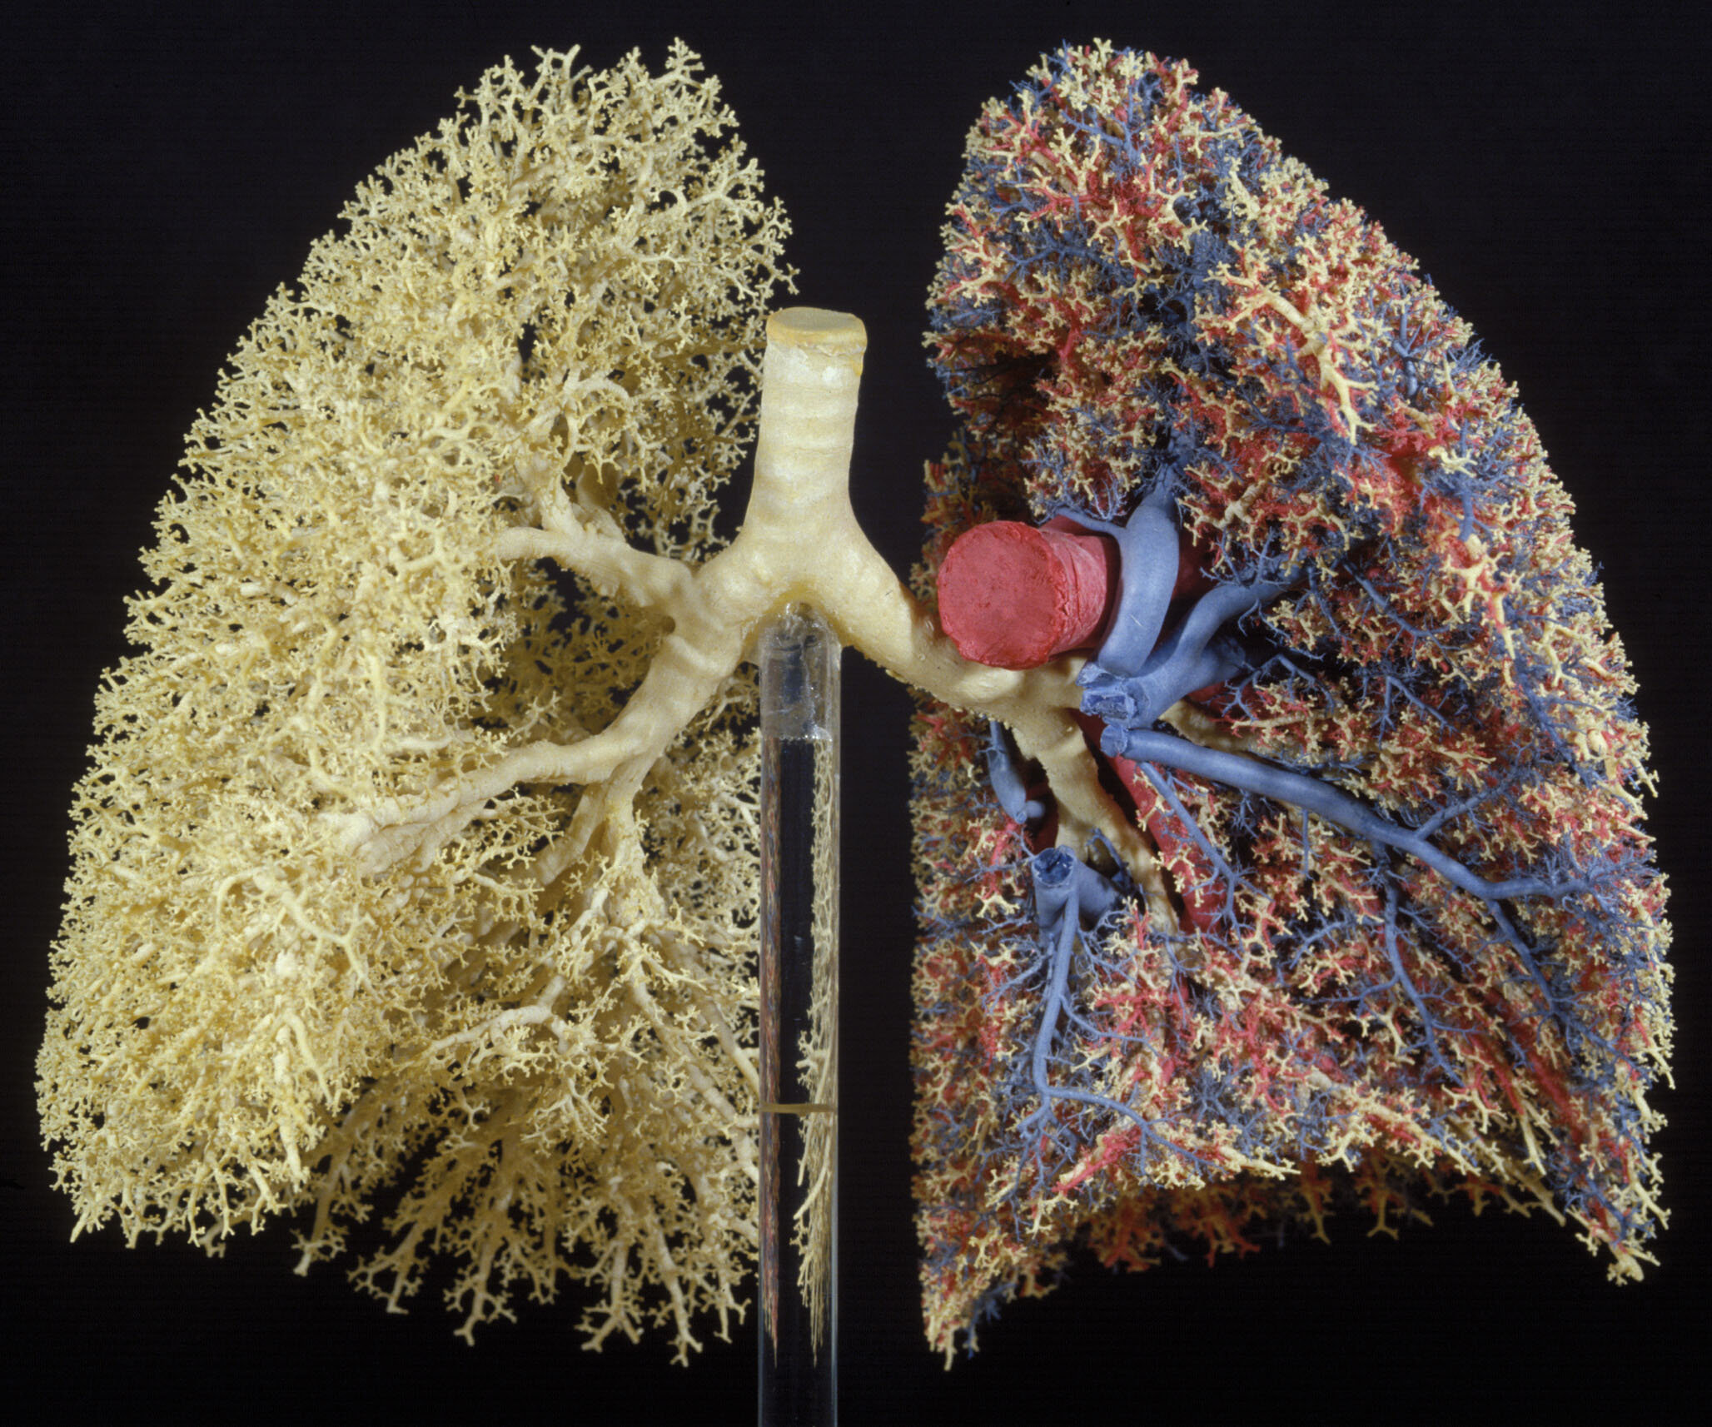
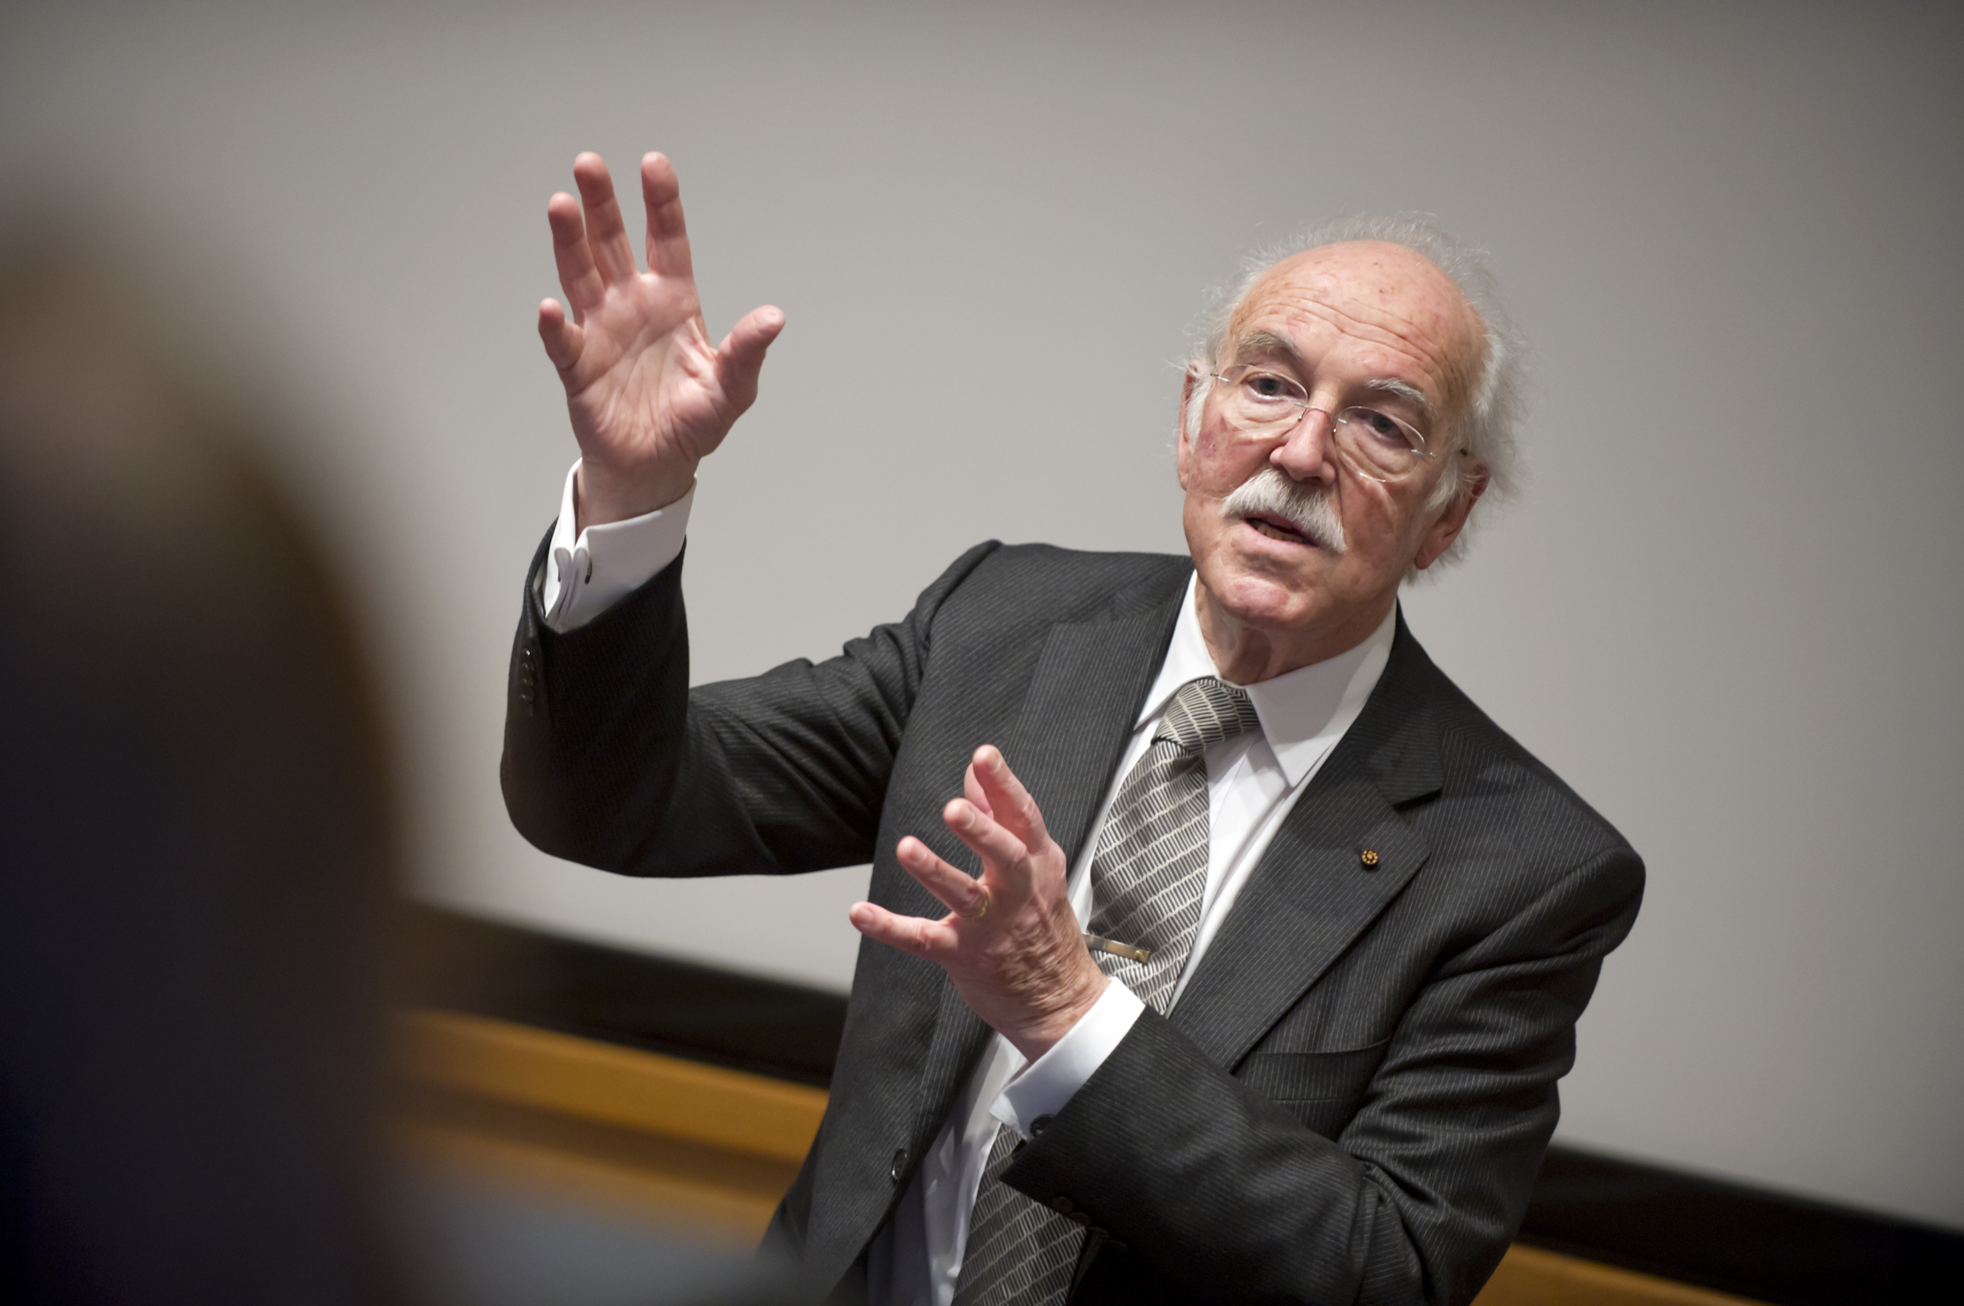
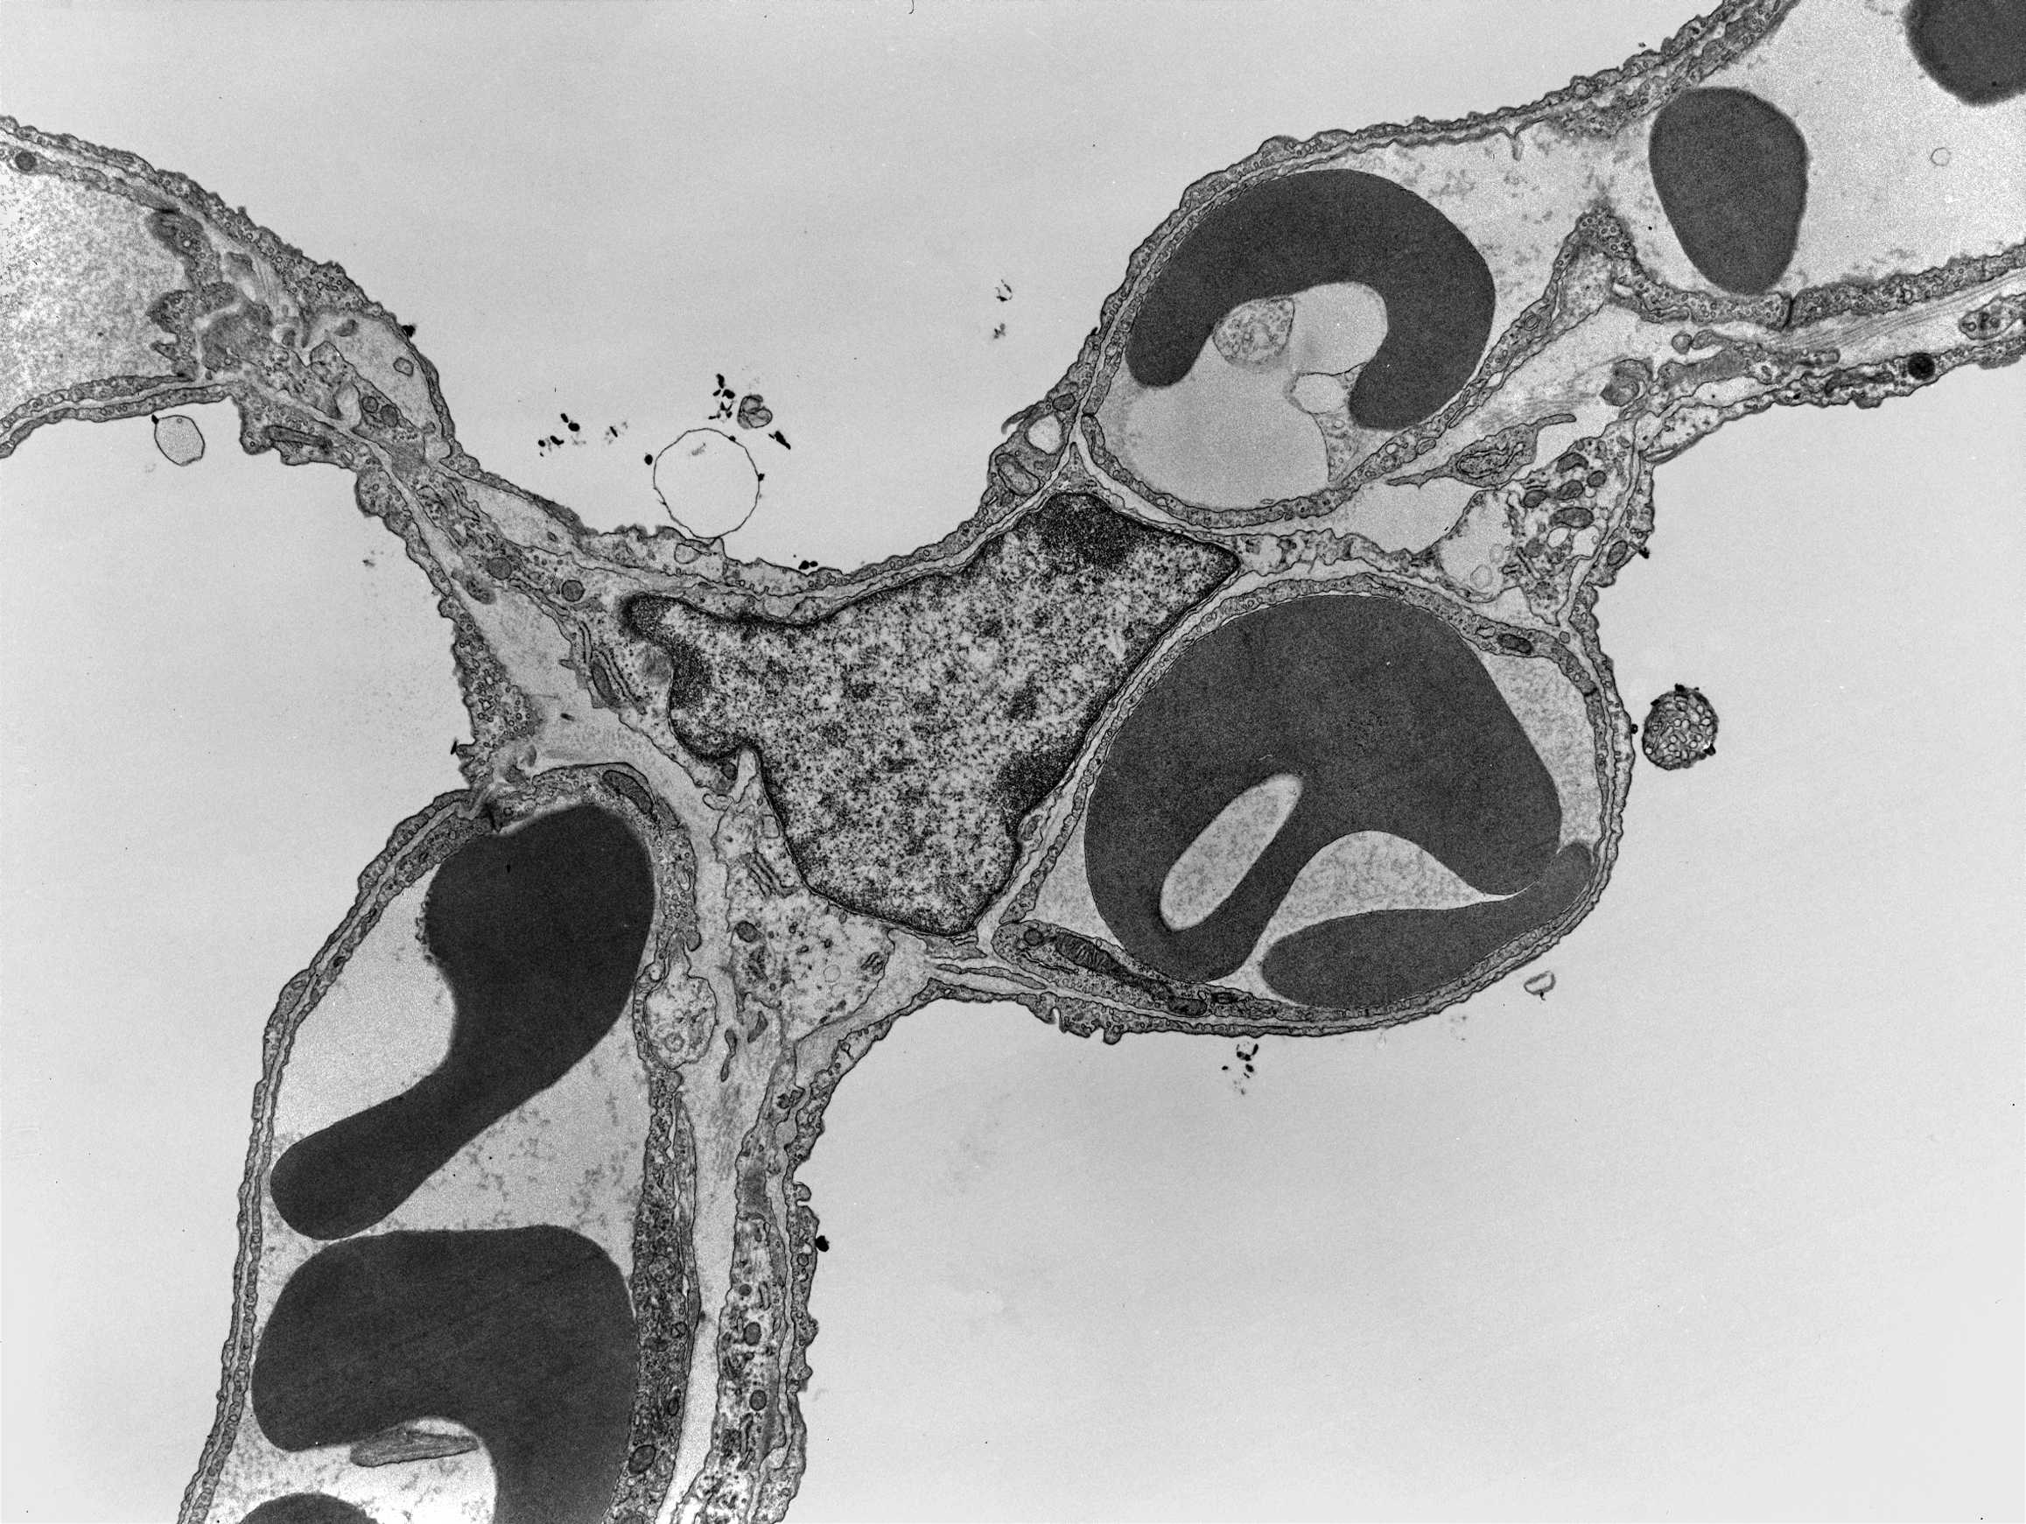
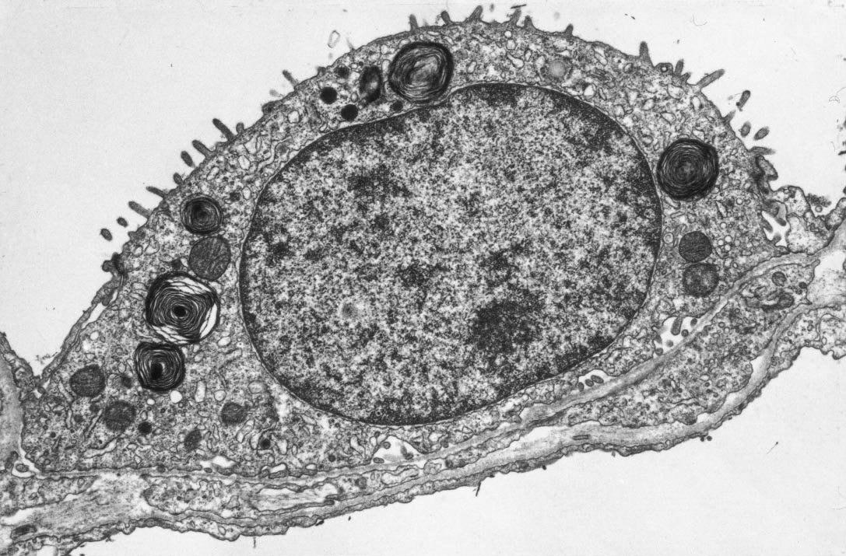
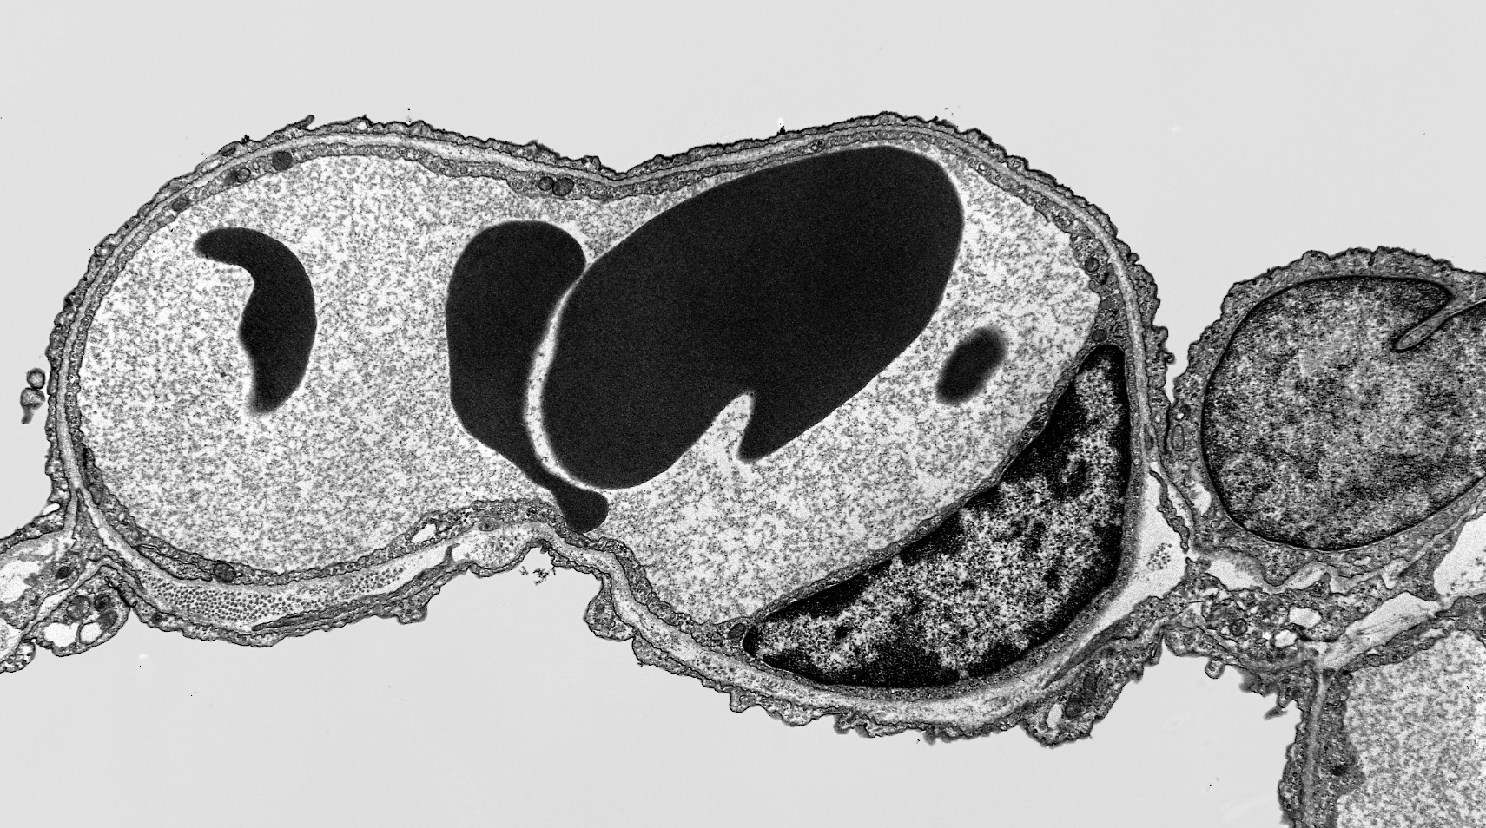
How to Make a Good Lung:
Ewald R. Weibel Institute of Anatomy University of Bern

Slide 3
How to Make a Good Lung:
Cells are the main operators
but …

Slide 4
How to Make a Good Lung:
Cells are the main operators
but …
it needs more than cells to make a good lung

Slide 5
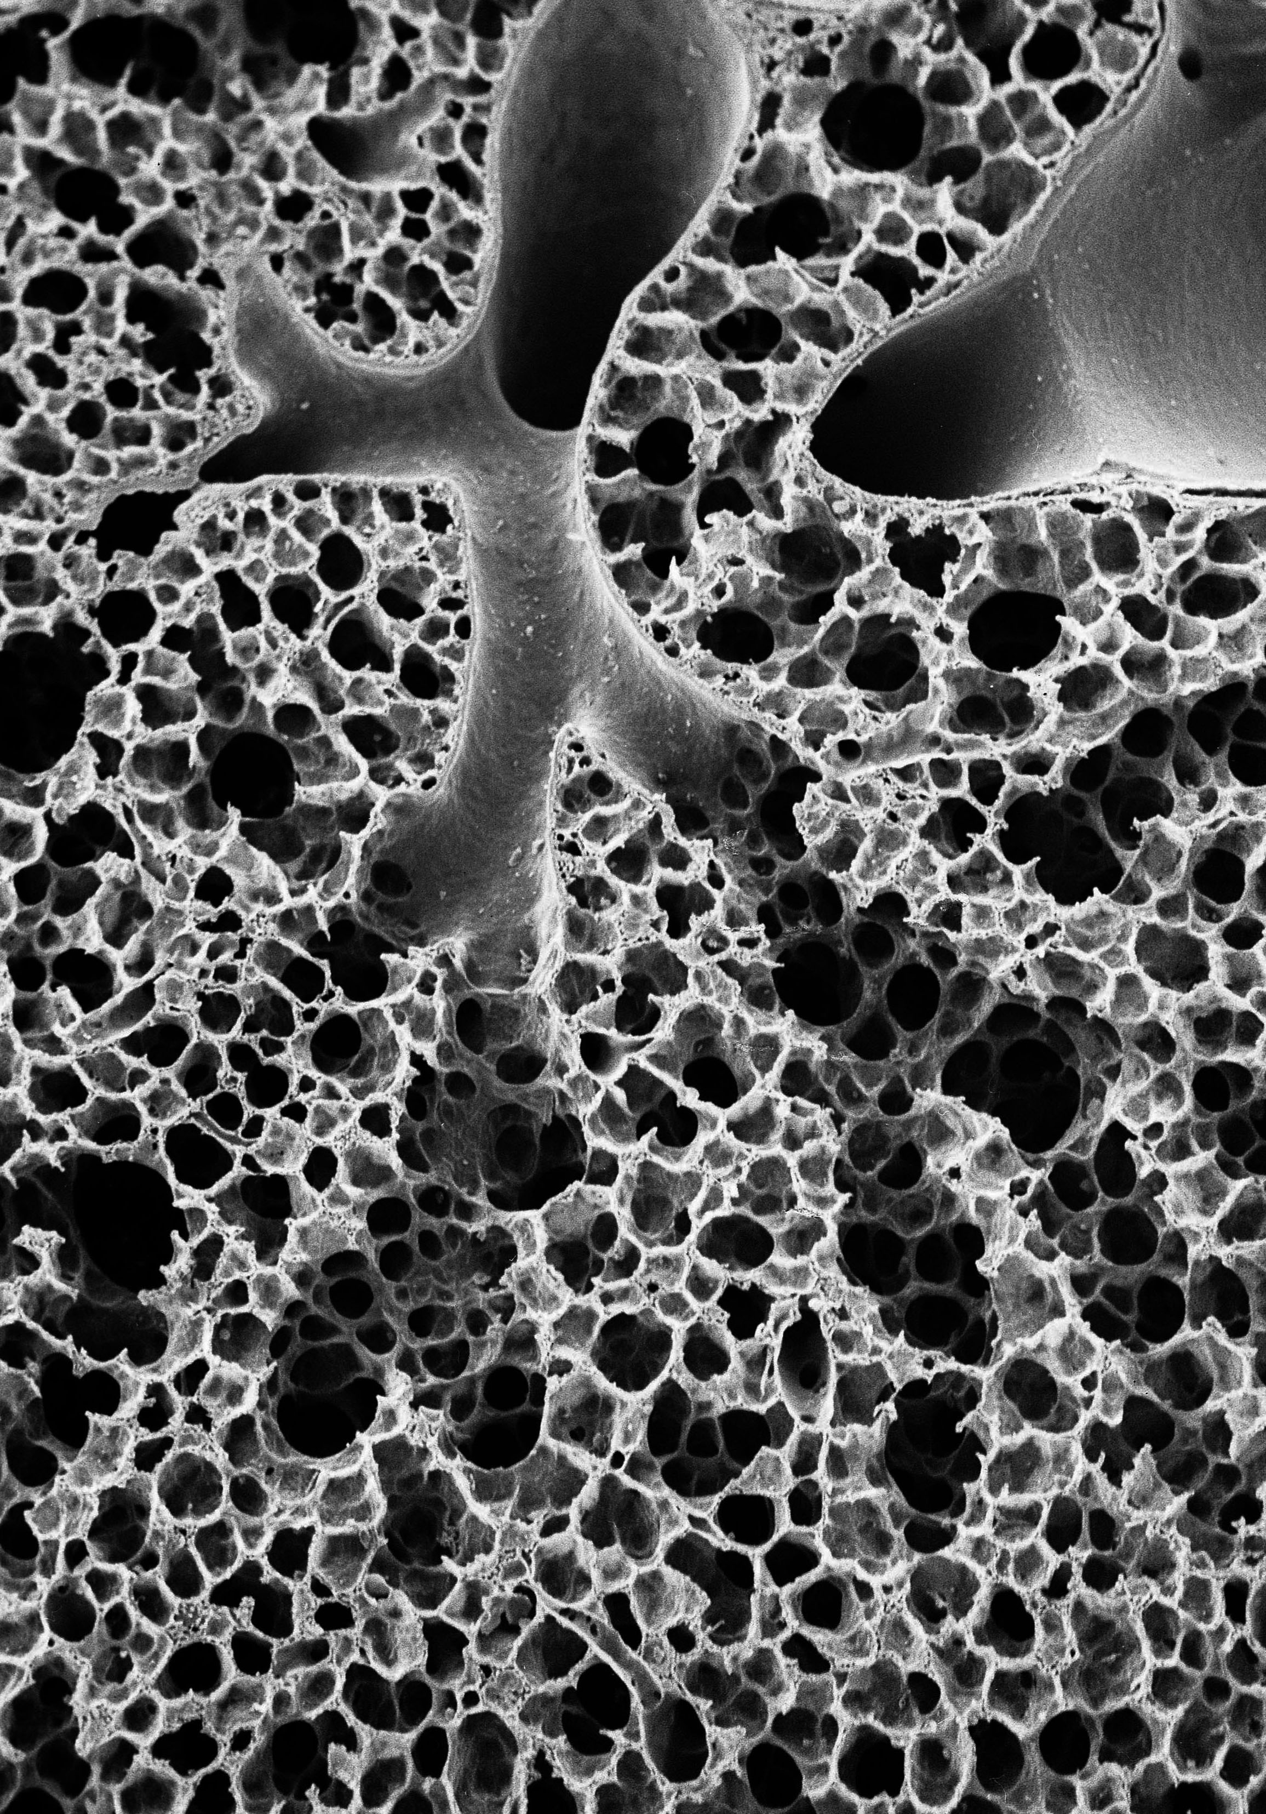
How to Make a Good Lung:
Design Principles
for Efficient Gas Exchange

Slide 6
What is a Good Lung?
Its structural design must
serve gas exchange as well as possible
O₂

Slide 7
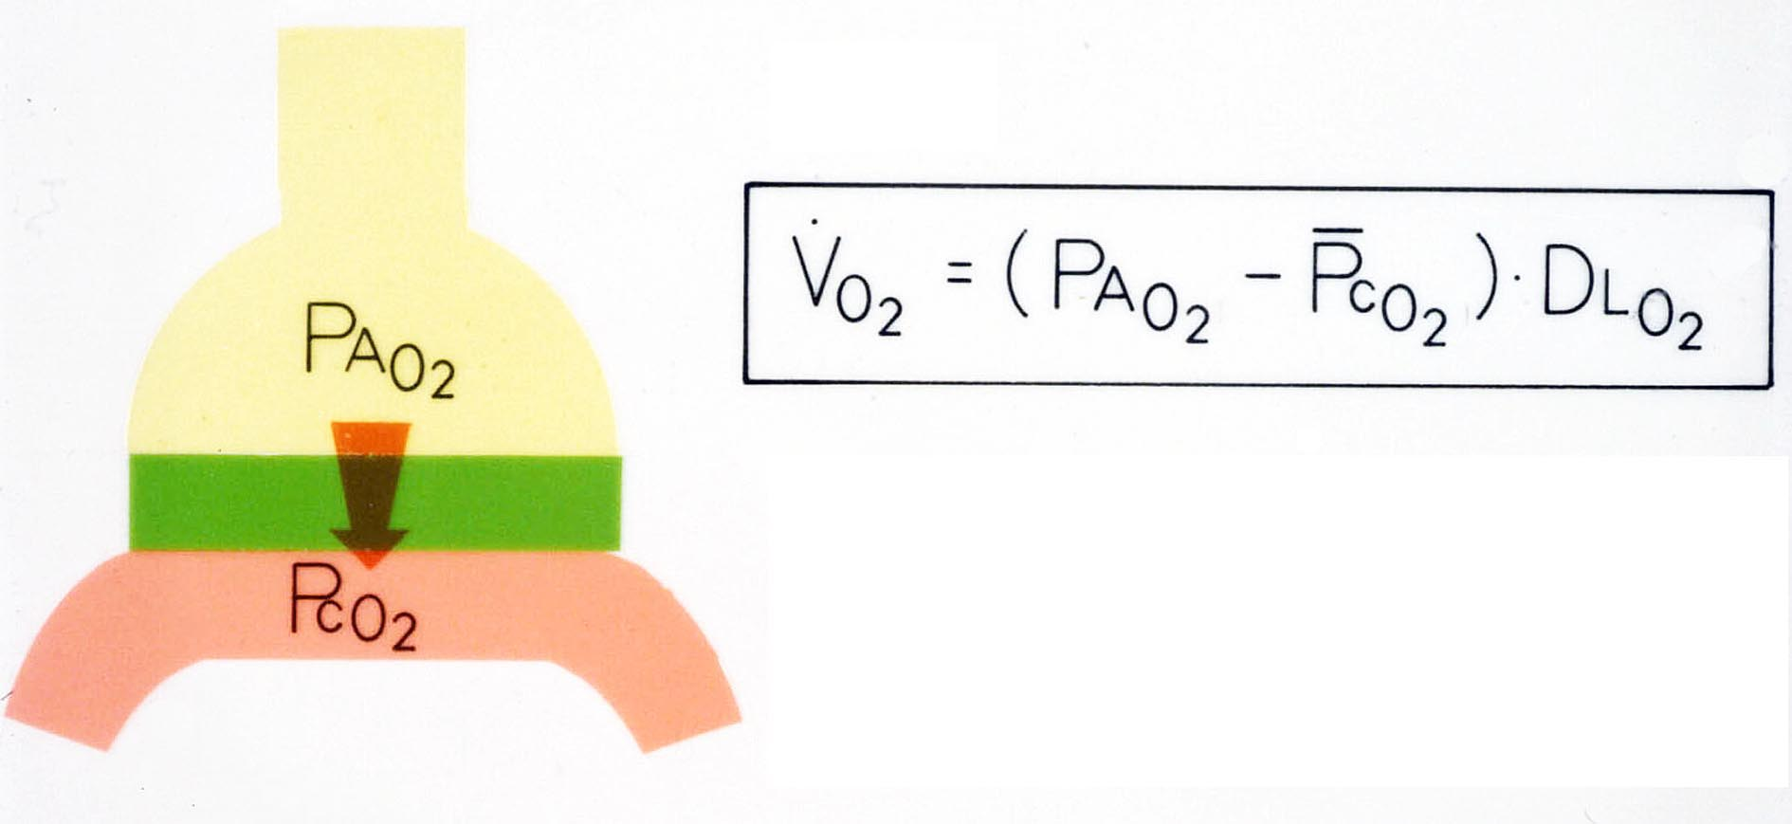
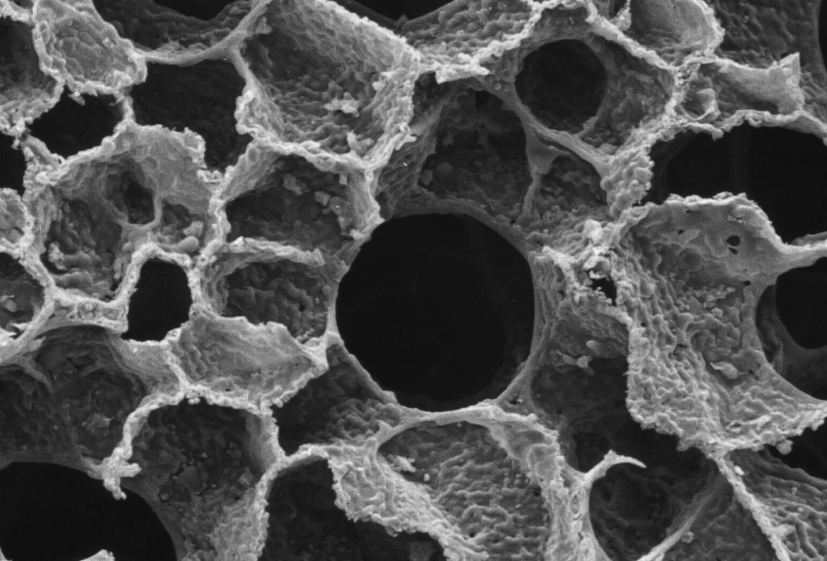
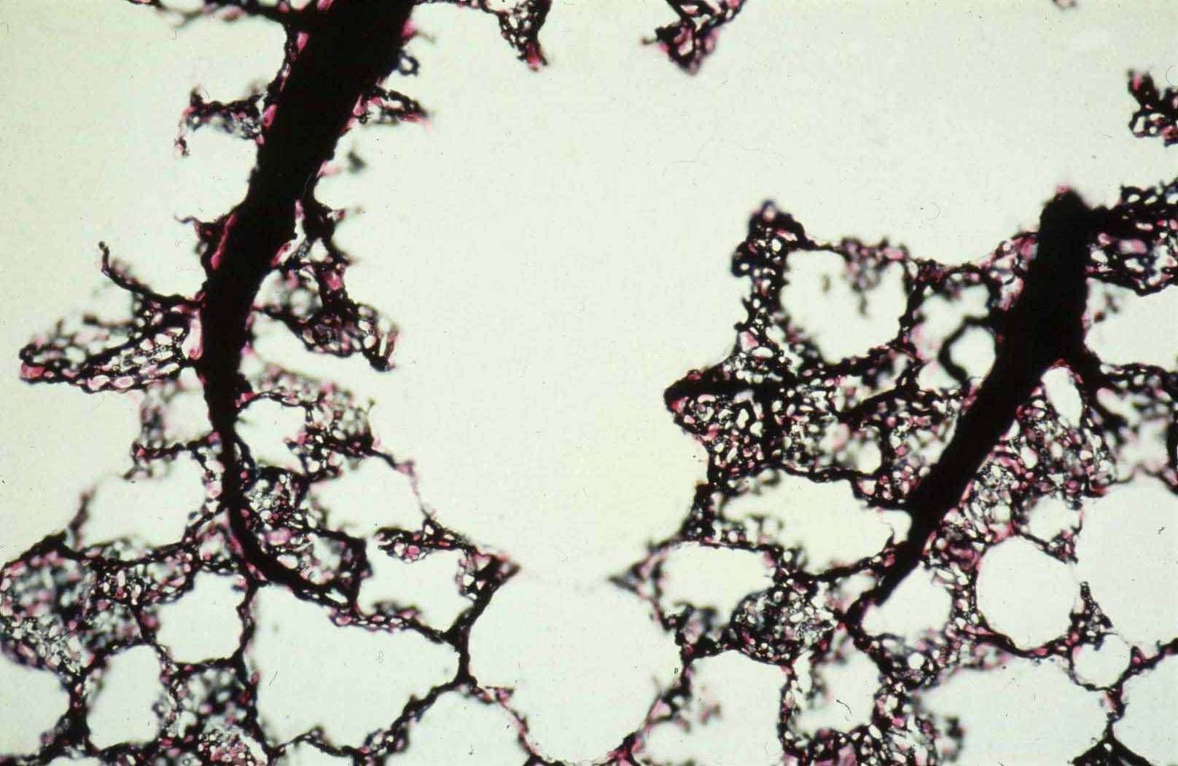
What is a Good Lung?
The definition of the physiologist
1909 Chr. Bohr 1910 A. & M. Krogh
Pulmonary diffusing capacity DL_{O2}
O₂
O₂

Slide 8
Vision of Domingo Gomez (1959):
Morphometry of the Human Lung determines gas exchange physiology
1909 Chr. Bohr 1910 A. & M. Krogh
Pulmonary diffusing capacity DL_{O2}
O₂
O₂

Slide 9
Vision of Domingo Gomez (1959):
Morphometry of the Human Lung determines gas exchange physiology
1909 Chr. Bohr 1910 A. & M. Krogh
DM
De
1957 Roughton & Forster :
Pulmonary diffusing capacity DL_{O2} has 2 components:
Membrane DM_{O2}
Blood De_{O2}
1/DL = 1/DM + 1/De

Slide 10
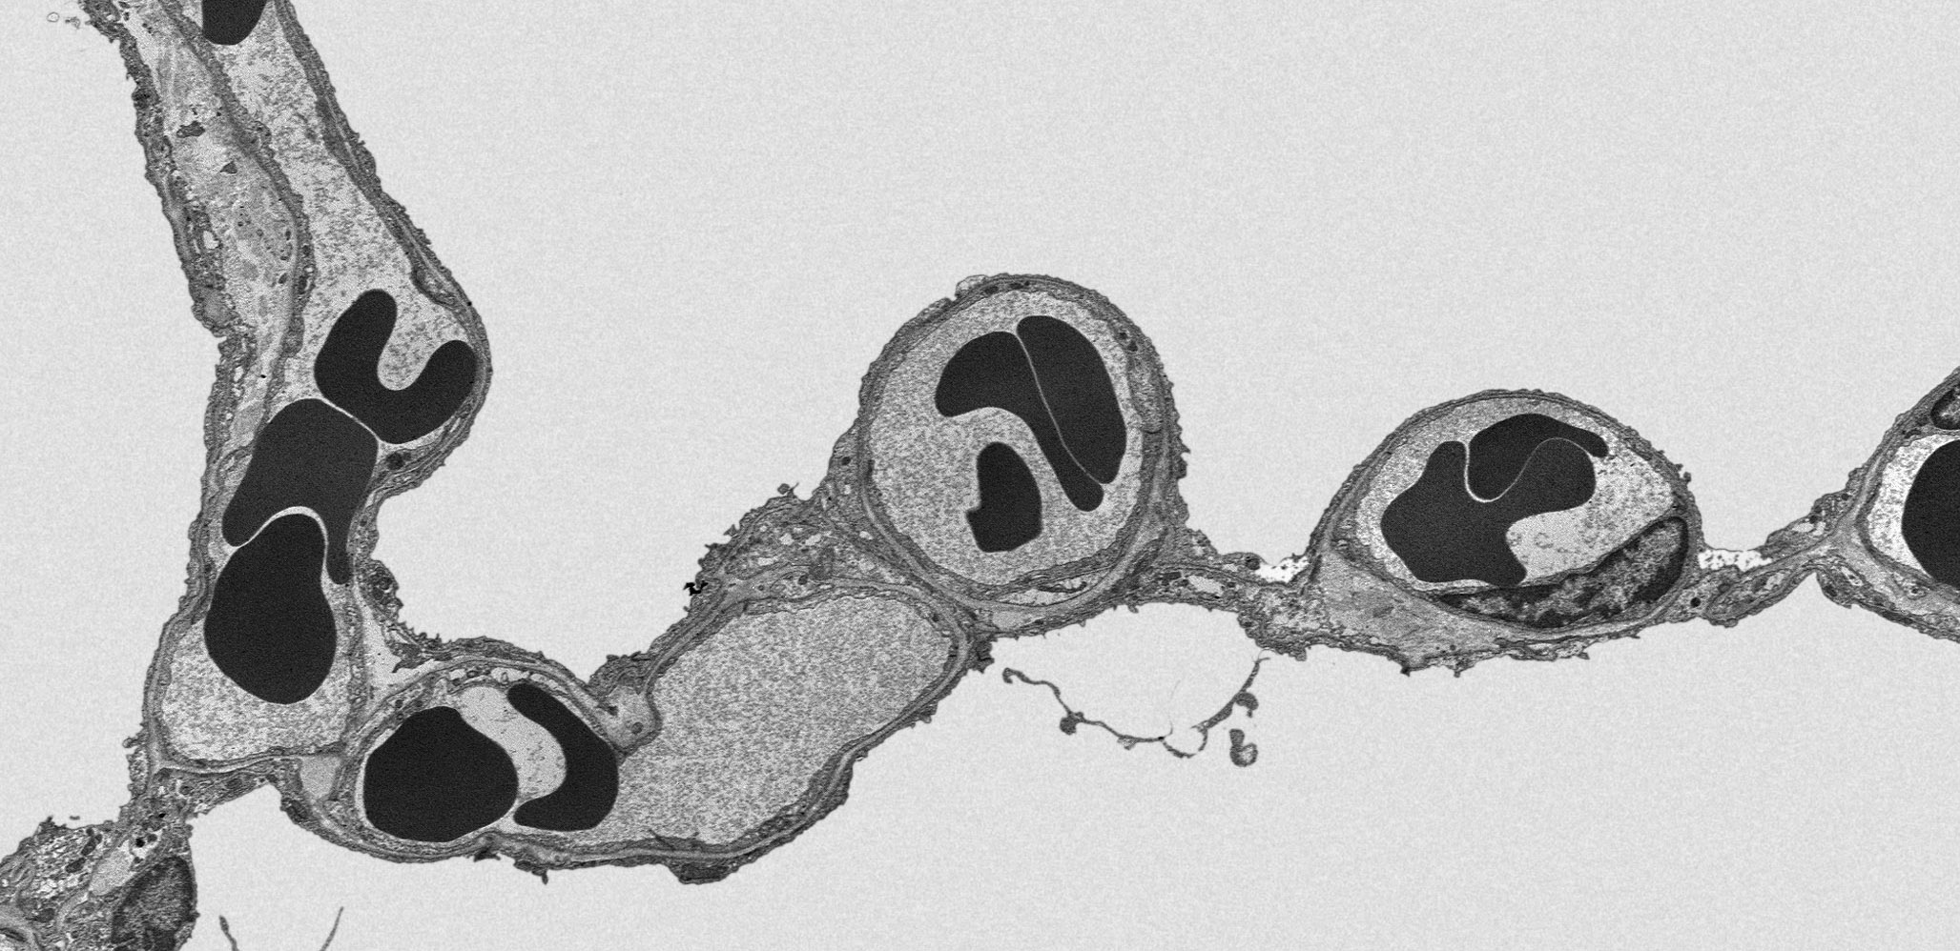
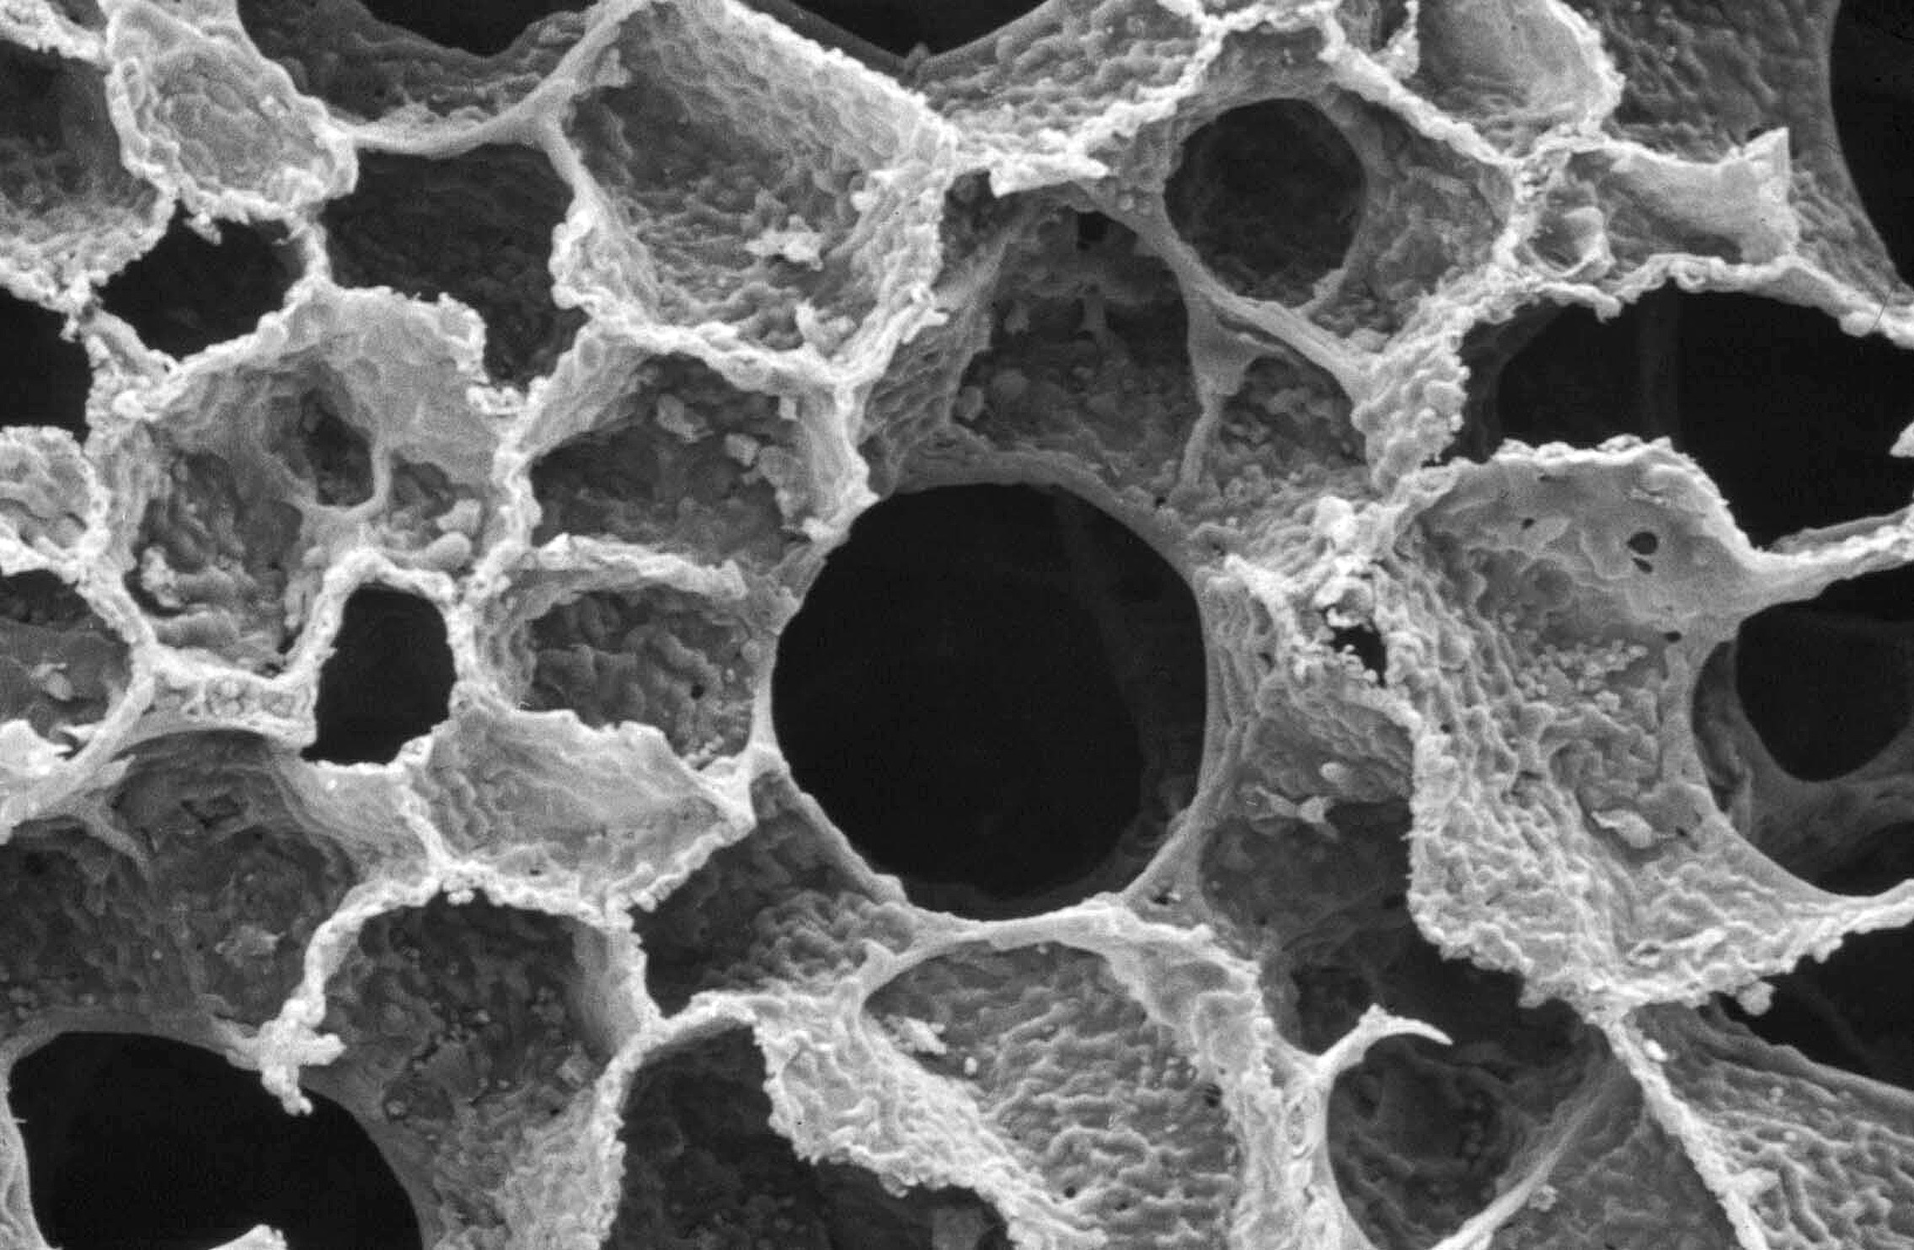
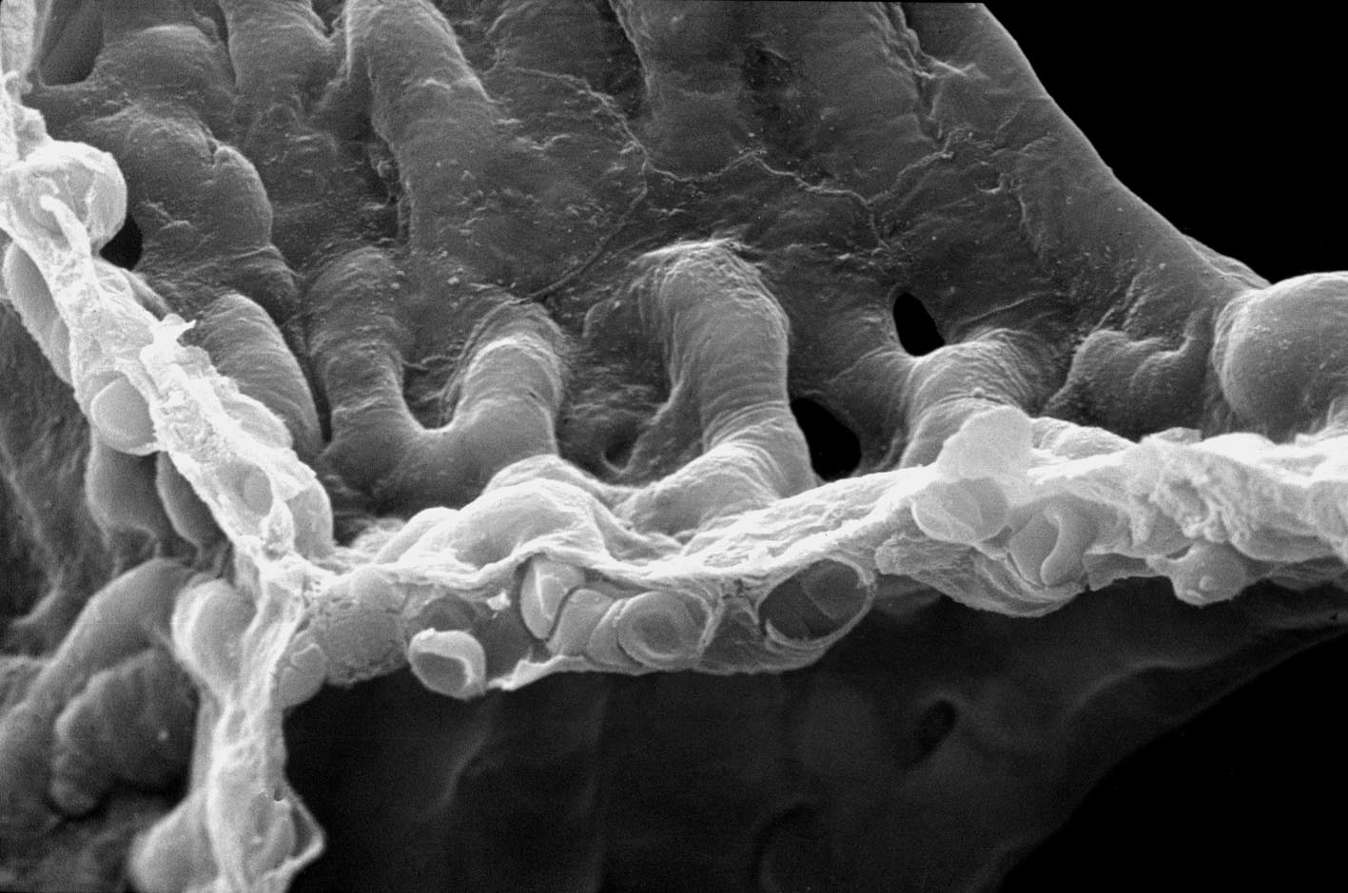
Morphometric Model for predicting DL_{O2}
D.M. Gomez, B.W. Knight, E.R. Weibel (1962-64) based on Roughton & Forster (1957)

Slide 11
Morphometric Model for predicting DL_{O2}
S(a) S(c)
τhb
V(c)
1/DL_{O2} = 1/DM_{O2} + 1/De_{O2}
DM_{O2} = K_{O2} · (S(a) + S(c))/2·τhb
De_{O2} = θ_{O2} · V(c)
D.M. Gomez, B.W. Knight, E.R. Weibel (1962-64) based on Roughton & Forster (1957)

Slide 12
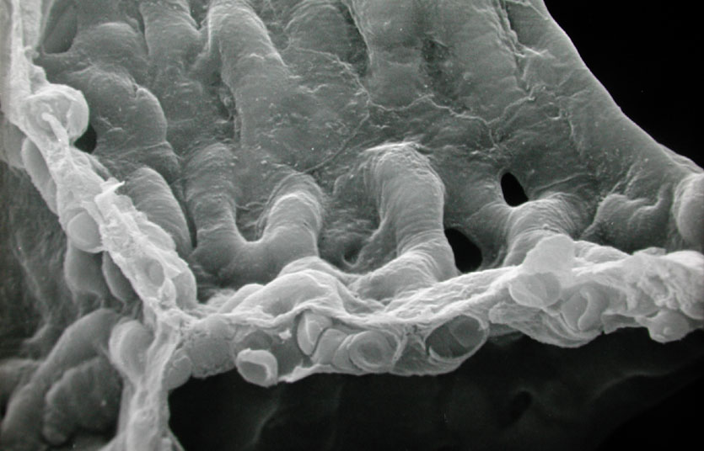
Morphometry of Human Lung & DL_{O2}
Body mass 74 ± 4 kg
Alveolar surface 130 ± 12 m²
Capillary surface 115 ± 12 m²
Capillary volume 194 ± 30 ml
Tissue barrier thickness 0.62 ± 0.04 µm
Total barrier thickness 1.15 ± 0.01 µm
Gehr, Bachofen, Weibel 1978/93

Slide 13
Morphometry of Human Lung & DL_{O2}
Body mass 74 ± 4 kg
Alveolar surface 130 ± 12 m²
Capillary surface 115 ± 12 m²
Capillary volume 194 ± 30 ml
Tissue barrier thickness 0.62 ± 0.04 µm
Total barrier thickness 1.15 ± 0.01 µm

Slide 14
Morphometry of Human Lung & DL_{O2}
Body mass 74 ± 4 kg
Alveolar surface 130 ± 12 m²
Capillary surface 115 ± 12 m²
Capillary volume 194 ± 30 ml
Tissue barrier thickness 0.62 ± 0.04 µm
Total barrier thickness 1.15 ± 0.01 µm
Diffusing capacity DL_{O2} 158 mlO₂.min^{-1.}mmHg⁻¹

Slide 15
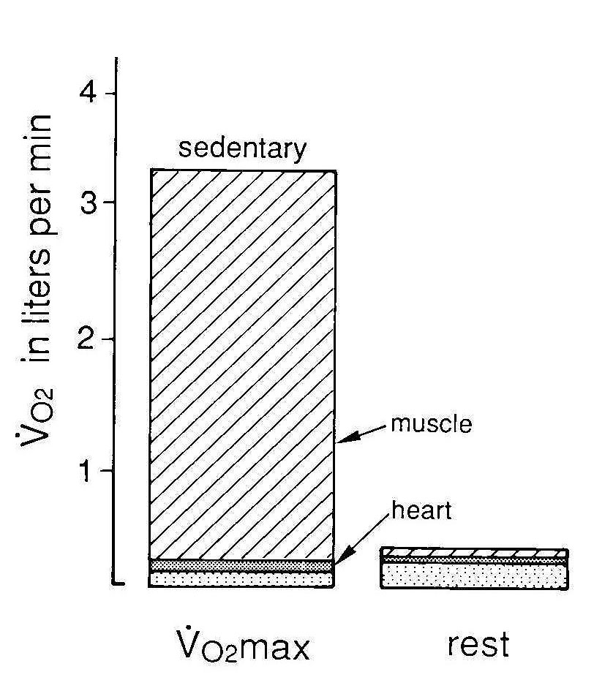
Lung und Exercise
Does the normal human lung have excess DL_{O2} ?
How much ?
Diffusing capacity DL_{O2} 158 mlO₂.min^{-1.}mmHg⁻¹
Physiological DL_{O2} rest 30 mlO₂.min^{-1.}mmHg⁻¹
exercise 100 mlO₂.min^{-1.}mmHg⁻¹

Slide 16
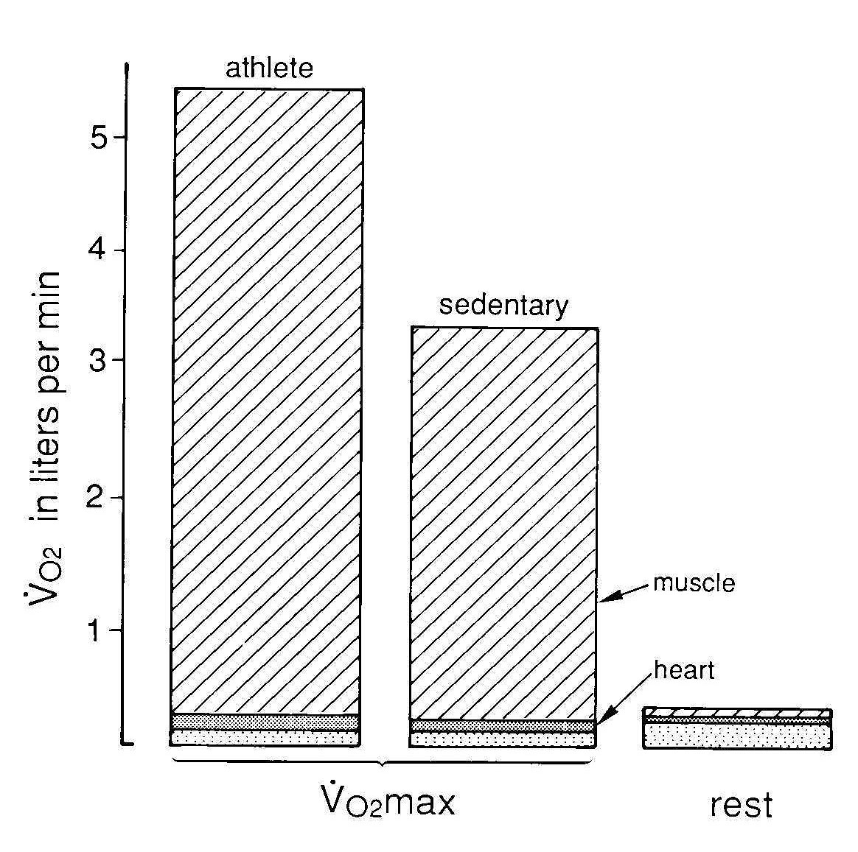
Is 1.5x excess capacity useful ?
Athletes increase
O₂ need 1.5 fold
by training muscle & heart
Adult lung cannot grow:
Athletes can train for higher V_{O2}max
“up to their DL_{O2}”
acquired during growth
•

Slide 17
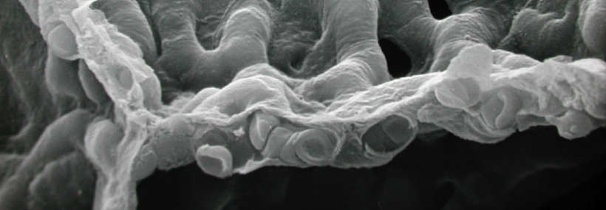
What is a Good Lung ? Large Surface — Thin Barrier
Merits: High Conductance for O₂
with some safety factor: allows work under limiting conditions

Slide 18
What is a Good Lung ? Large Surface — Thin Barrier
Merits: High Conductance for O₂
with some safety factor: allows work under limiting conditions
• Problems: • ventilate & perfuse large surface
• maintain surface large
• keep barrier thin

Slide 19
What is a Good Lung ? Large Surface — Thin Barrier
Merits: High Conductance for O₂
Problem 1+2: How to get O₂ & blood to all points on a surface the size of a tennis court?
Architecture of supply structures: Complexity & Modularity

Slide 20
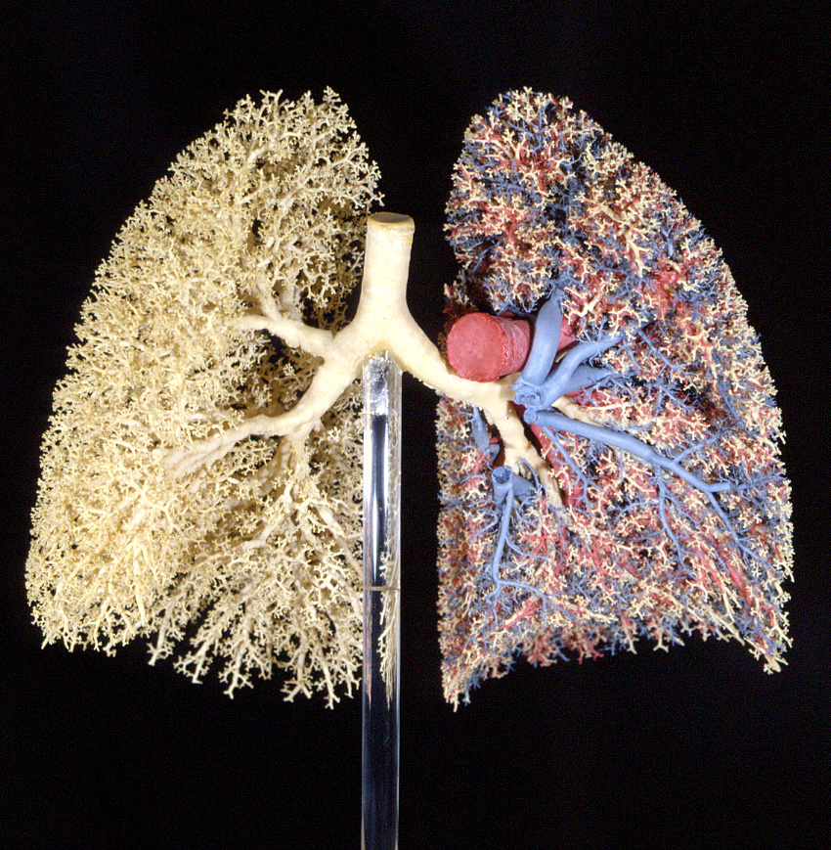
How to get O₂ to all points on a surface
the size of a tennis court?
2 joint problems:
How to fold up a sheet the size of a tennis court such that the surface can be ventilated efficiently
How to design a sprinkler system

Slide 21
Begin with
(1) how to fold up a sheet the size of a tennis court such that the surface can be ventilated efficiently

Slide 22
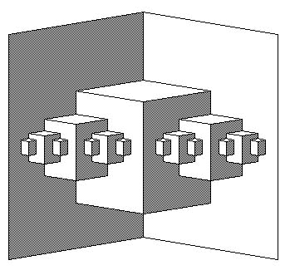
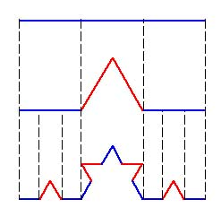
Fractal folding
Increase surface density
(1) how to fold up a sheet the size of a tennis court such that the surface can be ventilated efficiently

Slide 23
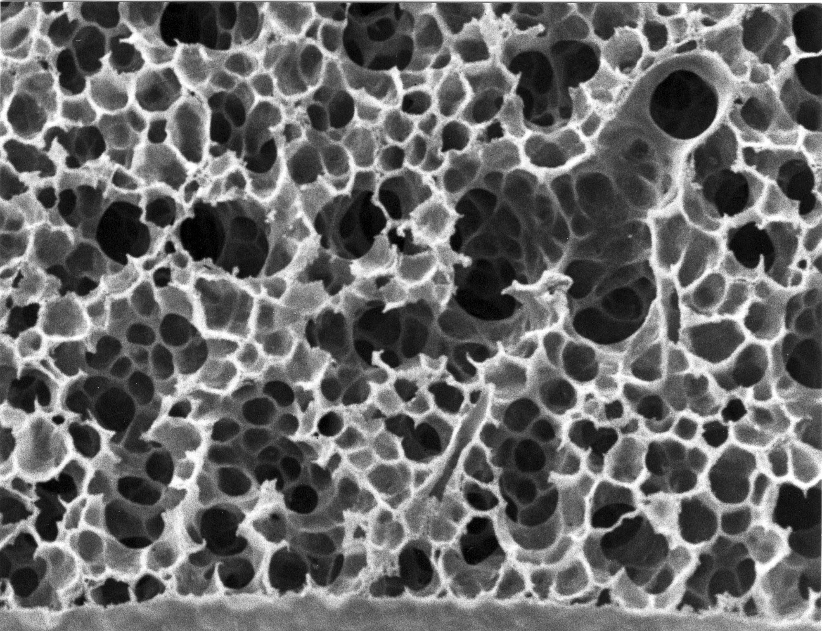
Fractal folding: — alveolar surface forms crumpled space-filling continuum
— alveoli open to airway
(1) how to fold up a sheet the size of a tennis court such that the surface can be ventilated efficiently

Slide 24
COMPLEXITY
MODULARITY
Fractal surface folding at airway periphery:
acinus = gas exchange module

Slide 25
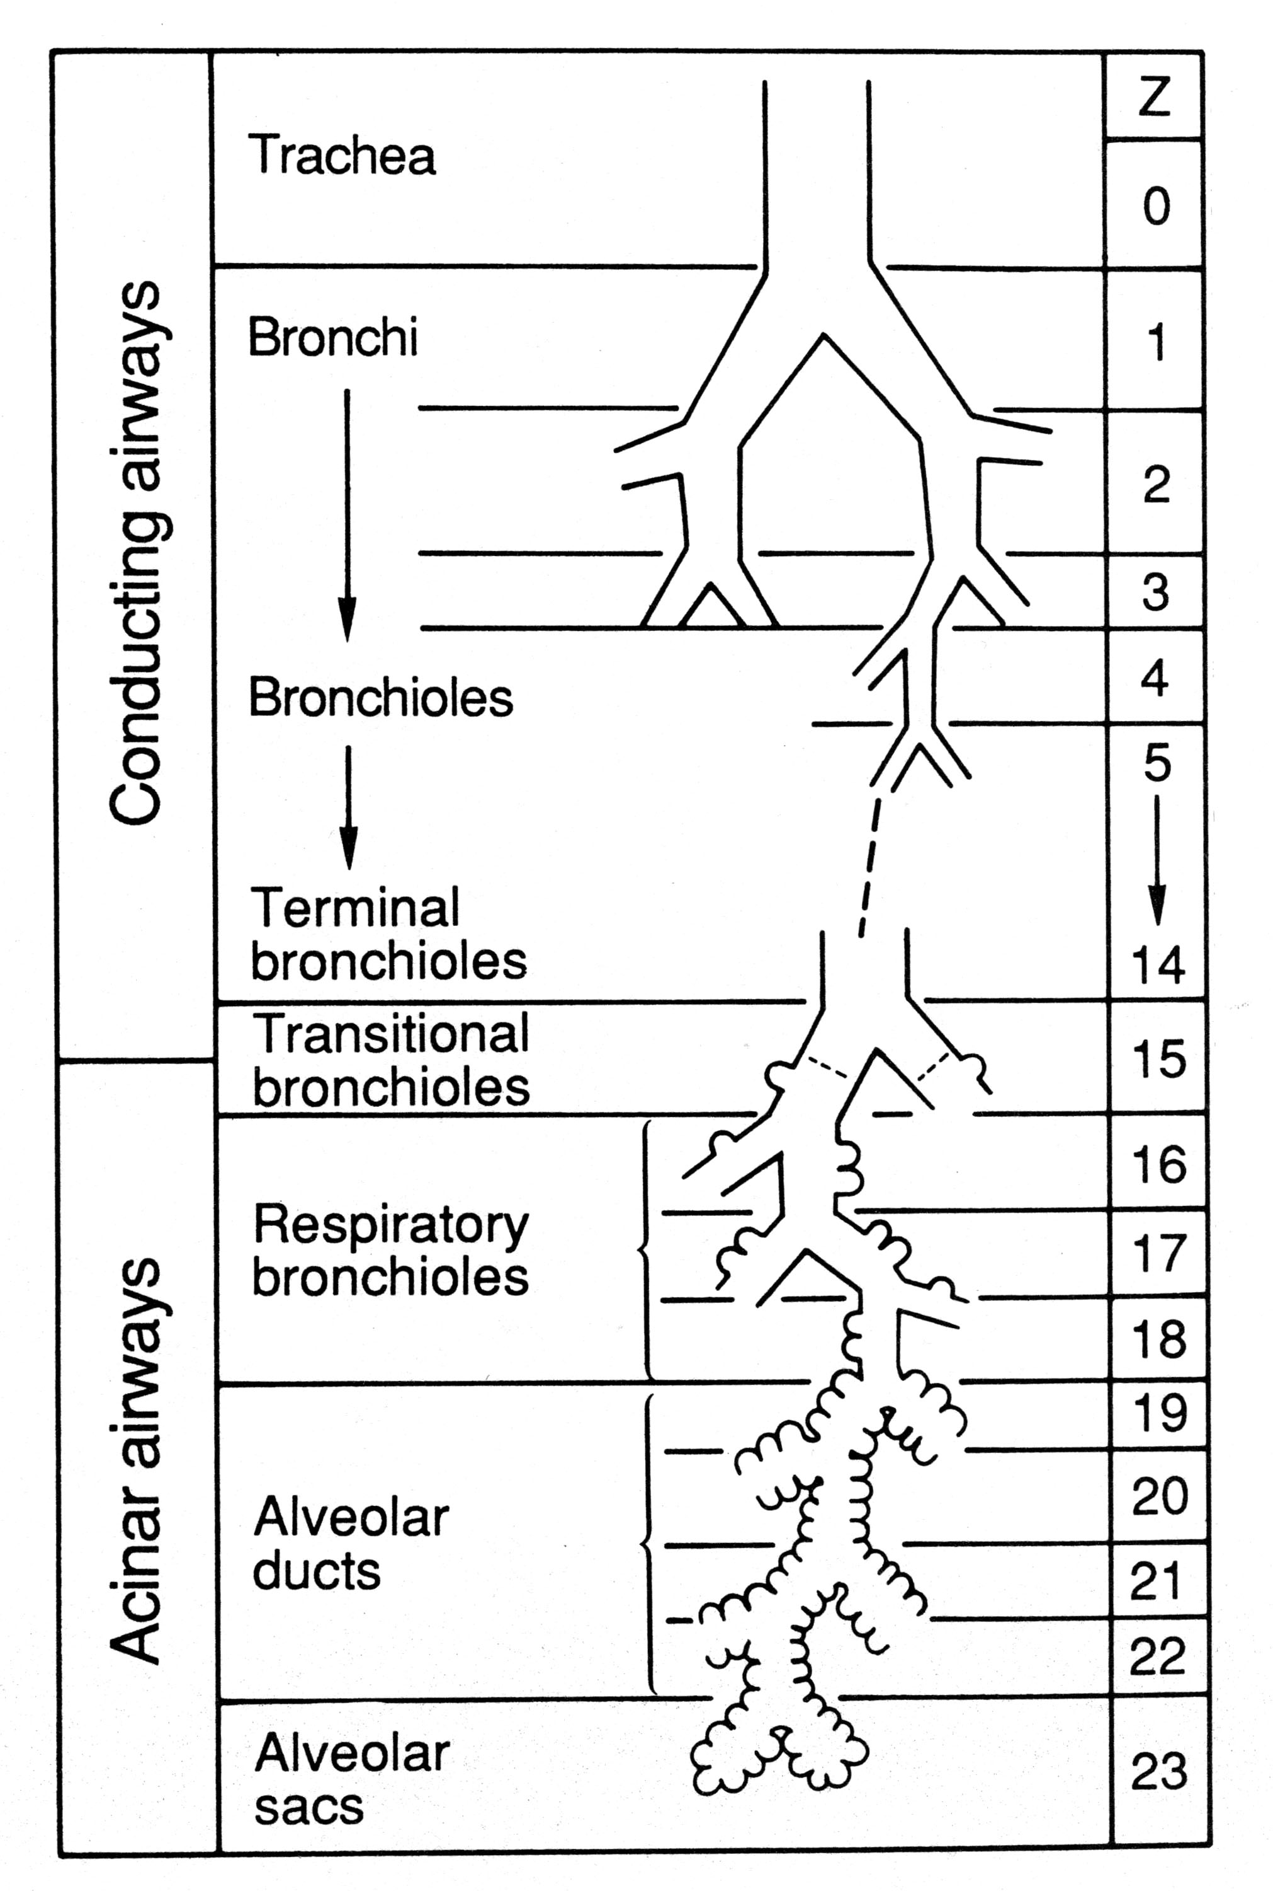
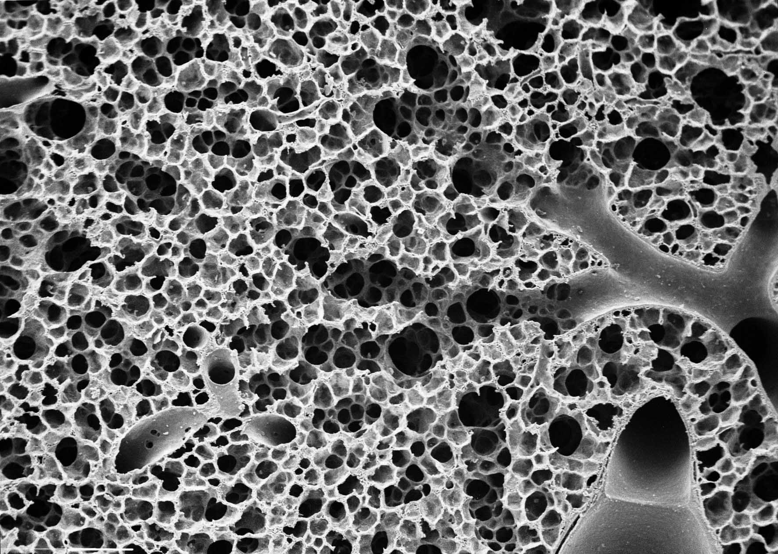
COMPLEXITY & MODULARITY
Fractal surface folding at airway periphery
— Conducting airways: bronchi
— Respiratory airways: acini
30‘000 acini = gas exchange modules

Slide 26
COMPLEXITY
MODULARITY
Fractal surface folding at airway periphery:
acinus = gas exchange module
(2) How to design a sprinkler system linked to 30’000 modules

Slide 27
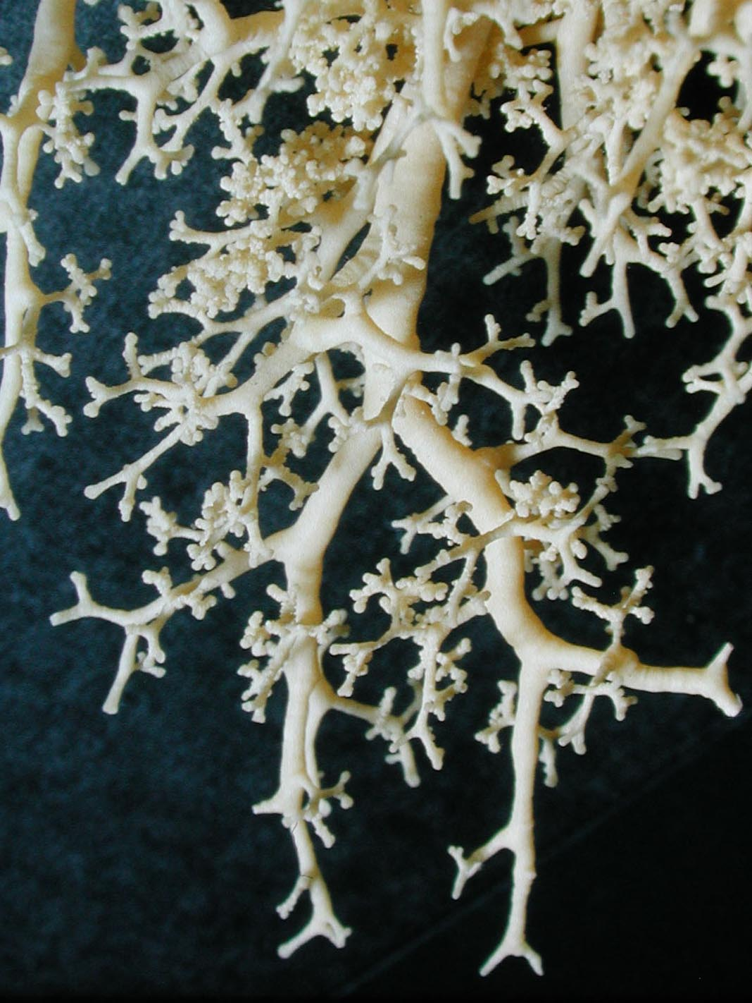
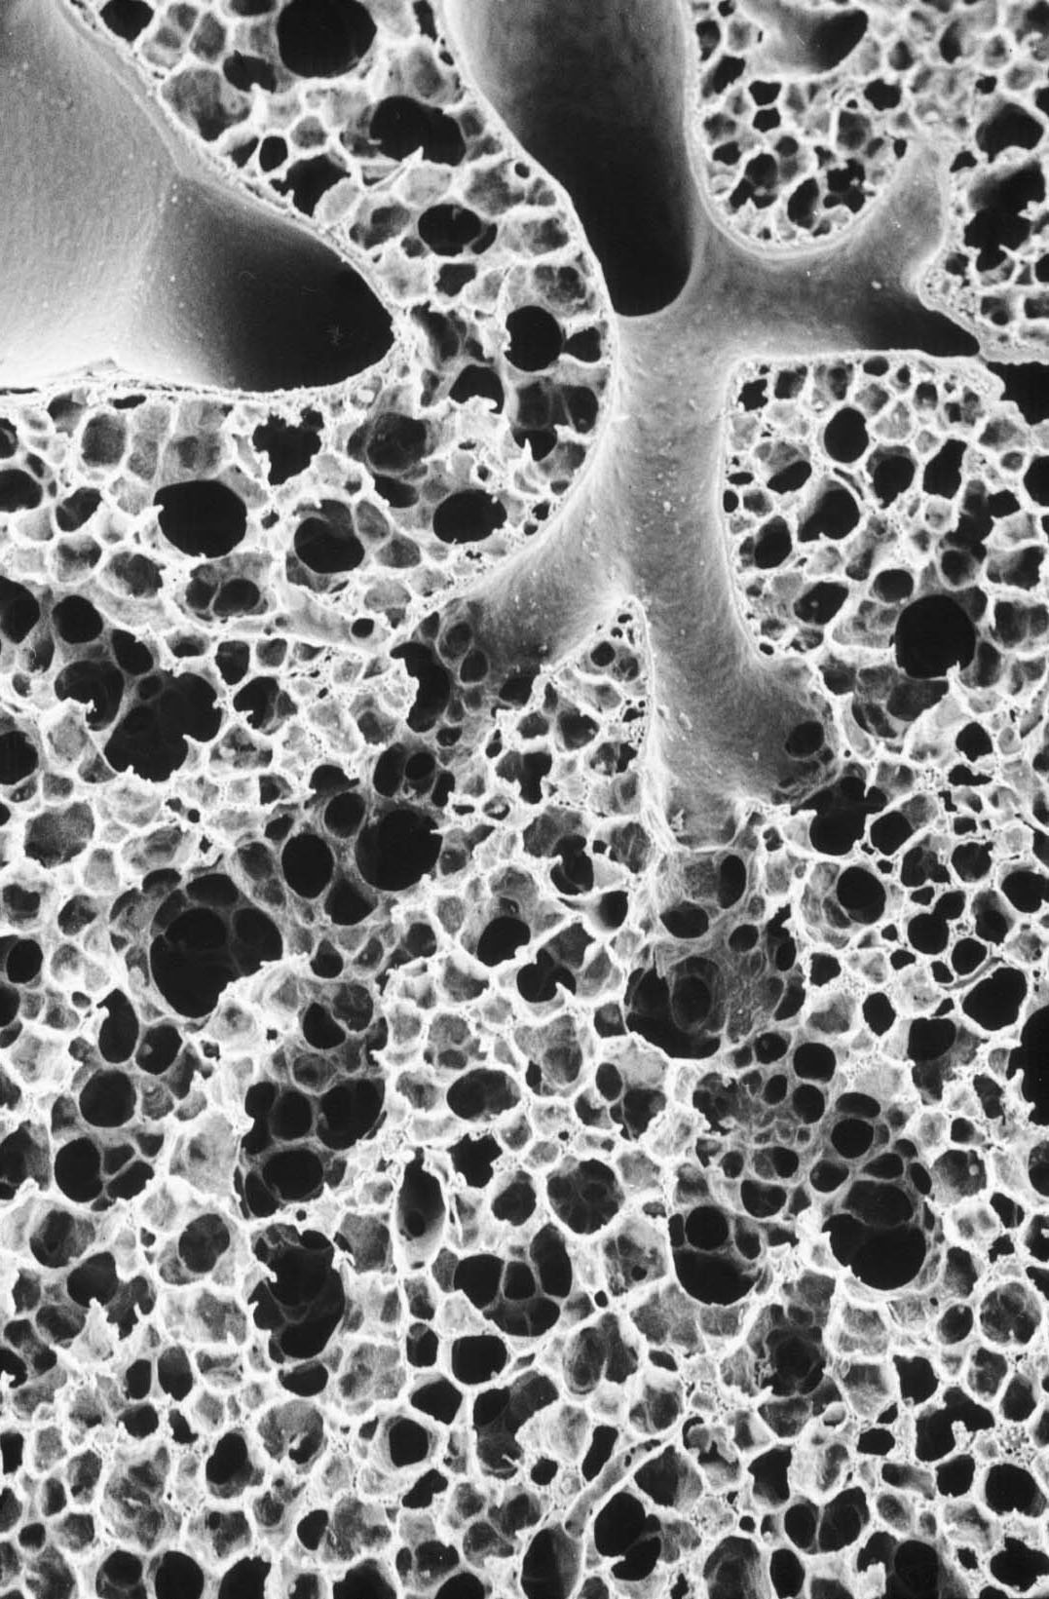
Problem 2: Design of airway tree
• dichotomy (23 generations)
• self-similar branching
• space-filling (into all corners)

Slide 28
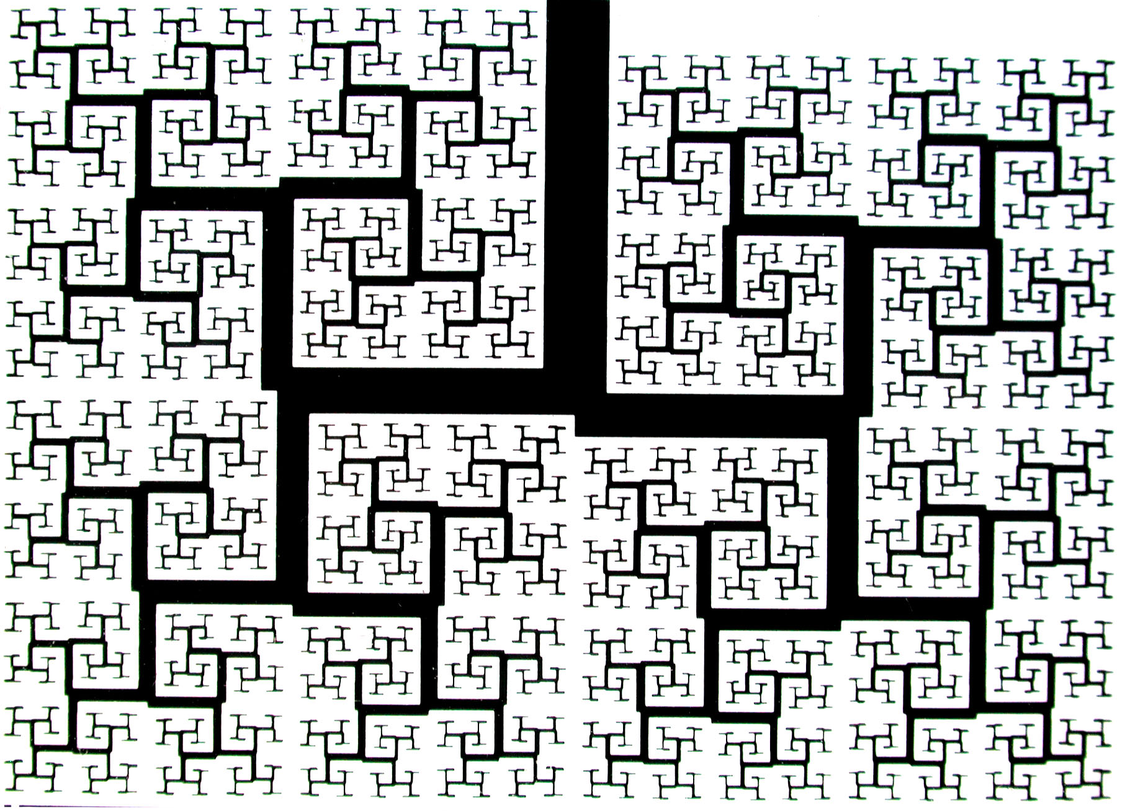
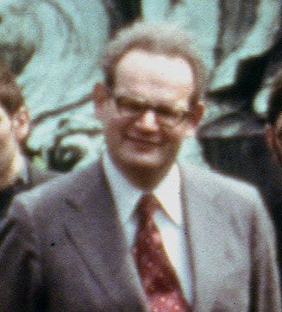
Problem 2: Design of airway tree
Fractal tree
• dichotomy
• space-filling (into all corners)
• self-similar branching
Benoit Mandelbrot (1925-2010)

Slide 29
Problem 2: Design of airway tree
Fractal tree
Is this of functional significance?
Benoit Mandelbrot
• dichotomy
• space-filling (into all corners)
• self-similar branching

Slide 30
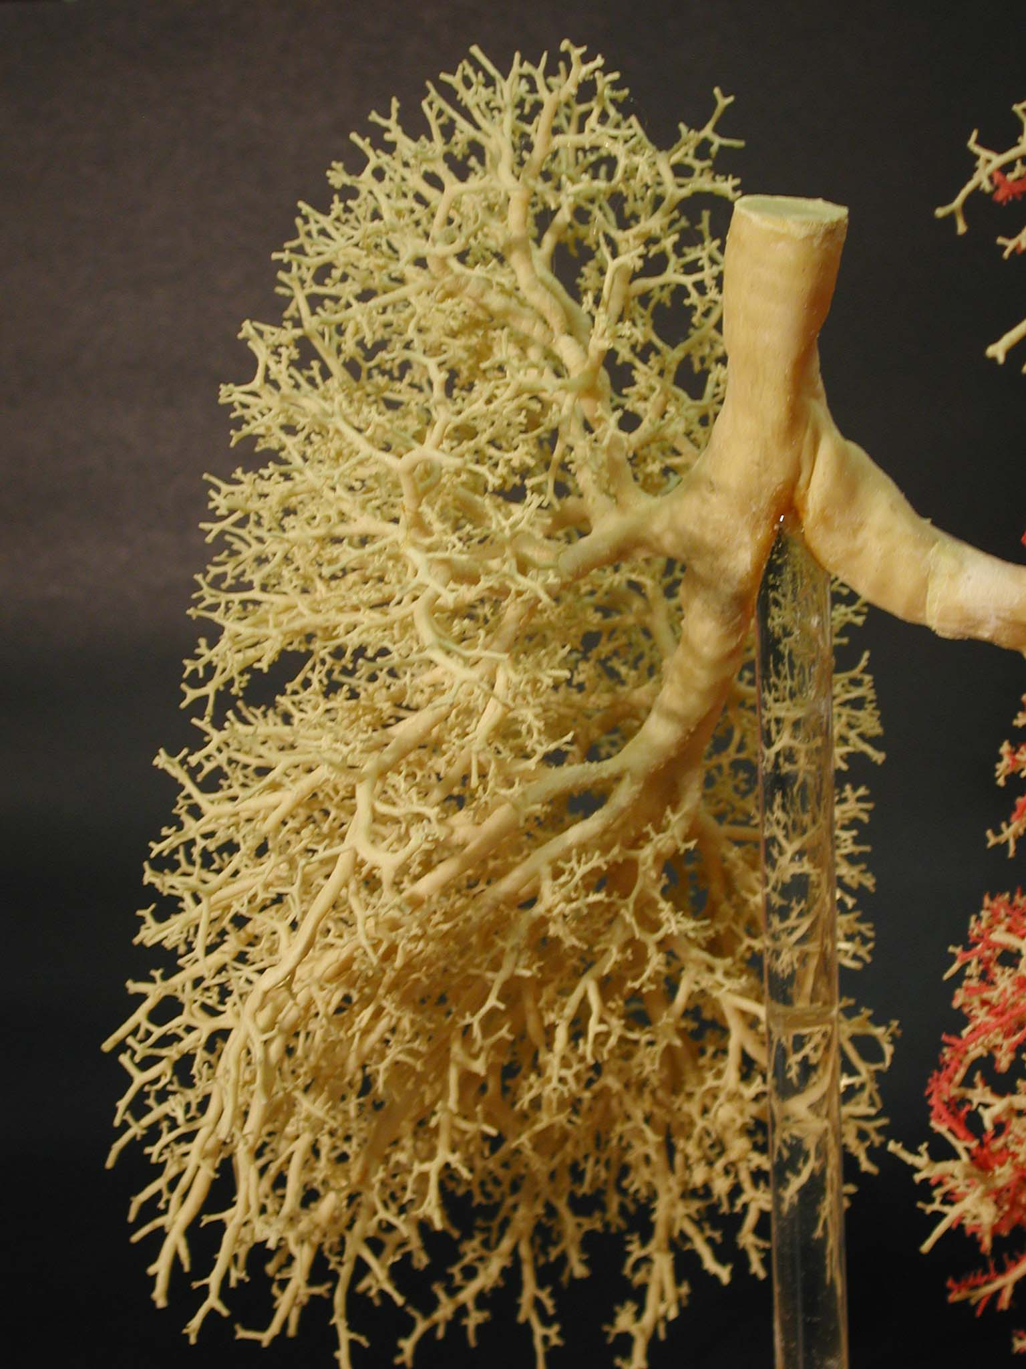
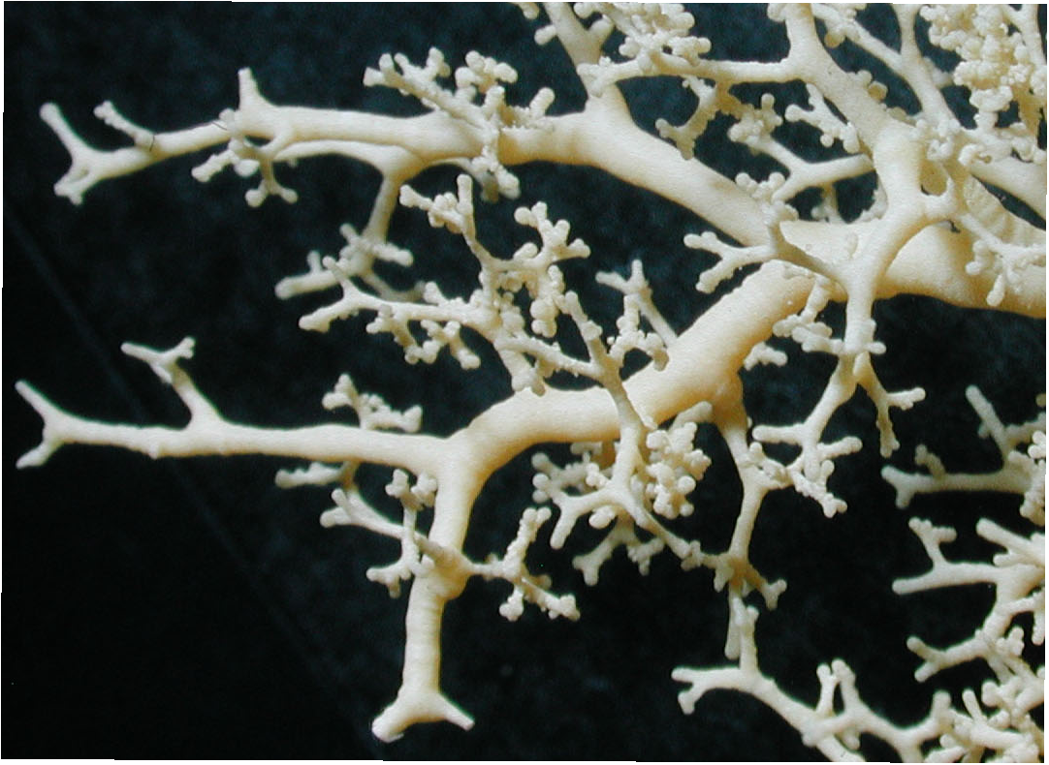
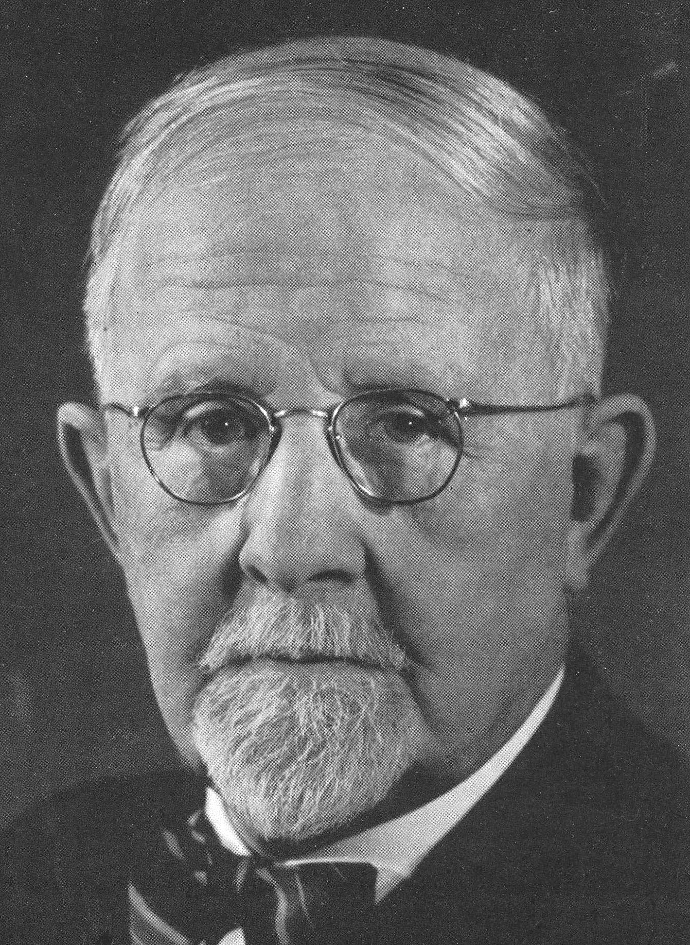
Self-similar branching optimizes convective ventilation
0
1 1
Optimize diameter of branching tubes:
minimize flow resistance & dead space volume
THEORETICAL PREDICTION:
symmetric tree:
reduction factor
Hess-Murray law
W.R. Hess (1917), C. Murray (1926)

Slide 31
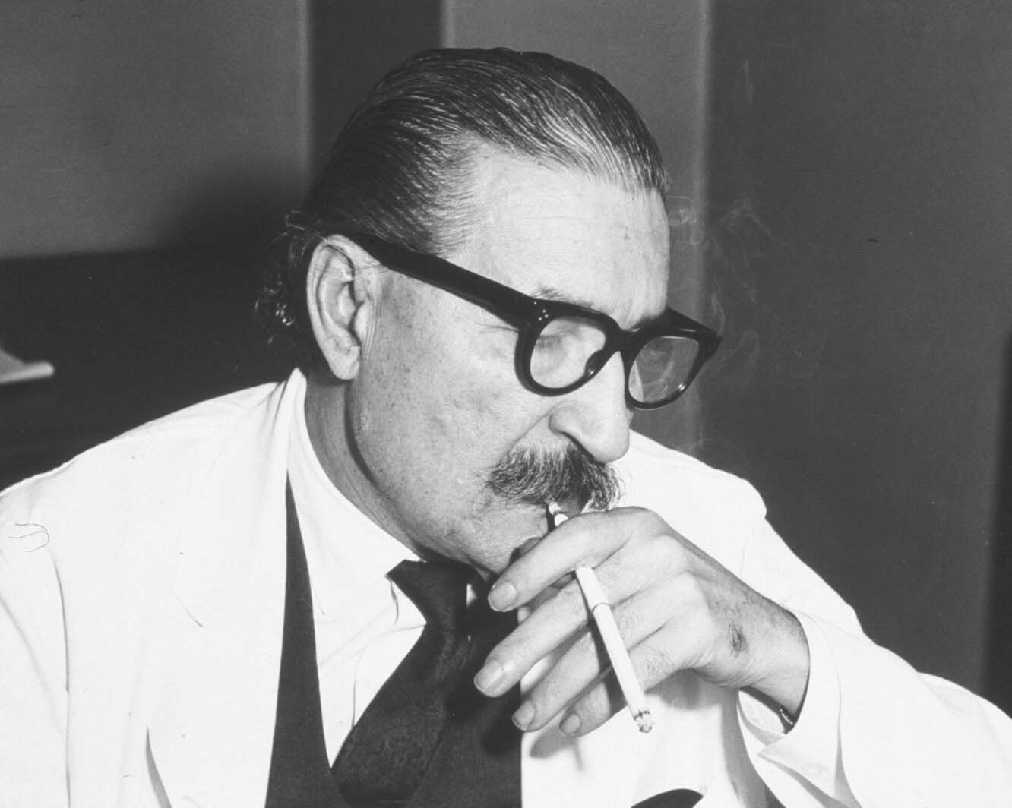
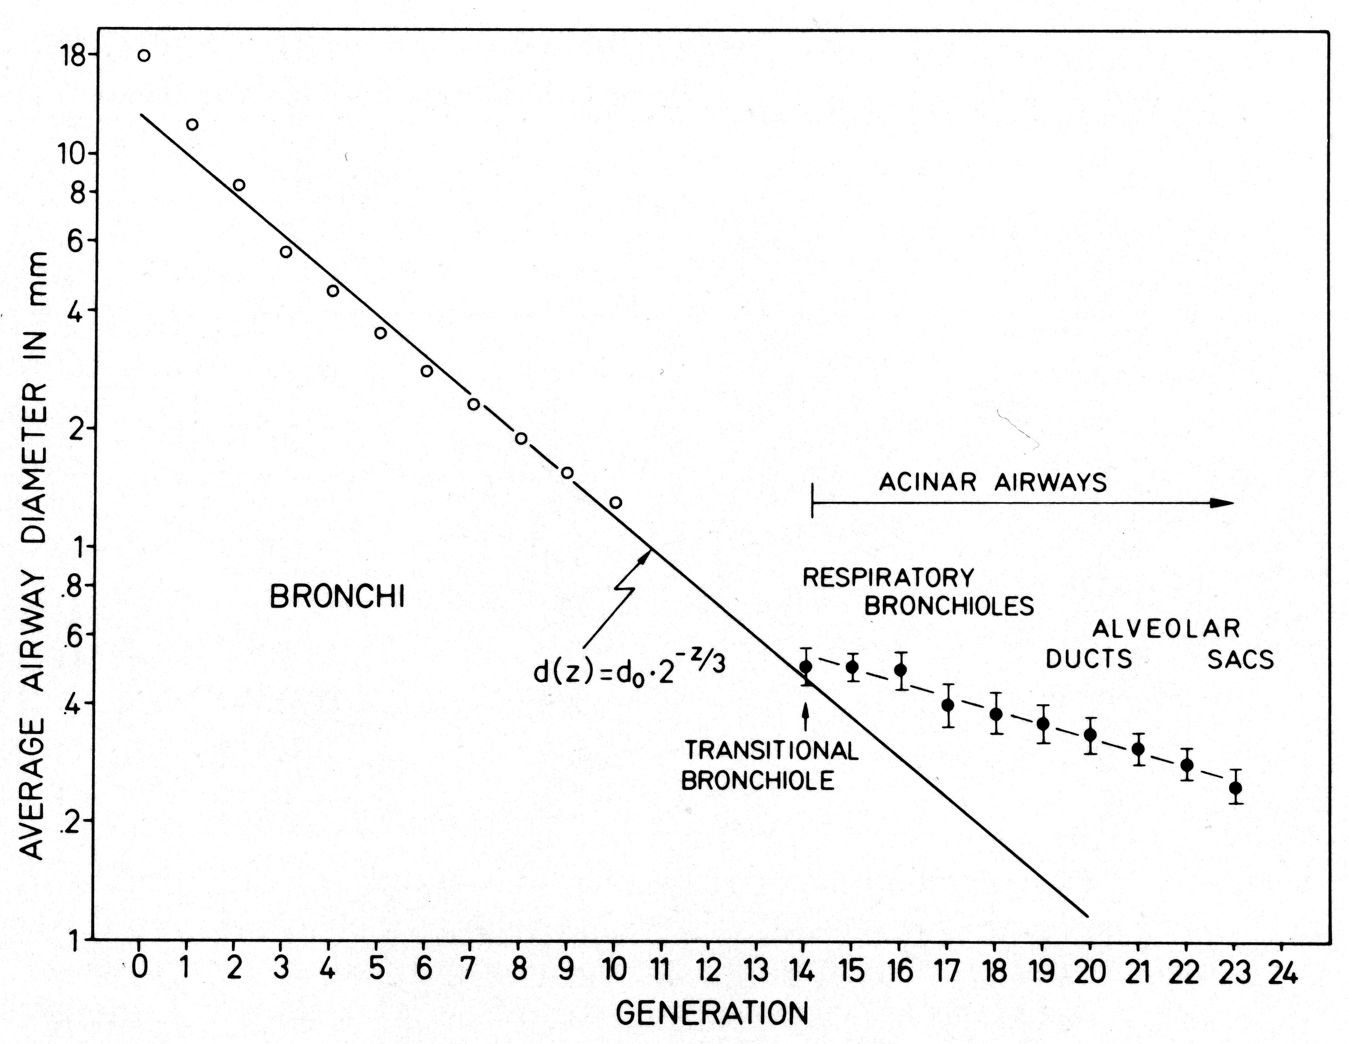
Conducting airways reduce d by factor (1/2)^{1/3} !
Weibel & Gomez 1962
d(z) = d₀·2^{-z/3}
minimize convection work in conducting airways

Slide 32
Conducting airways reduce d by factor (1/2)^{1/3}
Weibel & Gomez 1962
d(z) = d₀·2^{-z/3}
Haefeli-Bleuer 1988
Hess-Murray law of optimization
minimize convection work in conducting airways
not in acinar air ducts!

Slide 33
Conducting airways reduce d by factor (1/2)^{1/3}
Weibel & Gomez 1962
d(z) = d₀·2^{-z/3}
flow
Haefeli-Bleuer 1988
Is this of functional significance?
• in conducting airways: mass flow of air
• in acinar air ducts: + O₂ diffusion in air
diffusion

Slide 34
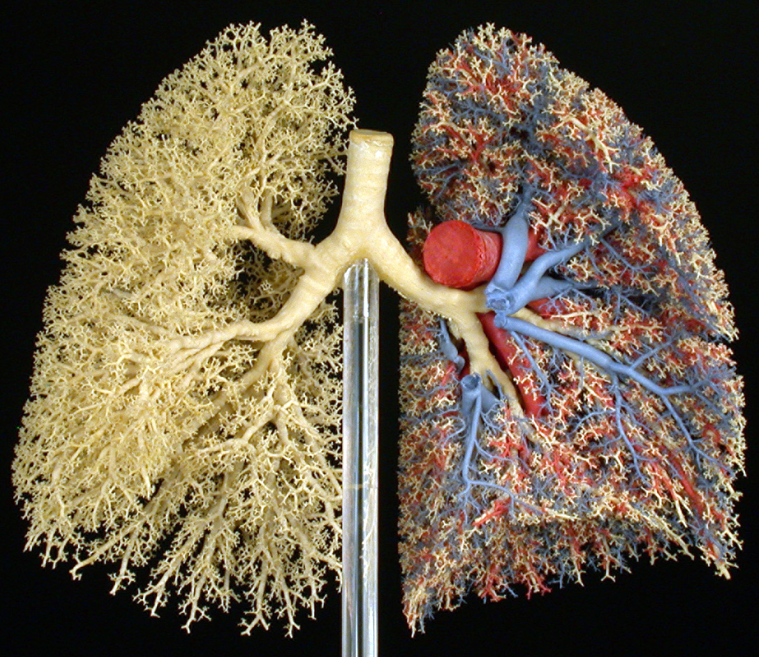
Problem 3:
How are ventilation & perfusion matched at level of gas exchanger: the acinus?

Slide 35
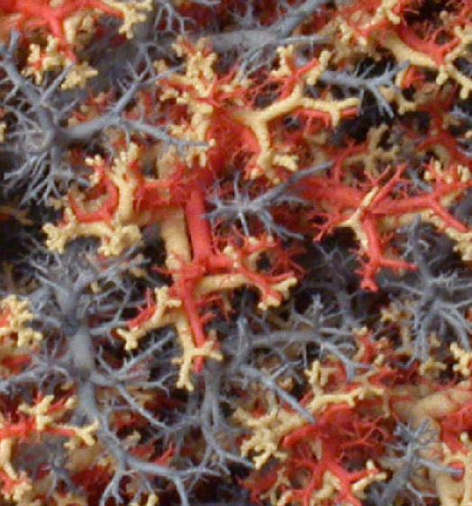
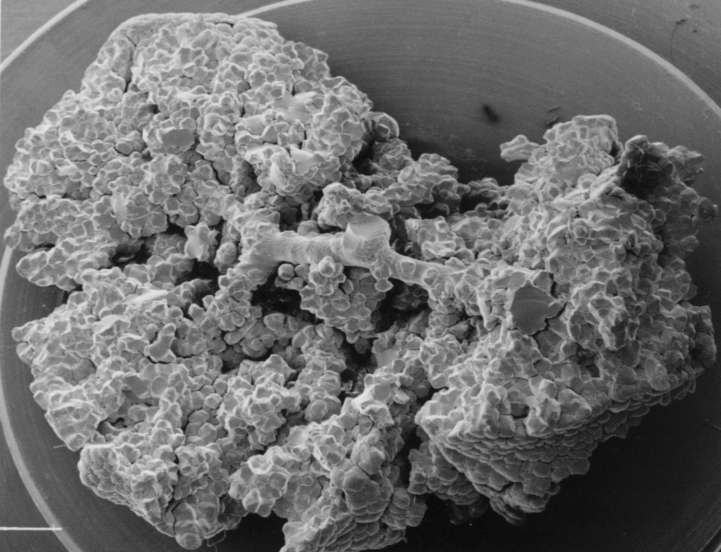
Architecture of pulmonary vasculature
CORRELATIVITY:
— arteries follow airways — veins interlobular
Pulmonary arteries
Pulmonary veins

Slide 36
Architecture of pulmonary vasculature
CORRELATIVITY:
— arteries follow airways — veins interlobular
Needs new approach:
HRCT =
nondestructive imaging
Pulmonary artery
Eric A. Hoffman, Univ. Iowa

Slide 37
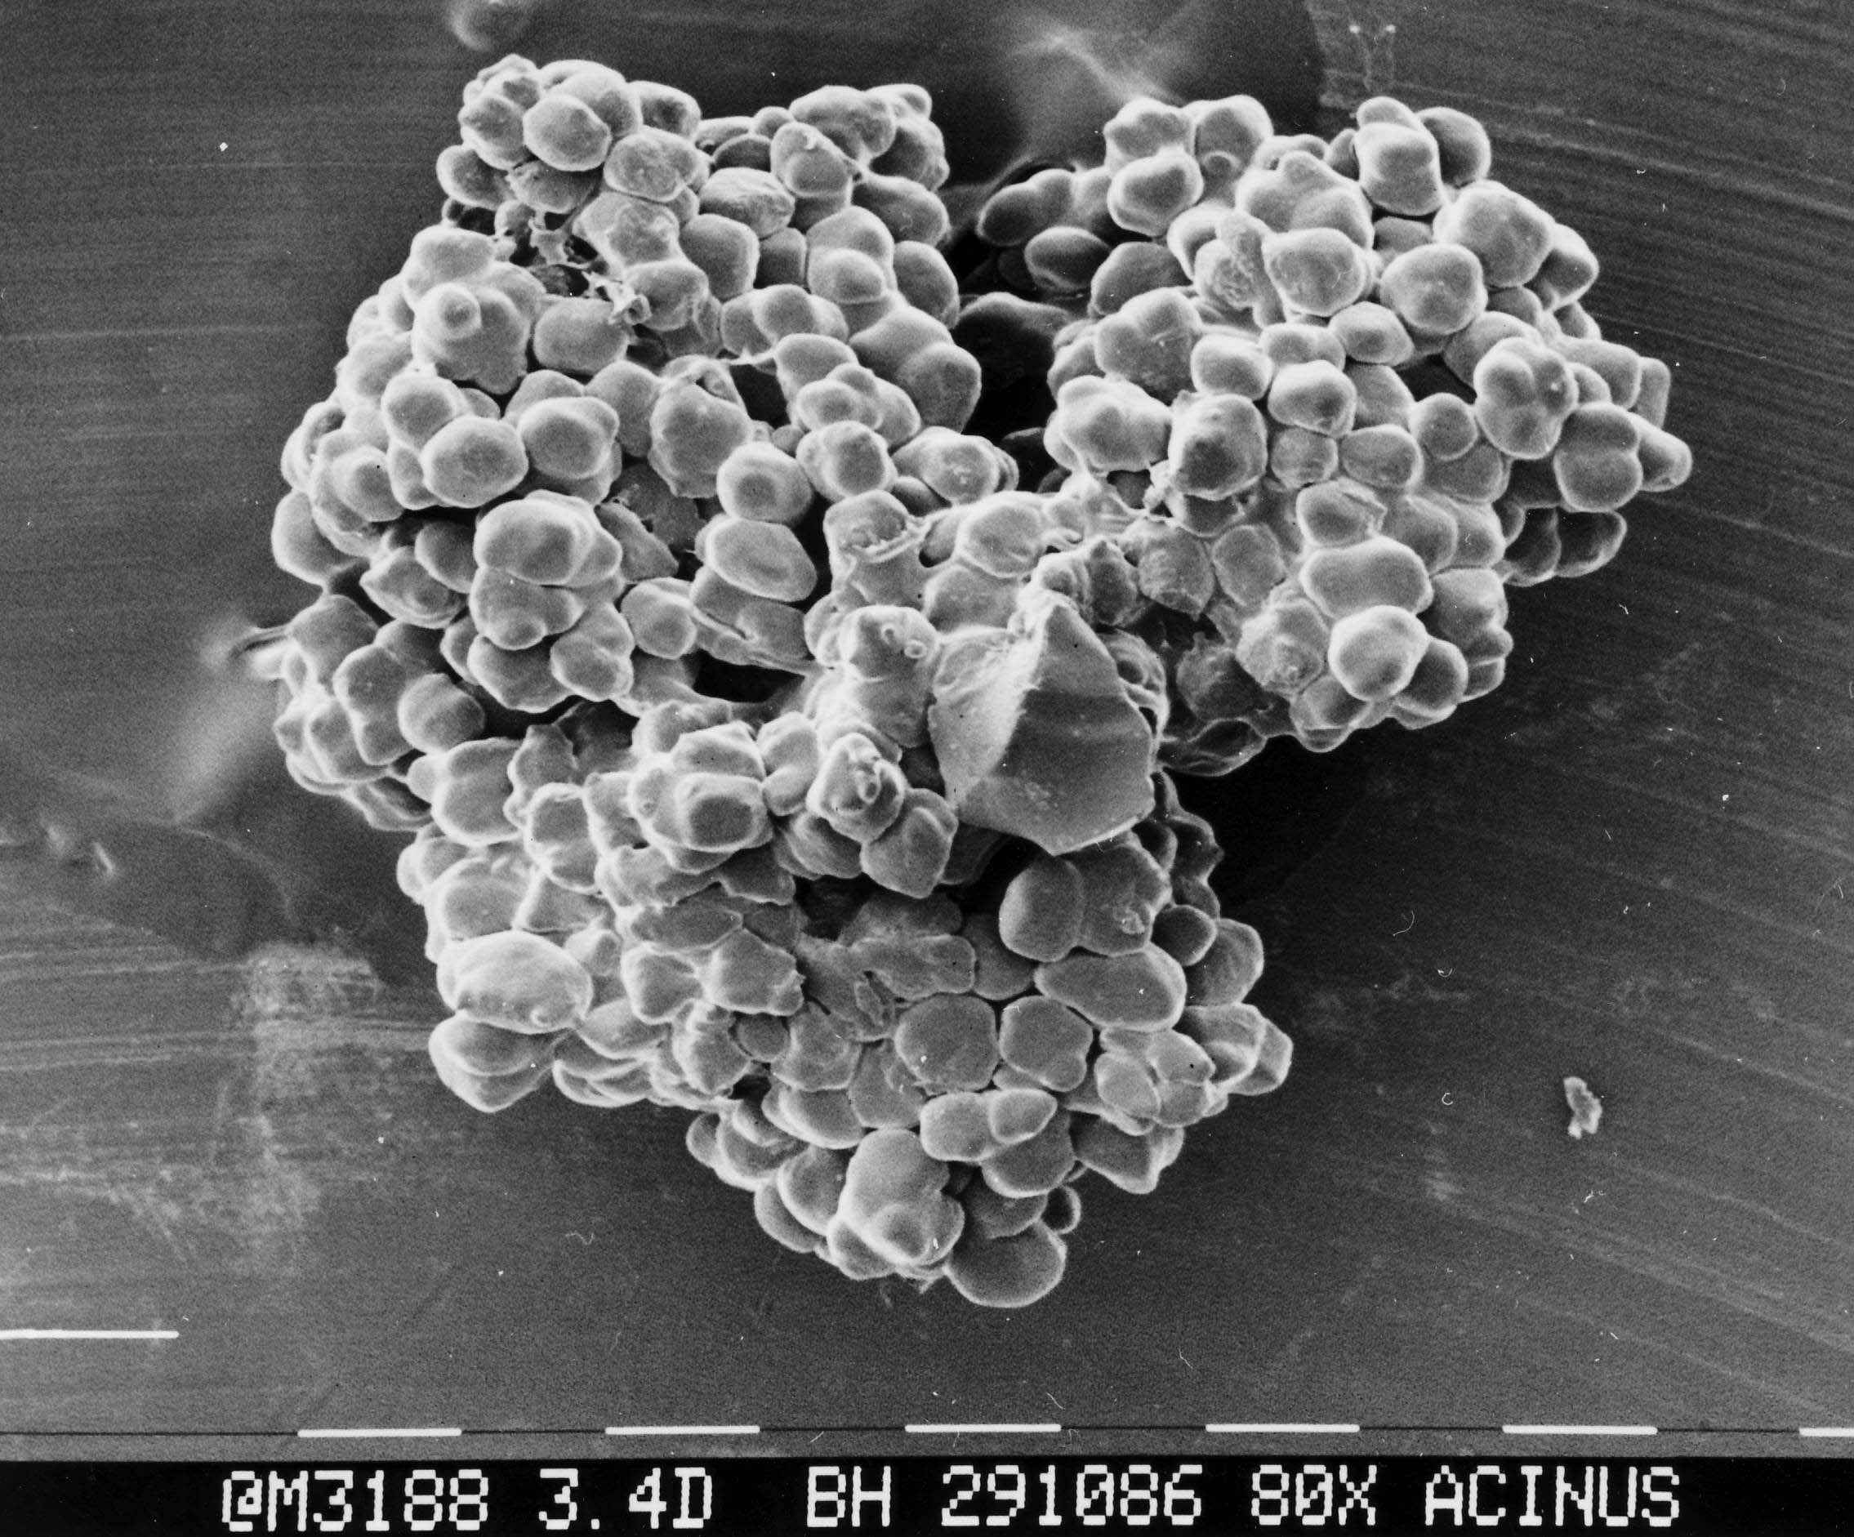
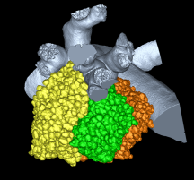
(1) Reconstruction of acinar airways by HRCT
Mouse
Dragos Vasilescu, E.A. Hoffman et al. PNAS 16 Oct 2012

Slide 39
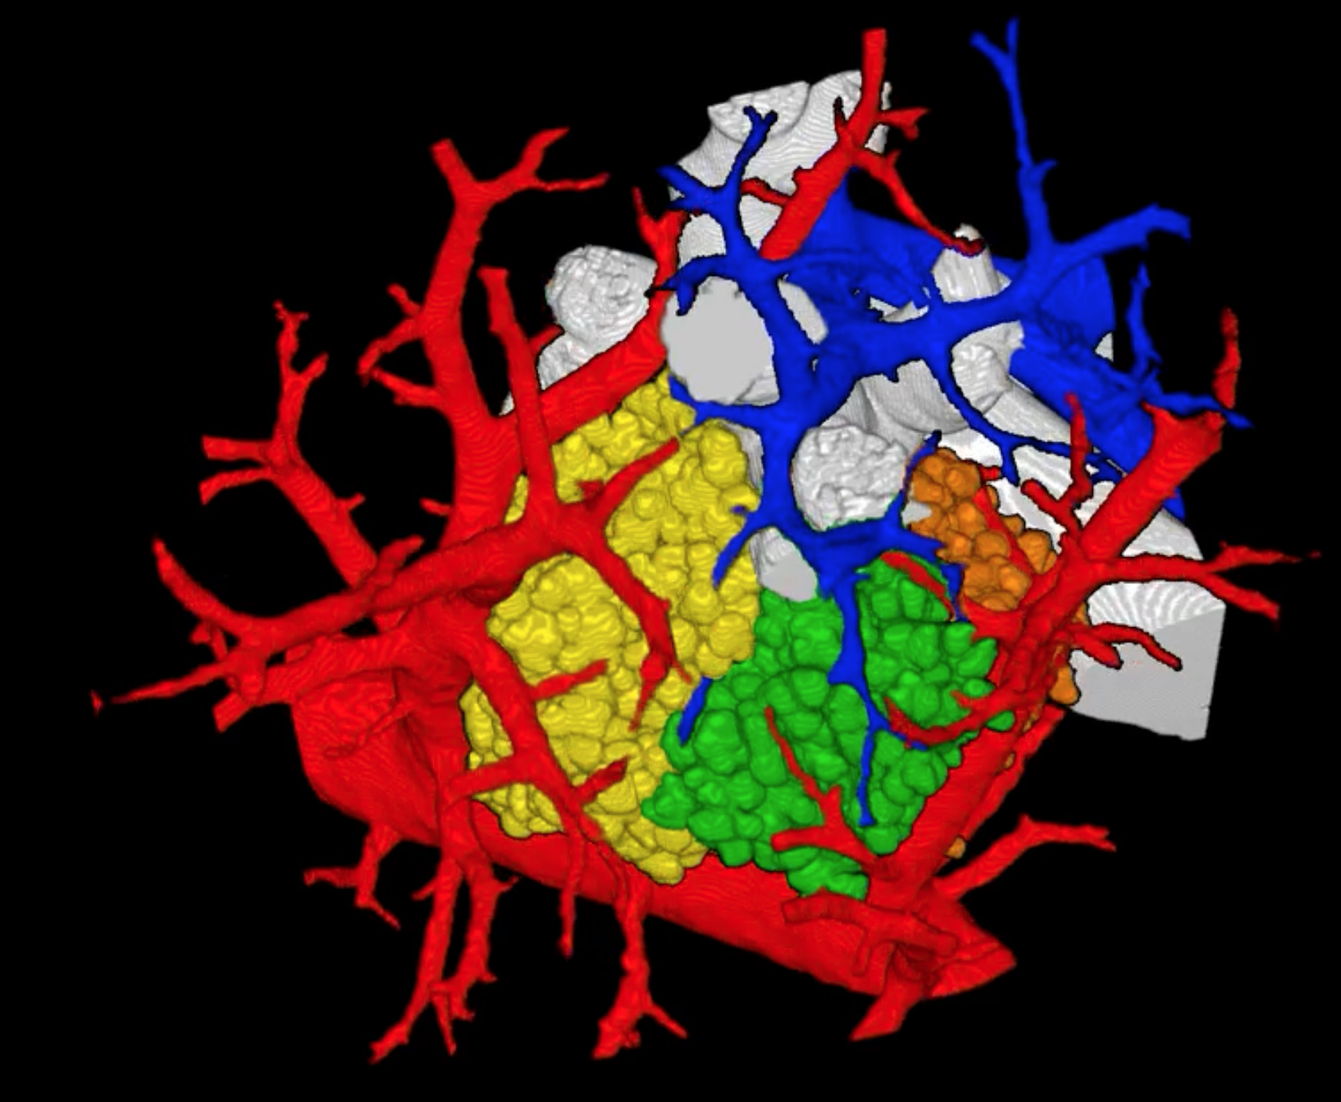
Acinar Gas Exchange Model
Ventilation Perfusion
PA
PV

Slide 40
Acinar Gas Exchange Model
Ventilation Perfusion
flow
diffusion
Serial ventilation of alveoli by diffusion of O₂ in air

Slide 41
Acinar Gas Exchange Model
flow
diffusion
Serial ventilation of alveoli by diffusion of O₂ in air
Parallel perfusion of capillary units

Slide 42
Acinar Gas Exchange Model
flow
diffusion
Serial ventilation of alveoli by diffusion of O₂ in air
Parallel perfusion of capillary units
O₂ concentration gradient
Gas exchange all along acinar pathway

Slide 43
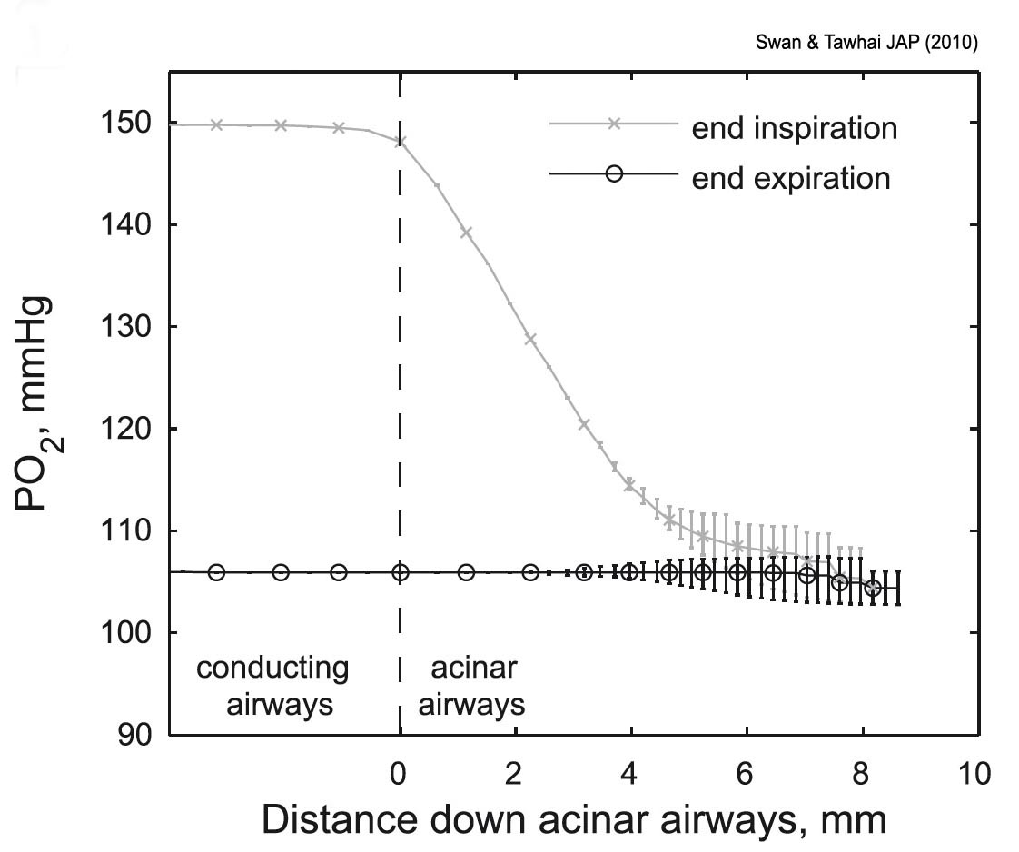
O₂ gradient depends on breathing cycle: — steep in inspiration — flat in expiration
Size of acinus small enough to avoid unventilated zone
Swan & Tawhai JAP (2010)

Slide 44
Acinar Gas Exchange Model
flow
diffusion
CORRELATIVITY of airways & blood vessels imperfect: Acinus small enough to avoid gas exchange deficit

Slide 45
Virtue of modular acinar design
• maximize packing density of gas exchangers on fractal surface
— while optimizing airways for efficient ventilation
• by limiting size of acinus limit effect of screening — ensuring O₂ supply throughout
SMALLER IS BETTER — BUT NOT TOO SMALL
Sapoval et al. 2000

Slide 46
Problem 4:
How to stabilize complex acinar surface against surface tension
Architecture of support structures:
CONNECTIVITY

Slide 47
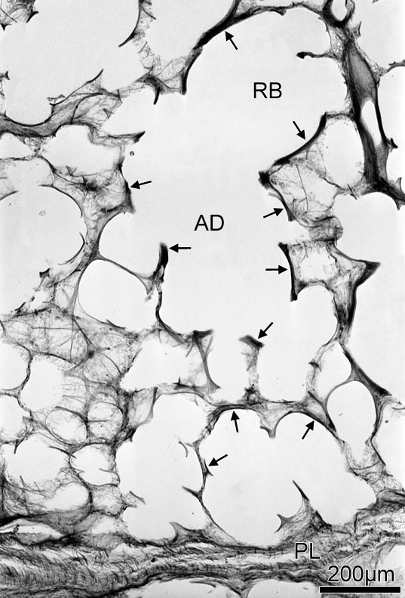
Stability of Surface: (1) Establish an Integral Fiber Continuum
RB
AD
CONNECTIVITY
Peripheral — Septal — Axial Fibers
Form Integral Fiber Continuum

Slide 48
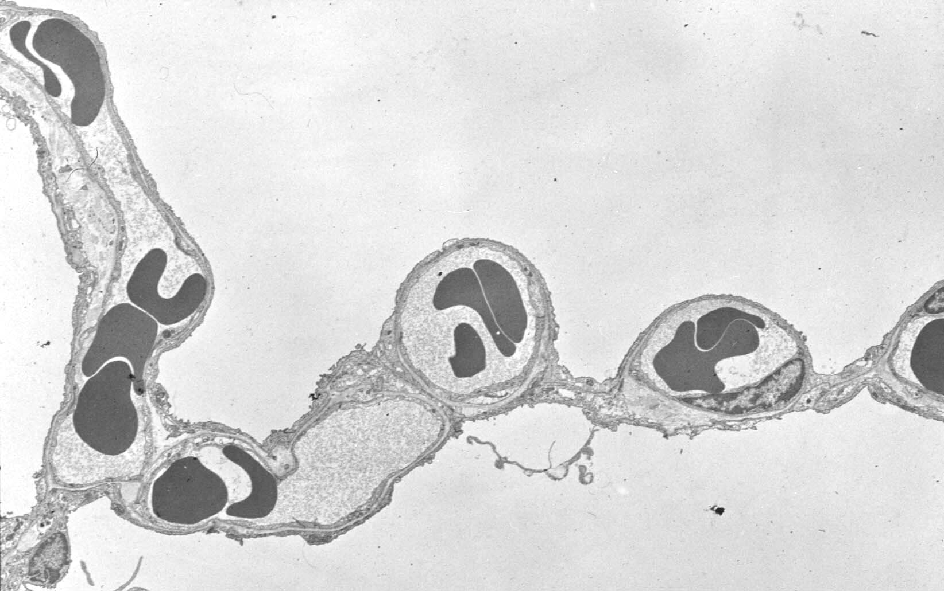
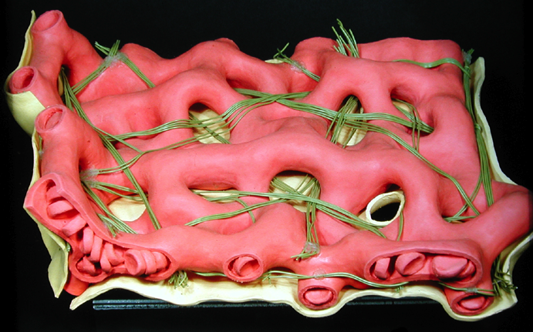
Stability of Surface: (1) Fiber continuum — Septal fibers
Allows capillaries to be supported with little fibers
Septal fibers
septal fibers
Axial fibers

Slide 49
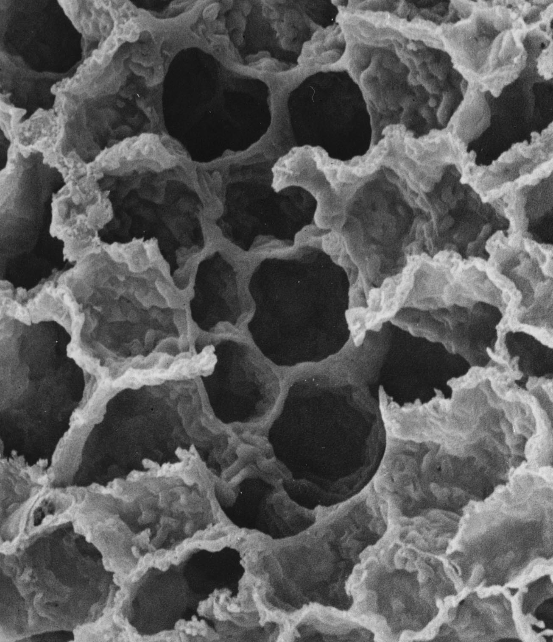
Stability of Surface: (1) Fiber continuum — Axial fibers
Allow alveoli to be formed

Slide 50
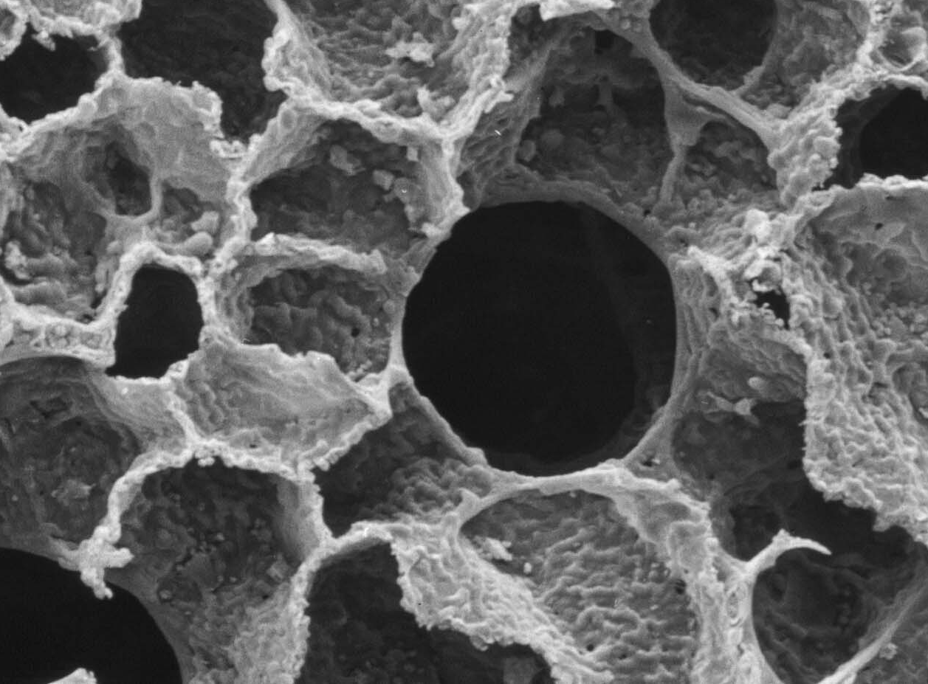
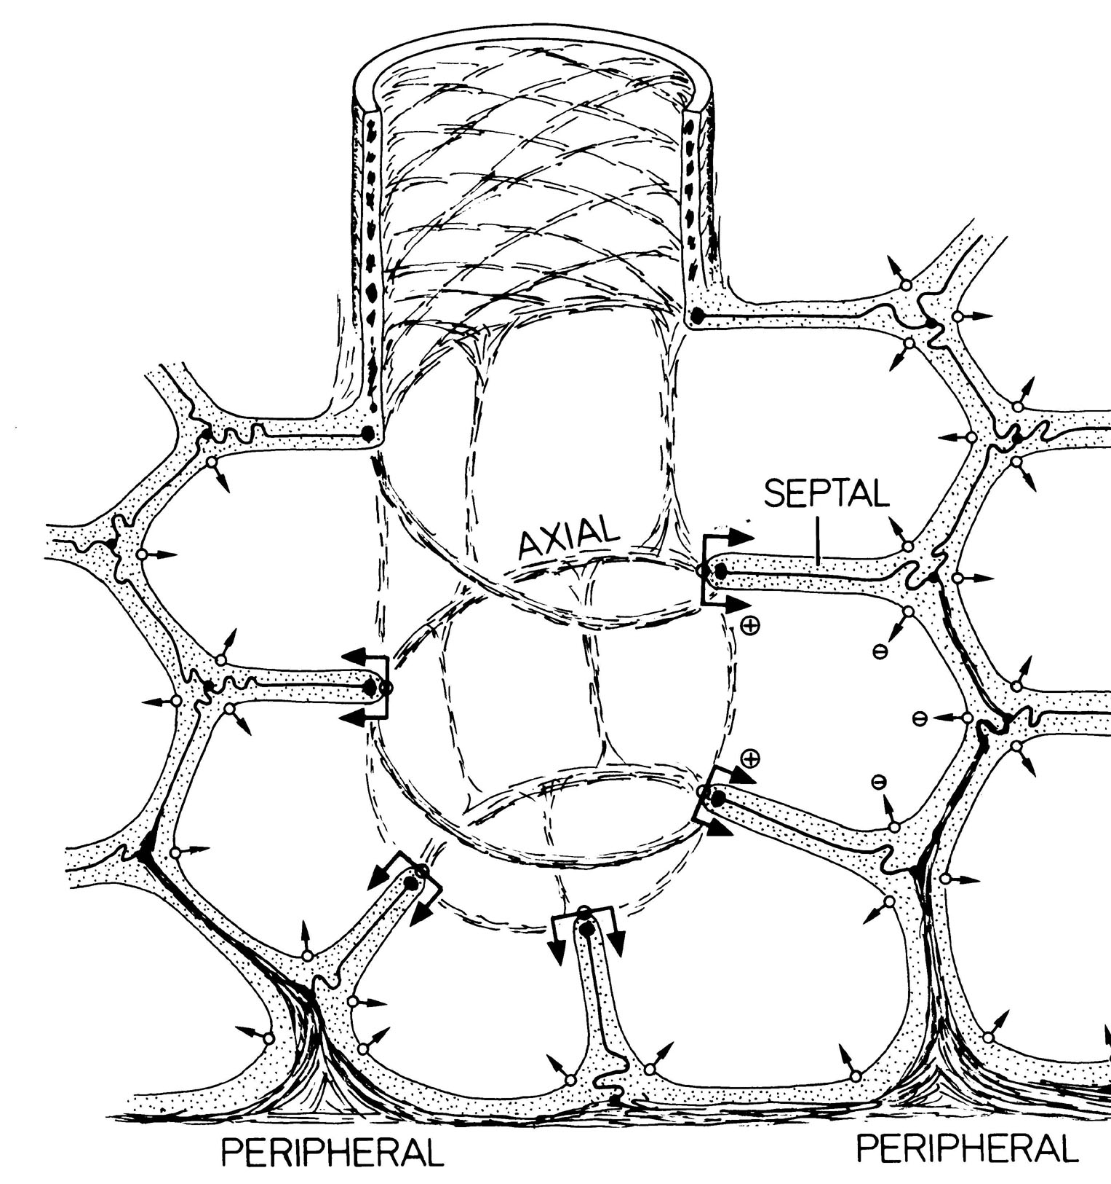
Stability of Surface: (1) axial fibers & (2) surfactant
Surface forces depend on surface tension and
curvature
Effect of Surface Tension

Slide 51
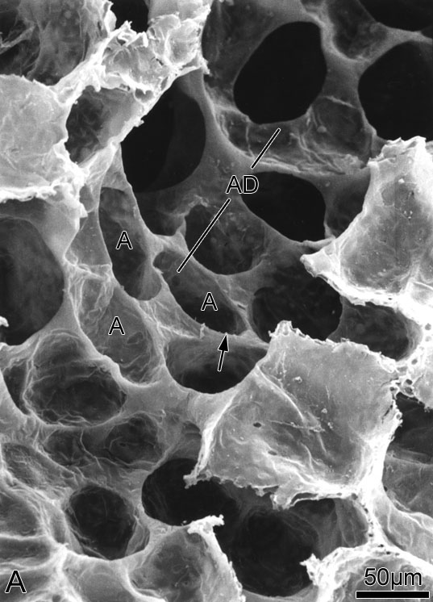
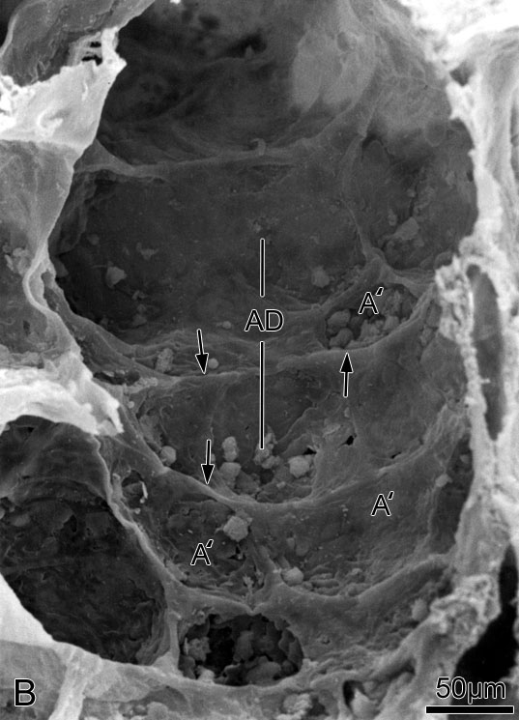
Stability of Surface: (1) axial fibers & (2) surfactant
Surface forces depend on surface tension and
curvature
+ Surfactant –
Effect of Surface Tension
Bachofen et al. (1979)

Slide 52
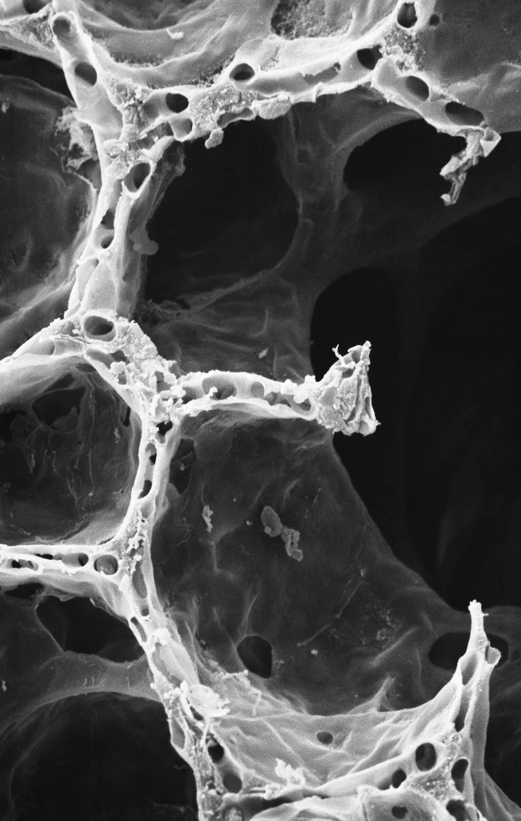
Stability of Surface: (1) axial fibers & (2) surfactant
Is this physiologically important?

Slide 53
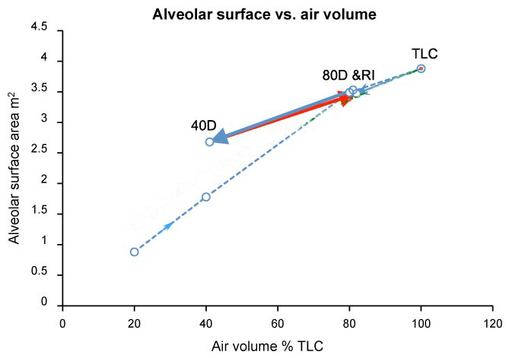
As we breathe alveolar surface changes less than air volume
— very low surface tension at 40% — higher surface tension at 80%
Surface tension effect on free edges strong
x1.2
x1.2
x2
x2
Bachofen & al 1987

Slide 54
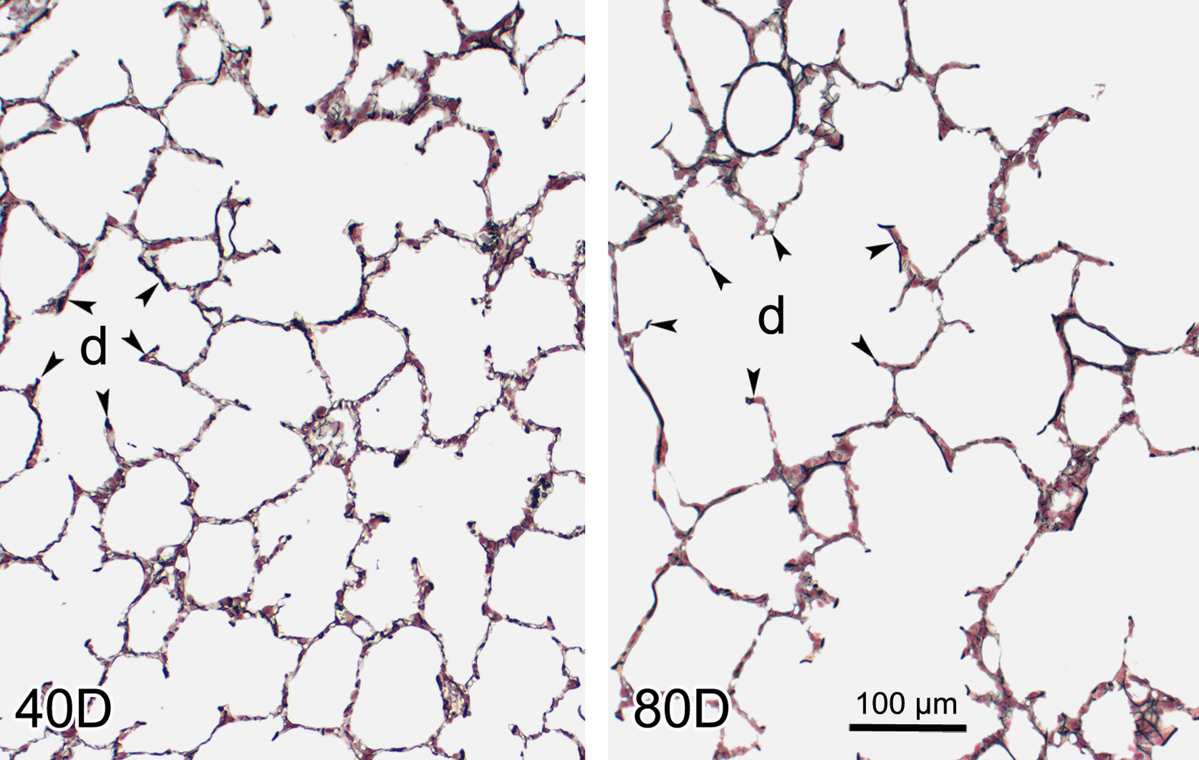
Effect of variable surface tension on alveolar duct geometry
— very low surface tension at 40% — higher surface tension at 80%
Surface tension effect on free edges strong
Volume variation predominantly in alveolar ducts

Slide 55
Effect of variable surface tension on alveolar duct geometry
— very low surface tension at 40% — higher surface tension at 80%
Volume variation predominantly in alveolar ducts
Volume variation predominantly in alveolar ducts
40D 80D

Slide 56
Problem 4:
How to stabilize complex acinar surface against surface tension
Architecture of support structures:
CONNECTIVITY
& Surfactant

Slide 57
Lung Design for Efficient Gas Exchange
Architectural solutions to keep it open, ventilated & perfused
— fit for gas exchange

Slide 58
Lung Design for Efficient Gas Exchange
Architectural solutions to keep it open, ventilated & perfused
— fit for gas exchange
Complexity (fractals)
Modularity (acini & capillary network) Correlativity (airways & vessels)
Connectivity (fiber continuum)

Slide 59
Who‘s done the work ?
Hans Bachofen
Marianne Bachofen
James Crapo (Duke/Denver)
Peter Gehr
Joan Gil
Beatrice Haefeli-Bleuer
Connie Hsia (Dallas)
Martin König
Samuel Schürch (Calgary)
Ruth Vock
C. Richard Taylor (Harvard)
Bernard Sapoval (Paris)
Eric Hoffman (Iowa)
&&&&
Institute of Anatomy
University of Berne

