Slide 1


Fibrosi Polmonare Idiopatica (IPF):
Problemi Diagnostici e Terapeutici
Pneumo Trieste 2017
Clinica Pneumologica dell’Università degli Studi di Milano-Bicocca
Ospedale San Gerardo – ASST Monza
Alberto Pesci
alberto.pesci@unimib.it

Slide 2
Interstitial Lung Disease
Exposure-related:
- Occupational
- Environmental
- Avocational
- Medication
Idiopathic interstitial pneumonia (IIP)
Connective tissue disease:
Scleroderma
Rheum. arth
Sjogren
Sarcoidosis
Other:
- Vasculitis/Diffuse alveolar hemorrhage (DAH)
- Langerhans cell histiocytosis (LCH)
Eosinophilic pneumonias
Neurofibromatosis
- LAM
Idiopathic pulmonary fibrosis (IPF)
Respiratory bronchiolitis interstitial lung dis. (RBILD)
Major
Desquamative interstitial pneumonia (DIP)
Cryptogenic organizing pneumonia (COP)
Acute interstitial pneumonia (AIP)
Nonspecific interstitial pneumonia (NSIP)
Rare
Lymphocytic interstitial pneumonia (LIP)
Idiopathic pleuroparenchymal fibroelastosis
Travis et al. Am J Respir Crit Care Med 2013; 188:733-48

Slide 3
Rationale
The availability of novel effective antifibrotic therapies, coupled with the limitations of traditional therapeutic combinations, have increased the urgency of making an
accurate and early diagnosis of IPF

Slide 4
Traditional algorithm for the diagnosis of interstitial lung disease
Am J Respir Crit Care Med Vol 183. pp 788–824, 2011

Slide 5
Medical history and clinical evaluation
Clinical evaluation has traditionally been more of an art than a science
A thorough clinical evaluation is central to the diagnosis of IPF for ruling out:
  Chronic hypersensitivity pneumonitis (cHP)
  Connective tissue disease-related interstitial lung disease
  Other IIP (fib. NSIP), drug toxicity, chronic sarcoidosis, asbestosis

Slide 6
Traditional algorithm for the diagnosis of interstitial lung disease
Am J Respir Crit Care Med Vol 183. pp 788–824, 2011

Slide 7
Imaging – Definite UIP
High-resolution CT of the chest has a central role in the initial evaluation of patients with suspected IPF and the results greatly influence subsequent management decisions
Am J Respir Crit Care Med Vol 183. pp 788–824, 2011

Slide 8

Definite UIP
Unfortunately definite usual interstitial pneumonia was present in only about a third of patients
Am J Respir Crit Care Med Vol 183. pp 788–824, 2011

Slide 9
Interobserver agreement for the presence of Honeycombing is remarkably poor
Studi | K coefficient
Lynch DA, et al. Am J Respir Crit Care Med 2005;172(4):488–493 | 0,31
Sundaram B, et al. AJR Am J Roentgenol 2008;191(4):1032–1039 | 0,45
Goldin J, et al. Chest 2009;136(5):1333–1340 | 0,16
Watadani T, et al. Radiology 2013; 266(3):936–944 | 0,40-0,58

Slide 10
Traction bronchiolectasis mimicking honeycombing

Slide 11
Radiologic Signs Overlap
Fibrosi
Cisti
Enfisema
GGO

Slide 12
Traditional algorithm for the diagnosis of interstitial lung disease
Am J Respir Crit Care Med Vol 183. pp 788–824, 2011

Slide 13
Imaging – Possible UIP
High-resolution CT of the chest has a central role in the initial evaluation of patients with suspected IPF and the results greatly influence subsequent management decisions
Am J Respir Crit Care Med Vol 183. pp 788–824, 2011

Slide 14
Imaging – Possible UIP
Studies report that in patients with suspected IPF, a basal predominant coarse reticular abnormality without honeycombing might be predictive of histopathological usual interstitial pneumonia
Gruden JF, et al.UIP diagnosed at surgical lung biopsy, 2000–2009: HRCT patterns and proposed classification system. AJR Am J Roentgenol 2013; 200: W458–67
Chung JH, et al. CT scan findings of probable UIP have a high predictive value for histologic usual interstitial pneumonitis. Chest 2015; 147: 450–59
Raghu G, et al. Diagnosis of IPF with high-resolution CT in patients with little or no radiological evidence of honeycombing: secondary analysis of a randomised, controlled trial. Lancet Respir Med 2014;2: 277–84
Salisbury ML et al. Predictors of idiopathic pulmonary fibrosis in absence of radiologic honeycombing: A cross sectional analysis in ILD patients undergoing lung tissue sampling. Respir Med 2016 Sep;118:88-95. doi: 10.1016/j.rmed

Slide 15
Predictors of idiopathic pulmonary fibrosis in absence of radiologic honeycombing: A cross sectional analysis in ILD patients undergoing lung tissue sampling
Salisbury ML et al. Respir Med 2016 Sep;118:88-95. doi: 10.1016/j.rmed
METHODS:
Included patients had no honeycombing, no connective tissue disease, underwent diagnostic lung biopsy, and had CT pattern consistent with fibrosing ILD (n = 200)
RESULTS:
A multivariable model adjusted for age and gender found increasingly extensive reticular densities (OR 2.93, CI 95% 1.55-5.56, p = 0.001) predicted IPF, while increasing ground glass densities predicted a diagnosis other than IPF (OR 0.55, CI 95% 0.34-0.89, p = 0.02). The model-based probability of IPF was 80% or greater in patients with age at least 60 years and extent of reticular density one-third or more of total lung volume
CONCLUSIONS:
In patients with suspected fibrotic ILD and absence of CT honeycombing, extent of reticular and ground glass densities predict a diagnosis of IPF. The probability of IPF exceeds 80% in subjects over age 60 years with one-third of total lung having reticular densities

Slide 16
Clinical Predictors of a Diagnosis of Idiopathic
Pulmonary Fibrosis
Charlene D. Fel, et al. Am J Respir Crit Care Med 181. pp 832–837, 2010

Slide 17
Imaging – Inconsistent UIP
High-resolution CT of the chest has a central role in the initial evaluation of patients with suspected IPF and the results greatly influence subsequent management decisions
Am J Respir Crit Care Med Vol 183. pp 788–824, 2011

Slide 18
Radiologic-pathologic discordance in biopsy-proven usual interstitial pneumonia
Yagihashi K et al. Eur Respir J 2016;47:1189-97
Two independent radiologists retrospectively reviewed 241 subjects who underwent HRCT and SLB. HRCT findings were classified as UIP, possible UIP and inconsistent with UIP. Histological findings were classified as definite, probable, possible and not UIP
Of the 241 cases, 102 (42.3%) had HRCT findings of UIP, 64 (26.6%) had possible UIP and 75 (31.1%) were inconsistent with UIP. Among those with UIP on HRCT, 99 (97.1%) had histologically definite or probable UIP (concordant group), and 71 (94.7%) of those with "inconsistent" HRCT features had histologically definite or probable UIP (discordant group)
In this population of patients enrolled with a diagnosis of IPF, 94.7% of those with HRCT findings "inconsistent with UIP" demonstrated histological UIP. This suggests that the term "inconsistent with UIP" is misleading.

Slide 19
Traditional algorithm for the diagnosis of interstitial lung disease
Am J Respir Crit Care Med Vol 183. pp 788–824, 2011

Slide 20
Pathology and biopsy techniques
Many patients are unable to undergo surgical lung biopsy because of advanced age or preclusive comorbidities, which ultimately denies them access to treatments that are only licensed when a diagnosis of IPF has been secured
Complications, including acute exacerbations of the underlying fibrotic lung disease, can occur following surgical lung biopsy
Hutchinson JP, et al. In-hospital mortality after surgical lung biopsy for interstitial lung disease in the United States. 2000 to 2011. Am J Respir Crit Care Med 2016; 193: 1161–67.
Collard HR, et al. Acute exacerbation of idiopathic pulmonary fi brosis. an international working group report. Am J Respir Crit Care Med 2016; 194: 265–75.

Slide 21
In-Hospital Mortality after Surgical Lung Biopsy for Interstitial Lung Disease in the United States. 2000 to 2011
Hutchinson JP et al. Am J Respir Crit Care Med 2016;193:1161-7
MEASUREMENTS AND MAIN RESULTS:
We estimated there to be around 12,000 surgical lung biopsies performed annually for interstitial lung disease in the United States, two-thirds of which were performed electively. In-hospital mortality was 1.7% for elective procedures but significantly higher for nonelective procedures (16.0%). Male sex, increasing age, increasing comorbidity, open surgery, and a provisional diagnosis of idiopathic pulmonary fibrosis or connective tissue disease-related interstitial lung disease were risk factors for increased mortality
CONCLUSIONS:
In-hospital mortality after elective surgical lung biopsy for interstitial lung disease is just under 2% but significantly higher for nonelective procedures. Identified risk factors for death should be taken into account when counseling patients on whether to pursue a histologic diagnosis

Slide 22
Transbronchial biopsy is useful in detecting UIP pattern
Tomassetti S et al. Respir Res 2012;13:96
TBB showing UIP (2 or 3 of the followings: patchy fibrosis, fibroblastic foci, honeycombing): specificity 100%
TBB showing UIP: sensitivity 20% (32% in Berbescu et al, Chest 2006; 0% in Shim et al, Pathol Intern 2010)
TBB in the main mimikers of UIP (f-NSIP, chronic HP, DIP, etc): sensitivity 12,5-16%, specificity 20-25%

Slide 23
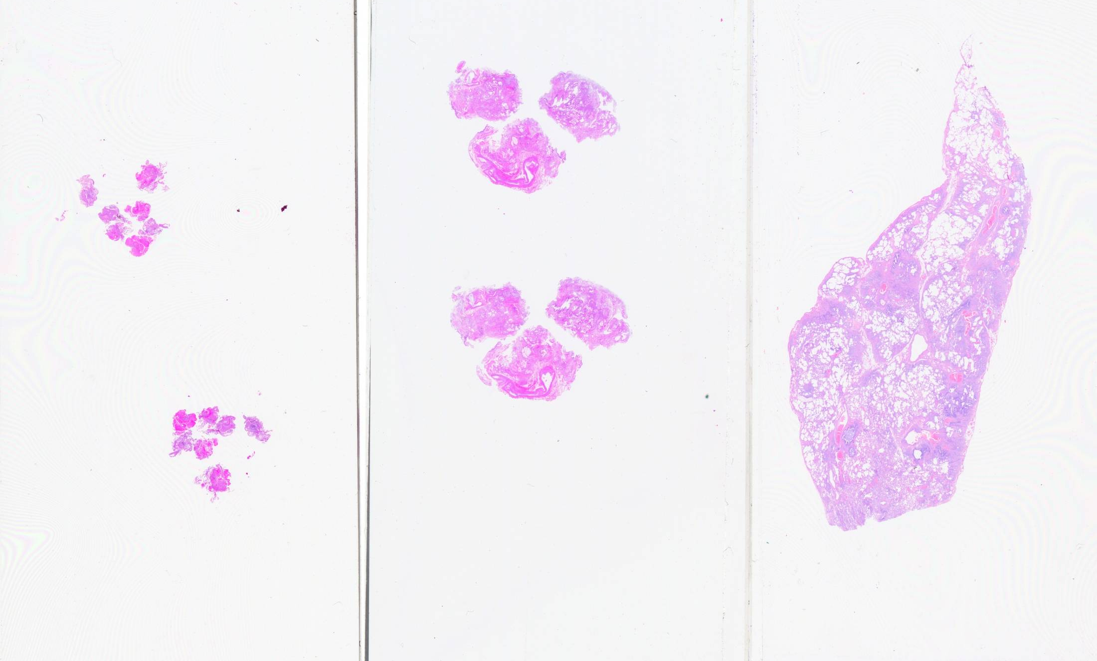
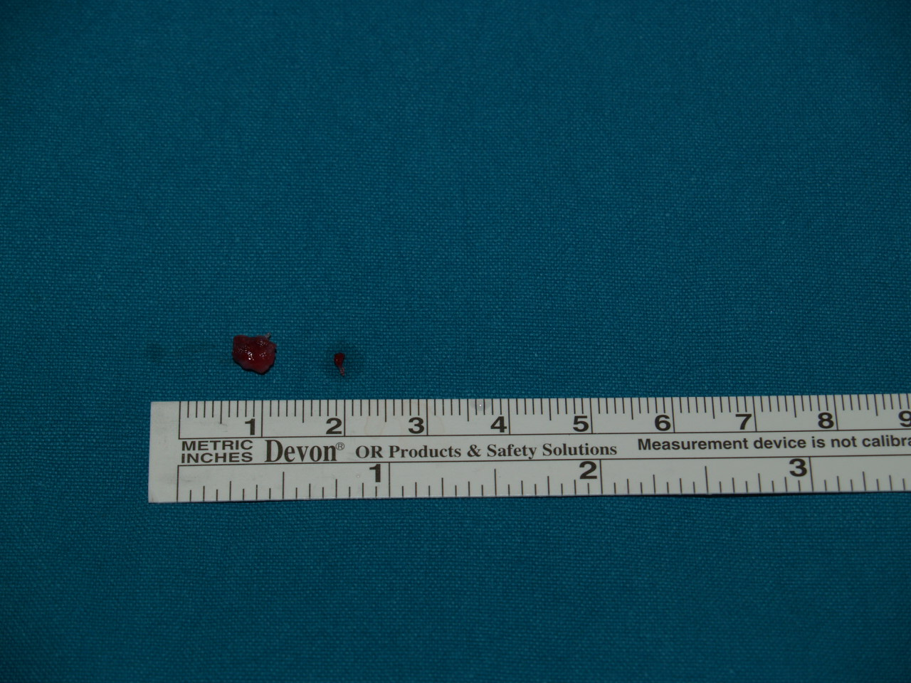
Cortesia: A. Dubini & V. Poletti, Forlì
TBB
Criobiopsia
VATS

Slide 24
Pathology and biopsy techniques
Transbronchial cryobiopsies by experienced operators yield larger samples than do transbronchial biopsies, although with higher complication rates
Sharp C, et al. Use of transbronchial cryobiopsy in the diagnosis of interstitial lung disease—a systematic review and cost analysis. QJM 2016; DOI: 10.1093
Casoni GL, et al. Transbronchial lung cryobiopsy in the diagnosis of fi brotic interstitial lung diseases. PLoS One 2014; 9: e86716.
Patel NM, et al. Cryobiopsy in the diagnosis of interstitial lung disease. A step forward or back? Am J Respir Crit Care Med 2016; 193: 707–09

Slide 25
Cryobiopsy in fibrotic ILD
Some technical issues need to be set out
Cryobiopsy seems to be safer than surgical lung biopsy, potentially increasing the number of patients with fibrotic ILD who can have a biopsy
Compared to surgical lung biopsy, its diagnostic accuracy is probably slightly lower in absolute terms but similar in an experienced multidisciplinary setting
Cryobiopsy may be a first invasive diagnostic step in many patients with fibrotic ILD
Pajares et al. Respirology 2014;19:900-906
Tomassetti et al. Am J Crit Care Med 2016;193:745-752
Ravaglia et al. Respiration 2016;91:215-227
Respirology (2016) doi: 10.1111/resp.12770

Slide 26
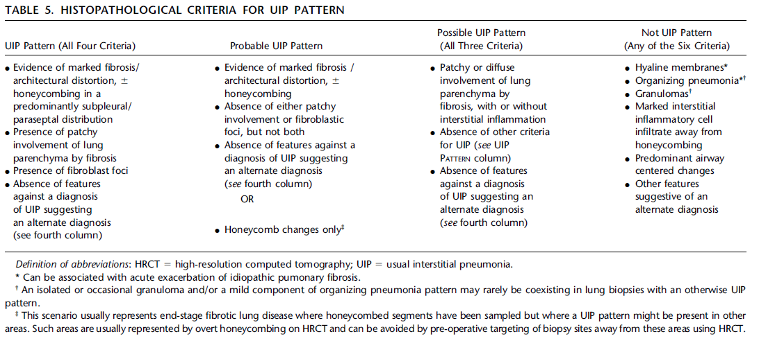
Histopathological criteria for UIP pattern
Am J Respir Crit Care Med Vol 183. pp 788–824, 2011

Slide 27

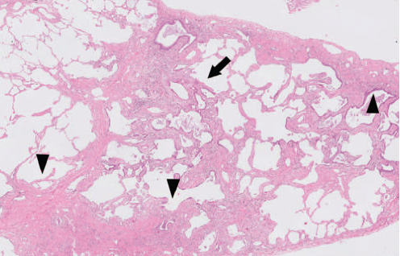
20 OLB / 11 pathologists /no knowledge of clinical & radiologic data
The generalized K coefficient was 0.23
If the diagnosis were divided into 2 groups: UIP vs non UIP K=0.37

Slide 28
Traditional algorithm for the diagnosis of interstitial lung disease
Am J Respir Crit Care Med Vol 183. pp 788–824, 2011

Slide 29
Multidisciplinary evaluation of IPF
Recent studies suggest diagnostic confidence is improved when a multidisciplinary approach to diagnosis is taken, involving expert chest radiologists, pathologists, and pulmonologists
Flaherty KR, et al. Idiopathic interstitial pneumonia: what is the eff ect of a multidisciplinary approach to diagnosis? Am J Respir Crit Care Med 2004; 170: 904–10.
Flaherty KR, et al. Idiopathic interstitial pneumonia: do community and academic physicians agree on diagnosis? Am J Respir Crit Care Med 2007; 175: 1054–60.
Tomassetti S, et al. Bronchoscopic lung cryobiopsy increases diagnostic confidence in the multidisciplinary diagnosis of idiopathic pulmonary fibrosis. Am J Respir Crit Care Med 2016; 193: 745–52.
Tominaga J, et al. Diagnostic certainty of IPF/UIP: the effect of the integrated clinico-radiological assessment. Eur J Radiol 2015; 84: 2640–45
Walsh SFL et al. Multicentre evaluation of multidisciplinary team meeting agreement on diagnosis in diffuse parenchymal lung disease:
a case-cohort studyLancet Respir Med 2016;4:557

Slide 30
Multidisciplinary evaluation of IPF
Flaherty KR, et al. Idiopathic interstitial pneumonia: what is the eff ect of a multidisciplinary approach to diagnosis? Am J Respir Crit Care Med 2004; 170: 904–10.
Tomassetti S, et al. Bronchoscopic lung cryobiopsy increases diagnostic confidence in the multidisciplinary diagnosis of idiopathic pulmonary fibrosis. Am J Respir Crit Care Med 2016; 193: 745–52.

Slide 31
Multicentre evaluation of multidisciplinary team meeting agreement on diagnosis in diffuse parenchymal lung disease: a case-cohort study
Multicentre evaluation of clinical data of patients who presented to the ILD (7o English patients with complete data)
Seven MDTMs, consisting of at least one clinician, radiologist, and pathologist, from seven countries evaluated cases of diffuse in a two-stage process:
  First, the clinician, radiologist (no clinical data), and pathologist (no clinical data) independently evaluated each case, selected up to five differential diagnoses from a choice of diff use lung diseases, and chose likelihoods for each of their differential diagnoses, without inter-disciplinary consultation.
  Second, these specialists convened at an MDTM and reviewed all data, selected up to five differential diagnoses, and chose diagnosis likelihoods.
We compared inter-observer and inter-MDTM agreements on patient first-choice diagnoses using kappa coefficient (κ). We then estimated inter-observer and inter-MDTM agreement on the probability of diagnosis using weighted kappa coefficient (κw).
Finally, we evaluated the prognostic significance of a first-choice diagnosis of IPF versus not IPF for MDTMs, clinicians, and radiologists, using univariate Cox regression analysis.
Walsh SFL et al. Lancet Respir Med 2016;4:557

Slide 32
Multicentre evaluation of multidisciplinary team meeting agreement on diagnosis in diffuse parenchymal lung disease: a case-cohort study
In conclusion, our study showed that diagnostic agreement between MDTMs is higher than interobserver agreement between clinicians, radiologists, and pathologists in the setting of diffuse parenchymal lung disease.
Walsh SFL et al. Lancet Respir Med 2016;4:557

Slide 33
The Future = Biological Markers
Many approaches are under investigation as potential robust diagnostic, molecular biomarkers:
MUC5B promoter polymorphism, matrix metalloproteinase (MMP)-7 and MMP-1, surfactant protein (SP)-D, endothelin-1, YKL-40, osteopontin, micro RNAs (miRNAs), S100A9 in BAL, CCL18
Ley B, et al. Molecular biomarkers in idiopathic pulmonary fibrosis. Am J Physiol Lung Cell Mol Physiol 307: L681–L691, 2014.

Slide 34
Future algorithm for the diagnosis of interstitial lung disease
Martinez FJ et al. Lancet Respir Med 2016

Slide 35
Management IPF
Riduzione dei fattori di rischio
    Fumo e Peso
Educazione del paziente
    Riunioni di gruppo
Comorbidità
    RGE, OSA, CAD, PH
Ossigenoterapia
    Notturna, sotto sforzo, a riposo
Vaccinazioni
    Influenzale, pneumococco
Riabilitazione
Valutazione trapianto
Palliazione fasi terminali
Terapia Medica

Slide 36
 | STRONG |  | WEAK
IPF TREATMENT | YES | NOT | YES | NOT
CORTICOSTEROIDS |  | √
COLCHICINE |  | √
CICLOSPORINE A |  | √
INTERFERON Υ |  | √
ETANERCEPT |  | √
PREDNISONE+AZA+NAC |  | √
ANTICOAGULATION |  | √
AMBRISENTAN |  | √
IMATINIB |  | √
BOSENTAN |  |  |  | √
MACITENTAN |  |  |  | √
SILDENAFIL |  |  |  | √
N-ACETYLCYSTEINE |  |  |  | √
PIRFENIDONE |  |  | √
NINTEDANIB |  |  | √
Am J Respir Crit Care Med Vol 192; pp e3–e19, 2015

Slide 37
Pirfenidone and Nintedanib:
AIFA inclusion criteria for the therapeutic use
 | Pirfenidone | Nintedanib
Forced vital capacity (FVC) | ≥ 50% (3 regioni < 90%) | ≥ 50%
Diffusing capacity of the lung for carbon monoxide (DL_{CO}) | ≥ 35% | ≥ 30%
Age, years | 40 – 80 | ≥ 40
Notes:
I

Slide 38

Quale terapia dare al paziente?
EFFICACIA
Nintedanib
Pirfenidone

Slide 39
Quale terapia dare al paziente?
EFFETTI COLLATERALI
Diarrea
D. Gastrici
Cute
D. Gastrici
Nintedanib
Pirfenidone

Slide 40

Decidere assieme al Paziente
Paziente
Preferenze
Tolleranza effetti coll.
Stile di vita
Medico
Efficacia del farmaco
Effetti collaterali
Comorbidità

Slide 41
Reflusso gastroesofageo e IPF
Raghu et al sono stati tra i primi a dimostrare un’associazione tra IPF e GERD
Uno studio recente ha inoltre dimostrato una maggior prevalenza di GERD nei pazienti IPF sia rispetto ai controlli sani che ad altri pazienti con ILD
Il trattamento del reflusso gastroesofageo nei pazienti IPF porta a qualche beneficio?

Slide 42
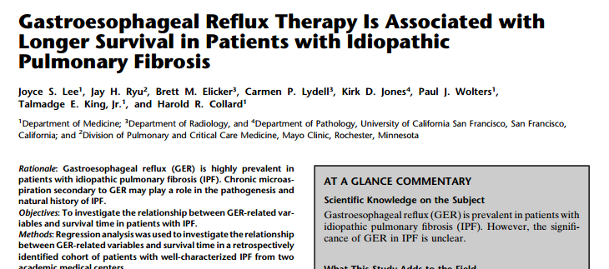
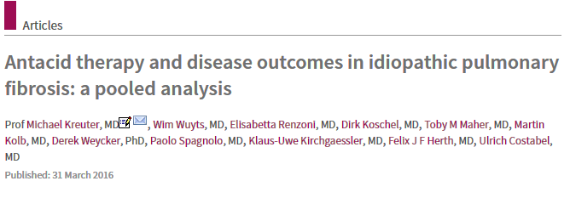
Risultati discordanti
Il trattamento del reflusso, specialmente se con terapia antiacida, è associato con minor fibrosi radiologica ed è un fattore indipendente nell’aumento del tempo di sopravvivenza nei pazienti IPF
La terapia antiacida non migliora l’outcome dei pazienti con IPF e può essere potenzialmente associata con un maggior rischio di infezioni in quelli con malattia avanzata

Slide 43
In assenza di evidenze definitive sarebbero necessari trials controllati per determinare se il trattamento del reflusso gastroesofageo, sia medico che chirurgico, nei pazienti con IPF sia veramente utile
I risultati dello studio prospettico randomizzato di fase II WRAP-IPF sulla LARS (laparoscopic anti-reflux surgery) nei pazienti con IPF e reflusso gastroesofageo sono largamente attesi

Slide 44
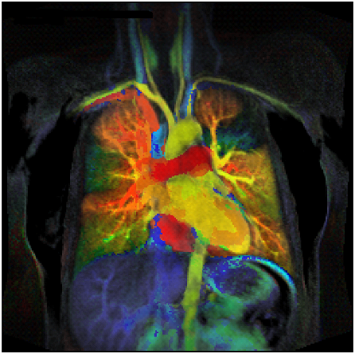
Grazie a tutti i presenti della cortese attenzione
Alberto Pesci

