Slide 1
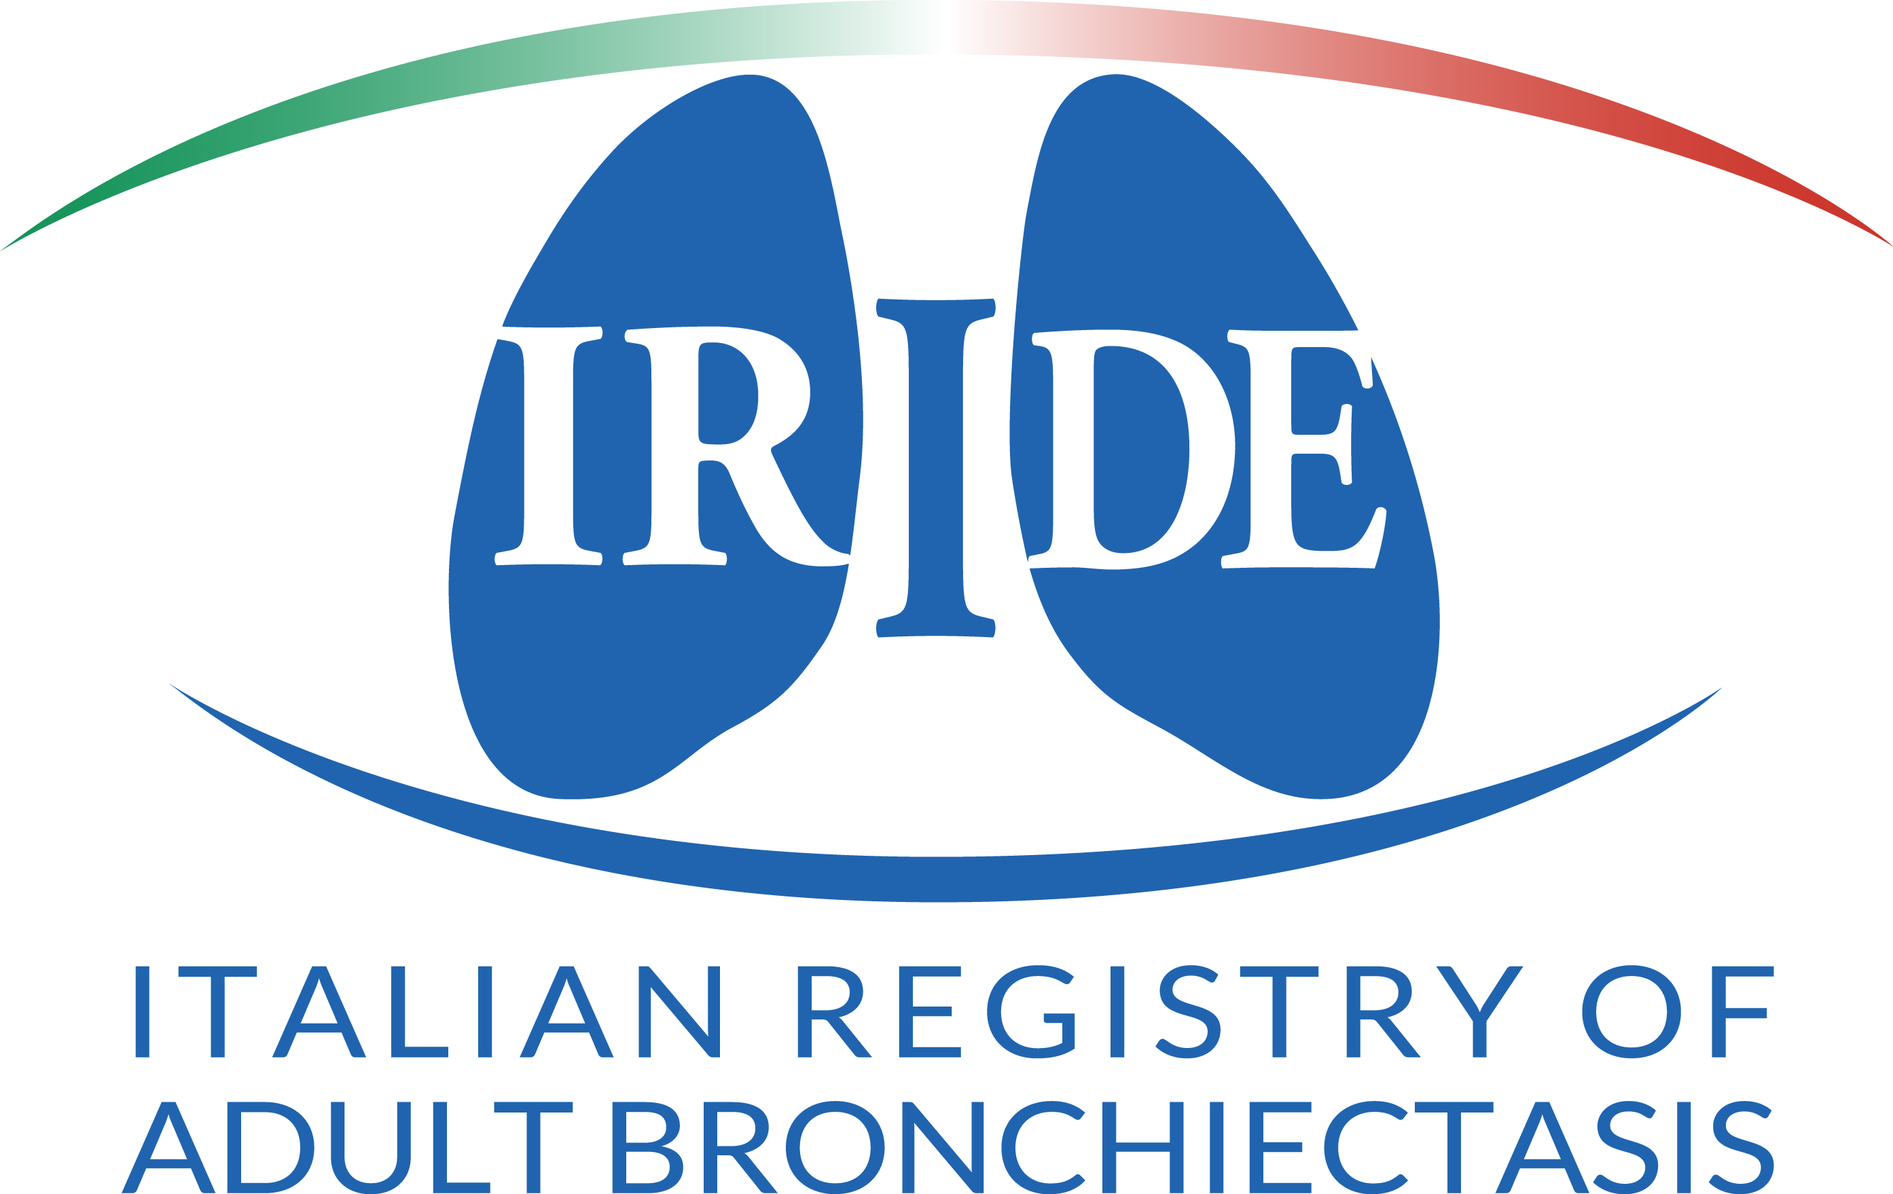

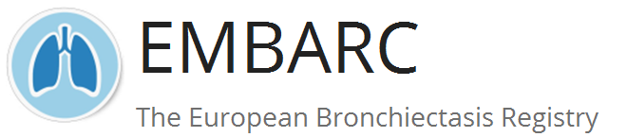
TRATTAMENTO MEDICO ATTUALE DELLE MICOBATTERIOSI NON-TUBERCOLARI
Stefano Aliberti
University of Milan, Milan, Italy
stefano.aliberti@unimi.it

Slide 2
Presenter disclosures
Clinical Trials
Aradigm; Zambon; Novartis; Insmed
Research Grant Support
EU Innovative Medicines Initiative, European Respiratory Society, Bayer Healthcare, Aradigm Corporation, Grifols, Regione Lombardia; Insmed
Consultancy
Bayer Healthcare; Astrazeneca, Grifols; Aradigm Corporation; Basilea; Zambon; Novartis; Horizon; Actavis

Slide 3
Plan
Why should we care of NTM?
What are the major challenges in the management of NTM?
What should we do?
What is the Italian response?

Slide 4
Plan
Why should we care of NTM?
What are the major challenges in the management of NTM?
What should we do?
What is the Italian response?

Slide 5
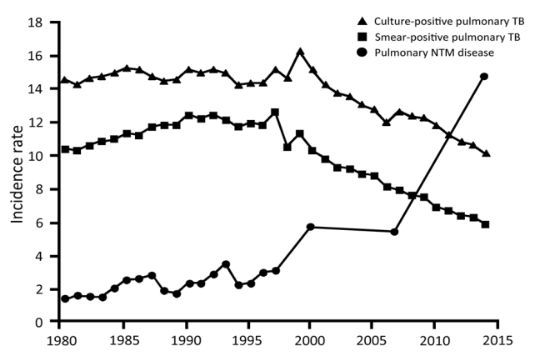
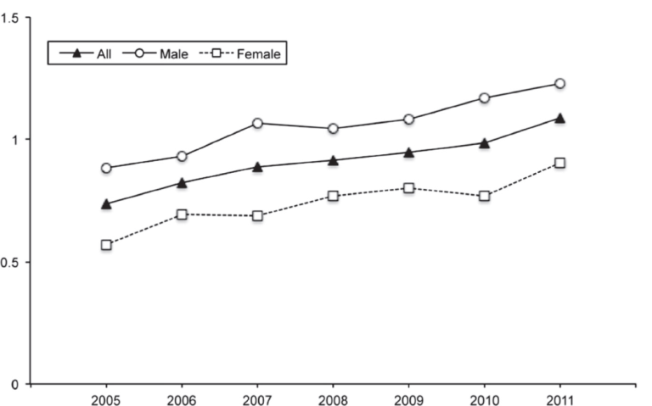
Burden of disease
2 - 22/100,000
Increasing incidence worldwide
Annual increase 2.9- 8.2% per yr
Hospital admissions ↑
Cost ↑
Hospitalizations
Arend 2009, Iseman 2008, Adjemian 2012, Prevots 2010, Ringshausen 2016, Namkoon 2016, Cowman 16, Ringshausen 2013, Mirsaedi 2015, Morimoto 2014
Notes:
5
Germany, Japan, UK
Namkoong based on doctor surveys to hospitals
Ringshausen based on health insurance data
RBH 2000–14, 5956 unique samples, 1205 unique subjects

Slide 6
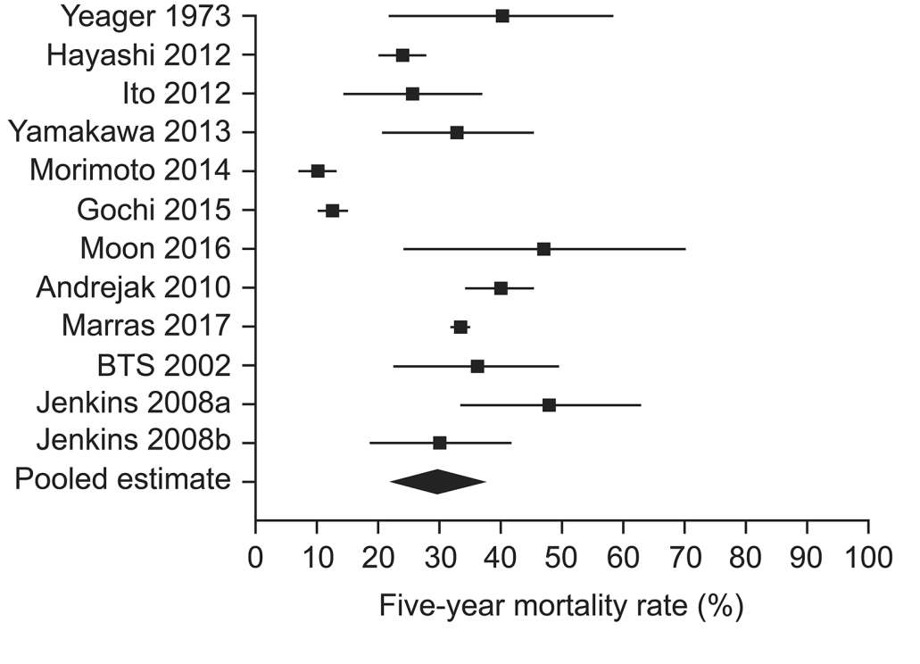
Mortality
5-year all-cause mortality 40.1% (Andrejak 2010 – Denmark)
Similar from BTS RCT (38.8% MAC, 48.5% Malmo, 38.2% Xenopi)
Xenopi 69.1% 5-year mortality (Andrejak 2009)
MAC – 23.9% 5-year mortality (Hayashi 2012)
In clari res 1-year mortality rate 34% (Griffith 2006 AJRCCM)
(Diel unpublished)
Notes:
86% (14% recultured during 48% after Rx)

Slide 7
Plan
Why should we care of NTM?
What are the major challenges in the management of NTM?
What should we do?
What can we do in Italy?

Slide 8
The heterogeneity of the disease
Different exposure
Hoefsloot 2013
Different NTM species give different clinical pictures
Diagnostic delay
Schönfeld N Pneumologie 2013
Mirsaeidi M. Int J Infect Dis 2013

Slide 9
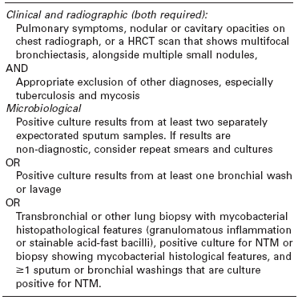
Diagnosis
Griffith et al 2007

Slide 10
Very complex and long treatment
Faverio P. Int J Mol Sci. 2016 Nov 16;17(11)

Slide 11
Plan
Why should we care of NTM?
What are the major challenges in the management of NTM?
What should I do?
What can we do in Italy?

Slide 12
DON’T DO THAT
Italian national audit
Adult Bx pts
2ndary care clinics
32 hospitals
2014 and 2015
1,361 pts (female: 53%; 70 yrs)
Aliberti S. Eur Respir J. 2016 Jul;48(1):244

Slide 13
Management of NTM-PD: key questions
Can the pre-existing / predisposing conditions be optimised?
Does the burden of treatment outweigh the burden of disease?
Is the patient willing and able to be on multi-drug treatment for >1 year?
Is there a potential role for surgical resection of the worst affected areas?
Do I want to do this myself, or do I refer to a specialist centre?

Slide 14
Present strategies – treatment - MAC
Severe MAC-pulmonary disease: | Antibiotic regimen:
AFB smear positive Radiological evidence of cavitation / severe infection Severe symptoms Signs of systemic illness | Rifampicin 600mg daily and Ethambutol 15mg/kg daily and Azithromycin 250mg daily or Clarithromycin 500mg twice daily And consider intravenous amikacin for up to 3 months or nebulised amikacin Antibiotic treatment should continue for a minimum of 12 months after culture conversion
Haworth et al 2017

Slide 15
Present strategies – treatment - Mabs
Haworth et al 2017

Slide 16
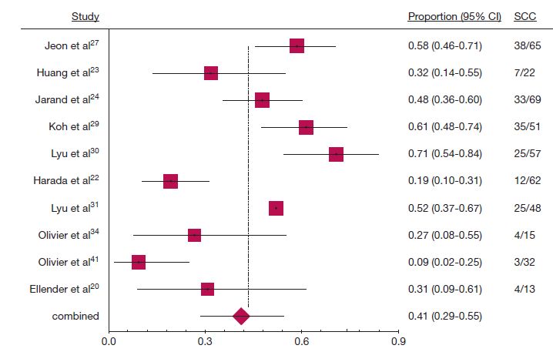
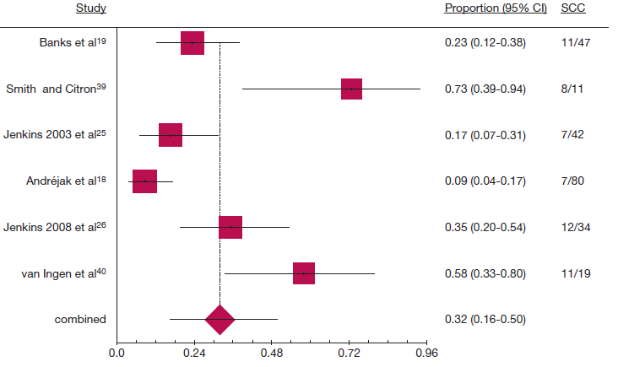
The unmet need
Refractory disease
MAC – 13-86% culture conversion (Wallace 2014)
- 16 studies 1462pts 60% sustained culture conv (Kwak 2017)
  Additional use of 2nd line drugs don’t improve outcome and are poorly tolerated (Jo KW 2014)
  M abscessus 41.2%, M kansasii 80.2%, M. xenopi 32%, M. malmoense 54.4%
  (Diel 2017)
MAbs
M xenopi
Notes:
86% (14% recultured during 48% after Rx)

Slide 17
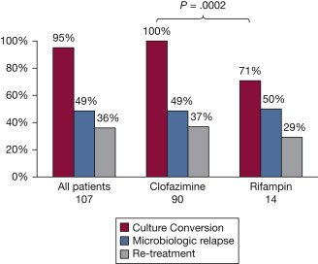
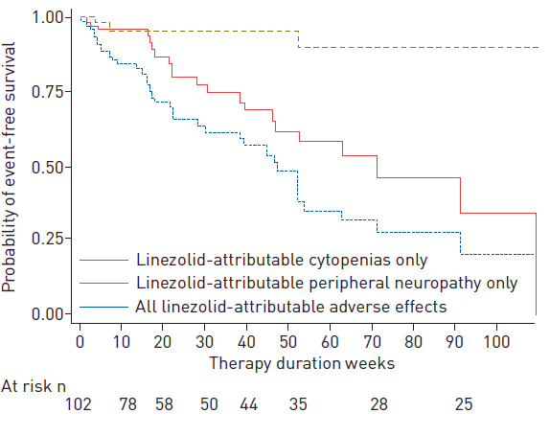
New strategies - better antibiotics
Clofazimine (Jarand et al Chest 2016, van Ingen 2012)
Bedaquiline (Philley et al Chest 2015)
  10 pt (6 MAC, 4 MAb)
  9/10 symptomatic ↑, 4/10 ↓, 4/10↑ radiol
  Linezolid (Winthrop et al ERJ 2015 )
  Tolerance not efficacy
  Amikacin nebulised (Olivier AnnAts 2014)
      15 Mab, 5MAC – 5 –ve, no CT correl
Notes:
Clofazimine (Jarand et al Chest 2016) – issues with definitions of culture conversion – likely not accurate
Sputum conversion 19/22 (86%)
Median time to sputum conversion 74 days (39,120)
2005-present
Approx 840 patients
At least 1 NTM +ve culture =127 (15%)
Data available on 57/89
M.abscessus = 40
M.massiliense = 13
M.bolleti = 4
30 profiles so far
M.abscessus Cluster I = 2
M.abscessus Cluster II = 7
Unique isolates = 12 (8 abscessus, 2 bolleti, 2 massilense)
Shared Isolates
3 pairs of abscessus – no evidence of contact
1 pair of massiliense – undergoing investigation

Slide 18
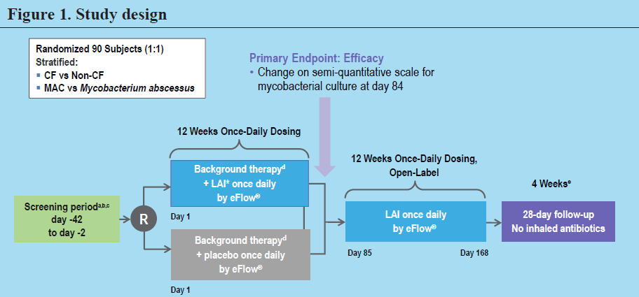
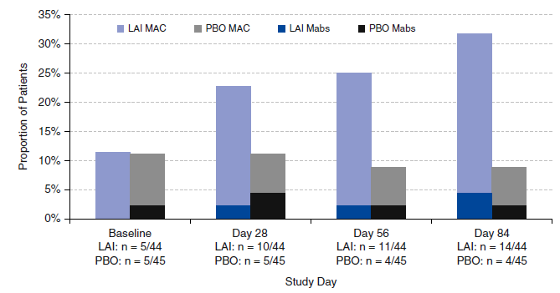
New strategies - better antibiotics
At least one negative sputum culture
Olivier et al 2017
Notes:
In this phase II study, we investigated the efficacy and
safety of liposomal amikacin for inhalation (LAI) in treatment refractory
pulmonary nontuberculousmycobacterial (Mycobacterium
avium complex [MAC] or Mycobacterium abscessus) disease.
Methods: During the double-blind phase, patients were randomly
assigned to LAI (590 mg) or placebo once daily added to their
multidrug regimen for 84 days. Both groups could receive open-label
LAI for 84 additional days. The primary endpoint was change from
baseline to Day 84 on a semiquantitative mycobacterial growth scale.
Other endpoints included sputum conversion, 6-minute-walk
distance, and adverse events.
Measurements and Main Results: The modified intention-totreat
population included 89 (LAI = 44; placebo = 45) patients. The
average age of the sample was 59 years; 88% were female; 92% were
white; and 80 and 59 patients completed study drug dosing during
the double-blind and open-label phases, respectively. The primary
endpoint was not achieved (P = 0.072); however, a greater proportion
of the LAI group demonstrated at least one negative sputum culture
(14 [32%] of 44 vs. 4 [9%] of 45; P = 0.006) and improvement in
6-minute-walk test (120.6 m vs. 225.0 m; P = 0.017) at Day 84.
A treatment effect was seen predominantly in patients without cystic
fibrosis with MAC and was sustained 1 year after LAI. Most adverse
events were respiratory, and in some patients it led to drug
discontinuation.
Conclusions: Although the primary endpoint was not reached, LAI
added to a multidrug regimen produced improvements in sputum
conversion and 6-minute-walk distance versus placebo with limited
systemic toxicity in patients with refractory MAC lung disease.
Further research in this area is needed.
In this multicenter clinical trial, we assessed
the novel drug formulation LAI in patients
who had persistently positive NTM cultures
despite having received ATS/IDSA
guidelines–based treatment (9) for at least
6 months before screening. Concern that
this treatment-refractory, advanced-disease
population, a high proportion of whom had
cavitary disease and macrolide resistance
(Table 1), would not achieve negative
sputum cultures within the 3-month
controlled phase led to selection of a
reduction in semiquantitative growth as the
primary endpoint.

Slide 19
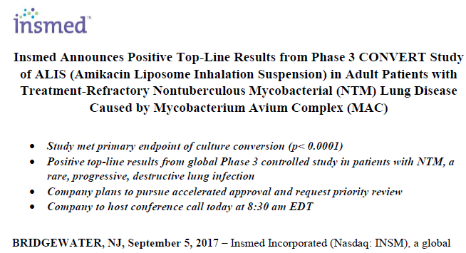
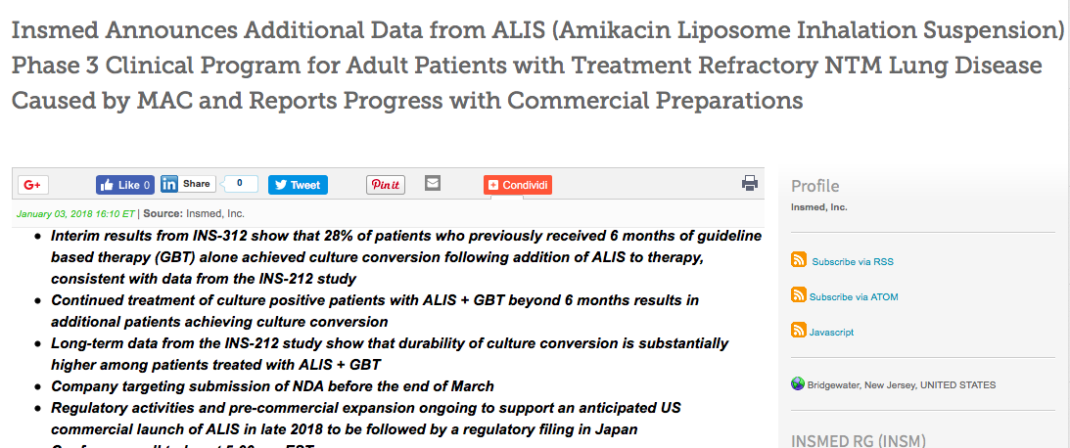
New strategies - better antibiotics
The CONVERT study enrolled 336 adult patients with NTM lung disease caused by MAC who were refractory to at least six months of GBT.
ALI 29% culture convert (3 consecutive –ve) sputa Month 6
No ALI 9% (p <0.0001)
Patients in either arm of the INS-212 study who did not achieve culture conversion by Month 6 had the option to enroll in INS-312 at month 8, an extension study that is evaluating treatment with ALIS plus GBT for 12 months.
124 pts
Among GBT, 28% converted
Among ALIS, 12% converted

Slide 20
A multidisciplinary approach is required

Slide 21
Plan
Why should we care of NTM?
What are the major challenges in the management of NTM?
What should I do?
What can we do in Italy?

Slide 22
irene@policlinico.mi.it
@registro_irene
NCT03339063 www.registroirene.it

Slide 23

IRENE 2018
NTM Day - LOMBARDIA
28-29 Giugno 2018
IRENE Clinical Fellowship
Ottobre 2018
Ca’ Granda Seminar
26 Marzo 2018
Villa Marelli retrospective
study
NTM Consilium
Attivo dal 1.6.18
Database
LAI
CF NTM microbiome project
Congressi nazionali
4 giornate bronchiettasie
Pubblicazione Protocollo IRENE
Registro IRENE
+ Biobank
+ Chest CT Repository

Slide 24
OSSERVATORIO NAZIONALE NTM-PD
Centri di Pneumologia, Malattie Infettive, Fibrosi Cistica, Medicina Interna e Ex-dispensari
20 centri con approvazione comitato etico locale
22 centri in attesa di risposta da comitato etico locale
10 centri in procinto di presentare i documenti al comitato etico locale
120 pazienti arruolati ad oggi
irene@policlinico.mi.it
@registro_irene
NCT03339063 www.registroirene.it

Slide 25




OSSERVATORIO NAZIONALE NTM-PD
irene@policlinico.mi.it
@registro_irene
NCT03339063 www.registroirene.it

Slide 26
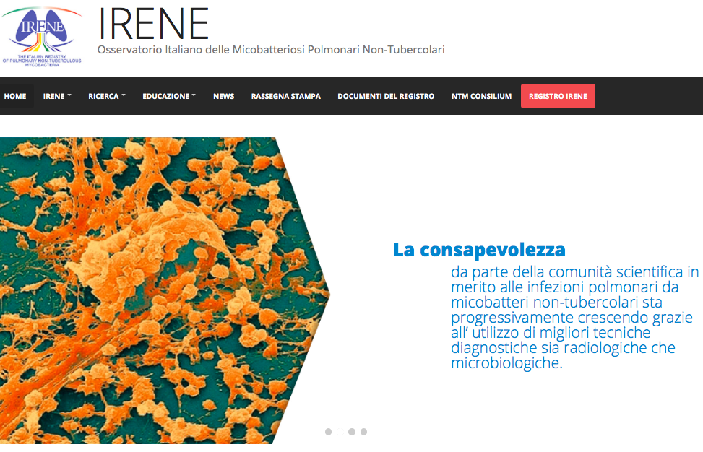
OSSERVATORIO NAZIONALE NTM-PD
www.registroirene.it
irene@policlinico.mi.it
@registro_irene
NCT03339063 www.registroirene.it

Slide 27
Conclusions
Why should we care of NTM?
What are the major challenges in the management of NTM?
What should I do?
What can we do in Italy?
Impact on quality of life and attributable mortality
When to start treatment / outcome recognition
Go for a multidisciplinary care and discussion
www.registroirene.it

Slide 28
Acknowledgements
IRENE Executive group
Francesco Blasi
Luigi Codecasa
Andrea Gori
IRENE Study Manger
Maura Spotti
IRENE Steering committee
Giovanni Sotgiu
Saverio De Lorenzo
Bruno Del Prato
Benny Assael
Giorgio Besozzi
Andrea Calcagno
Antonio Di Biagio
Enrico Girardi
Alberto Matteelli
Stefano Nardini
Giuliana Previdi
Nicola Sverzellati
Enrico Tortoli
Villa Marelli team
Luigi Codecasa
Maurizio Ferrarese
Paola Castellotti
Policlinico team
Francesco Blasi
Nicolò Vanoni
Fabrizio Nava
Bronchiectasis Program
International AB
James D Chalmers
Michael Loebinger
Mehdi Mirsaeidi
Jakko van Ingen
Dirk Wagner
www.registroirene.it

Slide 30
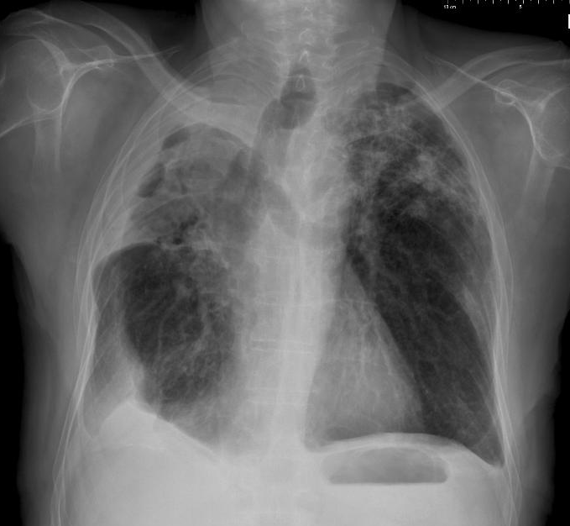
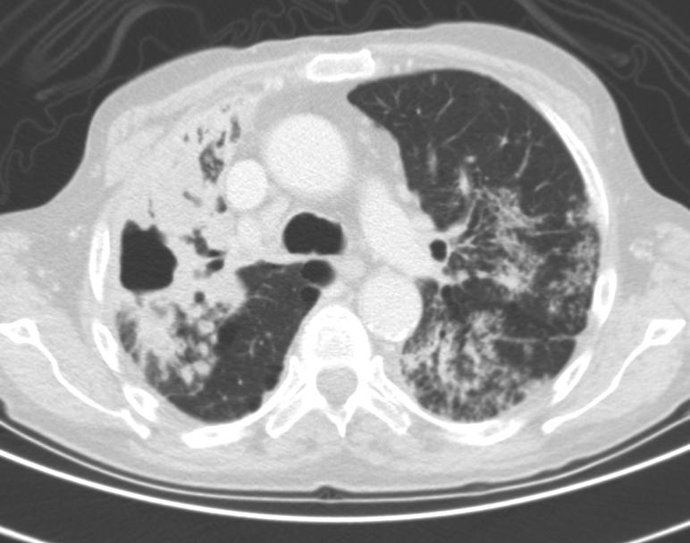
Fibro-cavitary NTM-PD
Epidemiology
Mostly males
Middle-aged (50-70 yrs old)
Pre-existing COPD, silicosis, fibrosis
Clinical course
TB-like, but slower
Microbiology
Often Ziehl-Neelsen positive sputum
High yield of culture
Radiology
Fibro-cavitary lesions, upper lobes

Slide 31
Nodular-Bronchiectatic NTM-PD
Epidemiology
Elderly (>60 yrs old) females
Scoliosis, mitral valve prolapse, low BMI
No pre-existing lung disease, CFTR mut.
Clinical course
Prolonged cough, fatigue, weight loss
Microbiology
Low yield of ZN &culture, repeat or BAL
Radiology
Bronchiectasis w/ nodules, tree-in-bud
Middle lobe and lingula worst affected
LADY WINDERMERE SYNDROME

Slide 32
Present strategies – treatment - MAC
Severe MAC-pulmonary disease: | Antibiotic regimen:
AFB smear positive Radiological evidence of cavitation / severe infection Severe symptoms Signs of systemic illness | Rifampicin 600mg daily and Ethambutol 15mg/kg daily and Azithromycin 250mg daily or Clarithromycin 500mg twice daily And consider intravenous amikacin for up to 3 months or nebulised amikacin Antibiotic treatment should continue for a minimum of 12 months after culture conversion
Haworth et al 2017

Slide 33
Present strategies – treatment - Mabs
Initial Phase ≥ 1 monthª | Continuation Phase
iv amikacin 15mg/kg daily or 3x / week^{b} iv tigecycline 50mg bd and where tolerated: iv imipenem 1g bd and where tolerated: oral macrolide ªpatients with clarithromycin resistant isolates may benefit from longer duration iv antibiotic treatment | nebulised amikacin^{b} oral macrolide and 1-3 oral antibiotics guided by drug susceptibility and patient tolerance: clofazimine linezolid minocycline moxifloxacin cotrimoxazole ^{b}substitute iv / nebulised amikacin for an alternative antibiotic if M. abscessus is resistant to amikacin (MIC >64mg/L or known to have a 16S rRNA gene mutation)
Haworth et al 2017

Slide 34
New strategies - better antibiotics
Clofazimine (Jarand et al Chest 2016, van Ingen 2012)
Notes:
Clofazimine (Jarand et al Chest 2016) – issues with definitions of culture conversion – likely not accurate
Sputum conversion 19/22 (86%)
Median time to sputum conversion 74 days (39,120)
2005-present
Approx 840 patients
At least 1 NTM +ve culture =127 (15%)
Data available on 57/89
M.abscessus = 40
M.massiliense = 13
M.bolleti = 4
30 profiles so far
M.abscessus Cluster I = 2
M.abscessus Cluster II = 7
Unique isolates = 12 (8 abscessus, 2 bolleti, 2 massilense)
Shared Isolates
3 pairs of abscessus – no evidence of contact
1 pair of massiliense – undergoing investigation

Slide 35
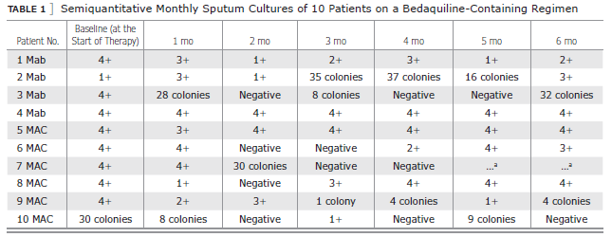
New strategies - better antibiotics
Clofazimine (Jarand et al Chest 2016, van Ingen 2012)
Bedaquiline (Philley et al Chest 2015)
  10 pt (6 MAC, 4 MAb)
  9/10 symptomatic ↑, 4/10 ↓, 4/10↑ radiol
  Linezolid (Winthrop et al ERJ 2015)
  Tolerance not efficacy
Notes:
Clofazimine (Jarand et al Chest 2016) – issues with definitions of culture conversion – likely not accurate
Avibactam as a betalactamase inhibitor seems to have some effect with abscessus
Tedizolid alternative to linezolid
Sputum conversion 19/22 (86%)
Median time to sputum conversion 74 days (39,120)
2005-present
Approx 840 patients
At least 1 NTM +ve culture =127 (15%)
Data available on 57/89
M.abscessus = 40
M.massiliense = 13
M.bolleti = 4
30 profiles so far
M.abscessus Cluster I = 2
M.abscessus Cluster II = 7
Unique isolates = 12 (8 abscessus, 2 bolleti, 2 massilense)
Shared Isolates
3 pairs of abscessus – no evidence of contact
1 pair of massiliense – undergoing investigation

Slide 36
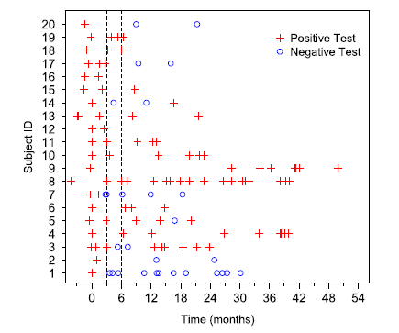
New strategies - better antibiotics
Clofazimine (Jarand et al Chest 2016, van Ingen 2012)
Bedaquiline (Philley et al Chest 2015)
  10 pt (6 MAC, 4 MAb)
  9/10 symptomatic ↑, 4/10 ↓, 4/10↑ radiol
  Linezolid (Winthrop et al ERJ 2015 )
  Tolerance not efficacy
  Amikacin nebulised (Olivier AnnAts 2014)
      15 Mab, 5MAC – 5 –ve, no CT correl
Notes:
Clofazimine (Jarand et al Chest 2016) – issues with definitions of culture conversion – likely not accurate
Sputum conversion 19/22 (86%)
Median time to sputum conversion 74 days (39,120)
2005-present
Approx 840 patients
At least 1 NTM +ve culture =127 (15%)
Data available on 57/89
M.abscessus = 40
M.massiliense = 13
M.bolleti = 4
30 profiles so far
M.abscessus Cluster I = 2
M.abscessus Cluster II = 7
Unique isolates = 12 (8 abscessus, 2 bolleti, 2 massilense)
Shared Isolates
3 pairs of abscessus – no evidence of contact
1 pair of massiliense – undergoing investigation

Slide 37
New strategies - better antibiotics
Olivier et al 2017

Slide 38
New strategies - better antibiotics
The CONVERT study enrolled 336 adult patients with NTM lung disease caused by MAC who were refractory to at least six months of GBT.
ALI 29% culture convert (3 consecutive –ve) sputa Month 6
No ALI 9% (p <0.0001).
Use in refractory disease – other uses?

Slide 39
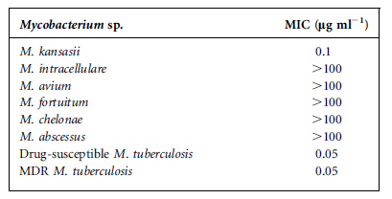
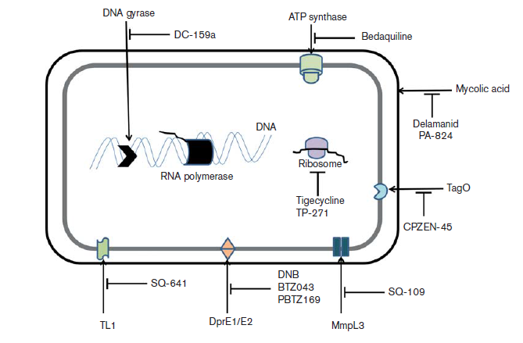
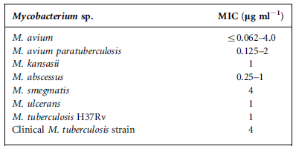
New strategies - better antibiotics
Soni et al J Med Micro 2016
Notes:
Sputum conversion 19/22 (86%)
Median time to sputum conversion 74 days (39,120)
2005-present
Approx 840 patients
At least 1 NTM +ve culture =127 (15%)
Data available on 57/89
M.abscessus = 40
M.massiliense = 13
M.bolleti = 4
30 profiles so far
M.abscessus Cluster I = 2
M.abscessus Cluster II = 7
Unique isolates = 12 (8 abscessus, 2 bolleti, 2 massilense)
Shared Isolates
3 pairs of abscessus – no evidence of contact
1 pair of massiliense – undergoing investigation

Slide 40
New strategies - better antibiotics
B lactam and avibactam
Notes:
Tedizolid was recently shown to have MICs twoto four-fold lower than linezolid against both. Compared with linezolid, tedizolid has higher bioavailability, longer halflife, lower hematological and neurotoxicity rates, and it accumulates in the lung and macrophages [3].

Slide 41
Treatment recommendations
American Thoracic Society
M. avium complex RIF-EMB-macrolide (+/- aminoglycoside) >12 mo
M. kansasii INH-RIF-EMB 12 mo
M. xenopi RIF-EMB-macrolide-moxifloxacin?
M. simiae Macrolide-moxifloxacin-cotrimoxazole-…?
M. abscessus 3-4 of amikacin, cefoxitin/imipenem, macrolide*, linezolid, tigecycline
With surgical debulking whenever feasible
Treatment duration
Pulmonary disease: 12 months after culture conversion
Griffith DE, et al., Am J Respir Crit Care Med 2007

Slide 42
Case series on MAC-PD
Prolonged culture conversion:
  RIF-EMB-macrolide based regimen: 333/478 (70%)
  Clofazimine-macrolide based regimen: 34/52 (65%)
  Macrolide resistance in vitro is a risk factor for treatment failure
  Fibro-cavitary disease is a risk factor for treatment failure
Differences in exact regimens
  Adjunctive aminoglycosides
  Adjunctive quinolones
Field S, et al., Chest 2003
van Ingen J, et al. Expert Rev Anti Infect Ther 2013
Lam PK et al., Am J Respir Crit Care Med 2006

Slide 43
Rationale for regimens - MAC
RIF-EMB: a legacy from TB
  But hardly active
  Synergistic, relevant?
  BTS trial: RE 27% cure rate
The macrolides matter most
But are weak bacteriostatic drugs
Amikacin works in vitro, for a while
And no influence on outcome in vivo
  If given iv…
Van Ingen J et al., Expert Rev Anti Infect Ther 2013
Ferro BE & van Ingen J. J Antimicrob Chemother 2015

Slide 44
Focus on M. abscessus
Regimens developed from susceptibility data!
Jarand et al, CID 2011
69 pt, 48% culture conversion
  Initial regimens based on susceptibilities
  Amikacin, imipenem, clarithromycin, ...
Jeon et al, AJRCCM 2009
65pt, 58% culture conversion
  4wk cefoxitin-amikacin (cefox often interrupted)
  cont w/ ciprofloxacin-doxycycline-clarithromycin
MYCOBACTERIUM ABSCESSUS
AMIKACIN | S
CEFOXITIN | I
IMIPENEM | I
CLARITROMYCIN | S=>R
CO-TRIMOXAZOLe | R
DOXYCYCLINE | R
CIPROFLOXACIN | R
MOXIFLOXACIN | R
LINEZOLID | R
TIGECYCLINE | MIC 0.125
CLOFAZIMINE | MIC 0.25
Van Ingen J et al., Expert Rev Anti Infect Ther 2013
Jeon K et al., Am J Respir Crit Care Med 2009
Jarand J, et al. Clin Infect Dis 2010

Slide 45
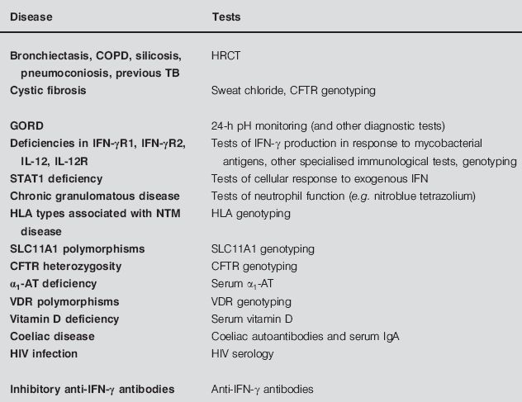
Other modifiable targets - host
Sexton 2008
  Oestrogen /Leptin Tsuyuguchi 2001 Ordway 2008
  Mucociliary clearance↓CBF + NO Fowler 2013
  Burden of immune, CFTR, cilia, con tissue variants Szymanski 2015
  Candidiate genes eg TTK protein kinase gene DNA damage repair Chen 2017
Notes:
DHEA is the
primary source of sex steroids in womenafter menopause. DHEA levels are knownto be variable in the elderly but overallo decline with age (13). Plasma levelsof DHEA have been found to besignificantly reduced in patients with activeM. tuberculosis
plasma DHEA levels correlated positively with the in vitro production of IFN-gamma by mycobacterial-stimulated PBMCs. TB also reduces the DHEA

Slide 46
Other modifiable targets - host
Cilia variants – Motility enhancer:
?Sildenafil
Immune variants –
Immune
modulator:
IFNγ
PNTM
Environment - Behavioral
modification
Pathogen -
Novel anti-
microbials
CF
variants – CFTR
modulators
Connective Tissue Variants - TGF-β attenuator: Losartan
From K. Olivier
Notes:
DHEA is the
primary source of sex steroids in womenafter menopause. DHEA levels are knownto be variable in the elderly but overallo decline with age (13). Plasma levelsof DHEA have been found to besignificantly reduced in patients with activeM. tuberculosis
plasma DHEA levels correlated positively with the in vitro production of IFN-gamma by mycobacterial-stimulated PBMCs. TB also reduces the DHEA

Slide 47
NTM Day - LOMBARDIA
28-29 Giugno 2018
IRENE Clinical Fellowship
Ottobre 2018
Ca’ Granda Seminar
26 Marzo 2018
Villa Marelli
Cohort Study
NTM Consilium
Attivo il 1.6.18
Database
LAI
CF NTM microbiome project
Congressi nazionali
4 giornate bronchiettasie
Pubblicazione Protocollo IRENE
Osservatorio IRENE

Slide 48
Metodologia
→ Valutare la prevalenza e i fattori di rischio di outcome sfavorevole (persistenza, recidiva, reinfezione, decesso) in pazienti adulti affetti da NTM-PD
Studio retrospettivo monocentrico
2010-2015
Pazienti adulti consecutivi afferenti presso gli ambulatori di Villa Marelli dell’ospedale Niguarda Ca’ Granda, Milano
Criteri di inclusione: Qualsiasi sesso; Età >= 18 anni; Qualsiasi etnia; Pazienti affetti da NTM-PD secondo i criteri ATS/IDSA 2007
Criterio di esclusione: pazienti affetti da fibrosi cistica
Outcome
Recidiva
Reinfezione
Persistenza
Decesso
Thanks to Luigi Codecasa, Maurizio Ferrarese, Paola Castellotti, Ana Pasat and Lisa Pancini
Notes:
Recidiva
Presenza di ripresa di sintomatologia e peggioramento radiologico con un colturale positivo della stessa specie dopo un colturale negativo che era stato associato a miglioramento clinico e radiologico.
Reinfezione
Presenza di ripresa di sintomatologia e peggioramento radiologico con un colturale positivo per un NTM di un’altra specie dopo un colturale negativo che era stato associato a miglioramento clinico e radiologico.
Persistenza
Persistenza della malattia in termini sia di segni e sintomi e radiologici con colturali sempre positivi della stessa specie senza mai colturale negativo.
Decesso
Decesso per qualsiasi causa

Slide 49
96 pazienti
Femmine: 65 (68%); Età mediana (IQR): 68 (55-76) anni
Clinica-Radiologia-Microbiologia
Segni/Sintomi
Tosse | 77 (80%)
Astenia | 42 (44%)
Frequenti riacutizzazioni | 42 (44%)
Sputo | 35 (36%)
Febbre | 28 (29%)
Emottisi | 20 (21%)
Dispnea | 14 (15%)
Perdita di peso | 12 (13%)
Sudorazioni notturne | 10 (10%)
Dolore toracico | 8 (8%)
Radiologia
Noduli | 68 (71%)
Bronchiettasie | 57 (59%)
Consolidamento | 36 (38%)
Albero-in-fiore | 19 (20%)
Noduli cavitati | 19 (20%)
Cavità | 4 (4%)
Specie di NTM
MAC | 61 (59%)
M. avium | 36 (38%)
M. intracellulare | 25 (26%)
M. kansasii | 13 (14%)
M. xenopi | 8 (9%)
M. abscessus | 3 (3%)
M. chelonae | 3 (3%)
M. scrofulaceum | 2 (2%)
M. gordonae | 1 (1%)
M. simiae | 1 (1%)
M. triplex | 1 (1%)
M. lentiflavum | 1 (1%)

Slide 50
Trattamento
Schemi di trattamento
Presenza del macrolide nello schema terapeutico | 84 (88%)
Somministrazone dei tre farmaci in associazione: Rifabutina o Rifampicina + Etambutolo + Azitromicina o Claritromicina | 80 (83%)
Trattamento iniziato per TBC poi modificato per NTM-PD | 5 (5%)

Slide 51
Outcome
Successo terapeutico | 66 (77%)
Fallimento terapeutico | 20 (23%)
Persistenza | 8
Recidiva | 7
Decesso | 3
Reinfezione | 2

Slide 52
Outcome
 | Fallimento terapeutico (n=20) | Successo terapeutico (n=66) | p-value
Astenia | 10 (50%) | 20 (30%) | 0.027
Microscopia positiva (BAAR+) | 15 (75%) | 44 (67%) | 0.050
3 o più colture positive | 8 (40%) | 5 (8%) | <0.001
Patologia neoplastica attiva | 3 (15%) | 0 (0.0%) | 0.007
Aspergillosi cronica | 3 (15%) | 0 (0.0%) | 0.007

