Slide 1
L’analisi dei Big Data è utile alla pratica medica?
Sara Marceglia
Dipartimento di Ingegneria e Architettura
Università degli Studi di Trieste

Slide 2
Big Data Disruption
There is a currency with no money

Slide 3
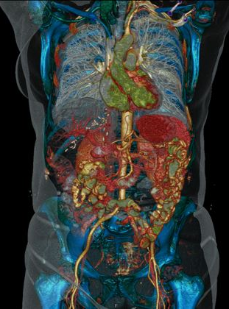
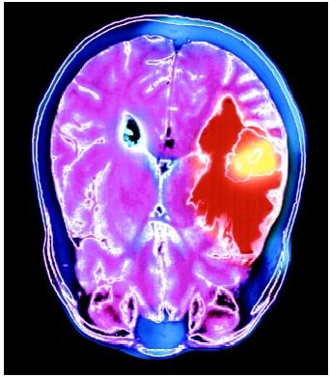
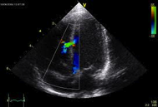
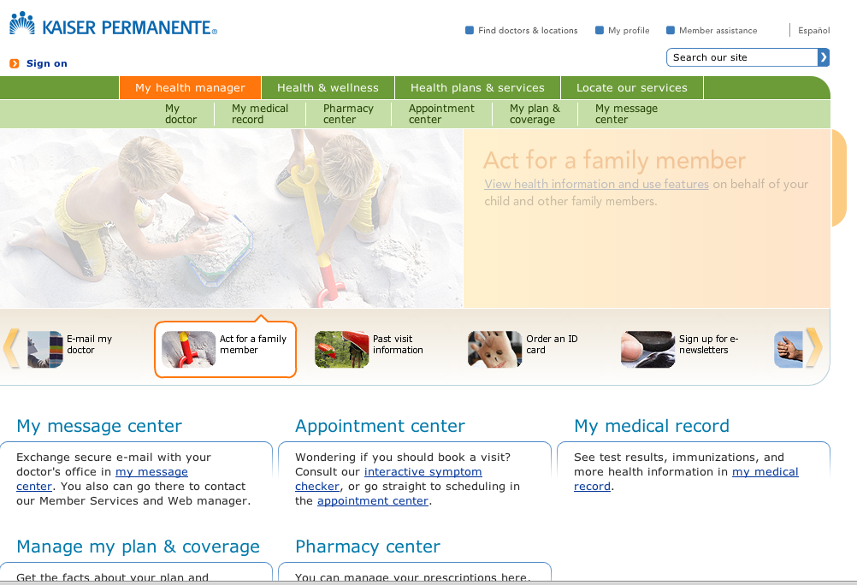
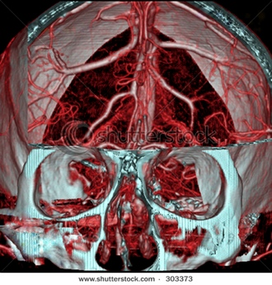
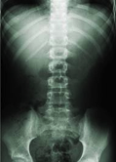
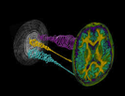
Big data in healthcare: clinical data
PERSONAL HEALTH RECORD
ELECTRONICHEALTH RECORD
BIODATA, BIOSIGNALS, BIOIMAGES

Slide 4
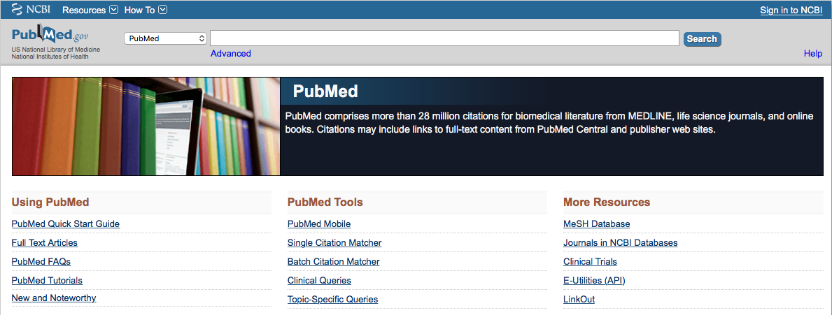
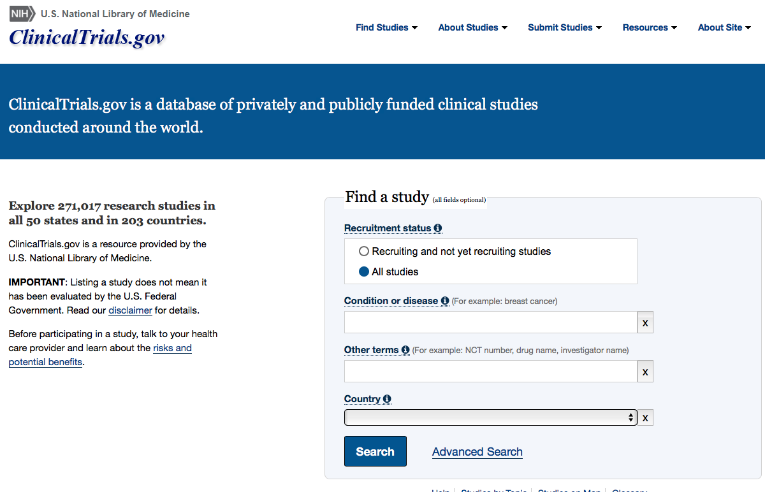
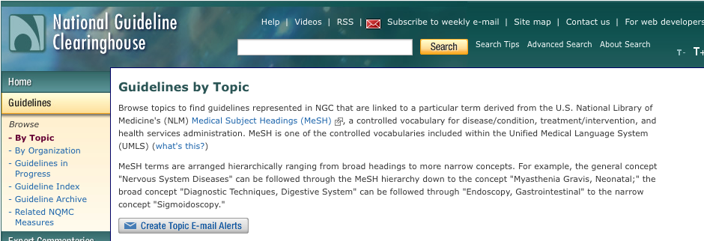
Big data in healthcare: evidence-based medicine

Slide 5
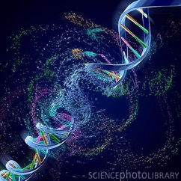
Big data in healthcare: omics
Toxicogenomics
Genomics
Transcriptomics
Metabolomics
Proteomics

Slide 6
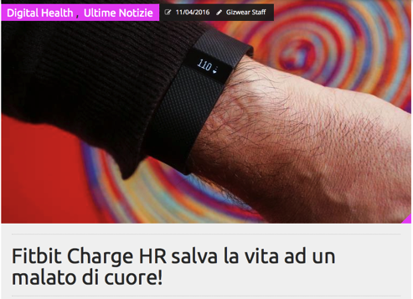
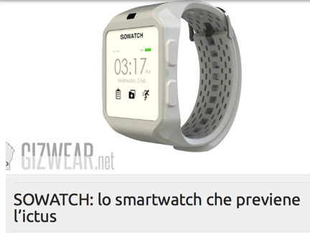
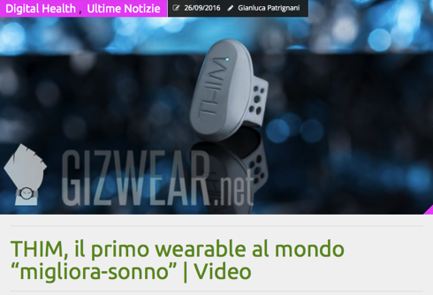
Big data in healthcare: wearables and implantable devices
The number of devices connected to the Internet was 12.5 billion in 2010, making the number of connected devices per person >1 (1.84) for the first time in history. Now they are 25 billions
Medtronic implantable device for treating chronic pain by delivering neurostimulation at the spinal cord is connected to a Samsung Galaxy Tab S2, to allow data capturing and IPG controlling

Slide 7
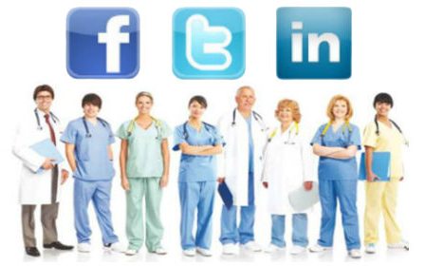
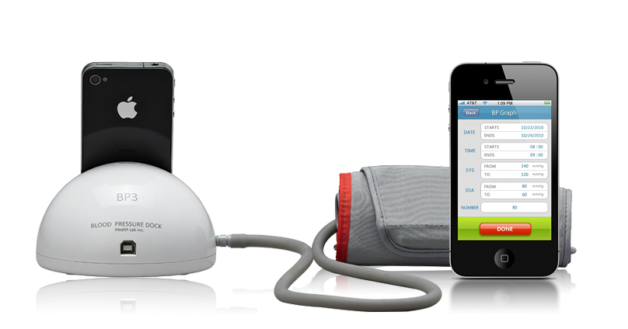
Big Data in healthcare: mobile health apps and social media
There are more mobile connections than people
Internet search engines like Google are the 3rd source of information (51,4%), Facebook is the fifth (43,7%).
Among younger people:
  First: Facebook (71,1%)
  Second: Google (68,7%)
  Fourth: YouTube (53,6%)

Slide 8
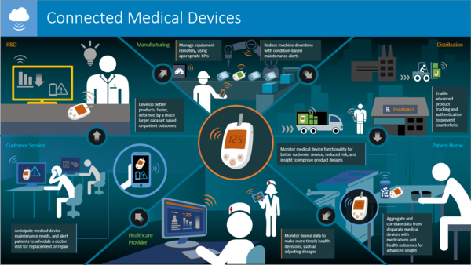
Internet of Health Things

Slide 9
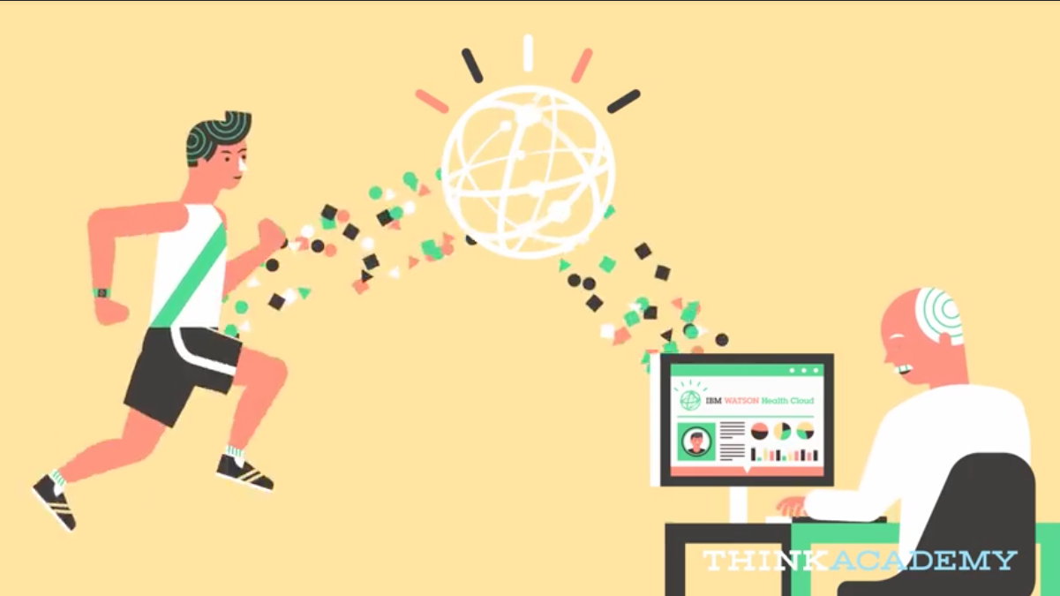
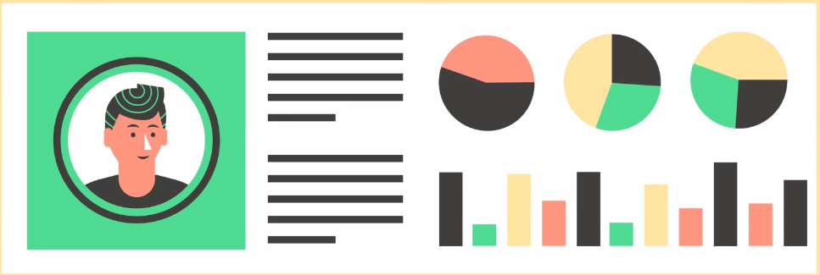
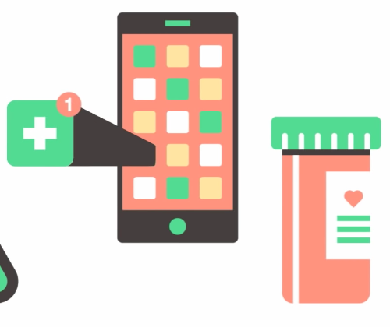
Big Data for Health scenarios (1)
www.ibm.com

Slide 10
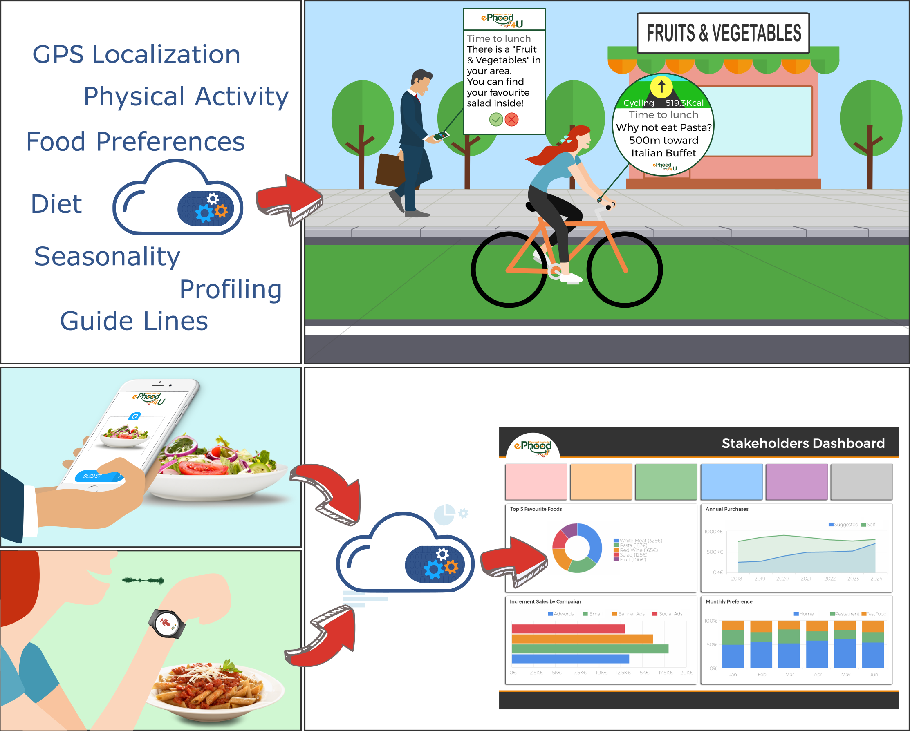
Big Data for Health scenarios (2)
SUPPORTING PERSONAL CHOICES
SUPPORTING STAKEHOLDERS

Slide 11
Expectations from Big Data in Healthcare
IMPROVING CLINICAL OUTCOMES
Comparative effectiveness research to identify the most cost-effective ways to diagnose/treat patients
DRUG DISCOVERY
Predictive modeling to identify candidate new drugs
GENOMIC ANALYTICS
More efficient sequencing and analysis to make genomic analysis part of the regular medical decision making process
TELEMONITORING
Real-time monitoring at home and in-hospital to prevent acute episodes and adverse events
CLINICAL RESEARCH
Improve clinical trial design, and improve data analysis to discover hidden information, e.g., adverse effects
PUBLIC HEALTH
Analyze disease patterns to improve public health surveillance, faster development of targeted vaccines, identify needs and provide targeted services
FRAUD ANALYSIS
Automatic analysis of claim requests to reduce frauds, waste, and abuse
PATIENT PROFILING
Segmentation, predictive modeling, to suggest lifestyle changes, and to evaluate risk profiles
EVIDENCE-BASED MEDICINE
Extract valuable information from available heterogeneous clinical data

Slide 12
Health Big Data in reality: the 4Vs
VOLUME
The size of data goes beyond the ability of common hardware/software
Healthcare volume → zettabyte (10²¹) to yottabyte (10²⁴)
VELOCITY
The rate of growth is very fast
There is a constant flow of data often in real time
VARIETY
Heterogeneous data (structured, unstructured, semi-structured)
Different data types
VERACITY
Errors and inaccuracies are possible
Error free outcomes are the goal
THE BIG DATA 4Vs

Slide 13
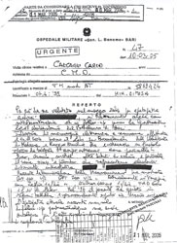
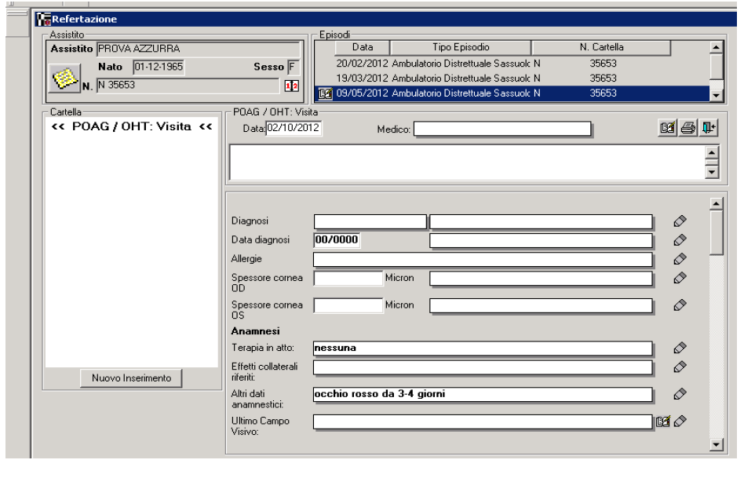
Health Big Data in reality: heterogeneity
STRUCTURED vs UNSTRUCTURED DOCUMENTS

Slide 14
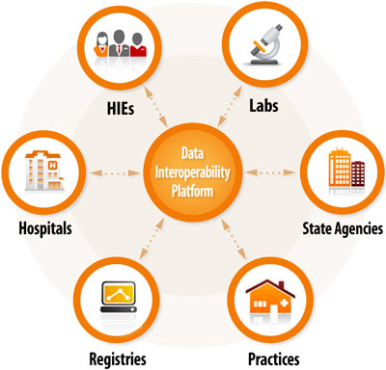
Health Big Data in reality: data silos
Healthcare data are stored in isolated “silos”
Interoperability is envisaged
Marceglia et al, JAMIA, 2015

Slide 15
Health Big Data in reality: analytics
Four-step process:
1- Data collection
2- Data aggregation
3- Data analysis
4- Information extraction

Slide 16
Cognitive Computing
Understanding
Reasoning
Learning
Interacting
Cognitive computing characteristics
Courtesy of IBM

Slide 17
Health Big Data in reality: hardware infrastructures
Big Data require a technological infrastructure that goes beyond the classical stand-alone system: nodes, distributed processing, high performance computing
http://www.rosebt.com/

Slide 18
Where we are: Decision Support Systems
77% accuracy

Slide 19
Where we are: Building Brain Computers
Closed loop systems for brain stimulation → stimulation parameters are changed moment-by-moment according to the patient’s clinical state
The patient’s clinical state is evaluated through the real-time analysis of local neuronal activity (local field potentials, LFPs) captured from the DBS electrodes while stimulation is on.
Arlotti et al, Neurology 2018

Slide 20
Where we are: Reading PubMed papers
Automatic system that mines published literature to identify new protein kinases that phosphorylate the protein tumor suppressor p53.
Proof of principle for automated hypothesis generation and discovery based on text mining of the scientific literature.

Slide 21
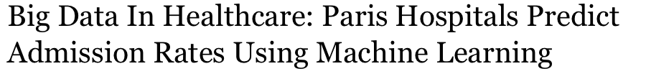

Where we are: Better use of resources
Big Data and machine learning systems used to forecast admission rates in order to improve the deployment of resources
Input: 10 years’ worth of hospital admissions records
Output: day and hour-level predictions of the number of patients expected through the doors.

Slide 22
Where we are: Personalized Medicine
Asthmapolis system→
Bluetooth-enabled sensors that track how often people are using their inhalers (along with location and time-of-day)
Analytics and mobile apps for iOS and Android to help patients visualize and understand their triggers and trends while receiving personalized feedback.
Doctors can review data and identify patients who are risk or need more help → 50% reduction uncontrolled asthma

Slide 23
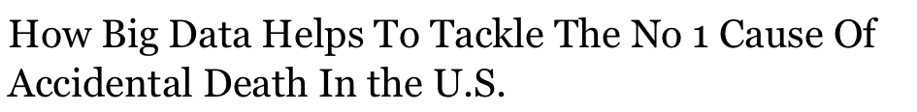
Where we are: Identifying risk factors
Target → preventing opioid abuse in US
The project used years’ worth of pharmacy data, along with claims data
Analysts were able to highlight risk factors that could indicate whether a person could be in danger of developing an opioid abuse problem.
Predictions can be made with “something like 85% accuracy.”
Doctors and other specialists can identify patients at risk and offer preventative care before the problem gets out of hand.

Slide 24
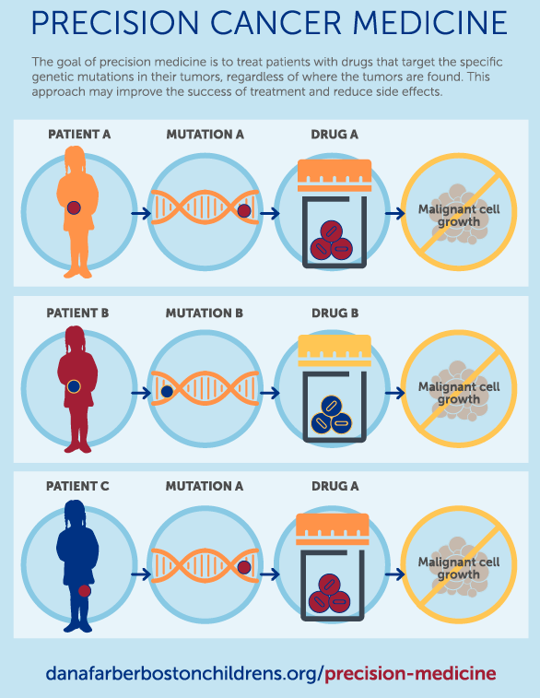
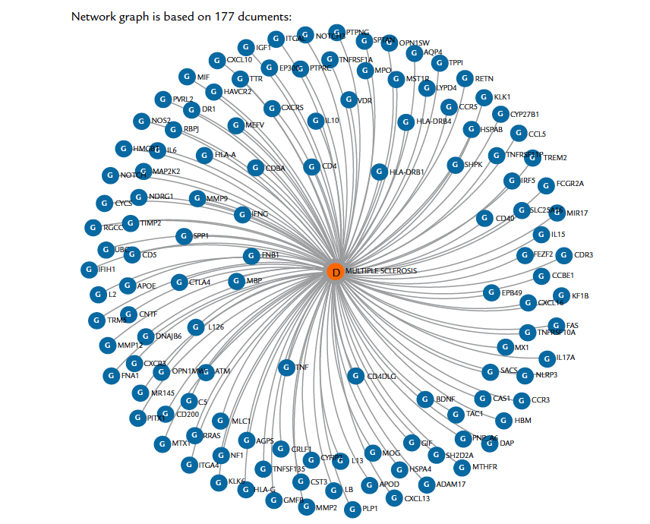
Where we are: Drug Discovery and Precision Medicine
Big omics data analysis together with literature analysis can speed up the process of identifying new candidate drugs

Slide 25
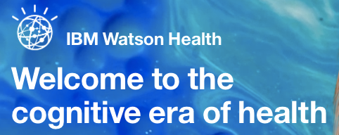
IBM Watson and Watson Health
WatsonHealth is a development of Watson to support health and life science
It is based on medical literature, patents, genomics, chemical and pharmacological data, medical terminologies, electronic health records, and bioimages
Watson is a platform of services to implement solutions based on cognitive computing
2011

Slide 26
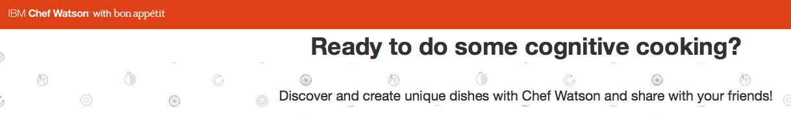
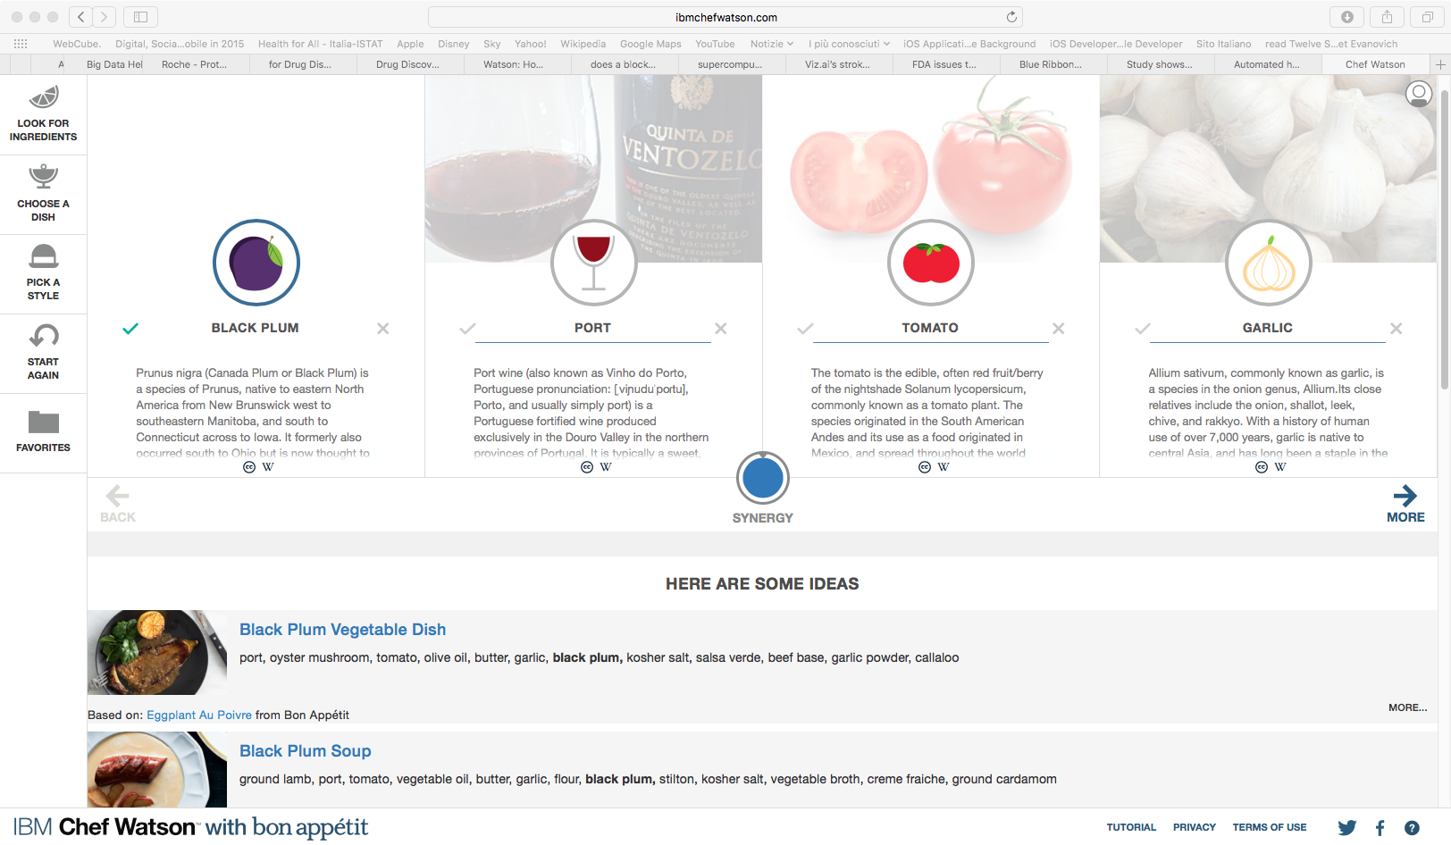
Watson for nutrition
Watson Chef can be the basis for giving smart tips on food and nutrition to patients and citizens
https://www.ibmchefwatson.com/

Slide 27
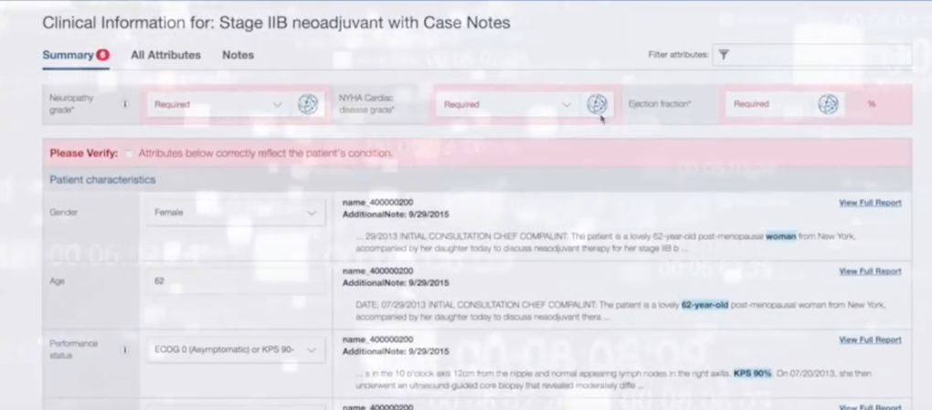
Watson for Oncology
362 cancer cases at the Memorial Sloan Kettering Cancer Center (New York, USA)
Treatment recommendations concordant in 96.4% of lung, 81.0% of colon and 92.7% of rectal cancer cases.
27

Slide 28
Watson for Drug Discovery
Searches scientific abstracts for genes, proteins, target chemical compounds, or interesting conditions and provides dynamic mapping of the links between them.
Explore predictions for new entity relationships by applying predictive algorithms to existing relationship networks
https://www.ibm.com/us-en/marketplace/ibm-watson-for-drug-discovery

Slide 29
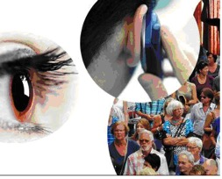

Caveats: data privacy
Individuals may have a limited or incorrect understanding of when data about their health is protected by law, and when it is not → some health-related information are stored in places that usually treat non-health information (e.g., Twitter, Facebook, etc) → HIPAA rule does not apply
Health information collected in different places without consistent security standards may pose a cybersecurity threat (of which individuals may be unaware)
Medical device manufacturers may not be covered entities or business associates under HIPAA. This leaves a health care provider using a medical device with potentially greater responsibility for assuring privacy and security protections for health information created and shared by the device

Slide 30
Caveats: regulations for automated DSS
Regulated devices based on the degree of human involvement, as opposed to doing so based on risk.
CDS won't be regulated if the physician can independently review and understand the basis of the software's decision
even low-risk products would be subject to FDA regulation if they are all automatic

Slide 31
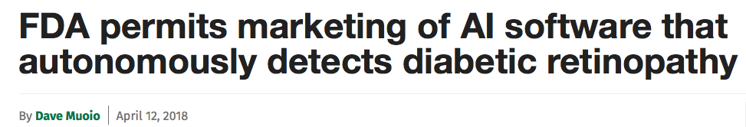
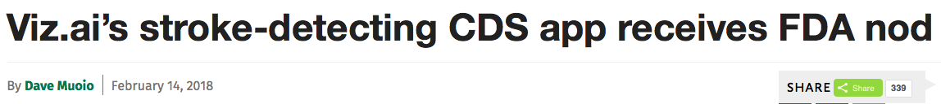
Caveats: regulations for automated DSS
www.mobilehealthnews.com

Slide 32
Conclusions
Big Data for Healthcare are a reality
They have the potential to improve care
There are challenges that should be addressed with multidisciplinary approaches

Slide 33
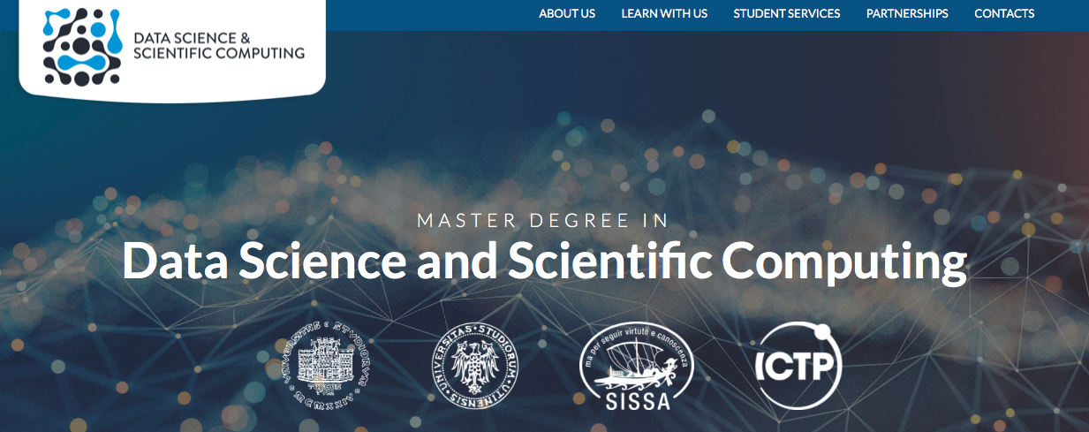
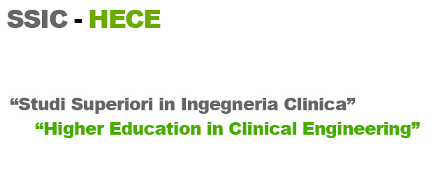
THANK YOU FOR YOUR ATTENTION
smarceglia@units.it
lbortolussi@units.it

