Slide 1
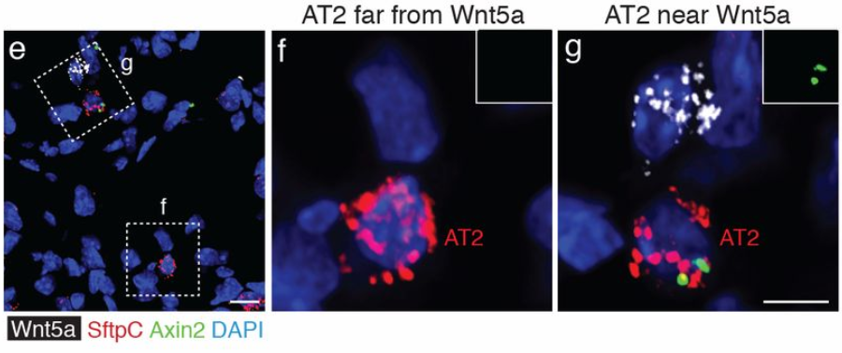
Single-cell Wnt signaling niches maintain stemness of alveolar type 2 cells
v
v
Ahmad Nabhan
Department of Biochemistry, Stanford University
Tushar Desai and Mark Krasnow Labs
Notes:
Names
LabSSS
Title:
20 secs

Slide 2
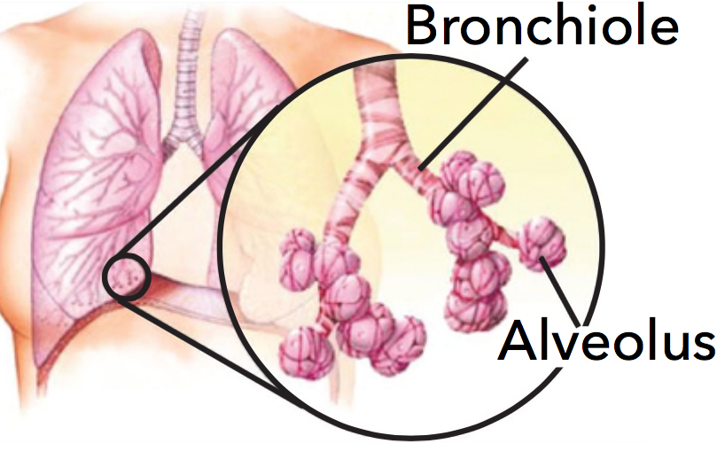
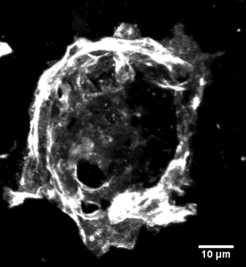
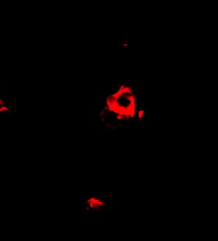
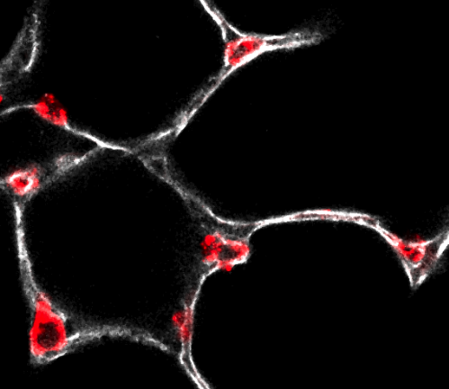
Alveolar type 1 (AT1) and 2 (AT2) cells comprise the alveolar epithelium
AT1
AT2
AT1
Alveolus
Notes:
Alveolar stem cells maintain the alveolar epithelium
Its compromised of
Here’s an image
Beneath this epithelial barrier
1 minute

Slide 3
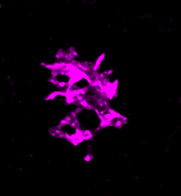
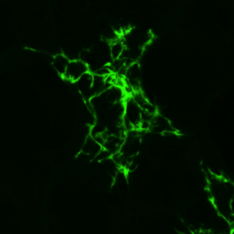
Alveolar type 1 (AT1) and 2 (AT2) cells comprise the alveolar epithelium
Endothelial
Fibroblast
AT1
AT2
AT1
Alveolus
Notes:
Alveolar stem cells maintain the alveolar epithelium
Its compromised of
Here’s an image
Beneath this epithelial barrier
1 minute

Slide 4
Lung stem cell activity: slow…but steady?
Lung stem cell activity slow
Turnover time
days
Years
Notes:
Alveolar stem cells maintain the alveolar epithelium
Its compromised of
Here’s an image
Beneath this epithelial barrier
1 minute

Slide 5
Lung stem cell activity: slow…but steady?
Lung stem cell activity slow
Turnover time
days
Years
Lung stem cell activity is misregulated in many major diseases
Lung cancer
Pulmonary fibrosis
Emphesyma
Notes:
Alveolar stem cells maintain the alveolar epithelium
Its compromised of
Here’s an image
Beneath this epithelial barrier
1 minute

Slide 6
Bifunctional stem cells: a new class of stem cells
Classic stem cells
Bifunctional stem cells
Self renews & gives rise to other
cell types
Dedicated stem cell function
e.g., hematopoietic, intestine, skin, muscle
(tissues with high cell turnover)
Self renews & gives rise to other
cell types
Stem cell &
physiological function
e.g., alveolar stem cell
(tissues with slow cell turnover)
Notes:
point out nature of fixed tissue
The alveolar stem cell performs both of these two functions, BUT, unlike there classical counterparts, alveolar stem cells are in the thick of the physiological function of the tissue while simultaneously serving its progenitor function
Bifunctional stem cells are being observed in other tissues with slow turnover, such as the liver, and so it seems that the system an organ employs depends on its needs high prof>special/dedicated stem cells….tissues with low turn over, need from stem cell function is intermettient and so the stem cells do othe jobs.
So now, before I tell you about our efforts to under the cellular mechanisms and molecular signals regulating these cells, I’ll introduce the tissue where they reside

Slide 7
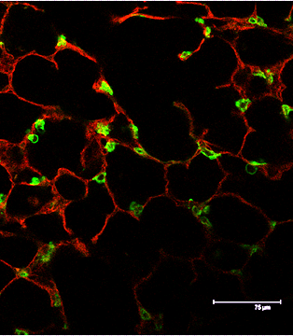
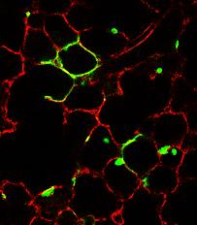
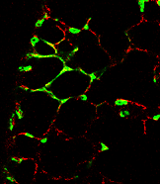
~1% of AT2 cells (called AT2*) act as bifunctional stem cells
AT2 cell lineage trace
AT2*
*
*
*
*
*
*
*
*
1 month
3 months
8 months
Barkauskas (2013) ;Desai et al (2014)
Notes:
Tushar desai, carried out a clonal analysisand again to form these growing renewal foci that highlight the heterogeneity among AT2 cells during aging .
110 sec min

Slide 8
~1% of AT2 cells (called AT2*) act as bifunctional stem cells
AT2 cell lineage trace
AT2*
*
*
*
*
*
*
*
*
1 month
3 months
8 months
AT1
AT2
?
AT2*
AT1
replenishment
AT2* self
renewal
Barkauskas (2013) ;Desai et al (2014)
Notes:
Tushar desai, carried out a clonal analysisand again to form these growing renewal foci that highlight the heterogeneity among AT2 cells during aging .
110 sec min

Slide 9
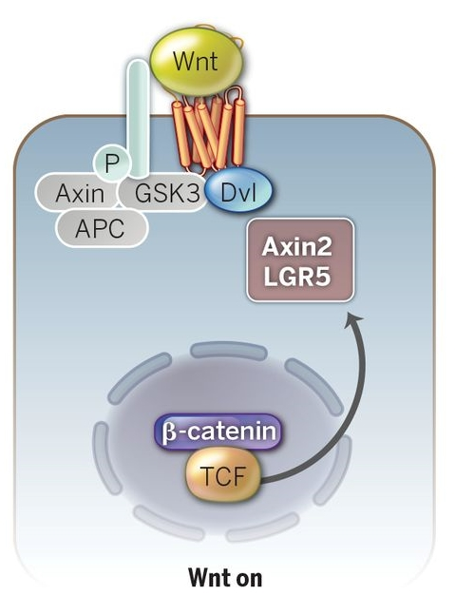
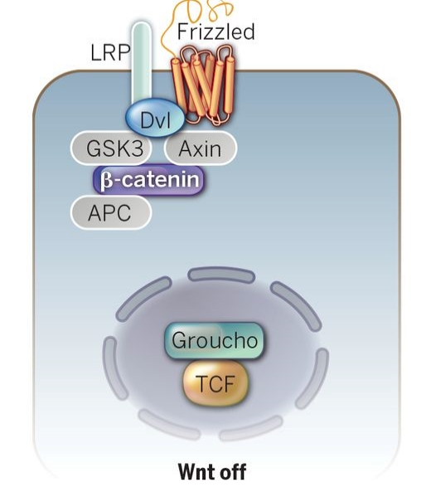
Wnt signaling is an exclusive marker of classic stem cells in adult tissues
Clevers et al., 2015
Notes:
Our attention turned to Wnt pathway activation as a marker of AT2 stem cells, and we were interested in this pathway because: it marks stem cells in other tissues,
Describe Wnt
Ligand, unbound,bound,beta catenin, target genes
Among these is Axin2, which is thought to be a universal target of the Wnt transcriptional program and is used as a proxy for Wnt activation
In classical systems, such as the gut, this marker is exclusive to stem cells and not found in physiologically functional cells.
However, we reasoned that our bifunctional stem cells, will share the expression of stem cells marker along with physiological markers, because they share physiological and stem cell function

Slide 10
Wnt signaling is an exclusive marker of classic stem cells in adult tissues
Do bifunctional stem cells co express physiological and stem cell markers?
Axin2-CreER > GFP
(Wnt pathway reporter
Clevers et al., 2015
Notes:
Our attention turned to Wnt pathway activation as a marker of AT2 stem cells, and we were interested in this pathway because: it marks stem cells in other tissues,
Describe Wnt
Ligand, unbound,bound,beta catenin, target genes
Among these is Axin2, which is thought to be a universal target of the Wnt transcriptional program and is used as a proxy for Wnt activation
In classical systems, such as the gut, this marker is exclusive to stem cells and not found in physiologically functional cells.
However, we reasoned that our bifunctional stem cells, will share the expression of stem cells marker along with physiological markers, because they share physiological and stem cell function

Slide 11
A rare subpopulation of AT2 cells is marked by high Wnt signaling
Axin2 Cre-ER> GFP
“Bulk” AT2 (Axin2 ⁻)
Axin2⁺ AT2
Axin2 Cre-ER> mTmG
Notes:
When we pulse label, Indeed we found that subsets of our AT2 cells expressed Axin2, and in situ and facs quantification revealed that about 1% of total AT2 population was Wnt responsive

Slide 12
A rare subpopulation of AT2 cells is marked by high Wnt signaling
Axin2 Cre-ER> GFP
“Bulk” AT2 (Axin2 ⁻)
Axin2⁺ AT2
Axin2 Cre-ER> mTmG
Notes:
When we pulse label, Indeed we found that subsets of our AT2 cells expressed Axin2, and in situ and facs quantification revealed that about 1% of total AT2 population was Wnt responsive

Slide 13
A rare subpopulation of AT2 cells is marked by high Wnt signaling
Axin2 Cre-ER> GFP
“Bulk” AT2 (Axin2 ⁻)
Axin2⁺ AT2
Axin2 Cre-ER> mTmG
GFP⁺ AT1 cells never observed
Notes:
When we pulse label, Indeed we found that subsets of our AT2 cells expressed Axin2, and in situ and facs quantification revealed that about 1% of total AT2 population was Wnt responsive

Slide 14
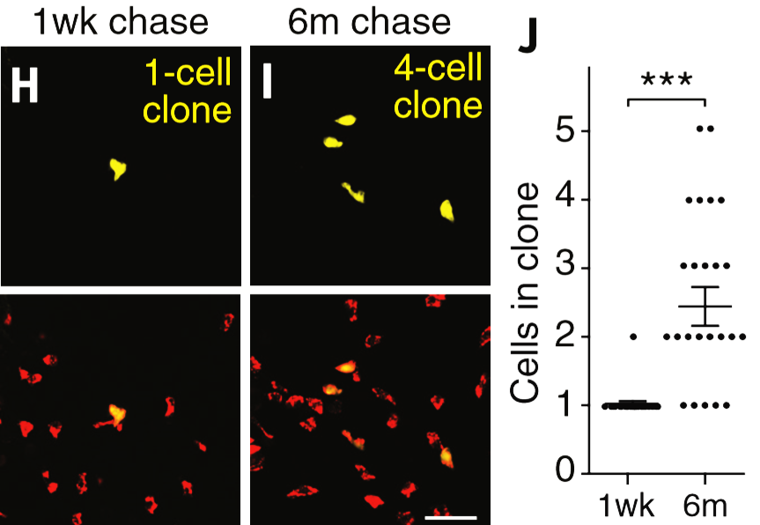
Wnt-active (Axin2⁺) AT2 cells are alveolar stem cells
Clonal expansion
Axin2-CreER>Rainbow
Axin2-CreER>mTmG
Notes:
To determine if this subpopulation exhibits stem cell activity, we first labeled single Axin2+ At2 cells using low doses of tamoxifen and a multicolor reporter
We found that indeed, these clones do expand and proliferate once every 2-3 montsh; remember in general, only 1% of AT2 cells proliferate after a year
We also did this quantification in a different way, were we calculated the % of AT2 cells carrying the axin2 lineage mark and found that over the period of a year the increase as a fraction of the population from 1 to6 %. Meaning they proliferating faster and slowly taking over the lung
Lastly, we co-stained for AT1 markers and found that we now see lineage labeled AT1 cells that are contigious with what we presume to be their parent AT2 cells, indicating that these cells had proliferate and one

Slide 15
Wnt-active (Axin2⁺) AT2 cells are alveolar stem cells
Clonal expansion
Lineage expansion
Axin2-CreER>Rainbow
Axin2-CreER>mTmG
Notes:
To determine if this subpopulation exhibits stem cell activity, we first labeled single Axin2+ At2 cells using low doses of tamoxifen and a multicolor reporter
We found that indeed, these clones do expand and proliferate once every 2-3 montsh; remember in general, only 1% of AT2 cells proliferate after a year
We also did this quantification in a different way, were we calculated the % of AT2 cells carrying the axin2 lineage mark and found that over the period of a year the increase as a fraction of the population from 1 to6 %. Meaning they proliferating faster and slowly taking over the lung
Lastly, we co-stained for AT1 markers and found that we now see lineage labeled AT1 cells that are contigious with what we presume to be their parent AT2 cells, indicating that these cells had proliferate and one

Slide 16
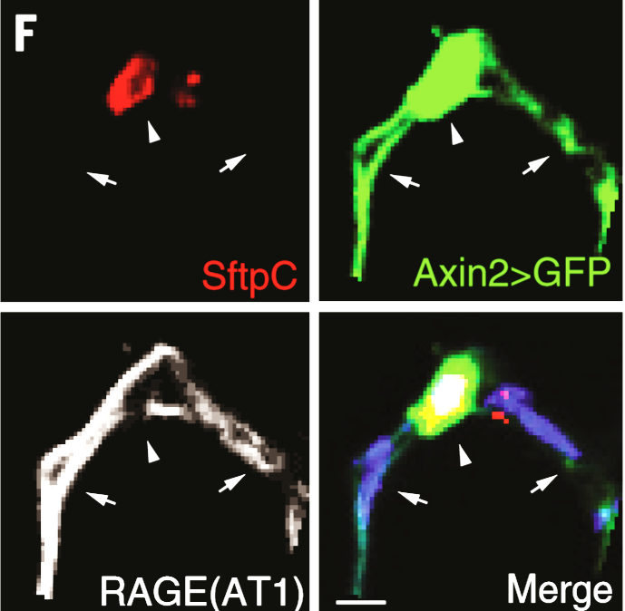
Wnt-active (Axin2⁺) AT2 cells are alveolar stem cells
Clonal expansion
Lineage expansion
AT2 → AT1
Axin2-CreER>Rainbow
Axin2-CreER>mTmG
Notes:
To determine if this subpopulation exhibits stem cell activity, we first labeled single Axin2+ At2 cells using low doses of tamoxifen and a multicolor reporter
We found that indeed, these clones do expand and proliferate once every 2-3 montsh; remember in general, only 1% of AT2 cells proliferate after a year
We also did this quantification in a different way, were we calculated the % of AT2 cells carrying the axin2 lineage mark and found that over the period of a year the increase as a fraction of the population from 1 to6 %. Meaning they proliferating faster and slowly taking over the lung
Lastly, we co-stained for AT1 markers and found that we now see lineage labeled AT1 cells that are contigious with what we presume to be their parent AT2 cells, indicating that these cells had proliferate and one

Slide 17
Wnt signaling marks AT2 stem cells
AT1
AT2
Wnt
AT2*
AT1
replenishment
AT2* self
renewal
Notes:
So now we can begin to refine our model, as we have found a marker for cells that carry out this activity.
This ofcourse raise the immediate question of , where is thWnt ligand coming from? WE know that it has to come from somewhere really close because its membrane bound

Slide 18
AT2* cells lie near single fibroblasts that express a Wnt ligand
Single cell RNAseq shows that a subset of alveolar fibroblasts
express Wnt5a and two other Wnts (Doug Brownfield)
Notes:
Reiterate the ligand has to be really close
Around the time we were thinking about, DB in the lab had begun scRNA sequencing of various cell types in the alveolar epithelium
we found that none of the AT2 cells expressed any of the 18 Wnt ligand genes, thus ruling out an autocrine signaling mechanism
The only cells type we found that had robust Wnt expression in the alveolus were fibroplasts, the had robust expression of 3 Wnt ligand genes, and Wnt5a was the most robustly expressed
To this end we using a new RNA in situ method to to visualize these players, the ligand, AT2 cells and Axin2 expression, and indeed we observed that AT2 cells near a niche cell are enriched
Descirbe image/describe graph
To prove that this associate is causative, we wanted to remove the Wnt emanating from the fibroblasts and see if theres a corresponding depletion of wnt signaling in the AT2 cells .

Slide 19
AT2* cells lie near single fibroblasts that express a Wnt ligand
Single cell RNAseq shows that a subset of alveolar fibroblasts
express Wnt5a and two other Wnts (Doug Brownfield)
Notes:
Reiterate the ligand has to be really close
Around the time we were thinking about, DB in the lab had begun scRNA sequencing of various cell types in the alveolar epithelium
we found that none of the AT2 cells expressed any of the 18 Wnt ligand genes, thus ruling out an autocrine signaling mechanism
The only cells type we found that had robust Wnt expression in the alveolus were fibroplasts, the had robust expression of 3 Wnt ligand genes, and Wnt5a was the most robustly expressed
To this end we using a new RNA in situ method to to visualize these players, the ligand, AT2 cells and Axin2 expression, and indeed we observed that AT2 cells near a niche cell are enriched
Descirbe image/describe graph
To prove that this associate is causative, we wanted to remove the Wnt emanating from the fibroblasts and see if theres a corresponding depletion of wnt signaling in the AT2 cells .

Slide 20
Each AT2 stem cell has a private single cell niche
Genetic inhibition of fibroblast Wnt secretion depletes Axin2⁺ AT2 cells
Notes:
So again this is our model, inhibition of Wnt secretion from these fibroblasts depeletes the Axin2+ AT2 population; thus confirming this hypothesis
So now when we activate Wnt signaling in adult AT2 cells, they don’t just start to proliferate indicating that the mitogentic signals is not Wnt
However, we found that wnt inhibited the differentiation of AT2 cells and inhibiting the signaling pathway was sufficient to promote AT2>AT1 differentiation. So this was our model.

Slide 21
Wnt niche maintains AT2 stem cell identity
Genetic inhibition of fibroblast Wnt secretion depletes Axin2⁺ AT2 cells
What is the consequence of Wnt inhibition?
Notes:
So again this is our model, inhibition of Wnt secretion from these fibroblasts depeletes the Axin2+ AT2 population; thus confirming this hypothesis
So now when we activate Wnt signaling in adult AT2 cells, they don’t just start to proliferate indicating that the mitogentic signals is not Wnt
However, we found that wnt inhibited the differentiation of AT2 cells and inhibiting the signaling pathway was sufficient to promote AT2>AT1 differentiation. So this was our model.

Slide 22
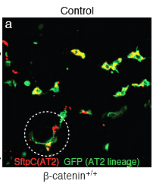
Wnt actively maintains AT2 (stem) cell state
AT2-Cre > GFP

Slide 23
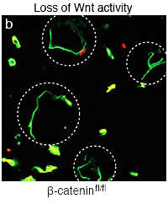
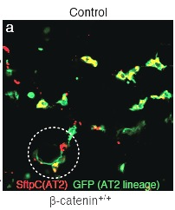
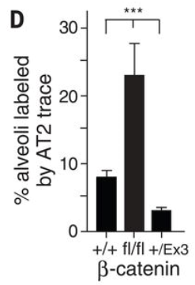
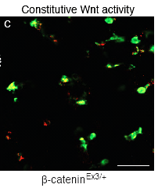
Wnt actively maintains AT2 (stem) cell state
Inhibit Wnt
AT2-Cre > GFP
Activate Wnt

Slide 24
Wnt niche maintains AT2 stem cell identity
Genetic inhibition of fibroblast Wnt secretion depletes Axin2⁺ AT2 cells
Inhibition of Wnt signaling promoted differentiation of AT2 cells
Activation of Wnt signaling in AT2 cells inhibited AT2→AT1 but did not induce proliferation
Notes:
So again this is our model, inhibition of Wnt secretion from these fibroblasts depeletes the Axin2+ AT2 population; thus confirming this hypothesis
So now when we activate Wnt signaling in adult AT2 cells, they don’t just start to proliferate indicating that the mitogentic signals is not Wnt
However, we found that wnt inhibited the differentiation of AT2 cells and inhibiting the signaling pathway was sufficient to promote AT2>AT1 differentiation. So this was our model.

Slide 25
Wnt niche maintains AT2 stem cell identity
Genetic inhibition of fibroblast Wnt secretion depletes Axin2⁺ AT2 cells
Inhibition of Wnt signaling promoted differentiation of AT2 cells
Activation of Wnt signaling in AT2 cells inhibited AT2→AT1 but did not induce proliferation
Notes:
So again this is our model, inhibition of Wnt secretion from these fibroblasts depeletes the Axin2+ AT2 population; thus confirming this hypothesis
So now when we activate Wnt signaling in adult AT2 cells, they don’t just start to proliferate indicating that the mitogentic signals is not Wnt
However, we found that wnt inhibited the differentiation of AT2 cells and inhibiting the signaling pathway was sufficient to promote AT2>AT1 differentiation. So this was our model.

Slide 26
Alveolar regeneration: more of the same?
Aging
Injury
???
Hierarchal
Spatially restricted
Axin2⁺
fibroblast niche
Does the same Axin2⁺ population carry out revolution?
Notes:
So again this is our model, inhibition of Wnt secretion from these fibroblasts depeletes the Axin2+ AT2 population; thus confirming this hypothesis
So now when we activate Wnt signaling in adult AT2 cells, they don’t just start to proliferate indicating that the mitogentic signals is not Wnt
However, we found that wnt inhibited the differentiation of AT2 cells and inhibiting the signaling pathway was sufficient to promote AT2>AT1 differentiation. So this was our model.

Slide 27
Genetic ablation of alveolar epithelium
Shh Cre → LSL-Diptheria toxin receptor
150ng DT
Time after DT injection
Notes:
So. Q#2 ; what is Wnt doing?
During homeostasis , alveolar stem cell activity is rare and transient, so a genetic injury is use to induce robust, synchronized AT2 stem cells activity.
This raised several questions:
Which cells?
Does Wnt also mark stem cells?
Is Wnt also important?
Ancillary stem cells are recruited during acute injury. They are also Wnt+.
During injury, Wnt signaling is expanded in ancillary stem cells and is required for ancillary recruitment.
Activation of Wnt signaling inhibited differentiated but did NOT induce proliferation.

Slide 28
Wnt inhibition disrupts alveolar regeneration
Shh Cre → LSL-Diptheria toxin receptor
150ng DT
Time after DT injection
Notes:
So. Q#2 ; what is Wnt doing?
During homeostasis , alveolar stem cell activity is rare and transient, so a genetic injury is use to induce robust, synchronized AT2 stem cells activity.
This raised several questions:
Which cells?
Does Wnt also mark stem cells?
Is Wnt also important?
Ancillary stem cells are recruited during acute injury. They are also Wnt+.
During injury, Wnt signaling is expanded in ancillary stem cells and is required for ancillary recruitment.
Activation of Wnt signaling inhibited differentiated but did NOT induce proliferation.

Slide 29
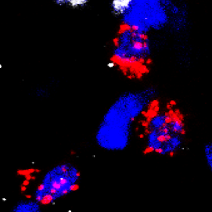
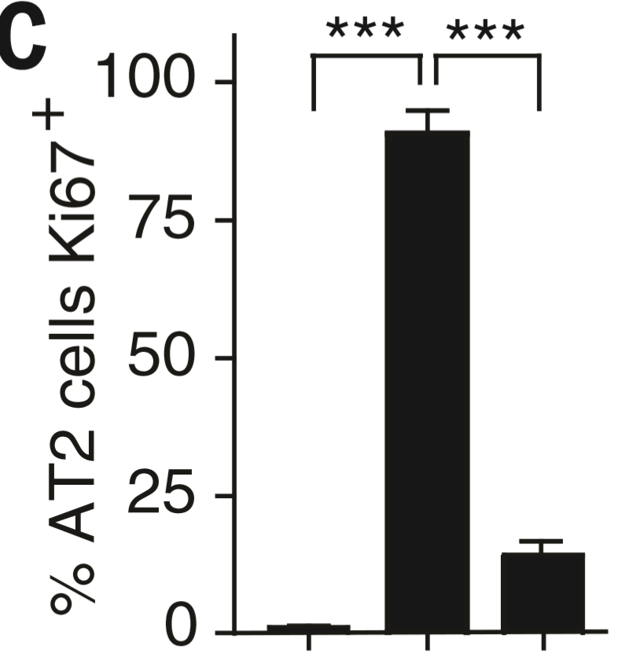
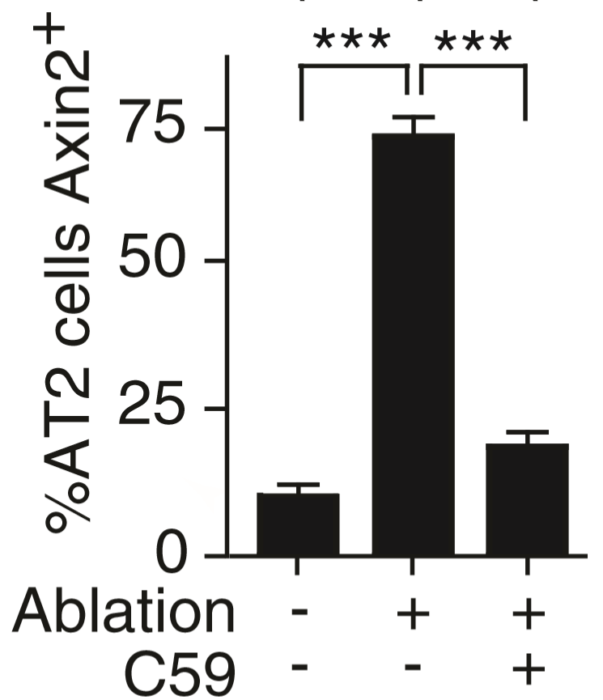
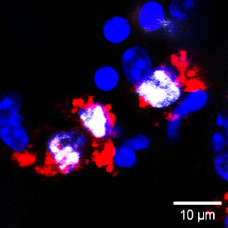
Queisent AT2 cells are recruited during injury as “emergency stem cell”
Recruitment of
quiescent AT2 cells
Induction of Wnt
quiescent AT2 cells
% AT2 cells Ki67⁺
Notes:
So. Q#2 ; what is Wnt doing?
During homeostasis , alveolar stem cell activity is rare and transient, so a genetic injury is use to induce robust, synchronized AT2 stem cells activity.
This raised several questions:
Which cells?
Does Wnt also mark stem cells?
Is Wnt also important?
Ancillary stem cells are recruited during acute injury. They are also Wnt+.
During injury, Wnt signaling is expanded in ancillary stem cells and is required for ancillary recruitment.
Activation of Wnt signaling inhibited differentiated but did NOT induce proliferation.

Slide 30
Wnt inhibition disrupts alveolar regeneration
Shh Cre → LSL-Diptheria toxin receptor
150ng DT
Time after DT injection
Notes:
So. Q#2 ; what is Wnt doing?
During homeostasis , alveolar stem cell activity is rare and transient, so a genetic injury is use to induce robust, synchronized AT2 stem cells activity.
This raised several questions:
Which cells?
Does Wnt also mark stem cells?
Is Wnt also important?
Ancillary stem cells are recruited during acute injury. They are also Wnt+.
During injury, Wnt signaling is expanded in ancillary stem cells and is required for ancillary recruitment.
Activation of Wnt signaling inhibited differentiated but did NOT induce proliferation.

Slide 31
Where does the extra Wnt come from
Wnt secretion from the fibroblast niche does not change
Notes:
So. Q#2 ; what is Wnt doing?
During homeostasis , alveolar stem cell activity is rare and transient, so a genetic injury is use to induce robust, synchronized AT2 stem cells activity.
This raised several questions:
Which cells?
Does Wnt also mark stem cells?
Is Wnt also important?
Ancillary stem cells are recruited during acute injury. They are also Wnt+.
During injury, Wnt signaling is expanded in ancillary stem cells and is required for ancillary recruitment.
Activation of Wnt signaling inhibited differentiated but did NOT induce proliferation.

Slide 32
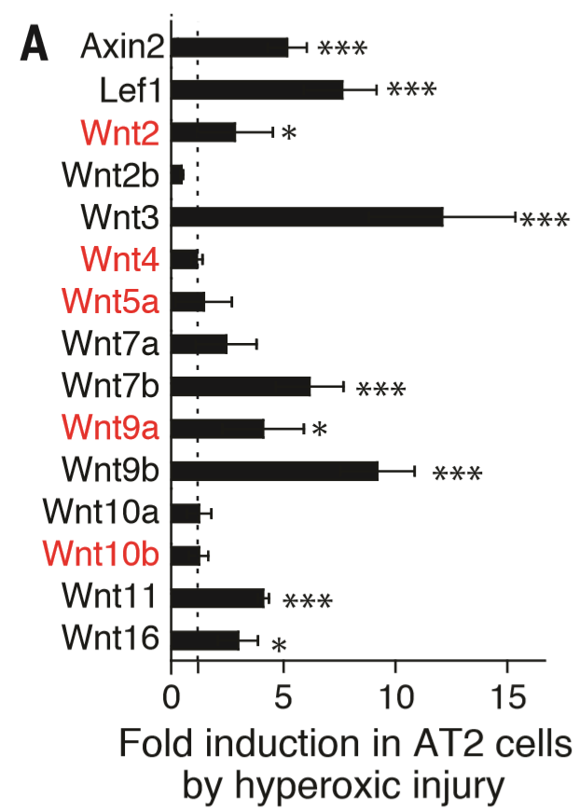
Acute injury induces autocrine Wnt expression in “bulk” AT2 cells
Wnt secretion from the fibroblast niche does not change
Autocrine Wnts induced
Notes:
So. Q#2 ; what is Wnt doing?
During homeostasis , alveolar stem cell activity is rare and transient, so a genetic injury is use to induce robust, synchronized AT2 stem cells activity.
This raised several questions:
Which cells?
Does Wnt also mark stem cells?
Is Wnt also important?
Ancillary stem cells are recruited during acute injury. They are also Wnt+.
During injury, Wnt signaling is expanded in ancillary stem cells and is required for ancillary recruitment.
Activation of Wnt signaling inhibited differentiated but did NOT induce proliferation.

Slide 33
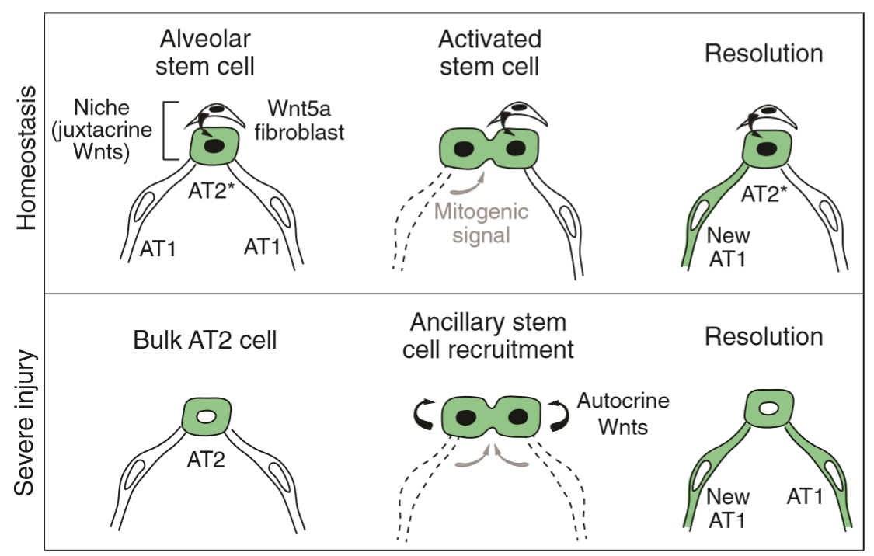
Wnt signaling confers “stemness” on mature AT2 cells
Notes:
Write out full citation

Slide 34
Acknowledgments
Desai Lab
Monica Nagendraan
Andres Anadalon
Yana Kazadaeva
Andres Andruska
Nick Juul
Krasnow Lab
Doug Brownfield
Stephen Chang
Alex Diaz
Hernan Espinoza
Astrid Gilich
Avin Veerakumar
Yin Liu
Peng Li
Joe Oudah
Kyle Traviglini
Nusse Lab
Cati logan
Harbury lab
Dan Riordan
Nabhan et al. Science. Feb 1st 2018
CMB training grant

