Slide 1
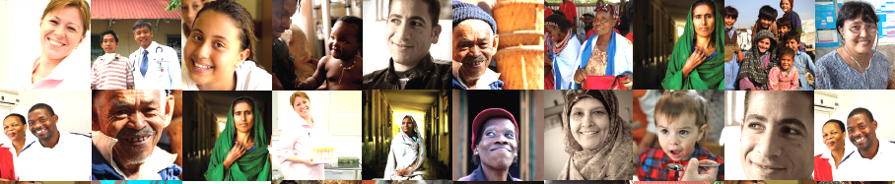


Situazione globale della tubercolosi,
e strategie e politiche internazionali per la lotta
Mario C. Raviglione
Global Health
Lunedi’ 16 Aprile 2018

Slide 2

Overview
Burden of TB, TB/HIV, MDR-TB
Impact of interventions, progress in control and care, and challenges
The End TB Strategy in the SDG era
The politics of ending TB in an unprecedented era of visibility and momentum
Situazione globale della tubercolosi,
e strategie e politiche internazionali per la lotta

Slide 3
Overview
Burden of TB, TB/HIV, MDR-TB
Impact of interventions, progress in control and care, and challenges
The End TB Strategy in the SDG era
The politics of ending TB in an unprecedented era of visibility and momentum
Situazione globale della tubercolosi,
e strategie e politiche internazionali per la lotta

Slide 4
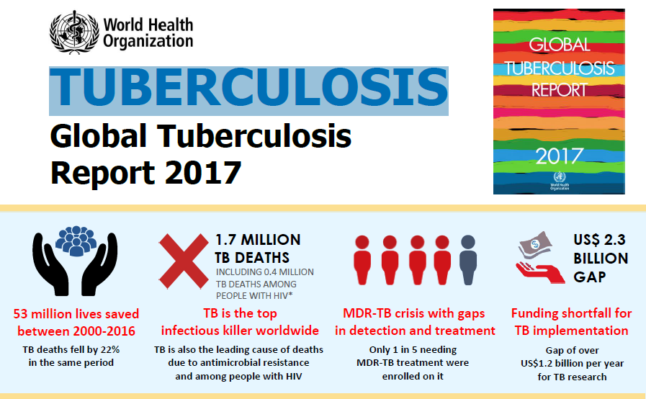


Slide 5

The Global Burden of TB, latest estimates 2016
Estimated number
of cases
Estimated number
of deaths
10.4 million
140 per 100,000
  6.7 million males
  3.7 million females
  1.4 million children
1.7 million*
1,070,000 in males
601,000 in women
253,000 in children
All forms of TB
HIV-associated TB
1 million (10%)
374,000
Multidrug-resistant TB
MDR/RR
490,000 (4.1% of new cases)
600,000 (incl. RR-TB)
240,000
Source: WHO Global TB Report 2017 * Including deaths attributed to HIV/TB

Slide 6
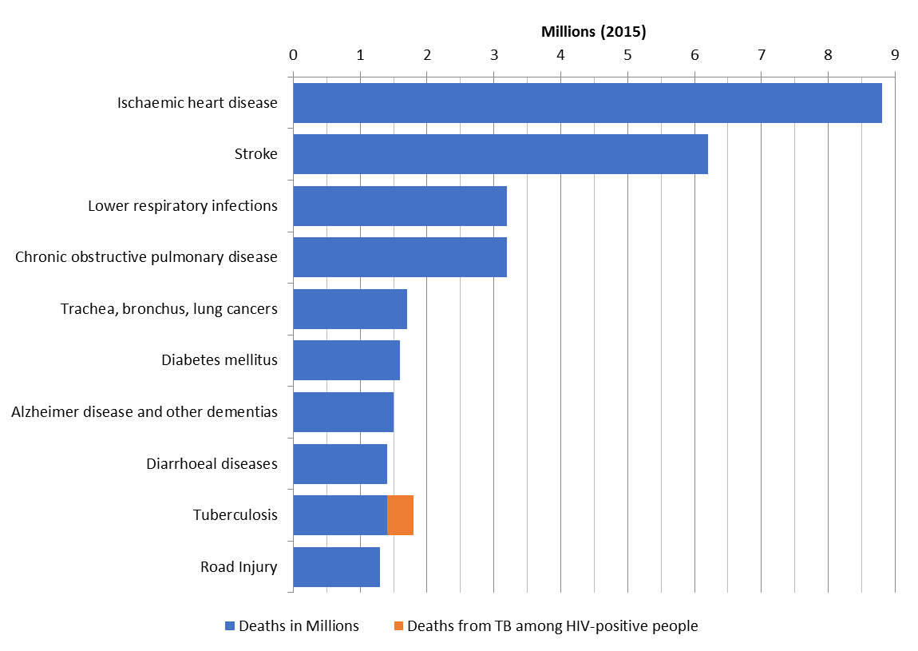
TB is one of the top 10 causes of death worldwide
Ranks 9th, the to infectious disease killer

Slide 7
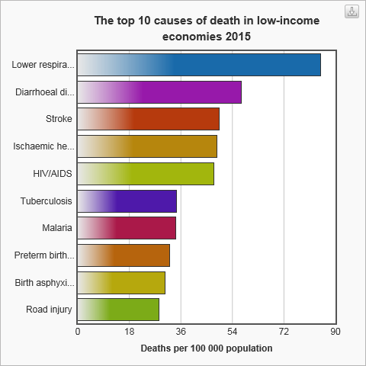
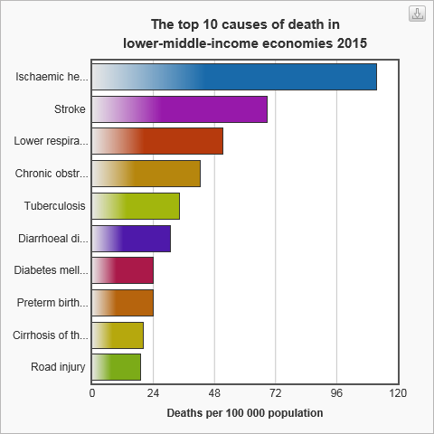
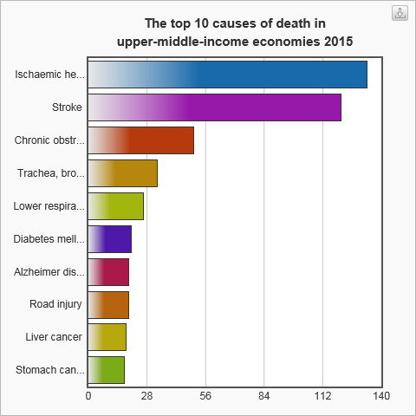
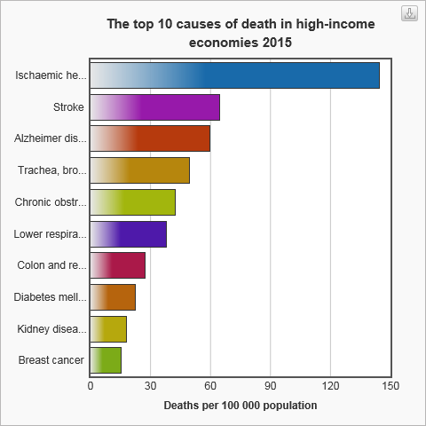

Causes of death by different income level 2015
Notes:
Income group: Economies are divided according to 2012 GNI per capita, calculated using the World Bank Atlas method. The groups are: low income, $1,035 or less; lower middle income, $1,036 - $4,085; upper middle income, $4,086 - $12,615; and high income,$12,616 or more.

Slide 8
TB is in every country
Highest incidence rates in Africa and parts of Asia
Incidence per
100 000 /year
45% South-East Asia
25% Africa
17% Western Pacific
7% Eastern Mediterranean
3% Americas
3% Europe

Slide 9
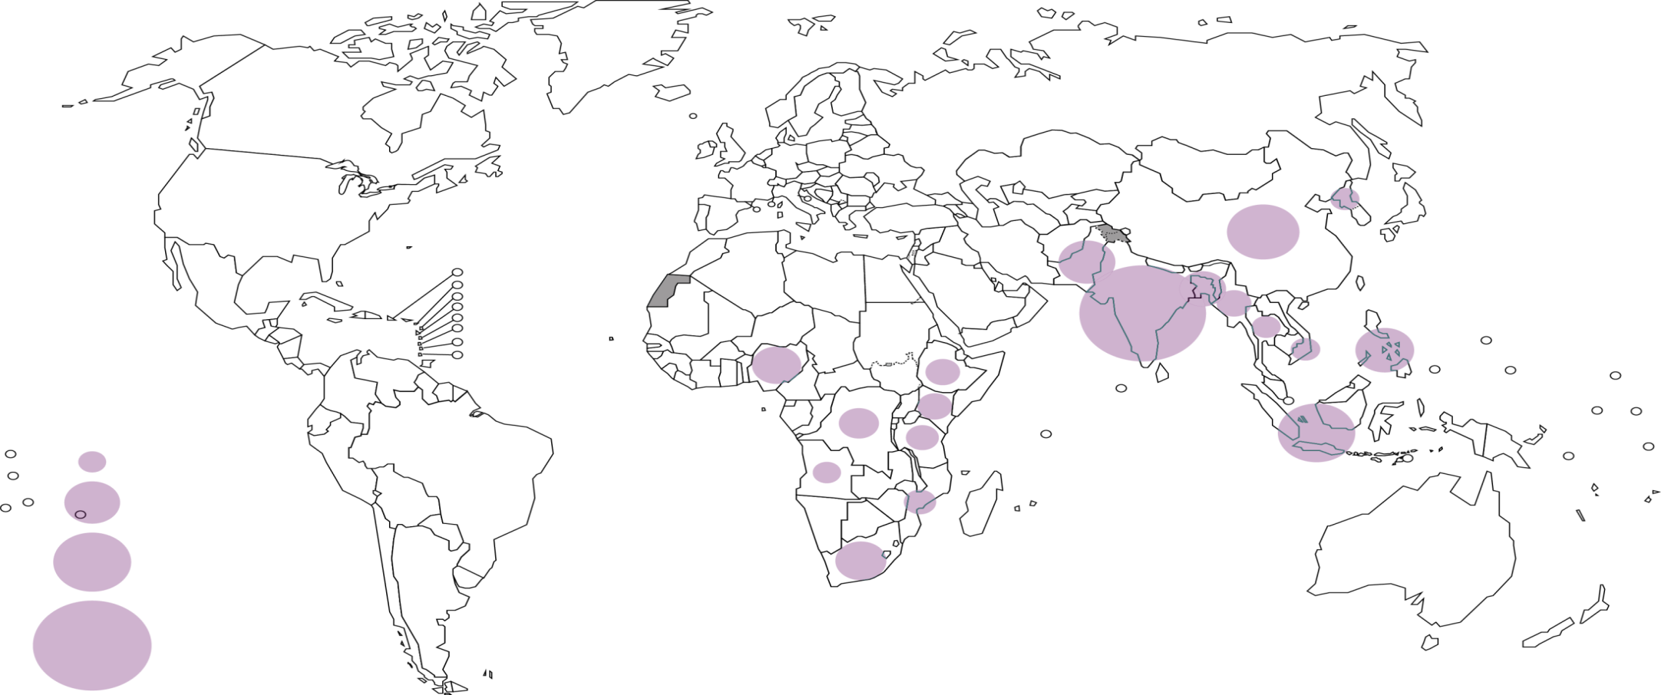
5 countries = 56% of cases in 2016
7 countries account for 64%
China
Pakistan
Nigeria
India
Philippines
Number of
incident cases
Indonesia
100 000
500 000
1 000 000
South Africa
2 500 000
circles shown for countries with at least 100,000 incident cases in 2016

Slide 10
Drug-resistant TB in every country (n=160 measured so far)
Globally: 490,000 new cases of MDR-TB and 110,000 of rifampicin-resistant TB
Highest % (35%) in former USSR countries
0-2.9
3-5.9
6-11.9
12-17.9
>18
% new TB cases with MDR/RR-TB

Slide 11

MDR/RR-TB: 3 countries, 47% cases
Russian Federation
China
India
Number of incident cases
1000
10 000
100 000
150 000
circles shown for countries with at least 1000 incident cases in 2016

Slide 12
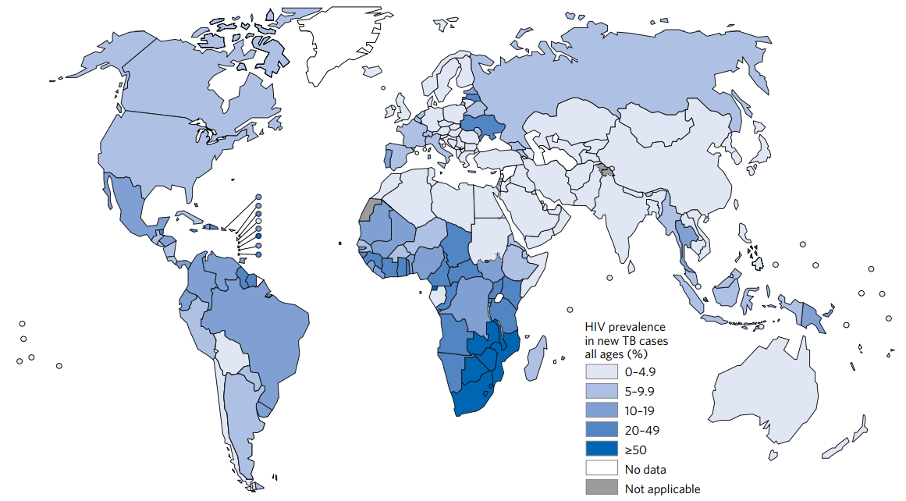
TB/HIV burden: largest in Africa
Estimated HIV prevalence in new TB cases, 2016
74% of TB/HIV cases
are in Africa
Ref: Global TB Control Report 2017

Slide 13
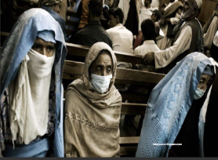
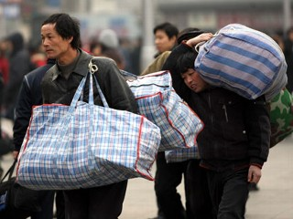
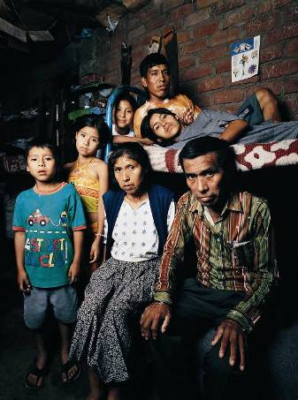
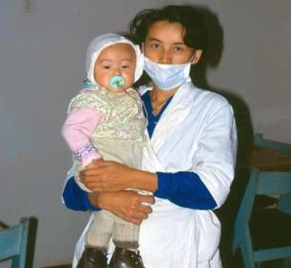
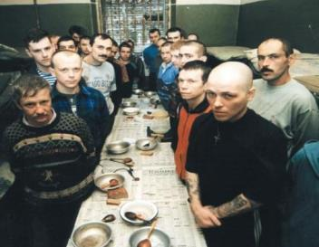
Who carries the burden of tuberculosis?
…mostly, the most vulnerable
TB spreads in poor, crowded & poorly ventilated settings
Half a million women and 250,000 children died of TB in 2016; 10 million “TB” orphans
Migrants, refugees, prisoners, ethnic minorities face risks, discrimination & barriers to care
TB linked to HIV infection, malnutrition, alcohol, drug and tobacco use, diabetes

Slide 14
Population attributable fraction:
Selected Risk Factors & Determinants
 | Relative risk for active TB disease | Weighted prevalence (22 HBCs) | Population Attributable Fraction in Adults
HIV infection | 20.6/26.7* | 1.1% | 19%
Malnutrition | 3.2** | 16.5% | 27%
Diabetes | 3.1 | 3.4% | 6%
Alcohol use (>40g / d) | 2.9 | 7.9% | 13%
Active smoking | 2.6 | 18.2% | 23%
Indoor Air Pollution | 1.5 | 71.1% | 26%
Sources: Lönnroth K, Raviglione M. Global Epidemiology of Tuberculosis: Prospects for Control. Semin Respir Crit Care Med 2008; 29: 481-491. *Updated data in GTR 2009. RR=26.7 used for countries with HIV <1%. **Updated data from Lönnroth et al. A consistent log-linear relationship between tuberculosis incidence and body-mass index.

Slide 15
Overview
Burden of TB, TB/HIV, MDR-TB
Impact of interventions, progress in control and care, and challenges
The End TB Strategy in the SDG era
The politics of ending TB in an unprecedented era of visibility and momentum
Situazione globale della tubercolosi,
e strategie e politiche internazionali per la lotta

Slide 16
Data sources, TB burden estimates
TB incidence
TB mortality
VR, WHO (n=111)
VR, IHME (n=18)
57%
Indirect (n=88)
Case notifications, standard adjustment
(n=134, 15% burden)
Drug-resistant TB
Prevalence survey (n=24, 68% burden)
Case notifications, expert opinion
(n=54, 17% burden)
Capture-recapture study
(n=5, 0.5% burden)
Surveillance (n=90)
Surveys (n=60)

Slide 17
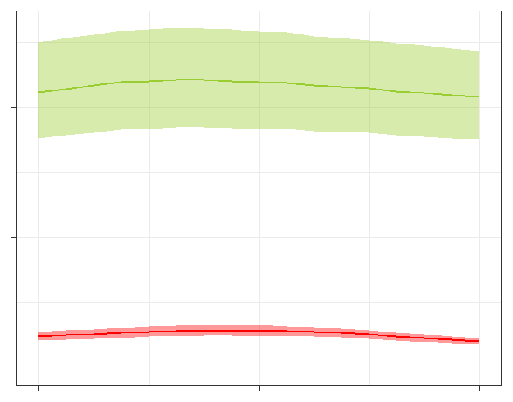
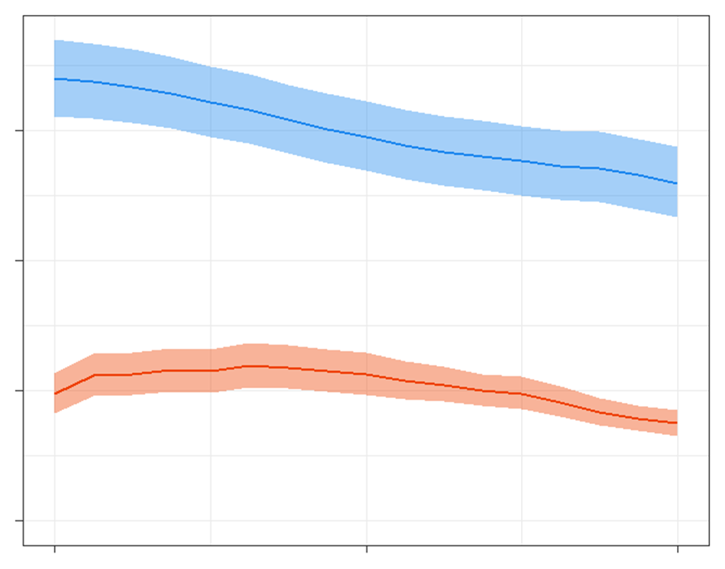
Estimates of TB disease burden 2000–2016
TB incidence
Peak of the epidemic
TB deaths
2
1.7
10.4
HIV-negative
1.3
10
Millions
Total
1
5
0.5
HIV-positive
0.4
HIV-positive (10% in 2016)
1.0
0
0
2000 2008 2016
2000 2008 2016
Incidence rate falling at about 2% per year
Mortality rate falling at about 3% per year

Slide 18
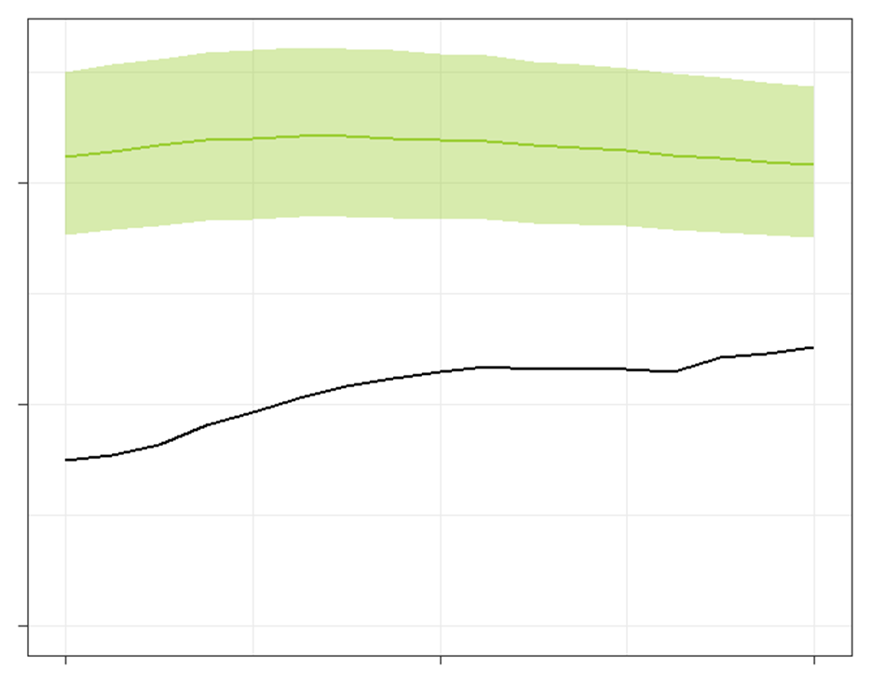
Case notifications increasing but large incidence: notification gap
Number of cases globally (millions)
Incidence
10.4
10
4.1 million cases
Underreporting, under-diagnosis
6.3
5
Case notifications
(61% of incidence in 2016)
Treatment success 83% globally in 2015, as in 2014
0
2000 2008 2016

Slide 19
Drug-resistant TB: treatment enrolments and gaps
Treatment success 54% in 2014, up from 52% in 2013
Number of cases globally
Incidence
600,000
TB
detection
400,000
MDR/RR-TB cases among notified TB patients (350,000)
DST
200,000
Detected
Enrolled on treatment
130,000 in 2016, 126,000 in 2015
0
2009 2010 2011 2012 2013 2014 2015 2016
Notes:
DST coverage in 2016 33% new (up from 25% in 2015), 60% previously treated (up from 53% in 2015), 39% overall (up from 31%).

Slide 20
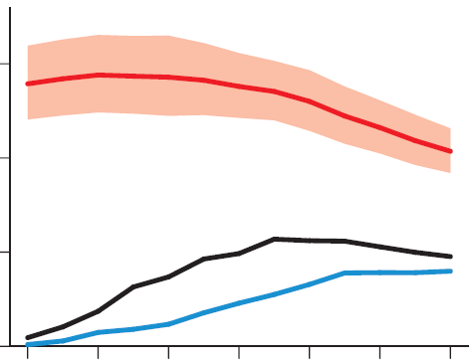
Global gaps in coverage of ART for
HIV-positive TB patients
Number of cases globally (millions)
TB incidence among people living with HIV
(74% in Africa)
1.5
1.0
TB detection, HIV testing
Notified TB patients known to be HIV-positive
(46% of incidence in 2016)
0.5
ART coverage
On ART
(85% of notified in 2016)
0
2004 2006 2008 2010 2012 2014 2016
Treatment success: 78% in 2015, up from 75% in 2014
Notes:
HIV testing, increased to 57% in 2016, up from 55% in 2015; in Africa, increase was from 81% in 2015 to 82% in 2016.

Slide 21
Overview
Burden of TB, TB/HIV, MDR-TB
Impact of interventions, progress in control and care, and challenges
The End TB Strategy in the SDG era
The politics of ending TB in an unprecedented era of visibility and momentum
Situazione globale della tubercolosi,
e strategie e politiche internazionali per la lotta

Slide 22
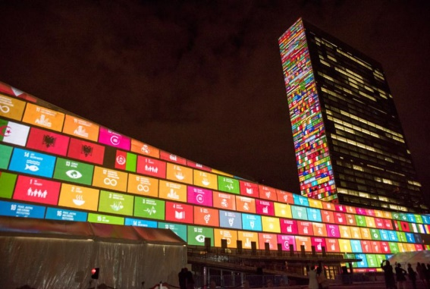
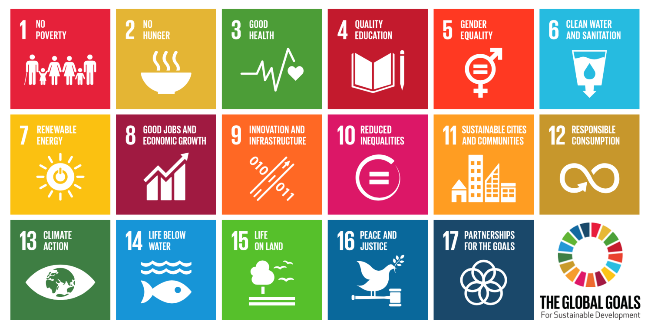

A new era with new ambitions
and a paradigm shift
UN Sustainable Development Goals: 2016 – 2030
17 goals and 169 targets
“Ensuring healthy lives and promote well-being for all at all ages”

Slide 23

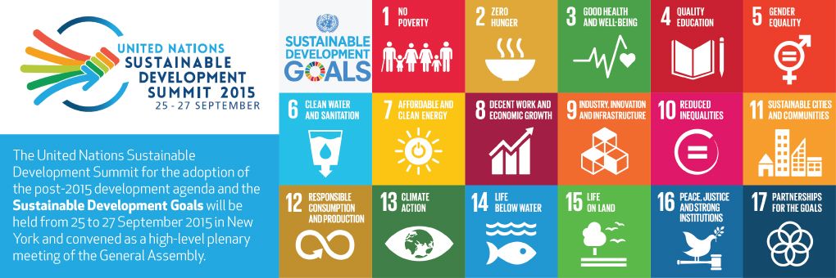


The opportunity of the SDG era
to reach the end TB targets
SDG Target 3.3 – BY 2030
end the TB epidemic

Slide 24
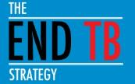
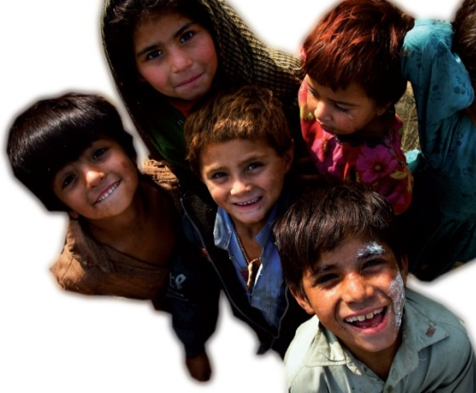
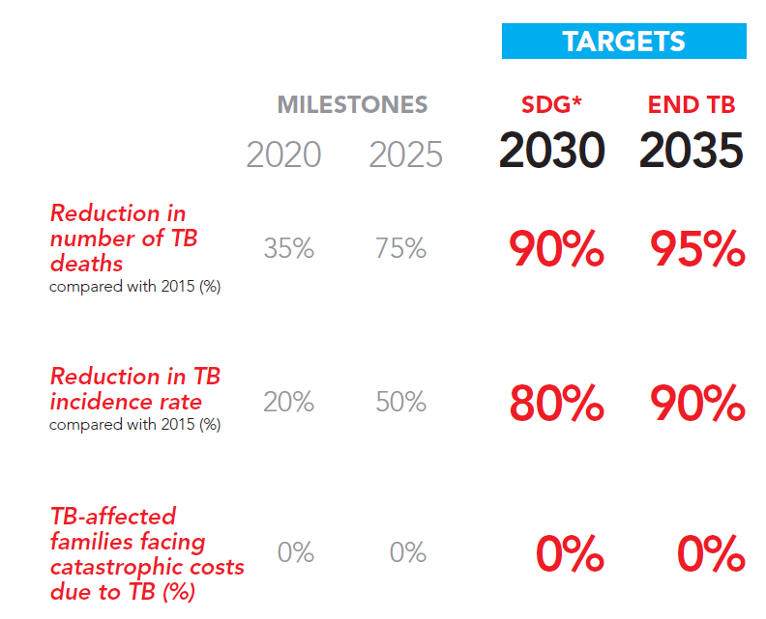
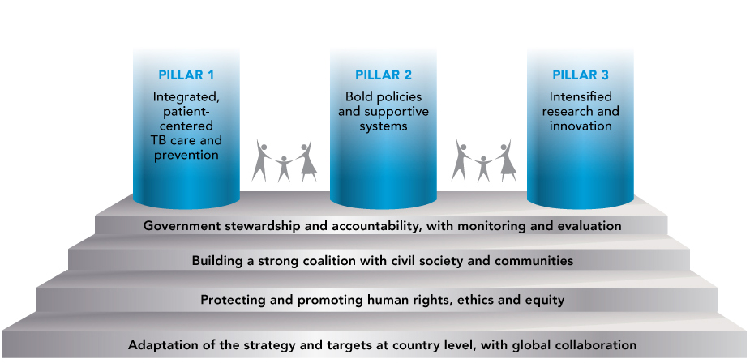
The End TB Strategy:
Vision, Targets and Pillars
Vision:
A world free of TB
Zero TB deaths, Zero TB disease, and Zero TB suffering
Goal:
End the Global TB epidemic

Slide 25
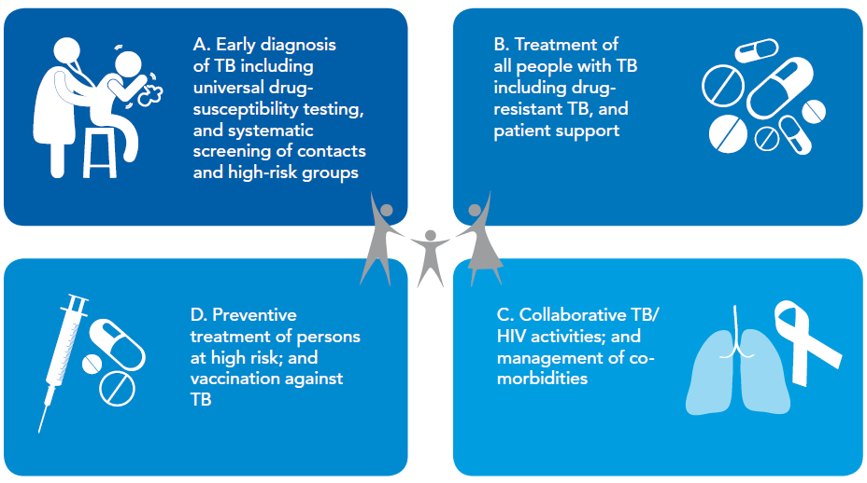
PILLAR 1: INTEGRATED, PATIENT-CENTRED CARE AND PREVENTION

Slide 26



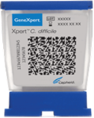
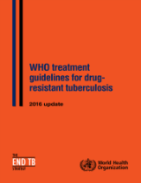
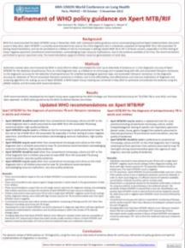
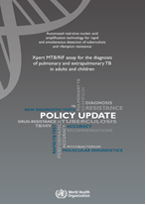
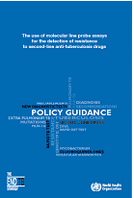
Precision in TB diagnosis and treatment possible in 2018
TREATMENT FOR DRUG SUSCEPTIBLE TB: 6HRZE or NEW Rx (?BNiMZ)
STANDARDIZED SHORTER 9-12 month
MDR-TB REGIMEN
4-6 Km-M-Pto-Cfz-Z-Hhd-E / 5 M-Cfz-Z-E
or NEW Rx (?BNiMZ)
DIAGNOSIS
NEGATIVE
NEGATIVE (MDR-TB)
POSITIVE
RESISTANCE TO
FLUOROQUINOLONES
A/O INJECTABLES
R-RESISTANT TB
First-line Rapid diagnostic
Xpert MTB/RIF
Second-line Line Probe Assay
POSITIVE (pre- or XDR-TB
TAILORED 18-24 month
MDR-TB REGIMENS
OR NEW REGIMENS (?BPaL)

Slide 27
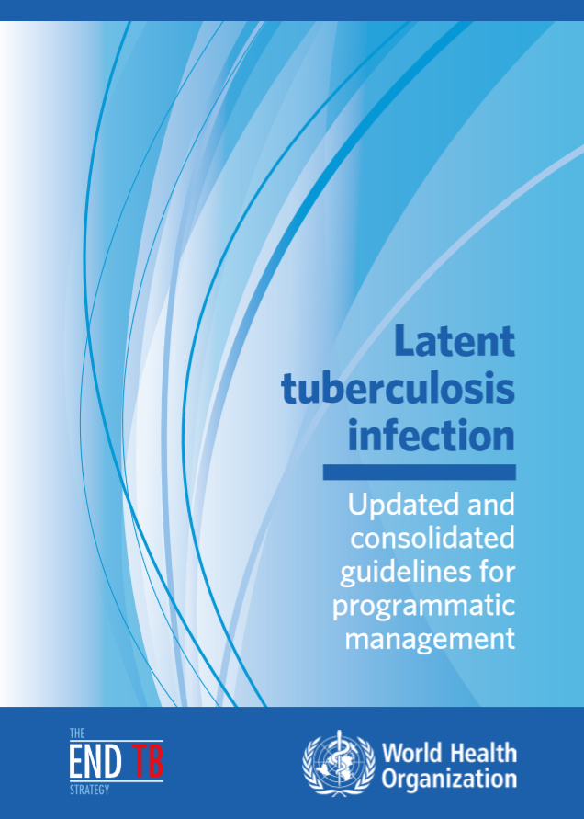
Latent TB infection – WHO guidelines 2018
All PLHIV with +/unknown TST
HIV-negative household contacts
Additional: test and treat anti-TNF, dialysis, pre-transplant, silicosis
Low incidence countries: consider in prisoners, HCW, migrants, homeless, illicit drug users
Screening: clinical (cough, fever, weight loss, night sweats) to rule-out TB, including CXR for PLHIV
TST or IGRA, but not a requirement
Treatment options: 6H, 3-4R, 3HR, 3HPw
Notes:
The natural history of tuberculosis begins with acquisition of infection through the inhalation of Mycobacterium tuberculosis organisms which undergo a period of bacterial replication and dissemination followed by immunological containment of viable bacilli. The result of this process is asymptomatic latent tuberculosis infection.
Currently it is not possible to directly diagnose M. tuberculosis infection in humans, and therefore latent tuberculosis infection is diagnosed by response to in-vivo or in-vitro stimulation by M. tuberculosis antigens using the tuberculin skin test or interferon-gamma release assays

Slide 28
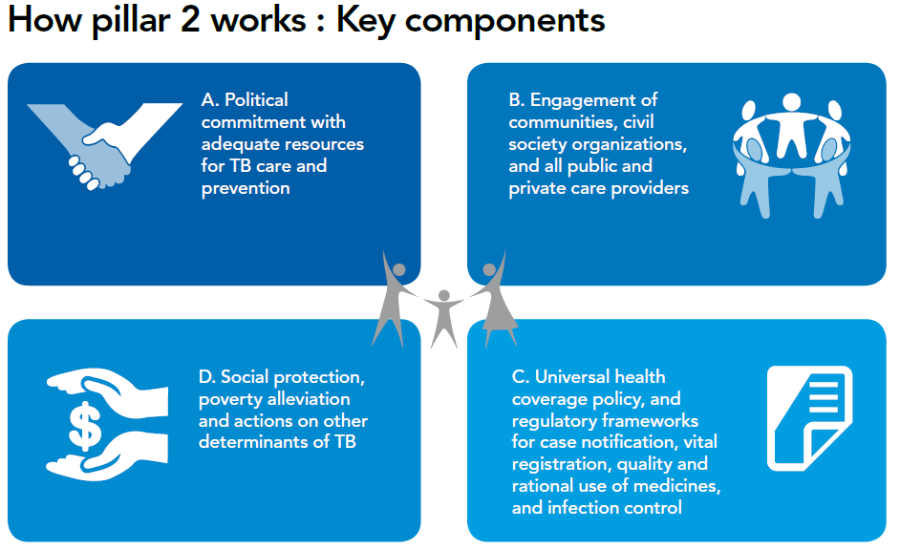
PILLAR 2: BOLD POLICIES AND SUPPORTIVE SYSTEMS

Slide 29
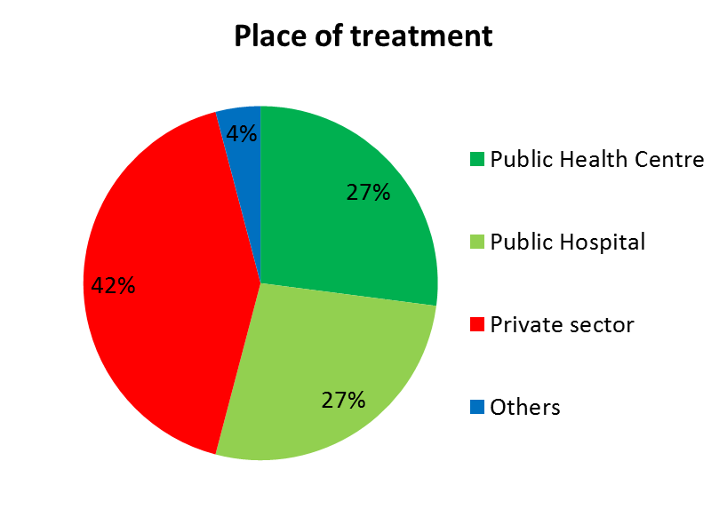
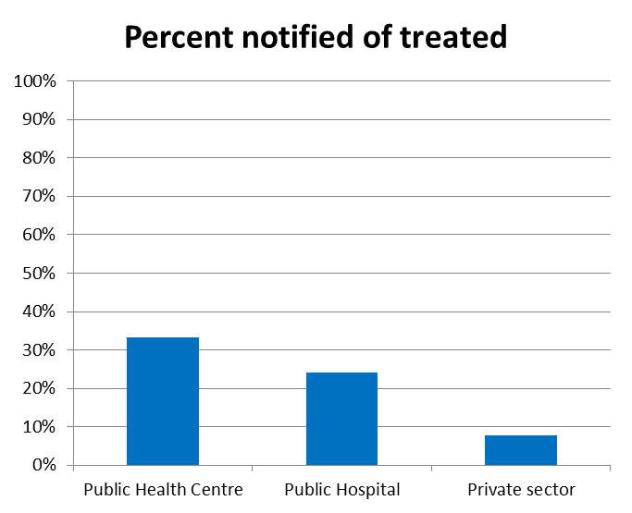
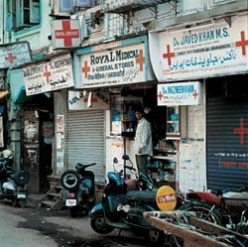
Indonesia prevalence survey 2014
and in India….

Slide 30
Composition of TB related costs, on average
Before treatment
50% of total costs
During treatment
50% of total costs
Direct medical
Direct non-medical
Indirect
Source: Tanimura T, Jaramillo E, Weil D, Raviglione M, Lönnroth K. Financial burden for tuberculosis patients in low- and middle-income countries – a systematic review. ERJ 2014.

Slide 31
Composition of TB related costs, on average
Before treatment
50% of total costs
During treatment
50% of total costs
UHC
Source: Tanimura T, Jaramillo E, Weil D, Raviglione M, Lönnroth K. Financial burden for tuberculosis patients in low- and middle-income countries – a systematic review. ERJ 2014

Slide 32
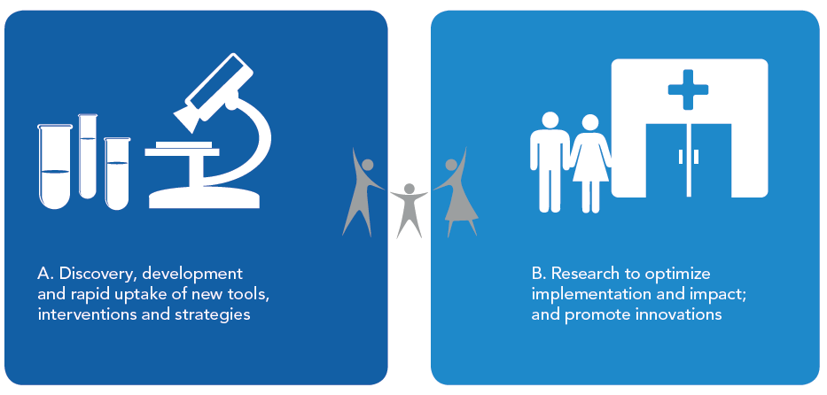
PILLAR 3: INTENSIFIED RESEARCH AND INNOVATION

Slide 33
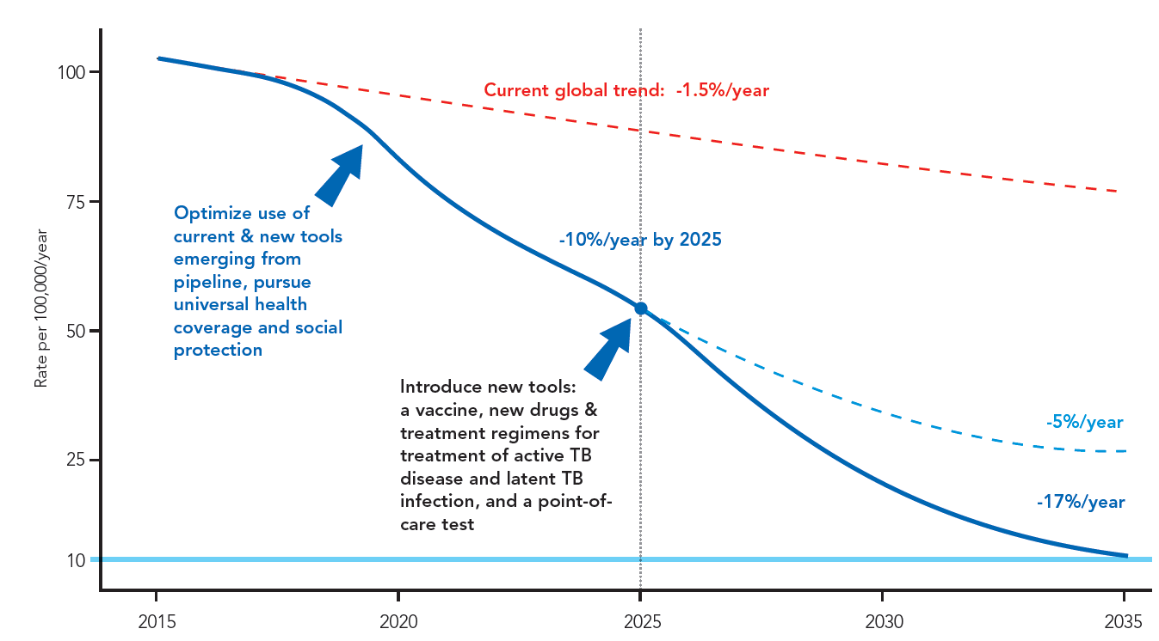
Innovations and Research are critical to break the trajectory of the TB epidemic
Better diagnostics, including new point-of care tests;
Safer, easier and shorter treatment regimens for disease and latent TB infection;
Effective pre- and post-exposure vaccines.
All technological and system innovations possible
Notes:
The 10% per year fall in incidence that is needed by 2025 has been previously achieved only within the wider context of UHC and broader social and economic development. UHC means providing all people with access to needed services of sufficient quality to be effective, without their use imposing financial hardship. Progress in the countries with the highest burden today, such as China, India, Indonesia, Nigeria and South Africa will strongly influence whether targets can be achieved or not. To lower cases to 10 per 100,0000 population by 2035 ("end the global TB epidemic") and achieve a 95% reduction in TB deaths by 2035 will need a technological breakthrough by 2025 that will allow an unprecedented acceleration in the rate at which TB incidence falls between 2025 and 2035. This will only happen with substantial investment in R&D in the years up to 2025, so that new tools such as a post-exposure vaccine or a short, efficacious and safe treatment for latent infection that could substantially lower the risk of developing TB among the approximately 2 billion people that are already infected, are developed.

Slide 34
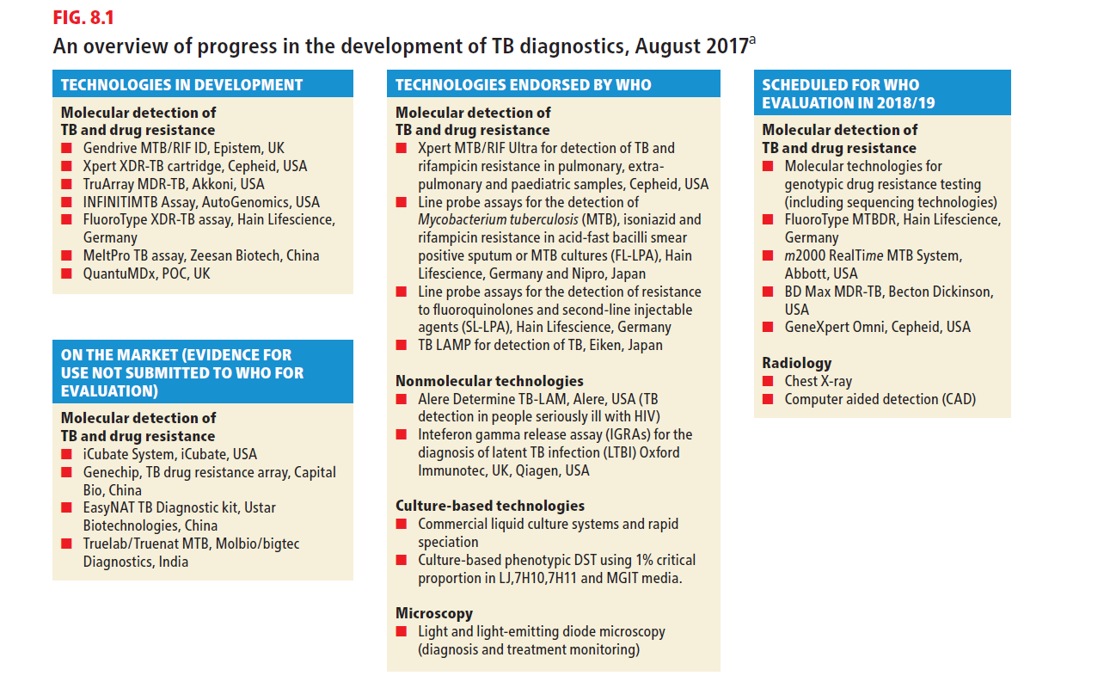
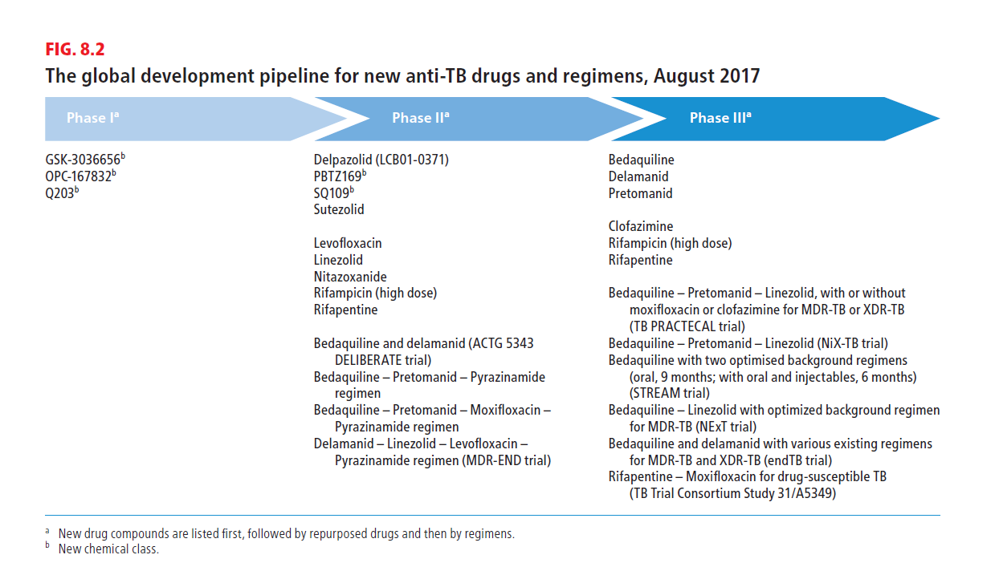
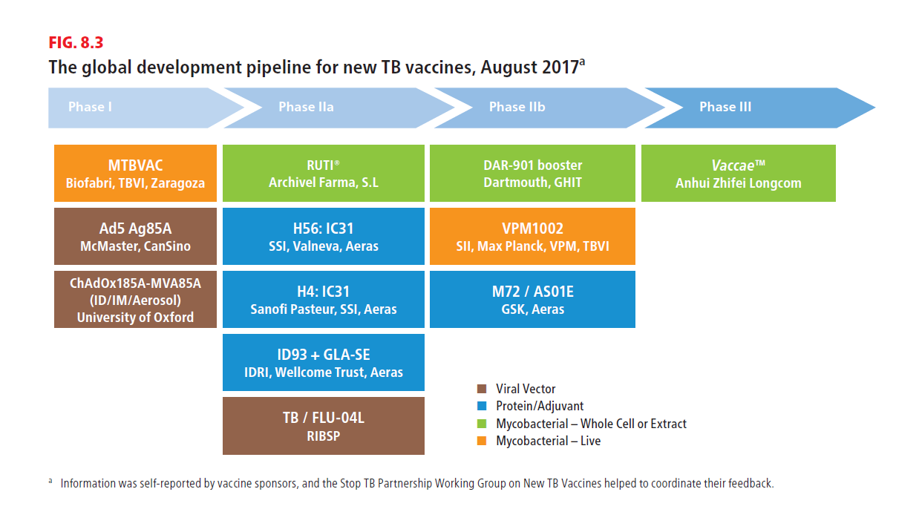
RESEARCH AND DEVELOPMENT
Which new tools in the horizon in 2018?
Diagnostics:
9 new diagnostics endorsed by WHO since 2007;
Several in development including whole genome sequencing on sputum;
By 2020: rapid & sensitive PoC test, triage test, predictive LTBI test, rapid DST
Drugs and regimens:
2 new drugs and 9-month regimen for MDR-TB
A shorter 12-w regimen for LTBI;
By 2020: 4-m regimens for DS-TB, 6/9-m regimens for MDR-TB, and other new drugs
Vaccines:
1 vaccine with no detectable efficacy in 2013
12 vaccines in various phases of clinical trials, but unlikely available before 2020

Slide 35

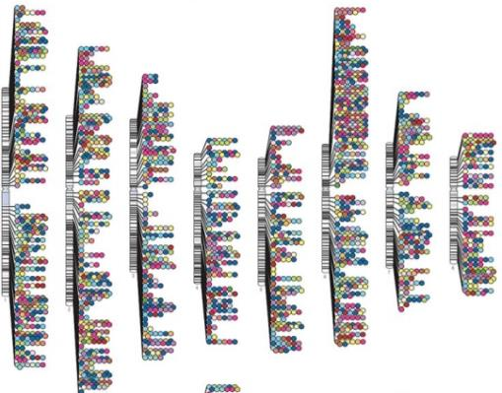
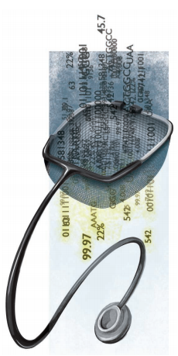

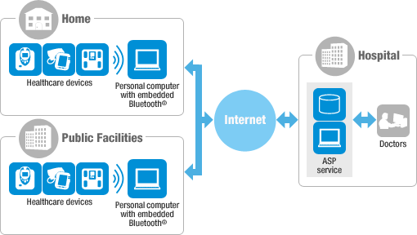

Transformational innovations to End TB
Precision medicine
Genomics
Big
data
Digital technologies
Internet of things
Research

Slide 36
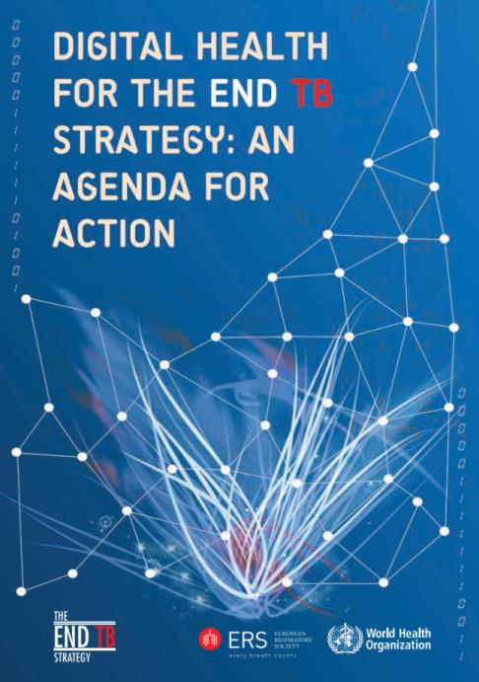
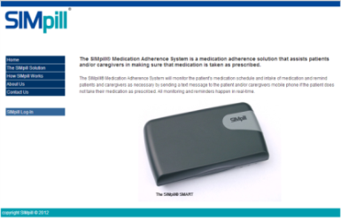
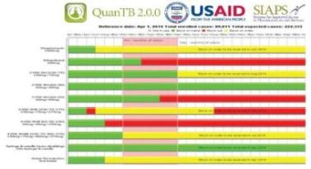
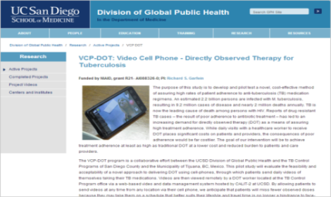
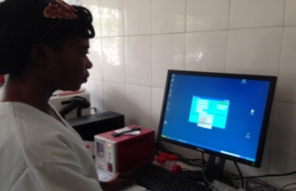
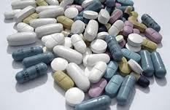






TB Digital health applications
Patient adherence
Programme management
Surveillance
eLearning
http://www.who.int/tb/areas-of-work/digital-health/Digital_health_EndTBstrategy.pdf

Slide 37
Overview
Burden of TB, TB/HIV, MDR-TB
Impact of interventions, progress in control and care, and challenges
The End TB Strategy in the SDG era
The politics of ending TB in an unprecedented era of visibility and momentum
Situazione globale della tubercolosi,
e strategie e politiche internazionali per la lotta

Slide 38









SDG 3 and its 13 targets by 2030
3.1 Reduce
Maternal
mortality
3.2 Reduce
child and
neonatal mortality
3.3 End the epidemics of AIDS, tuberculosis, malaria
& neglected tropical
diseases and combat
hepatitis, water-borne
and other communicable diseases
3.3 End the epidemics of AIDS, tuberculosis, malaria
& neglected tropical
diseases and combat
hepatitis, water-borne
and other communicable diseases
3.4 Reduce
mortality due to NCD and improve mental health
3.5 Strengthen
Prevention and treatment of substance abuse (narcotics, alcohol)
3.6 Reduce
Mortality
due to road traffic
injuries
3.7 Universal
access to sexual and
reproductive health-care services
3.8 Achieve
universal
health coverage
3.9 Reduce
deaths and illness
due to pollution
and contamination
3.a Strengthen implementation FCTC (tobacco)
3.b Access to affordable essential medicines and technologies
3.c Increased health financing and health workforce in developing countries
3.d Enhance capacity for early warning, risk reduction and management of national and global health risks

Slide 39
















Why a multisectoral approach to end TB?
POOR LIVING AND WORKING CONDITIONS
FOOD INSECURITY
STIGMA/DISCRIMINATION, MARGINALIZATION
AT-RISK BEHAVIOUR
Environment
GOAL 3:
HIV, NCD, RISK FACTORS
CROWDING, POOR VENTILATION
SILICA,
INDOOR AIR POLLUTION
MAL-NUTRITION
VULNERABLE GROUPS
incl. children, women,
migrants, prisoners, etc.
HIV/
AIDS
NCDs: diabetes, smoking, alcohol…
CONDUCIVE ENVIRONMENT FOR TRANSMISSION
IMPAIRED HOST DEFENCE/SUSCEPTIBILITY
EXPOSURE
LATENT INFECTION
ACTIVE DISEASE
SUFFERING
AND DEATHS
GOAL 3:
UHC TB SERVICES
GOAL 1: SOCIAL
PROTECTION WHEN ILL
TB CARE

Slide 40





FIRST WHO GLOBAL MINISTERIAL CONFERENCE
ENDING TB IN THE SUSTAINABLE DEVELOPMENT ERA: A MULTISECTORAL RESPONSE
Conference Vision
Aim: to accelerate implementation of the WHO End TB Strategy and address gaps in access to care and the MDR-TB crisis
Goal: to reach the End TB targets set by World Health Assembly and UN Sustainable Development Goals (SDGs)
Through: national and global commitments towards clear deliverables and accountability, eventually endorsed at the UN General Assembly High-Level Meeting on TB in 2018

Slide 41
Overview
Burden of TB, TB/HIV, MDR-TB
Impact of interventions, progress in control and care, and challenges
The End TB Strategy in the SDG era
The politics of ending TB in an unprecedented era of visibility and momentum
Situazione globale della tubercolosi,
e strategie e politiche internazionali per la lotta

Slide 42




End TB Report, World Health Assembly 2017
Response slow – Off target

Slide 43



What is holding us back?
The bottlenecks to end TB are fundamentally POLITICAL and FINANCIAL

Slide 44


Bottleneck n. 1: Political indifference

Slide 45


Bottleneck n. 2: Financial inadequacy
Stop TB Partnership Global Plan estimates of funding required
RESEARCH –
at least US$ 2 billion/yr needed
US$ billions
US$ 5 billion
US$ 2.3 billion
100%
$1.3 billion
funding gap
$720
available in 2016
50%
Low-income
25 HBCs excl. BRICS
BRICS
TAG TB R&D report 2017
Domestic funding*
International donor funding
*government budgets + loans for TB; publicly funded inpatient + outpatient care for TB patients

Slide 46









Finally, some visibility and sense of urgency
High-level commitment to End TB: 2017-18
High Level Meeting on TB

Slide 47


What is the key political recommendation today?
FIRST WHO GLOBAL MINISTERIAL CONFERENCE - Moscow 2017
ENDING TB IN THE SUSTAINABLE DEVELOPMENT ERA: A MULTISECTORAL RESPONSE

Slide 48

Accountability framework
Who is accountable?
What commitment/actions are accountable?
To whom is one accountable?
How is one held into account?
Source: GTB/WHO, 3-2018

Slide 49
Conclusions
The burden of TB is very high and challenges in at-scale implementation of all existing tools remain in many settings, despite clear evidence
Rapid molecular diagnostics, universal DST, treatment for all forms everywhere, but also progress in health services, systems, policies are the key
R&D is badly underfunded and new funding mechanisms and channels, especially in BRICS and MICs, are imperative to transform TB care and control
Lack of political commitment & investments at all levels - internationally, nationally and sub-nationally - are the bottlenecks and the top obstacle to progress
UNGA HLM on TB is a unique opportunity to make the political case about TB, show that cost-benefits are huge and that TB control is a global public good and a social justice imperative. However, to succeed in the field bold activism from the civil society is needed

Slide 50
Grazie a Trieste
e grazie a tutti

