Slide 1
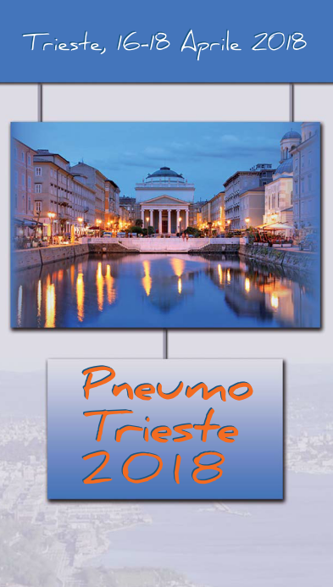

Anti-Synthetase Syndrome
and
Lung
Marco Sebastiani
Rheumatology Unit
Azienda Policlinico di Modena
University of Modena and Reggio Emilia

Slide 2

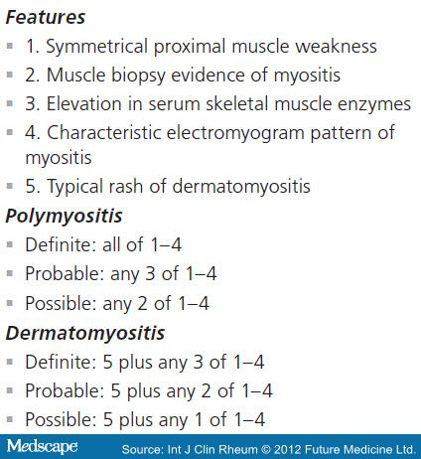
Criteri classificativi Bohan and Peter 1975
Idiopathic inflammatory myopathies (IIM), collectively known as myositis, are heterogeneous disorders characterized by muscle weakness and muscle inflammation.
The most common subgroups in adults are dermatomyositis (DM), polymyositis (PM) and inclusion body myositis (IBM), and in children, juvenile DM (JDM).

Slide 3
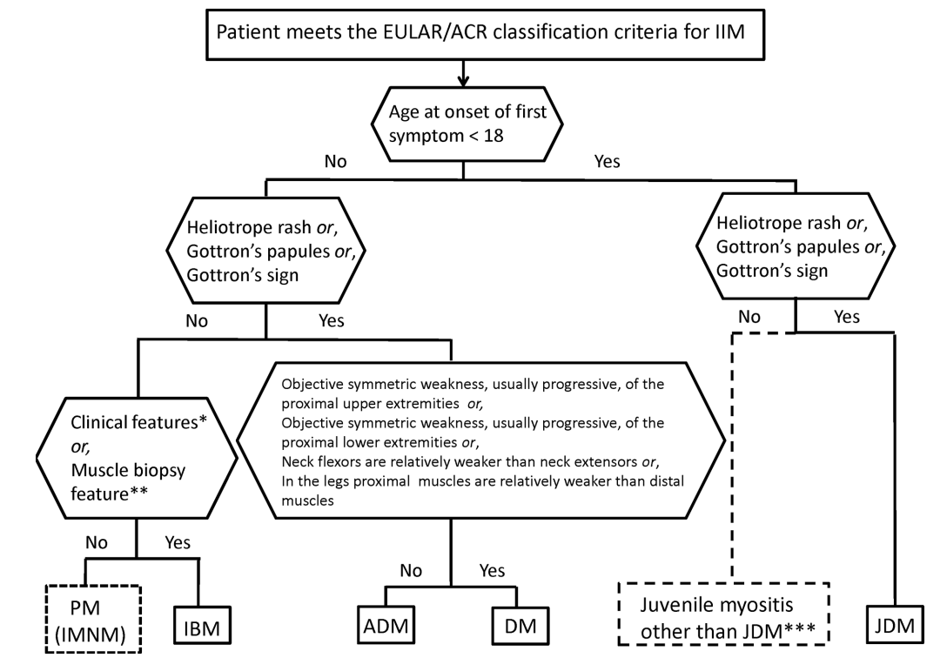

Classification tree for subgroups of IIM. A patient must first meet the EULAR/ACR classification criteria for IIM (probability of IIM ≥55%).
Ingrid E Lundberg et al. Ann Rheum Dis 2017;76:1955-1964
Notes:
Classification tree for subgroups of IIM. A patient must first meet the EULAR/ACR classification criteria for IIM (probability of IIM ≥55%). The patient can then be subclassified using the classification tree. The subgroup of PM patients includes patients with IMNM. For IBM classification, one of the following, *finger flexor weakness and response to treatment: not improved, or **muscle biopsy: rimmed vacuoles, is required for classification. ***Juvenile myositis other than JDM was developed based on expert opinion. IMNM and hypomyopathic DM were too few to allow subclassification. ACR, American College of Rheumatology; ADM, amyopathic dermatomyositis; DM, dermatomyositis; EULAR, European League Against Rheumatism; IBM, inclusion body myositis; IIM, idiopathic inflammatory myopathies; IMNM, immune-mediated necrotising myopathy; JDM, juvenile dermatomyositis; PM, polymyositis.

Slide 4
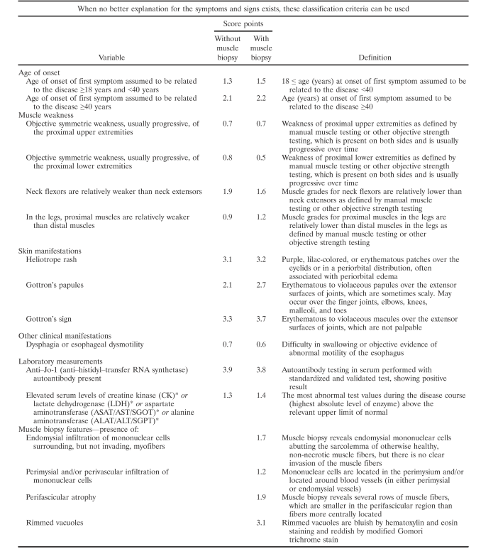
Probable IIM
score of ≥ 5.5 or
≥ 6.7 if biopsies are included
Definite IIM
score of ≥ 7.5 without muscle biopsy and
≥ 8.7 with muscle biopsy
http://www.imm.ki.se/biostatistics/calculators/iim/

Slide 5
PM/DM epidemiology
Prevalence: 2.9 - 34 cases/100.000 inhabitants,
Incidence: 2–11 cases/1.000.000 inhabitants per year
Peak incidence: 50–60 years
Female to male ratio: ≈2:1.
Juvenile-PM is much rarer than juvenile-DM.
PM/DM latitudinal gradient
  DM more common in latitudes closer to the equator
  PM in northern latitudes

Slide 6
Anti-synthetase antibodies
Anti-synthetase syndrome is a rare, autoimmune multi-system disorder characterized by a variable combination of:
inﬂammatory myositis
interstitial lung disease
arthritis
Raynaud’s phenomenon
fever
mechanic’s hands
Notes:
Diagnosis requires detection of autoantibody to one of the aminoacyl-t-RNA synthetases, of which eight are currently known. The most common is anti-Jo-1, followed by anti-PL-7, anti-PL-12 and anti-EJ

Slide 7
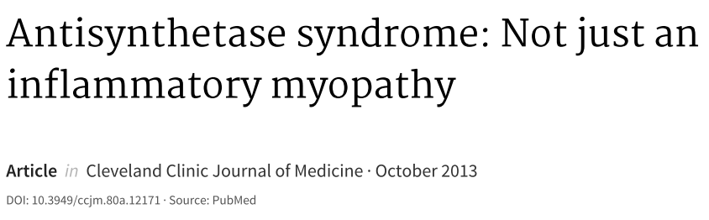
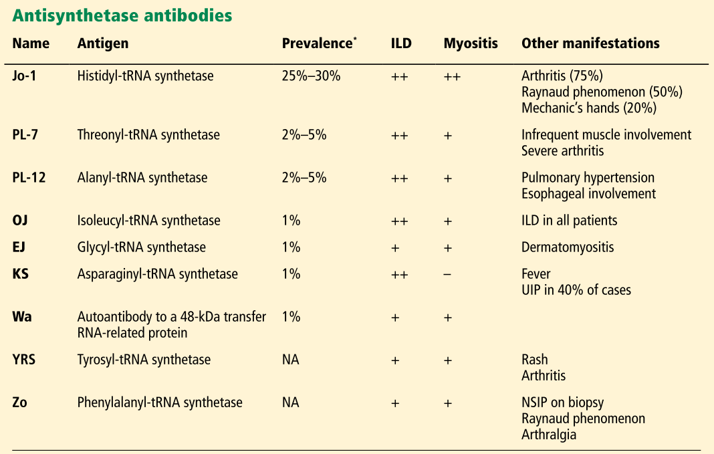

Slide 8

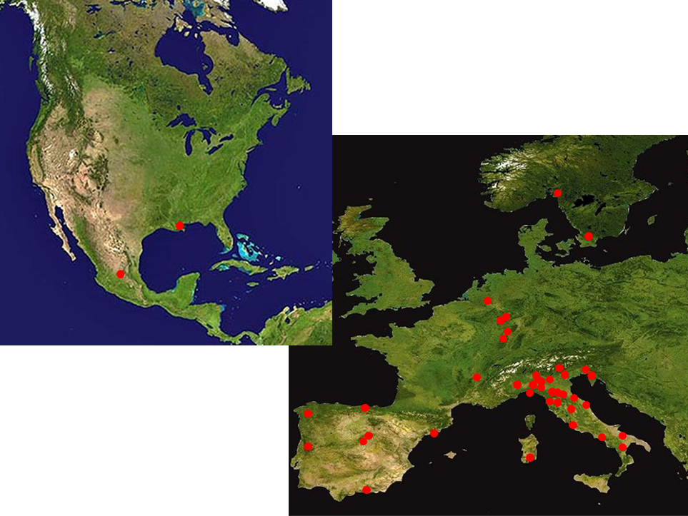
Collaborative Group
9 Countries
Patients from:
57 Rheumathology and Immunology centres
9 Pneumology centres
2 Neurology centre
1 Dermatology center
Data on file: 813 patients
Notes:
AENEAS (American and European NEtwork of Antisynthetase Syndrome) is an international collaborative group with centers from all around the world (Italy, Spain, Germany, France, Mexico, etc) which aims to study ASSD thoroughly and better understand its clinical and pathophysiological features

Slide 9
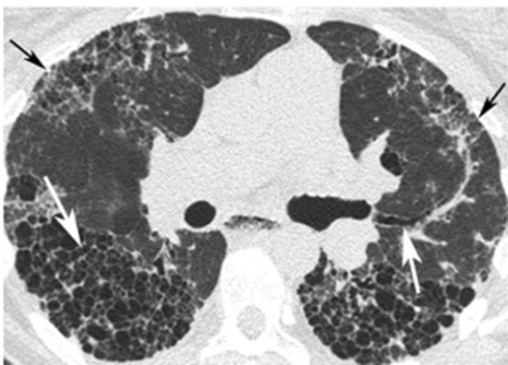
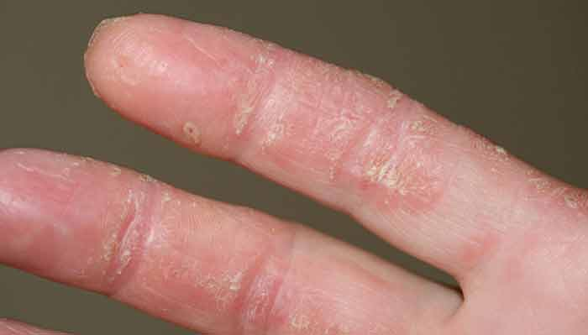
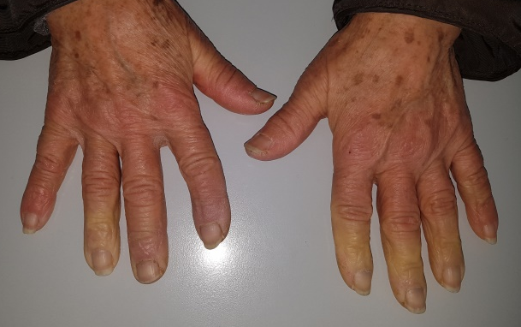
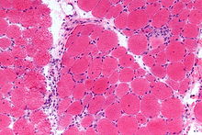
Relative to other subsets of the anti-synthetase syndrome (marked by alternative anti-synthetase antibodies such as anti-PL-7/threonyl-tRNA synthetase and anti-PL-12/alanyl-tRNA synthetase) that are lung predominant, patients with anti-Jo-1 antibodies typically manifest a more balanced distribution of myositis, Raynaud’s, mechanic’s hands, and ILD.

Slide 10
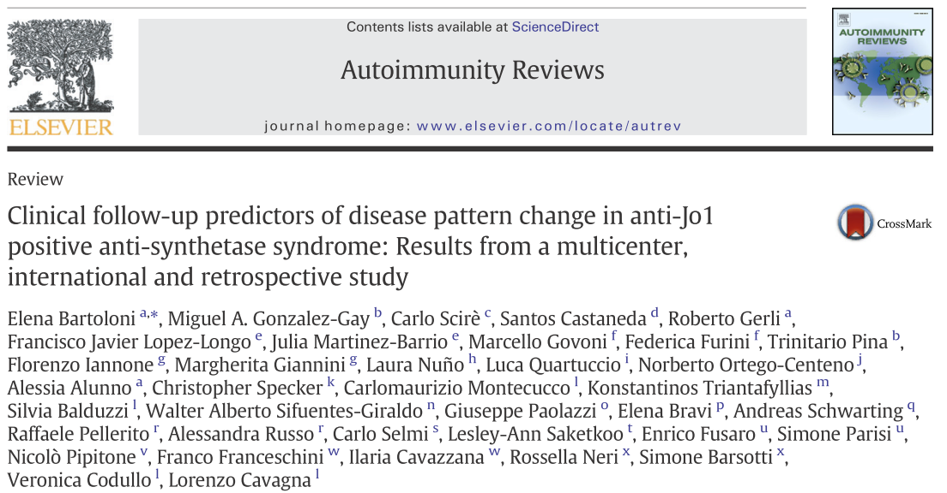
Anti-Jo1
An incomplete form, with one or two classic triad manifestations, characterizes about 80% of patients at disease onset in anti-Jo1 patients.
Nevertheless, the appearance of the complete classic triad manifestations is common during the follow-up of the disease.
Fever, Raynaud's phenomenon and mechanic's hands may be considered predictors of subsequent appearance of at least one of the classic triad manifestations in patients presenting with incomplete anti-Jo1 ASSD at disease onset.

Slide 11

ASSD anti EJ positive (n=21)
100%
100%
Arthritis
Myositis
ILD
Arthritis and ILD
DISEASE ONSET
LAST FOLLOW-UP
Myositis and ILD
Arthritis, myositis and ILD
0%
0%
Cavagna L, data on file

Slide 12
ASSD anti PL-7 positive (n=71)
100%
100%
Arthritis
ILD
Arthritis and ILD
DISEASE ONSET
Myositis
LAST FOLLOW-UP
Arthritis and myositis
Myositis and ILD
Arthritis, myositis and ILD
0%
0%
Cavagna L, data on file

Slide 13

ASSD anti PL-12 positive (n=70)
100%
100%
Arthritis
ILD
DISEASE ONSET
Myositis
LAST FOLLOW-UP
Arthritis and ILD
Arthritis and myositis
Myositis and ILD
Arthritis, myositis and ILD
0%
0%
Cavagna L, data on file

Slide 14
Spectrum of pulmonary involvement in IIM
Extrinsic lung disease | Intrinsic lung disease
Aspiration pneumonia | Interstitial lung disease
Infectious pneumonia | Non-specific interstitial pneumonia
Hypoventilation due to respiratory muscle weakness | Organising pneumonia
Congestive cardiac failure | Usual interstitial pneumonia
Pulmonary arterial hypertension | Diffuse alveolar damage
Pleuritis | Pulmonary capillaritis
Adapted from Schnabel A, et l. Curr Rheumatol Rep 2005;7:99-105.

Slide 15
ILD in IIMs
The major contributor to morbidity and mortality in IIMs
It may occur both at disease onset (up to 65% of cases) and during the follow-up (final prevalence up to 85% of cases in some subsets).
ILD presentation:
  acute/subacute when dyspnoea began acutely or progressed rapidly (within 4–6 weeks of symptom onset)
  chronic when dyspnoea began insidiously and progressed slowly
  asymptomatic when lung involvement was only instrumental without clinical correlates.
Fathi M et al, 2004; Levine SM et al, 2007; Cavagna L et al, 2015
Notes:
However, all clinicians know that fever is not a secondary issue in the setting and that fever management in SLE patients is not always easy.

Slide 16
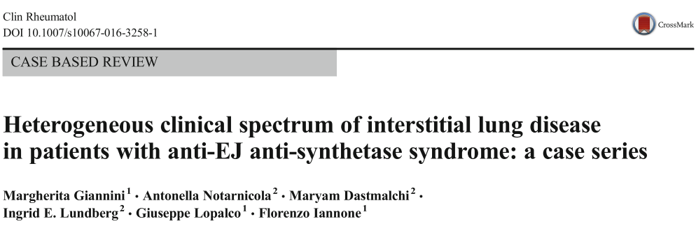
The positivity of some Myositis Specific Antibodies/Myositis associated antibodies is strictly associated with ILD occurrence (eg. the antisynthetase antibodies) and relevant evidences suggested their pathogenetic role
The phenotype of lung involvement in patients with ASS is heterogeneous.
Both non-specific interstitial pneumonia (NSIP) and usual interstitial pneumonia (UIP) have been described in association with anti-EJ Abs. However, ground glass opacities and traction bronchiectasis seem to occur more frequently than honeycombing areas

Slide 17
CT correlates of ILD in IIMs
Lung lesions: predominantly subpleural, and in lower dorsal lobes, with involvement of one or two slices of secondary pulmonary lobules, with subsequent extension of lesions in case of disease progression (Franquet T et al, 2001).
Main forms of IIMs-ILD:
  Non-specific interstitial pneumonia (NSIP) – the most common type (Kiely PD et al, 2013)
    Main characteristics: temporal homogeneity of lesions, with prevalence of alveolitis (Ground-glass opacification aspect), homogeneous septal tickening and maintenenace of the normal lobular architecture. It is important to remember that exists (and it is extremely frequent) also a fibrotic variant of NSIP, in which interstitial thickening is more due to uniform dense or loose fibrosis and mild chronic inflammation, and in which lung structures are still preserved. Occasionally, focal honeycomb fibrosis may be observed.
  Usual interstitial pneumonia (UIP)
    Main characteristics: temporal heterogeneity of lesions, with a patchy craniocaudal gradient of (irregular) peripheral septal thickening, bronchiectasis, ground glass opacities, and honeycombing. Lung architectural distortion, reflecting fibrotic changes, is another relevant characteristic of UIP.
  Organising pneumonia (OP)
    Main characteristic: patchy consolidation (from 2 centimetres to the entire lobe) with a predominantly subpleural and/or peribronchial distribution, in which air bronchograms and bronchiectasis are common. These consolidations are frequently migrant even without treatment
  Diffuse Alveolar Damage (DAD)
    Main characteritistic: diffuse Ground Glass aspect and it is typical of acute onset ILD.

Slide 18
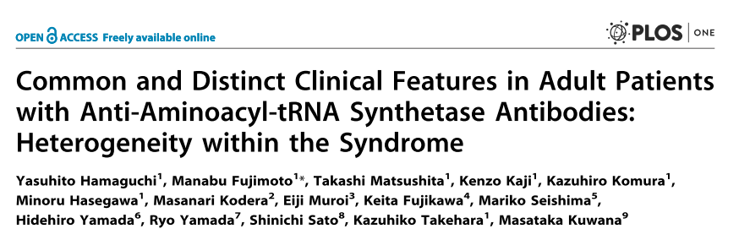
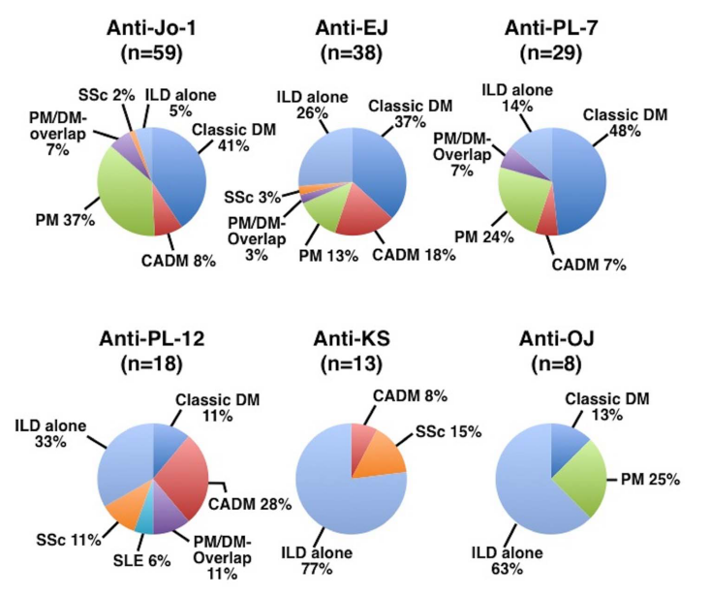
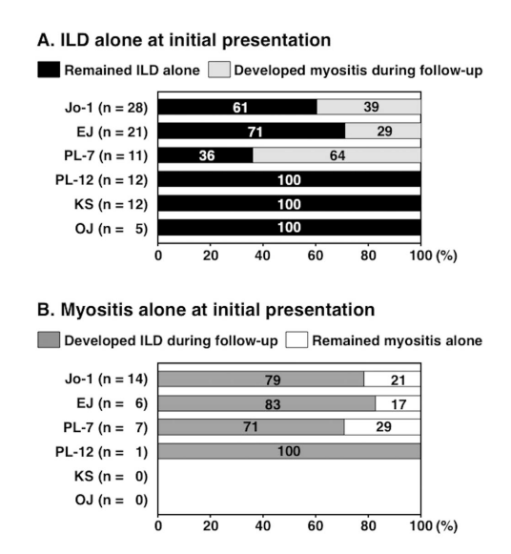

Slide 19
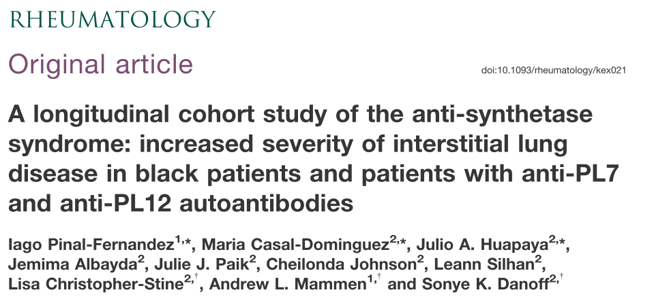
Population study:
124 (73.4%) anti-Jo1
23 (13.6%) anti-PL12
16 (9.5%) anti-PL7
3 (1.8%) anti-EJ
3 (1.8%) anti-OJ
Different anti-synthetase autoantibodies are associated with phenotypically distinct subgroups within the anti-synthetase spectrum.
Anti-PL7 and anti-PL12 syndromes are characterized by more severe interstitial lung disease.
Black race is a major prognostic factor associated with lung disease severity.

Slide 20
Clinically apparent lung involvement at the onset of the disease was common in anti-PL12 and anti-PL7 patients
anti-PL12 65% vs anti-PL7 56% vs anti-Jo1 26%
whereas sole muscle involvement was more common in anti-Jo1 patients
anti-Jo1 26% vs anti-PL12 0% vs anti-PL7 12%
During the course of follow-up, most patients experienced both muscle and lung involvement (>60% in all groups).
Anti-PL12 and anti-PL7 patients trended towards having lung involvement without ever experiencing muscle involvement
anti-PL12 30% vs anti-PL7 19% vs anti-Jo1 10%
Anti-Jo1 patients trended towards exclusive muscle involvement
anti-Jo1 26% vs anti-PL12 4% vs anti-PL7 0%

Slide 21
Autoantibody status and race seemed to be the most important prognostic factors associated with ILD severity.
Anti-PL12 patients showed the most severe ILD phenotype
  %FVC = 57%, %DLCO = 55%
Anti-Jo1 patients the mildest
  %FVC = 71%, %DLCO = 67%
Anti-PL7 patients presented intermediate ILD severity
  %FVC = 61%, %DLCO = 53%
Black patients showed strikingly more severe ILD than the rest of the patients
(>15% lower FVC and DLCO, all P < 0.001)

Slide 22
Assessment of Mortality in Autoimmune Myositis With and Without Associated ILD.
Population study:
831 patients (438, 53%, with PM; 362, 43%, with DM; 31, 4%, CADM
Median follow-up time of 4.5 years
Results:
Overall, 51 participants died (6 %).
Survival rates in non ILD patients at 1, 5, and 10 years: 99 (1 year), 95 (5 years), and 90 % (10 years)
Survival rates in ILD patients: 97 (1 year), 91 (5 years), and 81 % (10 years)
Risk of death in ILD patients vs non ILD patients: HR 2.13 95 % CI 1.06-4.25; p = 0.03
Johnson C, et al. Lung 2016;194:733-7

Slide 23
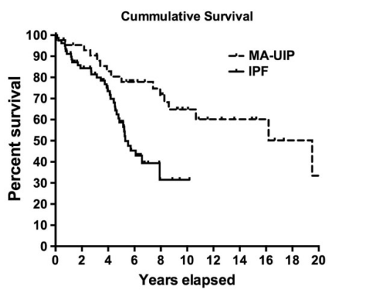
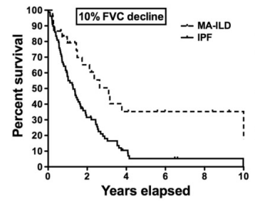
Myositis-associated UIP has a better survival than IPF
Population study:
81 idiopathic pulmonary fibrosis (IPF)
43 myositis-associated UIP (MA-UIP)
Outcome:
The median cumulative survival time in IPF vs MA-UIP was 5.25 vs 16.2 years. Cumulative survival was significantly worse in IPF-UIP vs MA-UIP [hazards ratio of IPF-UIP was 2.9 (95% CI: 1.5, 5.6)].
Aggarwal R, et al. Rheumatology (Oxford) 2017;56:384-389

Slide 24
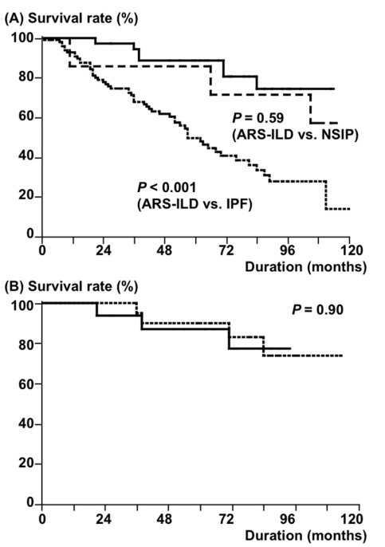
The long-term outcome of ILD with anti-aminoacyl-tRNA synthetase antibodies.
Population study:
36 patients with ASSD-ILD (20 with myositis and 16 without)
100 patients with IPF without anti-ASSD
7 patients with NSIP without anti-ASSD.
Outcome:
7 patients with ASSD-ILD (19%) and 51 with IPF (51%) died.
Patients with ASSD-ILD had better overall survival than those with IPF and similar survival compared to those with NSIP.
Similar prognosis for ASSD-ILD patients with and without myositis.
Myositis +/- p>0.5
Tanizawa K, et al. Respir Med 2017

Slide 25
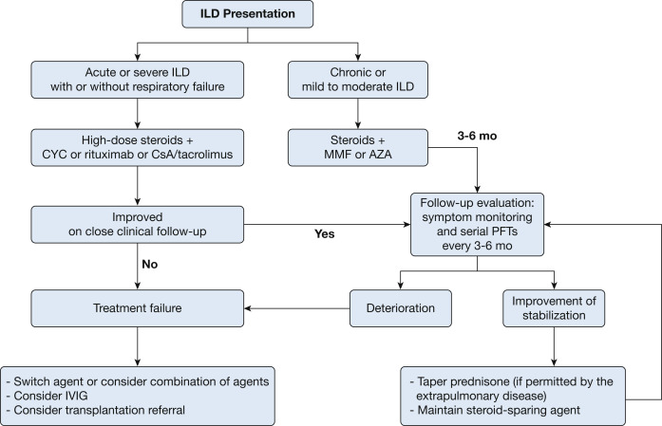
Management of Myositis-Related ILD
Moriset J, et al. Chest 2016;150:1118-1128

Slide 26
Cyclosporine
  Several data support their effectiveness in ASSD-related lung involvement
    Goh, Rheumatology Int 2016. 47 DM-ILD. Reduced mortality and ILD progression
    Cavagna, J Rheumatol 2013. 18 anti Jo-1 positive ASSD with ILD. Cys 3 mg/kg/day. Improved survival and stable/improved HRCT findings (Kazerooni score)
    Labirua-Iturburu, Clin Exp Rheumatol 2013. 15 PM/DM antsynthetase + ILD on CYS or tacrolimus. FVC increase or stabilitazation.
    Kotani, J Rheum 2008. 14 DM with acute/subacute ILD, combination therapy with glucocorticoids and cyclosporine (4 mg/kg/day) within 12 days from diagnosis. PFTs and HRCT lung findings improvement

Slide 27
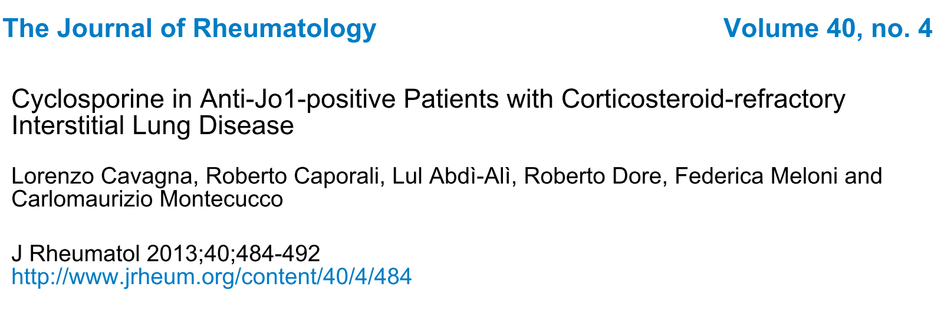
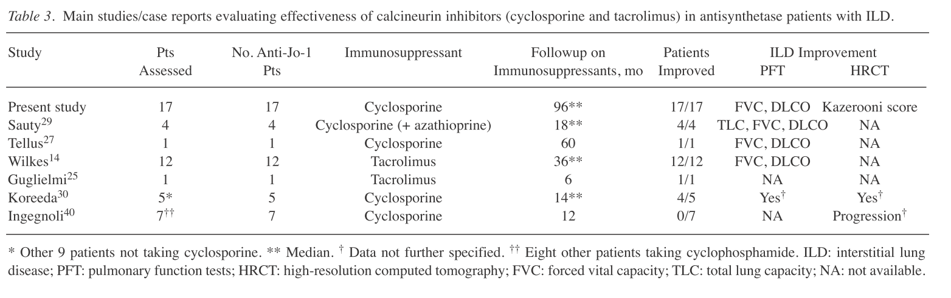

Slide 28
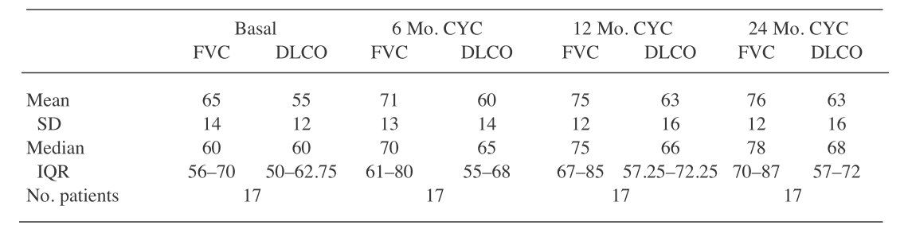
During the first year of the study, all patients were responsive to CYC and their respiratory symptoms improved.
At 1 year of treatment, a significant improvement was reported in FVC, DLCO, and total Kazerooni score because of reduction of ground-glass opacity.
17 ILD patients not responding to steroids
ILD onset acute in 7 cases
chronic in 10
HRCT pattern of ILD was consistent with
NSIP in 14 patients
UIP in 3 patients

Slide 29
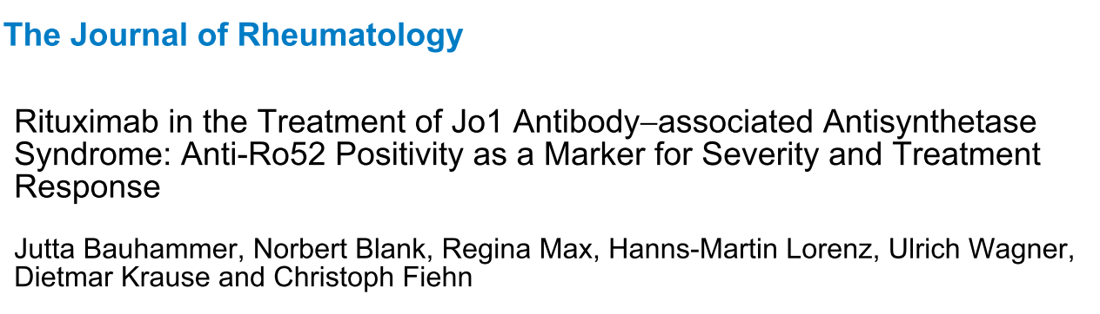
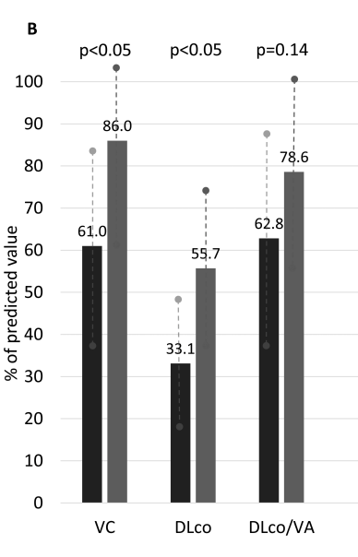
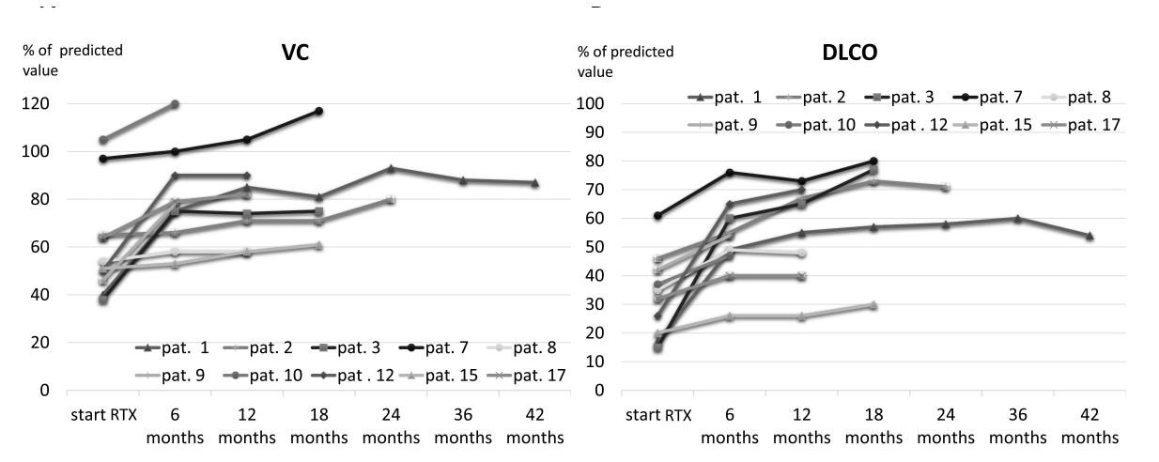
10 patients received Rituximab if had severe ILD refractory to IS drugs.
6 patients with acute-onset ILD
  Complete response 6/6
4 patients chronic progressive ILD
  Improvement 4/4

Slide 30
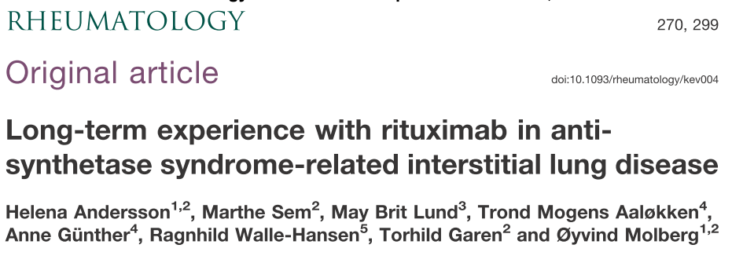
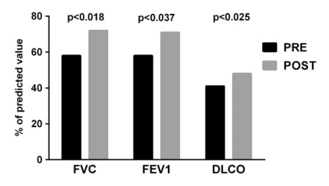
24 ASS patients with severe ILD and >12 months follow-up post-Rtx (median 52 months)
19 Jo1, 3 PL7, 2 PL12
Post-RTX, median percentage increase of:
- FVC 24% from 58% to 72% (P < 0.018)
- FEV1 22% from 58% to 71% (P < 0.037)
- DLCO 17% from 41% to 58% (P < 0.025)
Infections were the main severe side effects in 5/24 patients with 2 deaths

Slide 31
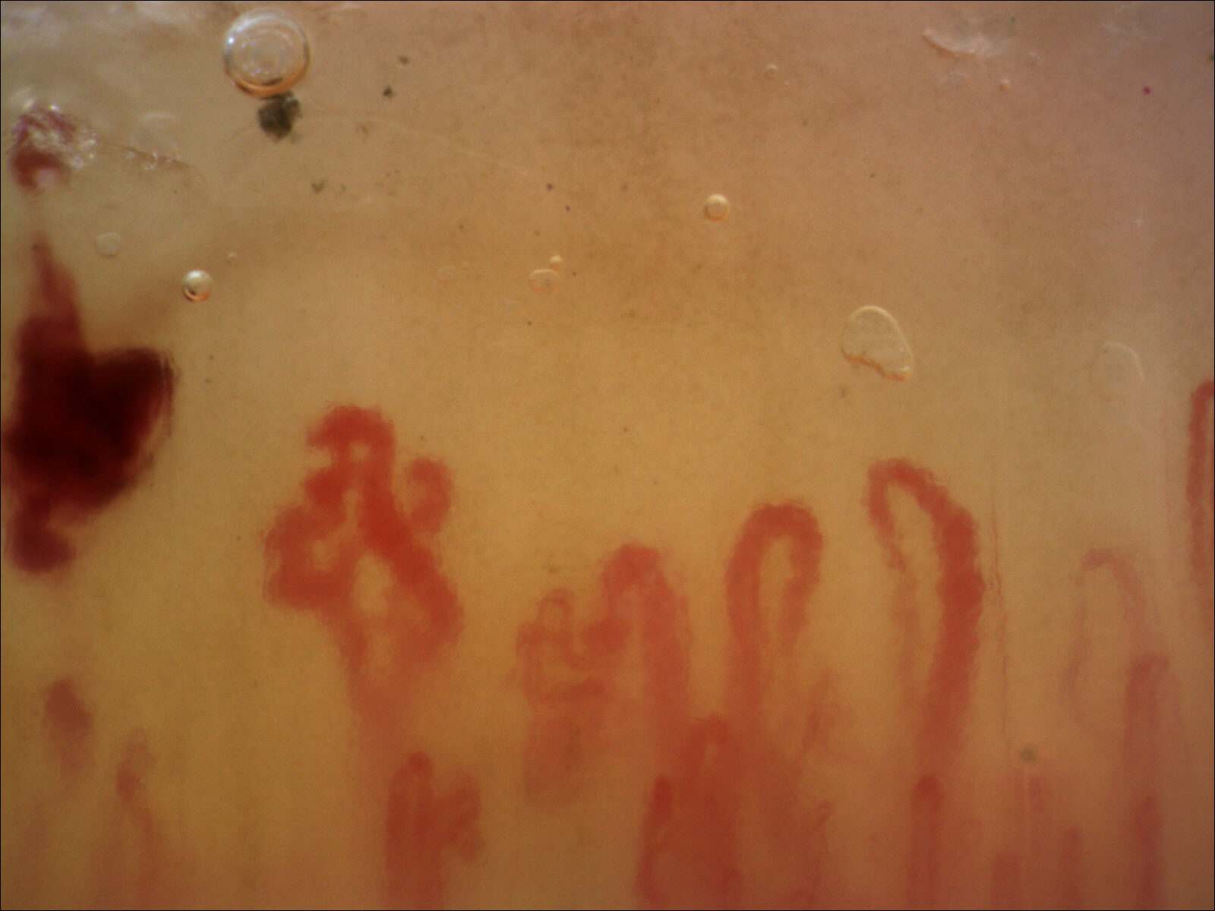
NASCAR
NAilfold capillaroSCopy in Antisynthetase syndRome
Aim of the study
To describe the capillaroscopic features of ASSD patients and to evaluate possible correlations with clinical and serological characteristics of the disease
SSc pattern
36,9% dei pazienti con ASSD p<0,005
Sebastiani M et al, submitted

Slide 32
Multivariate analysis, correlation with scleroderma pattern
 | Odds Ratio | 95%CI |  | p
 |  | Lower | Higher
Disease duration ≥24 months | 2,708 | 1,034 | 7,097 | 0,043
ILD ≥ second triad manifestation | 2,436 | 1,245 | 4,768 | 0,009
Anti-Jo1 | 3,044 | 1,449 | 6,396 | 0,003
Sebastiani M et al, submitted

Slide 33
Take Home Messages
In patients with inflammatory myopathies, lung involvement is heterogeneous
A search for anti-synthetase antibodies should be performed in all patients with ILD, regardless the presence of myositis or arthritis
A search for anti-synthetase antibodies should be performed also in patients with acute onset of ILD
Anti-PL12, -PL7, -KS, -EJ, -OJ are almost always associated to ILD, at disease diagnosis or during follow-up
NSIP is the most frequent ILD pattern, but no specific radiological or histological pattern of lung disease are associated to IIM

Slide 34

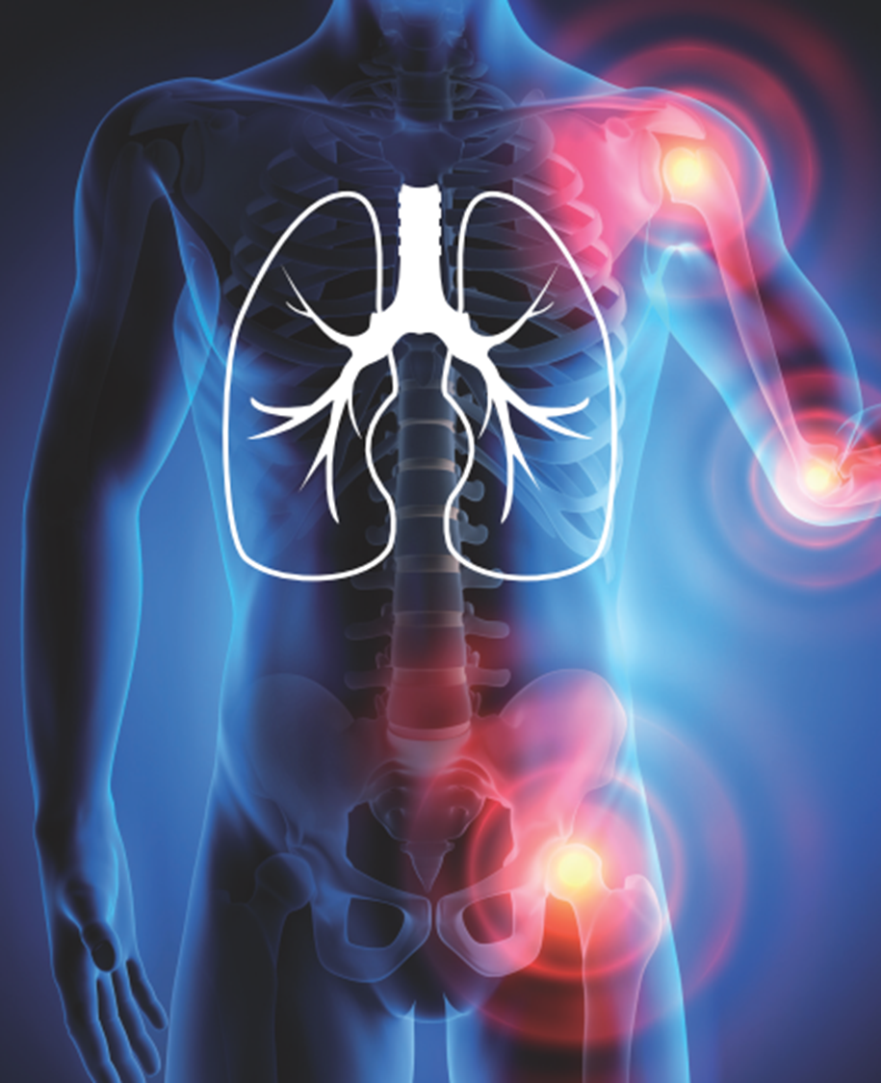
Cattedra e UOC Reumatologia
Direttore prof. Carlo Salvarani
Ambulatorio per le malattie rare del polmone
Reumatologia
dott. Andreina Manfredi
dott. Marco Sebastiani
dott. Giulia Cassone
Malattie apparato respiratorio
prof. Enrico Clini
dott. Fabrizio Luppi
dott. Stefania Cerri
Diagnostica per immagini
dott. Giovanni Della Casa
Chirurgia toracica
prof. Alessandro Stefani
Anatomia patologia
dott. Andrea Ambrosini Spaltro
Cardiologia
dott. Francesca Coppi

Slide 35
Dermatomyositis and Polymyositis in the Intensive Care Unit: A Single-Center Retrospective Cohort Study of 102 Patients.
Among 102 IIM patients admitted in ICU, infection (39.2%) was the leading cause, followed by acute exacerbation of underlying IIMs (27.5%) and coexistence of both (27.5%).
Acute exacerbation of IIM was associated to rapid progressive ILD (RP-ILD) in 87.5% of cases.
On ICU admission, acute respiratory failure (ARF) was the most common type (80.4%) of organ failure. The mortality rate in the ICU was 79.4%. The causes of ARF were RP-ILD (23.2%), pneumonia (43.9%), and the combination of both (32.9%).
Peng JM, et al. Plos One 2016;11:e0154441

Slide 36
PL7 e PL12
Multivariate analysis confirmed that patients with anti-PL12 autoantibodies showed lower CK concentrations and more severe ILD (lower FVC and DLCO) compared with patients with anti-Jo1 ASyS (all P < 0.05). Moreover, patients with anti-PL7 showed lower DLCO than anti-Jo1 patients (14%, P < 0.05) and a trend towards lower FVC (4%, P > 0.05). Consistent with the univariate study, black patients showed strikingly more severe ILD (18% lower FVC,
P < 0.001; 12% lower DLCO, P < 0.01) than white patients, with no interaction detected between the autoantibody status and the race (all P > 0.05).

Slide 37
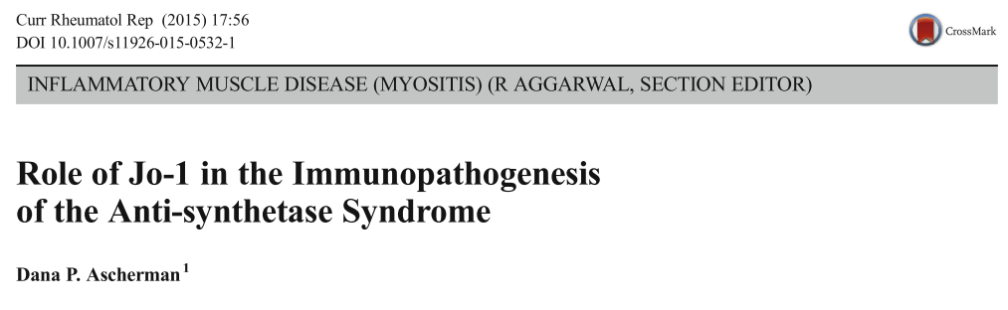
Jo1 pathogenesis
Although available data do not support a direct role for Jo-1-targeted antibodies in mediating tissue damage, several characteristics of the well-patterned humoral immune response implicate this autoantigen in disease pathogenesis.
Over the last decade, experimental data in humans and animal models support a novel paradigm in which histidyl-tRNA synthetase HRS (with/without its cognate tRNA) triggers components of both innate and adaptive immune responses, culminating in cell-mediated damage to a number of different tissues that prominently include muscle and lung. Given its pleiotropic immunostimulatory capacity, HRS likely bridges different phases of such tissue-targeted immune responses that are responsible for the initiation as well as perpetuation of the anti-synthetase syndrome.
Howard et al. demonstrated that two known myositis autoantigens, histidyl-tRNA synthetase (HRS=Jo-1) and asparaginyl-tRNA synthetase (ARS = KS), possess chemokine-like properties capable of stimulating (in vitro) lymphocytes, activated monocytes, and immature dendritic cells

Slide 38
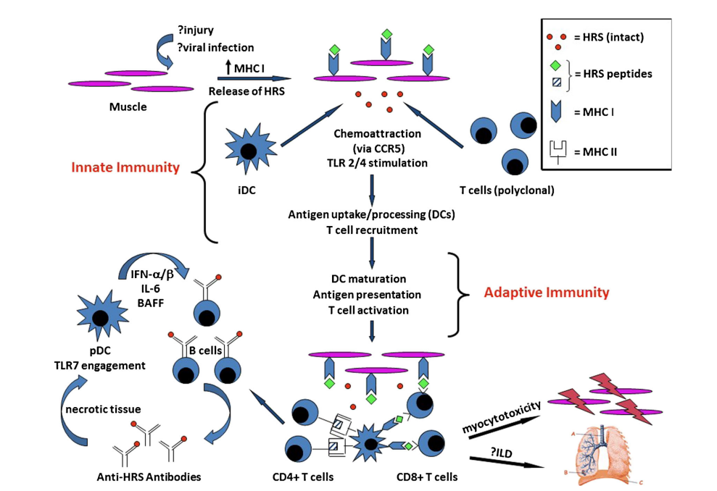
Contribution of Jo-1/HRS to the immunopathogenesis of the anti-synthetase syndrome. This schematic demonstrates the proposed relationship between muscle injury, upregulation of MHC class I expression, extracellular release of histidyl-tRNA synthetase (HRS=Jo-1), innate immune activation, antigen processing, generation of Jo-1-specific B/T cells, and cell-mediated end organ damage. Although this model suggests that immunological tolerance to HRS is breached in damaged muscle, data cited in the text indicate that tissue-specific alterations of HRS in the lung may play an equally important role in the breakdown/bypass of tolerance to this autoantigen. Also not shown is the potential link between pDC-derived IFN- α / β production and MHC I upregulation in muscle tissue. iDC immature dendritic cell, pDC plasmacytoid dendritic cell

Slide 39
Myositis was closely associated with anti-Jo-1, anti-EJ, and anti-PL-7, while interstitial lung disease (ILD) was
correlated with all 6 anti-ARS Abs. Dermatomyositis (DM)-specific skin manifestations (heliotrope rash and Gottron’s sign)
were frequently observed in patients with anti-Jo-1, anti-EJ, anti-PL-7, and anti-PL-12. Therefore, most clinical diagnoses
were polymyositis or DM for anti-Jo-1, anti-EJ, and anti-PL-7; clinically amyopathic DM or ILD for anti-PL-12; and ILD for anti-
KS and anti-OJ. Patients with anti-Jo-1, anti-EJ, and anti-PL-7 developed myositis later if they had ILD alone at the time of
disease onset, and most patients with anti-ARS Abs eventually developed ILD if they did not have ILD at disease onset.

