Slide 1
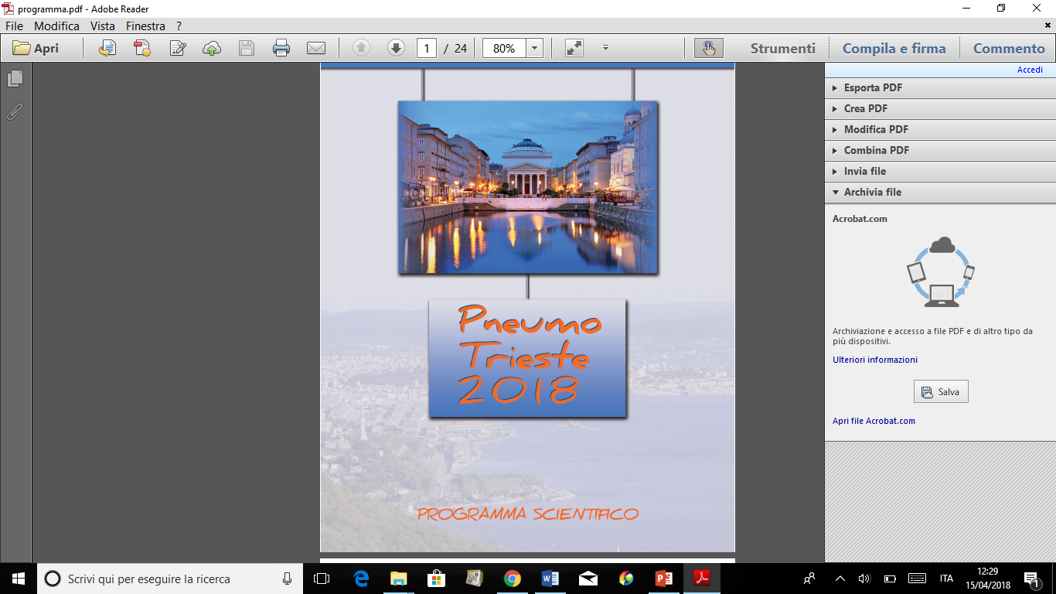
Trucchi e trappole delle cure odontostomatologiche per OSAS
Gabriele Vidoni
Cl. Stomatologica
Ospedali Riuniti di Trieste
g.vidoni@fmc.units.it

Slide 2
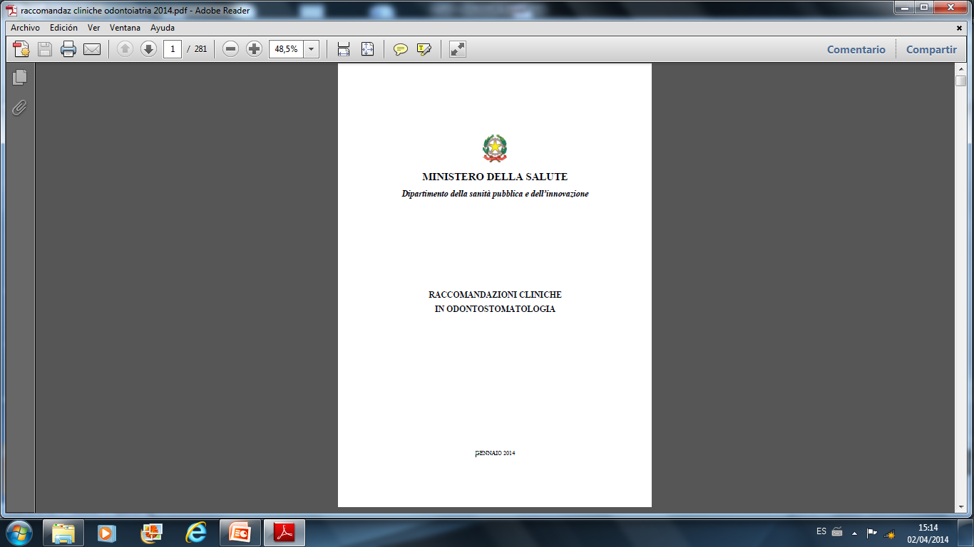

Slide 3
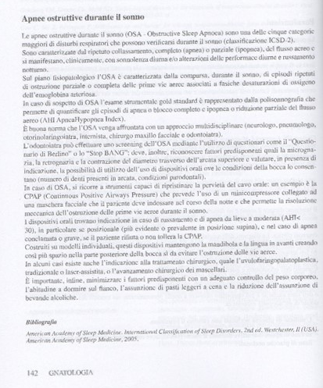
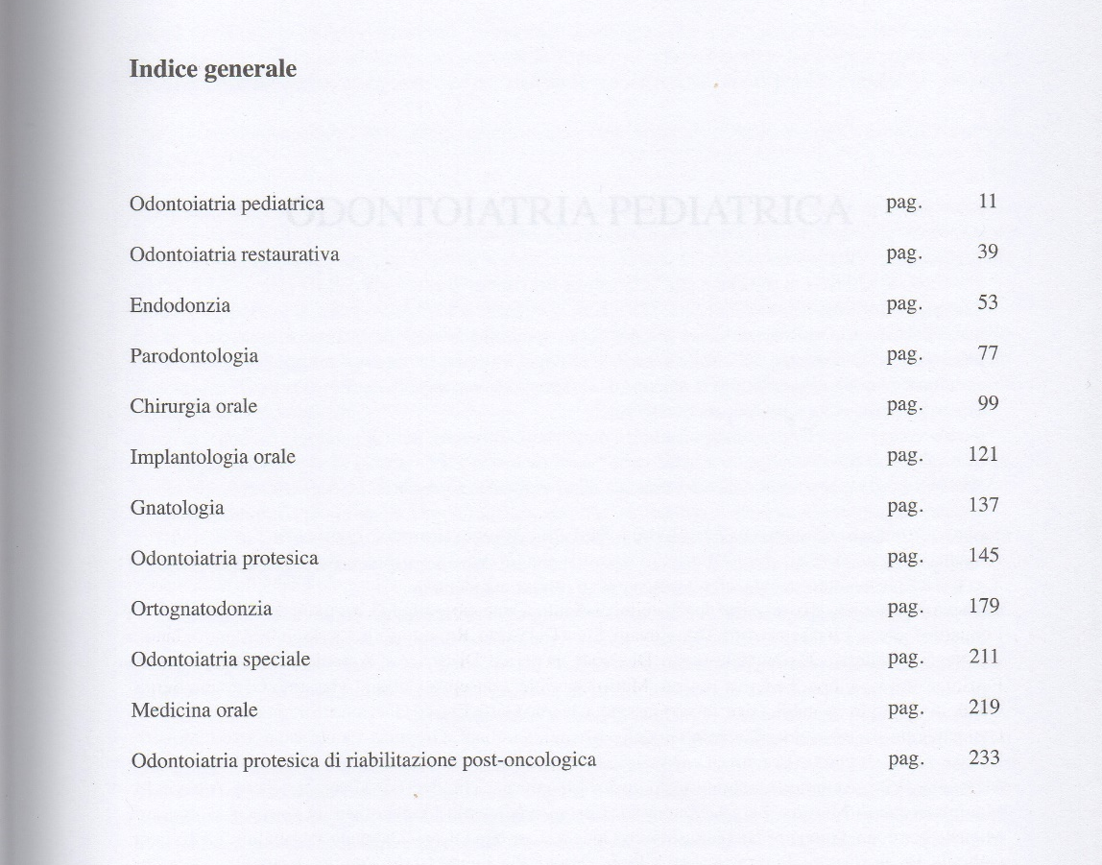

Slide 4
APNEE OSTRUTTIVE DURANTE IL SONNO
Una delle 5 categorie maggiori di disturbi respiratori che avvengono durante il sonno;
Buona norma approccio multidisciplinare;
Esame d’elezione: polisonnografia (AHI);
Trattamento d’elezione per OSAS severe é la CPAP;
American Academy of Sleep Medicine. International Classification of Sleep Disorders, 2nd ed. Westchester, Il (USA).American Academy of Sleep Medicine, 2005. Main C, et al. Surgical procedures and nonsurgical devices for the management of non-apnoeic snoring: a systematic review of clinical effects and associated treatment costs. Health Technol Assess. 2009 Jan;13(3): III, XI-XIV, 1-208.

Slide 5
L’odontoiatra puó fare screening tramite questionari (Berlino..), riconoscere fattori predisponenti e valutare indicazioni uso OA;
OSAS lievi\moderate o intolleranti a CPAP é indicato trattamento con OA;
Bisogna minimizzare fattori predisponenenti (controllo del peso, consigliare di dormire sul fianco, assunzione di pasti leggeri a cena, ridurre consumo di bevande alcoliche )
McDaid C, et al. Continuous positive airway pressure devices for the treatment of obstructive sleep apnoea-hypopnoea syndrome: a systematic review and economic analysis. Health Technol Assess. 2009 Jan;13(4):III-IV, XI-XIV, 1-119, 143-274.

Slide 6

L’odontoiatra puó fare screening tramite questionari (Berlino..), riconoscere fattori predisponenti e valutare indicazioni uso OA;

Slide 7
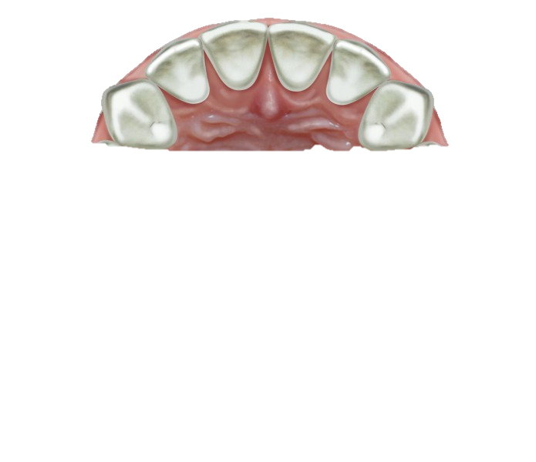
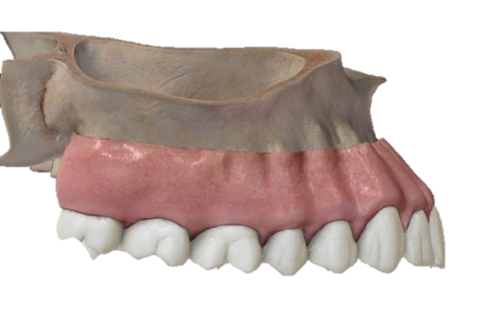
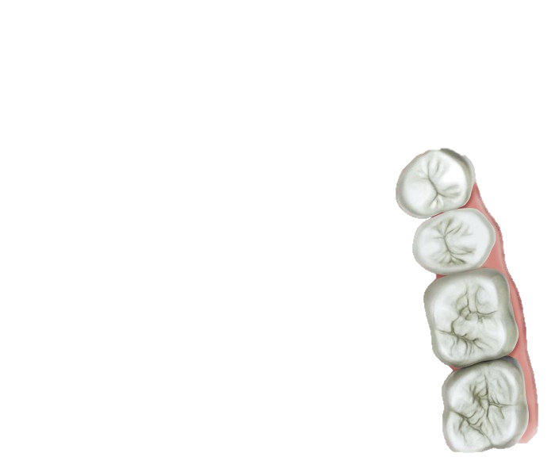
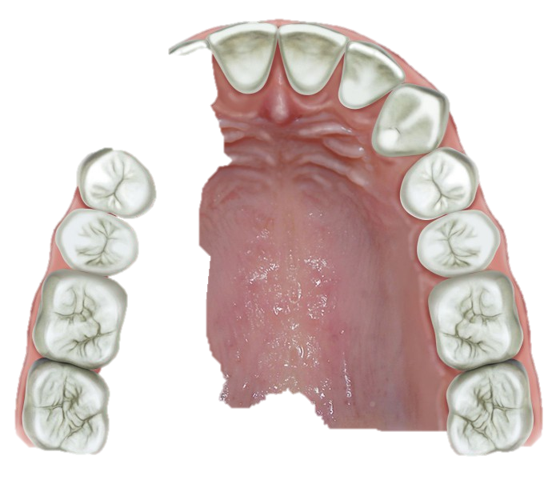
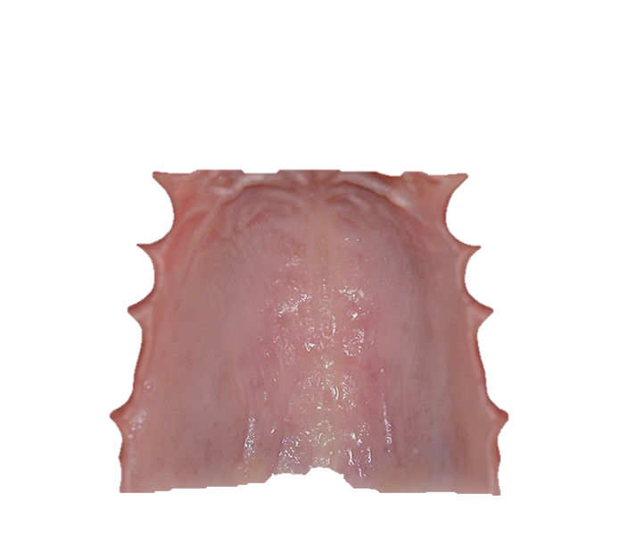
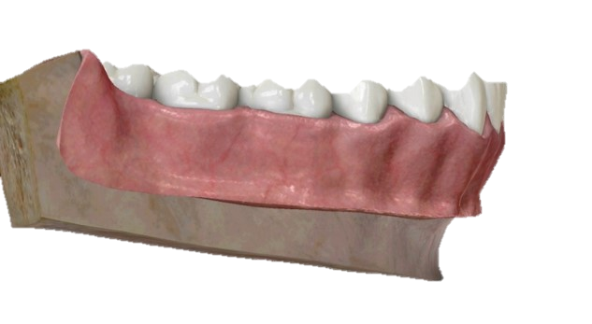
L’odontoiatra puó fare screening tramite questionari (Berlino..), riconoscere fattori predisponenti e valutare indicazioni uso OA;
RETROGNAZIA
PALATO STRETTO

Slide 8
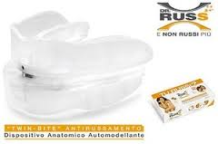
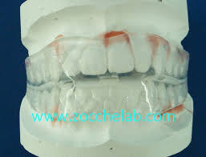
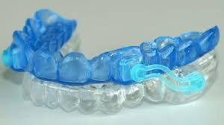
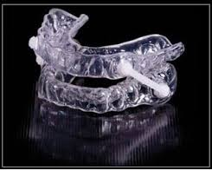
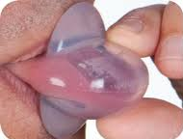
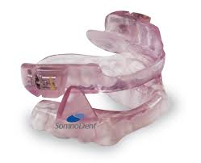
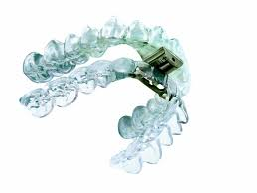
ORAL APPLIANCE

Slide 9
AVANZATORI MANDIBOLARI
RITENTORI LINGUALI

Slide 10
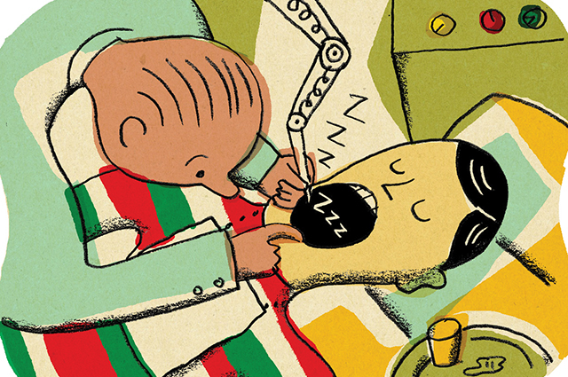
Esame obiettivo
Identificare se esistono le indicazioni per mettere un apparecchio
Presenza di un numero sufficiente di denti (>8 per arcata)
Valutare se non ci sono trattamenti in atto o se necessita trattamenti urgenti (es. carie penetranti, impianti, protesi…)
Stato parodontale
Presenza di protesi fisse o mobili
Dolore a carico dell’ATM o dei muscoli
Entitá della protrusione

Slide 11

1. Presenza di un numero sufficiente di denti (>8 per arcata)

Slide 12
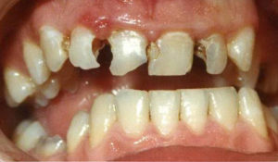
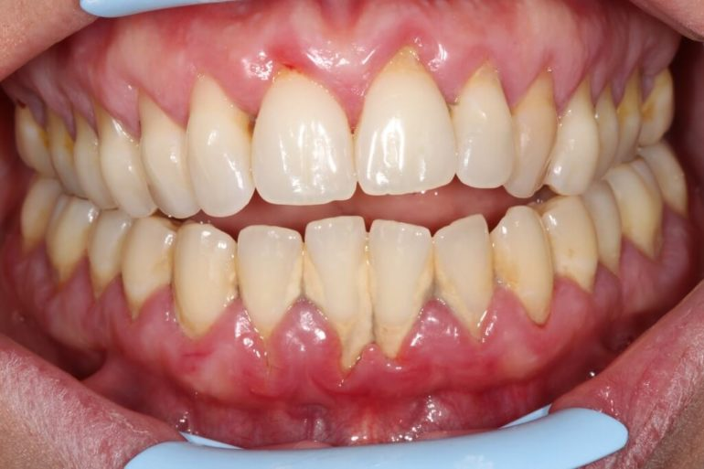
2. Patologie in atto o in fase di trattamento
3. Stato Parodontale

Slide 13
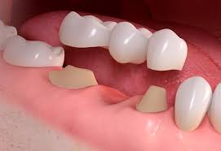
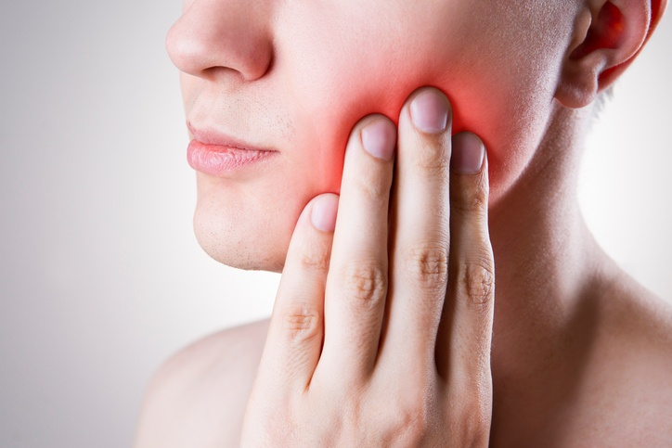
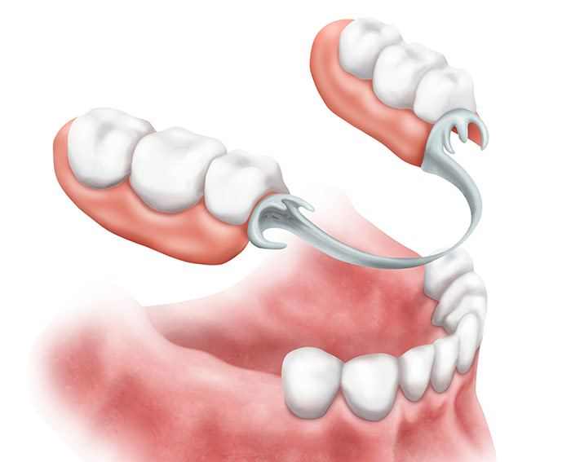
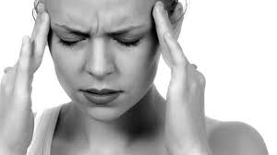
2. Presenza di protesi fisse o mobili
3. Dolore ATM o muscoli

Slide 14
6. Entità protrusione
Con protrusione inferiore ai 5 mm l’efficacia dell’apparecchio sarà sfavorevole

Slide 15
AVANZATORI MANDIBOLARI
RITENTORI LINGUALI

Slide 16
RITENTORI LINGUALI
AVANZATORI MANDIBOLARI
Paz edentuli
Con protrusione limitata
100% respiratori nasali
AHI < 30 (*Cunha et al 2017)
Intolleranti alla cPAP
soddisfino condizioni suff.
- EFFICACI
+ EFFICACI
Cunha T, C, A. et al. Predictors of succecc for mandibular repositioning appliance in obstructive sleep apnea syndrome. Braz. Oral Res. 2017; 31-37.

Slide 17
COMPLICAZIONI
Tipo 1 | Tipo 2 | Tipo 3
Ipersalivazione | Dolore articolare | Cambio di posizione mandibolare
Bocca secca | Dolore muscolare | Alterazione nella posizione dei denti
Pressione sui denti |  | Diminuzione della distanza tra incisivi sup e inf
Lieve dolore sui denti o sulle mucose
Scomfort occlusale al mattino
Indesiderate ma reversibile se trattate
Stati più severi, diff. Rev o irreversibile
Normali, temporanee
Adattamento all’apparecchio
Godolfin L. R. Disturbìos do sono e a odontologia. Tratamento do ronco e a apneia do sono. Santos Editora p 113.

Slide 18

Pazienti portatori discontinui di OA:
lamentano che gli OA sono fastidiosi da usare
Ritengono che gli OA sono poco o scarsamente efficaci
T= 12 mesi poi interrotto
*Nishigawa K, et al. Complications causing patients to discontinue using oral appliances for treatment of obstructive sleep apnea. J. Prost. Res. 2017:(61) 133-138.

Slide 19

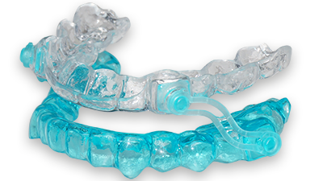
Dr.ssa Martina Caneva
AIM OF THE STUDY
AIM
to evaluate the efficacy of obstructive sleep apnea syndrome treatment with the use of a specific type of oral appliance, through the assessment of:
polisomnographic datas
symptoms reduction
detection of salivary markers of oxidative stress

Slide 20
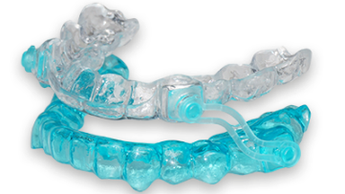
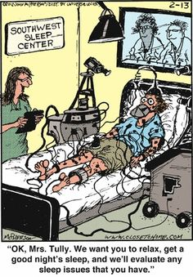
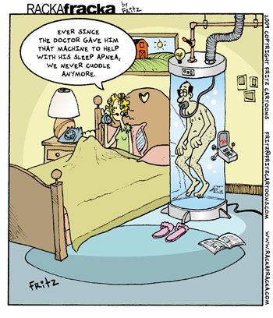
Dr.ssa Martina Caneva
MATERIALS AND METHODS
The study was performed between July 2015 and September 2017 in collaboration with the Pneumologic Department of Cattinara Hospital inTrieste
the diagnosis of OSAS was realized by the use of a domiciliar polysomnography system, SOMNOlab 2 (Weinmann, Hamburg, Austria).
INCLUSION CRITERIA
mild (AHI ≥ 5 and < 15) or moderate (AHI ≥ 15 and ≤ 30) OSAS
severe (AHI > 30) OSAS not tolerating CPAP
absence of grade III tooth mobility
absence of acute TMD
adequate number of teeth (20)

Slide 21

Dr.ssa Martina Caneva
MATERIALS AND METHODS
T1: 1 month from T0
T2: 2 months from T0
T3: 6 months from T0
POLYSOMNOGRAPHIC DATAS | TOTAL AHI
 | SUPINE AHI
 | NON SUPINE AHI
 | ODI
 | TIME WITH SaO₂ < 90%
GENERAL INFORMATIONS | AGE
 | SEX
 | BMI
ANATOMICAL FEATURES ORAL CAVITY | MALLAMPATI SCORE
 | DENTAL OCCLUSION CLASS
 | MANDIBULAR ADVANCEMENT (cm)
 | TOOTH MOBILITY
 | TEMPOROMANDIBULAR DISORDERS (TMD)
 | NUMBER OF ELEMENTS
 | PSR
1° visit
2° visit
T0
T1
T2
T3
General health
Symptoms
Polysomnographic datas
General informations
Anatomical features oral cavity

Slide 22
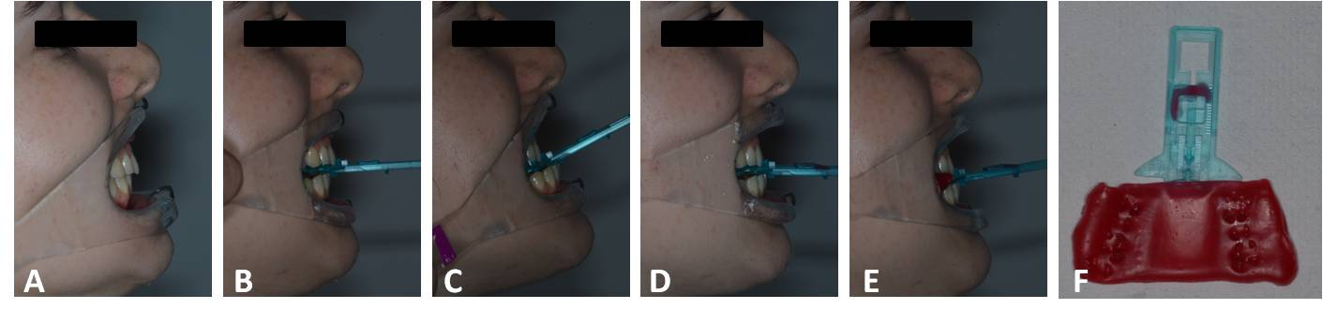
Dr.ssa Martina Caneva
MATERIALS AND METHODS
T1: 1 month from T0
T2: 2 months from T0
T3: 6 months from T0
1° visit
2° visit
T0
T1
T2
T3
General health
Symptoms
Polysomnographic datas
General informations
Anatomical features oral cavity
Alginate impressions and mandibular advancement determination

Slide 23
Dr.ssa Martina Caneva
MATERIALS AND METHODS
T1: 1 month from T0
T2: 2 months from T0
T3: 6 months from T0
1° visit
2° visit
T0
T1
T2
T3
General health
Symptoms
Polysomnographic datas
General informations
Anatomical features oral cavity
Delivering of the mandibular advancement device
Saliva collection
Compliance
Symptoms
Mandibular advancement
Saliva collection
BMI
Compliance
Symptoms
Mandibular advancement
Saliva collection
2° POLYSONMOGRAPHY
Alginate impressions and mandibular advancement determination
Compliance
Symptoms
Mandibular advancement
Saliva collection

Slide 24
Dr.ssa Martina Caneva
RESULTS
19 PATIENTS
AGE: mean 58.8
SEX: 74.4% male
BMI: Stable between T0 and T3
63.2% > 25
SEVERITY: 7 (36.8%) were severe; 7 (36.8%) were moderate; 5 (26.3%) were mild
MA: mean 0.4 cm
The majority of patients showed a IV class of Mallampati score and II Angle class

Slide 25
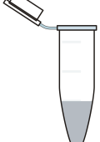
Dr.ssa Martina Caneva
MATERIALS AND METHODS
SALIVA PROTOCOL:
Collection under fasting conditions, before tooth brushing and avoiding smoking, excess alcohol intake and physical activity the evening before.
1 minute rinse and 5 minutes of spitting the unstimulated saliva in a collection tube.
The samples were poured in a Eppendorf tube and stored frozen as soon as possible at -20°C

Slide 26
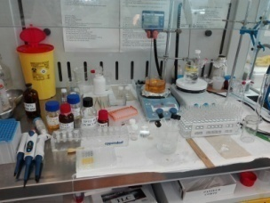
Dr.ssa Martina Caneva
MATERIALS AND METHODS
SALIVA PROTOCOL:
5 different protocols were tested:
AOPP (Advanced Oxidation Protein Products)
TBARS (Thiobarbituric Acid Reacting Substances)
AGE (Advanced Glycation End-products)
TOS (Total Oxidant Status)
FRAS (Ferric Reducing Ability of Saliva)
Wavelength spectrophotometric analysis
340 nm
(λex =525 nm, λem = 580-640 nm)
(λex =365 nm, λem = 410-460 nm)
560 nm and 750 nm
600 nm

Slide 27
Dr.ssa Martina Caneva
MATERIALS AND METHODS
OUTCOMES:
SYMPTOMS REDUCTION
AHI REDUCTION
ODI REDUCTION
INFLUENCE OF SLEEP POSITION
SALIVARY OXIDATIVE MARKERS REDUCTION
RELATIONSHIP BETWEEN OXIDATIVE STRESS MARKERS CONCENTRATION AND AHI VARIATION
CORRELATION BETWEEN AHI AND BMI
CORRELATION BETWEEN AHI AND MANDIBULAR ADVANCEMENT (MA)
 | GR | BR
Mean AHI % reduction | 80% | 50%

Slide 28
Dr.ssa Martina Caneva
SYMPTOMS REDUCTION
RESULTS
Symptoms variation between T0 and T3 reported by every patient.

Slide 29
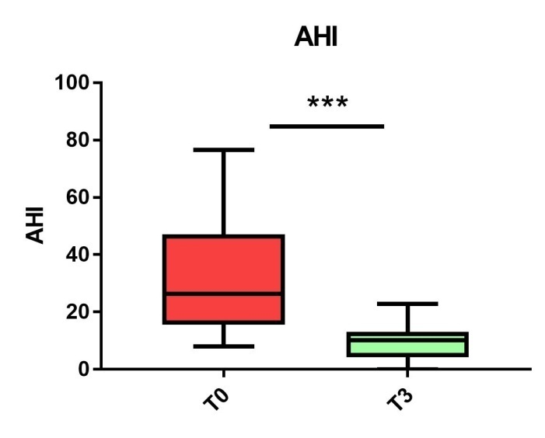
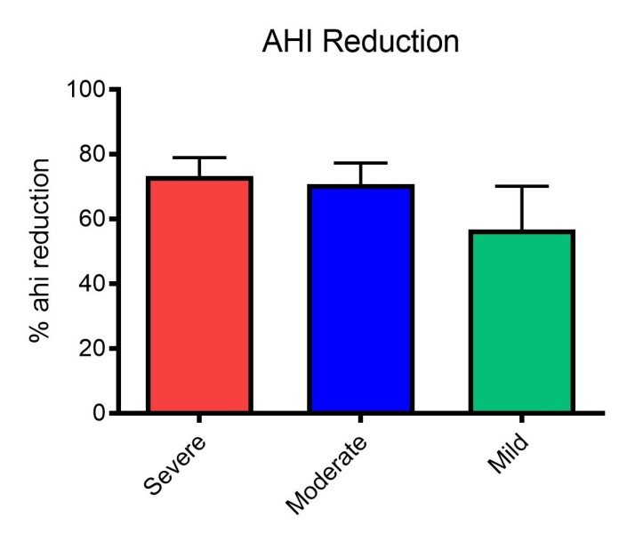
Dr.ssa Martina Caneva
RESULTS
AHI REDUCTION: 68.6%
AHI distribution at T0 and T3. (* p < 0.05)
AHI mean percentage reduction for severe, moderate and mild patiens

Slide 30
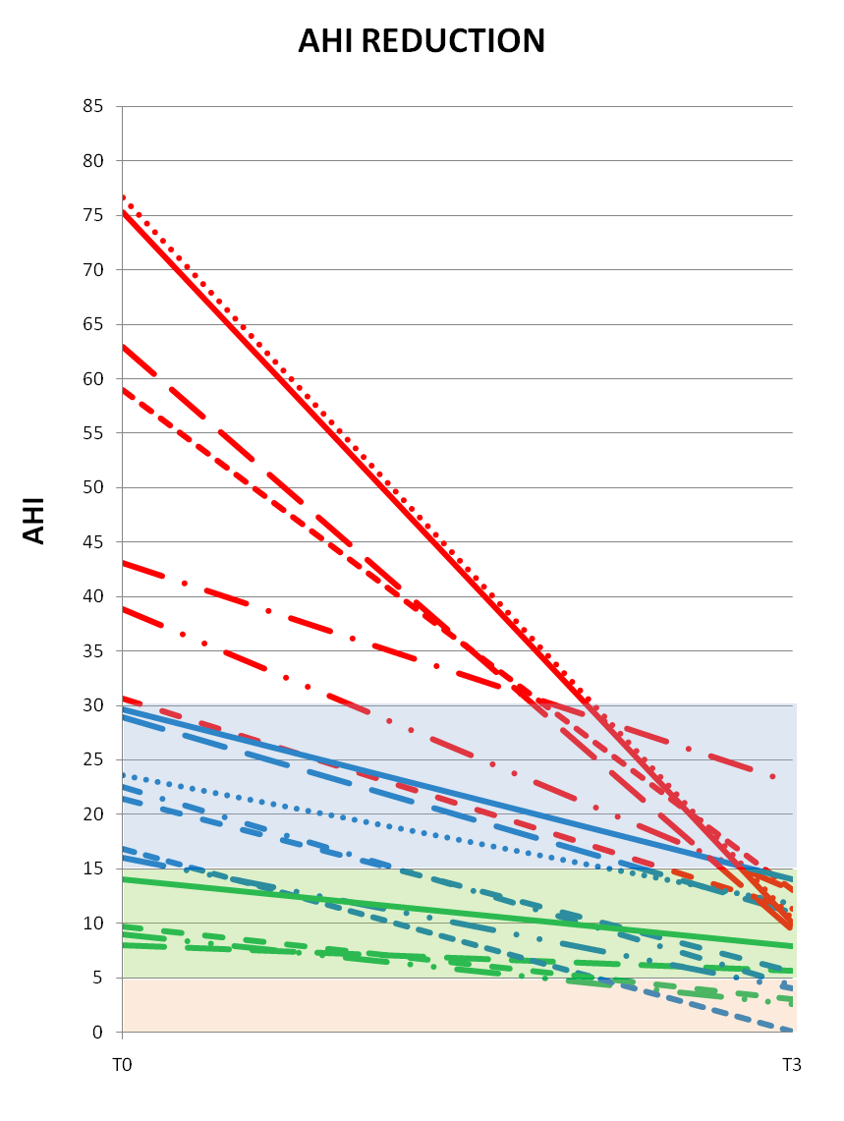
Dr.ssa Martina Caneva
RESULTS
T0
SEVERE
MODERATE
MILD
T3
MODERATE
MILD
PHYSIOLOGICAL

Slide 31
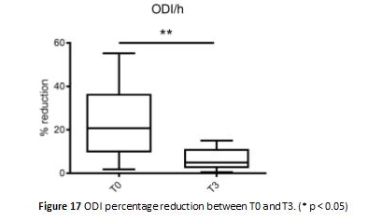
Dr.ssa Martina Caneva
3. ODI REDUCTIONS: 48,2%
RESULTS
Notes:
ODI: Oxigen desaturation Index

Slide 32
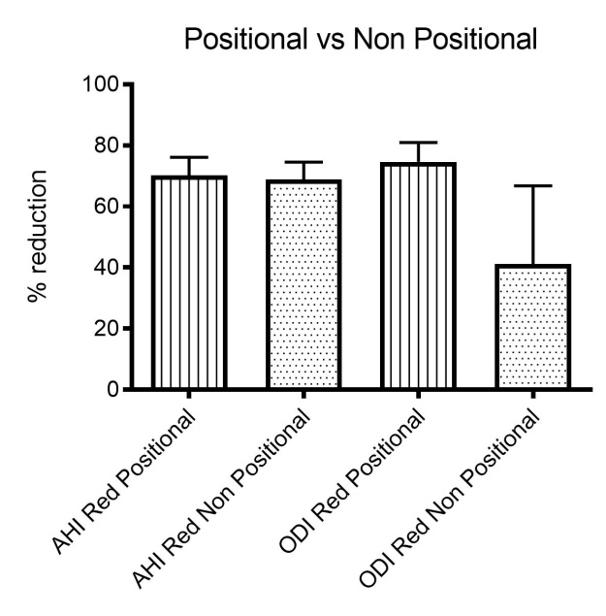
Dr.ssa Martina Caneva
RESULTS
INFLUENCE OF SLEEP POSITION
AHI mean percentage reduction and ODI mean percentage reduction between T0 and T3 in Positional and Non Positional patients. No statistically significant (>0,05)
Notes:
In quelli posizionali c’è un maggior calo del AHI e di ODI ma non statisticamente significativo

Slide 33
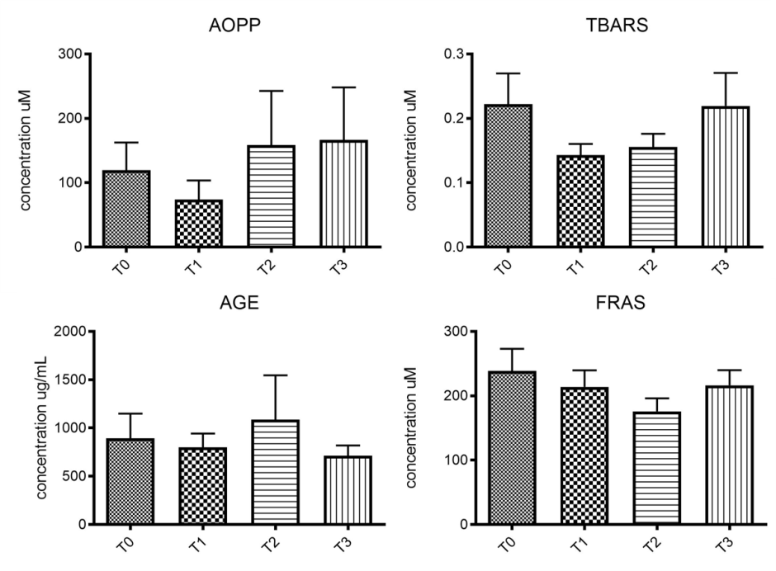
Dr.ssa Martina Caneva
RESULTS
SALIVARY OXIDATIVE MARKERS REDUCTION
 | T0 |  | T1 |  | T2 |  | T3
 | Mean | St.dv | Mean | St.dv | Mean | St.dv | Mean | St.dv
AOPP (μM) | 119.69 | 128.72 | 74.12 | 88.50 | 158.57 | 252.32 | 166.70 | 244.31
TBARS (μM) | 0.222 | 0.135 | 0.143 | 0.050 | 0.156 | 0.058 | 0.219 | 0.145
AGE (μg/mL) | 659.53 | 338.21 | 715.53 | 389.27 | 636.99 | 288.38 | 658.78 | 300.82
TOS (μM) | 0.054 | 0.024 | 0.036 | 0.007 | 0.029 | 0.025 | 0.025 | 0.005
FRAS (μM) | 238.71 | 109.16 | 213.86 | 81.58 | 175.96 | 64.13 | 216.27 | 74.50
Mean concentrations values and standard deviation (St. dv) of AOPP, TBARS, AGE, TOS and FRAS for all the different follow up times.

Slide 34
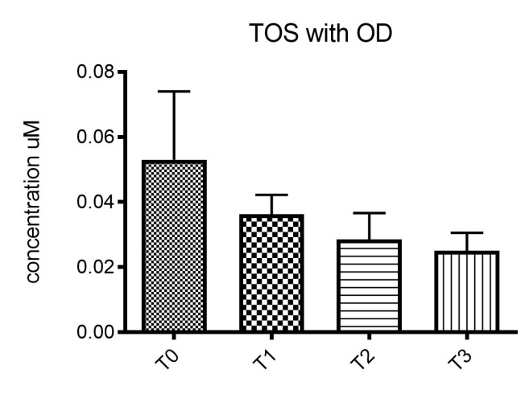
Dr.ssa Martina Caneva
RESULTS
SALIVARY OXIDATIVE MARKERS REDUCTION
Notes:
TOS: Total Oxidant Status

Slide 35
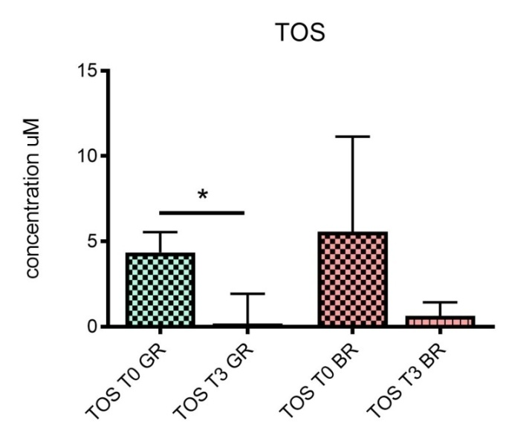
Dr.ssa Martina Caneva
RELATIONSHIP BETWEEN OXIDATIVE STRESS MARKERS CONCENTRATION AND AHI VARIATION
RESULTS
GR: Good Responders
BR: Bar Responders
Mean TOS concentration at T0 and T3 in GR and BR. (* p < 0.05)
Notes:
Per valutare se la concentrazione dei marker è relazionata alla variazione di AHI determinata dall’uso di OA, la concentrazione media dei diversi marker è stata relazionata nei paz GR e BR a T0e T3 e si è visto che per TOS c’era una diff stat sign solo nei GR

Slide 36
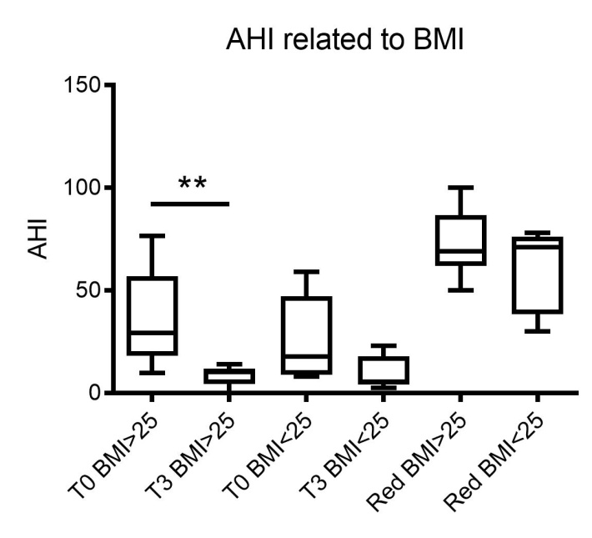
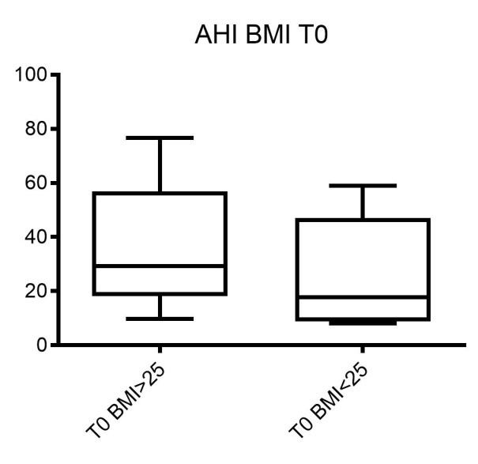
Dr.ssa Martina Caneva
CORRELATION BETWEEN AHI AND BMI
RESULTS
AHI distribution at T0 in patients with a BMI > 25 or < 25.
AHI distribution at T0 and T3 in patients with a BMI > 25 or < 25 and AHI percentage reduction in patients with a BMI > 25 or < 25.

Slide 37
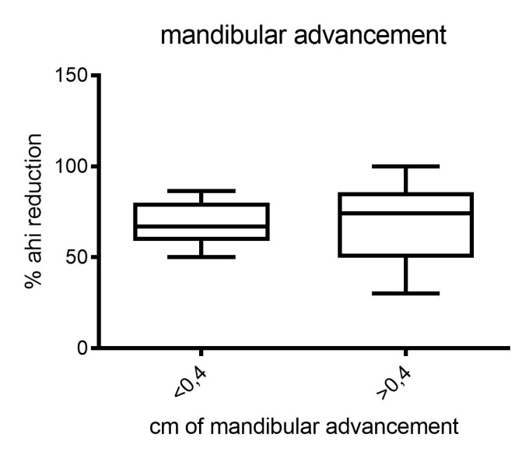
Dr.ssa Martina Caneva
CORRELATION BETWEEN AHI AND MANDIBULAR ADVANCEMENT (MA)
RESULTS
AHI percentage reduction related to the centimeters of mandibular advancement.
AHI percentage reduction in patients with a mandibular advancement less than 0.4 cm or more than 0.4 cm.

Slide 38
Dr.ssa Martina Caneva
CONCLUSIONS
Oral appliance is an effective option in obstructive sleep apnea treatment, being able to reduce the mean initial AHI of about 70% and to allow severe patients to fall within the mild range.
The difference in mean percentage of AHI reduction in mild, moderate or severe patients was not statistically significant.
Slightly better results were obtained for positional patients.
No linear correlation was found between the AHI reduction and entity of mandibular advancement (MA)
A good response of the OA therapy was observed also in overweight patients
TOS might represent a suitable protocol to discriminate good or bad responders of OA therapy.

Slide 39

GRAZIE PER L’ATTENZIONE

