Slide 1


Revisione dei Trial Clinici sulle Malattie Ostruttive dell’ultimo anno
Antonio Spanevello
Università degli Studi dell’Insubria , Varese - Como
Dipartimento di Medicina e Chirurgia
Istituti Clinici Scientifici Maugeri, IRCCS, Tradate
Dipartimento di Medicina e Riabilitazione Cardiorespiratoria

Slide 2
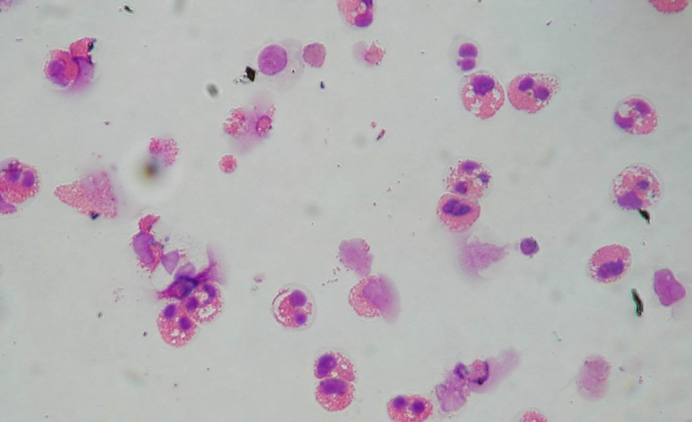
ASTHMA

Slide 3
QUADRUPLING INHALED GLUCOCORTICOID DOSE TO ABORT ASTHMA EXACERBATIONS
N Engl J Med 2018;378:902-10.
Tricia McKeever, Ph.D., Kevin Mortimer, Ph.D., Andrew Wilson, M.D., Samantha Walker, Ph.D., Christopher Brightling Ph.D., Andrew Skeggs, B.Sc., Ian Pavord, F.Med.Sci., David Price, F.R.C.G.P., Lelia Duley, M.D., Mike Thomas, Ph.D., Lucy Bradshaw, M.Sc., Bernard Higgins, Ph.D., Rebecca Haydock, B.Sc., Eleanor Mitchell, B.A., Graham Devereux, Ph. D., and Timothy Harrison, M.D.
The Authors tested the concept that a plan for patients to manage their asthma (self-management plan), which included a temporary quadrupling of the dose of inhaled glucocorticoids when asthma control started to deteriorate, would reduce the incidence of severe asthma exacerbations among adults and adolescents with asthma.
1871 adults and adolescents with asthma who were receiving ICS with or without add on therapy, and who had had at least one exacerbation in the previous 12 months were enrolled

Slide 4
Zone 1 described well-controlled asthma and recommended continuation of current treatment.

Slide 5
Zone 2 described deteriorating asthma control and recommended increased bronchodilator medication and an increase in the dose of inhaled glucocorticoids by a factor of 4 (quadrupling group) or increased bronchodilator medication alone (non-quadrupling group).
Notes:
47% of the participants had a peak-flow value recorded on activation of zone 2 of their self-management plan and at least one value on or after day 10 (54% of those in the quadrupling group and 41% of those in the nonquadrupling group).

Slide 6
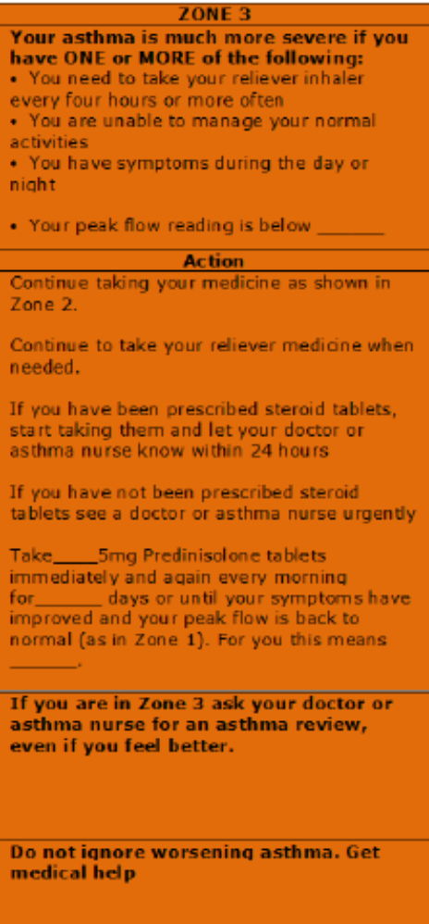
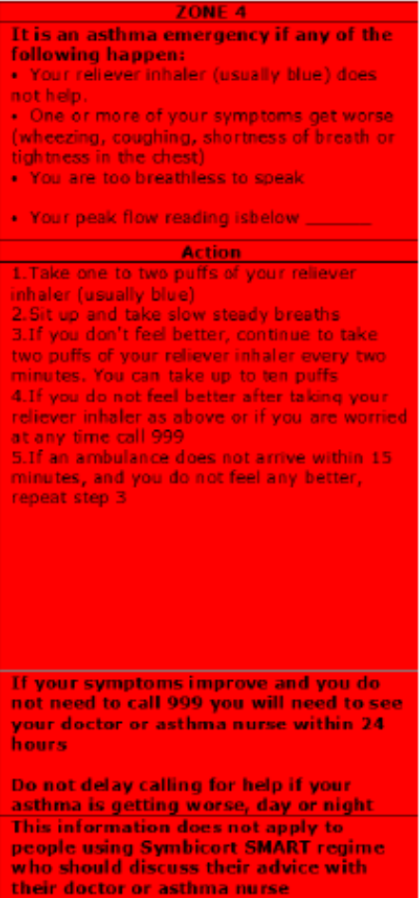
Zones 3 and 4 described the development of an exacerbation and when to start oral glucocorticoids and seek medical interruption (zone 3) and what to do in the event of a life-threatening exacerbation (zone 4).

Slide 7
The primary outcome was the time to a first severe asthma exacerbation, defined as treatment with systemic glucocorticoids or an unscheduled health care consultation for asthma

Slide 9
The number of participants who reported a severe exacerbation of asthma in the year after randomization was 420 (45%) in the quadrupling group as compared with 484 (52%) in the non-quadrupling group, p = 0.002

Slide 10
QUADRUPLING INHALED GLUCOCORTICOID DOSE TO ABORT ASTHMA EXACERBATIONS
N Engl J Med 2018;378:902-10.
Tricia McKeever, Ph.D., Kevin Mortimer, Ph.D., Andrew Wilson, M.D., Samantha Walker, Ph.D., Christopher Brightling Ph.D., Andrew Skeggs, B.Sc., Ian Pavord, F.Med.Sci., David Price, F.R.C.G.P., Lelia Duley, M.D., Mike Thomas, Ph.D., Lucy Bradshaw, M.Sc., Bernard Higgins, Ph.D., Rebecca Haydock, B.Sc., Eleanor Mitchell, B.A., Graham Devereux, Ph. D., and Timothy Harrison, M.D.
A total of 311 participants (33%) in the quadrupling group versus 377 (40%) in the non-quadrupling group started systemic glucocorticoids.
A total of 379 participants (41%) in the quadrupling group versus 442 (47%) in the non-quadrupling group had an unscheduled health care consultation.

Slide 11
QUADRUPLING INHALED GLUCOCORTICOID DOSE TO ABORT ASTHMA EXACERBATIONS
N Engl J Med 2018;378:902-10.
Tricia McKeever, Ph.D., Kevin Mortimer, Ph.D., Andrew Wilson, M.D., Samantha Walker, Ph.D., Christopher Brightling Ph.D., Andrew Skeggs, B.Sc., Ian Pavord, F.Med.Sci., David Price, F.R.C.G.P., Lelia Duley, M.D., Mike Thomas, Ph.D., Lucy Bradshaw, M.Sc., Bernard Higgins, Ph.D., Rebecca Haydock, B.Sc., Eleanor Mitchell, B.A., Graham Devereux, Ph. D., and Timothy Harrison, M.D.
SAFETY
As expected, the quadrupling group had a higher frequency of treatment-related adverse effects , such as oral candidiasis.
Particular attention to the issue of pneumonia, but there was no significant between groups

Slide 12
QUADRUPLING INHALED GLUCOCORTICOID DOSE TO ABORT ASTHMA EXACERBATIONS
N Engl J Med 2018;378:902-10.
Tricia McKeever, Ph.D., Kevin Mortimer, Ph.D., Andrew Wilson, M.D., Samantha Walker, Ph.D., Christopher Brightling Ph.D., Andrew Skeggs, B.Sc., Ian Pavord, F.Med.Sci., David Price, F.R.C.G.P., Lelia Duley, M.D., Mike Thomas, Ph.D., Lucy Bradshaw, M.Sc., Bernard Higgins, Ph.D., Rebecca Haydock, B.Sc., Eleanor Mitchell, B.A., Graham Devereux, Ph. D., and Timothy Harrison, M.D.
CONCLUSIONS
A temporary quadrupling of the dose of inhaled glucocorticosteroids when asthma control started to deteriorate resulted in fewer severe asthma exacerbations than a plan in which the dose was not increased.

Slide 13
DISCUSSION
The main strength of our trial is its pragmatic design and 80% recruitment in primary care, giving it considerable external validity.
Broad inclusion criteria ensured that the trial results are applicable to adult patients with a clinical diagnosis of asthma who are taking any licensed dose of inhaled glucocorticoids, with or without add-on medication and regardless of smoking status.
We minimized trial visits after training participants to follow a personalized self-managemente plan to reflect follow-up in clinical practice.

Slide 14
DISCUSSION
Our finding that approximately 50% of the patients included in the trial had an exacerbation, within a year, that led to treatment with oral glucocorticoids or an unscheduled health care consultation confirms that our inclusion criteria identified a group of patients at high risk for an asthma exacerbation and is consistent with generally poor asthma control reported in many asthma surveys.

Slide 15
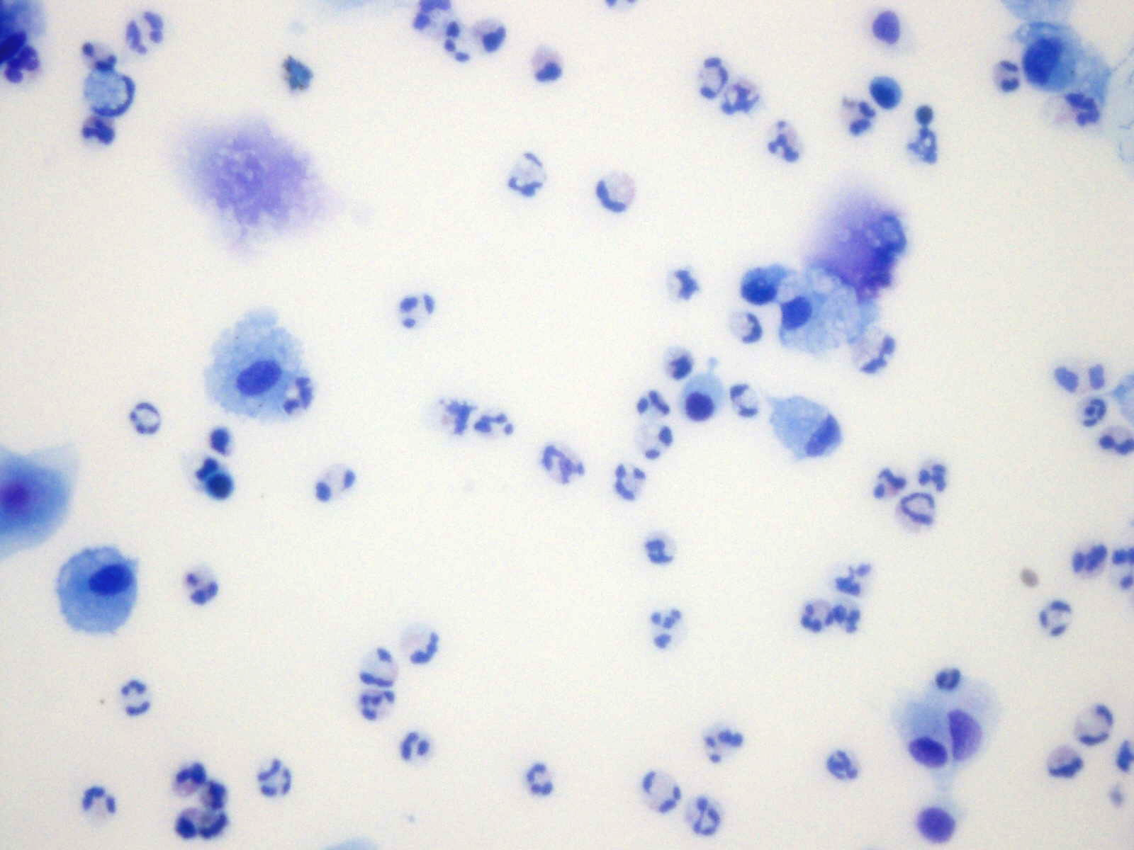
COPD

Slide 16
URTI: viral upper respiratory infections

Slide 17
Stolz D, et al.
Rationale
A growing body of evidence implicates viral respiratory tract infections as the predominant risk factor associated with exacerbations of COPD and the development of chronic airway disease.

Slide 18
Stolz D, et al.
Rationale
Combination therapy with high-dose inhaled corticosteroids ICS) and long-acting β₂ agonists (LABA) reduces the incidence of acute exacerbations in COPD.
However, high dose maintenance ICS have been associated with pneumonia. Thus, reduction of ICS exposure to the minimum required for preventing exacerbations is a goal in the management of COPD.

Slide 19
Stolz D, et al.
Rationale
In asthma, a flexible regimen of ICS and LABA “on-demand” in patients on low maintenance ICS/LABA significantly reduces steroid exposure while leading to a decrease in asthma exacerbation rate as compared to a fix regimen of high maintenance dose ICS/LABA.

Slide 20
Stolz D, et al.
The primary objective of the present study was to investigate whether intensified combinations therapy with ICS/LABA at the onset of URTI could reduce exacerbations in patients with COPD receiving low maintenance dose ICS/LABA.

Slide 21
Stolz D, et al.
At inclusion, all patients were assigned to open-labelled low maintenance dose of ICS/LABA (budesonide 200 μg/formoterol 6 μg, twice-daily), which was continued for the whole duration of the study.
Each patient was block-randomized 1:1 to receive the investigational medicinal product (IMP) as an inhaler intensified dosage of the cmbination ICS/LABA (budesonide 400 μg/formoterol 12 μg) or placebo.
Patients were instructed to keep the IMP at home and to start using the IMP only in case of an URTI symptoms (stuffed or running nose, sniffle, sneeze) for at least 12h twice daily, for 10 days.

Slide 22
Stolz D, et al.
The primary outcome measure was the number of patients that had an exacerbation occurring within 21 days after the onset of a URTI.
The secondary outcome measures were:
number of patients that required hospital admission of any cause within 21 days after URTI onset; (b) change in symptoms scores and lung function parameters; (c) exposure to steroids and antibiotics within 21 days of URTI.

Slide 23
ANY EXACERBATION
The proportion of patients developing any exacerbation following an URTI was 14,58% in the ICS/LABA group as compared to 16,20% in the placebo group (P = ,312).

Slide 24
SEVERE EXACERBATIONS
The percentage of patients who developed a severe exacerbation of COPD within 21 days of an URTI was significantly lower in the ICS/LABA group (2,1%), as compared to the placebo group (6,6%). P = ,010.

Slide 26
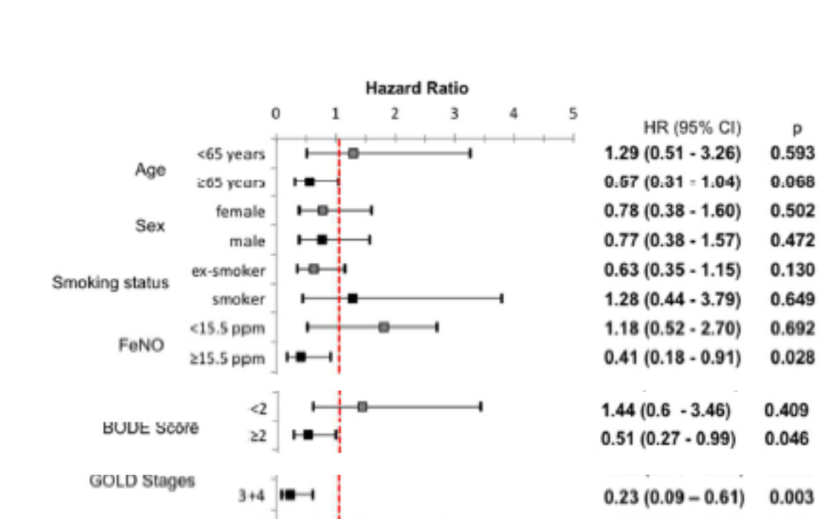
ICS/LABA significantly decreased the risk of any exacerbation in patients: (a) with severe airflow obstruction, i.e. GOLD stage 3 and 4;(b) with higher risk, i.e. GOLD groups C and D; (c) with (BODE ≥ 2 points) and (d) with higher exhaled nitric oxide.
Notes:
However, when the data were analysed by quartiles, there was no direct association of the FeNO
levels and the effect of ICS/LABA on the exacerbation risk (P=.120) (Table E2).

Slide 27
Stolz D, et al.
CONCLUSIONS
Intensified combination therapy with ICS/LABA for 10 days at URTI onset did not decrease the incidence of any COPD exacerbation but prevented severe exacerbation.
Patients with more severe disease had a significant risk reduction for any exacerbation.

