Slide 1
PneumoTrieste 2018
L’adulto con fibrosi cistica
Carlo Castellani
Centro Fibrosi Cistica Verona
Notes:
1

Slide 2
sono sempre di più

Slide 3
Dodge J et al. Eur Respir J 2007; 29: 522-6
Notes:
3

Slide 4
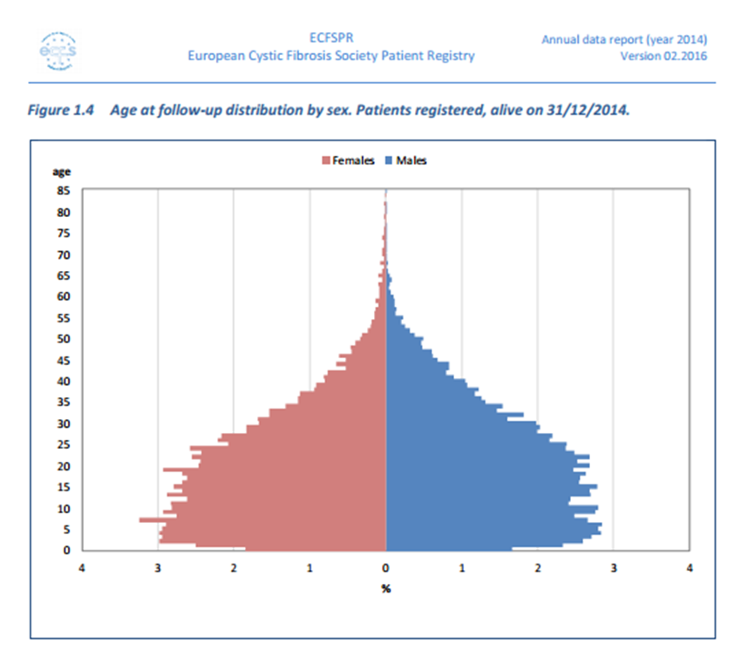
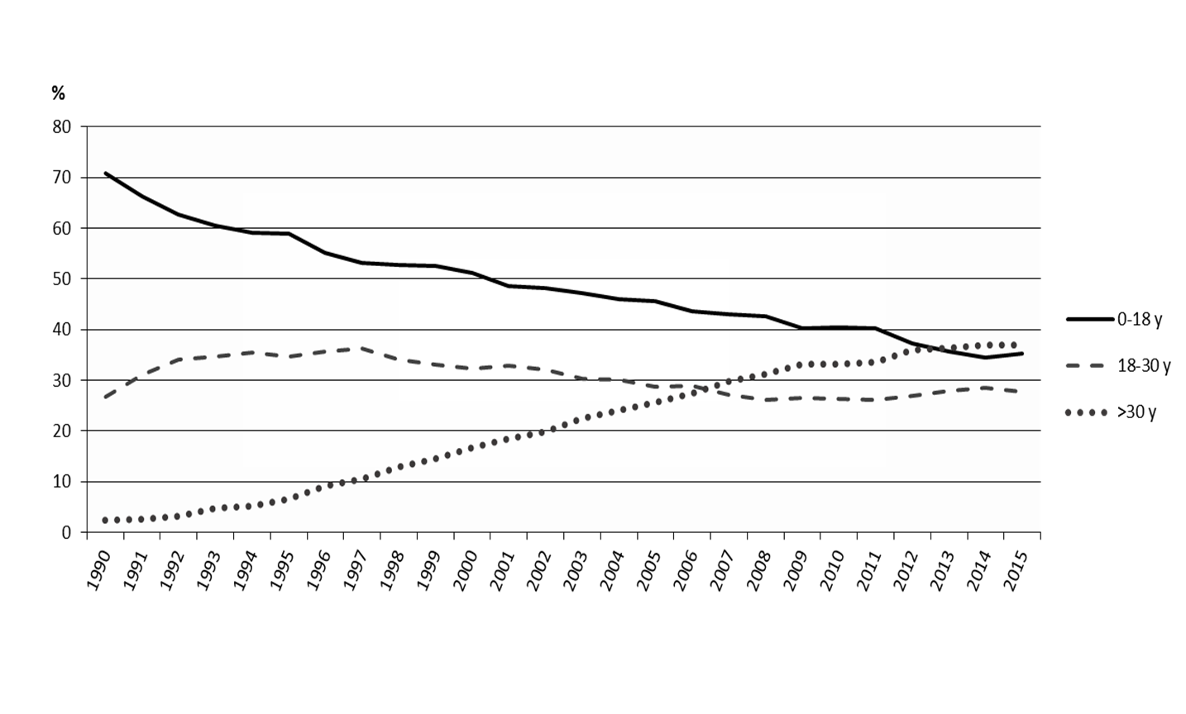

Slide 5
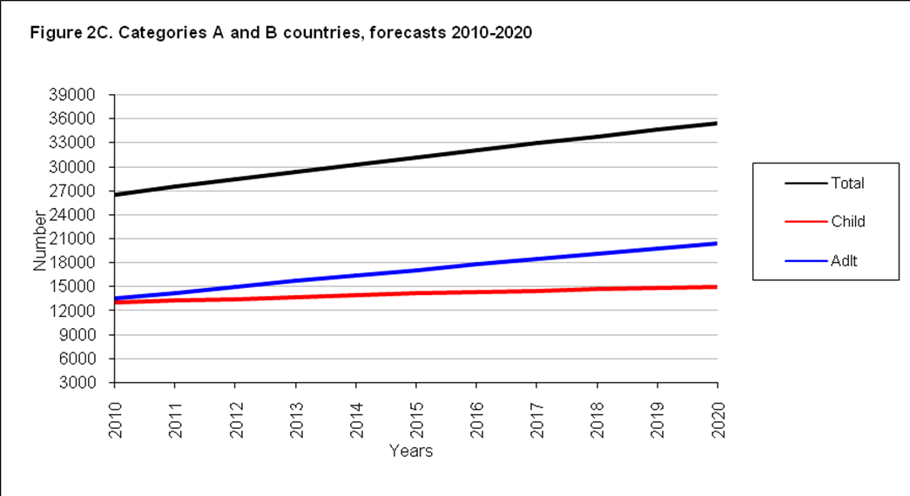
the number of adults is
expected to increase by 75% in the next 10 years
Burgel PR et al. Eur Respir J. 2015; 46:133-41

Slide 6
sono sempre di più
perché?

Slide 7
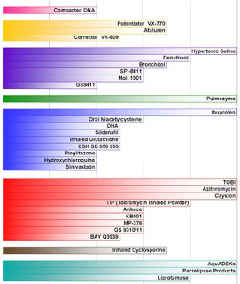
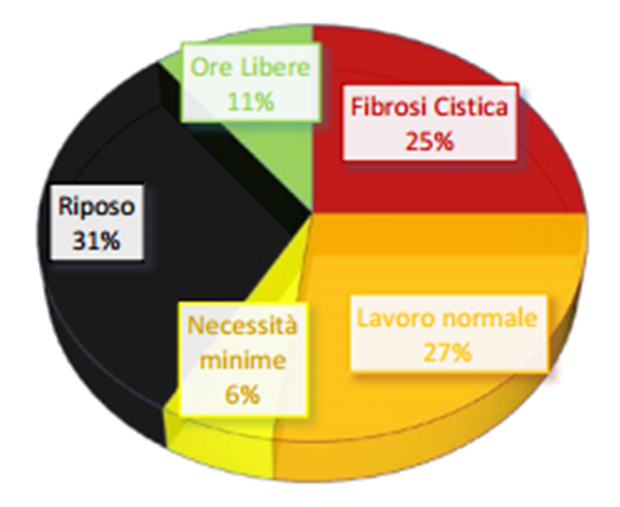
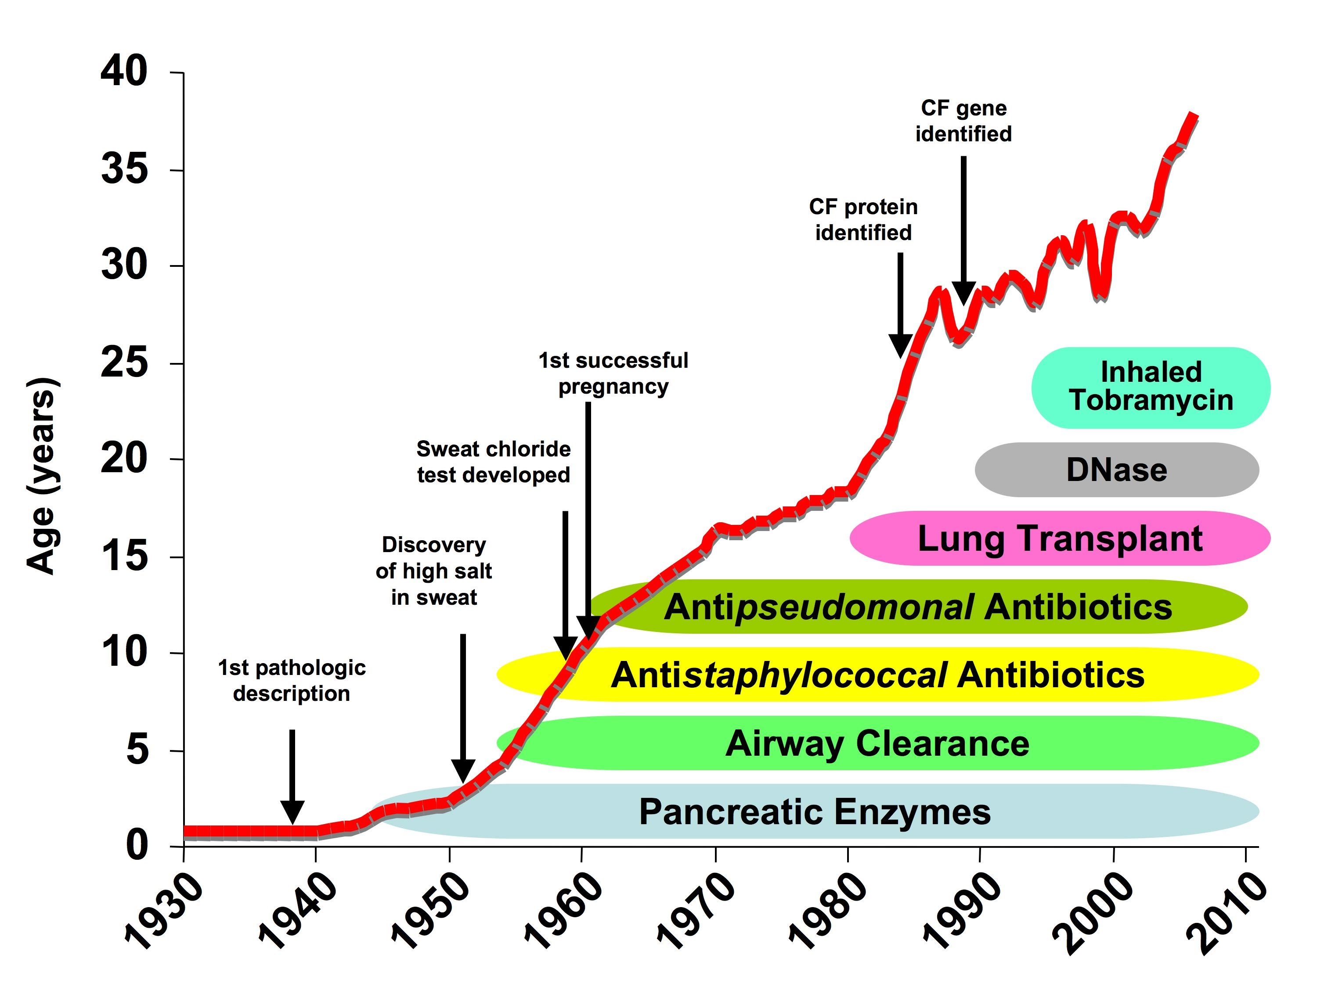

Slide 8
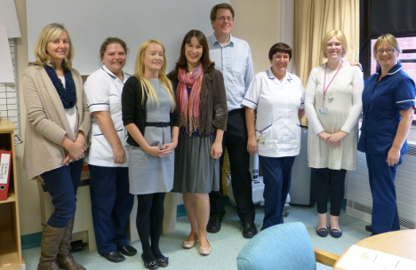
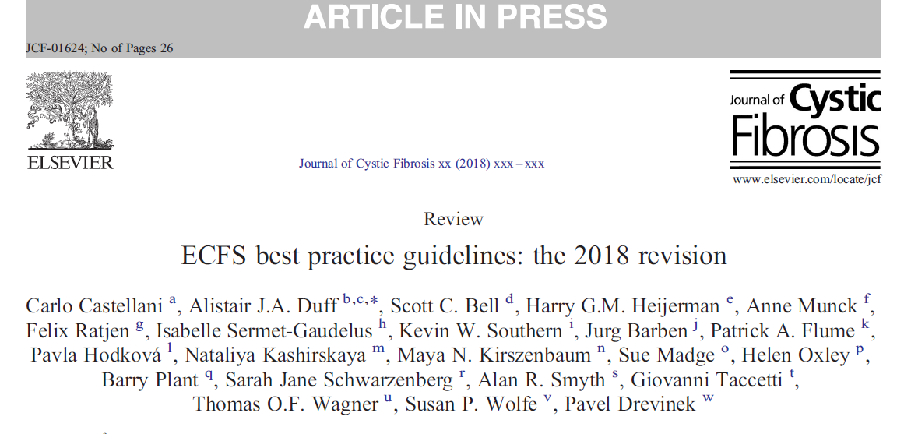
multidisciplinary team (MDT)
clinical director
specialist doctors
specialist nurses
physiotherapists
dieticians
microbiologists
pharmacologists
clinical geneticist
psychologists
social workers

Slide 9
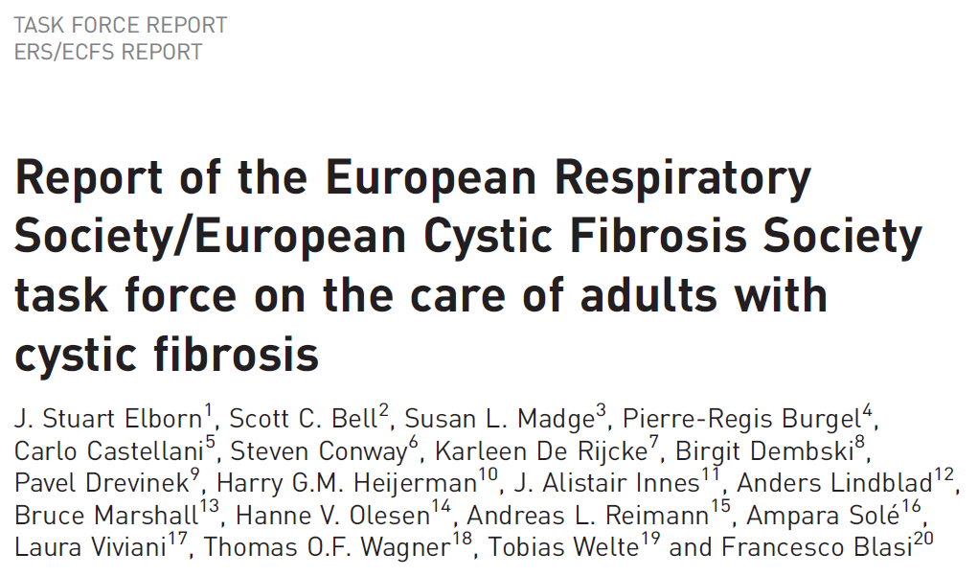
The best model is the establishment of a separate adult service
Transition clinics shared between paediatric and adult teams
There are excellent examples where paediatric teams deliver whole of life care for people with CF
However, in this situation it is important to have appropriately trained physicians, ideally with a background in adult pulmonology, as leaders for delivery of the service to adults with CF.
Other core physician team members could include infectious disease physicians, internists and gastroenterologists
The multi-organ challenges of CF also requires access to specialists from a wide range of disciplines including hepatology, nephrology, endocrinology, particularly diabetes and metabolic bone disease, and ear, nose and throat
Eur Respir J 2016; 47: 420–428

Slide 10
sono sempre di più
perché?
come trovarli

Slide 11
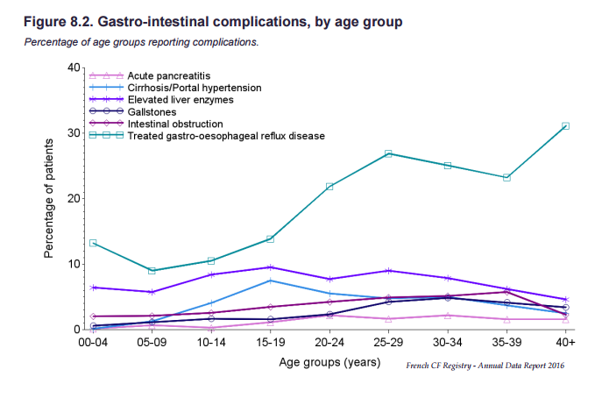
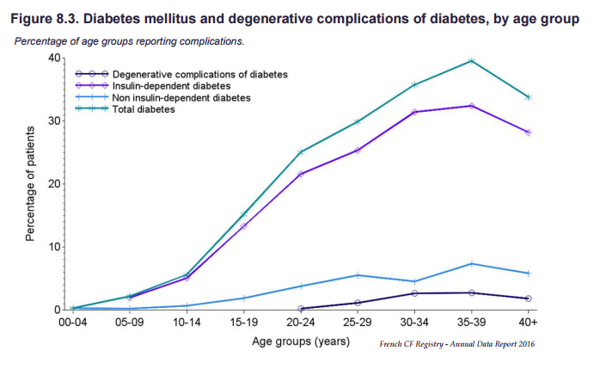
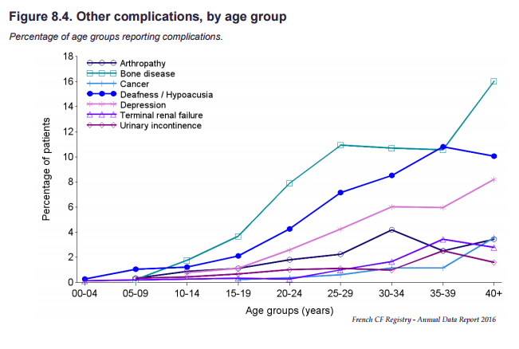

Slide 12
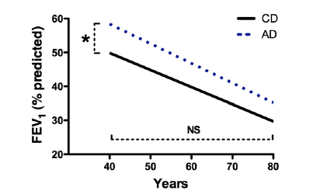
Decline in Lung Function and Cause of Death
AJR C C M Vol 182. pp 614–626, 2010

Slide 13
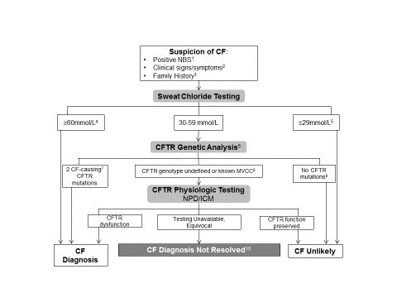

3849+10KbC>T

Slide 14
What does a diagnosis of CF imply?
AR -> parents of the patient are carriers
¼ risk of further CF children
prenatal diagnosis
extended family
children of the patient are (will be) carriers
chronic, life-limiting disease (implications for life plans)
aggressive, time-consuming and expensive treatment
health insurance issues
access to free care (in some countries)

Slide 15
in Italia
sono sempre di più
perché?
come trovarli

Slide 16
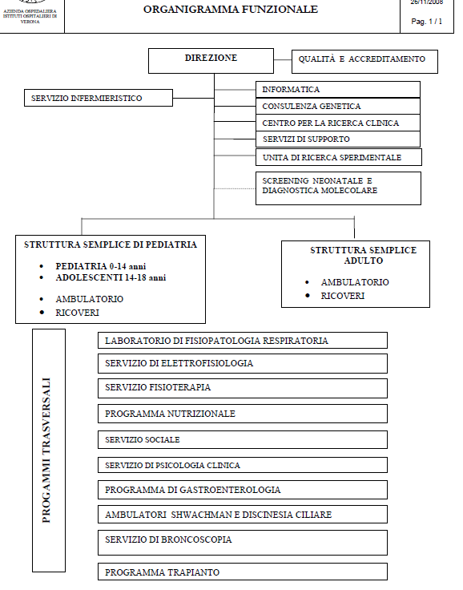

Law 548/93
Not
Just
Care

Slide 17
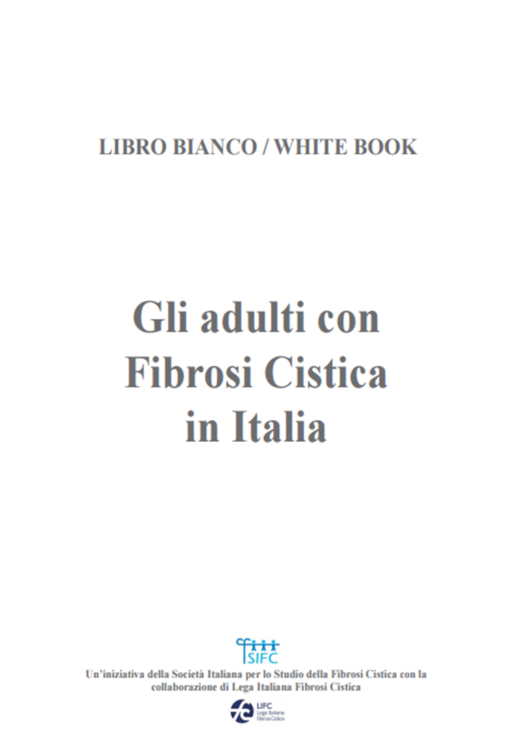
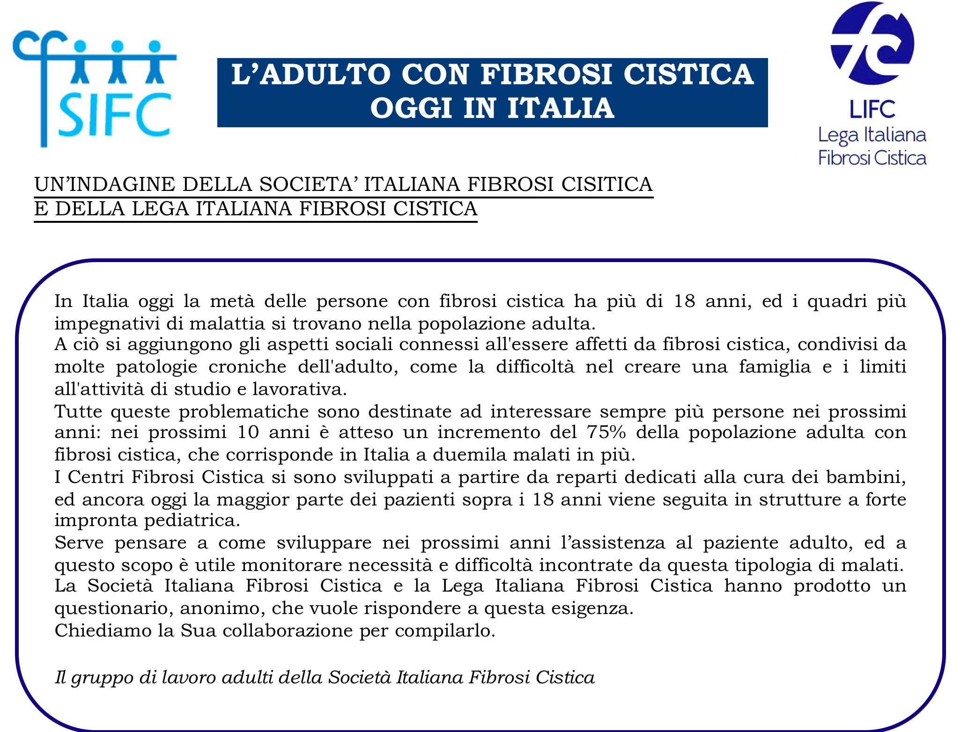
http://www.sifc.it/sites/default/files/libro%20bianco%20definitivo.pdf

Slide 18
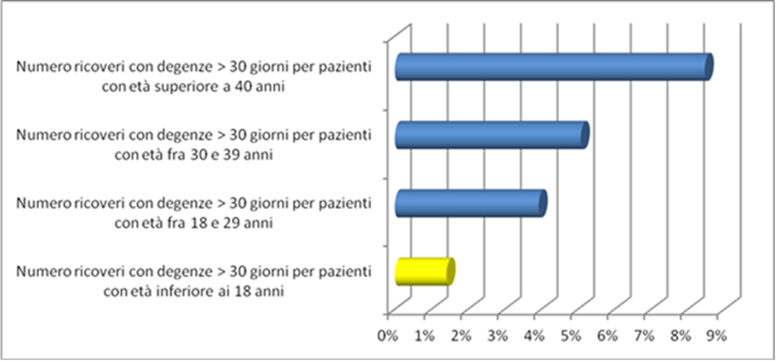
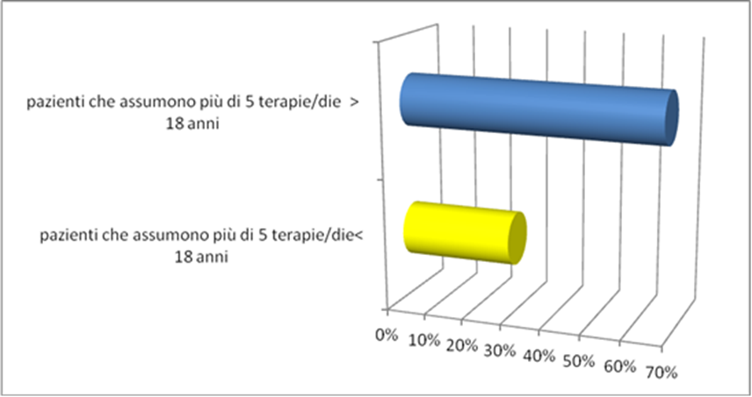
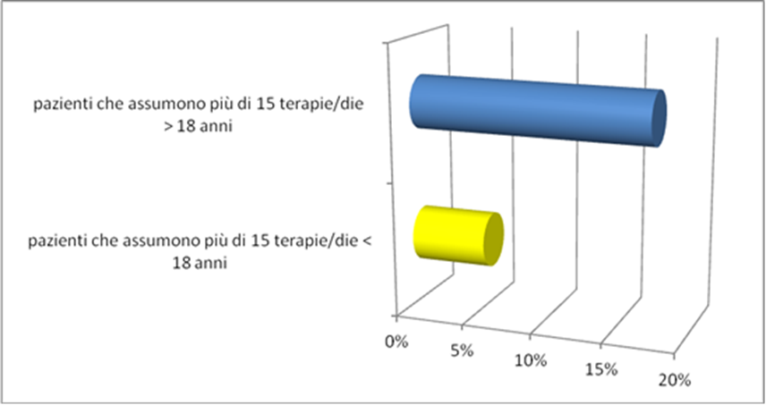

Slide 19
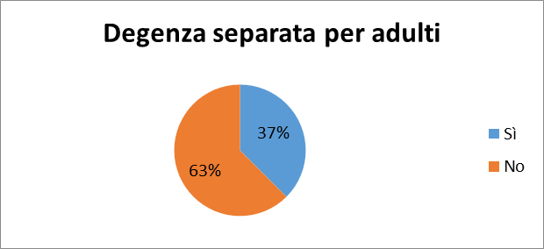
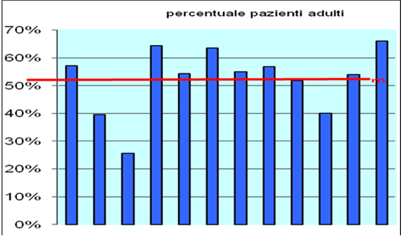
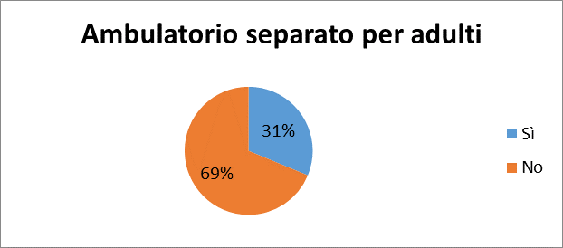
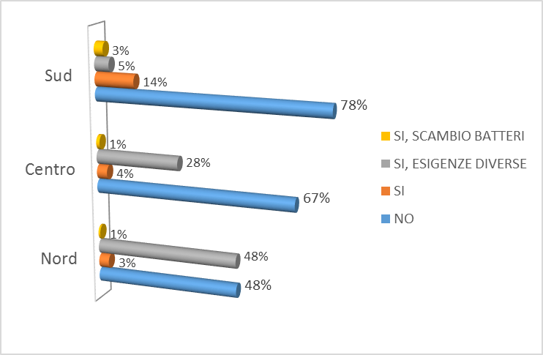
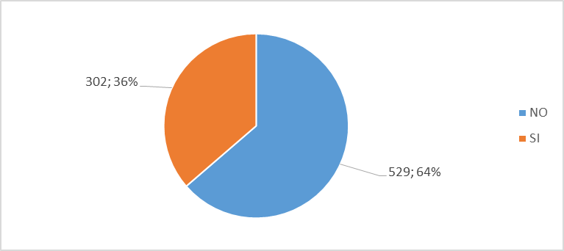
CENTRI MISTI
Patients thinking
it is an issue
being followed
together with CF children
Patients followed by the same doctors
who had followed them as children

Slide 20
2000 more adult patients with CF in the next 10 years
Hard to integrate into paediatric wards
Mixed centres will become adult centres with minor paediatric component
How to integrate adult centres in structures already in place
The «chronic patient» issue

Slide 21
in Italia
sono sempre di più
perché?
quale futuro
come trovarli

Slide 22
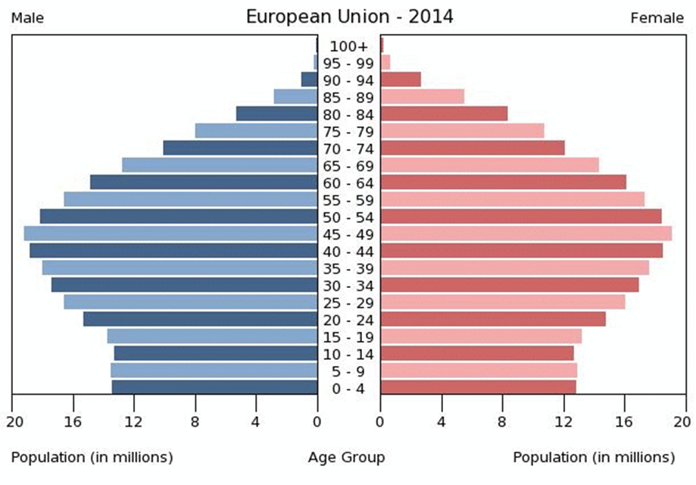
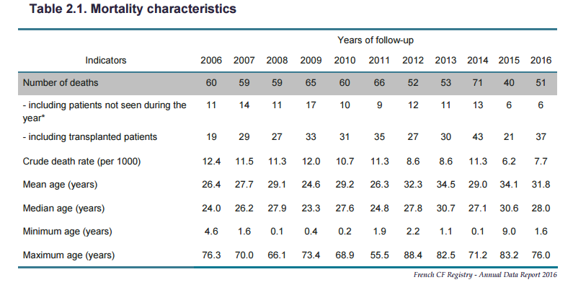

Slide 23

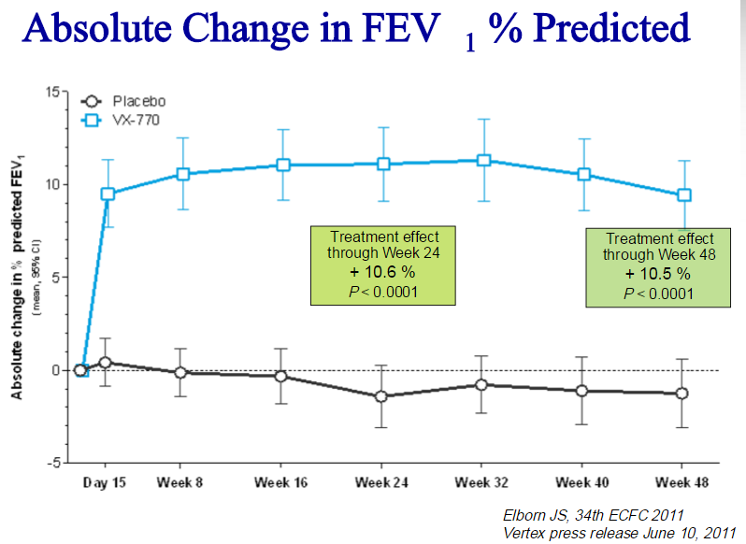
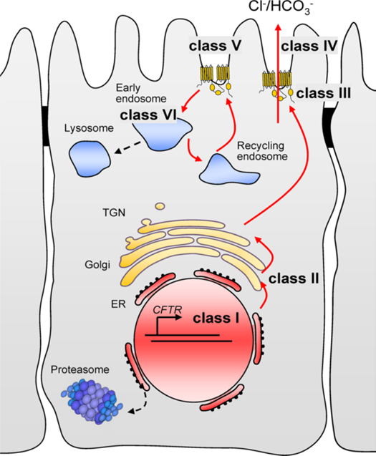
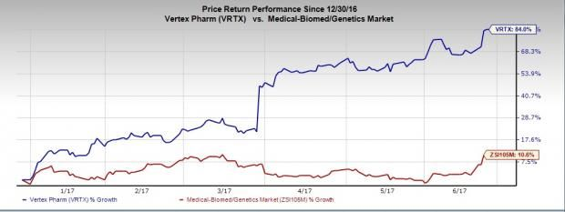

Slide 24
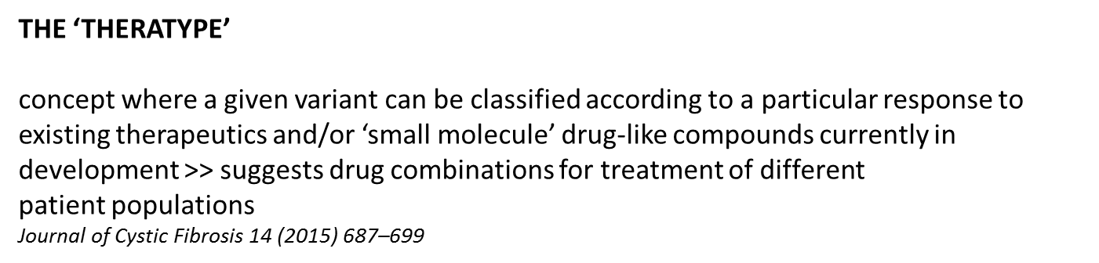
31 possible classes of mutations, including the original classes I, II, III/IV, V, and VI, as well as their 26 combinations
DOI:10.1091/mbc.E14-04-0935

Slide 25
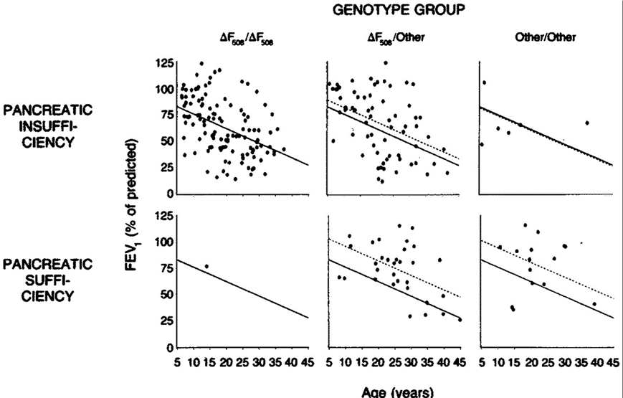
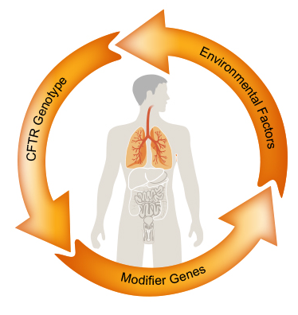

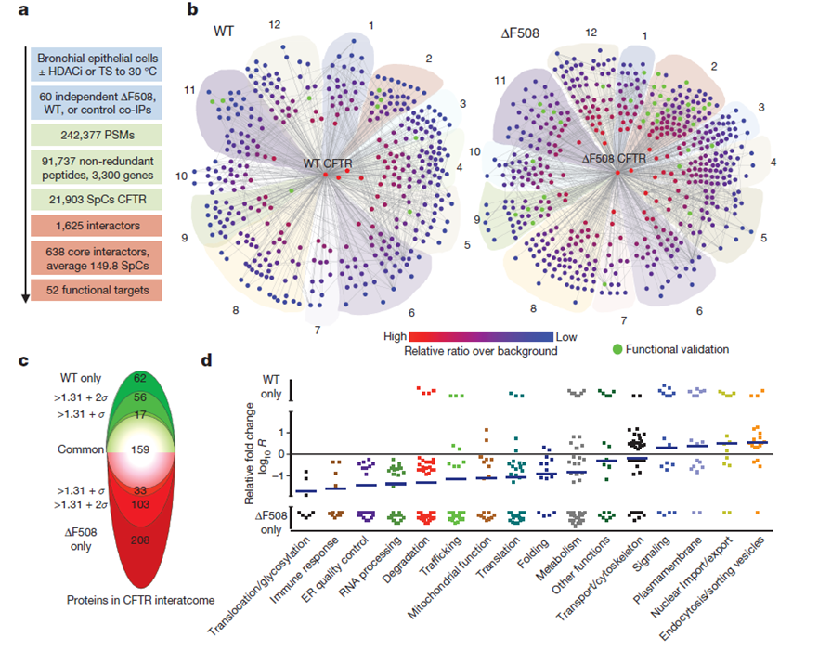
CFTR FUNCTIONAL LANDSCAPE
WT and ΔF508 CFTR interactome in bronchial epithelial cells
(proteins are grouped according to function)
doi:10.1038/nature15729

Slide 26
THE REAL CHALLENGE
is not describing the cystic fibrosis of the future

