Slide 1
Glucocorticoid Treatment in ARDS and Pneumonia
Why, When, Which, How Long
G. Umberto Meduri M.D.
Memphis VA Medical Center - UTHSC
gmeduri@uthsc.edu
Academic Freedom Saves Lives - DOI: 10.13140/RG.2.1.3936.1762

Slide 2
Disclosure - Conflict of Interest
None
Tante Grazie al grande Marco Confalonieri per l’ invito e per organizzare un bel congresso in una bellissima citta'
Academic Freedom Saves Lives - DOI: 10.13140/RG.2.1.3936.1762

Slide 3
Glucocorticoid Treatment in ARDS
How Does it work
Academic Freedom Saves Lives - DOI: 10.13140/RG.2.1.3936.1762

Slide 4






GRα
GRE binding site
Activated GRα
Tug of war
Activated NF- κ B
p65
p50
κB binding site

Slide 5


Regulation of Inflammation by GRα
TNFα and IL-1β
Activation HPA-axis
Ischemia/Reperfusion
Glucocorticoid
Systemic Inflammation
Physical stress
Cell Membrane
NF-κB-GR
IL-10
I-κB
Kinases
TNF−α
IL-1β
IL-6
Kinases
GRα
GRα
p
p
p65
I-κB
I-κB
p65
p50
p50
Glucocorticoid
receptor
mRNA
NF-κB
mRNA
Nucleus
X
TATA
GRE binding site
IκB gene
GRE binding site
IκB gene
p65
p50
κ B binding site
TATA
κB binding site
Notes:
The body needs mechanisms to keep acute inflammation in check,²⁵ and the GC-activated glucocorticoid receptor a (GRa) complex (GC-GRa) is the most important physiologic inhibitor of inflammation²⁶ affecting thousands of genes involved in stress-related homeostasis with more transactivation than transrepression.^{45,46}
It is now appreciated that the ubiquitously present cytoplasmic transcription factors nuclear factor-kB (NF-kB) – activated by inflammatory signals – and glucocorticoid receptor a – activated by endogenous or exogenous glucocorticoids – have diametrically opposed functions that counteract each other in regulating transcription of inflammatory genes
NF-kB is recognized as the principal driver of the inflammatory response, responsible for the transcription of greater than 100 genes, including TNF-a, IL-1β, and IL-6.⁴⁹
NF-kB is a heterodimeric protein composed of the DNA-binding proteins p65 and p50 constitutively present in the cytoplasm in an inactive form stabilized by the binding to the inhibitory protein IkBa.(4). Cellular activation by a multitude of adverse stimuli leads to phosphorylation and proteolytic degradation of IkBa.(4) The liberated NF-kB then translocates into the nucleus and binds to promoter regions of target genes to initiate the transcription of multiple cytokines including tumor necrosis factor-a (TNF-a), and the interleukins (IL) IL-1b, IL-2, IL-6, chemokines such as IL-8, cell adhesion molecules, and inflammation-associated enzymes(4)

Slide 6
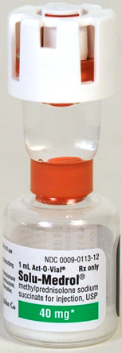
Regulated systemic inflam
IC: progressive reduction
Adaptive response
Disease resolution
GRα
GRE binding site
Activated GRα
Tug of war
Activated NF- κ B
p65
p50
κB binding site
Dysregulated systemic infl.
IC: persistent elevation
Maladaptive response
Disease progression
Trends Endocrinol Metab 2013;24:109-19

Slide 7
Day 1 to 8 - DNA binding: GC-GRα vs. NF-κB
Regulated
NF-κB reduction
Dysregulated
NF-κB increase
7.6
8
5
Improvers - Surv
7.4
Nonimprovers - Surv
3
Nonsurvivors
7.2
1
Log GC-GRα (nuclear)
R
3
5
8
7.0
1
5
8
6.8
3
1
No overlap in GR and NF-kB nuclear binding by d 3-5
6.6
6
7
8
9
10
Log NF-kB (nuclear)

Slide 8
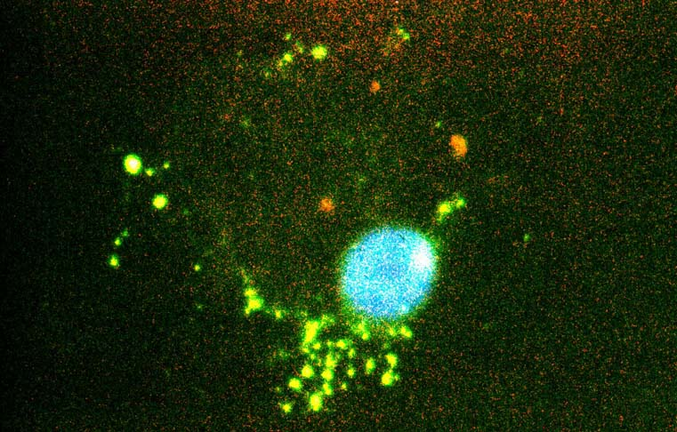
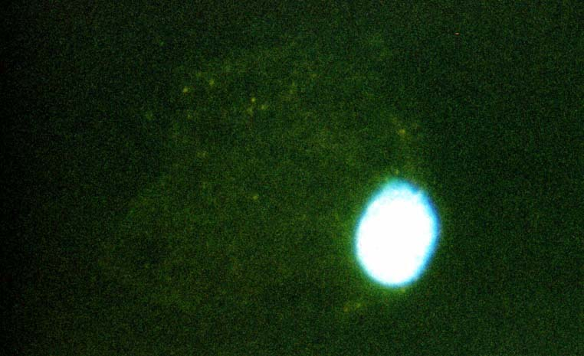
Fluorescent Microscopy
NF-κB localization in ARDS improver
Cytoplasm
Cytoplasm
⇐ nucleus
⇐ nucleus
Nuclear translocation
ARDS Day 1
ARDS Day 10
ARDS Day 10
NF-κB staining with FITC-Ab

Slide 9

Over Time -DNA binding: GC-GRα vs. NF-κB
Response to Prolonged Methylprednisolone Rx
Regulated
NF-kB reduction
Dysregulated
NF-kB increase
7.8
Methylprednisolone
10
7
Placebo
7.6
7.6
8
5
7.4
5
Log GC-GRα DNA binding
3
7.2
Log GC-GRα DNA binding
7.4
1
3
7.0
1
3
5
8
Regulated (N = 7)
6.8
Dysregulated (N =17)
6
7
8
9
7.2
10
Log NF-κB DNA binding
5
7
3
7.0
R
R
6
7
8
R
9
Log NF-κB DNA binding
AJRCCM 2002; 165: 983- 91

Slide 10
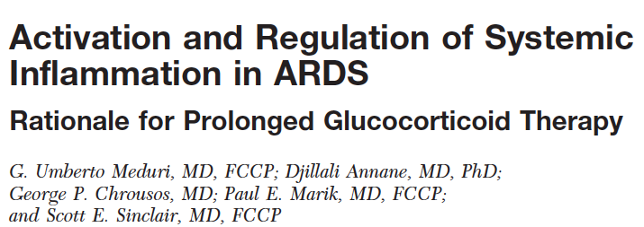
Response to Methylprednisolone Rx
Plasma and BAL measurements in ARDS patients
TNF-α, IL-1β, IL-6, IL-8, sICAM-1, CRP | ⬇⬇
Albumin | ⬆
IL-10; IL-10/IL-1β, IL-10/TNF-α, IL-1ra/IL-1β | ⬆
ACM permeability: BAL albumin, TP, PMN% | ⬇⬇
Surfactant [functional large aggregates] | ⬆
Procollagen type I and III | ⬇⬇
Protein C | ⬆
Plasma only
BAL only
Plasma & BAL
Decreased
Increased
In ARDS, no other Rx has shown this degree of biological response

Slide 11
Consensus Guidelines: ARDS
Recommendation: Conditional
Quality of evidence: Moderate
Pt: Mod.-severe ARDS < Day 14
Drug: Methylprednisolone
Protocol: Suppl. Digital Content 5
Crit Care Med 2017; 45: 2078-2088
Int. Care Med 2016; 42: 829-840

Slide 12
Methylprednisolone Rx - ARDS
Extubated <day 14
Extubated <day 14
B
O
L
U
S
B
O
L
U
S
Not improved* by day 5-7 ▶︎ ▶︎
Infusion in 240 cc NS at 10 cc/h
Infusion in 240 cc NS at 10 cc/h
Early ARDS
Late ARDS
* LIS = 1 point reduction or PaO2:FiO2 increase < 100

Slide 13
GC Rx in ARDS: 9 Randomized Trials [n=816]
IPDMA [ICM 2016]
4- Methylprednisolone (n = 322)
5- Hydrocortisone (n = 494)
* Severe CAP on MV meeting Berlin consensus definition of ARDS
# Subgroup analysis – RCT of patients with septic shock

Slide 14
IPDMA – MP Rx ARDS (n=322)
Message:WOW! Methylprednisolone works
Outcome by Day 28 [n=322]
Δ=
30%
Δ=
26%
Δ=
17%
Δ=
13%
p< 0.001
p< 0.001
p= 0.003
p< 0.001
UAB = unassisted breathing = extubated > 48 hours

Slide 15
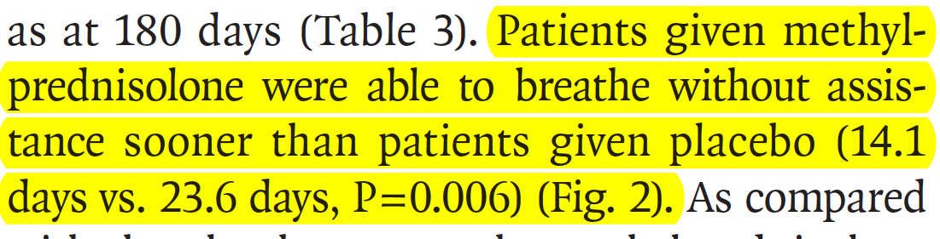
Time to successful extubation*
Message: Consistent sizable reduction in length of MV across 4 RCTs
Δ=
8.7
Δ=
9.5
Days
Δ=
9.8
Δ=
10.4
P =0.051
P <0.001
P =0.434
P =0.006
*48 h off MV

Slide 16
Additional benefits

Slide 17
MP Rx IPDMA: Hospital Mortality
Patients randomized < ARDS day 14 (N= 272)
19.9% vs. 38.7%, HR 0.51, 95% CI 0.32-0.83; p=0.006
NNT = 5.3
≈ 50% ⬇

Slide 18

LaSRS RCT
#GoodforJournalClub
NEJM 2006;354:1671
If you have relied on the NEJM 2016 LaSRS conclusions to forgo MP Rx in your patient with ARDS
It is time to look at the re-analysis of the data and the impressive response to MP Rx … An EYE OPENER …
DOI: 10.1097/CCM.0000000000003021

Slide 19
Rapid Tapering and Return to AB (MV)
Rapid vs. slow tapering:
LaRSR RCT:
MP group: increased risk for return to AB (p= 0.02).
Control group: no impact
MP group: more rapid return to MV (p=0.006)
⎶ 3 days from DC MP Rx
DC Rx
Return to AB

Slide 20
Glucocorticoid Treatment in ARDS
WHEN
Academic Freedom Saves Lives - DOI: 10.13140/RG.2.1.3936.1762

Slide 21
Time to successful extubation by d 28
Message: Start Treatment EARLY
Early ARDS (< Day 3)
RX: 1 mg/kg/day
HR 3.48 (CI 2.07-5.85) p<0.0001
Late ARDS (> Day 7)
RX: 2 mg/kg/day
HR 2.06 (9CI 1.44-2.95) p<0.0001
$ 100
> triple the rate of extubation
    Improved short and long term outcome
Wilson et al. Crit Care Med 2017 EpubDate 2017/12/21

Slide 22
Glucocorticoid Treatment in ARDS
WHICH
Academic Freedom Saves Lives - DOI: 10.13140/RG.2.1.3936.1762

Slide 23
Not all GC are created equal
In the past, exogenous glucocorticoids were thought to be qualitatively indistinguishable because they act via the same receptor.
Today qualitative differences have been discovered, and one glucocorticoid cannot be simply replaced by another.
Methylprednisolone is the preferred agent in the treatment of inflammatory lung diseases …. Let me prove it …
Clin Pharmacokinet 2005; 44: 61-98

Slide 24
GC: qualitative differences
GC receptor affinity
Genomic vs. non-genomic effects
?Potency equivalency table?
Lung penetration

Slide 25
GC- GR receptor affinity
Agonist [GC]: compound that binds to a receptor to produce a biological response
Drug receptor [GR]: specialized target macromolecule that binds a drug and mediates its pharmacological action
Magnitude of response: proportional to
  Number of drug-receptor complexes
  Binding affinity for receptor
J. Pharmaceutical Science 2003; 92 (7): 1521-1525

Slide 26
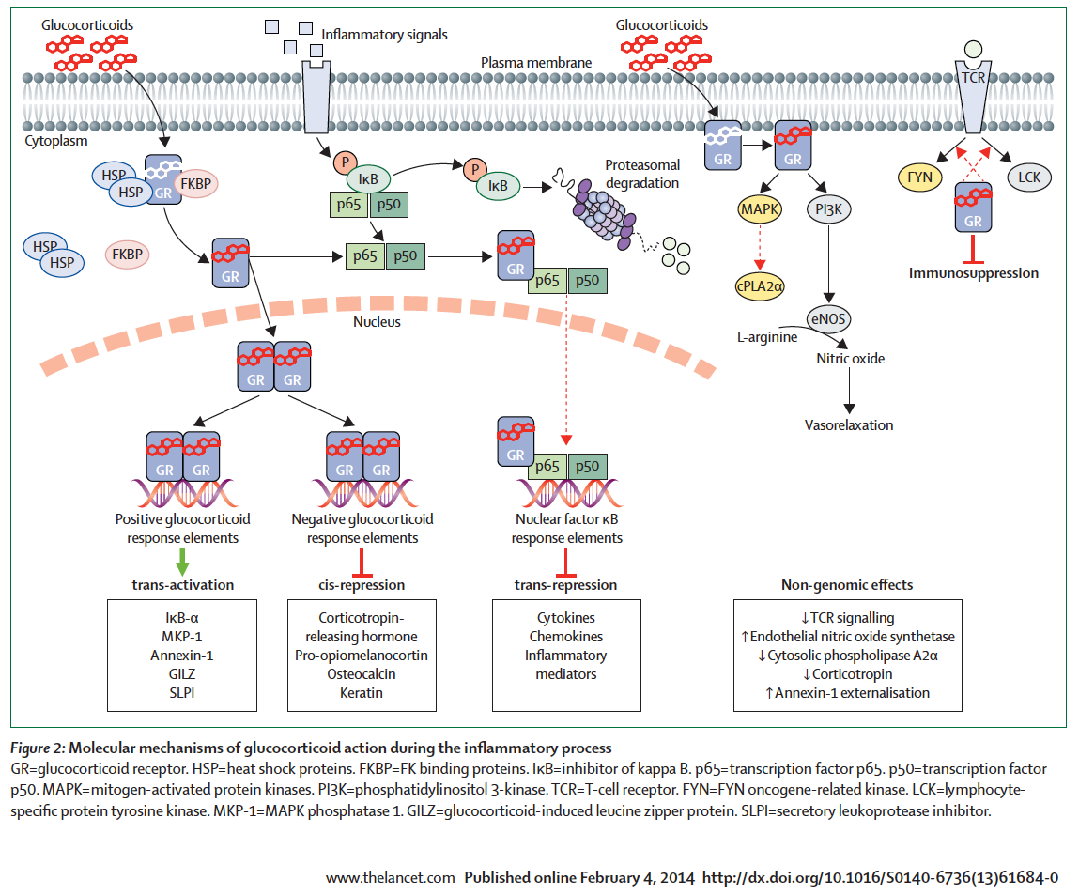

Non-genomic effects [rapid]
Membrane bound GR
Activation MAPK pathway
  inhibition of PLA2α > arachidonic ac.
Activation of PI3-kinase
  Induction of eNOS
Increase Annexin1 externalization
  ▼PMN activation /endothelial adherence
  ▲ AM phagocytosis of apoptotic PMNs
MAPK= microtubule associated protein k.
PL3k = phosphatedylinositol 3-kinase

Slide 27
Dose-response relationship
Genomic vs non-genomic effects
Most GR are occupied

Slide 28

Potency: Genomic vs non-genomic
Experiments on lung 549 epithelial cells
Message: these IC₅₀ levels do not conform with present glucocorticoid potency tables
549 cells transfected with p-NF-κB-SEAP or p-AP-1-SEAP – Incubated (2h) with GC
549 cells stimulated with IL-1β Incubated (3h) with GC
IC₅₀ (nM)
IC₅₀ (nM)
Pharm. Science, 2003; 5 (S1), Abstract R6173
IC₅₀ = 50% Inhibitory Concentration

Slide 29
Lung Penetration: Methylprednisolone
Lung: behave as a distinct and separate body compartment
Comparison^{[1-3]}: Methylpred. vs. prednisolone & prednisone
  MP: increased penetration into the lung
  MP: slower clearance from the lung
    MP: persists in the epithelial lining fluid compartment even when plasma levels have decreased
    MP: increased accumulation over time*
MP: Enhanced penetration at higher plasma concentrations
Braude et al. Lancet 1983; 2:995-7 -
Greos et al. ARRD 1991; 144:586-592 –
Vichyanondet al. J Allergy Clin Immunol 1989; 84:867-73.
Observed potency affected by DURATION of exposure

Slide 30
Glucocorticoid Treatment in ARDS
How Much
How Long
Academic Freedom Saves Lives - DOI: 10.13140/RG.2.1.3936.1762

Slide 31
Methylprednisolone vs. Hydrocortisone 1
Hospital Mortality
Methylprednisolone
19.9% vs. 38.7%
Δ = 18.8%
NNT=5.3
Hydrocortisone
35.1% vs. 45.7%
Δ = 10.6%
28.2% vs. 42.5%
Δ = 14.3%
NNT=7.0

Slide 32
At prima facie MP is the winner
But, what about
Dose > concentration
Mode of administration
Duration of treatment
Tapering to avoid rebound

Slide 33
Methylprednisolone vs. Hydrocortisone Protocol design affects outcome
Dosage:
  MP: 1-2mg/Kg/day
    MP dose 80-160 mg/day
  HC: 200-300 mg/day^{[a]}
    MP equivalent: 40-60 mg/day
Initial bolus:
  MP: 4 of 4
  HC: 2^{[b]} of 5
Infusion
  MP: 2 of 4
  HC: 1 of 5
Duration
  MP: 24-32 days
  HC: 7 days
Slow tapering
  MP: 3 of 4 ^{[c]}
  HC: none
[a] Annane 2006: HC + Fludrocortisone;
[b] Bolus 200 mg = Confalonieri 2005; Sabry 2011 (best results)
[c] ARDS network LaSRS MP Rx removed within 24-36h of achieving UAB

Slide 34
Dose: predicted concentration
Rachel Ness, Pharm.D. - Memphis VAMC

Slide 35
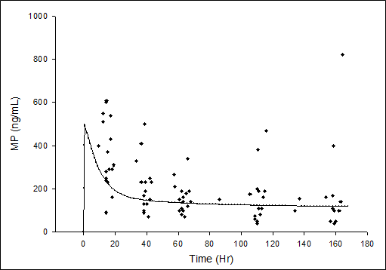
EARDS Methylpred.: Plasma levels
1. Bolus > high MP level =
genomic and
non-genomic effects
2. ± 24-36 h > ⬇️ Inflammatory cytokines* ⏩
⬆️ hepatic clearance [cytochrome p-450]
1
3. Steady state: medium level 203 ± 147 (50-820)
Hyperglycemia
Early ARDS
Bolus: 1mg/kg
Infusion: 1mg/kg/day
2
3
* Elevated inflammatory cytokines inhibit cytochrome p-450 MP clearance

Slide 36
I am lost – is it over?
I am lost
Give me a summary

Slide 37
Treatment protocol: Components
Glucocorticoids: ONLY treatment available for ARDS
Highly effective and safe [lowers rate of infections]
Drug: methylprednisolone superior to hydrocortisone
Bolus: important to achieve higher initial levels (up 36h)
Infusion: –steady state - prevent glycemic variability; ?improved mortality [1 observational study]?
Daily dose/potency: higher ︎doses ▶ increased benefits in sicker pts
Duration: 24-32 days superior to 7 days
Tapering: MUST – Restart Rx if rebound: MUST
  risk associated with drug removal on day 7 in pts still on MV = unknown but unlikely to be beneficial
Infections surveillance: imp. to identify NI in absence of fever

Slide 38




Is the Umbrella Effective?
Expert
hands
Inexpert
hands
In love
If you get wet do not blame the umbrella
Notes:
If you get wet do not blame the umbrella

Slide 40
Glucocorticoid Treatment in Community-acquired Pneumonia
Academic Freedom Saves Lives - DOI: 10.13140/RG.2.1.3936.1762

Slide 41
Consensus Guidelines: CAP
Crit Care Med 2018; 46: 146-148

Slide 42
Randomized Trials: 13 - n=2017
CAP – Not severe
7 RCTs (N= 1627)
CAP - Severe
6 RCTs (N= 390)

Slide 43
Investigated Drug & Duration of Rx
Days
Days
❏Hydrocortisone 6
❏ Prednisolone 4
❏ Methylprednisolone 2
❏ Dexamethasone 1

Slide 44
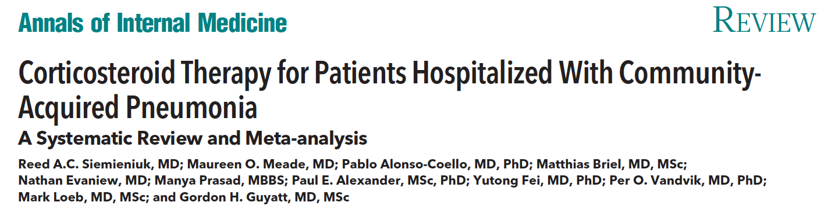

Estimation of absolute effect = from the median absolute effect of control groups of included studies

Slide 45
CAP- GC Rx - Meta-analyses

Slide 46
Registered Randomized Trials
Acronym (Country) | Identifier | Patient population | Intervention/ Comparison | Primary outcome | Target sample size | Start
ESCAPe (United States) | NCT01283009 | Hospitalised veterans with severe CAP | Methylprednisolone for 20 days vs Placebo | All-cause mortality at day 60 | 1450 – slow recruitment Stop at 580 pts | January 2012
Santeon-CAP (Netherlands) | EUCTR2011-004566-14-NL | Hospitalised patients with CAP | Dexamethasone vs Placebo | Length of hospital stay | 600 | January 2012
Peking Union (China) | NCT02552342 | Severe CAP | Methylprednisolone vs Saline | All-cause mortality at day 30 | 610 | May 2015
CAPE COD (France) | EUCTR2015-001239-19-FR NCT02517489 | Severe CAP | Hydrocortisone for 8-14 days vs Placebo | All-cause mortality at day 28 | 1200 | August 2015
AD-SCAP (Netherlands) | EUCTR2015-002340-14-NL | Intensive care patients with severe CAP | Adaptive trial with 7 arms; one arm includes Hydrocortisone | In-hospital mortality up to day 60 | 4000 | September 2015

Slide 47


Slide 48
Methylprednisolone: Dose-dependent Response vs. graded severity of inflammation [LPS]
Experimental simulation of intense inflammation
U937 cells > LPS (ng/ml): 100; 1,000; 5,000; 10,000 - [6 h]
TREATED with methylpred. (μg/ml): 50, 100, 150, 200, 250 - [6 h]
Cells lysed > total cellular mRNA TNF-α, IL-1β, IL-6

Slide 49
Methylprednisolone: Dose-dependent Response vs. graded severity of inflammation [LPS]
Inflection point
?Increased GRα saturation
Expression of TNF-α mRNA
Methylprednisolone (μg/ml)

Slide 50
Methylprednisolone: Dose-dependent Response vs. graded severity of inflammation [LPS]
Independent of: LPS dose & cytokine (TNF-α, IL-1β, IL-6).
Inflection point
?Increased GRα saturation
Expression of TNF-α mRNA
0
25
50
75
100
150
250
Methylprednisolone (μg/ml)
IC_{50%}
175 μg/ml

