Slide 1
Terapia della fibrosi polmonare idiopatica
Paolo Spagnolo
Clinica di Malattie dell’Apparato Respiratorio
Università degli Studi di Padova

Slide 2
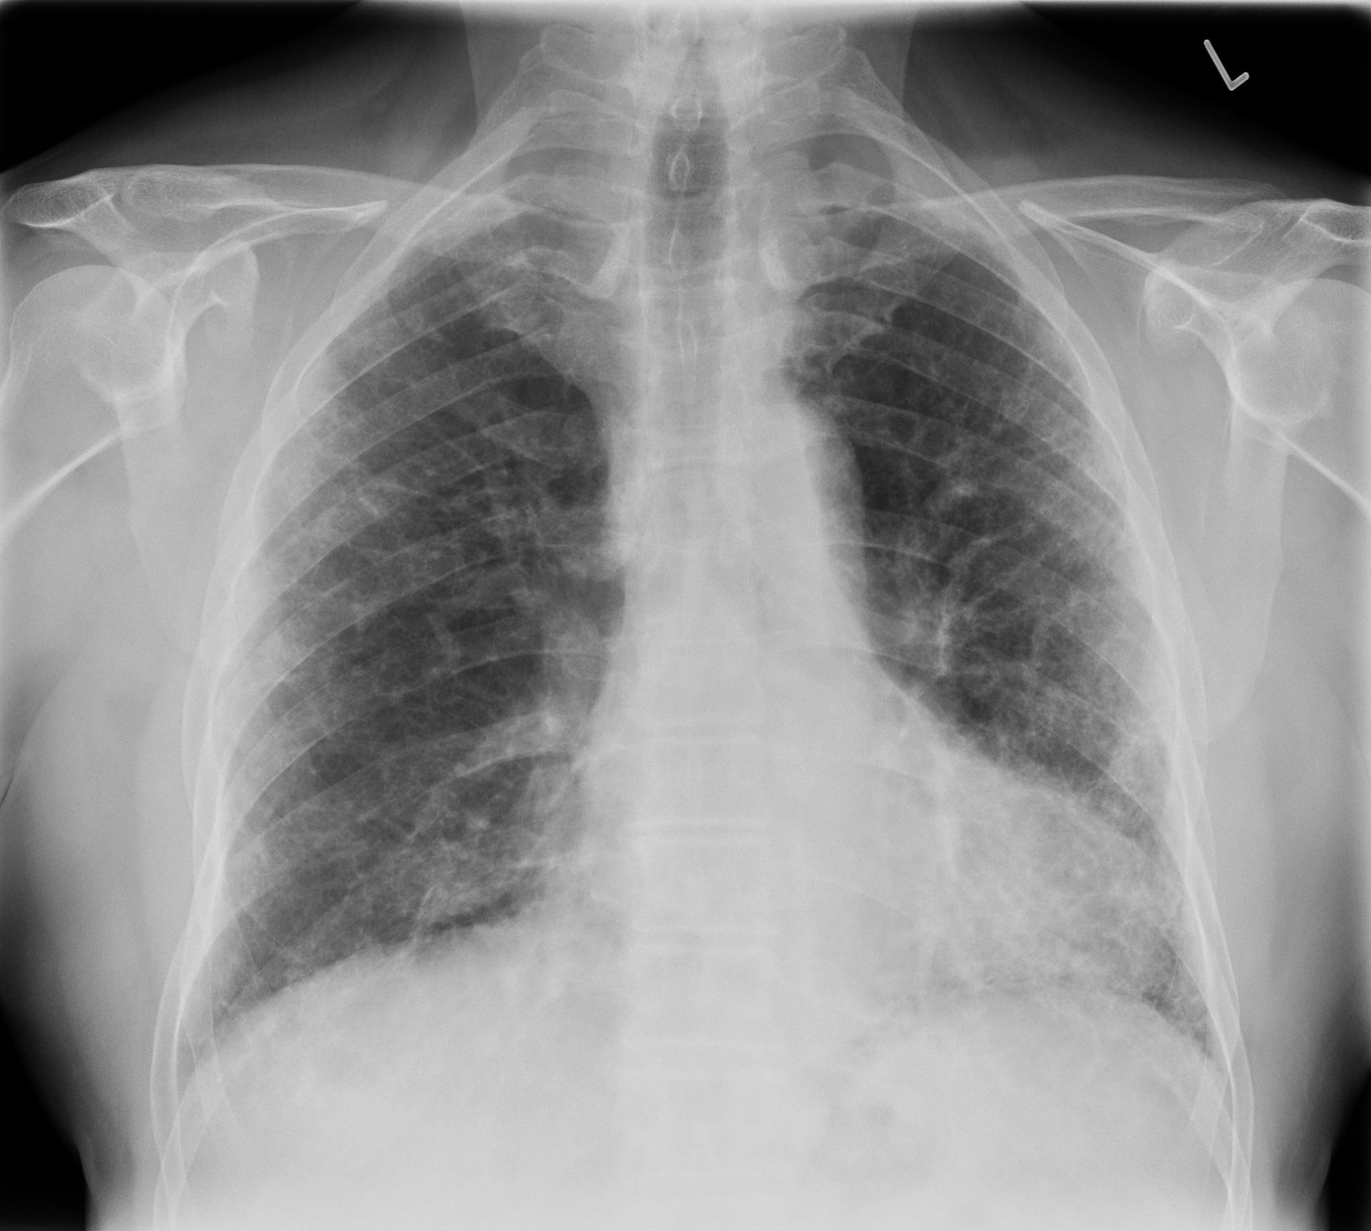

Slide 3
Idiopathic pulmonary fibrosis (IPF)
IPF is an unpredictable and ultimately fatal age-related interstitial lung disease of unknown cause with a median survival of approximately 3-5 years after diagnosis
IPF occurs primarily in older adults, and is associated with the histopathologic and/or radiologic pattern of usual interstitial pneumonia (UIP)
IPF: idiopathic UIP
Raghu G et al. Am J Respir Crit Care Med 2011;183:788-824

Slide 4
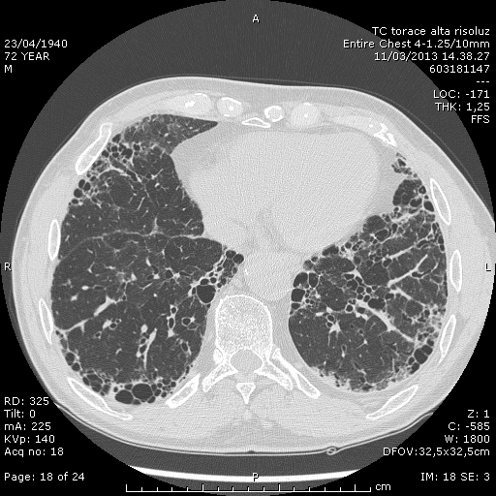
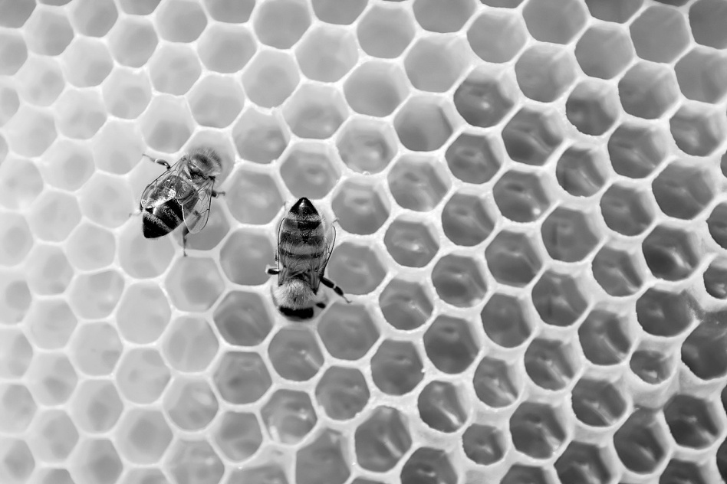
Radiological/HRCT pattern of UIP

Slide 5
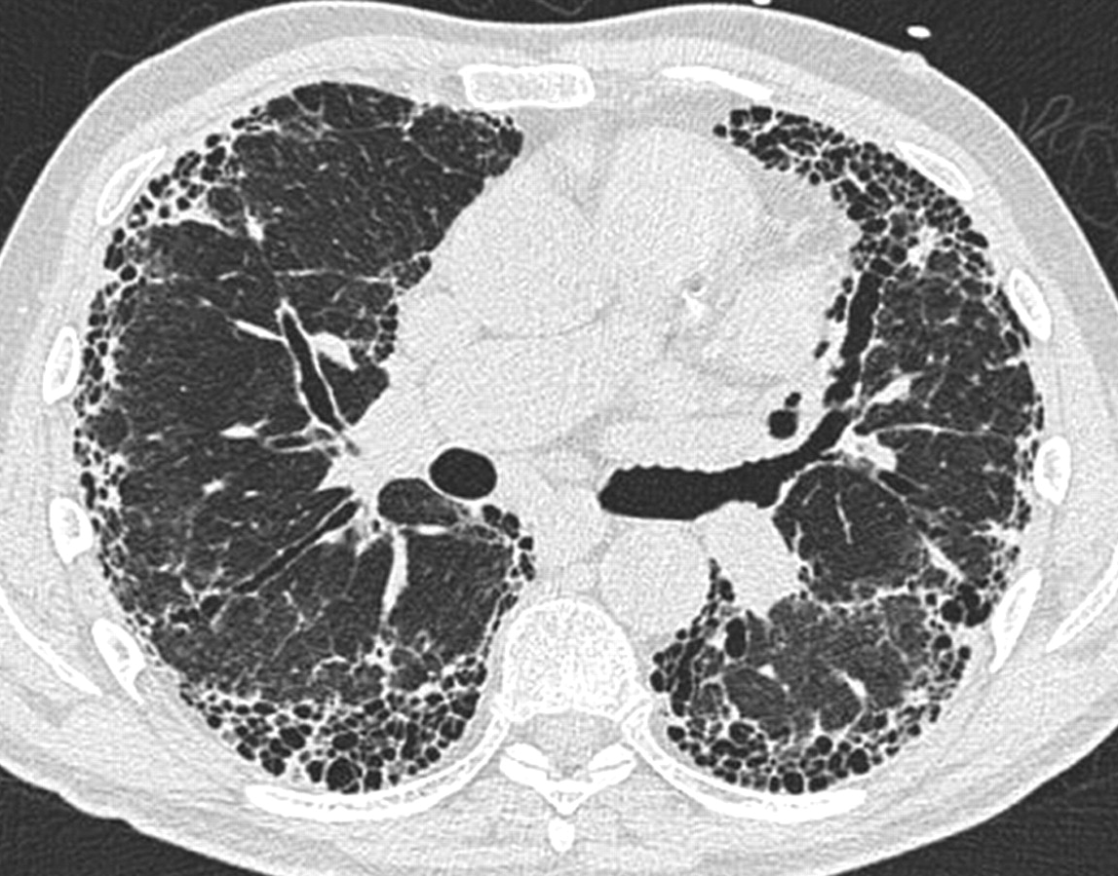

Slide 6
Patients with IPF exhibit a poor prognosis
Patients with IPF
Expected
100
80
60
Survival (%)
40
20
0
0
2
4
6
8
10
12
14
16
18
Time after diagnosis (years)
Bjoraker JA et al. Am J Respir Crit Care Med 1998;157:199-203
Notes:
Patients with IPF experience a progressive, unrelenting deterioration in clinical condition, making their prognosis particularly poor.
Bjoraker and colleagues compared the survival among a group of patients with IPF (n = 104) with the expected survival among a healthy cohort of people of equivalent age and sex. There was a rapid decrease in survival among the IPF patients within the first five years following diagnosis, marking a considerable difference between the two populations.
Bjoraker et al. Am J Respir Crit Care Med 1998;157:199–203.
6

Slide 7
“Mister IPF”
65 year old man
Former smoker
Dyspnea on exertion
Chronic dry cough
93% room air saturation
BMI = 33
Bibasilar “velcro-type” crackles
CXR: nonspecific/normal
PFTs: Mixed restriction/obstruction with a low DLCO
Often previously diagnosed with a different lung disease
Slide courtesy of Hal Collard (modified)
Notes:
Concomitant emphysema in approximately 30% of patients.

Slide 8
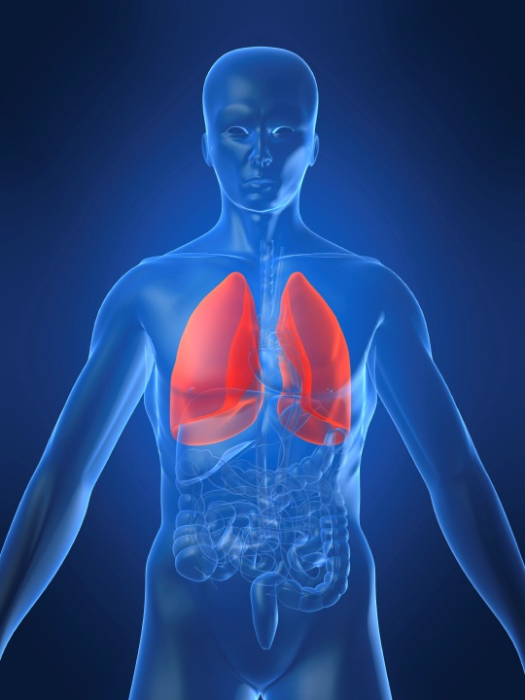
Risk factors and possible etiologies for IPF
Old age
Environmental factors
Other
Cigarette smoking
Strongly
associated
with IPF
Environmental pollutants
Associated with an increased risk of IPF
Exposure to metal and wood dusts, farming, raising birds, hairdressing, stone cutting/polishing, and exposure to livestock, vegetables or animal dust
Infection
A large number of studies have examined this, but findings are not conclusive
Gastroesophageal reflux disease
Proposed cause of repeated micro-injury
Genetic factors
Familial pulmonary fibrosis accounts for around 10% of total population with IPF
Notes:
Images purchased from iStockPhoto.

Slide 9
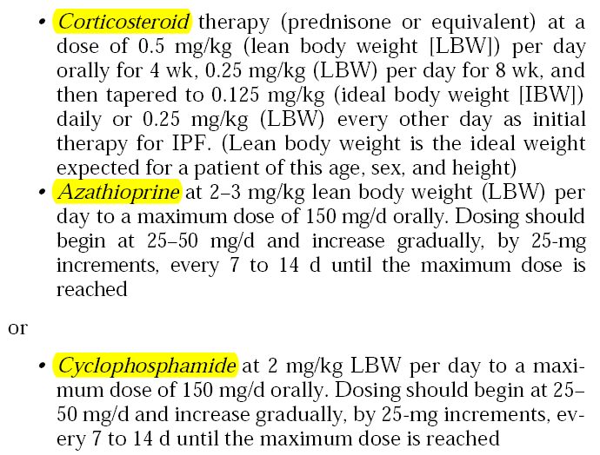
Recommendations by 2000 guidelines
ATS/ERS. Am J Respir Crit Care Med 2000

Slide 10
Azathioprine
27 patients with IPF;
prednisone (n=13) ± azathioprine (n=14);
Primary endpoints: survival and PFTs after 1 year
FVC, DLCO, PaO₂: non significant
Survival: non significant but in favor of azathioprine if corrected by age
More side effects in the prednisone arm, azathioprine well tolerated
Notes:
This was a prospective, randomized, double-blind study of only 27 patients.

Slide 11
NAC: Aim and Study Design
Does N-acetylcysteine (NAC) 600 mg tid over one year slow functional deterioration in IPF?
when administered in addition to prednisone plus azathioprine
Double-blind, placebo-controlled, parallel-group trial with randomization by country and stratified by VC (≤ or >60% predicted)
Demedts M et al. N Engl J Med 2005; 353: 2229-42
Notes:
NAC is a precursor to the antioxidant glutathione, which is known to be depleted in the lungs of IPF patients.
However, the study was flawed because of a high rate of drop-out among the study subjects.

Slide 12
High-dose N-Acetylcysteine in IPF: Effects on Vital Capacity and DL_{CO}
NAC
Placebo
0.1
2
0.0
0
Vital capacity (liters)
(% of predicted)
-2
-0.1
-4
-0.2
-6
-8
-0.3
-10
Baseline
6 mo
12 mo
Baseline
6 mo
12 mo
No. of patients: NAC 80 63 55
Placebo 75 60 51
80 63 55
75 60 51
0.5
2
0
DLCo (mmol/min/kPa)
0.0
(% of predicted)
-2
-4
-0.5
-6
-8
-1.0
-10
Baseline
6 mo
12 mo
Baseline
6 mo
12 mo
No. of patients: NAC 79 58 48
Placebo 74 59 47
79 58 48
74 59 47
Demedts M et al. N Engl J Med 2005; 353: 2229-42
Notes:
Both groups experienced decline of lung function over the 12-month study period; the difference was that one group declined more.

Slide 13
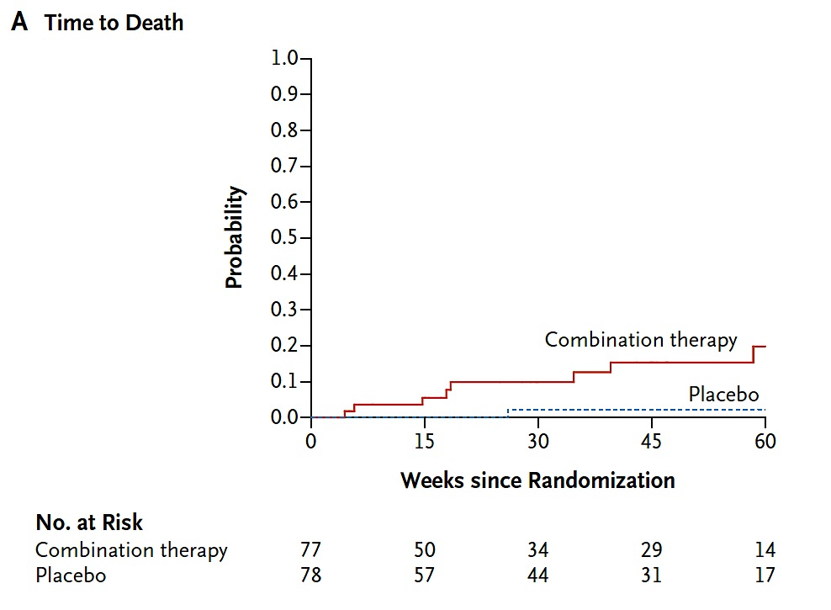
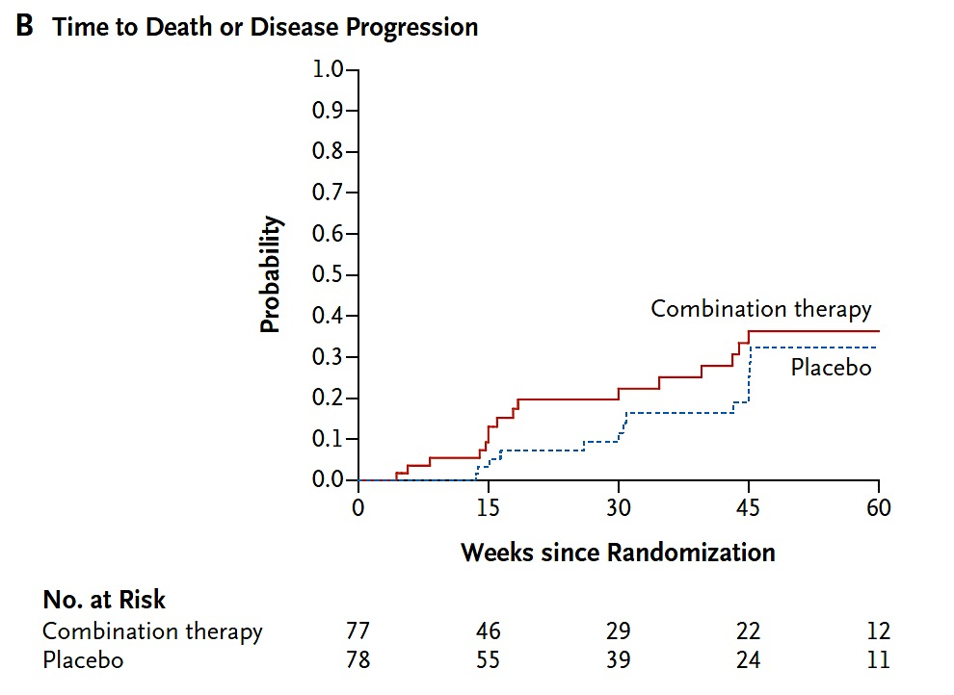
N-acetylcysteine/prednisone/azathioprine
IPF Clinical Research Network. N Engl J Med 2012; 366: 1968-77

Slide 14
Epithelial cell injury and activation
INJURY
Selman M, et al Ann Int Med 2002

Slide 15
Epithelial cell injury and activation
INJURY
Wound clot
Fibroblast Migration and Proliferation
Basement Membrane Disruption
Selman M, et al Ann Int Med 2002

Slide 16
Epithelial cell injury and activation
INJURY
Wound clot
Fibroblast Migration and Proliferation
Myofibroblast
Accumulation
Basement Membrane Disruption
Selman M, et al Ann Int Med 2002

Slide 17
Epithelial cell injury and activation
INJURY
Wound clot
Angiogenesis
Fibroblast Migration and Proliferation
Myofibroblast
Accumulation
Basement Membrane Disruption
Selman M, et al Ann Int Med 2002

Slide 18
Fibrosis and Impaired Reepithelialization
Epithelial cell injury and activation
INJURY
Epithelial Apoptosis
Wound clot
Angiogenesis
Fibroblast Migration and Proliferation
Myofibroblast
Accumulation
Basement Membrane Disruption
Selman M, et al Ann Int Med 2002

Slide 19
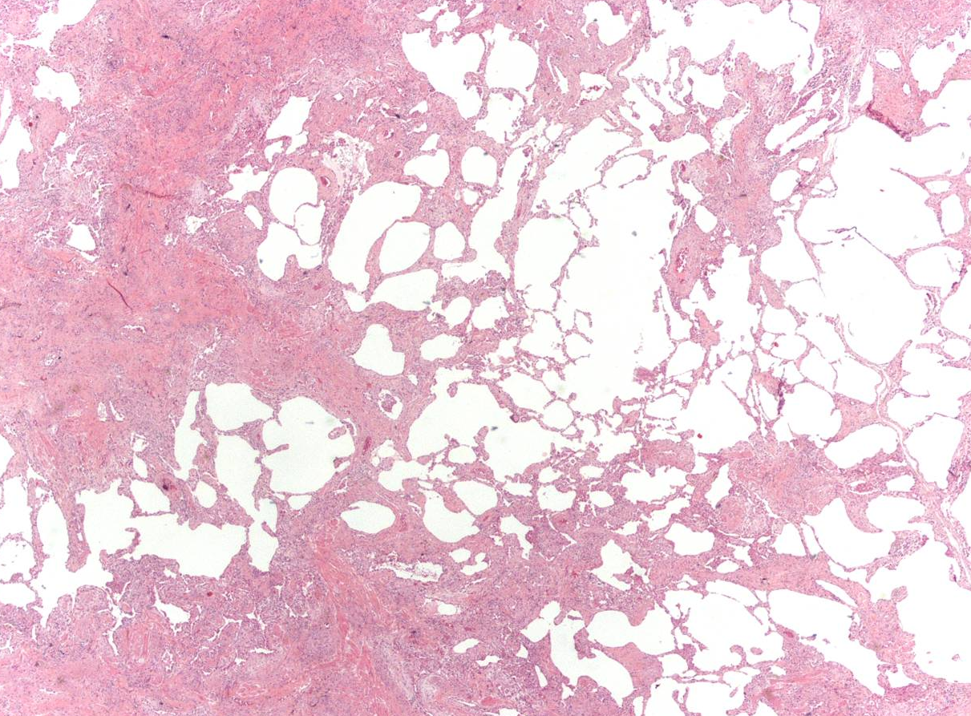

Slide 20
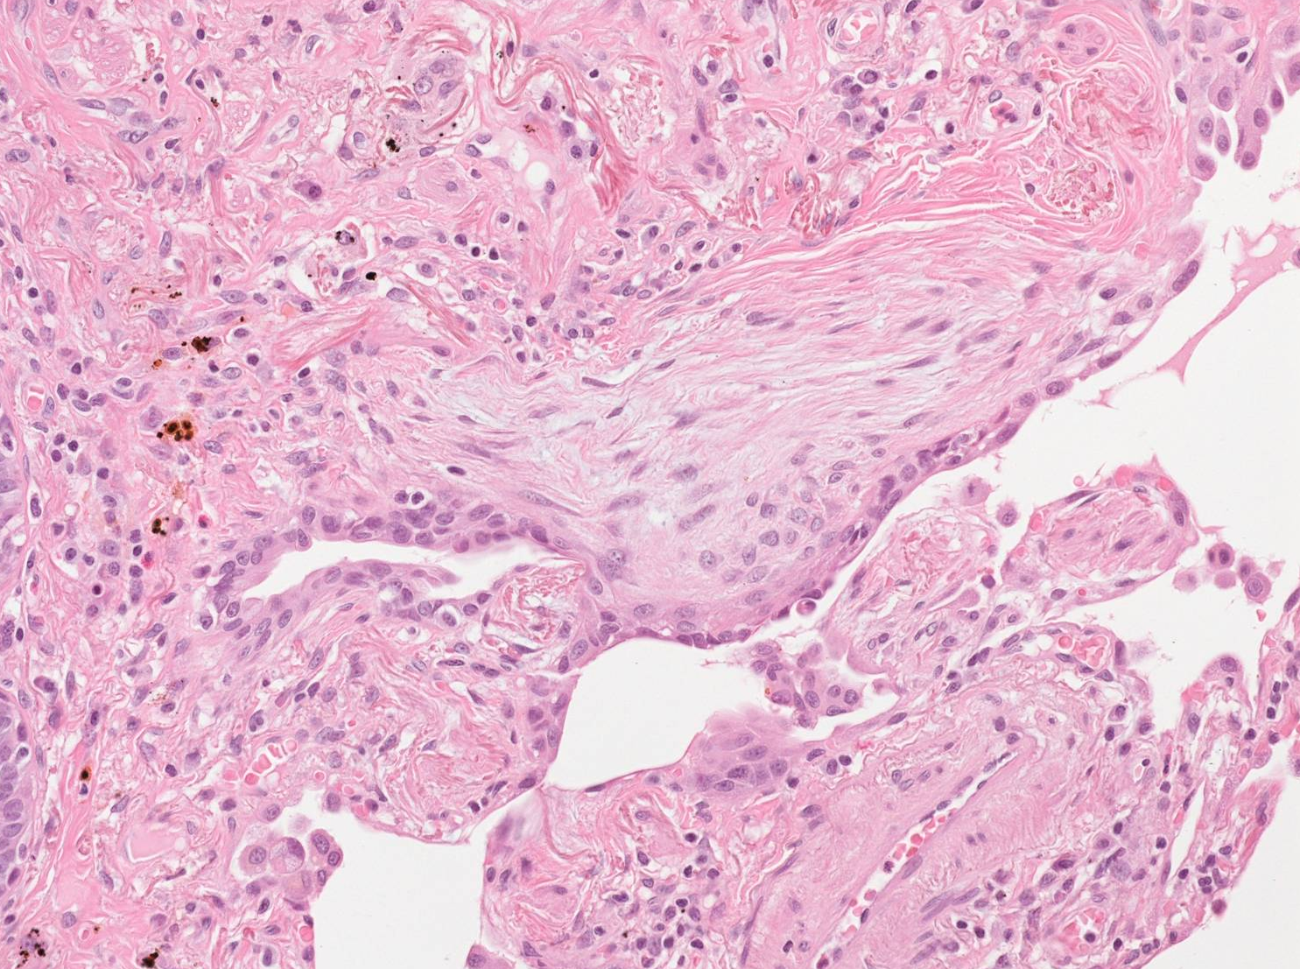

Slide 21
Recommendations in the 2015 IPF guidelines
Agent | 2015 guidelines
Anticoagulant | Strong recommendation against use
Combination prednisone/azathioprine/NAC | Strong recommendation against use
Ambrisentan | Strong recommendation against use
Imatinib | Strong recommendation against use
Nintedanib | Conditional recommendation for use
Pirfenidone | Conditional recommendation for use
Macitentan, bosentan | Conditional recommendation against use
Sildenafil | Conditional recommendation against use
Antiacid therapy | Conditional recommendation for use
NAC monotherapy | Conditional recommendation against use
Modified from Raghu G et al. Am J Respir Crit Care Med 2015; 192: e3-e19

Slide 22
Pirfenidone
Pirfenidone is an orally available, synthetic, pyridone compound with anti-inflammatory, anti-oxidant and anti-fibrotic properties
The mechanism of action is not fully understood
The drug is believed to act on multiple pathways, with in vitro cell-based studies and in vivo studies in animal models of pulmonary fibrosis providing insight into its anti-fibrotic activity
Oku H et al. Eur J Pharmacol 2008:590:400-8; Kim ES, Keating GM. Drugs 2015; 75: 219-30
Notes:
The anti-fibrotic properties of pirfenidone are attributed to ist effects on pulmonary levels of various cytokines and growth factors (mainly TGF-β1).

Slide 23
CAPACITY Studies 004 and 006: study design
Study 004
Pirfenidone 2403 mg/day* vs. placebo
vs. pirfenidone 1197 mg/day*
n = 435
Open-label
pirfenidone
(2403 mg/day)
72 Weeks
Study 006
Pirfenidone 2403 mg/day* vs. placebo
n = 344
Primary
endpoint
Study completion
Primary endpoint for both studies was change in percent predicted forced vital capacity (FVC) from baseline to week 72
Patients remained in the double-blind treatment allocation until the last patient completed 72 weeks
→ Thereafter, patients were offered a transition to an open-label extension study
*267 mg capsule formulation
Noble PW et al, Lancet 2011; 377: 1760-9

Slide 24
CAPACITY Study 004: main results
Pirfenidone 2403 mg/day
Pirfenidone 1197 mg/day
Placebo
(n = 174)
(n = 87)
(n = 174)
0
-5
Mean change from baseline
(% predicted FVC)
-10
-15
0
12
24
36
48
60
72
Time (weeks)
Endpoint
Pirfenidone 2403 mg/day vs. placebo
Absolute difference, % | 1.4 | 2.5 | 4.6 | 4.8 | 4.1 | 4.4
Relative difference, % | 53.5 | 65.2 | 63.7 | 52.3 | 38.3 | 35.3
p value | 0.061 | 0.014 | <0.001 | <0.001 | <0.001 | 0.001
Noble PW et al, Lancet 2011; 377: 1760-9

Slide 25
CAPACITY Study 006: main results
Pirfenidone 2403 mg/day
Placebo
(n = 171)
(n = 173)
0
-5
Mean change from baseline
(% predicted FVC)
-10
-15
0
12
24
36
48
60
72
Time (weeks)
Endpoint
Pirfenidone 2403 mg/day vs. placebo
Absolute difference, % | -0.4 | 2.8 | 2.4 | 1.9 | 0.6 | 0.6
Relative difference, % | -31.5 | 62.1 | 48.2 | 27.3 | 7.6 | 6.5
p value | 0.021 | <0.001 | 0.011 | 0.005 | 0.172 | 0.501
Noble PW et al, Lancet 2011; 377: 1760-9

Slide 26
ASCEND: study design and primary outcome
Day 1: Randomization 1:1 to pirfenidone 2403 mg/d or matched placebo
52 weeks
28 days
Treatment duration
Follow- up
Titration (2 weeks)
50 weeks
Primary endpoint: change in percent predicted FVC from baseline through week 52 calculated by using a ranked analysis of covariance (ANCOVA).
Magnitude of effect: categorical analysis of two clinically important thresholds of change (≥10% decline in FVC or death, and no FVC decline)
King TE Jr et al. N Engl J Med 2014; 370: 2083-92

Slide 27
Primary efficacy analysis: proportion of patients with %FVC decline ≥10% or death
Patients (%)
Absolute Difference (%) | 2.5 | 7.9 | 12.3 | 15.3
Relative Difference (%) | 54.0 | 58.0 | 57.8 | 47.9
Rank ANCOVA p-value | p<0.000001 | p<0.000001 | p=0.000002 | p<0.000001
King TE Jr et al. N Engl J Med 2014; 370: 2083-92

Slide 28
All-cause and IPF-related mortality sensitivity analysis
over 120 weeks
 | All-cause mortality |  |  |  | IPF-related mortality
 | Pooled analysis |  | Random-effects meta-analysis (all trials) |  | Pooled analysis
 | Pirfenidone (n=623) | Placebo (n=624) | Pirfenidone (n=804) | Placebo (n=764) | Pirfenidone (n=623) | Placebo (n=624)
Week 52
Deaths , n (%) | 22 (3.5%) | 42 (6.7%) | 25 (3.1%) | 47 (6.2%) | 10 (1.6%) | 28 (4.5%)
HR (95% CI) | 0.52 (0.31-0.87) | - | 0.53 (0.32-0.85) | - | 0.35 (0.17-0.72) | -
p value | 0.0107 | - | 0.0092 | - | 0.0029 | -
Week 72
Deaths , n (%) | 32 (5.1%) | 50 (8.0%) | 35 (4.4%) | 55 (7.2%) | 17 (2.7%) | 35 (5.6%)
HR (95% CI) | 0.63 (0.41-0.98) | - | 0.63 (0.41-0.96) | - | 0.48 (0.27-0.85) | -
p value | 0.0404 | - | 0.0305 | - | 0.0107 | -
End of study
Deaths , n (%) | 38 (6.1%) | 54 (8.7%) | 41 (5.1%) | 59 (7.7%) | 22 (3.5%) | 39 (6.3%)
HR (95% CI) | 0.69 (0.46-1.05) | - | 0.68 (0.46-1.01) | - | 0.55 (0.33-0.93) | -
p value | 0.0789 | - | 0.0585 | - | 0.0237 | -
Adapted from Nathan SD et al. Lancet Respir Med 2017;5;33-41

Slide 29
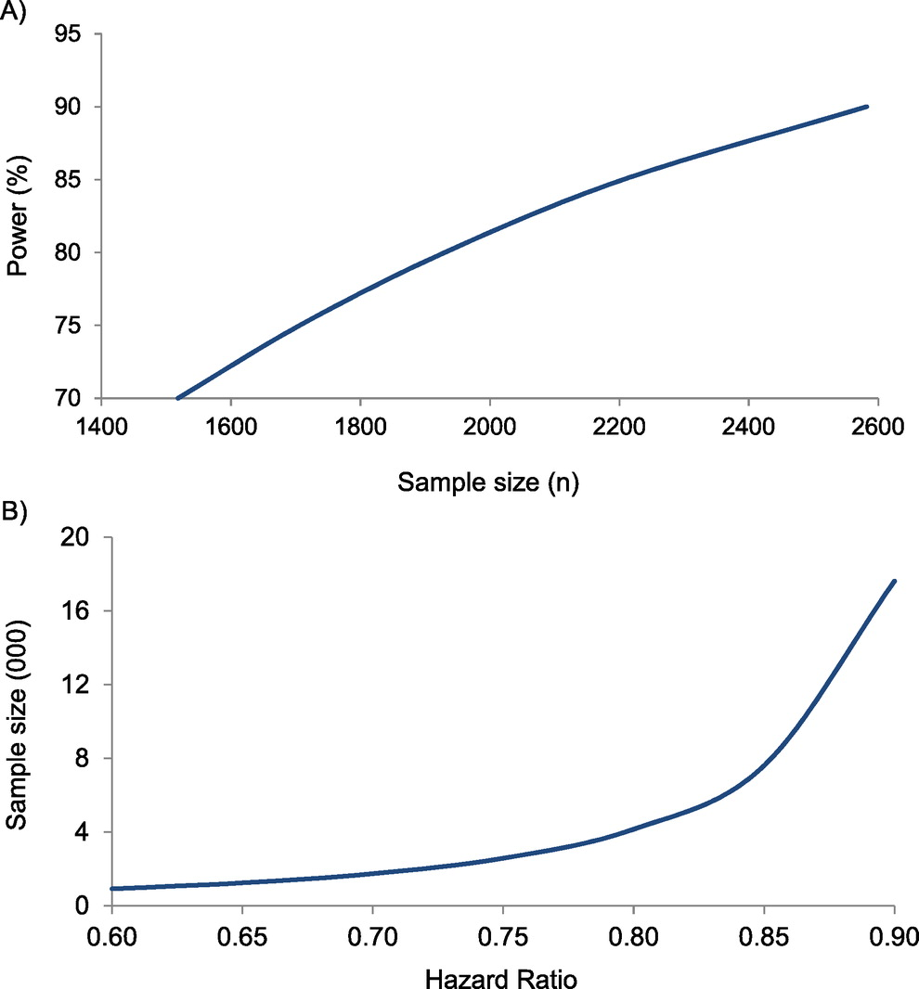
Power calculations and sample size estimates for mortality trials in IPF (placebo controlled)
King TE Jr et al. Am J Respir Crit Care Med 2014; 189: 825-831
Notes:
Power calculations and sample size estimates for mortality trials in idiopathic pulmonary fibrosis. (A) Sample size requirements for a trial with a 3-year enrollment period, 2 years of follow-up, and a hazard ratio of 0.75 (log-rank test for survival in two groups followed for fixed time with a fixed hazard ratio). (B) Sample size requirements for a two-arm trial with a 3-year enrollment period, 2 years of follow-up, and 90% power to detect a treatment effect with a two-sided α of 0.05 (log-rank test for survival in two groups followed for fixed time with fixed power and a constant hazard ratio over time).
These calculations however apply to placebo-controlled studies, not to actively controlled ones.

Slide 30
Nintedanib
Nintedanib is an orally available, small molecule, tyrosine kinase inhibitor originally developed for cancer
It acts primarily, but not exclusively, downstream of FGF, PDGF and VEGF, all of which are major growth factors involved in the pathogenesis of IPF
Nintedanib blocks the intracellular signaling needed for the proliferation, migration and differentiation of lung fibroblasts to myofibroblast, thus reducing extracellular matrix deposition
FGF: fibroblast growth factor; PDGF: platelet-derived growth factor; VEGF: vascular endothelial growth factor
Wollin L et al. Eur Respir J 2015; 45: 1434-45
Notes:
The anti-fibrotic properties of pirfenidone are attributed to ist effects on pulmonary levels of various cytokines and growth factors (mainly TGF-β1).

Slide 31
INPULSIS: study design and primary outcome
Two identical phase III RCTs that enrolled 1,066 patients with IPF/likely IPF
Randomized (3:2 ratio) to nintedanib/placebo for 52 weeks
nintedanib
n = 638
IPF
n = 1,066
placebo
n = 423
Primary endpoint: annual rate of decline in FVC (mL per year)
Richeldi L et al. N Engl J Med 2014; 370: 2071-82

Slide 32
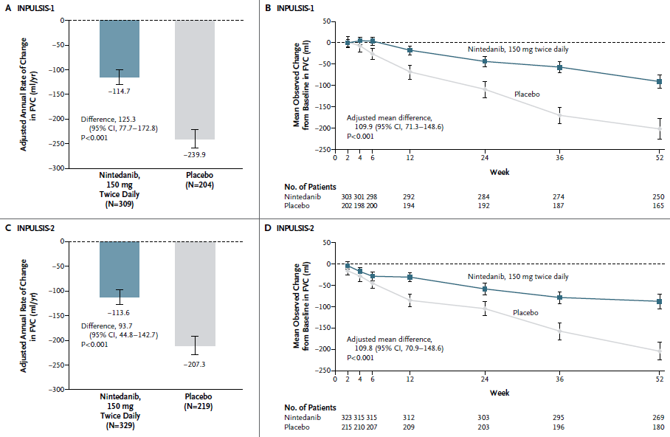
Notes:
Relative difference = 52% in INPULSIS-1
Relative difference = 45% in INPULSIS-2

Slide 33
Richeldi L et al. N Engl J Med 2014; 370: 2071-82; Colladr HR et al. Eur Resir J 2017; May 19;49(5). pii: 1601339

Slide 34
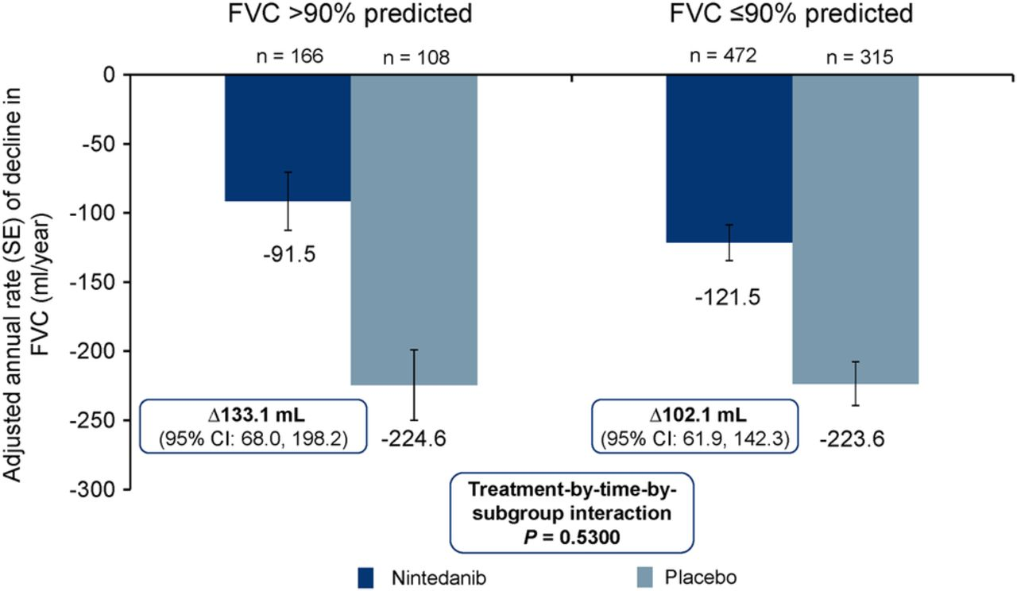
Annual rate of decline in FVC (mL/year) by subgroup
Kolb M et al. Thorax doi:10.1136/thoraxjnl-2016-208710
Notes:
The treatment-by-subgroup interaction p value was not significant (p=0.530), indicating that the treatment effect of nintedanib was not different between the subgroups.

Slide 35
Unanswered questions
Which drug should be used as first line treatment?
How long should we treat IPF patients for?
Should we combine pirfenidone and nintedanib?
How do we treat more severe patients?
How do we treat patients with comorbid disease (particularly PH)?
Does the effective of anti-fibrotic therapy last beyond the 52- to 72-week duration of clinical trials?
Spagnolo P et al. Lancet Respir Med 2015; 3: e31-e32

Slide 36
The holistic approach
Physiotherapy
Management
of nfections
Lung transplantation
Nutrition
Adherence to medication
Palliation of symptoms
Psychosocial assistance
Long-term oxygen therapy
Non-invasive ventilation
Vaccinations
Medical treatment
Patients
Family
Individually 5–6 times weekly
Training
Spagnolo P et al. Frontiers in Medicine (in press)
Notes:
Comprehensive care of patients with IPF

Slide 37
Conclusions
The approval of pirfenidone and nintedanib has dramatically changed the landscape of pharmacological treatment of IPF
The future – combination therapy vs. personalized therapy (or both?)
Better understanding of disease pathophysiology remains crucial

