Slide 1

Principi Fisiopatologici
Paolo Palange, FERS
Sapienza University
Rome, Italy

Slide 2
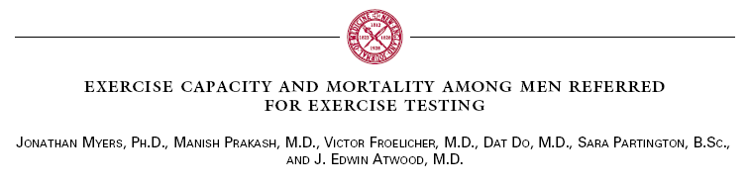
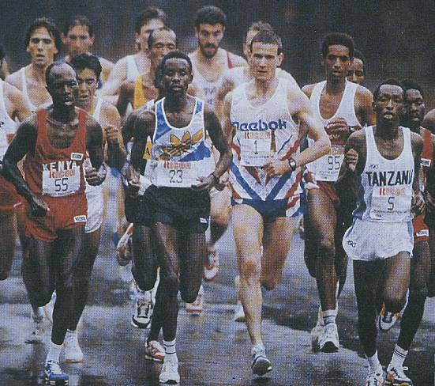
N Engl J Med 2002

Slide 3
Gulati M, N Engl J Med 2005

Slide 4
V’O₂ at rest and during exercise
CO₂

Slide 5
Fctors limiting exercise tolerange
Depletion of energy stores (Glycogen,CP)
Accumulation of fatigue metabolites (H⁺,H₂PO₄⁻)
Perception of symptoms limitation (Dyspnoea, Muscle)

Slide 6
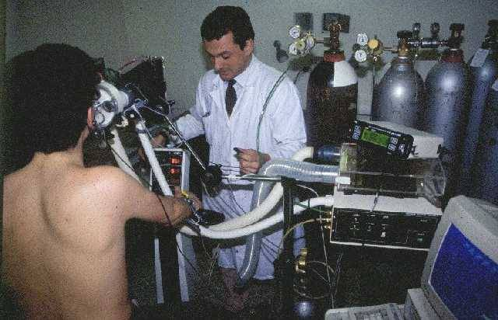
Cardio-pulmonary Exercise Testing (CPET)

Slide 7
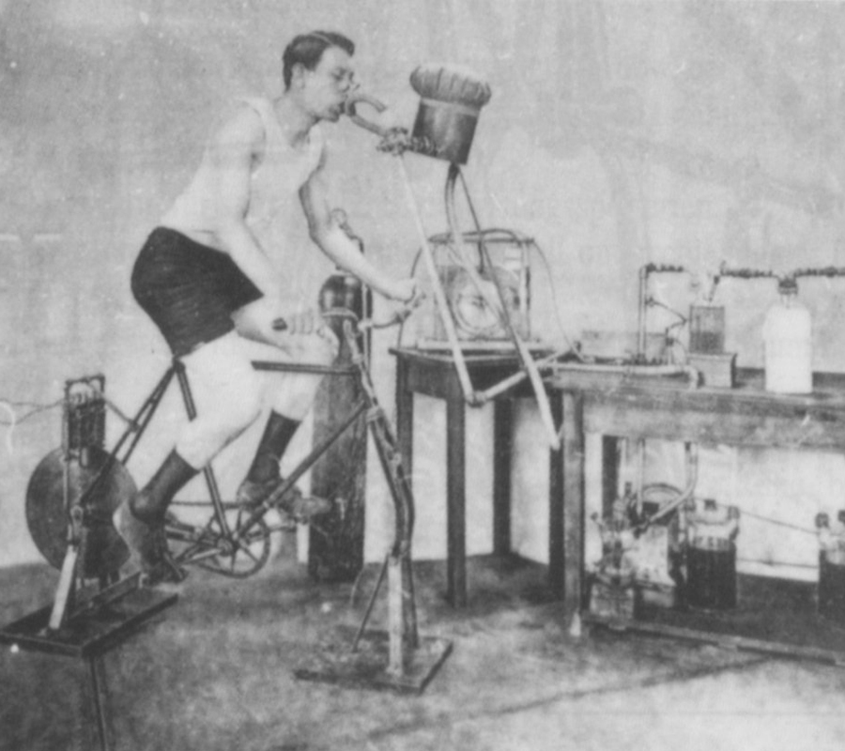
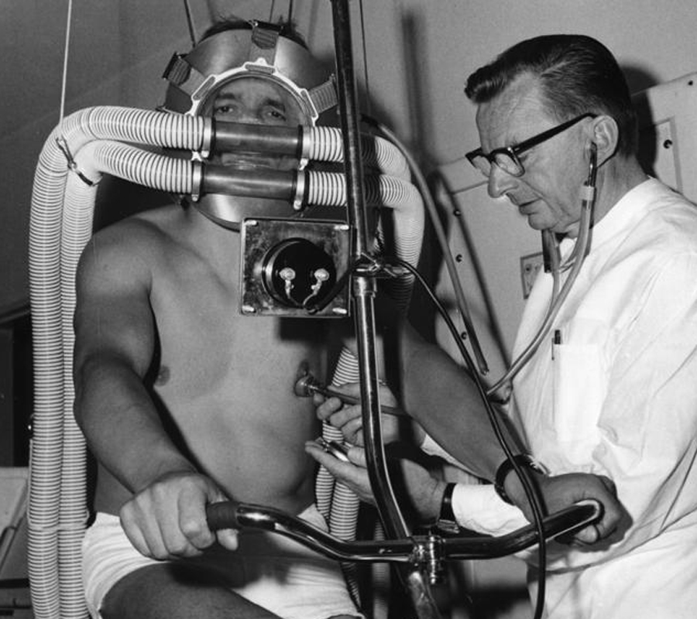
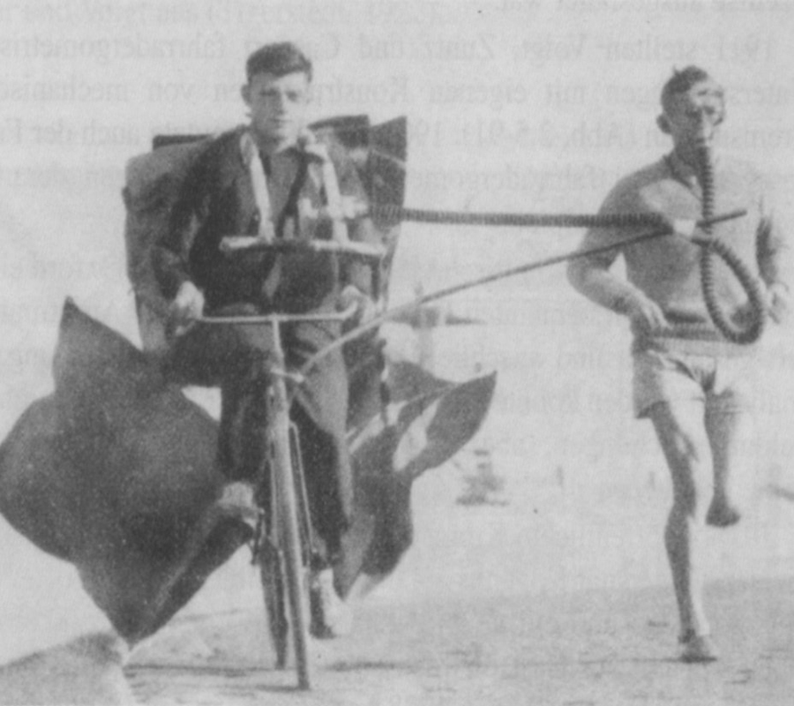
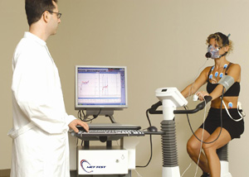
CPET: history

Slide 8

V’O₂ =
(F_{I}O₂ x V’_{I}) – (F_{E}O₂ x V’ _{E})
V’CO₂ =
(F_{E}CO₂ x V’ _{E}) – (F_{I}CO₂ x V’ _{I})

Slide 9
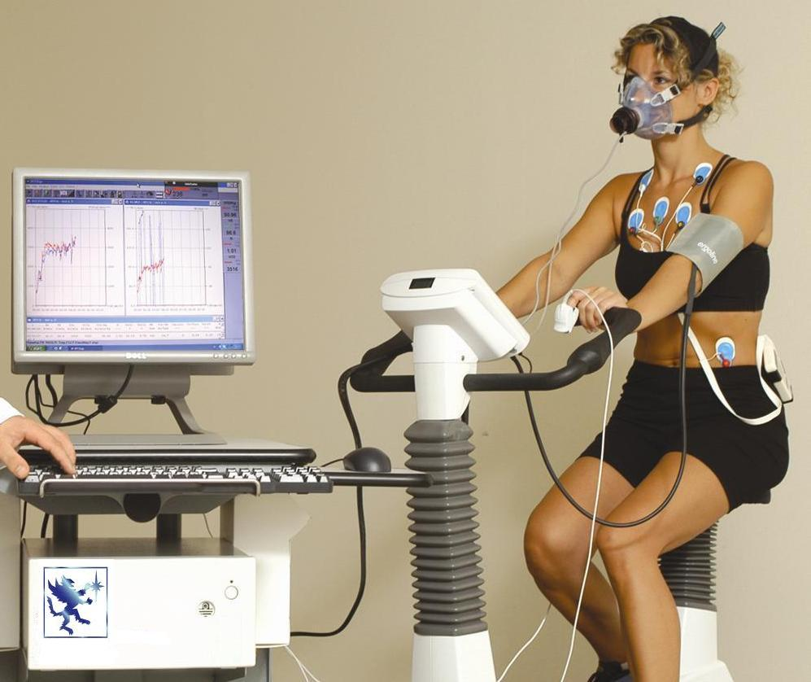
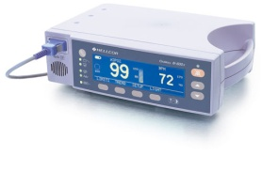
V’_{E}, RR, Vt, V’O₂, V’CO₂, PetO₂, PetCO₂,
HR, ECG
WATT
BP
SpO₂
BR, V’_{E}/MVV, IC, V’O₂/Kg, V’O₂@AT, METS, V’_{E}/V’CO₂, V’_{E}/V’O₂, V’O₂/HR, HRR,

Slide 10
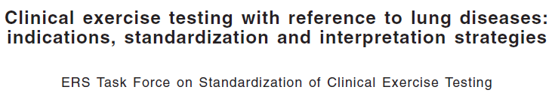
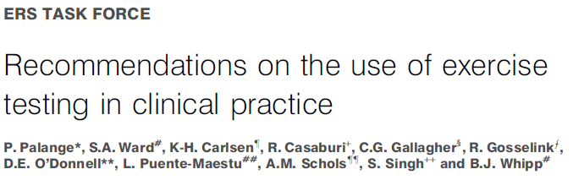


Slide 11
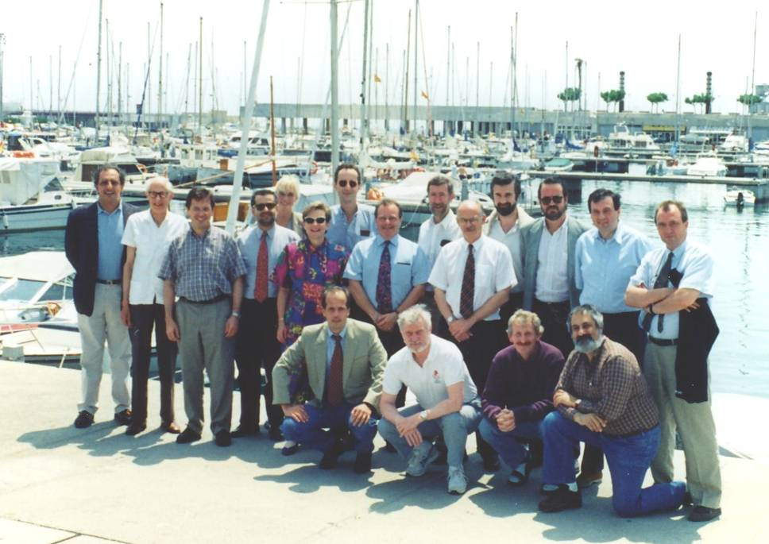
Eur Respir J 1997

Slide 12
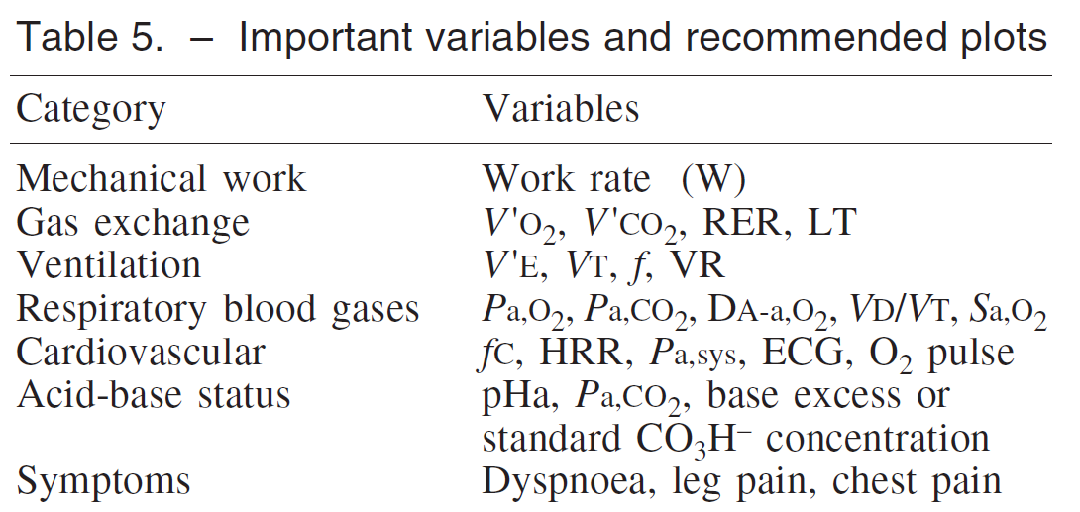
Eur Respir J 1997

Slide 13
O2
CO2
MUSCOLO
ADP
CO2
ATP
O2
Polmone
V’O₂=DO₂ (PcO₂ –PmitO₂)
Cuore
V’O₂=VE*(F_{I}O₂-F_{E}O₂)
V’O₂=Q*(CaO₂-CvO₂)

Slide 14
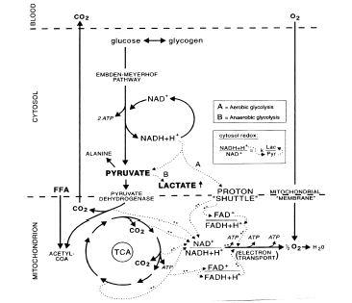
Metabolic Pathways for Energy Production

Slide 15
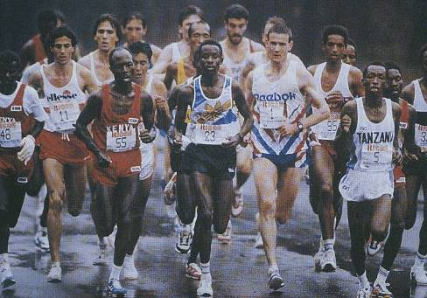
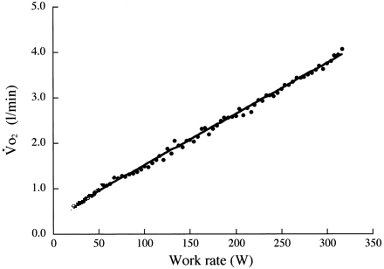

V’O₂–W relationship
*
V’O₂ peak
∼ 10 ml V’O₂/min/watt

Slide 16
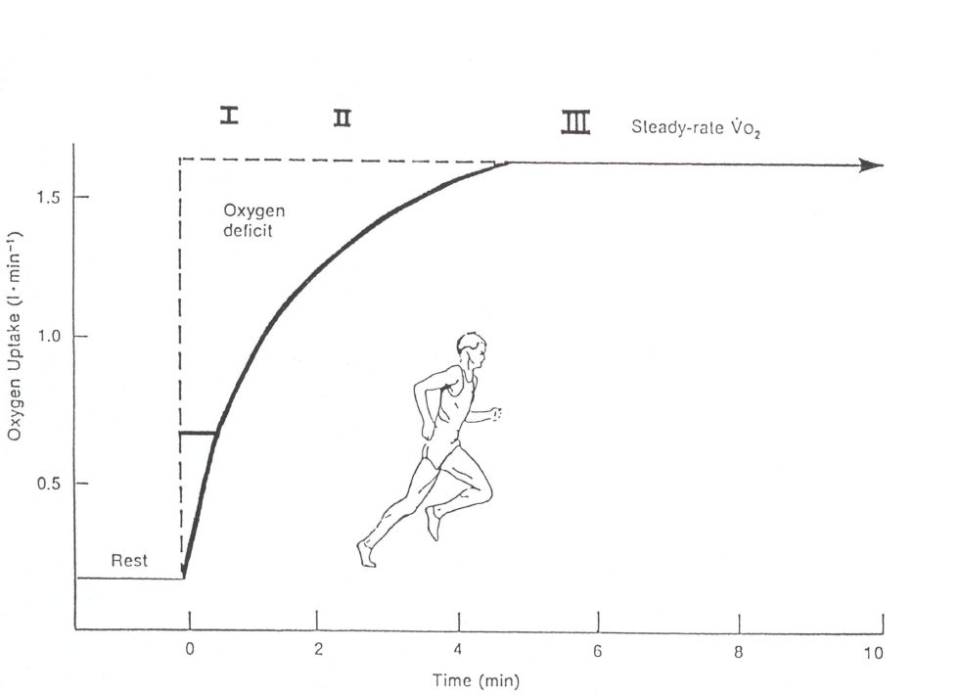
V’O₂ kinetics during moderate CWR exercise
Training
Aging

Slide 17
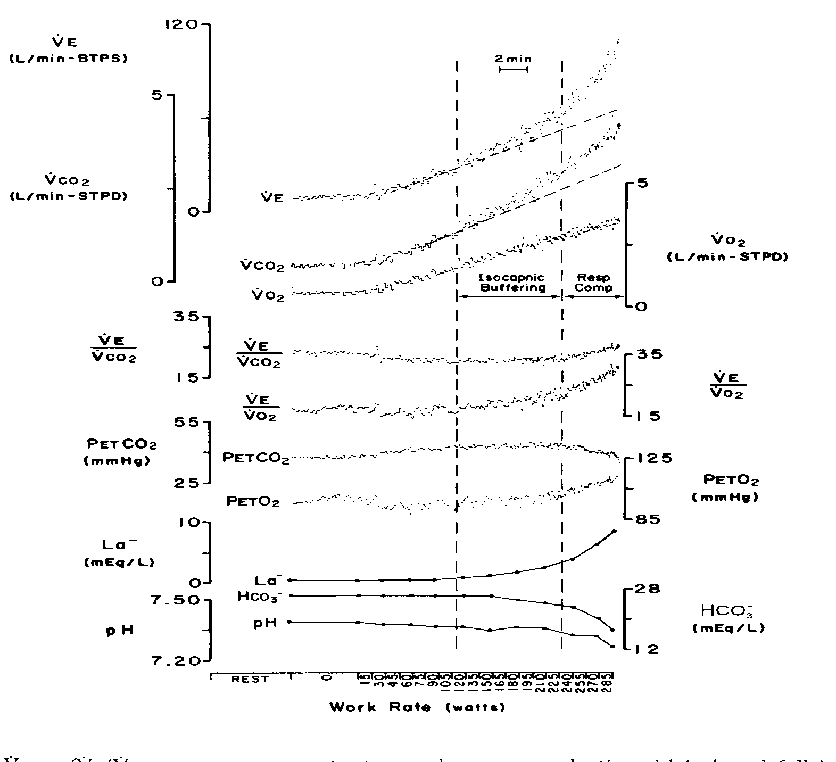
Maximal Incremental Test
LT
VCP

Slide 18
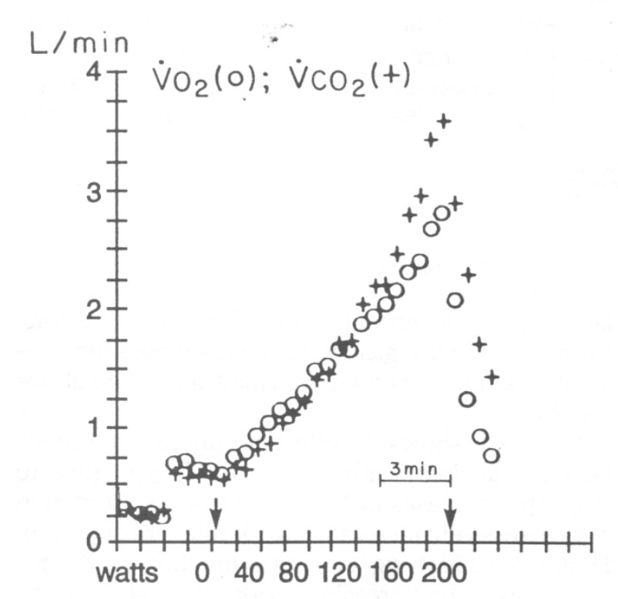
Linearity of Oxygen Uptake with
Work Rate Increases

Slide 19
Aerobic
Anaerobic
C₆H₁₀O₅ + H₂O
12,3*(C₆H₁₀O₅ + H₂O)
6O₂
37ATP
37ATP
ØO₂
W
24,6La⁻
6CO₂
16CO₂
anaerobic:aerobic > 2,5:1

Slide 21
Alveolar ventilation and PaCO2
PaCO2 = 863 * V’CO2
V’A
PaCO2 = 863 * V’CO2
V’E * (1-VD/VT)
Metabolic demand
Set Point
Gas exchange
efficiency

Slide 22
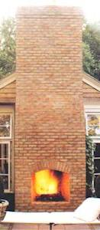
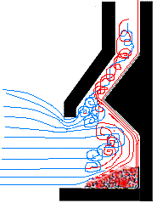
CO₂
“CO₂ output”
CO₂
V’_{E}
V’_{A}
CO₂
Lung gas exchange efficiency (V_{D}/V_{T})
O₂
CO₂ transport
+
CO₂ stores
V’CO₂
Q’CO₂
Muscle energetics
+
Buffers

Slide 23
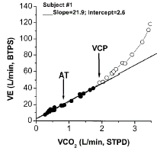
Ventilatory demand (V’_{E}/V’CO₂)
Sun XG, AJRCCM 2002

Slide 24
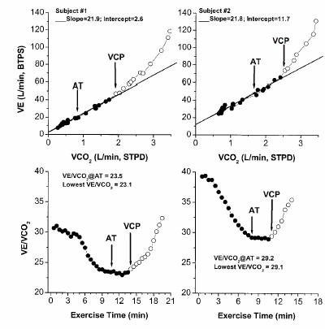
Ventilatory efficiency (V’_{E}/VCO₂)

Slide 25
The Fick Principle
Mass conservation (O₂) in a closed circuit
.
.
“O₂ extraction”
VO₂ = QT x C(a-v)O₂
(SV x HR)
“O₂ delivery”

Slide 26
.
Q
T
VO
=
(SV
X
HR)
x
C(a-v)O
2
2
m
EXERCISE INTENSITY
EXERCISE INTENSITY
Cardiovascular
Adjustments
m
∼ 5
CARDIAC OUTPUT
.
OXYGEN PULSE
VO₂/HR
∼ 5 L/min
OXYGEN UPTAKE

Slide 27
Dyspnea and Exercise limitation in COPD
K. Wasserman
Lung Diseases
V/Q mismatch Work of
breathing
⇑ V_{D}/V_{T}
⇓ P_{A}O₂ ⇓ pH
⇑ ventilatory ⇓ ventilatory
requirement capacity
Dyspnea and Exercise Limitation
ATP airflow ⇓ elastic
Lactate
V’CO₂ obstruction recoil
Muscle
Fatigue
V’E max =
FEV1 x40

Slide 28
Dyspnea and Exercise limitation in COPD
K. Wasserman
Lung Diseases
V/Q mismatch Work of
breathing
⇑ V_{D}/V_{T}
⇓ P_{A}O₂ ⇓ pH
⇑ ventilatory ⇓ ventilatory
requirement capacity
Dyspnea and Exercise Limitation
ATP airflow ⇓ elastic
Lactate
V’CO₂ obstruction recoil
Muscle
Fatigue

Slide 29
Dyspnea and Exercise limitation in COPD
K. Wasserman
Lung Diseases
V/Q mismatch Work of
breathing
⇑ V_{D}/V_{T}
⇓ P_{A}O₂ ⇓ pH
⇑ ventilatory ⇓ ventilatory
requirement capacity
Dyspnea and Exercise Limitation
ATP airflow ⇓ elastic
Lactate
V’CO₂ obstruction recoil
Muscle
Fatigue

Slide 30


Slide 31
COPD
FEV1 = 0.75 L

Slide 34
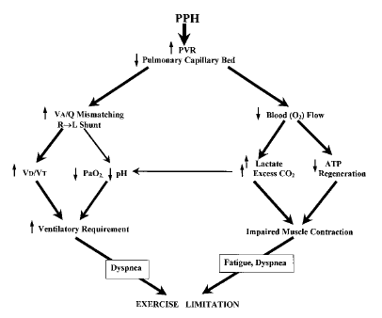
Exercise in patients with primary pulmonary hypertension (PPH)
Sun XG, Circulation 2001

Slide 35
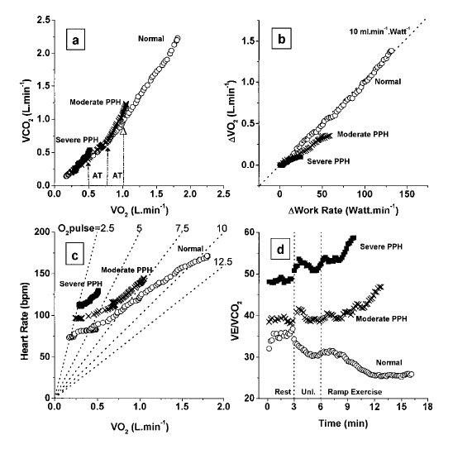
CPET in patients with primary pulmonary hypertension (IPH)
Sun XG, Circulation 2001

Slide 36
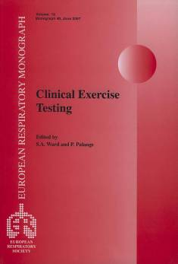
Eur Respir J 2007

Slide 37
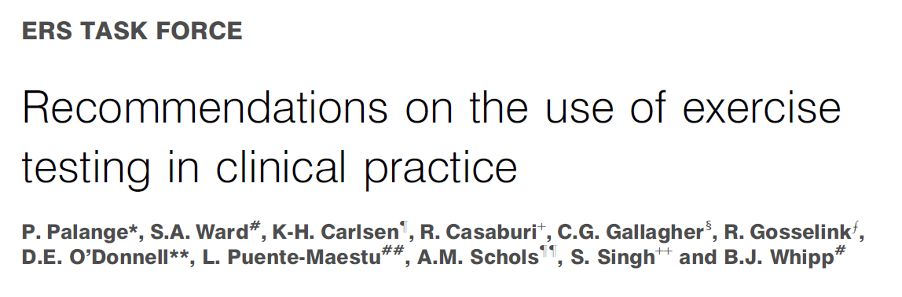

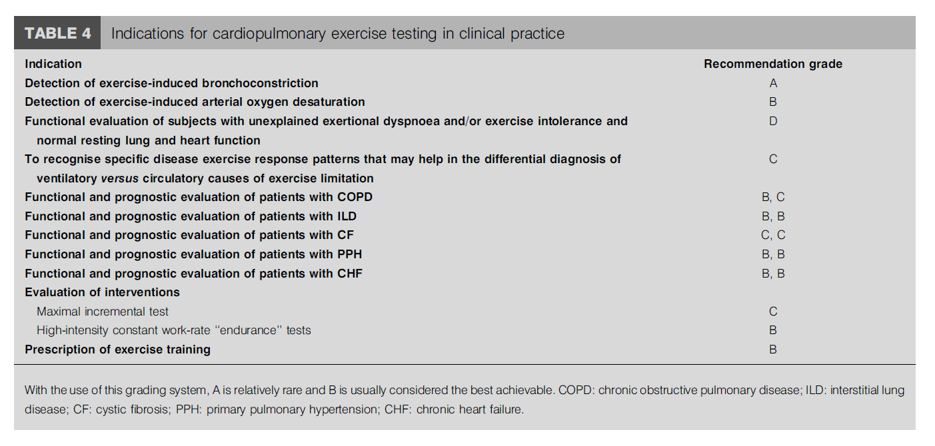
Eur Respir J 2007
HI CWR endurance TLIM

Slide 38
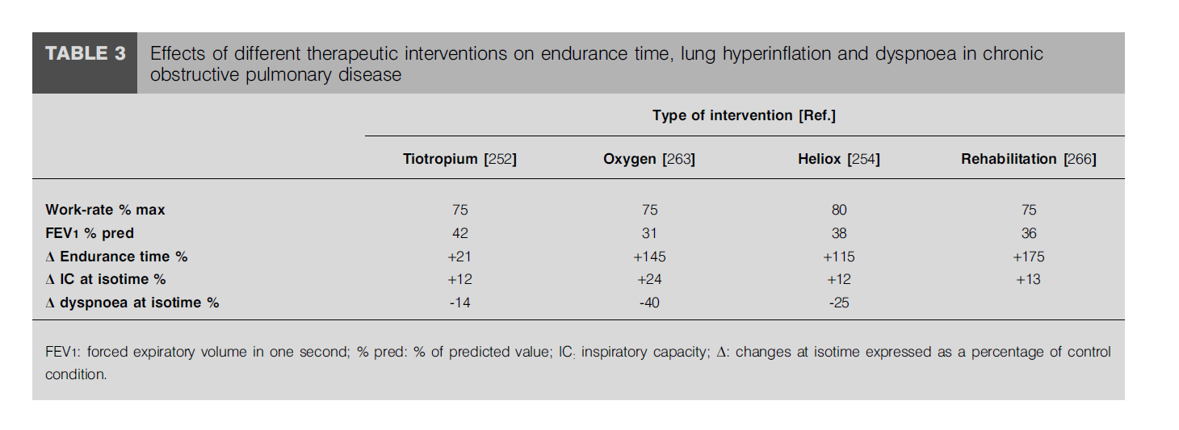
Eur Respir J 2007

Slide 39

Thanks
P. Palange
Notes:
39

