Slide 1

Markers prognostici dell'ipertensione polmonare come guida alla terapia
Sergio Harari
U.O. di Pneumologia – UTIR e Medicina Interna
Ospedale San Giuseppe – MultiMedica IRCCS
Milano
Pneumo Trieste
1-3 Aprile 2019

Slide 2
Conflict of interest disclosure
I have the following real or perceived conflicts of interest that relate to this presentation:
Affiliation / Financial interest | Commercial Company
Grants/research support: | Actelion Pharmaceuticals, Boehringer Ingelheim
Honoraria or consultation fees: | Actelion Pharmaceuticals, Boehringer Ingelheim, Roche
Participation in a company sponsored bureau: | No
Stock shareholder: | No
Spouse / partner: | No
Other support / potential conflict of interest: | No

Slide 3
Risk assessment is fundamental for the determination of an optimal treatment strategy
Non-vasoreactive
PAH patients
Low or intermediate risk
(WHO FC II-III)ª
High risk (WHO FC IV)ª
Initial
monotherapy^{b}
Initial oral combination^{b}
Initial combination including i.v. PGI₂^{c}
Patient already on treatment
Consider referral for
lung transplantation
Inadequate clinical response
Double or triple sequential combination
Inadequate clinical response
ª Some WHO-FC III patients may be considered high-risk;
^{b} Initial combination with ambrisentan plus tadalafil has proven to be superior to initial monotherapy with ambrisentan or tadalafil in delaying clinical failure;
^{c} Intravenous epoprostenol should be prioritized as it has reduced the 3 month rate for mortality in high-risk PAH patients also as monotherapy.
1. Galiè N, et al. Eur Respir J 2015; 46:903-75;
2. Galiè N, et al. Eur Heart J 2016; 37:67-119.

Slide 4
Risk Prediction Tools in PAH
Risk equations or models currently available to predict outcomes in PAH
  NIH registry equation¹ Haemodynamic variables (RAP, mPAP, CI)
  French network equation^{2,3} Gender, 6MWD, CO
  PH Connection (PHC) equation^{4,5} Haemodynamic variables (RAP, mPAP, CI)
  Scottish composite score⁶ Gender, aetiology, Age, 6MWD, RAP, CO
  REVEAL equation⁷ and risk score⁸ 19 variables (non-modifiable and modifiable)
  ESC/ERS risk stratification table⁹ Validated with 3 to 6 variables
  (FC, 6MWD, BNP/NT-proBNP, RAP, CI, SvO₂)
  Haemodynamic variables (RAP, mPAP, CI)
  Gender, 6MWD, CO
  Haemodynamic variables (RAP, mPAP, CI)
  Gender, aetiology, Age, 6MWD, RAP, CO
  12 variables (non-modifiable and modifiable)
  9 domains / Validated with 3 to 6 variables
  (FC, 6MWD, BNP/NT-proBNP, RAP, CI, SvO₂)
1. D’Alonzo. Ann Intern Med 1991. 2. Humbert. Circulation 2010. 3. Humbert. Eur Respir J 2010. 4. Thenappan. Eur Respir J 2010. 5. Thenappan. Chest 2012.
6. Lee. Eur Respir J 2012. 7. Benza. Circulation 2010. 8. Benza. Chest 2012. 9. Galiè N, Eur Heart J 2016 & Eur Respir J 2015.

Slide 5
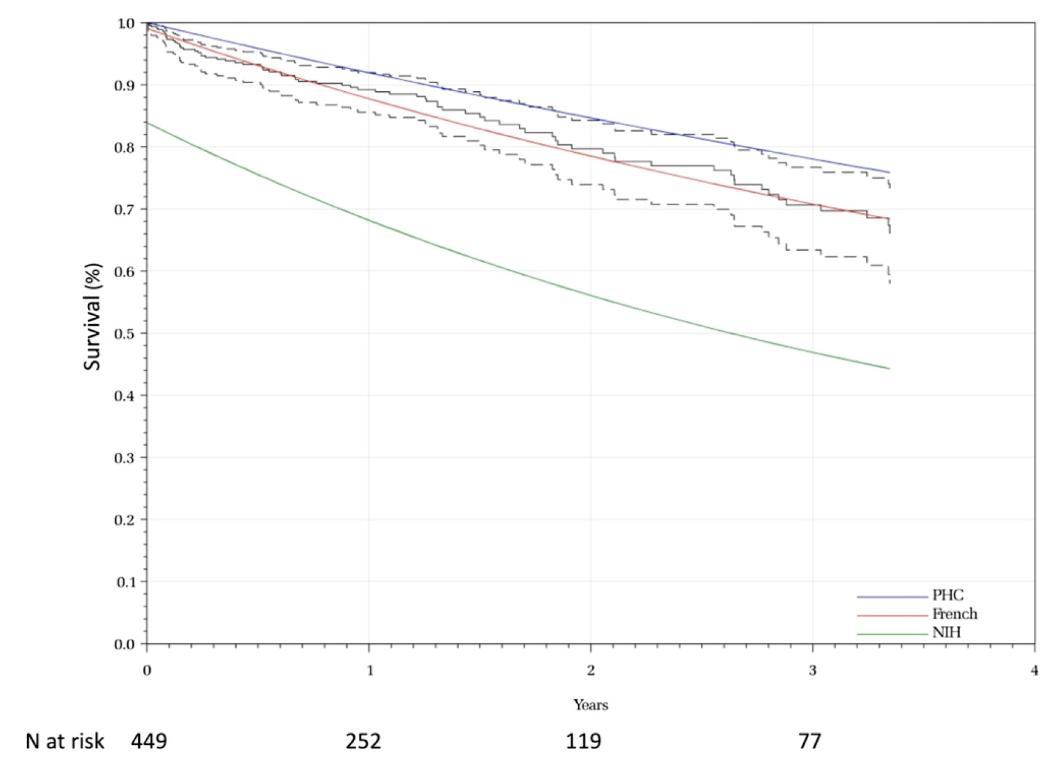
Validation and comparison of different tools
449 IHA-PAH patients from 4 RCTs and OLE (treprostinil and beraprost)
Actual survival (--- 95% CI)
PHC
French
NIH
Thenappan T, et al. Chest 2012; 141: 642-50.

Slide 6

Four recent registries assessing risk stratification in PAH
Swedish PAH Registry²
COMPERA³
REVEAL¹
French PH Registry⁴
Benza RL, et al. J Heart Lung Transplant. 2015;34:356–61.
Kylhammar D, et al. Eur Heart J 2017; ehx257.
Hoeper MM, et al. Eur Respir J 2017; 50:1700740.
Boucly A, et al. Eur Respir J 2017; 50:1700889.

Slide 7
Summary of four registries assessing risk scores
 | REVEAL¹ | SPAHR² | COMPERA³ | FPHN^{4,5}
Required variables, n | 12 | 8 | 6 | 4
Associated-PAH included | Yes | Yes | Yes | Only SSc⁵
Methodology | Score | Sum of grades (1 low-3 high) /nb available variables | Sum of grades (1 low-3 high) /nb available variables | Number of low risk variables
Definition of low-risk | ≤ 6 REVEAL score | <1.5 Average score | < 1.5 Average score | 3-4 of 4 low-risk criteria
External validation | Yes | Yes | Yes | Yes
Table 1: Summary of four registries assessing risk scores
*Incident patients only
1. Benza RL, et al. J Heart Lung Transplant. 2015;34:356–61. 2. Kylhammar D, et al. Eur Heart J 2017; ehx257. 3. Hoeper MM, et al. Eur Respir J 2017; 50:1700740.
4. Boucly A, et al. Eur Respir J 2017; 50:1700889. 5. Weatherald J, Boucly A, et al, Eur Respir J 2018; 52: 1800678.

Slide 8
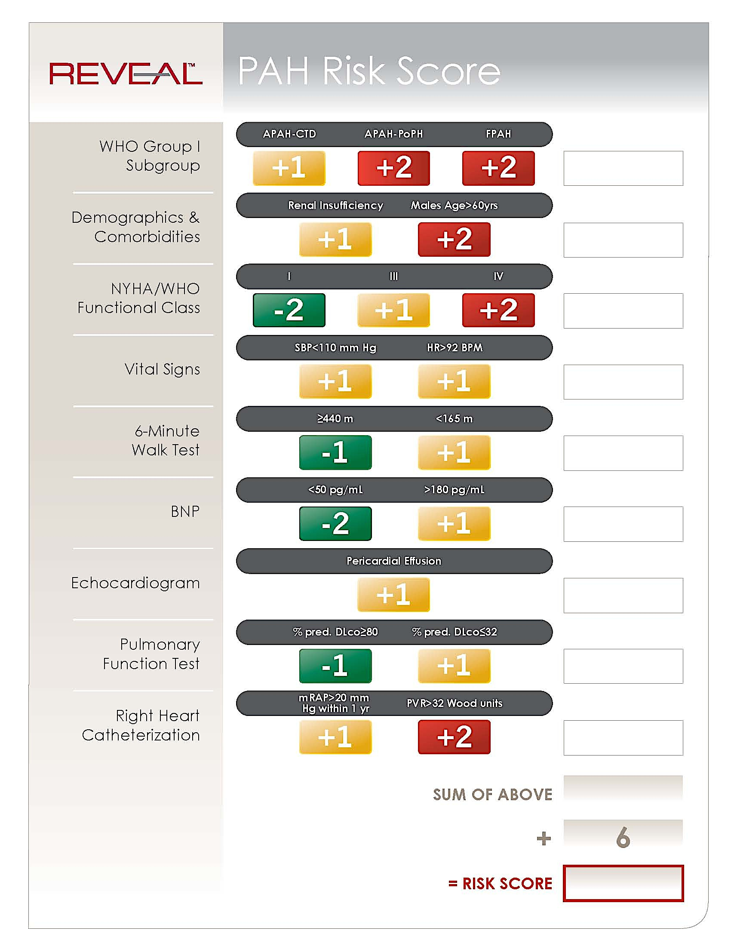
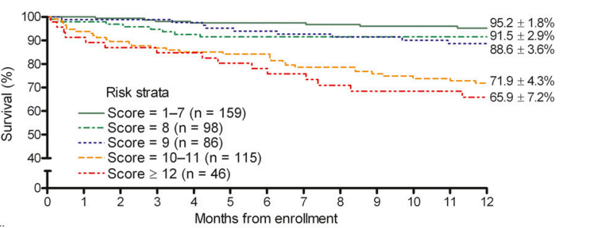
The REVEAL score
Score from 0 (low risk) to 22 (high risk)
Estimated survival at 1 year
Incident/prevalent cases
Survival according to risk score at enrollment
Aetiology
Demographics
& Comorbidities
NYHA FC
sBP & HR
6MWD
BNP
Echo (PE)
DLCO
RAP & PVR
Benza RL, et al. Circulation 2010. Benza RL, et al. Chest 2012.
Notes:
REVEAL score, although it is not clear how this translates to approach to treatment.
The limitations of the REVEAL score include the relatively short prediction period (1-year)
when assessed at follow-up and the large number of variables required (from 12 to 14variables). Simplified versions of the REVEAL score utilizing high-yield variables seem to have a similar predictive value as the original version.(24)

Slide 9
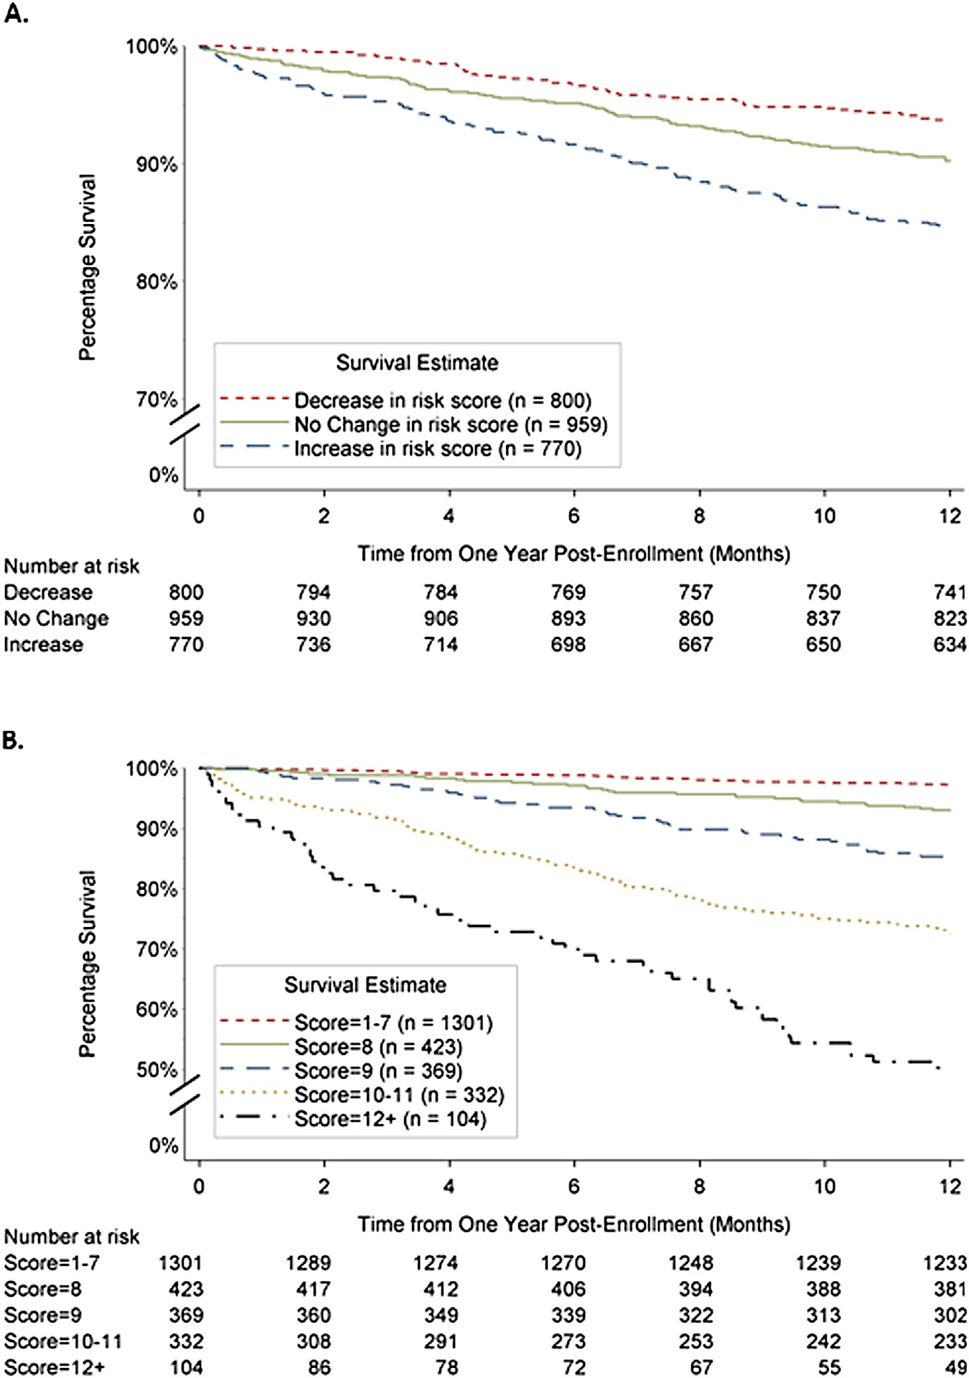
1-year survival according to REVEAL score at follow-up
Change in REVEAL score
REVEAL score at follow-up
Benza RL, et al. J Heart Lung Transplant. 2015;34:356–61.

Slide 10
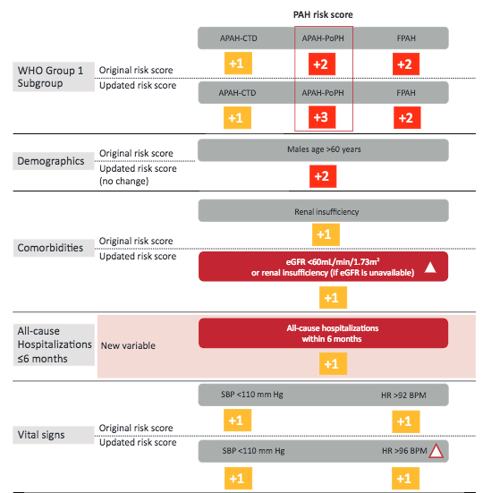
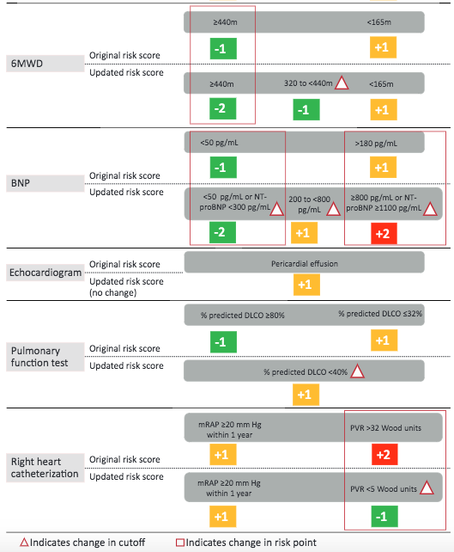
Updated REVEAL risk score calculator, n=2529
≥440m
POPH
< 50 pg/mL or NTproBNP <300
≥800 pg/mL or NTproBNP ≥1100
eGFR <60 ml/min/1.73 m²
or “renal insufficiency” if eGFR unavailable
All-cause hospitalisations within 6 months
DLCO <40% predicted
PVR > 32 UW
PVR < 5 UW
HR >96 bpm
Benza RL, et al. Chest 2019; in press.

Slide 11
Survival according to the updated REVEAL score
Benza RL, et al. Chest 2019; in press.

Slide 12
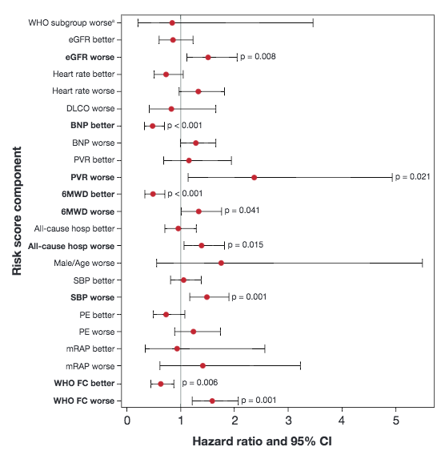
Prognostic factors according to change in risk score component between 12 and 24 months
Good prognosis
Improvement in BNP level
Improvement in 6MWD
Improvement in WHO/NYHA FC
eGFR worse
BNP better
Poor prognosis
Worsening of 6MWD
Worsening in WHO/NYHA FC
Worsening of renal function
Increase in PVR
Decrease in blood pressure
All cause hospitalisation
PVR worse
6MWD better
6MWD worse
All cause hosp.
SBP worse
WHO FC better
WHO FC worse
n=2191
Benza RL, et al. Chest 2019; in press.
Notes:
Identification of 3 good prognostic factors
Improvement in BNP level (normalisation?)
Improvement in 6MWD (threshold?)
Improvement in WHO/NYHA FC (II to I same than IV to III?)

Slide 13
REVEAL score
PRO | CON
All forms of PAH | 12 variables Including non modifiable variables
Incident and prevalent cases | Predicts survival at 1 year only (now up to 5 years with REVEAL 2.0)
At any time
External validation (French Registry)

Slide 14
2015 ESC/ERS Guidelines – Risk stratification in PAH
Determinants of prognosis | Estimated 1-year mortality
 | Low risk < 5% | Intermediate risk 5-10% | High risk > 10%
Clinical signs of right heart failure | Absent | Absent | Present
Progression of symptoms | No | Slow | Rapid
Syncope | No | Occasional syncope | Repeated syncope
FC | I, II | III | IV
6MWD | > 440 m | 165 - 440 m | < 165 m
CPET | Peak VO₂ > 15 ml/min/kg (> 65% pred.) VE/VCO₂ slope < 36 | Peak VO₂ 11 - 15 ml/min/kg (35-65% pred.) VE/VCO₂ slope 36 - 44.9 | Peak VO₂ < 11ml/min/kg (< 35% pred.) VE/VCO₂ slope ≥ 45
NT-proBNP plasma levels | BNP < 50 ng/l NT-proBNP < 300 ng/l | BNP 50–300 ng/l NT-proBNP 300–1400 ng/l | BNP > 300 ng/l NT-proBNP > 1400 ng/l
Imaging (echo, CMR) | RA area < 18 cm² No pericardial effusion | RA area 18–26 cm² No or minimal pericardial effusion | RA area > 26 cm² Pericardial effusion
Hemodynamics | RAP < 8 mmHg CI ≥ 2.5 l/min/m² SvO₂ > 65% | RAP 8–14 mmHg CI 2.0–2.4 l/min/m² SvO₂ 60–65% | RAP > 14 mmHg CI < 2.0 l/min/m² SvO₂ < 60%
Clinical Evaluation
Exercise Capacity
Right Ventricular Function
Galiè N, et al. Eur Respir J 2015; 46:903-75;
Galiè N, et al. Eur Heart J 2016; 37:67-119.

Slide 15
2015 ESC/ERS Guidelines – Risk stratification in PAH
Determinants of prognosis | Estimated 1-year mortality
 | Low risk < 5% | Intermediate risk 5-10% | High risk > 10%
Clinical signs of right heart failure | Absent | Absent | Present
Progression of symptoms | No | Slow | Rapid
Syncope | No | Occasional syncope | Repeated syncope
FC | I, II | III | IV
6MWD | > 440 m | 165 - 440 m | < 165 m
CPET | Peak VO₂ > 15 ml/min/kg (> 65% pred.) VE/VCO₂ slope < 36 | Peak VO₂ 11 - 15 ml/min/kg (35-65% pred.) VE/VCO₂ slope 36 - 44.9 | Peak VO₂ < 11ml/min/kg (< 35% pred.) VE/VCO₂ slope ≥ 45
NT-proBNP plasma levels | BNP < 50 ng/l NT-proBNP < 300 ng/l | BNP 50–300 ng/l NT-proBNP 300–1400 ng/l | BNP > 300 ng/l NT-proBNP > 1400 ng/l
Imaging (echo, CMR) | RA area < 18 cm² No pericardial effusion | RA area 18–26 cm² No or minimal pericardial effusion | RA area > 26 cm² Pericardial effusion
Hemodynamics | RAP < 8 mmHg CI ≥ 2.5 l/min/m² SvO₂ > 65% | RAP 8–14 mmHg CI 2.0–2.4 l/min/m² SvO₂ 60–65% | RAP > 14 mmHg CI < 2.0 l/min/m² SvO₂ < 60%
Clinical Evaluation
Exercise Capacity
Right Ventricular Function
Galiè N, et al. Eur Respir J 2015; 46:903-75;
Galiè N, et al. Eur Heart J 2016; 37:67-119.
Slide courtesy of Nazzareno Galiè

Slide 16
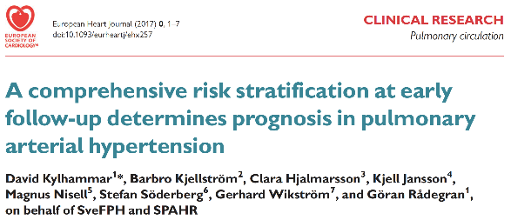
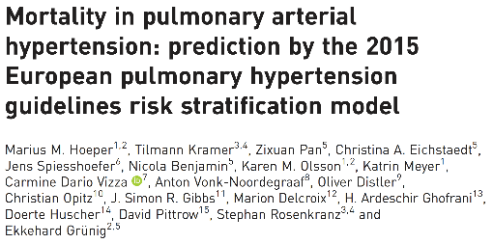
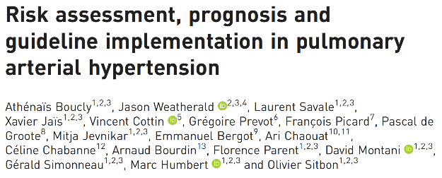
Validation of ESC/ERS risk stratification for PAH
Kylhammar (8 variables) | Hoeper (6 variables) | Boucly (4 or 3 variables)
n = 530 PAH (2008-2016) | n = 1588 PAH (2009-2016) | n = 1017 IPAH (2006-2016)
WHO 6MWD BNP RA area Pericardial effusion RAP CI SvO₂ | WHO 6MWD BNP RAP CI SvO₂ | WHO 6MWD RAP CI WHO 6MWD BNP
Sum of grades (1 low-3 high) /number available variables | Sum of grades (1 low-3 high) /number available variables | Number of low risk variables
Kylhammar D, et al. Eur Heart J 2017; ehx257; Hoeper MM, et al. Eur Respir J 2017; 50:1700740; Boucly A, et al. Eur Respir J 2017; 50:1700889.

Slide 17
Methodology used in The Swedish PAH Registry and COMPERA
Incident population of PAH: n= 530 (SPAHR), n= 1588 (COMPERA)
Assigned a score of 1 (low-risk), 2 (intermediate-risk) or 3 (high-risk) for each variable available;
Calculated average score, rounded to nearest integer to define the patient’s risk group.
Determinants of prognosis | Estimated 1-year mortality
 | Low risk < 5% | Intermediate risk 5-10% | High risk > 10%
Clinical signs of right heart failure | Absent | Absent | Present
Progression of symptoms | No | Slow | Rapid
Syncope | No | Occasional syncope | Repeated syncope
FC | I, II | III | IV
6MWD | > 440 m | 165 - 440 m | < 165 m
CPET | Peak VO₂ > 15 ml/min/kg (> 65% pred.) VE/VCO₂ slope < 36 | Peak VO₂ 11 - 15 ml/min/kg (35-65% pred.) VE/VCO₂ slope 36 - 44.9 | Peak VO₂ < 11ml/min/kg (< 35% pred.) VE/VCO₂ slope ≥ 45
NT-proBNP plasma levels | BNP < 50 ng/l NT-proBNP < 300 ng/l | BNP 50–300 ng/l NT-proBNP 300–1400 ng/l | BNP > 300 ng/l NT-proBNP > 1400 ng/l
Imaging (echo, CMR) | RA area < 18 cm² No pericardial effusion | RA area 18–26 cm² No or minimal pericardial effusion | RA area > 26 cm² Pericardial effusion
Hemodynamics | RAP < 8 mmHg CI ≥ 2.5 l/min/m² SvO₂ > 65% | RAP 8–14 mmHg CI 2.0–2.4 l/min/m² SvO₂ 60–65% | RAP > 14 mmHg CI < 2.0 l/min/m² SvO₂ < 60%
1
2
3
Score = 1 + 1 + 2 + 2 + 3 = 9
Score divided by the number of available variables = 9 / 5 = 1.8
Rounded to nearest integer = 2 → Intermediate risk
Kylhammar D, et al. Eur Heart J 2017; (Epub ahead of print).

Slide 18
Validation of ESC/ERS risk stratification in large registries
SPAHR: change in risk status
Baseline
Follow-up
Kylhammar D, et al. Eur Heart J 2017; Epub ahead of print;
Hoeper MM, et al. Eur Respir J 2017; 50:1700740.

Slide 19
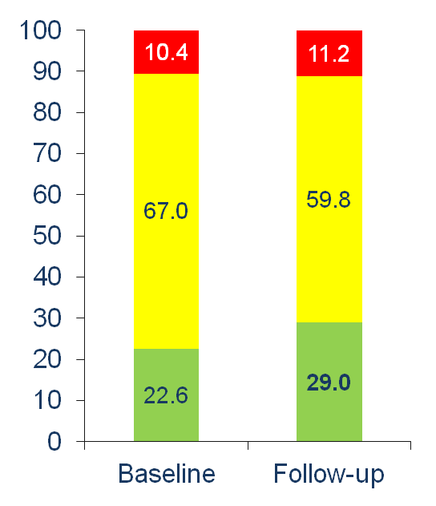
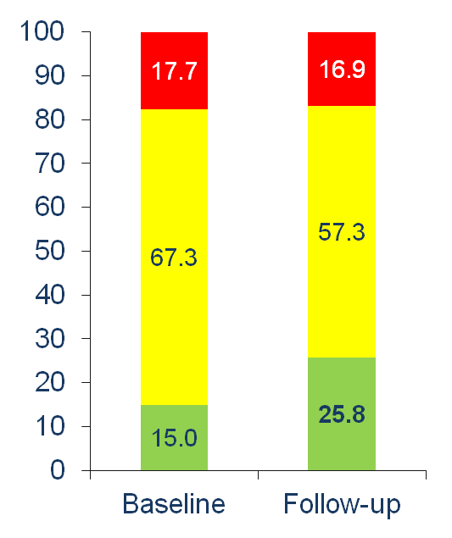
Around 75% of PAH patients did not achieve a low risk profile at follow-up
SPAHR
COMPERA
High risk
Intermediate risk
Low risk
Patients (%)
Patients (%)
(n = 163)
(n = 117)
(n = 347)
(n = 213)
Kylhammar D, et al. Eur Heart J 2017; Epub ahead of print.
Hoeper MM, et al. Eur Respir J 2017; 50:1700740.

Slide 20
SPAHR and COMPERA methodology
PRO | CON
6 – 8 variables (less than REVEAL) | Only incident cases
All forms of PAH | Lot of missing data
Predicts 5 year-survival | Estimated risk could be calculated with 2 variables only (misclassification)
Risk status at 1 year predicts survival irrespective of baseline status | High mortality rate in patients at low risk (COMPERA)

Slide 21
Association between the number low-risk criteria and survival
Retrospective study from French Registry
Incident patients with idiopathic, heritable and drug-induced PAH between 2006-2016 were analysed
The number of low-risk criteria present at diagnosis and at first re-evaluation were assessed:
  WHO/NYHA functional class I or II
  6-minute walk distance (6MWD) > 440m
  right atrial pressure < 8 mmHg
  cardiac index ≥ 2.5 L/min/m²
1017 / 1591 patients having all parameters available at both baseline and first re-evaluation
Determinants of prognosis | Low risk < 5%
Clinical signs of right heart failure | Absent
Progression of symptoms | No
Syncope | No
FC | I, II
6MWD | > 440 m
CPET | Peak VO₂ > 15 ml/min/kg (> 65% pred.) VE/VCO₂ slope < 36
NT-proBNP plasma levels | BNP < 50 ng/l NT-proBNP < 300 ng/l
Imaging (echo, CMR) | RA area < 18 cm² No pericardial effusion
Hemodynamics | RAP < 8 mmHg CI ≥ 2.5 l/min/m² SvO₂ > 65%
Boucly A., et al. Eur Respir J 2017; 50: 1700889.

Slide 22
Achievement of multiple low risk criteria is associated with improved long-term outcomes
Low-risk criteria:
NYHA FC I-II
6MWD >440 m
RAP <8 mmHg
CI >2.5 L/min/m²
Incident patients enrolled in the French registry
Boucly A., et al. Eur Respir J 2017; 50: 1700889.

Slide 23
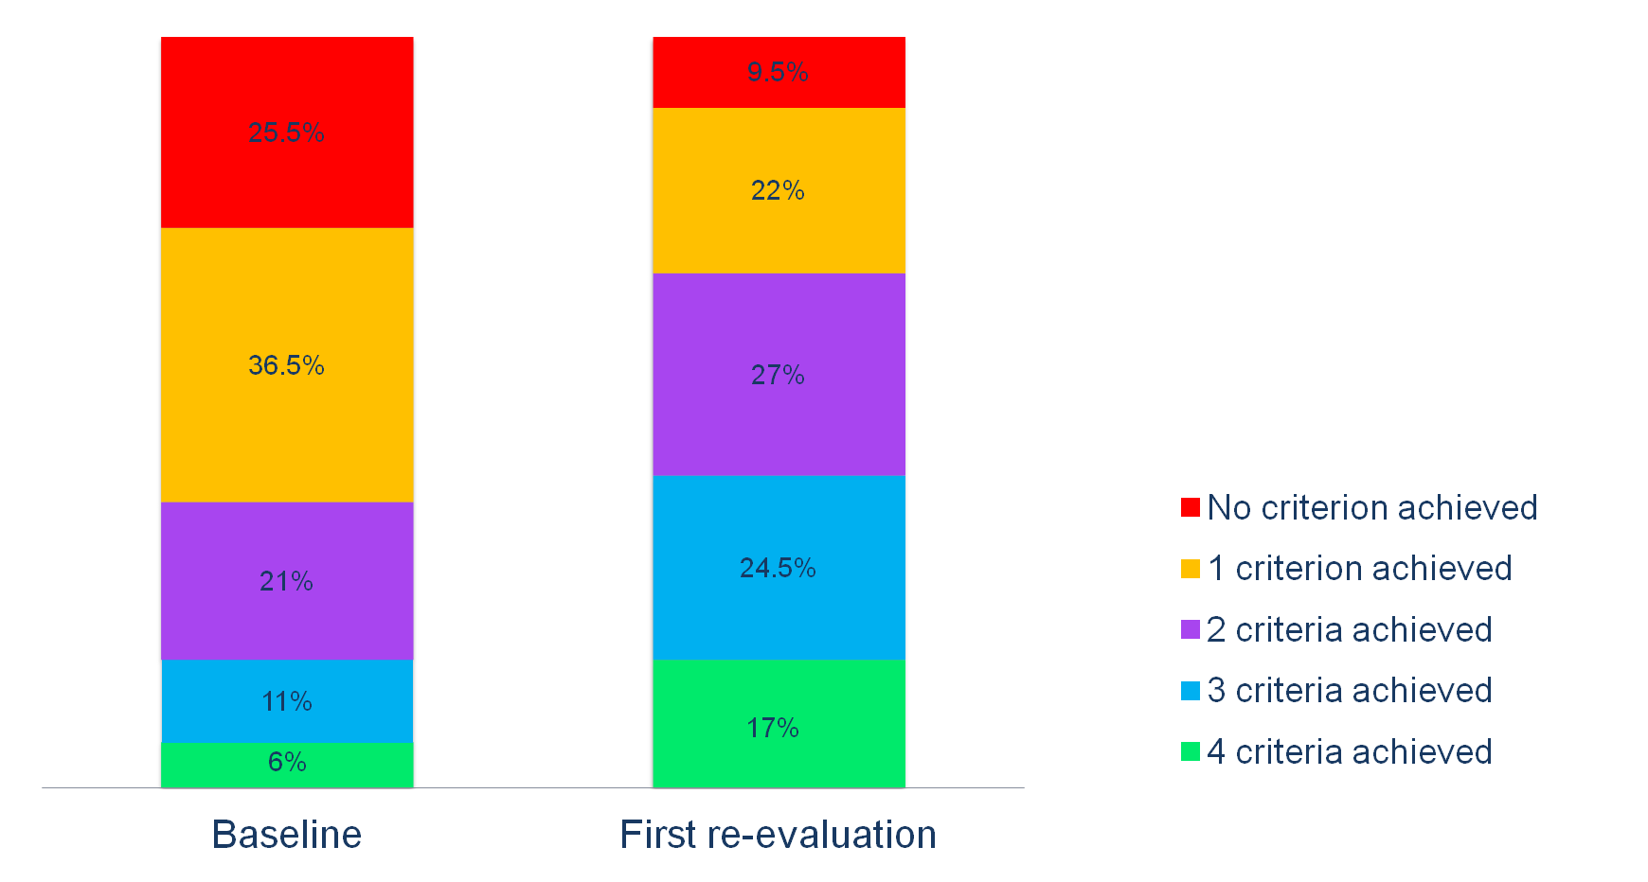
Change in “low-risk” criteria
Low-risk criteria:
NYHA FC I-II
6MWD > 440 m
RAP < 8 mmHg
CI ≥ 2.5 L/min/m²
Boucly A., et al. Eur Respir J 2017; 50: 1700889.

Slide 24
Even one high-risk criterion significantly increases patients mortality risk in PAH
100
80
4 IR criteria
60
High risk criteria
FC IV
CI < 2.0 L/min/m²
RAP > 14 mmHg
6MWD < 165 m
Survival (%)
1 HR 3 HR criteria
40
20
2, 3 or 4 HR criteria
p < 0.001
0
0
1
2
3
4
5
Patients at risk, n
Years
4 IR criteria | 20 | 15 | 9 | 10 | 8 | 6
1 HR criterion | 37 | 26 | 19 | 9 | 7 | 6
2,3 or 4 HR criteria | 38 | 22 | 11 | 4 | 3 | 2
IR: intermediate risk, HR: high risk
*Median (interquartile range) interval between diagnosis and first re-evaluation was 4.4 (3.6–6.4) months
Boucly A., et al. Eur Respir J 2017; 50: 1700889.

Slide 25
Number of non-invasive low-risk criteria at follow-up is also associated with prognosis
100
3 criteria
Non-invasive low-risk criteria:
NYHA FC I-II
6MWD >440 m
BNP <50 ng/L or NT-proBNP <300 ng/L
80
2 criteria
1 criterion
60
Survival (%)
Patients with all 3 non-invasive low-risk criteria (≈ 20%) had a 2-, 3- and 5-year survival of 100%, 99% and 97%, respectively
40
0 criteria
20
p < 0.001
0
0
1
2
3
4
5
Invasive hemodynamic risk assessment provides important prognostic information in patients who do not achieve 3 non-invasive low-risk criteria
Time (years)
Patients at risk, n (n = 603)
3 criteria | 115 | 97 | 81 | 63 | 38 | 26
2 criteria | 145 | 116 | 95 | 72 | 36 | 21
1 criterion | 175 | 136 | 101 | 62 | 38 | 24
0 criteria | 168 | 117 | 76 | 39 | 23 | 11
Non-invasive measurements were WHO/NYHA FC, 6MWD and either BNP or NT-proBNP
Boucly A., et al. Eur Respir J 2017; 50: 1700889.

Slide 26
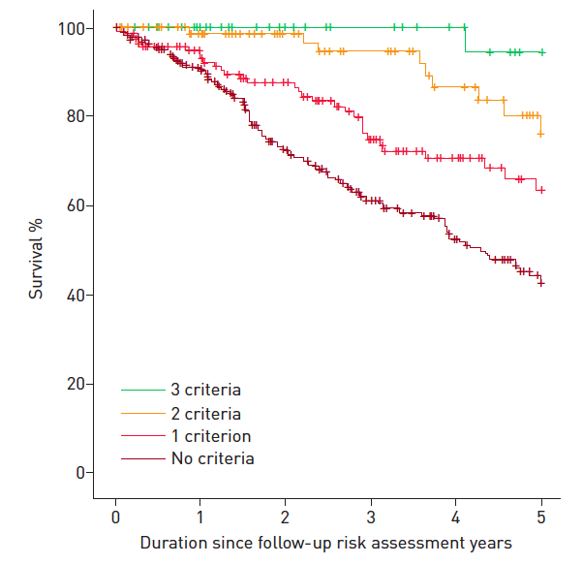
Validation of the simplified French methodology in COMPERA
579 idiopathic PAH
1st follow-up (median 4.6 months)
3 non invasive criteria:
  NYHA FC I-II
  6MWD > 440m
  BNP < 50 ng/L or
  NT-proBNP < 300 ng/mL
Hoeper M, et al. Eur Respir J 2018; 51: 1702606.

Slide 27
In PAH-SSc patients, achievement of multiple low-risk criteria at first re-evaluation leads to improved long-term outcomes
French Registry¹
PAH-SSc
n = 352
Johns Hopkins²
PAH-SSc
n = 151
1. Weatherald J, Boucly A, et al. Eur Respir J 2018; 52: 1800678. 2. Mercurio V, et al. Eur Respir J 2018; 52: 1800497.

Slide 28
French PH Network methodology
PRO | CON
4 variables including haemodynamics | Only incident cases
Simplified tool with 3 non-invasive variables | Not analysed in non-SSc CTD-PAH, CHD-PAH, PoPH, HIV-PAH
No missing data
Predicts survival at 5 years
To achieve 3-4 low-risk criteria could be considered as treatment goal

Slide 29
Limitations of Risk Assessment
Data derived from retrospective and prospective observational registries
Data collection was not standardized in all published registries
Significant missing data and patients lost to follow-up (SPAHR & COMPERA)
Other important prognostic features, e.g. imaging, Echo, and CPET, were not collected systematically
Intermediate risk patients is the largest group

Slide 30


Recommendations for evaluation of PAH severity and response to therapy
Recommendations for evaluation of PAH severity and response to therapy | Class | Level
It is recommended to evaluate the severity of PAH patients with a panel of data derived from clinical assessment, exercise tests, biochemical markers and echocardiographic and hemodynamic evaluations | I | C > B
It is recommended to perform regular follow-up assessments every 3 - 6 months in stable patients | I | C > B
Achievement/maintenance of a low-risk profile is recommended as an adequate treatment response for patients with PAH | I | C > B
Achievement/maintenance of an intermediate-risk profile should be considered an inadequate treatment response for most patients with PAH | IIa | C > B
Risk Stratification
Treatment
goal
1. Galiè N, et al. Eur Respir J 2015; 46:903-75;
2. Galiè N, et al. Eur Heart J 2016; 37:67-119.

Slide 31
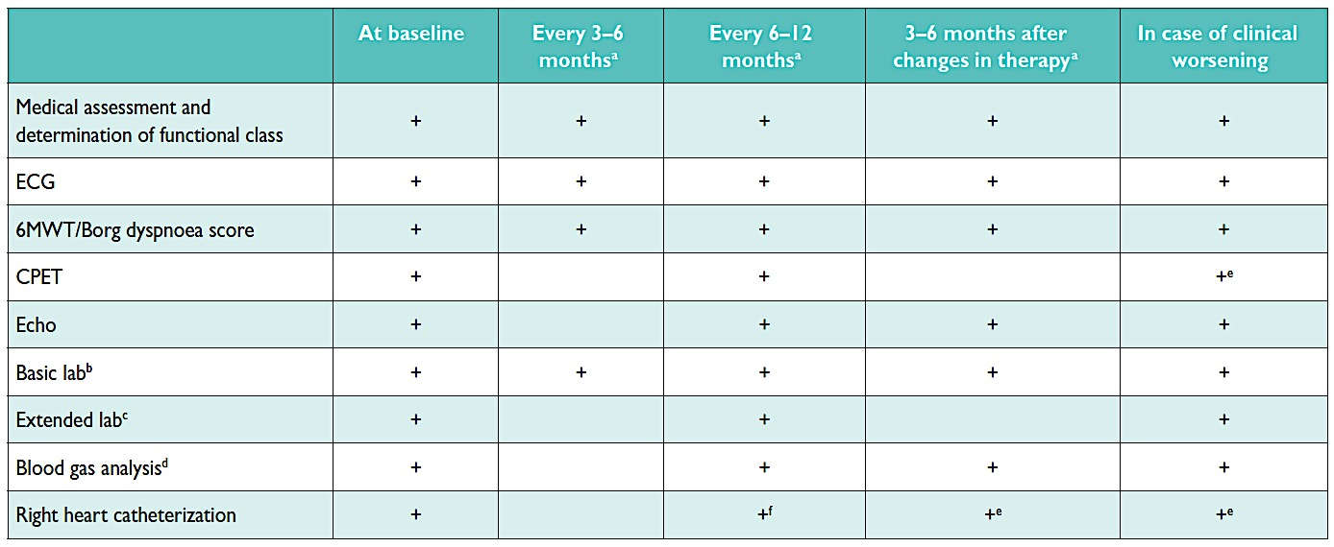
Suggested assessment and timing for the prospective and structured follow-up of patients with PAH
ªIntervals to be adjusted according to patient needs. ^{b}Basic lab includes blood count, INR (in patients receiving vitamin K antagonists), serum creatinine, sodium, potassium, ASAT/ALAT (in patients receiving ERAs), bilirubin and BNP/NT-proBNP. ^{c}Extended lab includes TSH, troponin, uric acid, iron status (iron, ferritin, soluble transferrin receptor) and other variables according to individual patient needs. ^{d}From arterial or arterialized capillary blood; may be replaced by peripheral oxygen saturation in stable patients or if BGA is not available. ^{e}Should be considered. ^{f}Some centers perform RHCs at regular intervals during follow-up.
Galiè N, et al. Eur Respir J 2015; 46:903-75;
Galiè N, et al. Eur Heart J 2016; 37:67-119.

Slide 32
Conclusions
Multi-parameter risk assessment is essential to determine prognosis and to define the optimum treatment strategy for all patients with PAH
Recent studies have provided strong evidence to support multi-parameter risk assessment in PAH patients, at baseline and follow-up, irrespective of the methodology utilised
Therefore, the ultimate goal of treatment should be to achieve a low risk profile at any time
Finally, less is more…

