Slide 1
Ossigenoterapia ad alti flussi nell’era post-COVID: un aggiornamento per il clinico ed il fisiopatologo
Prof. Claudia Crimi Department of Clinical and Specialistic Medicine, University of Catania
Respiratory Intensive Care Unit, Policlinico University Hospital
Catania, Italy
ERS Assembly 02.02 Noninvasive Ventilatory Support – Secretary

Slide 2
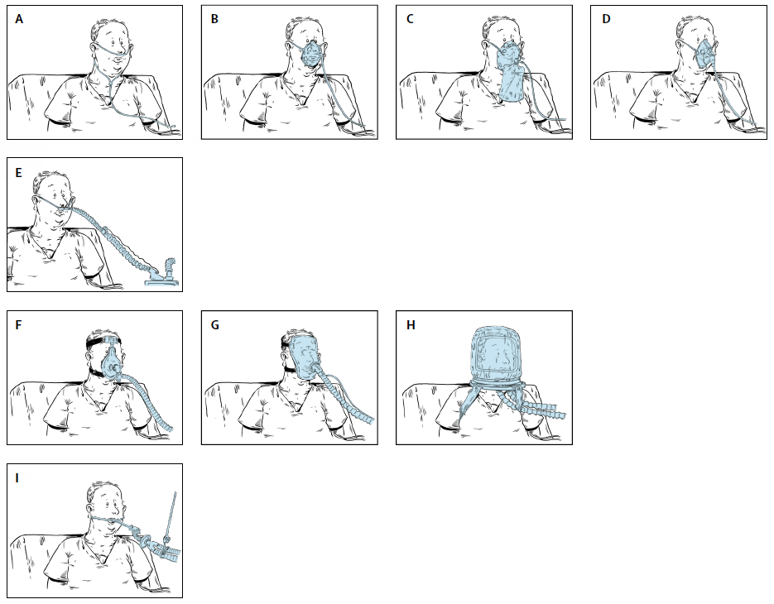
Noninvasive oxygenation strategies
Low-flow O₂
HFNC
NIV / CPAP
Azoulay E. et al Lancet Resp Med 2018
Notes:
HFNT is a respiratory support device, which is used during early non-invasive management of acute respiratory failure (ARF), alongside conventional oxygen therapy (COT), and non- invasive ventilation (NIV).

Slide 3
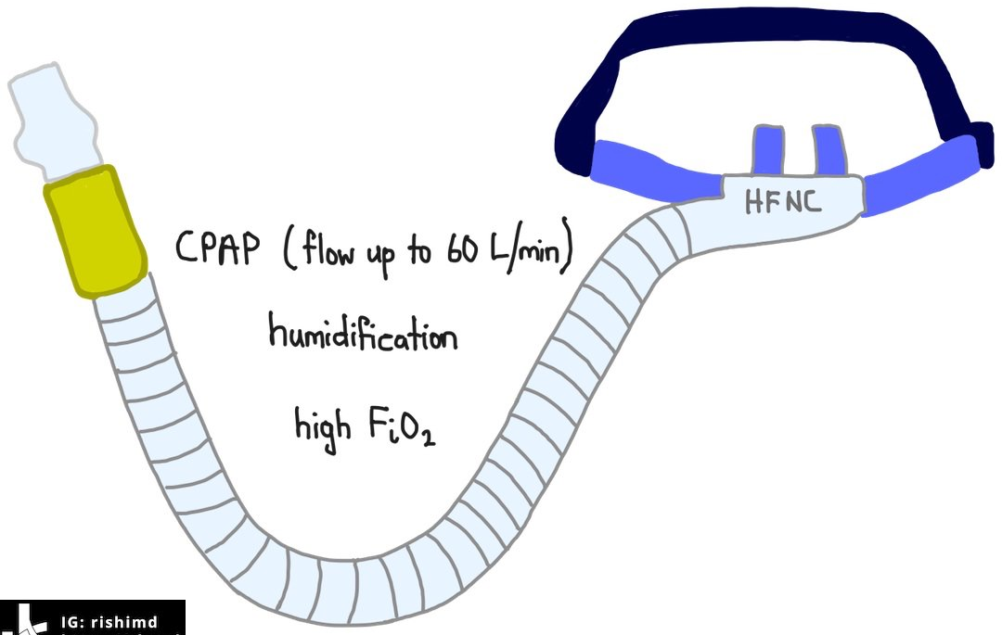
Why HFNT?
Mucociliary clearance
Comfort
Heat and Humidification
High Flow
Mucociliary clearance
Comfort
Meets Inspiratory Demands
Accurate oxygen delivery
Dead Space Washout
PEEP effect
Increase of EELV

Slide 4
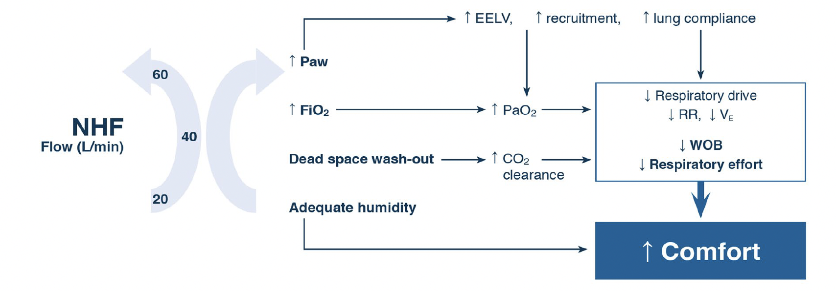
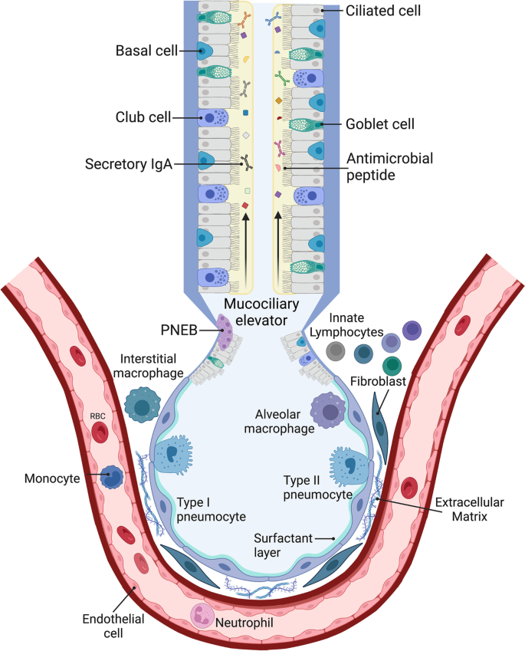
Innate immune response in the lungs
Physiologic Effects of High Flow Therapy
Ricard JD et al Intensive Care Med 2020
Notes:
COPD Patients adopted PLB to reduce RR improve dynamic hyperinflation, increase expiratory time and improve dynamic hyperinflation
Indeed, the mechanism of action of HFNC on ventilation resem-bles the breathing pattern of the pursed-lip breathing.
However, this effect depends on the size of the nasal cannula and the patient’s expiratory flow

Slide 5
Main effects of HFNT on Respiratory System
Airways
PEEP-like effect
Humidification
Dead space whash-out
Lungs = Gas exchange
High FiO2 effect
Diaphragm = Muscle Pump
PEEP-like effect
PEEP-like effect
Improve mechanics

Slide 6
When: choosing the right patient
Hypoxemic
Hypercapnic

Slide 7
ACUTE HYPOXEMIC RESPIRATORY FAILURE
Maggiore SM ICM 2023

Slide 8
Intubation: RR 0.85 [95% CI 0.74-0.99]
Escalation of respiratory support: RR 0.71 [0.51-0.98]
Rochwerg B et al. ICM 2020
Notes:
HFNC is superior to standard oxygen therapy for undifferentiated respiratory failure; however, when compared to NIV, low-quality evidence suggests similar outcomes.

Slide 9
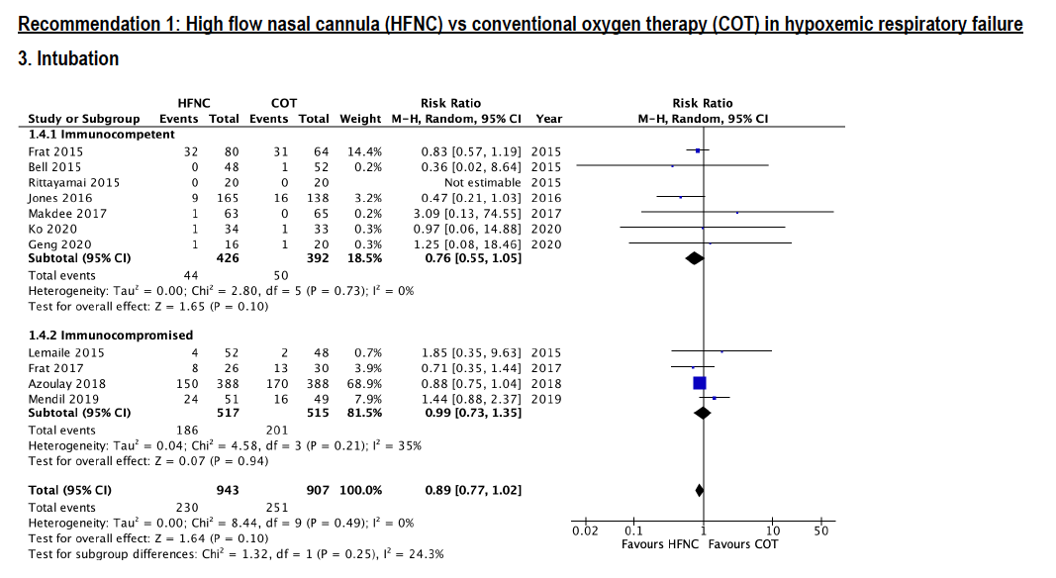
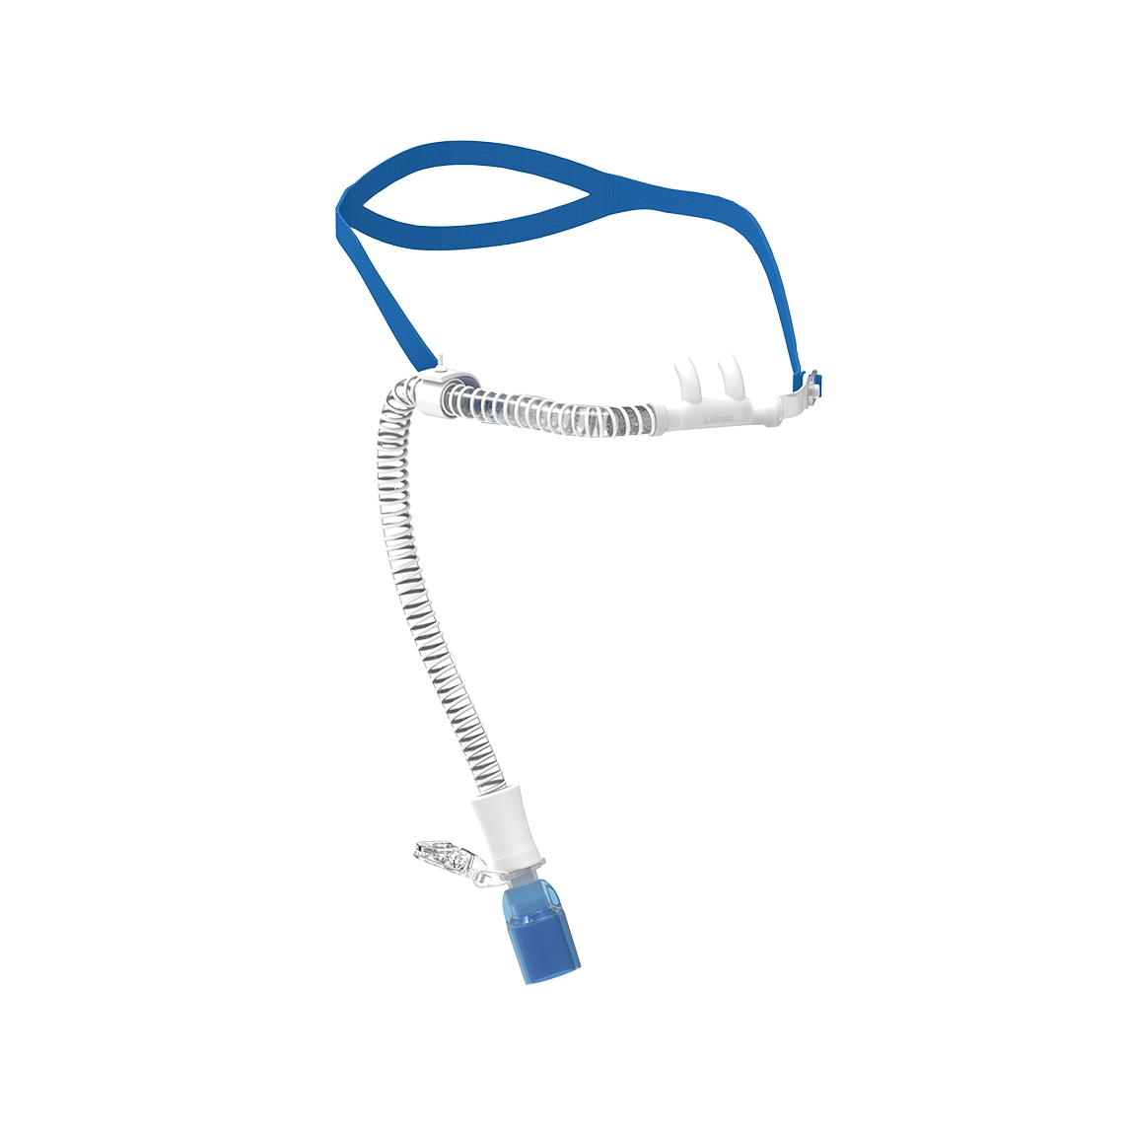
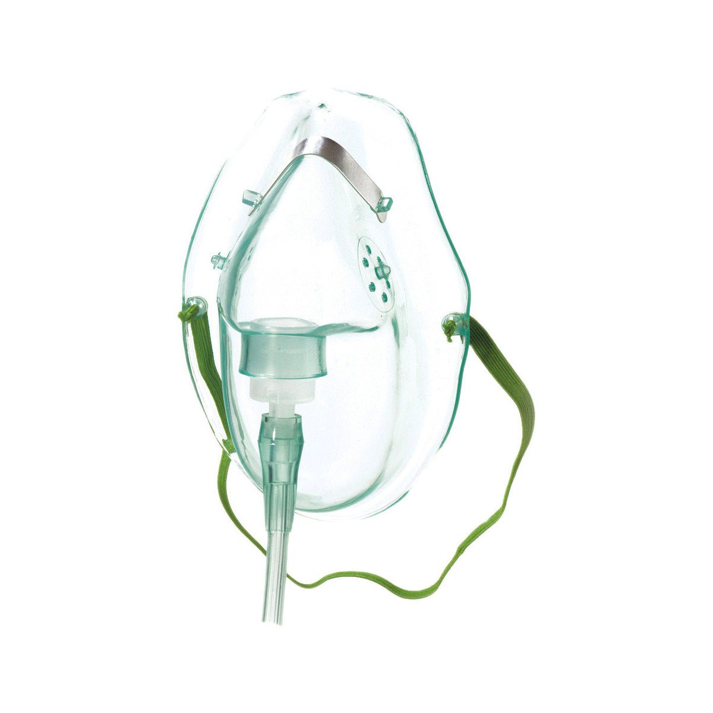
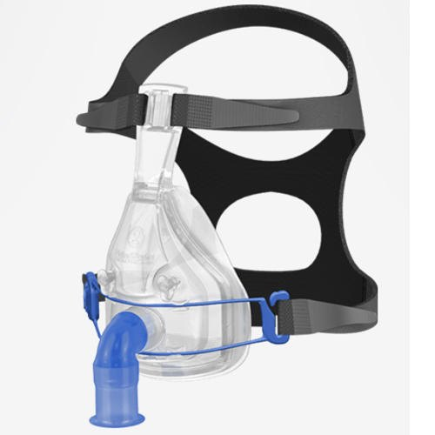
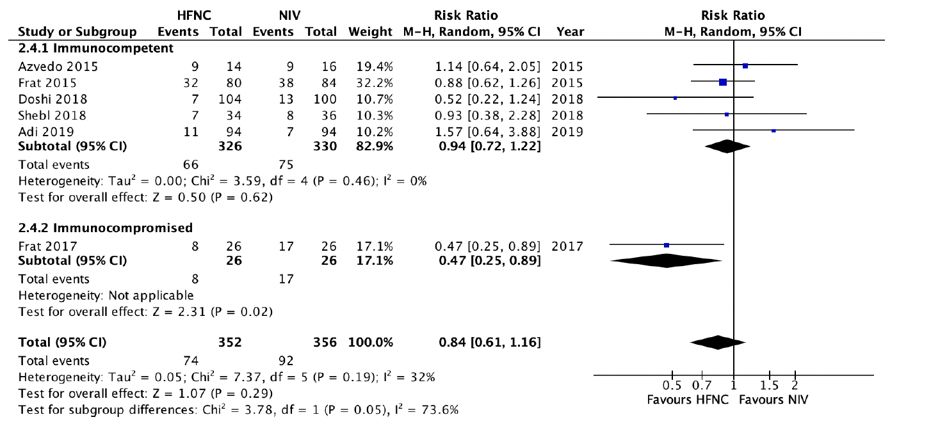
INTUBATION
Intubation: RR 0.89 [95% CI 0.77-1.02]
Escalation to NIV: RR 0.76 [0.43-1.34]
Oczkowski S et al ERJ 2022

Slide 10
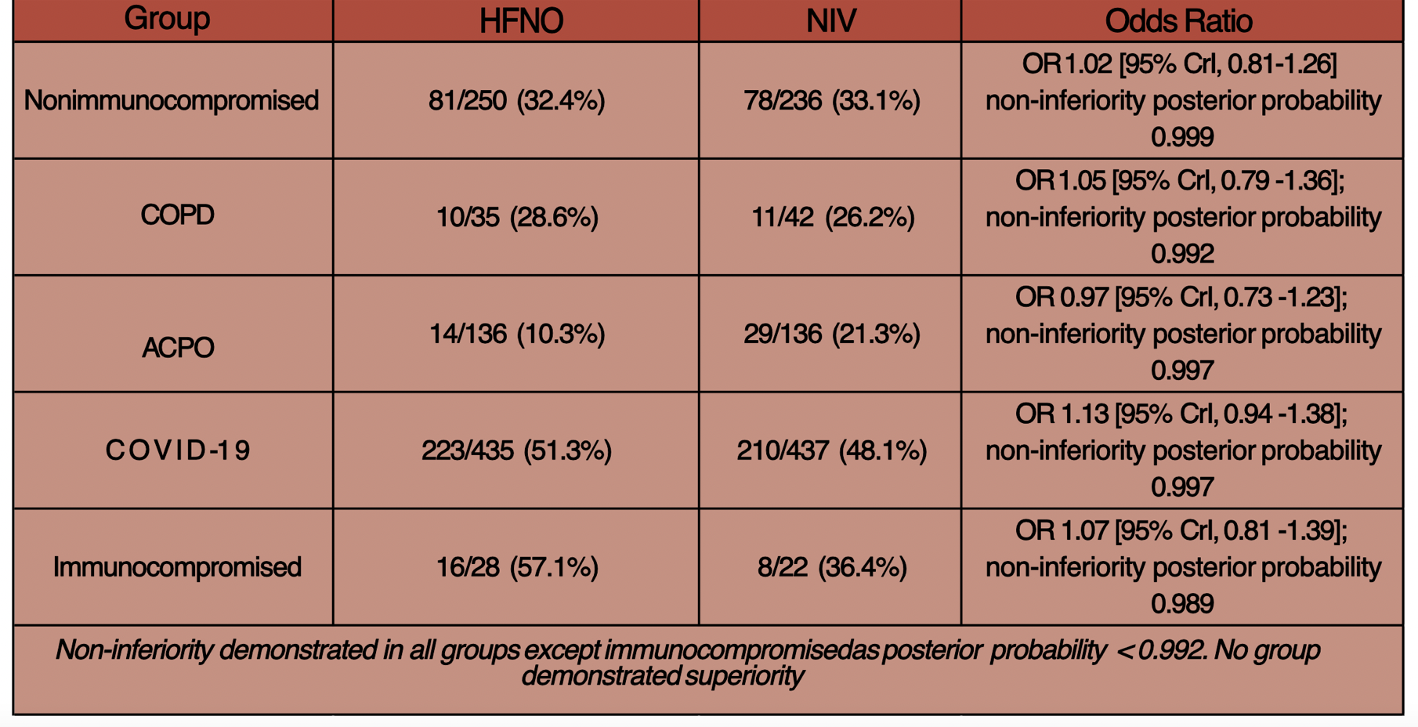
In adult patients with acute respiratory failure does the use of high-flow nasal oxygen compared to noninvasive ventilation reduce the rate of endotracheal intubation or death at 7 days?

Slide 11
1176 respondents among ERS Assembly 2, 1 and 9
Crimi C. et al under review

Slide 12
Late HFNT Failure & ETI may cause harm
Notes:
Purpose: Intubation in patients with respiratory failure can be avoided by high-flow nasal cannula (HFNC) use. However, it is unclear whether waiting until HFNC fails, which would delay intubation, has adverse effects. The present retrospective observational study assessed overall ICU mortality and other hospital outcomes of patients who received HFNC therapy that failed.
Methods: All consecutive patients in one tertiary hospital who received HFNC therapy that failed and who then required intubation between January 2013 and March 2014 were enrolled and classified according to whether intubation started early (within 48 h) or late (at least 48 h) after commencing HFNC.
Results: Of the 175 enrolled patients, 130 (74.3 %) and 45 (25.7 %) were intubated before and after 48 h of HFNC, respectively. The groups were similar in terms of most baseline characteristics. The early intubated patients had better overall ICU mortality (39.2 vs. 66.7 %; P = 0.001) than late intubated patients. A similar pattern was seen with extubation success (37.7 vs. 15.6 %; P = 0.006), ventilator weaning (55.4 vs. 28.9 %; P = 0.002), and ventilator-free days (8.6 ± 10.1 vs. 3.6 ± 7.5; P = 0.011). In propensity-adjusted and -matched analysis, early intubation was also associated with better overall ICU mortality [adjusted odds ratio (OR) = 0.317, P = 0.005; matched OR = 0.369, P = 0.046].
Conclusions: Failure of HFNC might cause delayed intubation and worse clinical outcomes in patients with respiratory failure. Large prospective and randomized controlled studies on HFNC failure are needed to draw a definitive conclusion.

Slide 13
Benefits
Risks
Crimi C. et al Breathe 2023

Slide 14
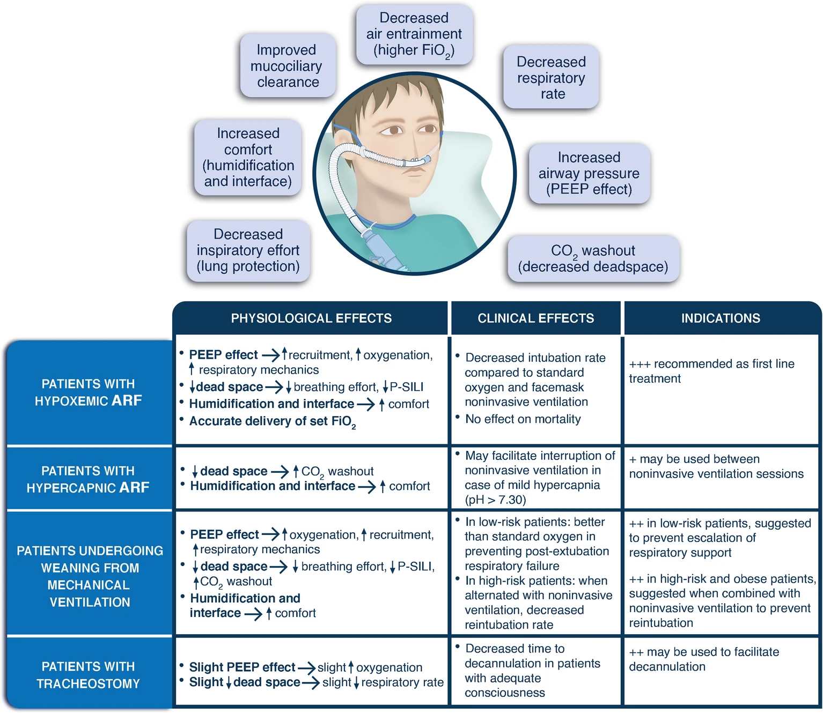
ACUTE HYPERCAPNIC RESPIRATORY FAILURE
Maggiore SM ICM 2023

Slide 15
Eur Respir J 2017
NIV SAVE LIVES!
Notes:
Let me start with a clear disclosure: NIV saves lives, and it is the gold standard for managing acute hypercapnic COPD exacerbations. That’s not in question.

Slide 16
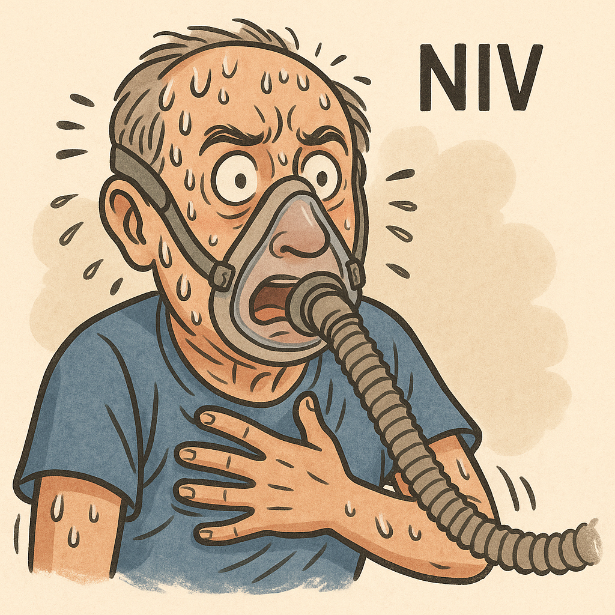
NIV in AECOPD
Expected
Vs.
Reality

Slide 17
Poor Tolerance
Mask discomfort, claustrophobia
Skin breakdown and sores
Intolerance & Non-Adherance
Anxiety, psychologycal distress
Worsening dysonea
Air Leaks and Inefficiency
Frequent mask leaks
Reduced ventilation effectivene
Communication Problems
Speaking interrupted
Frustration & NIV interruptions

Slide 18
NIV is beneficial as a first‐line intervention with usual care for reducing the likelihood of mortality and intubation in AECOPD
The magnitude of benefit for these outcomes appears similar for patients with acidosis of a mild (pH 7.30 to 7.35) versus a more severe nature (pH < 7.30), and when NIV is applied within the ICU or ward setting
The high incidence of intolerance in the NIV group clearly related to potential discomfort of NIV in the NIV group
Osadnik CR et al Cochrane Database Syst Rev 2017
Notes:
what happens when NIV isn't tolerated — or simply isn't possible? That's where the story of high flow nasal cannula begins."

Slide 19
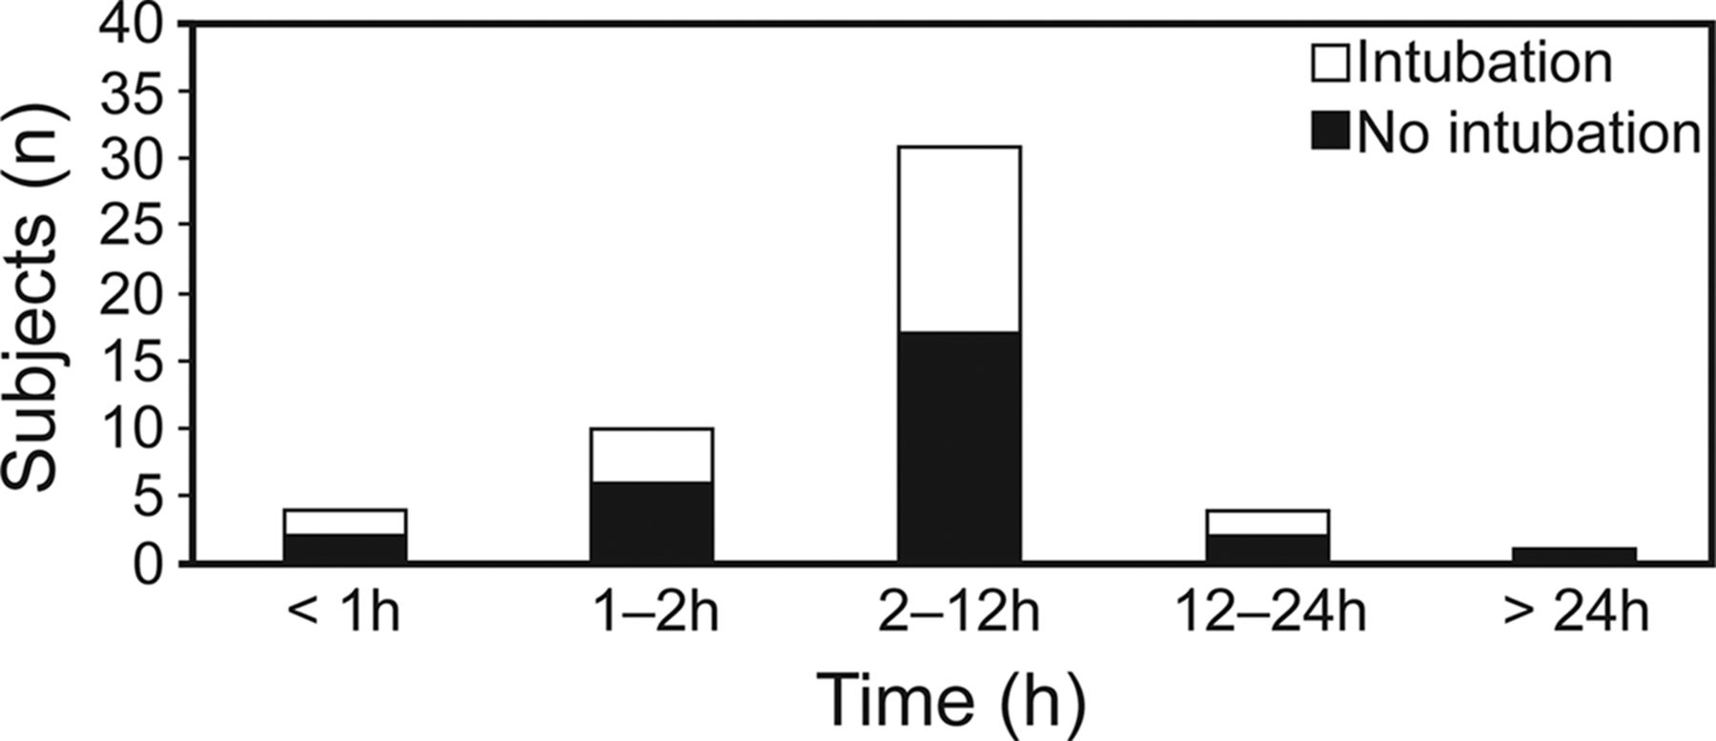
NIV treatment intolerance in COPD
Treatment Intolerance
11%
Liu J et al Respiratory Care 2016
Osadnik CR et al. Cochrane Database Syst Rev 2017
Notes:
Background: Non-invasive ventilation (NIV) with bi-level positive airway pressure (BiPAP) is commonly used to treat patients admitted to hospital with acute hypercapnic respiratory failure (AHRF) secondary to an acute exacerbation of chronic obstructive pulmonary disease (AECOPD).
Objectives: To compare the efficacy of NIV applied in conjunction with usual care versus usual care involving no mechanical ventilation alone in adults with AHRF due to AECOPD. The aim of this review is to update the evidence base with the goals of supporting clinical practice and providing recommendations for future evaluation and research.
Search methods: We identified trials from the Cochrane Airways Group Specialised Register of trials (CAGR), which is derived from systematic searches of bibliographic databases including the Cochrane Central Register of Controlled Trials (CENTRAL), MEDLINE, Embase, the Cumulative Index to Nursing and Allied Health Literature (CINAHL), the Allied and Complementary Medicine Database (AMED), and PsycINFO, and through handsearching of respiratory journals and meeting abstracts. This update to the original review incorporates the results of database searches up to January 2017.
Selection criteria: All randomised controlled trials that compared usual care plus NIV (BiPAP) versus usual care alone in an acute hospital setting for patients with AECOPD due to AHRF were eligible for inclusion. AHRF was defined by a mean admission pH < 7.35 and mean partial pressure of carbon dioxide (PaCO₂) > 45 mmHg (6 kPa). Primary review outcomes were mortality during hospital admission and need for endotracheal intubation. Secondary outcomes included hospital length of stay, treatment intolerance, complications, changes in symptoms, and changes in arterial blood gases.
Data collection and analysis: Two review authors independently applied the selection criteria to determine study eligibility, performed data extraction, and determined risk of bias in accordance with Cochrane guidelines. Review authors undertook meta-analysis for data that were both clinically and statistically homogenous, and analysed data as both one overall pooled sample and according to two predefined subgroups related to exacerbation severity (admission pH between 7.35 and 7.30 vs below 7.30) and NIV treatment setting (intensive care unit-based vs ward-based). We reported results for mortality, need for endotracheal intubation, and hospital length of stay in a 'Summary of findings' table and rated their quality in accordance with GRADE criteria.
Main results: We included in the review 17 randomised controlled trials involving 1264 participants. Available data indicate that mean age at recruitment was 66.8 years (range 57.7 to 70.5 years) and that most participants (65%) were male. Most studies (12/17) were at risk of performance bias, and for most (14/17), the risk of detection bias was uncertain. These risks may have affected subjective patient-reported outcome measures (e.g. dyspnoea) and secondary review outcomes, respectively.Use of NIV decreased the risk of mortality by 46% (risk ratio (RR) 0.54, 95% confidence interval (CI) 0.38 to 0.76; N = 12 studies; number needed to treat for an additional beneficial outcome (NNTB) 12, 95% CI 9 to 23) and decreased the risk of needing endotracheal intubation by 65% (RR 0.36, 95% CI 0.28 to 0.46; N = 17 studies; NNTB 5, 95% CI 5 to 6). We graded both outcomes as 'moderate' quality owing to uncertainty regarding risk of bias for several studies. Inspection of the funnel plot related to need for endotracheal intubation raised the possibility of some publication bias pertaining to this outcome. NIV use was also associated with reduced length of hospital stay (mean difference (MD) -3.39 days, 95% CI -5.93 to -0.85; N = 10 studies), reduced incidence of complications (unrelated to NIV) (RR 0.26, 95% CI 0.13 to 0.53; N = 2 studies), and improvement in pH (MD 0.05, 95% CI 0.02 to 0.07; N = 8 studies) and in partial pressure of oxygen (PaO₂) (MD 7.47 mmHg, 95% CI 0.78 to 14.16 mmHg; N = 8 studies) at one hour. A trend towards improvement in PaCO₂ was observed, but this finding was not statistically significant (MD -4.62 mmHg, 95% CI -11.05 to 1.80 mmHg; N = 8 studies). Post hoc analysis revealed that this lack of benefit was due to the fact that data from two studies at high risk of bias showed baseline imbalance for this outcome (worse in the NIV group than in the usual care group). Sensitivity analysis revealed that exclusion of these two studies resulted in a statistically significant positive effect of NIV on PaCO₂. Treatment intolerance was significantly greater in the NIV group than in the usual care group (risk difference (RD) 0.11, 95% CI 0.04 to 0.17; N = 6 studies). Results of analysis showed a non-significant trend towards reduction in dyspnoea with NIV compared with usual care (standardised mean difference (SMD) -0.16, 95% CI -0.34 to 0.02; N = 4 studies). Subgroup analyses revealed no significant between-group differences.
Authors' conclusions: Data from good quality randomised controlled trials show that NIV is beneficial as a first-line intervention in conjunction with usual care for reducing the likelihood of mortality and endotracheal intubation in patients admitted with acute hypercapnic respiratory failure secondary to an acute exacerbation of chronic obstructive pulmonary disease (COPD). The magnitude of benefit for these outcomes appears similar for patients with acidosis of a mild (pH 7.30 to 7.35) versus a more severe nature (pH < 7.30), and when NIV is applied within the intensive care unit (ICU) or ward setting.
RESP CARE STUDY
BACKGROUND: Noninvasive ventilation (NIV) intolerance is one reason for NIV failure. However, the characteristics, predictors, and outcomes of NIV intolerance are unclear.
METHODS: A prospective observational study was performed in the respiratory intensive care unit of a teaching hospital. Subjects with acute respiratory failure who used NIV were enrolled. Initially, continuous use of NIV was encouraged. However, if the subject could not tolerate NIV, it was used intermittently. NIV intolerance was defined as termination of NIV due to subject refusal to receive it because of discomfort, even after intermittent use was attempted.
RESULTS: A total of 961 subjects were enrolled in the study. Of these, 50 subjects (5.2%) experienced NIV intolerance after a median 2.4 h of NIV support. Age (OR = 0.98, 95% CI 0.963–0.996) and heart rate (OR = 1.02, 95% CI 1.006–1.030) measured before NIV were 2 independent risk factors of NIV intolerance. After 1–2 h of NIV, independent risk factors of NIV intolerance were heart rate (OR = 1.03, 95% CI 1.016–1.044) and breathing frequency (OR = 1.06, 95% CI 1.027–1.099). Intolerant subjects had no improvement in mean arterial pressure, heart rate, or breathing frequency after the NIV intervention. Moreover, intolerant subjects had a higher intubation rate (44.0% vs 25.8%, P = .008) and higher mortality (34.0% vs 22.4%, P = .08). The three most common complaints were that NIV worsened subjects' distress (46%), that NIV resulted in dyspnea (26%), and that the flow or pressure of NIV was too strong to bear (16%).
CONCLUSIONS: NIV intolerance worsened subjects' outcomes. Younger subjects with a high heart rate and breathing frequency may be more likely to experience NIV intolerance.

Slide 20
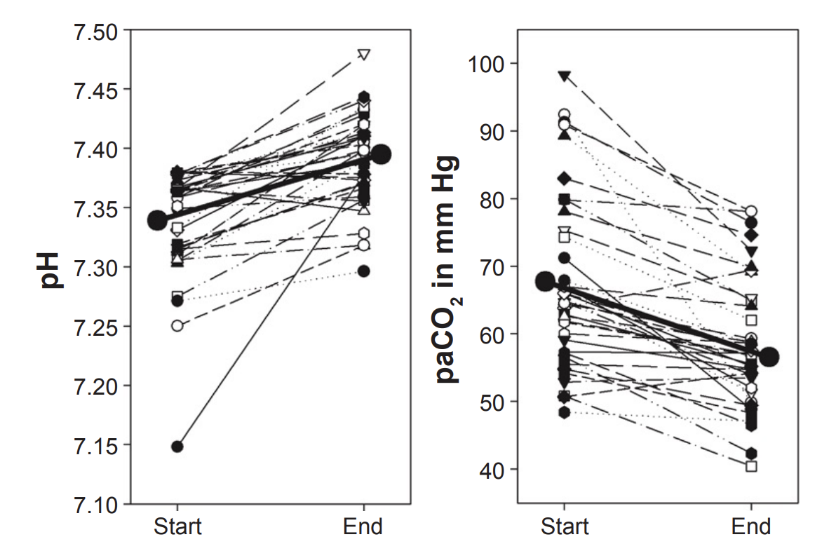
NIV INTOLERANCE
Single center retrospective study
38 AECOPD patients with pH <7.38 patients who stopped NIV for intolerance and received HFNT
HFNT Flow 26 ± 8 L/min, mean time 252 ± 251 minutes
Significant reduction of PaCO₂ and improvement in pH
Greatest improvements in pH and paCO2 found in 17 patients with baseline pH <7.35
Bräunlich J et al Int J COPD 2018

Slide 21
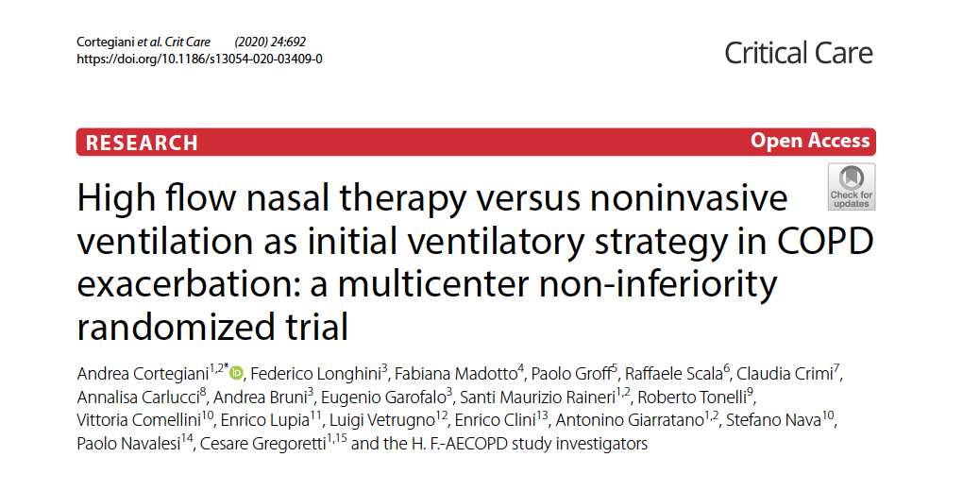
Multicentre non-inferiority RCT in 9 centers in Italy
80 pts mild-to-moderate AECOPD randomized to HFNT or NIV

Slide 22
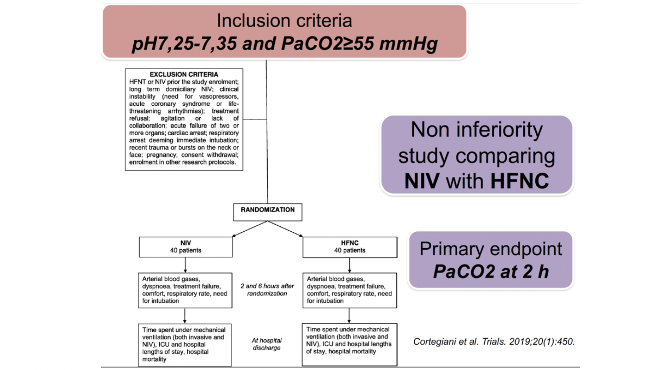
Cortegiani A, Crimi C et al Critical Care 2020

Slide 23
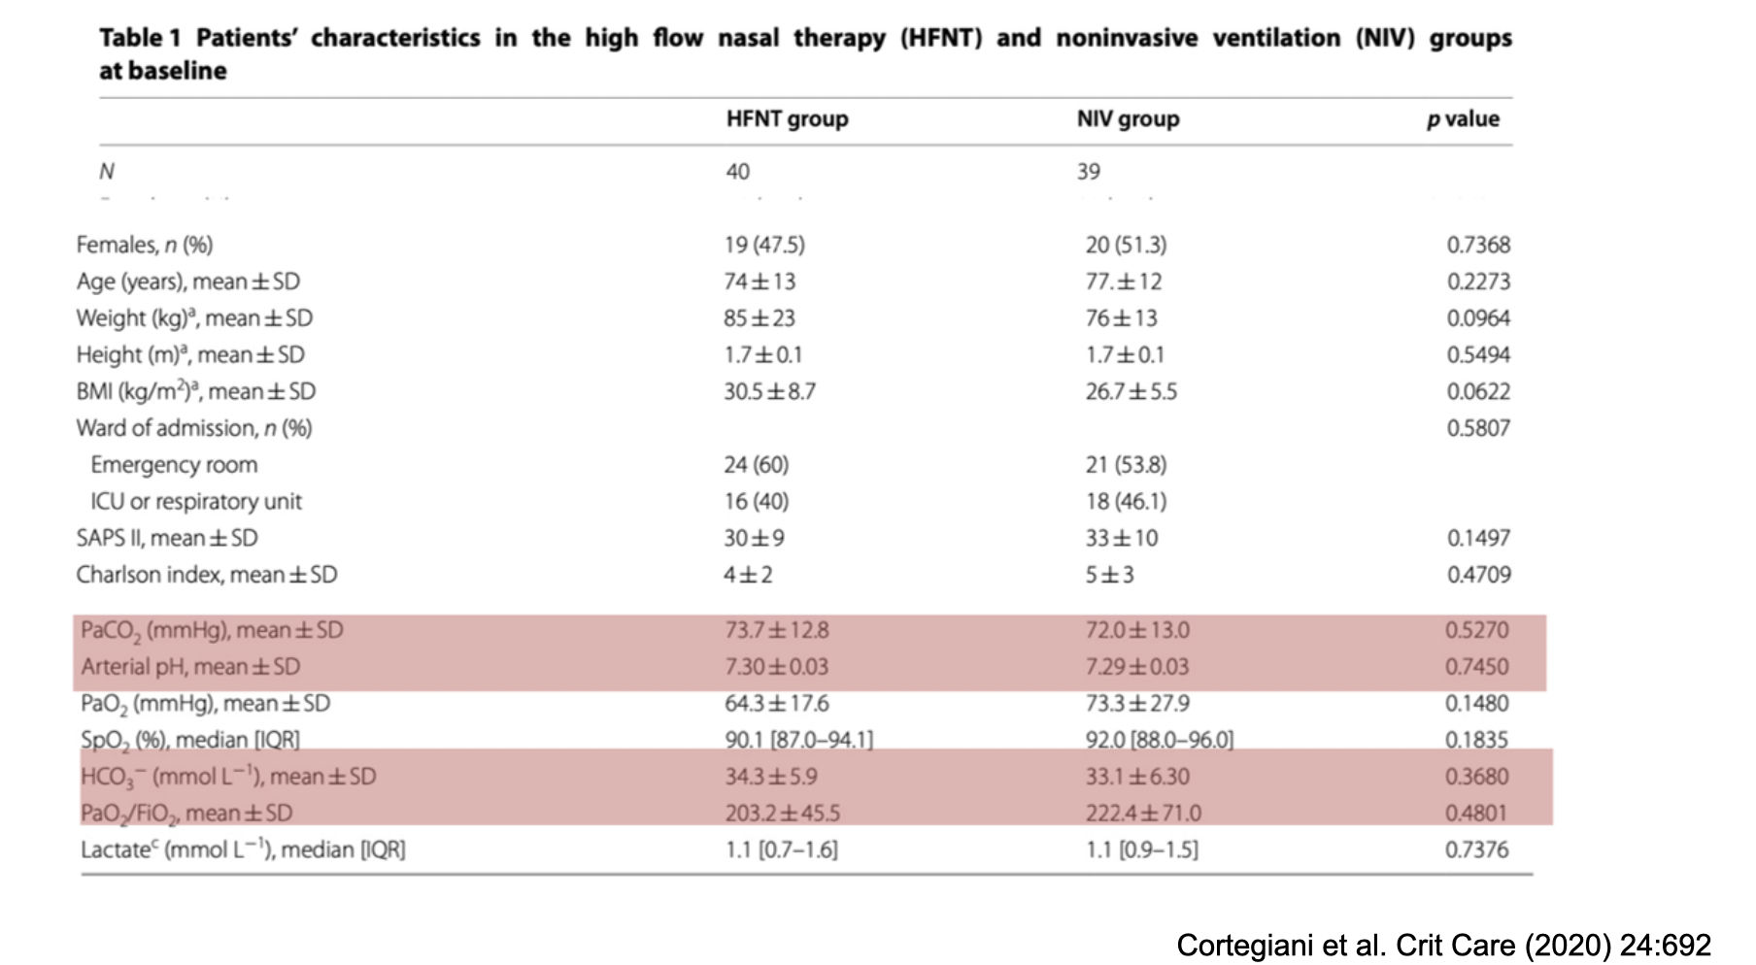
Cortegiani A, Crimi C et al Critical Care 2020

Slide 24
Primary endpoint: mean difference in PaCO₂ at 2 hours
Both treatments significant reduced PaCO2 over time
HFNT was non-inferior to NIV for the primary outcome
32% of HFNT switched to NIV within 6 hours
57% of HFNT received NIV during hospitalization
Longer time on NIV in patients randomized to HFNT
Cortegiani A, Crimi C et al Critical Care 2020

Slide 25
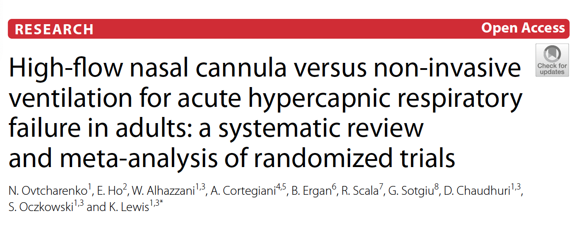
Mortality
RR 0.86, 95% CI 0.48–1.56, low certainty
8 RCTs for a total of 528 patients
Primary outcome: Mortality
Secondary outcome: Intubation, ICU and Hospital LOS, Comfort, Dyspnea
Evidence is inconclusive in identifying whether HFNC may be an alternative to NIV for patients with hypercapnic respiratory failure due to imprecision and heterogeneity
Intubation
RR 0.80, 95% CI 0.46–1.39, low certainty
Ovtcharenko N et al Critical Care 2022

Slide 26
Design: Randomized, controlled, non-inferiority trial (China, 2 ICUs)
Patients: AECOPD with pH 7.25–7.35, PaCO₂ ≥ 50 mmHg
Primary Outcome: Treatment failure (intubation or treatment switch)
Notes:
Background
Although cumulative studies have demonstrated a beneficial effect of high-flow nasal cannula oxygen (HFNC) in acute hypercapnic respiratory failure, randomized trials to compare HFNC with non-invasive ventilation (NIV) as initial treatment in acute exacerbations of chronic obstructive pulmonary disease (AECOPD) patients with acute-moderate hypercapnic respiratory failure are limited. The aim of this randomized, open label, non-inferiority trial was to compare treatment failure rates between HFNC and NIV in such patients.
Methods
Patients diagnosed with AECOPD with a baseline arterial blood gas pH between 7.25 and 7.35 and PaCO₂ ≥ 50 mmHg admitted to two intensive care units (ICUs) at a large tertiary academic teaching hospital between March 2018 and December 2022 were randomly assigned to HFNC or NIV. The primary endpoint was the rate of treatment failure, defined as endotracheal intubation or a switch to the other study treatment modality. Secondary endpoints were rates of intubation or treatment change, blood gas values, vital signs at one, 12, and 48 h, 28-day mortality, as well as ICU and hospital lengths of stay.
Results
225 total patients (113 in the HFNC group and 112 in the NIV group) were included in the intention-to-treat analysis. The failure rate of the HFNC group was 25.7%, while the NIV group was 14.3%. The failure rate risk difference between the two groups was 11.38% (95% CI 0.25–21.20, P = 0.033), which was higher than the non-inferiority cut-off of 9%. In the per-protocol analysis, treatment failure occurred in 28 of 110 patients (25.5%) in the HFNC group and 15 of 109 patients (13.8%) in the NIV group (risk difference, 11.69%; 95% CI 0.48–22.60). The intubation rate in the HFNC group was higher than in the NIV group (14.2% vs 5.4%, P = 0.026). The treatment switch rate, ICU and hospital length of stay or 28-day mortality in the HFNC group were not statistically different from the NIV group (all P > 0.05).
Conclusion
HFNC was not shown to be non-inferior to NIV and resulted in a higher incidence of treatment failure than NIV when used as the initial respiratory support for AECOPD patients with acute-moderate hypercapnic respiratory failure.

Slide 27
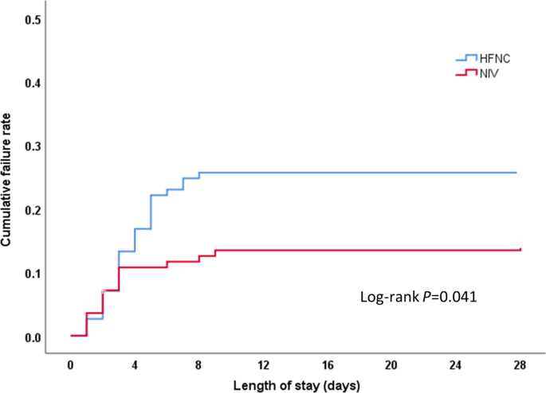
Treatment failure:
HFNC: 25.7%
NIV: 14.3%
Risk difference: +11.4% (exceeded non-inferiority margin)
Intubation rates:
HFNC: 14.2%
NIV: 5.4% (p = 0.026)
ICU/hospital stay and 28-day mortality: No significant difference
Tan et al Crit Care 2024

Slide 28
Study Design (COPD Arm)
Part of a large multicenter bayesian RCT comparing HFNC vs NIV across 5 respiratory failure phenotypes
Patients: 273 patients with AECOPD + respiratory acidosis
Primary endpoint: Composite of intubation or death by Day 7
📈 Key COPD Results
Treatment failure (intubation or death at Day 7):
HFNC: 28.6%
NIV: 26.2%
Odds ratio: 1.05 (95% Credible Interval: 0.79–1.36)
HFNC was non-inferior to NIV in AECOPD for preventing intubation or death at 7 days — offering a viable alternative, especially where NIV is not tolerated. (Posterior probability of non-inferiority = 0.992)

Slide 29
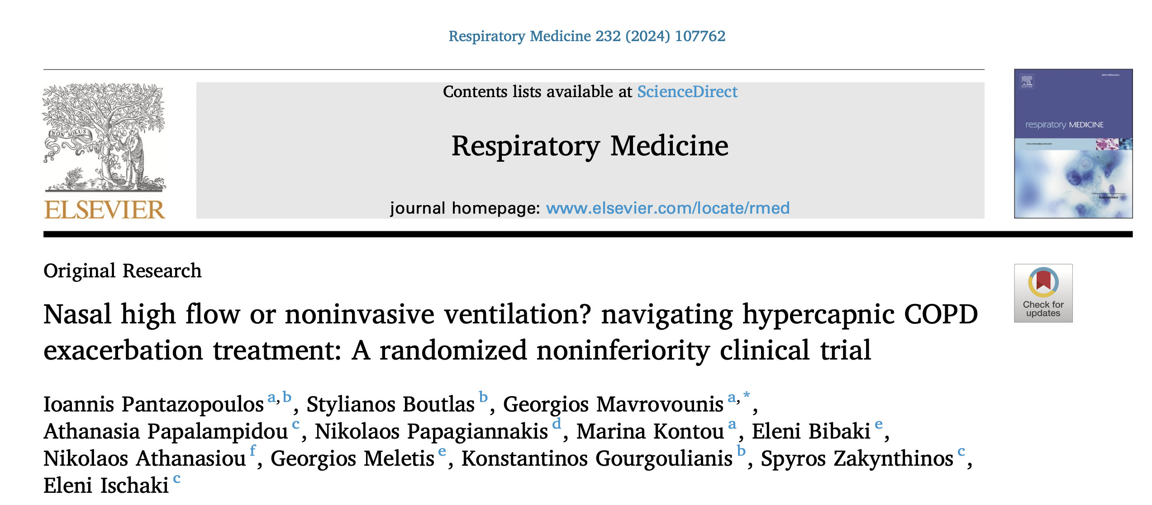
2024
Design: Multicenter, randomized, noninferiority trial (Greece, 3 centers)
Patients: AECOPD with pH 7.25–7.35 and PaCO₂ > 45 mmHg
Primary Endpoint: Treatment failure (IOT or treatment switch)
Secondary Endpoints: Comfort (dyspnea, VAS), respiratory parameters, complications
Notes:
Background: Noninvasive ventilation (NIV) has been the cornerstone for managing acute exacerbations of COPD (AECOPD) with hypercapnic respiratory failure. Nasal high flow (NHF) oxygen therapy has emerged as a po- tential alternative, offering a more tolerable modality with promising outcomes. The aim of the present study was to evaluate whether NHF respiratory support is noninferior to NIV with respect to treatment failure, in patients with mild-to-moderate hypercapnic AECOPD.
Methods: In this multi-center, randomized, noninferiority trial, 105 patients with AECOPD and respiratory failure type II were enrolled. Participants were randomly assigned to receive either NHF therapy or NIV. The primary endpoint was the frequency of treatment failure, defined as the need for intubation and invasive mechanical ventilation or a switch to the alternative treatment group. Secondary endpoints included changes in respiratory parameters, patient comfort indicators, and the occurrence of complications.
Results: The findings revealed no significant difference in the primary outcome between the groups, with a treatment failure rate of 19.6 % (10 out of 51) in the NHF group and 14.8 % (8 out of 54) in the NIV group. Interestingly, NHF users reported significantly lower levels of dyspnea and discomfort at multiple follow-up points. Despite the differences in patient comfort, respiratory parameters such as respiratory rate, arterial blood gases, and use of accessory muscles of respiration showed no significant disparities between the groups throughout the study period.
Conclusions: NHF therapy was similar to NIV in preventing treatment failure among patients with hypercapnic AECOPD, offering a viable alternative with enhanced comfort. Trial registration: The study was prospectively registered in ClinicalTrials.gov (Identifier: NCT03466385) on March 15, 2018.

Slide 30
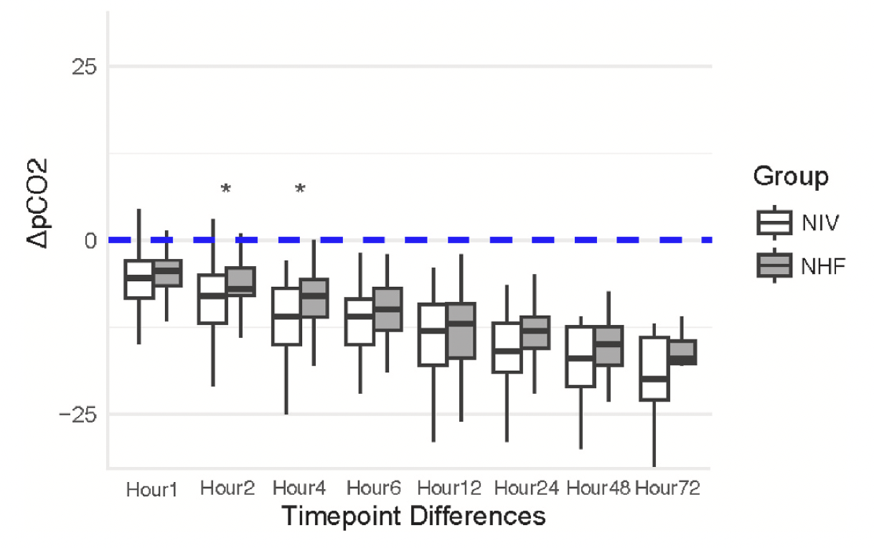
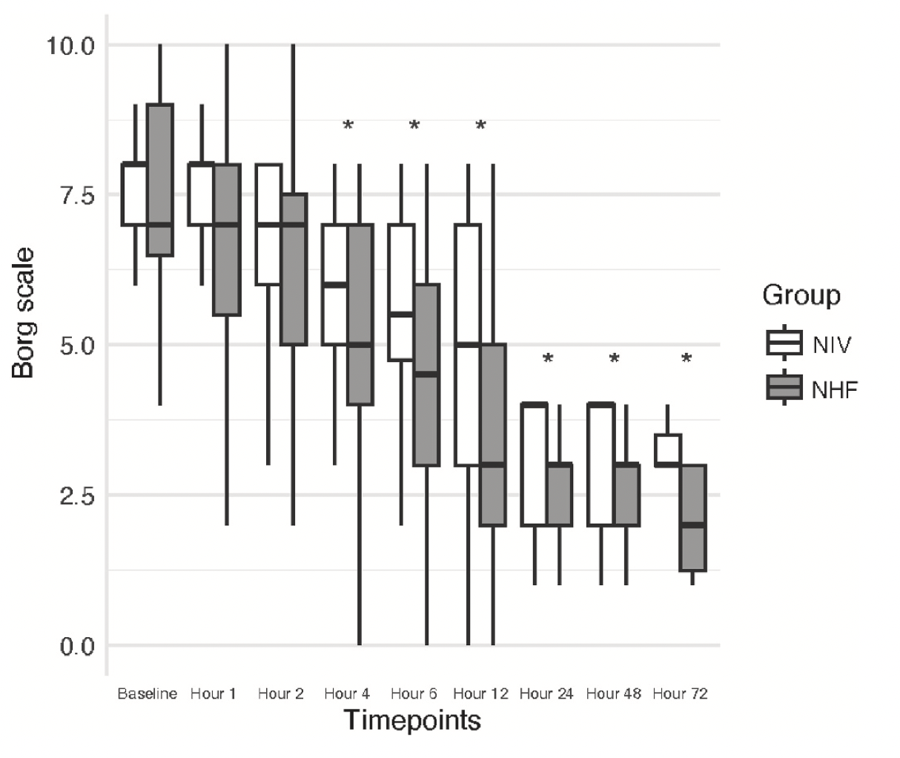
2024
Treatment failure: NIV 14.81 % (8/54) vs HFNT 19.61 % (10/51)
Observed risk difference in treatment failure between groups was 4.80 %,

Slide 31
ACUTE HYPERCAPNIC RESPIRATORY FAILURE
Secretions!!!!
Maggiore SM ICM 2023

Slide 32
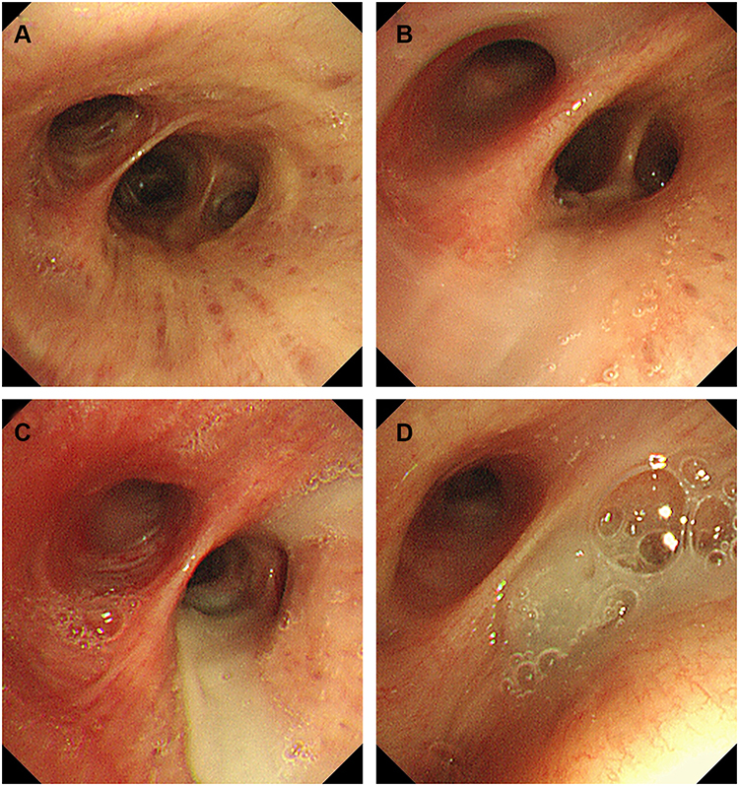
Correlation of Luminal Mucus Score in Large Airways and PaCO2 in AECOPD
78.4% of inpatients had luminal mucus plugging in at least one site and also that total LMS was proportional to PaCO2
Cheng Y et al Int J Chron Obstruct Pulmon Dis 2021
Notes:
Background and Objective: Luminal mucus plugging in small airways is associated with lung function decline and death of patients with chronic obstructive pulmonary disease (COPD). However, little attention has been paid to the possible role of mucus in large airways in acute exacerbation of COPD (AECOPD). Therefore, this study aimed to explore the relationship between the luminal mucus score of large airways and other physiological parameters of severe AECOPD. Subjects and Methods: A total of 74 AECOPD inpatients were enrolled in this cross-sectional study. All patients underwent lung function tests and bronchoscopy, and their luminal mucus was observed and scored through bronchoscopy. Four questionnaires, including the St. George Respiratory Questionnaire (SGRQ), modified Medical Research Council dyspnea scale (mMRC), COPD Assessment Test (CAT) and Exacerbation of Chronic pulmonary disease Tool (EXACT), were used to assess health-related quality of life (HRQoL). Results: The luminal mucus score of large airways was significantly correlated with spirometry parameters and HRQoL score. Both mMRC grade and SGRQ score were significantly positively correlated with luminal mucus score (ρ=0.527, P< 0.001; ρ=0.441, P< 0.001, respectively). Forced expiratory flow at 25% to 75% of the FVC (FEF_{25%-75%}) and FEV₁% predicted, as functional measures reflecting small airway disease, were significantly negatively correlated with luminal mucus score (ρ=− 0.518, P< 0.001; ρ=− 0.498, P< 0.001, respectively). The stepwise multiple linear regression model suggested that mMRC grade and FEV₁% predicted could predict luminal mucus score (R²=0.348, F=18.960, P< 0.001). Conclusion: For severe acute exacerbation of COPD, bronchoscopy-identified luminal mucus in large airways is associated with reduced lung function and worse health-related quality of life.

Slide 33
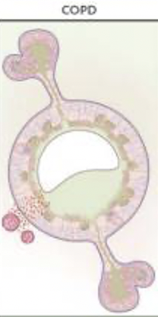
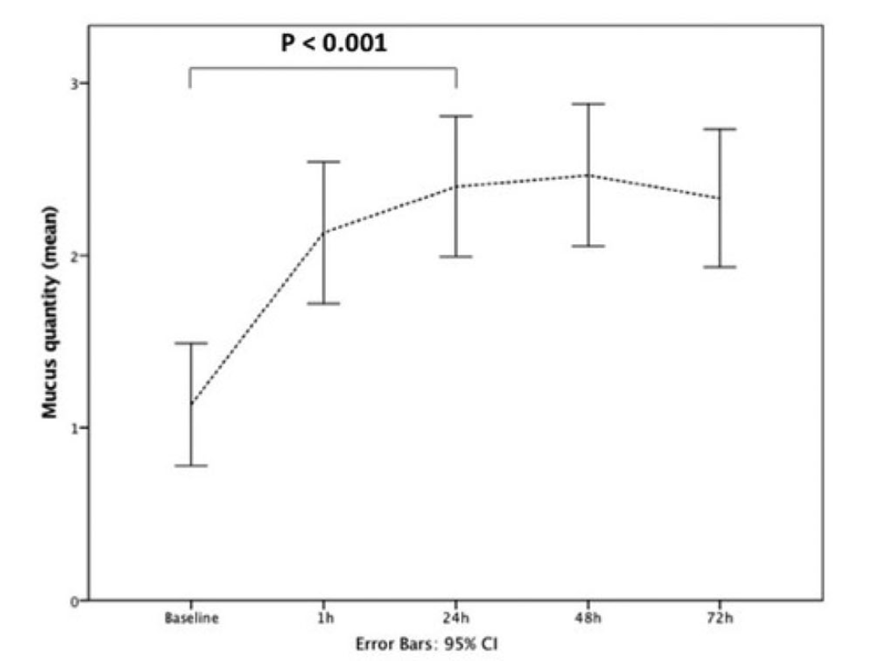
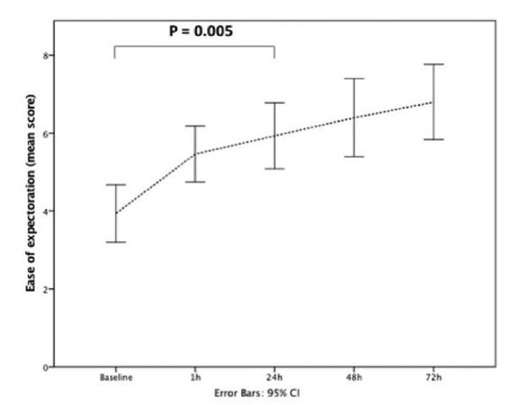
Prospective study including 15 AECOPD and documented bronchiectasis
Patients must had > pH 7.35, respiratory rate (RR) > 26 breaths/minute despite receiving maximal medical treatment and oxygen via face mask up to 10 L/m
HFNT Flow 50 L/min
After 24 h HFNT was effective in improving dyspnea score, decreasing RR, improving gas exchange, and increasing mucus expectoration
Crimi et al COPD 2020
Notes:
The efficacy and feasibility of high flow nasal therapy (HFNT) use in patients with acute exacerbation of chronic obstructive pulmonary disease (AECOPD) and bronchiectasis is unknown. We performed a single-center, single-arm prospective observational study in patients with AECOPD, documented bronchiectasis, pH ≥ 7.35, respiratory rate (RR) ≥ 26 breaths/minute despite receiving maximal medical treatment and oxygen via face mask up to 10 L/m. Patients received HFNT (Airvo 2, Fisher & Paykel) at a gas flow of 50 L/min and FIO₂ adjusted to maintain SpO₂ ≥92%. Dyspnea, rated by Borg scale, RR, arterial blood gases and mucus production (ranging from 1 to 3) were collected before and 1 h after starting HFNT and then every 24 h for 3 days. Tolerance was measured using a visual analogic scale (VAS). Fifteen patients were enrolled. After 24 h, patients showed a significant improvement in dyspnea score [Borg scale from 6.7 ± 1.4 to 4.1 ± 1.3 (p<.001)]; RR decreased from 29.6 ± 2.7 breaths/min to 23.2 ± 2.9 breaths/min (p<.001); pCO2 significantly decreased after 24 h [58.4 ± 13 vs. 51.7 ± 8.2 (p=.003)] while quantity of mucus production increased [(1.1 ± 0,6 vs. 2.4 ± 0.7, p<.001)]. No patient received invasive or noninvasive mechanical ventilation. Overall VAS score for HFNT tolerance was 6.5. HFNT was effective in improving dyspnea score, decreasing RR, improving gas exchange, and increasing mucus production in patients with AECOPD and coexisting bronchiectasis. Moreover, no safety concerns on its use were detected. Nevertheless, due to the single-arm design, the effect of HFNT could not be isolated from standard pharmacological treatment due to the study design.
pH >7.35

Slide 34
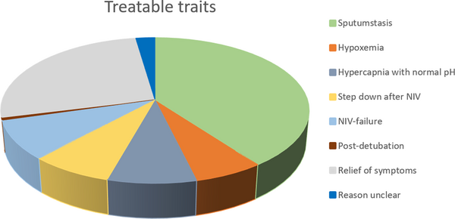
Reasons to initiate treatment with HFT in a group of COPD patients during an exacerbation
Fig 2. Treatable traits for HFNC in included COPD-patients.
173 pts
Retrospective design
Veenstra P, PLOS ONE 2022
Notes:
Background: The use of High-flow nasal cannula (HFNC) is increasing in admitted COPD-patients and could provide a step in between non-invasive ventilation (NIV) and standard oxygen supply. Recent studies demonstrated that HFNC is capable of facilitating secretion removal and reduce the work of breathing. Therefore, it might be of advantage in the treatment of acute exacerbations of COPD (AECOPD). No randomized trials have assessed this for admitted COPD-patients on a regular ward and only limited data from non-randomized studies is available.
Objectives: The aim of our study was to identify the reasons to initiate treatment with HFNC in a group of COPD-patients during an exacerbation, further identify those most likely to benefit from HFNC treatment and to find factors associated with treatment success on the pulmonary ward.
Material and methods: This retrospective study included COPD-patients admitted to the pulmonary ward and treated with HFNC from April 2016 until April 2019. Only patients admitted with severe acute exacerbations were included. Patients who had an indication for NIV-treatment where treated with NIV and were included only if they subsequently needed HFNC, e.g. when they did not tolerate NIV. Known asthma patients were excluded.
Results: A total of 173 patients were included. Stasis of sputum was the indication most reported to initiate HFNC-treatment. Treatment was well tolerated in 83% of the patients. Cardiac and vascular co-morbidities were significantly associated with a smaller chance of successful treatment (Respectively OR = 0.435; p = 0.013 and OR = 0.493;p = 0.035). Clinical assessment judged HFNC-treatment to be successful in 61% of the patients. Furthermore, in-hospital treatment with NIV was associated with a higher chance of HFNC failure afterwards (OR = 0.439; p = 0.045).
Conclusion: This large retrospective study showed that HFNC-treatment in patients with an AECOPD was initiated most often for sputum stasis as primary reason. Factors associated with improved outcomes of HFNC-treatment was the absence of vascular and/or cardiac co-morbidities and no need for in-hospital NIV-treatment.

Slide 35
PICO 8: Should HFNC or NIV be used in patients with acute hypercapnic respiratory failure?
«We suggest a trial of NIV prior to use of HFNC in patients with COPD and acute hypercapnic respiratory failure»
(conditional recommendation, low certainty of evidence).
Evidence for mortality and intubation is of low certainty, primarily due to imprecision, which does not rule out a clinically significant benefit or harm of HFNC versus NIV
While NIV has high evidence for hypercapnic acidotic respiratory failure, it cannot be tolerated by some patients, who may prefer HFNC, being more comfortable, and allowing easier communication, feeding and oral care
A trial of NIV allows clinicians to determine the severity of respiratory failure, the response to treatment and whether a patient can have a transition to HFNC.
Oczkowski S et al ERJ 2022

Slide 36
1176 respondents among ERS Assembly 2, 1 and 9
How likely it occurs in your practice to use HFNT in COPD exacerbation with hypercapnia?
Crimi C. et al under review

Slide 37
What should I do today with HHFT?
ARF:
HHFT may be useful to avoid ETI and escalation of treatment in de novo ARF - Patients benefit from HFNT requires clinician judgment and MONITORING!
AHRF:
NIV remains standard of care
May be a role for HHFT
Preventing the need for NIV
During breaks from NIV instead of standard oxygen therapy
As rescue therapy when NIV fails
Interface intolerance
Failure of ventilation
More studies needed

Slide 38
claudia.crimi@unict.it

