Slide 1
Interfaces for NIV:choosing the right one
CESARE GREGORETTI.G.GIGLIO FOUNDATION, CEFALU’
INTERNATIONAL UNICAMILLUS MEDICAL SCHOOL ROME; ITALY

Slide 2
COI
VIVISOL PHILIPS VYARE AIR LIQUIDE

Slide 3
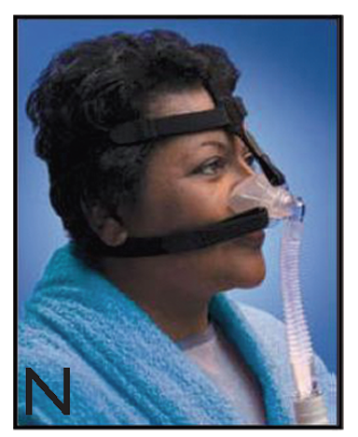
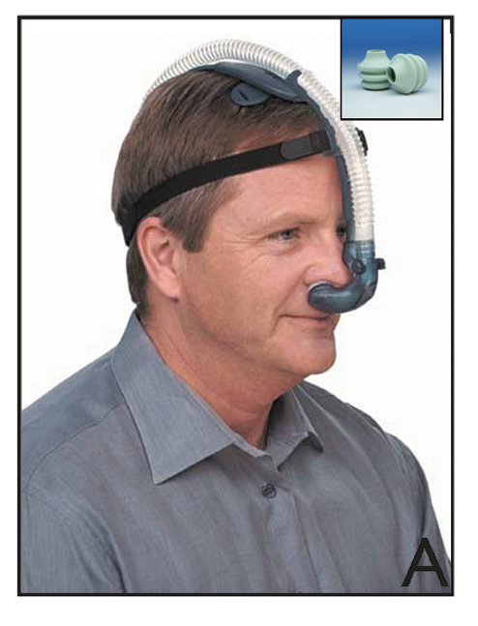
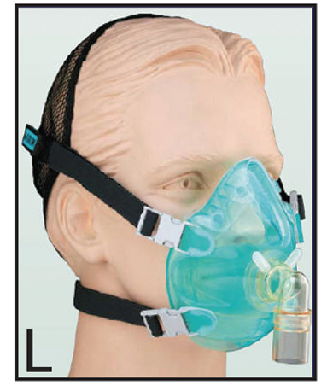
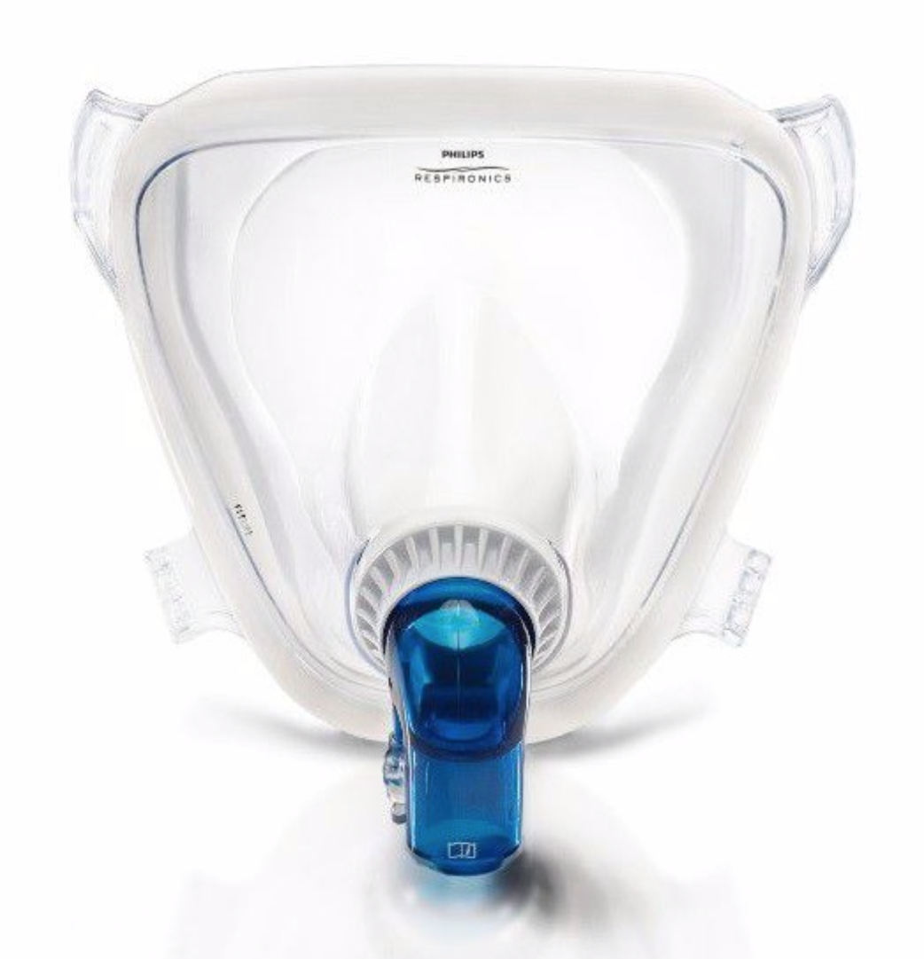
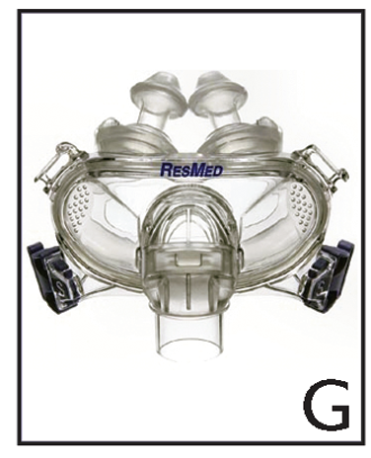
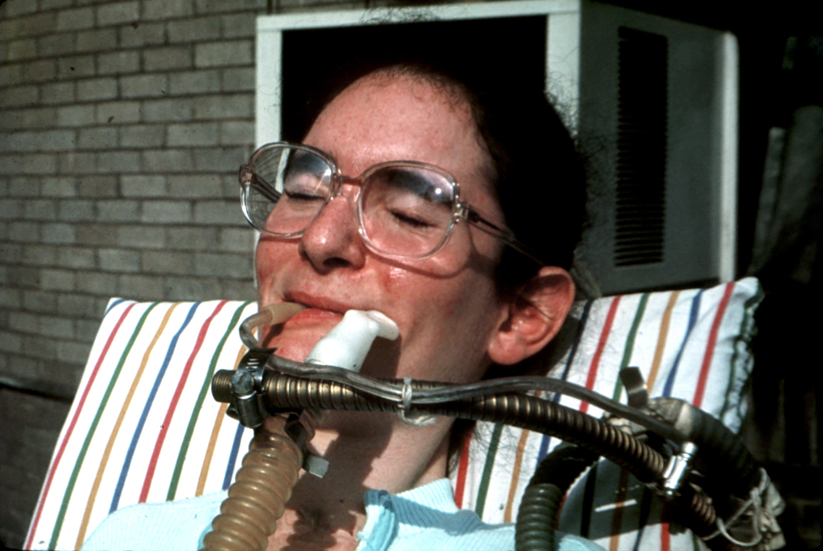
Interfaces : definitions
The term mask refers to an interface enclosing:
  the whole nose (full nasal mask),
  only the nostril (nasal plugs or nasal pillows-NP)
  nose and mouth (full face mask )
  nose , mouth and eyes (total full face mask)
  The term hybrid mask refers to an interface enclosing separately the mouth and the nose (as NP)
  The term helmet refers to an interface enclosing head and neck and kept in place by pits harness or dedicated system
  The term mouth-piece refers to an interface kept in place by lips and teeth
Nava S, Navalesi , Gregoretti C Respir Care 2009

Slide 4
Interfaces for acute setting
The term mask refers to an interface enclosing:
  nose , mouth (full face mask)
  nose , mouth and eyes (total full face mask)
  The term hybrid mask refers to an interface enclosing separately the mouth and the nose
  The term helmet refers to an interface enclosing head and neck and kept in place by pits harness or dedicated system
Navs S, Navalesi , Gregoretti C Respir Care 2009

Slide 5
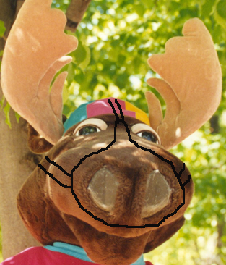
Interfaces can divided in:
CIRCUITS
One way
Two ways
Insp. valve
Insp. valve
Esp. valve
Non-Vented
Esp. valve
Vented
Non-Vented
“Vent system”
NO ACTIVE VALVE

Slide 6
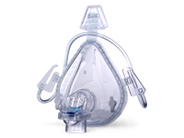
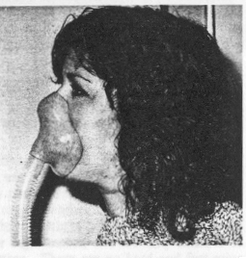
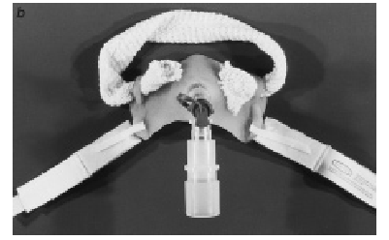
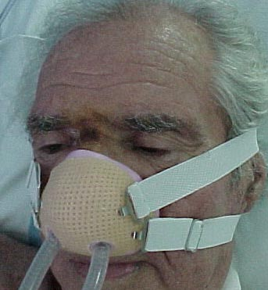
Interfaces can be futher divided in:
Standard industrial ready-to-use, commonly available in different sizes
Custom fabricated made-to-measure, moulded directly on the patient or from an impression previously obtained

Slide 8
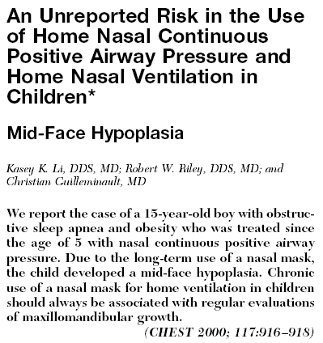
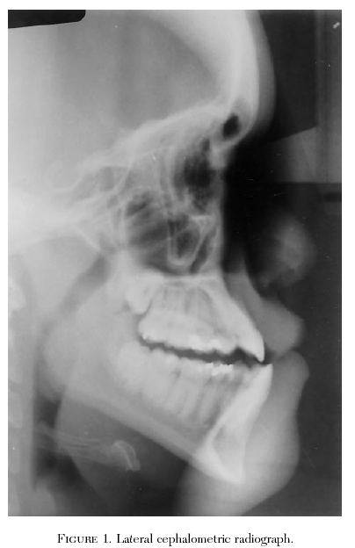
Global facial flattening was not related to the type of mask, presumably because both commercial and custom-made masks exert pressure on the same anatomical area.
We observed a correlation between global facial flattening and the underlying disease, with patients with OSA and NMDs being exposed to an increased risk.
These two groups were younger than the patients with CF, and their daily and cumulative use of NPPV was also longer than the patients with CF
.

Slide 9

Nasal Mask (NM)
Advantages compared to face mask ventilation
  Less interference with speech, feeding and cough
  Less danger with vomiting
  Claustrophobia uncommon
  No risk of asphyxia
  Possible better comfort (Navalesi et al CCM 2000)
  Less likelihood of skin lesions and better C02 removal with nasal pillows (Navalesi et al CCM 2000)
Contraindications
  Patients mouth breathing
  Nasal congestion
  Edentulism
  Nasal skin breakdown (only full nasal)

Slide 10
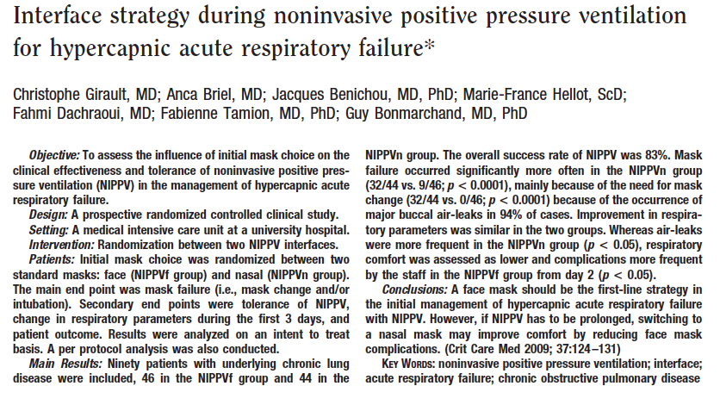
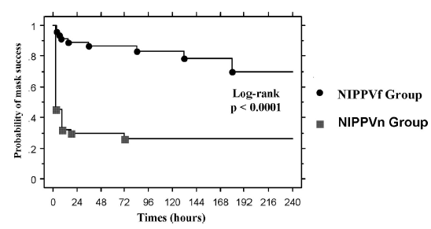

Slide 11
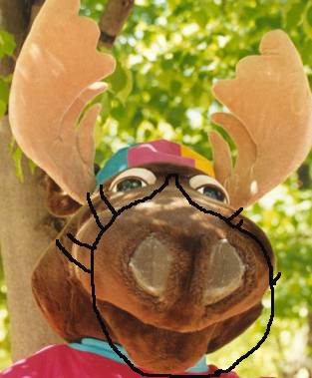
Full Face mask (FFM)
Advantages compared to nasal ventilation
  More stable airway pressure
  Fewer air leaks
  Less significant resistance to airflow
Contraindications
        Claustrophobia
        Vomit
        Gastric distension
        Tetraparetic patients
        Severe snorer

Slide 12

Total face mask (TFM)
Potential advantages compared to FFM
  Not traumatic on the bridge of the nose
  Less resistance to air flow
  Less need for cooperation
  Better comfort (Criner Chest 1994 T.N; Fraticelli CCM 2009)
Disadvantages compared to sFMV
  Slight less CO2 clearance ??
  Claustrophobia
Contraindications
        Gastric distension
        Claustrophobia
        Severe snorer

Slide 14
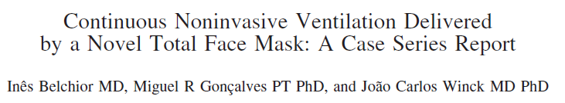
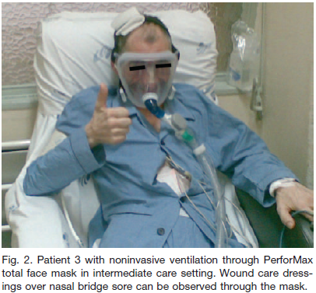
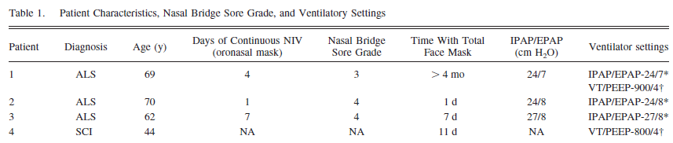

Slide 15
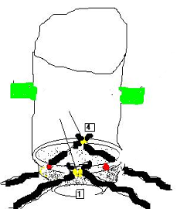
Helmet
Advantages compared toTFM ventilation
  More stable airway pressure (CPAP mode)
  Fewer air leaks
  Less significant resistance to airflow
  Less need for patient cooperation
Disadvantages compared to TFM
  CO2 clearance
  Pressurization delay and patient-ventilator interaction in PSV mode
Contraindications
        Claustrophobia
        Gastric distension

Slide 16
Hybrid mask
Advantages
  Same advantages of a TFFM but less cumbersome compared to a TFM
Drawbacks
  Bearded patients
  Leaks with high inspiratory pressure

Slide 17
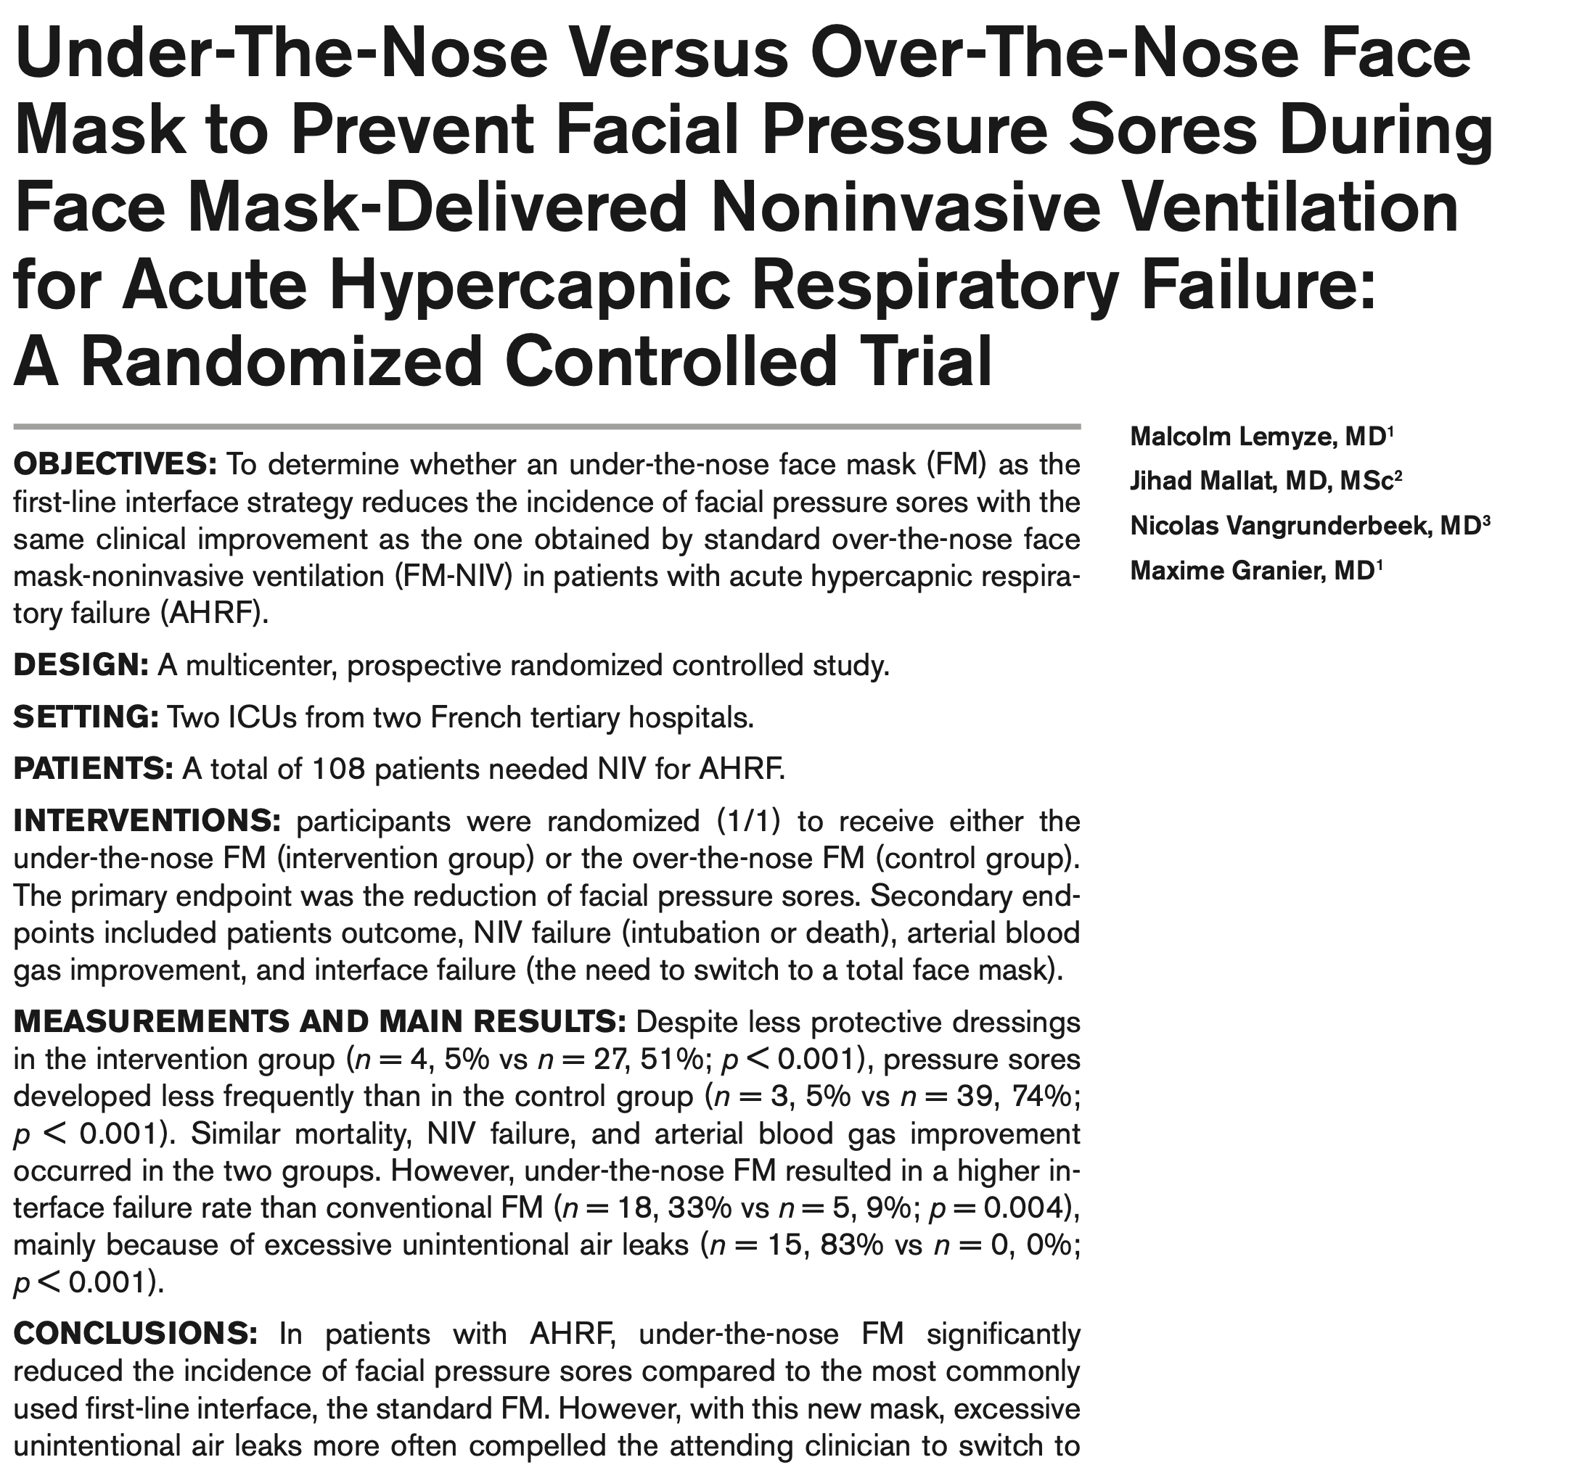
Crit Care Med. 2023 (9):1177-1184

Slide 18
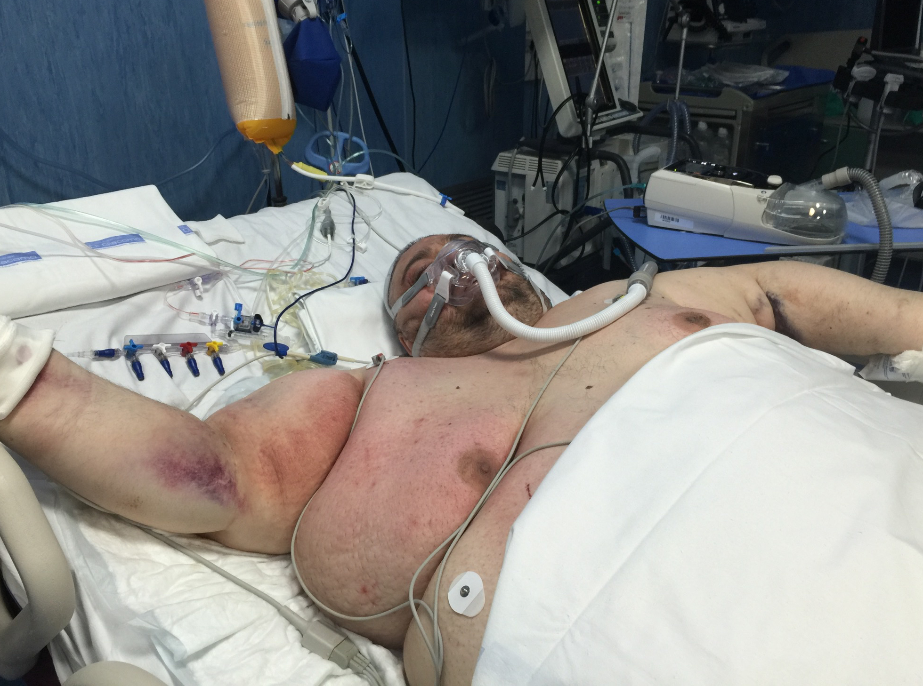
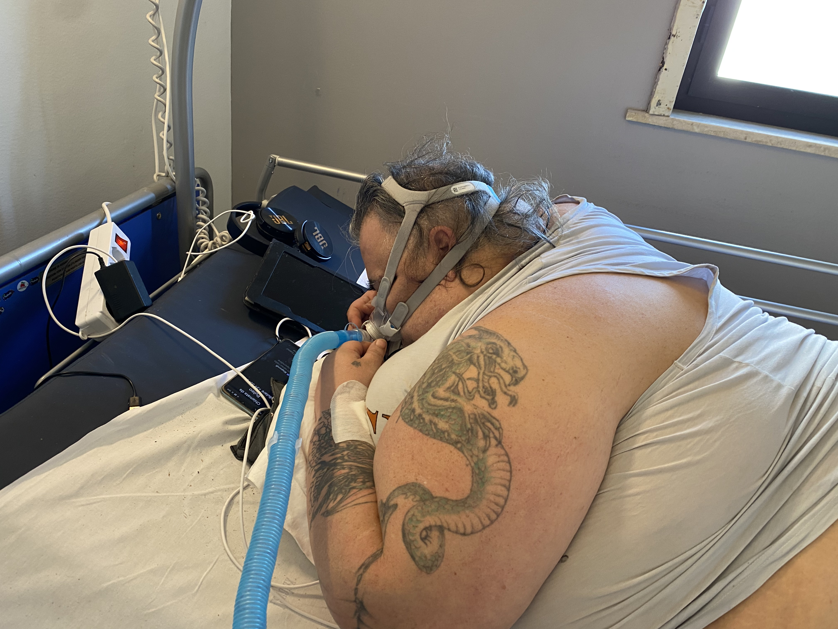

Slide 19
MOUTH-PIECE
ADVANTAGES vs nasal mask
  Can be used intermittently breath by breath, according to patient’s own needs.
Drawbacks
  Air leaks and patient-ventilator asinchrony
  Mouth dryness
  Dental and tempomandibular joint problems
may elicit gag reflex
  May stimulate salivation and eventually cause vomiting with risk of aspiration
  Cause ventilator to alarm
Modified by Shonhofer, Sortor Leger SERJ 2002 ; Bach Chest 1987

Slide 21
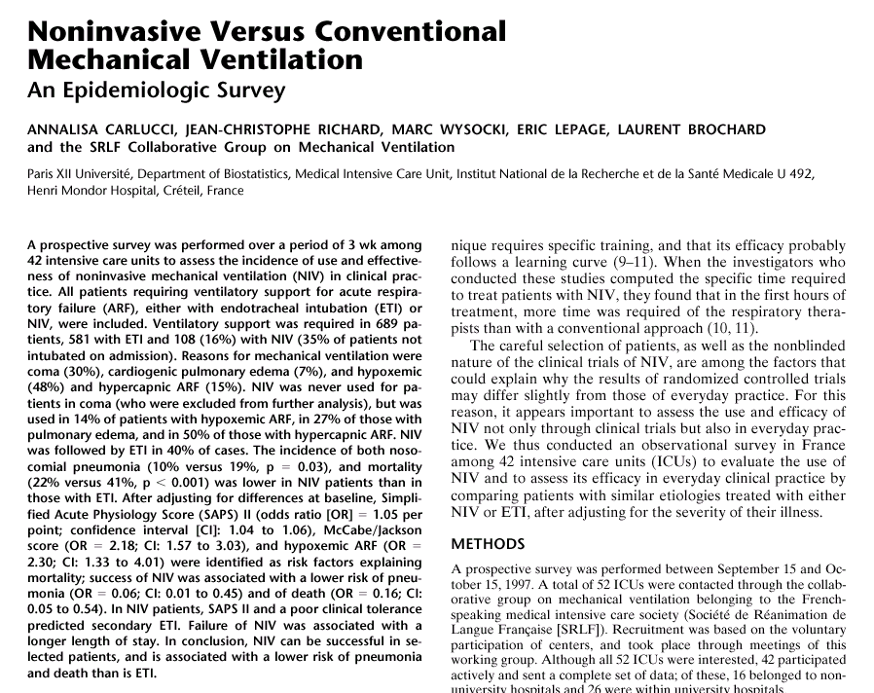

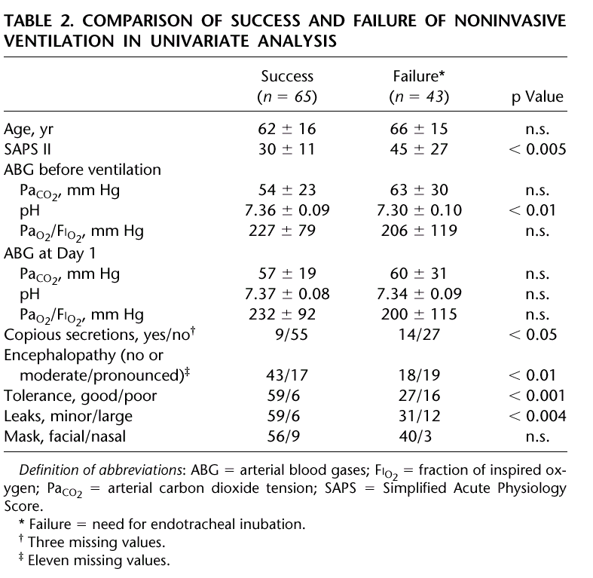

Slide 22
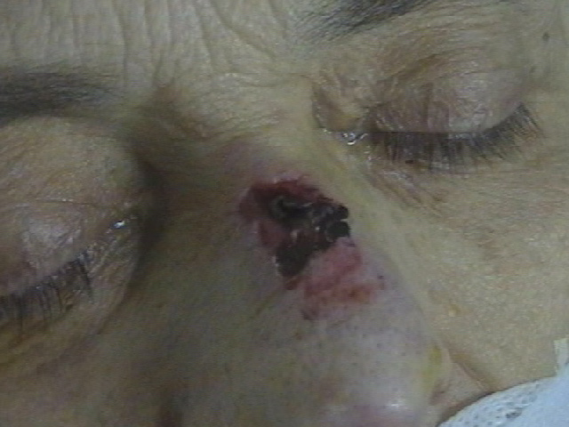
MASK FIT, TOLERANCE AND SKIN BREAKDOWN
In the acute patient, comfort may seem less important than the efficacy of the treatment.
However, even in the short-term ventilated acute patient, mask fit and care are needed to prevent skin breakdown.

Slide 23
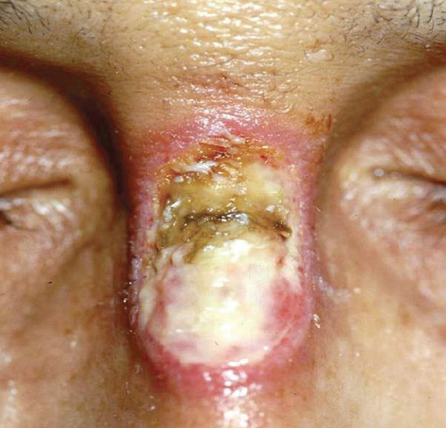
MASK FIT, TOLERANCE AND SKIN BREAKDOWN

Slide 24
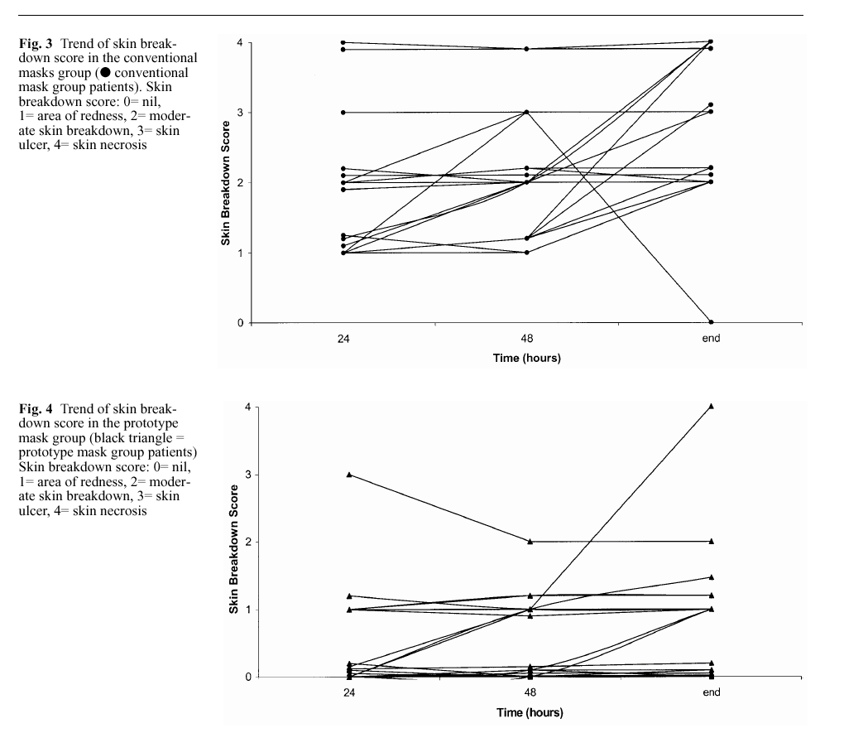
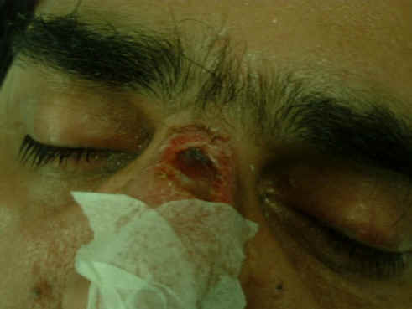
Gregoretti C et al Intensive Care Med 2002

Slide 25
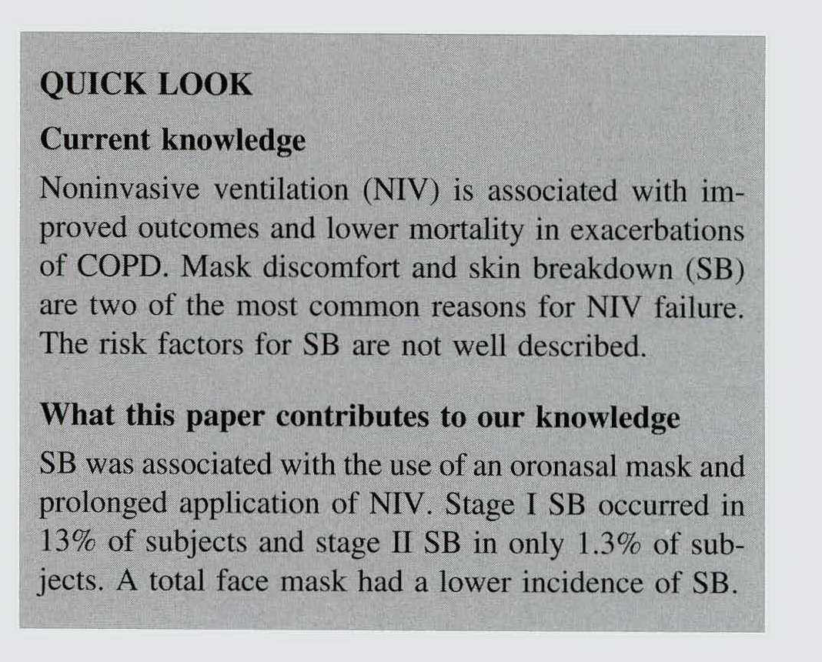
In patients with ARF undergoing NIV or CPAP, oronasal mask use for > 26 h was independently associated with development of skin break down
SB was observed in 48% of the subjects, with transient erythema in 18% (stageI), prolonged erythema in 23% (stage II), and skin necrosis
in 3% (stage III). The overall prevalence of SB was lowern our study (14.4%), as well as stage I (13.1%) and stageII (1.3%)
European Pressure Ulcer Advisory Panel, National Pressure UlcerAdvisory Panel. Prevention and treatment of pressure ulcers: quick reference guide. 2009. http://www.epuap.org/guidehnes/Final_Quick
_Prevention.pdf. Accessed May 14, 2014
Yamaguti W et al Respiratory Care 2014

Slide 26
TFM vs FFM:
TURBINE DRIVEN INTENTIONAL LEAK VENTILATOR
Lemyze et al Crit Care Med 2013; 41:481–488

Slide 27
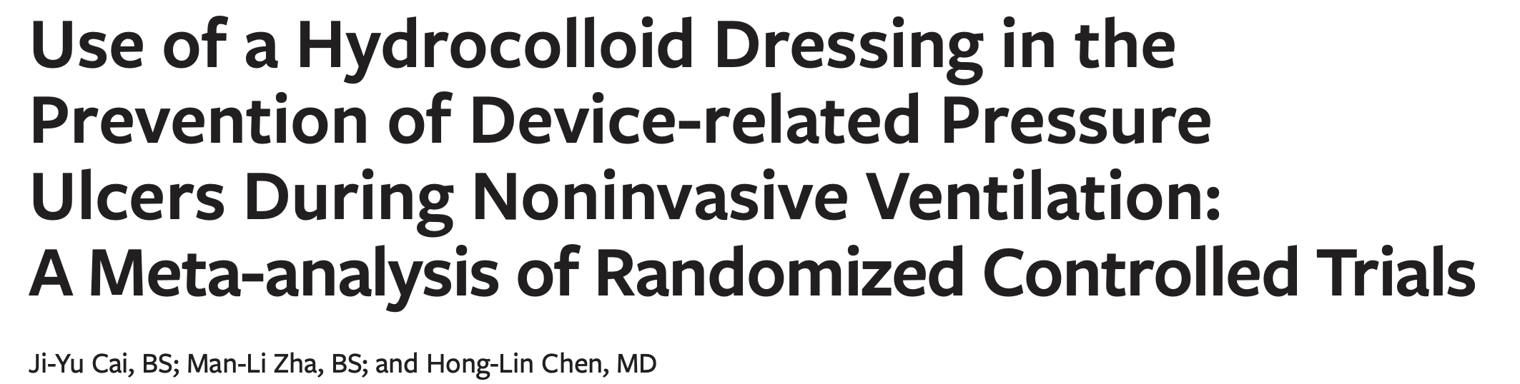
A meta-analysis of 22 RCTs showed use of a hydrocolloid dressing effectivey decreased the incidence of facial PUs in patients with NIV. Because the conclusions reached were mostly based on low-quality RCTs, the findings need to be further verified with more high quality RCTs. This research could help sup- port the role of hydrocolloid dressings in preventing facial PUs caused by NIV
Wound Management & Prevention 2019;65(2):30–38 doi: 10.25270/wmp.2019.2.3038

Slide 28
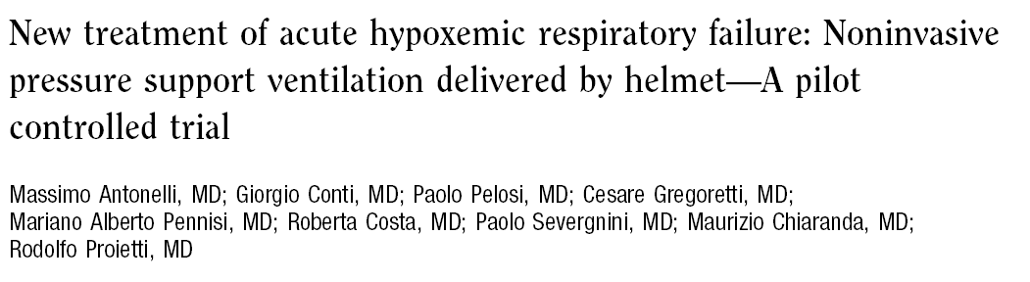
HELMET
MASK
p
Crit Care Med 2002;30:602-608
HOURS OF
CONTINUOUS NIV
36 ± 29
26 ± 13
0.05
ETI BECAUSE OF
INTOLERANCE
0
8
0.05
COMPLICATIONS RELATED TO NIV (Skin necrosis, Gastric Distension,
Eye irritation)
0
14
0.002

Slide 29
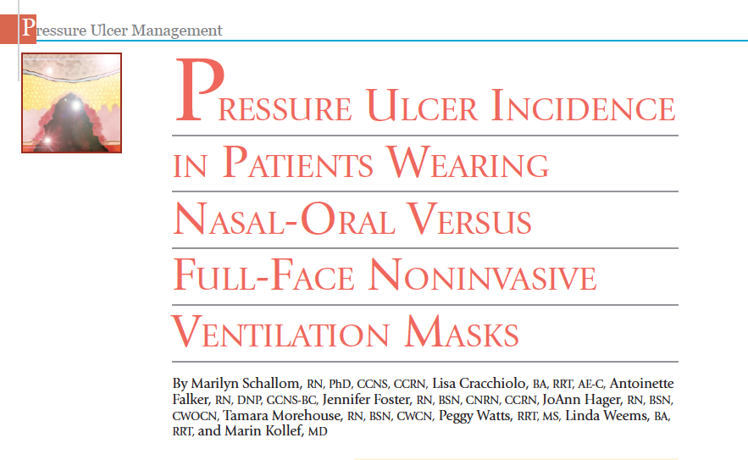
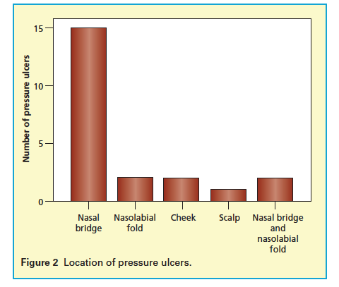
Time for pressure ulcer development ranged from 1.25 hours to 74 hours with a mean (SD) of 28.4 (19.46) hours for the nasal-oral phase and 24.75 to 98 hours with a mean (SD) of 61.37 (51.79) hours for the 2 pressure ulcers in the full-face phase

Slide 30
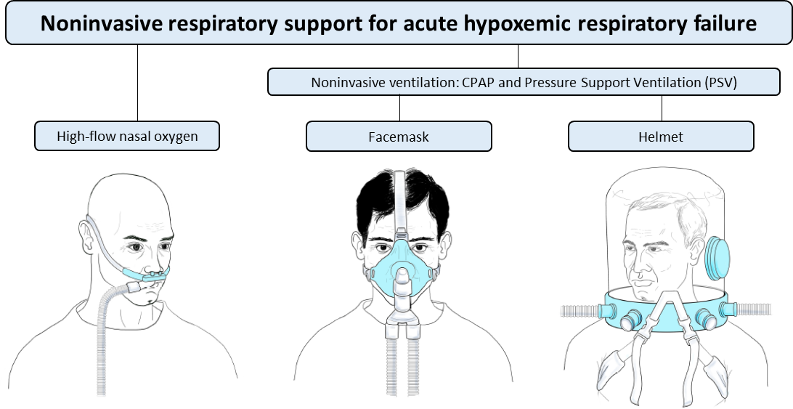
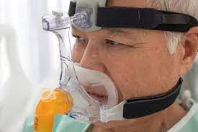
All these interfaces skip the nasal bridge
HYBRID ORO NASAL
TOTAL FACE
HELMET
Modified by D Grieco

Slide 31
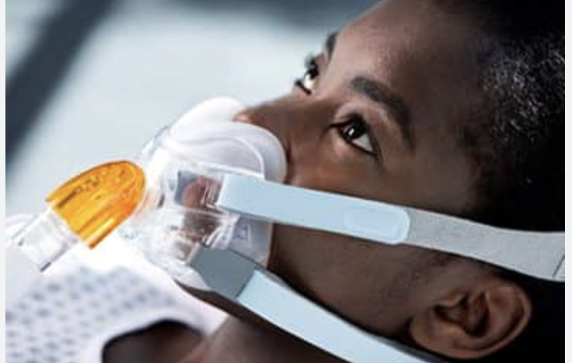
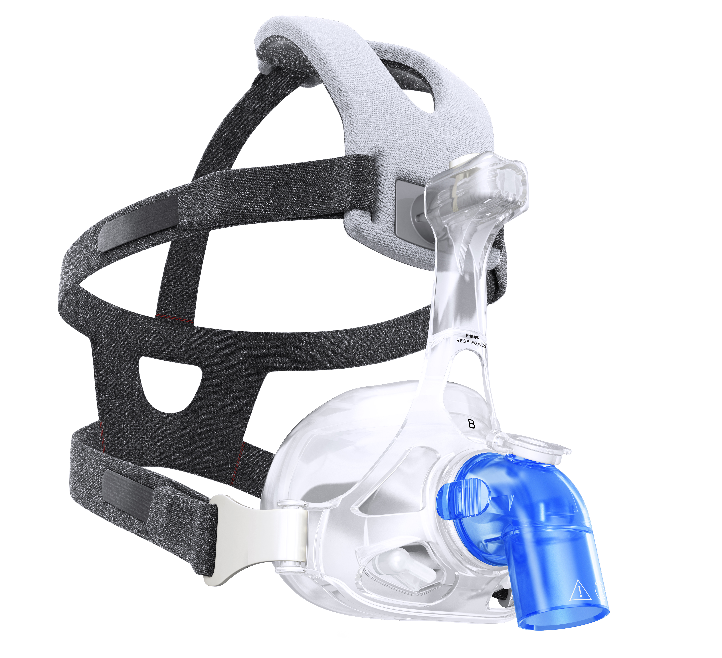
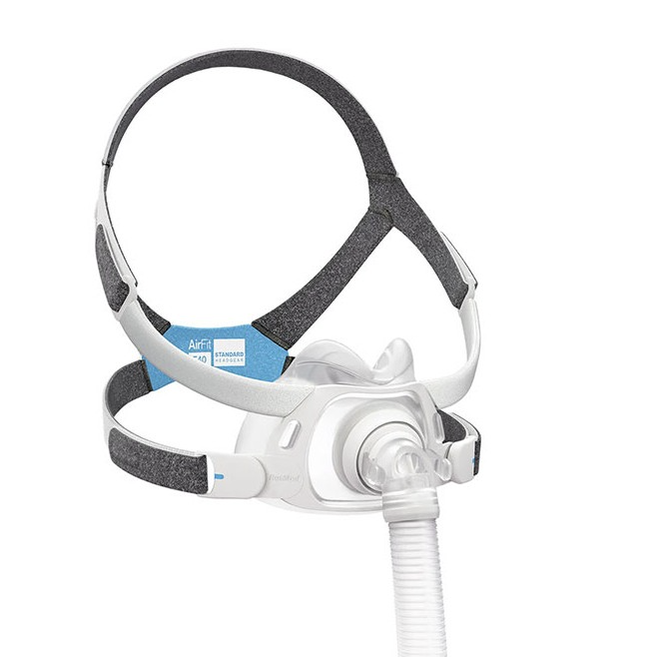
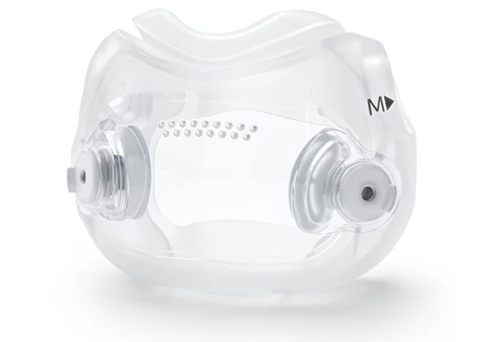
Small hybrid mask skips the nasal bridge as well as TFM

Slide 32
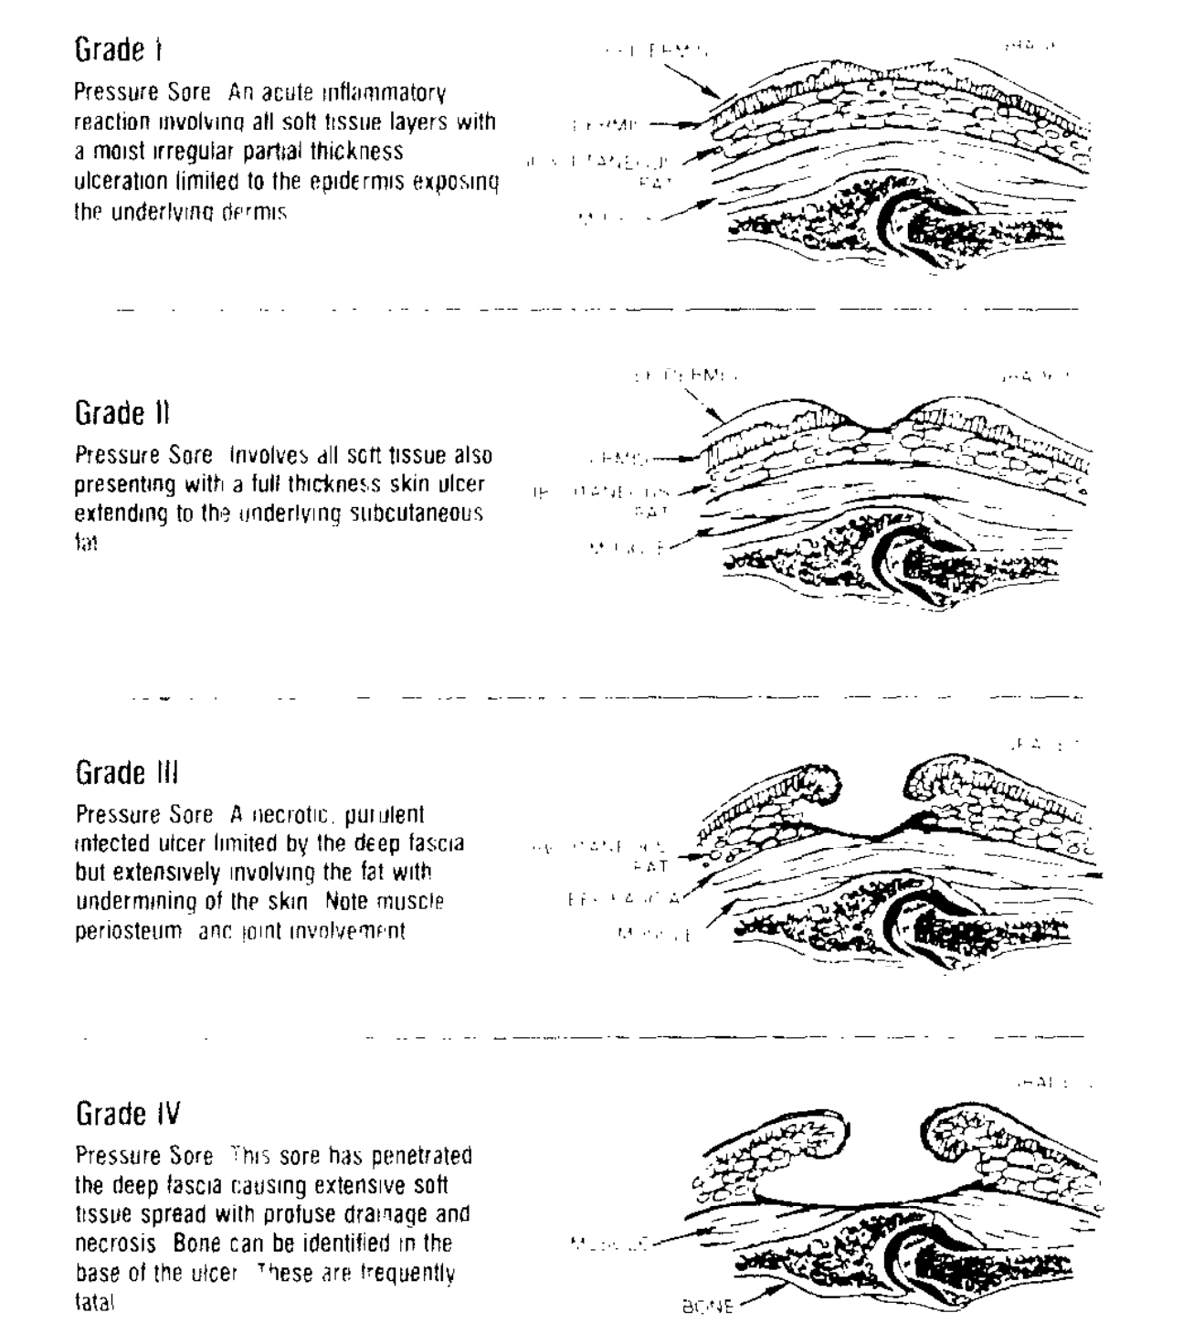
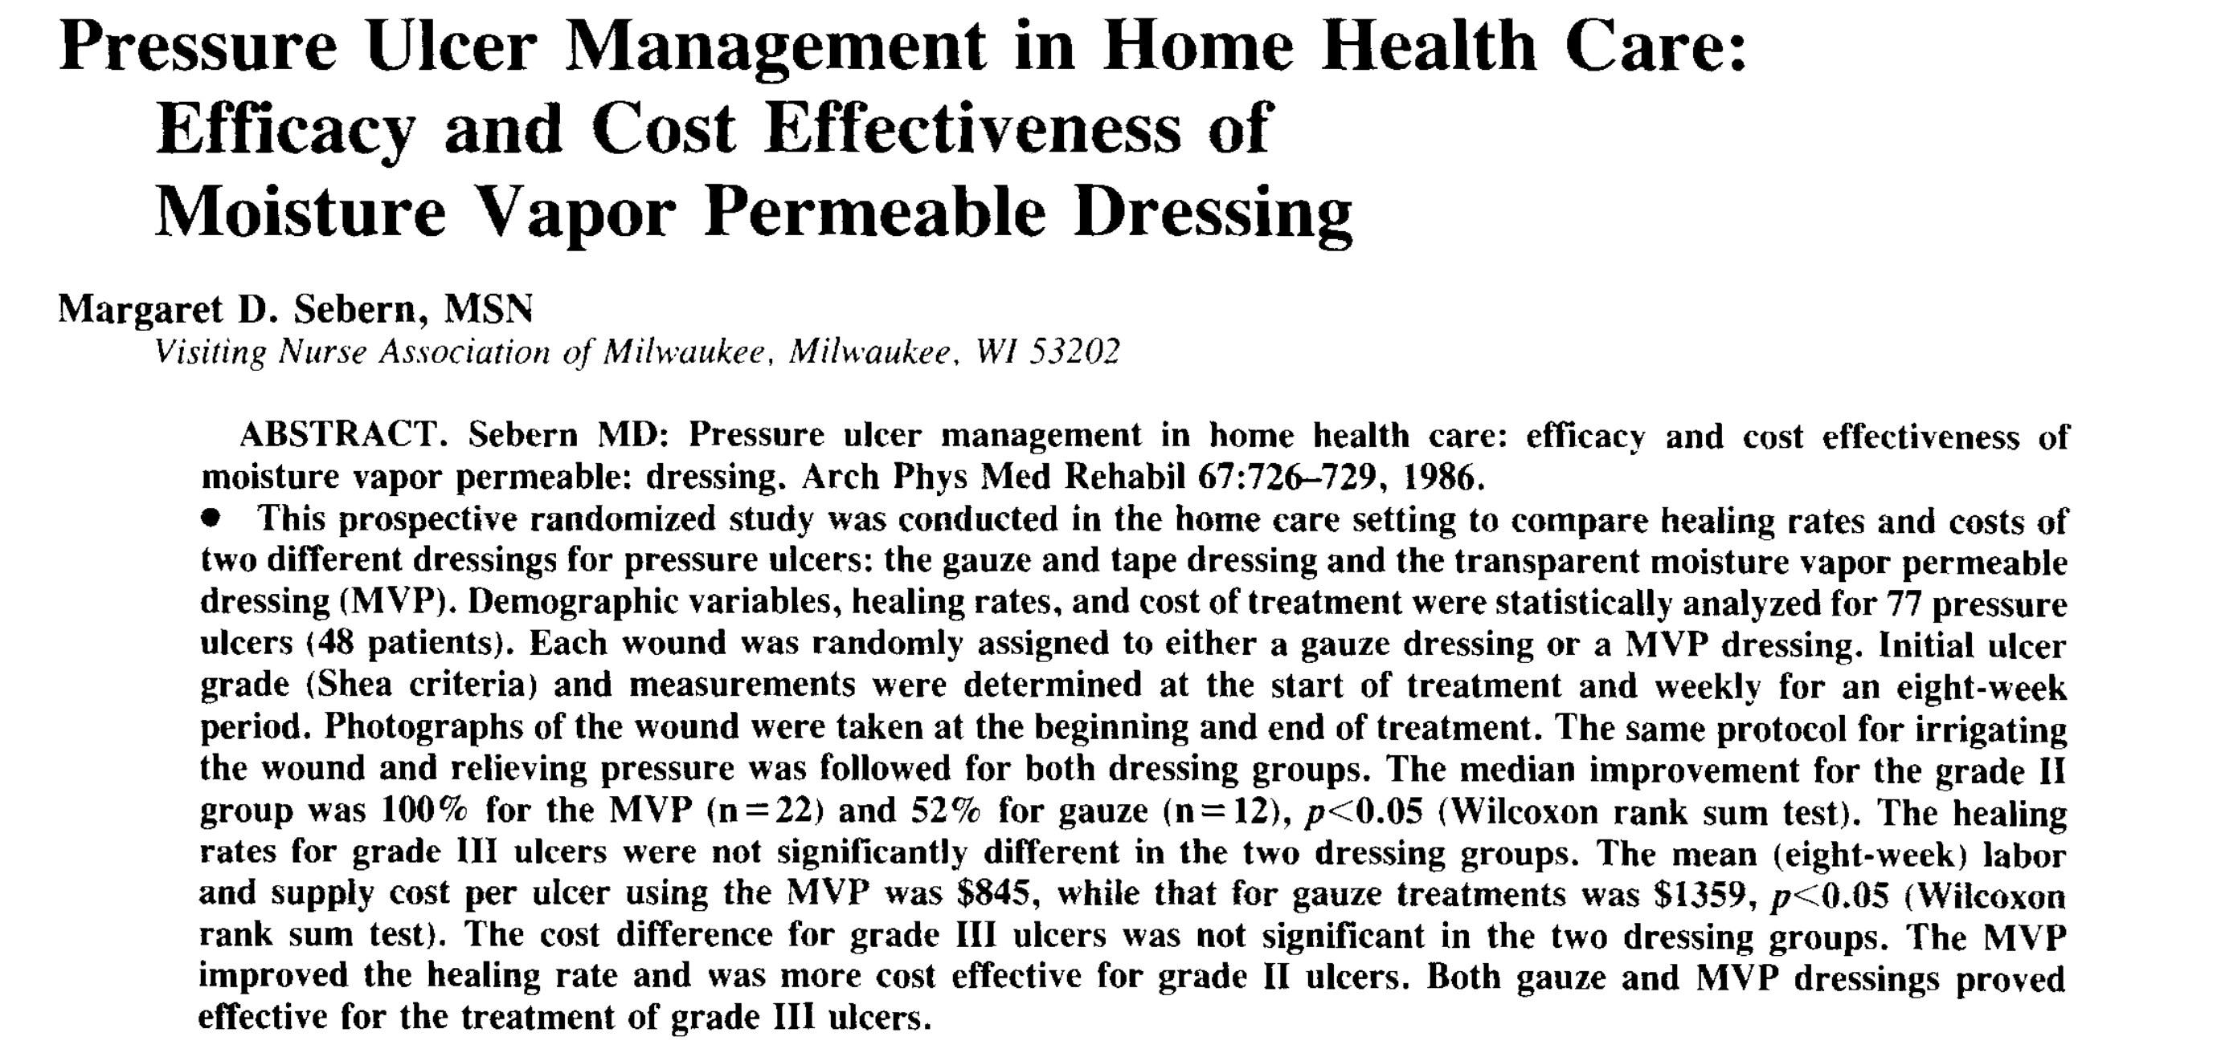
Arch Phys Med Rehabil Vol 67, October 1966

Slide 33
RATIONALE OF THE CHOICE
The choice of interface is influenced by numerous factors including:
  the type of respiratory failure (hypoxemic vs hypercapnic)
  circuit configuration, ventilator settings and intentional leaks
  time on NIV
  face contour
  patient tolerance

Slide 34
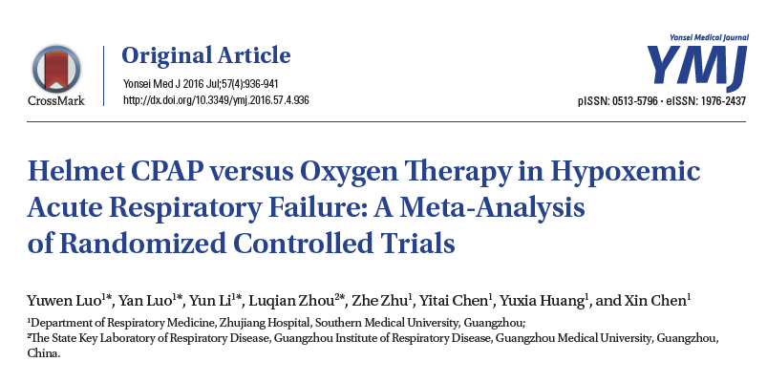
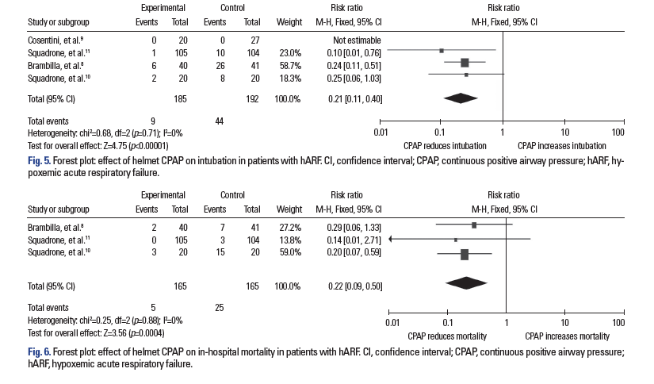
Rationale
The administration of a continuous positive airway pressure (CPAP) through a helmet improves oxygenation and avoids intubation

Slide 35
NPPV failure increases the risk of death
in hypoxemic “DENOVO” ARF
Demoule A et al Intensive Care Medicine 2006; 32:1756-1765

Slide 36
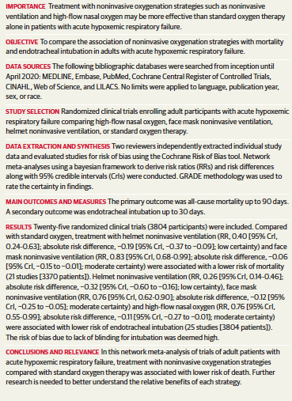
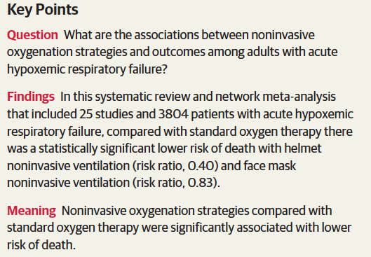
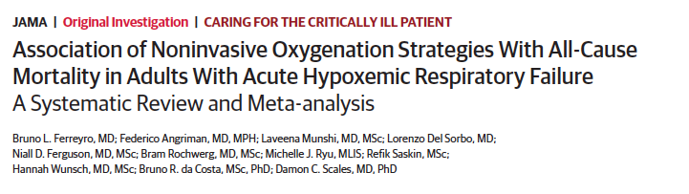
Rationale

Slide 38
INTERFACES, DEAD SPACE,
ABG… and patient’s effort
VDdyn = (VDphys) + (VDapp).
Vt
Interface

Slide 39
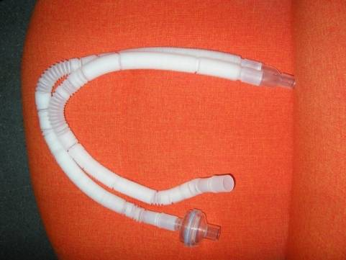
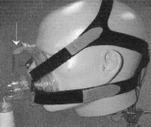
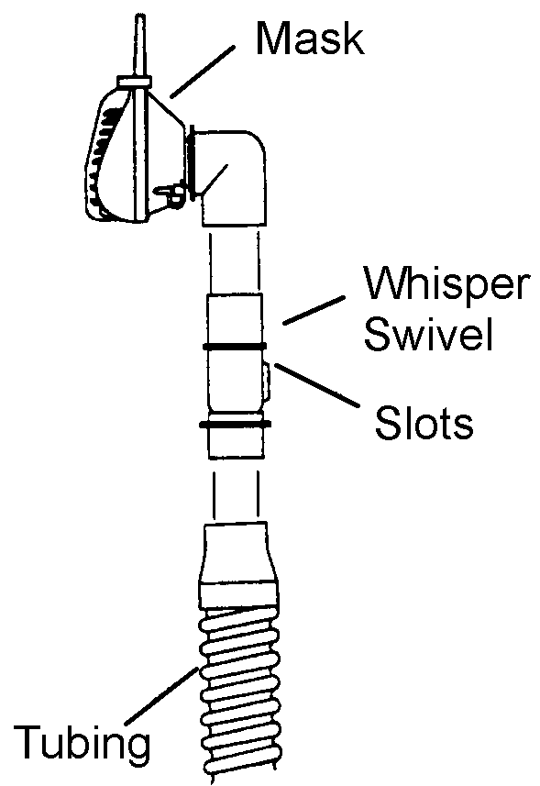
VDdyn = (VDphys) + (VDapp).
Vt
Interface
DEAD SPACE

Slide 40

VDdyn and non-intentional leaks circuit (non-vented interfaces)
Non-Vented
Esp. valve

Slide 41






Face mask and nasal plugs produced
a greater fall in PaCO2 than nasal mask
Non-Vented
COPD
RTD
VDdyn = (VDphys) + (VDapp).
Vt
Interface

Slide 42

VD dyn and non-vented mask
Numerical simulations, using computational fluid dynamics, were used to describe pressure, flow and gas composition during ventilation with the different interfaces. Fodil et al INTENSIVE CARE MED 2010
VT
This means:
the choice of interface based only on the effective VD is probably questionable.
Factors such as comfort, tolerance and leaks should also be taken into account during the decision-making process.
V
This results show that :
VD is about the internal volume of the smaller interface while is the half of Vt in the larger ones (TFM andt Helmet)
the less voluminous masks clearly remains the most favorable in terms of rebreathing with large Vt
this beneficial effect decreases quasi linearly as tidal volume decreases
Notes:
, Each interface was successively positioned upon the same adult mannequin head made of polystyrene. Each set-up, i.e. the mannequin–interface, was numerically reconstructed in three dimensions by using computed tomography (CT) images. In each three dimensional (3D) geometry, breathing flow was simulated for successive cycles (i.e. inspiratory ? expiratory pha- ses) by using CFD software (FLUENTÒ Fluent Inc., Lebanon, TN, USA) until an ‘‘equilibrium state’’ was reached. The equilibrium state is defined as the moment where the parameters (i.e. pressure, flow and gas com- position) become identical from one breathing cycle to the next breathing cycle.
The CFD procedure allows one to estimate gas composition, flow and pressure at any locus of the interface gas region and at any time of the breathing cycle. Gas composition was described as the mass frac- tion of each gas species, especially for oxygen (MFO2 ) and carbon dioxide (MFCO2 ). Then, we determined the effective dead space (VD) of the interface gas region defined as the rebreathed gas volume resulting from the exhaled gas trapped in this interface gas region as well as the volume of fresh air (Vfresh) that is inhaled by the mannequin during each inspiratory cycle

Slide 43

Signori et al Respir Care 2019
CO2 REBREATHING
STANDARD MASK vs NOVEL MASK

Slide 44
The Helmet
PiCO2 in semi-closed environment depends on:
i) the amount of CO2 produced by the subject (V˙CO2)
ii) the flow of fresh gas that flushes the environment (in the case of the helmet the “helmet ventilation”).
(e.g. air leaks, delivery of fresh gas)

Slide 45

The helmet is a closed but ventilated enviroment
Ventilator
V'tot
V'A
V'CO2
V'CO2
PACO2
PhCO2

Slide 46



Intensive Care Med 2003; 29: 1680-87

Slide 47


Crit Care Med 2004; 32: 2090-96

Slide 48

VDdyn and intentional leak circuit
(vented interfaces)
Vented
“Vent system”
NO ACTIVE VALVE

Slide 49
Pressure –Flow relationship in vented circuit
Vented
Vented

Slide 50

Vdyn
Vphys
Vdyn SB
PEEP ⇓ VDdyn near to Vdphys in vented masks .
PS without PEEP ⇓ VDdyn to a lesser extent, from 42% to 39% of VT, leaving VDdyn ⇑ than VDphys.
Vdyn IPAP16
Vdyn CPAP 4
Vdyn BILEVEL 16/4
VDdyn = (VDphys) + (VDapp).
Sattci E et al ERJ 04
Vt
Interface

Slide 51
VD dyn and vented mask
IPAP 23 EPAP 4 cmmH2O
Vented FFM
165ml
Leaks
24 L/m
Vented system
in the circuit
165ml
Leaks 15 L/m
Vented TFM
875 ml
Leaks 30 L/m
Vented FFM
Vented system
in the circuit
Vented TFM
(PDR) required to decrease end-tidal CO₂ ^{by 20% (from 75 to 60 mm Hg).}
Schettino et al Critical Care Med 2003

Slide 52




EXALATION SYSTEM
CPAP 4
DEAD SPACE??
Schettino. Crit Care Med 2003; 31:2178 -2182

Slide 53
Vented
TURBINE DRIVEN INTENTIONAL LEAK VENTILATOR
Lemyze et al Crit Care Med 2013; 41:481–488)
Notes:
The main findings of the present study can be summarized as follows:
1. When FM-NIV failed to reverse hypercapnic ARF in do- not-intubate patients, switching from FM to total FM can be proposed to prolong continuous application of NIV. In spite of their poor prognosis, a substantial number of these patients survived hospital discharge.
2. This strategy resulted in better correction of arterial blood gases.
3. The risk of developing facial pressure sores was closely re- lated to the duration of FM-NIV. Patients switched early to total FM developed less facial pressure sores compared to patients managed with FM for long periods of time.
4. In case of painful FM-induced facial skin damage switching to total FM enabled the continuation of NIV with better patient comfort.

Slide 54
Conclusions
No differences have been found yet in term of outcome between the use of a FM and a TFM in the acute setting
Skin breakdown increases when dedicated NIV masks are not used and may cause NIV failure
Nasal pillows, hybrid and total full face masks and helmets avoiding contact with nasal bridge may help in preventing/treating skin lesions
Vdyn is negligible when using PEEP in vented mask
This is also true in non vented circuit for less voluminous face mask with normal Vt

Slide 55
PERFORMANCE

Slide 56
Fraticelli et al Critical Care Medicine 2009

Slide 57



Oracle
Fraticelli AT et al. Crit Care Med 2009; 37:939–945

Slide 58


Slide 59

HFNO, helmet NIV, but not CPAP, reduced esophageal pressure. CPAP and NIV similarly increased oxygenation, end-expiratory lung volume, and VT, without affecting transpulmonary pressure.
American Journal of Respiratory and Critical Care Medicine 2023; 207:10

Slide 60
Pneumonology 2023
AJRCCM 2020

Slide 61
NIV, and to a lesser extent CPAP, mitigated pendelluft.
A high pendelluft percentage during HFNO (65% of VT), which progressively decreased with both helmet CPAP (38% of VT) and NIV (26% of VT)
American Journal of Respiratory and Critical Care Medicine 2023; 207:10
Intrapulmonary distribution of air in one representative patient.
Notes:
red pixels represent those deflating during inspiration, with color intensity displaying percentage of VT contributing to pendelluft.

Slide 62


