Slide 1
Ventilazione non invasiva con la "Bussola" della fisiopatologia respiratoria
Guido Polese
CEMS Verona

Slide 2
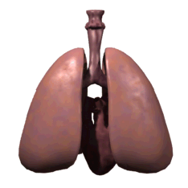
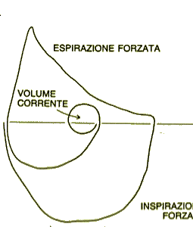
Respiratory cycle
http://www.lionden.com
Notes:
Permission to use this slide (a matter of academic integrity)
*If you are Kevin Patton's current student, you may use any slide for your own personal educational purpose.
**If you are a student not currently in Kevin's courses, you may use any slide for your own personal educational purpose and are also encouraged to feed the lions at http://www.lionden.com/feed_the_lions.htm
***If you are a teacher you may use any slide for your own nonprofit educational purpose and are also expected to feed the lions for each use of a slide. http://www.lionden.com/feed_the_lions.htm
****Commercial use is available only with Kevin's express written permission.
© KPatton@lionden.com . All rights reserved. DO NOT REMOVE THIS COPYRIGHT NOTICE LINE.
Feedback, suggestions, corrections are most welcome!

Slide 3
Respiratory cycle
Inspiration
Elastic recoil+ Resistance
Expiration
Elastic recoil- Resistance
http://www.lionden.com
Notes:
Permission to use this slide (a matter of academic integrity)
*If you are Kevin Patton's current student, you may use any slide for your own personal educational purpose.
**If you are a student not currently in Kevin's courses, you may use any slide for your own personal educational purpose and are also encouraged to feed the lions at http://www.lionden.com/feed_the_lions.htm
***If you are a teacher you may use any slide for your own nonprofit educational purpose and are also expected to feed the lions for each use of a slide. http://www.lionden.com/feed_the_lions.htm
****Commercial use is available only with Kevin's express written permission.
© KPatton@lionden.com . All rights reserved. DO NOT REMOVE THIS COPYRIGHT NOTICE LINE.
Feedback, suggestions, corrections are most welcome!

Slide 4

EQUAZIONE DI MOTO
E = mc²
.
Papp.RS = R V' + E VT + (PEEPi)
Spontaneous Ventilation Papp.rs = PMUS
Assisted Total Support Papp.rs = PVENT
Assisted Partial Support Papp.rs = PMUS+PVENT

Slide 5
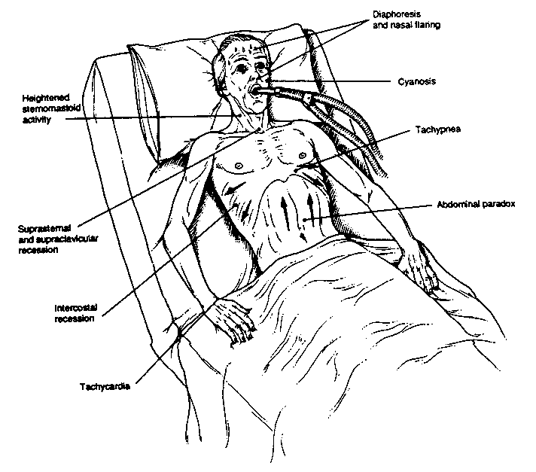
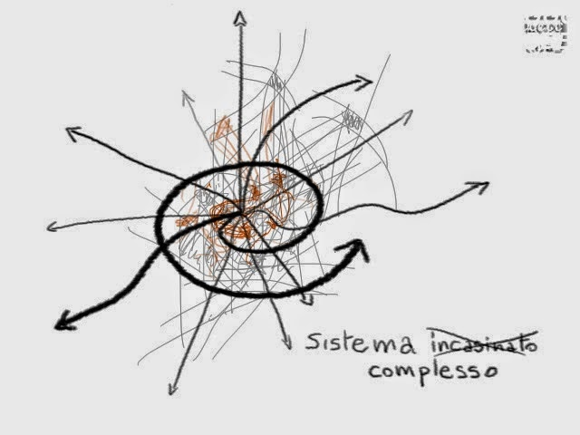

Slide 6
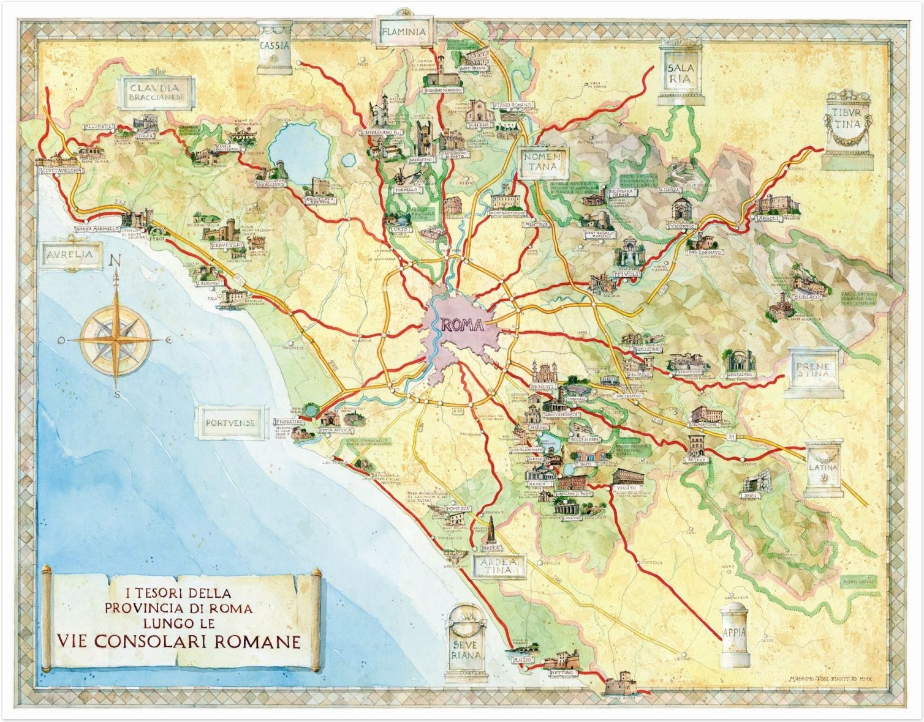
acidosi ipercapnia ipossiemia
BPCO
Obesità
Cifoscoliosi
EPA
IRA
Asma
SLA
Polmonite

Slide 7
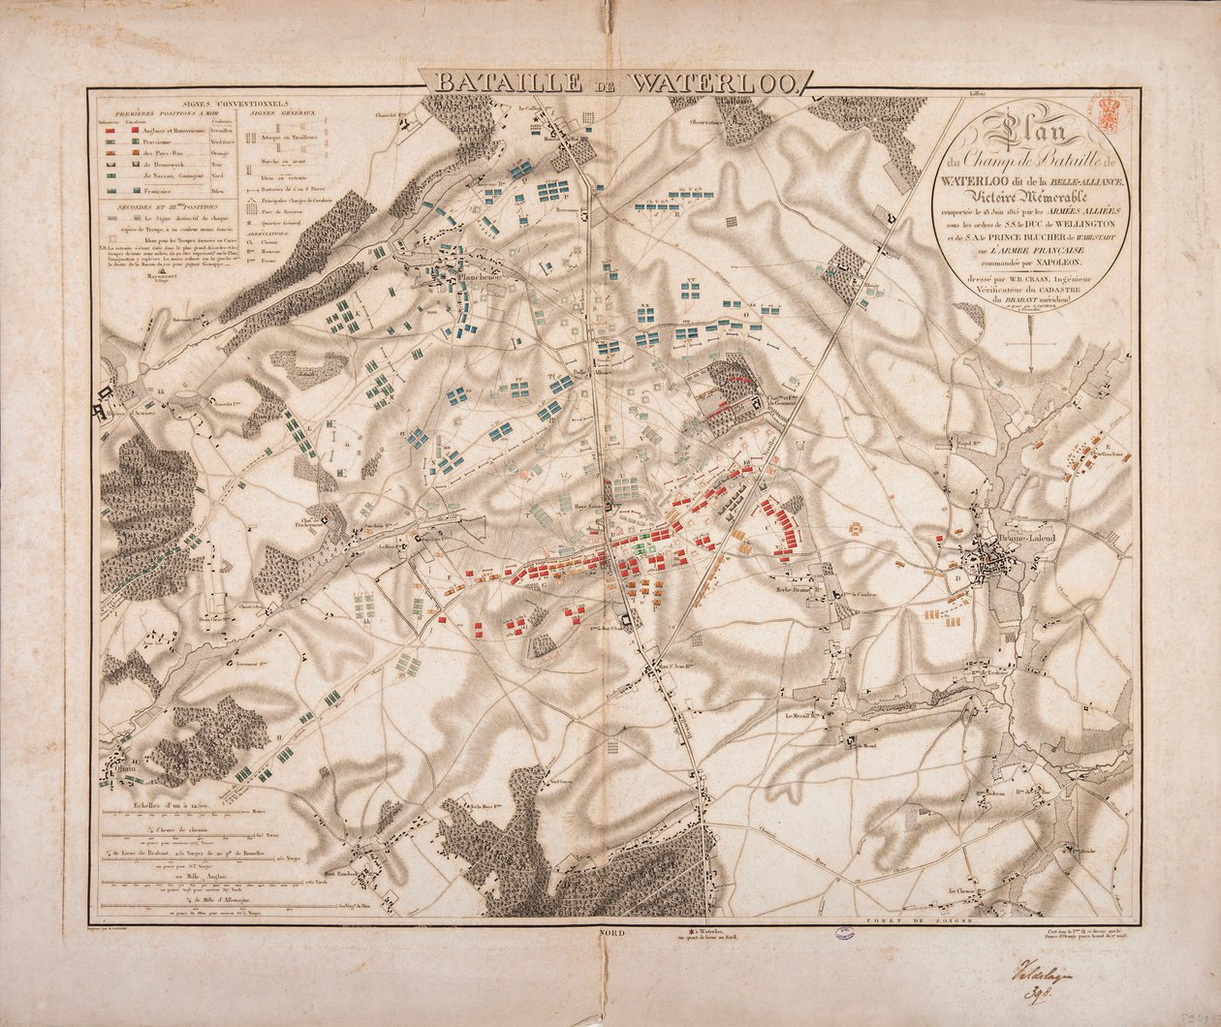
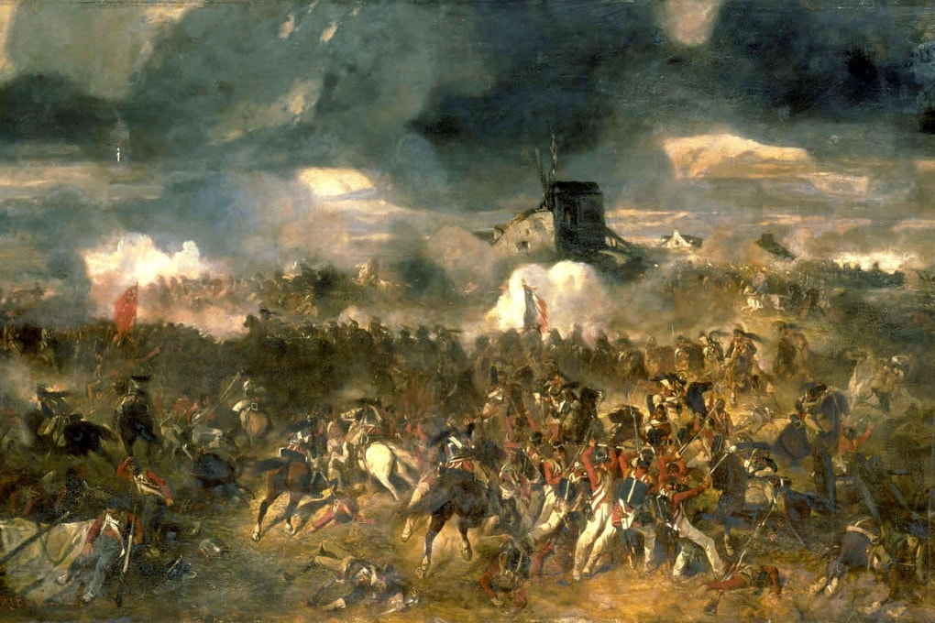
Il campo di battaglia

Slide 8

Il terreno di gioco!

Slide 9
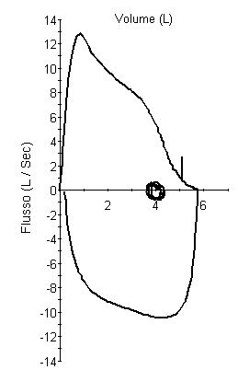
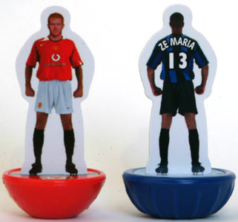
Il terreno di gioco!

Slide 11
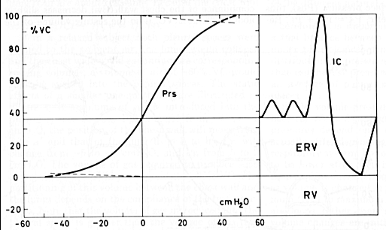
CAPACITA' INSPIRATORIA
VT

Slide 13
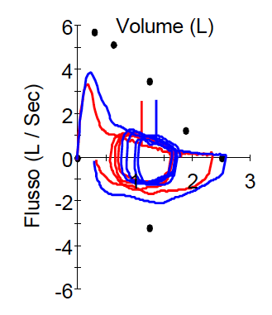
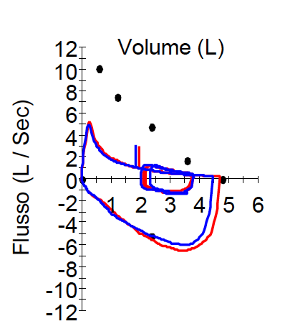
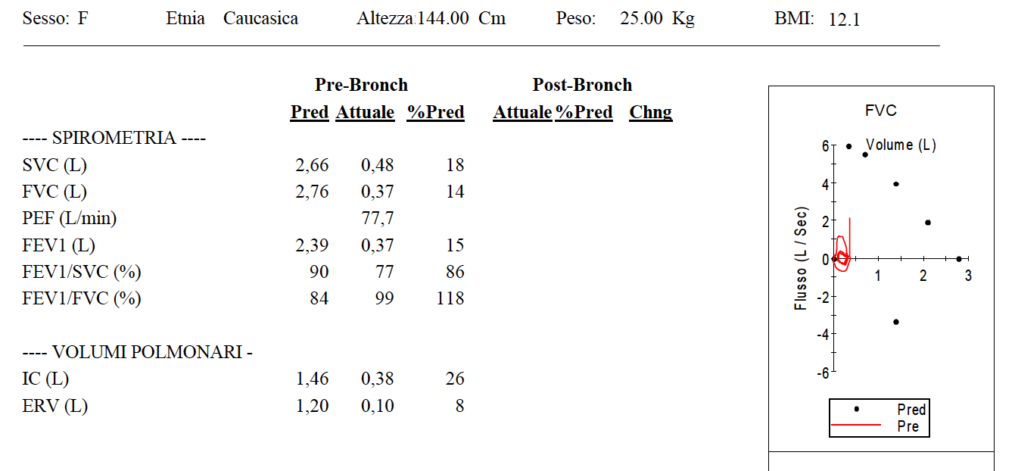
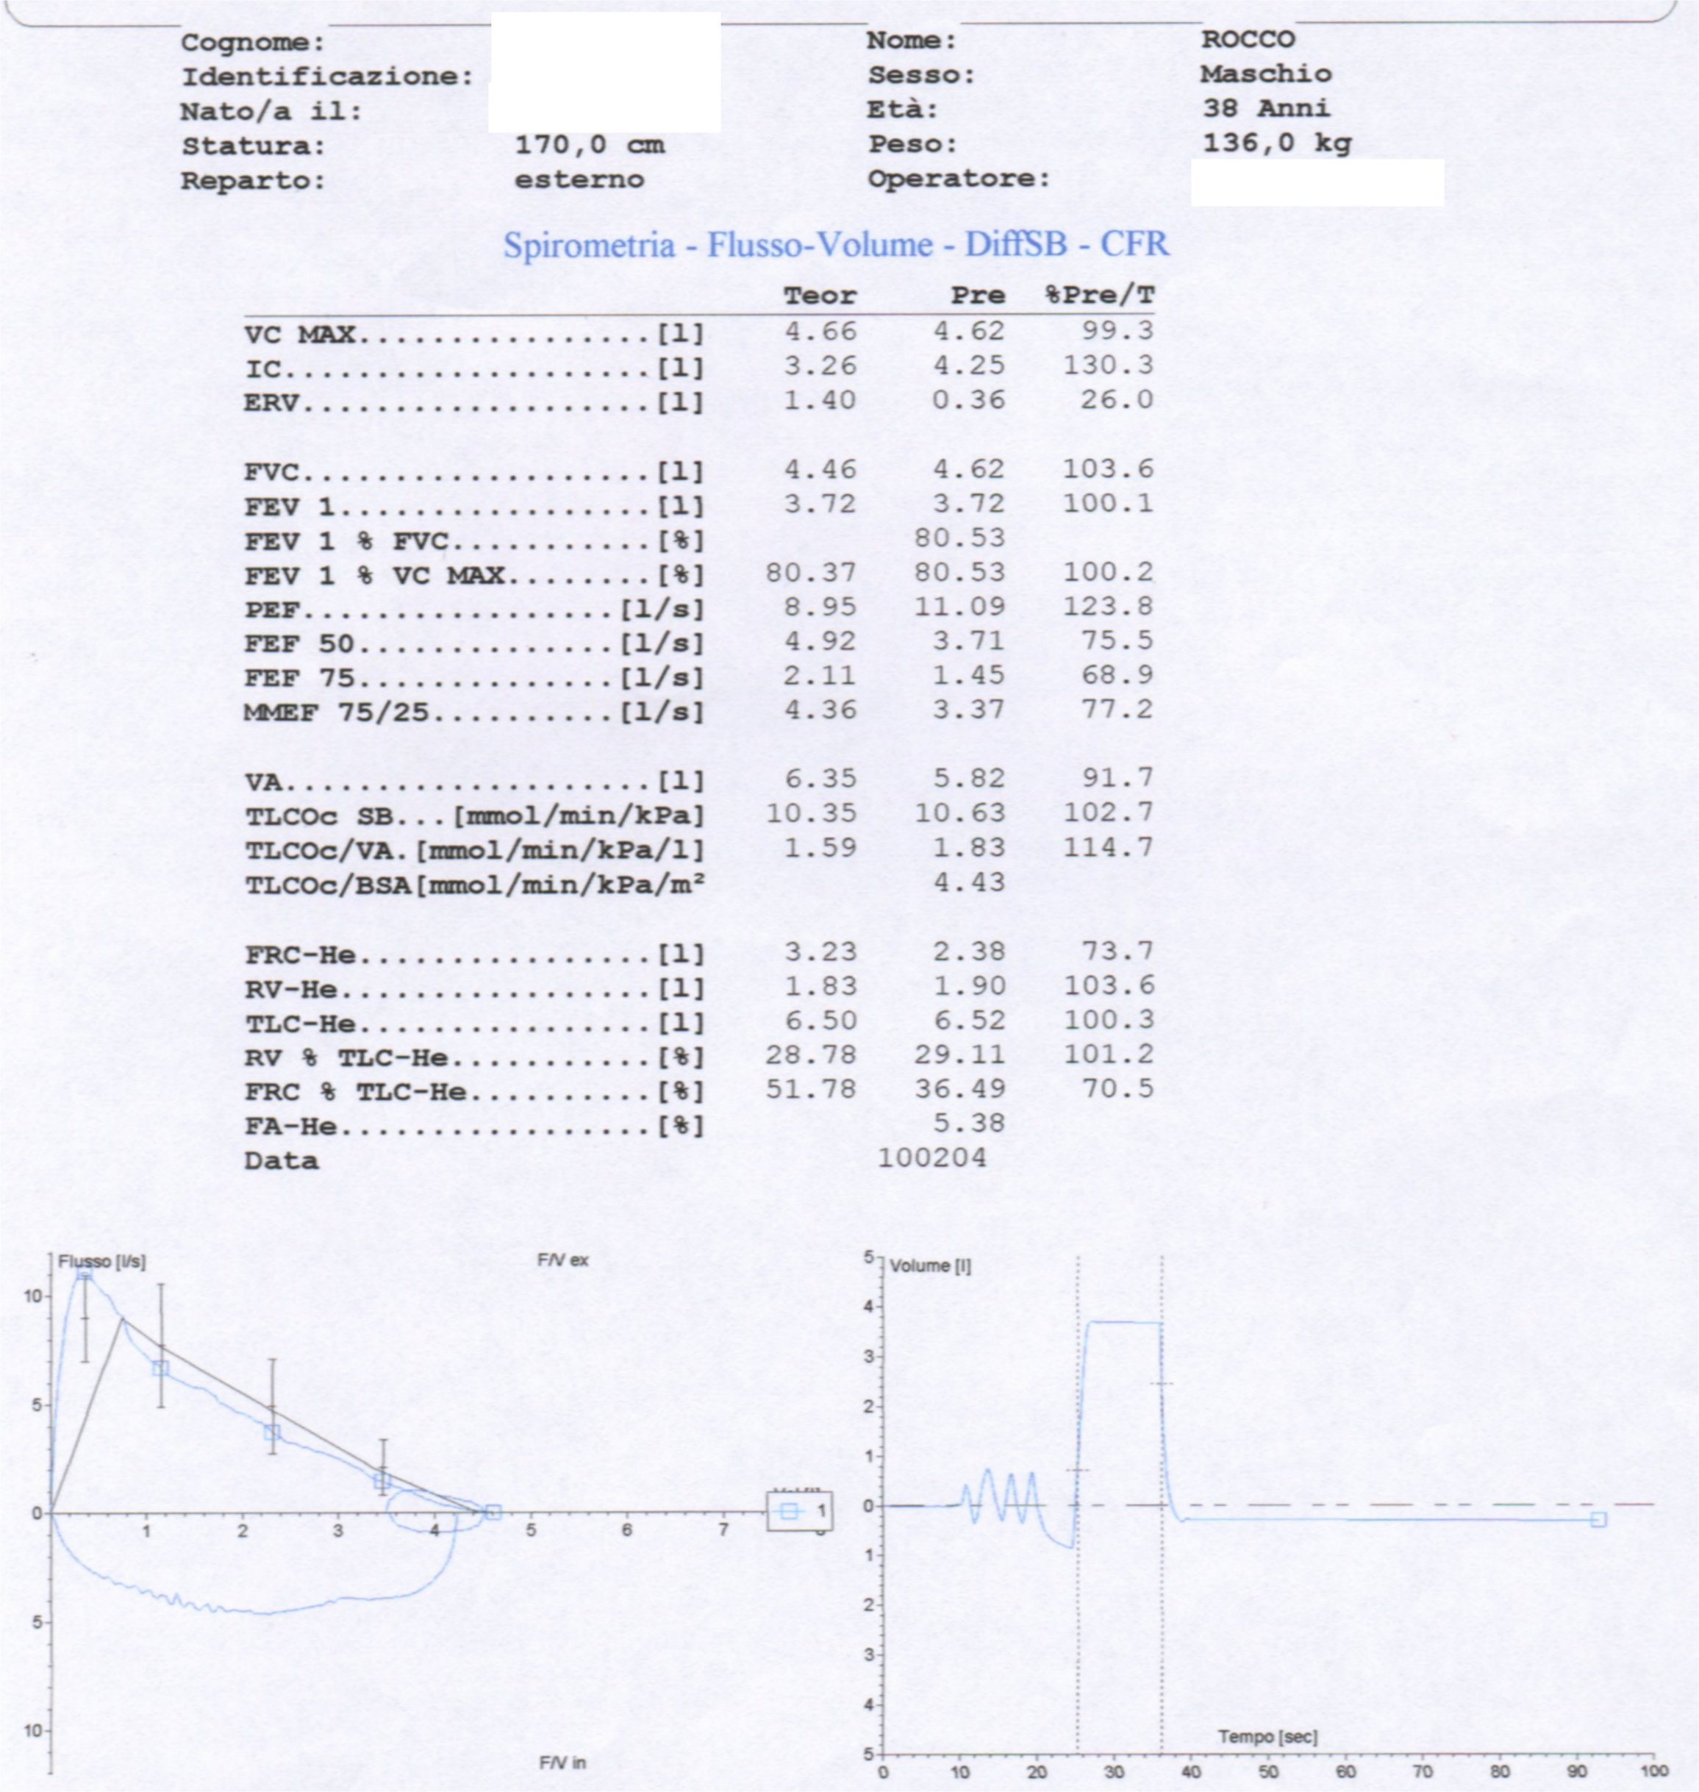
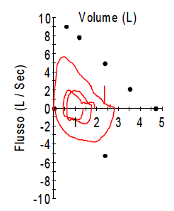
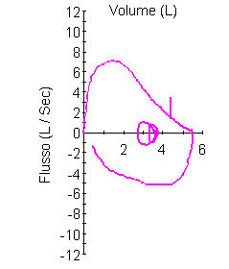
F/V una chiave d’interpretazione !

Slide 14
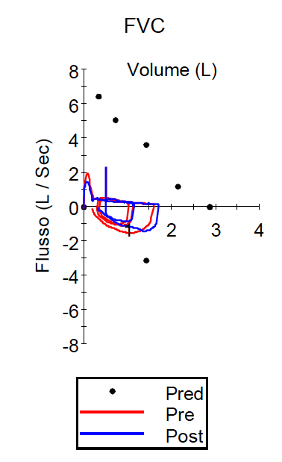
BPCO

Slide 15
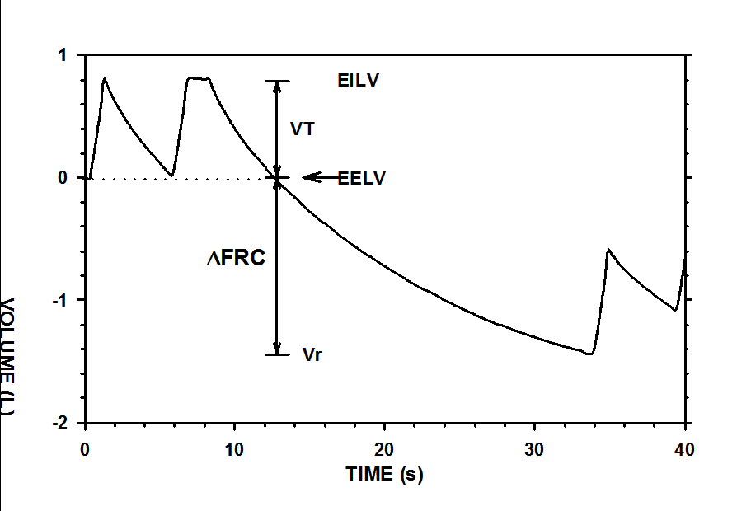
Iperinflazione dinamica
1.5 L.
Pmus = P0 + R V’ + E VT

Slide 16
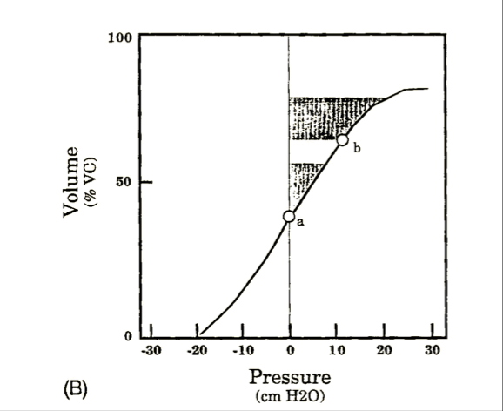
Similowski in Acute respiratory failure in chronic Obstructive Pulmonary Disease Ed. Derenne
PEEPi
PEEPi
Pmus = P0 + R V’ + E VT

Slide 17

Limitazione di flusso
https://www.nerdburger.it/spider-man-homecoming-unanalisi-del-trailer/
VCO2 resp muscles

Slide 18
EQUAZIONE DI MOTO
OSTRUTTIVI
Papp.RS = Pmus = P0 +R V’ + E VT
PEEPi (P0)
Rrs
FRC
➔ PEEP/EPAP (7-8)
➔ ΔP (10-15 )
➔ ?? (spray !!, farmaci,
disostruzione)
⬆supporto
⬇WOB
≠ VT
= ⬇V’CO2 ⬇PaCO2 (⬆PaO2)

Slide 19
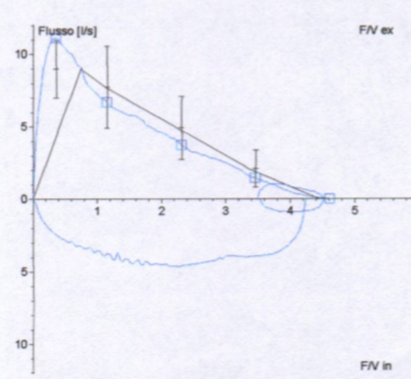
Obesità: “fatti non foste a viver sdraiati”
Polese, Inferno Villafranchese,
Canto 26° (di Santo Stefano)

Slide 20
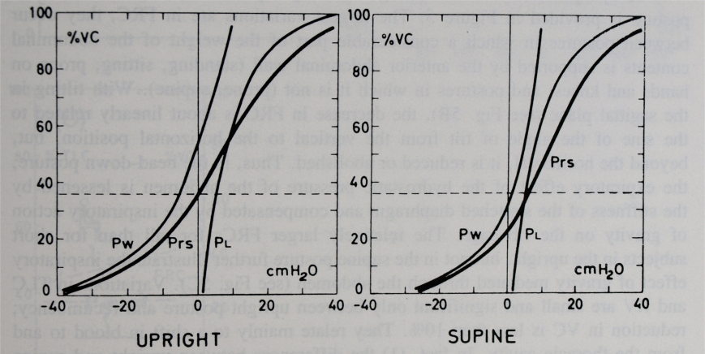
CURVA VOLUME-PRESSIONE: LA GRAVITA’
ERETTO - SUPINO
toraco-addominale
Papp.RS = P0 + R V’ + E VT

Slide 21

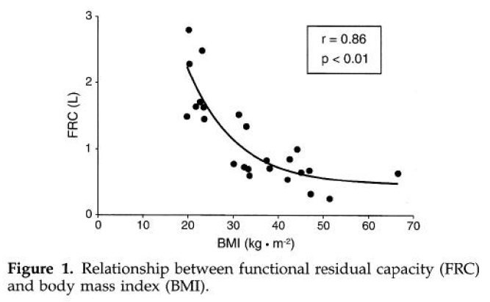
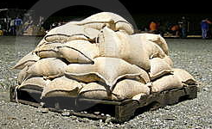

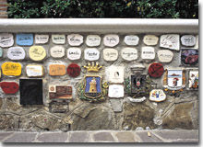
OBESITA’
RV
Papp.RS = P0 + R V’ + E VT
Pelosi P Anesth Analg 1998;87:654–660

Slide 22

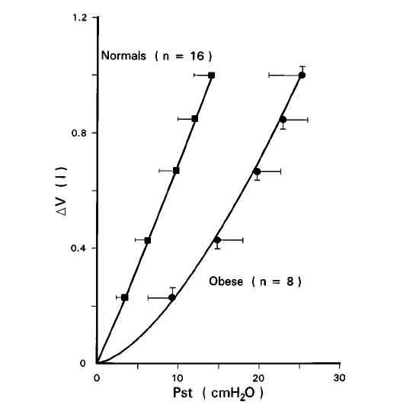
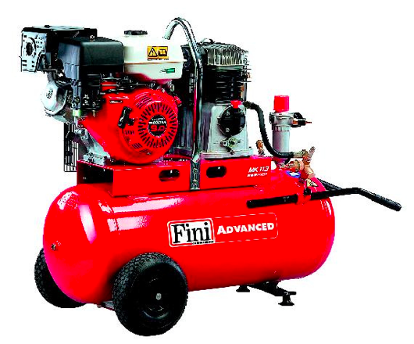
OBESITA’…. PESO = PRESSIONE
Papp.RS = P0 + R V’ + E VT
JAP 1997; 82: 811–818

Slide 23
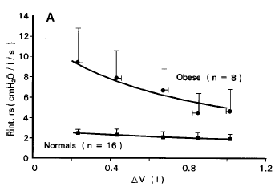
OBESITA’ = >> RESISTENZE
Papp.RS = P0 + R V’ + E VT
JAP 1997; 82: 811–818

Slide 24
Obeso: “vivere sdraiato”

Slide 25
EQUAZIONE DI MOTO
OBESI
Papp.RS = Pmus = P0 +R V’ + E VT
⬇FRC (⬆Rrs)
⬆Edyn,rs (CW)
(OSAS)
⬆supporto
➔ ⬆PEEP/EPAP (8-10)
➔ ⬆ΔP, PCV, ⬇Rise Time
⬆PEEP/EPAP (10-12)
= ⬆ VT

Slide 26
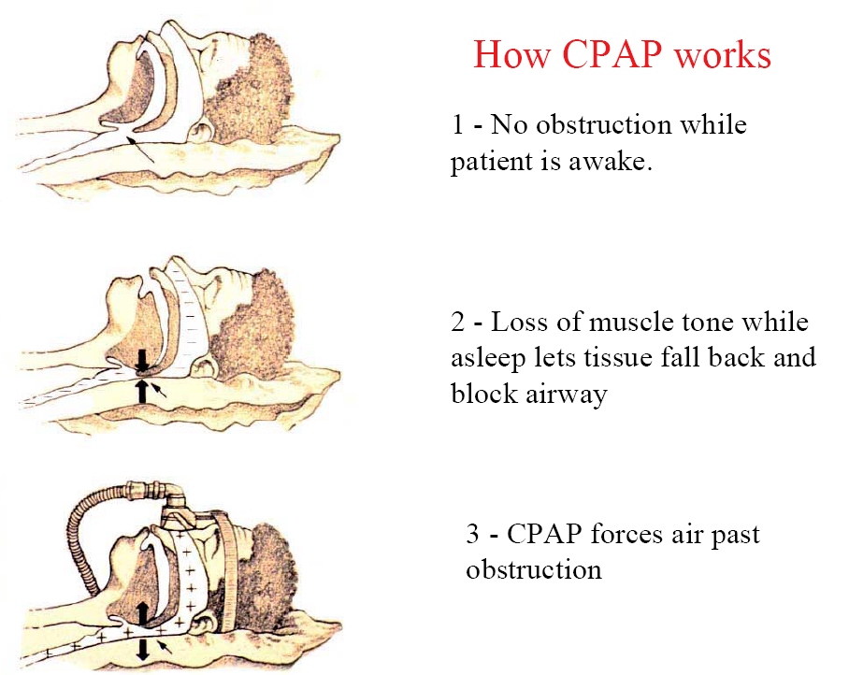
Obeso: “vivere sdraiato”
PS
PEEP

Slide 27
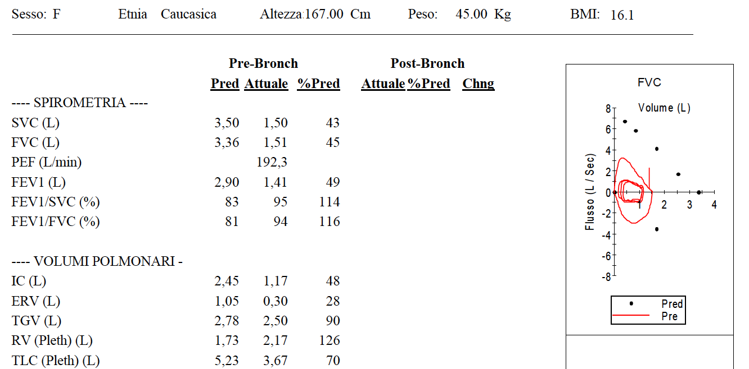
Restrizione di gabbia

Slide 28
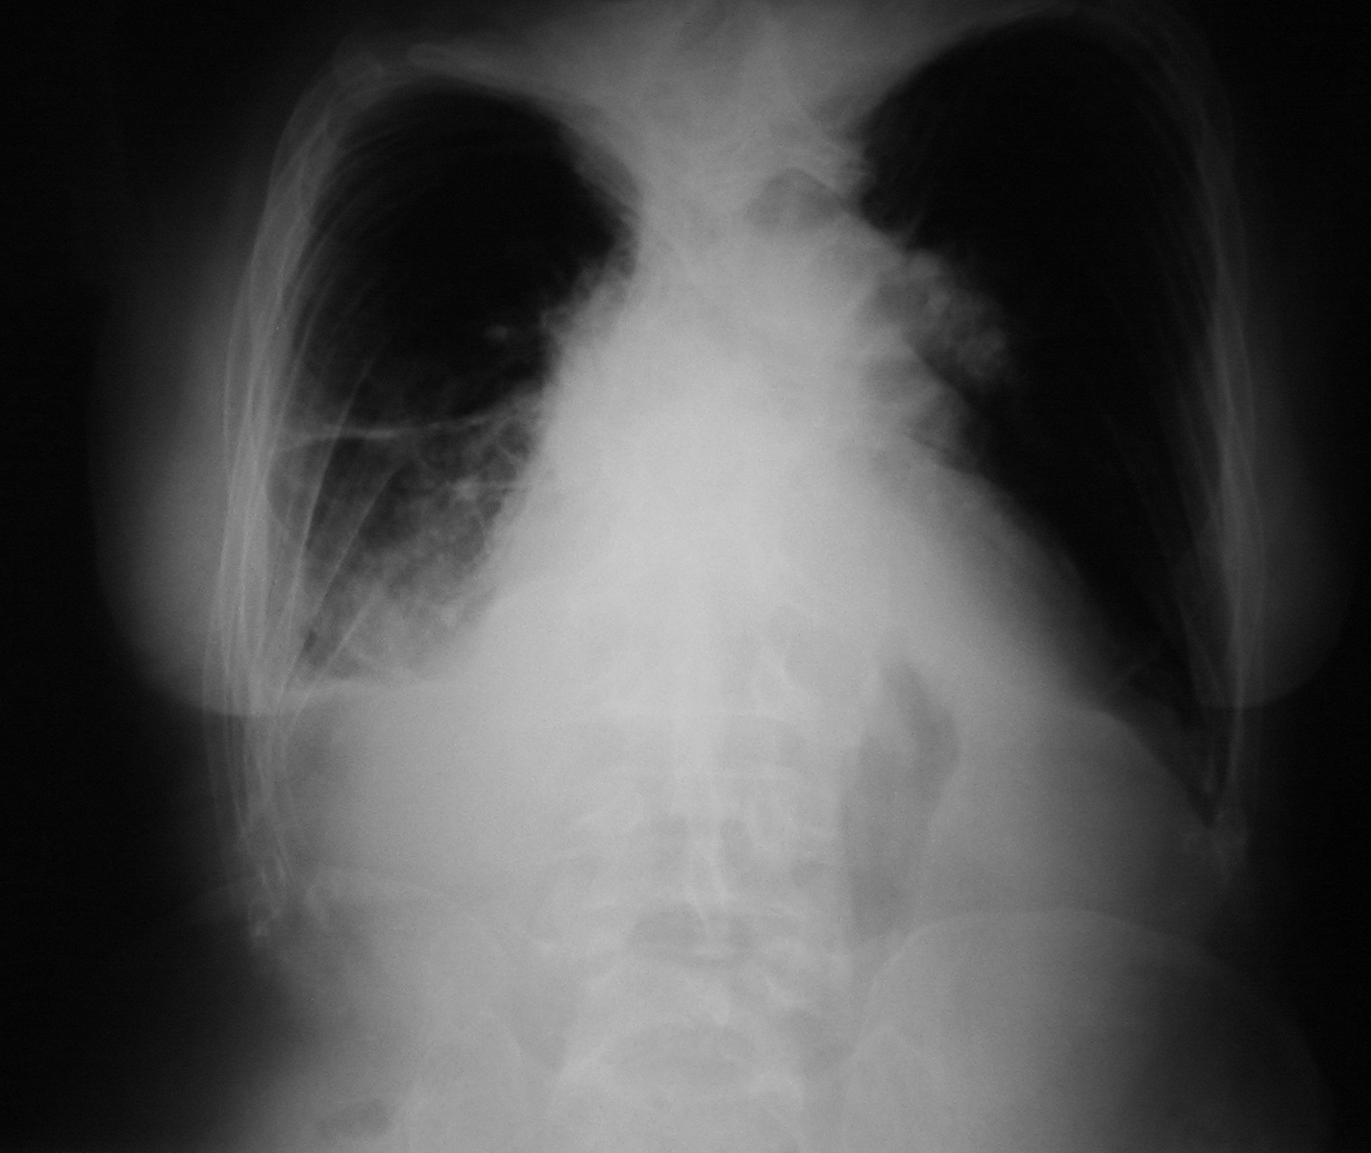
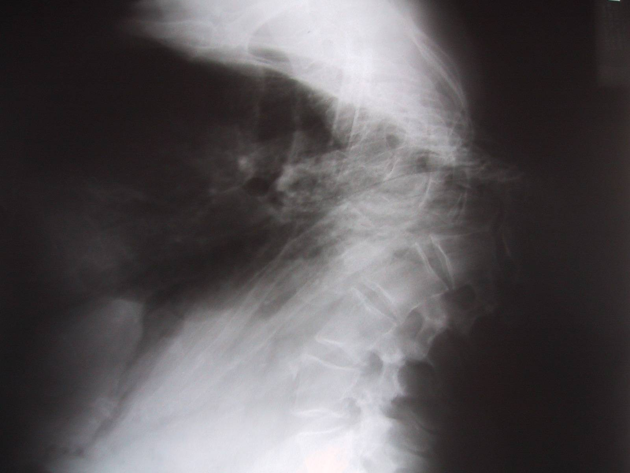
CIFOSCOLIOSI

Slide 29
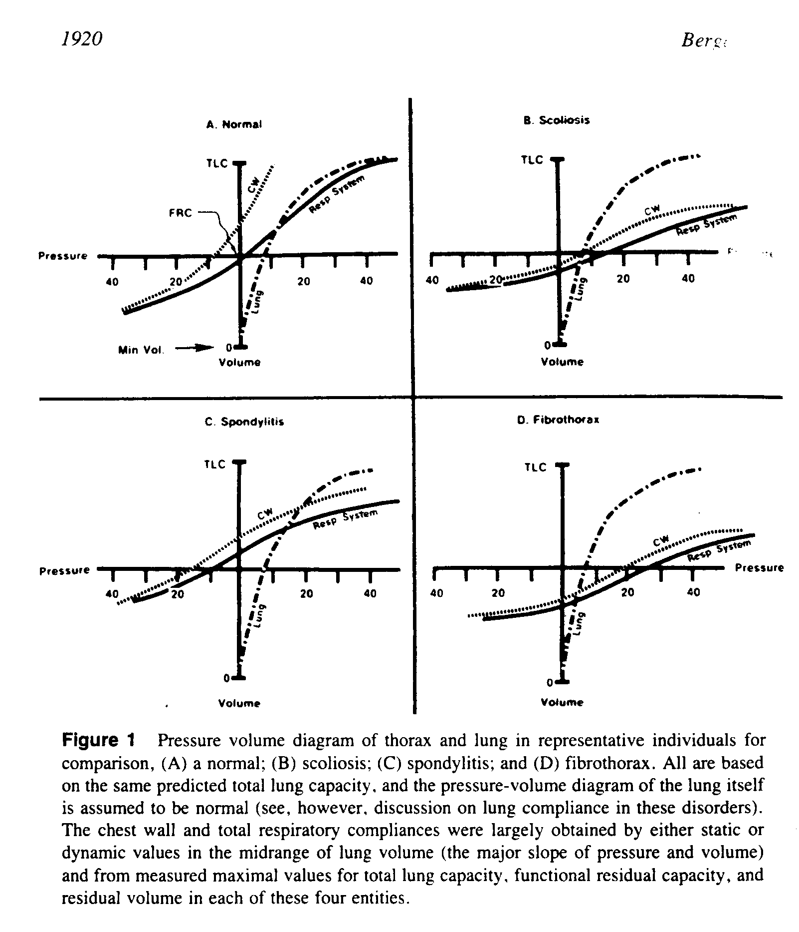


CIFOSCOLIOSI
Bergofsky EH The Thorax 1995:1915-50
Pmus = P0 + R V’ + E VT

Slide 30
Restrizione di gabbia

Slide 31
EQUAZIONE DI MOTO
CIFOSCOLIOSI
Papp.rs = P0 + R V’ + E VT
⬆Edyn,rs
⬆supporto
⬇WOB
➔ PCV, ⬆ΔP (20-25), ⬇Rise time
≠ VT
= ⬇V’CO2 ⬇PaCO2

Slide 32
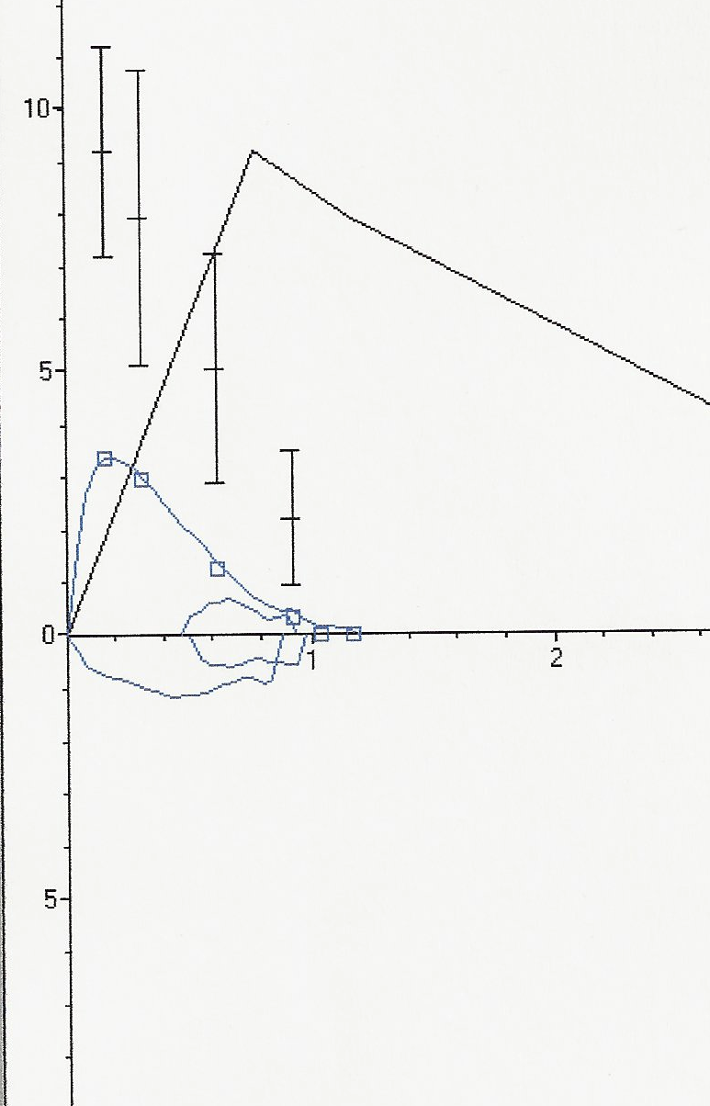
NMD: restrizione di pompa
?
?

Slide 33
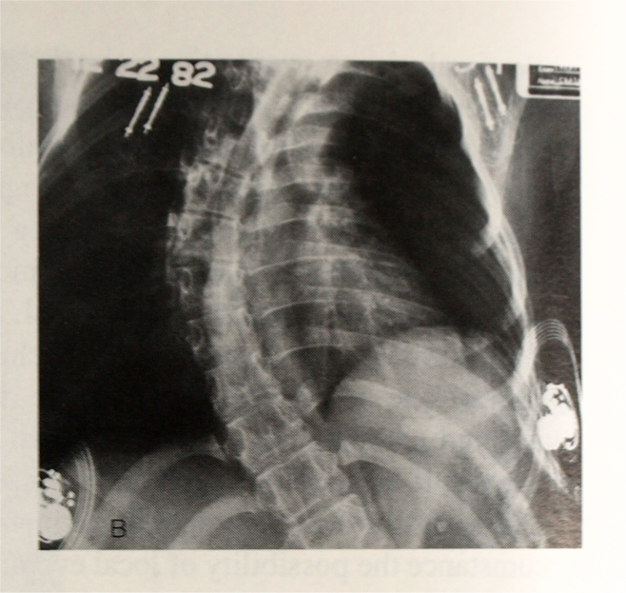

Slide 34
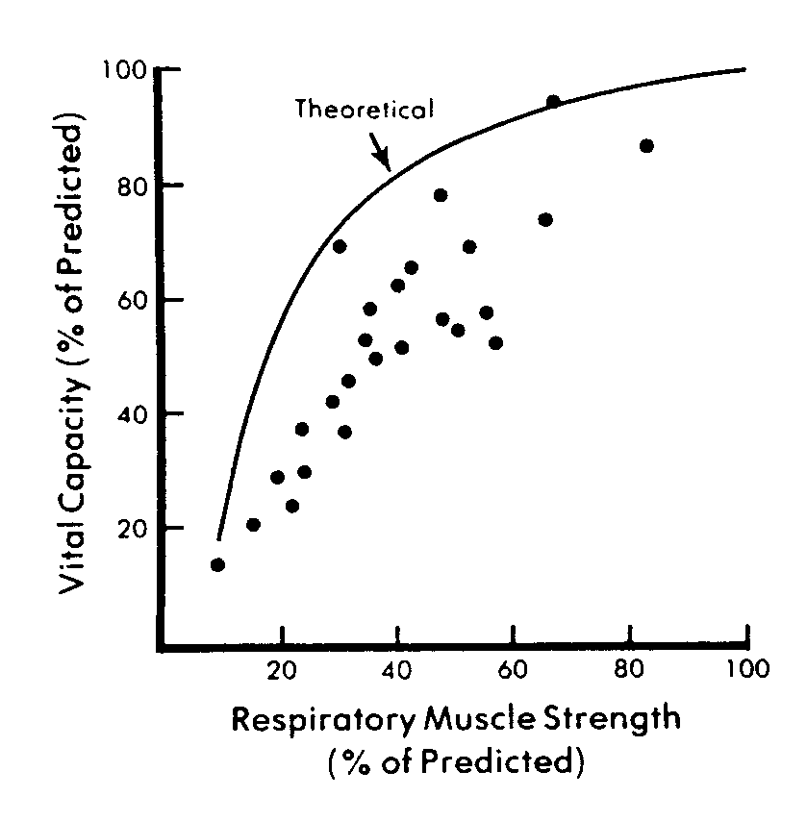
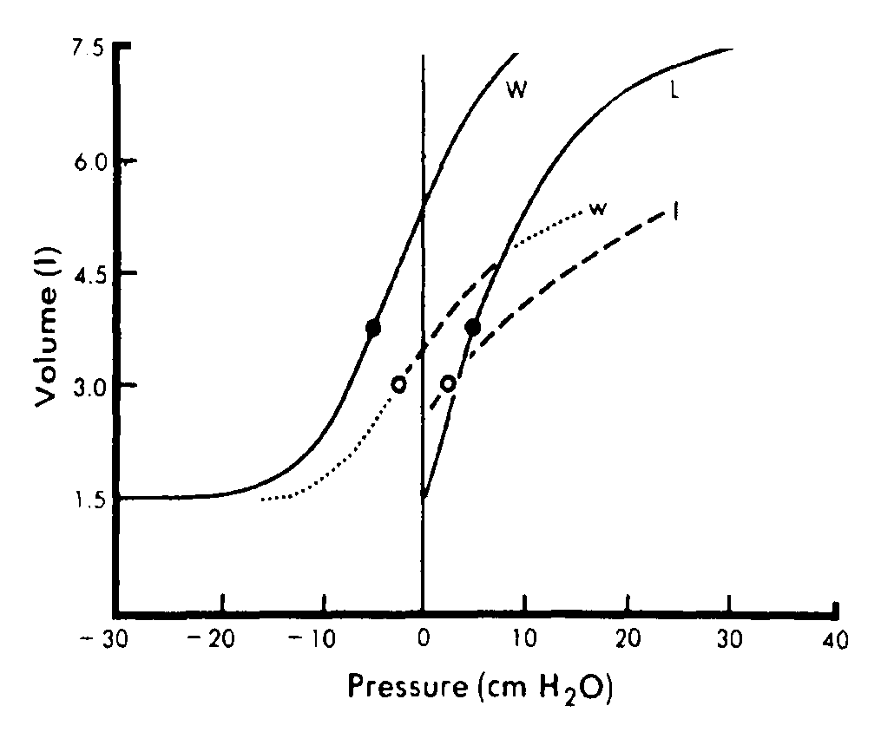
NEUROMUSCOLARI
De Troyer A Thorax 1980;35:603-10
De Troyer A The Thorax 1995:2177-211
Pmus = P0 + R V’ + E VT

Slide 35
Restrizione di pompa

Slide 36
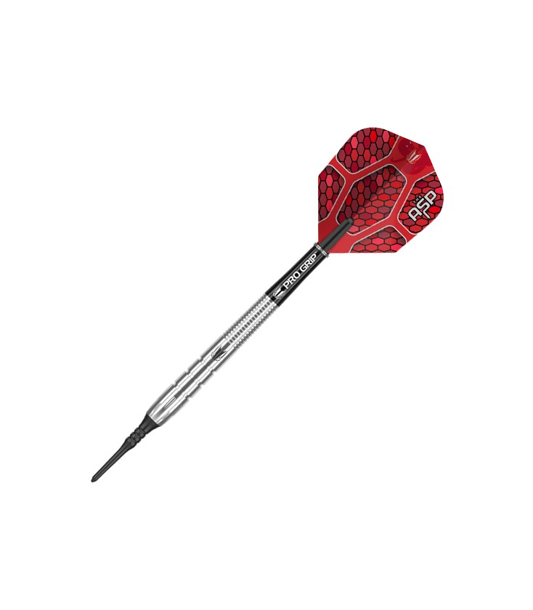

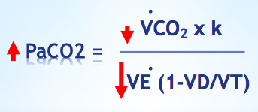
EQUAZIONE DI MOTO
NEUROMUSCOLARI
Papp.rs = Pmus = P0 + R V’ + E VT
VT
⬆Est,rs
FRC
➔ 5-6 ml/Kgr (4 tracheo)
➔ PCV, ⬆ΔP (5-10)
➔ ⬆PEEP/EPAP
PaCO2 60

Slide 37
F/V ricordiamocela prima di ventilare il paziente!

Slide 38
Piu volti (comorbidità)!

