Slide 1
I tracciati di ventilazione: una fonte sottoutilizzata di informazioni
Guido Polese
CEMS Verona

Slide 2
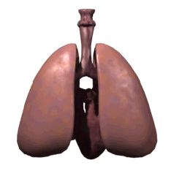
Respiratory cycle
http://www.lionden.com
Notes:
Permission to use this slide (a matter of academic integrity)
*If you are Kevin Patton's current student, you may use any slide for your own personal educational purpose.
**If you are a student not currently in Kevin's courses, you may use any slide for your own personal educational purpose and are also encouraged to feed the lions at http://www.lionden.com/feed_the_lions.htm
***If you are a teacher you may use any slide for your own nonprofit educational purpose and are also expected to feed the lions for each use of a slide. http://www.lionden.com/feed_the_lions.htm
****Commercial use is available only with Kevin's express written permission.
© KPatton@lionden.com . All rights reserved. DO NOT REMOVE THIS COPYRIGHT NOTICE LINE. Feedback, suggestions, corrections are most welcome!

Slide 3
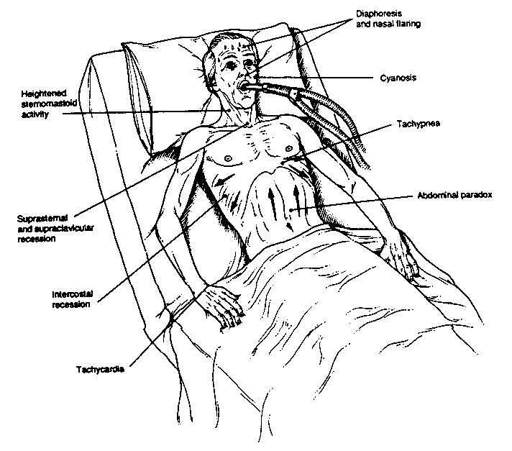
PO2
PCO2
pH
MUSCOLI RESPIRATORI
VE, VT, F
ADATTAMENTO
Notes:
ANDREA

Slide 4
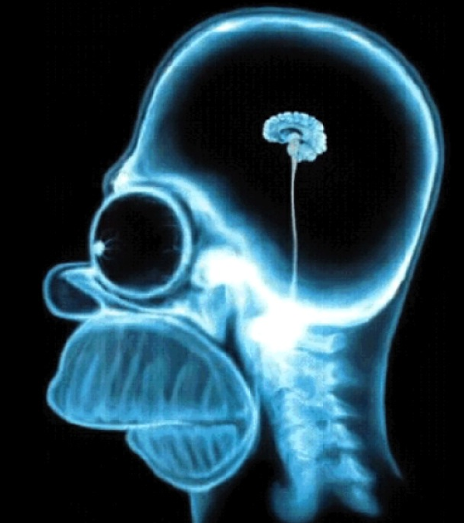
Cosa ci racconta
il PROFILO VENTILATORIO
Centri respiratori
⇓
Muscoli respiratori
⇓
Movimento gabbia toracica
(carico meccanico)
⇓
Ventilazione polmonare ⇒ Ventilazione alveolare
⇓
Esigenze metaboliche
VO₂
VCO₂
Può fare
PROFILO VENTILATORIO = STRATEGIA
Deve fare

Slide 5
Paziente e Meccanica

Slide 6
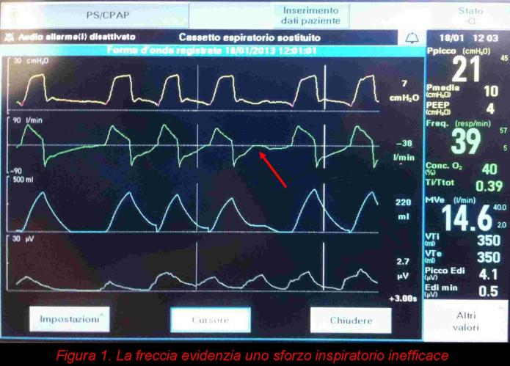

Slide 7
1 SACL

Slide 8
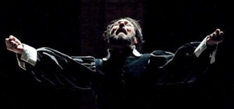
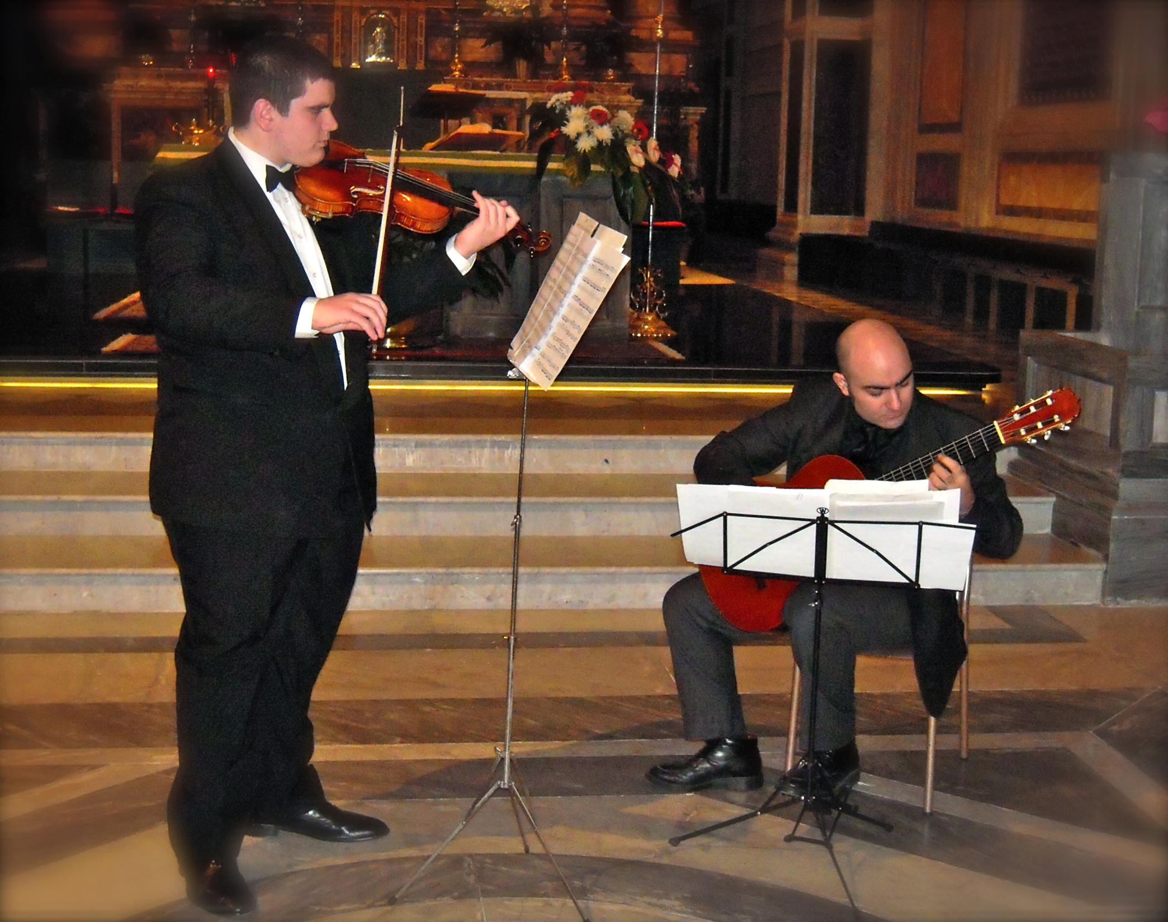
l'ESECUZIONE !
BPCO IRC IRC POLMONITE OBESITA' CIFOSI SCOPENSO IPTS POLMONARE ANSIA/DEPRESSIONE
… - - - …
Medico!!!
Ingegneri
Paziente- meccanica

Slide 9
…. l'esecuzione dell'Orchestra!
tracciato …….
Notes:
OBESO BPCO OSAS

Slide 10
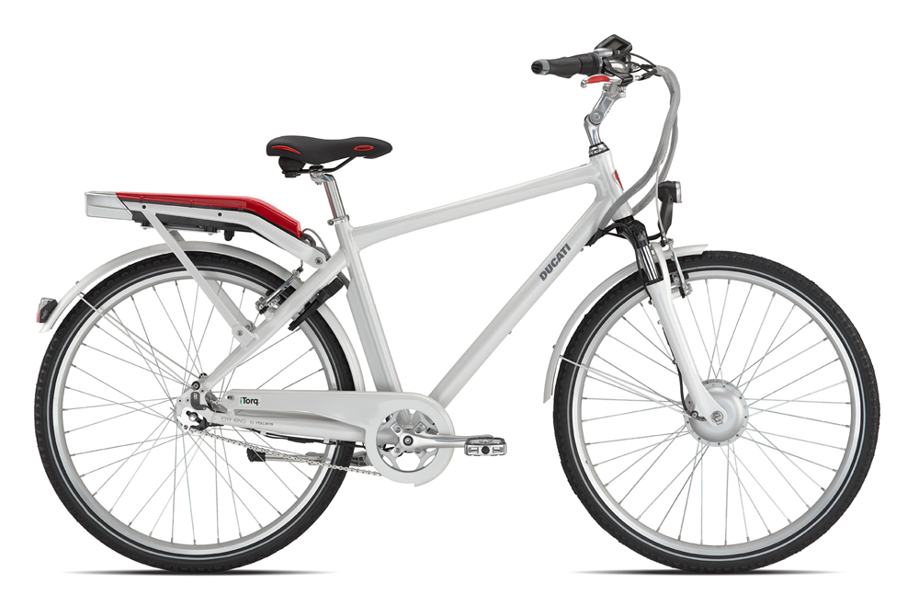
VM assistita = bicicletta elettrica
(pedalata assistita)

Slide 11
How do ABG improve ?
⇓ inspiratory effort
⇓ load imposed by
spontaneous ventilation
Vt and ⇓ (Vd/Vt) ⇒ ⇑ V’a
⇓ V’CO ₂


PaC0_{2 K}VCO₂
Va
⇓ PaC0₂
+ACUTO o NMD
+CRONICO
⇓ inspiratory effort
⇓ V’0₂
⇑ Vt ⇒ ⇑ V’a/Q’


⇑ Pa0₂
from P. Navalesi e C. Gregoretti

Slide 12
Curiosi, senza preconcetti, "ignoranti", attenti

Slide 13
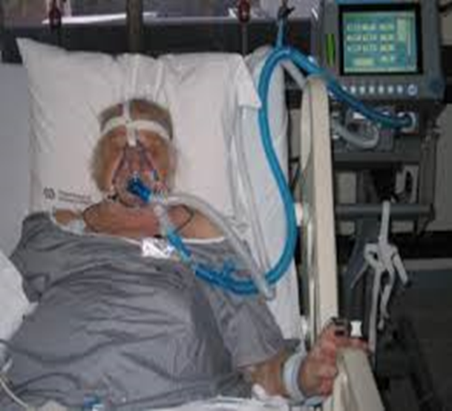
Ventilator waveforms provide real-time information about patient-ventilator interaction and ventilator function
Find the difference !
…. in ascolto 🦻
…. in "ascolto" 🙌
….in "ascolto" 👁️

Slide 14
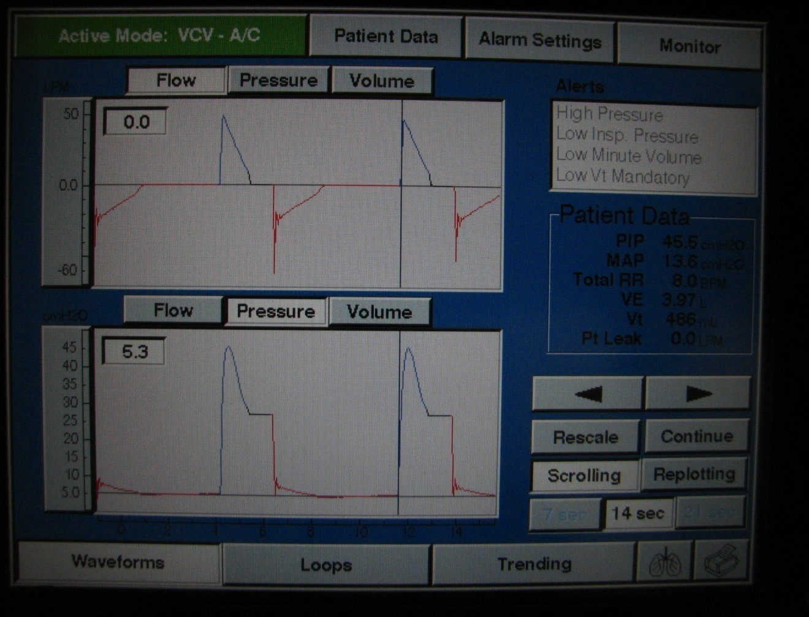
Types of Ventilator Waveforms: Scalars and Loops
ATS: Lyer V & Holets S
Scalars are waveform representations of pressure, flow or volume on the y axis vs time on the x axis
Flow vs time
scalar
Inspiratory
arm
Expiratory
arm
Pressure vs time
scalar
Volume vs time
scalar

Slide 15
Tracciato ventilatore

Slide 16
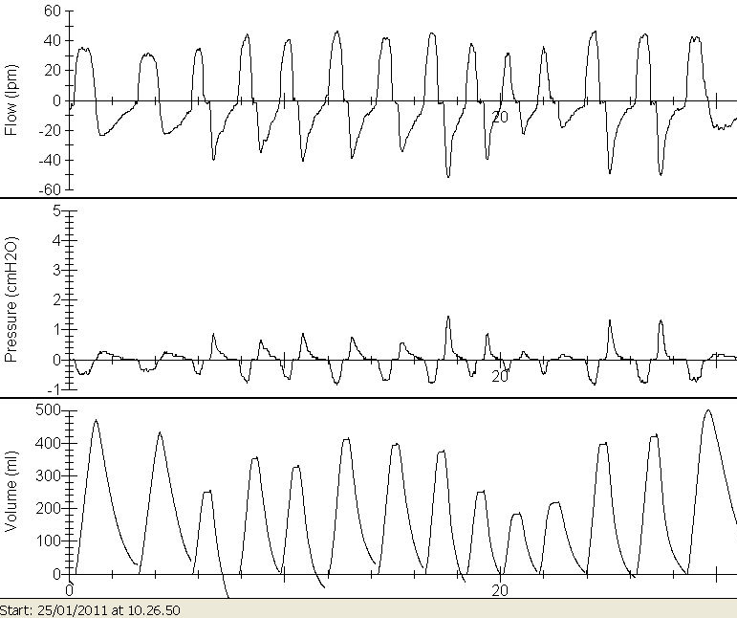
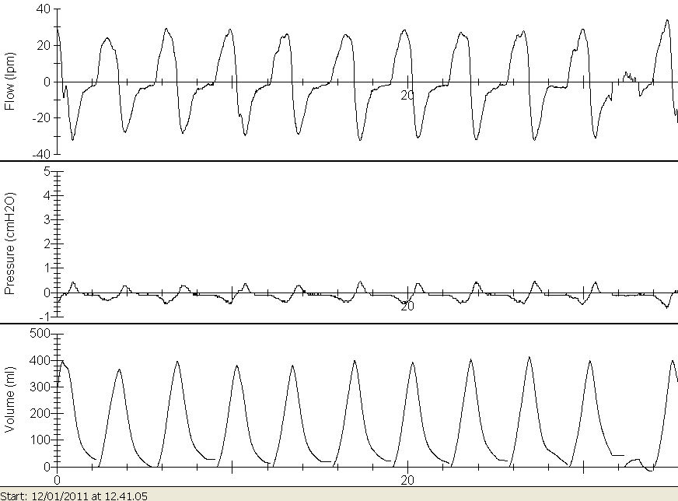
Profilo ventilatorio
40 Kgr. …. 100 Kgr. ….. IBW

Slide 17
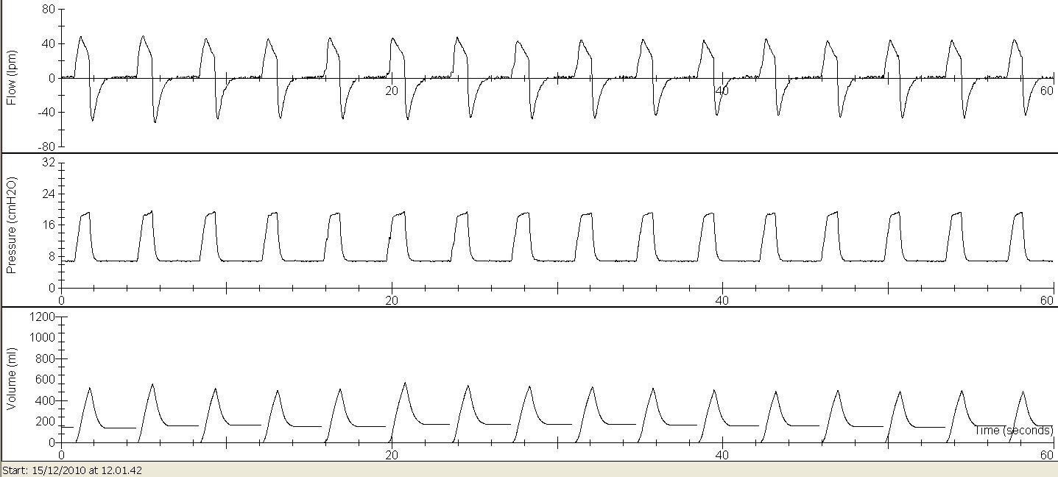
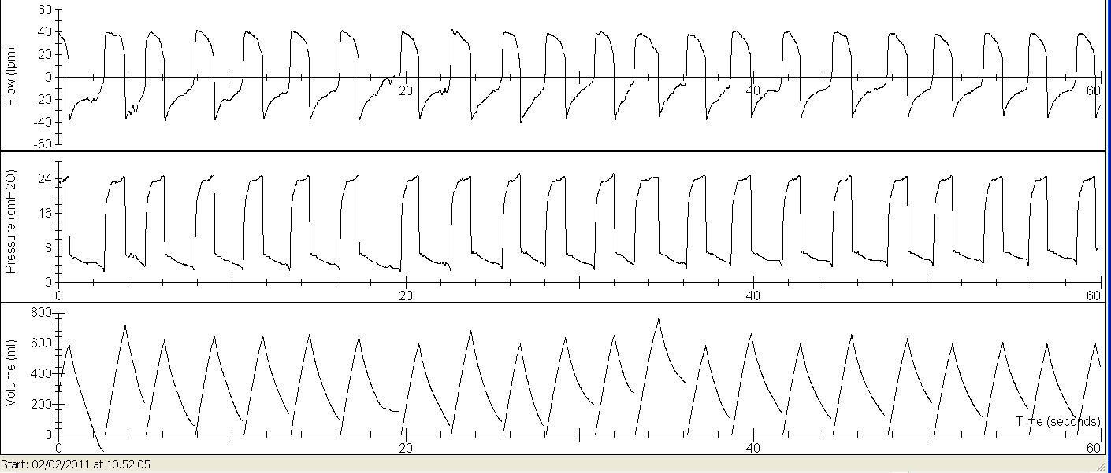

Slide 18
PSV “CONTROLLATA”

Slide 19
PSV “SINCRONIZZATA”

Slide 20
Airway pressure during PSV
A: inspiratory pressure trigger
B: rise of pressure provided by the initial flow into the airway
C: plateau of pressure support
D: end of pressure delivery

Slide 21
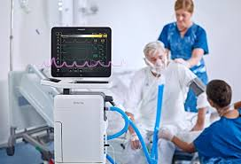
Patient-ventilator asynchronies (PVA)

Slide 22
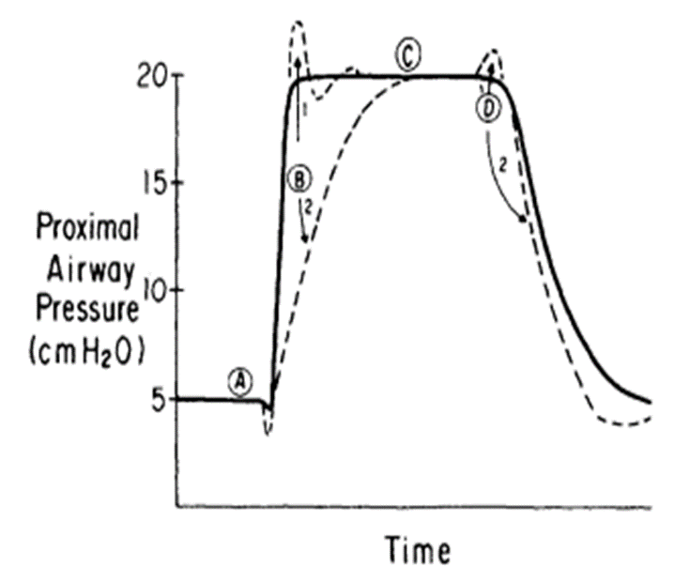
TRIGGERS

Slide 23
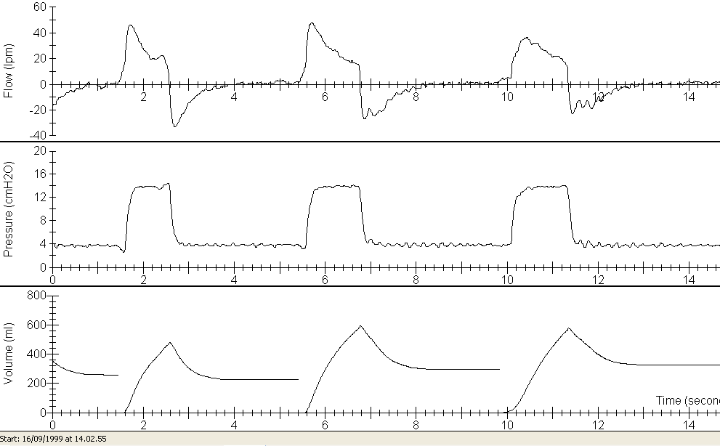
PSV

Slide 24
Auto-triggering
Cycle delivered by the ventilator without a prior airway pressure decrease, indicating that the ventilator delivered a breath that was not triggered by the patient
Can be due to airleaks, or to an excessively high trigger sensitivity.
Moreover, changes in airway pressure and/or flow secondary to cardiac oscillations or water accumulation in ventilator tubing can erroneously be sensed as triggering efforts

Slide 25
PSV
5 sec c.a

Slide 27
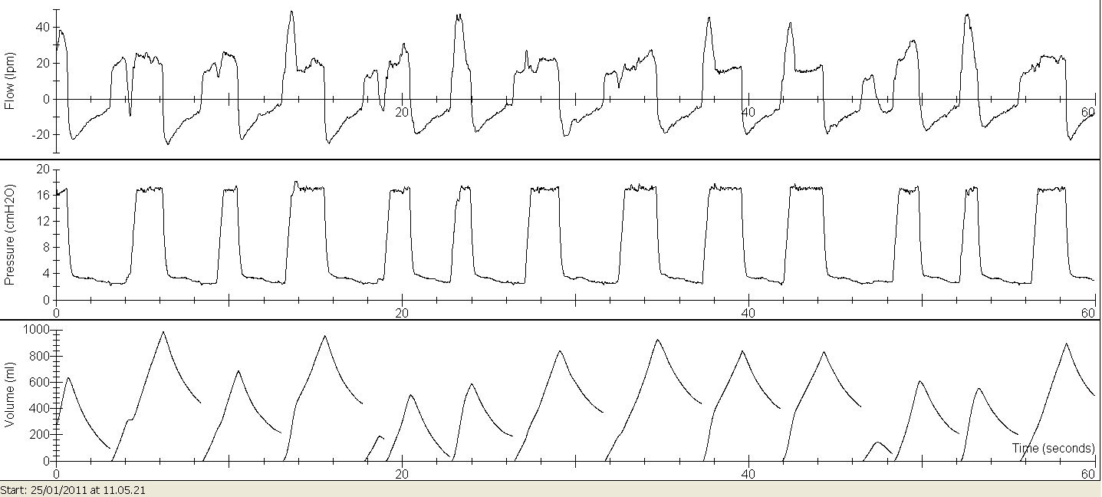
PSV “ASINCRONIA”

Slide 29
Ineffective efforts
Most frequent
Inspiratory effort not followed by a ventilator breath
Auto-PEEP common cause

Slide 30
Auto PEEP is an important impediment to the reachement of the set inspiratory threshold
Patient’s effort has to overcome auto-PEEP before pressure change
This effort is greater than the effort of triggering the ventilator

Slide 31
VF ?

Slide 32
AVOID INFFECTIVE EFFORT OR NOT that is the question

Slide 33
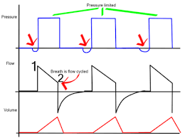
Presure support ventilation
Pressure rises to the set level of support and is maintained all along the inspiratory phase, but the ventilator is triggered by the patient
Volume and flow depend on pressure support setting, patient’s inspiratory effort and inspiratory time, airway resistance and lung+chest wall compliance

Slide 34
1
Flow (L/s)
0
-1
20
Paw (cm H₂O)
0
20
Pdi (cm H₂O)
0
0.09 s

Slide 35
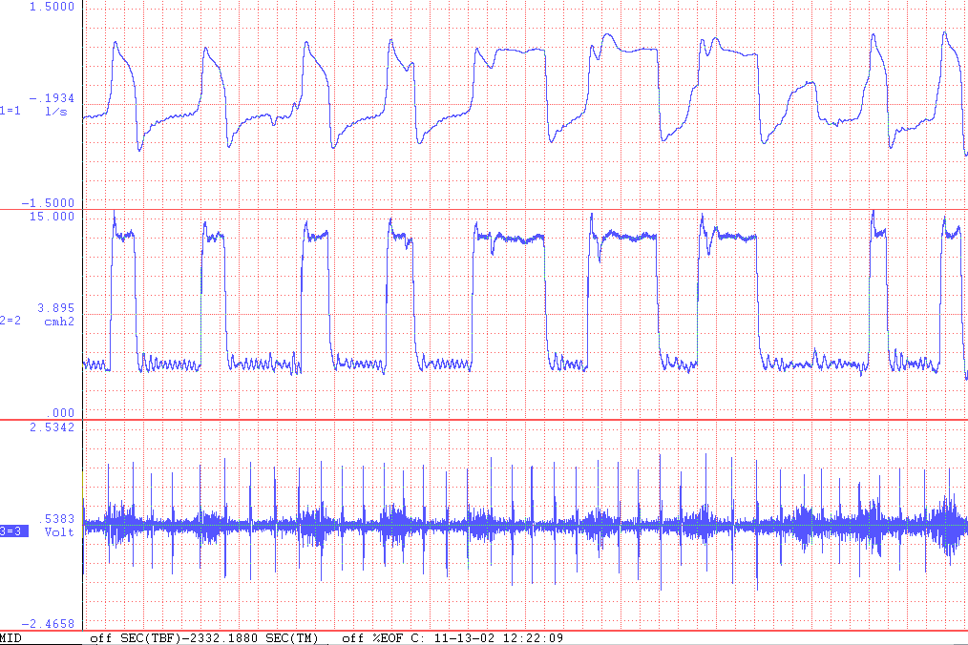
PSV

Slide 36
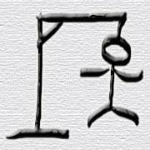
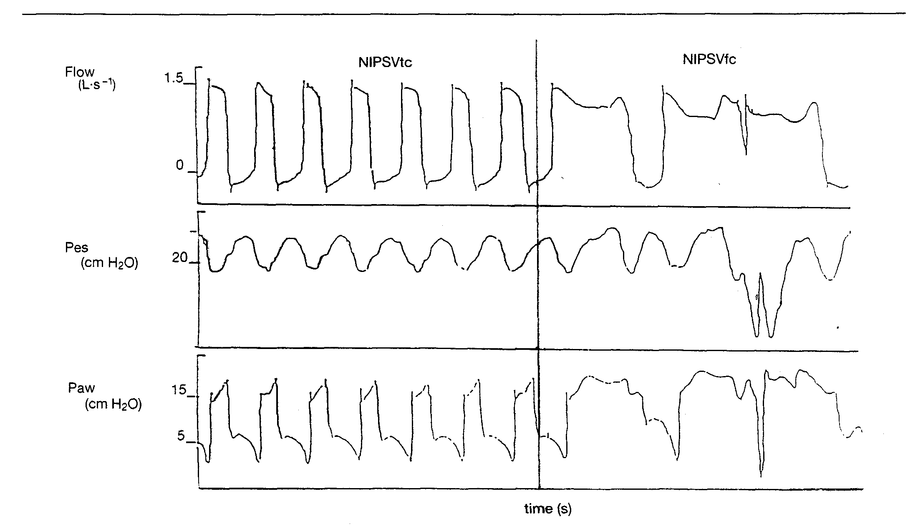
Hang Up
Calderini E Int Care Med 1999;25:662-7

Slide 37
Delayed cycling
Ventilator inspiratory time exceeds the patients neural inspiratory time, an asynchrony known as late, prolonged or delayed cycling occurs
Most frequent causes are an inappropriate timing in cycling setting and airleaks
Chronic obstructive pulmonary disease (COPD) and asthma are risk factors for delayed cycling

Slide 39
Premature cycling
The neural time is greater than the ventilator’s inspiratory time
Is more frequent in patients with low compliance or in case of inspiratory time set too short

Slide 40
Duble triggering
The patient’s effort exceeds the trigger threshold, it can activate another breath, generating a double-triggering
It can be detected by an expiratory flow waveform that start with a peak, but it returns rapidly to a level near to 0 (baseline)
Two consecutive ventilator cycles (triggered by the patient) separated by an expiratory time lower than one-half of the mean inspiratory time

Slide 41
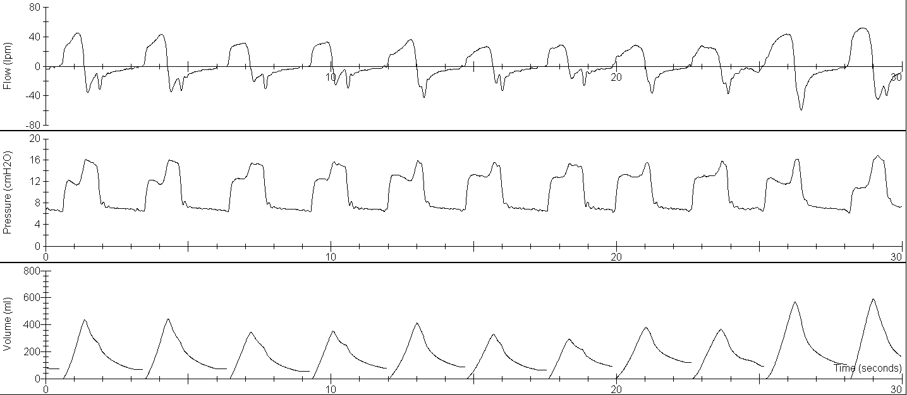
BR GA
PCV S/T IPAP 16 EPAP 8 FR 12 TI 1.2

Slide 42
PSV “ASINCRONIA”

Slide 44
Airway pressure during PSV
A: inspiratory pressure trigger
B: rise of pressure provided by the initial flow into the airway
C: plateau of pressure support
D: end of pressure delivery

Slide 45
PSV

Slide 46
Inspiration
Flow
0
Expiration
IPAP
Pressure
PS
EPAP
0
Inspiration
Expiration
Rise time
From ERS Jean-Paul Janssens

Slide 47
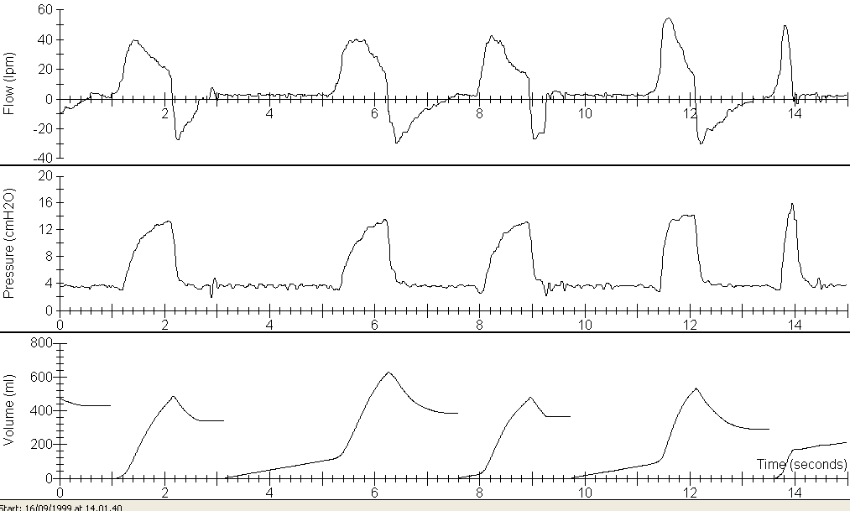
PSV “PERDITE”

Slide 48
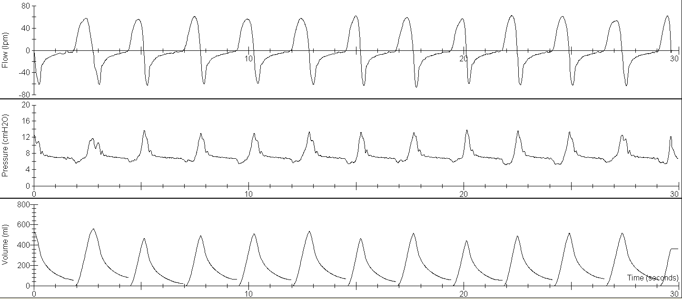
BR GA
PSV S/T AVAPS VT 400 IPAP 14-18 EPAP 8 FR 12 Ti 1.2
Rise Time 4
Rise Time 1

Slide 49
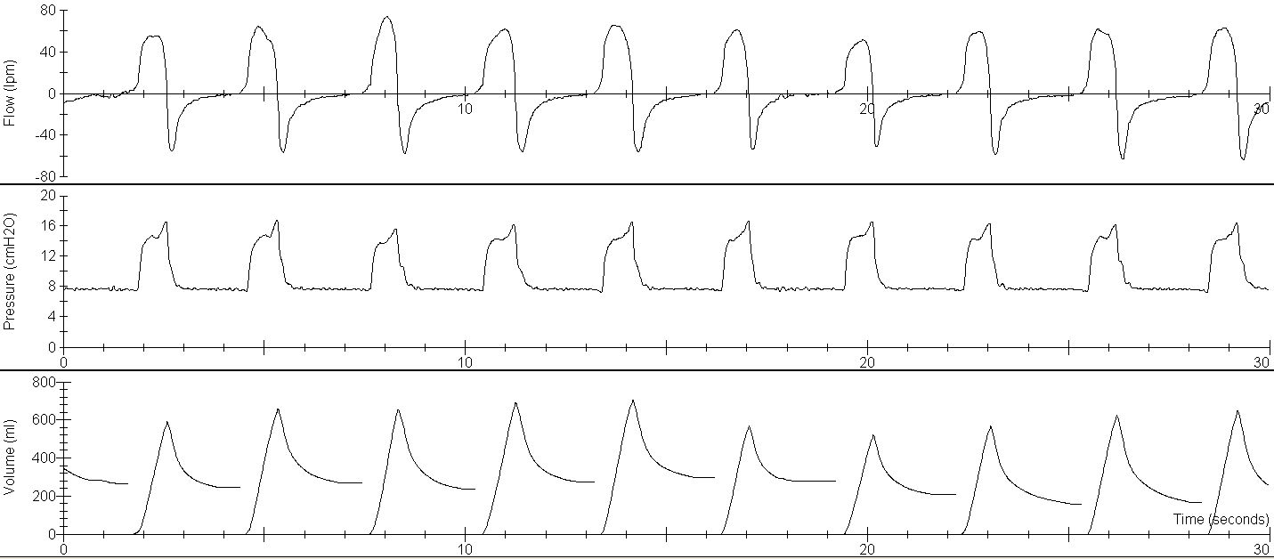
BR GA
PSV S/T AVAPS VT 400 IPAP 14-18 EPAP 8 FR 12 Ti 1.2 TOLTO FILTRO

Slide 50
A fast rise time is associated with high flow at the onset of inspiration
A slow rise time is associated with a lower flow at the onset of inspiration

Slide 51
Bonmarchand et al
LOWEST WOB WITH THE FASTEST RISE TIME

Slide 52
Recognizing Expiratory Flow Limitation (e.g. COPD, )
ASTHMA

Slide 53
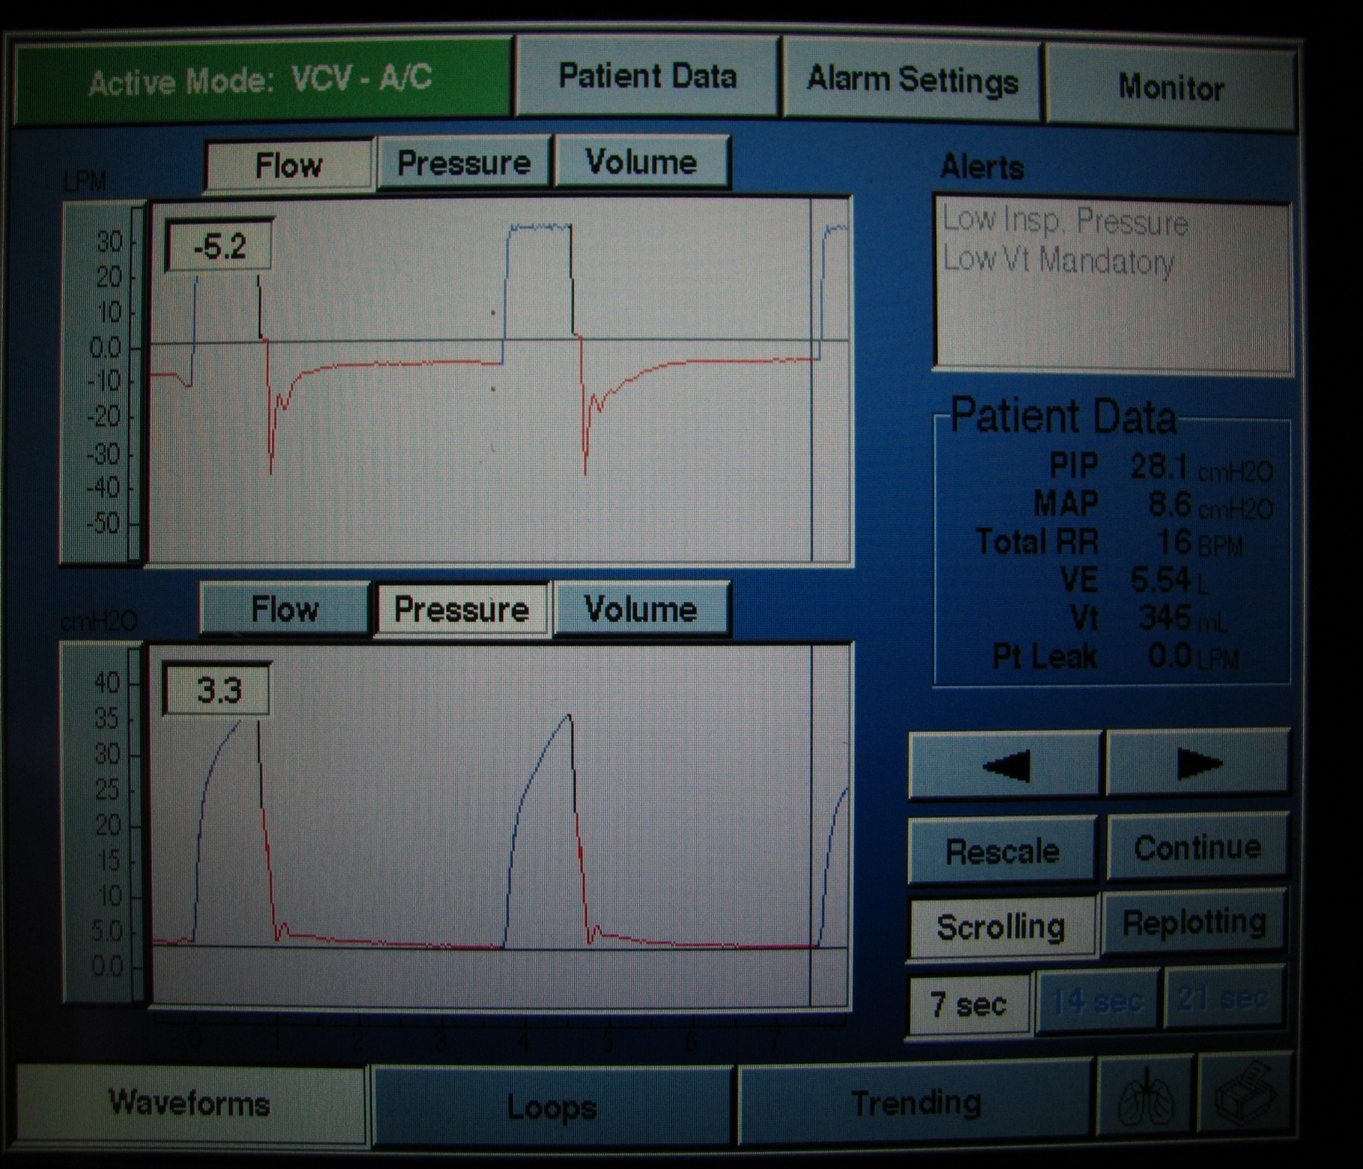
Recognizing prolonged expiration (air trapping)
Recognize
airway obstruction
when
Expiratory flow quickly tapers off
and then enters a prolonged
low-flow state without returning to
baseline (auto- PEEP)
This is classic for the flow
limitation and decreased lung
elastance characteristic of COPD
or status asthmaticus

Slide 54
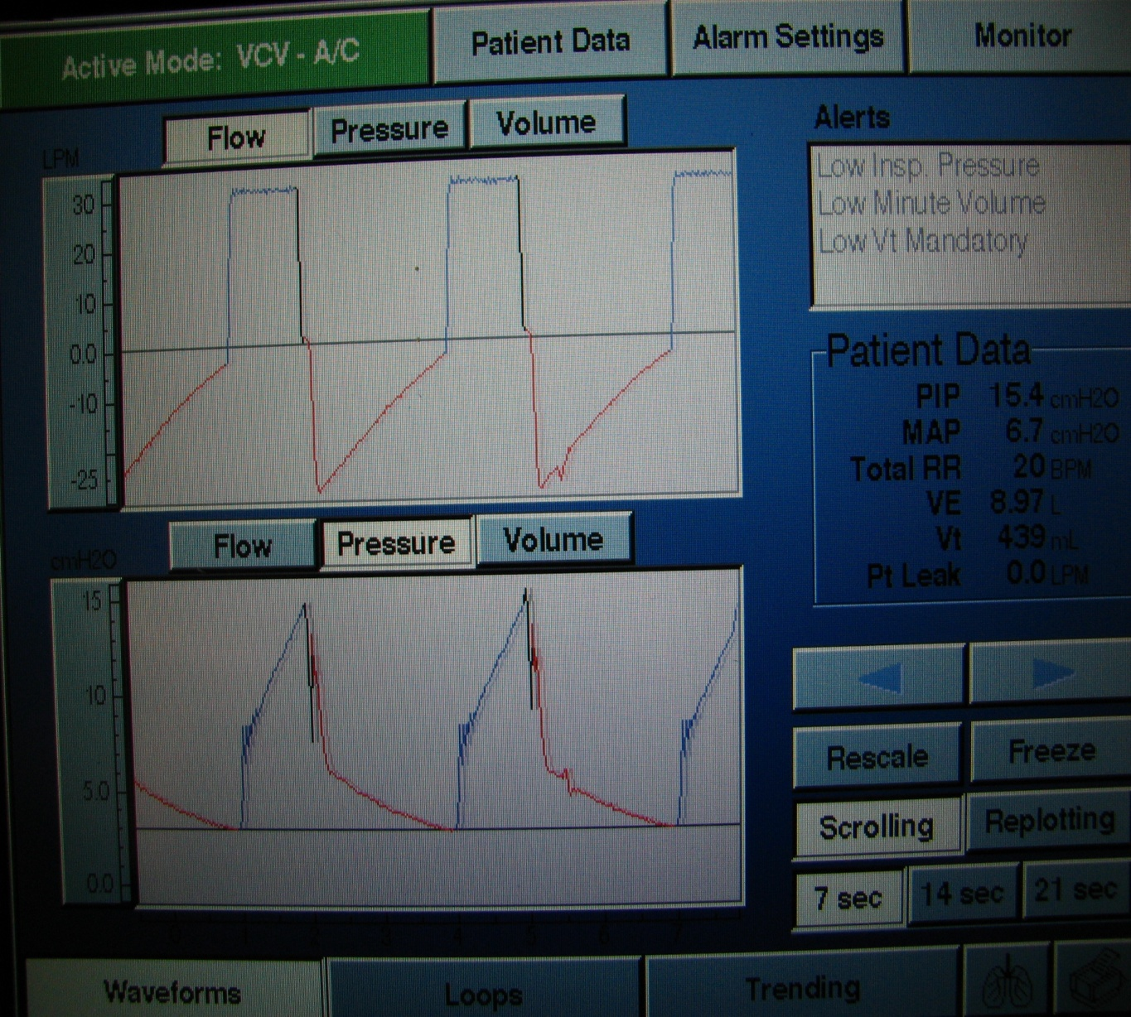
Detecting Auto-PEEP
Recognize
Auto-PEEP
when
Expiratory flow continues
and fails to return to
the baseline prior to the new
inspiratory cycle

Slide 55
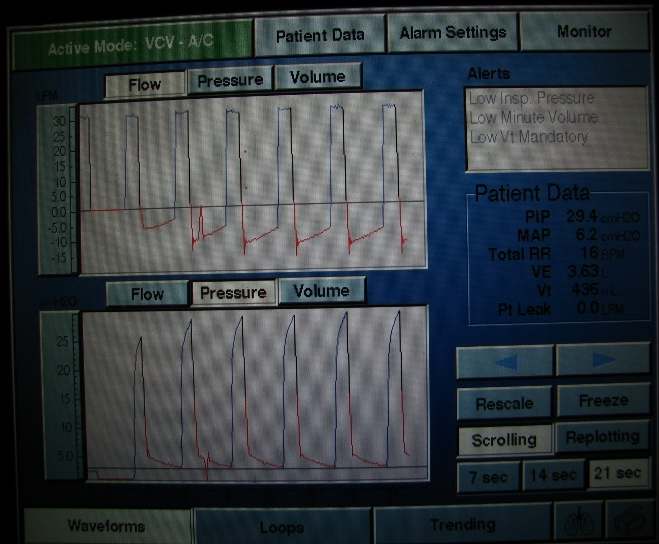
The development of auto- PEEP over several breaths in a simulation
Notice how the expiratory flow fails
to return to the baseline indicating
air trapping (AutoPEEP)
Also notice how air trapping causes
an increase in airway pressure
due to increasing end expiratory
pressure and end inspiratory
lung volume.
Notes:
55

Slide 56
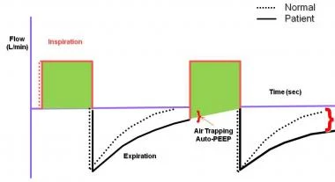
Auto-PEEP results in less positive or more negative mean intrathoracic pressure than does fully controlled mechanical ventilation

Slide 57
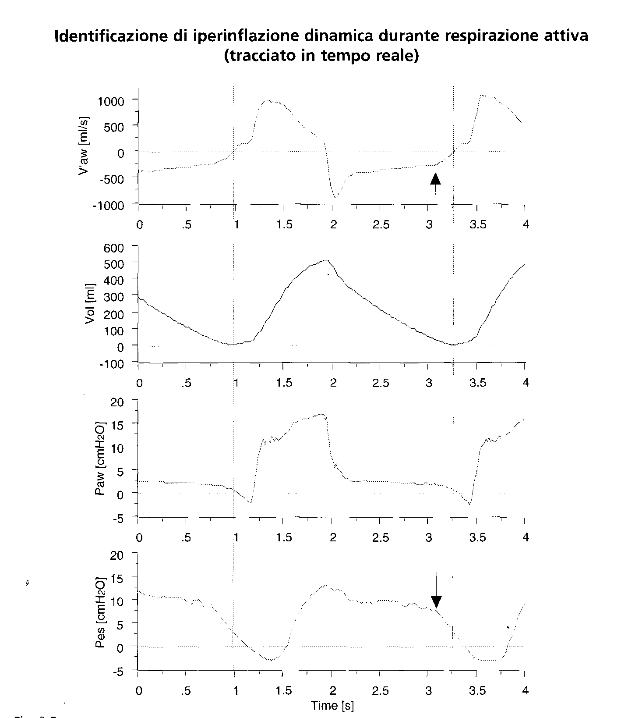
Dynamic
hyperinflation
Iotti GA Misure di meccanica respiratoria
durante ventilazione artificiale
Hamilton Medical

Slide 58
3A VAMI
PCO2 70
Notes:
OBESO BPCO OSAS

Slide 60
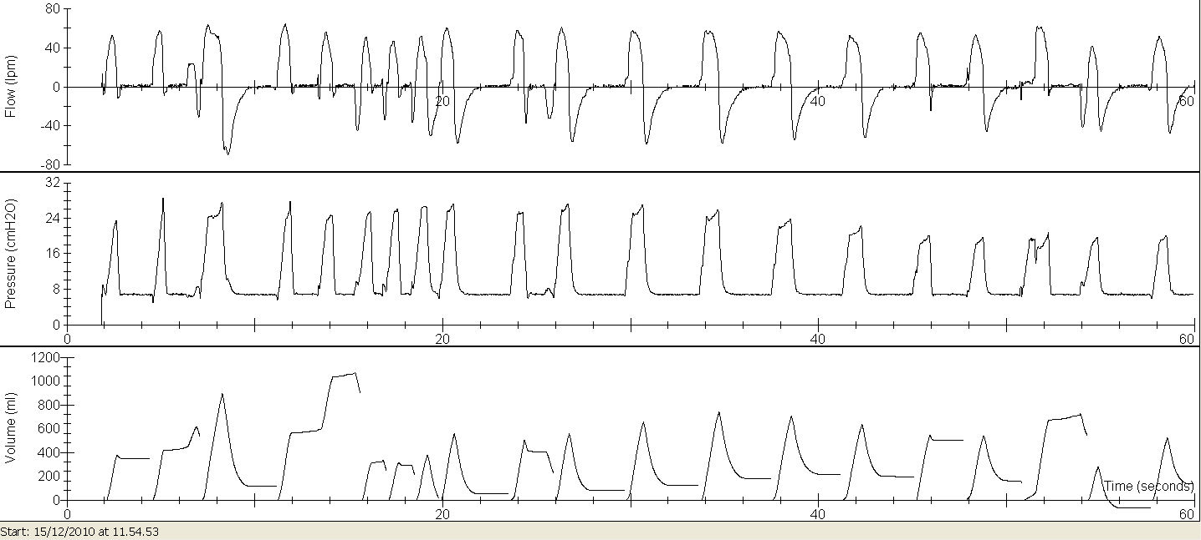
PSV “VTG”

Slide 61
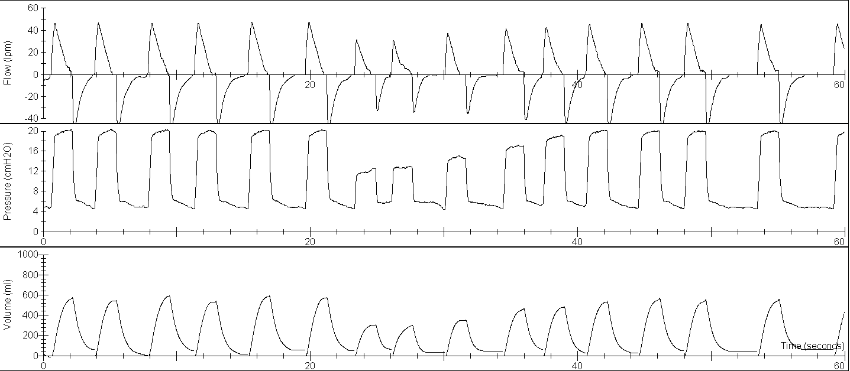
ZA FA ,
PCV S/T IPAP 12-20 EPAP 5 CURVA 1 FR 10 Ti/Tot 1:2 TRI1 VT 500 PMAX 20
Notes:
Zanella fabio

Slide 62
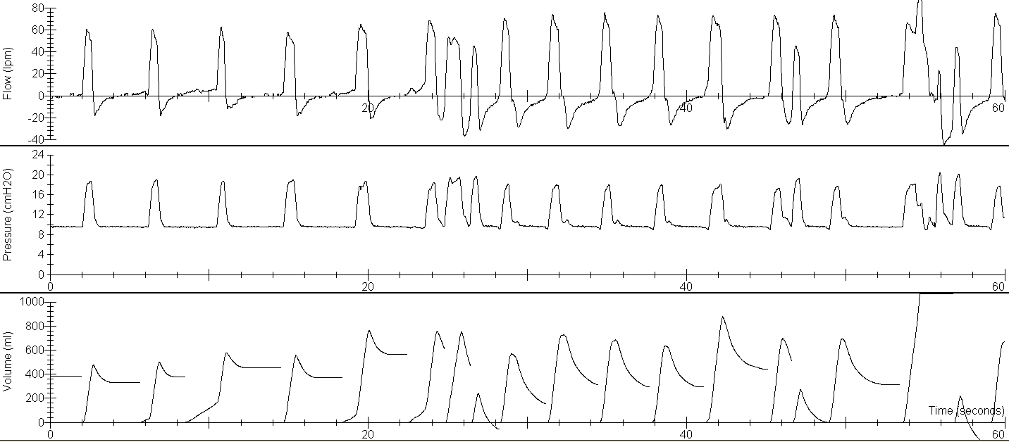
CA AQ
PSV ST IPAP 16-20 EPAP 10 curva 1 Fr 14 Tr. E Auto Tr. I 2 VT 450
Notes:
Cavazza acquilina

Slide 63
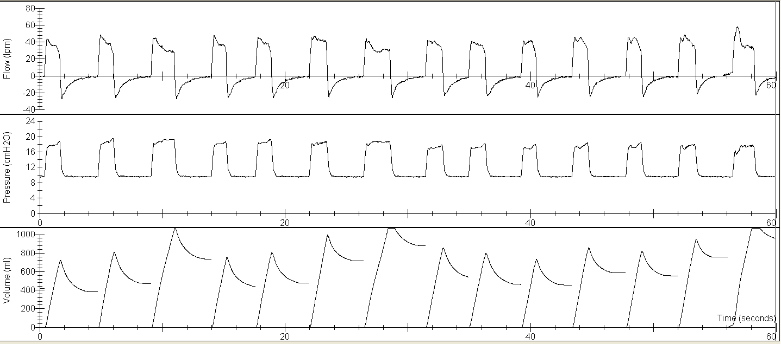
CA AQ
PCV ST ipap 16-20 epap 10 VT 450 TI 1.2 curva 1 Fr 14 Tr. E Auto Tr. I 2 VT 450

Slide 64
Il circolo virtuoso!!
Obiettivi
Verifica (tracciato)
Titolazione
Utilizzo

Slide 66
Non dimentichiamo !
Chi ha bene e va in cerca di meglio, trova il peggio.
Dal bene viene il meglio, e dal meglio il peggio.
Dopo un meglio, ne viene un peggio.
Il meglio è nemico del bene
Quando una cosa sta bene che basta, lasciala star perché si guasta
Se non può essere meglio, sia com'è.

Slide 67
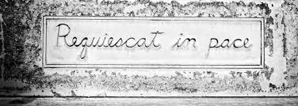
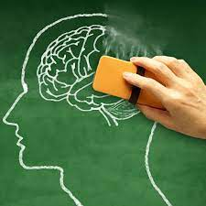
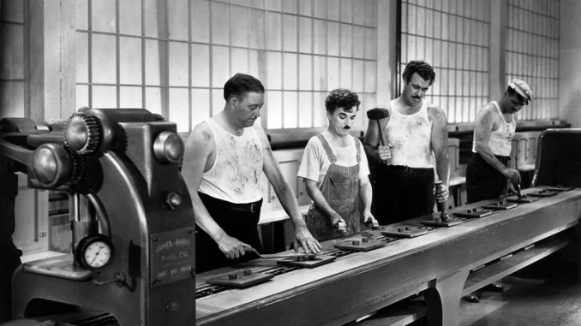
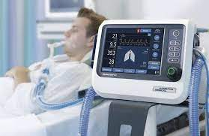
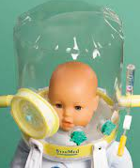
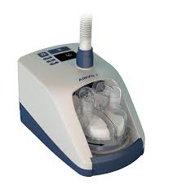
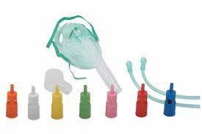
e poi venne il COVID ……
PSV

