Slide 1
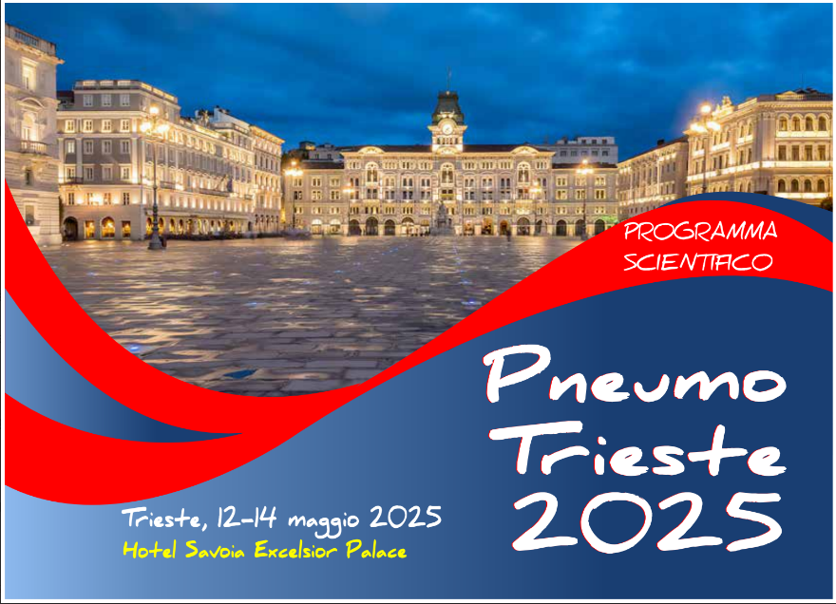
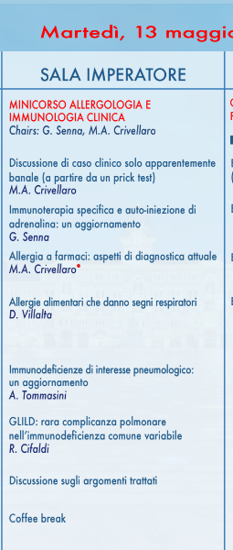

Allergia a farmaci:
aspetti di diagnostica Attuale.
Dr.ssa M.A.Crivellaro
Dipartimento Medicina dei Sistemi .
UOSD di Allergologia
Azienda Ospedale Università Padova
mariaangiola.crivellaro@unipd.it

Slide 2

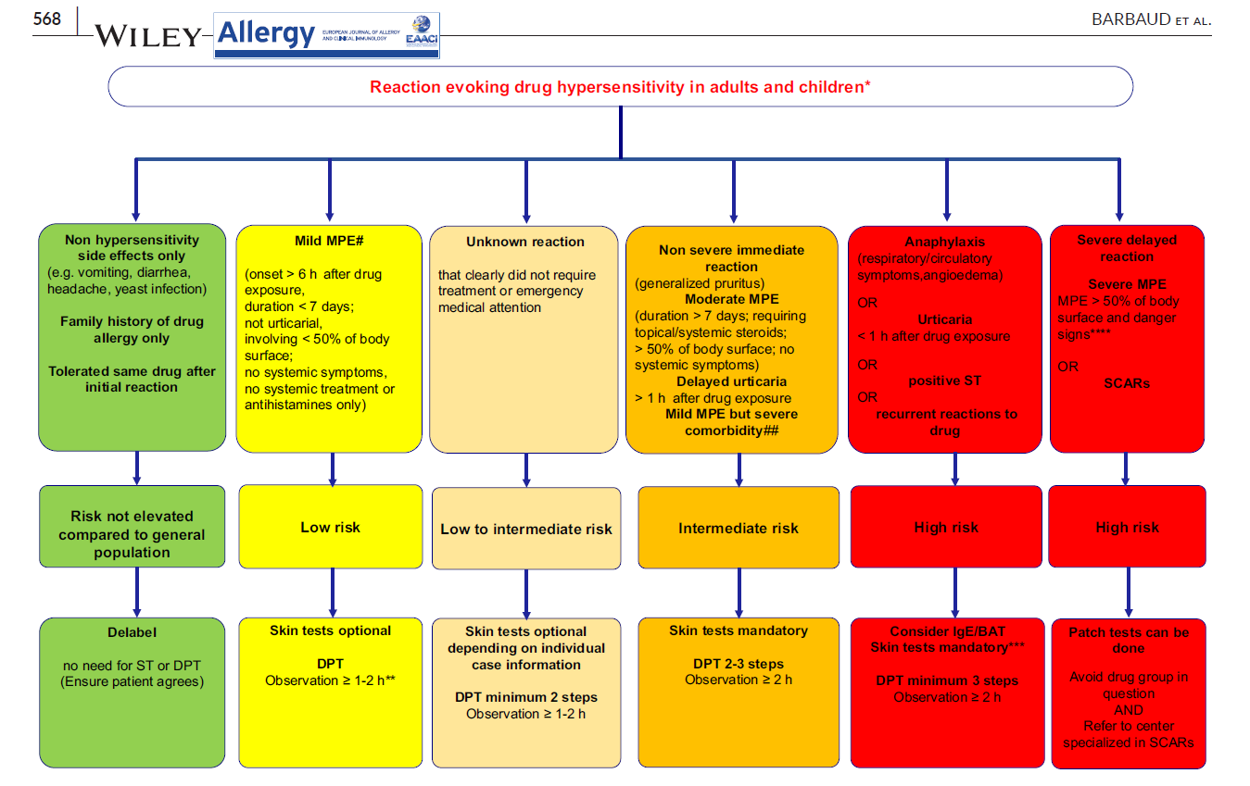
Algoritmo di stratificazione del rischio in base all’anamnesi , caratteristiche clinice e strategie di raccomandazione per l’iter diagnostico Test cutanei o Test di provocazione/Tolleranza)
2023
allergy

Slide 3


Adverse Drug Reactions (ADRs):
17%-25% in outpatient patients at primary care
Affect:
8%-10% of the general population
15 % in hospitalized patients
6.7% serious
0.32% fatality
Notes:
Partiamo dal dato epidemiologico
Adverse drug reactions (ADRs) affect more than 7% of the general population.
And Between 17% and 25% of outpatient patients at primary care centers reported ADRs. Tra il 17% e il 25% dei pazienti ambulatoriali dei centri di assistenza primaria hanno segnalato reazioni avverse.
Based on a recent meta-analysis, the overall incidence of ADRs in hospitalized patients was reported to be 15.1%.
Nearly one half of these reactions were serious.
These studies estimate that 6.7% of hospitalized patients have a serious adverse drug reaction with a fatality rate of 0.32%
The exact number of ADRs is not certain and is limited by methodological considerations.

Slide 4
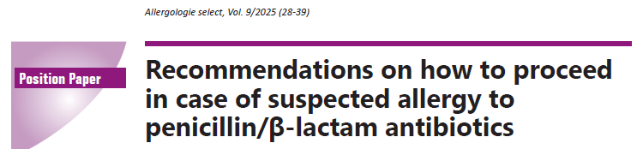
K. Brockow 2025
BLA are used very frequently, are most commonly drug Allergy
General population 5-10%
Hospedalized cases 10-25%
Mortality 0,0002%
However, only a small proportion of those with “penicillin allergy” label,
In over 90% of those who reported a penicillin allergy, allergy diagnostics, including provocation tests, were unable to prove it.
This means that ~ 1% of the population and 2% of inpatients suffer from BLA allergy
Severe anaphylaxis, have a high probability of a true BLA allergy based on their medical history.

Slide 5
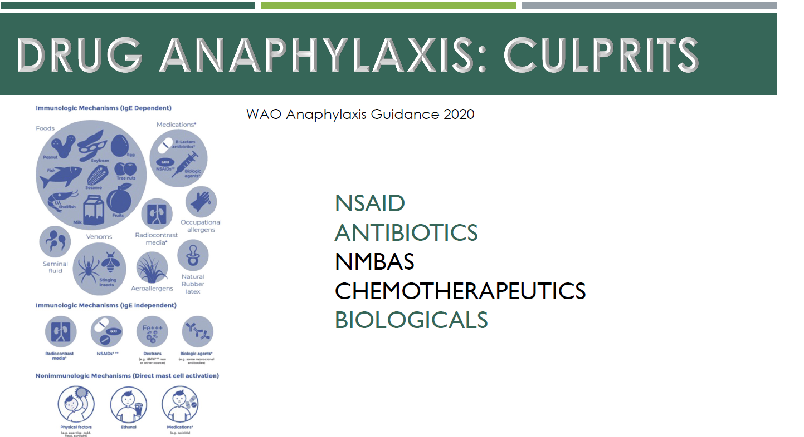
Notes:
E sulla base dei dati europei recenti i farmaci maggiormente segnalati come correlati ad anafilassi sono questi

Slide 6
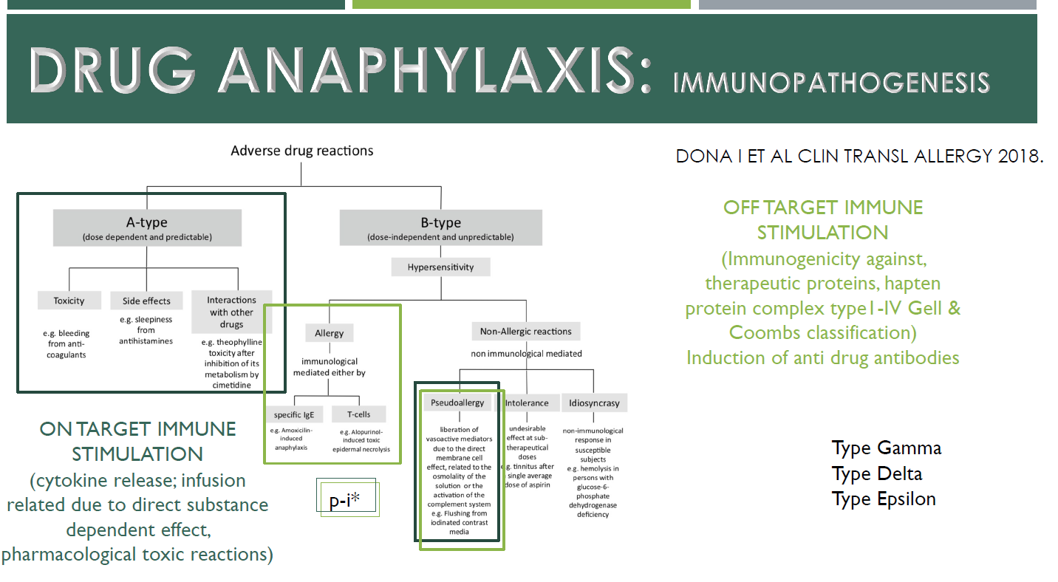
DRUG ALLERGY
80%
15%

Slide 7
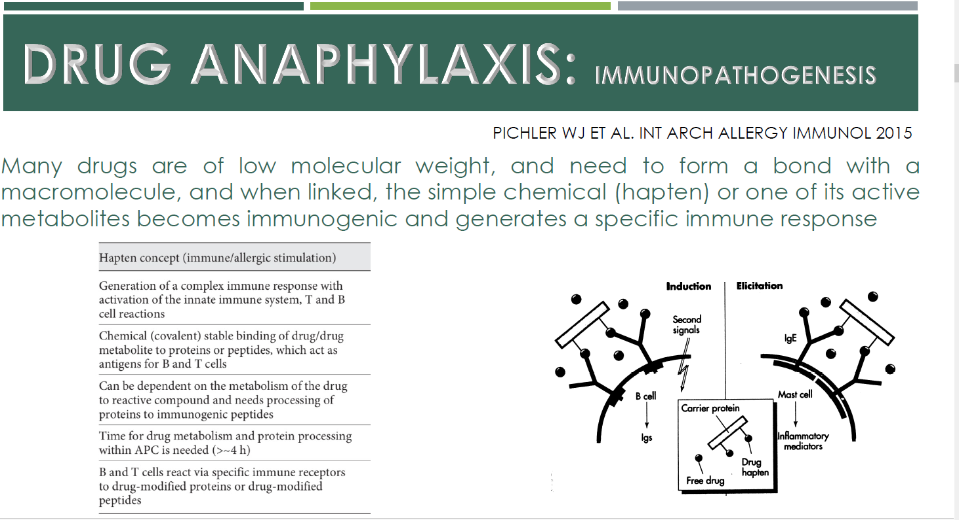
Notes:
la reazione allergica è legata ad una vera e propria reazione di I° grado in cui molecole a basso perso molecolare si legano ad apni dicìvenebdo imogeniocamente attivi generaldo un rispostta inmmunologica.

Slide 8
Pseudo allergy activity of the drug with receptors/enzyme MRGPRX2
Inhibition of cycloxygenase NSAID

Slide 9
MANIFESTAZIONI CLINICHE ADR
MANIFESTAZIONI CUTANEE:
Eruzioni esantematiche 46%
Orticaria/angioedema 23%
Dermatite da contatto 10-12%
Eruzioni fisse 10%
Dermatite esfoliativa 4%
Fotosensibilità 3%
Asma
Dispnea
Tosse
SINTOMI DI TIPO RESPIRATORIO:
ANAFILASSI

Slide 10
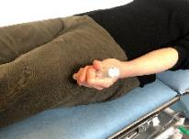
Anaphylaxis to COVID-19 vaccine
Anafilassi
VALUTARE : Airway, Breathing, Circulation, Disability, Exposure
Sintomi /segni
VIE RESPIRATORIE : disfagia, voce roca stridore, dispnea, tachipnea, respire sibilante , cianosi
CIRCOLAZIONE : tachicardia, ipotensione, vertiginid, stato confusionale , svenimento
CUTE / MUCOSE /GASTROINTESTINALE : prurito generalizzato, eritema, angioedema, vomito, , dolore addominale, diarrea
Sospettare anafilassi se :
Esordio acuto
Molto grave : problemi A, B,C
Sintomi cutanei / mucosi , gastrointestinali (non sempre presenti )
SOMMINISTRARE ADRENALINA I.M
Chiamare aiuto
Rimuovere possible fattore scatenante
Ottimizzare la postura in base ai sintomi
Prevalenti respiratori : posizione semi seduta con gambe elevate
Prevalenti cardiovasculari –posizione distesa con gambe elevate
Muraro A et al , EAACI Guidelines on Anaphylaxis Allergy 2021

Slide 11
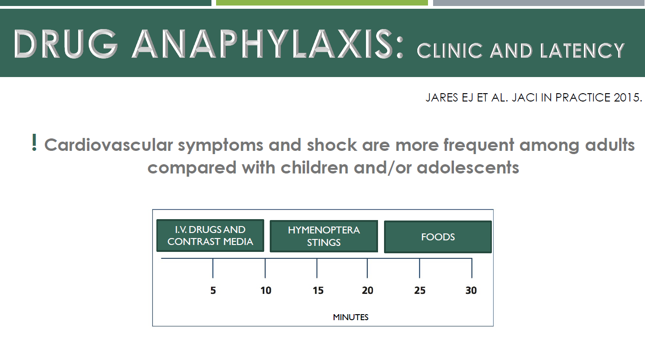
Notes:
……rapida

Slide 12
IgE- MEDIATE ( o mast- cellule)
Reazioni immediate
(≤1 h)
Non immediate
Ritardate
(> 6h)
Orticaria, angioedema, asma,
shock anafilattico, emolisi
Orticaria-angioedema tardivi
MECCANISMO
CELLULO – MEDIATO
Epidermolisi tossica
Lyell
Stevens-Johnsons
Eritema fisso (FDE)
Dermatite da contatto

Slide 13

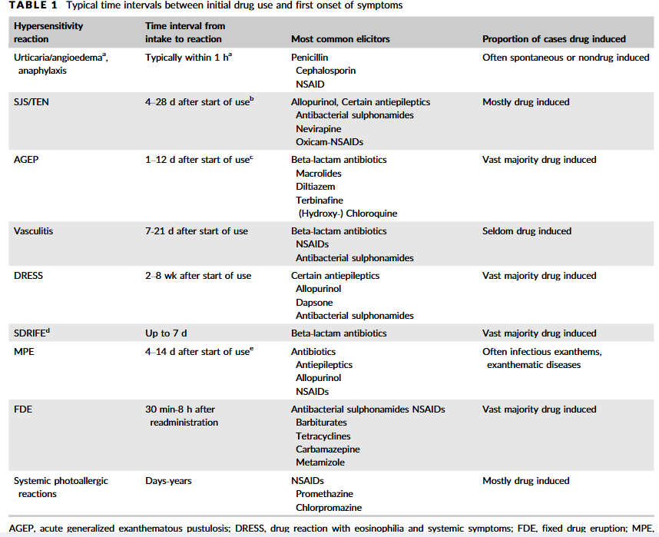
K. Brockow
2018
Pustolosi Acuta Generalizzata
Esantematica

Slide 14
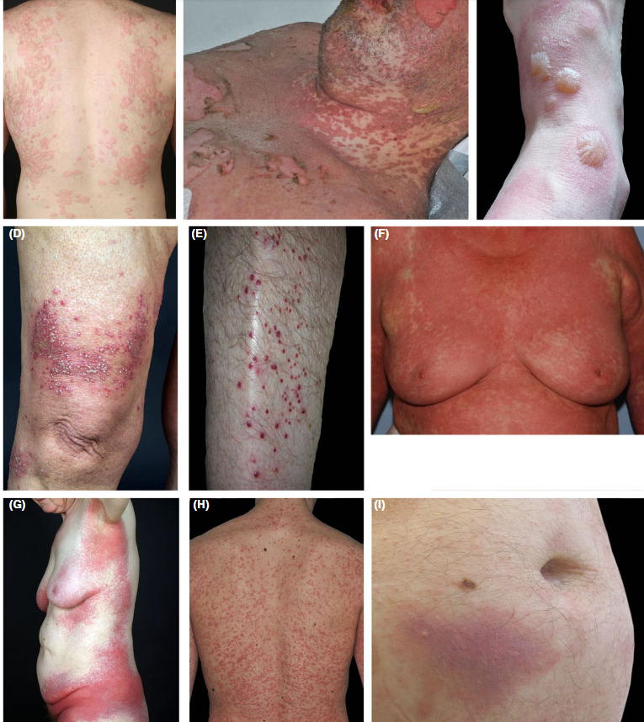
K. Brockow
2018
Quadri clinici di reazioni cutanee di ipersensibilità ai farmaci.
A: Orticaria con pomfi persistenti solo per <24 ore,
B: Stevens-Sindrome di Johnson con erosioni e croste mucose nonché lesioni atipiche a bersaglio e macule con bolle confluenti eerosioni,
C: eruzione cutanea fissa bollosa generalizzata con bolle centrali su eritema violaceo nettamente delimitato,
D: eruzione cutanea acuta generalizzata pustolosi esantematica con pustole superficiali su eritemi,
E: Vasculite con porpora palpabile,
F. reazione al farmaco con eosinofilia e sintomi sistemici con lesioni eritematose infiltrate diffuse,
G: Farmaco simmetrico-esantema intertriginoso e flessurale correlato condistribuzione intertriginosa,
H: Esantema maculopapulare con macule e papule diffuse in eruzione e
I: Iniezione-reazione del sito con placca violacea indurita dopo iniezione sottocutanea di un farmaco.
Notes:
Queste sono le manifestazioni cliniche ma, vediamole mnel dettaglio

Slide 15
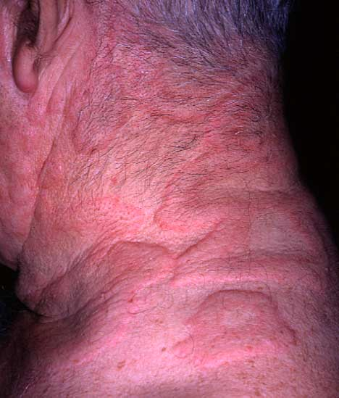
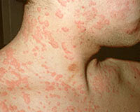
Anaphylaxis to COVID-19 vaccine
Orticaria
Penicilline
Cefalosporine
Sulfamidici
FANS
Miorilassanti

Slide 16

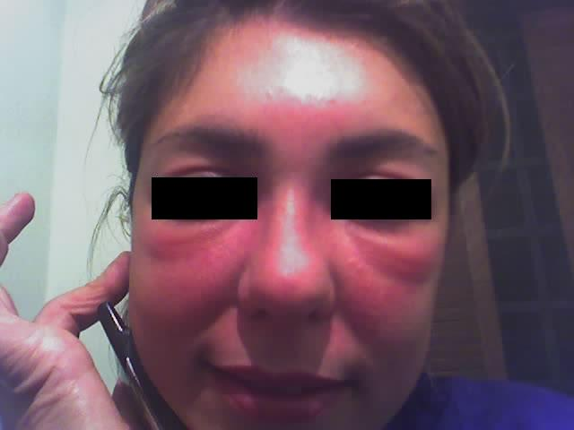
Angioedema/Edema della glottide
ACE- inibitori !!!!
Antibiotici
FANS
MDC
Anestetici Generali (e Locali ????)

Slide 17
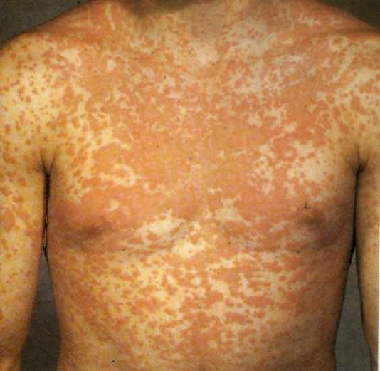
Reazioni esantematiche
Penicilline
Pirazolinici
Sulfamidici
Carbamezepina
Allopurinolo
Administration of AMPICILLIN and AMOXICILLIN is associated with the developement of morbilliform rashes in 5 - 10% of patients.
These patients are not a risk of a life threatening reaction to penicillin.
If patients with Epstein-Barr infections are given ampicillin or amoxicillina almost 100% will develope a non-pruritic rash.

Slide 18
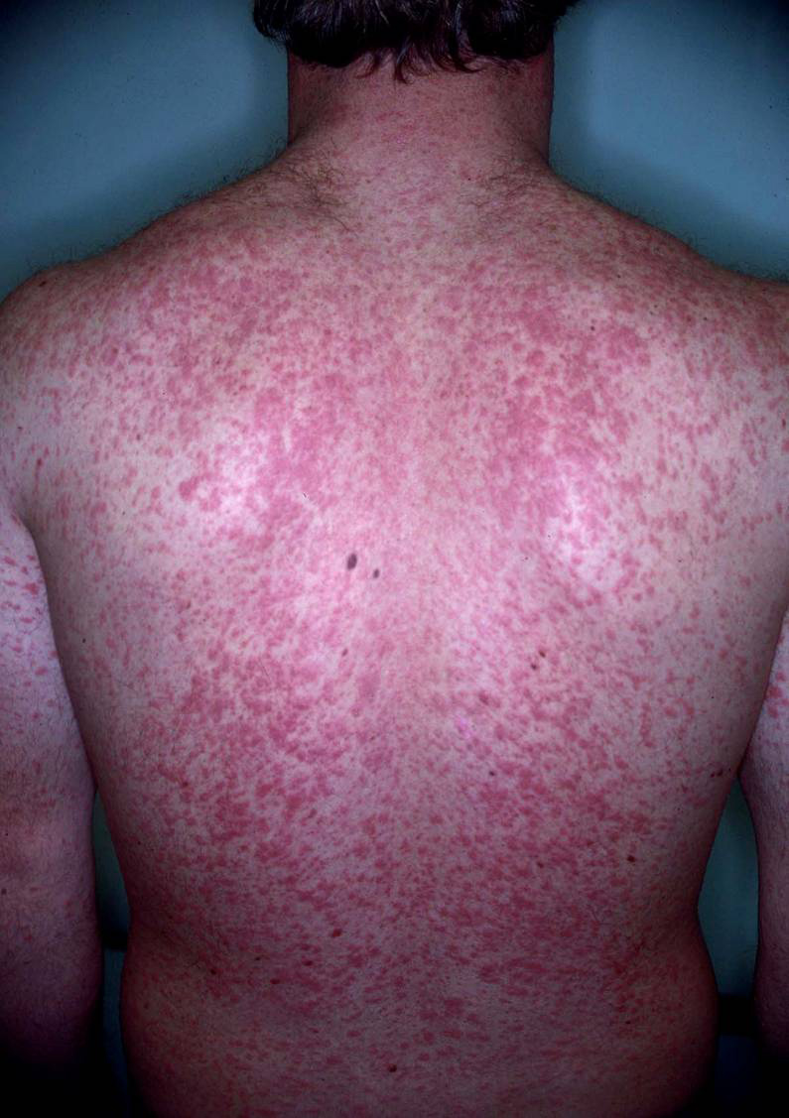
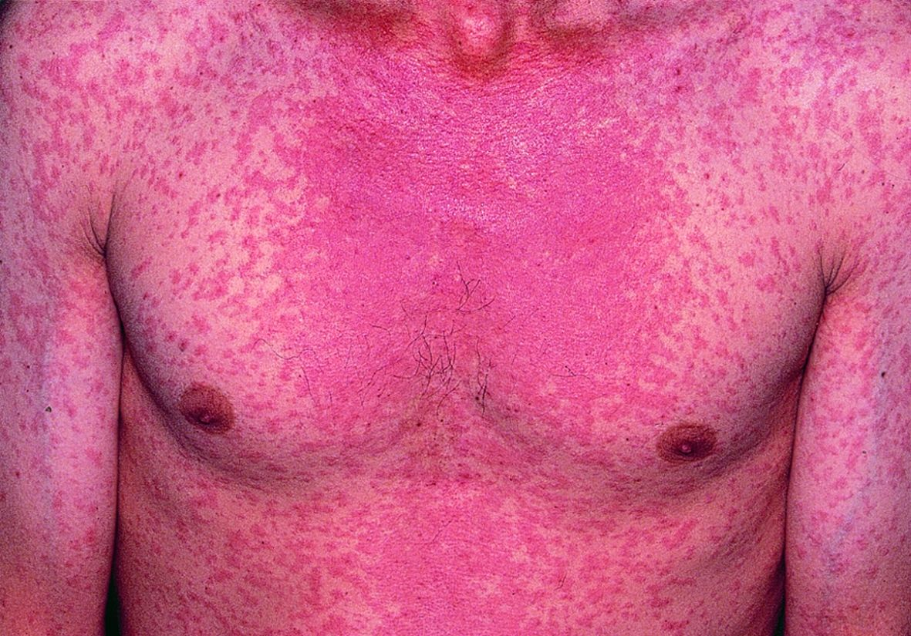
Anaphylaxis to COVID-19 vaccine
Eruzione morbilliforme

Slide 19
Anaphylaxis to COVID-19 vaccine
SEVERE REAZIONI AVVERSE AI FARMACI
Pustolosi Acuta Generalizzata Esantematica ( AGEP)
Drug – related Eosinophilia with Systemic Symptoms (DRESS)
Sindrome di Stevens Johnson (SJS)
Necrolisi Epidermica tossica o S. di Lyell
Dermatiti Esfoliative

Slide 20
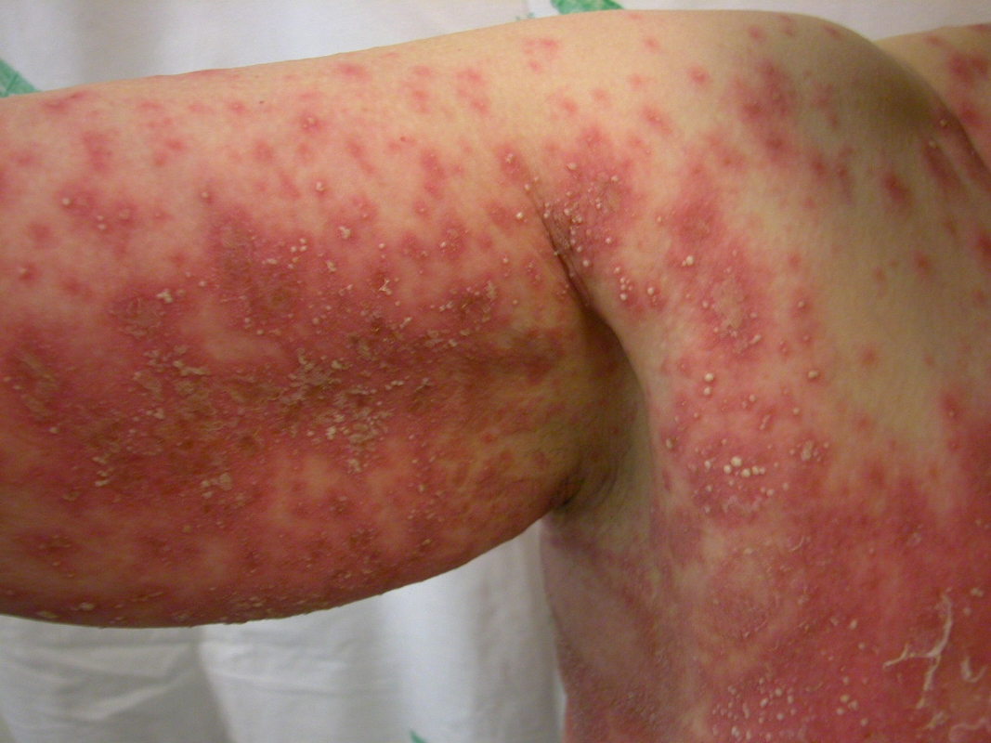
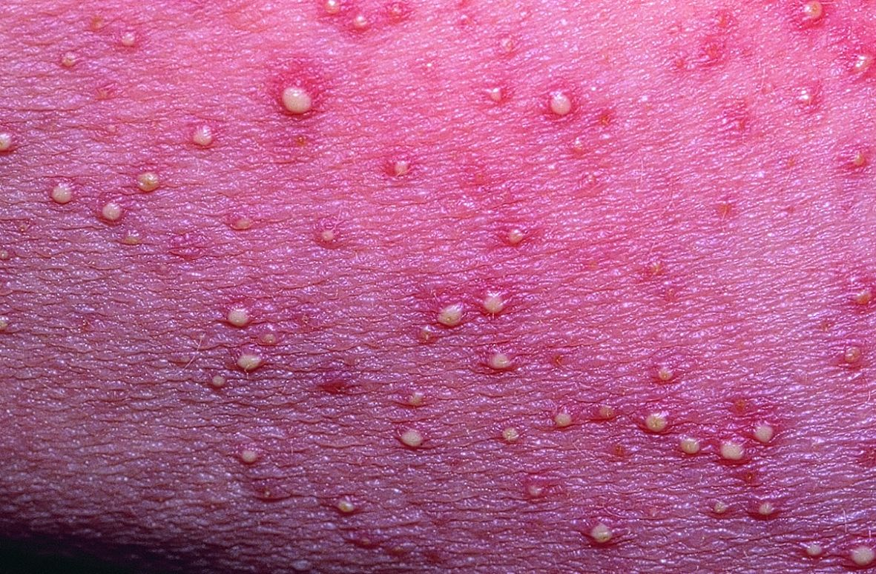
Anaphylaxis to COVID-19 vaccine
AGEP
Pustolosi Acuta Generalizzata Esantematica
Caratterizzate da un eritema diffuso che precede la comparsa di pustole diffuse non infette
Colpiscono soprattutto le pieghe e le zone di flessione
Colpisce soprattutto il sesso femminile
Eosinofilia è rara
Raro coinvolgimento d’organo
Solitamente il rush scompare entro 7-21 gg
Causa: antibiotici , antifungini e antimalarici

Slide 21
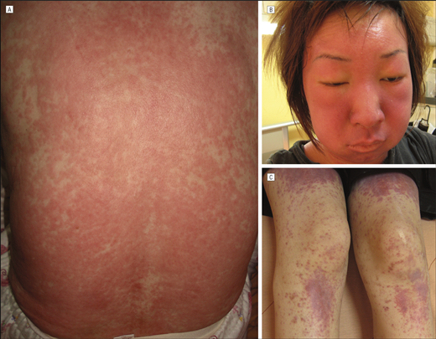
Drug – related Eosinophilia with Systemic Symptoms
DRESS
Esantema maculare
Eritema /angioedema facciale
Febbre
Malessere
Linfoadenopatia
Coinvolgimento di altri organi (fegato, rene)
Eosinofilia
AST, ALT
leucocitosi
Può iniziare anche dopo 12 settimane dall’inizio della terapia!
Sintomi e segni possono persistere per alcune settimane dall’interruzione della terapia!!!!!
Farmaco più frequentemente responsabile allopurinolo o barbiturici ( ma anche gli antibiotici)

Slide 22
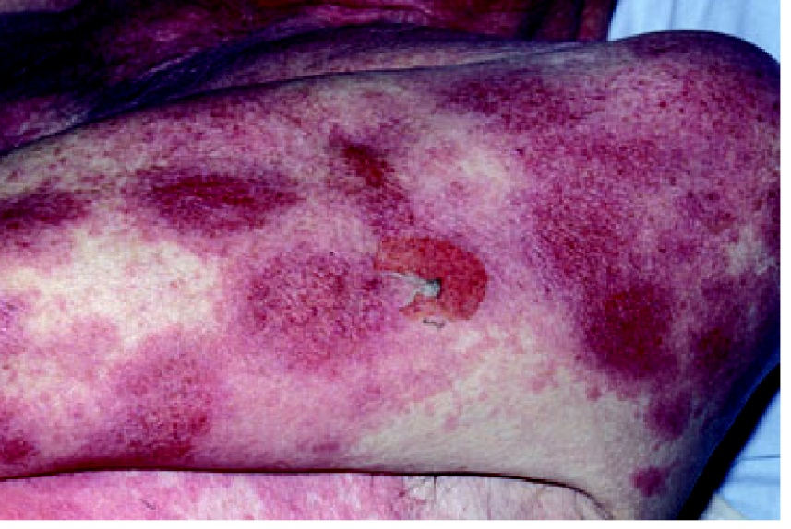
Anaphylaxis to COVID-19 vaccine
Dermatiti Esfoliative
Sindrome di Stevens - Johnson
Sindrome di Lyell o Necrolisi Epidermica tossica
Allopurinolo
Penicilline
Barbiturici
FANS
Sulfamidici
AnticonvulsivantI

Slide 23
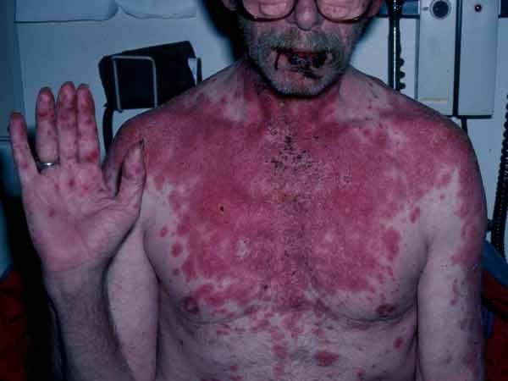
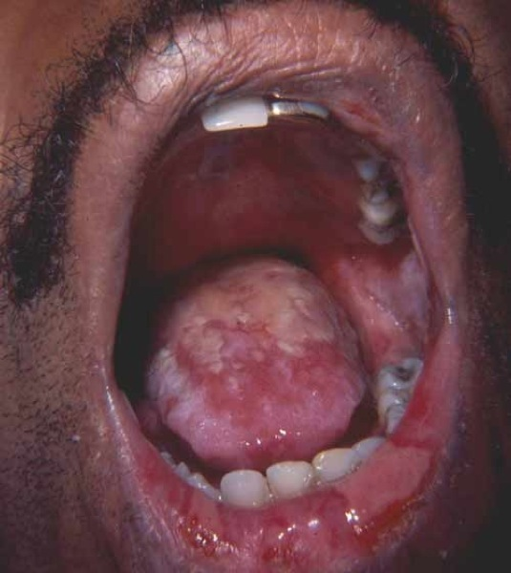
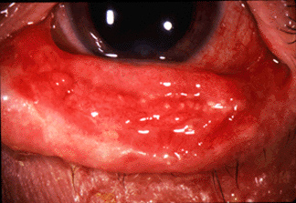
Sindrome di Stevens - Johnson
Febbre
Malessere
Milagie / artralgie
Citopenia

Slide 24
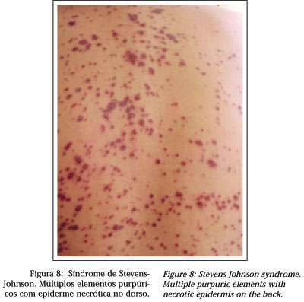
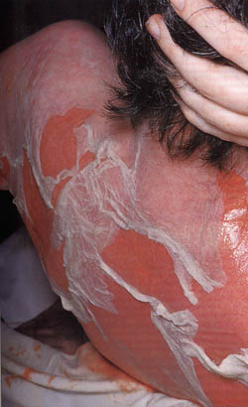
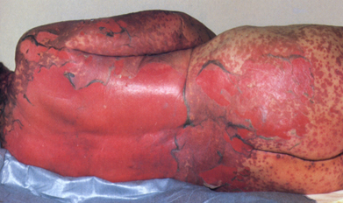
Sindrome di Lyell o Necrolisi Epidermica tossica

Slide 25
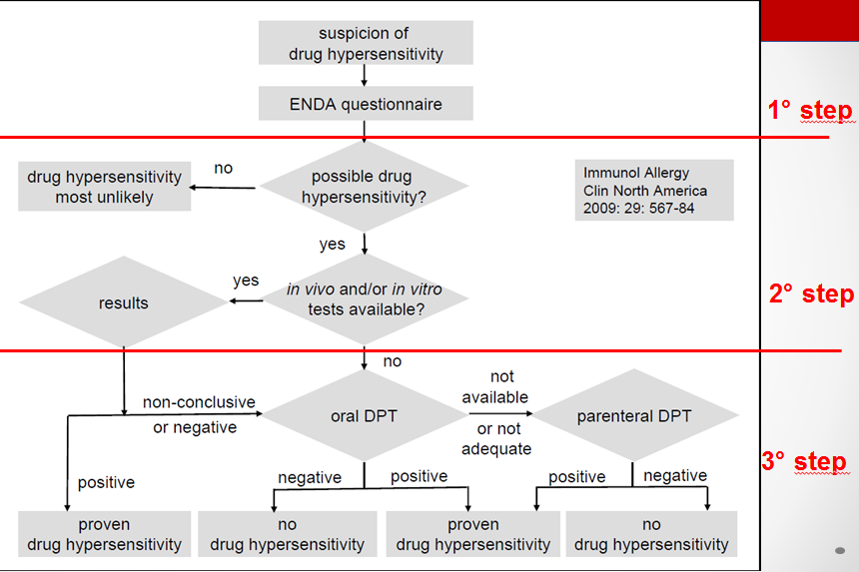

Anaphylaxis to COVID-19 vaccine
DIAGNOSI ADR
Drug Hypersensitivity Reactions
Drug Allergy
IgE-mediated drug allergy
Non-IgE-mediated drug allergy
Drug allergy is When a hypersensitivity reaction is caused by specific immunological mechanisms
can be antibody-mediated or cell-mediated.
A typical example of drug anaphylaxis is penicillin allergy
The diagnostic algorithm can be applied.
For Betalactam the diagnostic procedures consist of all 3 different steps particularly in the case of anaphylasis
Notes:
.

Slide 26
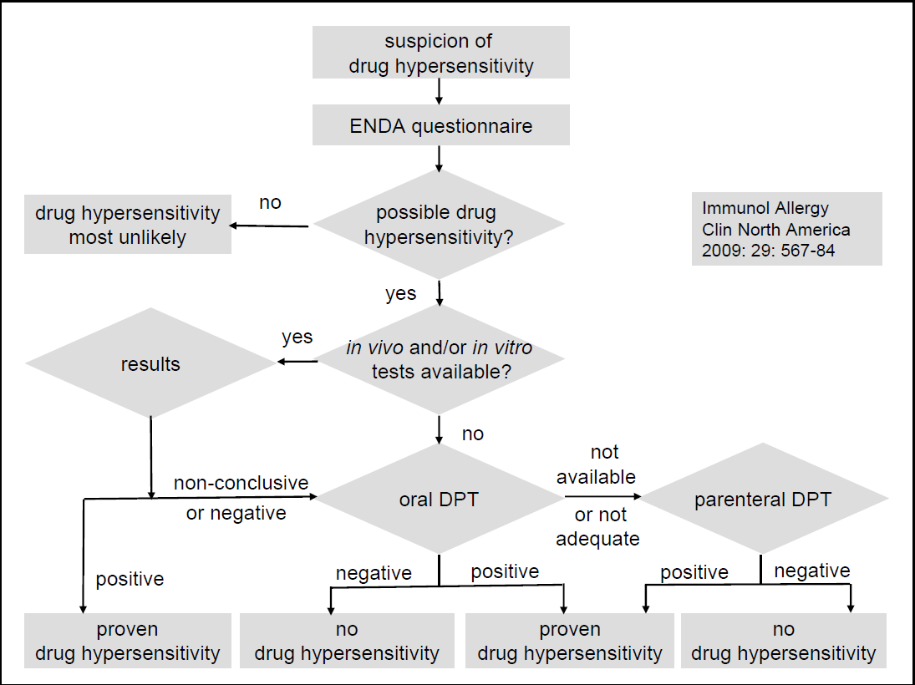
ADR Management
Anaphylaxis to COVID-19 vaccine
1° step
2° step
3° step
Is very important a correct diagnosis of ADR and this is the Algorithm
The diagnostic procedures used by the allergist, to diagnose drug allergies, in general consist of 3 different steps.

Slide 27
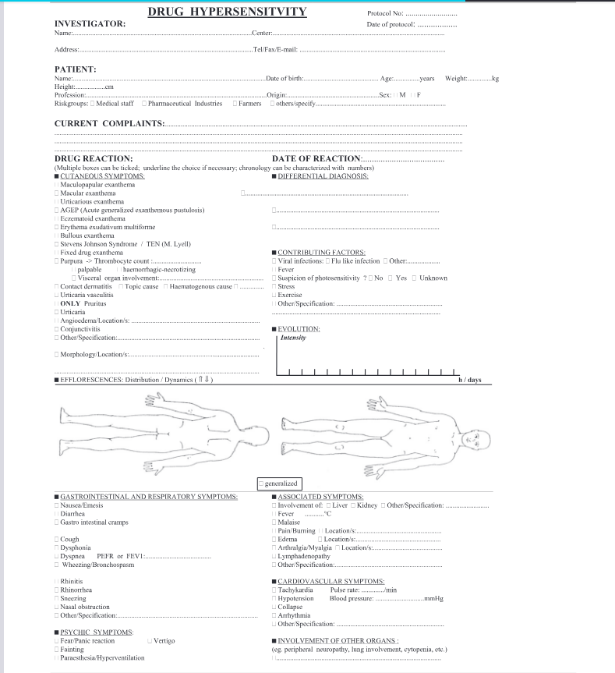
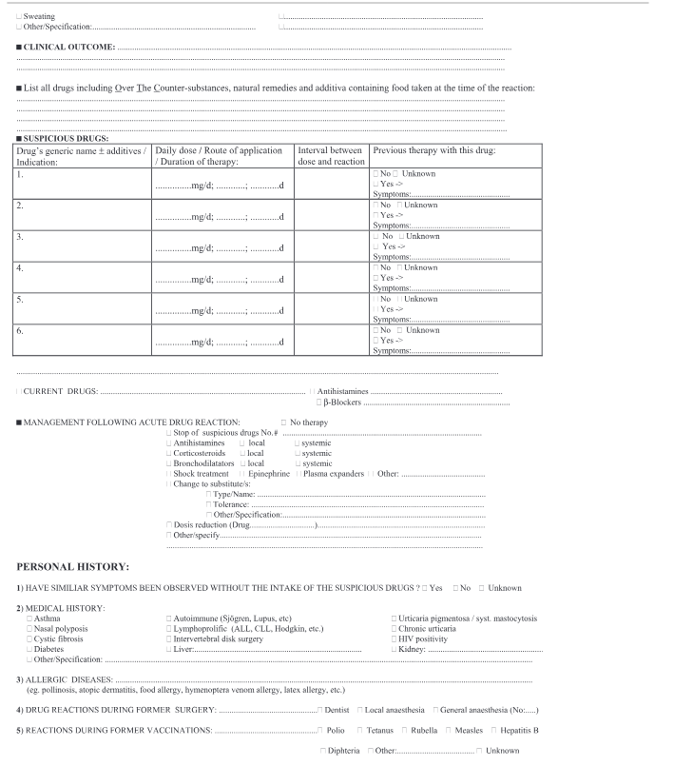
Questionario ENDA
Sintomaologia e cronologia
Farmaci assunti + cofattori
Altre patologie/
K.Brockow.2018

Slide 28
Anaphylaxis to COVID-19 vaccine
1° step
2° step
3° step
Is very important a correct diagnosis of ADR and this is the Algorithm
The diagnostic procedures used by the allergist, to diagnose drug allergies, in general consist of 3 different steps.

Slide 29
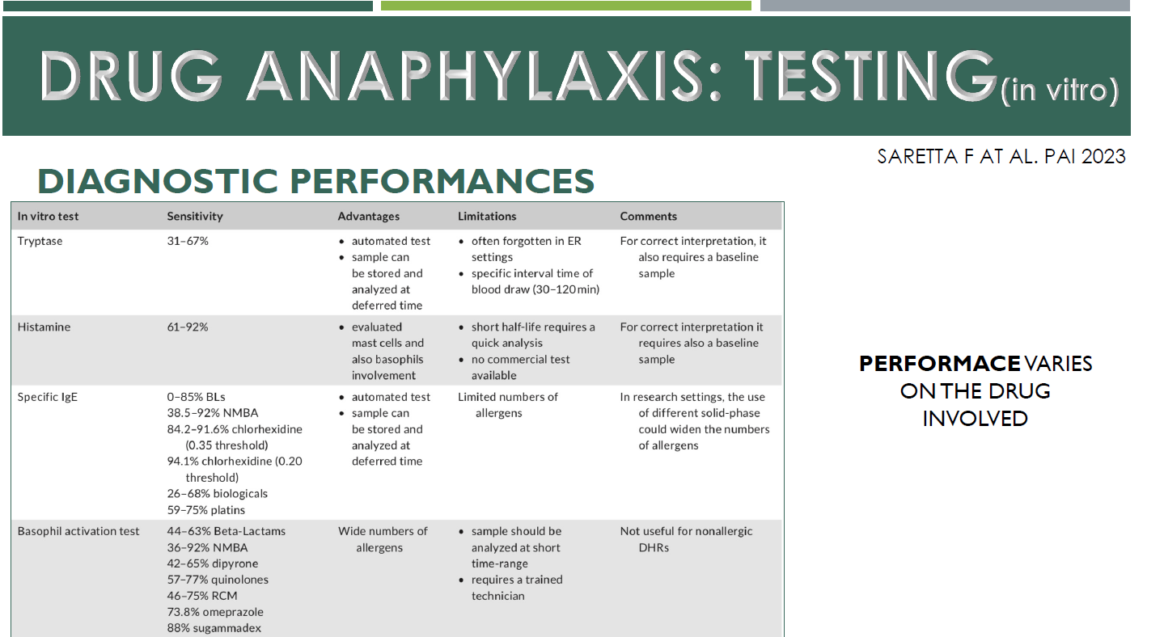
Mancanza di sensibilità ma specificità 90%

Slide 30
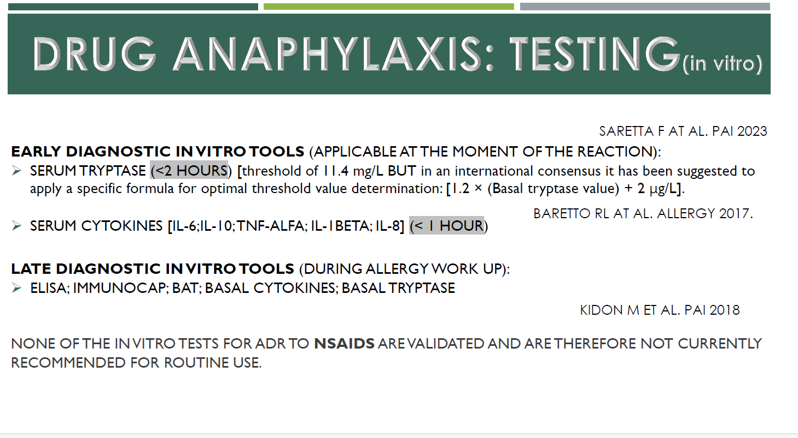

Slide 31
Diagnostic algorithm for Beta Lactams allergy : in Vivo Tests
Diagnostic algorithm for Beta Lactams allergy : in Vivo Tests
Anaphylaxis to COVID-19 vaccine
Anaphylaxis to COVID-19 vaccine
2023
allergy
Algoritmo di stratificazione del rischio in base all’anamnesi , caratteristiche clinice e strategie di raccomandazione per l’iter diagnostico Test cutanei o Test di provocazione/Tolleranza)

Slide 32
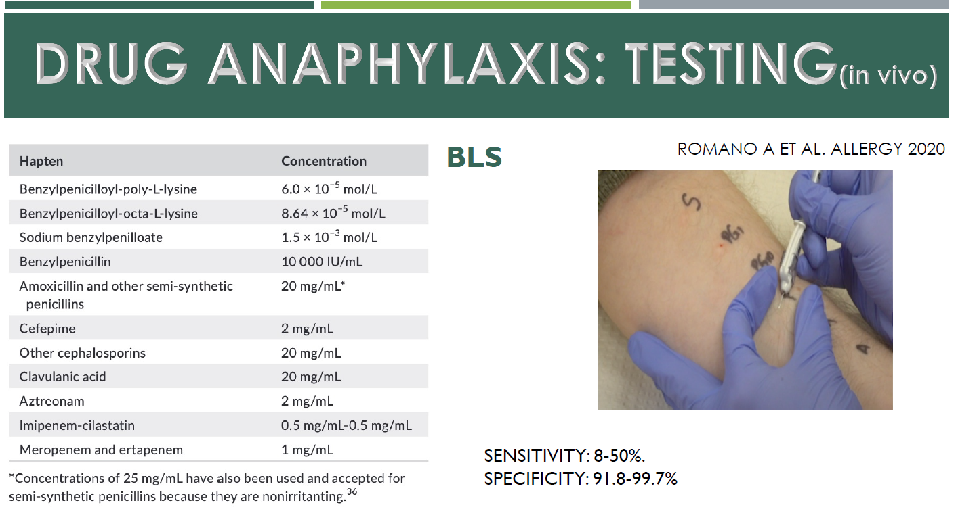

Slide 33
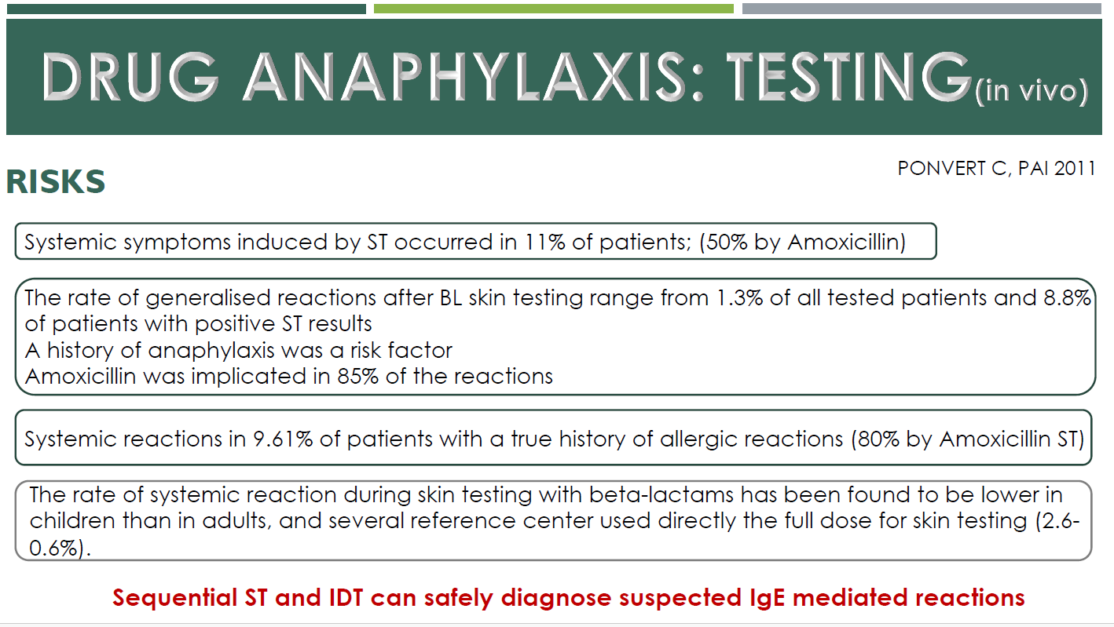

Slide 34
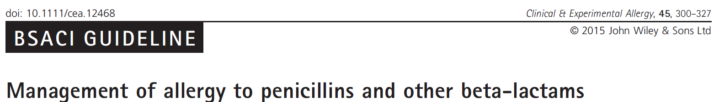
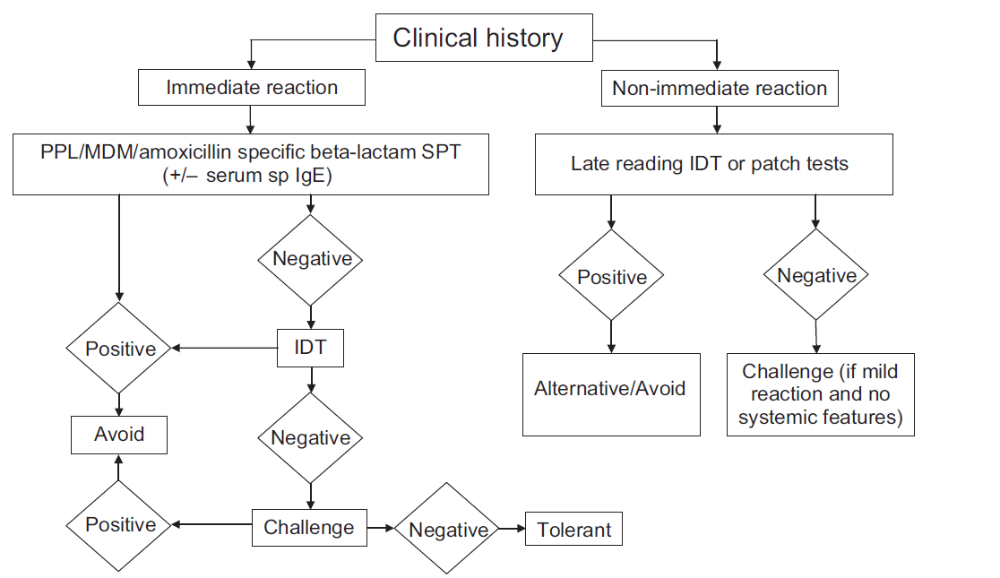
Diagnostic algorithm for Beta Lactams allergy : in Vivo Tests
Diagnostic algorithm for Beta Lactams allergy : in Vivo Tests
Anaphylaxis to COVID-19 vaccine
Anaphylaxis to COVID-19 vaccine
Notes:
Per la diagnostica alle penicillin abbiamo un orotocollo ben preciso

Slide 35
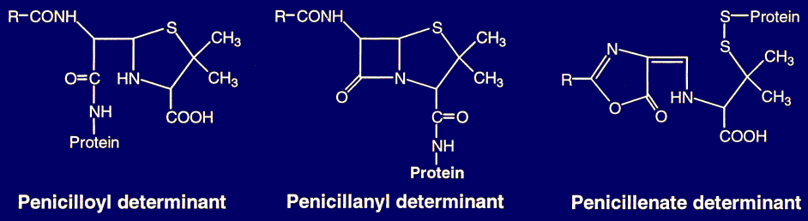
Anaphylaxis to COVID-19 vaccine
PPL
BPO
MDM
After administration, products of metabolism are formed and are:
Penicilloyl polylysine (PPL), is the most abundant penicillin metabolism product (more than 95 %); and other products such as
Benzylpenicillin, Benzylpenicilloate labelled as Minor Determinants (MD), account for approximately 15 % of allergic reactions, predominantly provoke anaphylactic reactions.
These determinants “determine” the allergic reactions, is iportant for diagnostic drug allergy to penicillin.
MD, Allergy and Clinical Immunology
Notes:
Imetaboliti delle penicillin sono

Slide 36
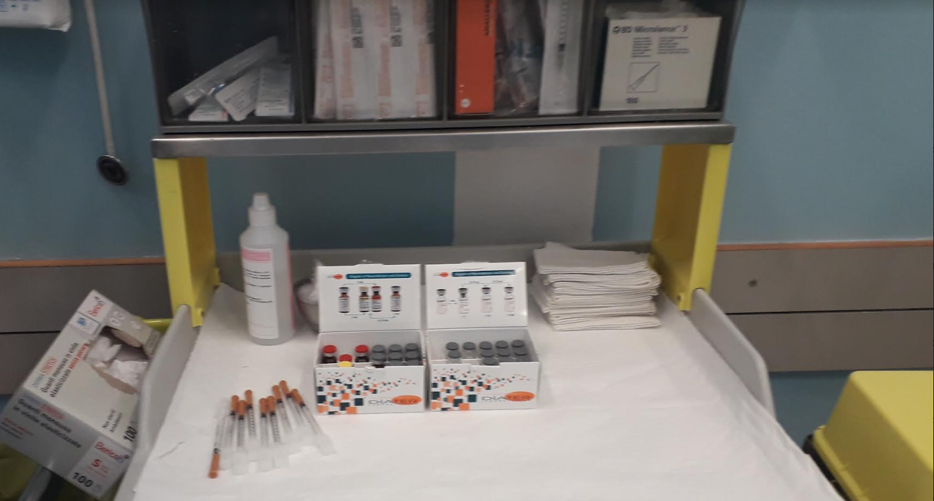
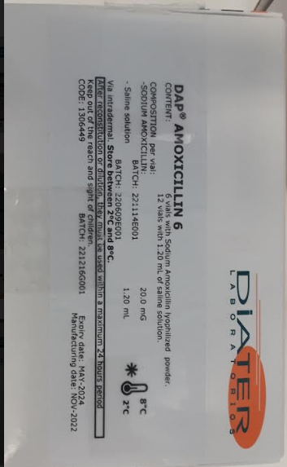
Diagnostic algorithm for Beta Lactams allergy : in Vivo Tests
This is what you need to have to prepare diagnostic tests
Skin tests can be performed with specific diagnostic prodacts
This is the commercially available diagnostic product that we use.
Foto confezione PPL ed MDM
DAP PENICILLINE
Notes:
This is the commersciallì aveìlbl diagnostic prodact that we use
.

Slide 37
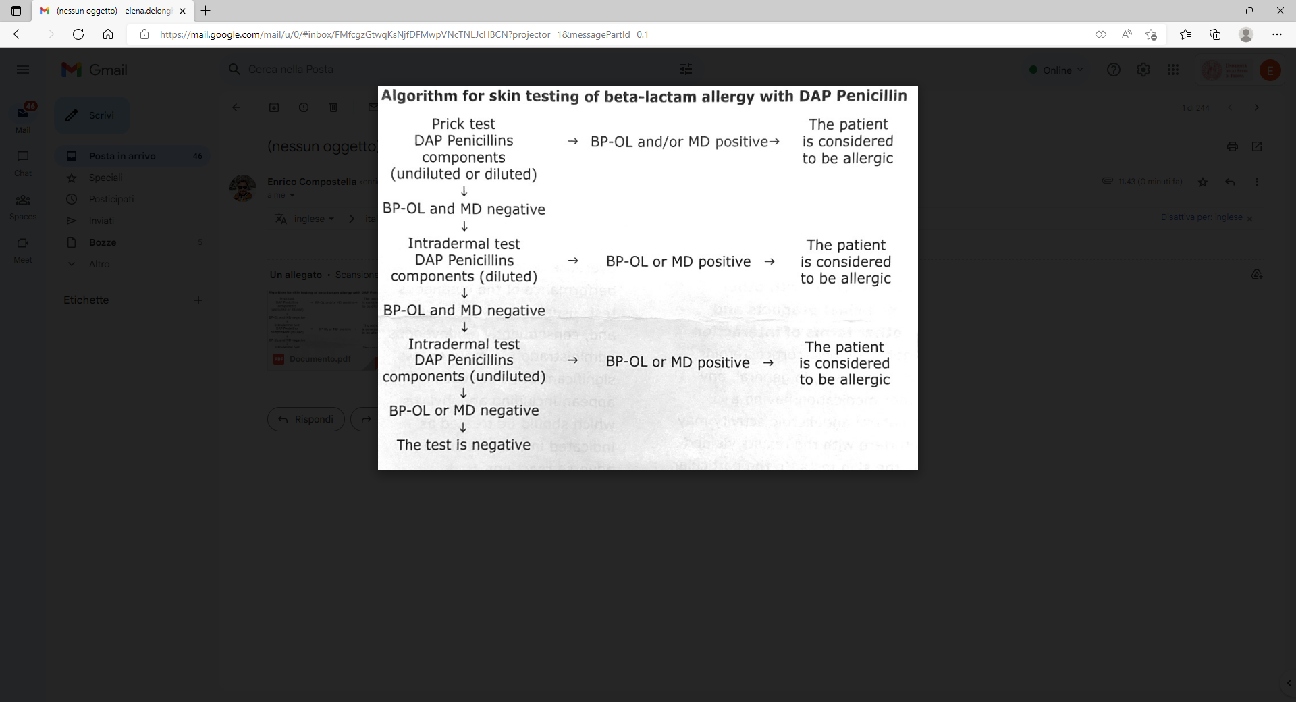
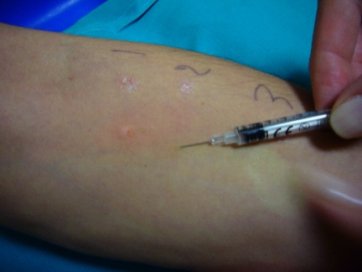
Diagnostic algorithm for Beta Lactams allergy : in Vivo Tests
Anaphylaxis to COVID-19 vaccine
/ Amox
/ Amox
/ Amox
After preparation
can be done SPT
Skin test is performed on the inner volar of the forearm
Method of administration :
Cutaneous skin tests
Prick test and Intradermal test must be done at a distance of at least 2 cm.
Intredermal Test : intradermally inject 0.02 – 0.05 ml of Amocicillin or BP-OL and MD.
Interpretation of the results
-Definitive skin test results must be read within 15-20 minutes from their puncture, being regularly observed
Warnings
- You must remain under close medical supervision for at least 30 minutes after being given the skin test.
Notes:
After preparation can be done SPT
The intradermal test (IDT) can help identify the culprit drug in both immediate and non-immediate reactions.
If the patient has a history of immediate hypersensitivity, the results of an IDT are read immediately, but if they have experienced a non-immediate reaction, the results are read after 1–2 days

Slide 38
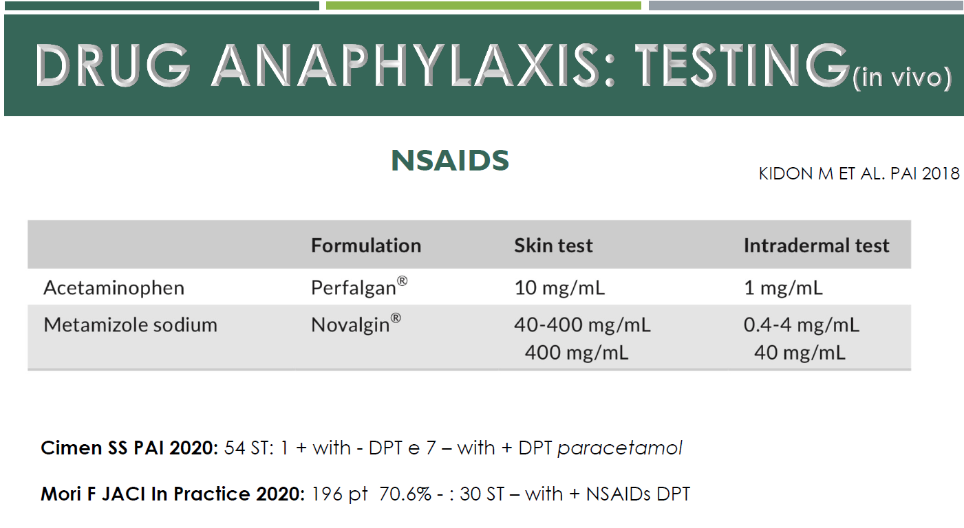

Slide 39
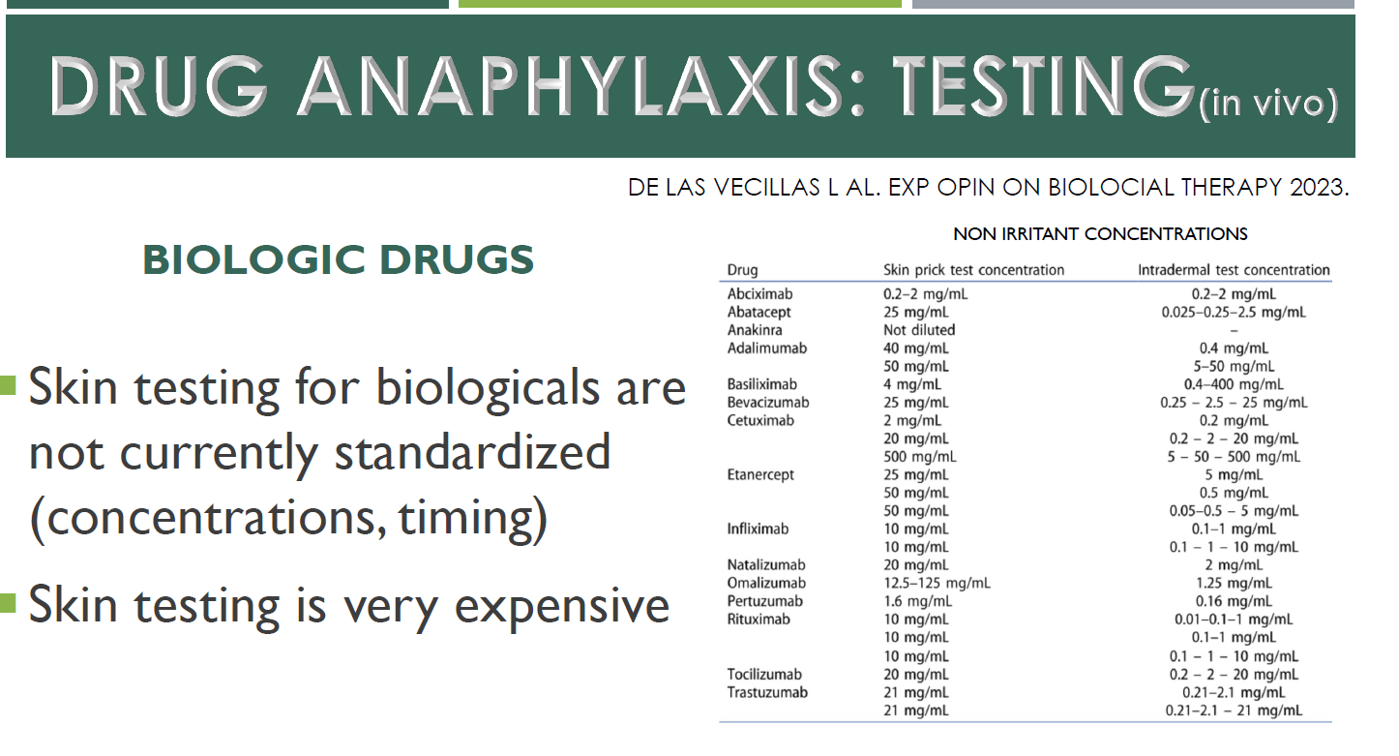

Slide 40
Diagnostic algorithm for Beta Lactams allergy : in Vivo Tests DPT
Anaphylaxis to COVID-19 vaccine
1° step
2° step
3° step
Is very important a correct diagnosis of ADR and this is the Algorithm
The diagnostic procedures used by the allergist, to diagnose drug allergies, in general consist of 3 different steps.

Slide 41
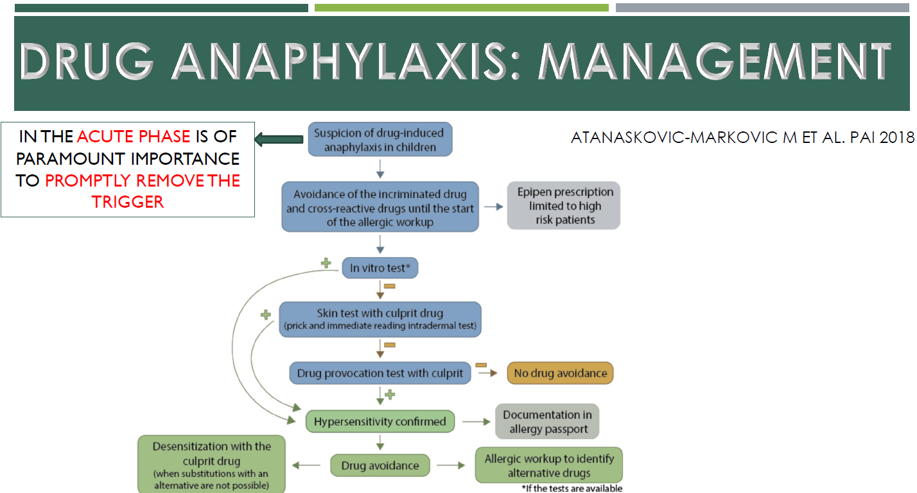

Slide 42
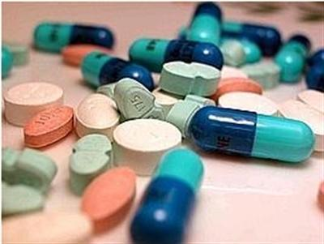
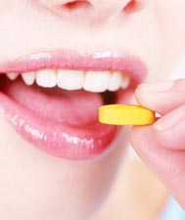
Test di Provocazione orale (DPT) = drug challenge = grade challenge = test dosing
Anaphylaxis to COVID-19 vaccine
E’ la somministrazione controllata di un farmaco , la tecnica che permette di confermare o escludere una farmaco- allergia
ENDA –Position Paper. Allergy 2023. 58:854-63
Notes:
Therefore the provocation test is

Slide 43

Anaphylaxis to COVID-19 vaccine
Indications for a DPT:
The provocation test is the gold standard in the diagnosis of adverse drug reactions
To confirm or rule-out a diagnosis in suggestive histories of drug hypersensitivity with inconclusive, negative, or unavailable allergy test results.
  To exclude cross-reactivity of related drugs in proven hypersensitivity
To provide safe alternatives in drug allergic patients and to prove tolerance
To exclude hypersensitivity in the presence of non-suggestive histories of drug hypersensitivity (subjective symptoms)
Notes:
Therefore the main indications of provocation test are:
Leggi
Leggi
- Leggi such as other antibiotics in b-lactam–allergic patients. This may also be helpful for anxious patients who would refuse to take the recommended drug without proof of its tolerance
to exclude hypersensitivity in the presence of unconvincing histories of drug hypersensitivity, for example patients with nonspecific conditions,
leggi* such as other antibiotics in b-lactam–allergic patients. This may also be helpful for anxious patients who would refuse to take the recommended drug without proof of its tolerance
to exclude hypersensitivity in the presence of unconvincing histories of drug hypersensitivity for example patients with nonspecific conditions, such as subjective symptoms under local anesthesia ( we think for example when a subject has to undergo dental procedures , we all experience fear and therefore the psychological component can provoke psychological symptoms that are very similar
*come altri antibiotici nei pazienti allergici ai b-lattamici. Ciò può essere utile anche per i pazienti ansiosi che si rifiuterebbero di assumere il farmaco raccomandato senza prova della sua tolleranz
a

Slide 44
Anaphylaxis to COVID-19 vaccine
Drug Hypersensitivity Reactions
Non Allergic Drug
Hypersensitivity
when other mechanisms can be proven, as in hypersensitivity to aspirin, the term non allergic hypersensitivity should be used.
A typical example of non allergic drug allergy is hypersensitivity to antinflammatpry drugs.
which block the cyclossigenasis patway which leads an increase of production leukotriens responsible of respiratory symptom and an increase of production of prostaglandins which seems to be responsible of instability of mastcells therefore responsible of urticaria
Notes:
The Algorithm ADR
In case of Non Allergic drug Hypersensitivity the diagnostic procedures used consist in I° and III° step, because in this case it’s not possible to perform the second Step

Slide 45
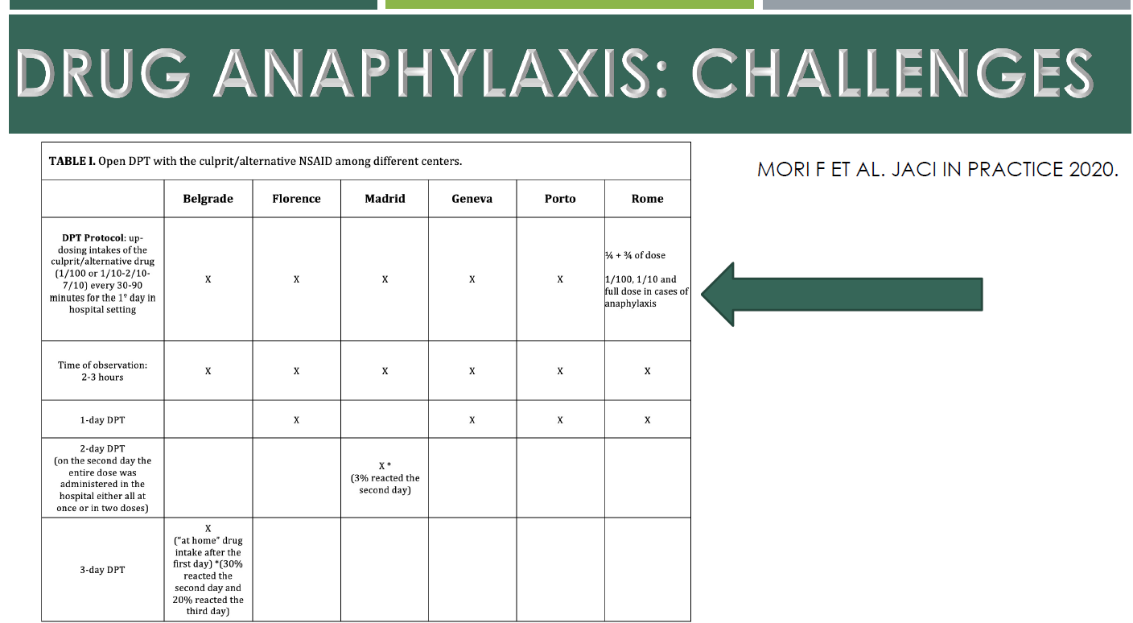

Slide 46
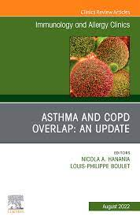
Anaphylaxis to COVID-19 vaccine
2023
2015
We know that BLM families,
share a four-membered β-lactam ring, which is part of the core structure of them.
The BLMs core is very unstable, so it cleaves after administration and covalently binds to serum and tissue proteins.
Notes:
Solo 1-2 % della popolazione ha una vera allergia a Beta Lattamici. Reazione crociata tra penicilline e Cefalosporine eè rara ed è causato dall’nello beta lattamico, solo 2% dei pz con vera allergia a penicilline reagisce alle cefalosporine .
Carbapenemi rischio basso di razione con penicilline e Cefalosporine
Aztreonam non ha reazione crociata con altri Beta lattamici se non Ceftazidime.
reazione crociata con altri beta lattamici eccetto Ceftazidime.
I BLM condividono un anello β-lattamico a quattro membri, che fa parte della struttura centrale delle famiglie BLM
The degradation process of cephalosporins is more rapid and leads to multiple fragmentations, but the haptenization mechanism is slower and more complex. The R-group side chains can also play a role as allergenic determinants, and some patients may produce specific IgE antibodies against them, sometimes without generating an immune response to the β-lactam structure [18–20].

Slide 47
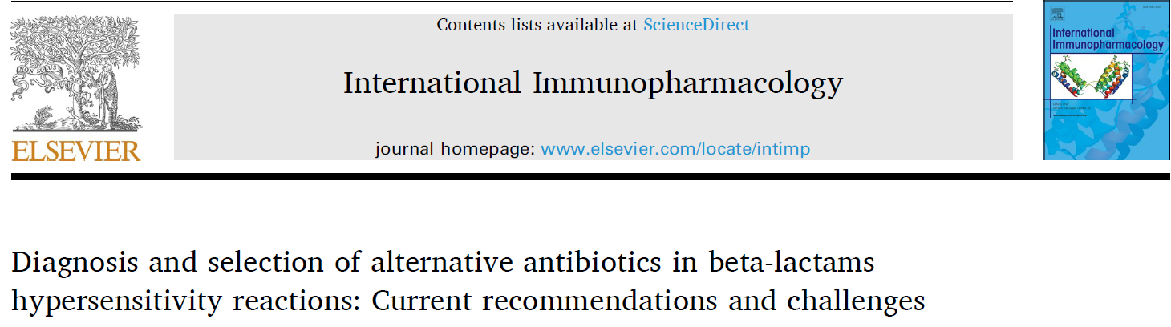

Diagnostic algorithm for Beta Lactams allergy : in Vivo Tests
Anaphylaxis to COVID-19 vaccine
Sensibilizzazione a Cefalosporine 1%-3%
Reazioni cutanee severe sono rare
Reazioni anafilattiche sono rare
Alternative drug choice
in patients with BLM
hypersensitivity
Zahra Kanannejad et all.
Notes:
challenge with alternative drugs is importan to understend and prescribe altri amtibiotics al paziente allergico
Challenge è importante per poter individuare la molecola di antibiotic che può assumere il paziente.
Nel paziente che necessita di penicillin è importante conoscere risk assessment……………………….
is recommended after negative skin testing for penicillin to definitively rule out hypersensitivity.
Alternative drug choice in patients with BLM hypersensitivity The most important challenge for both the patient and physician is selecting alternative drugs when faced with a known allergic drug. In both T-cell and IgE-mediated drug reactions, the intensity of the previous drug reaction is one of the main factors in determining an appropriate drug.
(Scelta del farmaco alternativo nei pazienti con ipersensibilità al BLM La sfida più importante sia per il paziente che per il medico è selezionando farmaci alternativi di fronte a un farmaco allergico noto. In sia le reazioni farmacologiche mediate dalle cellule T che quelle IgE, l'intensità della precedente reazione al farmaco)
Penicillin and cephalosporin cross-reactivity is due to identical three-dimensional structures and similarities in the R1 chains [26]. Cross-reaction between benzylpenicillin and cephalosporins is generally low and no clinically significant immunologic cross-reactivity between penicillin and cephalosporins has been shown

Slide 48


Knut Brockow 20251

Slide 49



Allergy 68 (2013) 1219–1232 © 2013
Samter’s Triad: State of the Art

Slide 50


Anaphylaxis to COVID-19 vaccine
J Invest Allergol Clin Immunol 2003; Vol. 14(4)
Notes:
For this reason several years ago we conducted a study to evaluate the nocebo e(i)ffects

Slide 51

“Nocebo Effect”
Anaphylaxis to COVID-19 vaccine
The Mind Power
When we perform a provocation test we must be considered the psychological factors
«NOCEBO EFFECT» that is the “occurrence of troublesome
symptoms after the administration of inert substances(called Placebo)”.
It is a negative suggestion.
Several studies have shown that:
It is very frequent among drug allergic patients
Affects up to 30% of patients.
Prevalence significantly higher in women than in men
Subjective symptoms but also objective!
Liccardi G. Bonadonna P et al J Invest Allergol Clin Immunol 2004
Barsky AJ et al. Review article. JAMA 2002
Notes:
Comparsa di sintomi fastidiosi dopo la somministrazione di sostanze inerti: “Placebo
In other words we must consider (kept in mind)
Several studies have shown that:
It is very frequent among drug allergic patients
and affects up to the 30% of patients, aboveall women.
The majority of symptoms are subjective therefore not objective (dizziness, itching, abdominal pain, shortness of breath, headache, anxiety) but as we showed some years ago they can also be objective (urticaria, erythema, tachicardia/bradicardia).
(Factors that can influence the nocebo effect are the PATIENT EXPECTATION and the PREVIOUS EXPERIENCE with drug.
Subjective symptoms: itching, dizziness, discomfort, shortness of breath, abdominal pain, headache, anxiety
Objective symptoms: skin reactions (urticaria, erythema, rash), tachicardia/bradicardia)

Slide 52
Anaphylaxis to COVID-19 vaccine
For this reason and to understand how much psychological components influence symptoms
In all patients a “Single Blind PLACEBO-controlled Provocation Test” should be done before an “active” DPT
Notes:
For this reason and to understand how much psychological components influence symptoms: in…..
In Verona we prepare pills with talc

Slide 53
Absolute Contraindications:
Anaphylaxis to COVID-19 vaccine
Severe Cutaneos Adverse Reactions
Immunocytotoxic reactions
ENDA –Position Paper. Allergy 2003. 58:854-63
Notes:
A DPT should never be performed in patients who have experienced severe reactions such as life-threatening skin reactions. And this is an important limitation!
In these cases the provocation test is also controindicated as it is for any alternative drug.
In a few conditions, e.g. in fixed drug eruptions, oral provocation testing seems safe even in children, if the patient suffered only a single or a few lesions, however it should not be used on patients who have had generalized bullous reactions that may sometimes be difficult to distinguish from Stevens-Johnson syndrome.
In case of anaphylaxis it may be performed in selected cases, after careful evaluation of risks and benefits

Slide 54
TAKE HOME MESSAGES
Farmacoresistenza
Costo Farmaciallergia sia nella gestione che nella prevenzione
De-etichettare false ADR.
E’ importante
gestire ADR perché:
L'evitamento ingiustificato dei β-lattamici può portare a complicazioni come infezioni
post-operatorie e aumento dei costi di trattamento.
È fondamentale chiarire le sospette allergie attraverso test allergologici.
allergy
2023

Slide 55
Allergia a farmaci:
aspetti di diagnostica Attuale.

Slide 56



Preparing Patients for DPT
Anaphylaxis to COVID-19 vaccine
Before test
Blood pressure
Pulse rate
Oxygen saturation (SO2%)
Spirometry
……..but also
during and at the end of DPT
It is essential to have well-trained medical staff doctors, nurses, who are immediately available in case of emergency, and facilities for continuous monitoring of the patient’s condition

Slide 57

Preparing Patients for DPT
Anaphylaxis to COVID-19 vaccine
Patients should be observed according to the type of reaction expected.
If the original reaction is delayed or not dangerous a DPT may be performed on an outpatient
Patients with more severe reactions ought to be hospitalized for a DPT
Notes:
If mild reactions have occurred, observation after stabilisation is recommended for at least 2 hours.
After severe reactions hospitalization is mandatory because of the possibility of biphasic episodes that can be lethal if not recognized early and treated adequately

Slide 58

EMERGENCY
Anaphylaxis to COVID-19 vaccine
Medical staff
Written emergency protocol
Emergency treatment
Facilities for continuous monitoring
In case of patients with a history of anaphylactic shock intravenous access is mandatory during the entire test
Physicians and nursing staff have to be present in order to monitor symptoms and cutaneous signs during thentest., It is very important to have a written emergency protocol, and emergency drugs and facilities for continuous monitoring available immediat
Notes:
ely.
In case of patients …leggi

Slide 59
Anaphylaxis to COVID-19 vaccine
Contraindications:
Pts who used drugs (antihistamines or oral steroids)
ENDA –Position Paper. Allergy 2003. 58:854-63
«International Consensus on drug allergy» Allergy 2014
Notes:
But is it possible to perform the challenge test in every situation?
A DPT with a suspected drug should not to be performed
Those who used medications that could affect the test outcome es…
But if the wash out is of few days with antihistamines or intravenous steroids for the treatment of systemic reactions, the washout period for topical steroids used to treat contact allergy might be as long as 3 weeks

