Slide 1
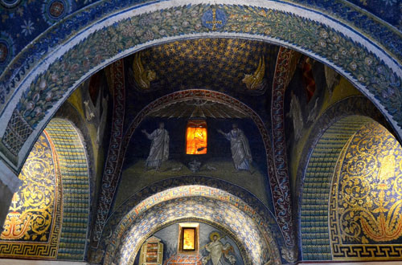
New Endoscopic Techniques to diagnose ILDs
WHEN TRANSBRONCHIAL CRYOBIOPSY IS MANDATORY and WHEN IT ISN’T
Venerino Poletti
University of Bologna/Morgagni Hospital- Forli (I) (Full Prof& Head Dept)
Aarhus Universitet (Full-Hon Prof)

Slide 2
Conflict of interest disclosure
I have no real or perceived conflicts of interest that relate to this presentation.
I have the following real or perceived conflicts of interest that relate to this presentation:
x
Affiliation / Financial interest | Commercial company
Honoraria FOR TALKS | Boehringer I, Chiesi, ERBE,Roche
Advisory Board member | AMBU, Boehringer I, Recordati rare Diseases
This event is accredited for CME credits by EBAP and EACCME and speakers are required to disclose their potential conflict of interest. The intent of this disclosure is not to prevent a speaker with a conflict of interest (any significant financial relationship a speaker has with manufacturers or providers of any commercial products or services relevant to the talk) from making a presentation, but rather to provide listeners with information on which they can make their own judgments. It remains for audience members to determine whether the speaker’s interests, or relationships may influence the presentation. The ERS does not view the existence of these interests or commitments as necessarily implying bias or decreasing the value of the speaker’s presentation. Drug or device advertisement is forbidden.
Notes:
These are my disclosures

Slide 3
Probability is not an objective property of the world but rather a degree of belief held by individuals
In this view,probabilities represent how strongly someone believes an event will occur, based on their current information
To make subjective probabilities meaningful and consistent, de Finetti introduced the idea of coherence through a
betting framework
Person’s probability assignments are coherent if they wouldn’t lead to a sure loss in a system of bets
Galavotti MC Pragmatism and the birth of subjective probability. Eur J Pragmat Am Philosoph 2019

Slide 4
If we believe that, based on the information gathered thus far, there a 70% chace of rain tomorrow
We possess predictive data that provide us with some insight into the state of the atmosphere and the
way it operates - though not a complete picture
2. We consider a 70% probability to be a hypothesis worth betting on, with a high likelihhod of being correct

Slide 5
The currently available information : the objective element in the
«game»
The «bet»: the subjective element of the «game»

Slide 6
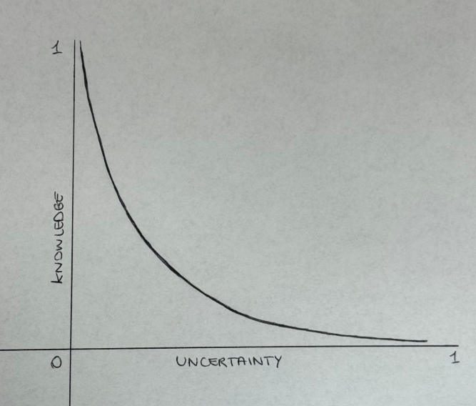
When TBLCB is mandatory and when it isn’t (in fibrosing ILDs)? :
to exist in a world in which «uncertainty» constitutes the prevailing condition
What are the potential complications
with increasing one’s level of medical
knowledge, and what risks are involved in
accepting a certain degree of clinical uncertainty

Slide 7
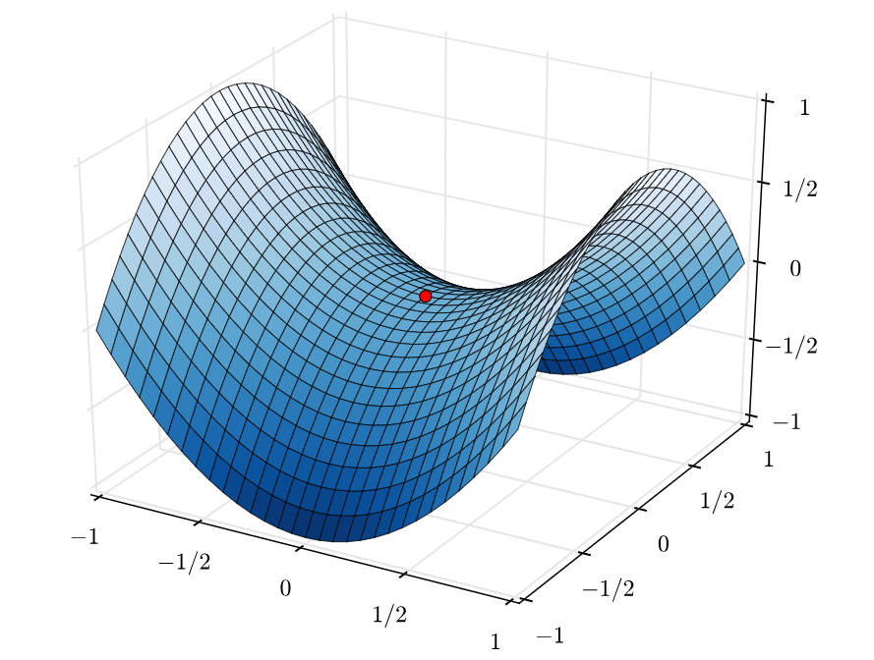
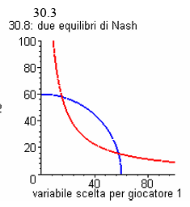
IS IT POSSIBLE TO MINIMIZE SUBJECTIVITY WHEN MAKING A DECISION UNDER
UNCERTAINTY, SUCH AS IN THE CONTEXT OF A WAGER?
Saddle point and the minimax theorem
In two-player zero-sum games a
saddle point represents a situation of
equilibrium where neither player
can unilaterally improve their outcome
[the point(s) of maximum acceptable loss
for one player intersect(s) with the
point(s) of maximum possible gain
for the other player]
*Von Neumann J & Morgensten O.
Theory of games and economic behavior
Princeton University Press, 1944.
*Ramsey FP. Truth and probability. In
The foundations of mathematics and other logic
essays, 1926
*de Finetti B. Theory of probability.
A critical introductory treatment. Wiley 1974
*Kadane JB. Principles of uncertainty. CBC Press 2021

Slide 8
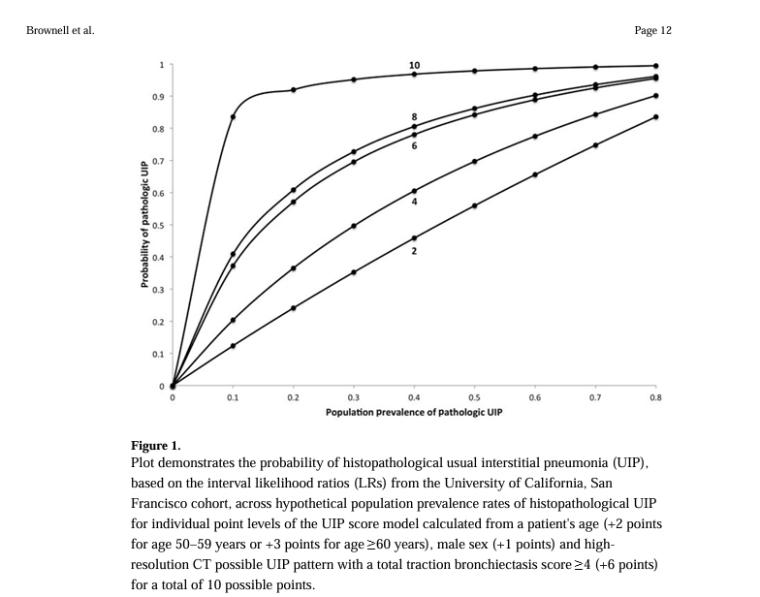
Possible UIP pattern had a specificity of 91.2% and a positive predictive value (PPV) of 62.5% for UIP pattern on surgical lung biopsy.
The addition of age, sex and total traction bronchiectasis score improved the PPV.
A possible UIP pattern on HRCT has high specificity for UIP on surgical lung biopsy, but PPV is highly dependent on underlying prevalence.
Adding clinical and radiographic features to possible UIP pattern on HRCT may provide sufficient probability of histopathological UIP across prevalence ranges to change clinical decision-making.

Slide 9
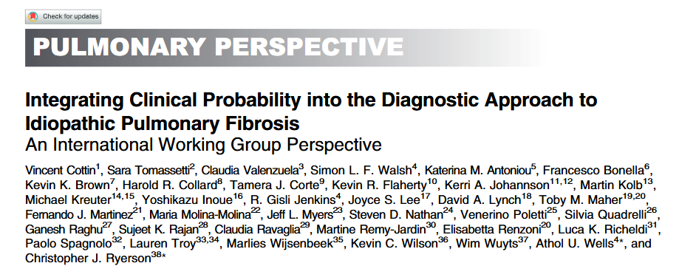
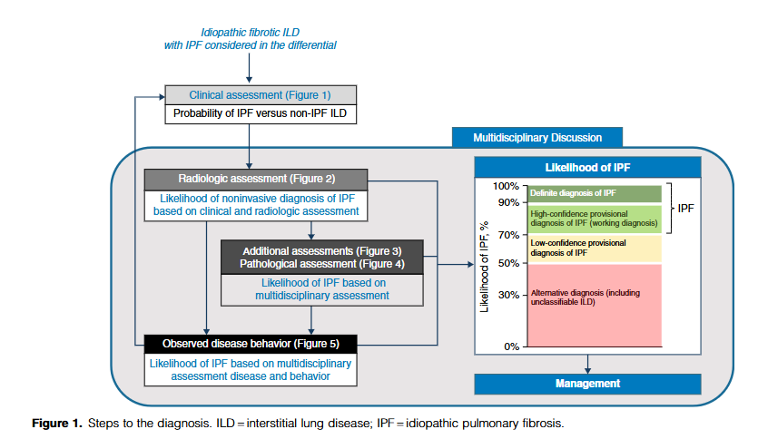
Am J Respir Crit Care Med 2022, 206,: 247–259.
PMID: 40260266
PMID: 40260266

Slide 10
CASE EXEMPLIFICATION

Slide 11
68 y/o male,former smoker (10 p/y). No symptoms. Normal spirometry: DLCO 75% of predicted. Monoclonal IgG lambda component in the serum (NGUS). Autoimmunity neg

Slide 12
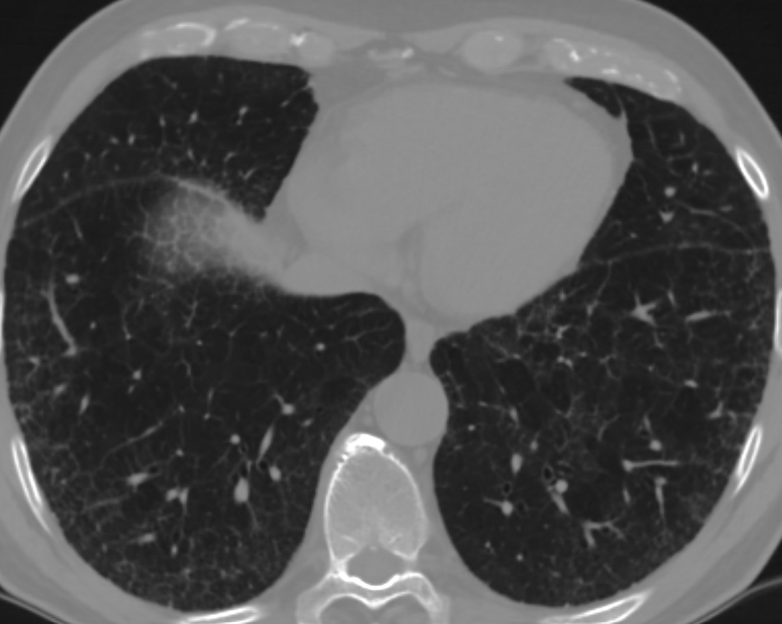
)
Notes:
Fine peripheral reticulation and minimal ground glass are present in both lower lobes.
Scattered pulmonary ossifications are evident along with the pleura in the left costophrenic angle (yellow arrow-head)

Slide 13
CT scan because of a che X ray reporting a nodule.
Fine peripheral reticulation and minimal ground glass are present in both lower lobes.
Scattered pulmonary ossifications are evident along with the pleura in the left costophrenic angle (yellow arrow-head)

Slide 14
DIFFERENTIAL DIAGNOSIS
-ILA
-microaspiration-cicatricial organizing pneumonia (with bone metaplasia)
-NSIP
-early IPF
-something unknown and/or unexpected

Slide 15
WHAT would constitute the most appropriate strategy for the patient to adopt?
-a watchful waiting approach
-BAL
-Transbronchial buipsy
-Transbronchial cryobiopsy
-Transbronchial cryobiopsy with cone beam CT guidance
-VATS
-Awaked (non-intubated) VATS
-

Slide 16
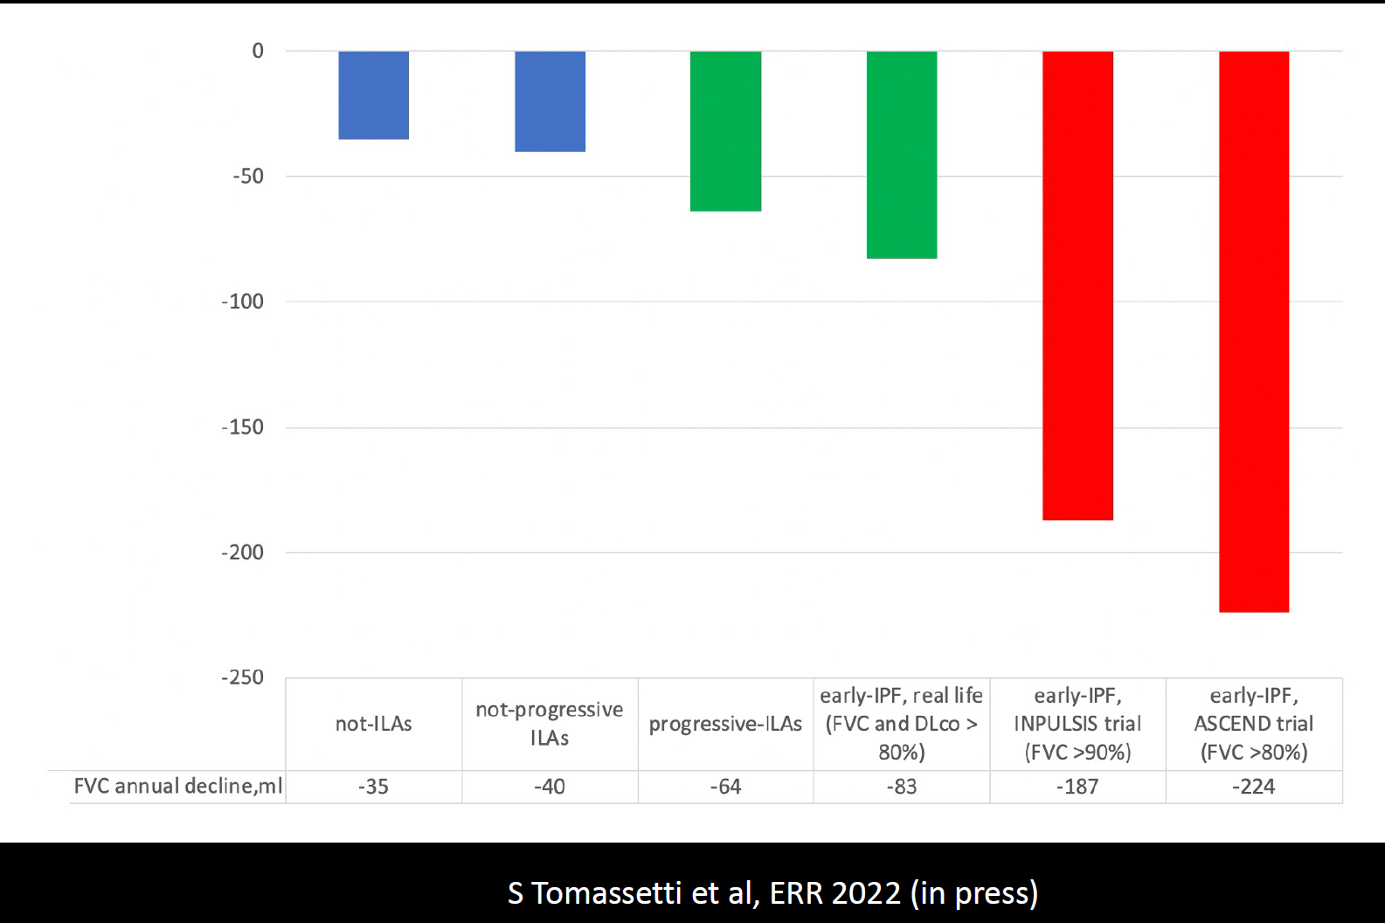

Slide 17
UIP pattern (in CT &/or histology: a relevant marker predicting progression regardless the final diagnosis
-Stock CJW, et al.Deep-learning CT imaging algorithm to detect usual interstitial pneumonia pattern in patients with systemic sclerosis-associated interstitial lung disease: association with disease progression and survival. Rheumatology in press
-Chilosi M, et al.The pathogenesis of IPF:from «folies à deux» to «culprit cell Trio» Pathologica 2025
-Chilosi M, et al. Alveolar stem cell exhaustion, fibrosis and bronchiolar proliferation»related entities. A narrative review. Pulmonology 2025

Slide 18
BAL: only significant lymphocytosis may suggest an alternative diagnosis
TBB :diagnostic yield for UIP <10-15%-low confidence; NSIP, DIP etc not reliable
TBLCB:diagnostic yield >80%- low rate of severe complications (on a day-hospital basis)
TBLCB with cone beam CT guidance [diagnostic yield >90% in limited extent ILD (<15) with high confidence by pathologists) - low rate of severe complications (on a day-hospital basis)]
VATS: diagnostic yield >90-05%; peri-operative mortality 1-2%;acute exacerbation in 30 days:around 6%:thoracic pain lasting >3 months 5-10%
Awake (non intubated VATS): diagnostic yield >90%; on a day hospital basis; transthoracic (uniportal) approach- complication (air leakage-pneumonia etc 5-10% but up to 23%%)
Radu D, et al Ann Thorac Surg 2022
Lachowicz JA, et al. Eur Respir Rev. 2024
Ravaglia C, et al. Respiration 2024
Patirelis A, et al. J Clin Med 2025

Slide 19
Transbronchial cryobiopsy with cone-beam CT guidance. Samples from the right lower lobe

Slide 20
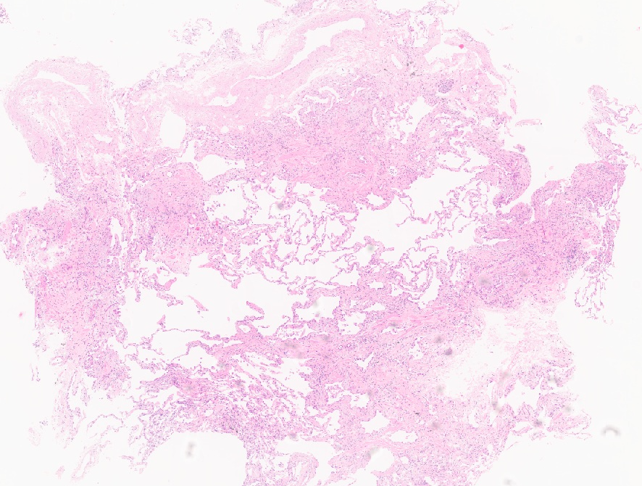
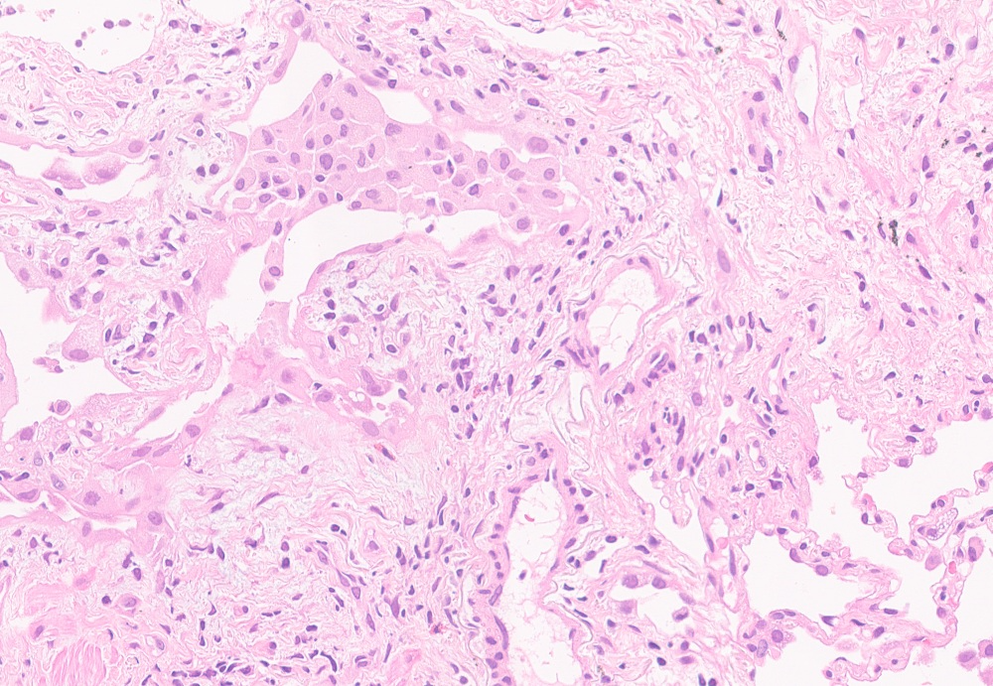
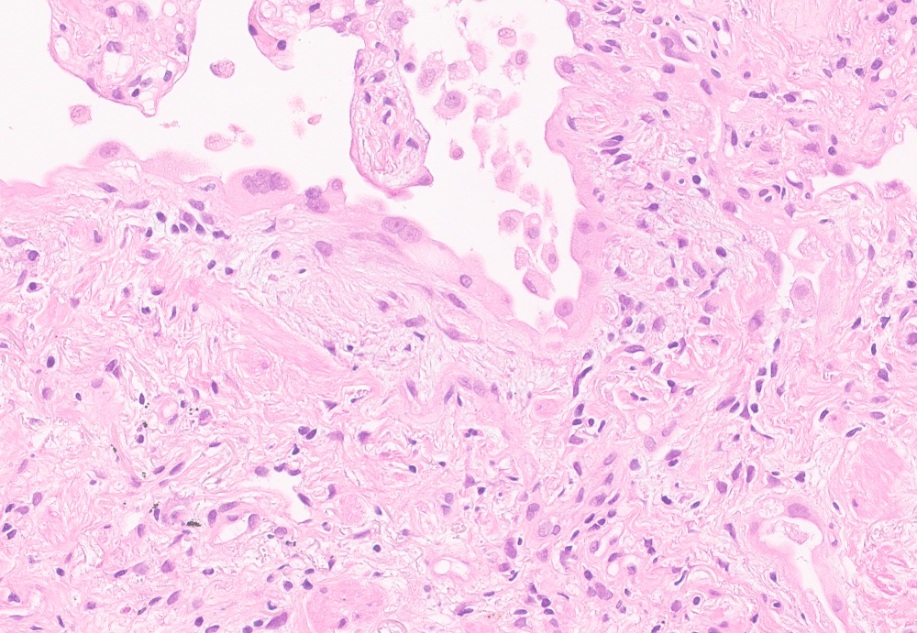
a
b
c

Slide 21
FINAL DIAGNOSIS
Clinical setting not against a diagnosis of IPF
HRCT: indeterminate UIP
CryoTBB: UIP high confidence (not honeycombing)
IPF
Treatment: Nintedanib

Slide 22
When TBLCB is mandatory and when it isn’t?: the question is flawed or at lest misleading
What are the potential complications
with increasing one’s level of medical
knowledge, and what risks are involved in
accepting a certain degree of clinical uncertainty
What is the role of TBLCB in this «bet framework»
having as competitors VATS and/or awake VATS?

Slide 23
THE BIOPTIC APPROACH:ELEMENTS OR FACTORS TO CONSIDER WHEN CALCULATING THE EQUILIBRIUM STATE
Diagnostic yield
Diagnostic accuracy
Complications
Impact on treatment and prognostication

Slide 24
Diagnostic yield
Diagnostic accuracy
Complications
Impact on treatment and prognostication

Slide 25
ERR, 2022
The 43 studies included 4550 patients (sample size range 12–359).
TBLC was performed in 2824 patients and SLB (by VATS) in 1814.
23 evaluated the diagnostic yield of TBLC after multidisciplinary discussion,
With a pooled diagnostic yield of 76.8% (95%confidence interval (CI) 70.6–82.1),
rising to 80.7% in centres that performed⩾70TBLC.
10 studies assessed the use of VATS and the pooled diagnostic yield was 93.5%(95%CI88.3–96.5).

Slide 26
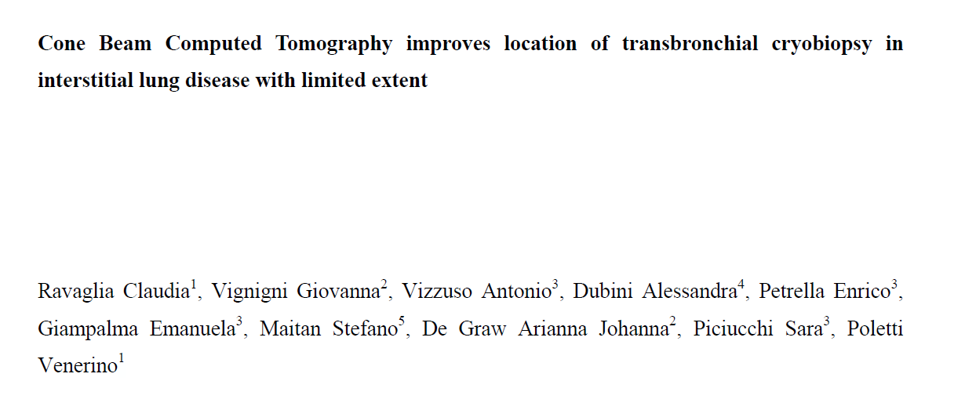
Respiration,2024

Slide 27
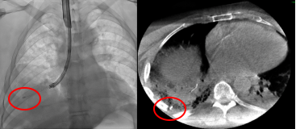
Role of cone-beam CT in early ILD
Number of patients, N | 36
Median Age, years (range) | 65 (27 – 80)
Gender Male, N (%) Female, N (%) | 16 (44) 20 (56)
Median FVC, % predicted (range) | 90 (54 – 128)
Median DLCO, % predicted (range) | 68 (32 – 96)
HRCT features, N (%) Reticulation Ground glass Traction bronchiectasis Honey combing Consolidation Micronodules (with cheerios aspects) | 16 (44) 25 (69) 13 (36) 2 (6) 11(31) 1 (3)
Ravaglia, et al. Respiration 2024
HRCT extent < 15 %
Notes:
-We have now some guiding systems, such as the cone-beam CT, which can help in making the probe-to-pleura relationship more accurate
-This may be particularly crucial for patients with ILD with limited extent of the disease on CT scan
-We combine cone-beam CT and cryobiopsy in patients with limited ILD; these are our data
………..

Slide 28
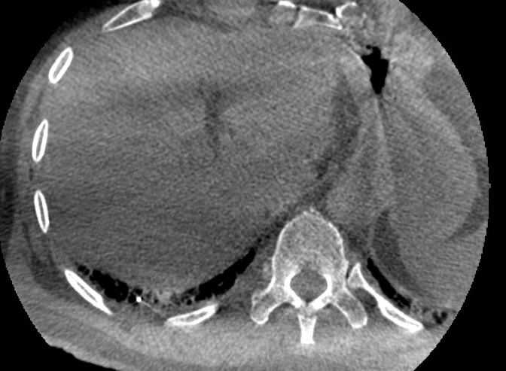
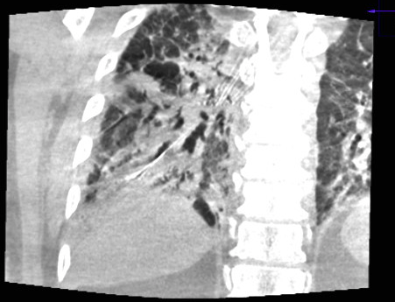
Mean Age (years) | 66
Mean FVC% predicted | 93%
Biopsy site - Single segment - Multiple segments Mean diameter of samples - long axis - short axis | 18 (64,3%) 10 (35,7%) 6.16 mm 4.24 mm
Mean sample number | 3.67
Pneumothorax - chest drainage | 7 (25%) - 21.4%
Pleural tissue present | 10 (37%)
Ravaglia C, et al Respiration 2024
Notes:
E allora abbiamo iniziato a fare la criobiopsia per le forme più precoci con la tecnica delle cone-beam CT, per migliorare il targeting accurato della criobiopsia. La cone-beam CT è già utilizzata in molte procedure mini-invasive, un arco a C ruota con un movimento circolare attorno a una regione di interesse, acquisendo immagini bidimensionali a 200 gradi e un software dedicato prende questi dati e crea quindi un immagine volumetrica tridimensionale di questa regione.
LA RESA DIAGNOSTICA è stata del 96%, di cui quasi l'80% delle diagnosi è stato fatto dopo il primo prelievo (i prelievi sono stati raccolti, tenuti separati ed esaminati singolarmente). Presenza di pleura nel 37% e incidenza di pneumotorace pari al 25%, vedete quasi tutti drenati

Slide 29
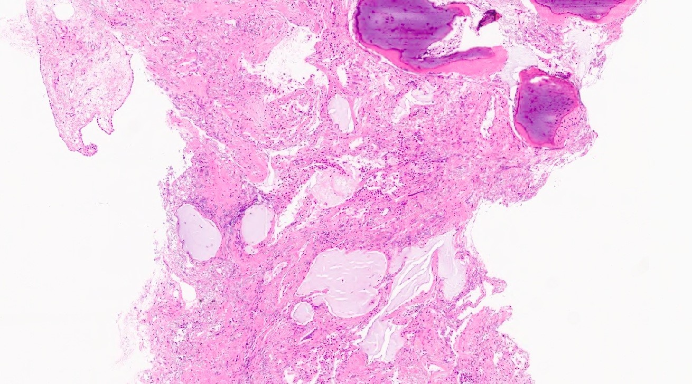
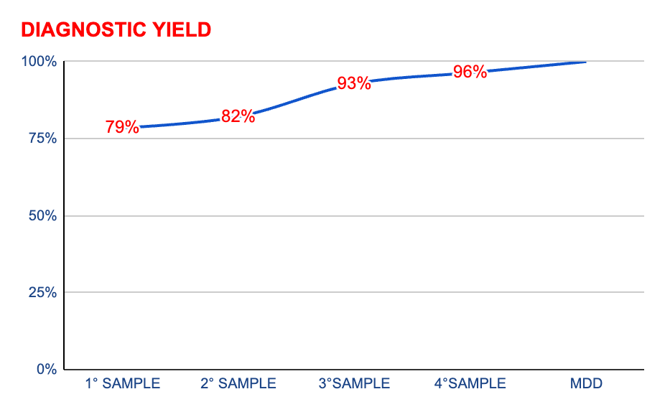
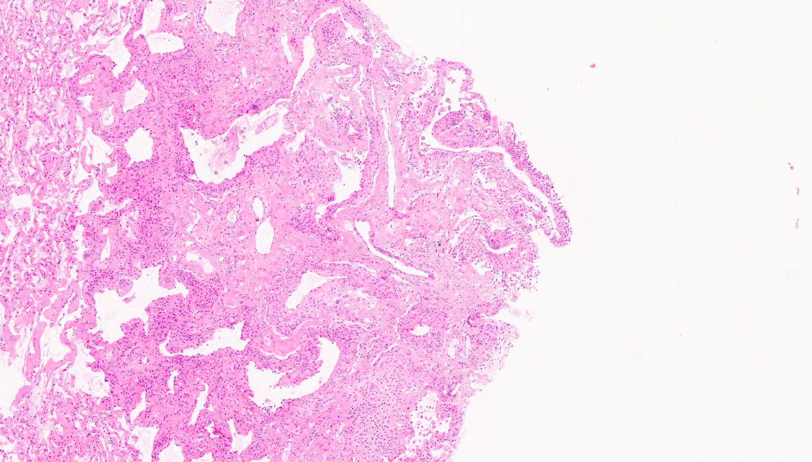
Role of cone-beam CT in early ILD
1° SAMPLE | 2° SAMPLE | 3°SAMPLE | 4°SAMPLE
79% | 82,14% | 92,80% | 94,40%
DIAGNOSTIC YIELD 94%
UIP high confidence 5/6=83%
Different pathologic patterns:
UIP (25 %), NSIP (16.7%), OP (11%), HP (5.6%).
Final MD obtained in 34/36 (94.4%).
Ravaglia, et al. Respiration 2024
Notes:
…………..
-Diagnostic yield was very good (> 90%), with almost 80% of diagnostic samples being the first one collected.
-Different pathologic patterns have been described (UIP, NSIP, OP, HP, .) and confidence level was high in the majority of cases.

Slide 30
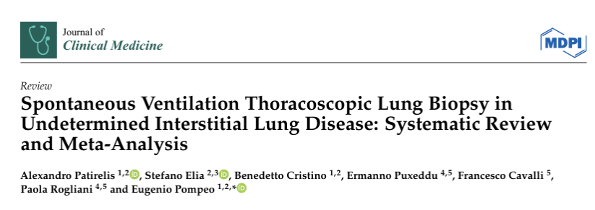
AWAKE-non intubated VATS
675 patients across 13 studies
Diagnostic yield ranged from 84.6% to 100%, with a mean of 97.1%.

Slide 31
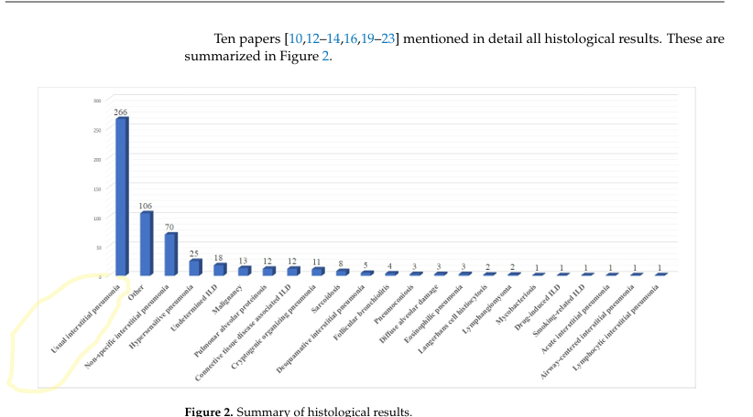
UIP=61% (in cryoTTB series UIP 25-35%)

Slide 32
Diagnostic yield
Diagnostic accuracy
Complications
Impact on treatment and prognostication

Slide 33
Results: Histopathology Assessment
Primary Endpoint
Guideline-refined histopathology:
Agreement 70.8%
κ_{w} 0.70 (95% CI 0.55 - 0.86)
Key Secondary Endpoint
Specific histopathology pattern:
Agreement 69.2%
κ 0.47 (95% CI 0.30 - 0.64)
Guideline-refined histopathological patterns
Troy, Grainge, Corte, Williamson…Lau, et al. Transbronchial Lung Cryobiopsy for Interstitial Lung Disease Diagnosis (COLDICE): A Multi-centre, Prospective, Comparative Study. Lancet Respir Med 2019
L Troy, et al. Lancet Reespir Med 2019

Slide 34
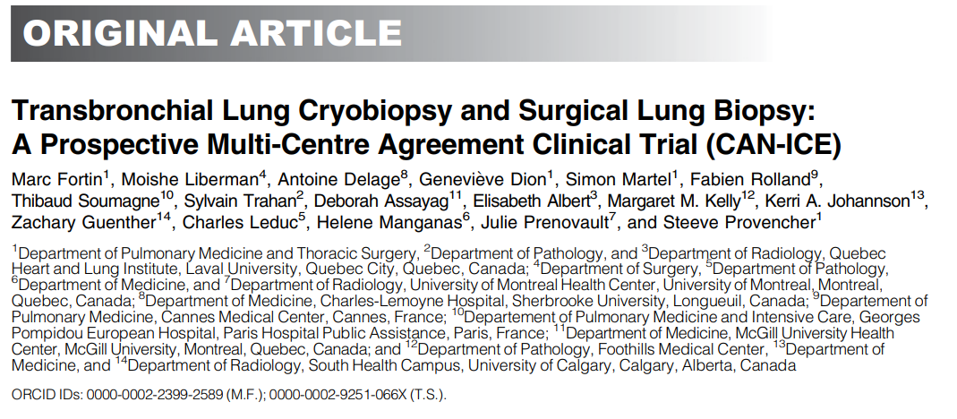
AJRCCM, 2023
20 patients
VERY LOW VOLUME OF ACTIVITY
Notes:
The paper by a Canadian group, is dealing with a very complex question: compare the data provided with transbronchial cryobiopsy with those obtained by surgical lung biopsy in patients with unclassifiable or low-confidence diagnosis of diffuse chronic ILD after a Multidisciplinary discussion (MDD) between clinicians and radiologists. Diagnostic agreement was evaluated for both pathological and MD diagnosis, within the same center and between different centers……..

Slide 35
PATHOLOGIC CONSIDERATIONS (and technical issues)

Slide 36
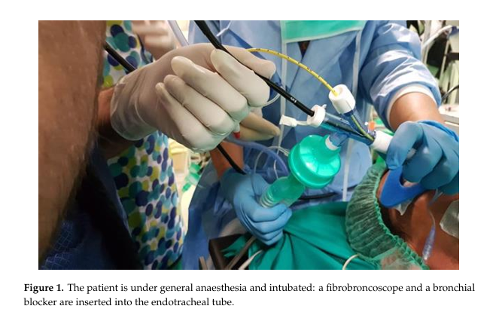
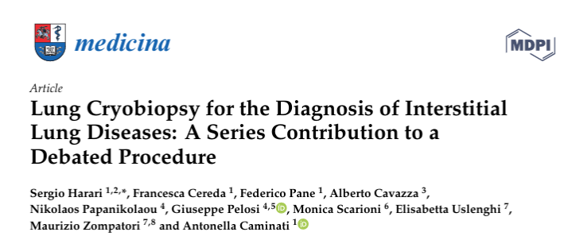

Slide 37
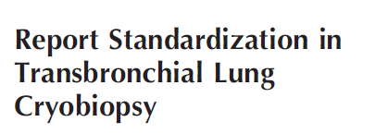
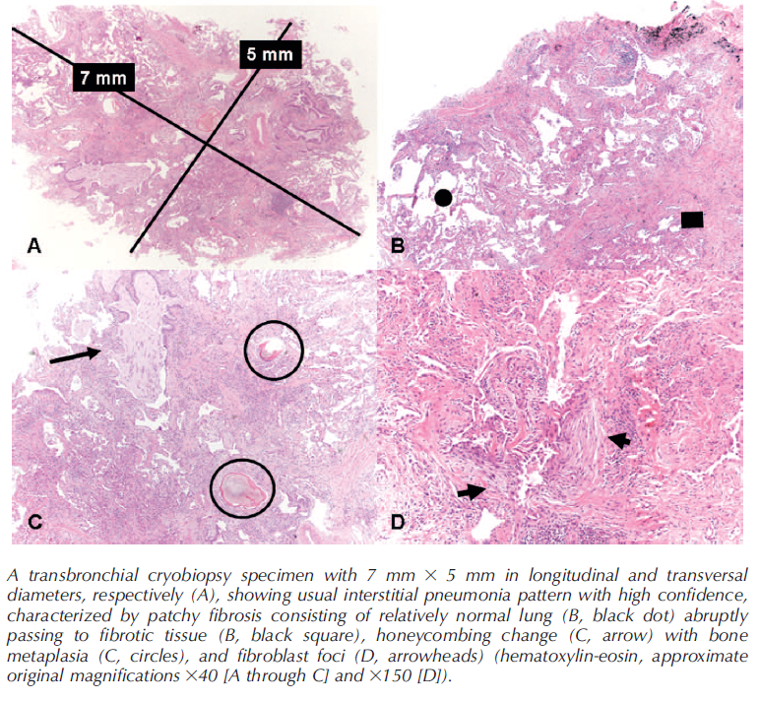
Ravaglia C,et al. Arch Pathol Lab Med 2018
-Site & Size
-Quantity of alveolated tissue
-Pleura,interlobular septa,centrilobular zones?
-Artifacts
-elementary lesions
-main alterations/ancillary findings
-immunohistohemical staining
Pattern (if any) and diagnostic confidence

Slide 38
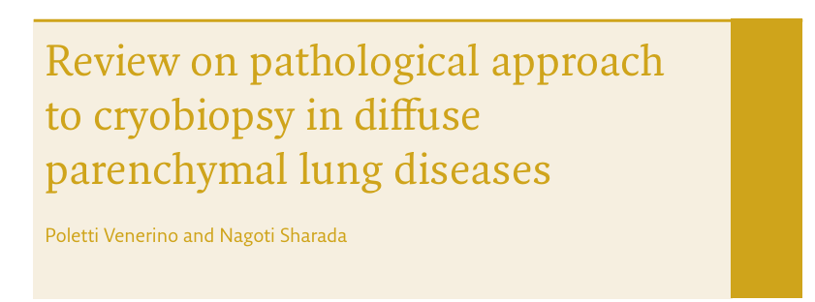
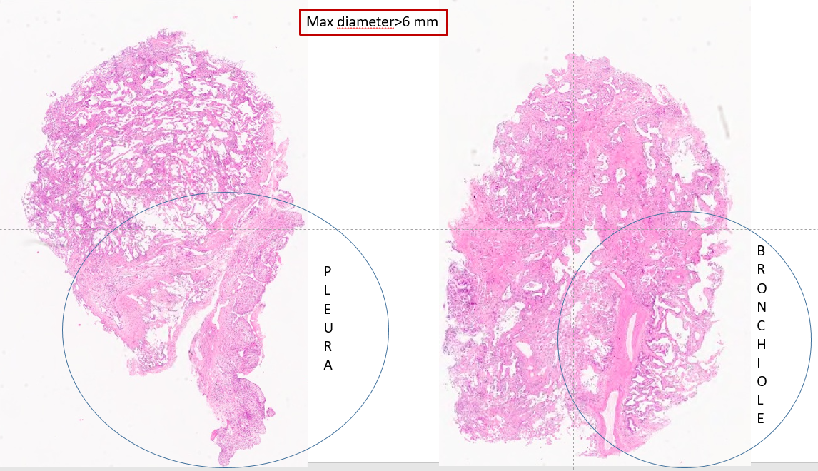
ERS Handbook: Respiratory Medicine 3 Ed, in press

Slide 39
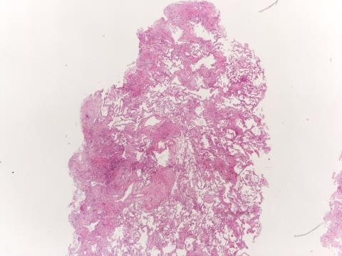
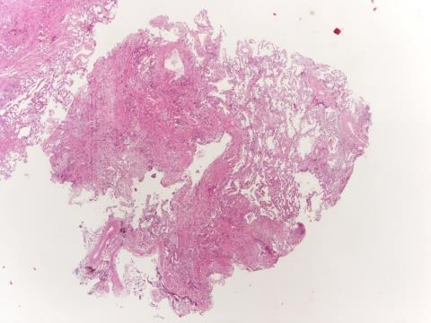
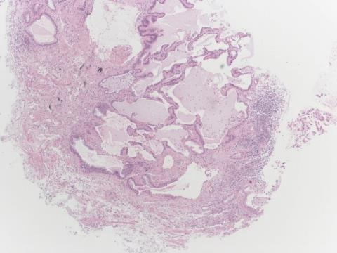
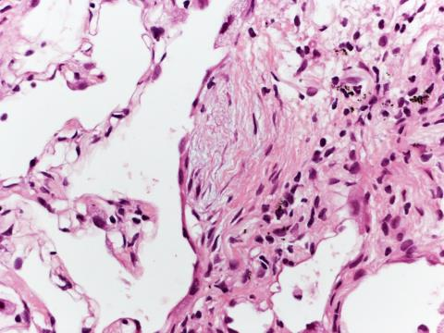
UIP Hi Confidence

Slide 40
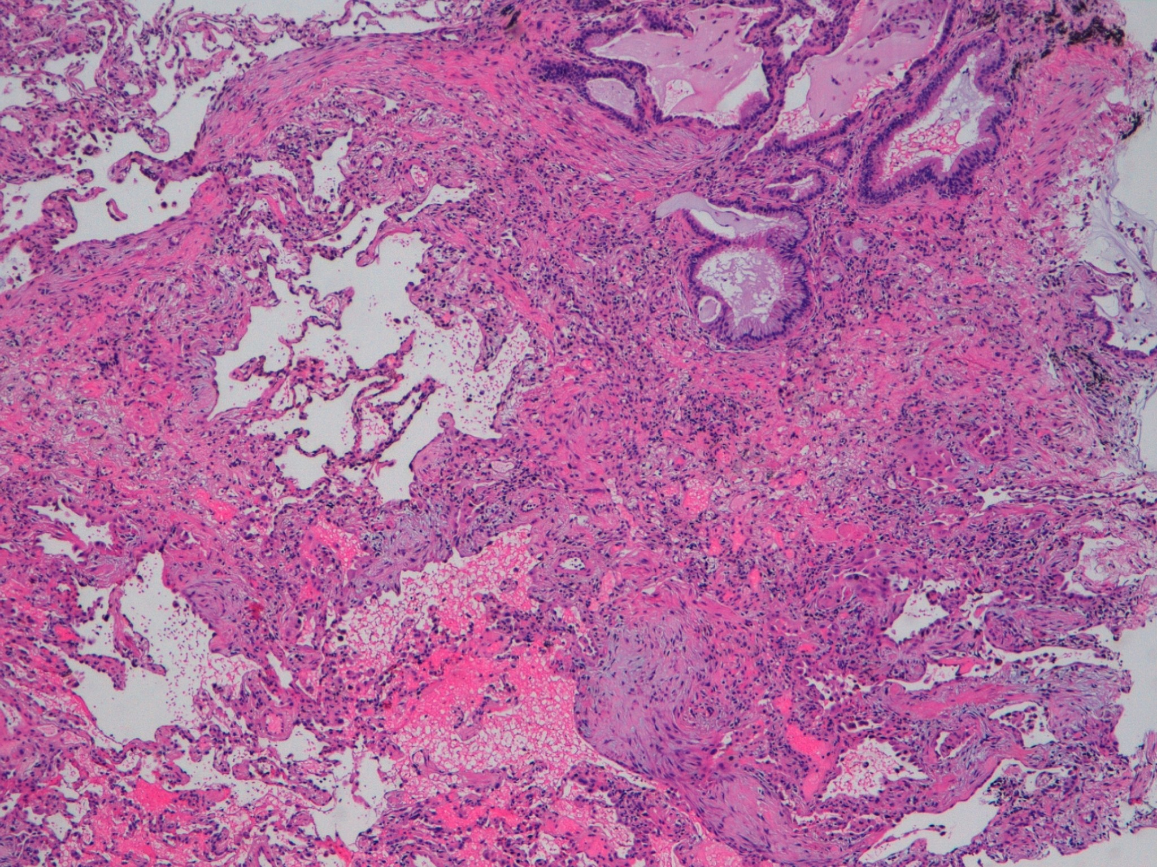

Slide 41
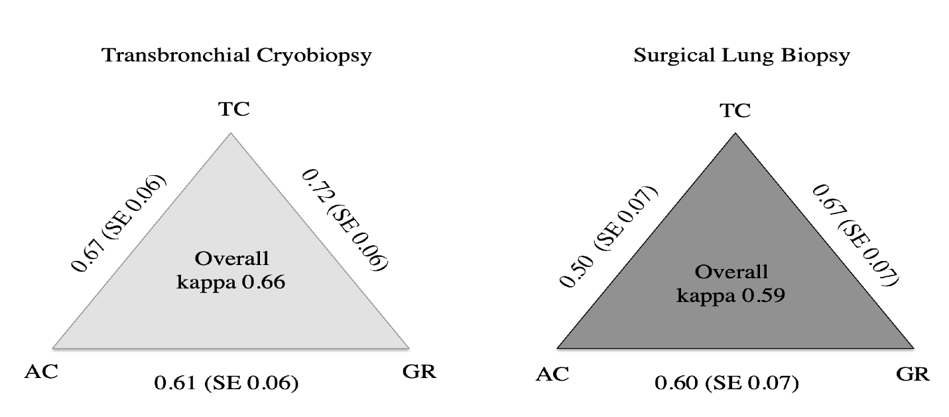
Pathological considerations
The area of samples strongly correlates with the diagnostic yield. The mean area of the samples was 41.99 ± 14.43 mm2 in the diagnostic group and 28.43 ± 11.66 mm2 in non diagnostic cases.
Hetzel J, et al, Respiration 2018;
Casoni GL, et al, PLOSone 2014
Colby TV, et al. Arch Pathol Lab Med, 2017
Ravaglia C, et al. Arch Pathol Lab Med 2019
Pathological distinction of UIP compared to non UIP:
Proportion of UIP cases diagnosed with high confidence was 89% for TBLC and 91% for SLB.
Kappa was similar between TBLC and SLB.
Tomassetti S, Ravaglia C, Wells AU et al, LRM 2020

Slide 42
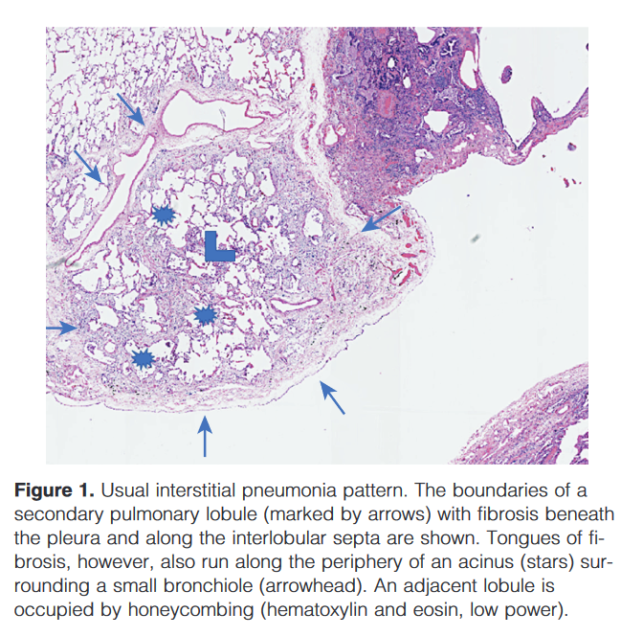
UIP pattern in cryobiopsies:the importance of visceral pleura in cryosamples
Paper | Pathol DY | % pleura | UIP high confidence | Pnx incidence
*Cooper WA et al, 2021 | 80 % | 9% | 12% | NA
Ravaglia C, BMC 2019 | 89% | 25% | NA | 19%
Ravaglia C, Pulmonology 2023 | 90% | 35% | 85% | 30%
Ravaglia C, Respiration 2024 | 96% | 37% | 83% | 25%
*High diagnostic confidence is reported more frequently for the interpretation of SLB than for TBLC (46.2% vs 12.3%, p=0.007)
Poletti V, et al. AJRCCM 2021
Notes:
And from the sub-pleural region, the patchy interstitial process of UIP pattern often emanates.
The combined findings generating “probable UIP” pattern have a peripheral acinar distribution; because the periphery of the acinus includes paraseptal, subpleural, and peribronchiolar regions, samples obtained by cryobipsy (although not quite perilobular) might be adequate enough to identify UIP.
In Cooper paper, visceral pleura was documented in about 9% of these samples. In other studies, 25-35% of the samples obtained by cryobiopsy showed pleura and UIP pattern was identified with increasing confidence, accepting however an increased rate of pneumothorax.

Slide 43
Diagnostic yield
Diagnostic accuracy
Complications
Impact on treatment and prognostication

Slide 44
Surgical lung biopsy for ILD is associated with
In-hospital mortality of 1.7% in elective patients, but
A significantly increased mortality
*of greater than 15% in unplanned procedures.
*Increasing age (>67 yrs)
*Presence of Comorbidities
§male sex, open surgery, and a provisional diagnosis of IPF-CS or CTD-ILD were also associated to increased mortality.

Slide 45
ERR, 2022
The 43 studies included 4550 patients (sample size range 12–359).
TBLC was performed in 2824 patients and SLB (by VATS) in 1814.
In TBLC, pooled incidences of complications were 9.9% (95%CI6.8–14.3) for significant bleeding
(6.9%for centres with⩾70 TBLC), 5.6%(95%CI3.8–8.2)for pneumothorax treated with a chest tube
and 1.4%(95%CI0.9–2.2) for acute exacerbation of ILD after TBLC.
The mortality rates were 0.6% and 1.7% forTBLC and VATS, respectively.

Slide 46
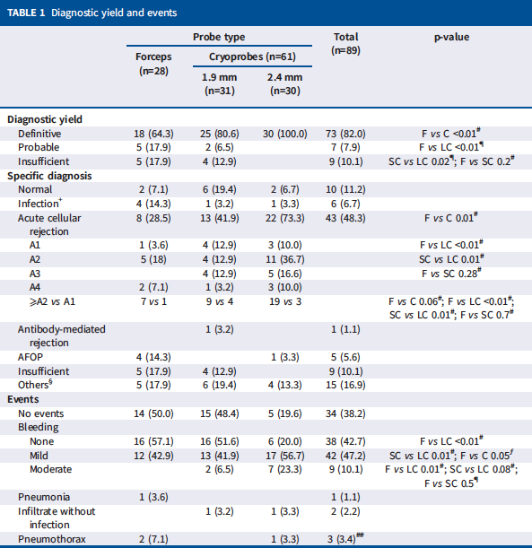
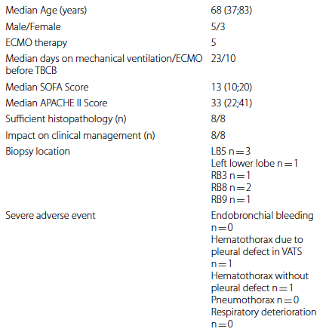
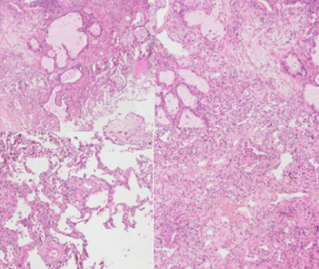
Loor K, et al. Eur Respir J 2023 Jan 6
Eisenmann S, et al. BMC Pulm Med 2023 Jan 5
Notes:
However, there is increasing literature about cryobiopsy in patients with severe respiratory failure, ARDS with dependency on mechanical ventilation with or without ECMO , with an acceptable level of safety and these are the most recent articles published on the topic which I will go through very quickly.

Slide 47
AWAKE (non-intubated) VATS
675 patients across 13 studies
Operative mortality was zero
*Morbidity ranged from 0.0% to 27.3%, with a median of 7.0%.
The most common complications were
*prolonged air leaks (23.4%),
*pneumonia (7.8%), and
*atelectasis (6.2%).
Hospitalization ranged from a mean of 1 day to a median of 8 days

Slide 48
Diagnostic yield
Diagnostic accuracy
Complications
Impact on treatment and prognostication

Slide 49
UIP pattern (in CT &/or histology): a relevant marker predicting progression regardless the final diagnosis
-Stock CJW, et al.Deep-learning CT imaging algorithm to detect usual interstitial pneumonia pattern in patients with systemic sclerosis-associated interstitial lung disease: association with disease progression and survival. Rheumatology in press
-Chilosi M, et al.The pathogenesis of IPF:from «folies à deux» to «culprit cell Trio» Pathologica 2025
-Chilosi M, et al. Alveolar stem cell exhaustion, fibrosis and bronchiolar proliferation»related entities. A narrative review. Pulmonology 2025

Slide 50
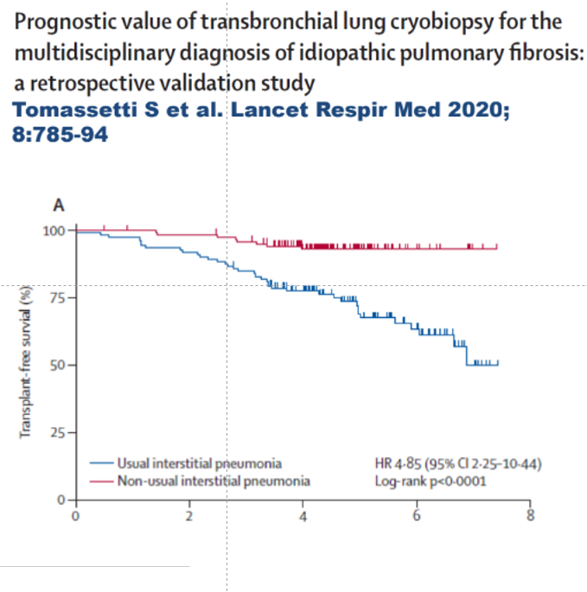

Slide 51
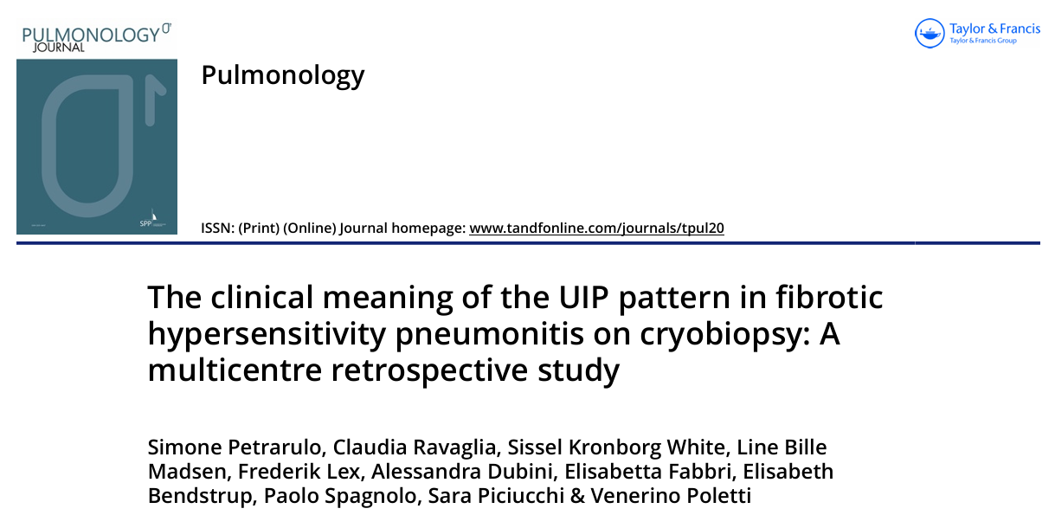

Slide 53
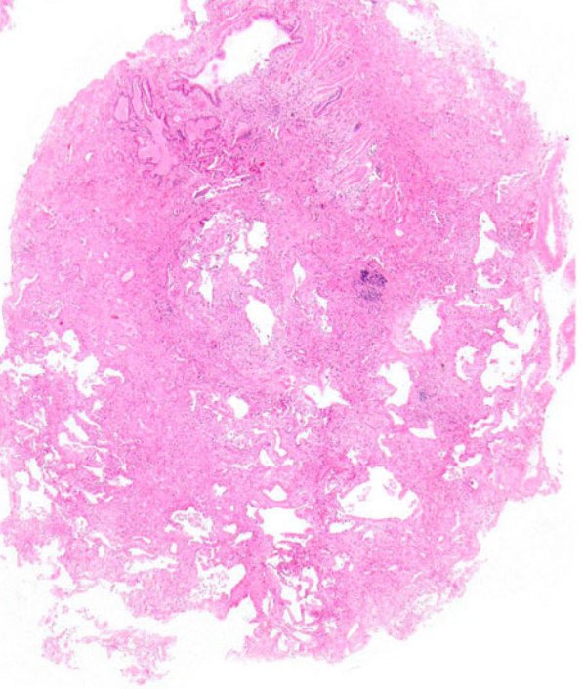
Feature | CTD cases, N (% of total) | IPF cases, N (% of total)
NSIP pattern without OP | 36/120 (30%) | 2/38 (5.2%)
OP without NSIP | 6/120 (5%) | 3/38 (7.8%)
NSIP + OP | 29/120 (24%) | 0/38 (0%)
UIP pattern | 28/120 (23%) | 27/38 (71%)
Interstitial giant cells | 7/120 (5.8%) | 0/38 (0%)
16/68 (24%) of patients with OP/NSIP-indeterminate UIP on HRCT had UIP on biopsy
 | IPF | fHP | CTD-DIL | Comparisons
Lymphoid aggregates/mm2 all cases | 0,042 | 0,039 | 0,079 | IPF vs fHP, p 0,98 IPF vs CTD, p 0,008 fHP vs CTD, p 0,09
Lymphoid aggregates/mm2 cases with UIP pattern | 0,044 | 0,029 | 0,054 | IPF vs fHP, p 0,61 IPF vs CTD, p 0,38 fHP vs CTD, p 0,08
Fibroblast foci/mm2 all cases | 0,12 | 0,080 | 0,034 | IPF vs fHP, p 0,79 IPF vs CTD, p 0,002 fHP vs CTD, p 0,13
Fibroblast foci/mm2 cases with UIP pattern | 0,16 | 0,27 | 0,12 | IPF vs fHP, p 0,21 IPF vs CTD, p 0,41 fHP vs CTD, p 0,13
Churg A, Poletti V, Ravaglia C, et al. Histopathology 2025
Notes:
-This study analyzed 120 cases with MD diagnosis of CTD-ILD, who had undergone lung cryobiopsy, of which 81 came from our department
-A NSIP pattern was found in 30% of cases and a combination of NSIP + OP in 24% (whereas these patterns were very uncommon in IPF biopsies); thus, an NSIP/OP-NSIP pattern favours a diagnosis of CTD–ILD over a diagnosis of IPF.
-But what is more interestingly is that a UIP pattern was found in 23% of CTD–ILD cases vs 71% of IPF cases!!
-Interesting is that 24% of patients with NSIP or OP/NSIP pattern on CT scan had a UIP pattern on cryobiopsy.

Slide 54
Ann Am Thorac Soc 2022

Slide 55
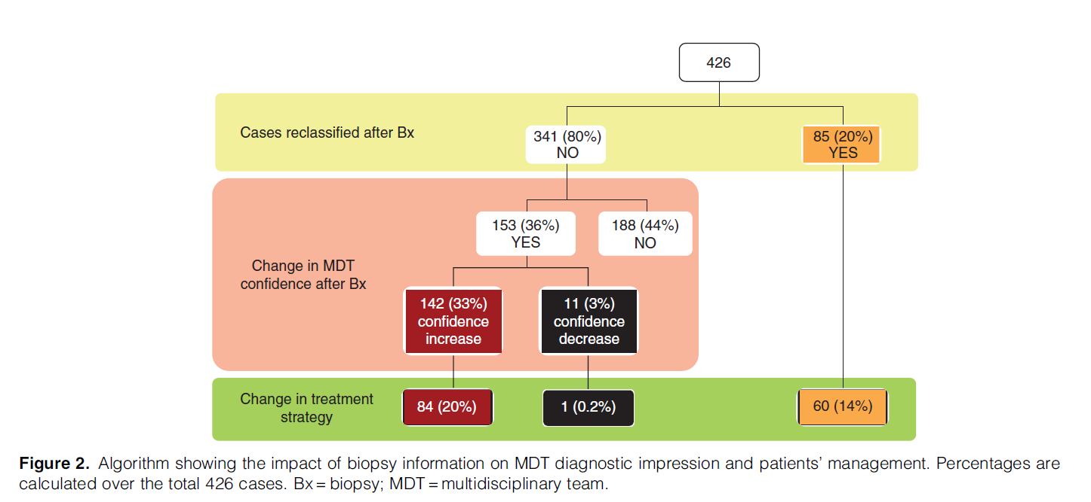

Slide 56
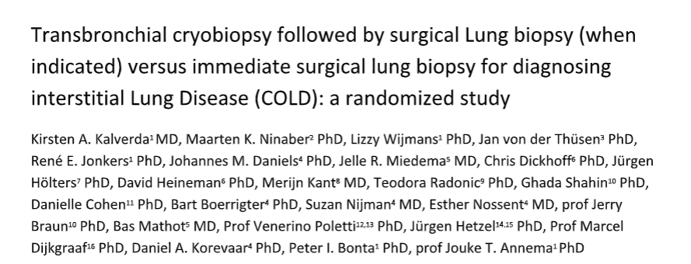
-CryoTBB in the diagnostic workflow
LRM, 2024

Slide 57
When TBLCB is mandatory and when it isn’t
What are the potential complications
with increasing one’s level of medical
knowledge, and what risks are involved in
accepting a certain degree of clinical uncertainty
Diagnostic yield
Diagnostic accuracy
Complications
Impact on treatment and prognostication
The role of TBLCB in the diagnostic work-flow
of fILDs

Slide 58
BIOPSY
Cottin V, et al. AJRCCM 2022, modified

Slide 59
WHEN TBLC IS TO BE CONSIDERED CLINICALLY USEFUL* (the value 1 is divided into 5 parts)
*genetic background/family history is part of the clinical setting (when present the need of biopsy decreases significantly)
 | HRCT UIP | HRCT PROBABLE UIP | Indeterminate UIP | OTHER THAN UIP
TYPICAL CLINICAL SETTING | ----- | -----+ | +++++ | +++++
ATYPICAL CLINICAL SETTING | --+++ | ++++- | +++++ | +++++
CTD-ILD | ----- | ----+ | ++++- | +++++
fHP ILA | ----- ----+ | ----- +++++ | ++++- +++++ | +++++ +++++

Slide 60
RESEARCH COULD BE PART OF THE GAME AS WELL

Slide 61
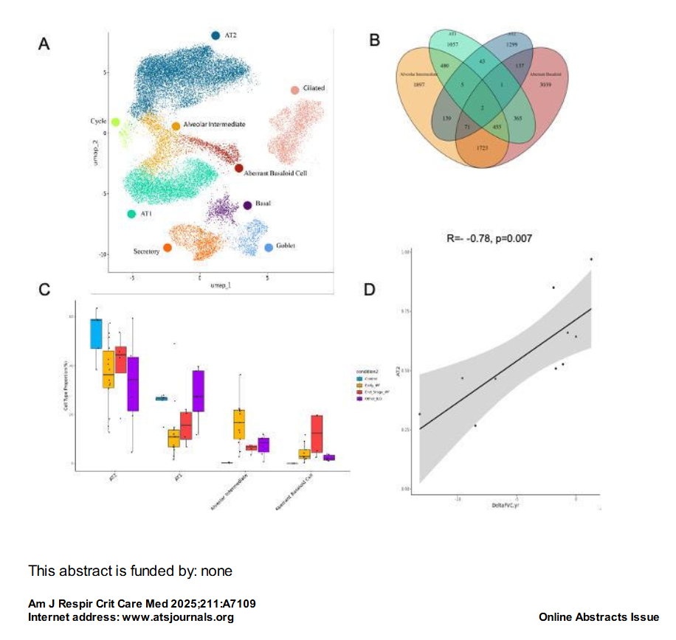
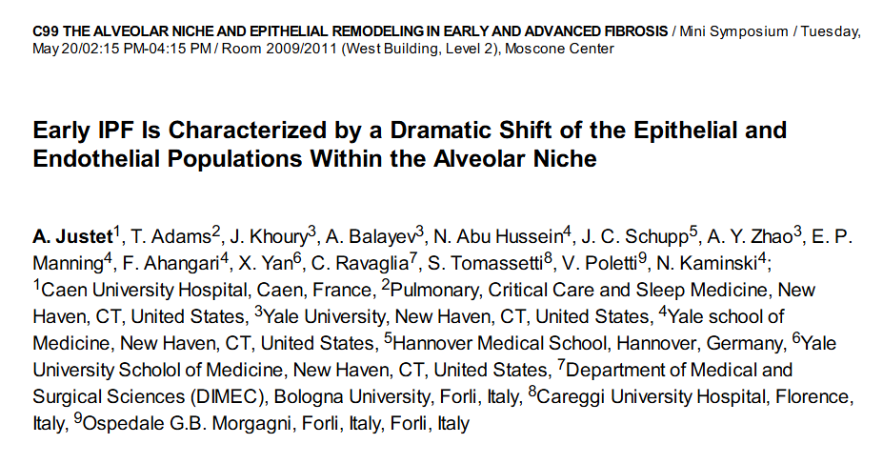
TISSUE AND RESEARCH.
CRYOTBB IS ENLARGING THE POSSIBILITIES FOR RESEARCH
Early IPF patients were predominantly male, with a mean age of 64 years. All patients had a normal FVC predicted value and a decreased predicted DLCO value (75 ± 13).
All Known Lung Cell Types were identified.
Early IPF is characterized by a shift in the alveolar cell populations. In comparison to control lungs AT1 and AT2 cell proportions are significantly declined and aberrant basaloid cells (TP63, CDH2, MMP7, CTSE positive cells) as well cell exhibiting intermediate phenotypes between AT1, AT2, and aberrant basaloid cells were observed (SFTPC or AGER, CTSE, CPA6, GDF15 positive cells but CDH2, TP63 negative).

Slide 62
New Endoscopic Techniques to diagnose ILDs
WHEN TRANSBRONCHIAL CRYOBIOPSY IS MANDATORY and WHEN IT ISN’T
Venerino Poletti
University of Bologna/Morgagni Hospital- Forli (I) (Full Prof& Head Dept)
Aarhus Universitet (Full-Hon Prof)

