Slide 1

Lung diseases in people addicted to illegal drugs
Claudia Ravaglia
University of Bologna (DIMEC) - GB Morgagni Hospital, Forlì (Italy)
TRIESTE - 13 MAY 2025
Notes:
-Greetings
-Lung diseases in people addicted to illegal drugs

Slide 2
Route of administration matters (injury phenotype)
Distinct pathophysiological consequences: particle size, systemic absorption, first-pass metabolism, tissue exposure, associated substances
Route of Administration | Primary Pulmonary Effects | Underlying Mechanisms
INHALATION (e.g., cannabis, crack cocaine, heroin vapor) | Bullous lung disease Diffuse alveolar damage Bronchial inflammation | Direct thermal and chemical injury to alveolar and airway epithelium Barotrauma from inhalation technique Oxidant injury and surfactant dysfunction
INTRAVENOOUS INJECTION (e.g., heroin, crushed pills with talc) | Foreign body granulomatosis Septic emboli Pulmonary hypertension | Microvascular embolization of insoluble excipients (talc, starch) Granulomatous inflammation Vascular remodeling and occlusion
SNORTED DRUGS (e.g., cocaine, methamphetamine) | Pulmonary vasoconstriction Alveolar hemorrhage Pulmonary hypertension | Systemic sympathetic activation Endothelial injury from vasospasm Platelet activation and thrombotic microangiopathy
Roset-Altadill A, et al. Eur J Radiol 2024
Notes:
-First of all, more than the specific substance, the ROUTE of administration does matter!!!
-In fact, it may critically result in DISTINCT pathophysiological consequences for the lung, due to to differences in particle size, systemic absorption, first-pass metabolism, tissue exposure and presence of associated substances
-And this is determinant for the PHENOTYPE of injury we observe both in clinical and pathological practice.
-So:
………………

Slide 3
Route of administration matters (injury phenotype)
Distinct pathophysiological consequences: particle size, systemic absorption, first-pass metabolism, tissue exposure, associated substances
Route of Administration | Primary Pulmonary Effects | Underlying Mechanisms
INHALATION (e.g., cannabis, crack cocaine, heroin vapor) | Bullous lung disease Diffuse alveolar damage Bronchial inflammation | Direct thermal and chemical injury to alveolar and airway epithelium Barotrauma from inhalation technique Oxidant injury and surfactant dysfunction
INTRAVENOOUS INJECTION (e.g., heroin, crushed pills with talc) | Foreign body granulomatosis Septic emboli Pulmonary hypertension | Microvascular embolization of insoluble excipients (talc, starch) Granulomatous inflammation Vascular remodeling and occlusion
SNORTED DRUGS (e.g., cocaine, methamphetamine) | Pulmonary vasoconstriction Alveolar hemorrhage Pulmonary hypertension | Systemic sympathetic activation Endothelial injury from vasospasm Platelet activation and thrombotic microangiopathy
Roset-Altadill A, et al. Eur J Radiol 2024
Notes:
…….
*INHALATION may be associated with direct injury to alveolar and airway epithelium, barotrauma from inhalation technique and oxidant injury and surfactant dysfunction
……….

Slide 4
Route of administration matters (injury phenotype)
Distinct pathophysiological consequences: particle size, systemic absorption, first-pass metabolism, tissue exposure, associated substances
Route of Administration | Primary Pulmonary Effects | Underlying Mechanisms
INHALATION (e.g., cannabis, crack cocaine, heroin vapor) | Bullous lung disease Diffuse alveolar damage Bronchial inflammation | Direct thermal and chemical injury to alveolar and airway epithelium Barotrauma from inhalation technique Oxidant injury and surfactant dysfunction
INTRAVENOOUS INJECTION (e.g., heroin, crushed pills with talc) | Foreign body granulomatosis Septic emboli Pulmonary hypertension | Microvascular embolization of insoluble excipients (talc, starch) Granulomatous inflammation Vascular remodeling and occlusion
SNORTED DRUGS (e.g., cocaine, methamphetamine) | Pulmonary vasoconstriction Alveolar hemorrhage Pulmonary hypertension | Systemic sympathetic activation Endothelial injury from vasospasm Platelet activation and thrombotic microangiopathy
Roset-Altadill A, et al. Eur J Radiol 2024
Notes:
…….
*INTRA-VENOUS INJECTION may cause microvascular embolization of insoluble excipients (such as talc), granulomatous inflammation and vascular remodeling and occlusion
……

Slide 5
Route of administration matters (injury phenotype)
Distinct pathophysiological consequences: particle size, systemic absorption, first-pass metabolism, tissue exposure, associated substances
Route of Administration | Primary Pulmonary Effects | Underlying Mechanisms
INHALATION (e.g., cannabis, crack cocaine, heroin vapor) | Bullous lung disease Diffuse alveolar damage Bronchial inflammation | Direct thermal and chemical injury to alveolar and airway epithelium Barotrauma from inhalation technique Oxidant injury and surfactant dysfunction
INTRAVENOOUS INJECTION (e.g., heroin, crushed pills with talc) | Foreign body granulomatosis Septic emboli Pulmonary hypertension | Microvascular embolization of insoluble excipients (talc, starch) Granulomatous inflammation Vascular remodeling and occlusion
SNORTED DRUGS (e.g., cocaine, methamphetamine) | Pulmonary vasoconstriction Alveolar hemorrhage Pulmonary hypertension | Systemic sympathetic activation Endothelial injury from vasospasm Platelet activation and thrombotic microangiopathy
Roset-Altadill A, et al. Eur J Radiol 2024
Notes:
……
SNORTED drugs may have a systemic vasoactive effects that target the pulmonary vascular bed via sympathetic tone and platelet activation with thrombotic microangiopathy

Slide 6
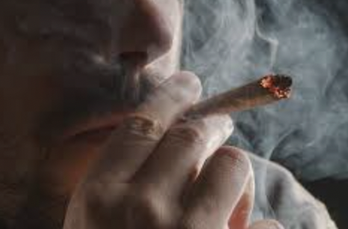
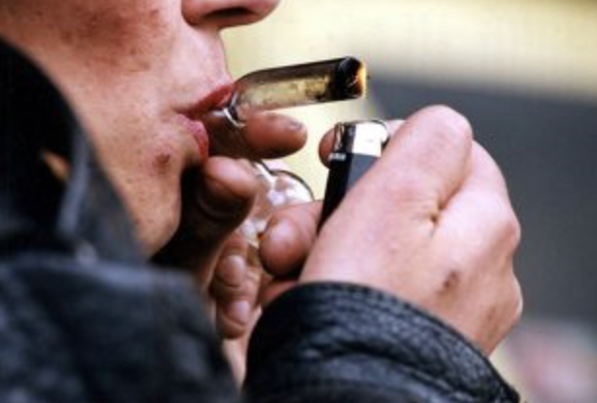
INHALATION (smoking, vaporizing)
Drugs involved: crack cocaine, methamphetamine, heroin vapors, marijuana
Smoked or vaporized
Direct thermal and chemical injury (epitelium and alveolar interface)
Patterns
  Diffuse alveolar hemorrhage (DAH) - crack cocaine
  Bullous lung disease - cannabis
  Bronchial inflammation and bronchospasm - heroin and meth vapors
  Thermal airway injury - high-temperature vapors (crack pipes)
Restrepo CS, et al. Radiographics 2007
Notes:
-The most direct route to lung damage is INHALATION.
-The two most common drugs inhaled are cocaine and cannabis are smoked or vaporized, exposing the epithelium and alveolar interface to direct thermal and chemical injury.
-And the 2 most common patterns are:
*Diffuse alveolar hemorrhage (particularly seen with crack cocaine)
*Bullous disease (especially in cannabis smokers)
*Bronchospasm and airway inflammation (mostly with heroin vapor)
-These manifestations can mimic autoimmune disease or emphysema, often leading to diagnostic confusion.

Slide 7
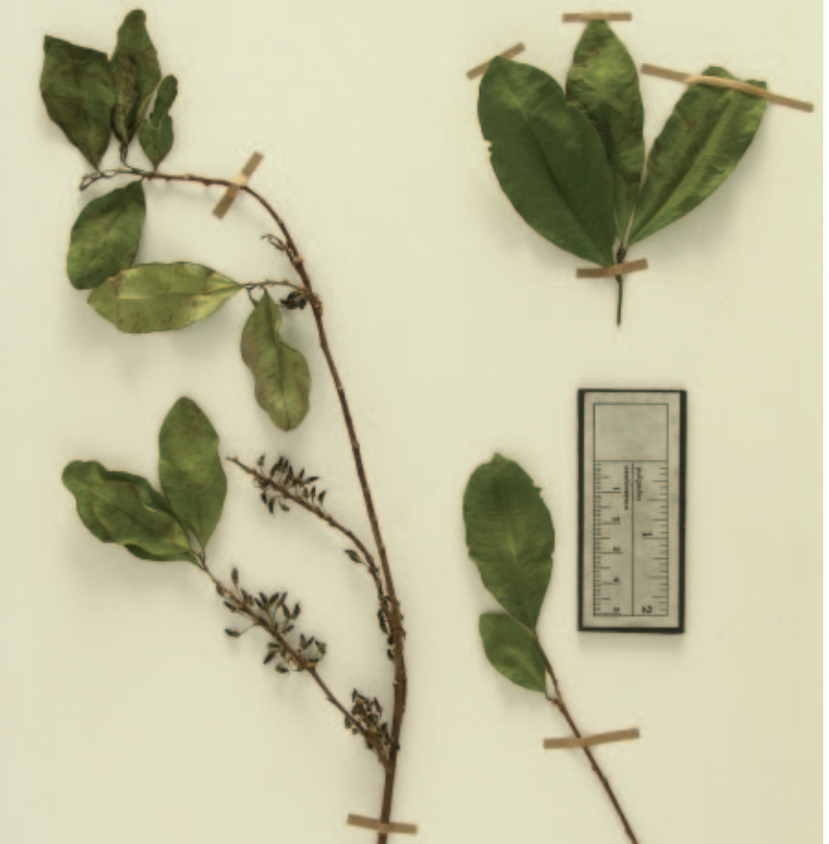
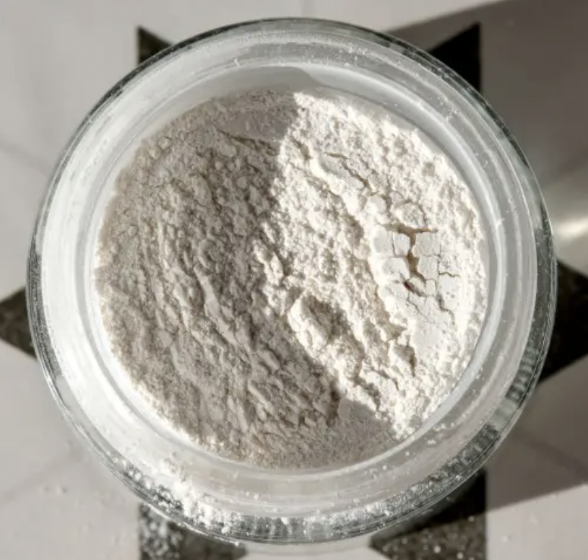
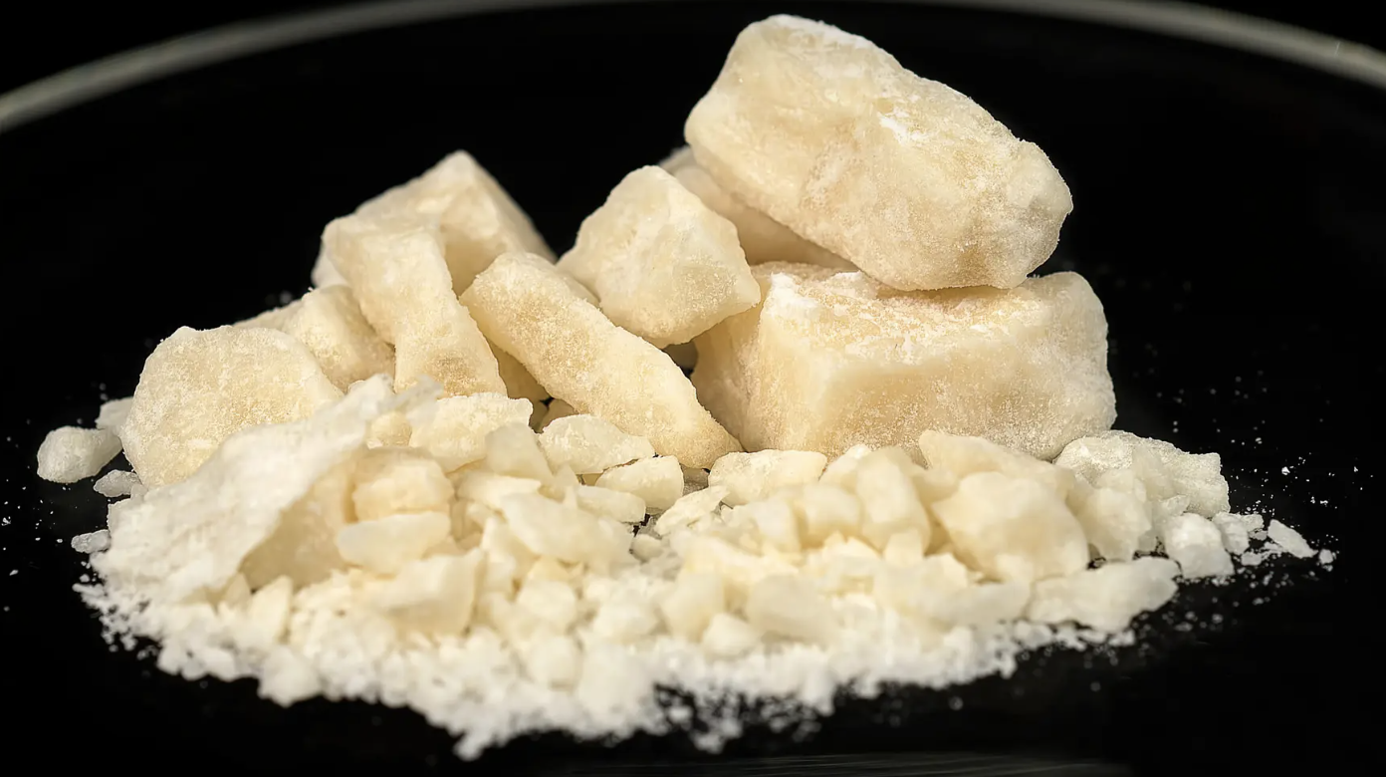
Cocaine is the most commonly used illicit drug among patients seen in hospital emergency departments and the most frequent cause of drug-related deaths reported by medical examiners. Sympathomimetic agent. 2 forms: powder and freebase.
FREEBASAE or CRACK
POWDER
Erythroxylum coca e Erythroxylum novogranatense
Restrepo CS, et al. Radiographics 2007
Notes:
-Cocaine is the most commonly used illicit drug among patients seen in hospital emergency departments and the most frequent cause of drug-related deaths reported by medical examiners.
-Cocaine is a potent sympathomimetic agent that can be found in 2 fundamental forms: powder cocaine (which can be taken orally, intravenously or sniffed), and smokable cocaine (called freebase or crack), which is considered to be more addictive)

Slide 8
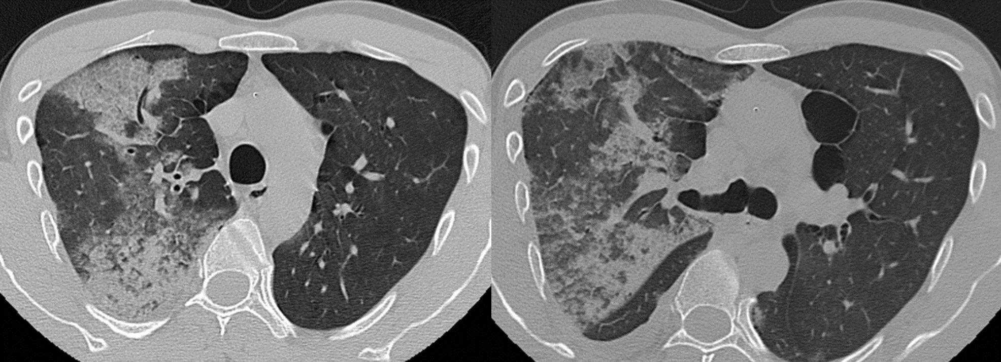
Diffuse Alveolar hemorrhage (DAH) is a medical emergency!!
37 yo, male
Smoker
Acute dyspnea and chest pain, within few hours of cocain use.
DAH: medical emergency that requires a timely diagnosis and etiology-specific treatment
In memory of Angelo Carloni
Notes:
-Diffuse Alveolar hemorrhage (DAH) is a medical emergency that can be life threatening, with massive bleeding and respiratory failure;
-Even when appropriately recognized, mortality may be high.
-therefore, it requires a timely differential diagnosis and an etiology-specific treatment
-On CT scan, we usually observe bilateral multifocal areas of ground-glass appearance that may be centrilobular with interlobular septal thickening.
-Acute respiratory symptoms usually develop within hours of use and are more common with the continuous use of cocaine.
-It has been proposed that chest pain may represent a local sensory response to acute airway irritation from the high concentration of cocaine in the inhaled smoke itself

Slide 9
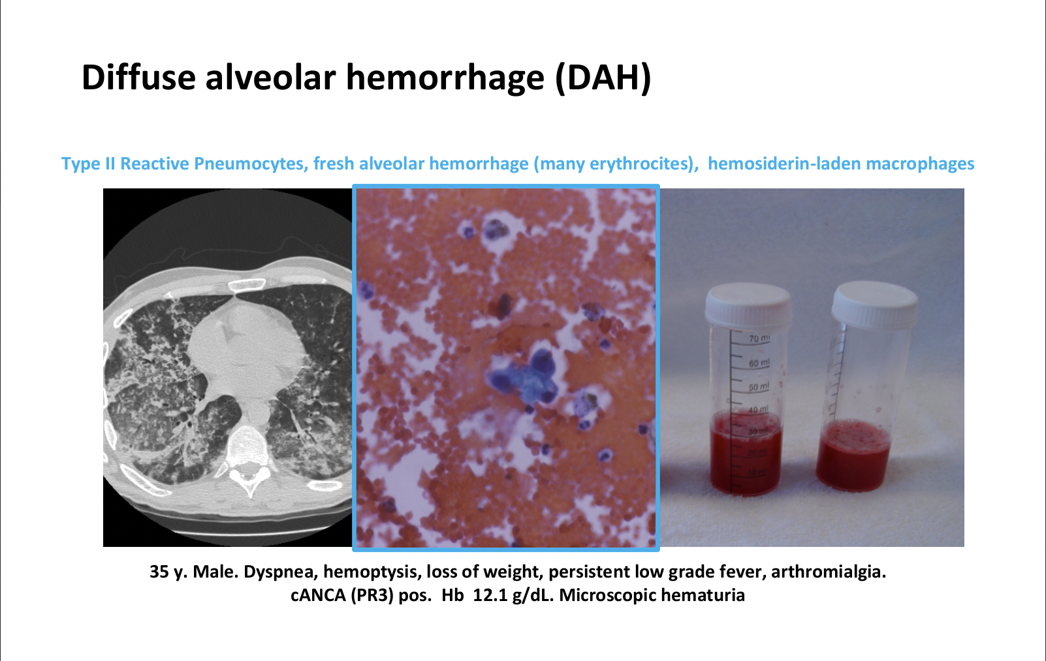
Notes:
This is the BAL in DAH

Slide 10
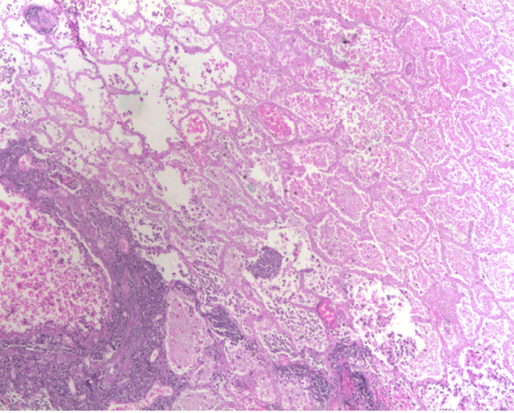
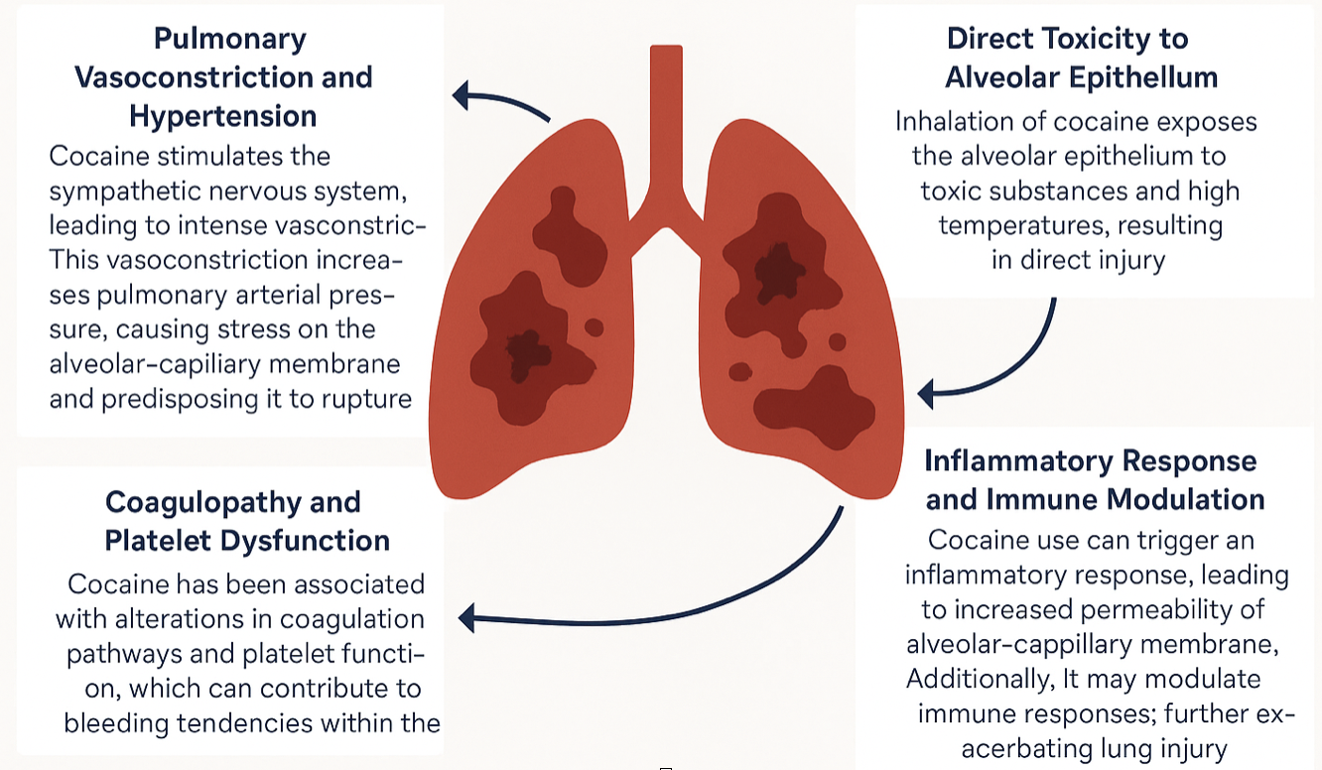
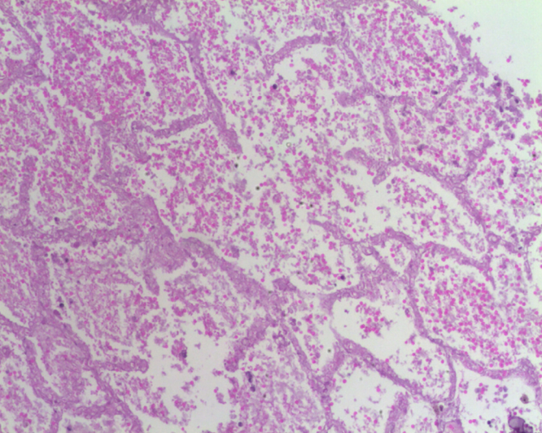
Pathophysiological Mechanisms of Cocaine-Induced DAH
Jiménez-Zarazúa O, et al. Heart Lung 2018
Notes:
-Cocaine-induced DAH results from a convergence of direct toxic effects and systemic pathophysiologic processes…………

Slide 11
Pathophysiological Mechanisms of Cocaine-Induced DAH
Jiménez-Zarazúa O, et al. Heart Lung 2018
Notes:
………
-First, cocaine, when inhaled, causes thermal and chemical injury to the alveolar epithelium, compromising the barrier integrity
…………

Slide 12
Pathophysiological Mechanisms of Cocaine-Induced DAH
Jiménez-Zarazúa O, et al. Heart Lung 2018
Notes:
………
-Second, it triggers inflammatory responses that increase permeability and may dysregulate innate immunity, further aggravating alveolar damage
…………….

Slide 13
Pathophysiological Mechanisms of Cocaine-Induced DAH
Jiménez-Zarazúa O, et al. Heart Lung 2018
Notes:
………
-Additionally, cocaine provokes intense pulmonary vasoconstriction through sympathetic activation, raising capillary pressures and mechanically stressing the alveolar-capillary interface
……………

Slide 14
Pathophysiological Mechanisms of Cocaine-Induced DAH
Jiménez-Zarazúa O, et al. Heart Lung 2018
Notes:
………
-Finally, its interference with platelet function and coagulation pathways adds a hemorrhagic predisposition.
-Understanding these pathways is essential for developing targeted therapeutic strategies and improving patient outcomes.

Slide 15
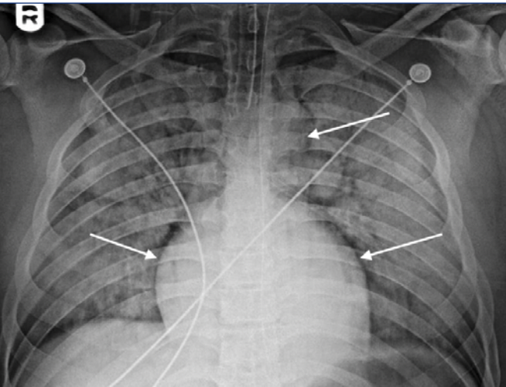
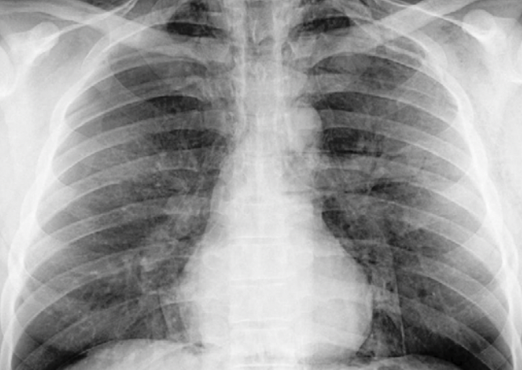
Dushay KM, et al. R I Med J 2013
Notes:
-Case reports describe spontaneous improvement of alveolar hemorrhage after cessation of crack or cocaine inhalation
-But spontaneous resolution should never be assumed, especially in the presence of respiratory failure!!

Slide 16
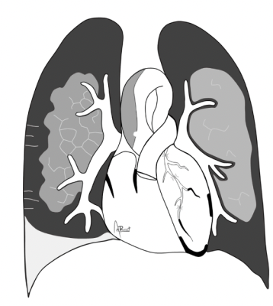
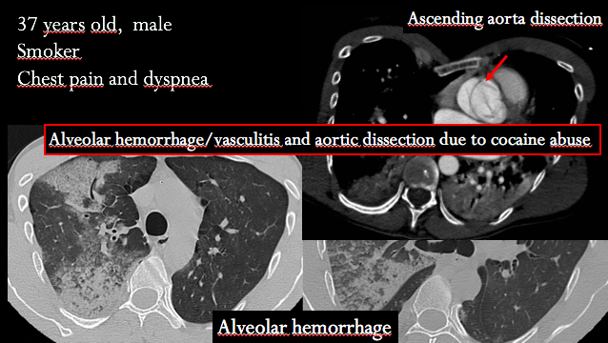
Ascending aorta dissection
In memory of Angelo Carloni
Notes:
-A brief degression: in this patient, ascending aorta dissection was also found ….

Slide 17
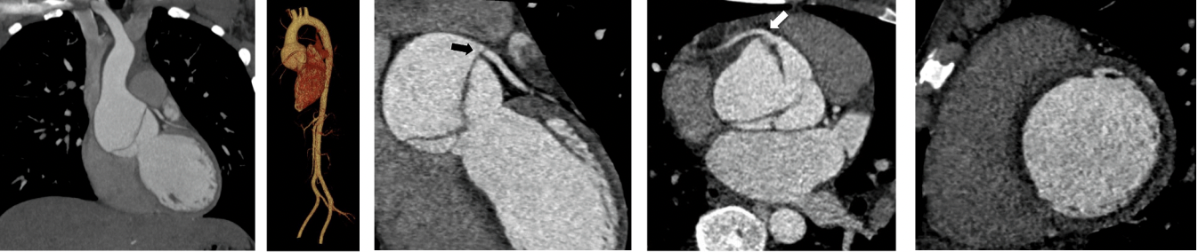
Ascending aorta dissection
CT angiogram
Increased myocardial contractility, tachycardia and hypertension => increased aortic shear stress
Findings: intimal flap, double lumen and dilatation of the aorta.
Complications: aortic rupture and extension to the coronary arteries
Roset-Altadill A, et al. Eur J Radiol 2024
Notes:
… which is due to a combination of *increased myocardial contractility, *tachycardia and *hypertension, thereby elevating the aortic shear stress and risk of endothelium injury.
-CT angiogram is the preferred imaging modality for the diagnosis. Findings include an intimal flap, a double lumen and dilatation of the aorta.
-Potential complications may be aortic rupture and extension to the coronary arteries
……

Slide 18
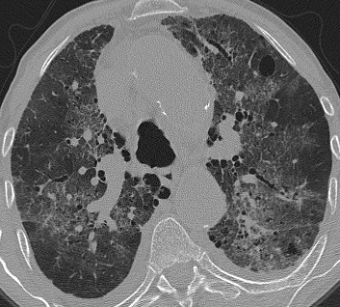
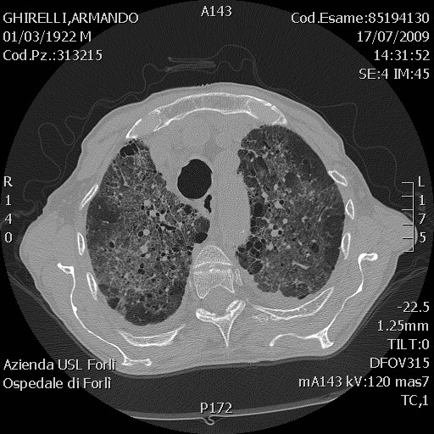
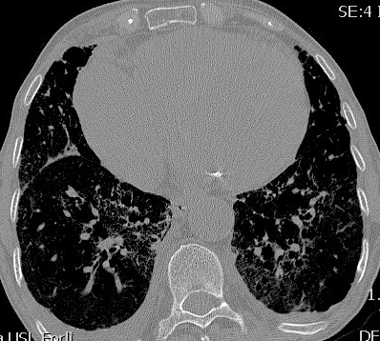
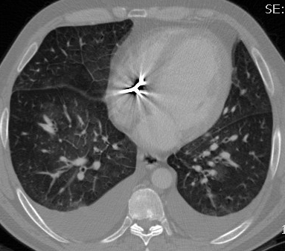
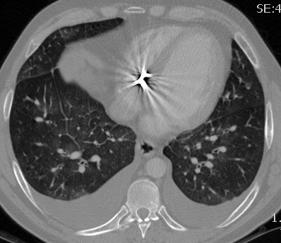
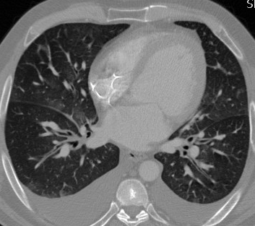
Cardiogenic pulmonary oedema
Notes:
….
-In these cases, cardiogenic pulmonary oedema may be frequent, with ground glass and smooth inter-lobular septal thichening, lower zones predominance

Slide 19
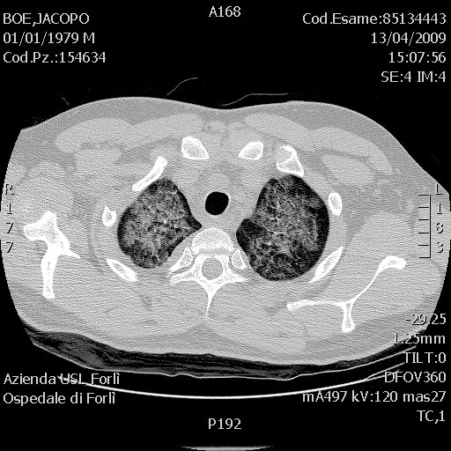
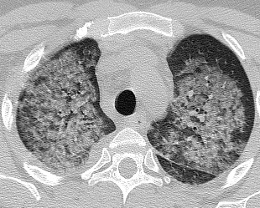
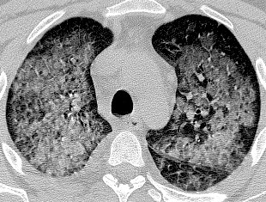
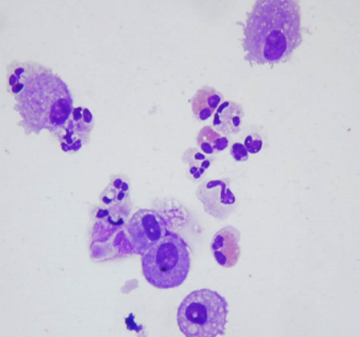
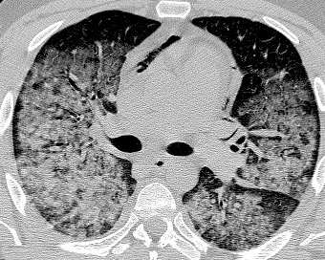
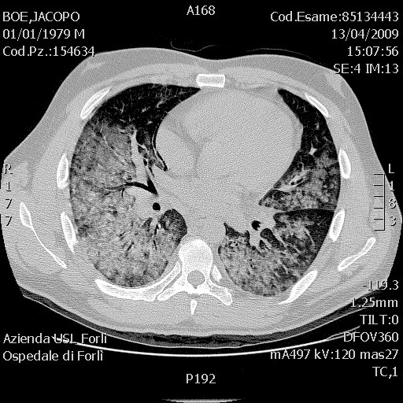
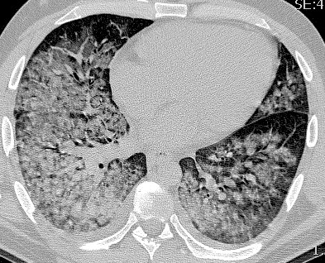
Crack Lung and Cocaine-induced Eosinophilic Lung Disease
Notes:
-Cocaine inhalation is well associated with pulmonary eosinophilia
-Affected patients usually have pulmonary eosinophilia at BAL and a variable degree of peripheral eosinophilia
-Imaging findings vary from predominantly interstitial and parahilar opacities to a more alveolar manifestation with airspace consolidation, with a patchy and random distribution or peripheral predominance.

Slide 20
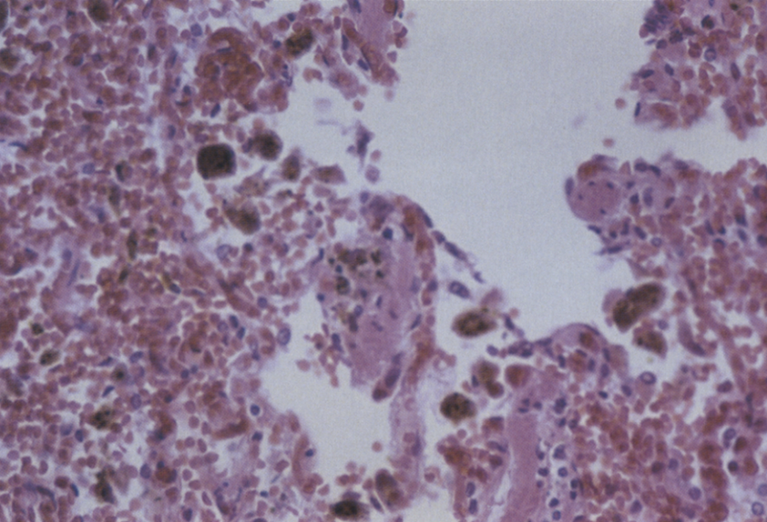
Asymptomatic Pulmonary Hemorrhage in Chronic Cocaine Use
Asymptomatic pulmonary hemorrhage has been documented in individuals using cocaine, particularly among habitual smokers
While diffuse alveolar hemorrhage (DAH) often presents with symptoms like hemoptysis, dyspnea, and hypoxia, studies have identified cases where pulmonary hemorrhage occurs without overt clinical signs.
A significant number of cocaine users exhibit histopathological evidence of pulmonary hemorrhage post-mortem, even in the absence of reported respiratory symptoms.
For instance, a study analyzing autopsies of individuals with positive cocaine toxicology found acute hemorrhage in 58% and chronic hemorrhage in 40% of cases.
Bailey ME, et al. Hum Pathol 1994
Notes:
-Chronic cocaine use can cause silent pulmonary hemorrhage, in chronic users without any clinical symptoms, with autopsy studies revealing significant alveolar haemorrhage in asymptomatic individuals

Slide 21
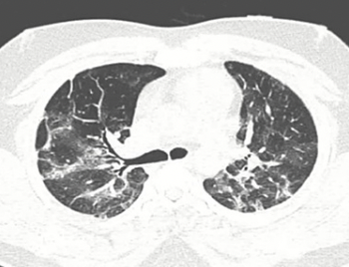
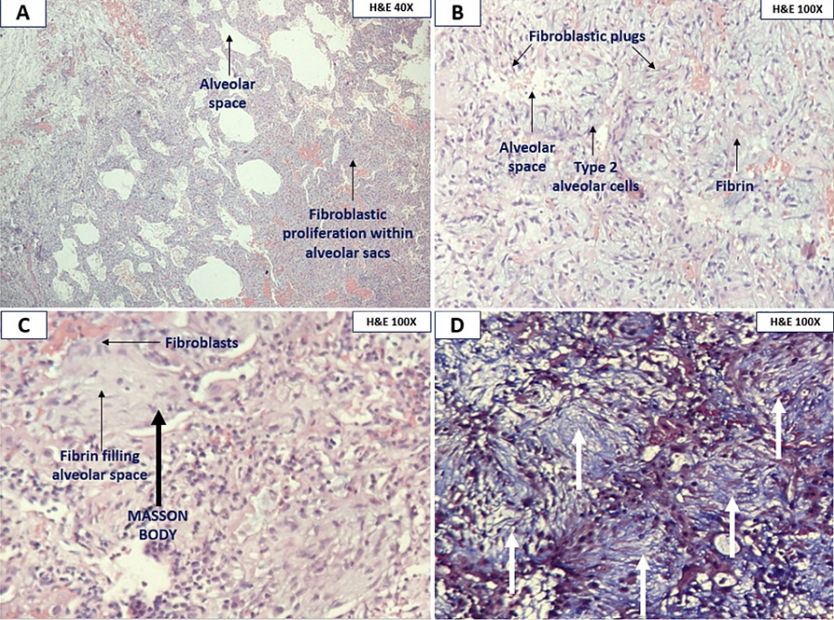
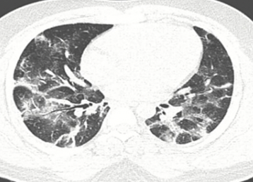
21-year-old male, cocaine use via smoking and snorting. Fever and sore throat
Nadaf Z, et al. Cureus 2023
Notes:
-Cocaine-induced Organizing pneumonia is uncommon.

Slide 22
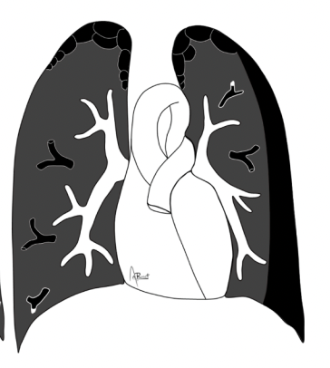
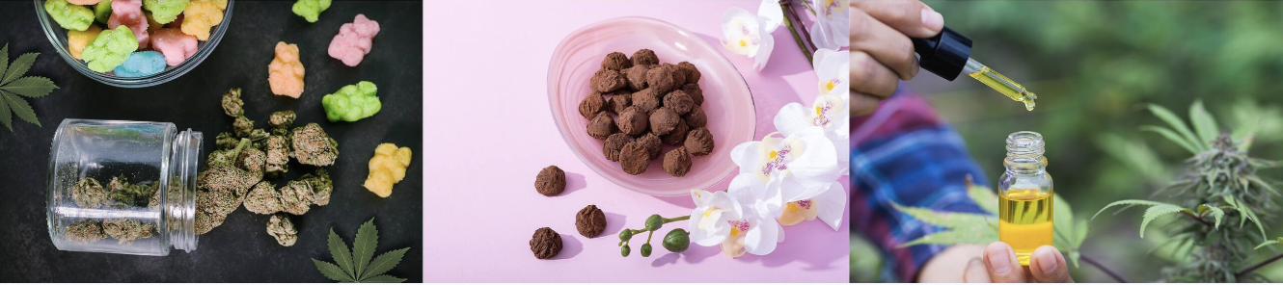
Cannabis (sativa) remains by far the most commonly consumed illicit drug, traffic of which in Europe is dangerously increasing (tetra-hydro-cannabinol).
Marijuana
Hashish
Hash oil
Roset-Altadill A, et al. Eur J Radiol 2024
Notes:
-Second “illicit” drug that can cause damage through inhalation is CANNABIS, which remains by far the most commonly consumed illicit drug in general
-Cannabis’ main component is tètra-hy’dro-cannàbinol
-Depending on the concentration of this cannabinoid, there are different types of recreational drugs: marijuana (an herbal compound that is usually smoked), hashish (a dried resin that can be smoked or ingested), and hash oil (the strongest product).

Slide 23
Pathophysiological Mechanisms
Limited longitudinal data and pathogenesis debated
Inhalation Techniques: Cannabis smokers often inhale deeply and hold their breath longer than tobacco smokers (increase intrathoracic pressure, alveolar rupture)
Inflammatory Response: irritants, inflammation of the airways, tissue damage and bulla formation
Synergistic Effects with Tobacco: the combined exposure may have additive detrimental effects on lung tissue.
Roset-Altadill A, et al. Eur J Radiol 2024
Notes:
-Cannabis smoking involves inhalation patterns that differ from tobacco, including longer breath-hold times and deeper inhalation.
-This generates high intra-thoracic pressure and may induce repetitive barotrauma at the alveolar level.
-Inflammatory responses and oxidative stress may also degrade the alveolar walls over time.
-Additionally, dual smoking with tobacco is common and likely synergistic
-However, longitudinal data are still limited and pathogenesis remains debated

Slide 24
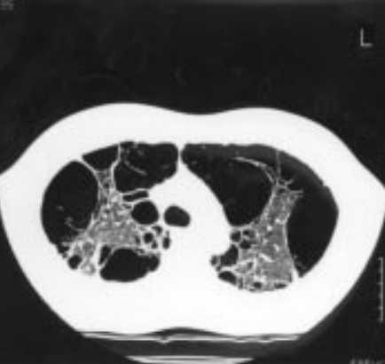
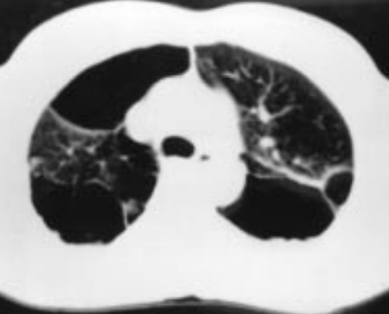
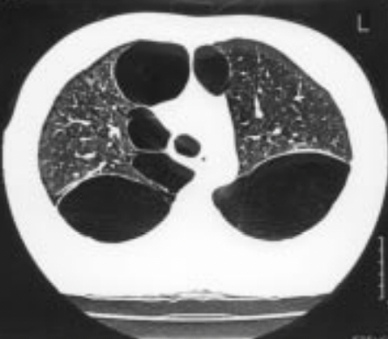
Large lung bullae in marijuana smokers (“vanishing lung”)
Emerging clinical concern (esp. young adults). Large air-filled spaces (bullae) in the lungs. Spontaneous pneumothorax.
Para-septal in distribution and upper lobes (different from lifetime of tobacco smokers)
Johnson MK, Set al. Thorax 2000
Notes:
-Bullous luxang disease associated with cannabis smoking is an emerging clinical concern, particularly among young adults.
-This condition is characterized by the formation of large air-filled spaces (bullae) in the lungs, which can lead to complications such as spontaneous pneumothorax.
-CT scan shows that these bullae are more para-septal in distribution and with a marked predisposition for the upper lobes, hence quite different from the more uniformly distributed bullae of centrilobular emphysema which are the typical changes associated with a lifetime of tobacco smoking

Slide 25
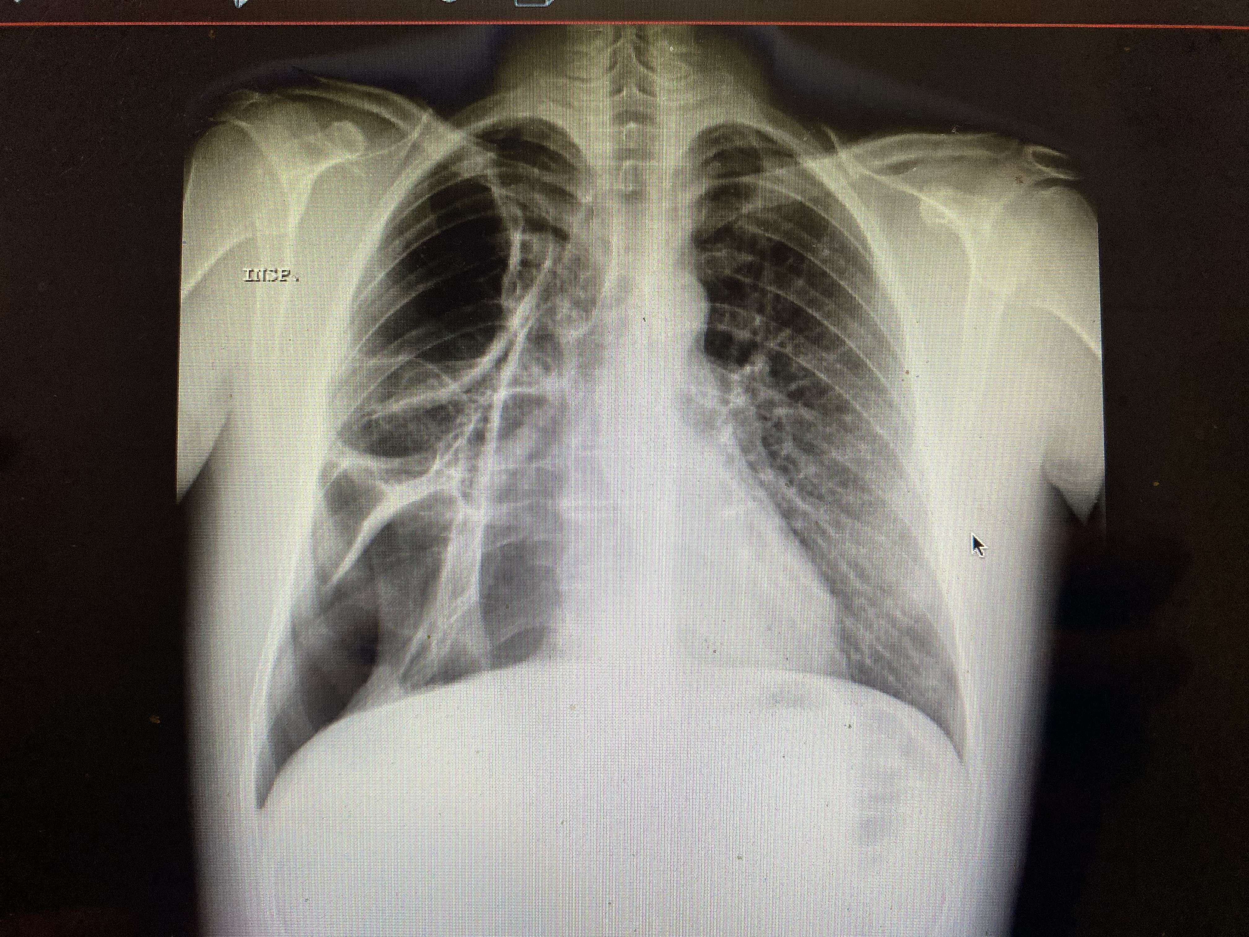
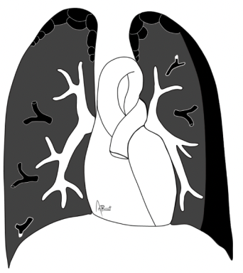
33 yo, male, 2 joints/day for > 10 years. Recurrent pneumothorax
Notes:
-Cannabis smokers are reported to present with pneumothorax (sometimes recurrent)

Slide 26
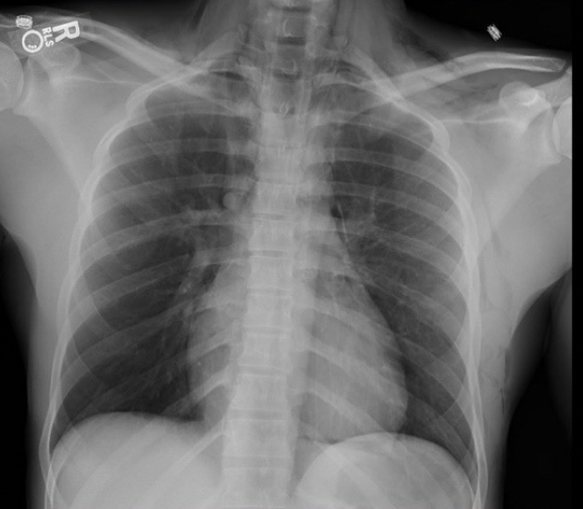
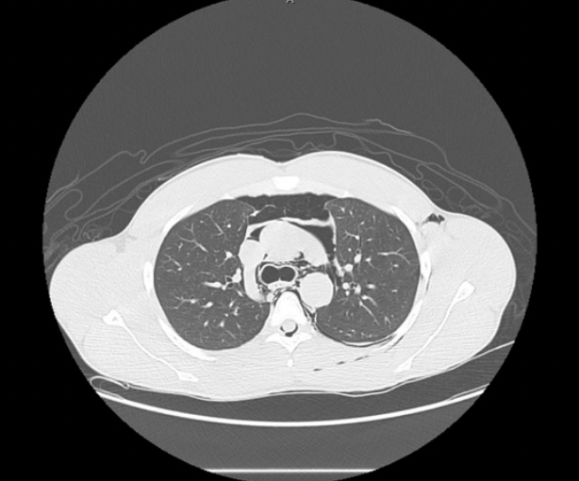
Healthy 22-year-old male with a history of recent marijuana use who presented with pneumomediastinum
Horugsa N, et al. Eur J Case Rep Intern Med 2024
Notes:
-Barotrauma in the form of pneumomediastinum has been reported to occur whilst smoking marijuana, due to larger inspiration volume and breath holding time more prolonged than cigarette.

Slide 27
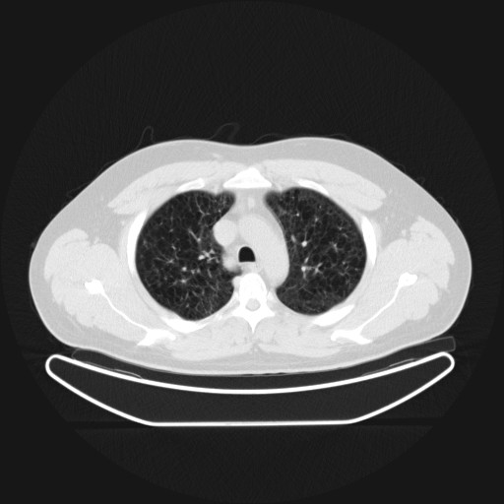
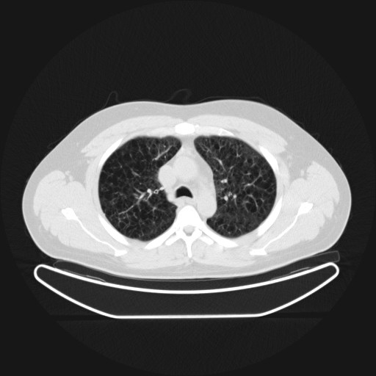
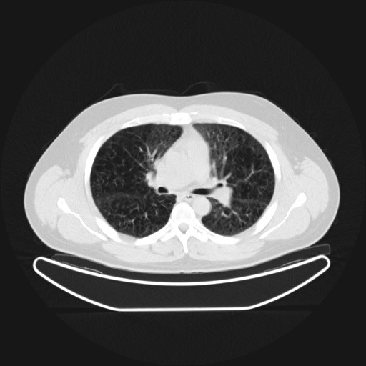
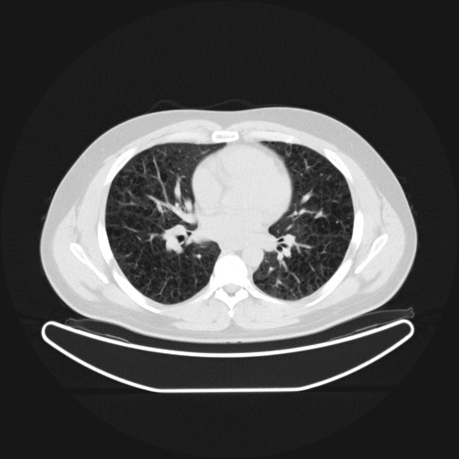
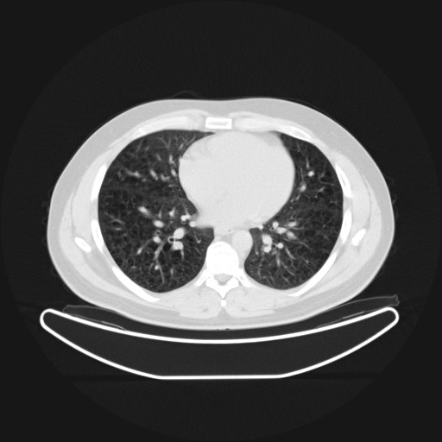
32-year-old male, non cigarette smoker.
Regular cannabis user.
Sales representative, asthmatic.
Dyspnea.
Notes:
-Here we have pulmonary emphysema.
-Although concomitant tobacco smoking remains a confounding factor in most cases, the young age of these patients supports that illegal recreational drugs play a role in the development of pulmonary emphysema.

Slide 28
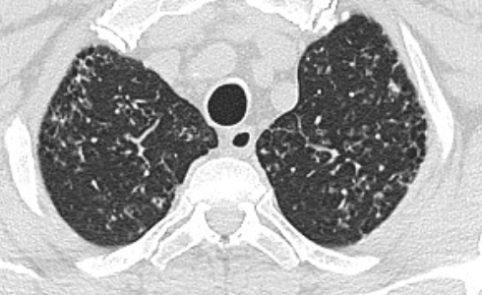
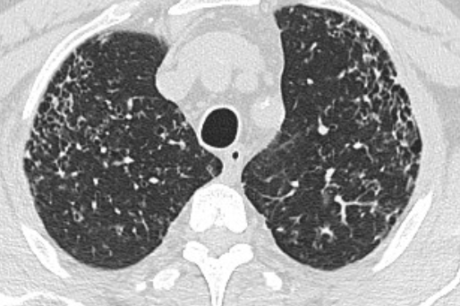
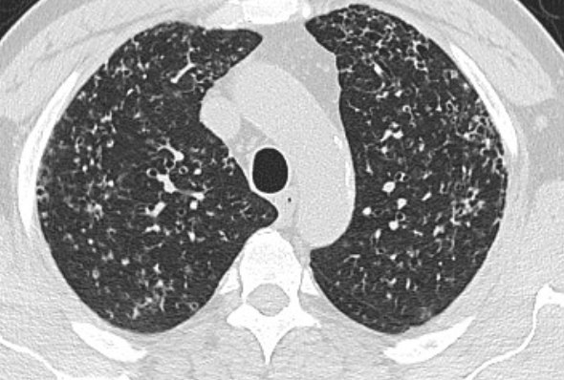
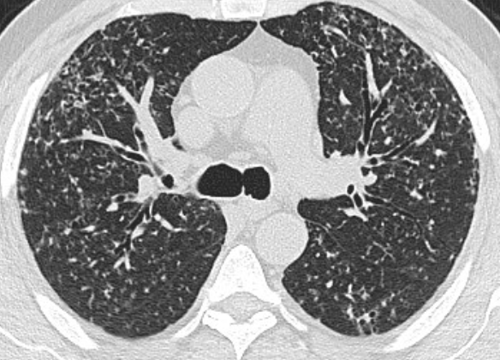
57-year-old, store-keeper
Non-cigarette smoker
Heavy cannabis use
Dry cough and dyspnea
Notes:
-Finally, PLCH may present in patients with significant history of heavy cannabis use.
-Although traditionally associated with tobacco smoking, these cases raise concerns about the potential role of cannabis smoking in the development of PLCH.
-CT is similar to the classic imaging findings of PLCH, with bilateral nodules and cysts primarily in the upper lobes, which can progress to irregularly shaped cysts, emphysematous bullae, and GG opacities.
…..

Slide 29






immunophenotype: CD1a+, S100+, Braf-V-600 +.
Notes:
…
-In this patient, Cryobiopsy showed proliferation of Langerhans cells with bronchiolocentric distribution of lesions; loosely formed, non-caseating granulomatous structures, some accompanying Inflammatory Infiltrate; immunophenotype: CD1a+, S100+, Braf-V-600 +.

Slide 30

Notes:
-Initially PLCH was thouth to be related only to smoking, which could lead to the accumulation of inflammatory cells in the lungs, releasing cytokines such as TGF-beta, IL-1 beta and TNF-alpha
-These cytokines contribute to granuloma formation and abnormal accumulation/activation of Langerhans cells

Slide 31


Blood 2010
Oncologist 2014
Notes:
-Now, we know that Langerhans cell histiocytosis (LCH) is a myeloid neoplastic disorder characterized by inflammatory lesions with clonal histiocytes.
-LCH is driven by activating mitogen-activated protein kinase (MAPK) pathway mutations.
-BRAFV600E is the most common mutation and is associated with more extensive disease at presentation and risks of front-line treatment failure, liver disease, and LCH-associated neurodegeneration.
-MAPK inhibitors are effective, but do not achieve cure in most cases.

Slide 32

Zahid I, et al. BMC Pulm Med 2025
Notes:
-In the literature there are some case reports reporting patients with extensive cannabis use in the absence of tobacco use, suggesting that cannabis might contribute to similar pathway in the lungs

Slide 33





Hanzal N, et al. Chest 2025
Notes:
-Like all oils when inhaled, the use of Cannabis oil may be associated with lipoid pneumonia

Slide 34

Transcriptomic changes in oxidative stress, immunity, and cancer pathways caused by cannabis vapor on alveolar epithelial cells
Wilson ET, et al. Cell Biol Toxicol 2025
Notes:
-Finally, acute exposure to cannabis vapor may significantly affect gene expression in alveolar epithelial cells belonging to pathways related to cancer, oxidative stress, and the immune response without being associated with a DNA damage response.

Slide 35


Slide 36

Intravenous injection: embolic and granulomatous disease
Drugs: crushed tablets (containing talc, cellulose), heroin, methadone, methamphetamine
Insoluble fillers lodge in the pulmonary capillaries
Patterns
  Pulmonary hypertension: chronic microvascular occlusion and remodeling
  Foreign body granulomatosis: talcosis with birefringent particles
  Septic emboli (IVDU, endocarditis)
Roset-Altadill A, et al. Eur J Radiol 2024
Notes:
-By contrast, IV injection bypasses the lungs initially, but the insoluble fillers, such as talc or microcrystalline cellulose, end up lodging in the pulmonary capillaries.
-The result is a foreign body granulomatous reaction (leading to interstitial lung disease), pulmonary hypertension, and even acute respiratory failure.
-We also see septic emboli, particularly in IVDU patients with endocarditis.

Slide 37






28 y, Male, Smoker, cocaine use, construction worker. Access to ER for chest pain, fever and shivering
Notes:
-This was a 28 y male, smoker, cocaine use, construction worker
-Access to Emergency Department for chest pain, fever and shivering
-CT scan showed diffuse nodules and micronodules, hilar and mediastinal adenopathies

Slide 38


Transbronchial lung cryobiopsy
One vascular structure exhibiting a necrotizing granuloma with palisading histiocytes within the vessel wall
Notes:
-We initially performed cryobiopsies, which revealed:
* finely pigmented macrophages within lung parenchyma
* thickened pleura with numerous newly formed blood vessels
* at least one vascular structure exhibiting a necrotizing granuloma with palisading histiocytes within the vessel wall
-No eosinophils or birefringent material under polarized light were observed in these samples

Slide 39





Surgical lung biopsy
Necrotizing granulomatous vasculitis with mild eosinophilia
Notes:
-Due to the limited amount of tissue obtained, we decided to confirm the clinical suspicion with additional material and therefore proceeded with surgical biopsy.
-The specimen revealed necrotizing granulomatous vasculitis with mild eosinophilia and morphological features consistent with prior episodes of alveolar hemorrhage.
-The etiology of the observed lesions was most likely related to cocaine abuse

Slide 40
Intravenous injection: granulomatous disease
IV injection of insoluble excipients (e.g., TALC)
Foreign materials -> pulmonary microvasculature
Granulomatous inflammation, multinucleated giant cells
Birefringent crystals under polarized light
Diffuse micronodular opacities
Mimics: sarcoidosis, HP, miliary TB
Feature | Description
Granulomas | Poorly formed, often perivascular, with foreign body giant cells
Birefringent particles | Talc and cellulose under polarized light microscopy
Fibrosis | Irregular interstitial collagen deposition in chronic stages
Vascular remodeling | Capillary obliteration and muscular hypertrophy
Roset-Altadill A, et al. Eur J Radiol 2024
Notes:
-Foreign body granulomatosis is an under-recognized complication of IV drug use, typically caused by injecting insoluble excipients like TACL or cellulose.
-It may be seen in cocaine users who frequently abuse multiple substances, injecting cocaine in combination with other substances (SPEED BALL)
-These particles embolize in the pulmonary microvasculature, provoking a chronic foreign body reaction.
-Histology shows non-necrotizing granulomas with multinucleated giant cells and birefringent particles under polarized light.
-Radiologically, it may mimic sarcoidosis, hypersensitivity pneumonitis, or miliary TB.
-Diagnosis often requires high clinical suspicion and biopsy is typically needed

Slide 41



Notes:
-Talc granulomatosis is rare in “sniffers” and probably results from frequent inhalation of talc used to cut or mix the cocaine sold on the street

Slide 42





- 40-year-old male
- IV heroin and cocaine user (high doses)
- Infection at the right inguinal injection site.
- Pleural effusion consistent with empyema.
- Laboratory findings: neutrophilic leukocytosis
Notes:
-This was a case of a 40-year-old male, IV heroin and cocaine user at high doses.
-He had an infection at the right inguinal injection site; after that he was admitted with a septic condition.
-Laboratory findings: neutrophilic leukocytosis.
-Pleural effusion wasvconsistent with empyema.

Slide 43

Intranasal insufflation (snorting): vascular injury and systemic toxicity
Drugs involved: cocaine, methamphetamine
Does not directly enter the lung
Systemic effects (vasoconstriction) => pulmonary vasculature
Patterns
  Pulmonary hypertension (sympathetic overdrive)
  Diffuse alveolar hemorrhage and non-cardiogenic edema (high doses)
Roset-Altadill A, et al. Eur J Radiol 2024
Notes:
-And finally, intranasal insufflation, or snorting.
-Though the drug doesn’t directly enter the lungs, its systemic effects—especially vasoconstriction—have profound consequences on the pulmonary vasculature.
-We see cases of DAH, non-cardiogenic pulmonary edema, and progressive pulmonary hypertension. The vascular endothelium becomes the target.

Slide 44
Pulmonary Damage Gallery
Cocaine: DAH, vasospasm
Heroin: pulmonary edema, bronchospasm
Cannabis: bullous disease
IV talc: granulomatous ILD
Roset-Altadill A, et al. Eur J Radiol 2024
Notes:
-So, we can identify frequent patterns or “signatures”:
*DAH with cocaine
*Bullae with cannabis
*Granulomas with talc
However, overlaps are substantial, making diagnosis a challenge.

Slide 45
Diagnostic Dilemmas
Mimics, missed histories, and misleading findings
Nonspecific or protean clinical presentations
Overlapping imaging findings with autoimmune, infectious, or idiopathic diseases
Concealed or unreliable patient histories
Lack of established diagnostic criteria in guidelines
Roset-Altadill A, et al. Eur J Radiol 2024
Notes:
-Diagnosing lung disease in people who use illicit drugs is not simply a matter of identifying the substance involved.
-The challenge lies in the fact that these syndromes often mimic well-characterized diseases, such as vasculitis, hypersensitivity pneumonitis, or idiopathic ILDs.
History of drug use is frequently concealed.
BAL may show hemosiderin or eosinophils.
Biopsy can show granulomas or hemorrhage.

Slide 46
Illicit drug injury | Common misdiagnosis | Shared features
Cocaine-induced DAH | ANCA-associated vasculitis | Hemoptysis, DAH on BAL, elevated CRP
Talcosis (IV use) | Sarcoidosis or HP | Granulomatous ILD, upper lobe predominance
Heroin lung | Cardiogenic edema | Rapidly progressive dyspnea, alveolar opacities
Cannabis bullous lung | Alpha-1 antitrypsin deficiency | Young, non-smoking males, upper lobe bullae
Notes:
-Clinically and radiographically, cocain-induced alveolar haemorrhage may be nearly indistinguishable from ANCA-associated vasculitis.
-In some cases, transient ANCA positivity has been reported in cocaine users due to levamisole contamination, further muddying the waters.
-Such patients may be mistakenly placed on aggressive immunosuppression without addressing the actual trigger.

Slide 47
Group | Etiology / Trigger | Key Features | Examples
PAUCI-IMMUNE VASCULITIS | ANCA-associated vasculitis | Capillaritis, DAH, glomerulonephritis, systemic symptoms | Granulomatosis with polyangiitis, Microscopic polyangiitis, Cocaine/Levamisole-induced vasculitis
IC-MEDIATED | Immune deposits in alveolar capillaries | Positive immunofluorescence (IgG, C3), systemic autoimmunity | SLE, Goodpasture’s syndrome (anti-GBM), cryoglobulinemia
DRUG-INDUCED DAH | Direct toxicity, hypersensitivity, immunomodulation | May mimic vasculitis or ARDS; often reversible if drug is withdrawn | Cocaine, Amiodarone, Nitrofurantoin, Cyclophosphamide, Bevacizumab, Alemtuzumab, Erlotinib
INFECTION-associated | Viral, bacterial, fungal infections | Acute febrile illness with hemoptysis and systemic symptoms | H1N1 influenza, Dengue virus, Leptospira spp., Staph. aureus pneumonia, CMV
COAGULOPATHY-related | Bleeding diathesis, platelet disorders, anticoagulants | No capillaritis; bleeding without inflammation | Thrombocytopenia, Warfarin toxicity, NOACs, Heparin, Thrombolytics, Dextran 70
HYPERSENSITIVITY reactions | Drug-induced immune activation | Often eosinophilic or lymphocytic infiltrates; possible systemic rash | Propylthiouracil, Hydralazine, Penicillin, Sulfasalazine, Phenytoin
MALIGNANCY-related | Primary or metastatic lung tumors | Focal or multifocal hemorrhage, may be associated with tumor necrosis | Angiosarcoma, choriocarcinoma, leukemic infiltration
IDIOPATHIC (rare) | No identifiable cause despite work-up | Diagnosis of exclusion | Idiopathic pulmonary hemosiderosis
Mechanical/BAROTRAUMA | Trauma or high-pressure ventilation | Usually localized; history of mechanical insult | Chest trauma, VILI (ventilator-induced lung injury), lung contusion
INHALATION EXPOSURES (non-drug) | Toxic gases, smoke, heated particles | Direct epithelial injury, capillary leak | Chlorine, phosgene, smoke inhalation from fires
Notes:
-A detailed drug history and immunologic panel (ANCA, anti-GBM, ANA, RF) are essential in narrowing down the diagnosis. -Infections must always be ruled out, especially in acute presentations with fever or neutropenia.
-Bronchoscopy with sequential BAL aliquots showing increasingly bloody return supports DAH diagnosis, regardless of cause.

Slide 48
Illicit drug injury | Common misdiagnosis | Shared features
Cocaine-induced DAH | ANCA-associated vasculitis | Hemoptysis, DAH on BAL, elevated CRP
Talcosis (IV use) | Sarcoidosis or HP | Granulomatous ILD, upper lobe predominance
Heroin lung | Cardiogenic edema | Rapidly progressive dyspnea, alveolar opacities
Cannabis bullous lung | Alpha-1 antitrypsin deficiency | Young, non-smoking males, upper lobe bullae
Notes:
-Talc exposure produces a foreign body granulomatosis pattern.
-On histology, this can resemble sarcoidosis or chronic hypersensitivity pneumonitis.
-Without a clear history of injection drug use—or in cases where such history is withheld—we risk misclassification.

Slide 49
Illicit drug injury | Common misdiagnosis | Shared features
Cocaine-induced DAH | ANCA-associated vasculitis | Hemoptysis, DAH on BAL, elevated CRP
Talcosis (IV use) | Sarcoidosis or HP | Granulomatous ILD, upper lobe predominance
Heroin lung | Cardiogenic edema | Rapidly progressive dyspnea, alveolar opacities
Cannabis bullous lung | Alpha-1 antitrypsin deficiency | Young, non-smoking males, upper lobe bullae
Notes:
-Severe bullous disease associated with cannabis in young patients who don’t smoke tobacco can sometimes mimick genetic emphysema, but AAT levels are normal.
-They often present with spontaneous pneumothorax, either primary or recurrent.
-These features are often misclassified unless a detailed cannabis history is obtained

Slide 50



What We Miss When We Don’t Ask
Ethical, epistemological, and deeply clinical dilemma
Notes:
-And all of these cases are further complicated by a central truth: patients often do not report illicit drug use.
-Thus, the diagnostic dilemma is not just radiologic or histologic. It is ethical, epistemological, and deeply clinical.

Slide 51
Translational Windows
What illicit drug-induced lung injuries teach us about pulmonary biology
Nonspecific or protean clinical presentations Illicit drug injuries = Human models of extreme pathophysiology
Mechanistic overlap with:
  Diffuse alveolar damage → ALI/ARDS models (e.g., heroin, meth, cocaine)
  Foreign body granulomatosis → non-infectious ILD (e.g., talcosis)
  Pulmonary vasculopathy → mimics PAH, chronic thromboembolism
  Sterile inflammation → cytokine release, NETosis, inflammasome activation
Underutilized for preclinical or translational insights
Opportunity: a “living experiment” in lung injury and repair
Roset-Altadill A, et al. Eur J Radiol 2024
Notes:
-Illicit drugs can serve as models for studying diffuse alveolar damage, immune activation, or vascular injury.
-Studying these extreme conditions might help us understand idiopathic or autoimmune ILDs better.
-Because these are stigmatized populations, they rarely enter clinical trials or mechanistic studies.
-Yet they represent natural experiments—acute, biologically rich, and temporally constrained models of injury.
-From a translational standpoint, these patients can inform us about: early-phase lung injury, prior to irreversible fibrosis, vascular remodeling in situ, cytokine-driven inflammation without pathogen involvement, granuloma formation from known antigens.

Slide 52
Beyond Toxins: A Socio-Biological Crisis
Pulmonary disease in people who use drugs (PWUD) is shaped by:
  Cumulative immunosuppression (HIV, HCV, malnutrition)
  Coinfections and colonization (TB, Pneumocystis, bacterial pneumonias)
  Environmental exposures (shelters, smoke, poor air quality)
  Neglect, stigma, and delayed care
  The lung is not just a target of drugs—but a barometer of inequality
Drugs as amplifiers of systemic vulnerability
Roset-Altadill A, et al. Eur J Radiol 2024
Notes:
-When we talk about illicit drugs and the lung, we tend to focus only on direct toxicity—alveolar hemorrhage, bullae, talcosis.
-However, most individuals are not just exposed to substances
-For example, HIV coinfection is common among people who inject drugs.
-Chronic viral infection, malnutrition, psychological stress, lack of access to care, leads to immunologic fragility.
-This doesn't just increase infection risk, it alters the lung's entire response to injury, inflammation, and repair.
-In these patients, we often encounter opportunistic infections (PJP, CMV, NOTT)
-Then there’s the environment (crowded shelters, street encampments, prison cells), cigarette use (nearly universal), co-inhalants
-Pulmonary symptoms are often minimized, leading to delayed diagnosis of serious conditions

Slide 53


Notes:
Thank you for your attention

Slide 54
Marchiori E et al. Pulmonary talcosis: imaging and pathologic findings. Lung. 2021
Lemyze M et al. Talc granulomatosis and acute respiratory failure in IVDU. Respiration. 2023

Slide 55
Frantz S et al. Cocaine-induced pulmonary complications: a review. J Thorac Dis. 2022
Ghofrani HA et al. Cocaine, endothelin, and pulmonary hypertension. Eur Respir Rev. 2021

Slide 56


Slide 57


Crack Lung and Cocaine-induced Eosinophilic Lung Disease
Restrepo CS, et al. Radiographics 2007

Slide 58
Elsayed H et al. Acute lung injury following inhaled heroin vapour. Respir Med Case Rep. 2022

Slide 59
Mechanisms of Injury
Endothelial toxicity, alveolar barrier disruption
Neurogenic inflammation, immune dysregulation
Notes:
Mechanistically, drugs affect the lung via vasospasm, direct epithelial toxicity, and neuro-immunologic pathways.
Some act like experimental models of ALI/ARDS, raising questions for translational research.

Slide 60
Diagnostic Dilemmas
Mimics, missed histories, and misleading findings
Nonspecific or protean clinical presentations
Overlapping imaging findings with autoimmune, infectious, or idiopathic diseases
Concealed or unreliable patient histories
Lack of established diagnostic criteria in guidelines
Notes:
These cases often mimic vasculitis, hypersensitivity pneumonitis, or idiopathic ILDs.
History of drug use is frequently concealed.
BAL may show hemosiderin or eosinophils.
Biopsy can show granulomas or hemorrhage.

Slide 61

Caso clinico emorragia alveolare da cocaina con ANCA positività
Caso clinico
Notes:
-Let’s start with one of the most dramatic examples: cocaine-induced diffuse alveolar hemorrhage.
We start with a clinical case: ……… a young person with acute respiratory failure and hemoptysis. Imaging shows DAH. Labs inconclusive. Tox screen positive for crack cocaine.
This case illustrates how illicit drugs can mimic autoimmune diseases and complicate diagnosis

Slide 62
Restrepo CS et al. Imaging manifestations of inhaled illicit drugs. Radiographics. 2020.
Polenakovik HM et al. Cocaine-induced vasculitis: a diagnostic challenge. J Clin Rheumatol. 2022.

Slide 63
Caso clinico talco IV, corpo estraneo, granuloma
Caso clinico
Notes:
-Then there was ……

Slide 64
Kane GC et al. Pulmonary granulomatosis from intravenous drug use: mimicking sarcoidosis. Chest. 2021.

Slide 65
Caso clinico edema polmonare da eroina
Caso clinico
Notes:
-In this case ….

Slide 66
Illicit drug injury | Common misdiagnosis | Shared features
Cocaine-induced DAH | ANCA-associated vasculitis | Hemoptysis, DAH on BAL, elevated CRP
Talcosis (IV use) | Sarcoidosis or HP | Granulomatous ILD, upper lobe predominance
Heroin lung | Cardiogenic edema | Rapidly progressive dyspnea, alveolar opacities
Cannabis bullous lung | Alpha-1 antitrypsin deficiency | Young, non-smoking males, upper lobe bullae
Notes:
-Heroin-induced pulmonary edema, particularly when rapidly progressing, is often labeled as cardiogenic or ARDS of unknown cause.
-Yet its pathophysiology may involve neurogenic and permeability-driven mechanisms distinct from both.

Slide 67
Caso clinico bolle da cannabis
Caso clinico
Notes:
-Then there was ……

Slide 68
Wood DM et al. Cannabis-induced bullous disease. Thorax. 2020.
Notes:
"Clinically, patients are typically young adult males with no significant tobacco use or occupational exposure. They often present with spontaneous pneumothorax—either primary or recurrent.
HRCT reveals large apical bullae and sometimes paraseptal emphysema, mimicking early-onset alpha-1 antitrypsin deficiency—but AAT levels are normal. These features are often misclassified unless a detailed cannabis history is obtained."

Slide 69
Beckett G et al. Structural violence and the lungs: An intersectional analysis. Lancet Respir Med. 2023.
Morris A et al. HIV, homelessness, and the pulmonary immune environment. Am J Respir Cell Mol Biol. 2022.
Bourgois P et al. Intimate Apartheid: Ethnography of race and vulnerability in drug users. Soc Sci Med. 2021.
Leung AN et al. Pulmonary infections in the immunocompromised drug user. Radiol Clin North Am. 2020.

Slide 70
Di Fusco Domenico
Amato Valerio (7-5-87)
Curreli Mattia -> versamento pleurico
Gonzalez Reyes Mario Enrique
Greggi Matteo (1-4-79): empiema + lesioni cavitate
Montali Alessandro (30-12-77): empiema pleurico in eroina + ascessi

Slide 71
Siddi Luigi (13-3-79): embolia polmonare settica dopo inoiezione eroina e cocaina nei piedi
Navarri Andrea: marjiuana enfisema
Masini Andrea (1-11-75): empiema in tossicodipendente

Slide 72
Nania Fabrizio (11-9-89): noduli in sigarette e cannabis
Pari Pierluigi (17-11-63): cannabis enfisema
Incerti Gabriele (9-1-72): cannabis, LES, PJP

