Slide 1
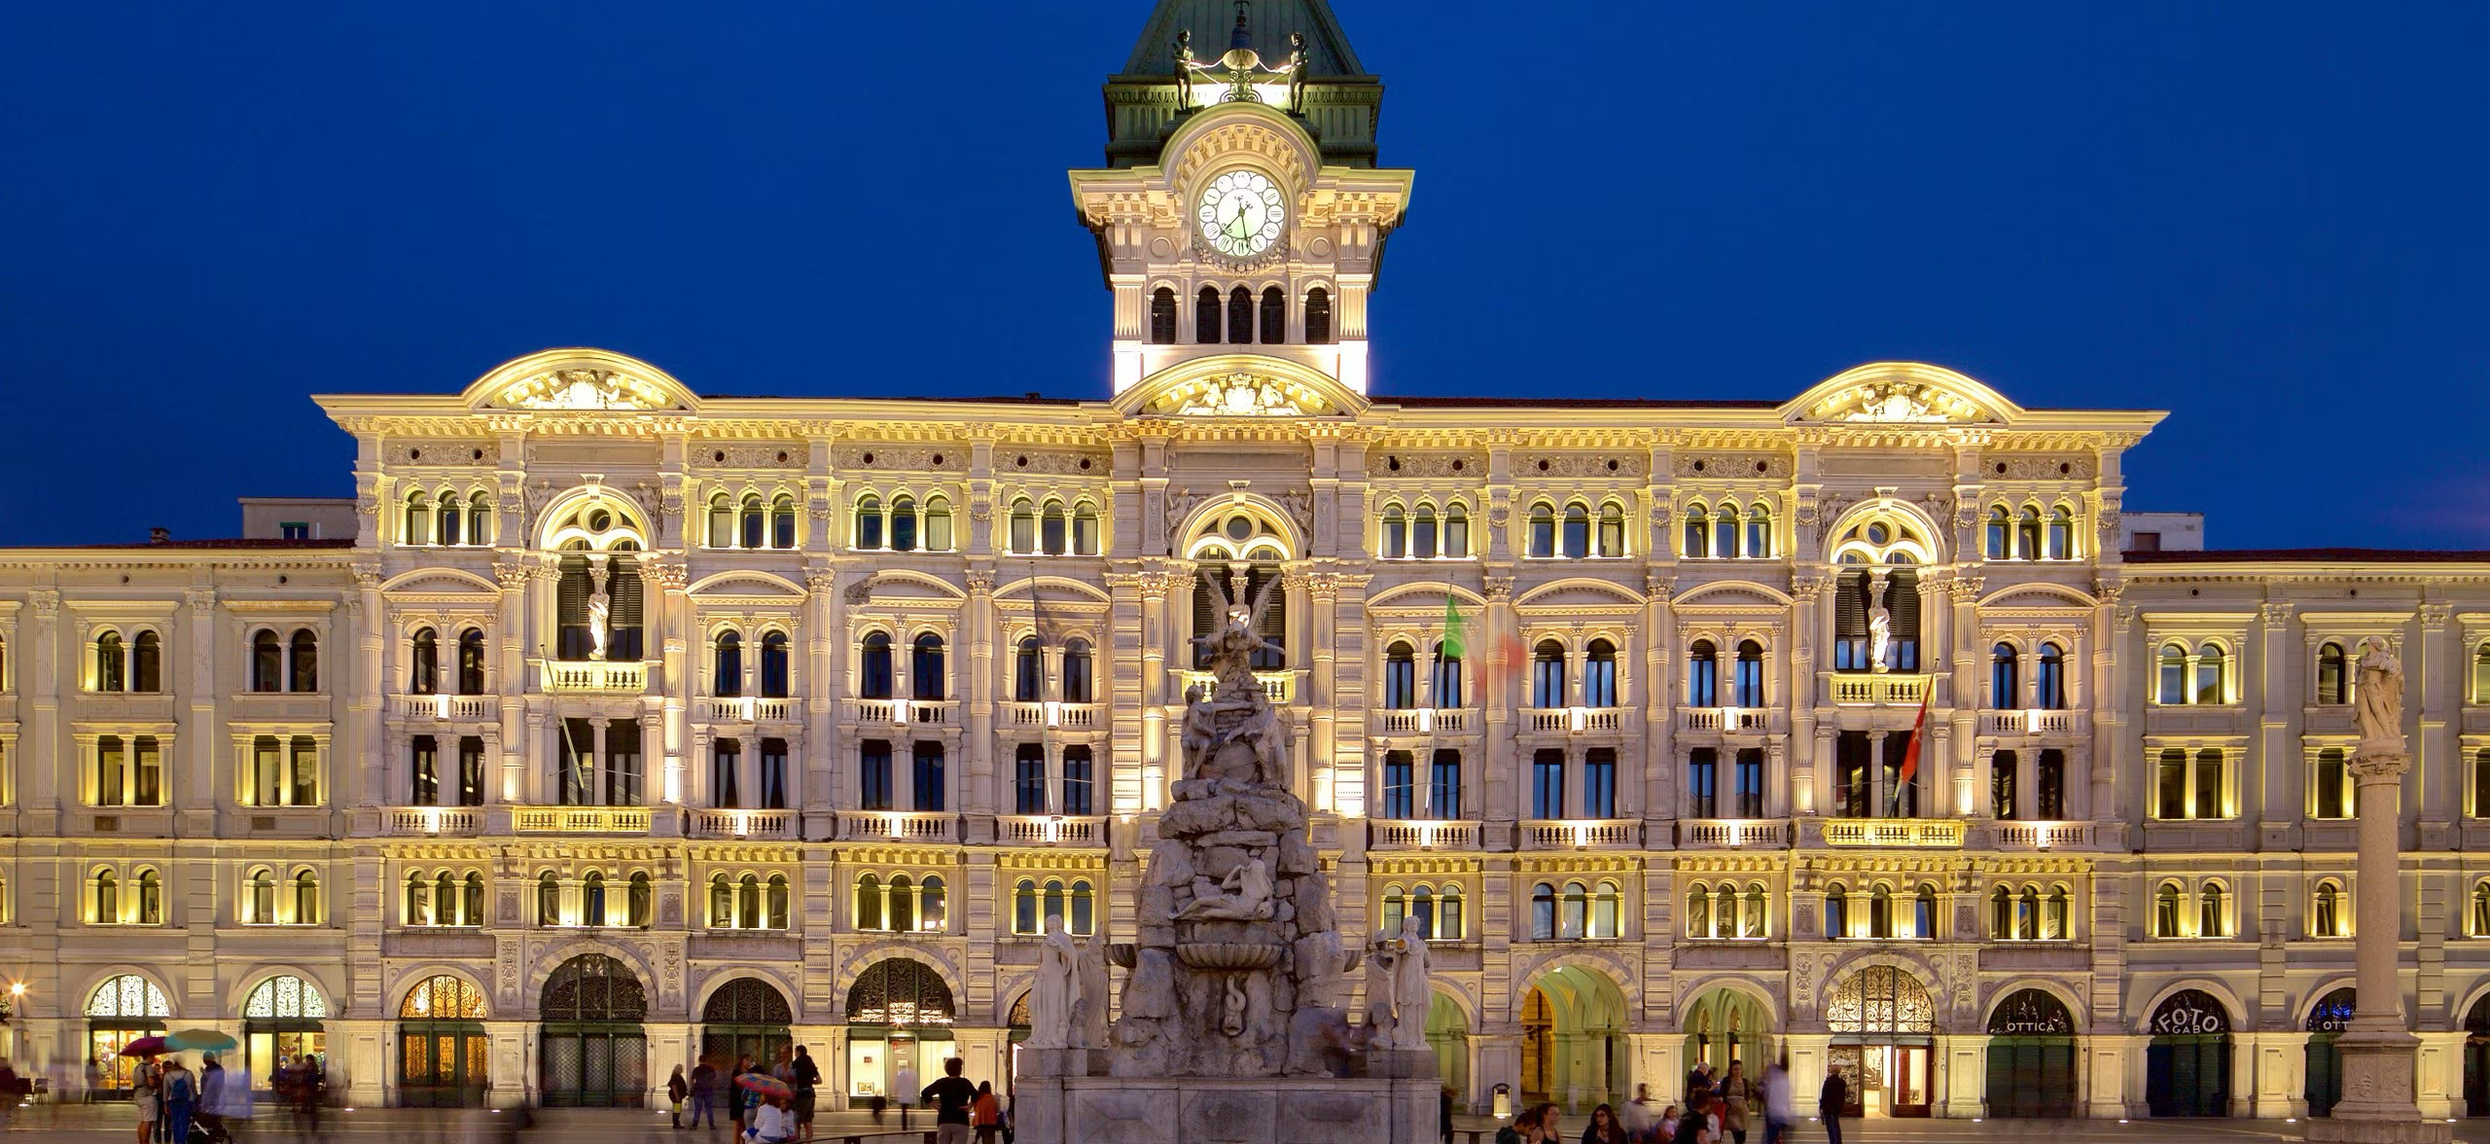
Pneumo Trieste 2025
Treatment for IPF and progressive pulmonary fibrosis: review of the current knowledge
Dott.ssa Nicol Bernardinello

Slide 3
Treatment for IPF and progressive pulmonary fibrosis: review of the current knowledge
Outline
Pharmacological treatment
The past (the “dark age”)
The present (the “new era”)
The future (hopefully, the “golden age”?)
The importance of the holistic approach

Slide 4
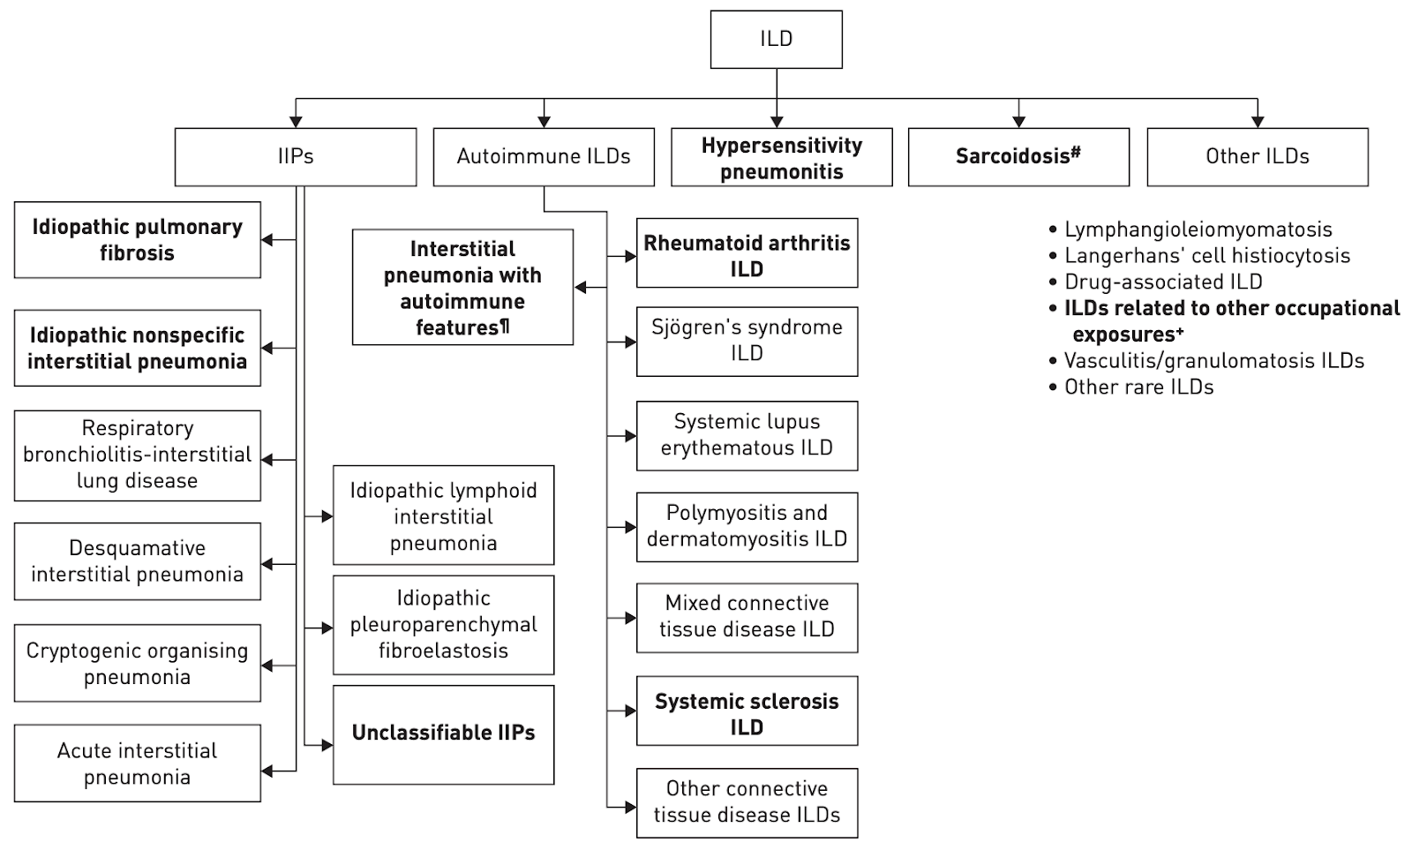
Table adapted from Cottin et al.
The term interstitial lung disease (ILD) refers to a wide and heterogeneous group of respiratory conditions that cause scarring of the lung.

Slide 5
IDIOPATHIC PULMONARY FIBROSIS (IPF)
IPF is an unpredictable and ultimately fatal age-related interstitial lung disease of unspecified aetiology, characterized by a median survival duration of approximately three to five years following diagnosis.
IPF occurs primarily in older adults and is associated with the histopathologic and/or radiologic pattern of usual interstitial pneumonia (UIP)
Raghu Get al. Am J Respir Crit Care Med 2011;183:788-824

Slide 6
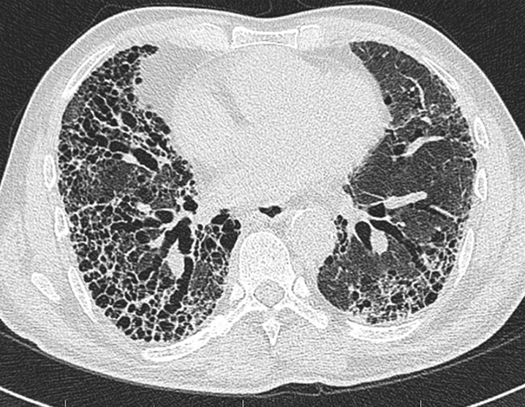
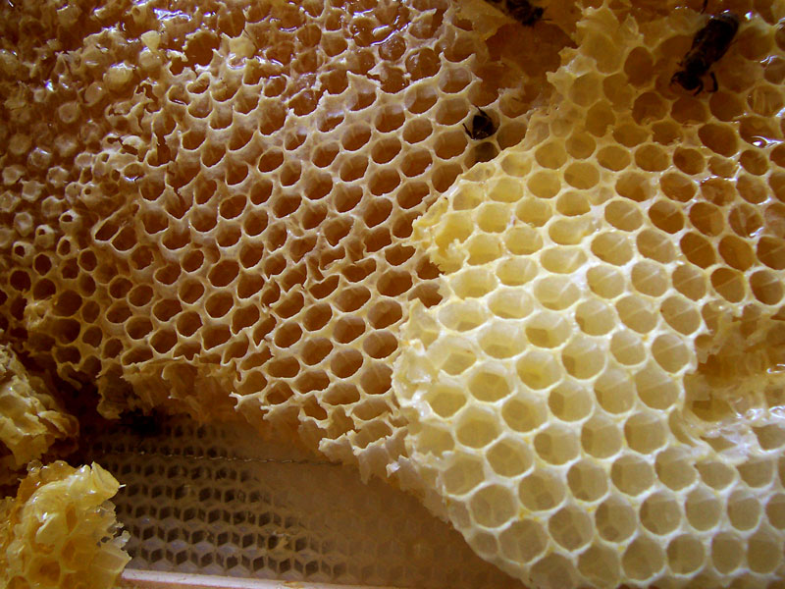
IPF: idiopathic UIP

Slide 7
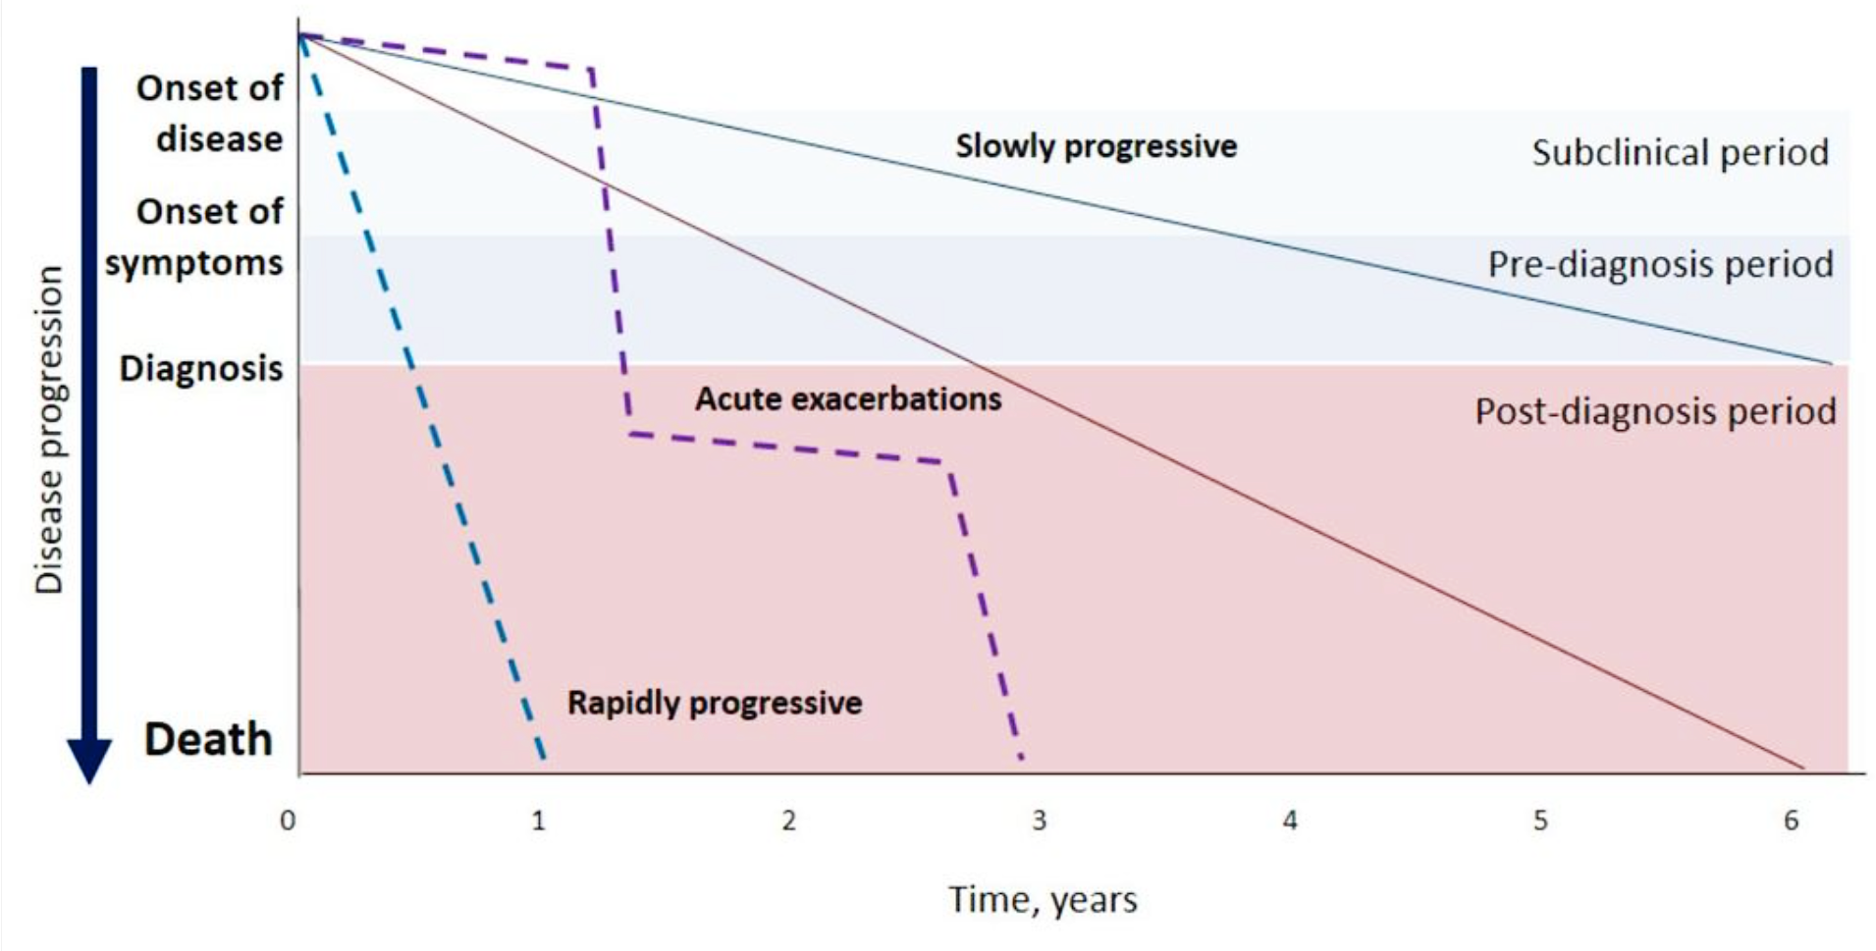
IPF clinical course
Ley B et al. Am J Respir Crit Care Med. 2011;183:431-440.

Slide 8
Pharmacological treatment: a Long and Winding Road

Slide 9
OLD THERAPEUTICS APPROACHES TO IPF
Corticosteroids
Colchicine
D-penicillamine
NAC
Glutathione
Warfarin
Imatinib
Bosentan
Azathioprine
Cyclophosphamide
IFN-g 1b
Etanercept
1950s
1990s
2005
2014
The dark age (the past)

Slide 10
PANTHER-IPF
Prednisone, Azathioprine and N-acetylcysteine: A Study That Evaluates Response in IPF
Randomized to NAC, NAC plus prednisone/azathioprine, or placebo for 60 weeks
Primary outcome: FVC decline
Secondary outcome: Acute exacerbation, disease progression
NEJM 2012;366:1968
The “dark age” (the past)

Slide 11
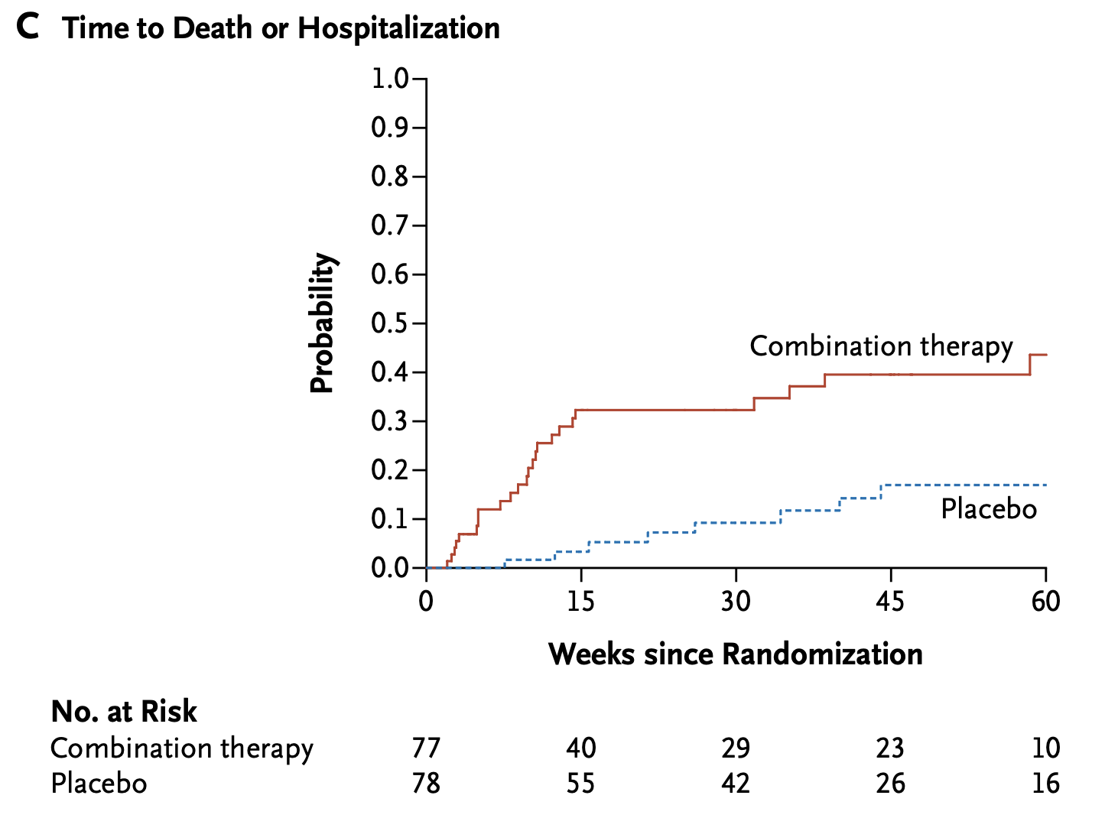
After the planned midpoint interim analysis, the data and safety monitoring board recommended discontinuation of the three-drug regimen because of an excess in the number of deaths, hospitalizations, and serious adverse events among patients in the combination-therapy group
The “dark age” (the past)

Slide 12
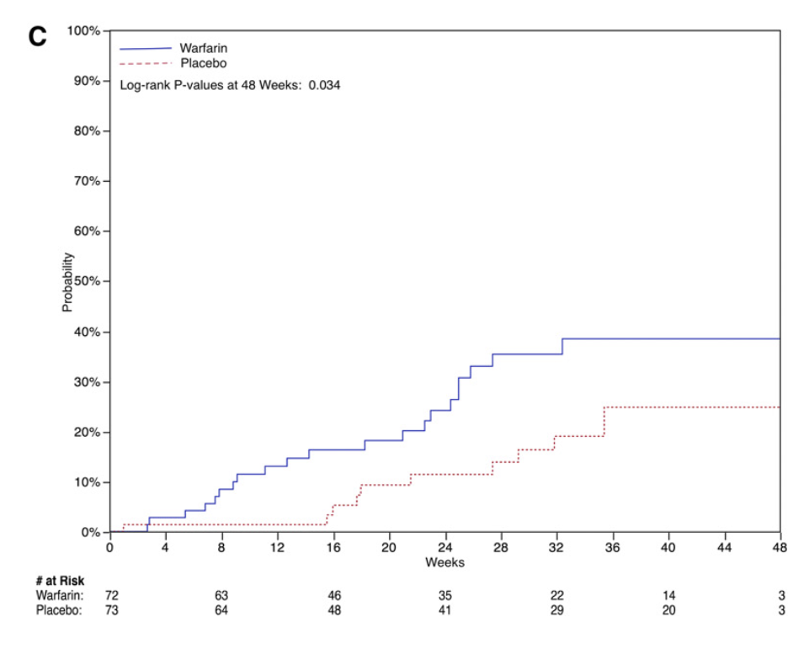
..in this study, the use of warfarin in patients with progressive IPF was associated with increased mortality when compared with placebo (adjusted hazard ratio, 4.85; 95% conﬁdence interval, 1.38–16.99)
The “dark age” (the past)

Slide 13
2011 – 2015: a new era for IPF
The “new era” (the present)

Slide 14
Pirfenidone
Pirfenidone is an orally available, synthetic, pyridone compound with anti-inflammatory, anti-oxidant and anti-fibrotic properties.
The mechanism of action is not fully understood.
The drug is believed to act on multiple pathways, with in vitro cell-based studies and in vivo studies in animal models of pulmonary fibrosis providing insight into its anti-fibrotic.
Oku H et al. Eur J Pharmacol 2008:590:400-8; Kim ES, Keating GM. Drugs 2015; 75: 219-30

Slide 15
King E.T. et al. 2011

Slide 16
Nintedanib
Orally available, small molecule, tyrosine kinase inhibitor originally developed for cancer
It acts primarily, but not exclusively, downstream of FGF, PDGF and VEGF, all of which are major growth factors involved in the pathogenesis of IPF
Nintedanib blocks the intracellular signaling needed for the proliferation, migration and differentiation of lung fibroblasts to myofibroblast
Wollin Let al. Eur Respir J 2015; 45: 1434-45
Notes:
Yes CAPACITY 004 but no 006, ASCEND ok

Slide 17
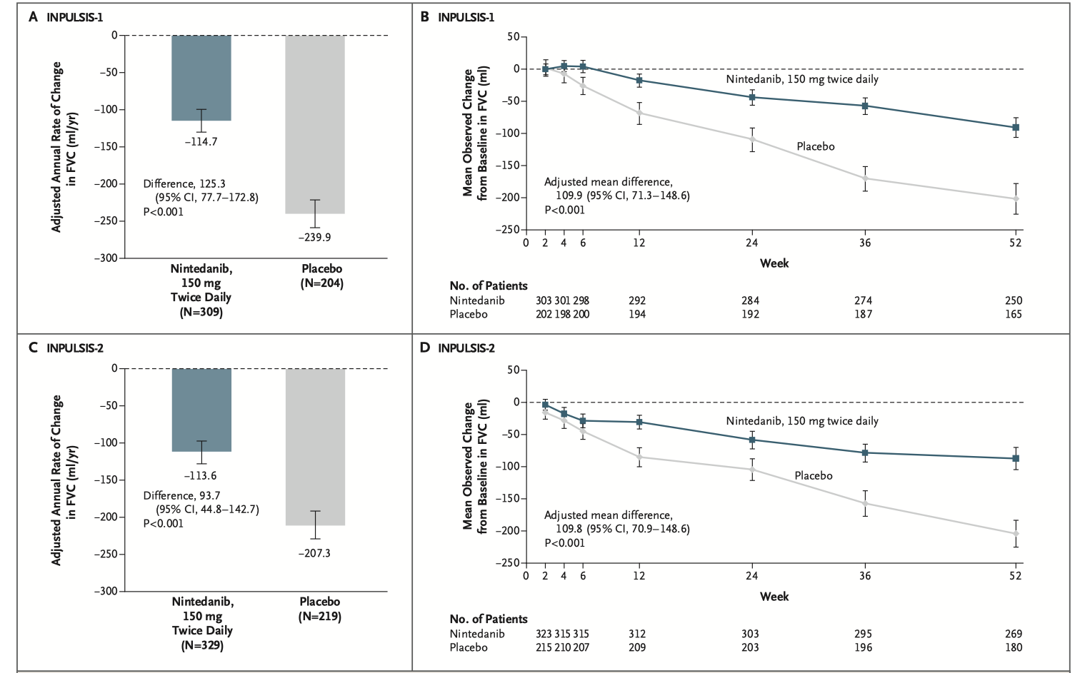
Richeldi L. et al. 2014

Slide 18
TEN YEARS OF CLINICAL TRIALS IN IDIOPATHIC PULMONARY FIBROSIS
CC9001
CO-TRIMOXAZOLE
NERANDOMILASRT
NINTEDANIB + SILDENAFIL
PIRFENIFONE +
SILDENAFIL
CYCLOPHOSPAMIDE
NINTEDANIB
SIMTUZUMAB
ZIRITAXESTAT
PAMREVLUMAB
2014
2016
2018
2020
2022
2024
GLFG1205
PIRFENIDONE + NAC
TRALOKINUMAB
PIRFENIDONE + NAC
ZINPENTRAXINE
PIRFENIDONE
ZINPENTRAXINE
BMS-986020
LEBRIKIZUMAB
NALBUPHINE
Phase III
Phase II
The “new era” (the present)
Notes:
Despite high hopes of success, however, three promising potential IPF therapies, ziritaxestat, pentraxin-2 and pamrevlumab, all recently failed

Slide 19
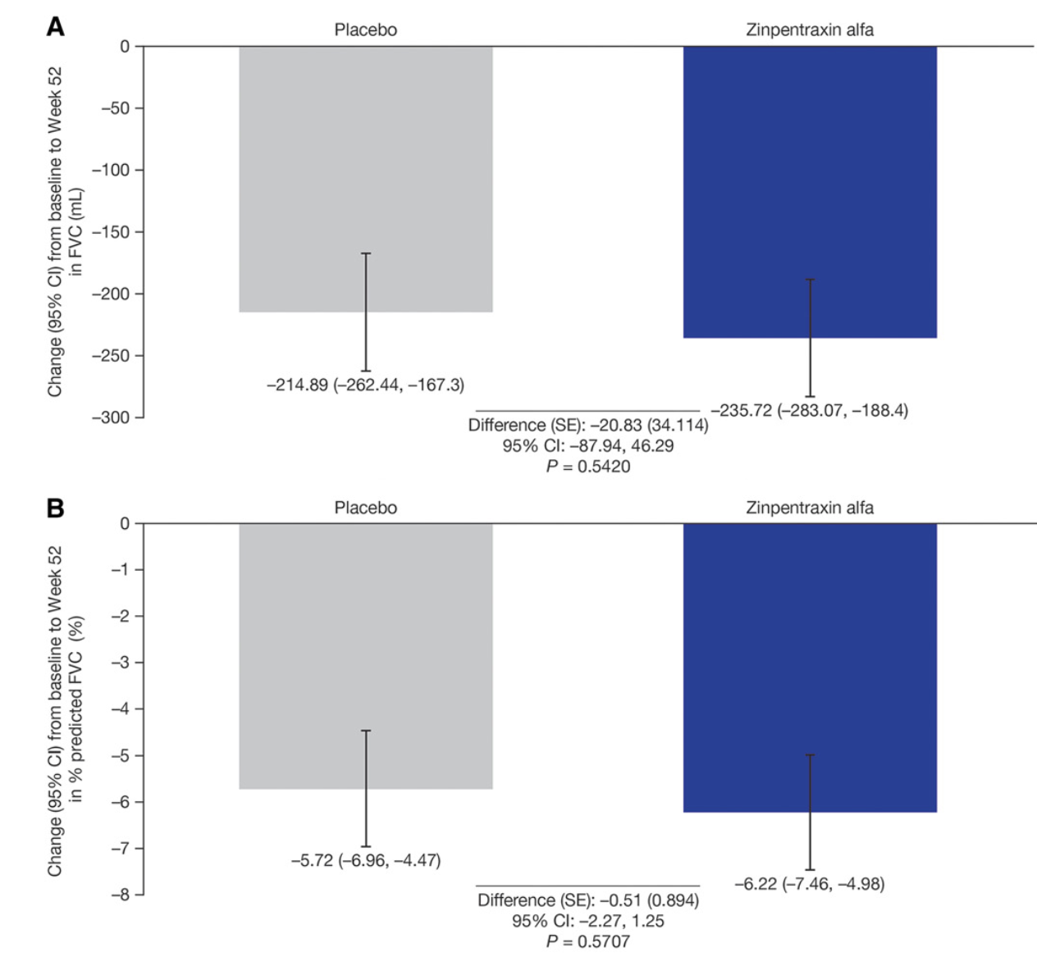
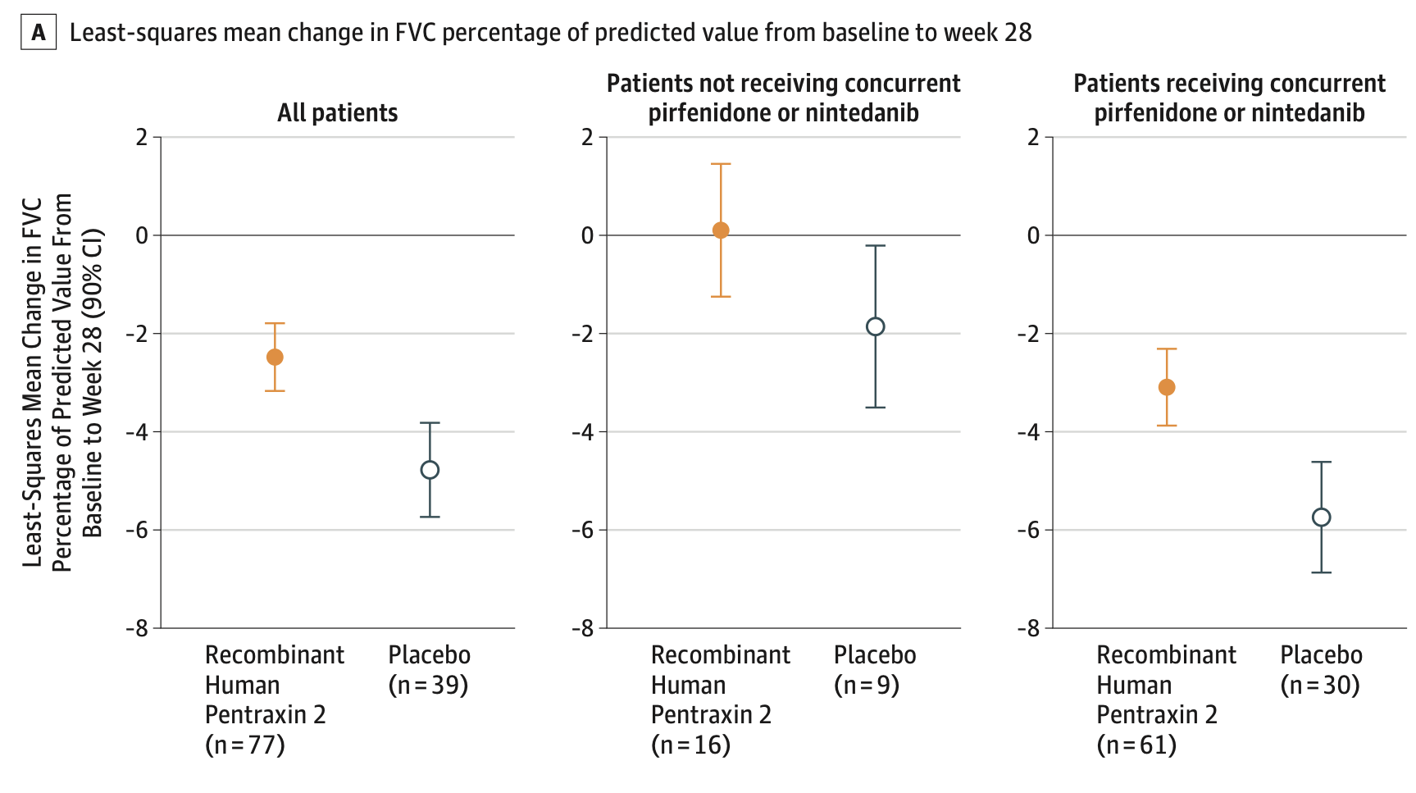
PENTRAXINE
Pentraxin-2, also known as serum amyloid P, is an endogenous blood protein that plays a key role in regulating wound healing and fibrosis via modulation of monocyte differentiation
Richeldi et al., Am J Respir Crit Care Med 2024
Raghu G, et al. JAMA 2018; 319:2299–2307

Slide 20
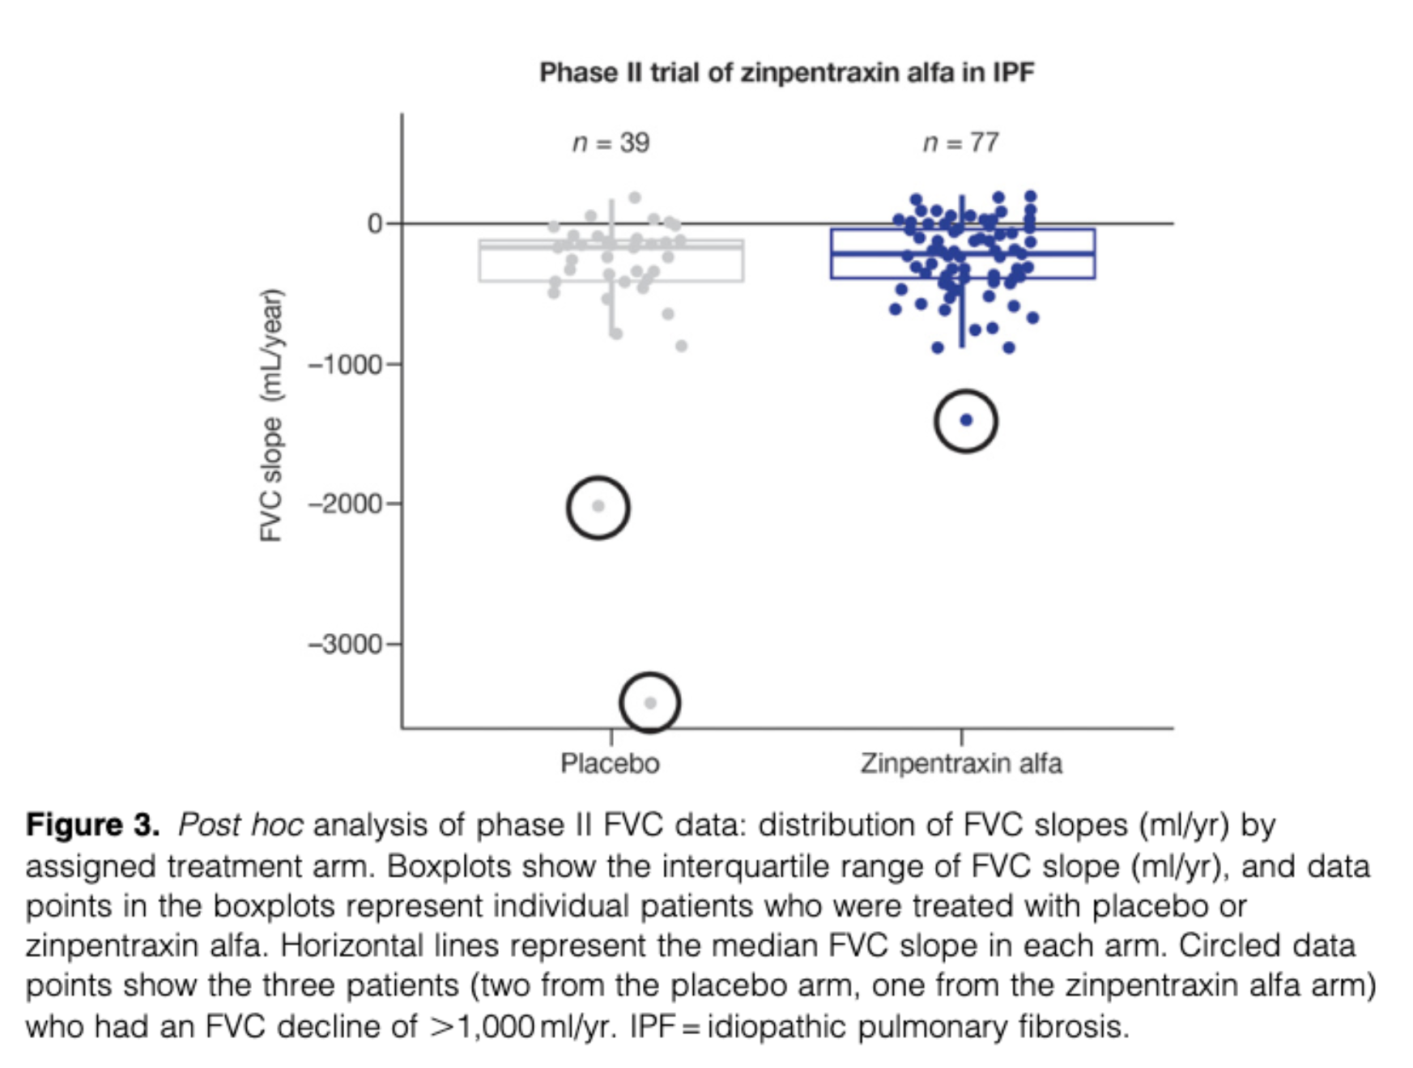

Slide 21
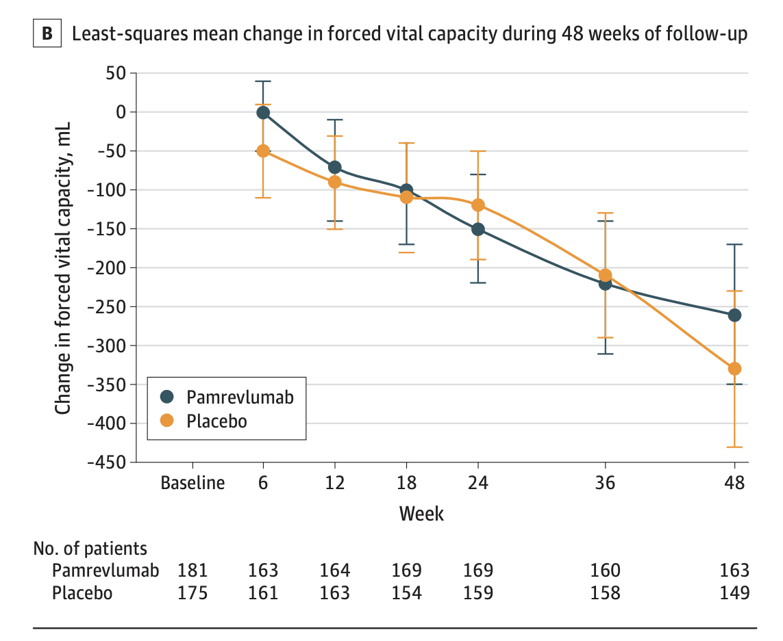
PAMREVLUMAB
Pamrevlumab is a fully recombinant human monoclonal antibody against connective tissue growth factor (CTGF), a secreted matricellular protein that modulates several biological activities associated with tissue remodeling and fibrosis.
Raghu G. et al., Jama 2024

Slide 22
Ziritaxestat
Ziritaxestat is a small molecule that selectively inhibits autotaxin, an enzyme involved in the production of lysophosphatidic acid, a profibrotic mediator that is upregulated in patients with IPF
ISABELA 1 and 2
Ziritaxestat was associated with increased all-cause mortality rates compared to placebo
Maher TM et al. Jama 2023

Slide 23
What have we learned?
The small sample size and relatively short duration may have contributed to the failure to reproduce positive results.
Importance of analyzing data at the patient level and routinely performing sensitivity analyses that exclude outliers
Missing data in small early-phase trials can disproportionately influence estimates of effect size.
Spagnolo P. et al. Curr Op Pulm Med 2024

Slide 24
2019 - the new era for ILD

Slide 25
Another important milestone
In a patient with ILD of known or unknown etiology other than IPF who has radiologic evidence of pulmonary ﬁbrosis, PPF is deﬁned as at least two of the following three criteria occurring within the past year with no alternative explanation:
Worsening respiratory symptoms
Spirometric evidence of disease progression
Radiological evidence of disease progression

Slide 26
Not only IPF: progressive pulmonary fibrosis (PPF)
S.K. Rajan Et Al. 2021

Slide 27
INBUILD trial
K.R. Flaherty et al. 2019

Slide 28
The “golden age”? (the future)

Slide 29
Nerandomilast
Nerandomilast (BI 1015550) is an oral preferential PDE4-B inhibitor which has shown antifibrotic effects in vitro and in vivo, inhibiting TGFβ1-induced myofibroblast transformation and ECM deposition, and has a synergistic action compared to nintedanib.

Slide 30
FIBRONEER-IPF and FIBRONEER-ILD meets the primary endpoints (2024-2025)
Richeldi L. et al., Jama 2022
FIBRONEER-ON

Slide 31
New horizons
TARGETING ALVEOLAR MACROPHAGES
Axatilimab
TARGETING FIBROBLASTS
BMS‑986020 and Admilparant (BMS‑986278)
TARGETING EPITHELIAL CELLS
Bexotegrast (PLN‑74809)
The “golden age”? (the future)

Slide 32
New horizons
INHALED DRUGS
Treprostinil
IPF‑RELATED COUGH DRUGS
Extended‑release Nalbuphine (NAL ER)
STEM CELLS
REGEND001
The “golden age”? (the future)

Slide 33
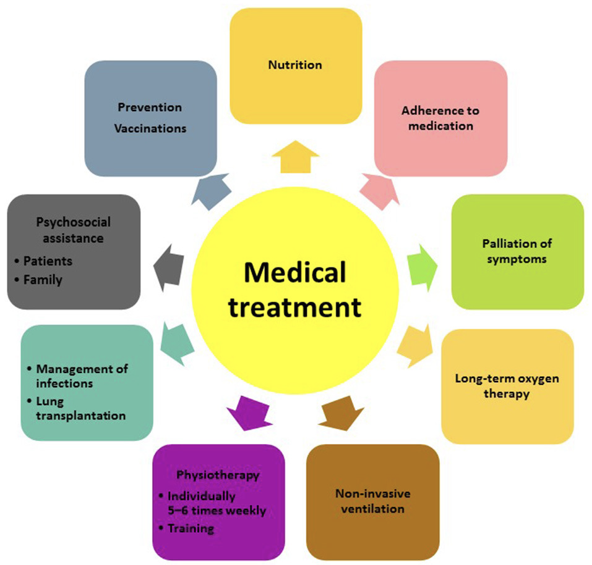
The holistic approach
Spagnolo P. et al. 2018

Slide 34
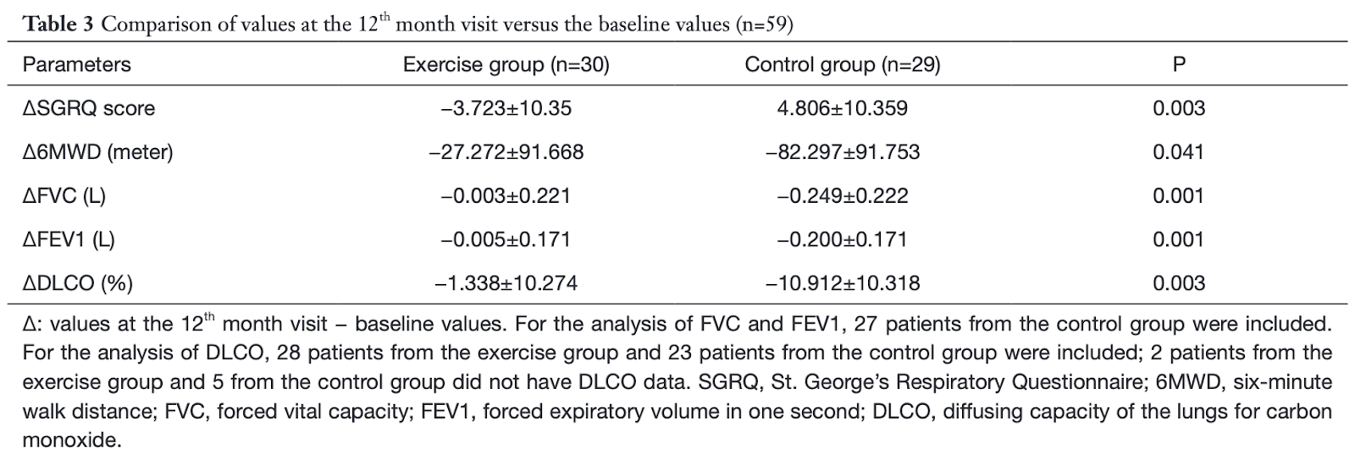
NON-PHARMACOLOGICAL TREATMENTS: REHABILITATION
Shen L. Ann Palliat Med. 2021 Jul;10(7):7289-7297.

Slide 35
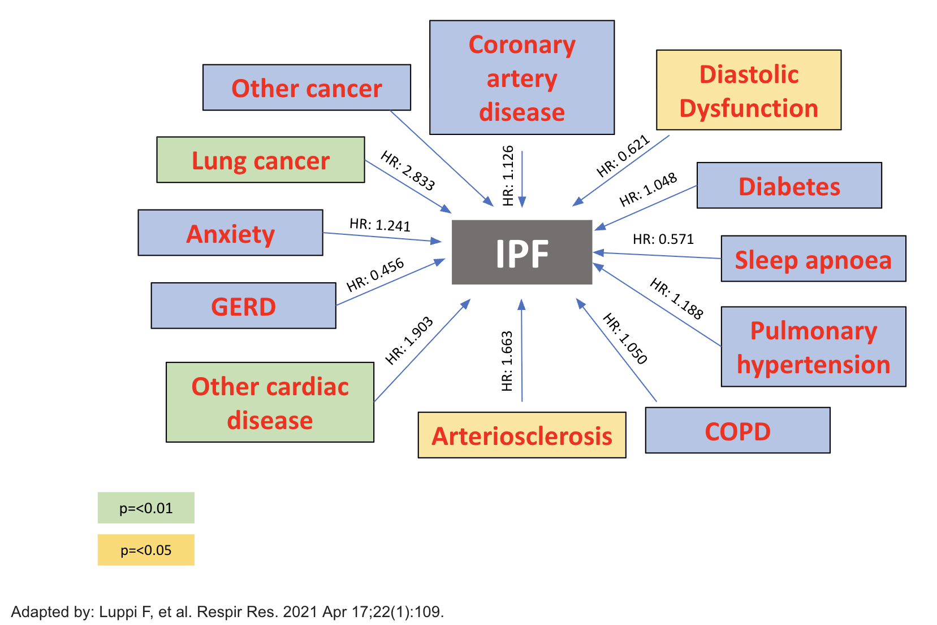
IMPACT OF IDIOPATHIC PULMONARY FIBROSIS AND COMORBIDITIES ON MORTALITY

Slide 36
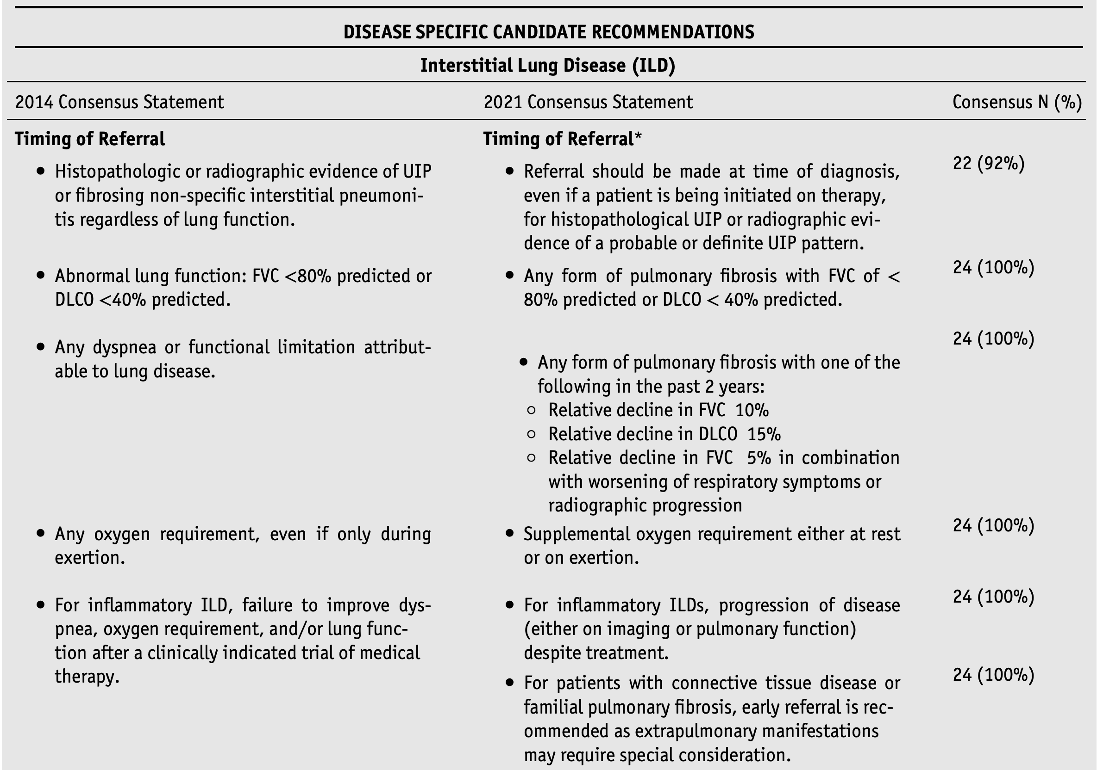
NON-PHARMACOLOGICAL TREATMENTS: LUNG TRANSPLANTATION
Leard et al. Consensus document for the selection of lung transplant candidates, 2021

Slide 37
CONCLUSION
The approval of antifibrotics has changed the management of IPF and PPF irreversibly.
Several promising drugs are being developed for IPF, reflecting the urgent need for better treatments for patients with this disease.
Innovative approaches can enhance success rates in late-phase clinical trials.
A comprehensive understanding of disease pathophysiology remains crucial.

Slide 38
THANKS FOR YOUR ATTENTION!!

