Slide 1
The JAK pathway in fibrotic ILD
Robert Vassallo, MD
Professor of Medicine
Departments of Medicine, Physiology and Biomedical Engineering
Mayo Clinic, Rochester, MN.

Slide 2
Disclosures
Non-Federal funding / Financial Relationship(s) in past 5 years:
Research Grant Funding from Pfizer, Bristol Myers Squibb, Sun Pharmaceuticals.
I have participated as a co-investigator on the Genentech sponsored TRAIL-1 clinical trial (Pirfenidone for RA-ILD).
Consulting activity with Rion LLC, Sanofi and Regeneron.
Off Label Usage - None

Slide 3
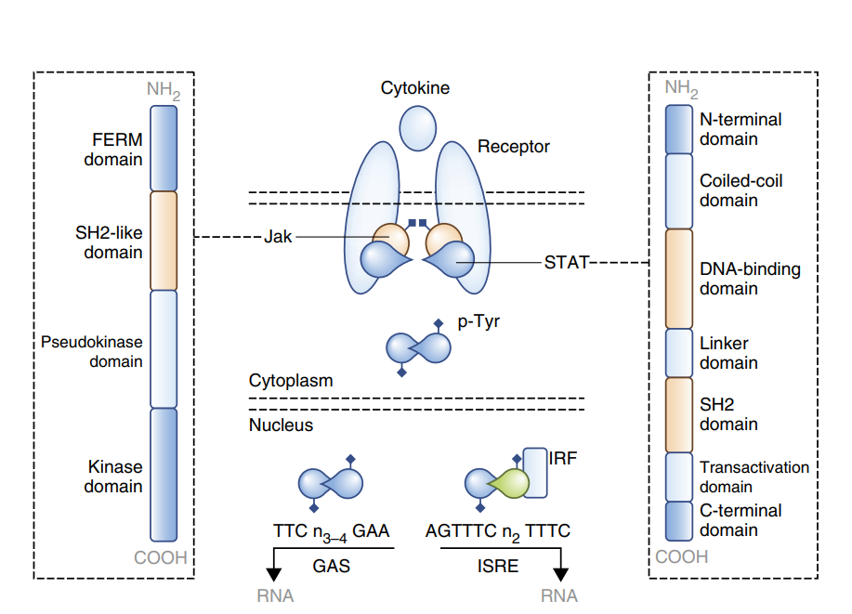

JAK STAT signaling
In ancient Rome, Janus was the god of beginnings, gates, transitions, time, duality, doorways, and endings. He is usually depicted as having two faces. The month of January is named for Janus (Ianuarius).
The Janus Kinase (JAK)/Signal Transducer and Activator of Transcription (STAT) pathway is a fundamental and evolutionarily conserved intracellular signaling cascade essential for communication between the extracellular environment and the cell nucleus.
Nature Immunology Vol 18, 2017.
Notes:
Figure 1 The canonical Jak–STAT pathway. Canonical Jak–STAT signaling begins with extracellular association between cytokines and their corresponding transmembrane receptors (top, middle). Receptor oligomerization then precipitates the trans-activation of Jaks that, in turn, phosphorylate the cytoplasmic tails of the receptors to create the requisite docking sites for STATs. This puts Jaks and STATs in spatial proximity and allows the former to mediate tyrosine-phosphorylation (p-Tyr) of the latter, which results in STAT dimerization, nuclear translocation, DNA binding and, ultimately, modulation of gene transcription. All STATs can engage the GAS motif, except STAT2, which participates in a trimeric complex (STAT1–STAT2–IRF9) that engages the ISRE. Mammalian Jaks are composed of four domains (far left): the FERM domain, which mediates interaction with upstream receptors and promotes kinase function; the SH2-like domain, which also mediates interaction with upstream receptors; the pseudokinase domain, which limits unwarranted kinase activity; and the kinase domain, which contains the tyrosine residues necessary for trans-activation and the catalytic elements necessary for the tyrosine-phosphorylation of receptors, Jaks and STATs. Mammalian STATs are composed of seven domains (far right): the N-terminal domain, which is involved in protein-protein interactions; the coiled-coil domain, which is also involved in protein-protein interactions and contains nuclearlocalization signals; the DNA-binding domain, which directly interfaces with DNA and contains nuclear import–export signals; the linker domain, which is structurally important and promotes transcriptional activity; the SH2 domain, which mediates dimerization and interaction with upstream receptors; the transactivation domain, which contains the phosphorylated tyrosine residues necessary for canonical signaling; and the C-terminal domain, which contains phosphorylated serine residues that support both canonical functions and non-canonical functions.

Slide 4
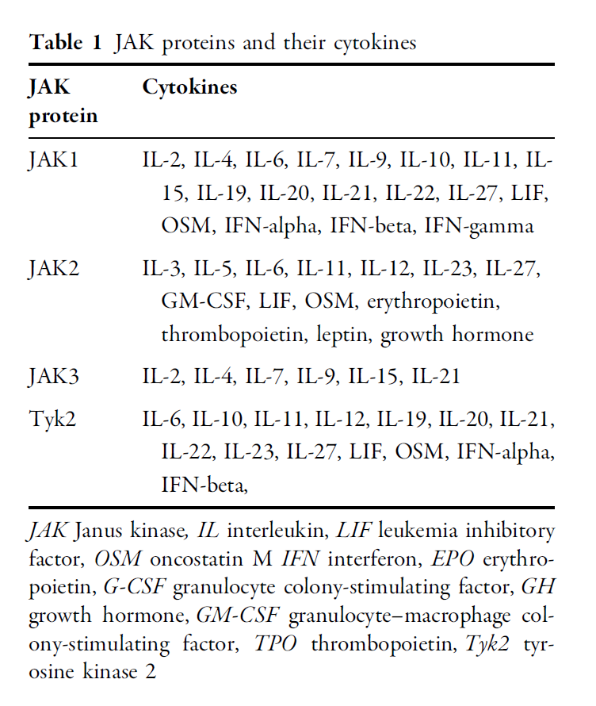
Samuel, C. et al. Dermatol Ther (Heidelb) 13, 729–749 (2023).

Slide 5
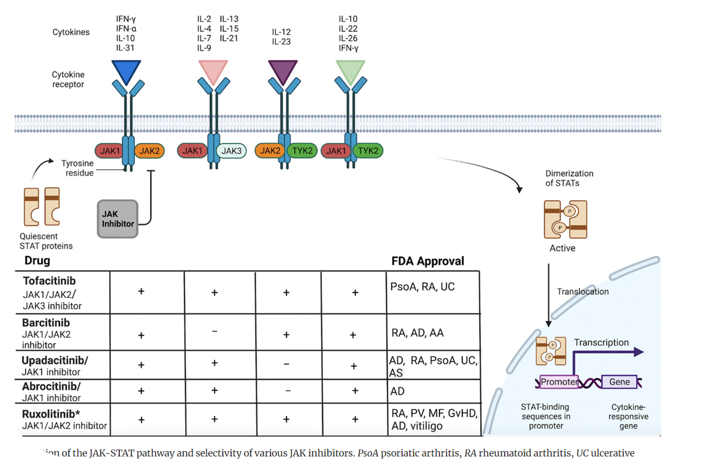
Samuel, C. et al. Dermatol Ther (Heidelb) 13, 729–749 (2023).

Slide 6
Mechanisms relevant to fibrotic ILD
Fibroblast Proliferation and Survival: IL6 & IL13 stimulate lung fibroblasts proliferation. JAK/STAT signals may contribute to the resistance of fibroblasts to apoptosis.
Fibroblast-to-Myofibroblast Transition (FMT): The JAK2/STAT3 pathway regulates myofibroblast differentiation, as defined by alpha-SMA expression and collagen synthesis by key pro-fibrotic stimuli like TGF-β and IL-6/IL-13 in lung fibroblasts.
Epithelial-Mesenchymal Transition (EMT): Inhibition of JAK2/STAT3 signaling reduced the expression of mesenchymal markers induced by TGF-β in alveolar type II epithelial cells.
Autoimmun Rev. 2022 Oct;21(10):103168. 2) Immunotherapy. 2021 Feb;13(3):241-256.
3) Front Med (Lausanne). 2022 Jun 6;9:859330.

Slide 7
Mechanisms relevant to fibrotic ILD
Extracellular Matrix (ECM) Production: signaling via IL-6/STAT3 and IL-13/STAT6 can directly stimulate the synthesis and secretion of collagens and fibronectin by fibroblasts. STAT3, in particular, may directly regulate collagen I expression.
Cellular Senescence: JAK/STAT signaling, particularly STAT3 activation downstream of IL-6 or TGFβ, is involved in senescence responses in lung fibroblasts and epithelial cells.
Modulation of Inflammatory Responses: JAK-STAT signaling is fundamental to the inflammatory component and mediates the effects of numerous pro-inflammatory cytokines.
Autoimmun Rev. 2022 Oct;21(10):103168. 2) Immunotherapy. 2021 Feb;13(3):241-256.
3) Front Med (Lausanne). 2022 Jun 6;9:859330.

Slide 8
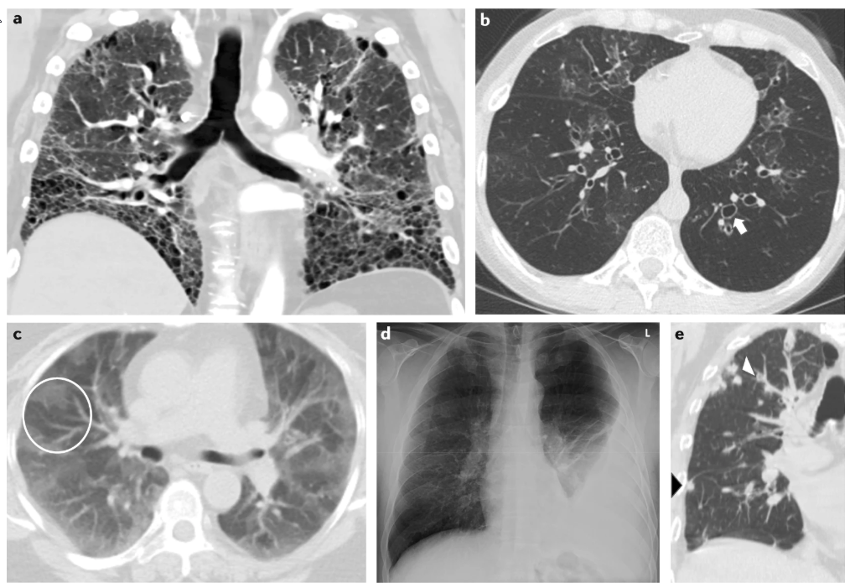
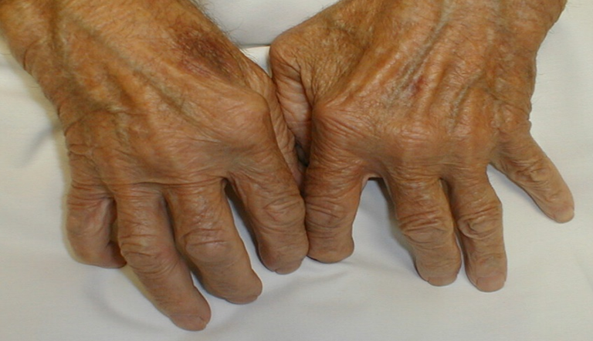
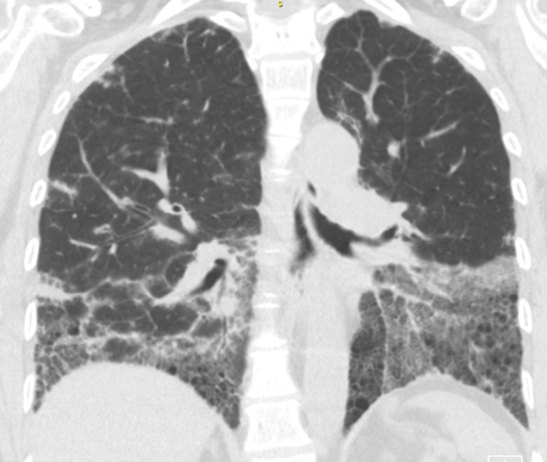
Wang et al, Nat Rev Rheumatol. 2019 Oct;15(10):581-596.

Slide 9
Translational and Clinical Relevance
Several JAK inhibitors have been approved for the treatment of RA and other autoimmune diseases.
Whether a selective JAK inhibitor (JAK1/2/3/TYK2) is preferred as a therapeutic for autoimmune disease with fibrotic organ involvement (like RA with ILD) is not known.
Biologically, the influence of JAKs on TGFβ signaling in lung fibroblasts is not well defined.

Slide 10
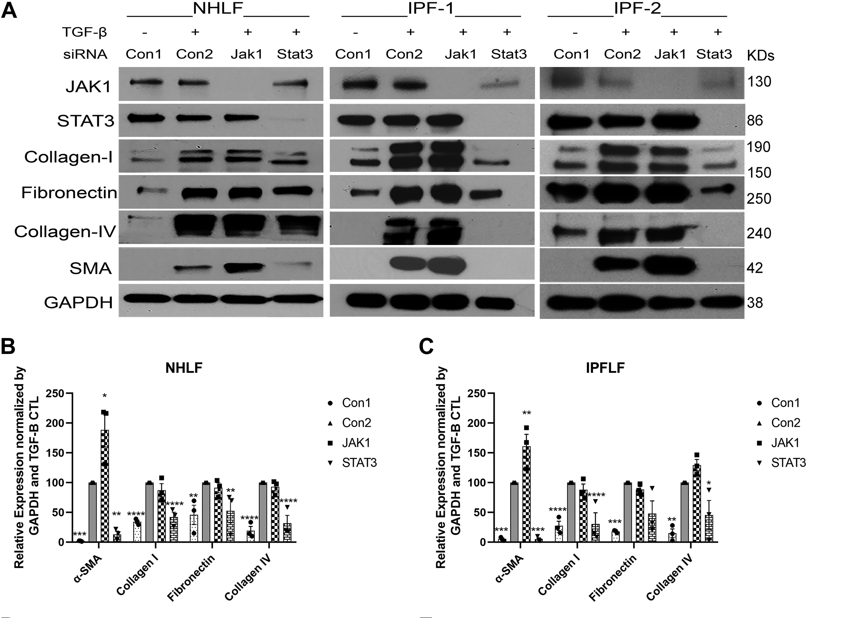
Am J Physiol Lung Cell Mol Physiol. 2022 Dec 1;323(6):L698-L714.
Notes:
Figure 1. Transcriptional silencing of JAK1 and STAT3 has opposite effects on TGF-β-induced myofibroblast transdifferentiation and proliferation. A: Western blot of SMA and ECM performed on NHLF or IPFLF cell lysates following siRNA-mediated knockdown of JAK1 (siJAK1), STAT3 (siSTAT3), or nontargeting control (siCon) with or without 24-h TGF-β stimulation (2.5 ng/mL, n = 3). B and C: semiquantification of SMA, collagen I, fibronectin, and collagen IV as shown in A. TGF-β-stimulated Con2 (siCon) served as positive control for each comparison. Transcriptional silencing of JAK1 significantly increased SMA expression in NHLF (n = 3, *P < 0.05) and IPFLF (n = 3, **P < 0.01) but did not significantly alter ECM protein expression. In contrast, transcriptional silencing of STAT3 significantly decreased SMA and ECM protein expression in NHLF (**P < 0.01, ****P < 0.0001) and SMA and collagen I in IPFLF (*P < 0.05, ****P < 0.0001). D and E: proliferation of NHLF and IPFLF was determined using the IncuCyte system following transcriptional silencing of JAK1 and STAT3 and subsequent stimulation with TGF-β (2.5 ng/mL, n = 4). Silencing JAK1 did not alter cell proliferation, whereas silencing STAT3 significantly decreased proliferation of both NHLF (n = 4, ***P < 0.001) and IPFLF (n = 4, *P < 0.05). ECM, extracellular matrix; IPFLF, diseased lung fibroblast; JAK, Janus kinase; NHLF, normal human lung fibroblast; SMA, smooth muscle actin; STAT, signal transducers and activators of transcription; TGF-β, transforming growth factor-beta; n = number of experimental replicates.

Slide 11
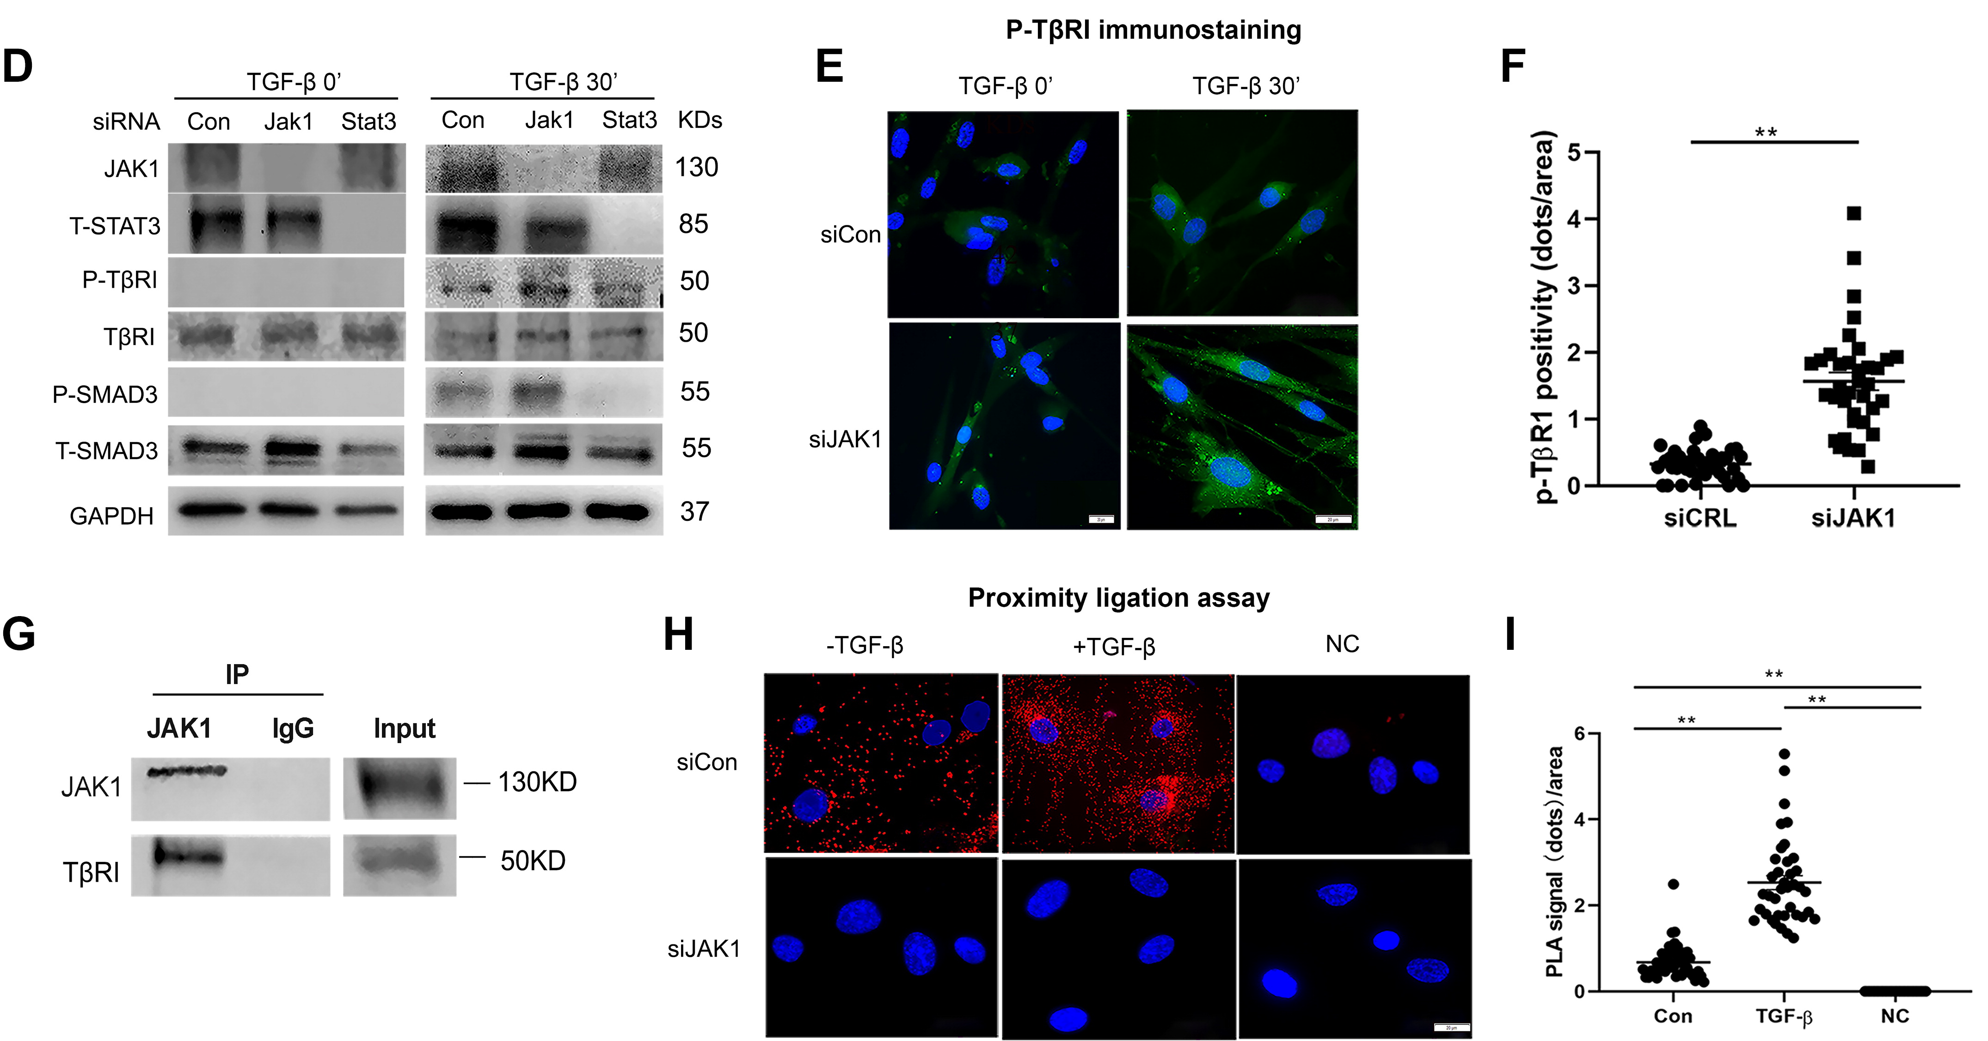
Am J Physiol Lung Cell Mol Physiol. 2022 Dec 1;323(6):L698-L714.
Immunostaining of P-TβRI (green punctate staining) ± TGF-β stimulation in siRNA-mediated JAK1 knockdown or nontargeting control (siCon) NHLF cells. H: physical interaction between JAK1 and TβRI in NHLF was determined using the proximity ligation assay (PLA) in NHLF cells treated with or without TGF-β (2.5 ng/mL) for 24 h after siJAK1 and siCon silencing. The red punctate staining pattern indicates positive PLA signals, suggesting JAK1/TβRI complex formation in siCon condition, while JAK1 suppression prevented complex formation.
DOI: (10.1152/ajplung.00428.2021)
Notes:
Figure 4. Physical interaction of JAK1 with TβRI demonstrated by immunoprecipitation/Western blot and PLA. A and C: the dependency of TβRI kinase by JAK1-mediated TGF-β signaling was tested using ALK-5 inhibitor SB431542. SMA and P-SMAD3 levels were determined by Western blot in NHLF after transcriptional silencing of JAK1 followed by TGF-β stimulation for either 24 h or 30 min and subsequent 24-h incubation with SB431542 (10 µM). B: semiquantification of SMA differences between siJAK1 and siCon (ΔSMA = siJak1 − siCon) was compared among DMSO, SB431542, TGF-β alone, or TGF-β+ SB431542 treatment groups as shown in A (n = 3). Incubation with SB431542 significantly decreased ΔSMA in TGF-β-stimulated cells (**P < 0.01). C: the influence of ALK-5 inhibitor SB431542 on NHLF SMA expression at basal condition (without TGF-β treatment) was tested with cells grown on 0.2 kPa Cytosoft silicone gel after JAK1 silencing. TGF-β-treated cells in C served as controls for cell fibrotic response (n = 3). D: to determine whether JAK1 and STAT3 regulate TβRI and SMAD3 phosphorylation, NHLF cells were stimulated with TGF-β (2.5 ng/mL) for 30 min following JAK1 and STAT3 transcriptional silencing and the expression of P-TβRI and P-SMAD3 was then examined by Western blot (n = 3), which showed an increase in P-TβRI followed by an increase in P-SMAD3 after 30 min TGF-β stimulation in JAK1 suppressed cells, whereas STAT3 silencing showed no effect on P-TβRI but completely suppressed P-SMAD3. E: immunostaining of P-TβRI (green punctate staining pattern) with or without TGF-β stimulation in siRNA-mediated JAK1 knockdown or nontargeting control (siCon) NHLF cells (scale bar: 20 µm). F: quantification of P-TβRI staining using Image J software demonstrates significant increase of P-TβRI staining in JAK1-suppressed NHLF cells (**P < 0.01). G: TGF-β-stimulated NHLF cells were subjected to immunoprecipitation by rabbit anti-JAK1 antibody or rabbit IgG isotype control. The rabbit anti-JAK1 pull-down fraction was then probed for mouse anti-JAK1 or goat anti-TβRI by Western blot, respectively. A specific band at the predicted molecular size was detected for both JAK1 and TβRI (n = 3), suggesting complex formation between the two molecules. H: physical interaction between JAK1 and TβRI in NHLF was determined using the proximity ligation assay (PLA) in NHLF cells treated with or without TGF-β (2.5 ng/mL) for 24 h after siJAK1 and siCon silencing (n = 3). The red punctate staining pattern indicates positive PLA signals, suggesting JAK1/TβRI complex formation in siCon condition, while JAK1 suppression prevented complex formation. NC is a negative control for PLA specificity (scale bar: 20 µm). I: quantification of PLA-positive signals using ImageJ. TGF-β stimulation significantly increased JAK1/TβRI complex formation in siCon condition (**P < 0.01). NHLF, normal human lung fibroblast; PLA, proximity ligation assay; SMA, smooth muscle actin; TGF-β, transforming growth factor-beta; TβRI, TGF-β type 1 receptor; n = number of experimental replicates.

Slide 12
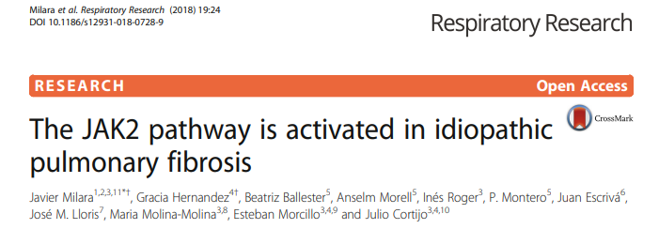
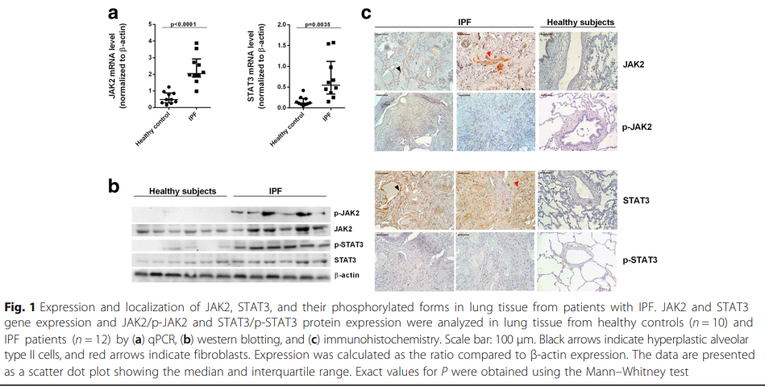

Slide 13
*
Wang S, et al. FASEB J. 2022; 36:e22336.
Notes:
MANUSCRIPT IN PREPARATION

Slide 14
Wang S, et al. FASEB J. 2022; 36:e22336.

Slide 15
Wang S, et al. FASEB J. 2022; 36:e22336.

Slide 16
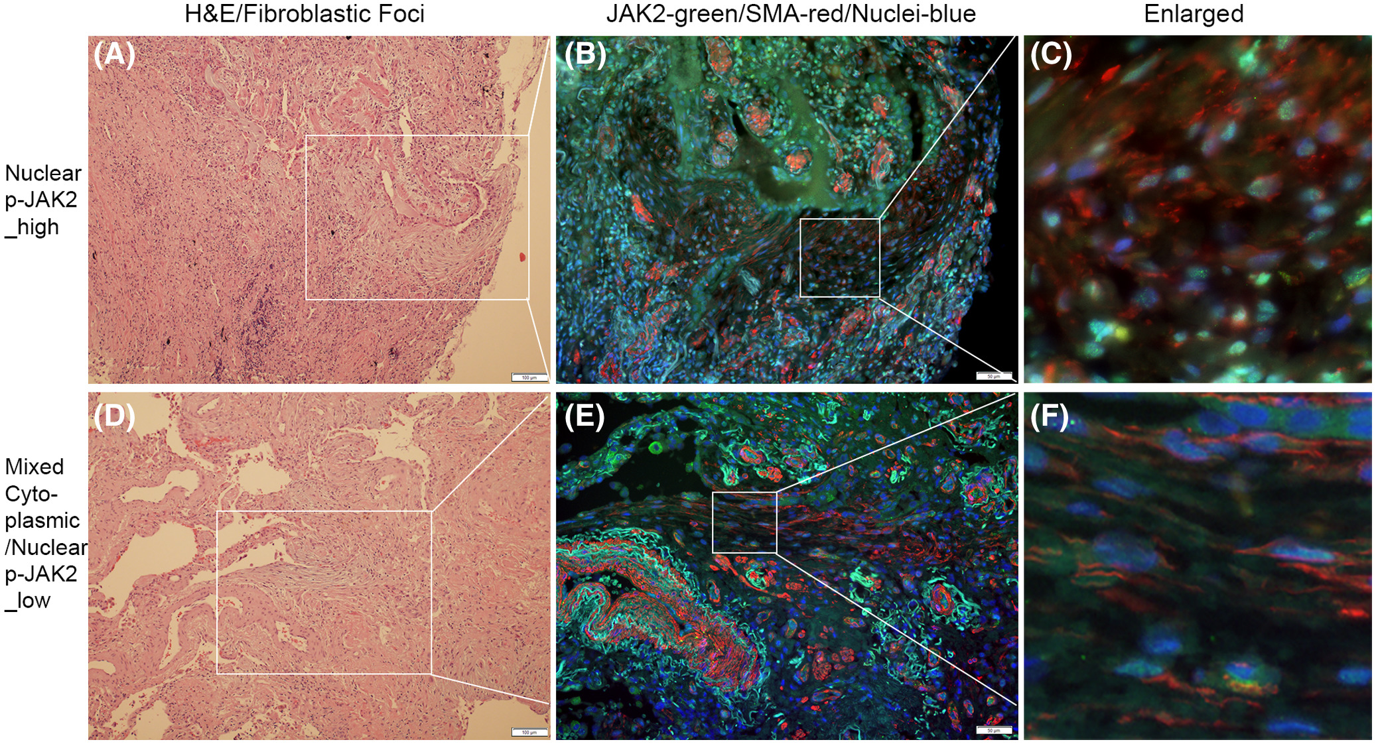

Slide 17
STAT5 colocalizes with either cytoplasmic p-JAK2 or nuclear p-JAK2, suggesting a key role in JAK2 mediated signaling transduction in both diseases

Slide 18
JAK2 inhibitor CEP33779 significantly alleviated bleomycin induced pulmonary fibrosis in a mouse model
Wang S, et al. FASEB J. 2022; 36:e22336.

Slide 19
Final comments
Inhibition of specific JAK isoforms may be desirable in fibrotic lung disease.
JAK1 appears to have a regulatory role in TGFβ signaling and it’s suppression does not suppress matrix generation or fibroblast proliferative responses.
Inhibition of JAK1 is not associated with attenuated fibroblast responses to TGFβ. Inhibition of JAK1 in vivo is also not associated with attenuation of bleomycin induced pulmonary fibrosis.

Slide 20
Final comments
RNA sequencing of RA-ILD lung biopsies identified a JAK2 pathway gene signature that distinguishes RA-UIP from idiopathic UIP.
IHC identified JAK2 phosphorylation in lung biopsies and STAT5A&B as the downstream transcriptional activator.
In vitro studies with normal and IPF derived lung fibroblasts revealed a central role for JAK2 as an essential intermediary molecule in TGF-β-mediated myofibroblast trans-differentiation, proliferation, and extracellular matrix protein production.

Slide 21
Future directions
Isoform and Cell-Type Specificity: the need for further research on the precise roles of individual JAK and STAT isoforms (e.g., STAT1 vs. STAT3, nuclear JAK2) within different lung cell types (epithelial cells, fibroblasts, macrophages, lymphocytes) during fibrosis initiation and progression.
The need for selective Inhibitors with optimized selectivity profiles, potentially targeting specific JAK isoforms (e.g., JAK2-selective) or even downstream STAT proteins, to maximize anti-fibrotic efficacy while minimizing adverse effects related to blocking essential physiological signaling.
Exploring the impact of combination JAK inhibition with standard anti-fibrotic therapies for fibrotic lung diseases.

Slide 22


Acknowledgements
Shaohua Wang, MD, MPH, Faping Wang, MD, PhD, and many other lab members.
Dan Tschumperlin, PhD and several of his lab members.
Eric Matteson, MD, MPH and many others.
Funding:
  NHLBI - 5R03HL096829-02
  Rheumatology Research Foundation
  Hurvis Foundation – (internal gift Mayo Clinic)
  Pfizer

