Slide 1




Emodinamica protettiva: una strategia “nuova” per proteggere
il paziente critico
Dr. Filippo D’Amico
Center for Intensive Care and Anesthesiology, San Raffaele H
Vita-Salute San Raffaele University
@drfdamico • damico.filippo@hsr.it

Slide 2


Slide 3
Similarities between perioperative and critically ill patients
Similar outcomes
Similar therapeutic targets
Similar need for support
Frequent use of inotropic and vasopressor drugs for haemodynamcs management
Continous monitoring of vital parameters
Need for ventilatory support
Maintenance of fluid and electrolyte balance
Use of invasive catheters for vascular access

Slide 4


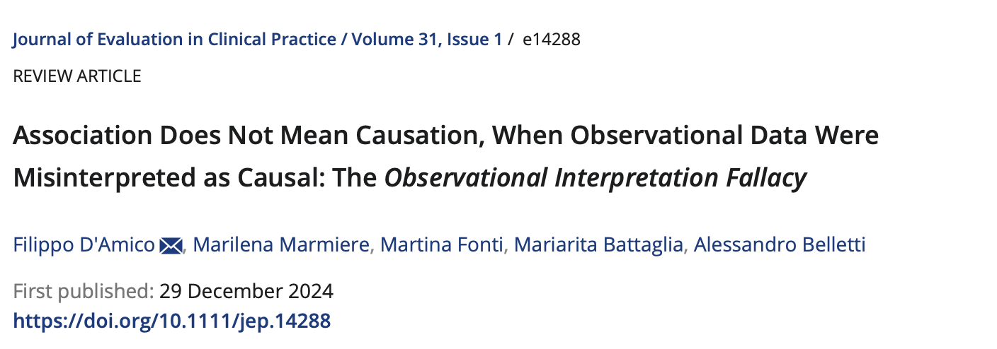

Slide 5
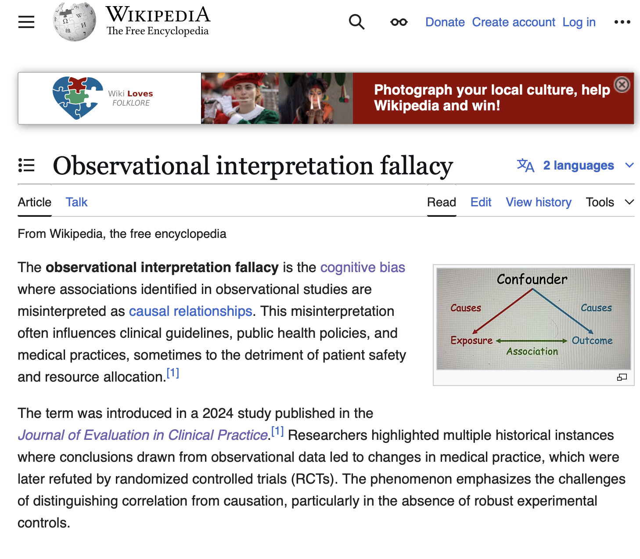
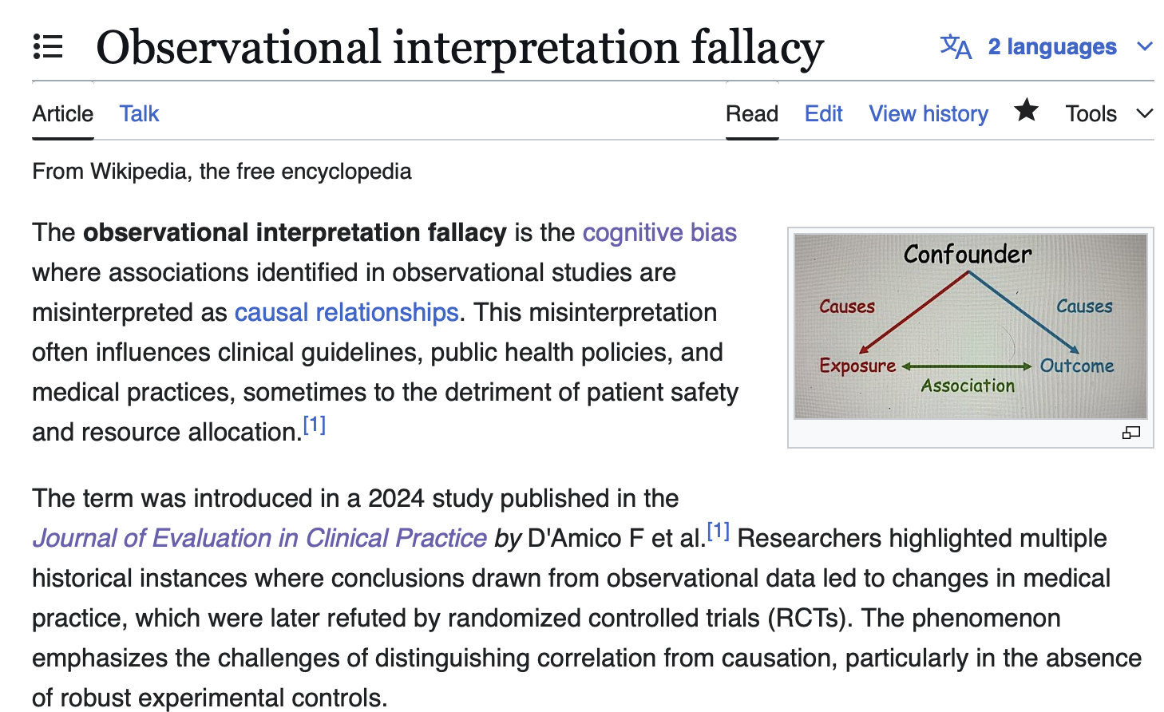

Slide 6
The enemy: intraoperative hypotension
Linked to myocardial injury, acute renal injury, and death.
            Sessler et al. Intensive Care Med. 2018
Just 5 minutes <55 mmHg MAP spells trouble with acute kidney and myocardial injury.
Walsh et al. Anesthesiology 2013
Ten minutes at <80mmHg MAP, or even shorter stints below 70 mmHg or <55 mmHg, unleash end-organ injury. Wijnberge et al. BJS open 2021

Slide 7
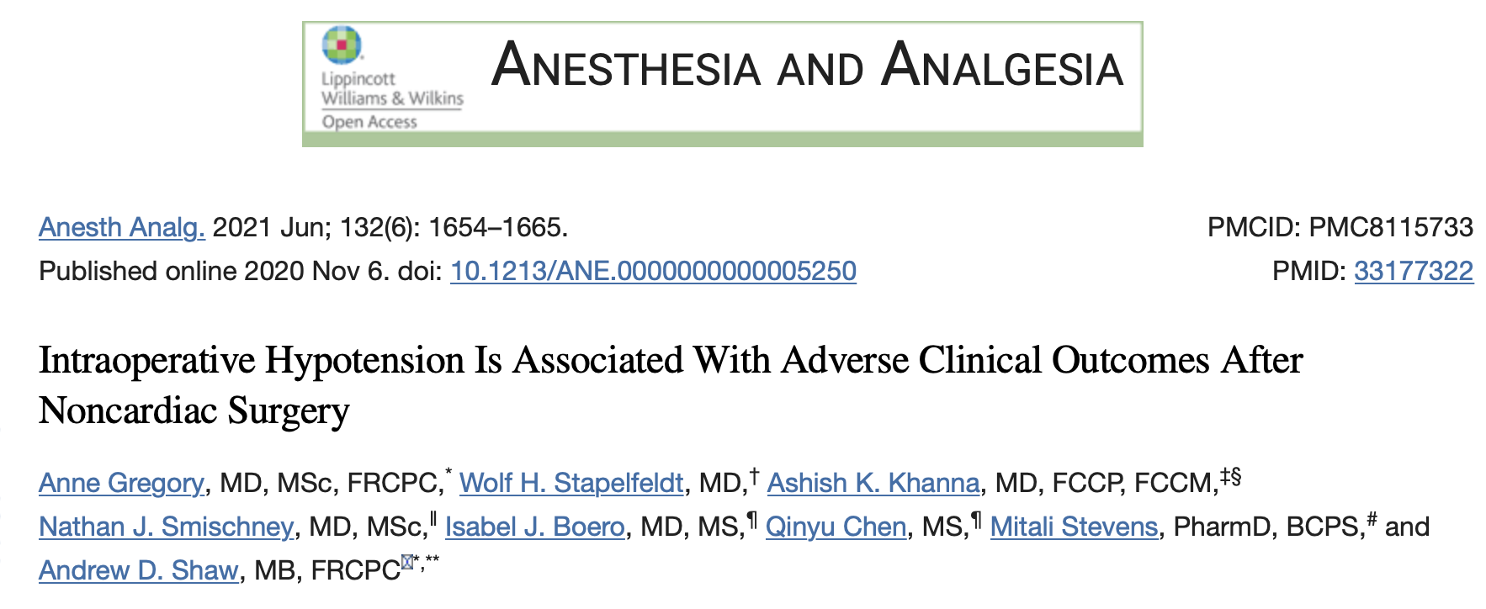
Multicenter retrospective cohort study
369,222 noncardiac surgical procedures
Gregory et al. Anesth Analg. 2021.

Slide 8
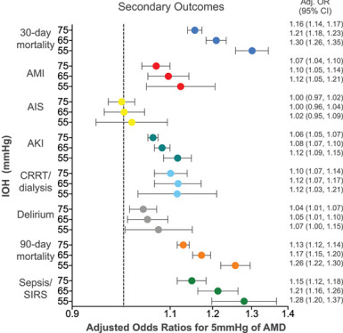
IOH increased 30-day major adverse cardiac or cerebrovascular events.
Gregory et al. Anesth Analg. 2021.

Slide 9
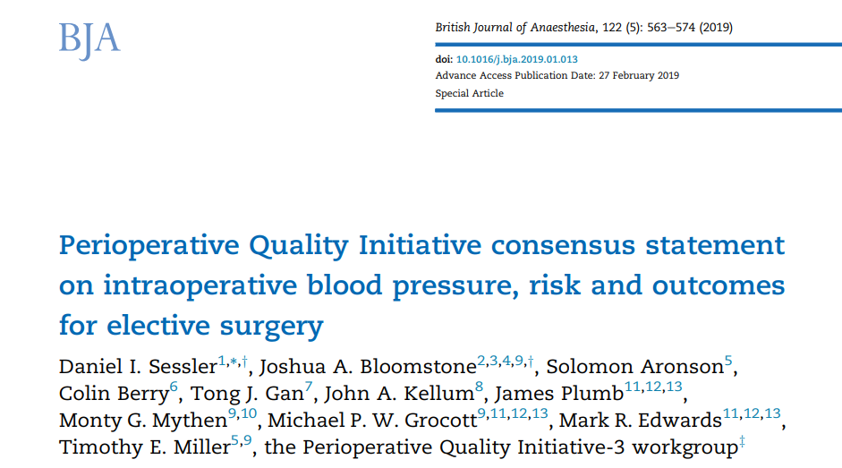
Consensus statement 1:
Intraoperative mean arterial blood pressures below 60–70 mmHg are associated with myocardial injury, acute kidney injury, and death.
Sessler DI et al. Br J Anaesth. 2019

Slide 10
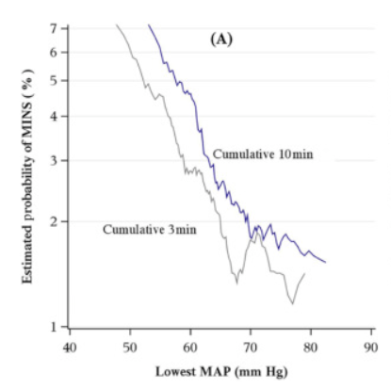
Injury is a function of hypotension severity and duration.
Sessler DI et al. Br J Anaesth. 2019

Slide 11
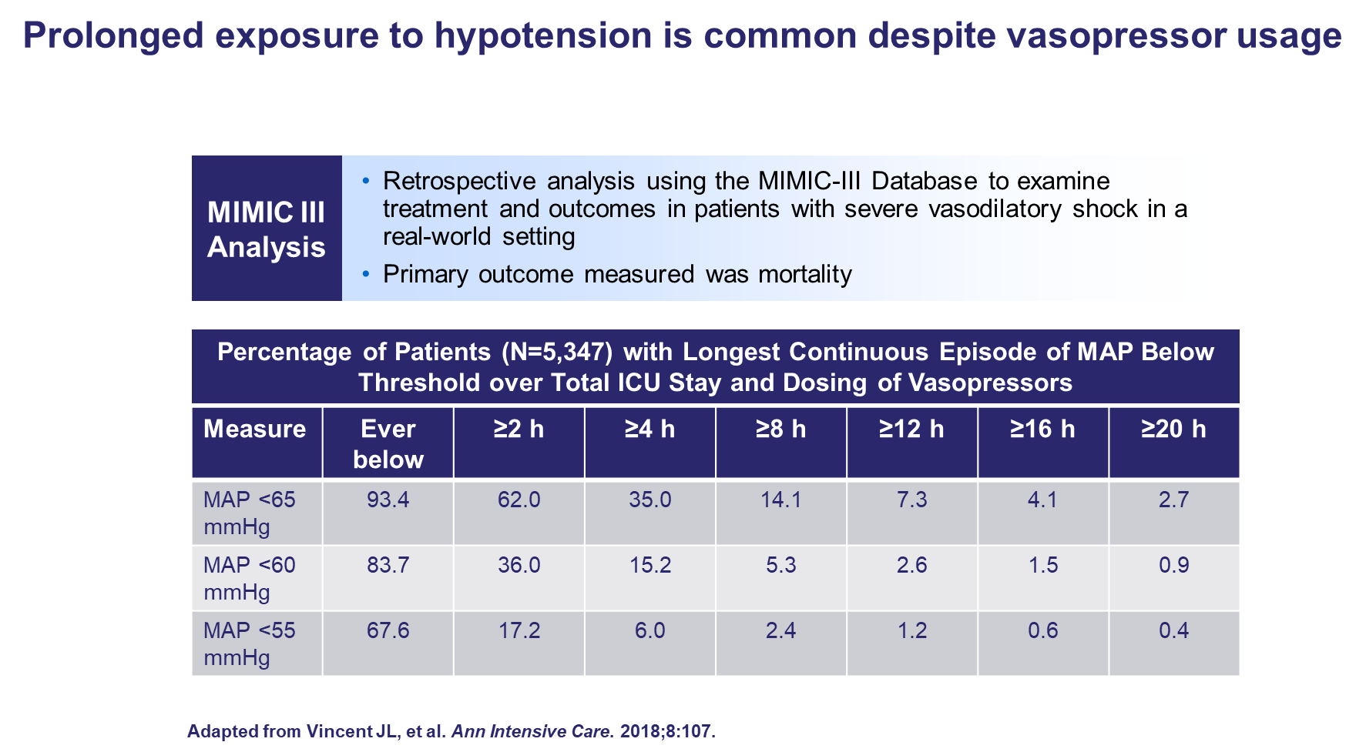

Slide 12
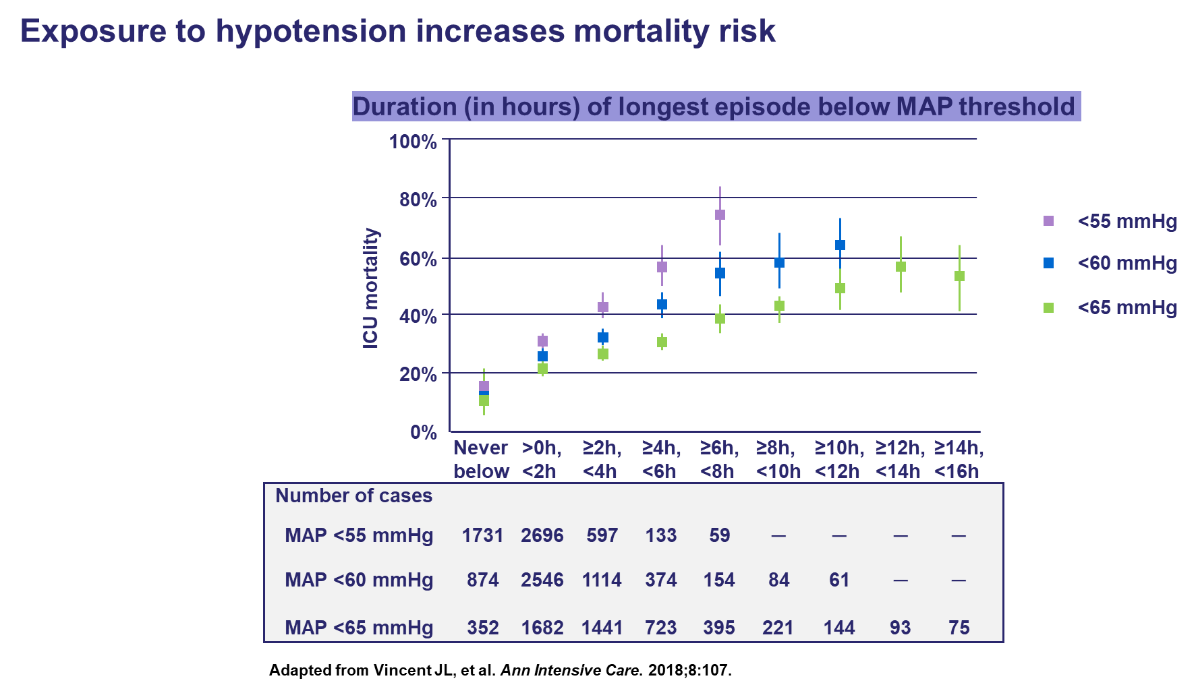

Slide 13

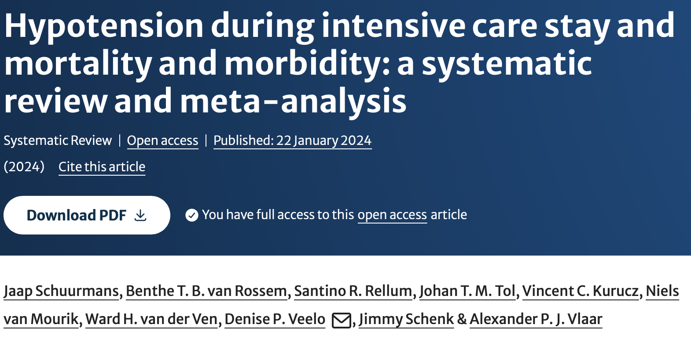
Exposure to hypotension during ICU stay was associated with increased mortality and morbidity in the majority of articles included in this systematic review.
The descriptive findings for mortality were underscored by meta-analysis including RCTs and observational studies

Slide 14
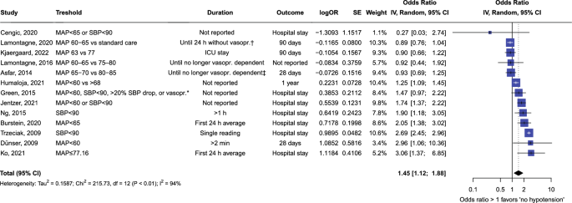
RCT
NON- RCT
Randomized studies appear to have an opposite direction compared to non-randomized studies.

Slide 15
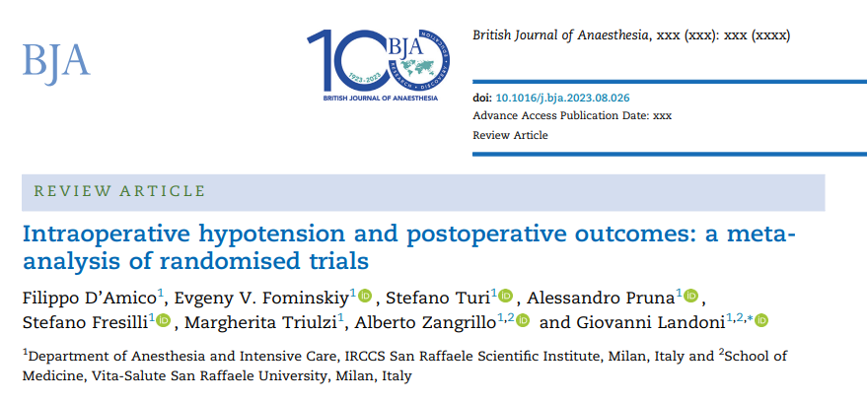

Slide 16
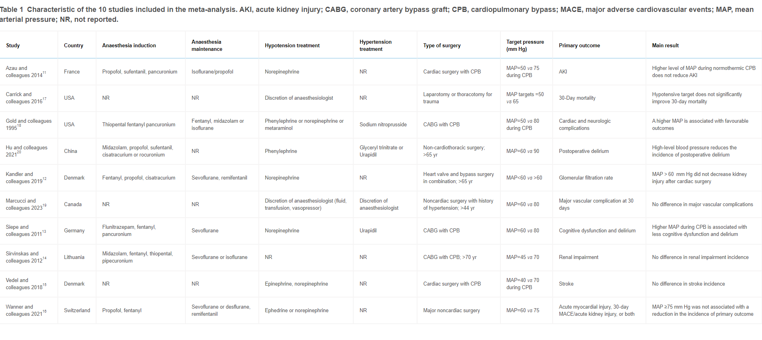
Ten RCTs included

Slide 17
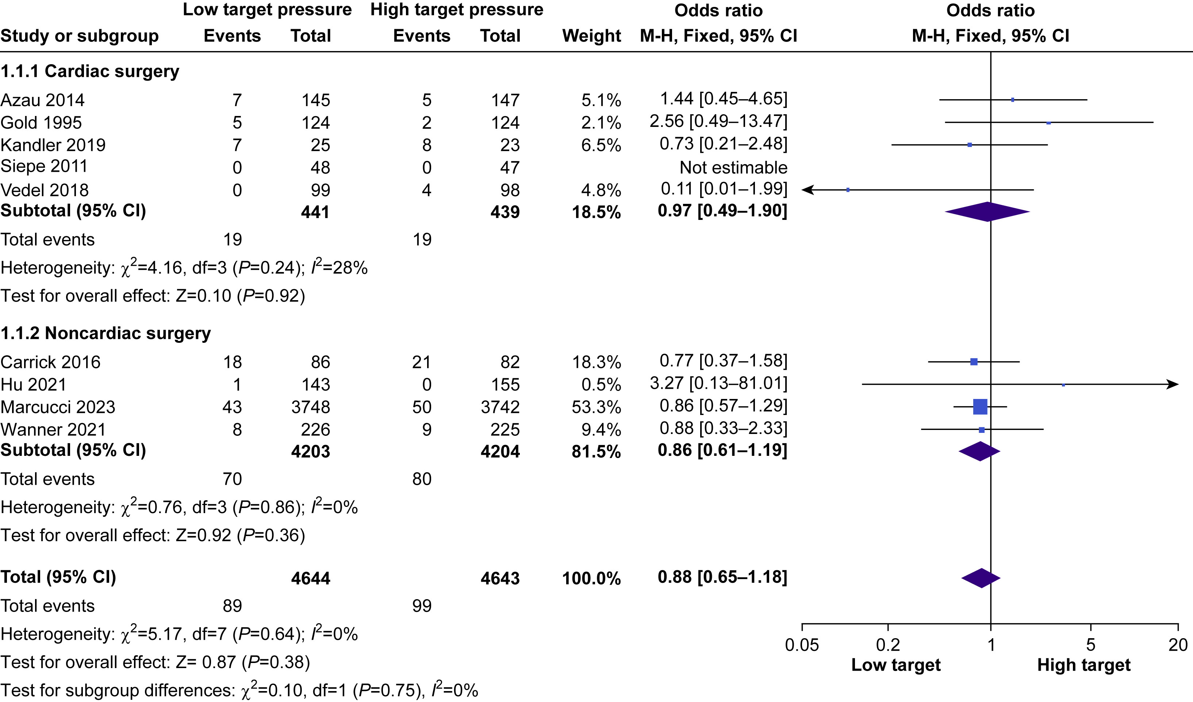

Slide 18
Primary outcome: Mortality
Odds Ratio
M-H, Fixed, 95% CI
0.88
(0.65-1.18)
Low target
High target

Slide 19
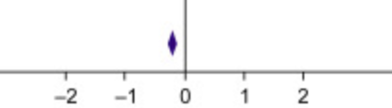
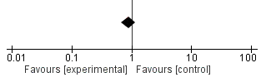
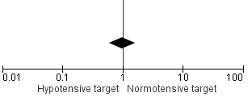
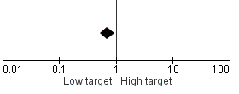
Secondary outcome
LOS
AKI
-0.20
(-0.26; -0.13)
0.89
(0.68; 1.17)
AF
Stroke
0.71
(0.52; 0.96)
0.98
(0.59; 1.63)

Slide 20
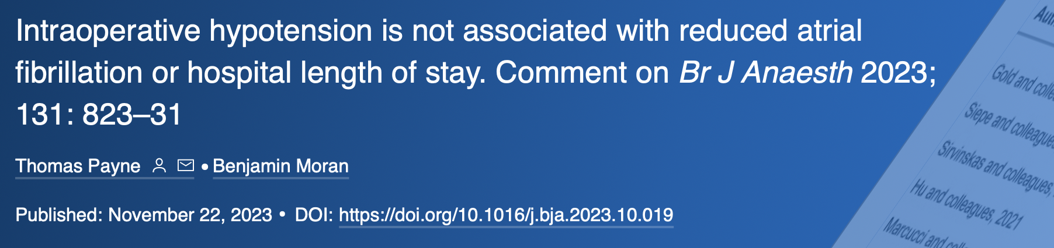
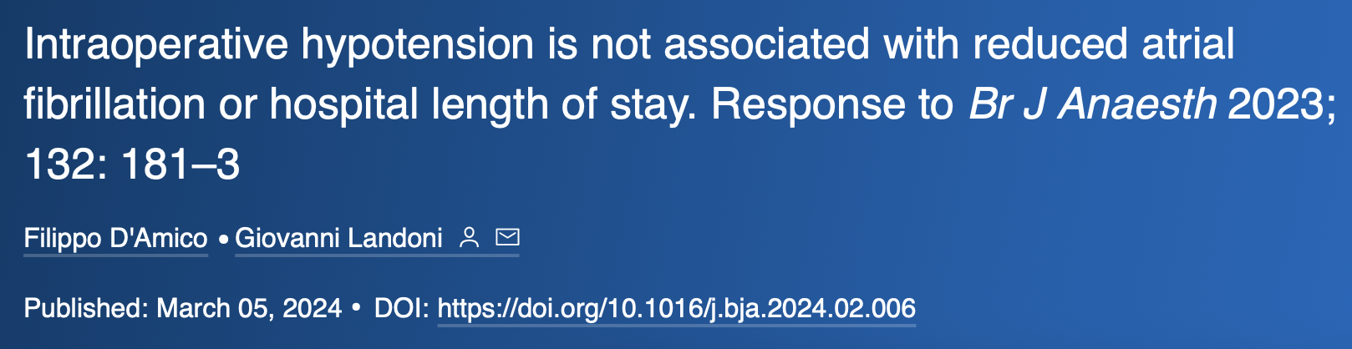
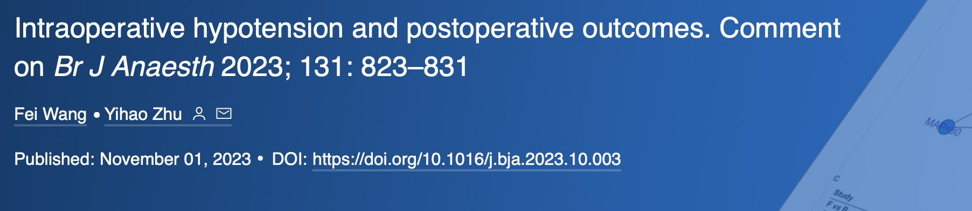
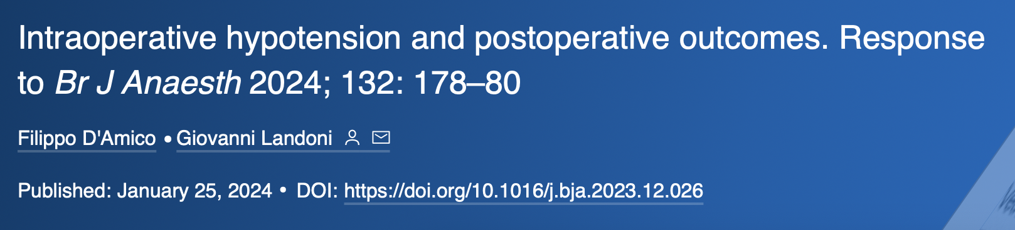
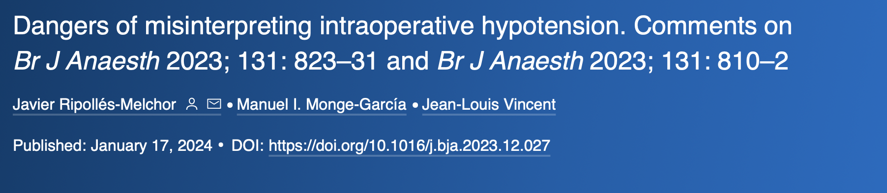
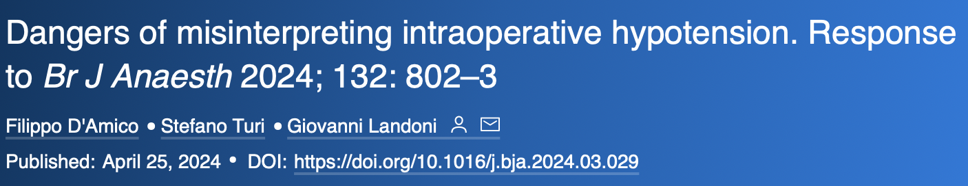
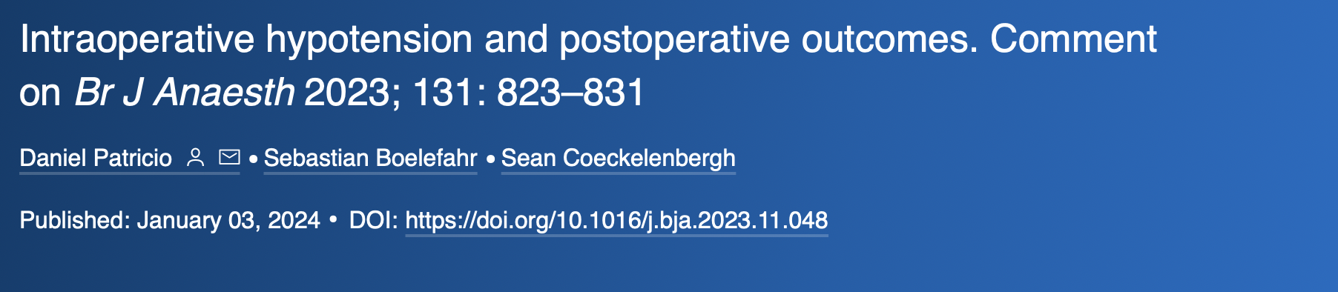
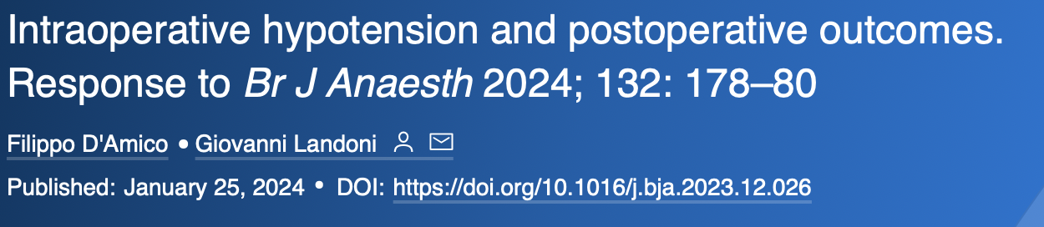
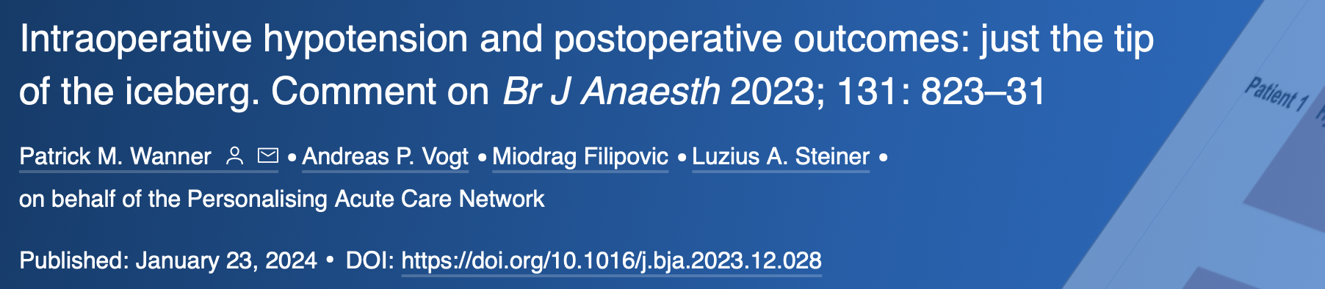
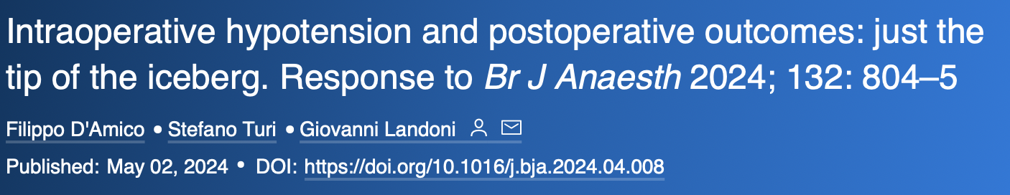
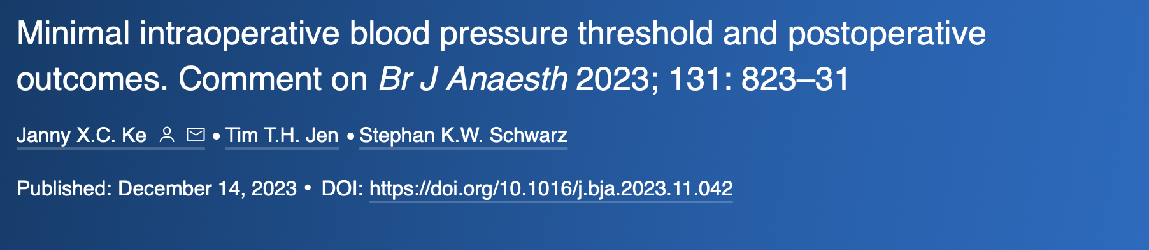

Slide 21
What would happen if all randomized studies, both in critically ill and perioperative settings, comparing a high blood pressure target to a low one were analyzed?

Slide 22

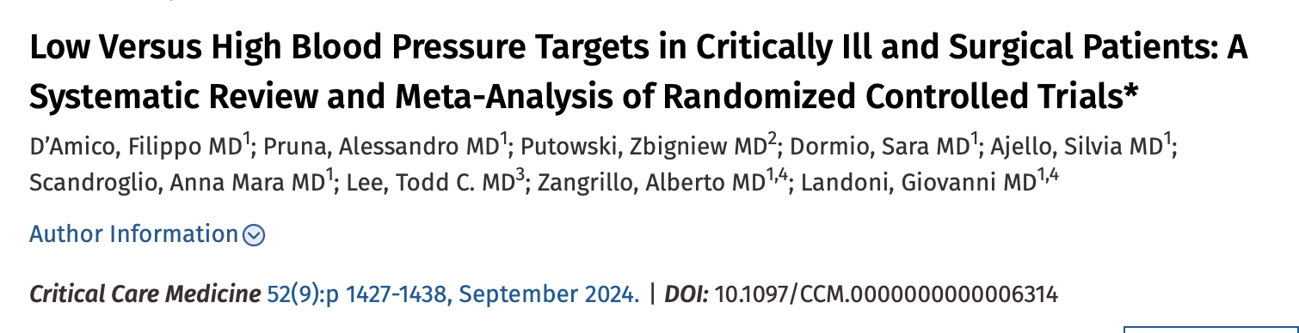

Slide 23
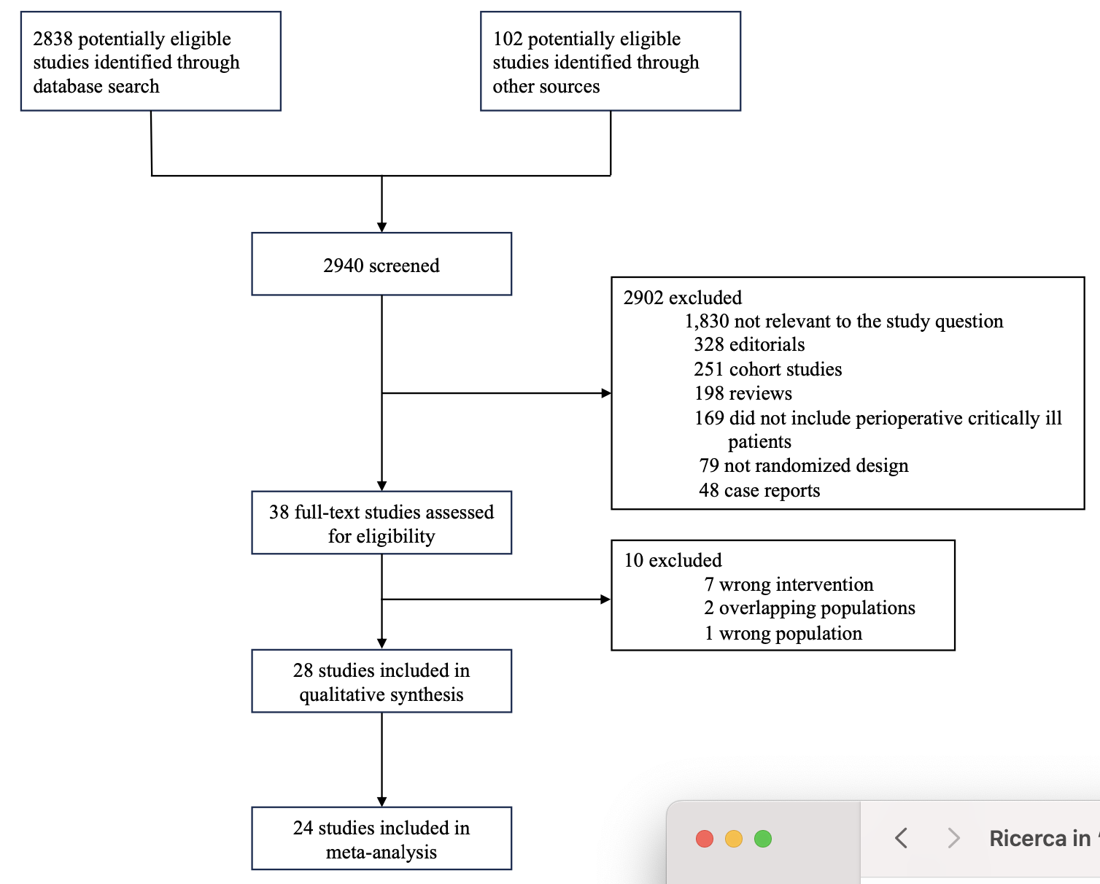
28 RCTs (15,672 overall patients) which met the inclusion criteria
12 studies were performed in critically ill settings

Slide 24
Overall mortality
More than 20 sensitivity analyses
Odds Ratio
M-H, Random, 95% CI
0.93
(0.87-0.99)
Low target
High target

Slide 25
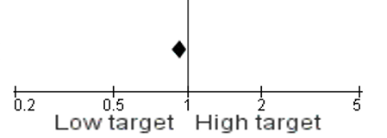
Critically Ill mortality
Odds Ratio
M-H, Random, 95% CI
0.93
(0.87-1.00)

Slide 26
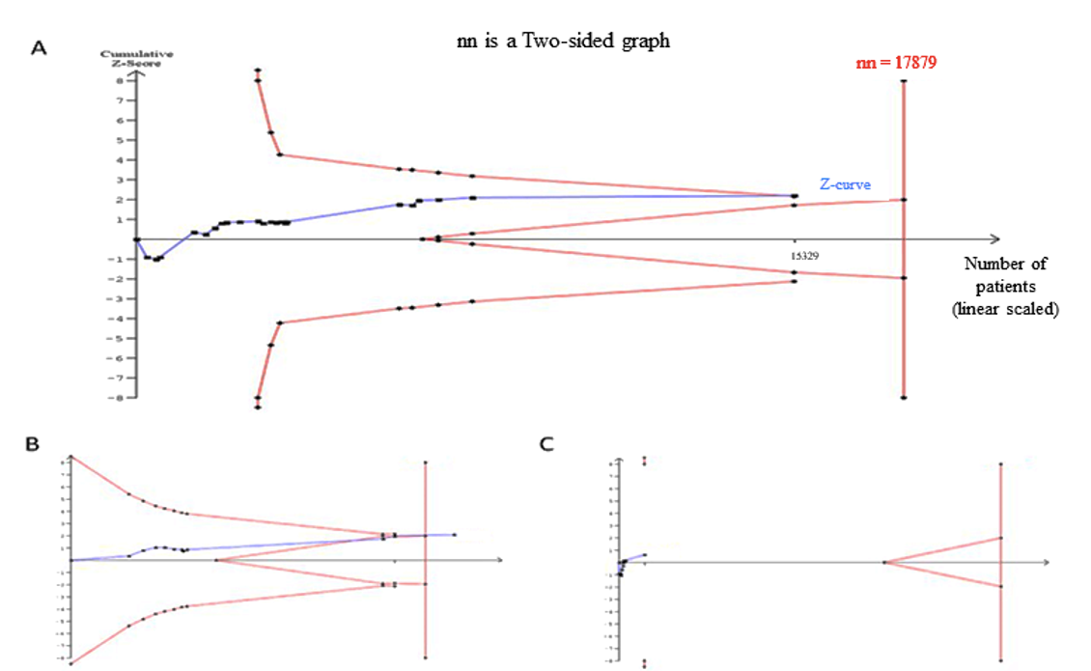
The required sample size was achieved in critically ill setting!

Slide 27
The Bayesian meta-analysis found a 97.4% probability of any increase in mortality!
The absolute risk reduction was 10 fewer deaths per 1000 patients (95% CI 1 fewer to 19 fewer), corresponding to a NNT of 100 (95% CI 53 to 1000).

Slide 28
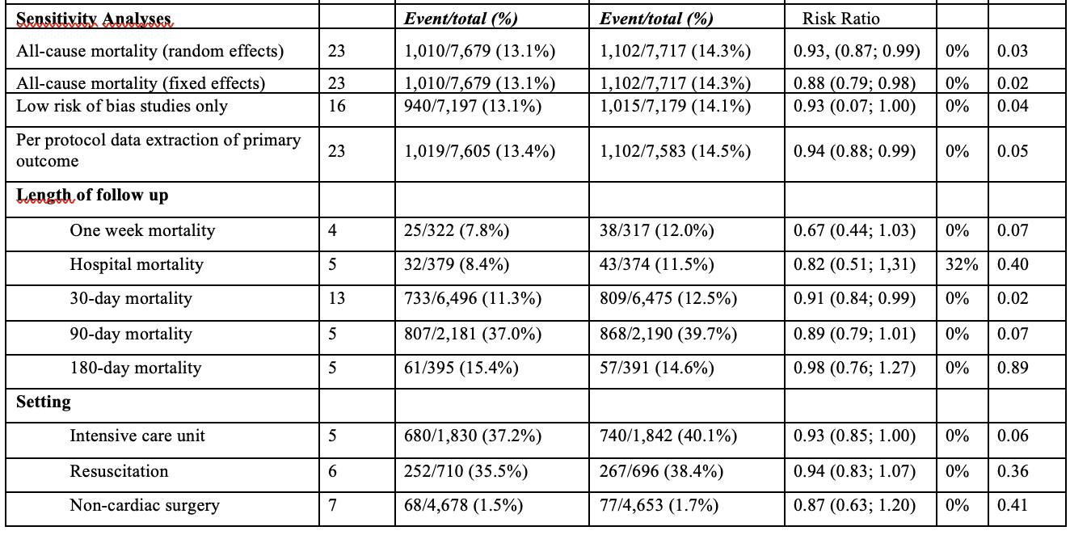
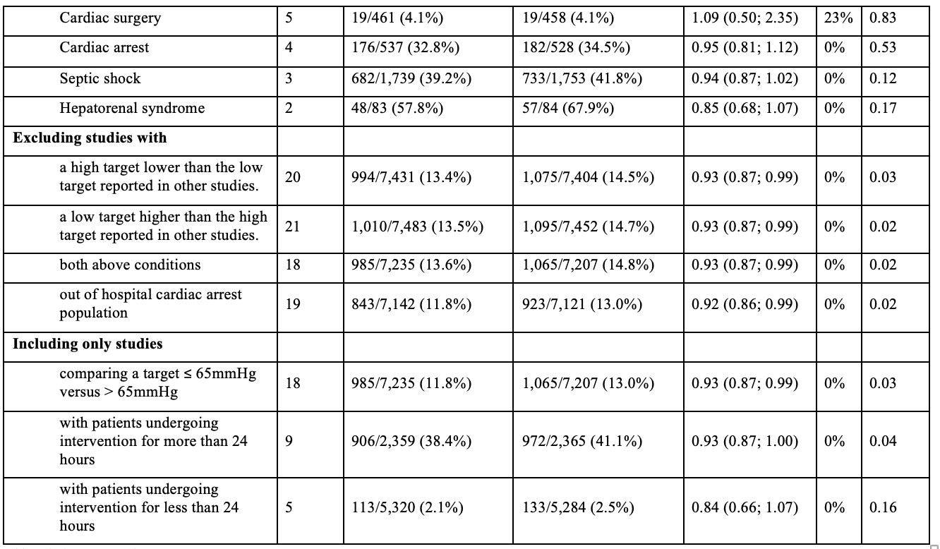
More than 20 sensitivity analyses
under review at Critical Care Medicine

Slide 29
Secondary outcome
Patients requiring transfusion.
AKI
0.73
(0.54; 0.99)
0.98
(0.74; 1.28)
AF
Stroke
0.70
(0.55; 0.89)
1.02
(0.53; 1.97)

Slide 30

​Why hypotension seems not to be detrimental to patients when studied in RCTs ?

Slide 31
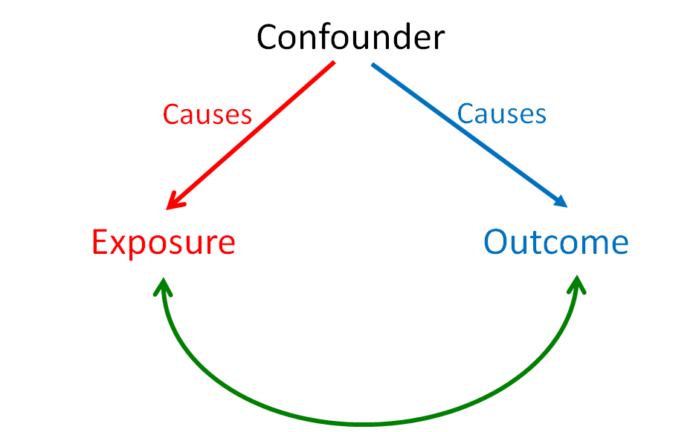
Association is not the same as causation

Slide 34
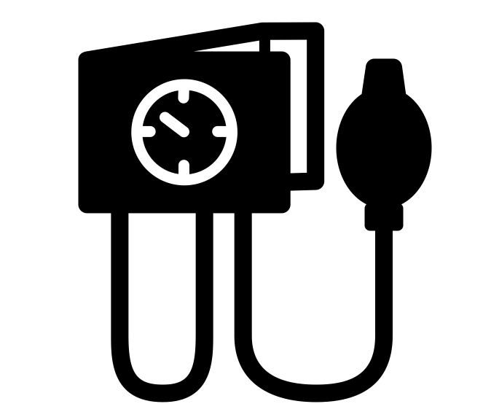

Bias due to confunding?
Hypotension and heightened mortality might be distinct, correlated occurrences.
FRAGILITY
HYPOTENSION
ADVERSE EVENT

Slide 35
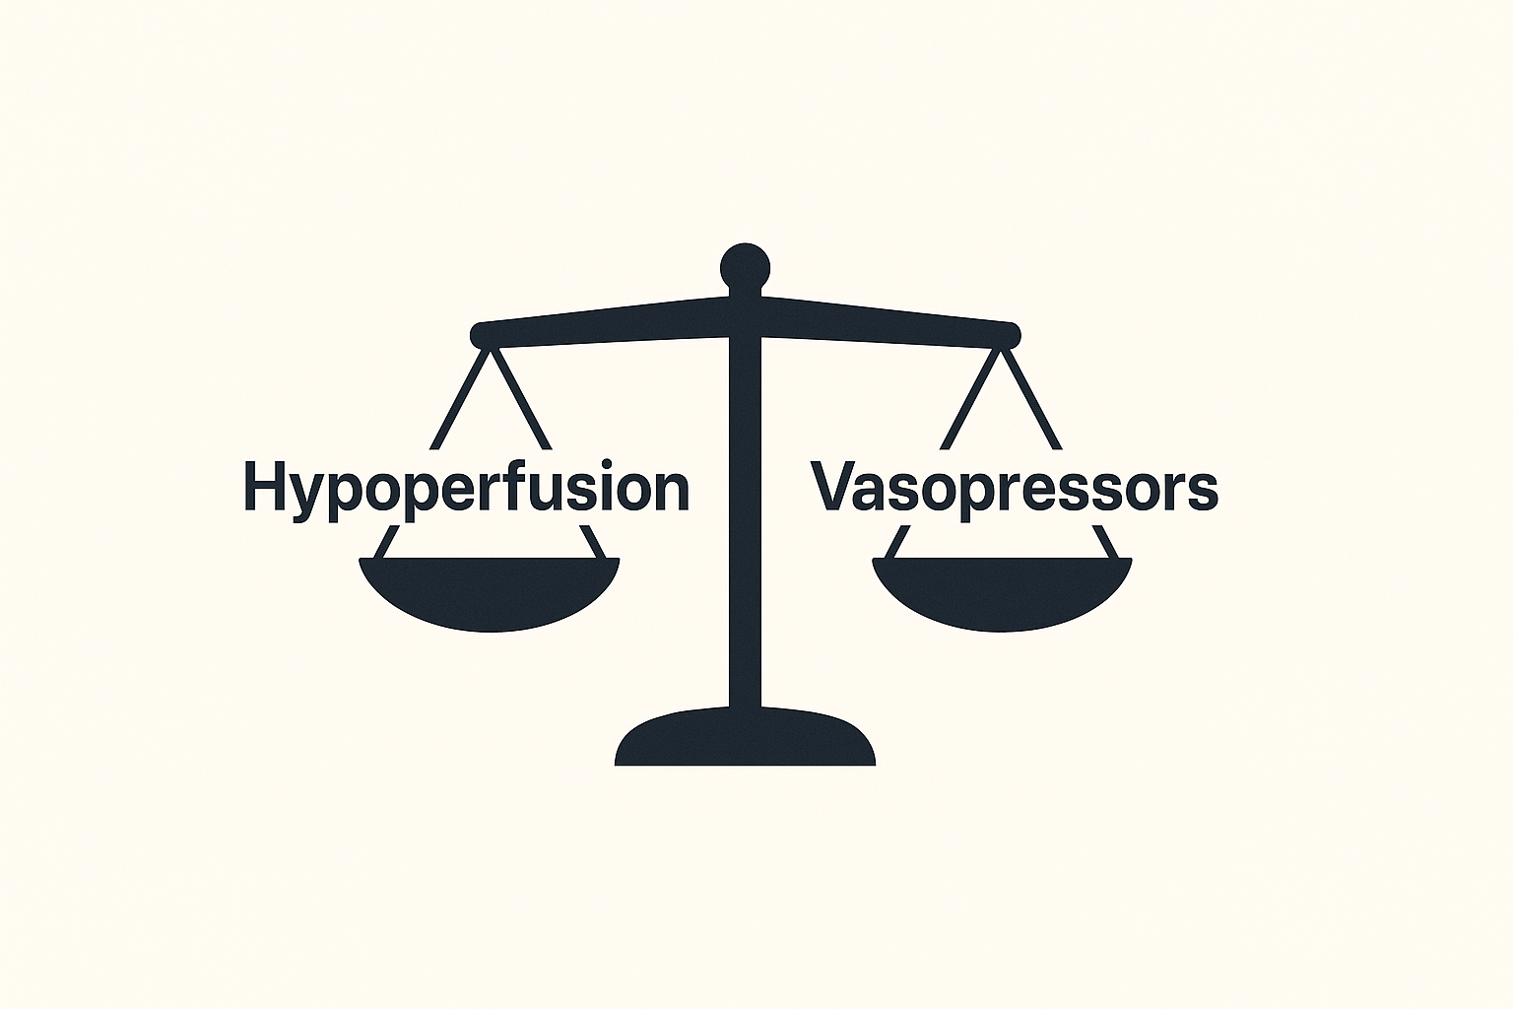

Slide 36

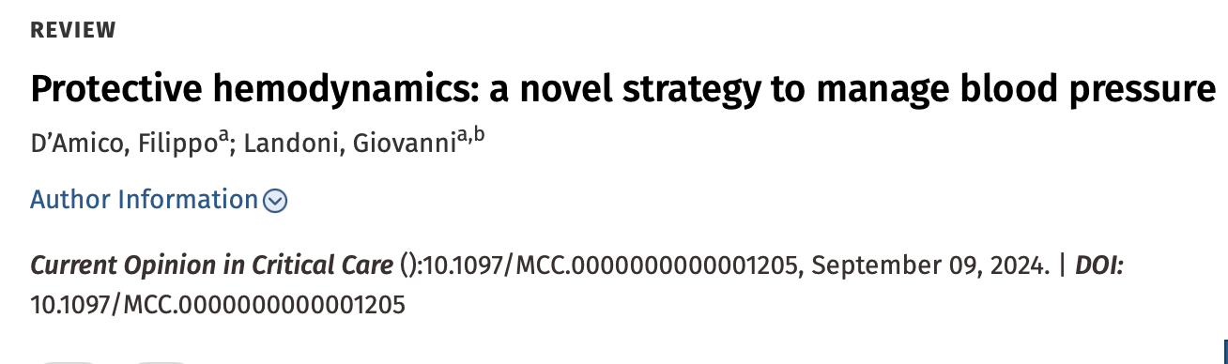

Slide 37
The term protective hemodynamics refers to a clinical management strategy aimed at maintaining the stability while simultaneously reducing the risk of damage or complications associated with interventions.
The primary goal of protective hemodynamics is to limit the damage associated with excessive vasoconstriction.

Slide 38
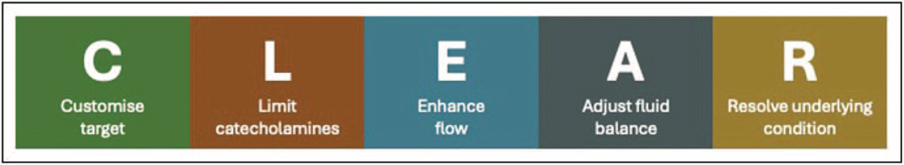

Slide 39
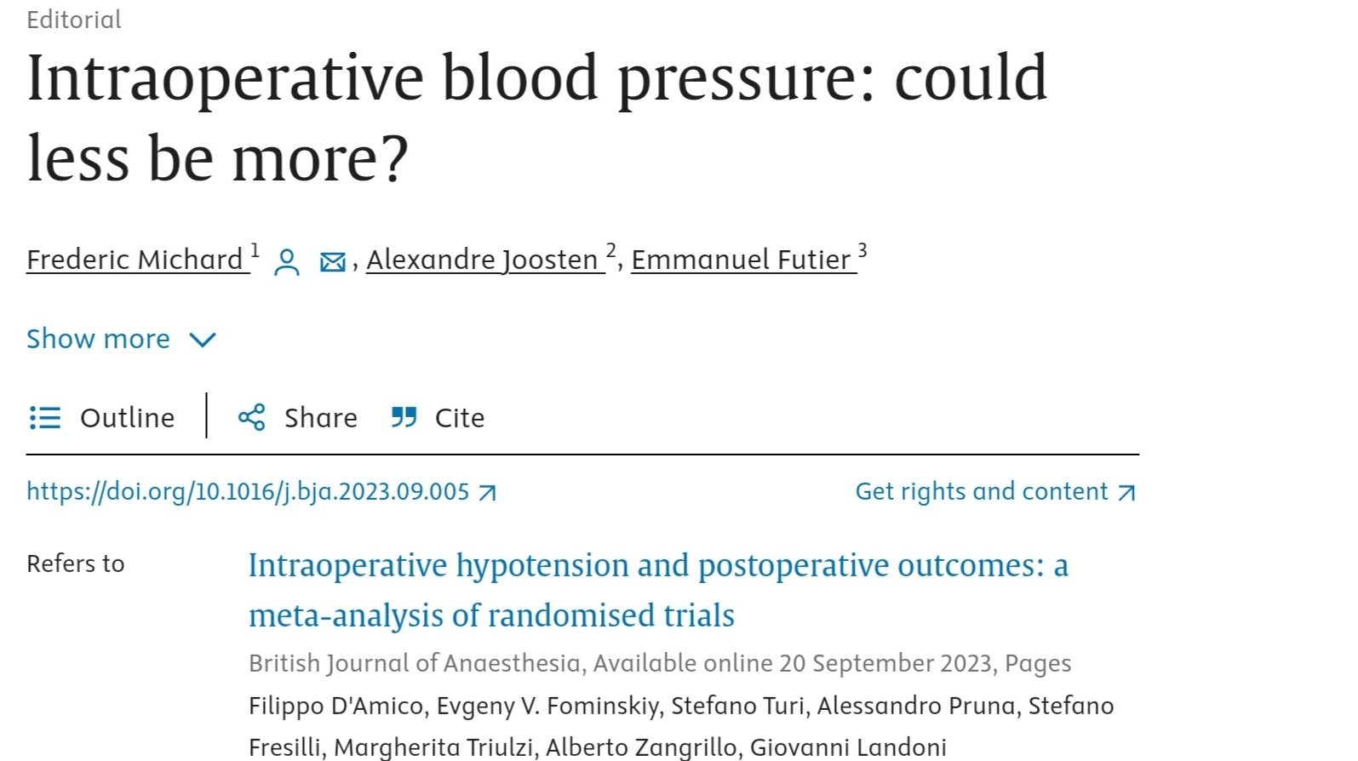

Slide 40
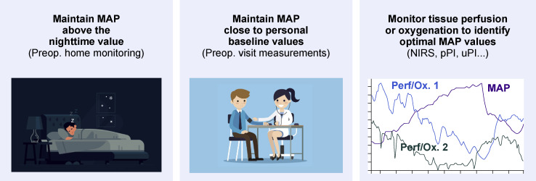
Michard et al. Br. J. Anaesth. 2023.

Slide 41

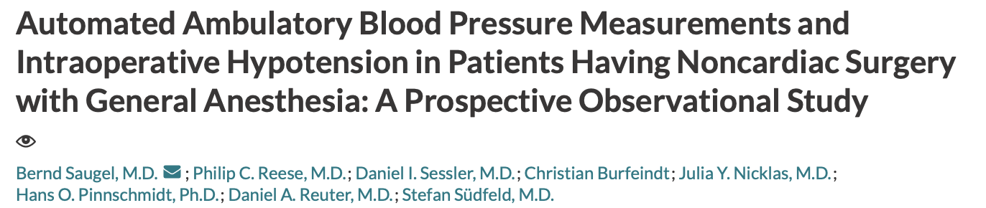
In one thirds of patients the lowest nighttime MAP was below 65 mmHg, with some as low as 50 mm Hg

Slide 42
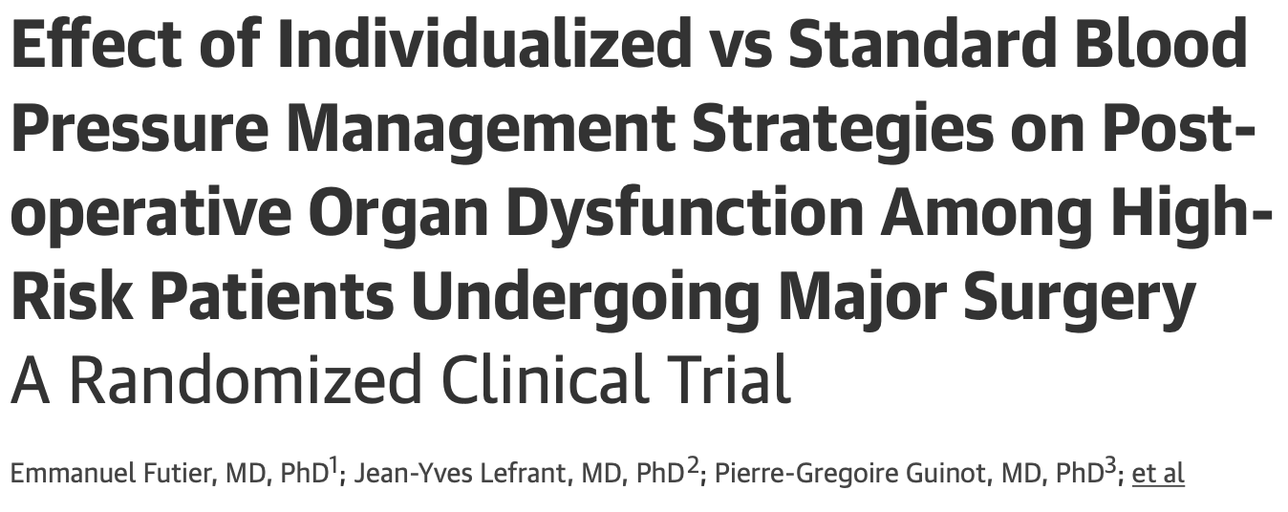
Targeting an individualized systolic blood pressure, compared with standard management, reduced the risk of postoperative organ dysfunction.

Slide 43

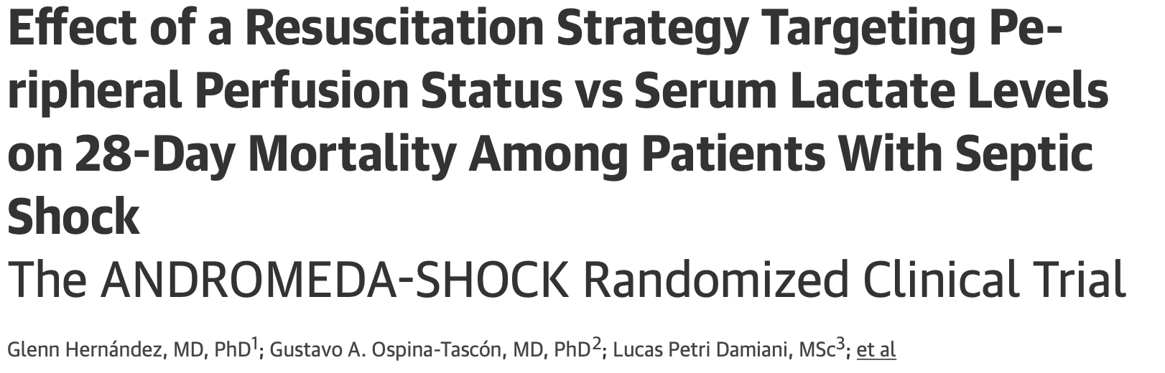
By day 28, 34.9% in the peripheral perfusion group 43.4% in the lactate group had died.
Peripheral perfusion–targeted resuscitation was associated with less organ dysfunction at 72

Slide 44
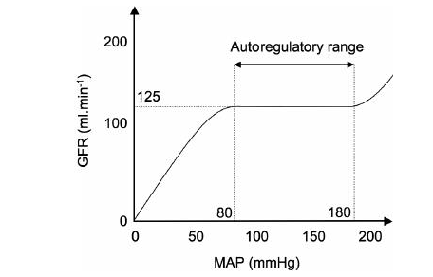
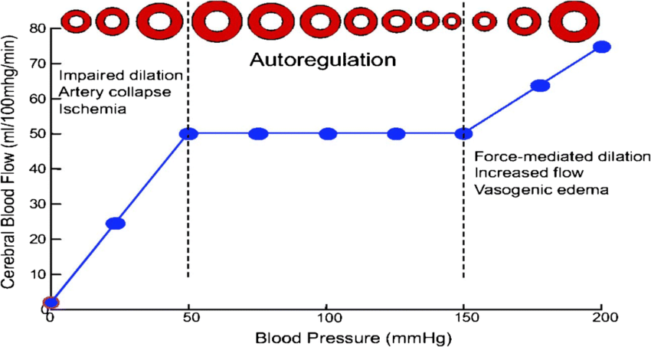

Slide 45
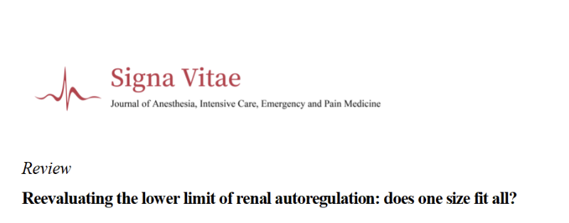
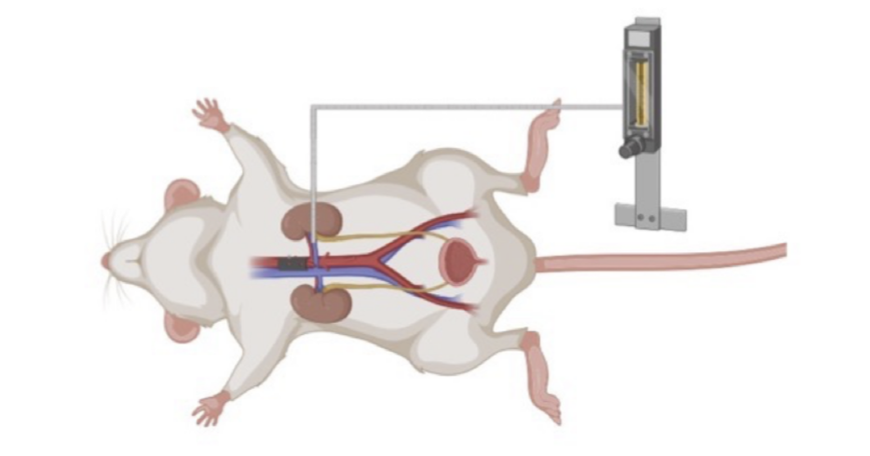
Filippo D’Amico et al. Signa Vitae, in press

Slide 46
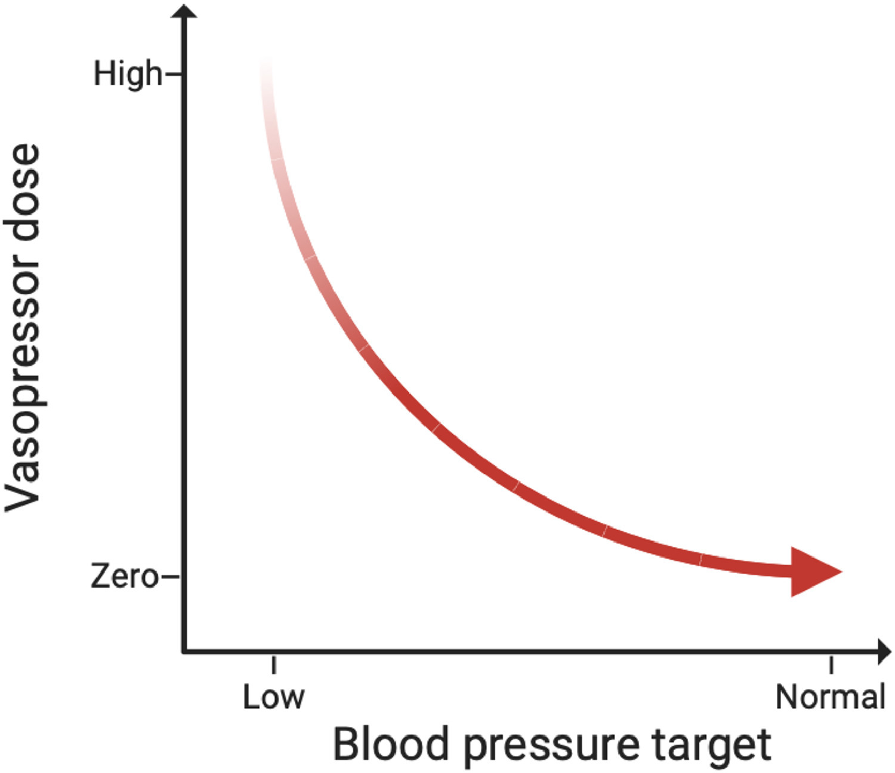

Slide 47

Excessive vasoconstriction should be avoided, and other resuscitation strategies should not be neglected.
De Backer et al. Intensive Care Med 2024 .

Slide 48




ADVERSE REACTIONS
FLUIDS
VASOCONSTRICTORS
TRENDELENBURG
PULMONARY EDEMA
ORGAN EDEMA
ELECTROLITE UNBALANCE
HEPATIC CONGESTION
MALABSORPTION
HYPOTHERMIA
COAGULATION DERANGEMETNS
ISCHEMIA
TACHYARRHYTHMIAS (AF)
HYPOPERFUSION
AKUTE KIDNEY INJURY
HYPERGYCEMIA
ORGAN FAILURE
SKIN NECROSIS
CARDIAC ARRHYTHMIAS
ALTERED VENTILATION TO PERFUSION RATIO
INCREASED INTRAOCULAR AND INTRACRANIAL PRESSURE
BRACHIAL PLEXUS INJURY
DECREASE IN LOWER EXTREMITIES ARTERIAL BLOOD FLOW

Slide 49




Slide 50

The right vasopressor, for the right patient, at the right time
D’Amico F et al. Current opinion in critical care, 2024 .

Slide 51


Slide 52


A noradrenaline-induced increase in MAP was not associated with an overall increase in renal perfusion
Schneider, Antoine G., et al. "Contrast-enhanced ultrasonography to evaluate changes in renal cortical microcirculation induced by noradrenaline: a pilot study." Critical Care 18 (2014): 1-9.

Slide 53

No significant difference in sublingual microcirculatory flow expressed as MFI according to 2 different levels of MAP during CPB.

Slide 54


Slide 55


Slide 56


Norepinephrine increased arterial pressure but decreased the cerebral blood flow and CO
MAP can thus not be interpreted as end organ flow.

Slide 57


Slide 58
The first crucial step in managing a hypotensive patient is diagnosing and treat the underlying cause.
Hemorrhage
Hypovolemia
Poor inotropism
Bradycardia
Arterial-ventricular coupling
Outflow obstruction.
Systemic inflammatory response
Temperatures
Oversedation

Slide 59
The C.L.E.A.R. approach aims at minimizing iatrogenic harm, improving long-term patient outcomes and advocates for a shift from rigid numerical targets to a more nuanced, patient-centric strategy.

Slide 60


Slide 61
Take home message
BLOOD PRESSURE IS NOT END-ORGAN FLOW
Hypotension is a marker of adverse events, not the direct cause of them.
Protective hemodynamic could be the future of hemodynamics managment

Slide 62


