Slide 1
Infezioni virali polmonari in pazienti immunodepressi
Maddalena Peghin MD PhD, Associate professor Infectious and Tropical Diseases Unit University of Insubria-ASST-Sette Laghi, Varese, Italy

Slide 2
Disclosures
I have financial relationships:
Speaker for Pfizer, Thermofisher, Dia Sorin, Menarini, MSD , Gliead
AND
My presentation does not include discussion of off-label or investigational use

Slide 3
Characteristics of respiratory viral infections in immunocompromised patients
Epidemiology
Clinical impact
Direct effects
Indirect effects
Viral shedding
RV positive patients and starting of immunosupression
Notes:
This is my outline and I would like to start with
This is my outline -I will discuss each topic and I would like to start with

Slide 4
Characteristics of respiratory viral infections in immunocompromised patients
Epidemiology
Clinical impact
Direct effects
Indirect effects
Viral shedding
RV positive patients and starting of immunosupression
Notes:
This is my outline and I would like to start with
This is my outline -I will discuss each topic and I would like to start with

Slide 5
Burden, epidemiology, and outcomes of RV infections in SOT a nationwide, prospective Swiss Transplant Cohort Study
3.294 SOT (334 LTR, 2960 Non-LTR) from 2008 to 2015 in Switzerland
Follow-up was 3.4 years (IQR 1.61–5.56): 696 RV
60 %
Incidence rate
LTR 320 /1000 person-years
12 %
Incidence rate
Non-LTR 30.6 /1000 person-years
Mombelli et al. Am J Transplant. 2021
Notes:
Community-acquired respiratory viruses (CARVs) pose a particular challenge due to the frequent exposure post-transplantation.
RV Have been best characterized in lung transplant recipients, However, much less is known about clinical presentations and outcomes
of RVIs in non–lung transplant SOT recipients.
The Swiss Transplant Cohort Study represents a remarkable accomplishment, involving detailed, prospective data collection on most solid organ transplants performed at Swiss transplant centers. large prospective cohort of SOT recipients involving both lung and non-lung transplant recipients.
prospective data collection on most solid organ transplants performed at Swiss transplant centers. In the study by Mombelli et al, 696 RVIs were diagnosed in 3294 SOT recipients, with median follow-up of 3.4 years. Cumulative incidence :60% in LTR 12% in non-LTR

Slide 6
Distribution of major respiratory virus in immunocompromised hosts before the pandemic
Virus | Family | Genome | Diversity | Distribution (%)
Rhinovirus | Picornaviridae | RNA | A, B, C, >100 types | 21–62 %
Coronavirus | Coronaviridae | RNA | OC43, E229, HKU1, NL63 | 13–29 %
Influenza virus | Orthomyxoviridae | RNA | A, B, C / H3N2, H1N1pdm | 2-16 %
Respiratory syncytial virus | Paramyxoviridae | RNA | A and B | 6–20 %
Parainfluenza virus | Paramyxoviridae | RNA | 1, 2, 3 and 4 | 3–18 %
Metapneumovirus | Paramyxoviridae | RNA | A1, A2, B1, B2 | 4–7 %
Adenovirus | Adenoviridae | DNA | 7 species, > 50 serotypes | 1–25 %
Ison et al. Clin Microbiol Rev. 2019
Notes:
The rhinoviruses are the most important members of Picornaviridae family causing respiratory diseases in humans; other viruses in this group that can cause respiratory disease are enteroviruses. Over 100 serotypes of rhinovirus have been identified, a fact that has significantly hamstrung the development of vaccines for this ubiquitous human pathogen.
Coronaviruses have been documented in both upper and lower tract specimens and are typically the second or third most commonly detected viruses in lung transplant patients Orthomyxoviridae(which contains the influenza viruses) and Paramyxoviridae (which contains the parainfluenza viruses (PIVs), human respiratory syncytial virus [RSV], and human metapneumocirus

Slide 7
Seasonality in SOT follows that of general population
Peghin et al. Am J Transplant. 2017
Mombelli et al. Am J Transplant. 2021
Notes:
The distribution of RV infections throughout the year suggests that seasonal patterns of RV circulation in SOT are similar to those circulating in the general population
The seasonal patterns of the RV in SOT are similar to those seen in immunocompetent hosts.
Influenza, RSV, HPIV, HMPV, and HCoV follow seasonal patterns, typically occurring in winter in temperate climates, while picornavirus is encountered throughout the year/present all year-round higher incidence rates in winter and autumn
Consequently, vigilance regarding community RV infections is required while caring for SOT recipients
Consequently, we suggest that clinicians be aware of circulating community RV infections to vigilantly maintain knowledge of the epidemiology among SOT

Slide 8
Viral, environmental and host determinants of
respiratory virus transmission
Notes:
What did we learn? There are several factors that affect respiratory virus transmission. Seasonal environmental factors modulate host airways immune response and affect viability and transmission ways of respiratory viruses. Human behaviour affects the contact affect the contact between infected and susceptible individuals
viral interaction dynamics and changes in social behavior resulting from the COVID-19 pandemic affected the epidemiology of seasonal RVI in general population and SOT recipients and will need to be closely monitored in the upcoming years.

Slide 9
COVID-19 social distancing and strong reduction in RVs circulation change in incidence in 2020–2021
Swartz et al. Eur Respir J 2022
Notes:
Yearly numbers of respiratory virus infections over the years, split by virus type. Percentages indicate the change in incidence of 2020–2021 compared with the average of the previous 4 years. During this period, rhinoviruses have become predominant and appeared to be relatively unaffected by the COVID‐19 restrictions.

Slide 10
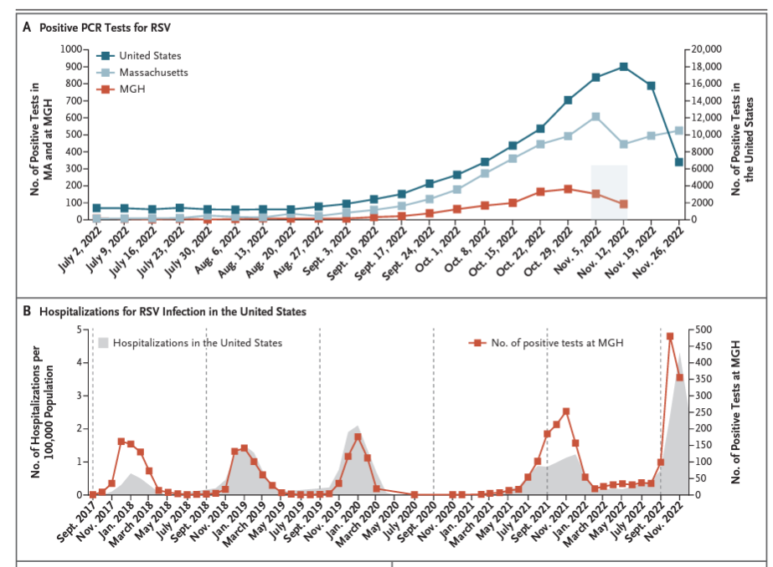
A “tripledemic’’of SARS-CoV-2,Influenza and RSV infections
2022/2023 winter season
2023/24 winter season
Adams et al. N Engl J Med. 2023 www.cdc.gov

Slide 11
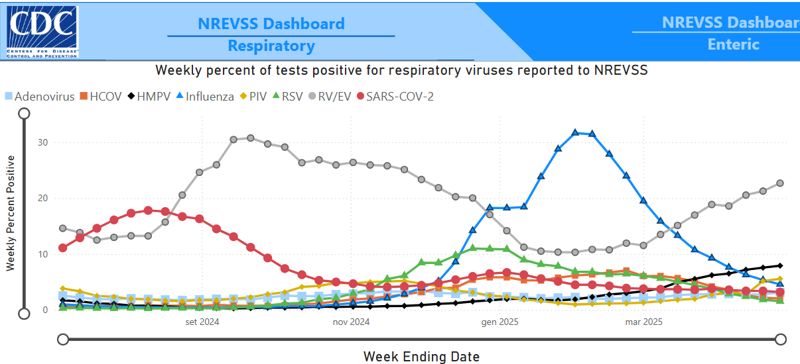
https://www.cdc.gov/nrevss/php/dashboard/index.html. Updated 2 may 2025

Slide 12
Epidemiology of respiratory viral infections in immunocompromised patient
In immunocompromised patients, the trend and seasonal peak roughly reflect the classic behavior of RV in the population
Some cases may be observed earlier in immunocompromised hosts than in the general community as harbingers of an impending outbreak

Slide 13
RV and nosocomial setting

Slide 14
Respiratory viruses are important causes of nosocomial infections among immunosuppressed patients
RV as a cause of HAP (≈ 32%) and VAP (≈ 5.1%)
Majority of nosocomial RV in the immunocompromised (≈ 45-60%)
Zildeberg et al. Viruses 2023 Luyt et al. Semin Respir Crit Care Med 2022
Notes:
Nosocomial respiratory viral infections are a longstanding but underappreciated problem in hospitals.
Although respiratory viruses have long been recognized as causes of pneumonia and respiratory failure in the community setting, more recent evidence identifies them as etiologic agents in NP.
Historically, clinicians have considered hospital-acquired pneumonia (HAP) and ventilator-associated pneumonia (VAP),to be essentially bacterial processes.
Recent reports however, indicate that viruses likely play an important role in NP.
these pathogens are important causes of NP, especially among immunosuppressed patients

Slide 15
Severe Human Parainfluenza Virus Community- and Healthcare Acquired Pneumonia in Adults prospective observational cohort study; Seoul, South Korea, 2010–2019. 143 PIV
61.5% PIV occurred in immuncompormised
Immunospression > risk factor for nosocomial PIV (p= 0.001)
55.2% mortality
Ha Park et al. Emerg Infect Dis . 2024 Jun;30(6)

Slide 16
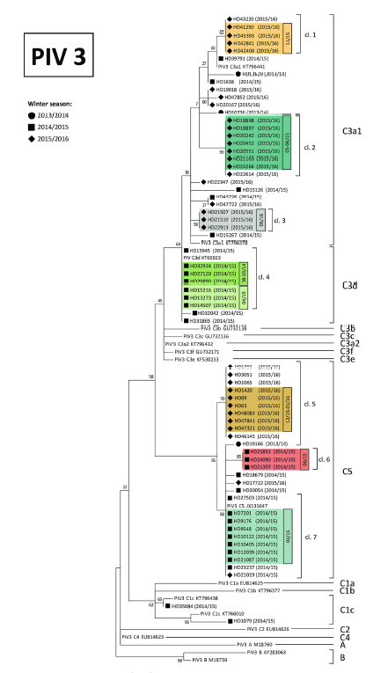
Parainfluenza virus infections in patients with hematological malignancies or stem cell transplantation prospectvive study; Heidelberg, Germany 2013-2016; 109 PIV infection 75 in HSCT.
43% of PIV infections were nosocomial
7 clusters
sequence and phylogenetic analysis
Tabatabai et al. PLoS One 2022 Jul 29;17(7)

Slide 17
Nosocomial RV in immunocompromised hosts
Hospital-acquired non-SARS-CoV-2 RV infections account for 6.8-43%
Nosocomial acquisition in immunocompromised host is an independent risk factor for
progression to LRTI
increased length of stay
ICU admission
Risk for outbreaks of RV
Importance of adequate infection control measures and vaccination
Peghin et al. Am J Transplant. 2017
Read et al. Lancet 2021
Mombelli et al. Am J Transplant. 2021
Tabatabai et al. PLoS One 2022 Jul 29;17(7)
Notes:
Nosocomial acquisition of influenza has been described as a risk factor for admission to ICU. Nosocomial transmission of RV in transplant wards has been associated with significant mortality/morbidity early after transplant.
As community and nosocomial spread has been reported for all reviewed RVIs, strict adherence to infection control measures is key to preventing outbreaks.
All are potential nosocomial pathogens which can be spread by staff or visitors with mild upper respiratory illness or who are asymptomatic.
Robust and rigorous infection control practices may be associated with minimized risk of nosocomial spread of COVID-19 to hospitalized patients

Slide 18
Characteristics of respiratory viral infections in immunocompromised and immunocompetent patient
Epidemiology
Clinical impact
Direct effects
Indirect effects
Viral shedding
RV positive patients and starting of immunosupression
Notes:
This is my outline and I would like to start with
This is my outline -I will discuss each topic and I would like to start with

Slide 19
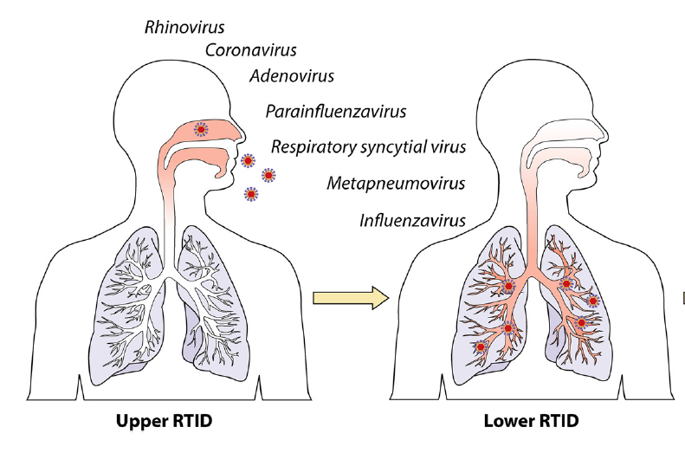
Direct, cytopathic and tissue-invasive effects in immunocompromised hosts: more than just a cold
Upper Respiratory Tract Infection, URTI
Greater risk of progression
Greatest in individuals with significant T cell defect
6-56%
Lower Respiratory Tract Infection, LRTI
Tracheobronchitis
Bronchiolitis
Pneumonia
Hospital admission and ICU admission
Respiratory failure
Mechanical ventilation
Increased mortality
Notes:
The viruses all cause a range of disease, from mild congestion and rhinorrhea to more severe tracheobronchitis, bronchiolitis, and pneumonia. No one virus is exclusively associated with one clinical syndrome. Many common respiratory viral infections in SOT patients are mild, self-limiting upper respiratory tract infection and do not require hospitalization. However, compared to immunocompetent hosts and due to alterations in cellular and humoral immunity, infections can cause protracted symptoms with greater risk of progression to LRTI, prolonged periods of viral shedding and increased mortality.

Slide 20
likelihood of the respiratory viral disease progression
immune status
type of virus

Slide 21
Risk factors for complications and mortality
Solid organ transplant
Early onset post-trasplant (< 3 months)
Steroid boluses, OKT3
Young children (< 1 year)
Lung transplant recipients (LTR)
Hematopoietic stem cell transplantation (HSCT)
Early onset post-transplant (< 3 months)
Chronic GVHD
Lymphopenia (CD4 + T cell < 100)
Steroids
Allogenic HSCT
Gottieb et al Curr Opin Organ Transplant 2019, 24:311–317
Pinana et al. CID Nov 2024
Notes:
pediatric, lung and heart-lung transplantation recipients appear to have the greatest risk of respiratory viral infections with more severe courses and complications

Slide 22
Etiology of RV infections in lung transplant recipients and severity Vall d'Hebron Hospital, Barcelona; prospective cohort study (2009–2014) 98 patients; Mean follow-up was 3.4 years- 258/1094 (23.6%) positive NPS- 40.1% LRTI
Event | Picorna virus | Corona virus | FLU | HMPV | PIV | RSV | Adeno virus | Boca virus
Asymptomatic | 37 (54.4) | 18 (26.4) | 1 (1.5) | 2 (2.9) | 5 (7.4) | 3 (4.4) | 1 (1.5) | 1 (1.5)
Symptomatic | 70 (43.2) | 27 (16.7) | 27 (16.7) | 16 (9.9) | 13 (8.0) | 7 (4.3) | 2 (1.2) | 0
URTI | 47 (48.5) | 18 (18.6) | 16 (16.4) | 8 (8.2) | 4 (4.1) | 2 (2.1) | 2 (1.2) | 0
LRTI | 23 (35.3) | 9 (13.9) | 11 (16.9) | 8 (12.3) | 9 (13.9) | 5 (7.9) | 0 | 0
Tracheobronchitis | 22 (39.3) | 8 (14.2) | 9 (16.1) | 8 (14.3) | 7 (12.5) | 2 (3.6) | 0 | 0
Pneumonia | 1 (11.1) | 1 (11.1) | 2 (22.2) | 0 | 2 (22.2) | 3 (33.3) | 0 | 0
FLU + Paramyxovirus VS Picornavirus: higher association with pneumonia (p = 0.02)
FLU + Paramyxovirus VS Picornavirus: higher risk of hospitalization 34.2% vs 14.2% (p < 0.001)
Peghin et al. Am J Transplant. 2017
Notes:
All RVs cause a variety of direct effects, and no one virus is exclusively associated with one clinical syndrome, although some RVs show varying tropism for the respiratory tract . Picornaviruses (43.2%) were the most frequently encountered RVs. That finding is in agreement with the knowledge that this RV is the primary cause of acute viral respiratory illnesses. Rhinovirus is followed by coronaviruses and influenza (both 16.7%).
Overall, 40.1% (65 of 162) of symptomatic RV infections progressed to LRTID. Interestingly, certain viruses, namely influenza and those from the paramyxoviridae family (which includes RSV, HMPV and PIVs), were more likely to be
associated with LRTID (pneumonia) and higher hospitalization rates

Slide 23
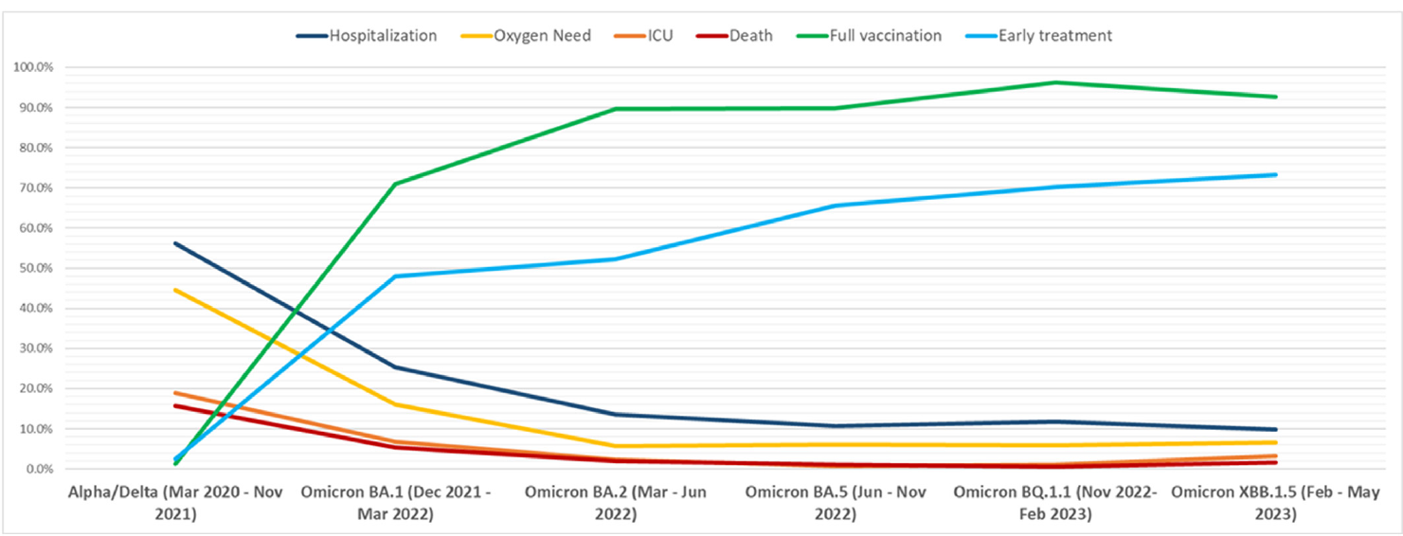
Longitudinal outcomes of COVID-19 in SOT transplant recipients Toronto; cohort study: in 1975 SOT across various SARS-CoV-2 waves (2020-2023)
Severe COVID-19 rate highest during the Wildtype/Alpha/Delta wave (44.6%) and lower in Omicron waves (5.7%-16.1%)
Lung transplantation associated with severe COVID-19 (OR: 4.62, 95% CI: 2.71-7.89)
Early treatment (OR: 0.29, 95% CI: 0.19-0.46 ) and 3 vaccine doses (0.35, 95% CI: 0.21- 0.60) associated with reduced severity
Solera et al. Am J Transplant. 2024

Slide 24
Characteristics of respiratory viral infections in immunocompromised and immunocompetent patient
Epidemiology
Clinical impact
Direct effects
Indirect effects
Viral shedding
RV positive patients and starting of immunosupression
Notes:
This is my outline and I would like to start with
This is my outline -I will discuss each topic and I would like to start with

Slide 25
Bacterial coinfections in RV in SOT Multi-season prospective Swiss Transplant Cohort Study 3294 SOT (2008-2015) ; Follow-up was 3.4 years (IQR 1.61–5.56)
696 RVs in 3294 SOT with median follow-up of 3.4 years
Bacterial coinfection: 7.6% (53)
Etiology: 15 P.aeruginosa, 11 S.pneumoniae, 11 H. influenzae, 2 S.aureus, 14 others
 | No ICU (n = 664) | ICU (n = 27) | p | Adjusted OR (95% CI) | p
Bacterial coinfection | 42 (6.3%) | 11 (40.7%) | <.00001 | 5.1 (1.8–14.0) | 0.0016
Bacterial coinfection as a risk factors for ICU admission after RV infection
Mombelli et al. Am J Transplant. 2021
Notes:
Multi-season prospective Swiss Transplant Cohort Study
Transplant recipients are at higher risk of infectious complications compared to immunocompetent hosts. Respiratory viral infections are a significant risk factor for subsequent development of bacterial pneumonia.
Bacterial super-infection, with S. pneumoniae and S.aureus, is a well known complication of severe FLU. Previous studies suggest a role for RV infections in facilitating colonization and infection with P. aeruginosa (RV infections involving the lower respiratory tract in LTRs predispose to P. aeruginosa isolation (HR 8.54, 95% CI 1.54–47.4, p = 0.01)

Slide 26
RV and bacterial coinfections in HSTC
Bacterial co-infection: 5-27%
Increased risk for mortality in RV + bacterial coinfection (HR 2.65, 95% C.I. 1.2-6.9, P = .017)
Marinelli et al. Biology of Blood and Marrow Transplantation 2020 (26) Pinana et al. TID Agust 2018

Slide 27
Feys et al. J Fungi (Basel) 2021 Dec
Notes:
Solid-organ transplantation (SOT) AND hematopoietic stem cell transplantation (HSCT) are well-known risk factors for invasive pulmonary aspergillosis (IPA).
Recent studies have drawn attention to invasive pulmonary aspergillosis (IPA) as a complication of coronavirus disease 2019 (COVID-19) and flu
Invasive pulmonary aspergillosis is increasingly recognized as a complication of severe influenza and coronavirus disease 2019. The extent to which other respiratory viral infections predispose to IPA is unclear.
In this figure we describe a comparison between IAPA and CAPA. the similarities and differences between CAPA and IAPA are described. Both co-infections occur in ICU-admitted patients. Corticosteroids and anti-IL-6 therapy have been implicated in CAPA pathophysiology, while this is the case for corticosteroids and oseltamivir in IAPA. IAPA tends to occur earlier, more frequently and with more frequent angioinvasion than CAPA. Both lead to an increased mortality.
The extent to which other respiratory viral infections predispose to IPA is unclear. it is unclear whether NI-RVIs predispose patients to IPA

Slide 28
Invasive fungal infections after RV infections in lung transplant Johns Hopkins Hospital, Baltimore; retrospective study 2010-2021 202 RVI episodes: 50 FLU, 31 SARS-CoV-2, 30 MPV, 44 PIV, 47 RSV
31 RVI (15%) associated with secondary IFI (80% aspergillosis )
IFIs post RVIs were associated with lung allograft failure and CLAD stage progression
Permpalung et al. J Heart Lung Transplant 2023
Notes:
A total of 202 RVI episodes (50 influenza, 31 severe acute respiratory syndrome coronavirus-
2, 30 metapneumovirus, 44 parainfluenza, and 47 respiratory syncytial virus) in 132
patients was included for analysis. Thirty-one episodes (15%) were associated with secondary
IFIs, and 27 occurred in LTRs with lower respiratory tract infection (LRTI; 28% from 96 LRTI
episodes). Aspergillosis was the most common IFI (80%).
In multivariable analysis, RVI with LTRI was associated with IFI (adjusted odds ratio [95% confidence interval (CI)] of 7.85 (2.48-24.9).
Importantly secondary
IFIs post RVIs were associated with lung allograft failure
and CLAD stage progression.

Slide 29
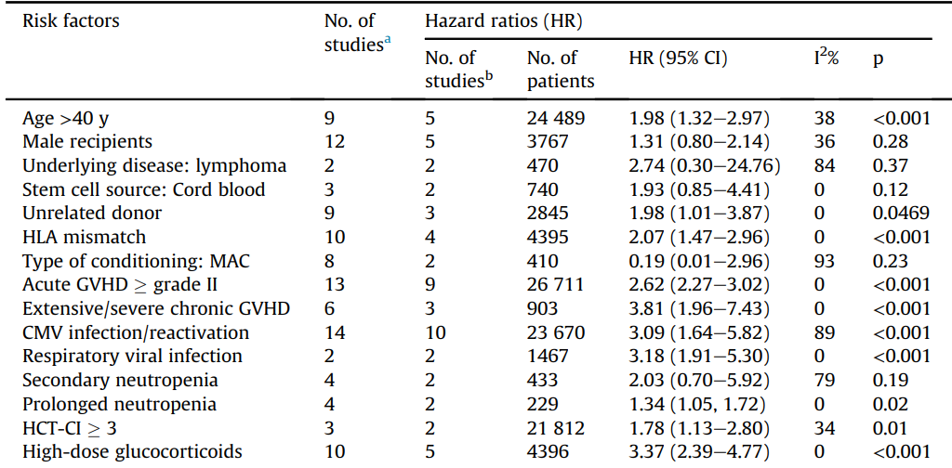
Independent risk factors for invasive aspergillosis /invasive mould infections after HSCT 45 studies - meta-analysis
Biyun et al. Clin Microbiol Infect 2024 May;30(5):601-610

Slide 30
Characteristics of respiratory viral infections in immunocompromised patients
Epidemiology
Clinical impact
Direct effects
Indirect effects
Viral shedding
Management of RV positive patients starting immunosupression
Notes:
This is my outline and I would like to start with
This is my outline -I will discuss each topic and I would like to start with

Slide 31
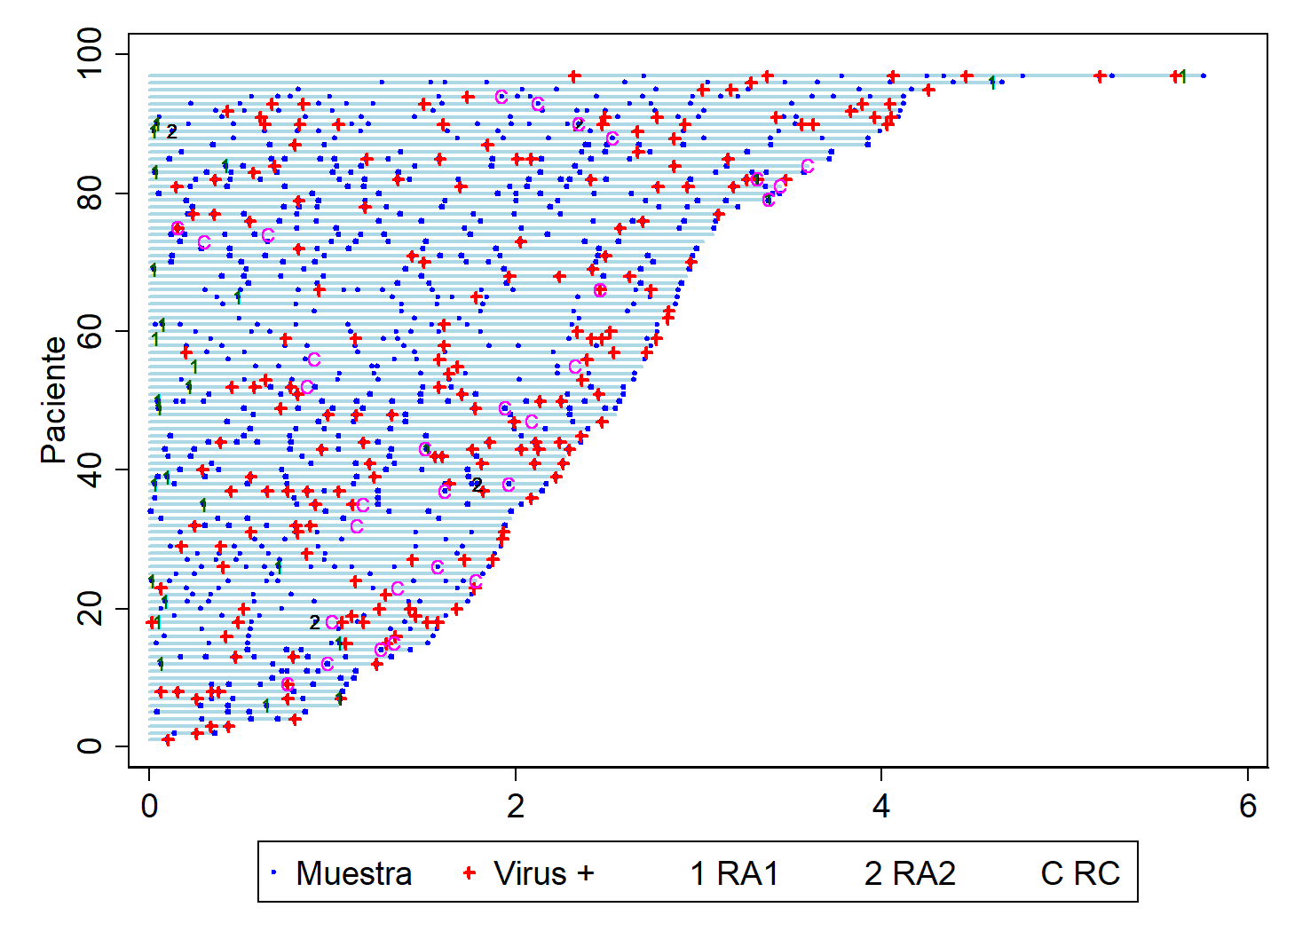
RV are a risk factors for CLAD in LTR Vall d'Hebron Hospital, Barcelona; prospective cohort study (2009–2014) 98 patients starting from hospital discharge after transplantation– Mean follow-up was 3.4 years
38.8% developed CLAD, in a median time of 20.4 months
Variable | Multivariate Analysis HR (95% CI) | p
Acute rejection | 2.97 (1.51–5.83) | 0.002
CMV pneumonitis | 3.76 (1.23–11.49) | 0.02
LRTI respiratory virus (+) | 3.00 (1.52–5.91) | 0.002
Peghin et al. Clin Infect Dis 2019
Notes:
Lung transplant recipients with CARVs in the lower respiratory tract are at increased risk to develop CLAD.

Slide 32
HSCT and pulmonary outcomes after viral infections
RV infections < 3 months after allogeneic HCT
BOS and obstructive airflow decline associated with PIV and RSV infections
LRTI as independent factor for late onset non-infectious pulmonary complications
Functional pulmonary explorations and long-term surveillance are warranted after RV infections which occurred early after HCT.
Pochon et alFront. Microbiol., 2019

Slide 33
Characteristics of respiratory viral infections in immunocompromised patients
Epidemiology
Clinical impact
Direct effects
Indirect effects
Viral shedding
RV positive patients and starting of immunosupression
Notes:
This is my outline and I would like to start with
This is my outline -I will discuss each topic and I would like to start with

Slide 34
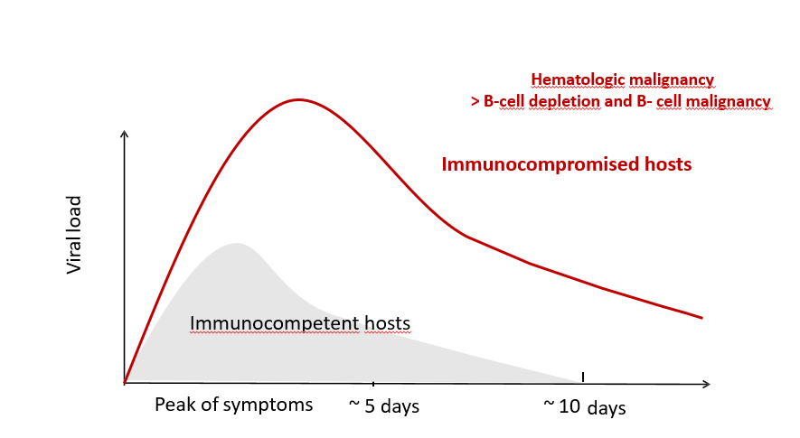
Pinana et al. . Curr Res Transl Med. 2024 Jul
OHM et al. Infection 2023 Nov 29 Li et al. BMC Infectious Diseases (2021) 21:767 Pinana et al. . Curr Res Transl Med. 2024 Jul
Notes:
viral shedding was significantly longer in immunocompromised hosts than in immunocompetent hosts.

Slide 35
Consequences of prolonged shedding
Higher risk of nosocomial transmission
Increased risk of resistant variant
Influenza: increased risk of emergence with H275Y neuraminidase (NA) mutation
SARS-CoV-2: shedding > 56 days accumulated spike mutations, distinct from common mutations
Raglow at al. Lancet Microbe 2024; 5: e235–46

Slide 36
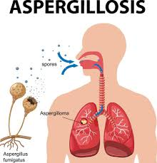
Increased risk of invasive aspergillosis in immunocompromised patients with persistent SARS-CoV-2 viral shedding > 8 weeks two Paris Hospitals; retrospective bicentric case control study, 2020-2022
29 (16 SOT, 55.2%) with persistent viral shedding VS 40 (30 SOT, 75%) controls
Patients with persistent viral shedding were at risk of
hospitalization (OR: 4.8; 95 CI, 1.5–15.6; p = .008)
death (log-rank test p <0.01)
invasive aspergillosis (OR: 10.17; 95 CI, 1.15–89.8; p = .037)
Melenotte et al. Open Forum Infect Dis. 2024
Notes:
Workup should be undertaken to assess for persistent COVID-19
infection, opportunistic infection or coinfection, and/or
complications of COVID-19 in those with ongoing symptoms.

Slide 37
Risk factors for SARS-CoV-2 viral shedding in immunocompromised patients 2 groups in Germany (n=144/n=36) during the Omicron era
Viral shedding after start of antiviral treatment shorter in patients receiving two antivirals VS one antiviral (median 15 days vs. 31 days)
Early ( < 5 days) combination treatment of COVID-19 effectively prevented prolonged viral shedding in 85.6% of cases
Götz V et al. Infection 2023 Dec 14 OHM et al. Infection 2023 Nov 29
Notes:
mmunocompromised patients with COVID-19 often shed virus for prolonged periods despite antiviral therapy. For such patients, some centers use combination therapy with one or two direct-acting antivirals (DAA) with or without an anti–SARS-CoV-2 monoclonal antibody (mAb), although supporting evidence is scarce. Now, two groups in Germany have addressed COVID-19 management in immunocompromised patients during the Omicron era.

Slide 38
Immunocompromised patients with persistent SARS-CoV-2 viral shedding > 8 weeks two Paris Hospitals; retrospective bicentric case control study, 2020-2022
29 (16 SOT, 55.2%) with persistent viral shedding VS 40 (30 SOT, 75%) controls
Increased risk of persistent viral shedding
lymphocytopenia (<0.5 G/L) (: 4.3; 95% CI, 1.2–14.7; p = .019)
unvaccinated patients (OR, 6.6; 95% CI, 1.7–25.1; p = .006)
Melenotte et al. Open Forum Infect Dis. 2024

Slide 39
Characteristics of respiratory viral infections in immunocompromised patients
Epidemiology
Clinical impact
Direct effects
Indirect effects
Viral shedding
Management of RV positive patients starting immunosupression
Notes:
This is my outline and I would like to start with
This is my outline -I will discuss each topic and I would like to start with

Slide 40
Should transplantation be delayed in HCT candidates with RV?
14-25% have respiratory viruses detected pre-HCT (≤90 days before)
Campbell et al. Clin Infect Dis. 2015;61(2):192-202 Kim et al Blood sept 2022

Slide 41
RV in hematopoietic cell transplant candidates: impact of pre-existing RV disease on outcomes
Symptomatic patients
Pretransplant LRTI due to any RV alone is associated with increased overall mortality after HSCT
Pretransplant URTI is associated with variable results especially for Rhinovirus and endemic HCoV
Asymptomatic patients
RV isolation is not associated with increased mortality
Transplant delay, whenever feasible, in case of symptomatic positive RV in patients undergoing HSCT should be considered
Campbell et al. Clin Infect Dis. 2015;61(2):192-202 Kim et al Blood sept 2022

Slide 42
Should transplantation be delayed in SOT candidates with RV?
Benefits and risks of
non-lung transplantation in RV positive recipients
longer time waiting for an organ increases the risk of mortality and graft failure
lack of evidence
Heald-Sargent et al. Transpl Infect Dis 2024 Jun;26(3) Lim et al. Sci Rep. 2022;12(1):17614

Slide 43
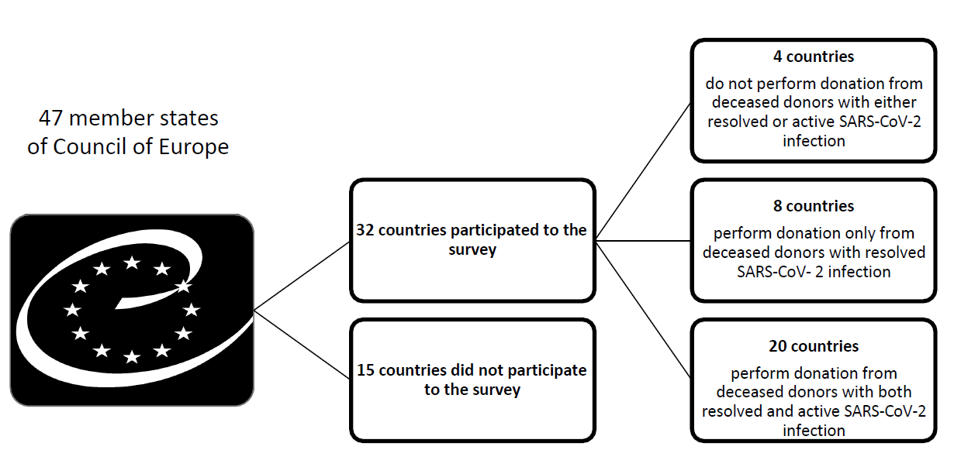
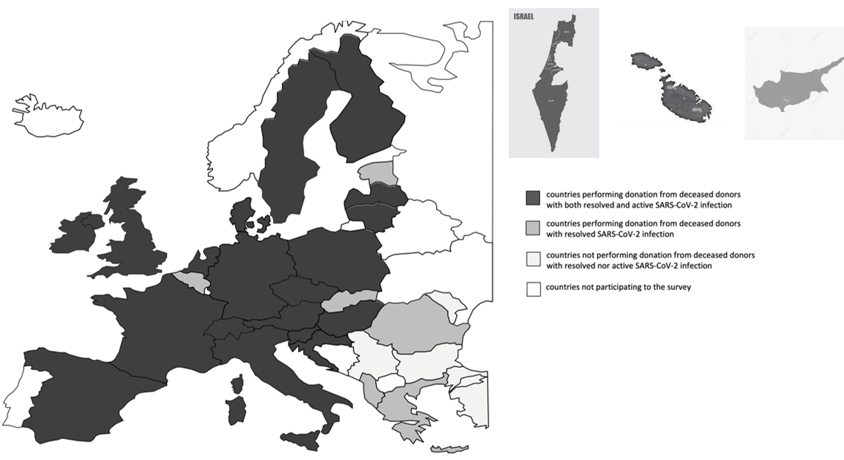
Candidates with active SARS‑CoV‑2 infection
Recipients with active SARS‑CoV‑2 infection * 57.1% were not allowed to receive organs * 38.1% case-by-case ID disease evaluation * 1 country allowed transplantation routinely
Peghin et al. Transpl Int. 2024 Nov 21;37:13705

Slide 44
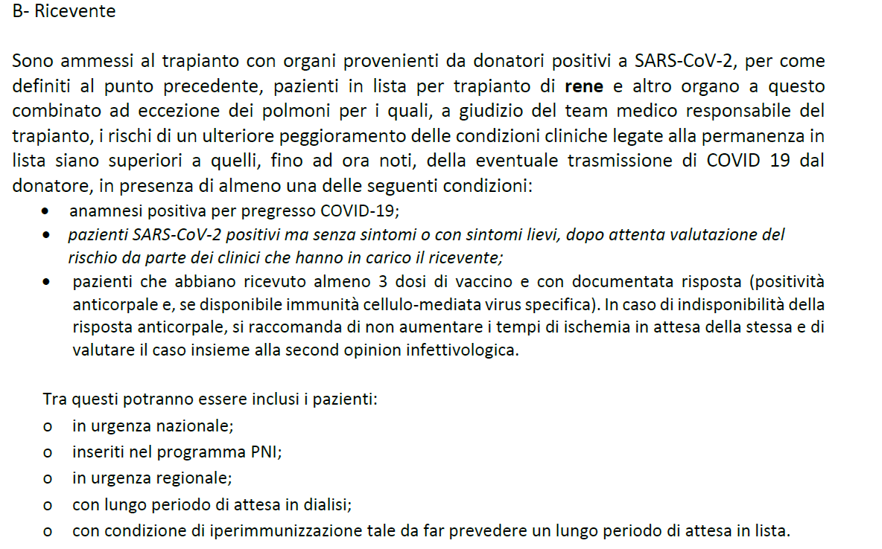
transplanting SARS-CoV-2 PCR+ recipients
Italian national protocol allows transplantation of individuals with active infection routinely (asymptomatic/mild)
www.cnt.it
Notes:
Wide variability exists in transplant practices for SARS-CoV-2 positive candidates for transplantation. The excellent graft and patient post-transplant outcomes presented in recent series favor an individualized approach

Slide 45
Zavala et al. Transpl Infect Dis 2023 Oct;25(5):e14110
Notes:
Wide variability exists in transplant practices for SARS-CoV-2 positive candidates for transplantation. The excellent graft and patient post-transplant outcomes presented in recent series favor an individualized approach

Slide 46
Should transplantation be delayed in HCT or SOT candidates with RV?
Consider an individualized approach
the urgency of HCT/SOT
type of SOT (lung)
degree of conditioning regimen/immunosuppression
individual risk factors for progression
type of virus
location of the infection (URTI, LRTI)

Slide 47
Conclusions
The epidemiology of seasonal respiratory virus has been changing with the pandemic
RVs are potential nosocomial pathogens
RVs cause a variety of direct and indirect immune modulated effects
Knowledge of viral complications in immunocompromised patients is an essential step to continue improving survival and quality of life
Notes:
there are several unanswered questions that need to yet be addressed through implementation of appropriate studies.
Nonetheless, there are several significant gaps in our knowledge that warrant further investigation

Slide 48
Grazie

