Slide 1
Extracellular Vesicle-Based Therapeutics for COPD
Pre-clinical data generated using an emphysema mouse model
Robert Vassallo, M.D.
Pulmonary and Critical Care Medicine
Trieste – May 2025

Slide 2
Disclosures Non-Federal funding / Financial Relationship(s) in past 5 years:
Research Grant Funding from Pfizer, Bristol Myers Squibb, Sun Pharmaceuticals.
I have participated as a co-investigator on the Genentech sponsored TRAIL-1 clinical trial (Pirfenidone for RA-ILD).
Consulting activity with Rion LLC, Sanofi and Regeneron.
Off Label Usage - None

Slide 3
Goals of presentation today
Succinctly outline concepts for regenerative approaches for lung disease and COPD, with a focus on exosomes.
Review data on nebulized exosomes in a murine model of cigarette smoke-induced emphysema.

Slide 4
REGENERATIVE MEDICINE FOR ADVANCED LUNG DISEASE

Slide 5
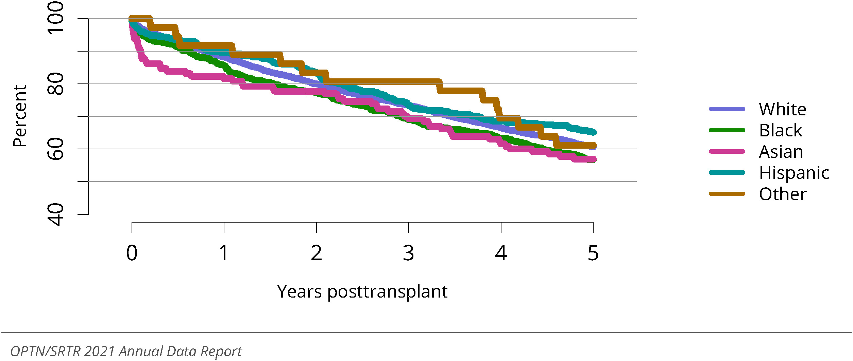
Patient survival among adult lung transplant recipients, 2014-2016, by race.
Valapour et al. OPTN/SRTR 2021 Annual Data Report: Lung,
American Journal of Transplantation, 23 (2), Supplement 1, 2023,

Slide 6
Approaches to Lung Regeneration
The promise of regenerative technologies - the potential to use cell-based and other approaches to restore structure, form, and function in diseased lungs.
Imperative of understanding the mechanisms by which the lung can regenerate and how lung repair and regeneration are impaired in COPD.

Slide 7
The lung contains several regenerative or stem cell-like cells
Alveolar Type II (AT2) can self-renew and differentiate into both AT2 and alveolar type I (AT1) cells. [J Clin Invest. 2013 Jul;123(7):3025-36.]
Bronchioalveolar stem cells (BASCs), located at the bronchioalveolar duct junction, can differentiate into AT1, AT2, club cells, and ciliated cells, in response to lung injury. [EMBO J. 2019 Jun 17;38(12):e102099]
Club cells, particularly Muc5b+ and large club (ML-club) cells, can proliferate & differentiate into alveolar cells. [Stem Cells. 2023,16;41(8):809-820]
Distal airway stem cells (DASCs: p63+ Krt5+): can differentiate into alveolar and bronchiolar epithelial cells. [Nature. 2015 Jan 29;517(7536):616-20.]
Lineage-negative epithelial progenitors (LNEPs), club-like cells, also involved in alveolar repair.[Cell Stem Cell. 2020 Mar 5;26(3):346-358.e4.]

Slide 8
Regenerative approaches for lung disease
1) Stem cells.
2) Cell-free approaches – Extracellular Vesicles.
3) Tissue engineering.
4) Regenerative pharmacology.
5) Other approaches.

Slide 9
Extracellular Vesicles and Exosomes
What are they?

Slide 10
Extracellular Vesicles
Naturally released, membrane-bound particles originating from cells. EVs are Intercellular Messengers that transfer molecules between cells, both near and far.
Heterogeneous: vary significantly in:
Size: nanometers (<100 nm) to larger micrometers (>1 μm).
Origin: Formed via different cellular pathways (e.g., endosomal route for exosomes, plasma membrane budding for microvesicles).
Content: Carry a diverse cargo reflecting the parent cell.
Rich Cargo: Proteins (surface and internal), Lipids (making up the membrane), Nucleic Acids (mRNA, miRNA, other non-coding RNAs, DNA fragments).

Slide 11
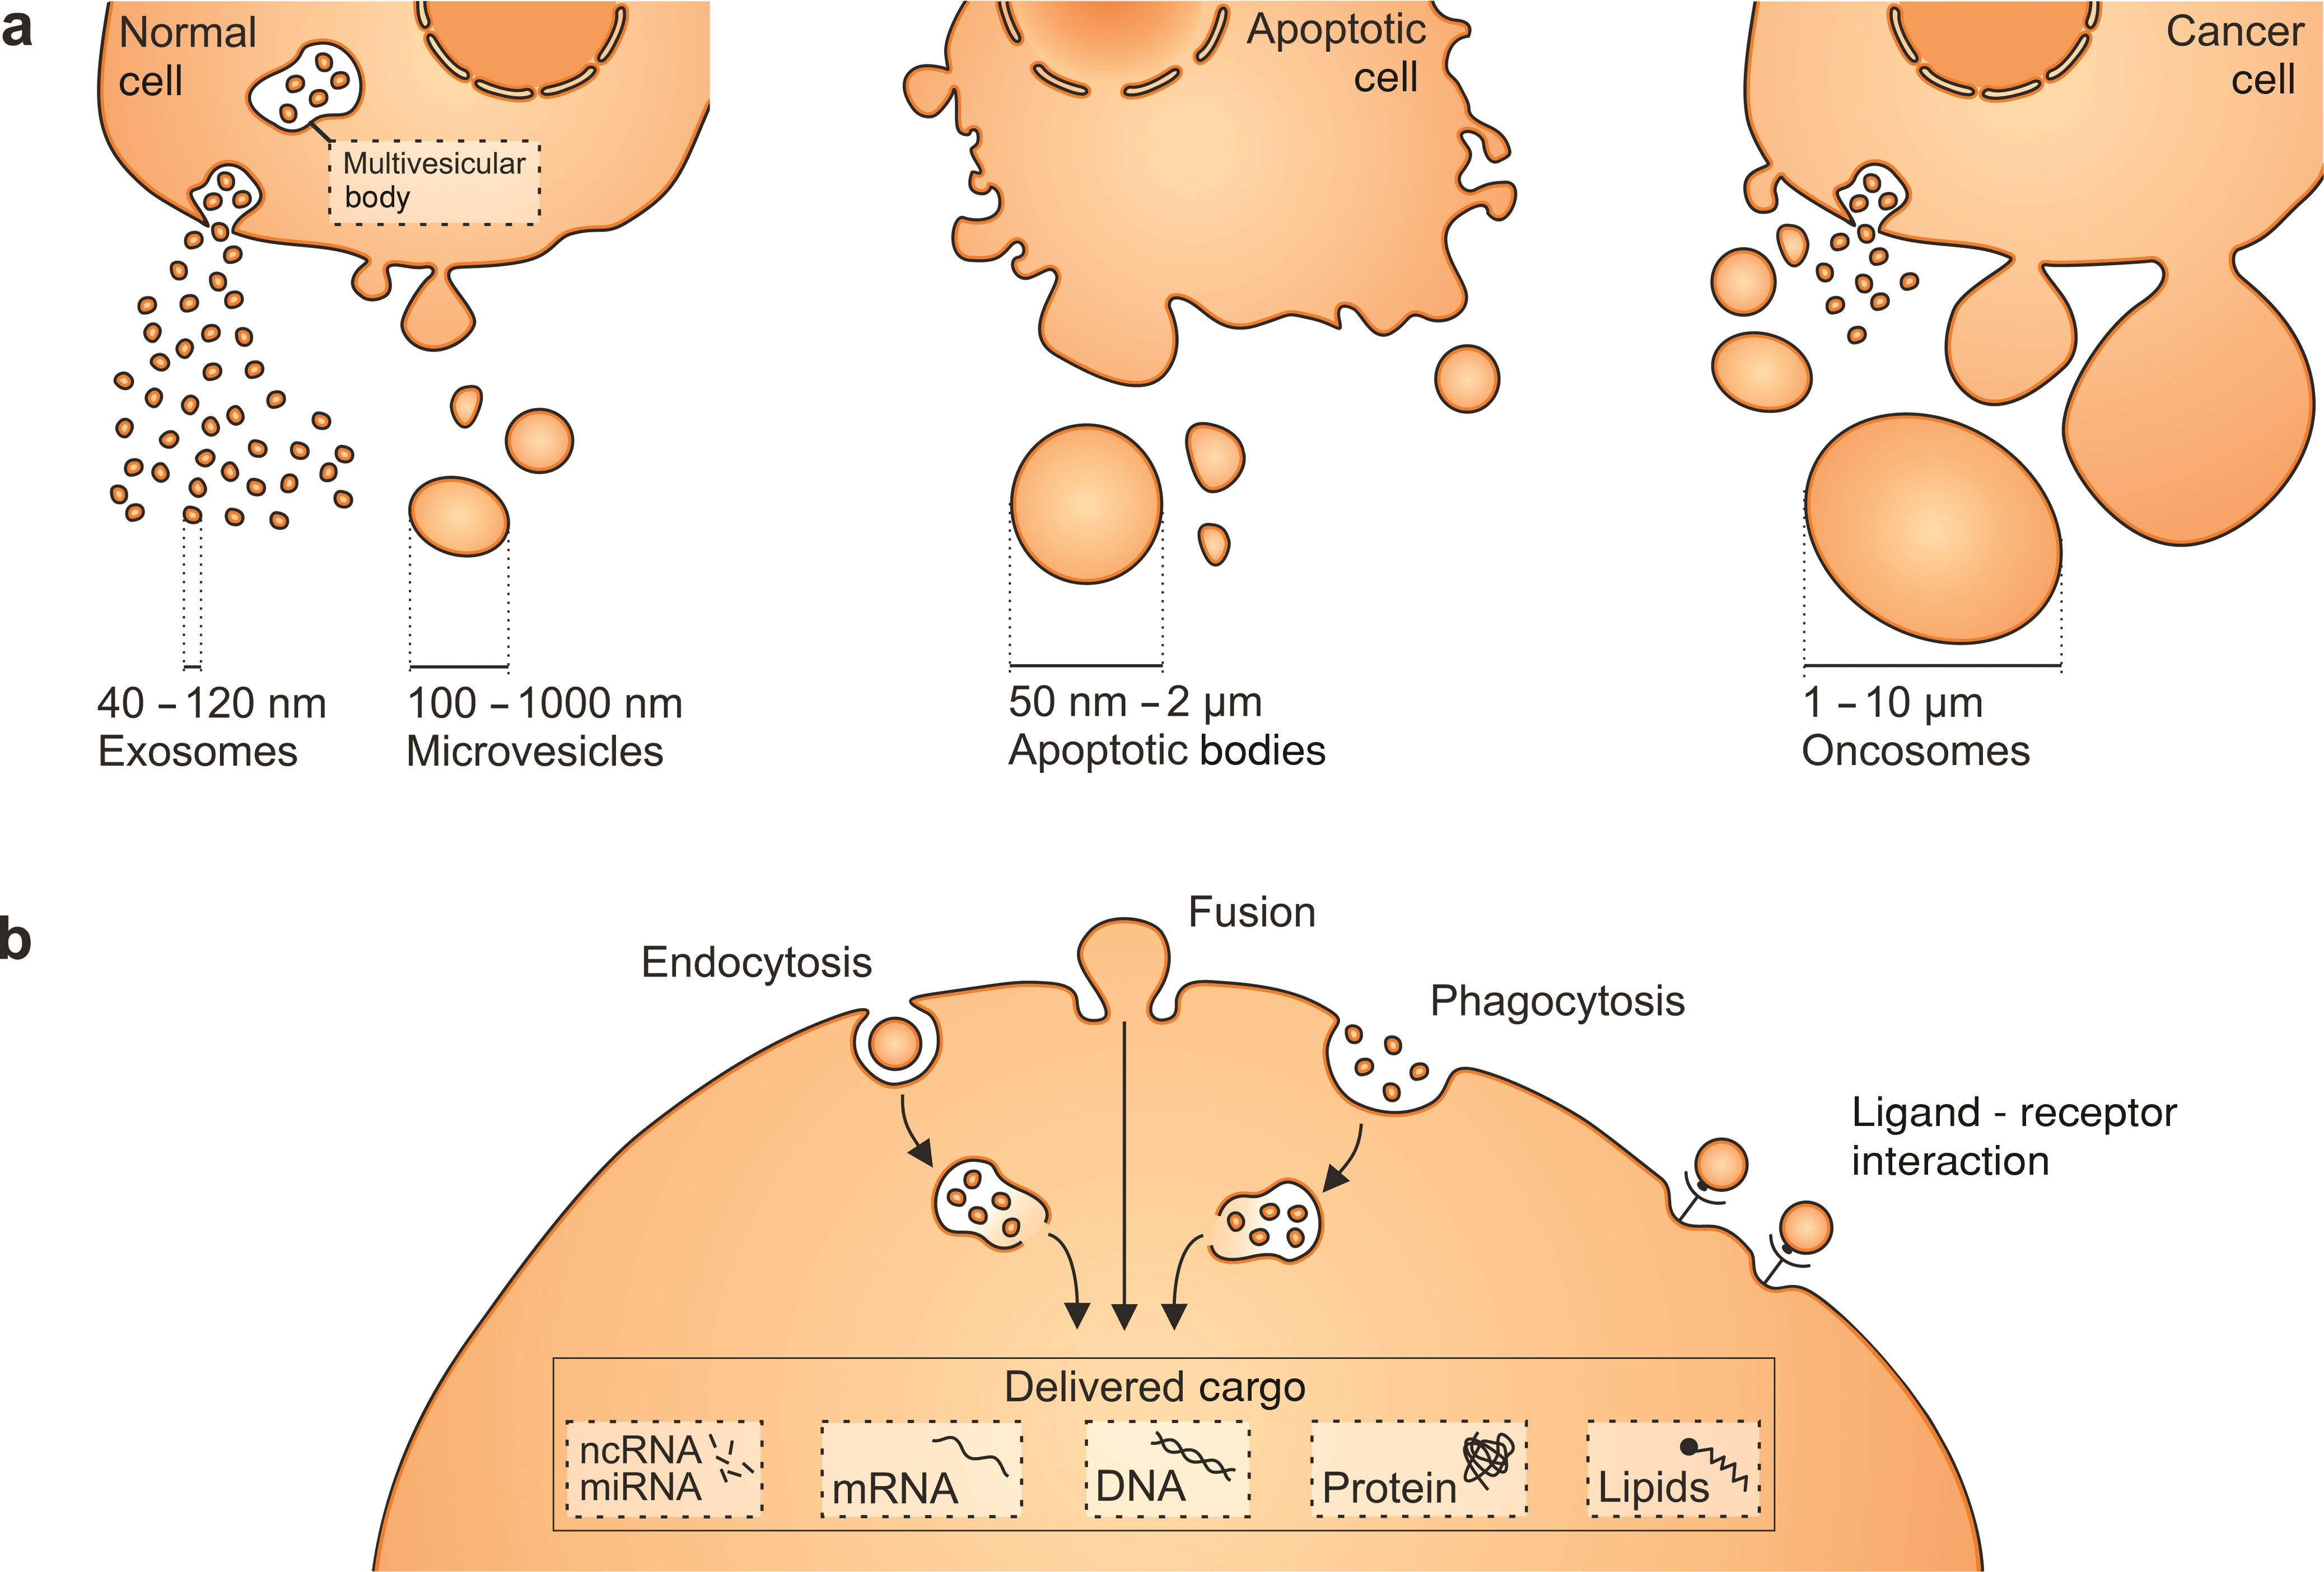
Major Subtypes: Exosomes:
Exosomes: (30−150 nm) with endosomal origin
Microvesicles: Larger EVs ( 100−1000 nm) budding directly from the cell surface.
Apoptotic Bodies: Released from cells undergoing programmed cell death.
Notes:
Figure 1. Cells produce different types of extracellular vesicles (EVs) that vary in size. (a) Exosomes and microvesicles (MVs) are produced by normal and diseased cells. Apoptosis triggers the release of apoptotic bodies. In addition, some cancer cells were reported to generate large EVs, termed oncosomes. (b) EVs can be taken up via different mechanisms, including endocytosis, membrane fusion, or phagocytosis. They deliver nucleic acids, proteins, and lipids that can be functional in recipient cells. Ligand–receptor interactions on the cell surface can also result in biological effects and help to target vesicles to specific cell types. Abbreviations: nm, nanometers; μm, micrometers.
Unless provided in the caption above, the following copyright applies to the content of this slide: © The Author(s) 2015. Published by Oxford University Press on behalf of the American Institute of Biological Sciences. All rights reserved. For Permissions, please e-mail: journals.permissions@oup.com.

Slide 12
Exosomes vs. Extracellular Vesicles (EVs)
Extracellular Vesicles (EVs)
Broad Category: The umbrella term for all membrane-bound vesicles released by cells.
Diverse Origins: Formed through various mechanisms, including direct budding from the plasma membrane (microvesicles) or during apoptosis (apoptotic bodies).
Variable Size: Wide size range, from small (<100 nm) to large (>1 μm).
General Function: Cell-to-cell communication, waste removal, transport of molecules.
Exosomes
Specific Subtype: A distinct type of EV.
Specific Origin: Uniquely formed inside the cell within multivesicular bodies (MVBs) and released when MVBs fuse with the cell membrane. (Endosomal Origin)
Defined Size: Generally smaller, typically 30−150 nm in diameter.
Specific Markers: Often enriched in specific proteins related to their endosomal origin (e.g., CD9, CD63, CD81, ALIX, TSG101).
All exosomes are EVs, but not all EVs are exosomes.

Slide 13
Why exosomes
Mesenchymal stem cell-derived exosomes (MSC-Exos) have anti-inflammatory, antifibrotic, and immunomodulatory properties.
Reduce fibroblast activation and can modulate immune responses by delivering immunoregulatory factors (1).
In COPD, MSC-Exos inhibit apoptosis of pulmonary microvascular endothelial cells through the miR-30b/Wnt5a pathway (2).
Exosomes derived from lung spheroid cells can reestablish normal alveolar structure and reduce collagen accumulation and myofibroblast proliferation (3).
1) International Journal of Molecular Sciences. 2024;25(8):4378. doi:10.3390/ijms25084378.
2) International Journal of Nanomedicine. 2025;20:1191-1211. doi:10.2147/IJN.S487097.
3) Nature Communications. 2020;11(1):1064. doi:10.1038/s41467-020-14344-7.

Slide 14
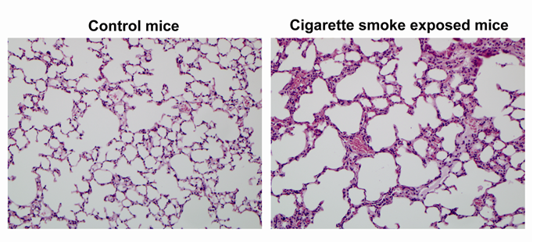
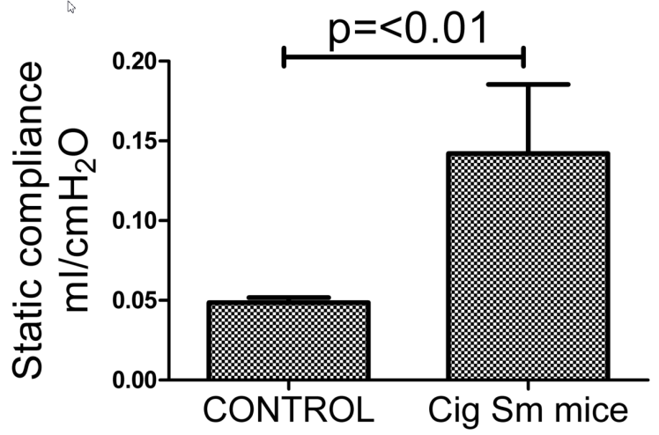
EVs for COPD
Pre-clinical study using an established mouse model of emphysema.

Slide 15
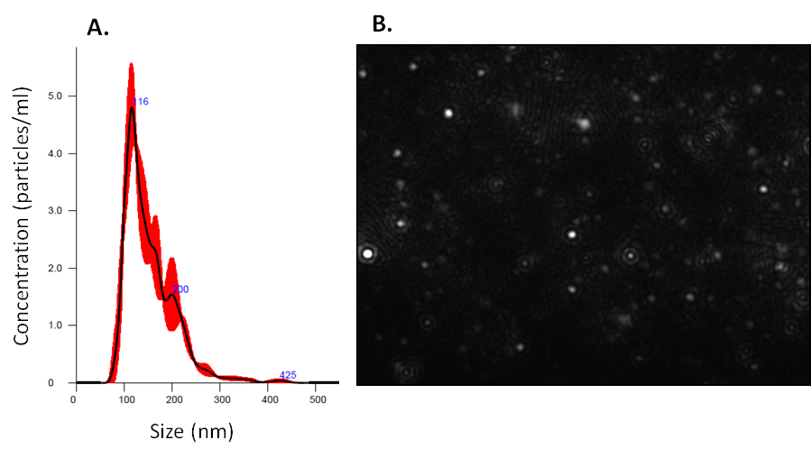
Platelet-derived exosomes – PEP
B2
B3
B4
SOD1
SOD2
SOD3
HO-1
CD63
Tubulin
Unpublished Data – courtesy Dr Atta Behfar, MD, PhD

Slide 16
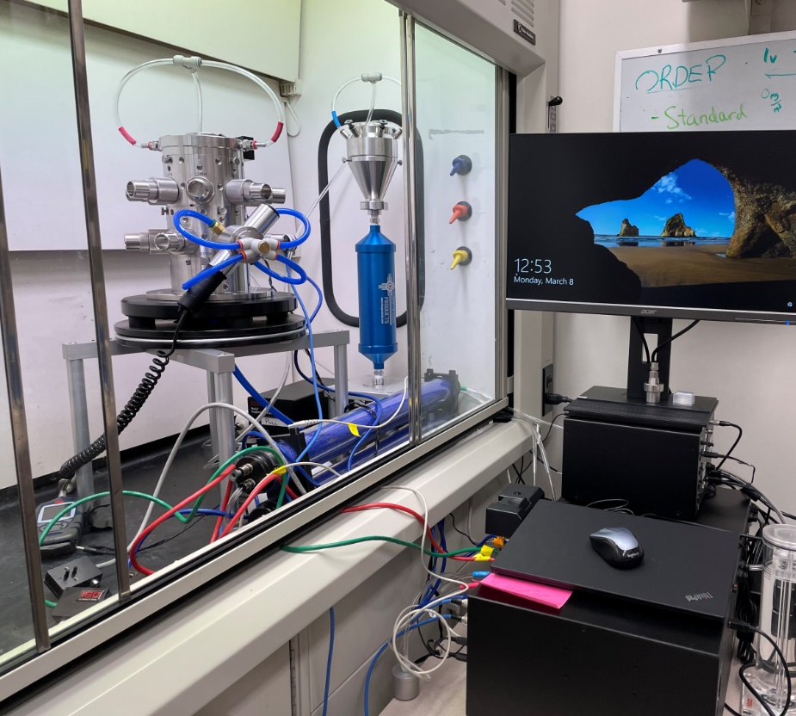
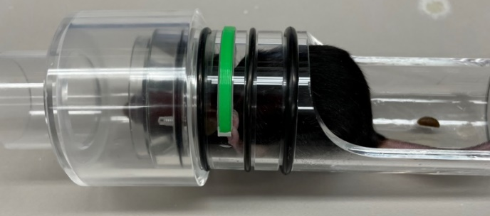
Study Design & Data
Study Groups:
Negative control (n=10): saline instillation and saline nebulization
Positive control/CS (n=10): placebo controls of CS exposed mice
10% PEP/CS (n=10) : nebulized 25 minutes, 3 days a week
20% PEP/CS (n=11) : nebulized 25 minutes, 3 days a week
20% PEP only (n=14): nebulized 25 minutes, 3 days a week
The inhalation tower and mouse unit
Day1: cigarette smoke exposure
13 weeks
Week14: PEP nebulization started
Week18:Lung Mechanics and sacrificing
10 or 20% PEP nebulization
4 weeks

Slide 17
Monitoring of PEP nebulization
Spontaneous breathing curve of awake mouse during PEP nebulization

Slide 18
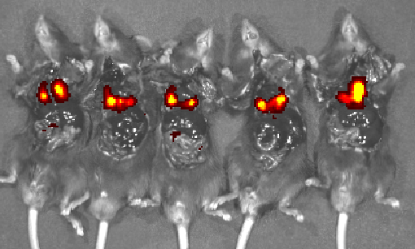
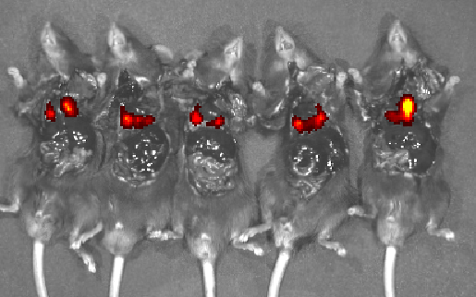
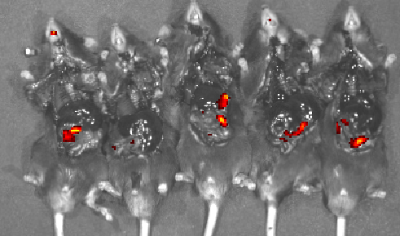
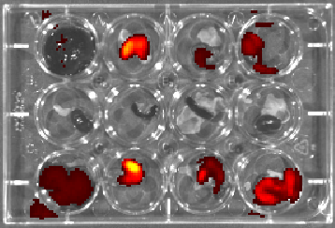
30 sec exposure
15 sec exposure
After lungs were removed 30 sec exposure
Other organs after 60 sec exposure
Liver Stomach Colon Intestine
Kidney Spleen Spleen Kidney
Liver Stomach Colon Intestine
Group1
Group3
Unpublished Data

Slide 19
Wang et al Transl Res. 2024 Jul:269:76-93.

Slide 20
PEP nebulization attenuates CS induced murine emphysema
H&E lung sections

Slide 21
PEP nebulization reversed key signaling pathways and biological activities activated by CS in vivo
Wang et al Transl Res. 2024 Jul:269:76-93.

Slide 22
Wang et al Transl Res. 2024 Jul:269:76-93.

Slide 23
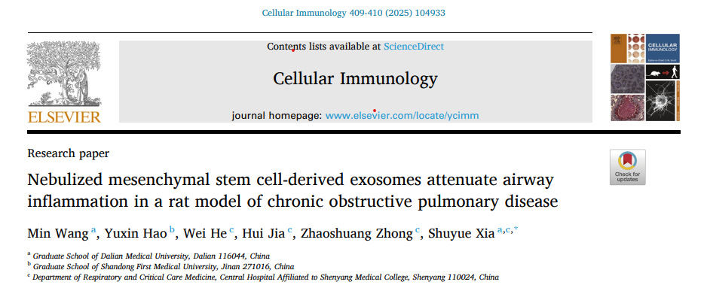
Nebulized BMSC-Exos reduced pulmonary inflammatory infiltration, bronchial mucus secretion, and collagen deposition in a rat COPD model.
BMSC-Exos decreased TNF-α, IL-6, and IL-1β, and the pro-fibrotic factor TGF-β1 in serum, bronchoalveolar lavage fluid (BALF), and lung tissue.
Nebulized BMSC-Exos significantly inhibited airway remodeling and epithelial–mesenchymal transition (EMT) by suppressing the Wnt/β-catenin signaling pathway.

Slide 24
Conclusions
Nebulization effectively delivered the platelet exosomes into the alveolar region, where they were taken up by type I/II alveolar epithelial cells and macrophages.
Lung function testing and morphometric assessment showed a significant attenuation of CS-induced emphysema.
Platelet EVs suppressed several CS-induced gene pathways and recruited immunoregulatory T cells in the lung.

Slide 25
Regenerative Therapies – Challenges
Variability in Sources: Different sources of cells/EVs (e.g., bone marrow, adipose tissue, umbilical cord) can lead to variability in efficacy and safety.
Delivery Methods: Effectively delivering cells or exosomes to the lungs is challenging. Invasive procedures carry risks, while non-invasive methods may not ensure adequate targeting/retention in the lung.
Immune Response: There is a risk of immune rejection when using allogeneic stem cells. Autologous cells/EVs reduce this risk, but their harvesting can be more complex.
Efficacy and Mechanism of Action: Understanding their therapeutic effects in COPD is still evolving. More research is needed to clarify the mechanisms and ensure consistent outcomes.
Safety and Long-Term Effects: The long-term safety is not fully understood, particularly concerning potential tumorigenesis (with stem cells) or adverse immune reactions.
Regulatory Challenges: Regen therapies often face stringent regulatory scrutiny, which can delay clinical applications and accessibility for patients.
Clinical Trial Design: Difficult and costly.

Slide 26
Acknowledgements
Shaohua Wang, MD, MPH
Weixa Xua, MD, PhD
Rachel Para (Med Stud)
Amarilys Alarcon Calderon, MD
Behfar Laboratory
CRM funding

