Slide 1


Novità nella terapia biologica
per Asma Severa e BPCO
Gabriella Guarnieri
Fisiopatologia Respiratoria
Dip.to di Scienze Cardio-Toraco-Vascolari e Sanità Pubblica
Azienda Ospedale Università di Padova

Slide 2
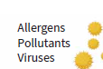
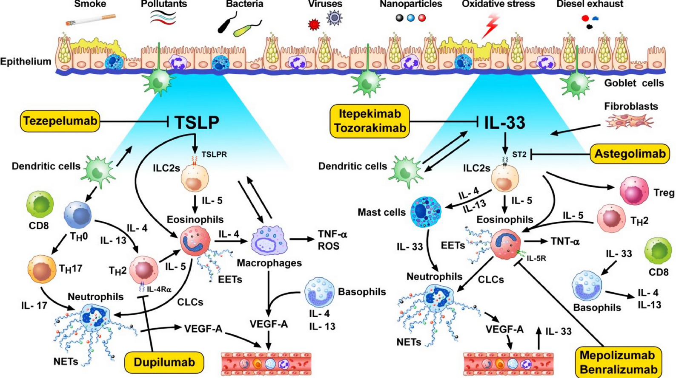
Depemokimab
Varricchi G, et al. European Journal of Internal Medicine 125 (2024) 28–31

Slide 3
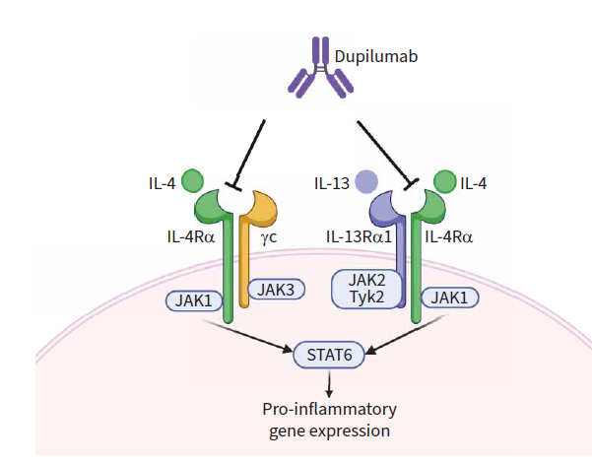

Slide 4
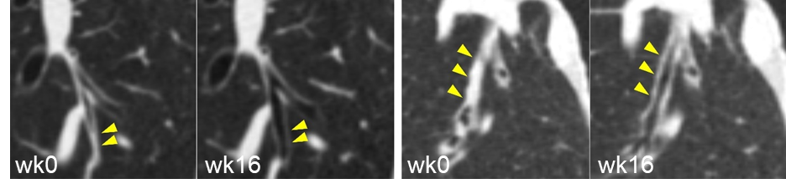
Dupilumab reduces Mucus Pluggingª in just 16 weeks in Patients With Moderate-to-Severe Asthma compared with placebo
Difference: −4
(95% CI, −7 to −1), P=0.02
Dupilumab
Placebo
−3 (−6 to −1)
P=0.02
1 (−1 to 2)
P=0.37
20
Mucus Plugs Before and After Dupilumab
15
Mucus score
10
5
0
Week 0
n=13
Week 16
n=13
Week 0
n=10
Week 16
n=10
Dupilumab significantly decreases intraluminal mucus plugging compared with placebo
ªAssessed by CT mucus score. CT, computed tomography; MOA, mechanism of action; RCT, randomized controlled trial. Svenningsen S, et al. ATS. 2023.Oral Presentation 638
Notes:
Svenningsen_ATS_2023/slide 8/c
Svenningsen_ATS_2023/slide 8/e

Slide 5
Rapid Effect of Dupilumab in Reducing Mucus Plugging

Slide 6


Dupilumab Reduced Airway Hyperresponsiveness Assessed With Saline and Mannitol
Saline Bronchoconstriction¹
Mannitol Challenge²
Difference: 9.7%
(95% CI 1.5 to 17.9), p=0.02
N=17
4
Despite ICS Sparing
8.0% (2.2 to 13.8)
p=0.02
-1.7 (-8.8 to 5.4)
p=0.37
3
10
2
00
1
0
Doubling Diff
¹²⁹Xe MRI VDP %
-10
-1
-2
-20
-3
-30
-4
Wk 2
Wk 4
Wk 12
wk0
n=9
wk16
n=9
wk0
n=7
wk16
n=7
1st dose
2nd dose
3rd dose
6th dose
Dupilumab
Placebo
PD10
RDR
FEV₁, forced expiratory volume in 1 second; PD₁₀, provocative dose of mannitol resulting in a 10% decrease in FEV₁; RDR, response dose ratio.*P<0.05. †P<0.01. ‡P<0.001
1. Svenningsen S, et al. Poster Presented at the American Thoracic Society International Congress. Washington DC, USA. May 19-24, 2023.2. Stewart KE, et al. Presented at the American Thoracic Society International Congress. San Diego, CA. May 17-22, 2024.
Notes:
Svenningsen ATS 2023/p8/col1
Stewart ATS 2024/Figure1A

Slide 7
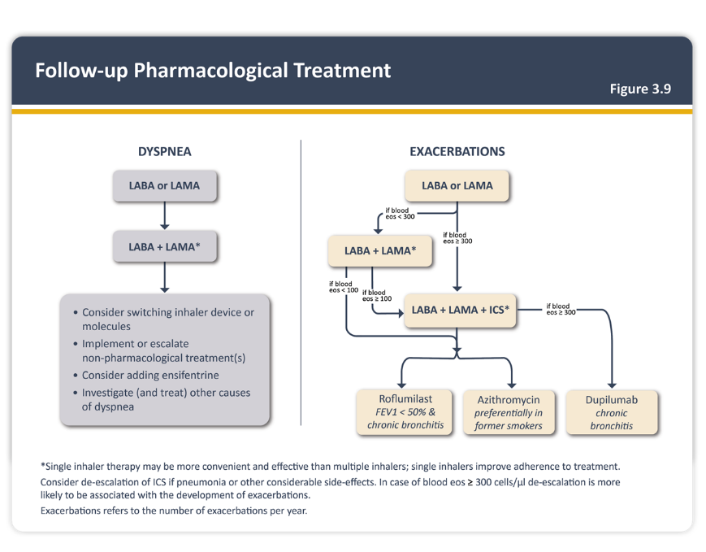
The GOLD 2025 Update refreshed Figure 3.9 to include ensifentrine and dupilumab
New for 2025
All copies and use of Work shall bear the copyright notice © [2024–2025] Global Strategy for Diagnosis, Management, and Prevention of COPD all rights reserved . Use is by express license from the owner.
EOS, eosinophils; FEV₁, forced expiratory volume in 1 second; ICS, inhaled corticosteroids; LABA, long-acting beta-agonist; LAMA, long-acting muscarinic antagonist.
https://goldcopd.org/wp-content/uploads/2024/11/GOLD-2025-Report-v1.0-15Nov2024_WMV.pdf. Accessed December 2024.
Notes:
GOLD 2025. pg58, figure 3.9

Slide 8
Baseline Demographics and Disease Characteristics
POOLED BOREAS + NOTUS
 | Pooled
 | Placebo (n=936) | Dupilumab (n=938) | All (n=1874)
Age, years | 65.0 (8.3) | 65.1 (8.0) | 65.1 (8.2)
Sex, n (%)
Female | 302 (32.3) | 320 (34.1) | 622 (33.2)
Male | 634 (67.7) | 618 (65.9) | 1252 (66.8)
Region,* n (%)
Asia | 66 (7.1) | 67 (7.1) | 133 (7.1)
Latin America | 256 (27.4) | 255 (27.2) | 511 (27.3)
East Europe | 358 (38·2) | 361 (38·5) | 719 (38·4)
Western Countries | 256 (27.4) | 255 (27.2) | 511 (27.3)
Race, n (%)
White | 813 (86.9) | 815 (86.9) | 1628 (86.9)
Black | 10 (1.1) | 7 (0.7) | 17 (0.9)
Asian | 70 (7.5) | 74 (7.9) | 144 (7.7)
American Indian or Alaskan Native | 30 (3.2) | 25 (2.7) | 55 (2.9)
Native Hawaiian or Pacific Islander | 1 (0.1) | 1 (0.1) | 2 (0.1)
Multiple | 12 (1.3) | 16 (1.7) | 28 (1.5)
 | Pooled
 | Placebo (n=936) | Dupilumab (n=938) | All (n=1874)
Hispanic or Latino ethnic group, n (%)
Hispanic or Latino | 278 (29.7) | 283 (30.2) | 561 (29.9)
Non-Hispanic or non-Latino | 650 (69.4) | 650 (69.3) | 1300 (69.4)
Unknown | 8 (0.9) | 5 (0.5) | 13 (0.7)
Smoking status, n (%)
Former smokers | 654 (69.9) | 662 (70.6) | 1316 (70.2)
Current smokers | 282 (30.1) | 276 (29.4) | 558 (29.8)
Smoking history, median (Q1–Q3), (pack-years) | 38 (22–50) | 35 (22–48) | 36 (22–50)
Emphysema, n (%) | 301 (32.2) | 289 (31.0) | 590 (31.5)
BMI, kg/m² | 27.7 (5.6) | 27.8 (5.4) | 27.8 (5.5)
Background medication, n (%)
Triple therapy (ICS+LAMA+LABA) | 919 (98.2) | 921 (98.2) | 1840 (98.2)
In the pooled population, the demographic and clinical characteristics of the two groups were balanced at baseline
Data are mean (SD) unless indicated otherwise.
*Asia: Japan, China, South Korea; Latin America: Argentina, Colombia, Peru, Chile, Brazil, Mexico; East Europe: Russia, Ukraine, Poland, Bulgaria, Lithuania, Latvia, Czech Republic, Slovakia, Romania, Serbia, Turkey, Hungary; Western Countries: Australia, Belgium, France, Portugal, Spain, Germany, Netherlands, United Kingdom, South Africa, Canada, USA, Greece, Finland, Denmark, Israel, Sweden, Italy.
BMI, body mass index; COPD, chronic obstructive pulmonary disease; ICS, inhaled corticosteroid; LABA, long-acting β2-agonist; LAMA, long-acting muscarinic antagonist; Q1–Q3, interquartile range; SD, standard deviation.
Bhatt SP, et al. 2025. Lancet Respir Med. 2025:S2213-2600(24)00409-0
8

Slide 9
Dupilumab Phase 3 Studies: Annual Rate of Moderate or Severe Exacerbations
POOLED BOREAS + NOTUS
Rate Ratio (95% CI)
0.687 (0.595–0.793)
P<0.001*
Annualized rate of moderate or severe COPD exacerbation over 52-week treatment period
Dupilumab | 0.794
Placebo | 1.156
Difference (95% CI) | 0.687 (0.595–0.793)
P value* | <0.0001
31% reduction in moderate or severe exacerbations over 52 weeks
*Nominal P value.
Bhatt SP, et al. 2025. Lancet Respir Med. 2025:S2213-2600(24)00409-0.

Slide 10
Treatment Difference in Exacerbation Rate by Baseline Eosinophils
Rate ratio 0.7
95% CI
(0.61, 0.81)
Rate ratio 0.71
95% CI
(0.61, 0.83)
Rate ratio 0.71
95% CI
(0.61, 0.83)
Rate ratio 0.72
95% CI
(0.61, 0.83)
1.2
Comparison
1.0
Dupilumab vs Placebo
0.8
Treatment rate ratio for all
moderate/severe exacerbations
0.6
0.4
0.2
0
100
300
500
700
900
1100
Baseline Blood Eosinophils (cell/µL)
Consistent efficacy of dupilumab was observed in lowering exacerbation rates across a wide range of baseline blood eosinophil counts
CI, confidence interval; COPD, chronic obstructive pulmonary disease; ITT, intent-to-treat.
Bhatt SP, et al. 2025. Lancet Respir Med. 2025:S2213-2600(24)00409-0
10

Slide 11
Dupilumab Phase 3 Studies: Change in Pre-BD FEV₁ at Week 12 in Patients With Baseline FeNO ≥20 ppb
POOLED BOREAS + NOTUS
LSMD (95% CI)
0.131 (0.074–0.187)
P<0.0001
+131 mL improvement in lung function at Week 12 (P<0.0001)
BD, bronchodilator; CI, confidence interval; FeNO, fractional exhaled nitric oxide; FEV₁, forced expiratory volume in 1 second; LS, least squares; LSMD, least squares mean difference; ppb, parts per billion.
Bhatt SP, et al. 2025. Lancet Respir Med. 2025:S2213-2600(24)00409-0.

Slide 12
Dupilumab Phase 3 Studies: Change in Pre-BD FEV₁ at Week 52 in Patients With Baseline FeNO ≥20 ppb
POOLED BOREAS + NOTUS
LSMD (95% CI)
0.106 (0.042–0.17)
P=0.0012
+106 mL improvement in lung function over placebo at Week 52 (P=0.0012)
BD, bronchodilator; CI, confidence interval; FeNO, fractional exhaled nitric oxide; FEV₁, forced expiratory volume in 1 second; LS, least squares; LSMD, least squares mean difference; ppb, parts per billion.
Bhatt SP, et al. 2025. Lancet Respir Med. 2025:S2213-2600(24)00409-0.

Slide 13
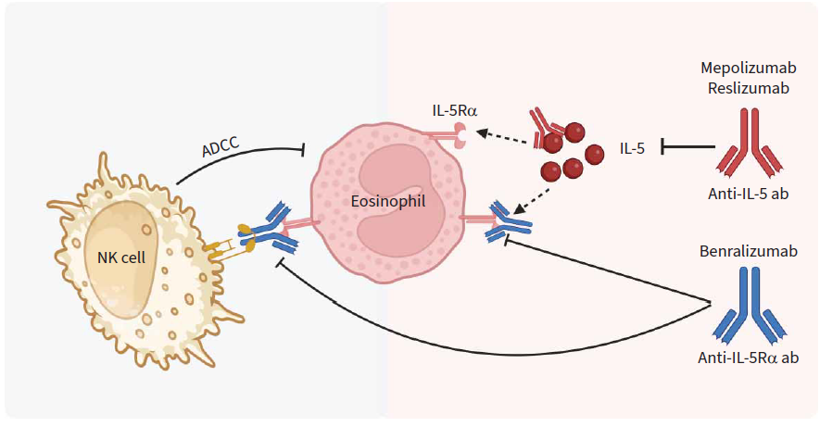

Slide 14
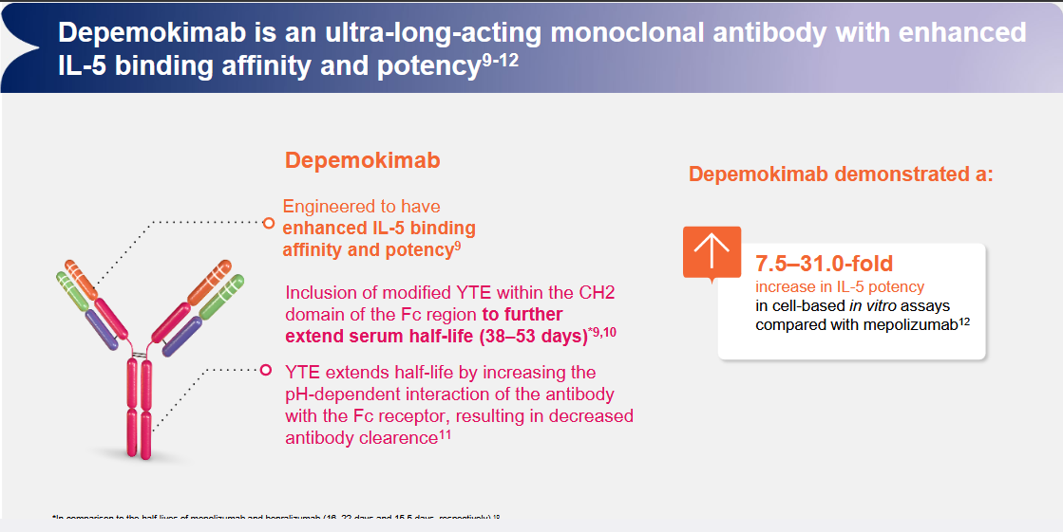

Slide 15
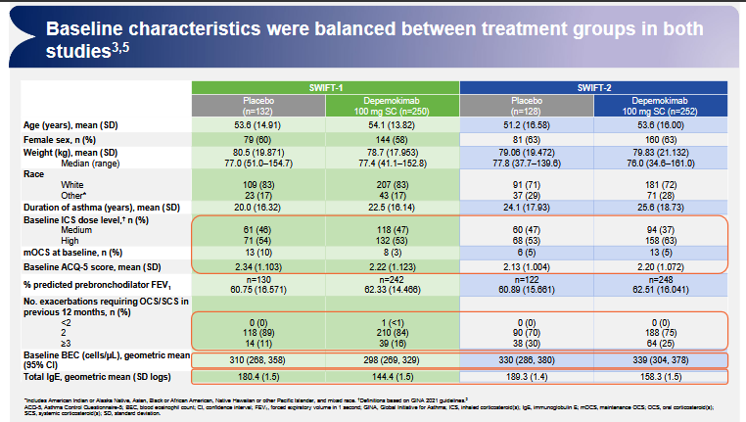

Slide 16
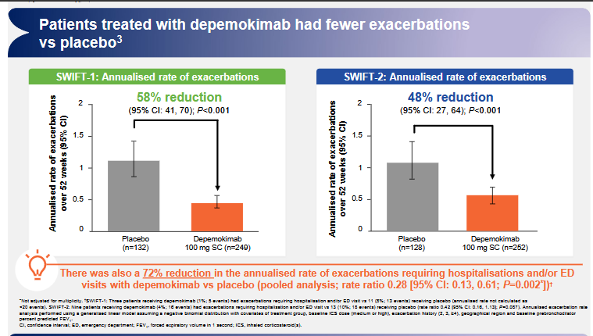

Slide 17
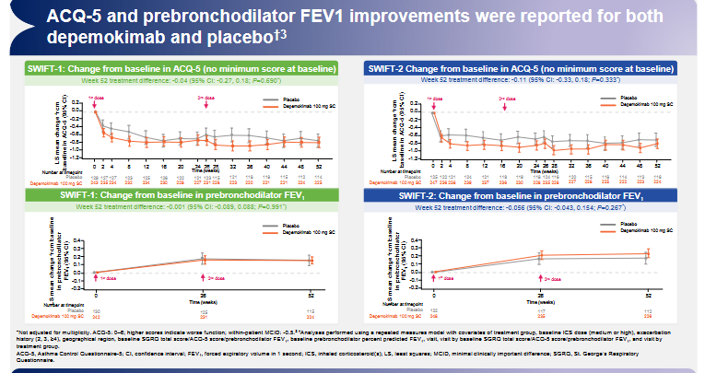

Slide 18
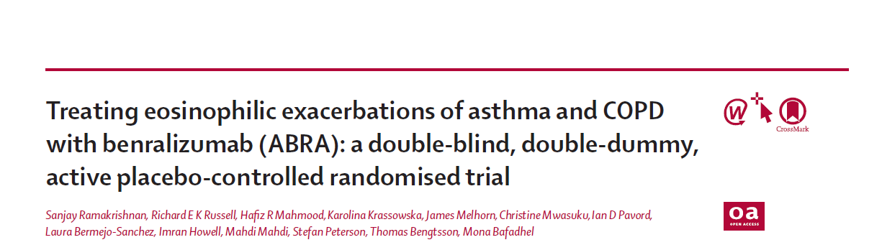
Oral corticosteroids (OCS) remain the mainstay of therapy in acute exacerbations. Even short-term use is associated with adverse events and morbidity and mortality.⁷⁻¹²
Less harmful alternatives to reduce the cumulative harm of OCS therapy are urgently warranted.⁸
The ABRA study investigated a single dose of benralizumab alone or in combination with OCS compared with short course of OCS in acute eosinophilic exacerbations of asthma and COPD³

Slide 19
ABRA Clinical Study Design
Phase 2, multicenter, randomized, double-blind, double-dummy, active-placebo controlled randomized clinical trial
Trial Entry
Visit 1
Exacerbation & Randomization
Visit 2
Efficacy assessments
Key eligibility criteria
Exacerbation of asthma or COPD with eosinophils ≥300 cells/uL at time of exacerbation
Benralizumab
100 mg SC x1 STAT
Co-primary endpoints
Day 28 VAS symptoms & Day 90 treatment failure rates (death, hospitalization, retreatment)
Secondary endpoints
Treatment failure risk within 30 days of randomization Time to treatment failure PROs (ie ACQ-7, AQLQ total, ACT, EuroQOL 5D-3L) Change from baseline in lung function parameters (ie, FEV₁, FVC, PEF) MRC Dyspnea scale and CAT
Adults ≥18 years
Patients with asthma with current or historic evidence of variable airflow limitation and a smoking pack year history <10
Patients with COPD with current or historic evidence of FEV1/FVC <0.7 and smoking pack year history ≥10
History of ≥1 exacerbation requiring SCS in previous 12 months
Evidence of eosinophilic inflammation (within 2 years) including FeNO ≥25 ppb and/or peripheral bEOS ≥250 cells/uL and/or sputum eosinophils ≥3% of the total cell count.
BENRA + PRED Group
(N=52)
Prednisolone 30 mg PO for 5 days
Benralizumab
100 mg SC x1 STAT
BENRA Group
(N=53)
Follow-up, Visits 3-7
(90 days)
Patients Randomized 1:1:1
(N=158)
Placebo PO for 5 days
Placebo
SC x1 STAT
PRED Group
(N=53)
Prednisolone 30 mg PO for 5 days
Disclaimer: Benralizumab 100 mg SC x1 STAT is not indicated for the treatment of acute exacerbations in asthma or COPD
Note: Never smokers were defined as those with less than 100 cigarette inhalations in a lifetime, while former smokers had ceased smoking at least 6 months before randomization.
ACQ-5 = 5-Item Asthma Control Questionnaire; ACT = asthma control test; AQLQ = Asthma Quality of Life Questionnaire; BENRA = benralizumab; bEOS = blood eosinophils; CAT = COPD assessment test; COPD = chronic obstructive pulmonary disease; FeNO = fractional exhaled nitric oxide; FEV₁ = forced expiratory volume in 1 second; mg = milligrams; MRC = medical research council; PO = Per Os (by mouth); PRED = prednisolone; PRO = patient-reported outcome; QOL = quality of life; SC = subcutaneous; SEA = severe eosinophilic asthma; SCS = systemic corticosteroids; STAT = STATim (immediately); VAS = visual analogue scale
Ramakrishnan S et al. Article and Supplementary Appendix. Lancet Respir Med. 2025;13:59-68.
Notes:
Note:
Present Slide.
Additional Information:
Study treatments were administered within 10 min of randomization.
According to study protocol, no antibiotics were administered at randomization.
Randomized patients were classified as moderate or severe exacerbations of COPD, or moderate, acute severe, or life-threatening asthma exacerbations.
Patients could be recruited for randomization from the emergency department or from the study pool.
The study pool included those with a prior physician-confirmed diagnosis of asthma or COPD, history of at least one exacerbation in prior 12 months, and prior history of bEOS >250 cells/uL.
Patients in the study pool could contact the study team at the time of exacerbation to assess for eligibility for the study.
Treatment failure was defined as a composite of death, hospital admission, and any need for re-treatment requiring systemic glucocorticoids or antibiotics. It could be self-reported by patients or by an independent healthcare provider not involved in the study.
Reference:
Ramakrishnan S, Russell RE, Mahmood HF et al. Treating eosinophilic exacerbations of asthma and COPD with benralizumab (ABRA): a double-blind, double-dummy, active placebo-controlled randomised trial [Article and Supplementary Appendix]. Lancet Respir Med. 2025;13:59-68.

Slide 20
Time to First Treatment Failure in PRED and Pooled-BENRA Groups
1.0
The time to treatment failure within 90 days was significantly longer in the pooled-BENRA group vs the PRED group (HR 0·39 [95% CI 0·25–0·61]; log-rank p=0.0003)
There was no difference between BENRA and BENRA plus PRED group (HR 0.76 [95% CI 0.43–1.36], log-rank p=0.68)
Number needed to treat with pooled-BENRA to prevent a treatment failure was 4.
0.9
Pooled BENRA
PRED
0.8
0.7
0.6
0.5
Proportion of patients without event (%)
0.4
0.3
0.2
0.1
0.0
0
1
2
3
4
5
6
7
8
9
10
1
1
12
Number at risk
Pooled-BENRA group
PRED group
Time in study (weeks)
105
98
86
79
79
72
68
66
65
61
59
55
49
53
46
41
33
28
24
22
20
16
15
14
12
11
Results are descriptive only. P-values are not corrected for multiplicity.
Notes: The PRED group indicates the prednisolone only group (blue line). The pooled-BENRA group indicates the benralizumab alone and the benralizumab plus prednisolone groups pooled together (red line).BENRA = benralizumab; CI = confidence interval; HR = hazard ratio; PRED = prednisolone
Ramakrishnan S et al. Lancet Respir Med. 2025;13:59-68.
Notes:
Note:
Present Slide.
Reference:
Ramakrishnan S, Russell RE, Mahmood HF et al. Treating eosinophilic exacerbations of asthma and COPD with benralizumab (ABRA): a double-blind, double-dummy, active placebo-controlled randomised trial. Lancet Respir Med. 2025;13:59-68.

Slide 21
Changes in MRC Dyspnea Scale
At day 28, there was a significant improvement in MRC dyspnea scale between the pooled-BENRA group vs PRED group (mean difference 0.39 [95% CI 0.08 to 0.69]; p=0.013)
Mean change MRC Dyspnea Scale
0.2
BENRA
BENRA+PRED PRED
–0.0
Change in MRC (1–5)
–0.2
–0.4
–0.6
–0.8
–1.0
Results are descriptive only. P-values are not corrected for multiplicity. BENRA = benralizumab; CI = confidence interval; MRC = medical research council; PRED = prednisolone
Ramakrishnan S et al. Article and supplementary appendix. Lancet Respir Med. 2025;13:59-68.
–1.2
–10 0
10
20 30 40 50 60
70
80
90
Days since dose administration
Notes:
Note:
Present Slide.
Reference:
Ramakrishnan S, Russell RE, Mahmood HF et al. Treating eosinophilic exacerbations of asthma and COPD with benralizumab (ABRA): a double-blind, double-dummy, active placebo-controlled randomised trial [article and supplementary appendix]. Lancet Respir Med. 2025;13:59-68.

Slide 22
Mean change in ACT and CAT
There was a non-significant improvement in pooled-BENRA vs PRED for ACT (mean difference 1.6 [95% CI -0.4 to 3.6], p=0.12) or CAT (mean difference 3.6 [-2.9 to 10.1], p=0.27) at day 90.
Mean change in ACT
Mean change in CAT
7
5
Benra+Plac Benra+Pred Plac+Pred
6
5
0
Change in ACT (5–20)
Change in CAT (0–40)
4
–5
3
2
BENRA
BENRA+PRED PRED
–10
1
0
–15
Results are descriptive only. ACT = asthma control test; BENRA = benralizumab; CAT = COPD assessment test; PRED = prednisolone
Ramakrishnan S et al. Article and supplementary appendix. Lancet Respir Med. 2025;13:59-68.
–1
–10
0
10
20
30
40
50
60
70
80
90
–10
0
10
20
30
40
50
60
70
80
90
Days since dose administration
Days since dose administration
Notes:
Note:
Present Slide.
Reference:
Ramakrishnan S, Russell RE, Mahmood HF et al. Treating eosinophilic exacerbations of asthma and COPD with benralizumab (ABRA): a double-blind, double-dummy, active placebo-controlled randomised trial [article and supplementary appendix]. Lancet Respir Med. 2025;13:59-68.

Slide 23
Post-hoc Sub-group Analysis for Time to Treatment Failure in PRED and Pooled-BENRA Groups
 | Pooled-BENRA group events (n/N; %) | PRED group events (n/N;%) |  | HR (95% CI) | Log-rank p value
Primary analysis
Intention-to-treat population | 47/105 (44.8%) | 39/53 (73.6%) |  | 0.39 (0.25–0.61) | 0.0003
Adjudicated diagnosis
Asthma | 23/53 (43.4%) | 25/35 (71.4%) |  | 0.44 (0.25–0.78) | 0.0037
COPD | 19/36 (52.8%) | 10/13 (76.9%) |  | 0.43 (0.20–0.93) | 0.027
Asthma and COPD | 5/14 (35.7%) | 3/5 (60.0%) |  | 0.69 (0.16–2.91) | 0.611
FEV₁ strata
≥50% predicted normal | 32/78 (41.0%) | 27/40 (67.5%) |  | 0.51 (0.30–0.85) | 0.0087
<50% predicted normal | 15/27 (55.6%) | 12/13 (92.3%) |  | 0.18 (0.07–0.47) | 0.0012
Smoking history
Current smoker | 6/11 (54.5%) | 4/4 (100%) |  | 0.25 (0.05–1.15) | 0.055
Ex-smoker | 23/53 (43.4%) | 19/27 (70.4%) |  | 0.48 (0.26–0.89) | 0.017
Non-smoker | 18/41 (43.9%) | 16/22 (72.2%) |  | 0.45 (0.23–0.89) | 0.018
Gender
Male | 13/41 (31.7%) | 22/31 (71.0%) |  | 0.39 (0.19–0.77) | 0.0050
Female | 34/64 (53.1%) | 17/22 (77.3%) |  | 0.45 (0.25–0.81) | 0.0066
Age, years
<50 | 11/34 (32.4%) | 9/13 (69.2%) |  | 0.38 (0.16–0.93) | 0.028
≥50 | 36/71 (50.7%) | 30/40 (75.0%) |  | 0.49 (0.30–0.80) | 0.0080
Eosinophils, cell per µl
300-500 | 25/55 (45.5%) | 13/16 (81.3%) |  | 0.39 (0.20–0.77) | 0.0048
>500 | 22/50 (44.0%) | 26/37 (70.3%) |  | 0.49 (0.27–0.86) | 0.012
Fractional exhaled nitric oxide, parts per billion
≤30 | 22/39 (56.4%) | 12/17 (70.6%) |  | 0.61 (0.30–1.23) | 0.16
>30 | 23/63 (36.5%) | 25/34 (73.5%) |  | 0.36 (0.20–0.65) | 0.0003
Point estimates for time to treatment failure all favored
pooled-BENRA irrespective of age, sex, disease,
baseline FEV₁, or the biomarkers at exacerbation
(ie, bEOS and FeNO)
Results are descriptive only. p-values are not corrected for multiplicity.
Notes: Data are presented according to diagnosis, steady state lung function, smoking history, sex, age, and exacerbation biomarkers (esoinophills and fractional exhaled nitric oxide). The PRED group indicates the prednisolone only group.
The pooled-BENRA group indicated the benralizumab alone and the benralizumab plus prednisolone groups pooled together.
BENRA = benralizumab; bEOS = blood eosinophils; CI: confidence interval; COPD = chronic obstructive pulmonary disease; FeNO = fractional exhaled nitric oxide; FEV₁ = forced expiratory volume in 1 second; HR = hazard ratio; PRED = prednisolone.
Ramakrishnan S et al. Lancet Respir Med. 2025;13:59-68.
0.1
0.25
0.5
1
2
Favours BENRA
Favours PRED
Notes:
Note:
Present Slide.
Reference:
Ramakrishnan S, Russell REK, Mahmood HR, et al. Treating eosinophilic exacerbations of asthma and COPD with benralizumab (ABRA): a double-blind, double-dummy, active placebo-controlled randomised trial. Lancet Respir Med. 2025;13:59-68.

Slide 24

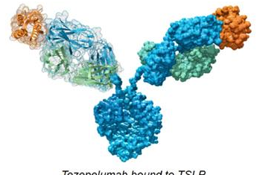

Viruses^{2a}
Bacteria^{3b}
Smoke^{4c}
Allergens^{5b}
Fungi^{6b}
Human
bronchial
epithelial cells
TSLP
Tezepelumab^{7–9}
TSLP
Tezepelumab
Potential impact on
effector cells in
COPD
Tezepelumab bound to TSLP
Tezepelumab for COPD
Fibroblasts^{10b}
Platelets^{11a}
T cells,^{12,13b} neutrophils,^{14,15b} eosinophils^{16,17b}
TSLPR+ fibrocytes^{18a}
Airway smooth
muscle cells^{19,20b}
Dendritic cells^{21a}
TSLP
Airway smooth muscle²²
Notes:
Lange 2021
p311/col1/para7
/lines9-11
Lange 2021
p255/col2/para2/lines6-13
Nakamura 2008
p1209/col2/para6/lines4-14
Dong 2016
p2/para4/lines3-5
Kouzaki 2009
Fiugre 3
Jin 2021
Figure 2C/D
Wu 2019
Figure 1
Figure 3
p4947/col1/para1/
lines3-7
Tworek 2020
Methods/Results/Conclusions
Shan 2010
p7141/col2/para4
Redhu 2012
Figure 2
p999/col1/para1/lines2-9
Paplinska-Goryca 2020
p8/para3/lines3-4
Zhang 2007
p378/col1/para1/lines4-9
Varricchi 2018: Figure 3
Gauvreau 2014: p2103/col1/para3/lines
1-4
Corren 2017: p937/col1/para4/lines1-4
Akamatsu 2008
Abstract/lines4-7
Williams 2021
Abstract/line3, 10-11
West 2016
p4/end paragraph 1
Wang 2020
p3/col2/para2/lines1-5
Wong 2010
p309/col1/para2/lines7-13
Narendra 2019
p1046/col2/para1

Slide 25
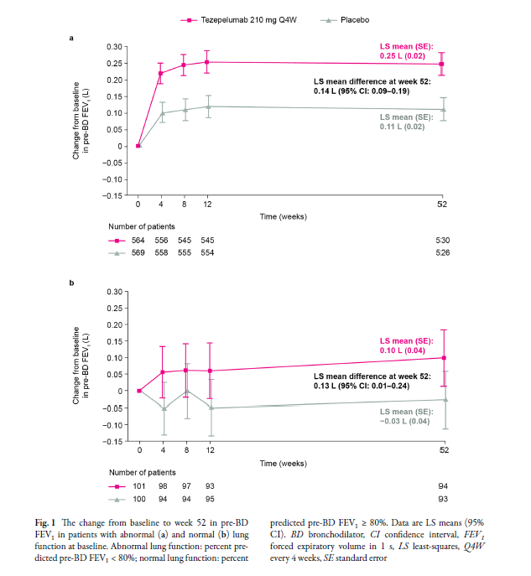
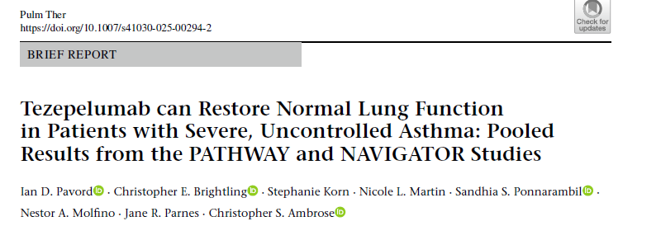

Slide 26

COURSE: multicenter, double-blind, randomised, placebo-controlled,
Phase IIa, parallel-group study
Patients were enrolled irrespective of baseline BEC level, inflammatory drivers,
emphysema, or chronic bronchitis²
Select inclusion criteria^{1,2}
Moderate to very severe physician-diagnosed COPD for at least 12 months prior to enrollmentª
At least two documented moderate^{b} to severe^{c} COPD exacerbations within 2–52 weeks prior to enrollment
CAT score of ≥15, both at enrollment and on the day of randomization
Treatment with triple inhaled maintenance therapy^{d} for COPD throughout the year prior to enrollment, with a stable ICS dose for
≥3 months prior to enrolment^{e}
Current or former smokers with a tobacco history of at least 10 pack-years
Select exclusion criteria¹
Patients with asthma or other clinically important pulmonary diseases (other than COPD)
ªDiagnostic criteria: post-BD FEV₁/FVC <0.70 and a post-BD FEV₁ ≥20% and ≤80% of predicted normal value; ^{b}A moderate COPD exacerbation was defined as an exacerbation that required treatment with systemic corticosteroids for ≥3 days (or one injection of depot formulation) and/or antibiotics; ^{c}A severe COPD exacerbation was defined as an exacerbation that resulted in hospitalization (defined as an inpatient admission of ≥24 hours in the hospital, in an observation area, the emergency department, or other equivalent healthcare facility, depending on the country and healthcare system) or death; ^{d}Medium- or high-dose ICS/LABA/LAMA (ICS total daily dose of fluticasone propionate >250 µg or equivalent); ^{e}the total cumulative duration that the patient was not using triple inhaled maintenance therapy (ICS/LABA/LAMA) must not have exceeded 2 months.
BD = bronchodilator; BEC = blood eosinophil count; CAT = COPD Assessment Test; COPD = chronic obstructive pulmonary disease; FEV₁ = forced expiratory volume in
1 second; FVC = forced vital capacity; ICS = inhaled corticosteroid(s); LABA = long-acting β₂-agonist; LAMA = long-acting muscarinic antagonist.
1. Singh D et al. Lancet Respir Med. 2025;13:47–58; 2. Singh D et al. Supplementary appendix. Lancet Respir Med. 2025;13:47–58

Slide 27






COURSE: multicenter double-blind, randomised, placebo-controlled, Phase IIa, parallel-group study
Objective
Patient population
Primary endpoints
Objective
Patient population
Smoking Status
Assess the efficacy and safety of tezepelumab
Adult patients (40–80 years of age) with moderate to very severe COPD irrespective of baseline BEC level, inflammatory drivers, emphysema, or bronchitis history²
Annualized rate of moderateª or severe^{b} COPD exacerbations over
52 weeks
N=333
Tezepelumab 420 mg SC Q4W
12 weeks
post-treatment follow up
Tezepelumab for COPD
Placebo SC Q4W
Randomization
52 weeks of treatment
The annualised rate of moderate or severe COPD exacerbations over 52 weeks was 1·75 for tezepelumab versus 2·11 for placebo (rate ratio 0·83 [90% CI 0·64–1·06
The primary endpoint was not met
In prespecified subgroup analyses, the annualised rate of moderate or severe COPD exacerbations over 52 weeks was 2·04 with tezepelumab versus 1·71 with placebo (rate ratio 1·19 [95% CI 0·75–1·90]) in patients with a baseline BEC of less than 150 cells per μL, 1·64 versus 2·47 (0·66 [0·42–1·04]) in patients with a baseline BEC of 150 cells per μL to less than 300 cells per μL, and 1·20 versus 2·24 (0·54 [0·25–1·15]) in patients with a baseline BEC of 300 cells per μL or higher.
1. Singh D et al. Lancet Respir Med. 2025;13:47–58; 2. Singh D et al. Supplementary appendix. Lancet Respir Med. 2025;13:47–58

Slide 28
The Phase III EMBARK and JOURNEY studies will investigate the efficacy and safety of tezepelumab in patients with COPD^{1,2}
Objective
Patient population
Primary endpoint
Evaluate the efficacy and safety of tezepelumab in adult patients with COPD
Adult patients (aged 40–80 years) with moderate to very severe COPD on triple or dual inhaled therapy,ª a history of ≥2 moderate or ≥1 severe exacerbations in prior 12 months, and BEC of ≥150 cells/μL
Annualized rate of moderate or severe COPD exacerbations
up to 76 weeks
Tezepelumab Dose 1 SC Q4W
Safety Follow-up
Screening
(Estimated N=990
per trial)
Randomization 1:1:1
Tezepelumab Dose 2 SC Q4W
Placebo SC Q4W
52 weeks minimum; up to 76 weeks maximum
12 weeks
Select secondary endpoints
Change from baseline in pre- and post-BD FEV₁ at Week 52
Change from baseline and clinically meaningful improvement^{b} in the SGRQ and CAT total score over 52 weeks
Annualized rate of severe COPD exacerbations up to 76 weeks
Time to first moderate to severe, and severe COPD exacerbation up to 76 weeks
Annualized rate of moderate or severe COPD exacerbations among patients with BEC ≥300 cells/µL
ªTriple (ICS+LABA+LAMA) or dual inhaled COPD therapy for ≥3 consecutive months prior to Visit 1; ^{b}Defined as a decrease of 4 points in the SGRQ total score or a decrease of 2 points in the CAT total score from baseline.
BD = bronchodilator; BEC = blood eosinophil count; CAT = COPD assessment test; COPD = chronic obstructive pulmonary disease; FEV₁ = forced expiratory volume in one second; ICS = inhaled corticosteroids; LABA = long-acting beta₂ agonist; LAMA = long-acting muscarinic antagonist; SC = subcutaneous; SGRQ = St. George’s Respiratory Questionnaire; Q4W = every 4 weeks.
1. Study NCT06883305. ClinicalTrials.gov website. https://clinicaltrials.gov/study/NCT06883305; 2. Study NCT06878261. ClinicalTrials.gov website. https://clinicaltrials.gov/study/NCT06878261.

Slide 29
A phase 2a trial of the IL-33 mAb Tozorakimab in patients with COPD: FRONTIER-4
Methods: FRONTIER-4 was a phase 2a, randomized, double-blind, placebo-controlled study. Patients received tozorakimab 600 mg or placebo subcutaneously every 4 weeks for 24 weeks. The primary endpoint was change in pre-bronchodilator (BD) FEV₁ from baseline to week 12. Secondary outcomes included post-BD FEV₁, time-to-first COPDCompEx event and safety.
Results: 135 patients (tozorakimab, n=67; placebo, n=68)
At 12 weeks tozorakimab showed a greater increase from baseline in pre-BD FEV₁ (least-squares mean [LSM]: 24 mL [80% confidence interval (CI): -15,63]; p=0.216) that was not statistically significant, and in post-BD FEV₁ (LSM: 67 mL [80% CI: 17,116]; p=0.044), when compared with placebo.
Tozorakimab showed improvements versus placebo (LSM [80% CI]) in change from baseline in pre-BD FEV₁ (69 mL [9,130]; p=0.072) and post-BD FEV₁ (124 mL [47,201]; p=0.020) at week 12 in a pre-specified subgroup of patients with ≥2 prior exacerbations.
Singh D, Guller P, Reid F, Doffman S, et al. Eur Respir J. 2025 Apr 3:2402231.

Slide 30
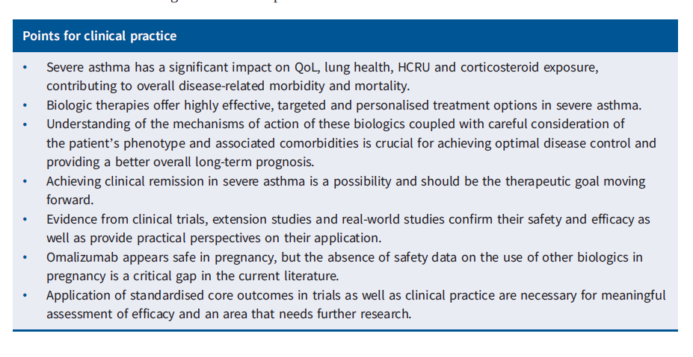
Considerations - 1 SEVERE ASTHMA
SEVERE ASTHMA

Slide 31
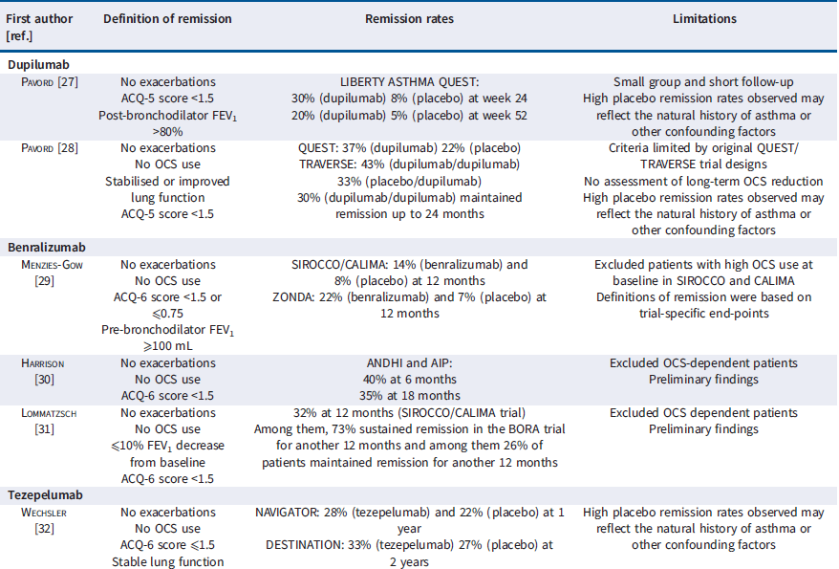
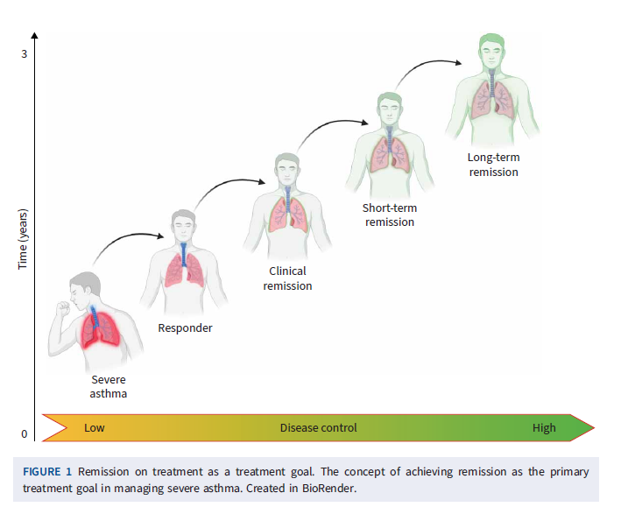
Remission in Severe Asthma
Principe S, et al. Eur Respir Rev 2025; 34: 240181

Slide 32
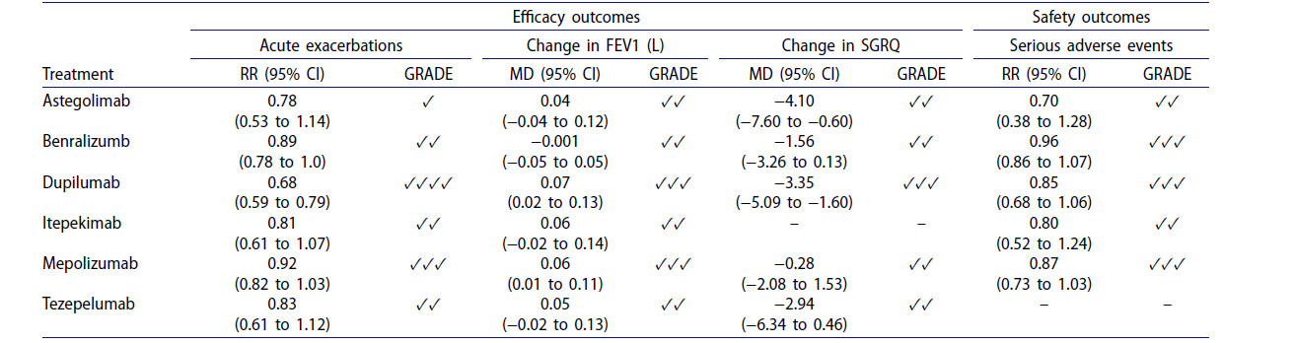
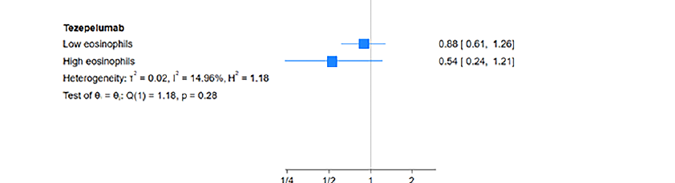
Considerations - 2 COPD
Pitre T, et al. COPD: Journal of ChronicObstructive Pulmonary Disease 2025, VOL. 22, NO. 1,

Slide 33
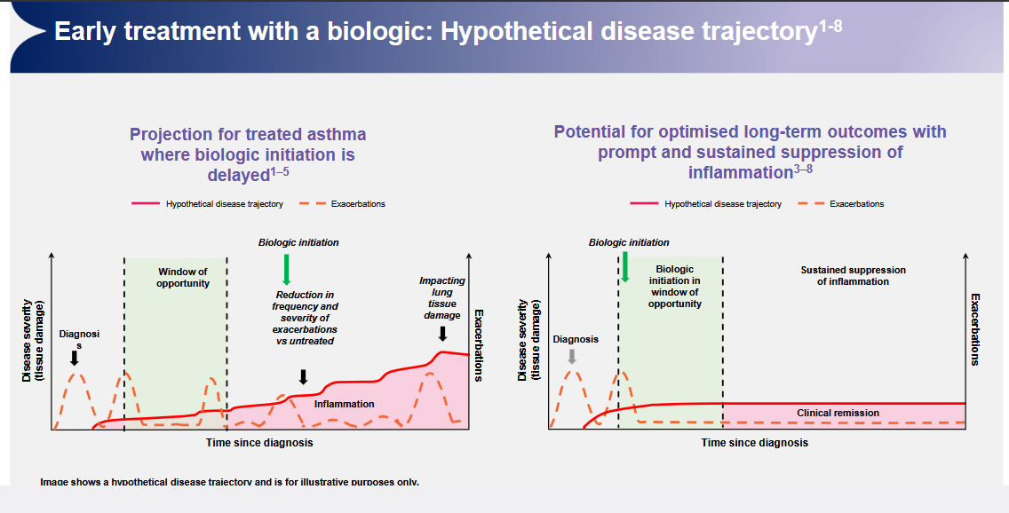
……Proposta

