Slide 1
Pharmacotherapy of asthma and COPD:
clinical and pharmacological considerations
Paolo Montuschi, MD
Visiting Professor of Respiratory Medicine and Pharmacology
Imperial College of Science Technology and Medicine
Faculty of Medicine, National Heart and Lung Institute
London, United Kingdom
Catholic University of the Sacred Heart
Faculty of Medicine, Roma, Italy

Slide 2
Pharmacotherapy of asthma and COPD
Data generation
Evidence base
Outcome
individual
untargeted research
system medicine studies
generating hypotheses
personalised pharmacotherapy
unmet need requiring
diagnostic molecular biology test
phenotype
targeted research
hypothesis-driven studies
pharmacotherapy of clinical phenotypes
e.g., biologic drugs for severe
eosinophilic asthma and COPD
RCTs
epidemiological studies
population
regulatory drug approval
therapeutic options
guidelines
e.g., inhaled triple therapy

Slide 3
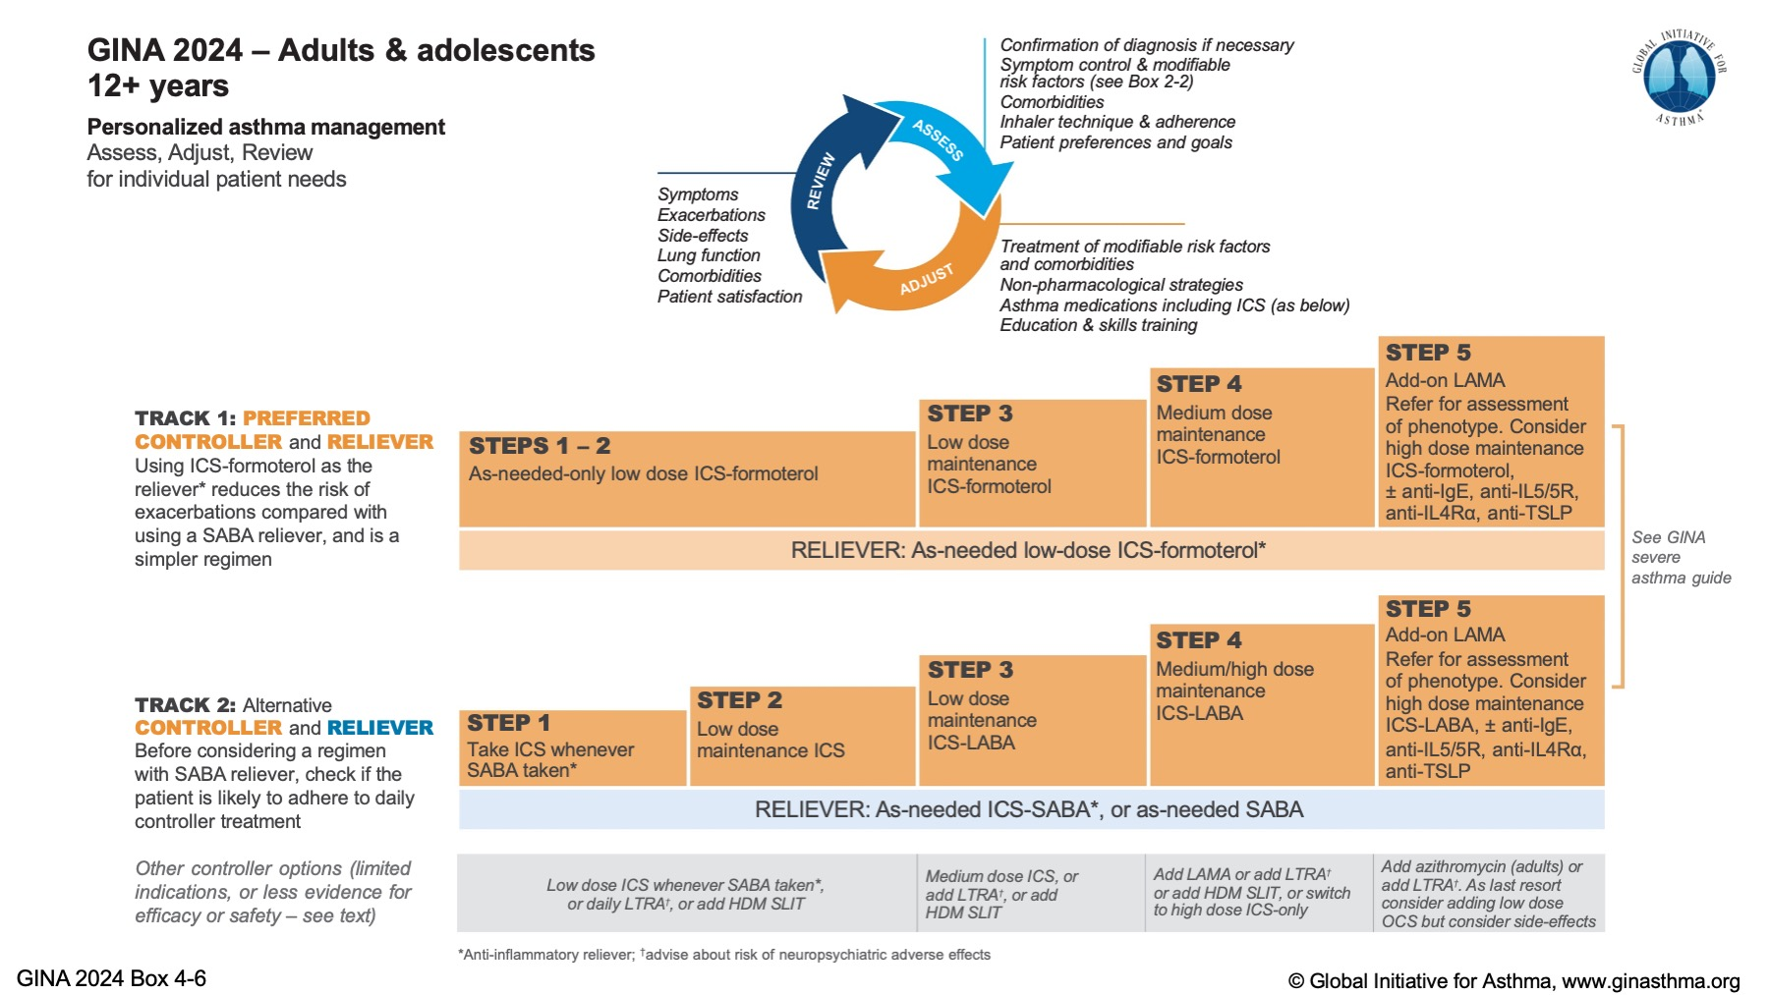

Slide 5
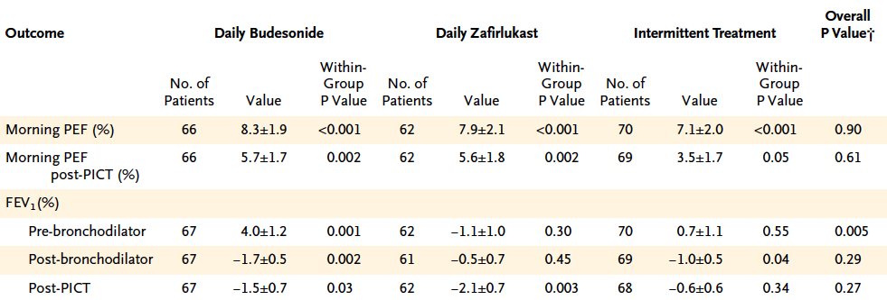
Improving Asthma Control Trial (IMPACT) PFT
+ 3.3% (105 mL in 1 year for baseline FEV₁ = 3.2 L)
The change in the post-bronchodilator FEV₁ in the 46 patients with an FEV₁ at entry that was 70-79% of
the predicted value was not different from that in the 144 patients with an FEV₁ at entry tha was ≥80% of
the predicted value (P = 0.59)
Unless otherwise stated, values reflect mean (±SE) changes from baseline to the end of treatment period (before the period of intense combined treatment [PICT]).
Boushey HA et al, N Engl J Med 2005

Slide 6
Improving Asthma Control Trial (IMPACT) inflammatory outcome measures
If not treated, airway inflammation increases over time as reflected by increased F_{E}NO
and sputum eosinophil cell counts in the intermittent treatment group
Unless otherwise stated, values reflect mean (±SE) changes from baseline to the end of treatment period (before the period of intense combined treatment [PICT]).

Slide 7
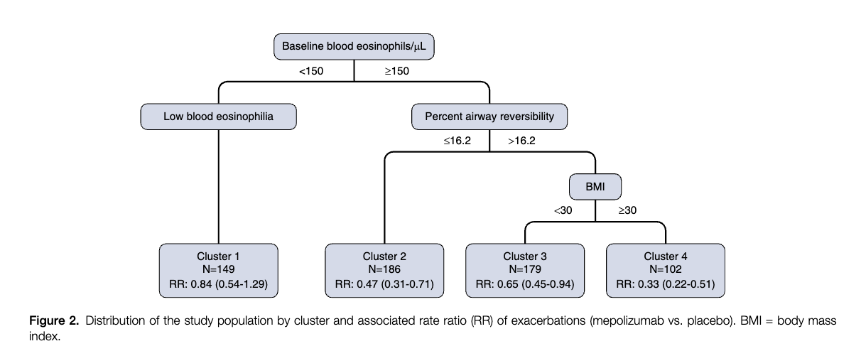

Slide 8
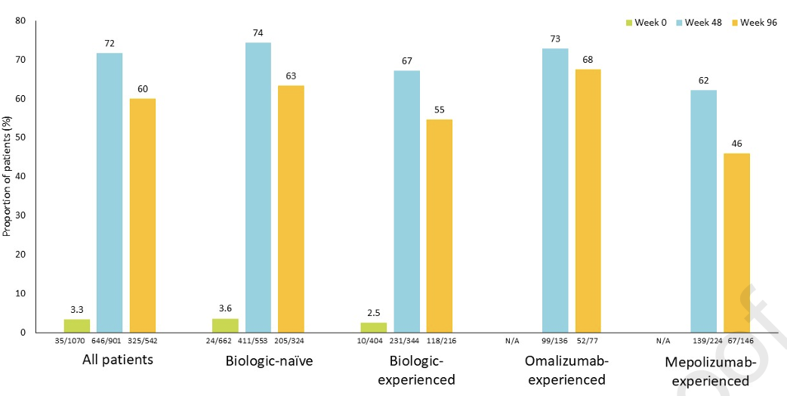
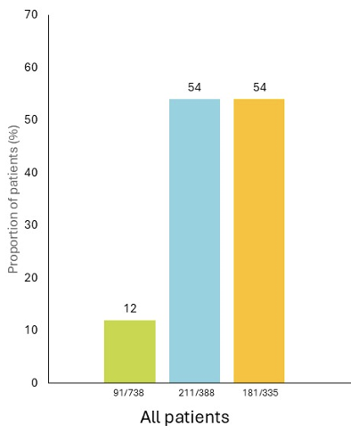
no asthma
exacerbations achieved
well controlled asthma with
mean ACQ6 ≤0.75

Slide 9
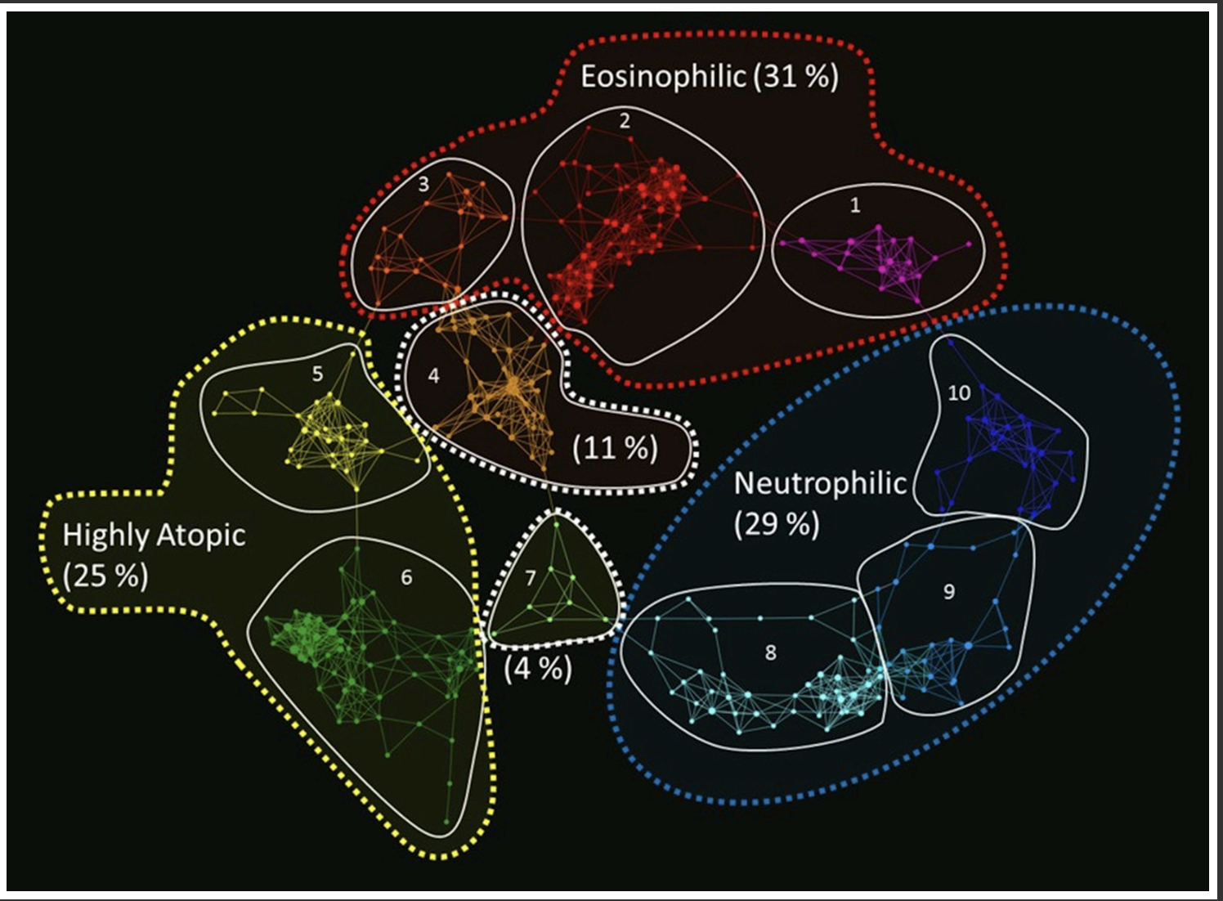
Phenotyping of asthma based on sputum proteomics
Schofield JPR et al, J Allergy Clin Immunol. 2019 Jul;144(1):70-82

Slide 10
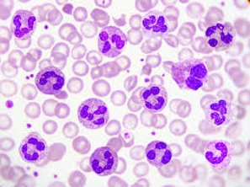

Slide 11
ACOS
LABA
dyspnea
LABA
LAMA
dyspnea
ICS
LABA
Mepolizumab
chronic
bronchitis
LAMA
MATINEE study
improvement

Slide 12
A pragmatic, unvalidated, algorithm combining ACOS and/or eosinophilic phenotype
AECOPD history
Asthma history
Blood eosinophil count
AHR assessment
(GOLD, 2018)
(COPD Spanish guidelines, 2012)
(WISDOM Study post-hoc analysis, 2016)
(COPD Spanish guidelines, 2012)
Asthma history
Frequent AECOPD
ICS-containing FDC if
Eosinophils ≥300/μl
Reversibility test
> 15% or 400 ml
Single or dual bronchodilator therapy based on COPD symptom level

Slide 13
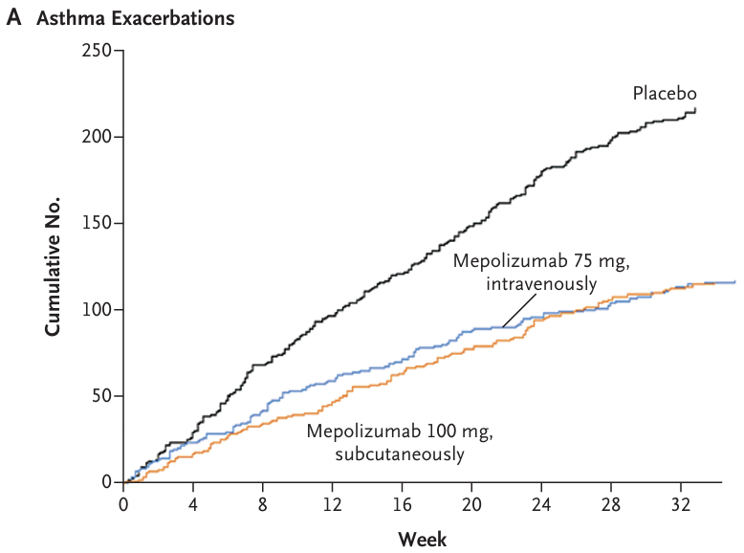
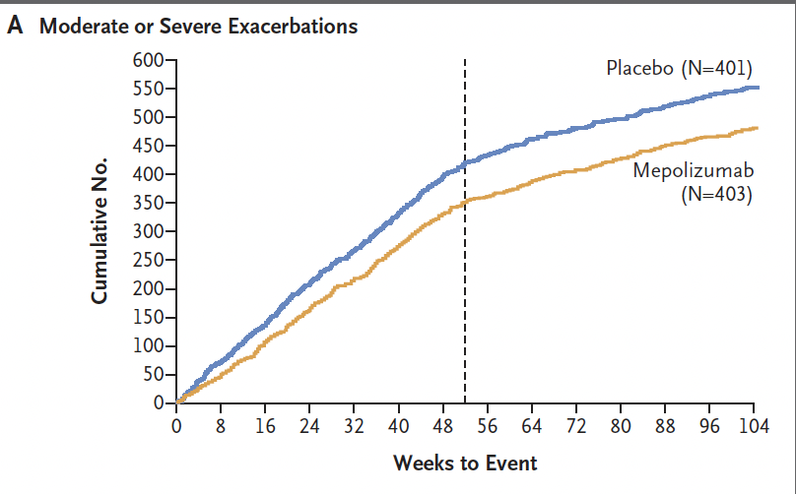
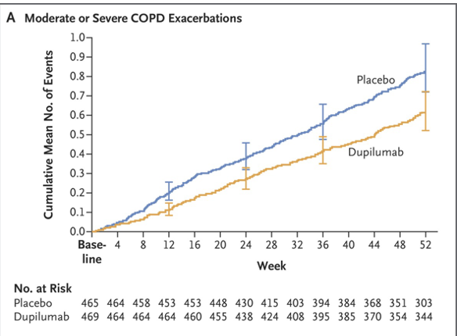
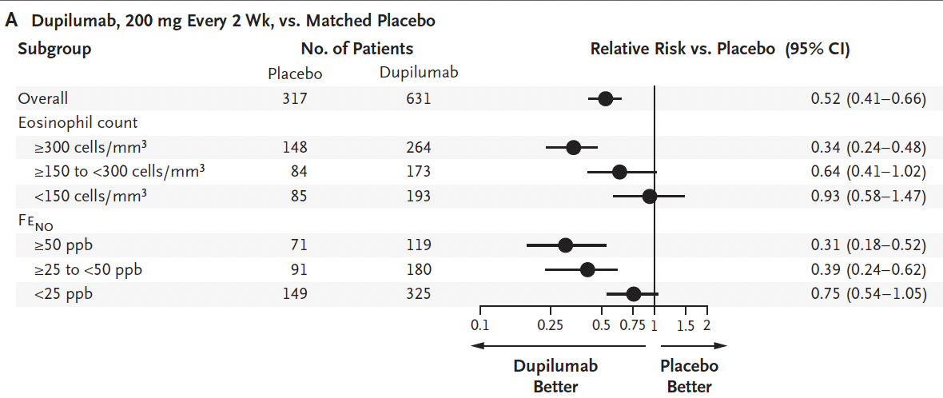
Mepolizumab MENSA study
eosAsthma -53%
Mepolizumab MATINEE study
eosCOPD -21%
Dupilumab NOTUS study
eosCOPD -34%
Dupilumab QUEST study
eosAsthma -48%

Slide 14
Tezepelumab: NAVIGATOR study
-56% acute asthma exacerbations rate
Tezepelumab: COURSE study in COPD
no effect on asthma exacerbation rate
The annualised rate of moderate or severe COPD exacerbations over 52 weeks was 1·75 for tezepelumab versus 2·11 for placebo (rate ratio 0·83 [90% CI 0·64–1·06]; p=0·10 [one-sided]; the primary endpoint was not met).

Slide 15
Personalised medicine
A medical model using characterization of individuals’ phenotypes and genotypes (e.g. molecular profiling, medical imaging, lifestyle data) for tailoring the right therapeutic strategy for the right person at the right time, and/or to determine the predisposition to disease and/or to deliver timely and targeted prevention
Personalised therapies
Prediction of individual risk
Individual preventive interventions
https://health.ec.europa.eu/medicinal-products/personalised-medicine_en

Slide 16
Personalised pharmacotherapy of asthma and COPD
Asthma and COPD are heterogeneous diseases in trajectories, risk for exacerbations and therapeutic response
This is likely due to various underlying molecular mechanisms (endotypes)
Identifying endotypes at the individual level is pivotal for developing targeted personalised therapies

Slide 17
Pharmacological implications for asthma and COPD endotyping
change in
RCT design
more personalised
pharmacotherapy
Endotyping
duration
cost savings
efficacy
tolerability
probability to
succeed
repositioning
existing drugs
drug discovery
cross disease
treatments
better treatment
new indications
efficacy
tolerability

Slide 18
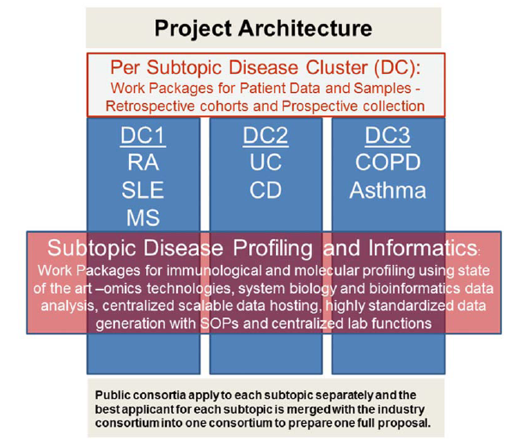

Slide 19
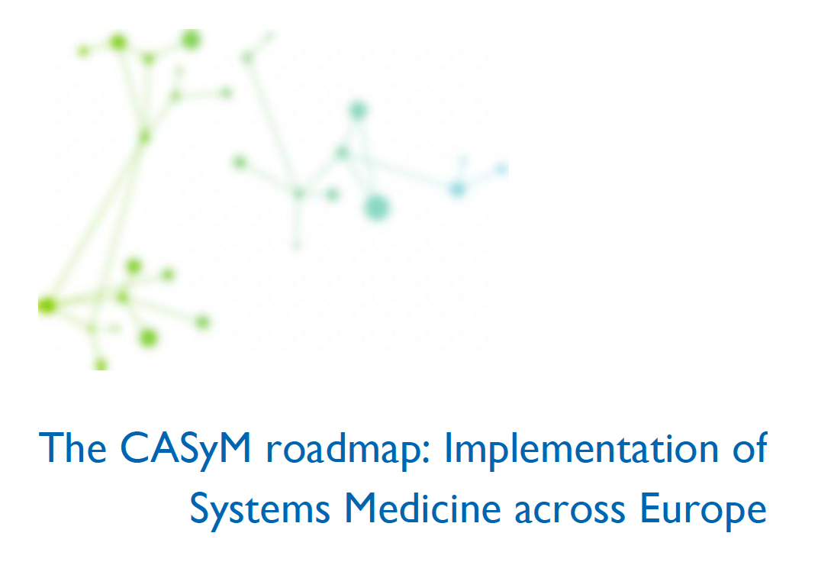
Systems Medicine: pillars
multidimensional data
hypothesis free research
machine learning
artificial intelligence
Available at: https://www.casym.eu/lw_resource/datapool/_items/item_328/roadmap_1.0.pdf

Slide 20
Key questions in severe asthma pharmacotherapy
How safe are biologic drugs in the long-term?
PALUMBA and MELTEMI studies addressed safety of Mepo and Benra at 5 years
When to consider shifting of a biologic therapy?
12 months as suggested by NICE recommendations
Do biologics induce a sustainable clinical remission?
only in approximately 30% of persons at 2 years with Benra (XALOC-1 study)
Are biologics for severe asthma DMDs? no answer
How long should the biologic therapy be maintained? no answer
Is it possible to step down or suspend biological therapies? How? no answer
Which biologic drug should be used at the individual level?
predictive tests of therapeutic response to targeted therapies at the individual level are not currently available

Slide 21
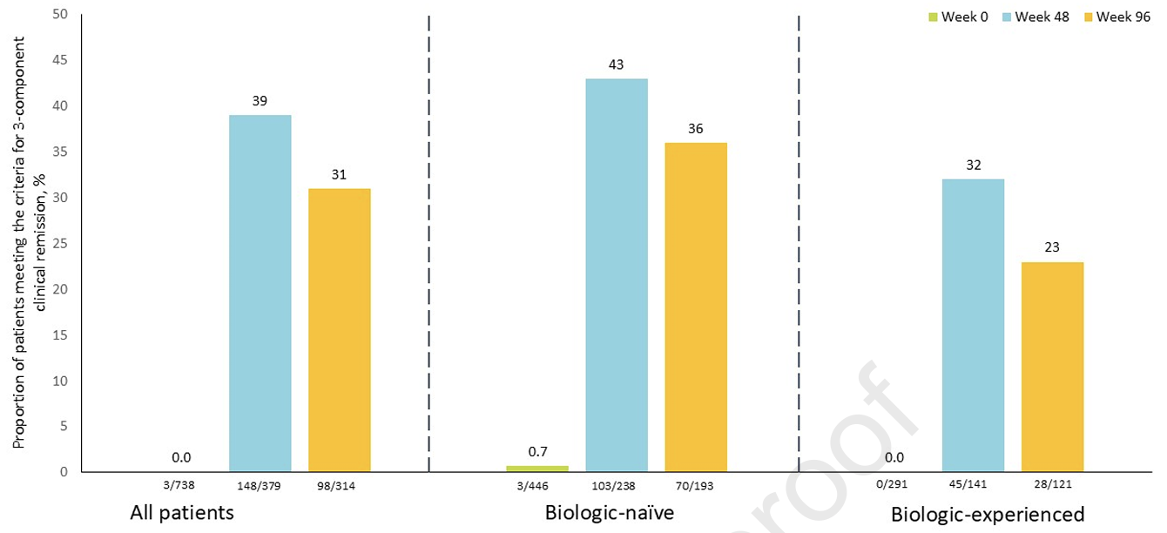
3 component severe asthma
clinical remission achieved

Slide 22
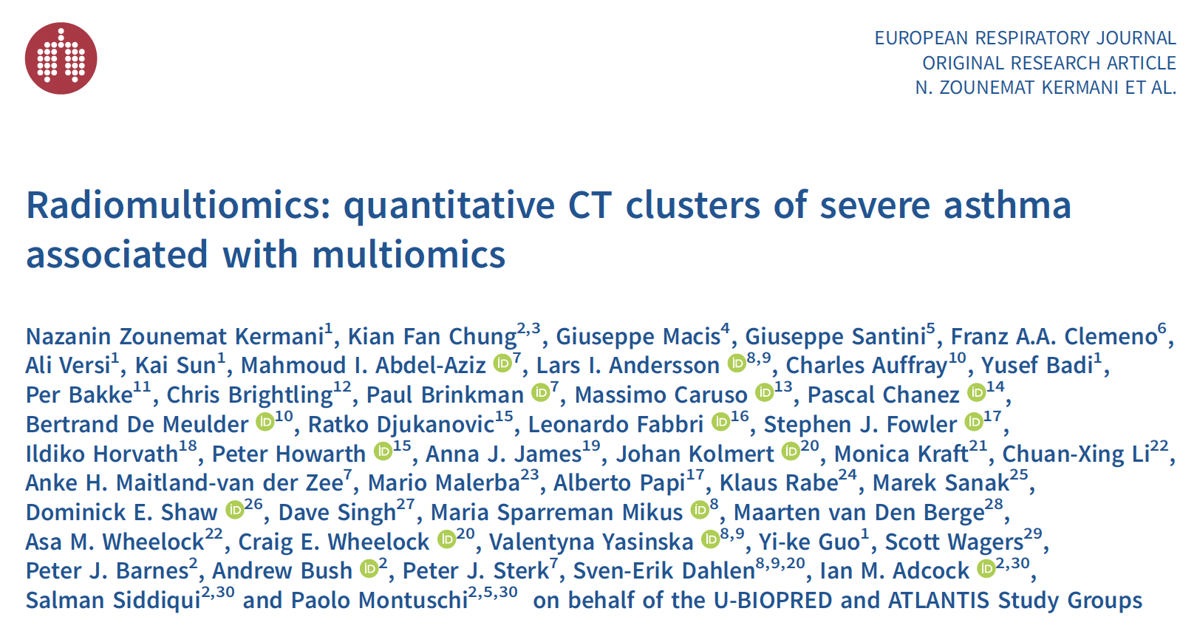

Slide 23
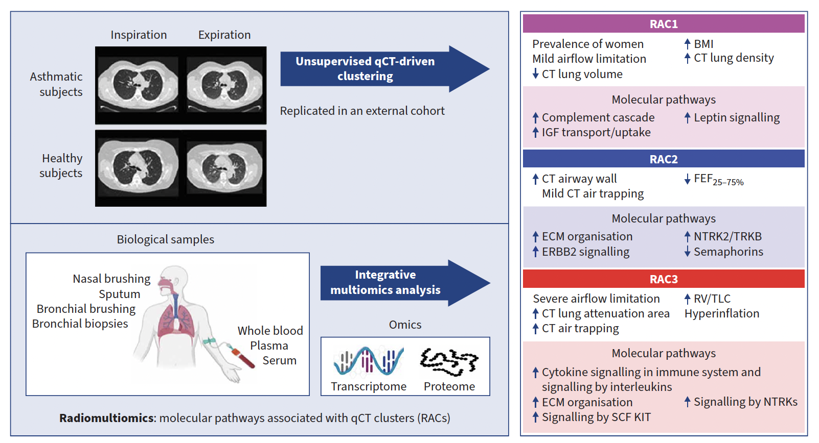

Slide 24
Pharmacological implications
To provide an asthma clinical model to assess the effects of targeted pharmacotherapies on airway remodelling and associated endotypes in persons with severe asthma
To improve the design and probability of success of clinical studies by selecting groups of severe asthma participants sharing similar airway structure and pathway expression characteristics
This might foster more personalised pharmacotherapeutic strategies

Slide 25
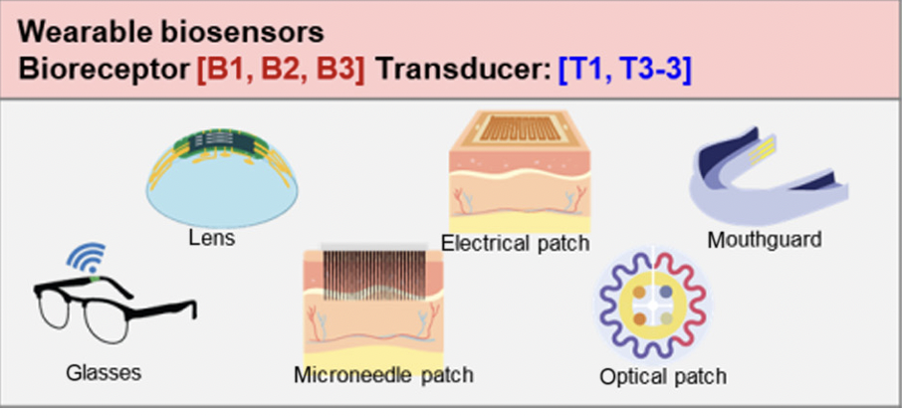
A platform for clinical decision-making support
digital twins
telemedicine
in-built clinical/omics
datasets
AI tools

Slide 26
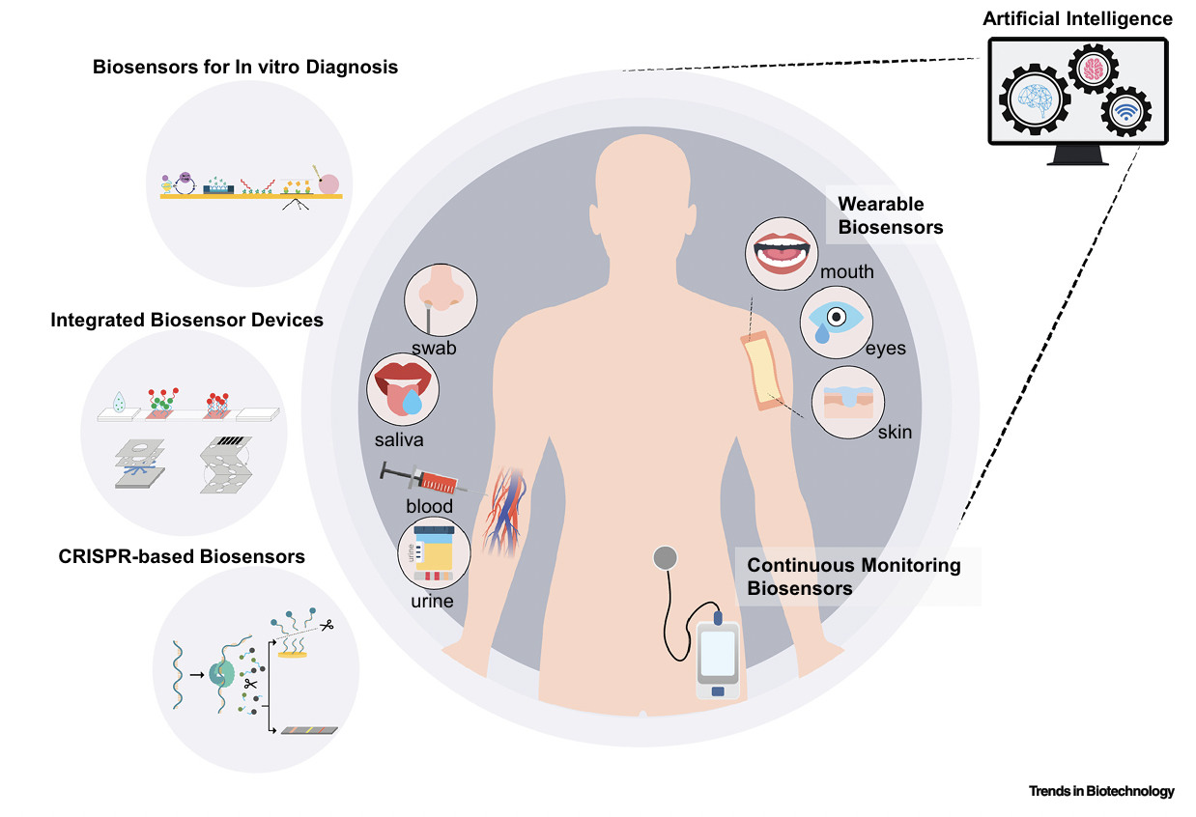
Chemometrics to predict individual pharmacotherapeutic response

Slide 27
R & I flowchart
discovery
PoC
evidence base
KT/TT
validation
identifying molecular phenotypes and endotypes by untargeted research
replication/validation of phenotypes/endotypes in external datasets
testing the effects of new or existing drugs on endotypes enriched in phenotypes of individuals with clinically similar disease
large prospective controlled randomised clinical trials
development of standardised easy-to-use analysers and predictive AI-based models

Slide 29
Benralizumab, Mepolizumab
Dupilumab
Tezepelumab
https://www.nice.org.uk/

