Slide 1


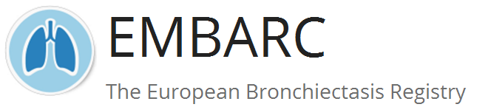



Malattia polmonare da Mycobacterium avium refrattaria e con limitate opzioni terapeutiche
Mattia Nigro, MD
PhD Student - Humanitas University, Milan
Respiratory Unit - IRCCS Humanitas Research Hospital, Milan
mattia.nigro@humanitas.it
@MattiaNigro23

Slide 2
Disclosures
I have no personal or financial conflicts of interest to declare

Slide 3
Growing Interest in NTM-Pulmonary Diseases
PUBMED (1990-2022): NON-TUBERCULOUS MYCOBACTERIA & PULMONARY DISEASE

Slide 4
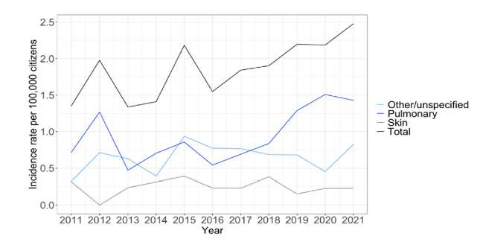
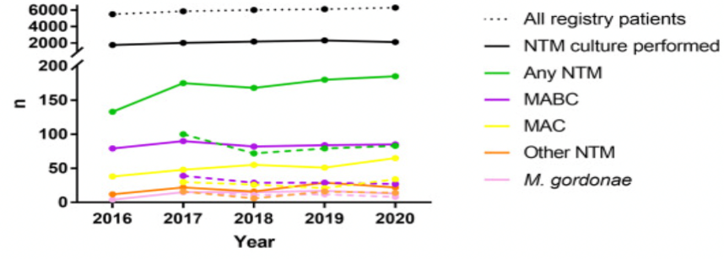
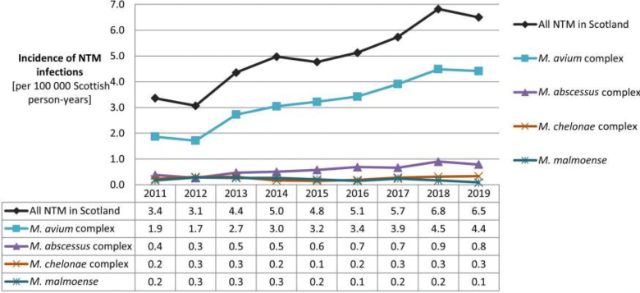
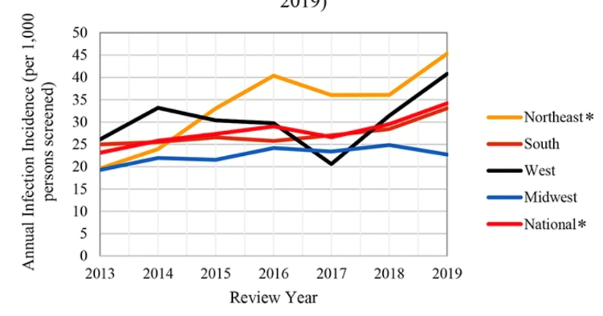


Trends in NTM-Pulmonary Disease
ALL ISOLATES (51% PULM.); DENMARK 2011-2021
CYSTIC FIBROSIS; GERMANY 2016-2020
DAHL VN INFECT DIS (LOND). 2023 JUN;55(6):439-443. DOI: 10.1080/23744235.2023.2194411.
STEINDOR M INT J INFECT DIS 2023; DOI: 10.1016/j.ijid.2023.01.032
ALL ISOLATES (81% PULM.); SCOTLAND 2011-2019
CYSTIC FIBROSIS; USA 2010-2019
JARCHOW-MAC DONALD A OPEN FORUM INFECT DIS . 2022 DOI: 10.1093/OFID/OFAC665
MARSHALL JE BMC INFECT DIS 2023; DOI: 10.1186/s12879-023-08468-6

Slide 5
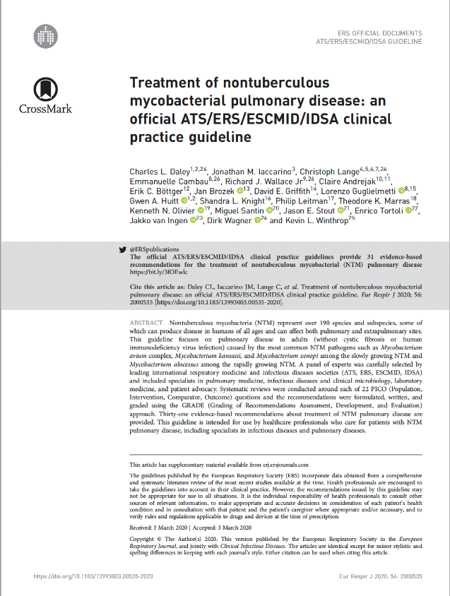

ATS/ERS/ESCMID/IDSA Guideline
M. avium complex
M. kansasii
M. xenopi
M. abscessus
DALEY C ET AL. ERJ 2020;56:2000535

Slide 6
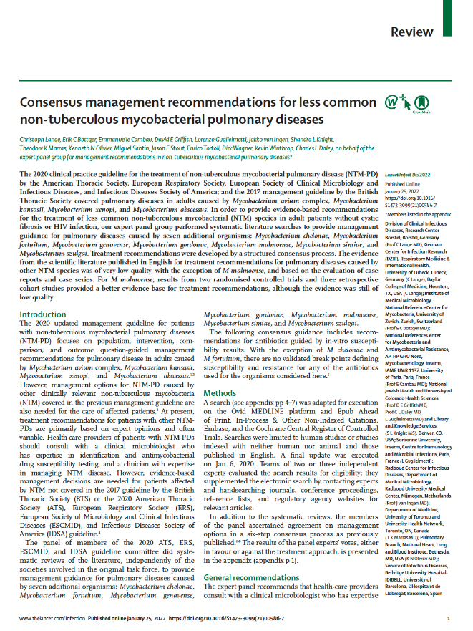

Guidelines on Less Common NTM-PD
M. chelonae
M. fortuitum
M, genavense
M. gordonae
M. malmoaense
M. simiae
M. szulgai
LANGE C ET AL. LANCET INFECT DIS 2022; S1473-3099(21)00586-7

Slide 7
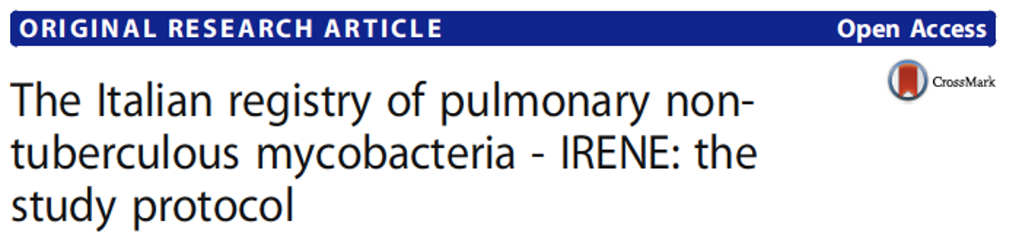
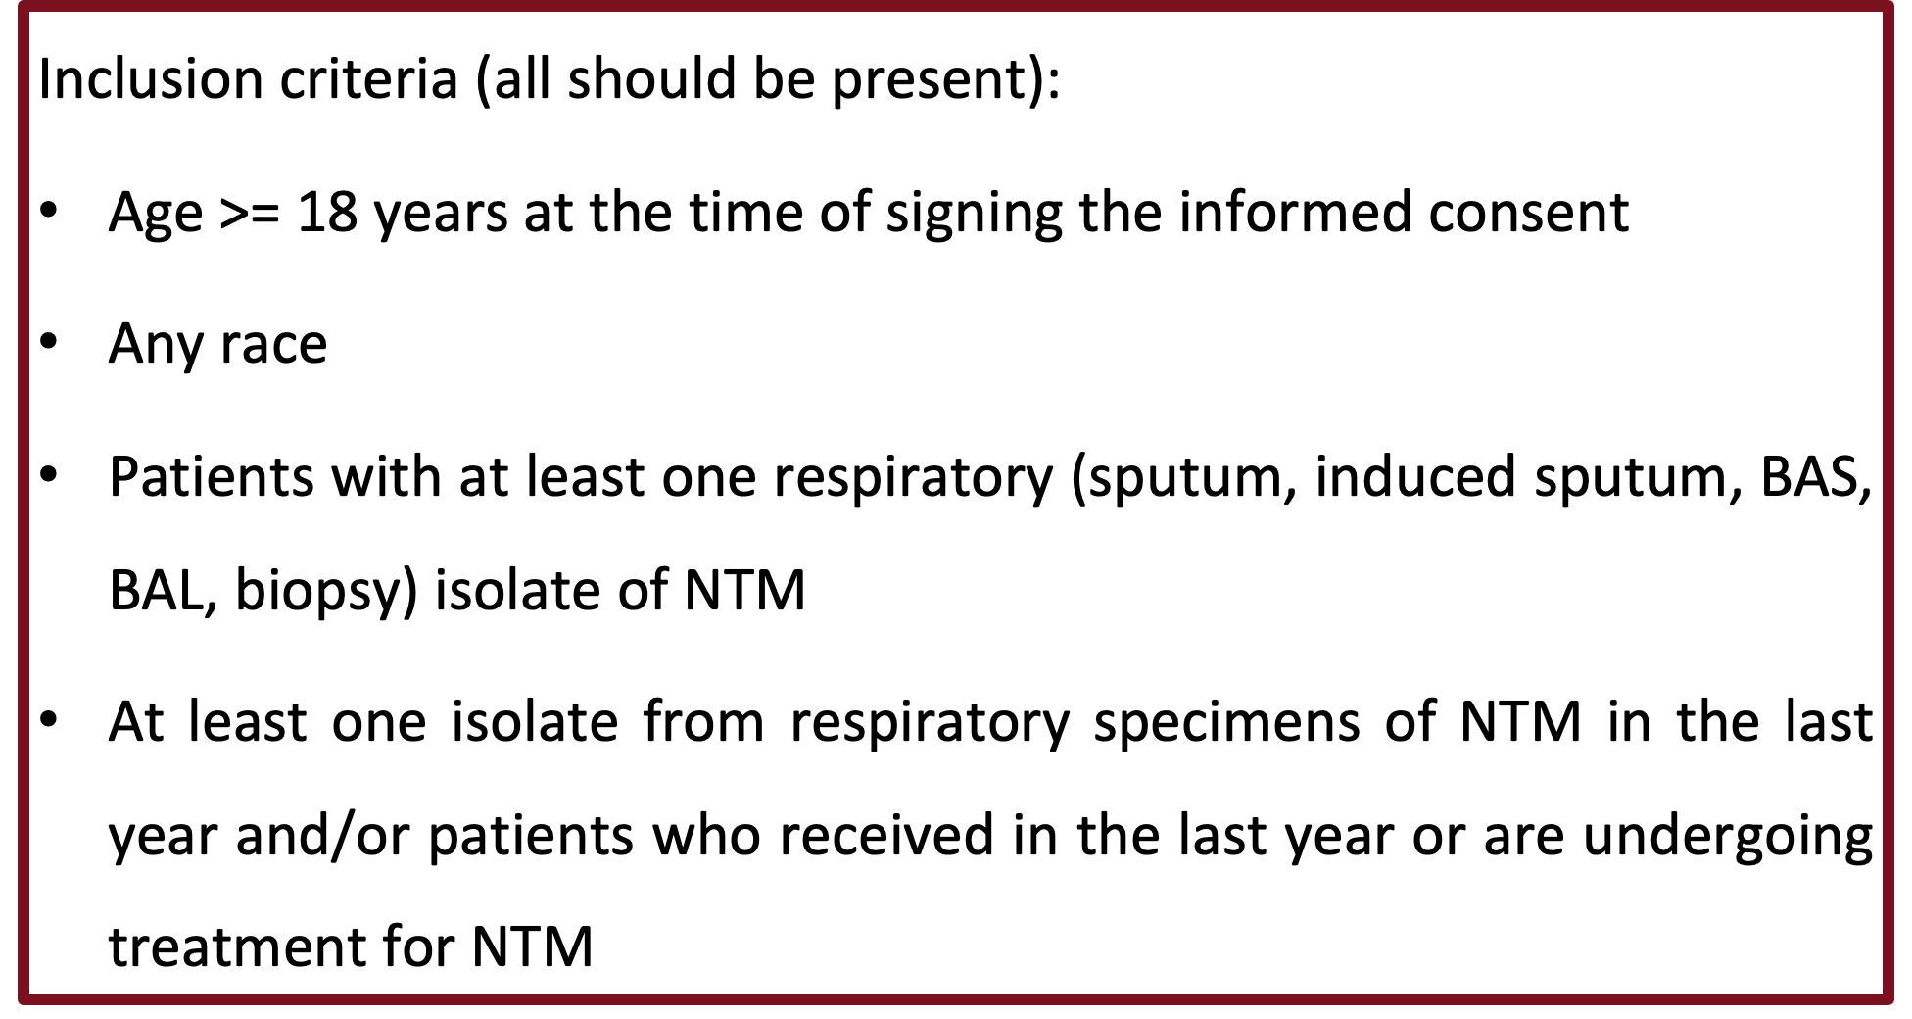

The Italian landscape – The IRENE registry
1,288 pazienti
*
Other NTM = 25.8%
MAC = 72.9%
Periodo: 2017-2023
Centri: 79
*MAC+Other NTM= 17 (1.3%)
irene@policlinico.mi.it
@registro_irene
NCT03339063 www.registroirene.it

Slide 8

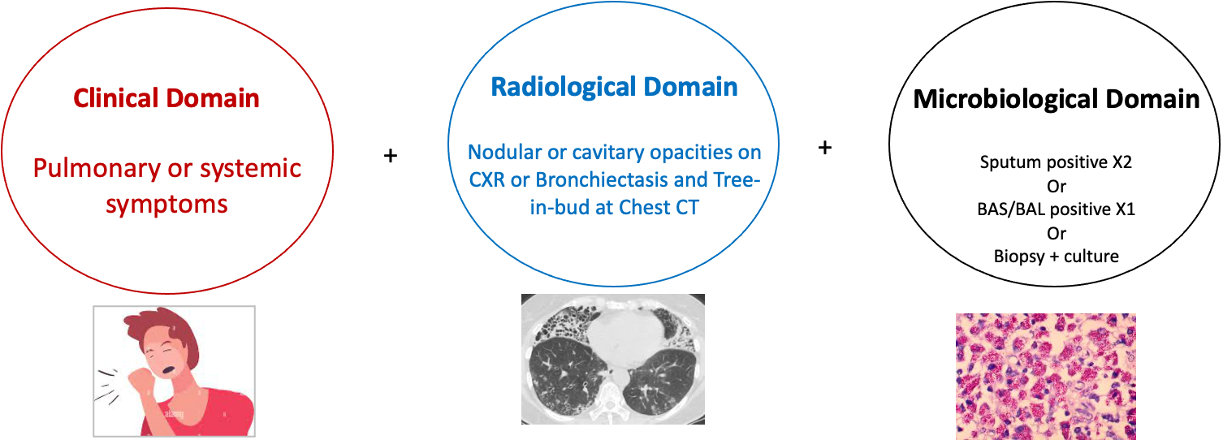
Diagnosis of NTM-PD
Clinical domain
Radiological domain
Microbiological domain
Pulmonary or systemic symptoms
Nodular or cavitary opacities on CXR
Bronchiectasis and tree-in-bud at Chest CT scan
Sputum positive (at least 2 samples)
BAL/BAS positive
Biopsy/culture positive
Treatment decision should be individualized
Daley CL. Clinical Infectious Diseases 2020; 71(4):e1-e36

Slide 9
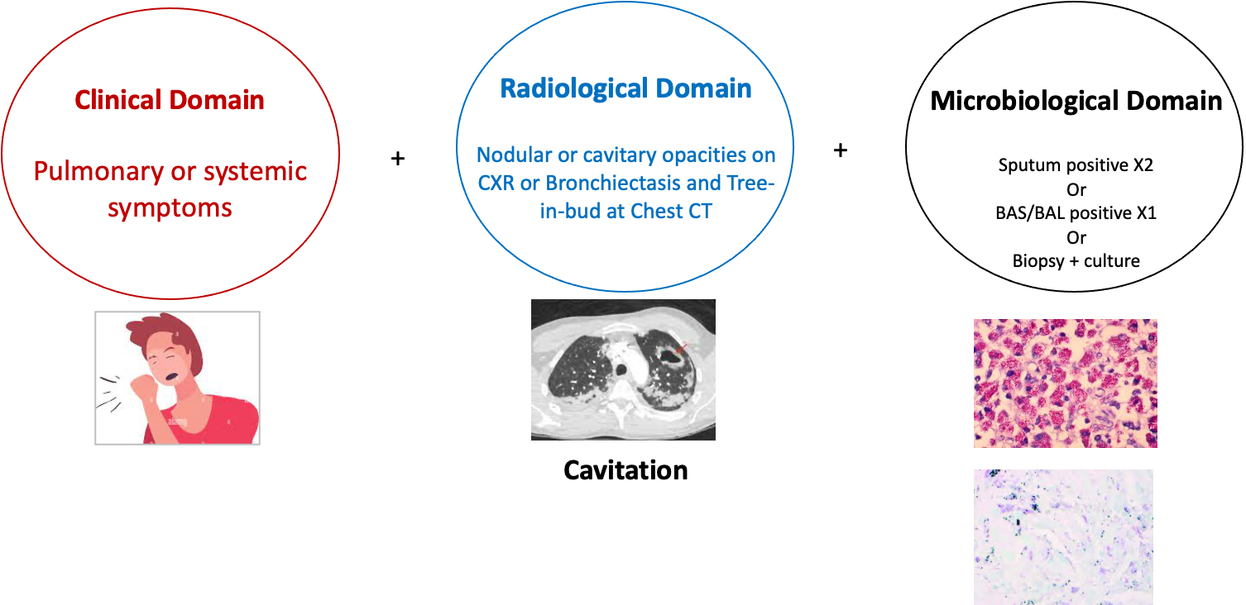
Watchful waiting vs Treatment
Treatment > Watchful waiting
Treatment >>> Watchful waiting
Daley CL. Clinical Infectious Diseases 2020; 71(4):e1-e36

Slide 10
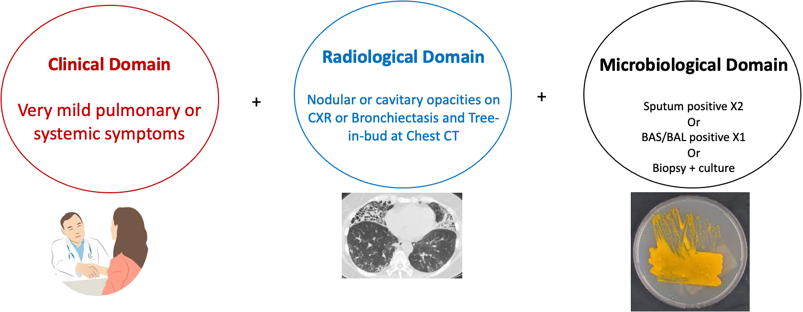
Watchful waiting vs Treatment
Watchful waiting > Treatment
Pathogenicity of the organism – pro treatment
Patient’s symptoms (severe fatigue – pro treatment)
Factors associated with poor prognosis (cavitation, low BMI, low albumin, Elevated inflammatory biomarkers) – pro treatment
Underlying immunosuppression – pro treatment
Risks and benefits of therapy
Potentials for recurrence / reinfection
Patient’s priorities, wish and ability to receive treatment
Goals of therapy
(Take time to discuss this with the patient)
Daley CL. Clinical Infectious Diseases 2020; 71(4):e1-e36

Slide 11
“Watchful Waiting” is not a Passive Process,
It is doing SOMETHING!
Patients with bronchiectasis should be started on airway clearance which can be transformative symptomatically.
10-15% cases have sputum AFB culture conversion (Moon et al. Resp Med, 2019; Hwang et al. ERJ, 2017)
Airway clearance is likely a necessary element for any successful antibiotic therapy of nodular/bronchiectatic NTM/MAC lung disease
Management of other detected microrganisms might be appropriate to explore the quote of disease activity related to NTM.
If not started on antimycobacterial therapy, patients are engaged with a physician who will manage bronchiectasis and evaluate status of NTM/MAC INDEFINITELY.

Slide 12
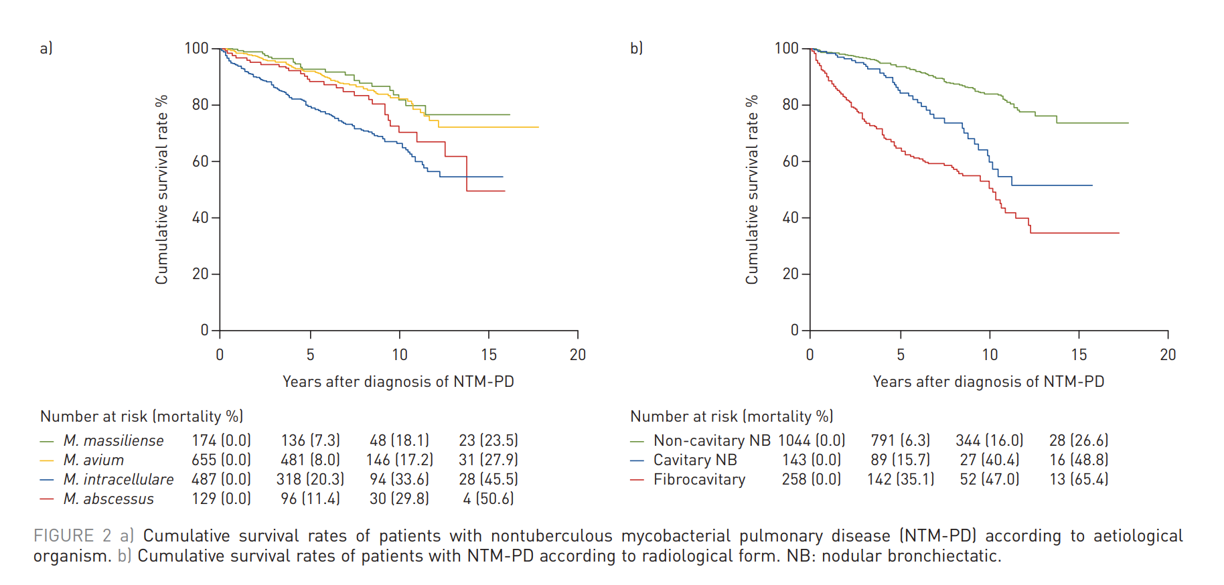
Patients with NTM-PD have high mortality rates
Large cohort study (n = 1,445). Overall mortality rates were:
12.4% at 5 years
24.0% at 10 years
36.4% at 15 years
The following factors were associated with mortality:
Old age
Male sex
Low BMI
Chronic pulmonary aspergillosis
Malignancy
Chronic heart or liver disease
Elevated ESR
Juhn BW et al. Eur Resp J 2020, 55; 1900798

Slide 13
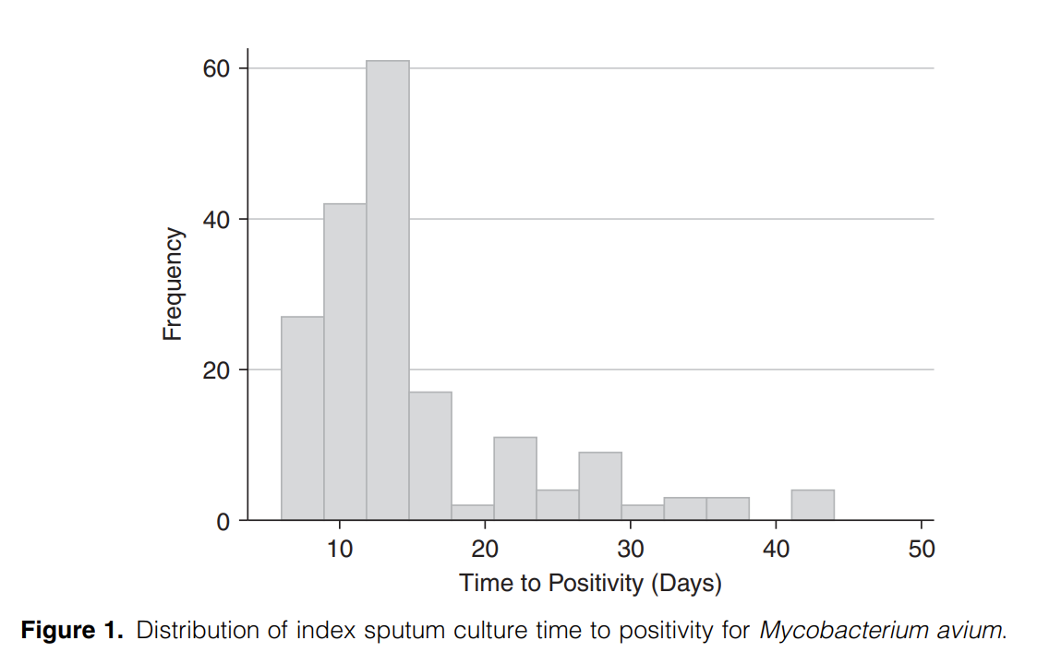
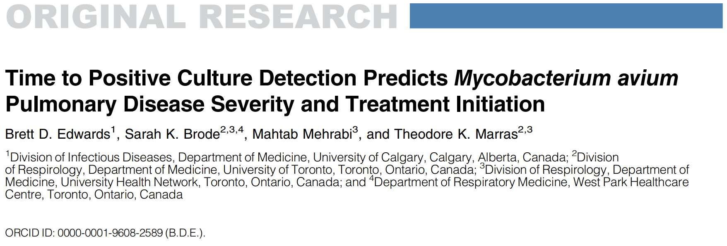
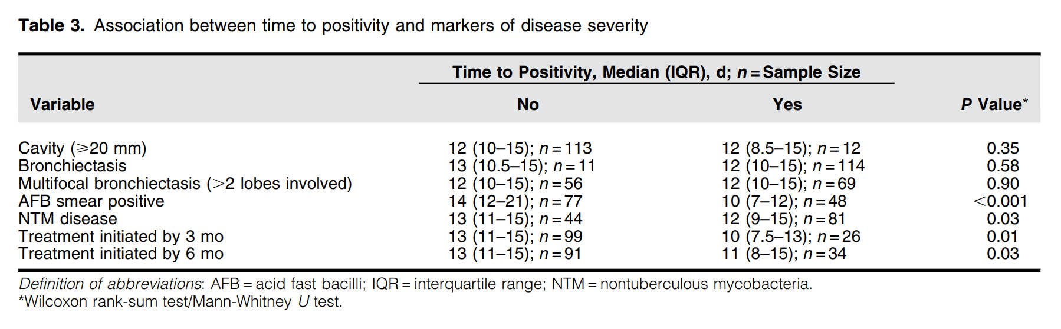
Time to Positive Culture Detection Predicts Mycobacterium avium Pulmonary Disease Severity and Treatment Initiation
Edwards BD et al. Ann Am Thorac Soc 2022, 19;925

Slide 14
Treatment is a real issue for NTM-PD patients
- The EMBARC-ELF patient survey -
‘Which aspects concerning management of NTM-PD posed a challenge for you?’
Shteinberg M, etal. ERJ Open Res 2021;7:00807-2020.
Weighted average rating scale
Notes:
Patient grading of nontuberculous mycobacteria (NTM) pulmonary disease (NTM-PD) and management impact and needs. a) “Which of
the following issues were most challenging?” (n=135). Weighted average rating scale (1–4) where 1 is “not an issue” and 4 is “very difficult”.
b) “Rate how your daily activities are limited by NTM-PD” (n=134). Weighted average rating scale (1–4) where 1 is “not limited at all” and 4 is “very
much limited”. c) “Which aspects concerning management of NTM-PD posed a challenge for you?” (n=132). Weighted rating scale (1–4) where 1 is
“not difficult” and 4 is “very difficult”. d) “What issues need more attention to improve the management of NTM-PD?” (n=135). Weighted average
rating scale (1–4) where 1 is “unimportant” and 4 is “very important”.

Slide 15
How do we counsel a patient at the beginning of the treatment journey?
Take time to discuss treatment burden with the patient (over at least 2 visits)
Discuss the available data on possible adverse events with the patient
Inform the patient about the multidisciplinary team who will take care of her/him during this long journey
Present her/him a clear program (of visits, imaging, blood tests, etc.) and discuss possible exit strategies
Give her/him contacts of local patients’ association
Give her/him time to discuss with her/his family and caregiver

Slide 16
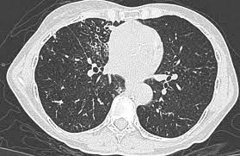
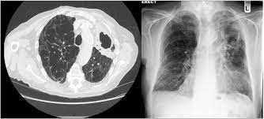
Treatment of MAC-PD
Treatment should be performed for at least 12 months after culture conversion
Daley CL. Clinical Infectious Diseases 2020; 71(4):e1-e36

Slide 17
What happens once treatment is started
Host
Pharmacokinetics
Immune Defenses
Toxicity
Virulence
Outcome
Drugs
Pharmacodynamics
Mycobacteria
Resistance

Slide 18
What happens once treatment is started
Host
Pharmacokinetics
Immune Defenses
Toxicity
Virulence
Outcome
Drugs
Pharmacodynamics
Mycobacteria
Resistance

Slide 19
Side-effects of oral and IV GBT for MAC-PD
Azithromycin | Clarithromycin
Gastrointestinal symptoms (primarily diarrhoea)¹ Reversible hearing impairment¹ | GI symptoms (metallic taste, nausea, and vomiting)¹ Inhibition of hepatic metabolism of rifabutin and enhancement of rifabutin toxicity¹
Hepatitis¹ Risk of QT prolongation and infrequent arrhythmias^{3,4} → Fatalities reported³
Rifampin | Rifabutin
Hepatotoxicity¹ Rarely, severe immunologic reactions (acute renal failure, thrombocytopenia)¹ | Uveitis¹ Polyarthralgia syndrome¹ Fever, chills¹ Leukopenia, granulocytopenia¹ Polymyalgia¹
Orange discoloration of secretions and urine¹ GI disturbances (nausea, vomiting)¹ Hypersensitivity (fever, rash)¹ Hepatitis¹ High drug interaction potential due to CYP450 induction¹ ‘Flu-like’ symptoms, thrombocytopenia, renal failure¹
Ethambutol
Optic neuritis^{1,4} Loss of red-green colour discrimination⁴ Loss of visual acuity Usually reversible but irreversible blindness has been reported⁵ → regular ophthalmological examinations necessary^{1,4}
IV Aminoglycosides
Exposure-dependent vestibular or auditory toxicity¹ Dizziness, vertigo, ataxia, tinnitus, hearing loss¹ May be irreversible¹ Nephrotoxicity² Patients taking amikacin should be monitored for nephrotoxicity and should be referred for regular vestibular and auditory test regularly⁴
GBT, guideline-based therapy; GI, gastrointestinal; IV, intravenous; MAC-PD, Mycobacterium avium complex pulmonary disease.
1. Griffith ED, et al. Am J Respir Crit Care Med 2007; 175:367–416; 2. Smith CR, et al. Johns Hopkins Med J 1978;142:85–90; 3. Albert RK, et al. Am J Respir Crit Care Med 2014;189:1173–80; 4. Haworth CS, et al. Thorax 2017;72:ii1-ii64; Kumar A, et al. J Clin Neuroophthalmol 1993;13:15–17.

Slide 20
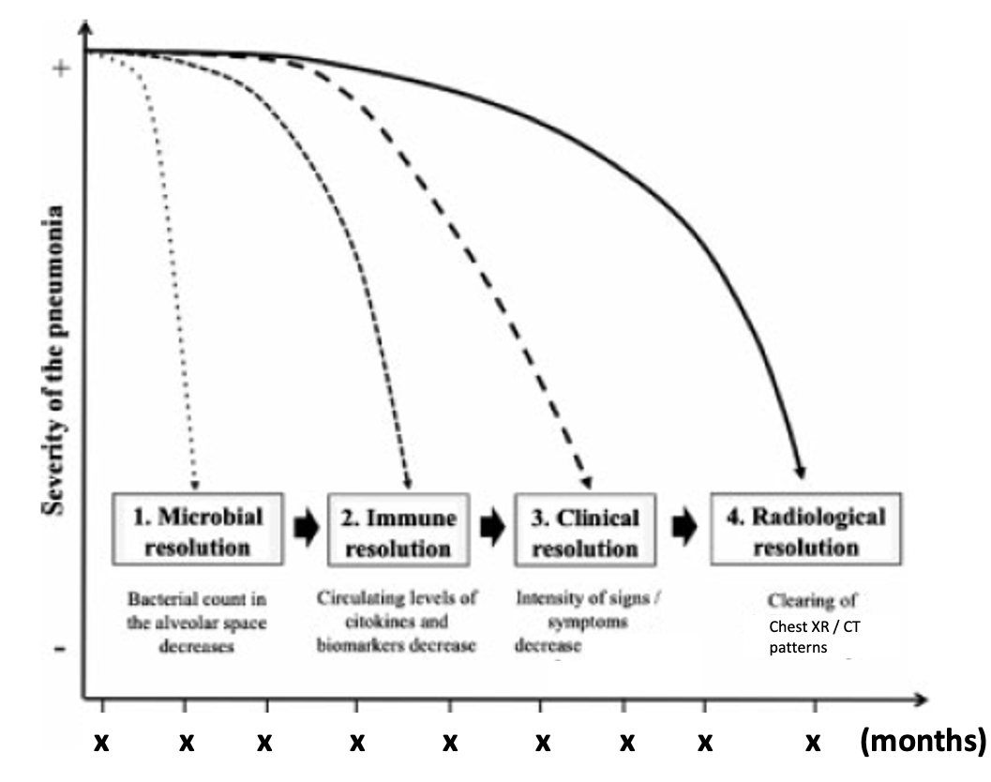
What happens after treatment initiation?
Sputum culture every 1-2 months
If unable to have spontaneous sputum, induced sputum
Bronchoscopy in exceptional circumstances
Daley CL. Clinical Infectious Diseases 2020; 71(4):e1-e36

Slide 21
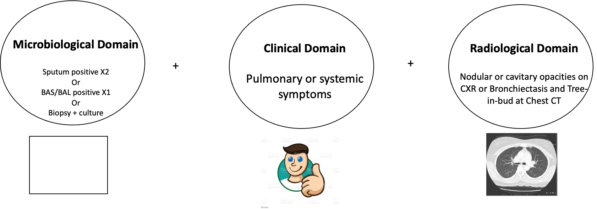
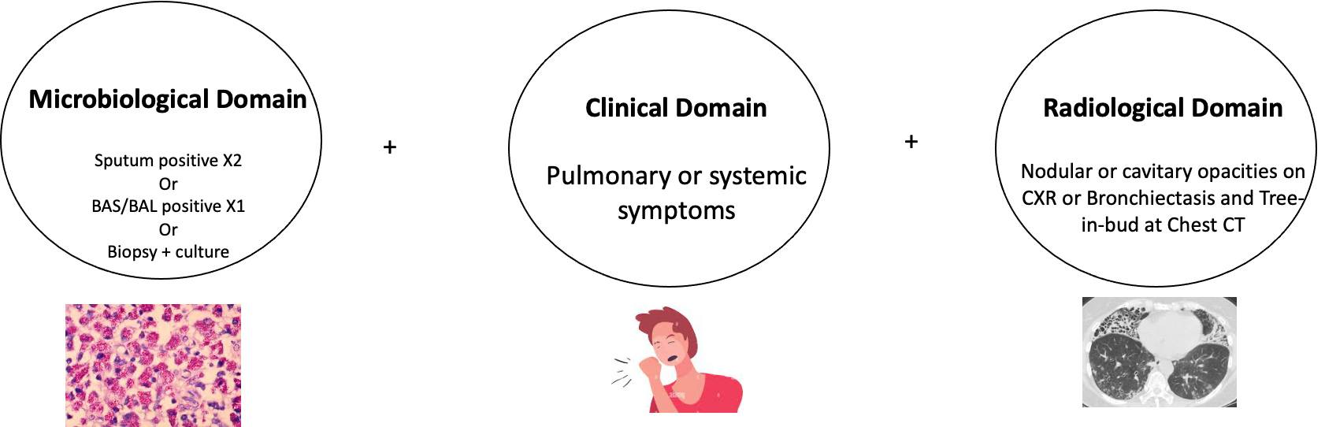
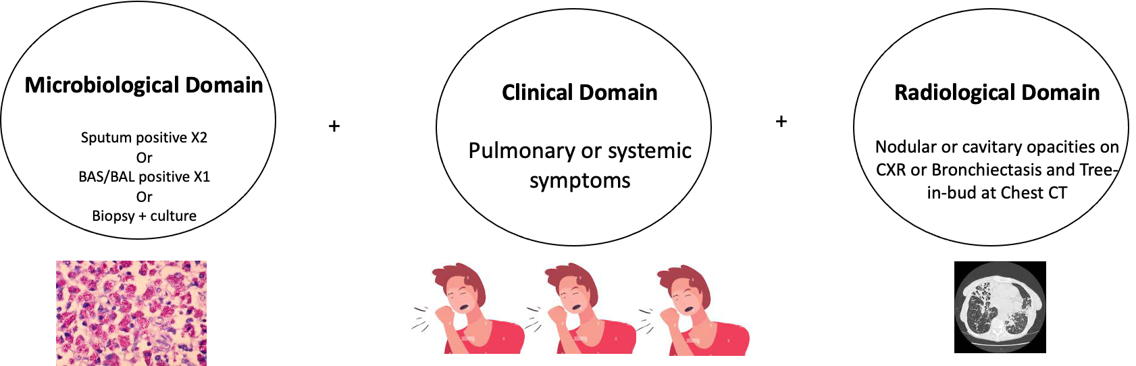
How we currently follow up a NTM-PD patient under treatment
NTM-PD
+ Severity of the disease -
Months
Notes:
Increased lines size and enlarged figures

Slide 22
Refractory MAC-PD
Defined as remaining sputum culture positive after
6 months of guideline-based therapy
Daley CL. Clinical Infectious Diseases 2020; 71(4):e1-e36

Slide 23
The CONVERT study
11
6
34
9
53
10
61
10
65
10
41
3
Griffith D.E. Am J Respir Crit Care Med 2018

Slide 24
The CONVERT study
Treatment-emergent adverse events (TEAEs) occurred at a comparable rate in both treatment arms
Adverse reaction, n (%) | ALIS + oral GBT (n=223) |  | Oral GBT alone (n=112)
Any TEAE | 219 (98) |  | 102 (91)
Any serious TEAE | 45 (20) |  | 20 (18)
TEAE leading to discontinuation of ALIS | 39 (18) |  | –
TEAE leading to discontinuation of oral GBT | 9 (4) |  | 3 (3)
Rate of adverse events was consistent up the end of the study at Month 28²
ALIS, amikacin liposomal inhalation solution; GBT, guideline-based therapy.
1. Griffith DE, et al. Am J Respir Crit Care Med 2018;198:1559–69; 2. Griffith DE, et al. Chest 2021;160:831–42.

Slide 25


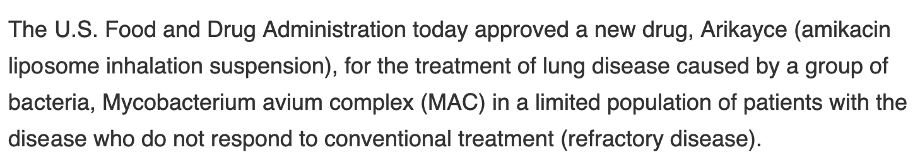


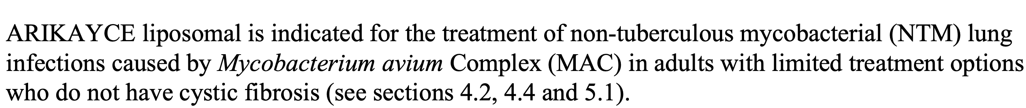

Slide 26
A MAC-PD Patient with Limited Treatment Options
MAC-PaLTO Consensus Conference
Methodology – Delphi Consensus
A board of independent European experts and thought leaders in pneumology convened in Milan to discuss the issue and elucidate the lack of a clear indication of what “limited treatment options” actually means.
Aliberti S. ERJ Open Research 2024

Slide 27
A MAC-PD Patient with Limited Treatment Options
Aliberti S. ERJ Open Research 2024

Slide 28
A MAC-PD Patient with Limited Treatment Options
Aliberti S. ERJ Open Research 2024

Slide 29
Conclusions
Treatment of NTM-PD is long and tough for patients (possibly harder than the disease in some cases)
A microbiological evaluation at 6 months is necessary to understand the trajectory of MAC-PD and to define refractory disease
To be able to copes with AEs and complete treatment patients need strong support family members or caregivers, physicians, and patients’ associations
The availability of referral centers and support from a multidisciplinary team following clear/shared programs are important

Slide 30

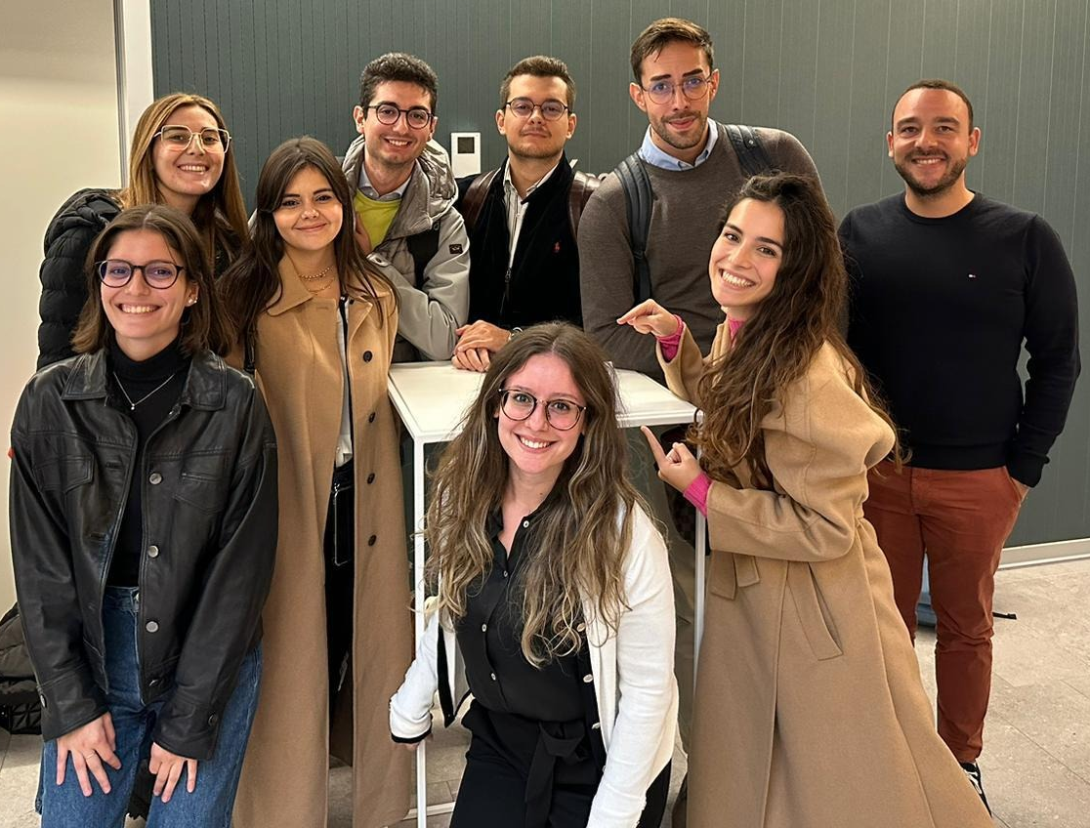
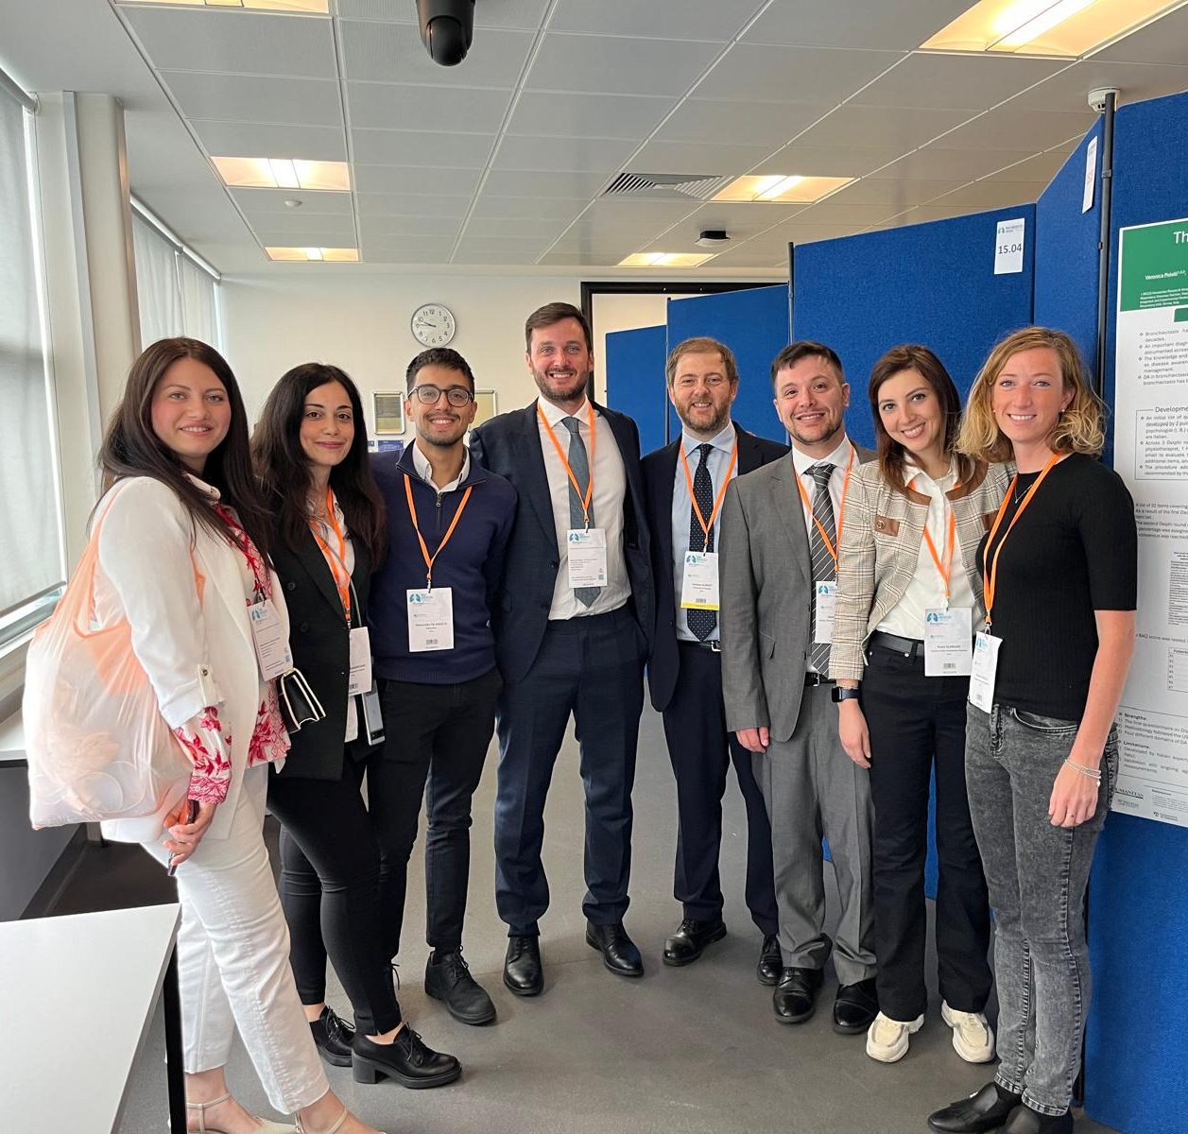

Acknowledgements
Respiratory Unit - Humanitas Humanitas University

