Slide 1
Cambio di programma nel trattamento dei pazienti con BPCO:
la linearità della triplice terapia inalatoria
Dejan Radovanovic, MD, PhD
Section of Respiratory Diseases, L. Sacco University Hospital
Department of Biomedical and Clinical Sciences
Università degli Studi di Milano
dejan.radovanovic@unimi.it
UNIVERSITÀ
DEGLI STUDI
DI MILANO

Slide 2
Il sottoscritto Dejan Radovanovic
ai sensi dell’art. 3.3 sul Conflitto di Interessi, pag. 17 del Reg. Applicativo dell’Accordo Stato-Regione del 5 novembre 2009,
dichiara
che negli ultimi due anni ha avuto rapporti diretti di finanziamento con i seguenti soggetti portatori di interessi commerciali in campo sanitario:
Astra Zeneca
Berlin Chemie
Glaxo Smith Kline
Menarini
Roche
Sanofi

Slide 3
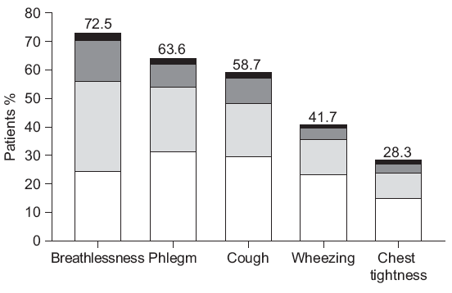
67% already on LABA/ICS
Rennard S et al. Eur Respir J 2002

Slide 4
Real world exacerbation risk in patients with COPD – Italian data
% patients
Data from Italian COPD registry
GULP Study
Santus P et al. Int J COPD 2024

Slide 5
Real world exacerbation risk in patients with COPD – Italian data
% patients
Data from Italian COPD registry
GULP Study
Santus P et al. Int J COPD 2024

Slide 6
Real world exacerbation risk in patients with COPD – Italian data
% patients
Data from Italian COPD registry
GULP Study
Santus P et al. Int J COPD 2024

Slide 7
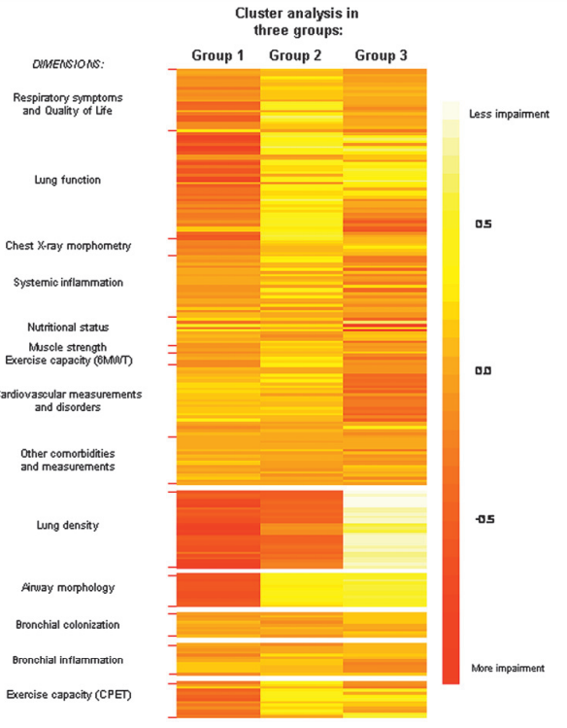
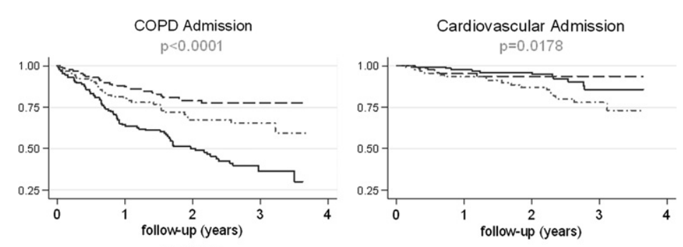
342 patients at their first severe exacerbation
and at their first COPD diagnosis
≈ 20%
≈38%
Severe obstruction, more emphysema
Moderate obstruction
Moderate obstruction, more obese, more HF
Garcia-Aymerich J et al. Thorax 2011

Slide 8
LAMA
ICS/LABA
LAMA/LABA
Bronchodilation
Bronchodilation
Anti-inflammatory
Anti-inflammatory

Slide 9
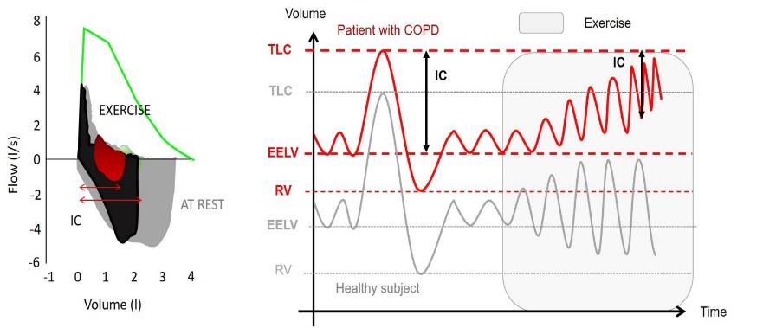
DYNAMIC HYPERINFLATION
Danzo F et al. Expert Rev Respir Med 2022

Slide 10
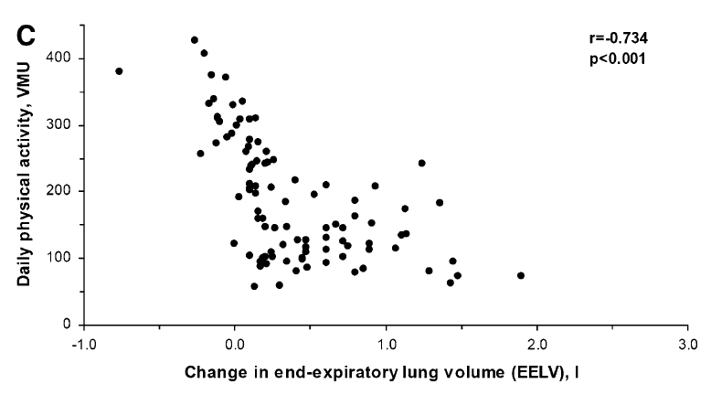
Garcia Rio F et al. Am J Respir Crit Care Med 2009

Slide 11
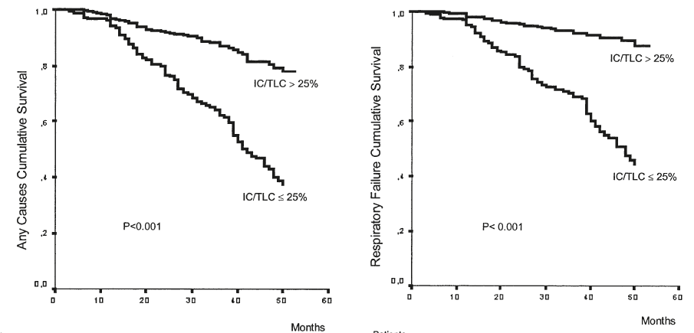
HYPERINFLATED PATIENTS DIE MORE AND SOONER
Casanova C et al. Am J Respir Crit Care Med 2005

Slide 12
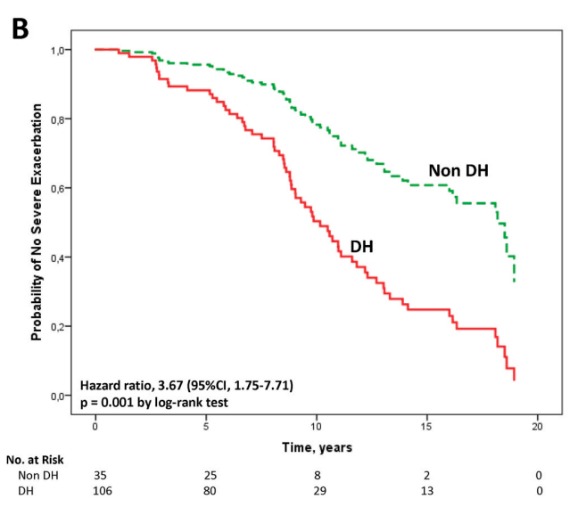
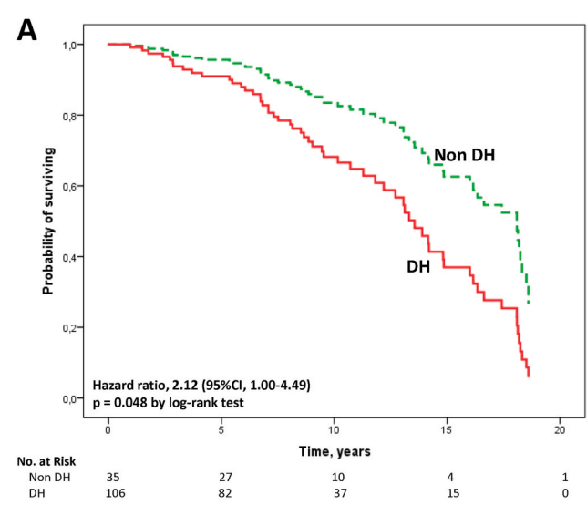
Lorenzana et al. Respir Med 2024

Slide 13
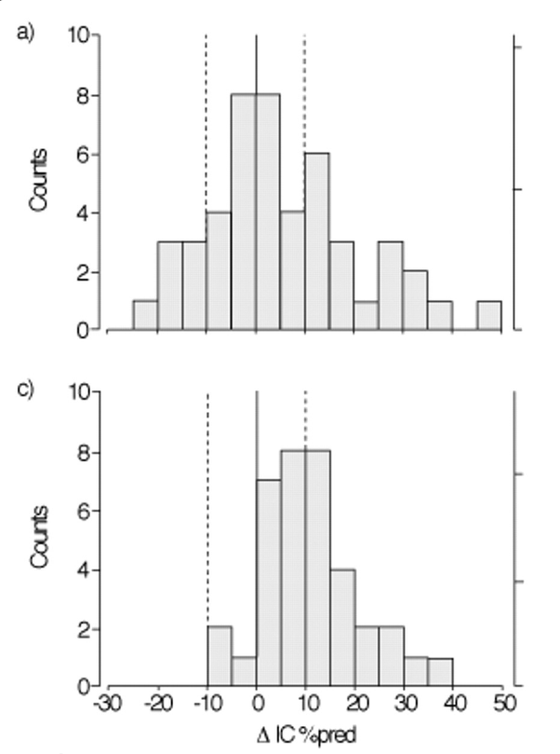
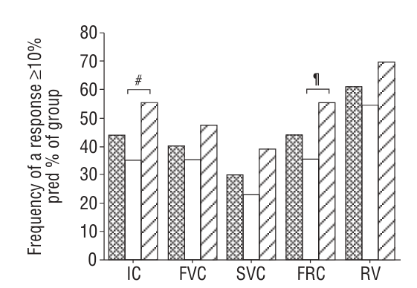
Moderate COPD
Severe COPD
Severe COPD
Moderate COPD
Tashkin DP et al. Eur Respir J 2008

Slide 14
EMAX -Early MAXimisation of bronchodilation for improving COPD stability
46
Trough IC
Trough FVC
189 ml (IC 95% 152,225)**
p<0.001
116 ml (IC 95% 80,152)**
p<0.001
79 ml (IC 95% 42,116)**
41 ml (IC 95% 4,77)*
p<0.001
p<0.001
125
107
Variazione media LS dal basale (ml)
Variazione media LS dal basale (ml)
67
46
-64
-9
UMEC/VI n = 812
UMEC n = 804
SAL n = 809
UMEC/VI n = 812
UMEC n = 804
SAL n = 809
Maltais F et al. Respir Res 2019
Notes:
Tutti e tre i trattamenti hanno indotto miglioramenti vs il basale del punteggio TDI (dispnea) e della scala per la valutazione dei sintomi respiratori (E-RS): tutti i trattamenti sono quindi risultati efficaci, Anoro più delle monoterapie

Slide 15
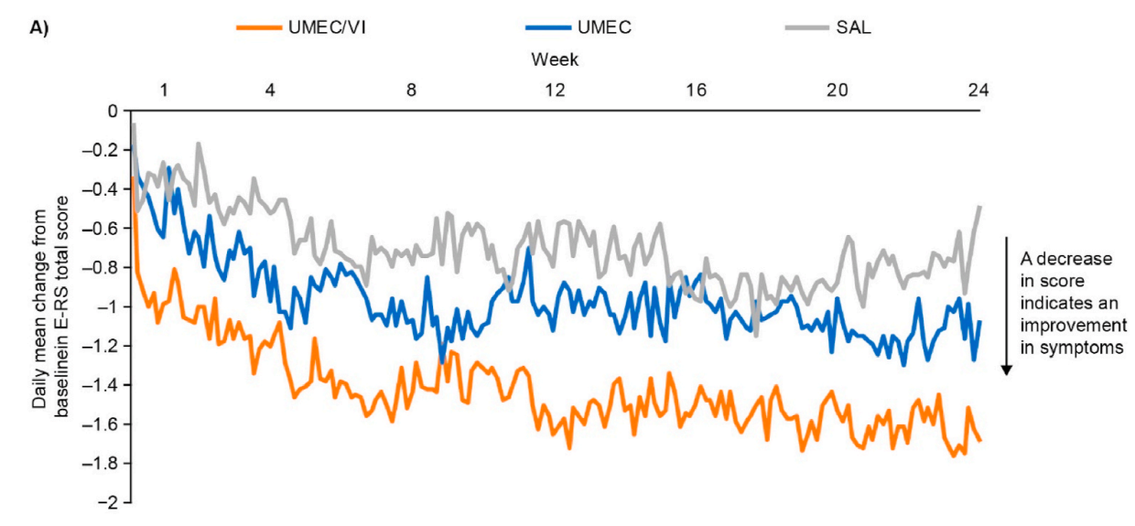
Early improvement in symptoms WITH UMEC/VI vs. monotherapy in the EMAX trial
Maltais F et al. Respir Med 2022

Slide 16
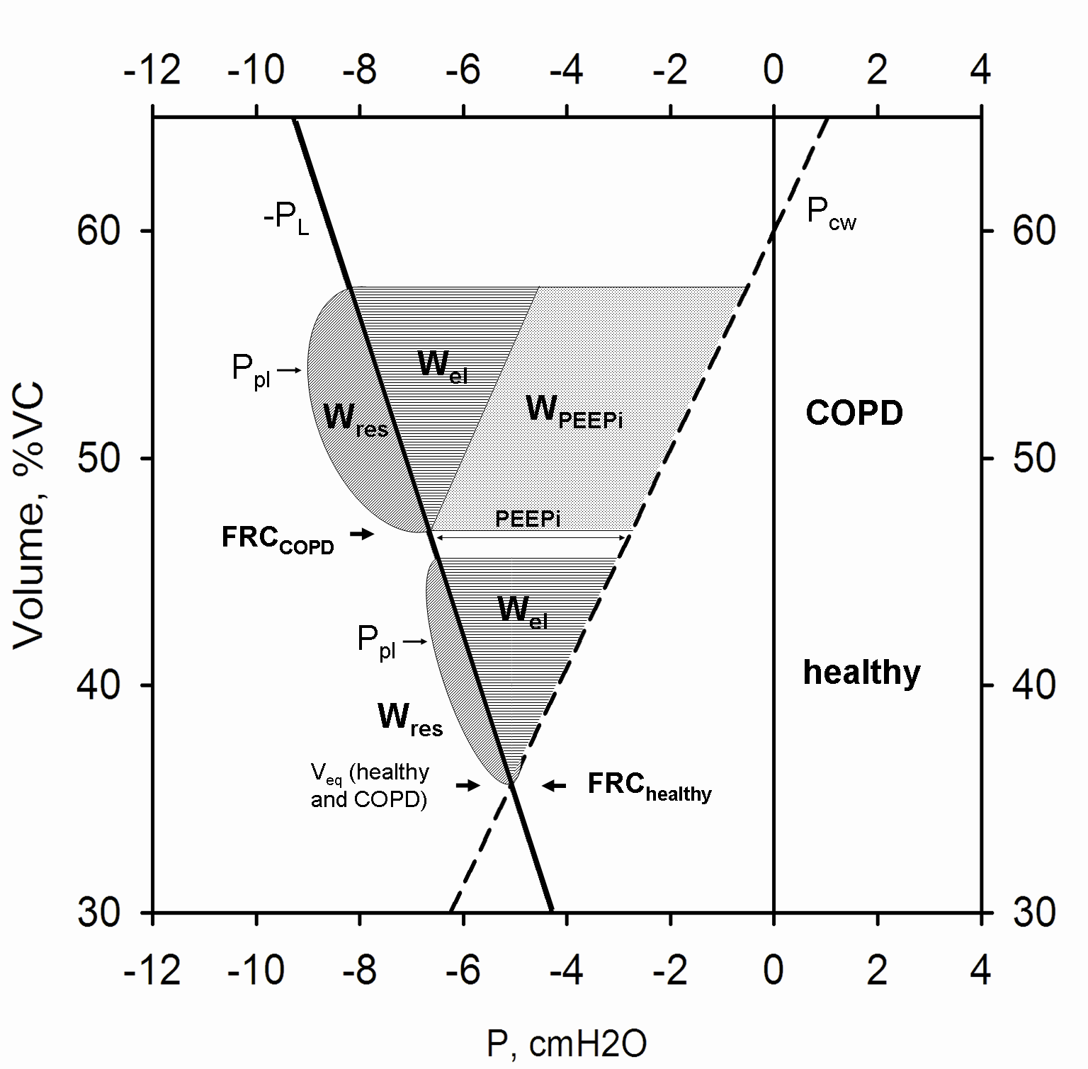
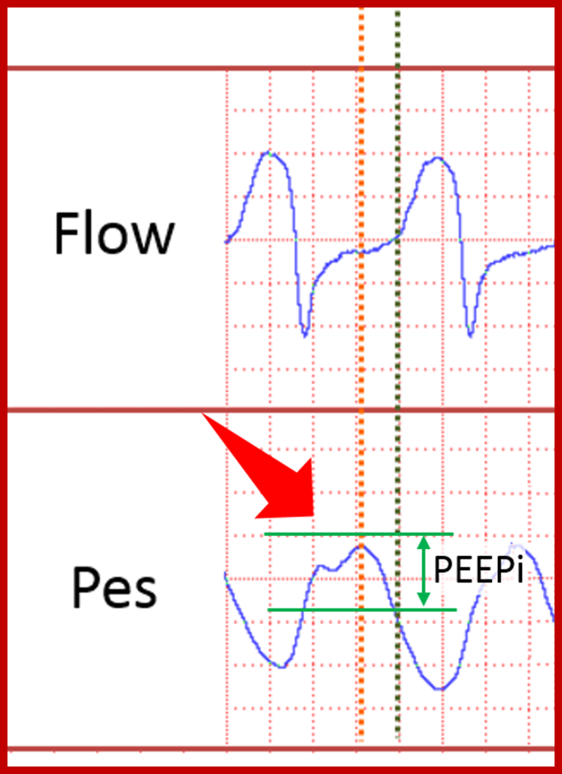
Radovanovic D et al. ERJ 2017 (Suppl 61)
Courtesy of Prof. Franco Laghi, Loyola University, Chicago

Slide 17
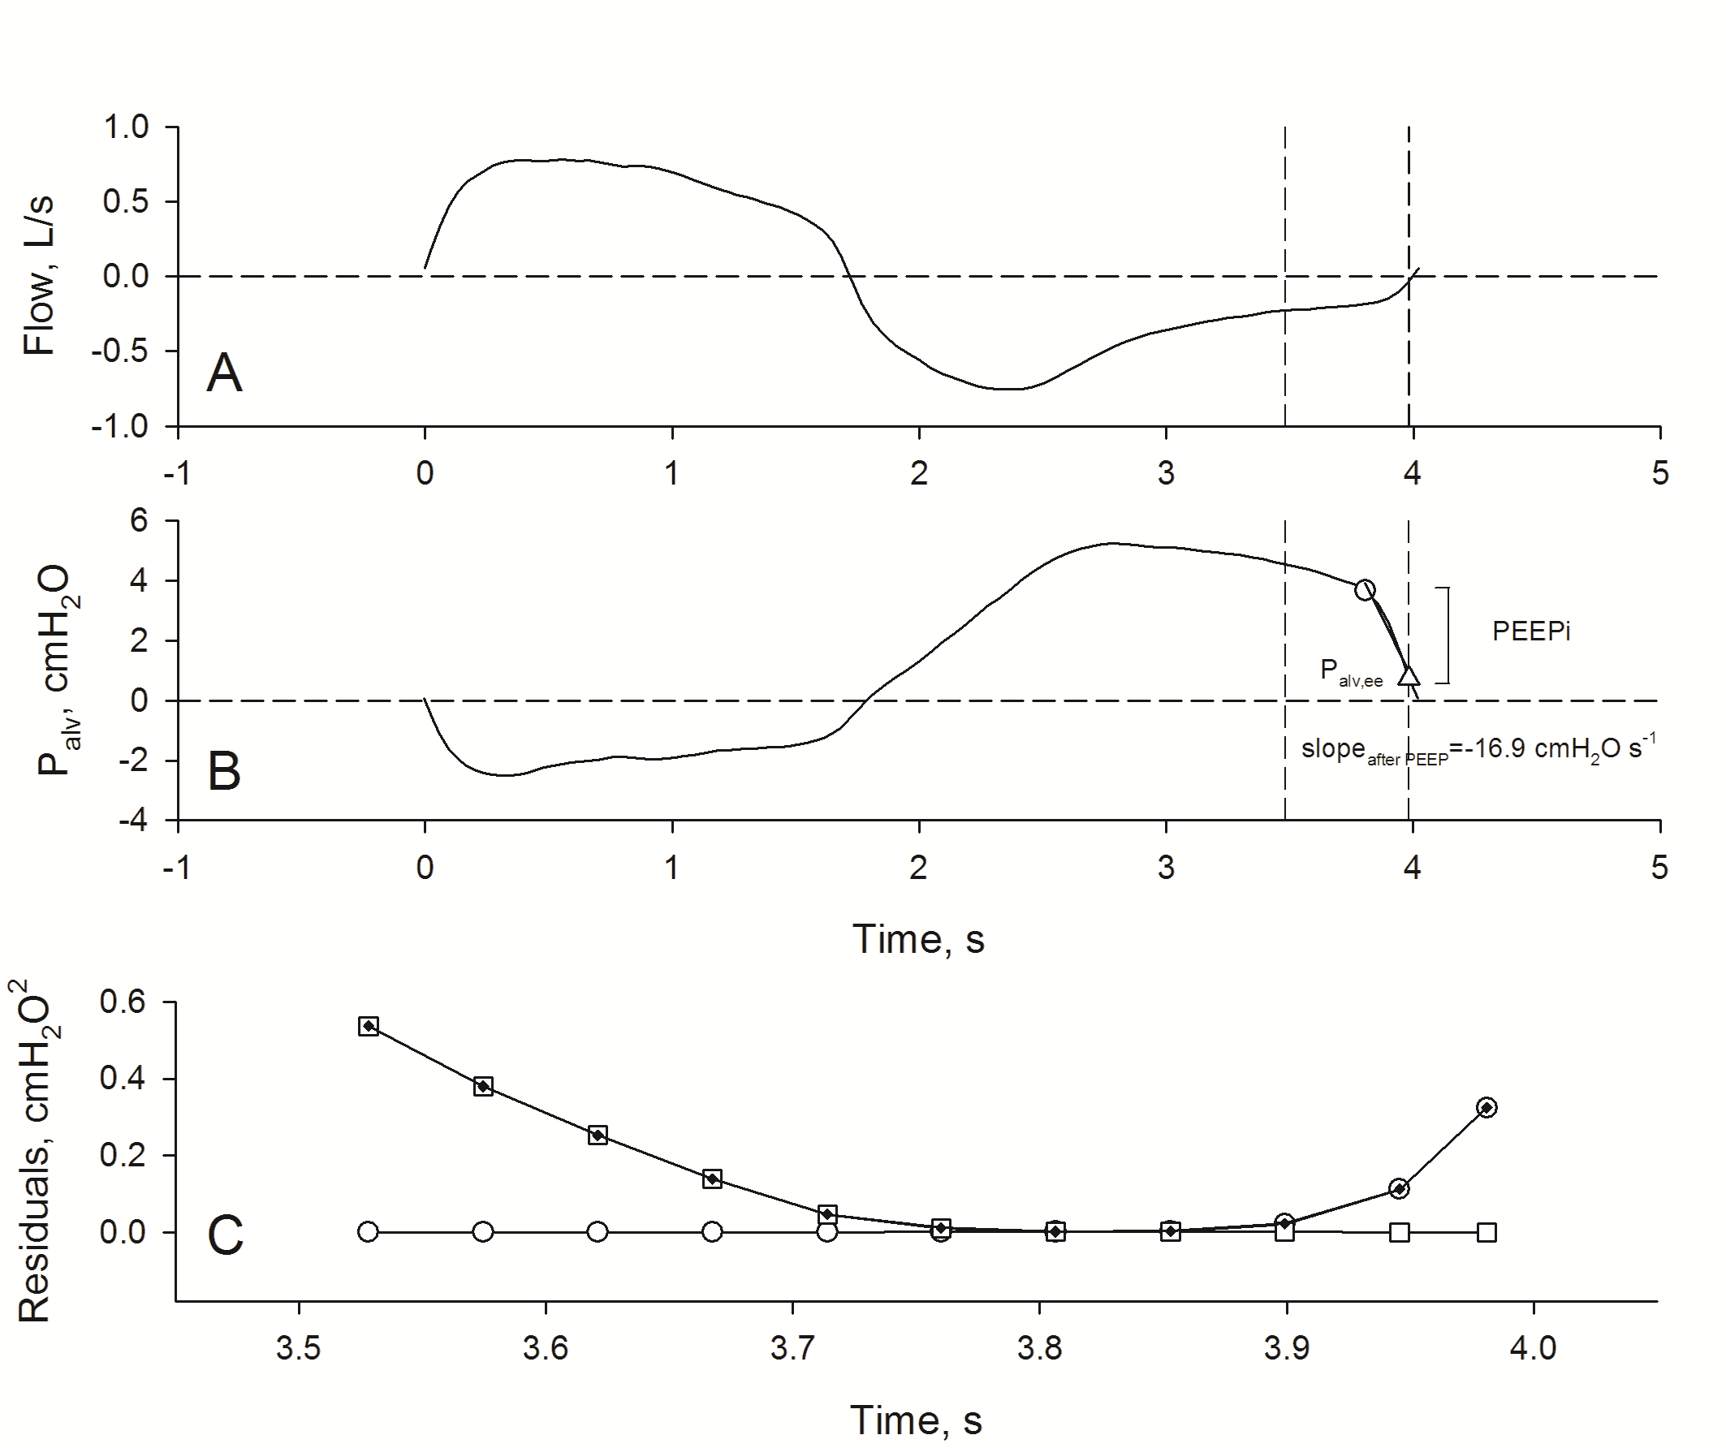
Zilianti C et al. Diagnostics 2021
Radovanovic D et al. ERJ 2017 (Suppl 61)

Slide 18
3.8 (1.9-5.7) cmH2O
0.0 (6.7) cmH2O
Zilianti C et al. Diagnostics 2021
Radovanovic D et al. ERJ 2017 (Suppl 61)

Slide 19
Zilianti C et al. Diagnostics 2021
Radovanovic D et al. ERJ 2017 (Suppl 61)

Slide 20
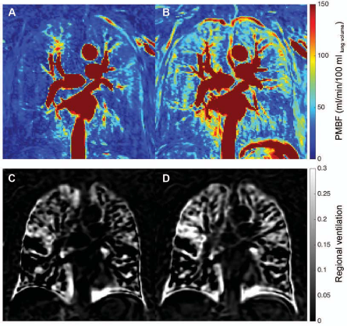
Pecchiari M et al. J Appl Physiol 2017
Vogel-Claussen J et al. AJRCCM 2019

Slide 21
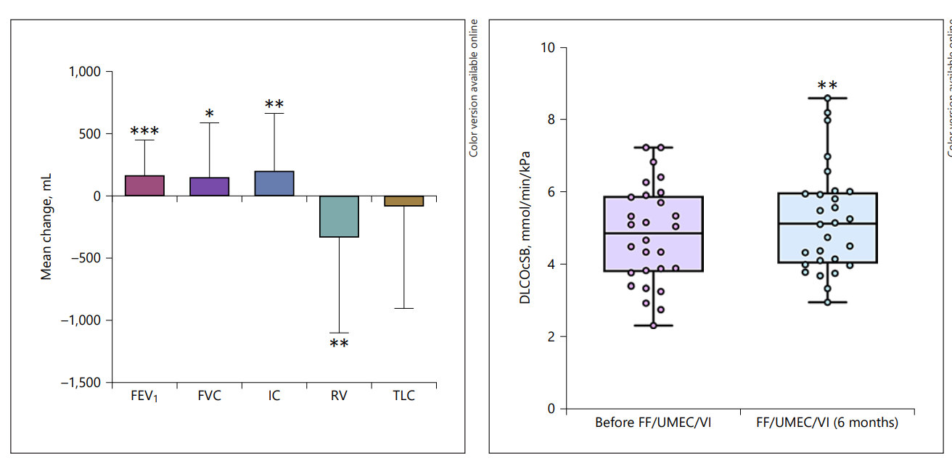
Effect of fluticasone/umeclidinium/vilanterol
Real life data
Pelaia C et al. Respiration 2021

Slide 22
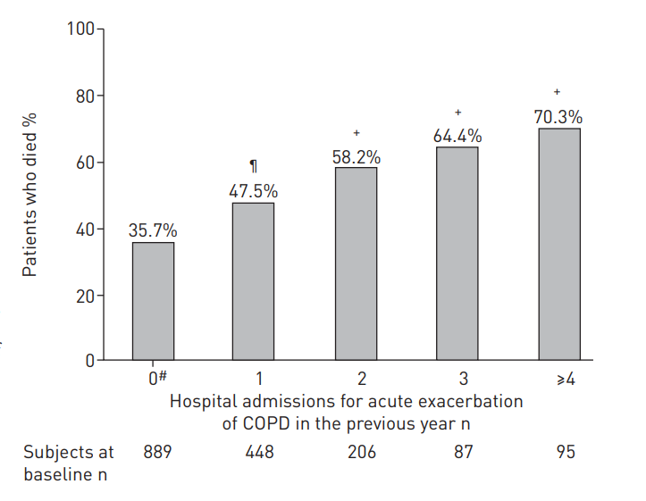
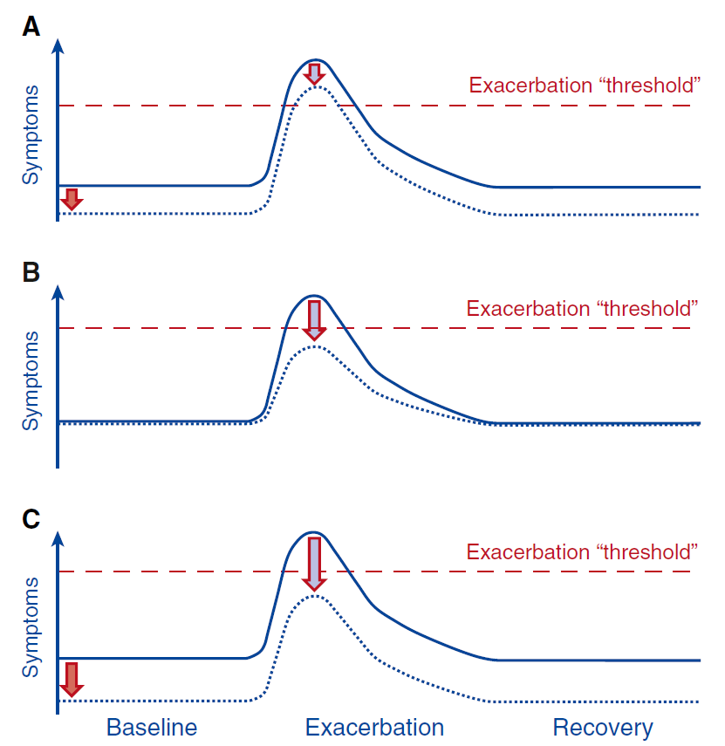
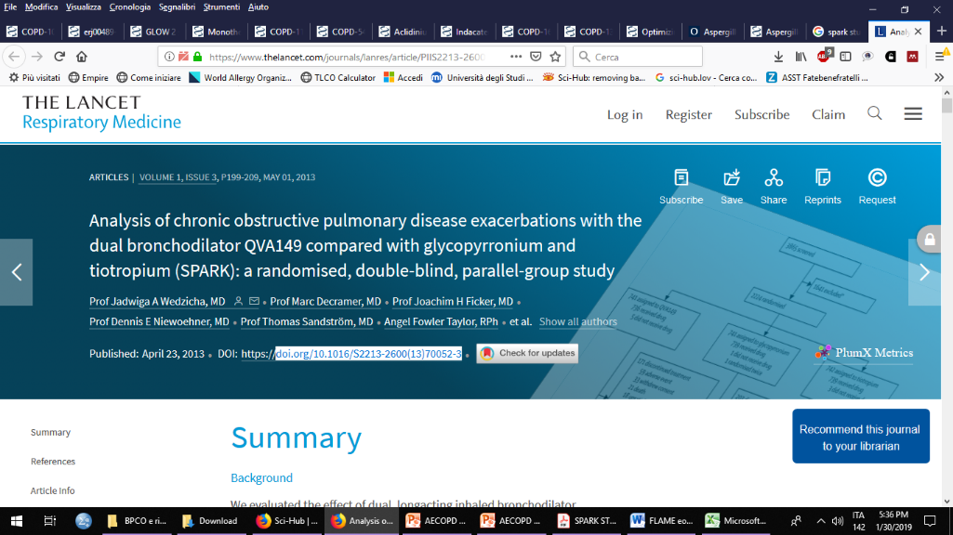
Hohfeld JM et al. Lancet Respir Med 2018

Slide 23
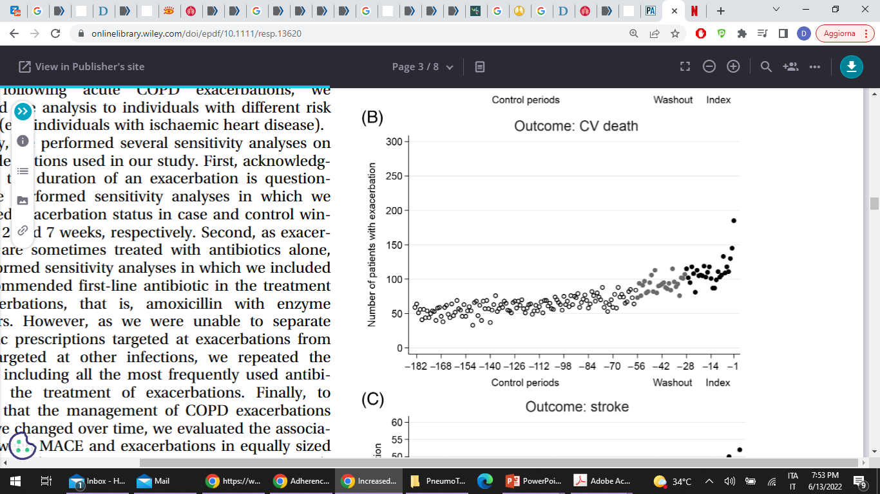
Bronchodilator act reducing the critical threshold for experiencing an exacerbation
Adapted from Beeh K. AJRCCM 2017

Slide 24
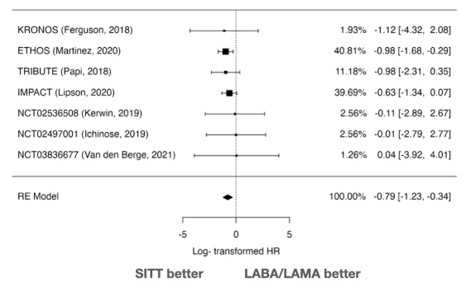
COPD exacerbations and risk of death:
high regardless of number of events
Piquet J et al. Eur Respir J 2013
1.0
0.9
0.8
Only 50% of patients were alive
within 3.6 years of their first
severe exacerbation
0.7
0.6
0.5
Proportion surviving
50%
0.4
0.3
0.2
0.1
N = 73106
0
0
2
4
6
8
10
12
14
16
18
Median follow up 18 months
Time after first severe exacerbation (years)

Slide 25
The COPD “Comorbidome”
Cardiovascular diseases are among the most prevalent of comorbidities and have one of the strongest associations with increased risk for death
OSA
CVA
Hyperlipidemia
Pulmonary HTN/RHF
PAD
CHF
Pulmonary Fibrosis
Diabetes
CAD
Lung Cancer
Anxietyª
A. Fibrillation
Hypertension
BPH
Breast Cancerª
Death
Esophageal Cancer
Prevalence
Diabetes w/Neuropathy
Pancreatic Cancer
Liver Cirrhosis
Substance Abuse
50%
Erectile Dysfunction
CRF
Gastric Duodenal Ulcer
Depression
10%
Risk
1/HR=0.5
DJD
GERD
Solidoro P et al. Front Med 2022; Almagro P et al. Eur Respir J 2015

Slide 26
CARDIOVASCULAR DEATH
OR 4.33 (95%CI 4.15-4.52)
in the first 4 weeks following AECOPD
Patients with severe AECOPD had almost 6 times the risk of having MACE
compared with patients with moderate AECOPD
Reilev M et al. Respirology 2019

Slide 27
GOLD 2023 has strengthened the emphasis on the importance of preventing premature mortality with pharmacotherapy
Triple therapy is the only pharmacotherapy with evidence supporting a reduction in mortality in patients with COPD¹
Non-pharmacological options that reduce mortality include smoking cessation, pulmonary rehabilitation, long-term oxygen therapy, non-invasive positive pressure ventilation and lung volume reduction surgery
Therapy
RCT*
Treatment effect on mortality
Patient characteristics
Pharmacotherapy
LABA + LAMA + ICS
Yes
Triple compared with dual LABD relative risk reduction:
IMPACT: HR 0.72 (95% CI 0.53, 0.99)²
ETHOS: HR 0.51 (95% CI 0.33, 0.80)³
Symptomatic people with a history of frequent and/or severe exacerbations
Page 68, Table 3.6
GOLD 2023 report

Slide 28
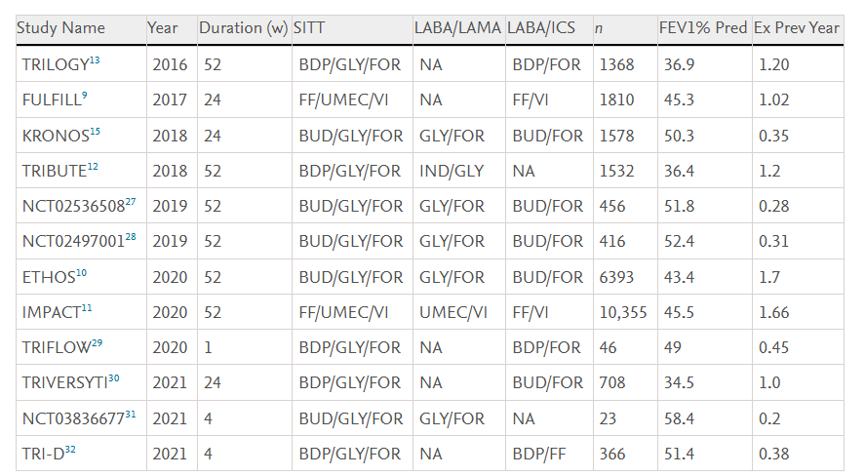
All-Cause and Cardiovascular mortality with SITT
vs ICS/LABA or LABA/LAMA:
a systematic review and metanalysis
Hammadi A et al. Arch Bronconeumol 2025

Slide 29
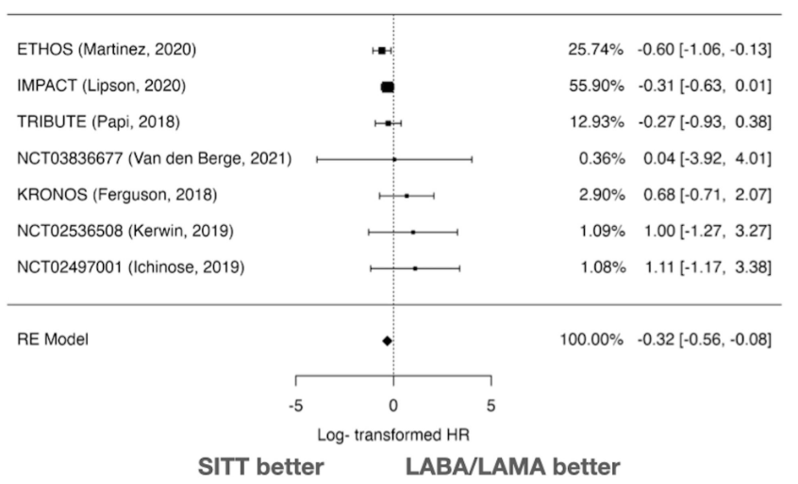
All-Cause mortality with SITT
vs LABA/LAMA
Cardiovascular mortality with SITT
vs LABA/LAMA
-27.3% reduction vs LABA/LAMA
-54.4% reduction vs LABA/LAMA
Hammadi A et al. Arch Bronconeumol 2025

Slide 30
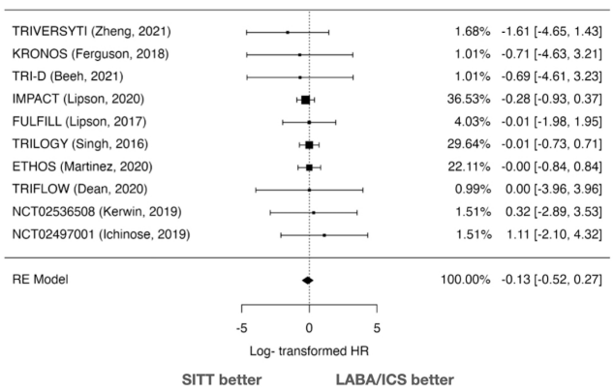
All-Cause mortality with SITT
vs LABA/LAMA
Cardiovascular mortality with SITT
vs LABA/LAMA
No difference vs ICS/LABA
No difference vs ICS/LABA
Hammadi A et al. Arch Bronconeumol 2025

Slide 31
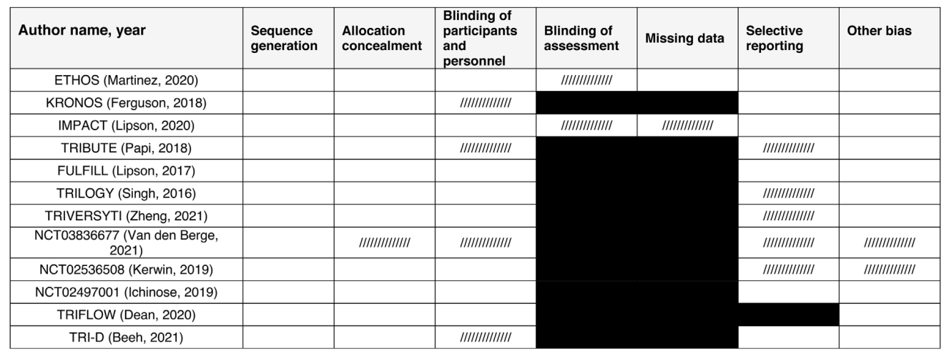
Hammadi A et al. Arch Bronconeumol 2025

Slide 32
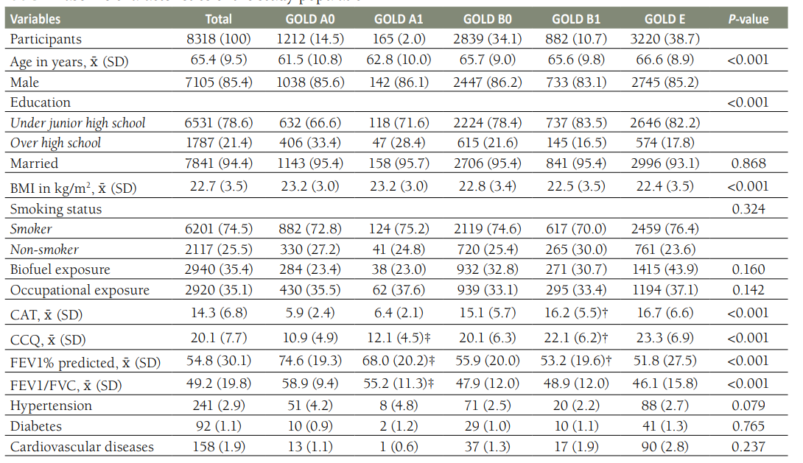
Lin L et al. J Glob Health 2024

Slide 33
Lin L et al. J Glob Health 2024

Slide 34
Lin L et al. J Glob Health 2024

Slide 35
Lin L et al. J Glob Health 2024

Slide 36
Lin L et al. J Glob Health 2024

Slide 37
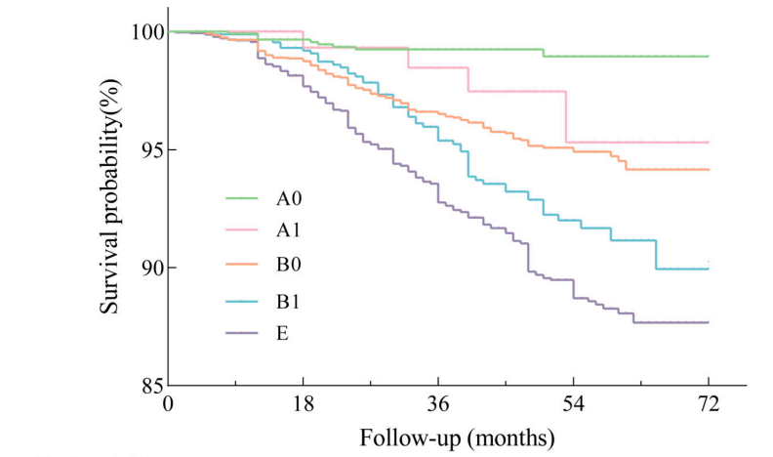
Lin L et al. J Glob Health 2024

Slide 38
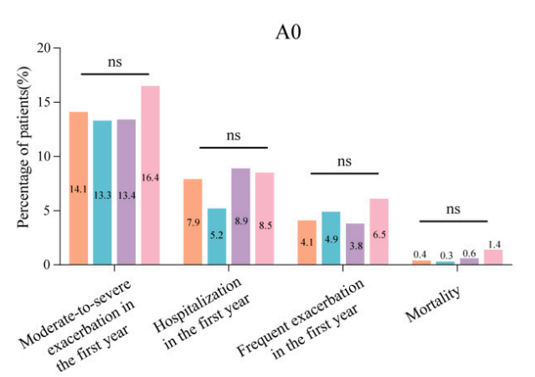
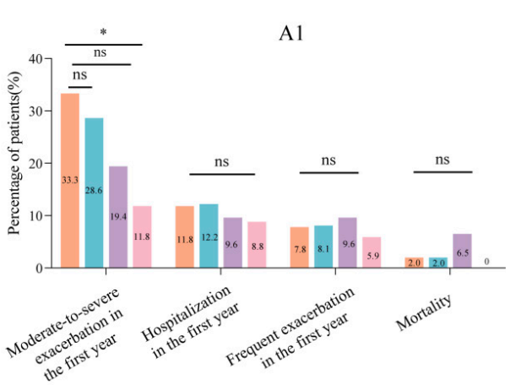
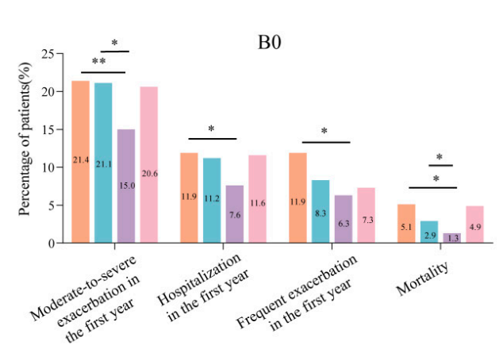
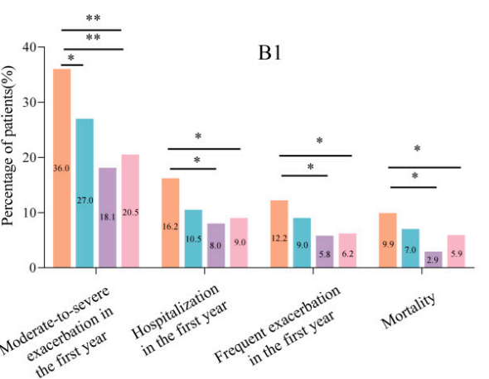

Slide 39
Mortality reduction with triple therapy in IMPACT trial
-42% vs LABA/LAMA
HR = 0.58 (95% CI, 0.38–0.88; P = 0.011) VS UMEC/VI
HR = 0.61 (95% CI, 0.40–0.93; P = 0.022) VS FF/VI
Lipson DA et al. Am J Respir Crit Care Med 2020

Slide 40
Mortality in patients on triple therapy at screening in IMPACT trial
HR = 0.62 (95% CI, 0.38–1.00; P = 0.051) VS UMEC/VI
HR = 0.71 (95% CI, 0.46–1.10; P = 0.124) VS FF/VI
Lipson DA et al. Am J Respir Crit Care Med 2020

Slide 41
Mortality in patients on ICS at screening in IMPACT trial
HR = 0.63 (95% CI, 0.44–0.89; P = 0.009) VS UMEC/VI
HR = 0.82 (95% CI, 0.60–1.13; P = 0.229) VS FF/VI
Lipson DA et al. Am J Respir Crit Care Med 2020

Slide 42
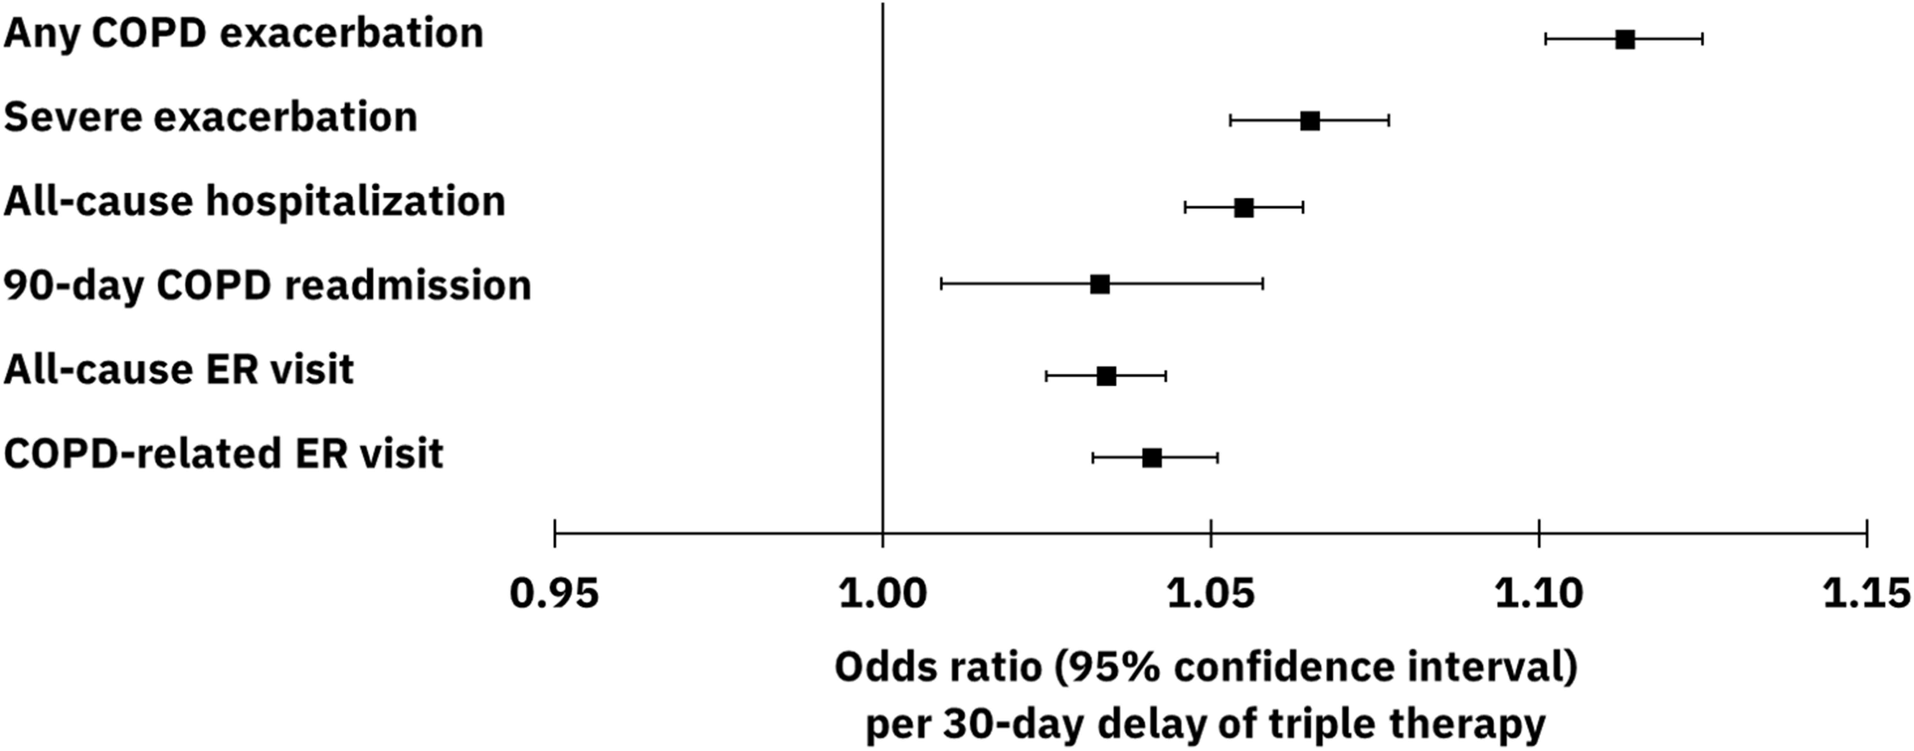

Slide 43
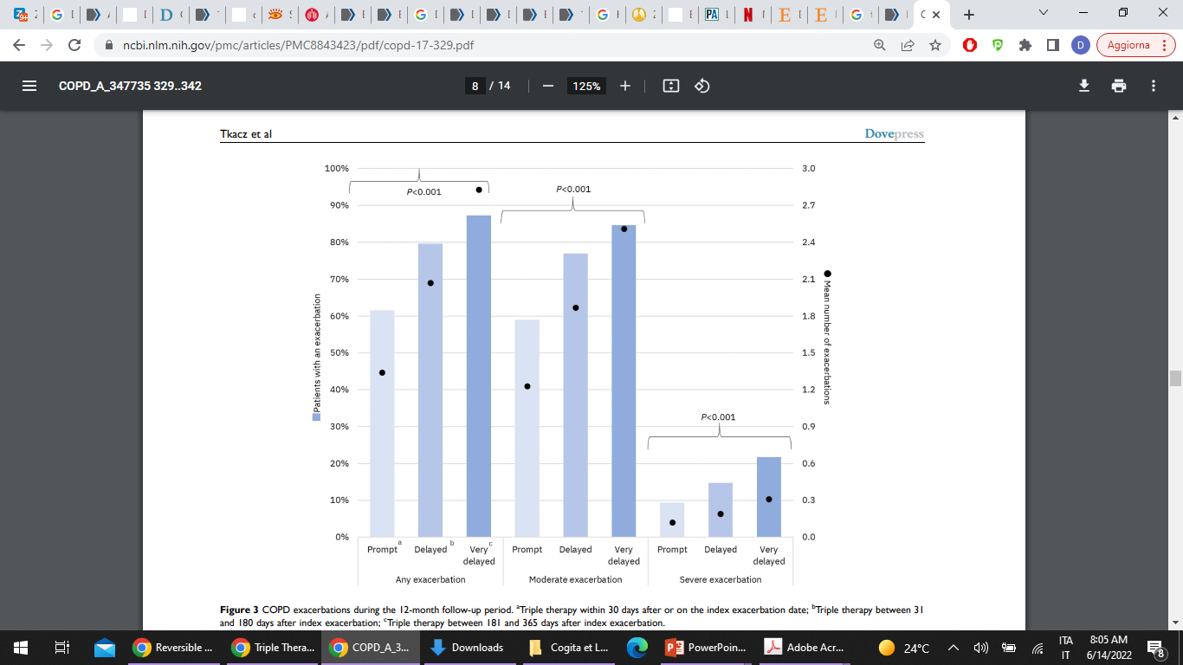
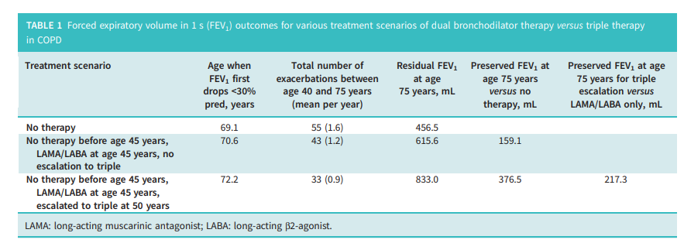
Singh D et al. ERJ Open Res 2024

Slide 44
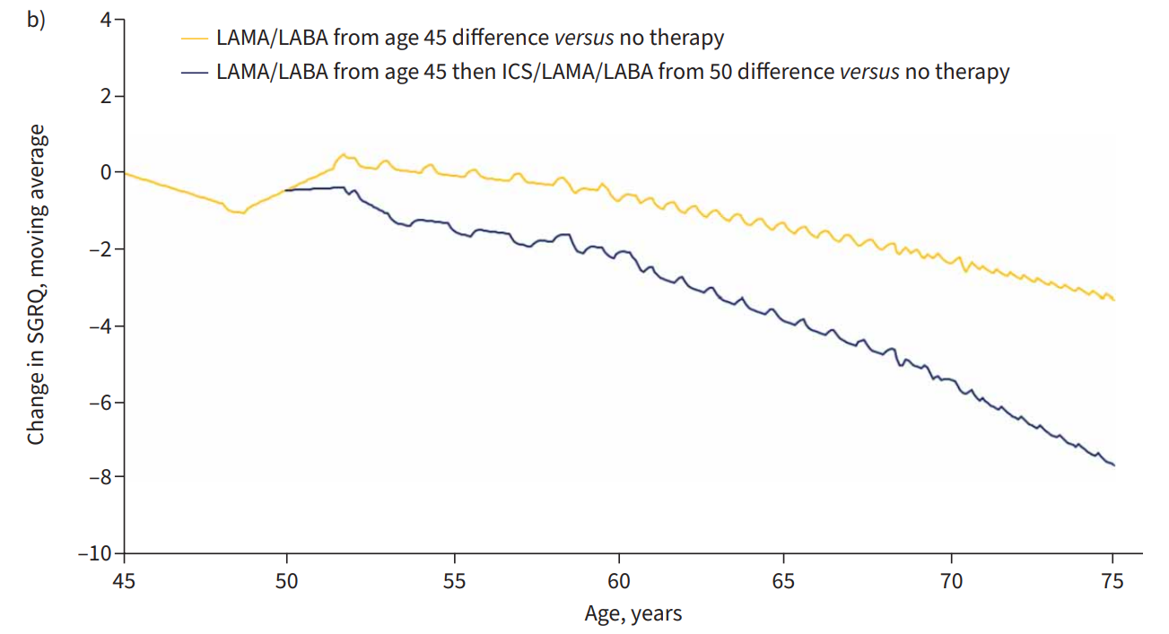
Singh D et al. ERJ Open Res 2024

Slide 45
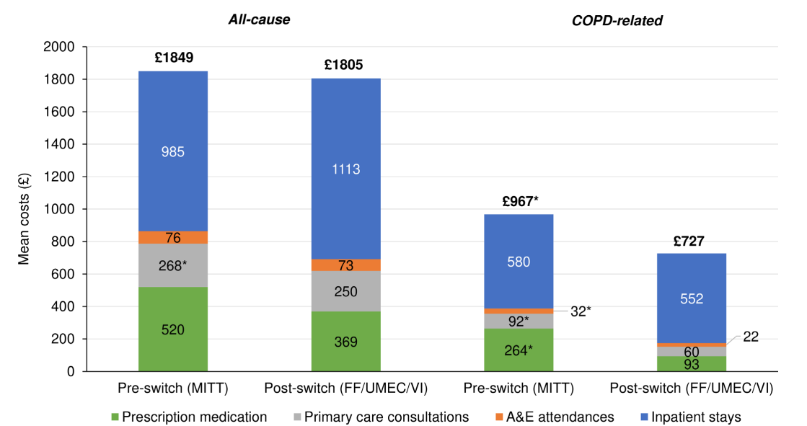
Singh D et al. ERJ Open Res 2024

Slide 46
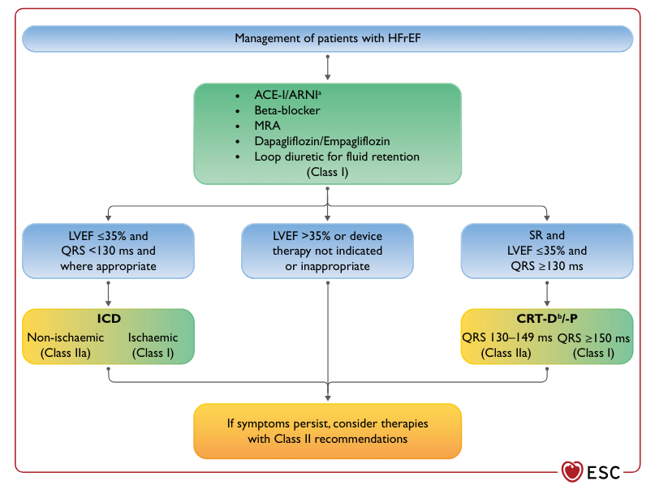
Promptly Initiating Triple Therapy Is Associated with Decreased Morbidity
and Economic Burden in COPD - PRIMUS Study
Tkacz J et al. Int J Chron Obstruct Pulmon Dis 2022

Slide 47
LAMA
ICS/LABA
LAMA/LABA
ICS/LABA/LAMA

Slide 48
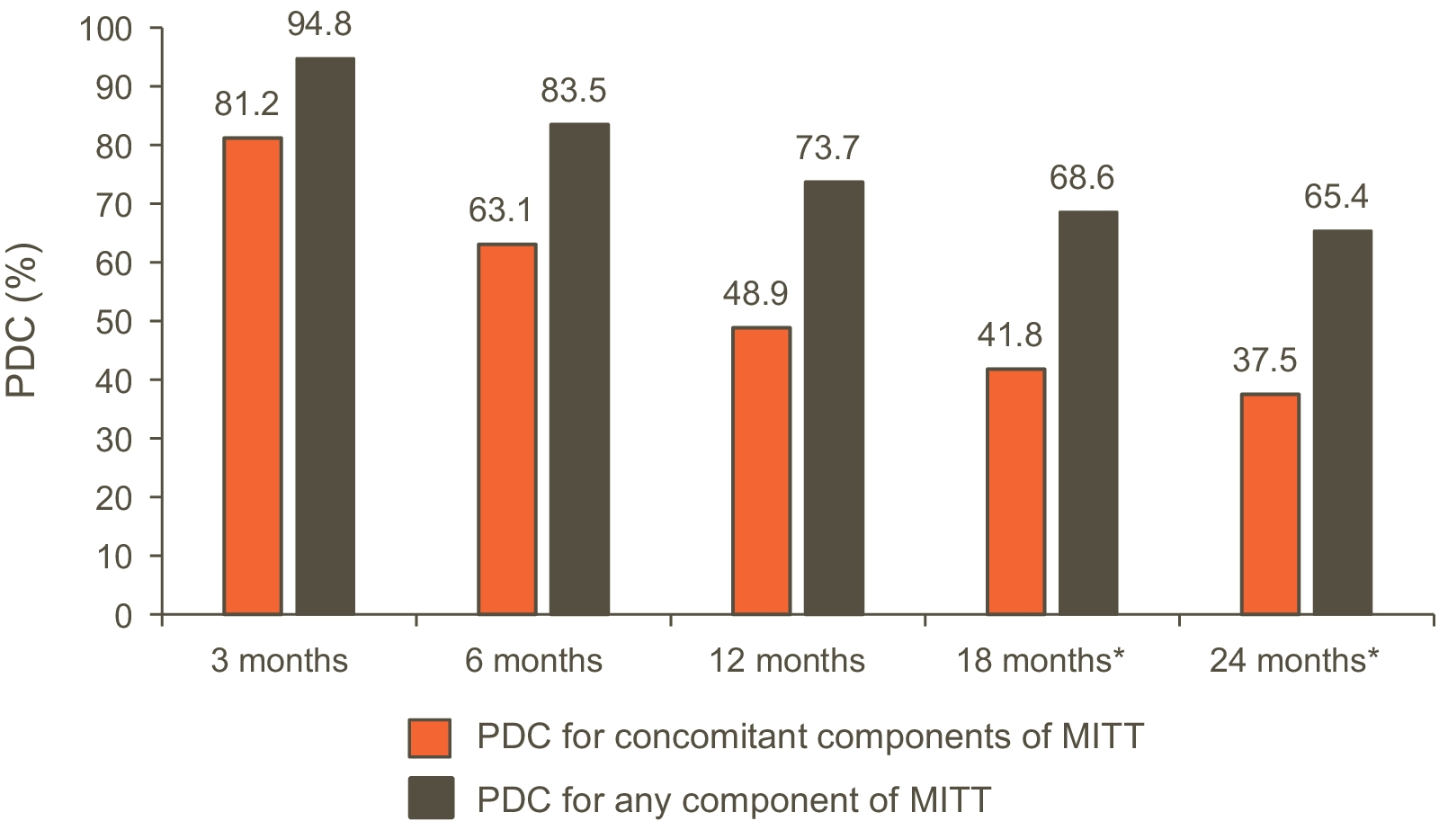
Adherence to MITT is scarce, and is reduced with time
Proportion of days covered (%)
Lee C-H et al. Respir Res 2022

Slide 49
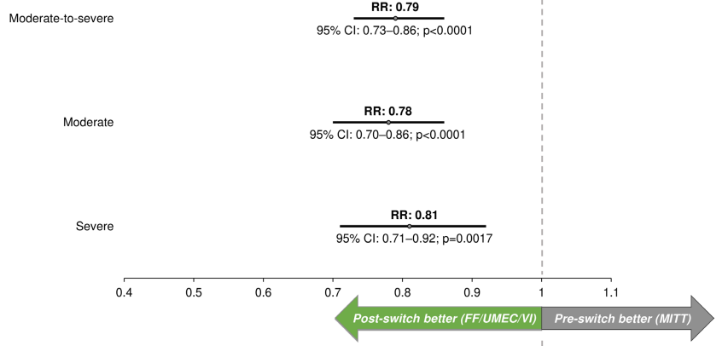
N = 2533 patients
Rothnie KJ et al. BMJ Open Repir Res 2024

Slide 50
ESC Guidelines on management of Heart Failure 2021

