Slide 1


Polmonite fulminante acquisita in comunità:
una non comune, ma pericolosa malattia
Francesco Salton
SC Pneumologia, Trieste
francesco.salton@asugi.sanita.fvg.it

Slide 2

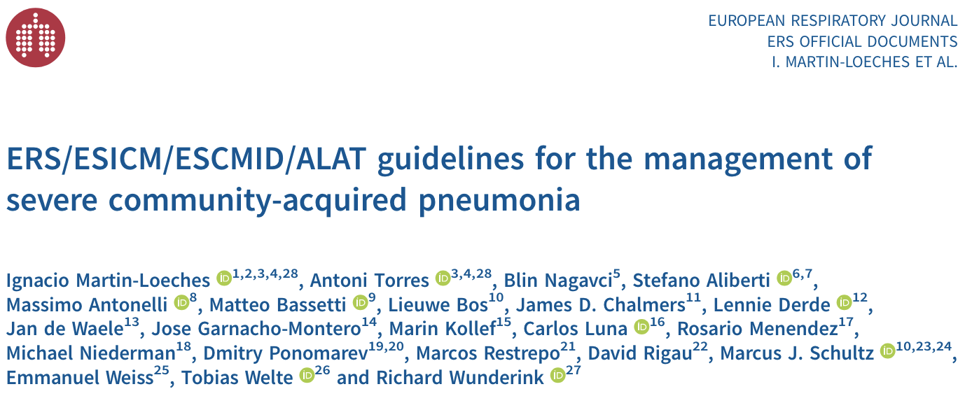
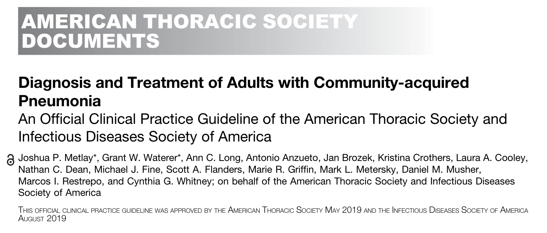

Le ultime LLGG sulla polmonite fulminante
Notes:
Approximately 40% of patients with CAP will require hospitalisation, and 5% of these patients will be admitted to the intensive care unit (ICU), primarily due to shock or the need for invasive or non-invasive mechanical ventilation [2]. Severe CAP (sCAP) is accepted terminology used to describe ICU-admitted patients with CAP as they might require organ support. Data from a large cohort (CAPNETZ) have shown that the highest mortality is observed in patients who do not meet these criteria initially but deteriorate over the course of time (sCAP on admission: 17%; sCAP on day 4 to 7: 48%)

Slide 3
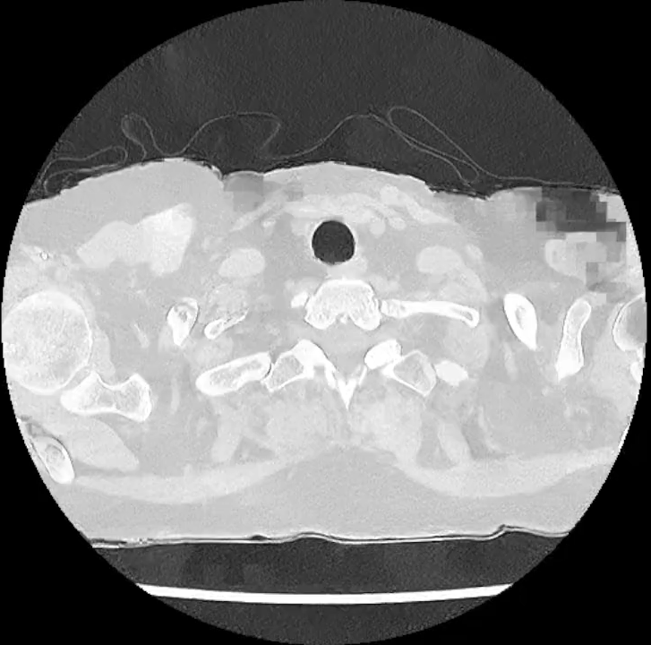
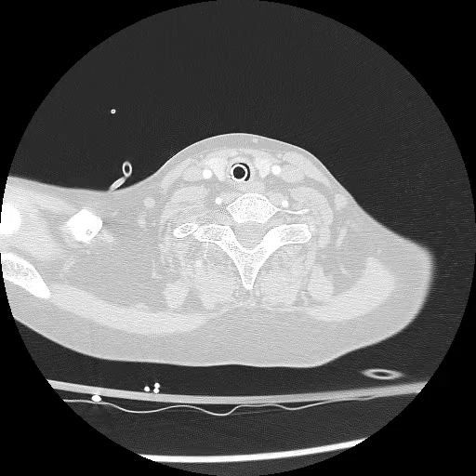
Polmonite fulminante?
12/08/2024
13/08/2024

Slide 4
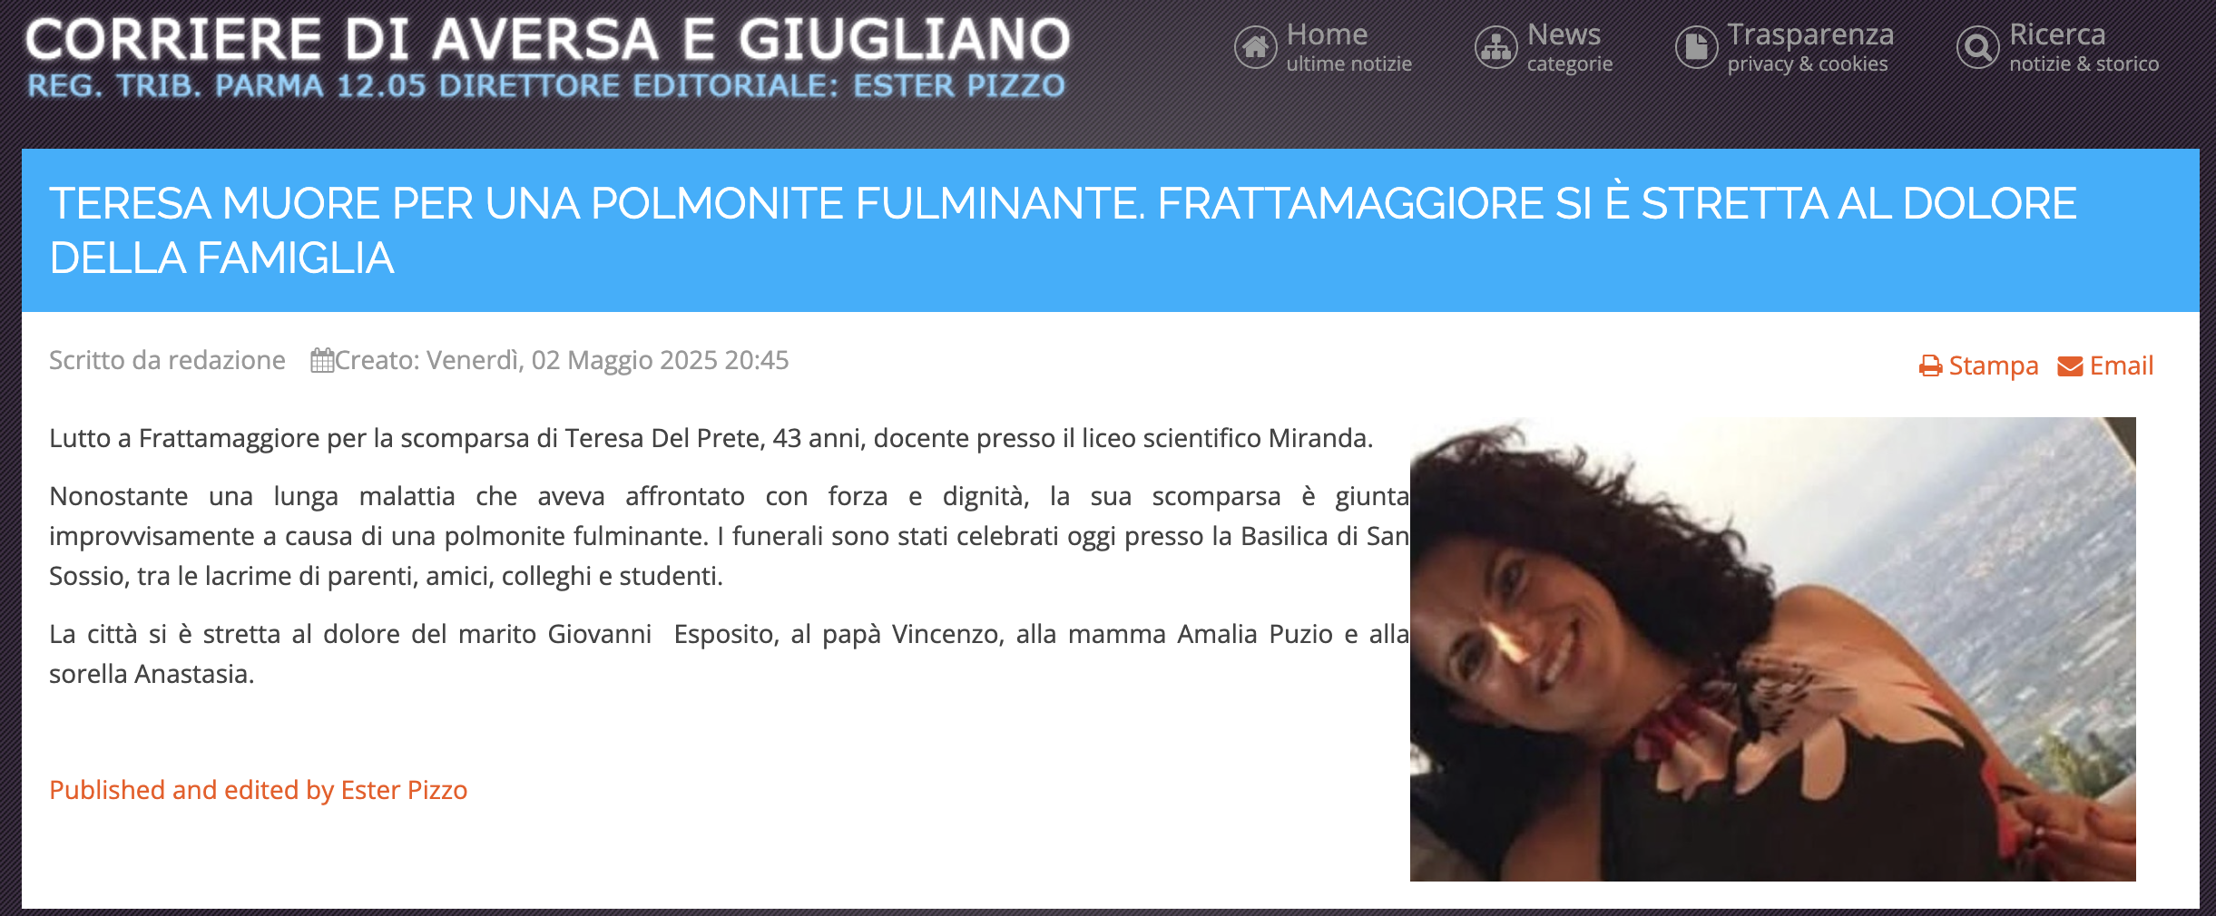

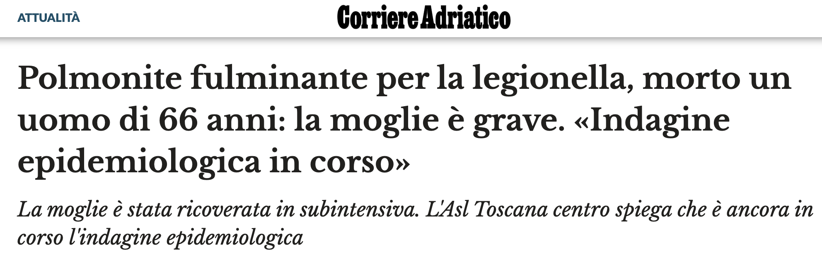

Slide 5
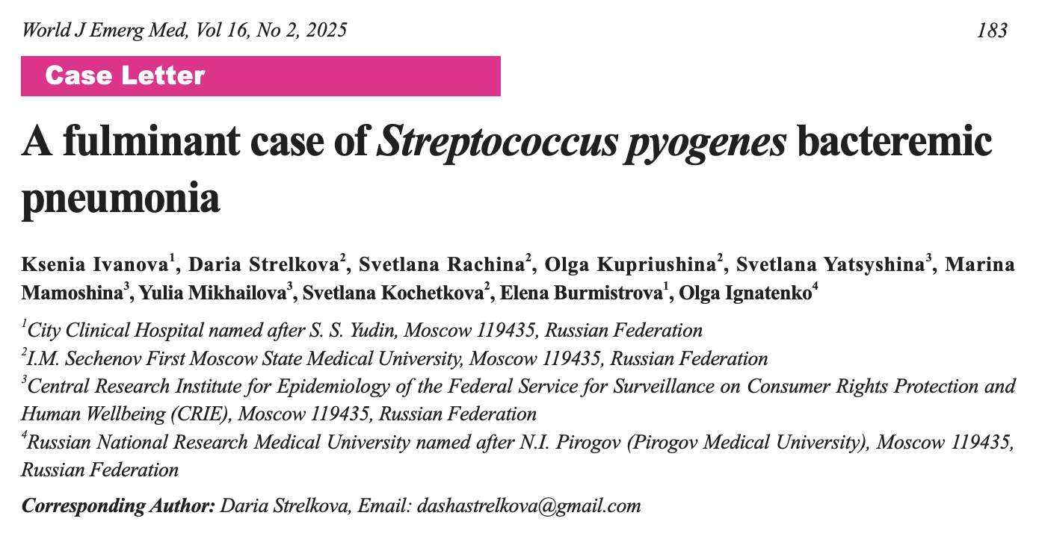
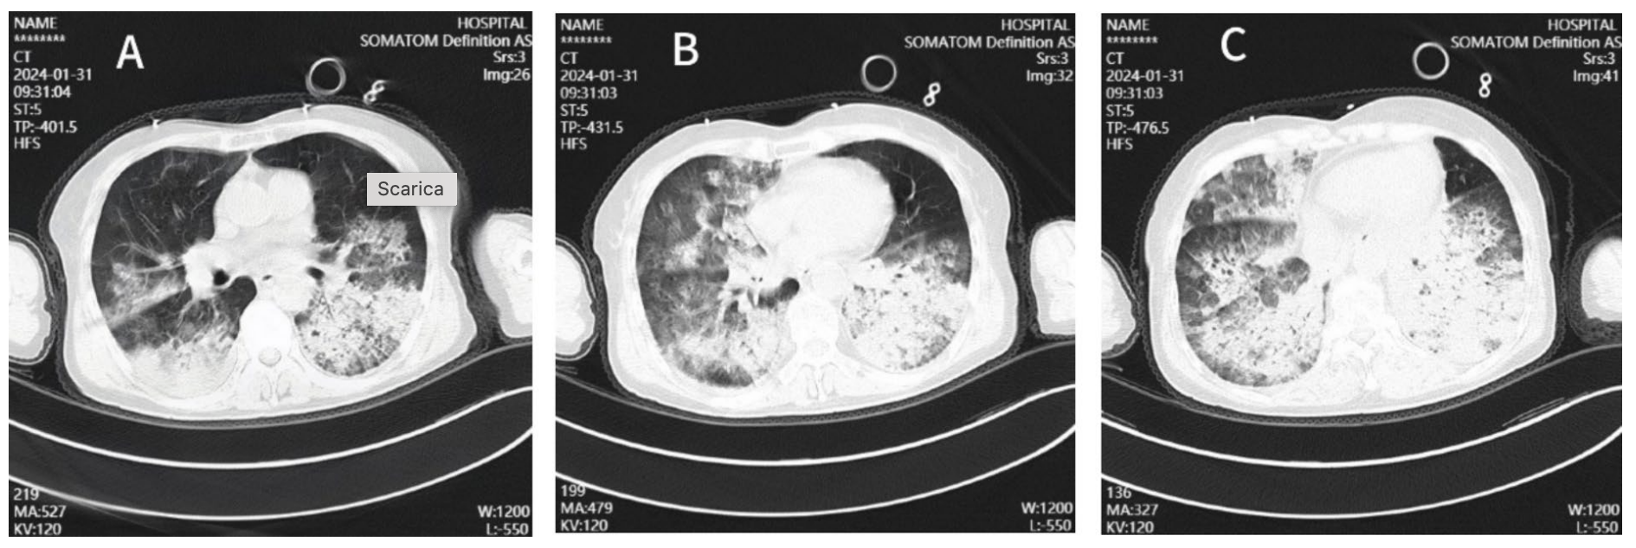
La letteratura sulle polmoniti fulminanti
[…] By the fourth hour of hospitalization, respiratory failure had progressed, with the PaO2/FiO2 dropping to 190 mmHg, and lactate levels increasing to 3.6 mmol/L. The patient was intubated, and required norepinephrine administration. Hemodiafiltration was performed for detoxication. Given the signs of septic shock and the positive S. pyogenes test, antibiotic therapy was switched to a combination of clindamycin and meropenem. Despite ongoing intensive therapy, the patient’s condition deteriorated […]

Slide 6
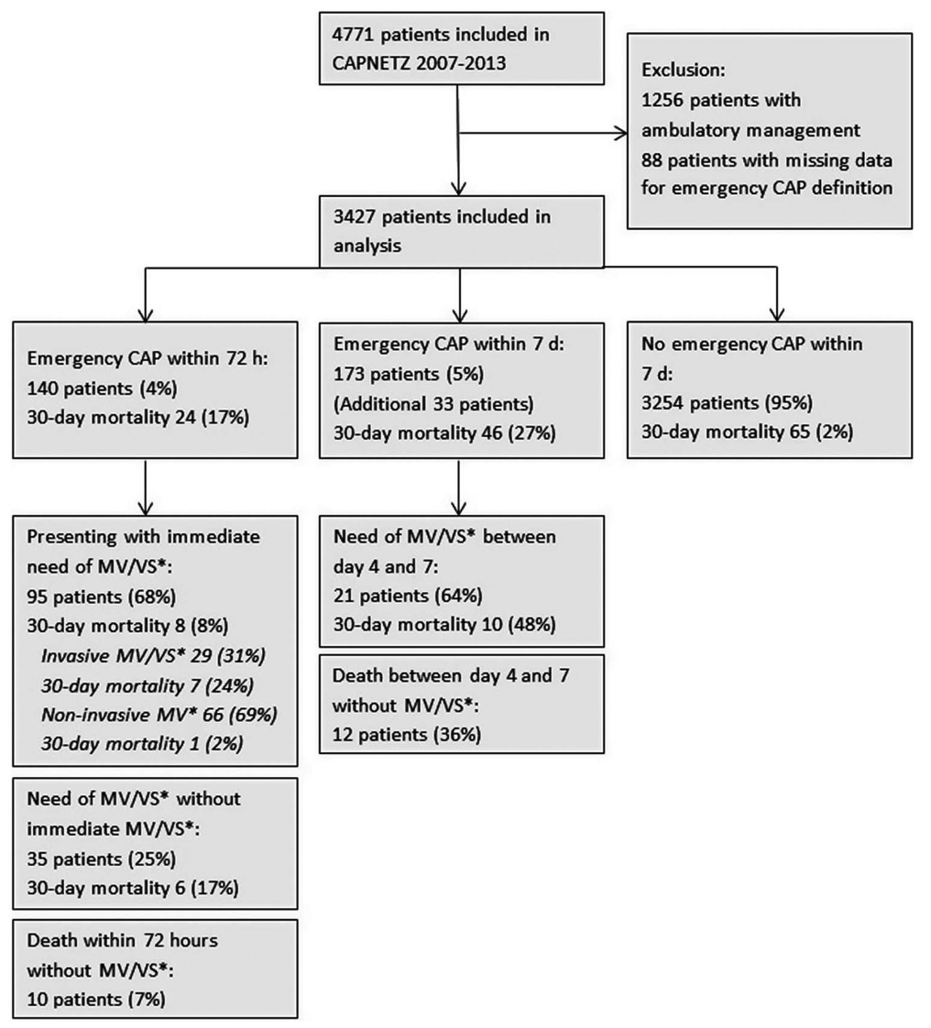

Dimensioni del problema
3427 hospitalized patients
Inclusion criteria:
Age ≥18 years
Pulmonary infiltrates
At least one of: fever, cough, sputum, focal chest signs on auscultation
Exclusion criteria:
Immune deficiency
Active TB
Nosocomial infection
Higher 30-day mortality is observed in patients who deteriorate over time:
Emergency CAP* on admission = 17%
Emergency CAP* on day 4 to 7 = 48%
This may in part be attributable to progressive pneumonia, but “mis-triage” of patients with unrecognized severe pneumonia may be a contributing factor.
*Emergency CAP =
IMV/NIV o vasopressori o morte
Kolditz M et al. Community-acquired pneumonia as medical emergency: predictors of early deterioration. Thorax 2015
Notes:
Data from a large cohort (CAPNETZ) have shown that the highest mortality is observed in patients who do not meet these criteria initially but deteriorate over the course of time (sCAP on admission: 17%; sCAP on day 4 to 7: 48%).
This may in part be attributable to progressive pneumonia, but “mis-triage” of patients with unrecognized severe pneumonia may be a contributing factor.
Rispetto a dati FulmisCAP: non criteri di gravità, non pandemia COVID-19.

Slide 7
Dimensioni del problema
Circa il 5% dei pazienti con CAP necessitano di ricovero in ICU, spesso a causa di shock o necessità di ventilazione meccanica (polmoniti gravi, sCAP)
Mortalità +22% se shock settico, +25% se necessità di ventilazione meccanica invasiva, +30% se entrambe
Notes:
Approximately 40% of patients with CAP will require hospitalisation, and 5% of these patients will be admitted to the intensive care unit (ICU), primarily due to shock or the need for invasive or non-invasive mechanical ventilation [2]. Severe CAP (sCAP) is accepted terminology used to describe ICU-admitted patients with CAP as they might require organ support. Data from a large cohort (CAPNETZ) have shown that the highest mortality is observed in patients who do not meet these criteria initially but deteriorate over the course of time (sCAP on admission: 17%; sCAP on day 4 to 7: 48%)

Slide 8
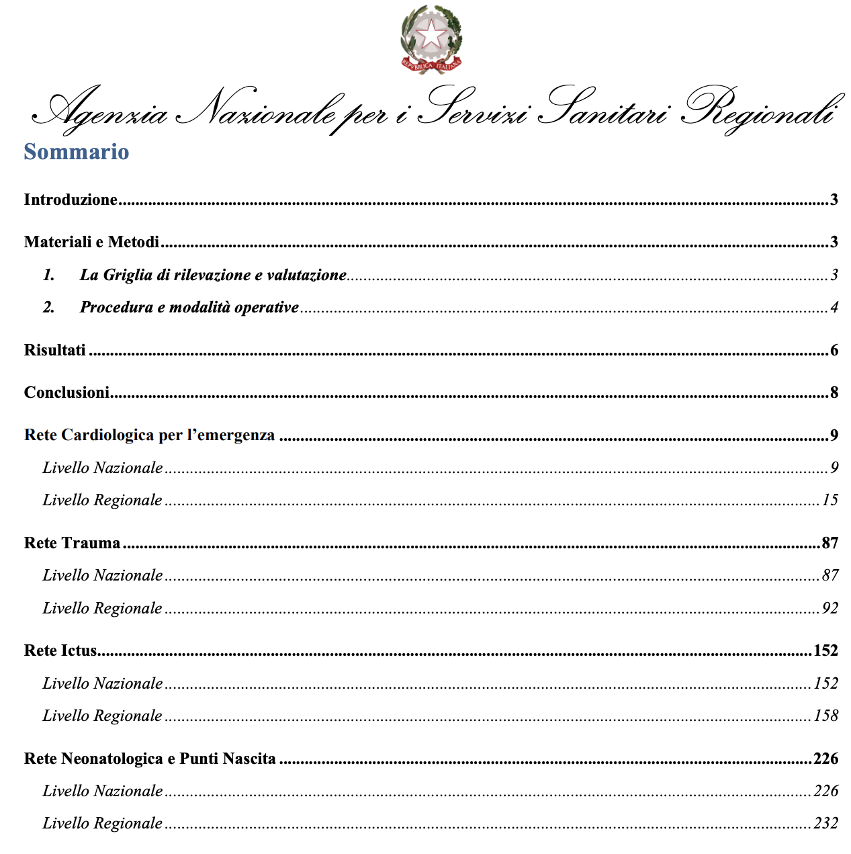


Patologie tempo-dipendenti
Patologie che se non curate immediatamente portano il quadro clinico del paziente in una situazione che potrebbe essere irrecuperabile e di conseguenza alla morte o all'inabilità permanente.
Polmonite?
ARDS?
Sepsi?
Notes:
Per AGENAS non sono patologie tempo-dipendenti né polmoniti gravi, né sepsi, né ARDS

Slide 9



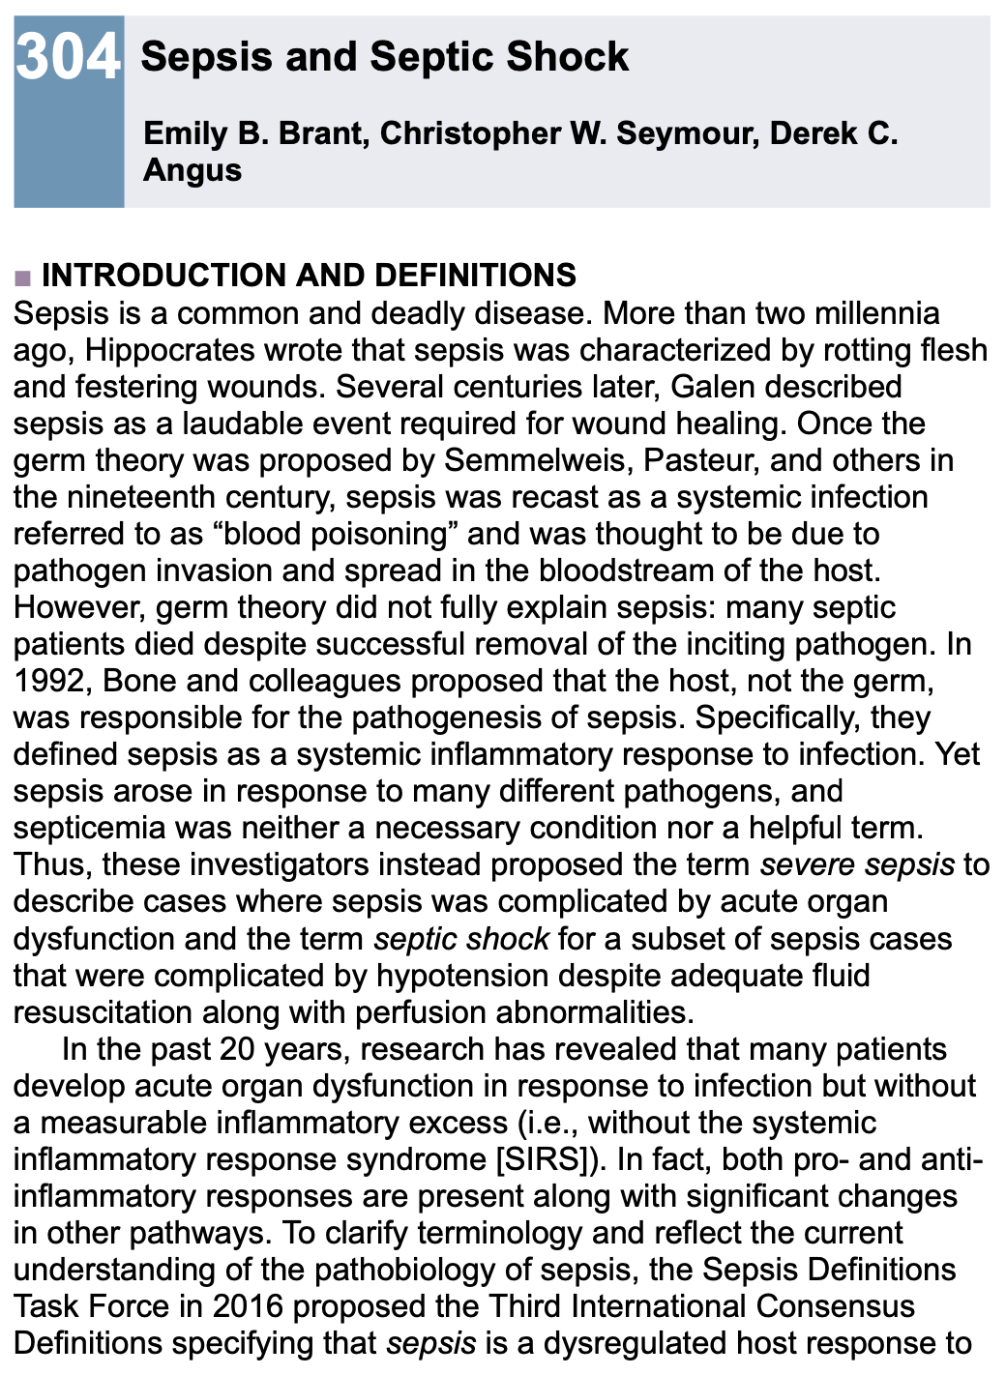
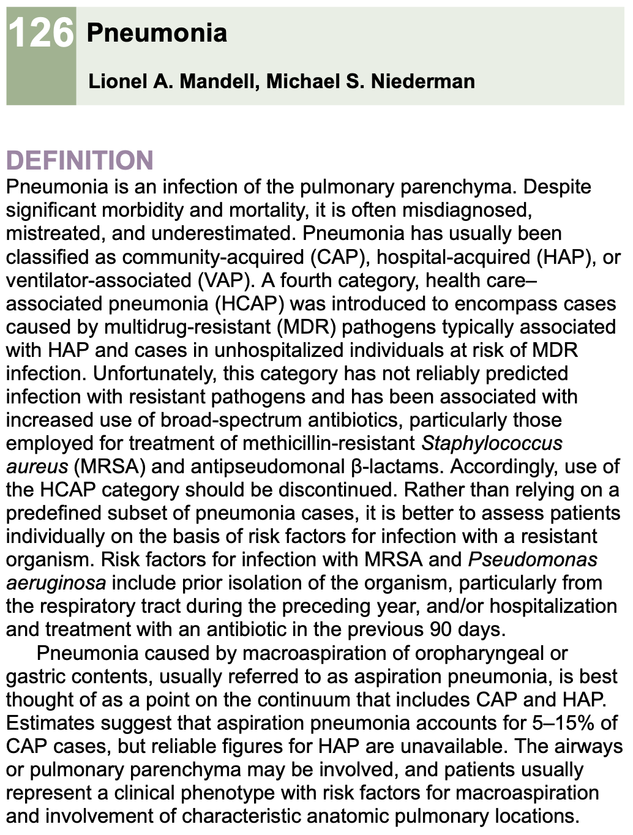
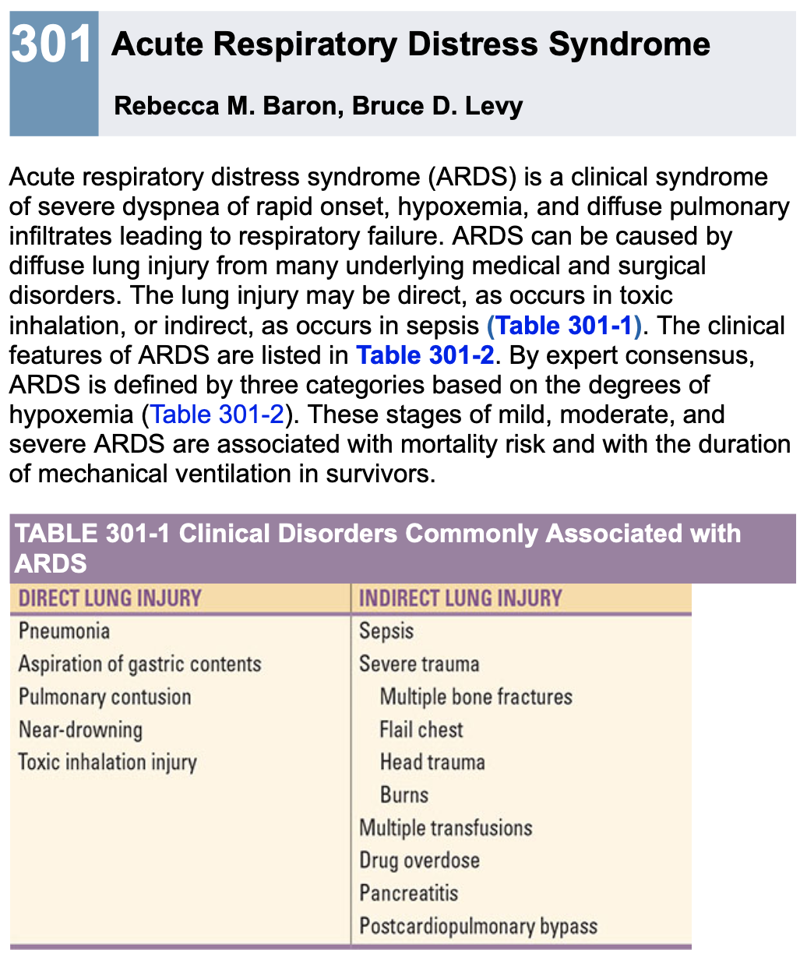
Polmonite/ARDS/sepsi nei libri (e nelle LLGG)
Loscalzo J. et al. Harrison’s principles of internal medicine, 21st ed. McGrawHill 2022

Slide 10

Polmonite/ARDS/sepsi in biologia
Polmonite
ARDS
ARDS
Sepsi

Slide 11
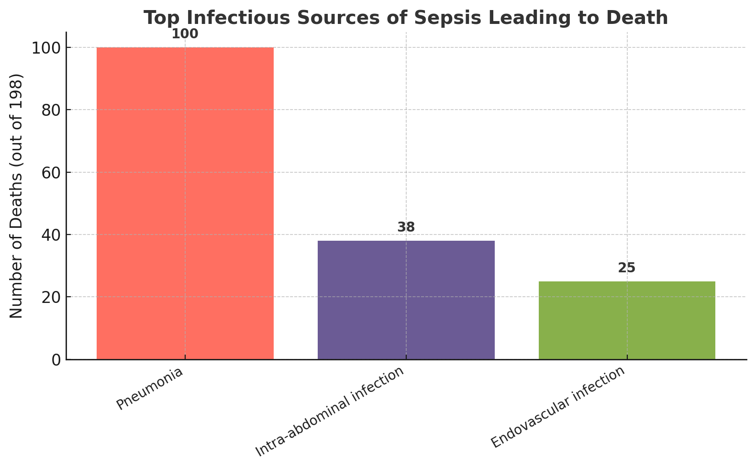
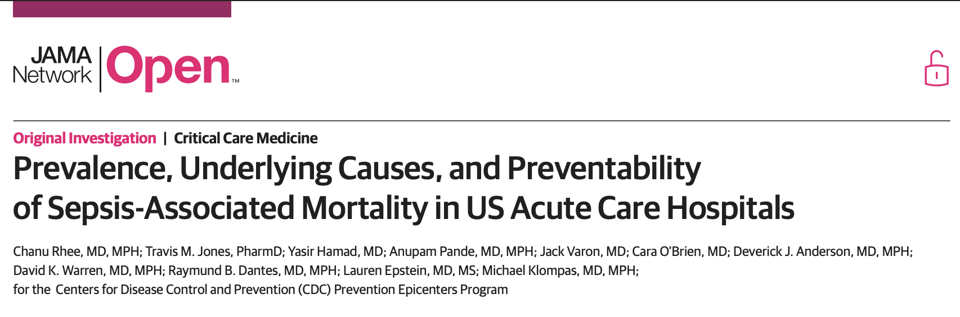
1. Polmonite è la più comune causa di sepsi
The most common infectious source of sepsis among patients in whom sepsis was the immediate cause of death was pneumonia (100 of 198, 50.5%), followed by intra-abdominal infections and endovascular infections.

Slide 12

2. Sepsi è la causa più comune di (morte in) ARDS
Sepsis is an underlying cause for approximately 75% of patients with ARDS (59% pneumonia, 16% extrapulmonary sepsis)
Sepsis syndrome with multiple organ failure remains the most common cause of death in ARDS (30 to 50%), while respiratory failure causes a small percentage (13 to 19%) of deaths
26 to 44% of deaths occurred early (< 72 h after ARDS onset), and 56 to 74% occurred late (> 72 h)
1. Bellani G, et al. Epidemiology, patterns of care, and mortality for patients with acute respiratory distress syndrome in intensive care units in 50 countries. JAMA. 2016
2. Stapleton RD, Wang BM, Hudson LD, Rubenfeld GD, Caldwell ES, Steinberg KP. Causes and timing of death in patients with ARDS. Chest. 2005
3. Matthay, M.A et al. Acute respiratory distress syndrome. Nat Rev Dis Primers 2019
4. Bos, Lieuwe D J et al. Acute respiratory distress syndrome: causes, pathophysiology, and phenotypes. The Lancet 2022
Notes:
Of 29144 patients admitted to participating ICUs, 3022 (10.4%) fulfilled ARDS criteria. Of these, 2377 patients developed ARDS in the first 48 hours and whose respiratory failure was managed with invasive mechanical ventilation. The period prevalence of mild ARDS was 30.0% (95% CI, 28.2%-31.9%); of moderate ARDS, 46.6% (95% CI, 44.5%-48.6%); and of severe ARDS, 23.4% (95% CI, 21.7%-25.2%).

Slide 13
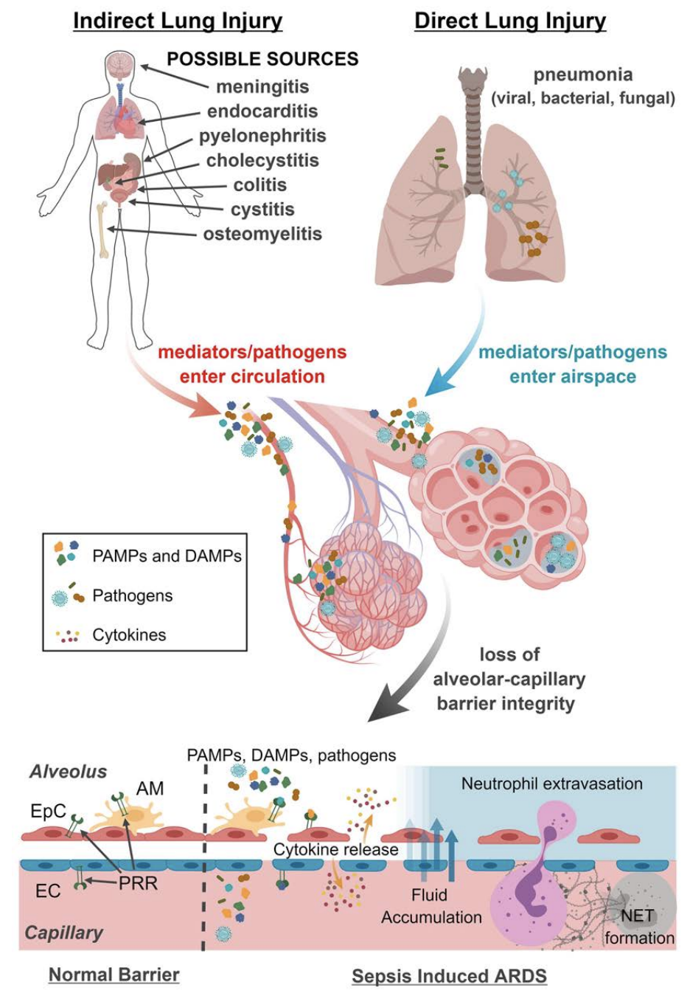
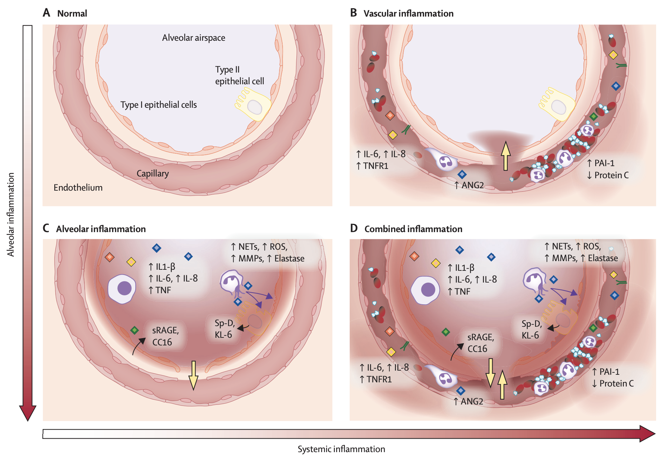
Meccanismi fisiopatologici condivisi
1. Bos, Lieuwe D J et al. Acute respiratory distress syndrome: causes, pathophysiology, and phenotypes. The Lancet 2022
2. Joshua A. Englert et al. Integrating molecular pathogenesis and clinical translation in sepsis-induced acute respiratory distress syndrome. JCI Insight 2019
Notes:
(A) The normal alveolus, without inflammation or injury. (B) The changes observed in the hyperinflammatory subphenotype, which is characterised by systemic inflammation, endothelial dysfunction, and coagulation. Without alveolar inflammation, the injury caused by inflammation is driven from the systemic compartment towards the alveolar compartment (yellow arrow), resulting in increased permeability and alveolar oedema. (C) The changes in patients with alveolar hyperinflammation without a systemic hyperinflammatory subphenotype. Alveolar epithelial cells, alveolar macrophages, and neutrophils have a central role in proinflammatory cytokine production. Epithelial cells and macrophages are essential in production of proinflammatory molecules. Neutrophils produce various injurious molecules that damage type 1 and type 2 pneumocytes resulting in increased levels of pneumocyte injury markers. Without systemic inflammation, the injury caused by inflammation in this scenario is driven from the alveolar towards the systemic compartment (yellow arrow), also resulting in increased permeability and alveolar oedema. (D) The combined presence of systemic and alveolar hyperinflammation. Under these circumstances, inflammation induces lung injury, increased permeability, and alveolar oedema from both directions.
Although these panels illustrate the extreme situations, the severity of systemic and alveolar inflammation exists on a spectrum that probably varies considerably from patient to patient, contributing to heterogeneity.

Slide 14
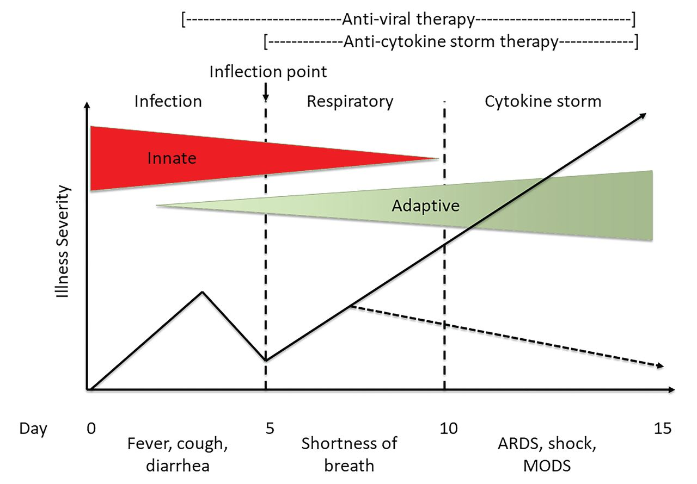
L’infiammazione come driver di danno
MOF
Antimicrobial therapy
Anti-cytokine storm therapy
Adapted from Chatham WW et al. The Journal of Rheumatology 2020

Slide 15
Sepsi e shock settico: definizioni (basate sulla fisiopatologia)
Sepsis is a syndrome characterized by organ dysfunction and an aberrant immune response to an infection.
Results from the local or systemic release of mediators that exert deleterious effects at the site of infection or in organs distant from the inciting infection.
Can be identified as an acute change in total SOFA score ≥2 points consequent to the infection, which reflects an overall mortality risk of approximately 10%
Septic shock = sepsis with persisting hypotension requiring vasopressors to maintain MAP ≥65 mm Hg and having a serum lactate level >2 mmol/L (18 mg/dL) despite adequate volume resuscitation → mortality >40%.
Singer M, et al. The Third International Consensus Definitions for Sepsis and Septic Shock (Sepsis-3). JAMA. 2016
Notes:
Sepsis should be defined as life-threatening organ dysfunction caused by a dysregulated host response to infection. For clinical operationalization, organ dysfunction can be represented by an increase in the Sequential [Sepsis-related] Organ Failure Assessment (SOFA) score of 2 points or more, which is associated with an in-hospital mortality greater than 10%. Septic shock should be defined as a subset of sepsis in which particularly profound circulatory, cellular, and metabolic abnormalities are associated with a greater risk of mortality than with sepsis alone. Patients with septic shock can be clinically identified by a vasopressor requirement to maintain a mean arterial pressure of 65 mm Hg or greater and serum lactate level greater than 2 mmol/L (>18 mg/dL) in the absence of hypovolemia. This combination is associated with hospital mortality rates greater than 40%.

Slide 16
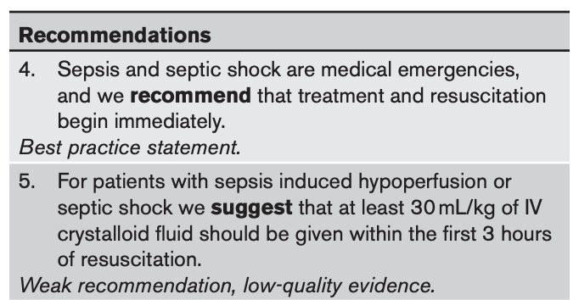
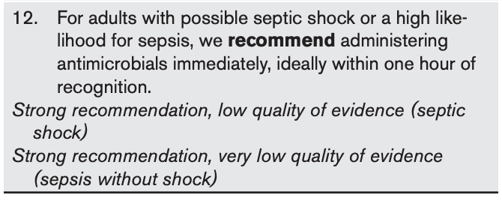
Sepsi e shock settico: prima è meglio
Sepsi e shock settico sono tempo-dipendenti!
Each additional hour of time from ED arrival to administration of antimicrobials is associated with 1.04-1.19 increased odds of in-hospital mortality
Evans L. et al. Surviving Sepsis Campaign: International Guidelines for Management of Sepsis and Septic Shock 2021. Critical Care Medicine 2021
Notes:
In a study of 49,331 patients treated at 149 New York hospitals, each additional hour of time from ED arrival to administration of antimicrobials was associated with 1.04 increased odds of in-hospital mortality, p < 0.001 (1.07 (95% CI, 1.05−1.09) for patients receiving vasopressors vs. 1.01 (95% CI, 0.99−1.04) for patients not on vasopressors) (98). In a study of 35,000 patients treated at Kaiser Permanente Northern California, each additional hour of time from ER arrival to administration of antimicrobials was associated with 1.09 increased odds of in-hospital mortality (1.07 for patients with “severe” sepsis [lactate ≥ 2, at least one episode of hypotension, required noninvasive or invasive mechanical ventilation or has organ dysfunction] and 1.14 for patients with septic shock); which equated to a 0.4% absolute mortality increase for “severe” sepsis and a 1.8% absolute increase for septic shock (110). Finally, in a study of 10,811 patients treated in four Utah hospitals, each hour delay in time from ED arrival to administration of antimicrobials was associated with 1.16 increased odds of in-hospital and 1.10 increased odds of 1-year mortality (1.13 in patients with hypotension vs 1.09 in patients without hypotension) (111).

Slide 17
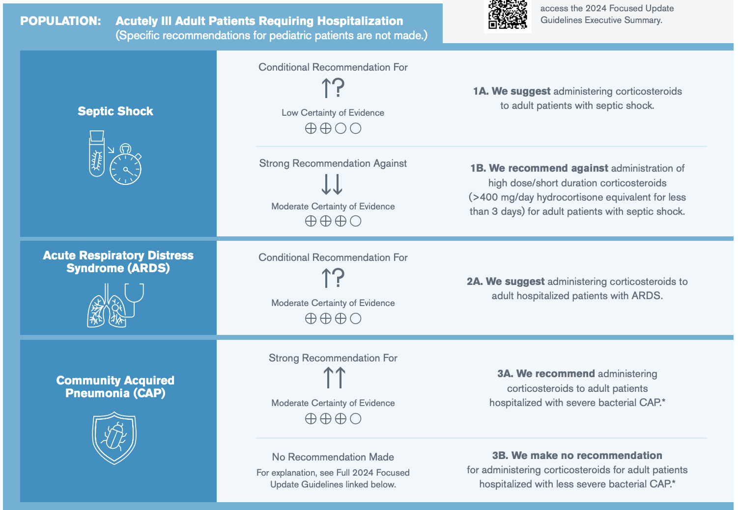
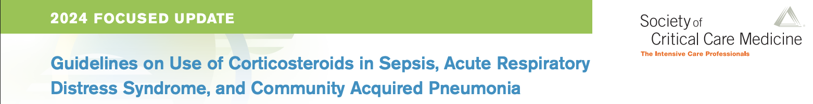
Glucocorticoidi in CAP/ARDS/shock settico
Notes:
Anti cytokine-storm

Slide 18
Sepsi e shock settico
Sepsis is a syndrome characterized by organ dysfunction (SOFA score ≥2 points) due to an aberrant immune response to an infection.
Mortality 10%
Septic shock = sepsis with persisting hypotension requiring vasopressors to maintain MAP ≥65 mm Hg and having a serum lactate level >2 mmol/L (18 mg/dL) despite adequate volume resuscitation.
Mortality 40%
Each additional hour of time from ED arrival to administration of antimicrobials is associated with 1.04-1.19 increased odds of in-hospital mortality
Evans L. et al. Surviving Sepsis Campaign: International Guidelines for Management of Sepsis and Septic Shock 2021. Critical Care Medicine 2021
Notes:
In a study of 49,331 patients treated at 149 New York hospitals, each additional hour of time from ED arrival to administration of antimicrobials was associated with 1.04 increased odds of in-hospital mortality, p < 0.001 (1.07 (95% CI, 1.05−1.09) for patients receiving vasopressors vs. 1.01 (95% CI, 0.99−1.04) for patients not on vasopressors) (98). In a study of 35,000 patients treated at Kaiser Permanente Northern California, each additional hour of time from ER arrival to administration of antimicrobials was associated with 1.09 increased odds of in-hospital mortality (1.07 for patients with “severe” sepsis [lactate ≥ 2, at least one episode of hypotension, required noninvasive or invasive mechanical ventilation or has organ dysfunction] and 1.14 for patients with septic shock); which equated to a 0.4% absolute mortality increase for “severe” sepsis and a 1.8% absolute increase for septic shock (110). Finally, in a study of 10,811 patients treated in four Utah hospitals, each hour delay in time from ED arrival to administration of antimicrobials was associated with 1.16 increased odds of in-hospital and 1.10 increased odds of 1-year mortality (1.13 in patients with hypotension vs 1.09 in patients without hypotension) (111).

Slide 19
sCAP: stratificazione del rischio
Although historically site of care (outpatient, inpatient general ward, or ICU) has served as a severity surrogate, decisions about site of care may be based on considerations other than severity and can vary widely between hospitals and practice sites.
Notes:
Approximately 40% of patients with CAP will require hospitalisation, and 5% of these patients will be admitted to the intensive care unit (ICU), primarily due to shock or the need for invasive or non-invasive mechanical ventilation [2]. Severe CAP (sCAP) is accepted terminology used to describe ICU-admitted patients with CAP as they might require organ support. Data from a large cohort (CAPNETZ) have shown that the highest mortality is observed in patients who do not meet these criteria initially but deteriorate over the course of time (sCAP on admission: 17%; sCAP on day 4 to 7: 48%)

Slide 20
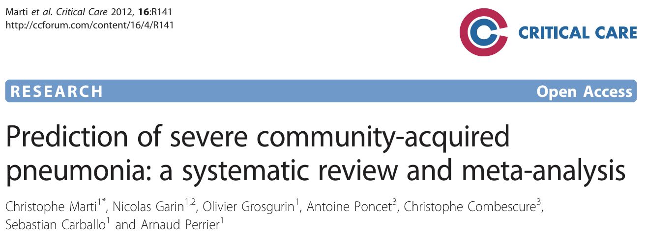
Stratificazione del rischio
We recommend that clinicians use a validated clinical prediction rule for prognosis, preferentially the Pneumonia Severity Index (PSI) over the CURB-65, to determine the need for hospitalization in adults diagnosed with CAP.
Several prognostic models have been designed to predict the need for higher levels of inpatient treatment intensity (ICU/mortality) using severity-of-illness parameters based on patient outcomes.
Simchen E. et al. Survival of critically ill patients hospitalized in and out of intensive care. Crit Care Med 2007
Notes:
Risk stratification tools that are used regularly include the Pneumonia Severity Index (PSI), British Thoracic Society (BTS) CURB-65 score (Table 4), and Severe Community- Acquired Pneumonia Score (Table 5) jointly produced by the American Thoracic Society and Infectious Disease Society of America (ATS/IDSA). 2 Both PSI and CURB-65 have been more extensively validated to recognize low-risk patients and are not as good at predicting need for critical care support. Other risk stratification scores have been developed, including SMART- COP (Table 6), which was created to help identify patients who may require invasive respiratory or vasopressor support. 4 Both ATS/IDSA and SMART-COP perform well as risk stratification tools in identifying patients who require ICU admission, but further validation is required for both.
Llgg consilgliano di usare score es psi ma può avere valore nella gestione extraospedaliera mentre non riesce a prevedere efficacemente l’outcome di scap e non può guidare il trattamento. Inoltre gli score possono sottostimare la gravità in pazienti giovani e non comorbidi
Question 6: Should a Clinical Prediction Rule for Prognosis plus Clinical Judgment versus Clinical Judgment Alone Be Used to Determine Inpatient versus Outpatient Treatment Location for Adults with CAP? Recommendation. In addition to clinical judgement, we recommend that clinicians use a validated clinical prediction rule for prognosis, preferentially the Pneumonia Severity Index (PSI) (strong recommendation, moderate quality of evidence) over the CURB-65 (tool based on confusion, urea level, respiratory rate, blood pressure, and age >65) (conditional recommendation, low quality of evidence), to determine the need for hospitalization in adults diagnosed with CAP.
The PSI and CURB-65 were not designed to help select the level of care needed by a patient who is hospitalized for CAP. Several prognostic models have been designed to predict the need for higher levels of inpatient treatment intensity using severity-of-illness parameters based on patient outcomes (ATS 2001, IDSA/ATS 2007, SMART-COP, and SCAP score). Studies of prognostic models have used different end points, including inpatient mortality (57, 58), ICU admission (57–59), receipt of intensive respiratory or vasopressor support (59, 60), or ICU admission plus receipt of a critical therapy (61). In comparative studies, these prognostic models yield higher overall accuracy than the PSI or CURB-65 when using illness outcomes other than mortality (58, 59, 61). The 2007 IDSA/ATS CAP guidelines recommended a set of two major and nine minor criteria to define severe pneumonia requiring ICU admission (Table 1). These criteria were based on empirical evidence from published studies and expert consensus. All elements are routinely available in emergency department settings and are electronically calculable (51, 61). Several groups have validated these criteria in pneumonia cohorts from different countries (57–59, 61), with a meta-analysis reporting one major or three minor criteria had a pooled sensitivity of 84% and a specificity of 78% for predicting ICU admission (62). Without the major criteria, a threshold of three or more minor criteria (recommended in the 2007 IDSA/ATS guideline) had a pooled sensitivity of 56% and specificity of 91% for predicting ICU admission (63).
SMART-COP is an alternative, validated prediction rule for identifying patients with pneumonia who need vasopressor support and/or mechanical ventilation. The eight SMART-COP criteria and the nine 2007 IDSA/ATS minor criteria have five overlapping elements: hypoxia, confusion, respiratory rate, multilobar radiographic opacities, and low systolic blood pressure. SMART-COP had a pooled sensitivity of 79% and specificity of 64% in predicting ICU admission
Liapikou A, Ferrer M, Polverino E, Balasso V, Esperatti M, Piñer R, et al. Severe community-acquired pneumonia: validation of the Infectious Diseases Society of America/American Thoracic Society guidelines to predict an intensive care unit admission. Clin Infect Dis 2009;48: 377–385. 58.
Phua J, See KC, Chan YH, Widjaja LS, Aung NW, Ngerng WJ, et al. Validation and clinical implications of the IDSA/ATS minor criteria for severe community-acquired pneumonia. Thorax 2009;64:598–603. 59.
Chalmers JD, Taylor JK, Mandal P, Choudhury G, Singanayagam A, Akram AR, et al. Validation of the Infectious Diseases Society of America/American Thoracic Society minor criteria for intensive care unit admission in community-acquired pneumonia patients without major criteria or contraindications to intensive care unit care. Clin Infect Dis 2011;53:503–511.

Slide 21
Stratificazione del rischio
La sCAP è un processo DINAMICO e rapidamente evolutivo…
…che cerchiamo di decifrare con strumenti STATICI
Gli score predittivi:
Forniscono una valutazione puntiforme che non tiene conto dell’evoluzione clinica
Sono stati disegnati e validati su popolazioni di studio diverse da quella di applicazione
Non danno informazioni su come migliorare l’outcome

Slide 22
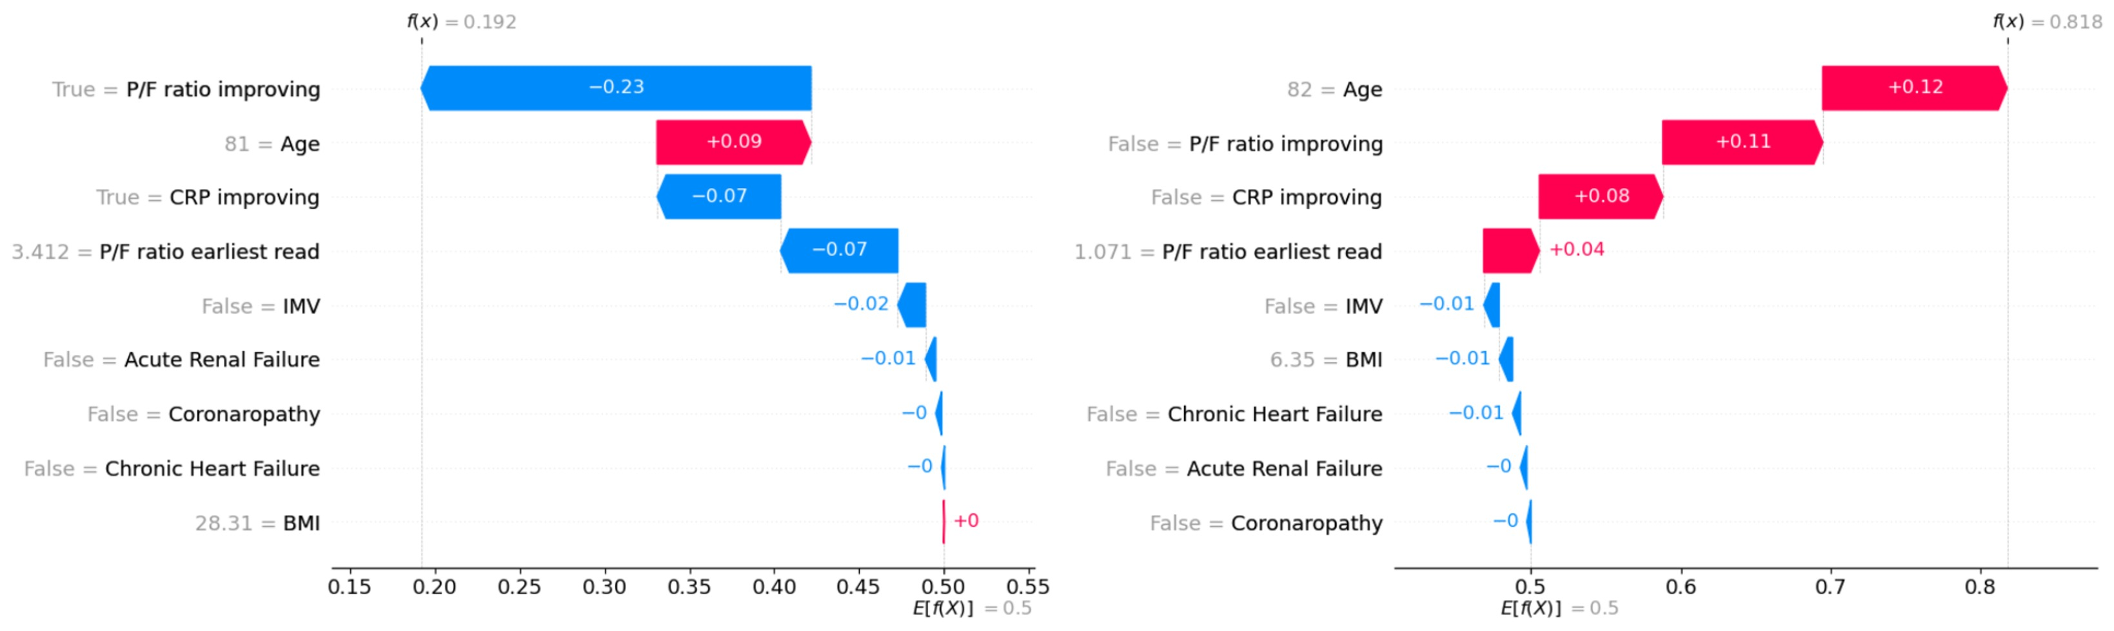
ML per la predizione dell’outcome
Paziente sopravvissuto
Paziente deceduto
Salton F et al., Int J Tuberc Lung Dis 2024
Notes:
Waterfall plots showing the SHAP values for all the features of two sample patients offer a local explanation of the model’s output, estimating the impact of each feature on the outcome predicted by the algorithm (RF). The color represents the sign of the SHAP contribution. Left Panel: Prediction for a survived patient; Right Panel: Prediction for a dead patient. The SHAP values attributed to the single features of the patients are sorted by the most influential factors for the individual prediction.

Slide 23

Actionable AI
Gli algoritmi predittivi «predicono» cosa succederà ma non danno informazioni su «cosa fare»
J.M. Smit, P.A. Van Der Zee, S.C.M. Stoof, M.E. Van Genderen, D. Snijders, W. G. Boersma, P. Confalonieri, F. Salton, M. Confalonieri et al. Lancet Respir Med 2025

Slide 24
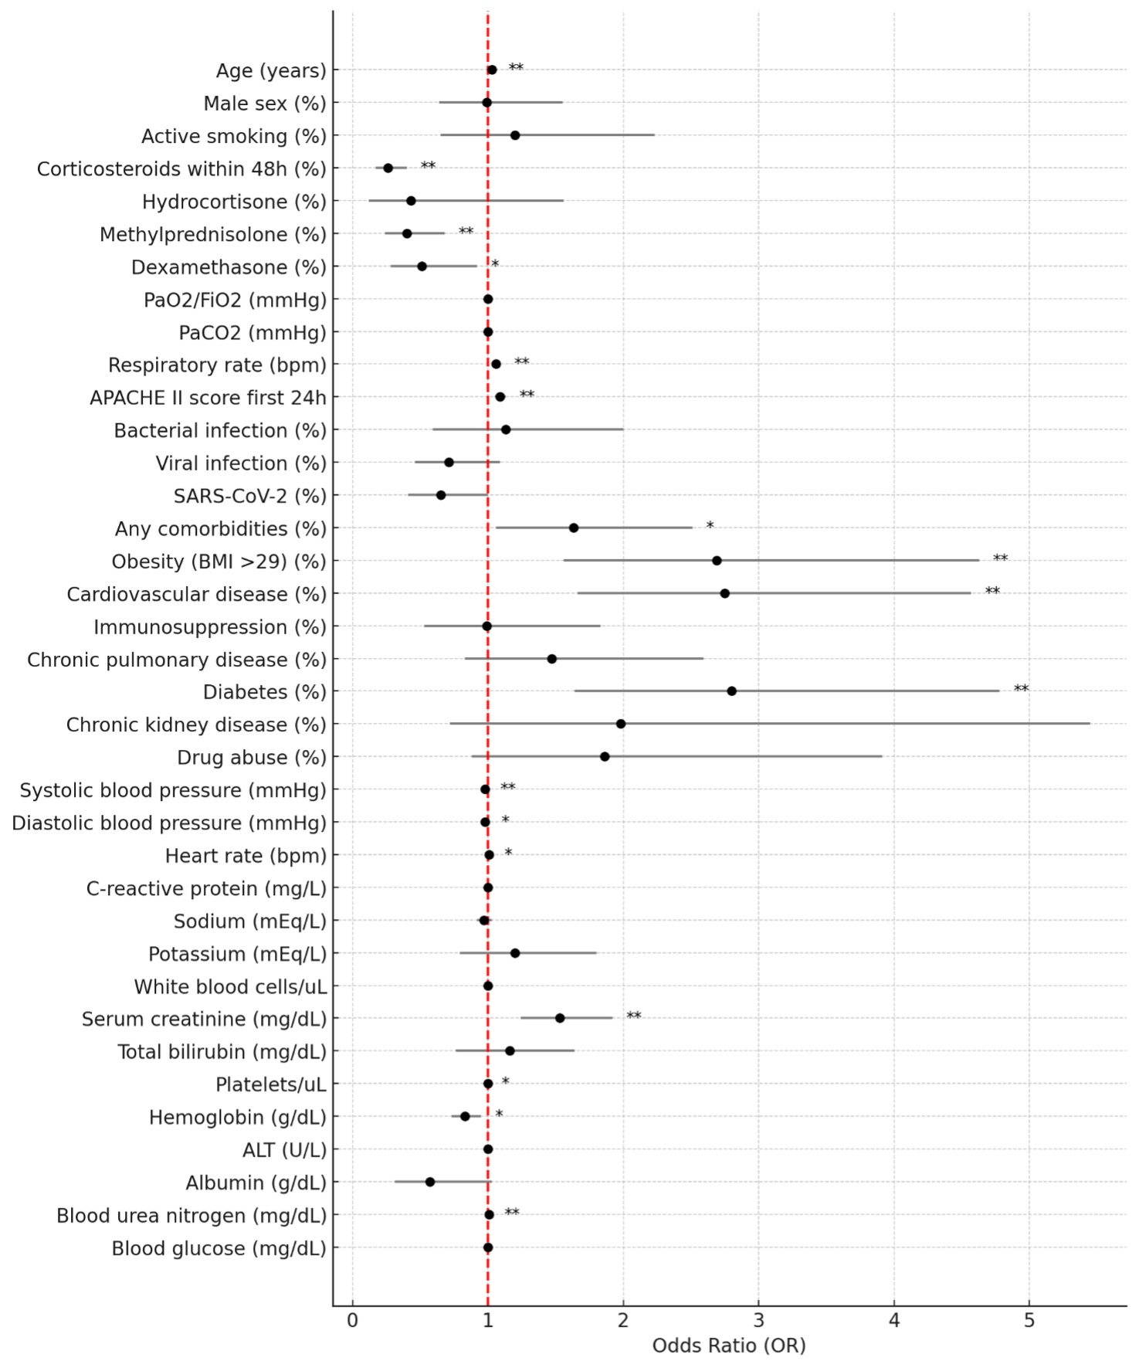
Polmoniti fulminanti in real life
Definizione: sCAP (ATS/IDSA) con decesso ≤ 7 giorni
1517 pazienti
Incidenza 89/1517 (5.6% )
COVID-19 164/1428 (11.5%) deceduti > 7 giorni Vs 12/89 (13.5%) ≤ 7 giorni
93.4% deceduti in ARDS, 70.2% sepsi, and 72.7% MOF
Glucocorticoidi <48h sono il fattore protettivo più forte (OR 0.26, CI 95% 0.16-0.40, p<0.001)
Fattori di rischio: età più avanzata, obesità, diabete, comorbidità cardiovascolare, insufficienza renale
Deceduti entro 48h = 19/1517 (1.3%)
Unpublished data

Slide 25
TAKE-HOME MESSAGES
Una piccola ma non trascurabile quota di sCAP ha decorso fulminante con decesso entro 7 giorni
Polmonite, sepsi e ARDS sono strettamente interconnesse dal punto di vista clinico e patogenetico e spesso si sovrappongono → infiammazione sistemica disregolata con MOF
Esistono linee-guida separate per polmonite grave, per ARDS, per sepsi
La CAP con i caratteri di gravità (criteri ATS/IDSA) dovrebbe essere considerata patologia tempo-dipendente
Nuovi metodi di scoring, che includono AI, possono migliorare le capacità predittive e la gestione
Notes:
I percorsi (a partire da PS) dovrebbero prevedere l’intervento precoce dello pneumologo (se presente UTIR)
Direzione: medicina di precisione anche in critical care

Slide 26


You are here

