Slide 1

La pneumopatia iatrogena a cui si pensa meno dellʼamiodarone
Sara Tomassetti, MD
Firenze, IT

Slide 2
COIs
Nessun conflitto sulla tematica trattata
Altro: speaker’s fees Boehringer – Ingelheim, ERBE; Research grant: Astra Zeneca; Consultancy: Boehringer –Ingelheim.

Slide 3




BOOK
Fibrotic Interstital Lung Diseases
Editors: AU Wells, S Tomassetti, S Walsh

Slide 4
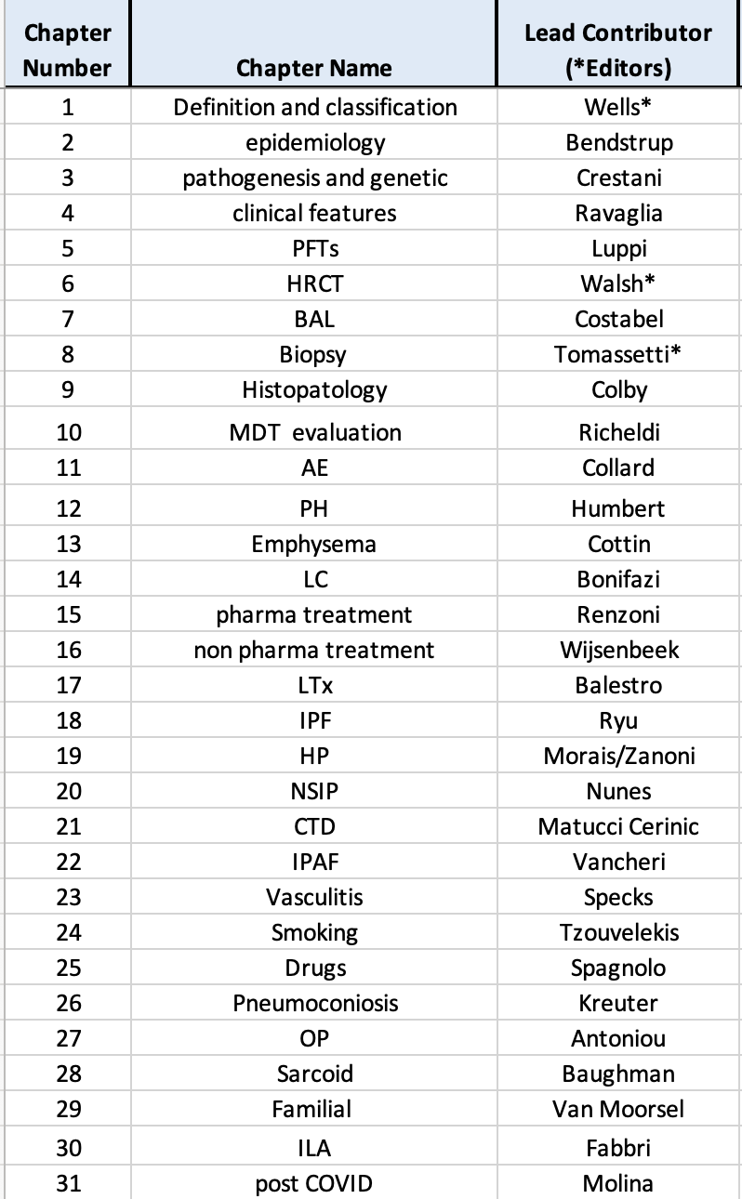

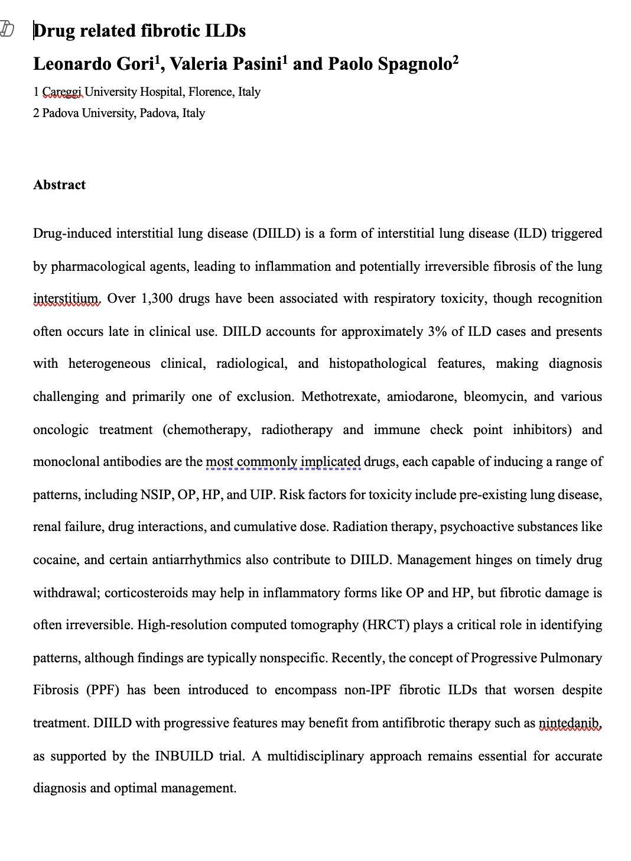
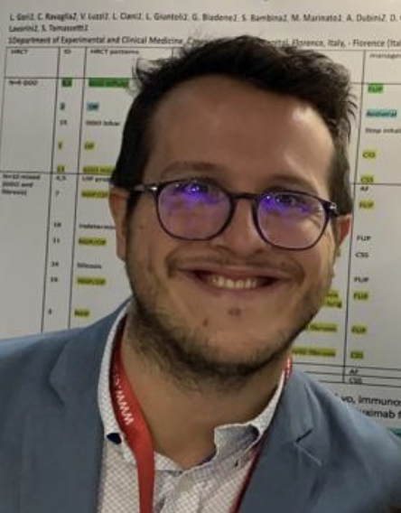
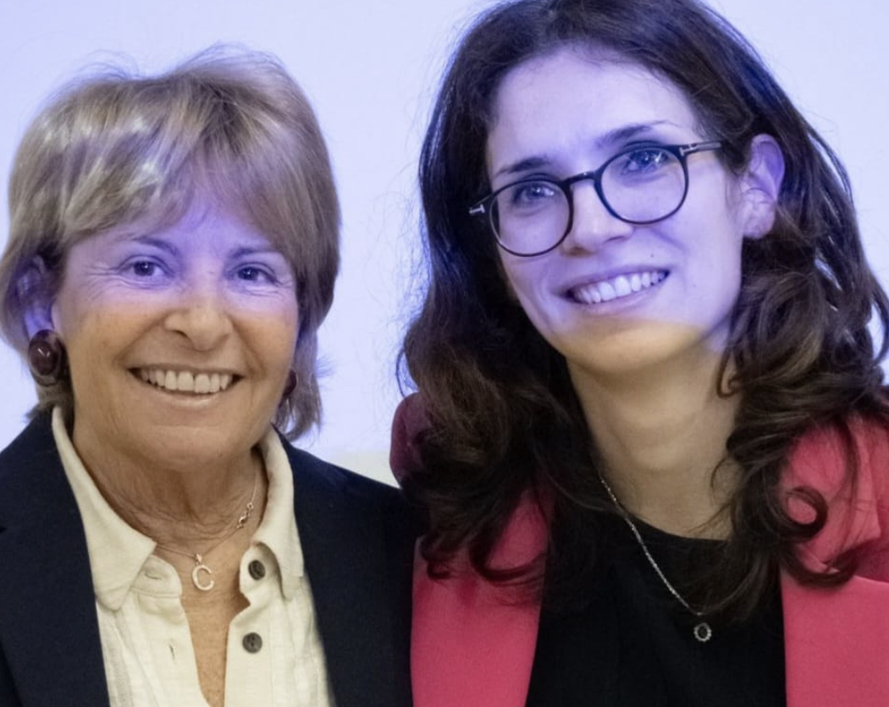

Slide 5
Drug Induced Lung Diseases (DILD)
Clinical relevance
Epidemiology
Pathogenesis
Diagnosis and management
Specific examples of DILD other than amiodarone

Slide 6
DILD - Clinical Relevance
ILD can be a severe and potentially fatal drug adverse reaction
If timely recognized and treated can be reversible
Fibrotic ILDs are less frequent than acute cases and may result from a persistent injury – not recognized and perpetuated pulmonary toxicity
Key message: always collect detailed drug history when evaluating an ILD, especially if the onset is acute-subacute.

Slide 7
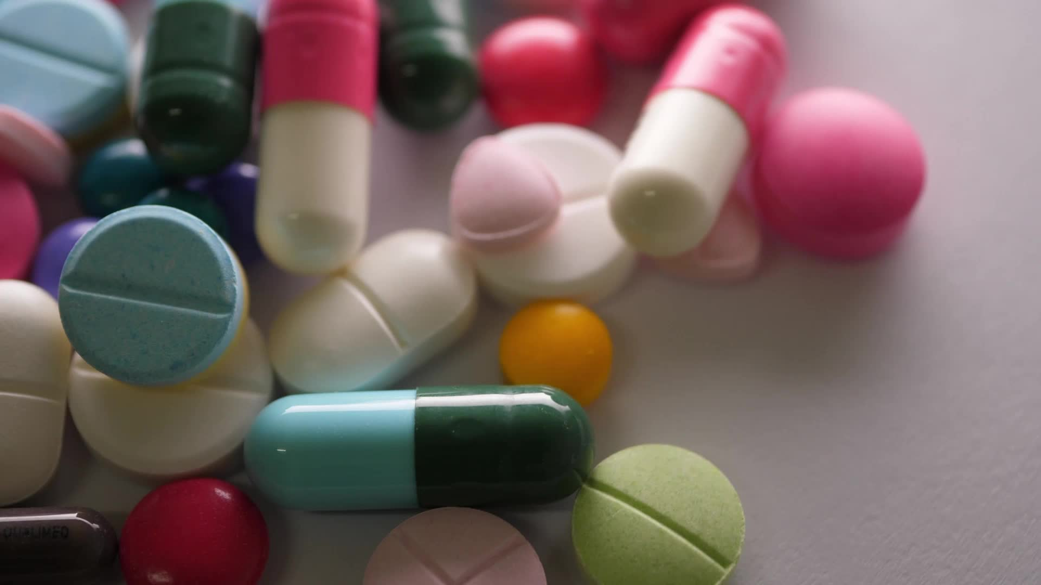
DILD - Epidemiology
Drugs account for 3% of all ILD cases and about 8-10% of acute lung injury (ALI) cases.
Drug ILD :
  Prevalence in the general population, 2.6/100.000
  Incidence in the general population, 1.2/100.000 year
Radiation induced ILD:
  Prevalence in the general population, 0.6/100.000
  Incidence in the general population, 0.1/100.000 year
Duchermann B. et al, ERJ 2017

Slide 8
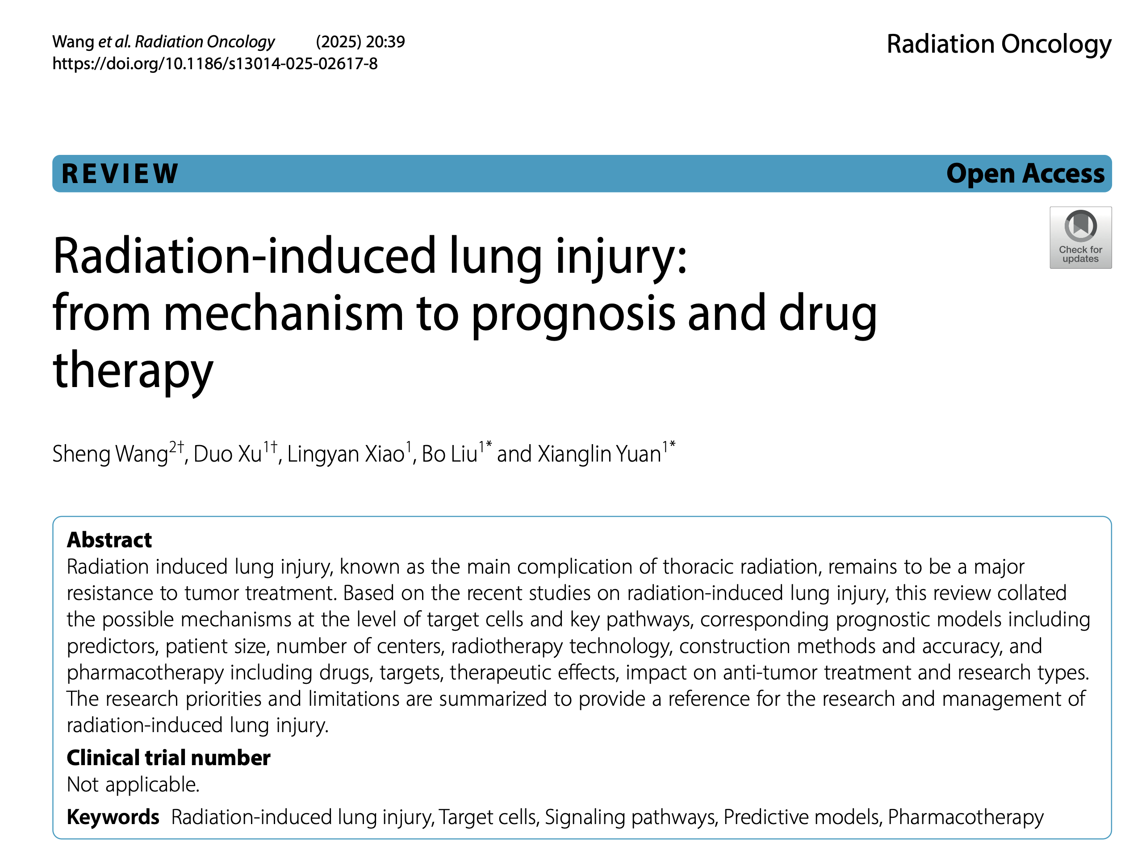

Slide 9
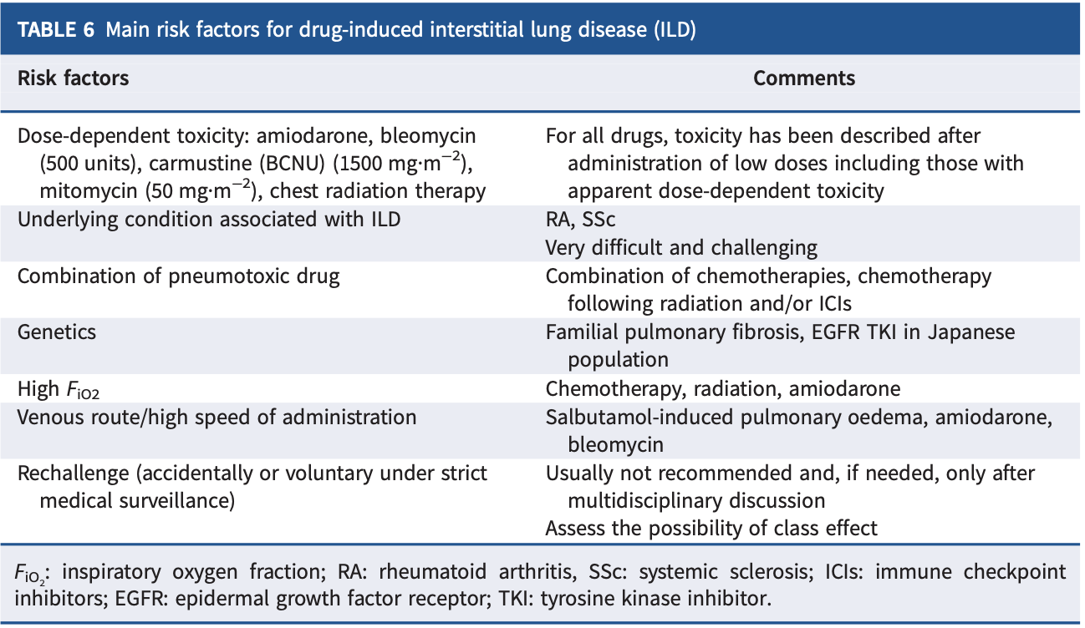
Spagnolo P et al, ERJ 2022

Slide 10
DILD – Pathogenetic Mechanisms
Direct cell toxicity, apoptosis (direct drugs mechanisms of action)
Cell toxicity through drugs metabolites (drugs biotransformation)
Oxygen radicals (drugs biotransformation, enhanced by O2)
Intracellular deposition of phospholipids (Macrophages - lipoid pneumonia; phospholipase dysregulation – Amiodarone and Amitriptiline)
Immune mediated lung toxicity (ICI)
drugs act as trigger
drugs dysregulate the immune system balance (acting as adjuvant of specific reactions or facilitator of certain immune mediated patterns of response)
Spagnolo P et al, ERJ 2022; Harrison et al, Expert rev Resp Med 2023

Slide 11
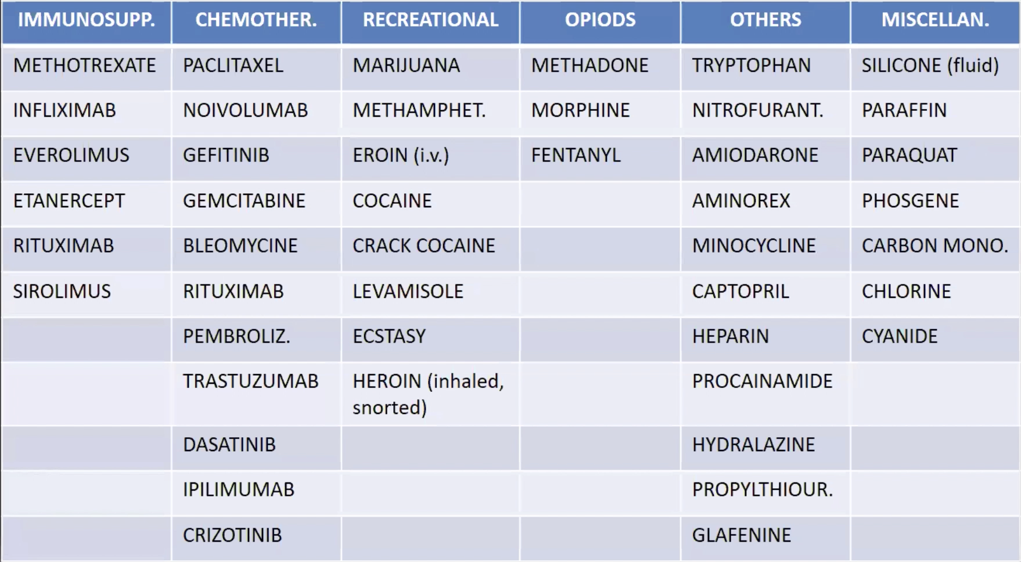
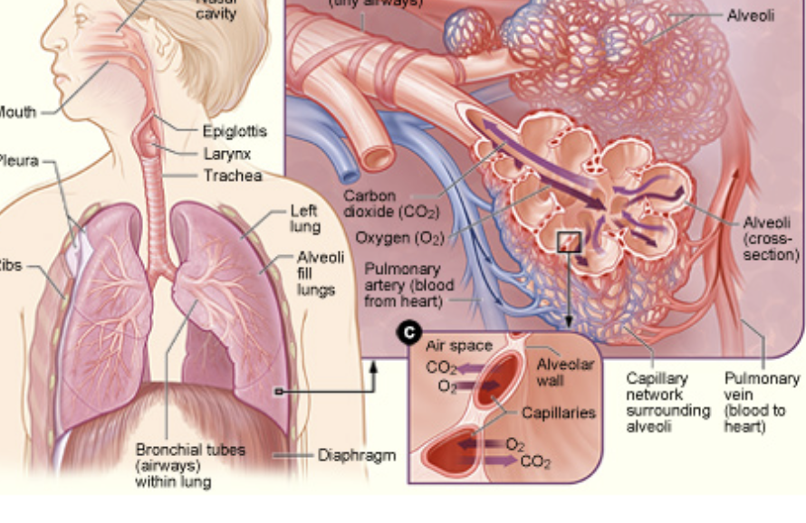


DILD – Pathogenesis, a complex scenario
several drugs
(more than 400
to date)
mechanisms of actions
time
and
dose
exposures
different targets
(airways,
alveoli, intersitium, capillary, pleura)
Patient’s
predisposition
Adapted from Spagnolo P et al, ERJ 2022

Slide 12
DILD, different patterns of lung damage
Pneumonitis
(Organizing Pneumonia, ALI)
Fibrosis
( NSIP, f-HP, rarely UIP)
Granulomatosis (HP, sarcoid)
Bronchiolitis (obliterans)
Vascular
(PVOD; Vasculitis; AH; PH)
Alveolar filling (lipoid pneumonia)
Non-DILD:
bronchospasm
Non cardiogeneic pulmonary edema
Pleural effusions
Spagnolo P et al, ERJ 2022

Slide 13
To note:
one drug can cause different patterns of damage
one pattern can be related to different drugs.
Spagnolo et al, ERJ 2022

Slide 14
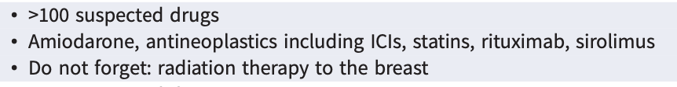
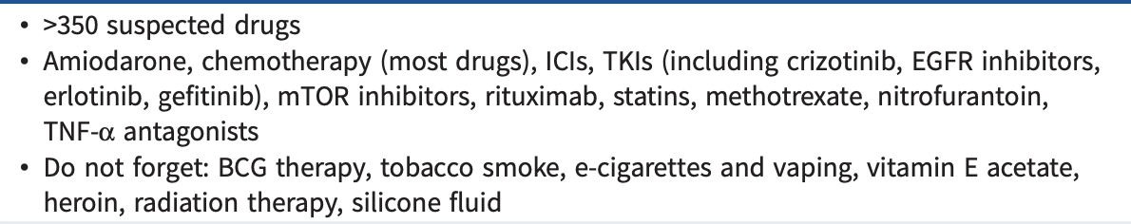
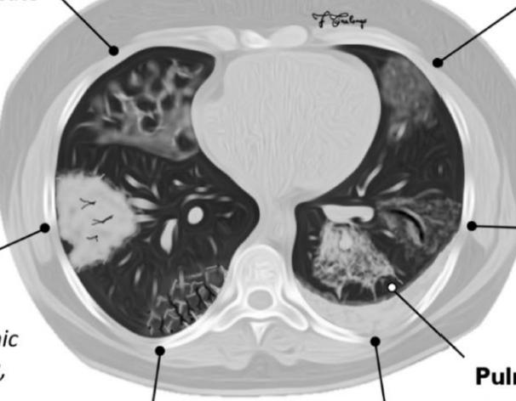
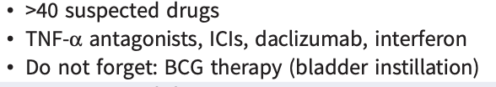
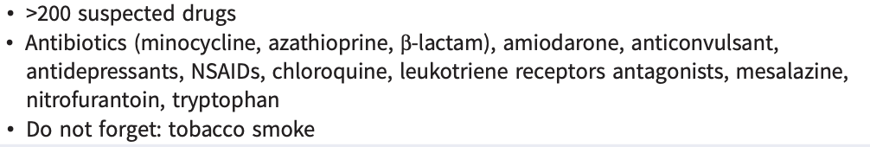
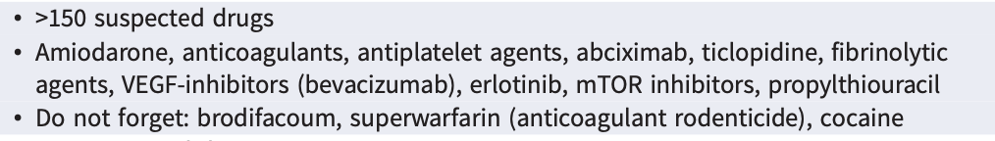
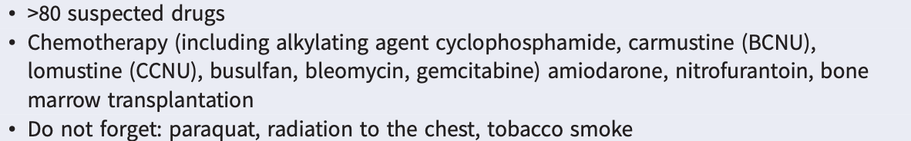

Organizing Pneumonia
Acute or subacute ILD (including ARDS)
Granulomatosis
Eosinophilic Pneumonia
Alveolar Hemorrhage
Pulmonary Fibrosis
To note: PPFE, 10 drugs CHT, BMT
Adapted from Spagnolo et al, ERJ 2002 and Distefano G et al, Diagnostics 2020

Slide 15

DILD diagnosis and management
Clinical reasoning – suspicion, medical history
Temporal relation between symptoms, DILD onset and drug
Exclusion of other causes (infection, congestive heart failure, radiation-induced lung injury, progression of the underlying disease, pulmonary embolism)
Improvement on drug withdrawal with or without corticosteroid therapy
Rechallenge (?)

Slide 16
DILD, BAL
Lymphocytosis
  Usually CD4 in OP, cellular or mixed NSIP, sarcoid-like reactions
  More often CD8+ in HP
Eosinophilia – Eosin Pneumonia
Neutrophilia (or mixed alveolitis, lymp + neutr) in DAD, with or without activated Pneumocytes
Macrophages hemosiderin laden – AH
Vacuolate Macrophages – Red oil positivity in Lipoid Pn (large irregular); Amiodarone, Amitriptiline (fine)

Slide 17
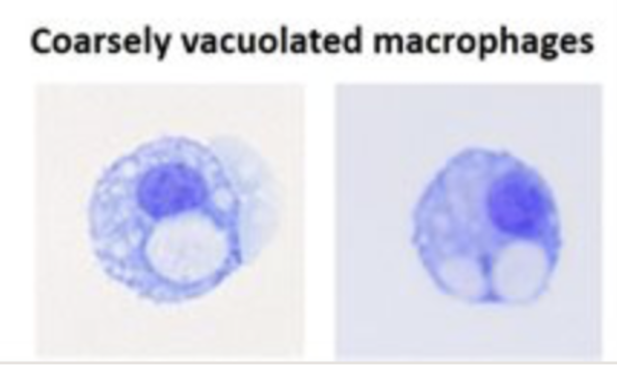
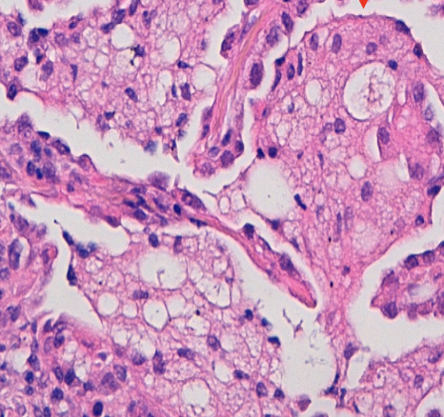
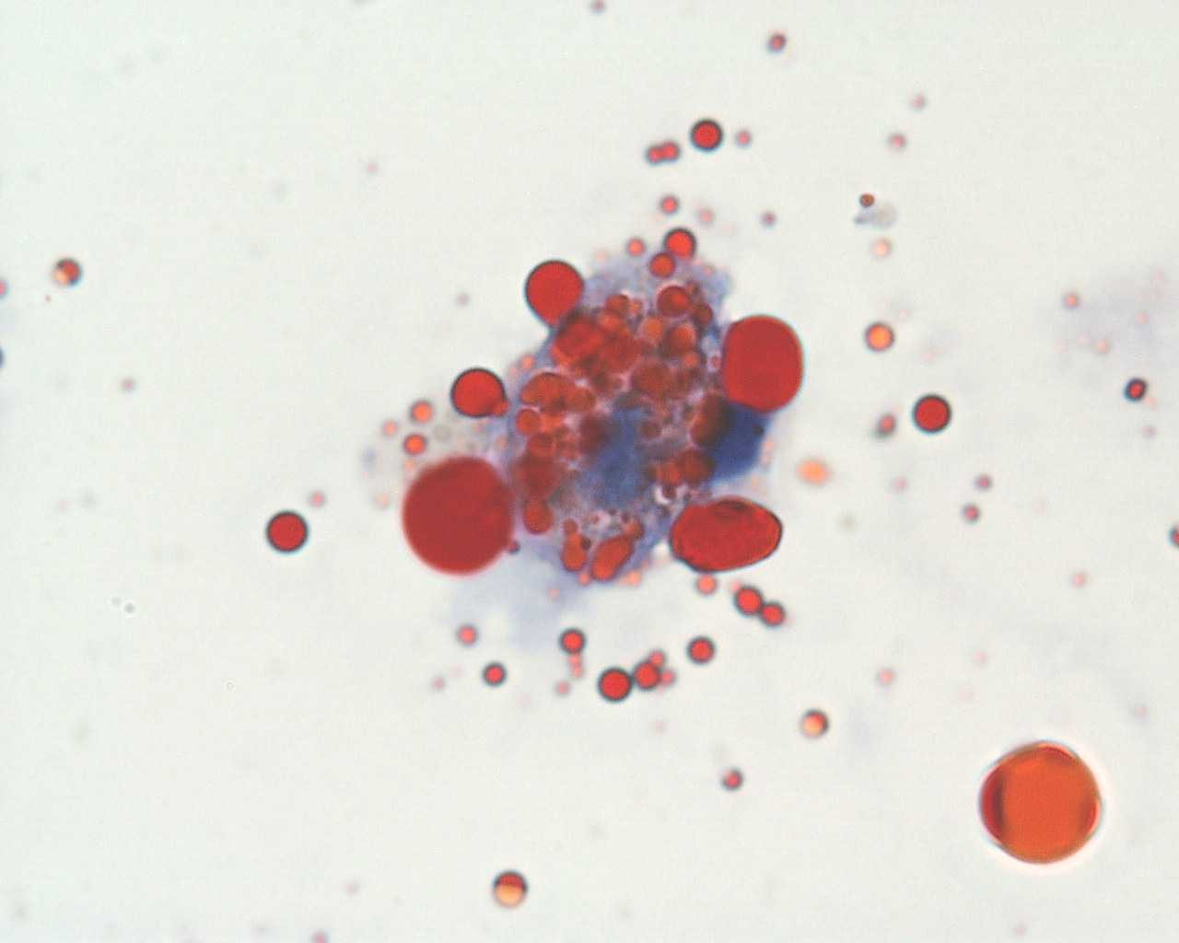
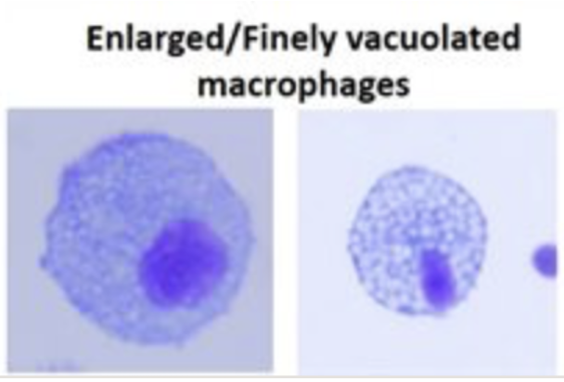
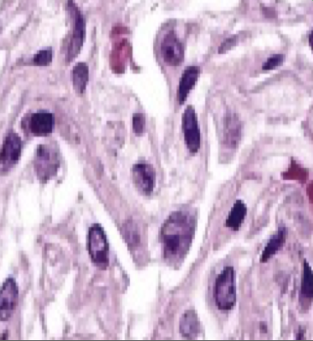
Lipoid
Pneumonia
Amiodarone

Slide 18
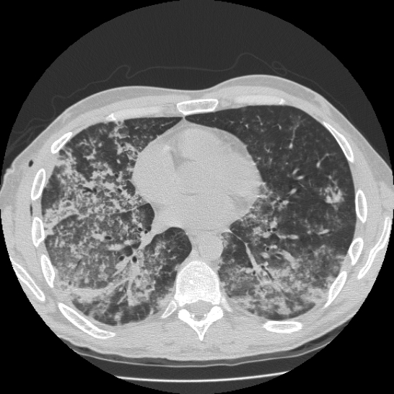
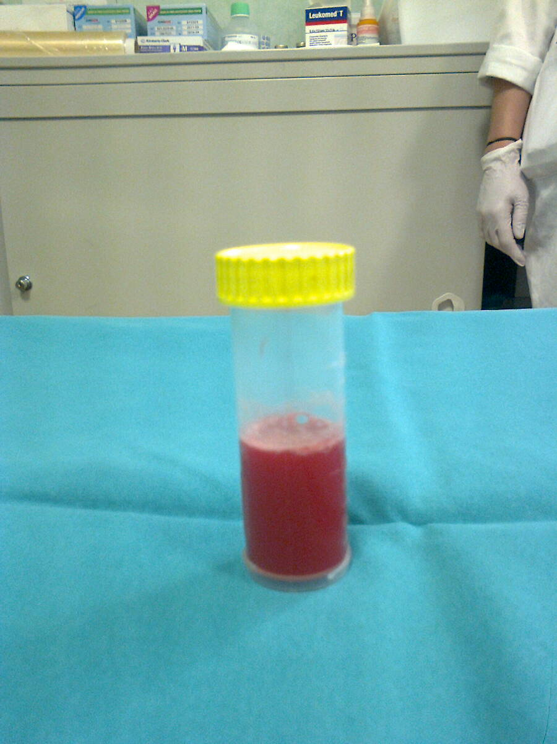
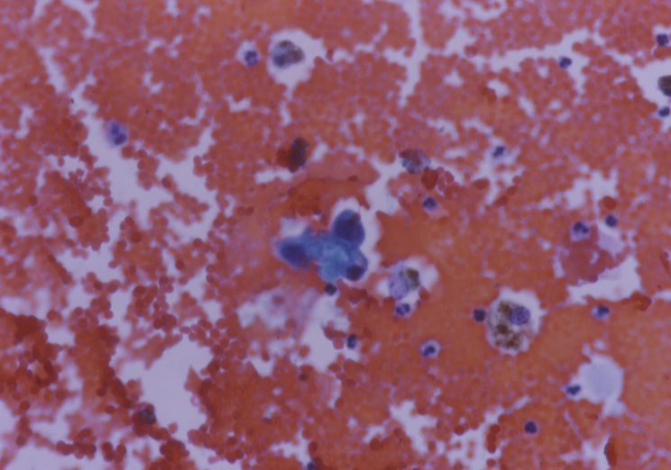
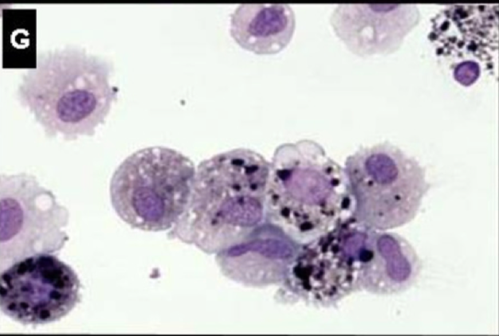

BAL in AH
Fresh alveolar hemorrhage, many erythrocites, and hyperplastic type II Pneumocytes
(emosiderin laden Mac)
1h, increased erythrocytes
48h, mac with phagocytosed erytrocytes fragments
72h, haemosiderin laden mac
May be accompanyed by neutrophilic, eosinophilic granulocytosis

Slide 19
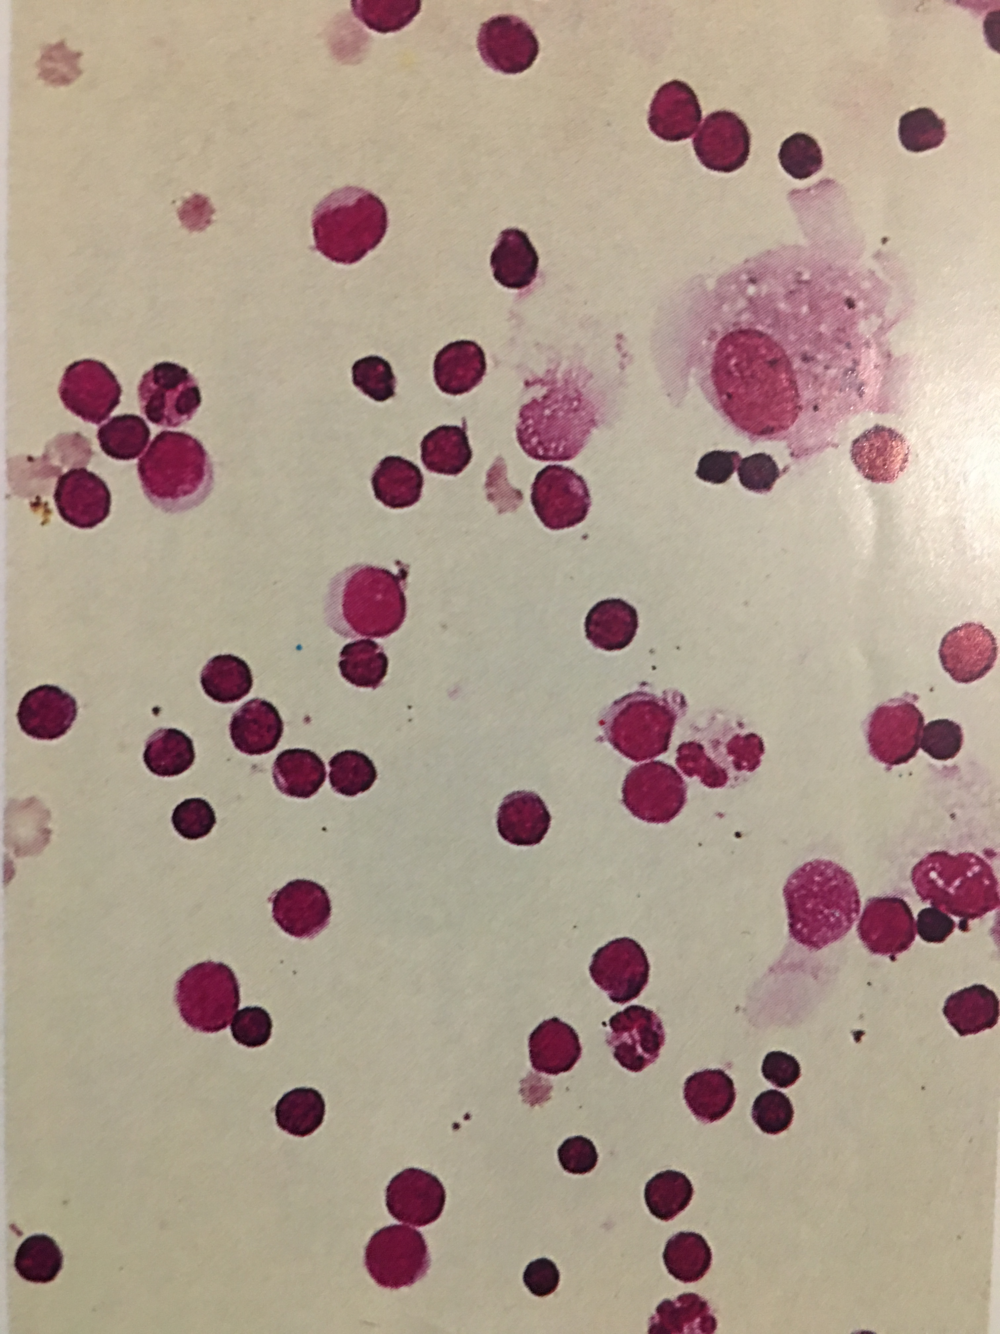
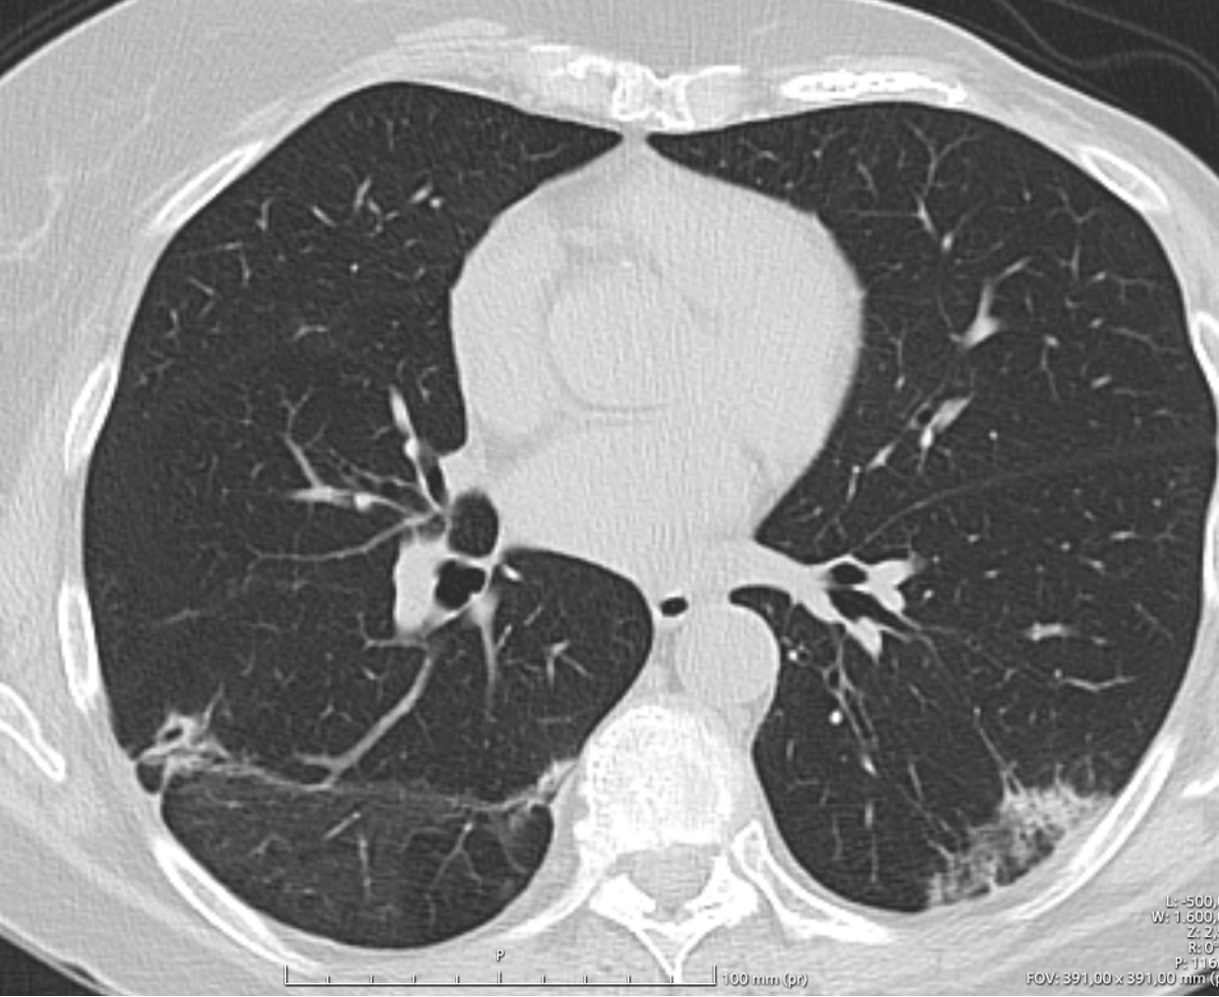
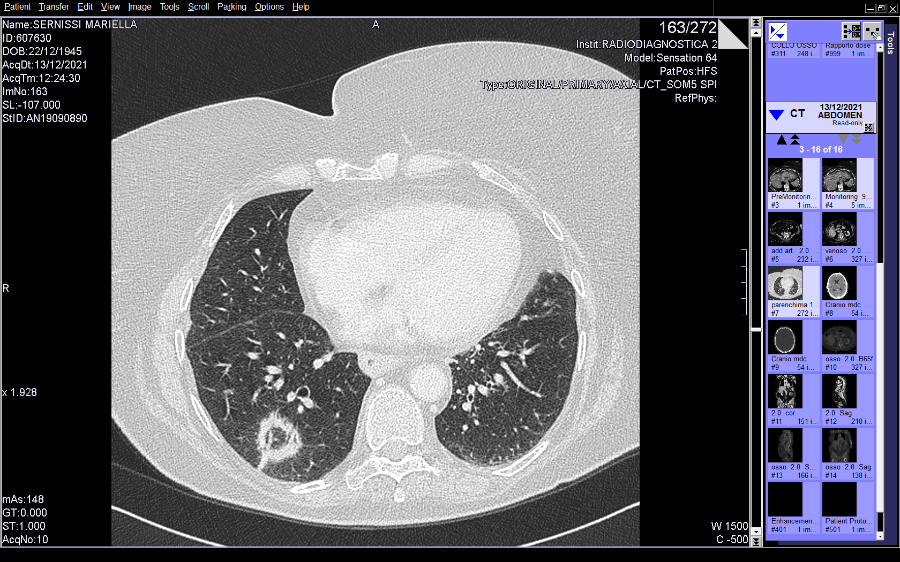
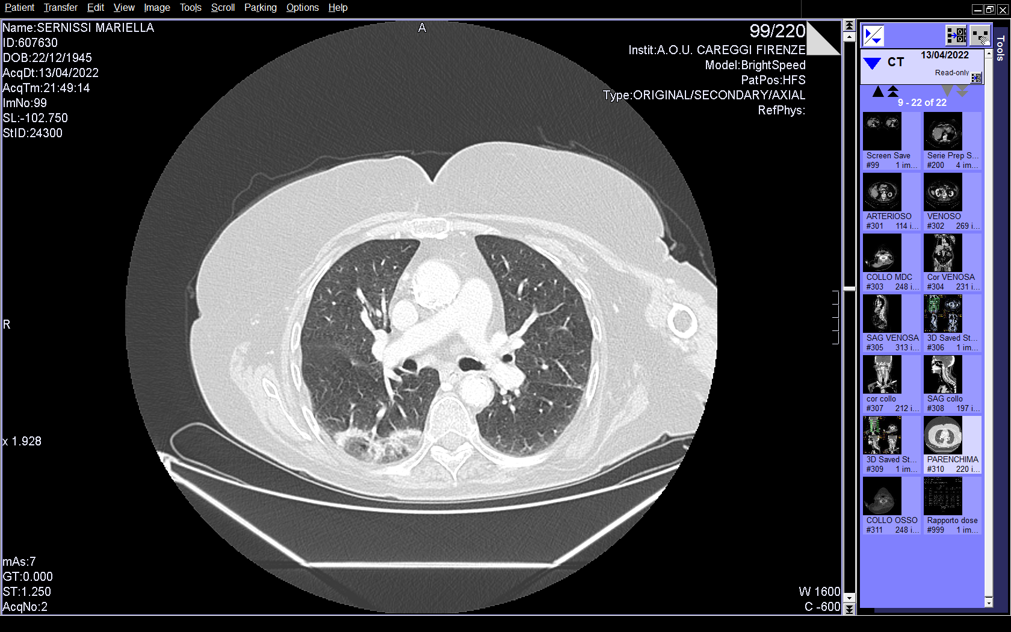
Organizing Pneumonia
BAL lymphocytosis
HCV, 3 months of Sofosbuvir
Lung ADK, Pembrolizumab
Antineoplastic drugs, among the most common causative agents
Notes:
Borgioli Fiorella Sofotivir
Sernissi Marinella pembrolizumab

Slide 20
Immune Check Point Inhibitors (ICI)
🧬 Anti-PD-1 (Programmed Death-1 inhibitors)
These drugs block the PD-1 receptor on T lymphocytes, reactivating the immune response against cancer cells.
Nivolumab
Pembrolizumab
Cemiplimab
🧪 Anti-PD-L1 (Programmed Death Ligand-1 inhibitors)
These block PD-L1, which is expressed by tumor cells or other cells in the tumor microenvironment, preventing the inhibition of T cells.
Atezolizumab
Avelumab
Durvalumab
🧯 Anti-CTLA-4 (Cytotoxic T-Lymphocyte–Associated protein 4 inhibitors)
These inhibit CTLA-4 on T cells, enhancing early immune activation against tumors.
Ipilimumab
Tremelimumab

Slide 21
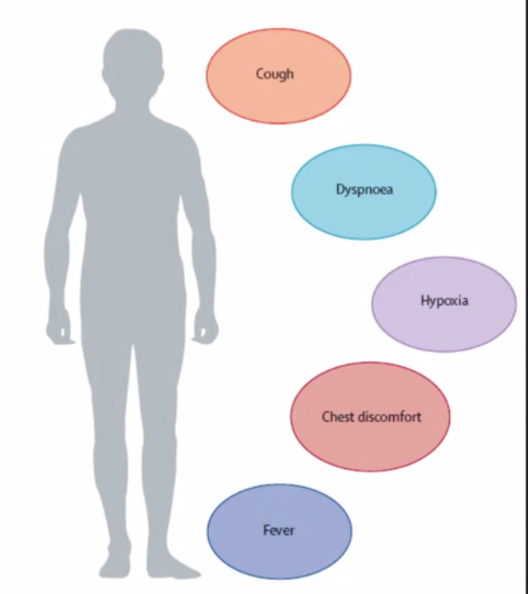
Antineoplastic drugs: ICI
  3-6% lung tox (grade > 2, 1-2%) – real life up to 19%
  Pathogen.: abnormal autoreactive T-cell activation
  Time: days to > 1 year after treatment initiation, median 3 months
  Patterns: OP (the most frequent, 65%), NSIP, HP, EoP, DAD, AH, sarcoid-like (to note, not-DILD: pleural, airway)
  Predictors (from RCT):
      Class of drugs: anti-PD1 > anti-PDL1 > anti–CTLA-4 ²
      Treatment factors: ICI combination > ICI monotherapy
      Tumor type: NSCLC > others; SQC >ADK
      Smoking history
      Underlying lung diseases ; autoimmune disease
      Asian > non asian
Rashdan S, LRM 2018; Spagnolo P et al, ERJ 2022; Nishino JAMA 2016

Slide 22
ICI lung tox management
Grade 1 (mild: asymptomatic, radiographic abnormalities only): ICI withdrawal should be discussed, although the benefit/risk balance of maintaining immunotherapy will generally encourage continuing ICI.
Grade 2 (moderate: symptoms without limitation of daily activities): requires ICI discontinuation; glucocorticoid treatment may be considered.
Grade 3 (severe: symptoms with limitation of daily activities, or requirement of oxygen therapy): requires definitive drug discontinuation and glucocorticoid treatment.
Grade 4 (life-threatening or disabling): requires definitive drug discontinuation and intravenous glucocorticoids; immunosuppressants may be needed.
Grade 5 (fatal).
Note: rechalleng may be indicated only for grade 1 and 2
Spagnolo P et al, ERJ 2022

Slide 23
Steroid-refractory ICI-pneumonitis
Courtesy of Prof. M Bonifazi

Slide 24
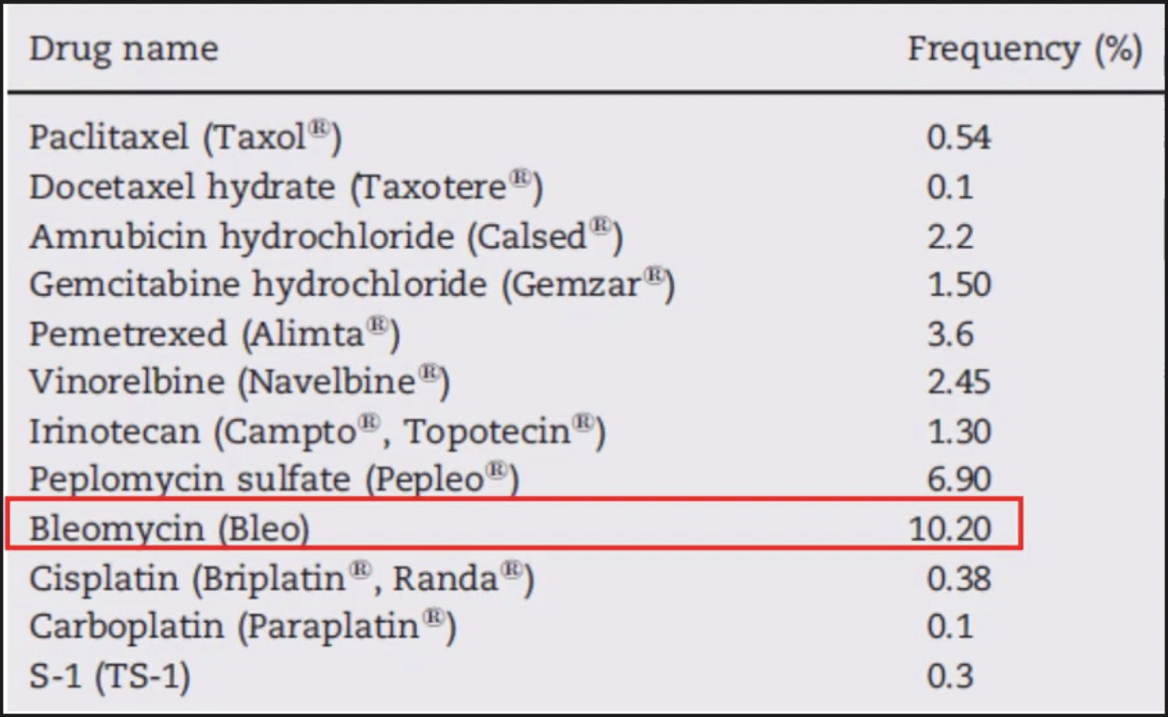
Antineoplastic drugs: CHT
10-20% lung tox
Pathogen: direct damage, ox stress, immune-mediated
Time: weeks to few months after treatment initiation
Among most common drugs: Bleomycin and Cyclophosphamide
Patterns: PPFE, UIP, NSIP, OP, DAD, AH, EoP and DIP
Kubo et al, Respir Invest 2013

Slide 25
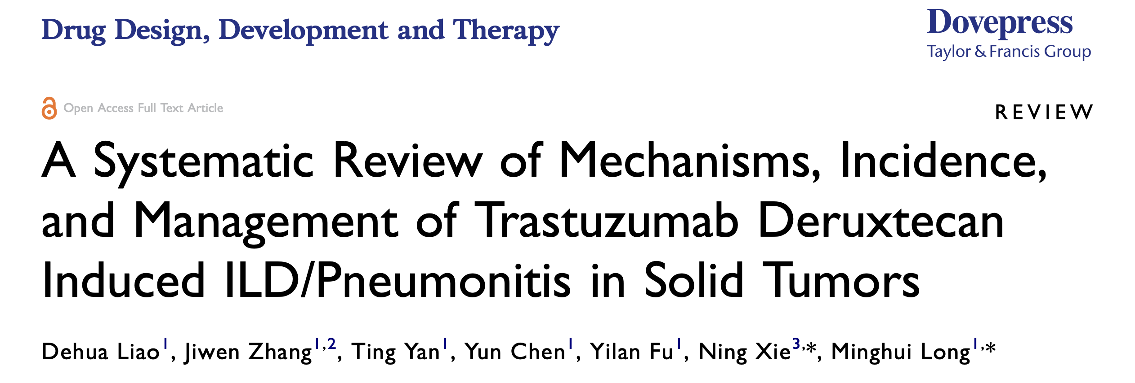
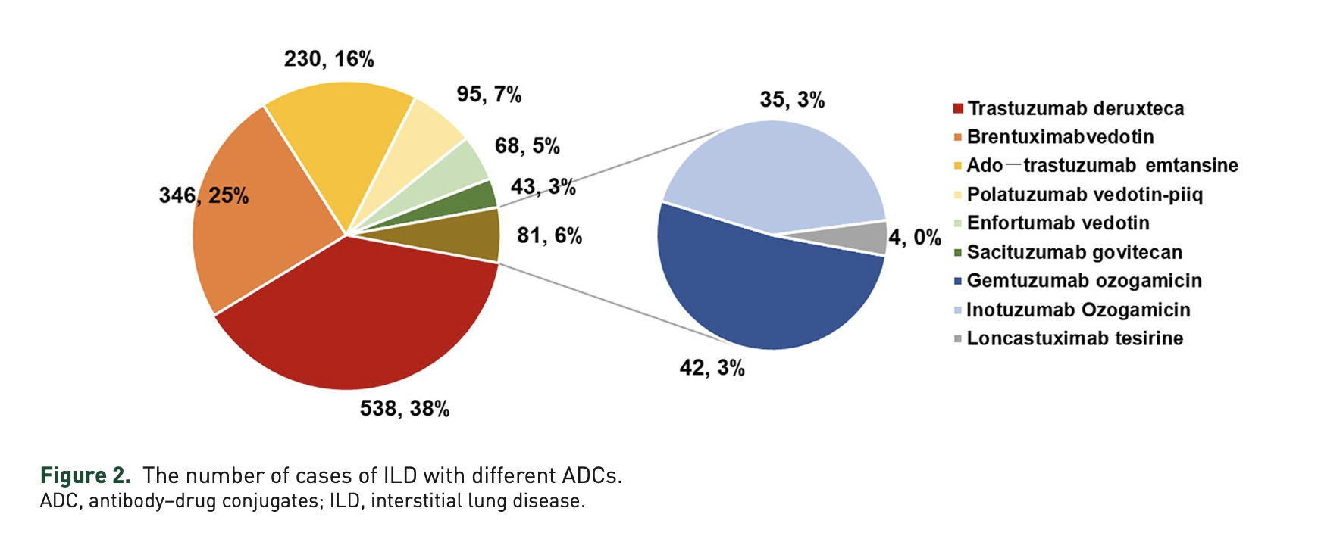
March, 2025
T-DXd indicated in HER2 solid tumors (breast, gastric, NSLC etc)
Incidence of ILD 12.4%
Any grade ILD, usually mild (G1-2)
breast cancer 9-16%
gastric 9-10%
NSCLC 6-26%
>G3 in less than 1%, with the exception of NSCLC 4.4%
Shi et al, Ther Adv RD, 2024

Slide 26
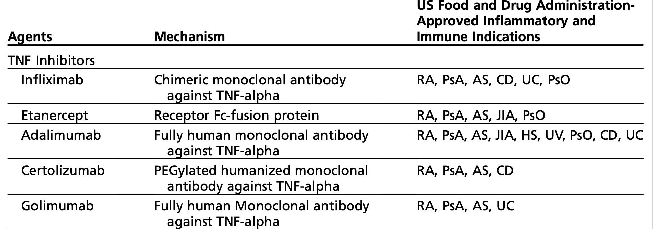
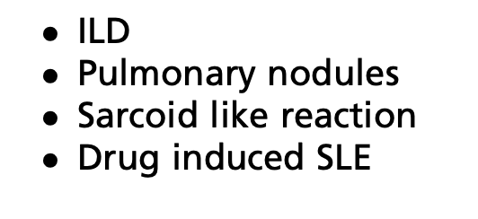
Pulmonary Complications of Biological Therapies in Inflammatory and Autoimmune Diseases
Yeo et al, Clin Chest Med 2025

Slide 27
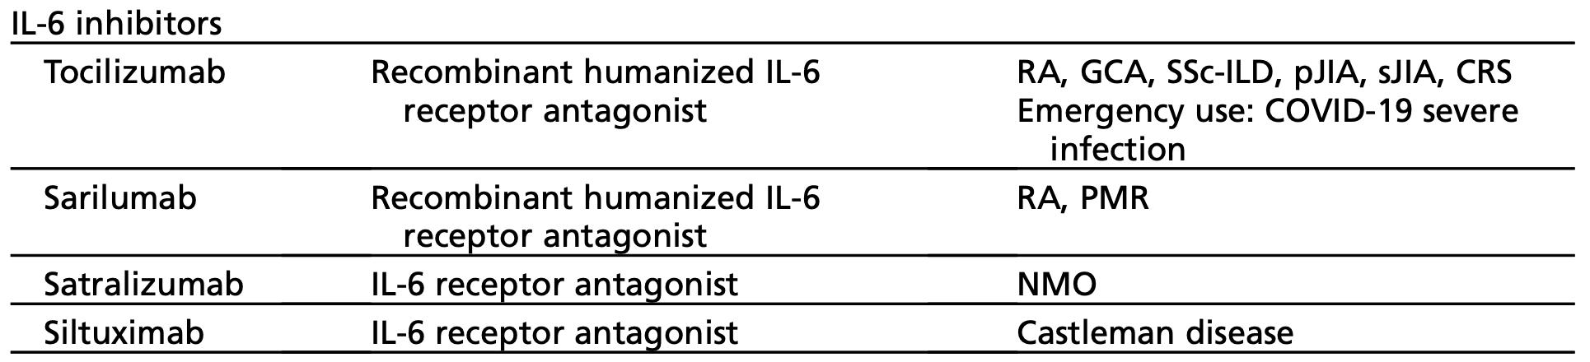
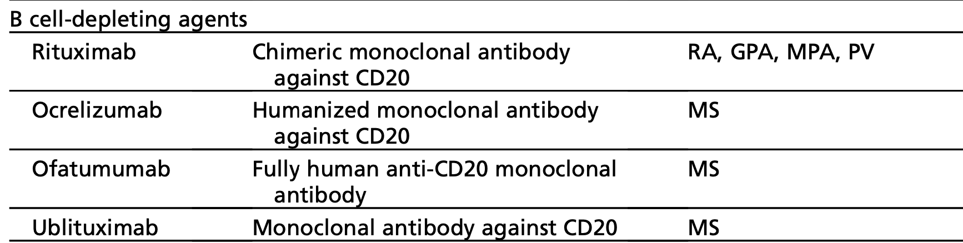

Pulmonary Complications of Biological Therapies in Inflammatory and Autoimmune Diseases
Yeo et al, Clin Chest Med 2025
….

Slide 28
Methotrexate is safer than previously thought
only 0.43% cases of MTX-induced pneumonitis occurred in a large SLR of MTX monotherapy in 3463 RA patients receiving the drug up to 36.5 months¹
in RA-ILD, MTX possibly is beneficial and not toxic²
MTX was associated with a decreased risk of ILD in a retrospective, case–control study of RA patients with (n=410) or without (n=673) ILD³
MTX and tofacitinib seems to decrease the risk of ILD in RA patients, in a recent SLR - respectively 0.49 (95 %C| 0.32 to 0.76, p < 0.001) and 0.36 (95 %C| 0.15 to 0.87, p = 0.024).⁴
1) Salliot et al, Ann Rheum Dis 2009; 2) Cottin ERJ 2021; 3) Juge et al, ERJ 2021; 4) Zhang et al, Semin Arthr Rheum 2024

Slide 29
Drugs that can cause AH
RECREATIONAL: cocaine and crack lung
INDUCED LUPUS (rare – induced vasculitis): Hydralazine; Procainamide; Propylthiouracil; Minocycline; Penicillamine
CHEMOTHERAPY (direct toxicity): Cyclophosphamide; Mitomycin C; Bleomycin; Cytarabine.
BIOLOGICS (very rare – induced vasculitis or IC deposition): RTX, sirolimus, tacrolimus.
Anticolagulants, trombolitics.

Slide 30


Some cases
Thanks to Elisabetta Rosi
Senior Pulmonologist,
Careggi Univ Hospital, Fi
GIM coordinator
Thanks to Lucia Del Frate
Pavia and Florence Univ
Resident

Slide 31
DILD
When more than one drug is involved …

Slide 32
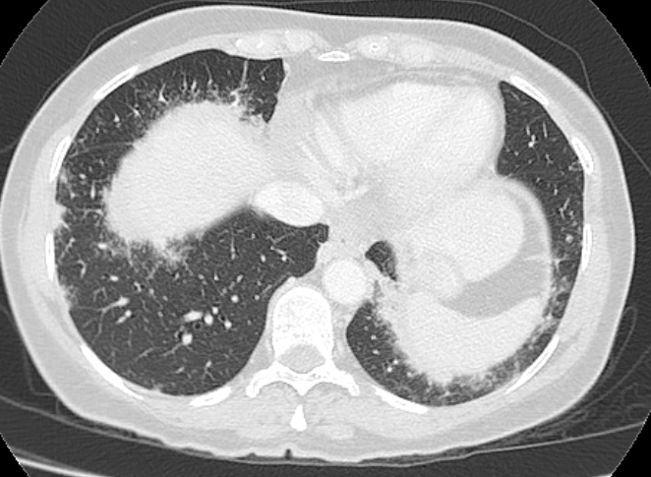
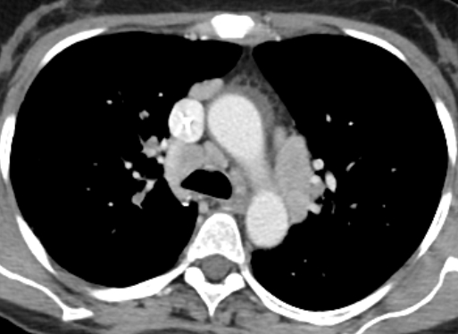
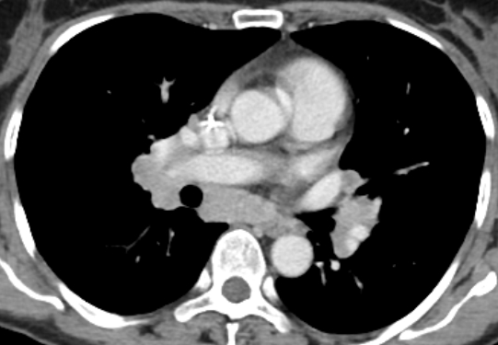
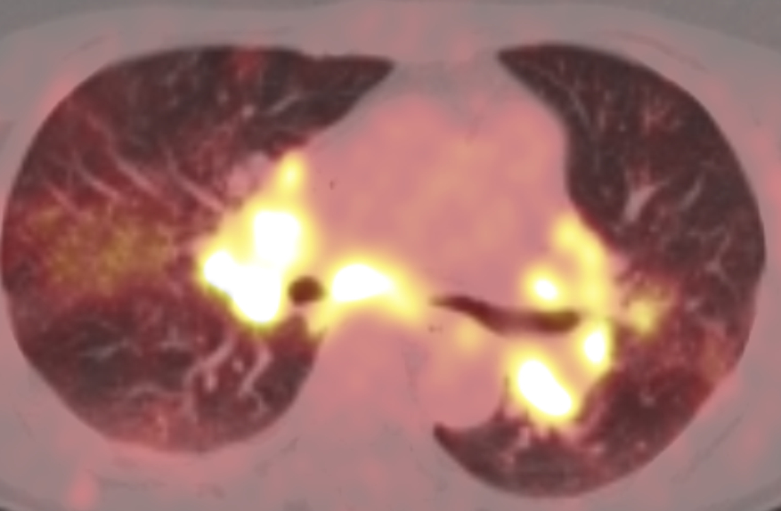
CASE #2
65 yo. F. Non-smoker. Exposed to flour at work.
Medical history:
-Invasive carcinoma of the left breast (12/2023). (note: no lung nodules and no mediastinal involvement at diagnosis)
→ Neoadjuvant therapy: from 12/2023 to 06/2024 7 cycles of chemotherapy and immunotherapy (Abraxane [nab-paclitaxel] + Atezolizumab).
→ 08/2024 left quadrantectomy was performed and immunotherapy was continued until September 2024.
On October 2024 the patient reports spontaneous onset of a dry cough and mild fatigue.
She also complains the appearance of a non-itchy papular rash, mainly on the palms of the hands and upper limbs since September 2024.

Slide 33
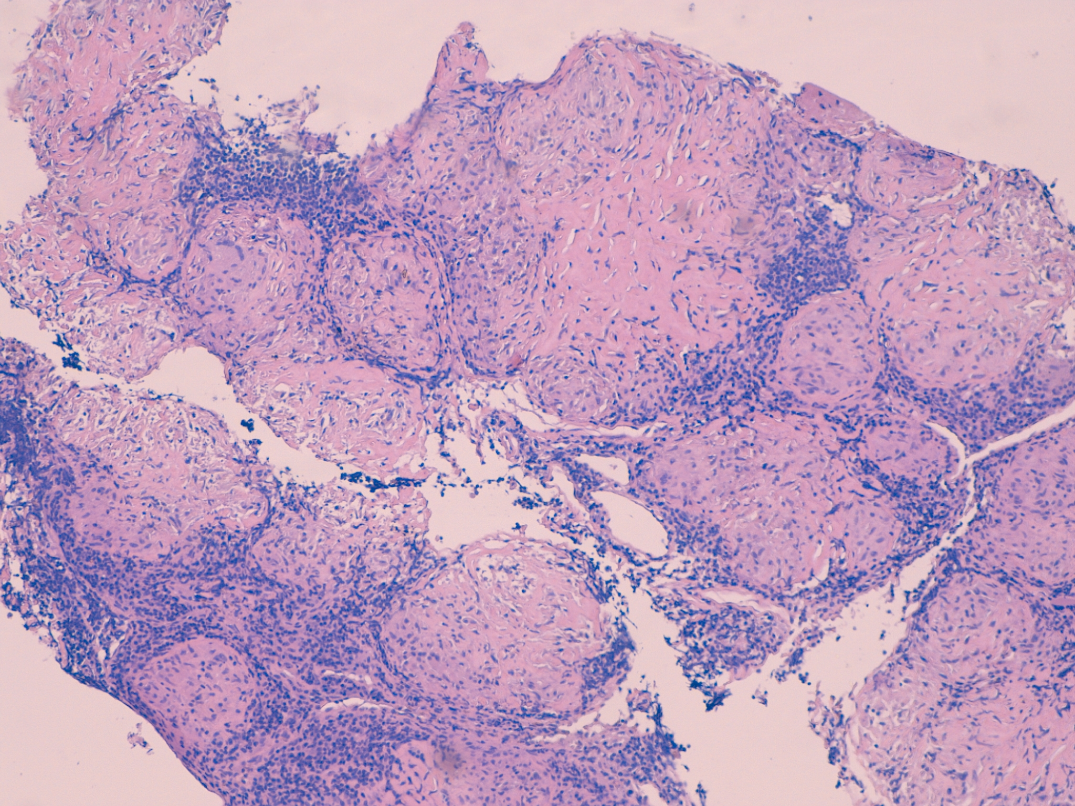
LN cryoBx
BAL:
Lymphocytes49.3%, CD4/CD8 15.
Monocytes/macrophages 49.2%
Neutrophils 1.4%
Eosinophils 0.1%.
Negative microbiology.

Slide 34
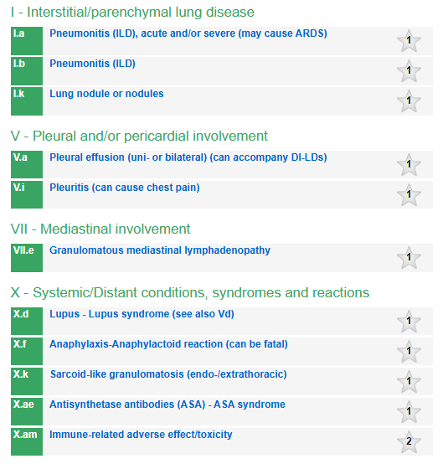
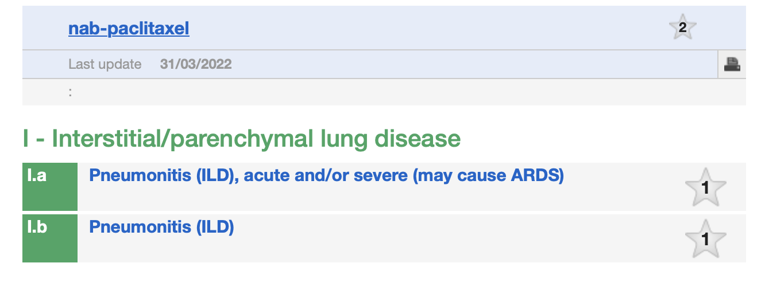
Conclusions
pneumotox.com
Atezolizumab
Abraxane

Slide 35
Resolution over time confirmed the diagnosis
On October 2024 Atezolizumab was discontinued and prednisone 25 mg in a slow-tapering dose was introduced. RT was initiated in November.
On February 2025 a CT scan showed clear reduction of both parenchimal nodules and mediastinal lymphoadenopathies.
Both dry cough and skin lesions has solved.

Slide 36
Mild DILD from unknown drug tox:
when pneumotox doesn’t help

Slide 37
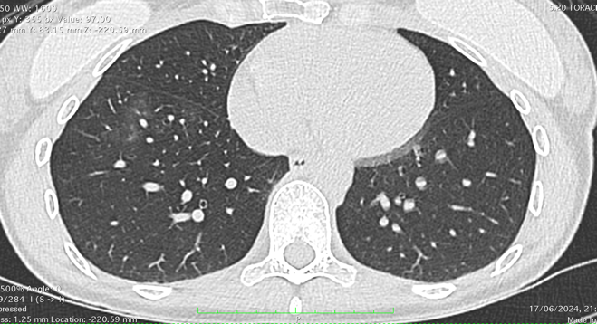
41 yo, F, never smoker.
Migraine, treated with Ab anti CGRP (galcanezumab)
TD: galcanezumab 120mg s.c. monthly (since 5-3-24).
In May 2024 (after 2 months) flu-like syndrome, no fever, persistent asthenia.
Pneumotox: 0 results
BAL: Lymphocytosis 73%, prevalence CD8+ 8, ratio 0.6.
Galcanezumab was stoped with symptoms and HRCT resolution.

Slide 38

DILD - dramatic but reversible
Thanks to Luca Ciani
Interventional Pulmonologist
Careggi Univeristy Hospital,
Florence

Slide 39
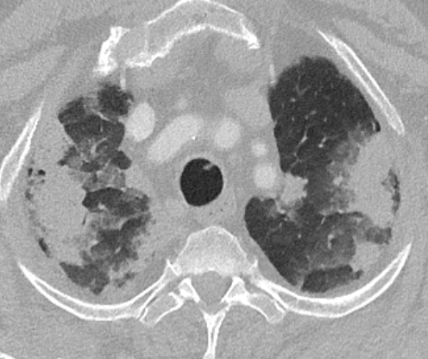
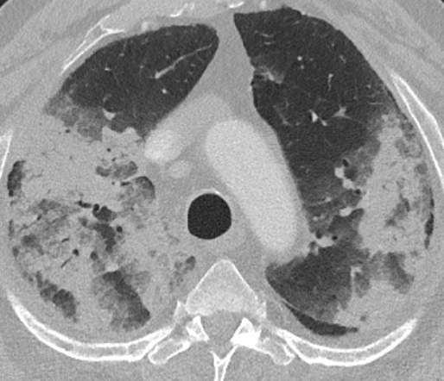
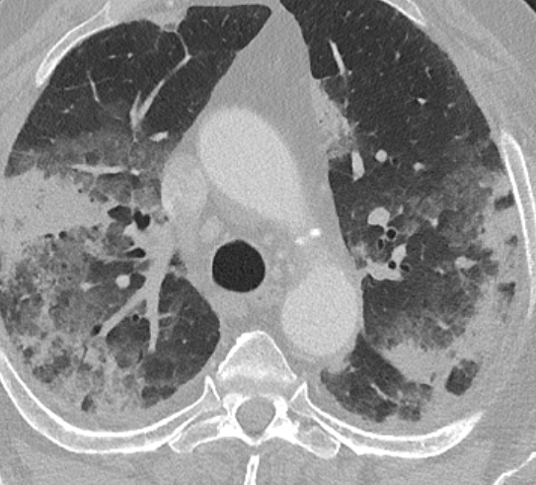
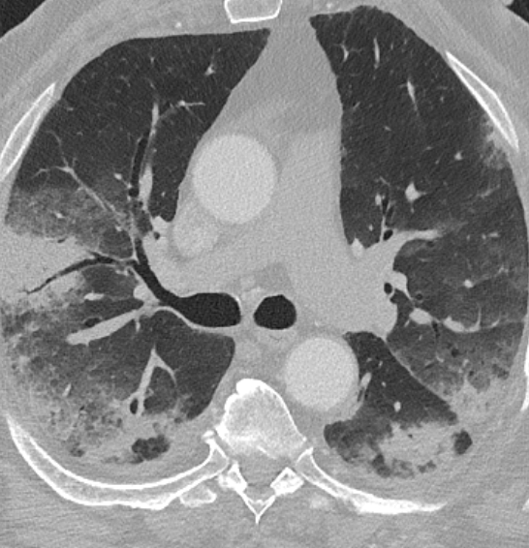
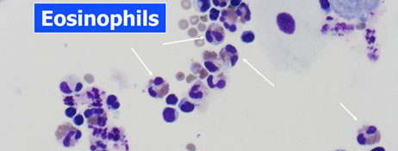
Male, 72 y/o, former smoker (stop in 1981, 10 p/y).
Arterial hypertension, dyslipidemia, MI PTCA and stenting in 2014. Home therapy: cardioaspirin, ramipril, bisoprolol, statin
Admitted for erysipela in Int Med. Normal respiratory sound, eupnoic in room air, with SpO2 97%. Chest X-ray normal. Treatment with Tazocin and daptomycin, after one week he develops respiratory failure, low oxygen flow, bilateral inspiratory crackles , LAB: mild anemia (Hb 11 g/dL), no leukocytosis (WBC 8000/mm³), CRP 130 mg/L, PCT 0.99 mg/L, ESR 69 mm/h.
Daptomycin, Pneumotox:
  ARDS, AFOP, cNSIP, OP
  Eosinophilic pneumonias (both acute and chronic)
  PPFE
48% eosinophils

Slide 40



CSS treatment, daptomycin stop
The chest CT at one month shows a significant reduction in pulmonary consolidations

Slide 41
The devil is in the details

Slide 42





74yo
Breast cancer
Amiodarone treatment
Trombotic microangiopathy
Spirometry lower limit with very severe reduction in DLco
OP
BAL lymphocytosis

Slide 43
Conclusions
DILD diagnosis: clinical reasoning (history, temporality), HRCT and BAL are the key elements
LBx can be useful in selected cases
Pneumotox is currently a fundamental tool for DILD, emerging AI tool will change the scenario soon.
Treatment is suspension of the drug and
  acute-subacute inflammatory DILD -> CSS,
  fibrotic progressive DILD -> Nintedanib is a currently available option and Nerandomilast an interesting new drug (trial data not yet available).

Slide 44
Thank you

Slide 45

Review of 47 relevant articles, 33 cases.
EudraVigilance database : 11.334 AE related to Montelukast, 746 (6%) were EGPA, fatal EGPA in 7 (0.69%)
Treatment duration 12.7months (wide range from <1 to 48 months)
Clinical characteristics:
Females (63%),
Lung is the most frequently involved and biopsied site,
neuropathy (54% of cases), fever and cutaneous manifestations (48% of patients), arthralgia or myalgia (45%), sinusitis (33%) and cardiac symptoms (15%).
Treatment: CSS in all, cyclophosphamide or azathioprine in 1/3
Notes:
73% adults

Slide 46
DILD, laboratory findings
Increased eosinophils
  eosinophilic pneumonia
  rarely, hypersensitivity pneumonitis (HP)
  mild eosinophilia, in other DILD not presenting as eosinophilic pneumonia (i.e. amiodarone-induced pulmonary disease),

Slide 47
DILD
The importance of the clinical scenario, when OP is not so obvious

Slide 48


CASE #1
Hospital Admission, Oct 2023

Slide 49
CASE #1
Hospital Admission, Oct 2023
Female, 23 years old
Non-smoker. Student. No familial history of pneumopathies.
Medical history:
- Relapse of Ulcerative Colitis known since 12/2022 and under treatment with Mesalazine since then (Pentacol 1200 mg 3 times/day).
Mild anemia Hb 10. mg/dl, neutrophils 11’000/mmc, CRP 41 mg/l.
BAL Lymphocytes: 32.5%; CD4/CD8 = 3.3
Monocytes/Macrophages: 62.9%
Neutrophils: 4.0%
Eosinophils: 0.6%
Negative microbiology-virology
OP related to the disease or to the drug? Mesalazine was stopped, Infliximab was started, the lesion resolved.

Slide 50


pneumotox.com

