Slide 1
COPD or something else?
How can we do better in the diagnostic workup of smoking-related lung diseases
Robert Vassallo, M.D.
Pulmonary and Critical Care Medicine
Trieste – May 2025

Slide 2
Disclosures Non-Federal funding / Financial Relationship(s) in past 5 years:
Research Grant Funding from Pfizer, Bristol Myers Squibb, Sun Pharmaceuticals.
I have participated as a co-investigator on the Genentech sponsored TRAIL-1 clinical trial (Pirfenidone for RA-ILD).
Consulting activity with Rion LLC, Sanofi and Regeneron.
Off Label Usage - None

Slide 3
What is “COPD”
COPD is a multifactorial and heterogeneous lung condition characterized by chronic respiratory symptoms (dyspnea, cough, sputum production and/or exacerbations) due to abnormalities of the airways (bronchitis, bronchiolitis) and/or alveoli (emphysema) that cause persistent, often progressive, airflow obstruction.
Page 4: GOLD 2025 report

Slide 4
Clinical Case #1 - History
Chief complaint: Shortness of breath.
72-year-old former smoker – cumulative 35 pack years – referred for a second opinion: “Does the patient have COPD?”
First noted dyspnea five years ago after pneumonia – told to have COPD.
Started on fluticasone/salmeterol ➔ no relief.
The patient was able to do activities of daily living, but experienced dyspnea with any activity.

Slide 5
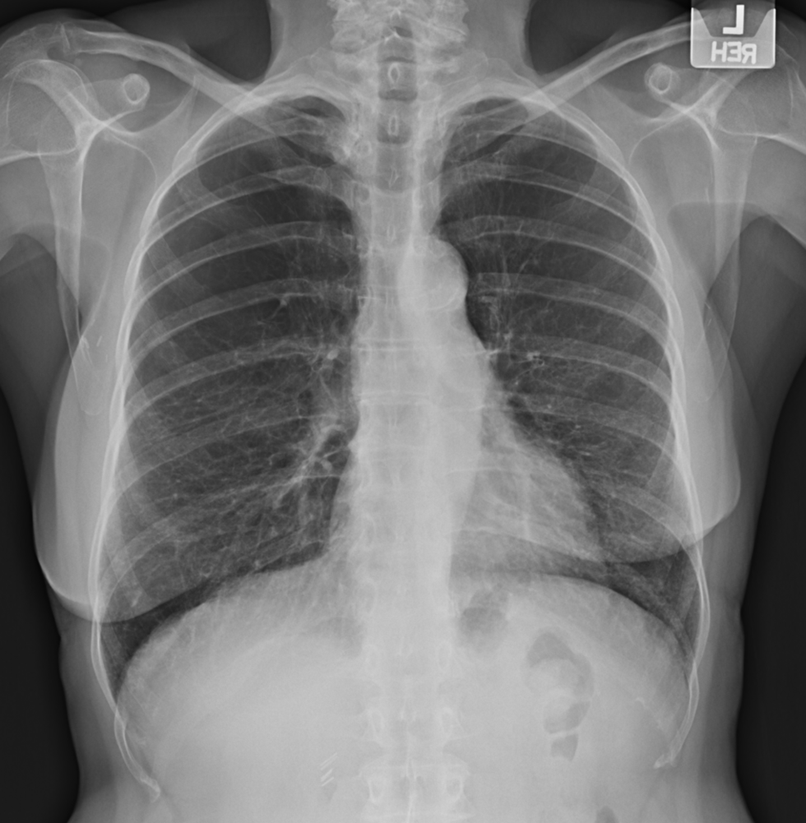
Pulmonary function studies:
FEV1: 1.68L (79% predicted)
FVC: 2.8L (105% predicted)
FEV1/FVC: 59
The patient was informed, “You likely have mild COPD, but this does not explain your shortness of breath. Maybe you are anxious….”

Slide 6
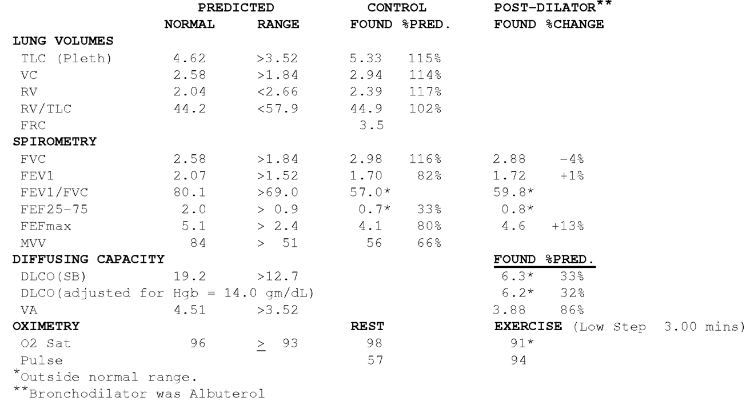
Pulmonary Function Testing – repeated spirometry with lung volumes and DLCO

Slide 7
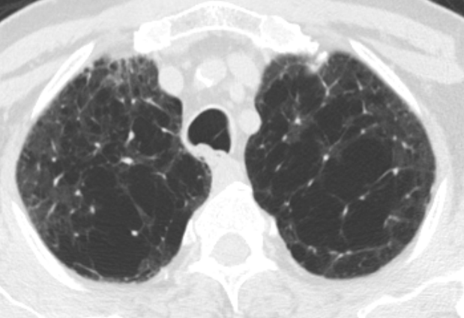
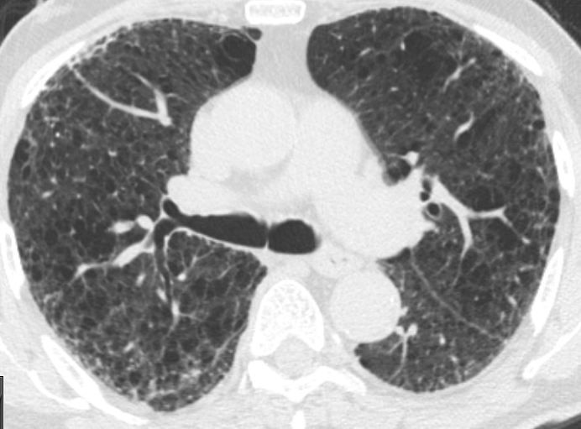
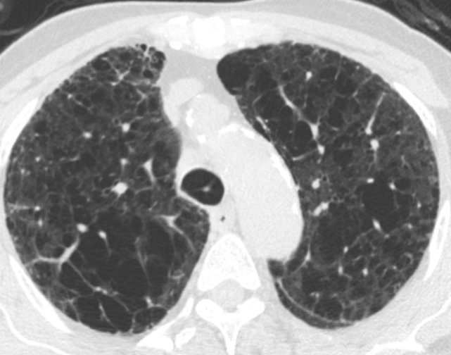
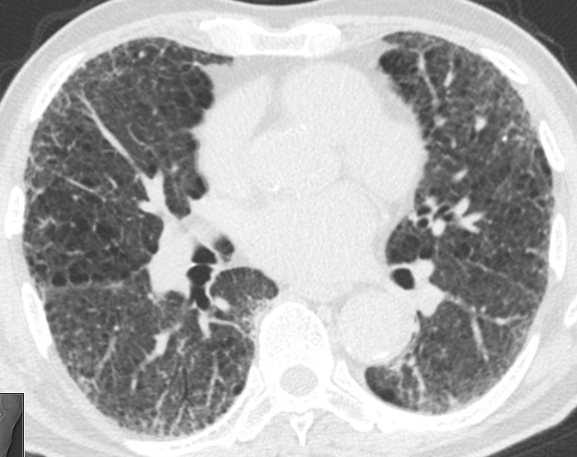

Slide 8
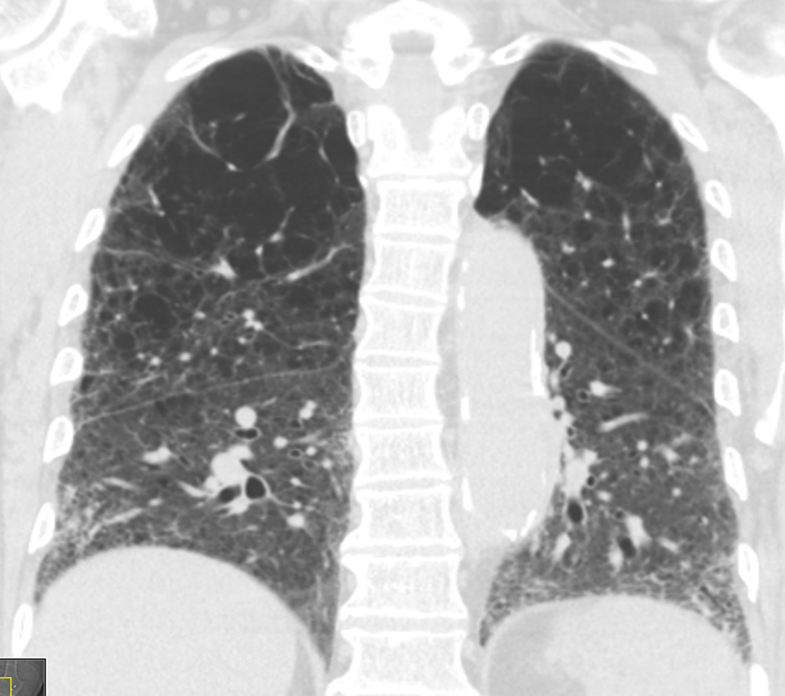
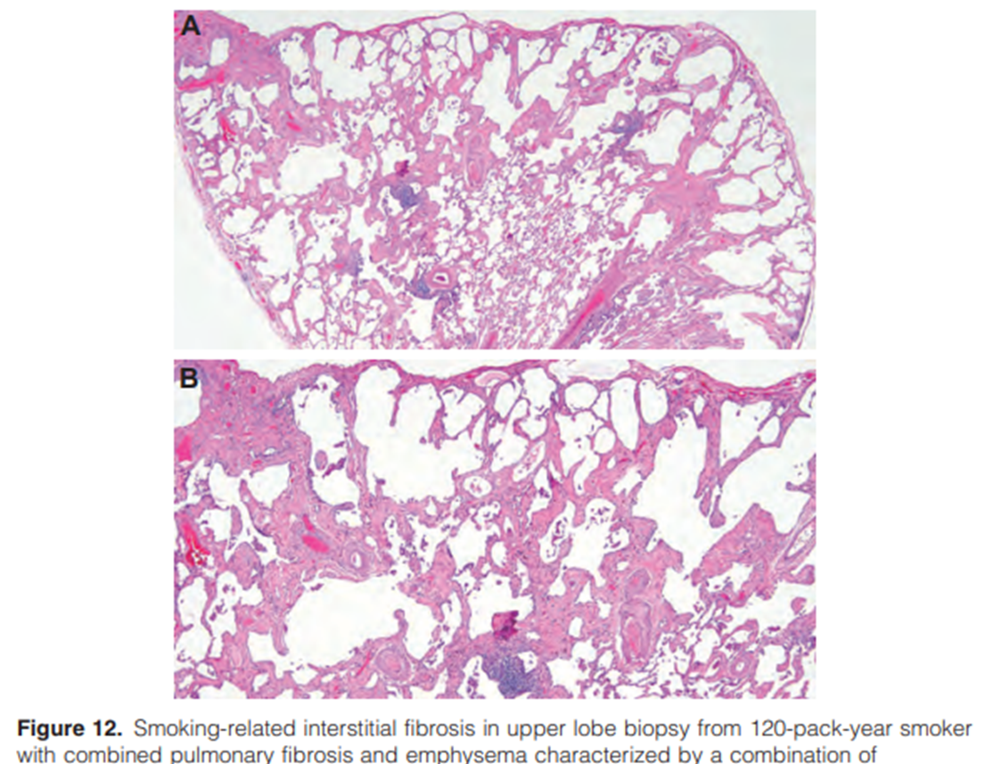
Combined Pulmonary Fibrosis and Emphysema
Am J Respir Crit Care Med Vol 206, Iss 4, pp e7–e41, Aug 15, 2022

Slide 9
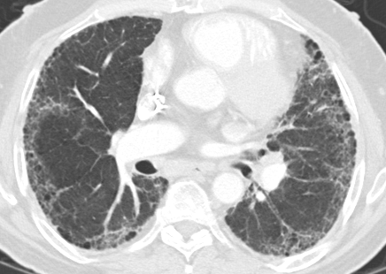
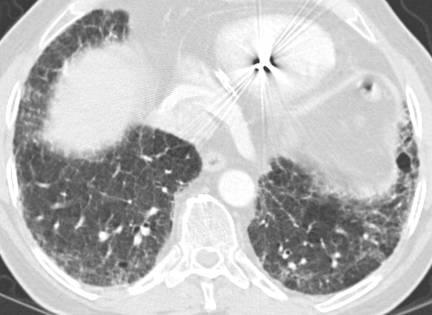
Case #2
68-year-old ex-smoker with RA
Notes:
Clinic Number: 7-064-448
Patient Name: Mr. James Robert Spaight

Slide 10
CPFE
Patients may have severe emphysema even though the FEV₁ is preserved.
CPFE is an entity seen in smokers as well as some patients with RA.
CPFE requires the determination of DLCO and HRCT for diagnosis, and the evaluation of a smoker with persistent dyspnea should include these tests.
The occurrence of PH is relatively high: consider screening with echocardiography.

Slide 11
Priorities and Future Research
Understanding Pathogenesis: determine the shared and distinct pathogenetic mechanisms underlying CPFE.
Improving Diagnostic Methods: Develop more precise diagnostic criteria and tools to differentiate CPFE from other pulmonary conditions.
Exploring Treatment Options: It is crucial to investigate new pharmacological treatments and management strategies tailored specifically for CPFE patients.
Longitudinal Studies: Understanding the natural history and progression of CPFE.
Genetic and Environmental Factors: Identify at-risk populations and preventive measures.
Am J Respir Crit Care Med Vol 206, Iss 4, pp e7–e41, Aug 15, 2022

Slide 12
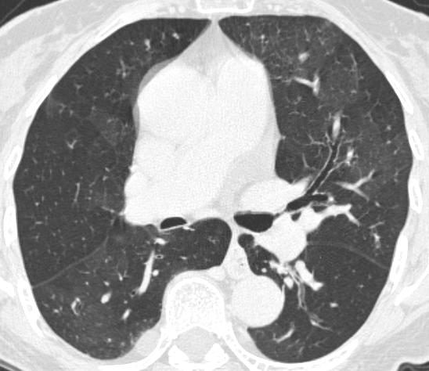
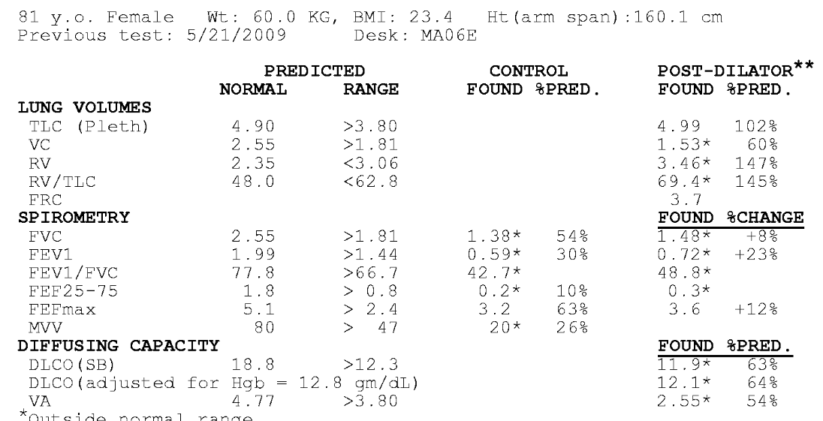
Case #3: 81-year-old never smoker referred for “COPD evaluation”.
History of seropositive RA
Bronchiectasis and small airway disease – bronchiolitis – can also cause fixed obstructive lung disease on PFT

Slide 13
When smokers develop “COPD” at a young age….

Slide 14
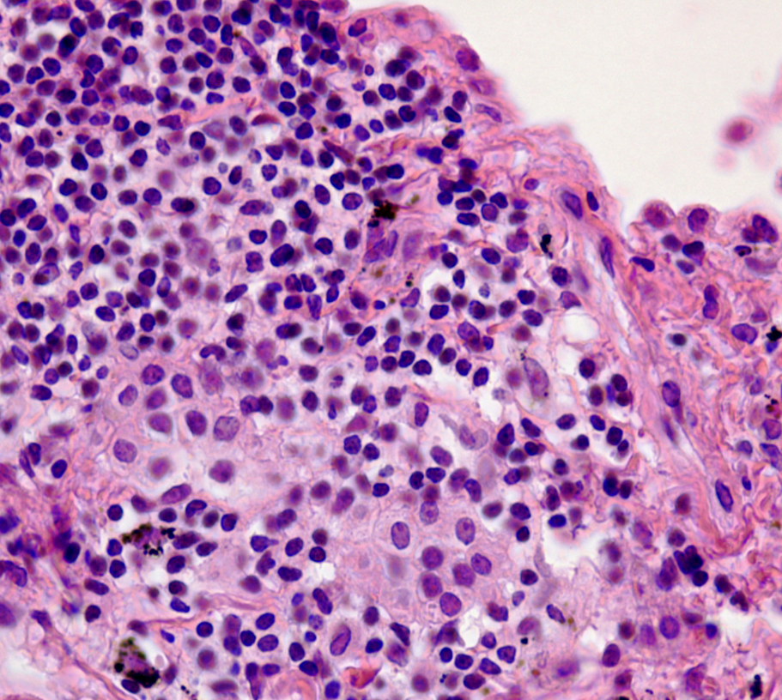
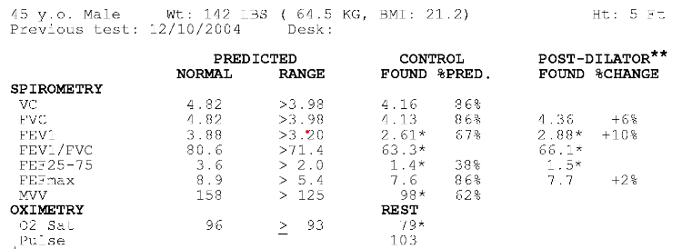
Pulmonary Langerhans cell Histiocytosis
Case #4: 45-year-old male, smoker, with “COPD”. His PFT shows obstruction. DLCO cannot be measured due to low resting oxygen saturation. Echo ➔ estimated RVSP 75 mmHg

Slide 15
Cysts vs emphysema
Morphology and Wall Thickness:
Emphysema: areas of low attenuation without distinct walls - centrilobular, panlobular, or paraseptal emphysema: "holes" in the lung parenchyma.
Lung Cysts: Well-circumscribed, air-filled spaces with thin, perceptible walls (usually ≤ 4 mm). Cysts can be solitary or multiple.
Distribution:
Emphysema: Centrilobular emphysema ➔ upper lobes. Paraseptal emphysema ➔ subpleural and adjacent to the interlobular septa.
Lung Cysts: The distribution of cysts varies with the underlying disease.
Associated Findings:
Emphysema: associated with other signs of COPD, such as bronchial wall thickening and air trapping.
Lung Cysts: Depending on the underlying condition, lung cysts may be associated with other radiologic findings, such as ground-glass opacities in LIP or nodules in PLCH.
1) International Journal of Chronic Obstructive Pulmonary Disease. 2008;3(2):193-204. doi:10.2147/copd.s2639.
2) The American Journal of Medicine. 2014;127(1):94.e7-23. doi:10.1016/j.amjmed.2013.09.020.
3) Chest. 2016;150(4):945-965. doi:10.1016/j.chest.2016.04.026.
4) Lung. 2022;200(6):817-820. doi:10.1007/s00408-022-00576-5.

Slide 16
In the evaluation of a smoker with COPD, especially if <50 years of age, consider:
A1AT deficiency
HIV infection
Cocaine and other inhalational drugs
Primary connective tissue disorders like cutis laxa
Histiocytic syndromes
Hypocomplementemic urticarial vasculitis syndrome

Slide 17
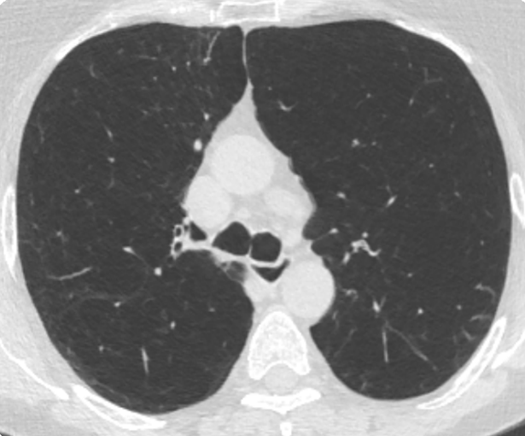
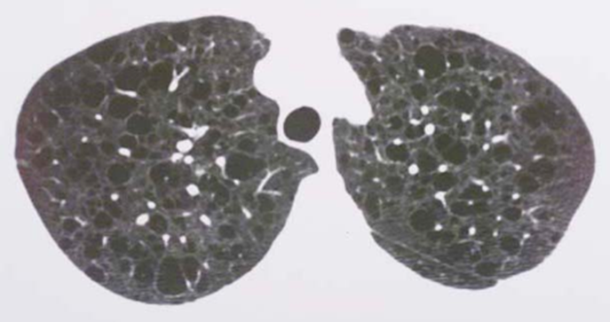
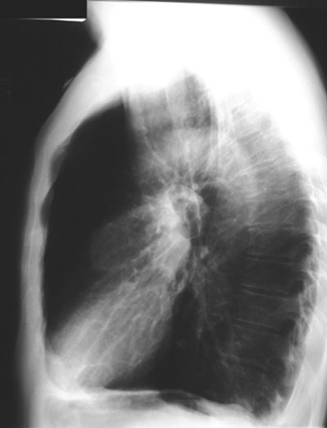
Smoking tobacco accounted for approx. 7.7 million deaths in 2019
Emphysema
PLCH
CPFE
Smoking injures the lungs in different ways. Airflow limitation, restrictive lung disease, and mixed patterns can result.

Slide 18
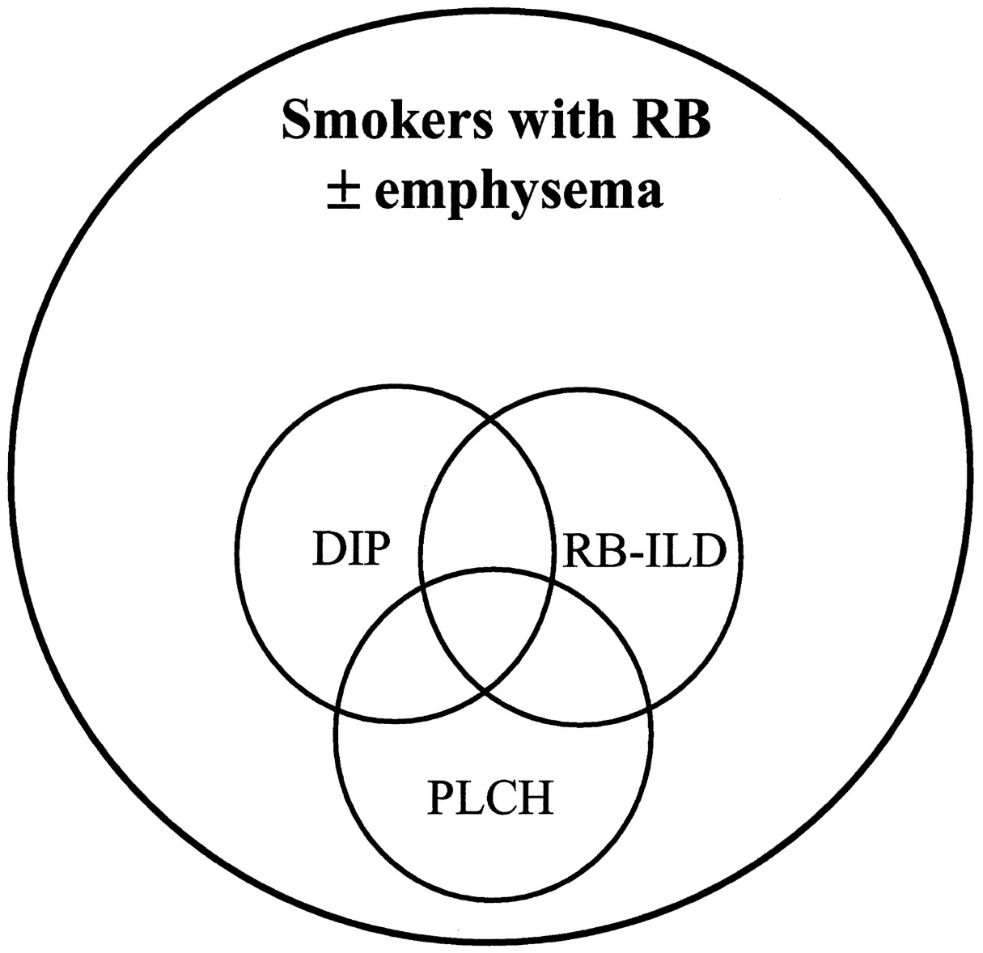
Nonproportional Venn diagram illustrating the spectrum of airways and interstitial injury associated with cigarette smoking
Chest 2003;124:1199-1205

Slide 19
Final comments
Consider the measurement of lung volumes and diffusing capacity in every patient with suspected COPD.
COPD is not one disease.
If spirometry is relatively well preserved, and the DLCO is disproportionately reduced, consider further assessment for CPFE.
Remember that obstruction on pulmonary function testing can be due to different pathologies along the airways and lung parenchyma.

Slide 20
HRCT is an essential part of the evaluation
HRCT may identify disease characteristics that may guide therapy:
Upper lobe predominant disease (lung volume reduction)
Extent of airway disease vs emphysema
Presence of bronchiectasis
CPFE
Mucus plugging
Lower lobe predominant disease in A1-ATD

Slide 21
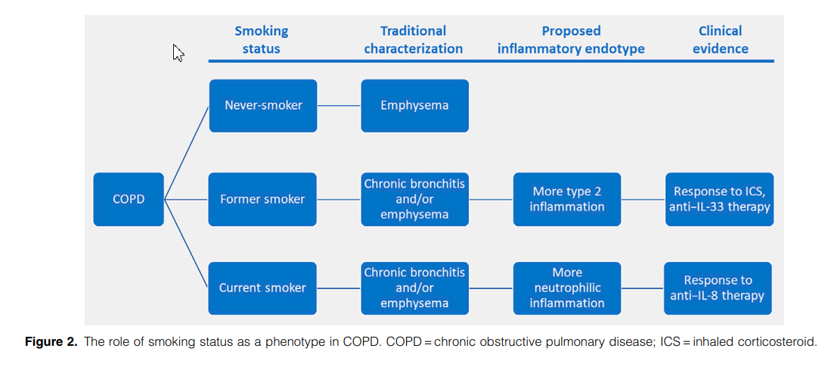
Celli et al. Am J Respir Crit Care Med Vol 211, (5), 729–736, 2025

Slide 22
QUESTIONS & ANSWERS

