Slide 1
Deficit di alfa-1 antitripsina: last year in review
Andrea Vianello
Respiratory Pathophysiology Division, Department of Cardio-Thoracic and Vascular Sciences, University of Padova, Padova, Italy

Slide 2
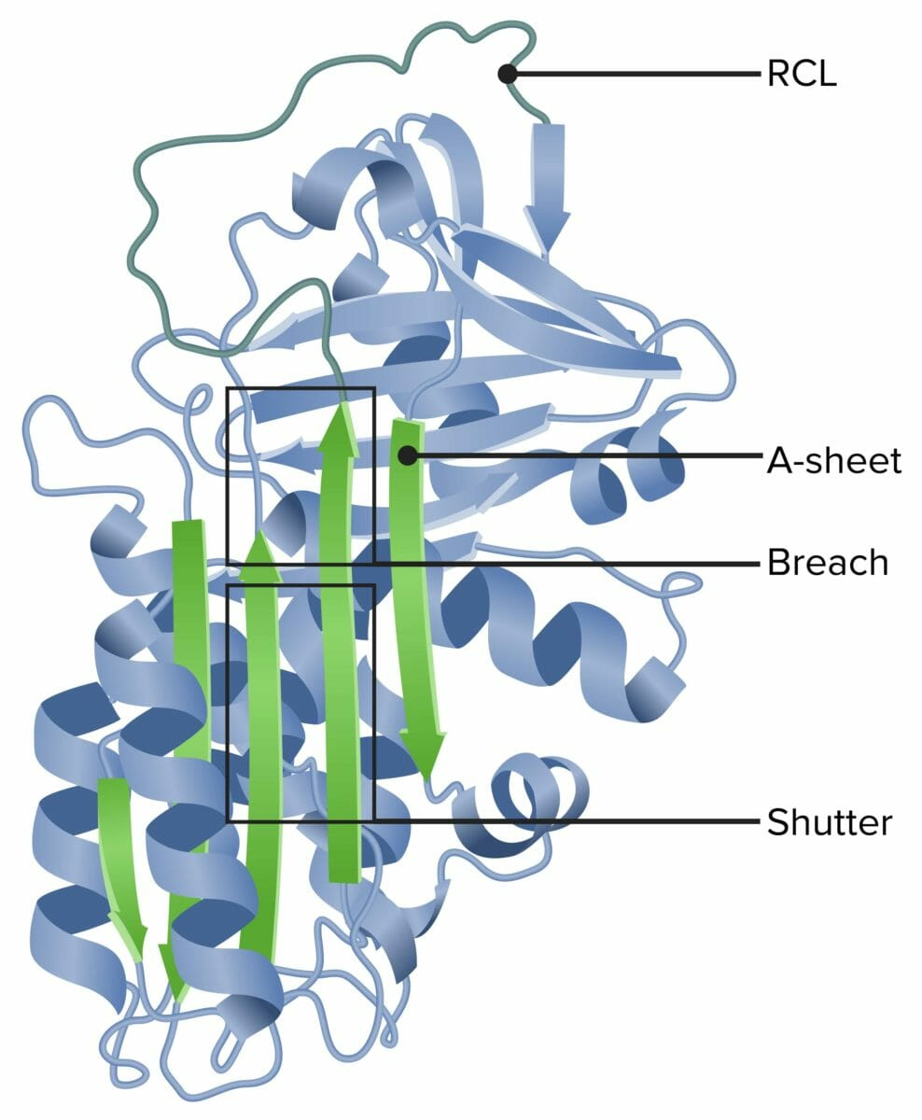
Alpha 1-Antitrypsin Deficiency
A rare, underdiagnosed genetic disorder;
Reduced serum concentrations and/or functionality of alpha 1-antitrypsin (AAT);
Increased risk of developing emphysema, cirrhosis, panniculitis and vasculitis;
Greater susceptibility to viral infection, persistent infections;
Weekly intravenous augmentation treatment: the only condition-specific therapy

Slide 3
Alpha 1-Antitrypsin Deficiency
A rare, underdiagnosed genetic disorder;
Reduced serum concentrations and/or functionality of alpha 1-antitrypsin (AAT);
Increased risk of developing emphysema, cirrhosis, panniculitis and vasculitis;
Greater susceptibility to viral infection, persistent infections;
Weekly intravenous augmentation treatment: the only condition-specific therapy

Slide 4
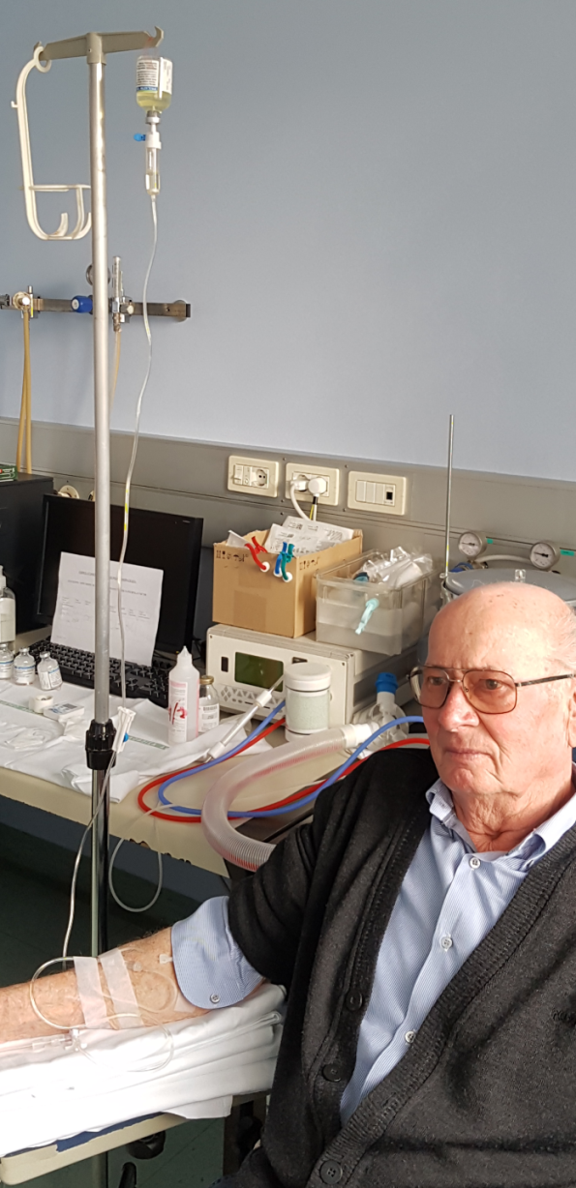
IV Augmentation Therapy (AT): evidence of efficacy.
AT approval based on clinical studies that proved that the infusion:
Increase plasma and ELF levels of AT;
Is safe and well tolerated.
FEV₁ as a primary outcome in most clinical trial;
No RCT proving AT efficacy on usual respiratory outcomes, such as exacerbations, symptoms and QoL;
No RCT exceeding patients with emphysema;
Lack of studies on commitment to therapy.
Notes:
lung epithelial lining fluid (ELF).

Slide 5
Controversial questions about AT
Should FEV₁ be used as a primary outcome measure in clinical trial?
Should AT be suggested for patients with disease other than emphysema?
Could self-administration significantly improve commitment to therapy?

Slide 6
Should FEV₁ be used as a primary outcome measure in clinical trial?

Slide 7
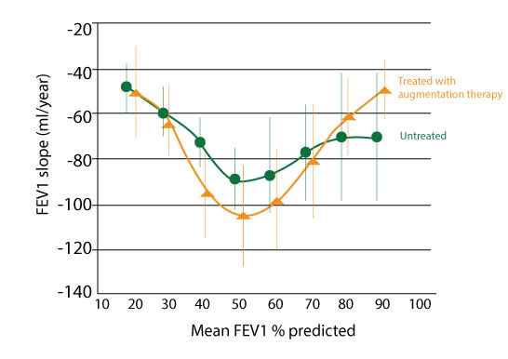
NHLBI registry: FEV₁ decline
The Alpha-1-Antitrypsin Deficiency Registry Study Group. Am J Respir Crit Care Med 1998; 158:49-59.

Slide 8
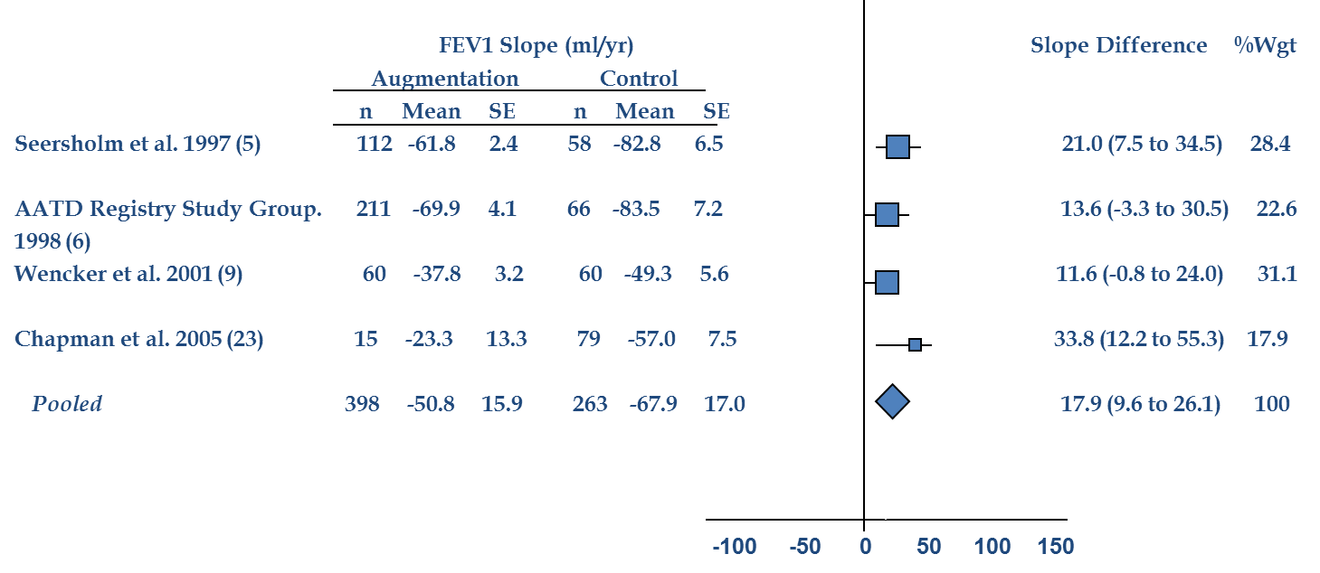
AT in patients with FEV₁ 30-65% predicted
Chapman et al. J COPD 2009; 6:177-184

Slide 9
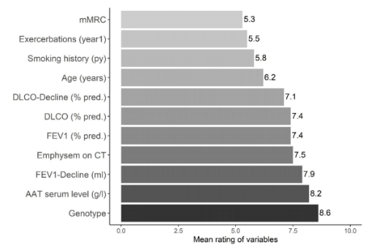
Opinions and attitudes of pulmonologists about AT
Mean scores of variables associated with prescription of augmentation therapy.
Freulich T, at al. , Int J Chron Obstruct Pulmon Dis . 2022:17 53–64

Slide 10
FEV₁ as an outcome measure in clinical trial
AT reduced mortality in very severe patients, although decline in FEV₁ % was not affected by therapy.
Loss of lung tissue may progress although FEV₁ is relatively stable;
If the population has reached a plateau in lung function, FEV₁ decline is unlikely to be a sensitive metric.
Miravitlles M, et al. Eur Respir Rev 2023; 32: 230170.

Slide 11
AT for severe AATD
Retrospective observational study: patients enrolled in registries in Ireland, Austria and Switzerland;
A higher survival probability in those receiving AT therapy (HR: 0.61);
Survival benefits were decoupled from lung function decline measured by FEV₁;
AT therapy significantly reduced FEV₁ decline in only a subset of patients.
Fraughen DD, et al. Am J Respir Crit Care Med. 2023;208:964-74.

Slide 12
FEV₁ is an uneffective outcome measure in clinical trial
Real-world evidence: AT therapy is beneficial to survival, even if lung function measures do not improve;
FEV₁ decline is not a sensitive outcome in severe disease;
Projections of the number of patients required to detect a difference in FEV₁: sample size would be prohibitive!
Ther Adv Respir Dis 2025;19: 1–17

Slide 13
Should AT be suggested for patients with disease other than emphysema?

Slide 14
Types of patients that are referred for AATD testing in Europe.
Usual clinical practice to test bronchiectatic patients for AATD
Chorostowska-Wynimko, et al. Resp Med. 2023;220:107450

Slide 15
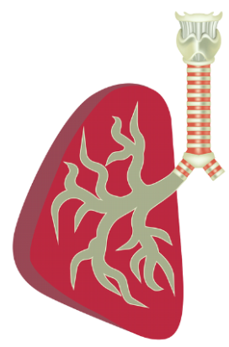
AATD & bronchiectasis
EARCO registry: 800 patients with ZZ deficiency: 9% had radiological features of bronchiectasis alone; 27% of those with emphysema had radiological evidence of bronchiectasis;
AATD bronchiectatic patients: much more individual characterisation (identification of bacterial colonization, airways neutrophilia, as well as exacerbation history).
Stockley RA, et al ERJ Open Res. 2024; 10: 00139-2024
Notes:
EARCO (European Alpha-1 antitrypsin deficiency Research Collaboration) International Registry.

Slide 16
AATD & bronchiectasis
No proof that AATD causes bronchiectasis, however:
Lack of AAT anti-inflammatory properties bronchial wall inflammation eventually bronchiectasis;
Patients with a Pi*ZZ genotype: higher risk of bacterial infections;
Lower AAT levels in patients with bronchiectasis.
Buck et al, et al Resp Med Case Rep. 2022;39 : 101740

Slide 17
Should AT be suggested for patients with AATD and bronchiectasis?
No RCT demonstrating a clinical improvement AT is not currently indicated in bronchiectasis, however:
In sporadic case reports, off-label AT therapy was effective in reducing exacerbations;
Inhaled AT could be more effective than i.v. AT. Influence on local airways inflammation and proteinase activity.
Stockley RA, et al ERJ Open Res. 2024; 10: 00139-2024

Slide 18
Inhaled AAT in AAT-deficient individuals
Kamada-AAT for Inhalation administered with an eFlow® nebuliser.
Brantly M, et al. ERJ Open Res 2025; 11: 00537-2024

Slide 19
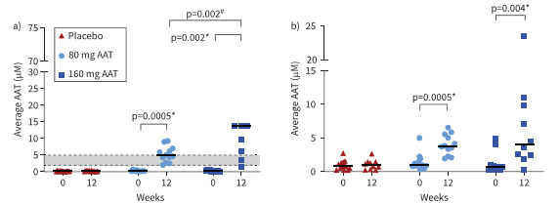
Inhaled AAT in AAT-deficient individuals
Levels of antigenic AAT and antineutrophil elastase capacity in the epithelial lining fluid at baseline and after 12 weeks of treatment with AAT for inhalation or placebo..
Brantly M, et al. ERJ Open Res 2025; 11: 00537-2024

Slide 20
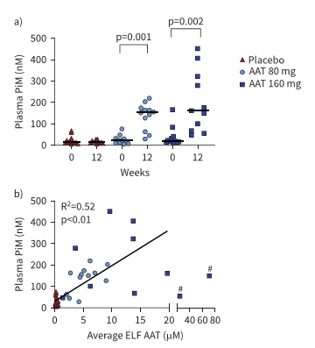
Inhaled AAT in AAT-deficient individuals
M-specific AAT measured in plasma and ELF antigenic AAT versus plasma PiM.
Brantly M, et al. ERJ Open Res 2025; 11: 00537-2024

Slide 21
AATD & asthma
A risk factor for chronic airflow limitation and emphysema;
Prevalence: 2-3% (10.5% carriers of a deficiency gene) ⁽¹⁾;
Likely underestimated, due to the lack of systematic screening and overlapping clinical features ⁽²⁾.
Eden E, Holbrook JT, Brantly ML, et al. J Asthma 2007;44:605-8.
Siri D, Farah H, Hogarth DK. Ann Allergy Asthma Immunol 2013;111:458-64.

Slide 22
Types of patients that are referred for AATD testing in Europe.
Chorostowska-Wynimko, et al. Resp Med. 2023;220:107450

Slide 23
AATD & asthma: effect on airflow limitation
A wide variation in bronchodilator response;
Degree of lung function impairment greatly variable;
Patients with AATD showing bronchial hyper-reactivity more more rapid decrease in lung function.
Cazzola et al. Eur Respir Rev. 2020;29:190073

Slide 24
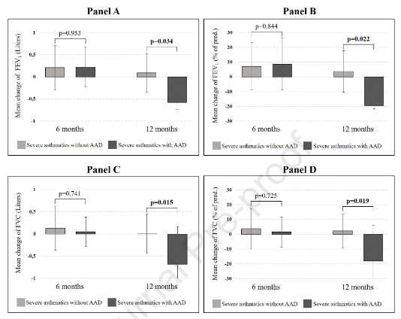
Effect of AATD on lung volume decline in severe asthmatic patients
Significant changes of different lung function parameters
Vianello a, et al. J Allergy Clin Immunol Pract. 2021 ;9:1414-16

Slide 25
Should AT be suggested for patients with AATD and asthma?
AT is effective in reducing the rate of decline of lung density, no other significant effects on respiratory symptoms or exacerbations;
AT is not more effective in preventing loss of lung function in those with asthma compared to those without;
AT is not currently indicated in AATD patients with asthma.
Miravitlles M, et al. Eur Respir Rev 2023; 32: 230170.

Slide 26
Could self-administration significantly improve commitment to AT?

Slide 27
New therapeutic options for AAT replacement therapy
Kamada’s inhaled: a new phase 3 study in moderately affected patients underway to determine the efficacy and safety of AAT inhalation therapy (NCT04204252);
A new IV therapy involving a recombinant AAT-IgG4 Fc fusion protein to enhance AAT half-life. Phase 1 study: normal AAT serum levels maintained when dosed every 3 weeks;
A subcutaneous formulation under investigation in comparison to the IV formulation.
Erion DM, et al. Chest. 2025;167:444-52
Notes:
AT regimens can be inconvenient due to the need for lifetime weekly infusions.

Slide 28
Potential advantages of self-administration
Allowing patients to manage their own disease;
Decreasing need for RN home visits or travel to outpatient infusion centers;
Allowing freedom to travel, improving quality of life and self-determination;
Reducing contacts with health care providers and patients.
Despite these benefits, a very small demand for self-administration amongst AATD patients exists.
Colello et al. Pulm Ther . 2022

Slide 29
Self-administration: a patient survey
AlphaNET survey: 555 AATD patients requiring i.v. AAT
Self-administering patients: 7.9% of the responders:
Training by home nursing agencies;
2-3 training sessions;
93%: greater independence as the major benefit;
83.7%: no difficulties in self-administration.
Sanhaus RA, et al. Int J Chron Obstruct Pulmon Dis. 2020;15: 3313–22.

Slide 30
Self-administration of AT in Italy
Baseline demographic and clinical data of patients receiving AT treatment.
IJTLD OPEN 2025; 2:53–55

Slide 31
Survey on self-administration of AT in Italy
13/43 (30.2%) were willing to switch to a self-infusion programme.
18/43 (41.9%) were
unaware that the therapy could be self-administered.
Reasons why patients surveyed were unwilling to switch to self-administration of therapy
IJTLD OPEN 2025; 2:53–55

Slide 32
Trained patients can self-administer IV therapy at home

Slide 33
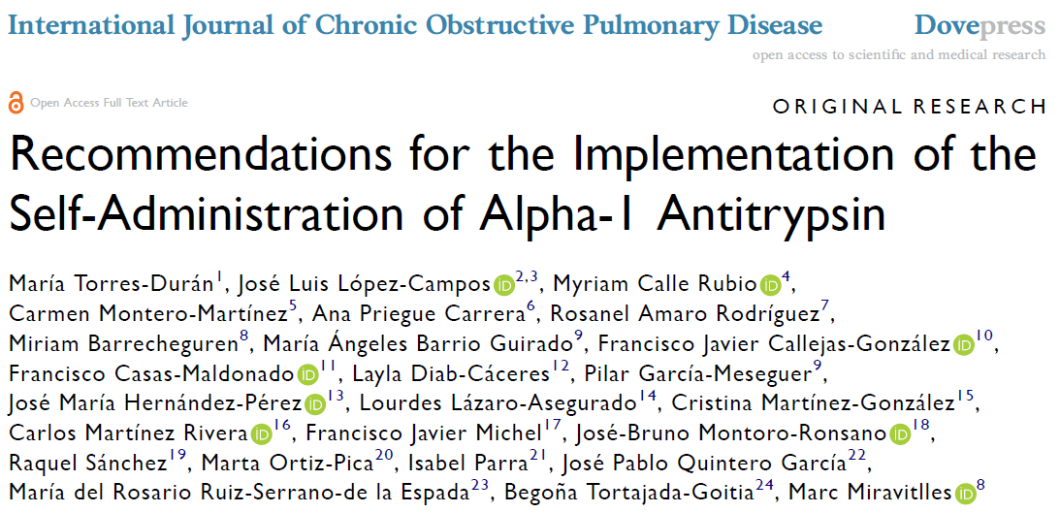
Objectives of self-administration
To empower the patient
To promote patients independence & treatment adherence
To avoid nosocomial infection
To reduce the cost of therapy
Int J Chron Obstruct Pulmon Dis 2023

Slide 34
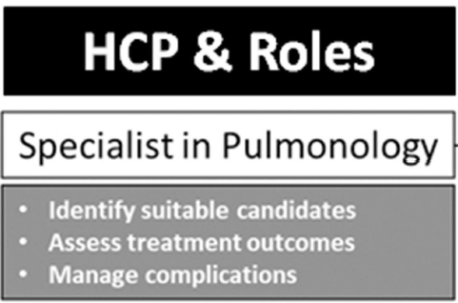
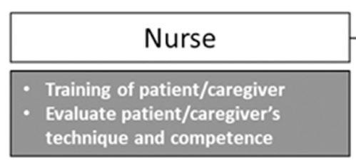
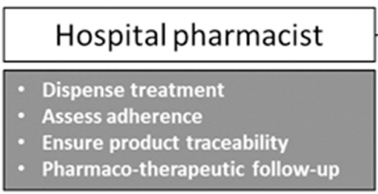
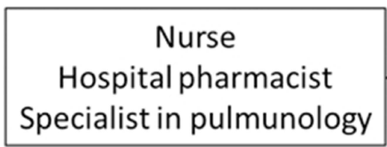
STEP I – Selection of Patients
STEP III – Dispense of treatment
STEP II – Training of Patients/Caregivers
First self-administration at the hospital
First self-administration at the patients’home
Monitoring treatment adherence
Assessment of outcomes & complications
STEP IV – Self-Administration at hospital - home
STEP V – Follow-up
Torres-Duran M, Int J Chron Obstruct Pulmon Dis 2023

Slide 35
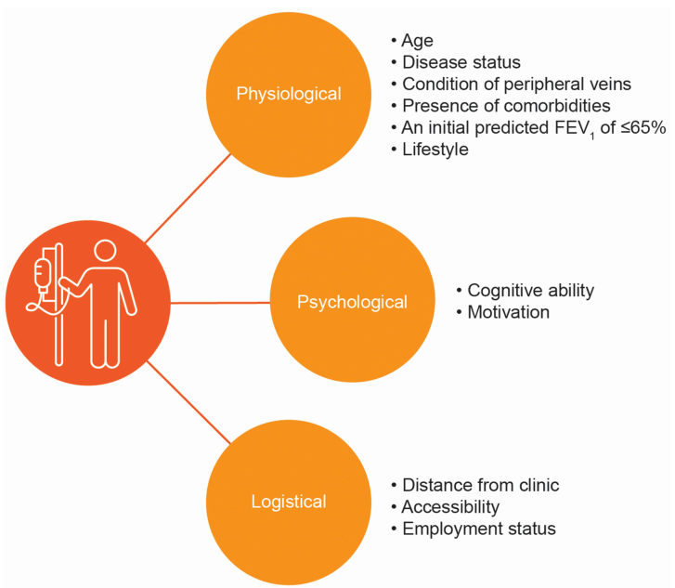
The ideal candidate to self-administration
<50 years of age
no comorbidities
symptomatic
initial predicted FEV1 of ≤65%
Herth FJF, et al. Int J Chron Obstruct Pulmon Dis. 2021;16: 2983-96.

Slide 36
Challenges of AATD self-management
Timely information to all of the HCPs regarding the possibility of self-administration of AT;
HCPs adequate skills for selecting, training and monitoring patients who prefer self-administering their AT.
Vianello , et al. IJTLD OPEN 2025; 2:53–55

Slide 37
Augmentation Therapy in AATD: last year in review
Defining appropriate outcome measures is challenging, due to great heterogeneity in progression of lung disease;
In the next future, indication to treatment could exceed patients with lung emphysema;
Self-administration should be encouraged, as it can be highly beneficial for patients.

