Slide 1


Ventilatory control during sleep in central and obstructive apnoea:
Targeted treatment according to endotypes
Danny J. Eckert
Matthew Flinders Professor
Director- Adelaide Institute for Sleep Health/ FHMRI Sleep Health, Flinders University, Australia
Lead Investigator- Brigham and Women’s Hospital, Boston USA (part-time)
Pneumo Trieste 2025, Trieste, Italy Weds May 14th, 2025

Slide 2
PRESENTER CONFLICT OF INTEREST DISCLOSURE
I wish to disclose the following potential conflicts of interest related to content in this presentation:
Type of Potential Conflict | Details of Potential Conflict
Grant/Research Support | National Health and Medical Research Council of Australia Leadership Fellow, Cooperative Research Centre Grant (Industry partner: Oventus Medical), Research Grants from Bayer, Apnimed, Takeda, Invicta Medical, SomnoMed, Eli Lilly & Withings
Consultant | Bayer, Apnimed (+ Advisory board), Takeda, Invicta Medical (+ Advisory board), Mosanna Therapeutics, SleepRes
Other | In-kind equipment for research from: Philips, ResMed, Fisher and Pykel, Nox, Oventus, SomnoMed, ProSomnus, Withings, 3 Shape Patent: OSA endo-phenotyping treatment algorithm

Slide 3





Slide 4
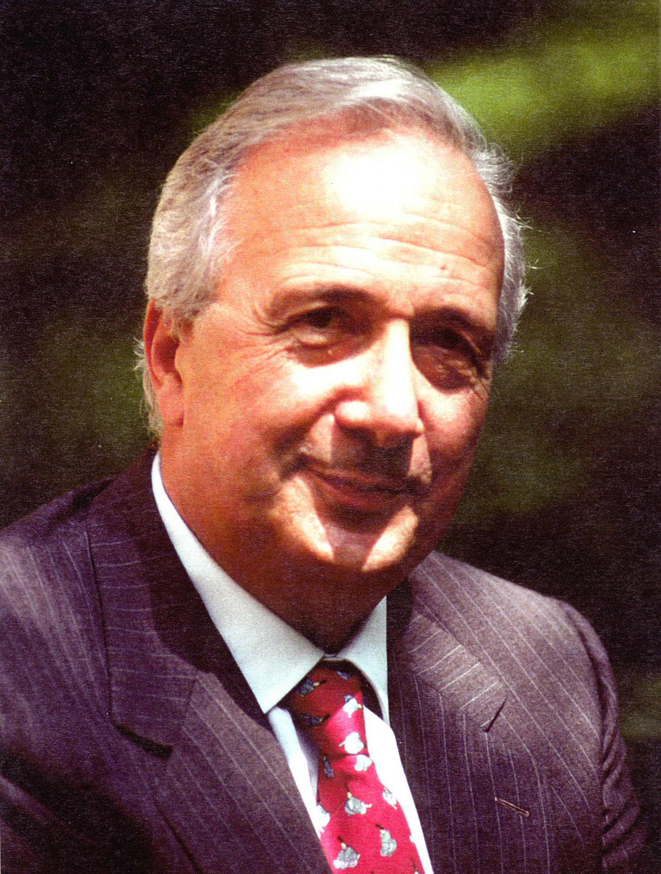
Snoring and its potential adverse cardiovascular consequences
“…during sleep the heavy snorer suffers respiratory difficulty which can affect alveolar ventilation,
the systemic arterial pressure and, very likely, the pulmonary pressure as well”.
“It is probable that, over a period of years, this ventilatory and hemodynamic situation has adverse effects on the cardiac muscle”.
Professor Elio Lugaresi
Lugaresi et al, Electroencephalogr Clin Neurophysiol (1975)

Slide 5
Snoring and its potential adverse cardiovascular consequences
Professor Elio Lugaresi
“These preliminary epidemiological data therefore suggest that heavy and habitual snoring represents a risk factor for the cardiovascular system”.
Lugaresi et al, Sleep (1980)

Slide 6
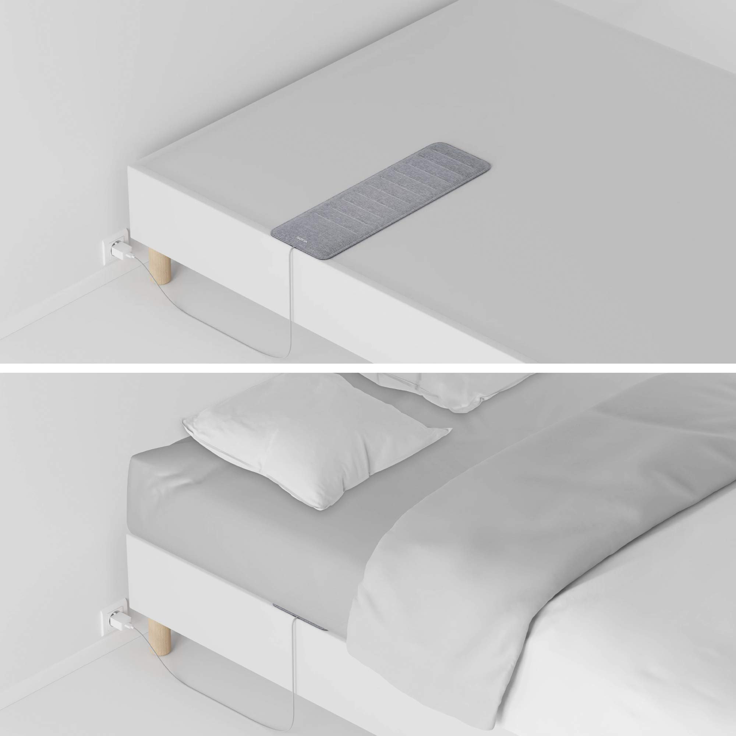
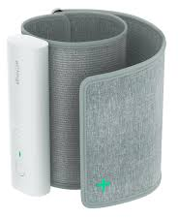
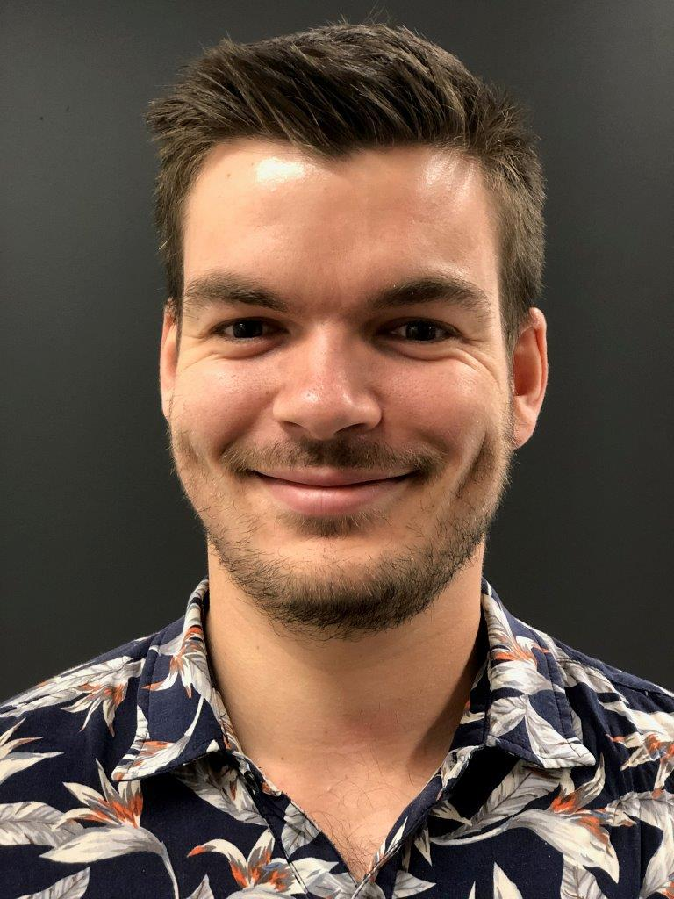
Regular snoring is associated with hypertension
New under-mattress technology
>12,000 people studied for ~9 months
~30, 15 and 7% of the study population snored for an average of >10, 20, and 30% per night
A higher proportion of time spent snoring associated with a ~2-fold increase in uncontrolled hypertension independent of OSA
Lechat et al, Nature Digital Medicine (2024)

Slide 7
Outline
Overview of the 4 key pathophysiological traits/endotypes that contribute to sleep apnoea
    Role of ventilatory control instability (high loop gain) in central and obstructive apnoea
Implications for targeted personalised therapy
    Non-CPAP interventions to reduce ventilatory control instability and sleep disordered breathing severity
Unique translational research trial- Australia’s Sleep Revolution

Slide 8
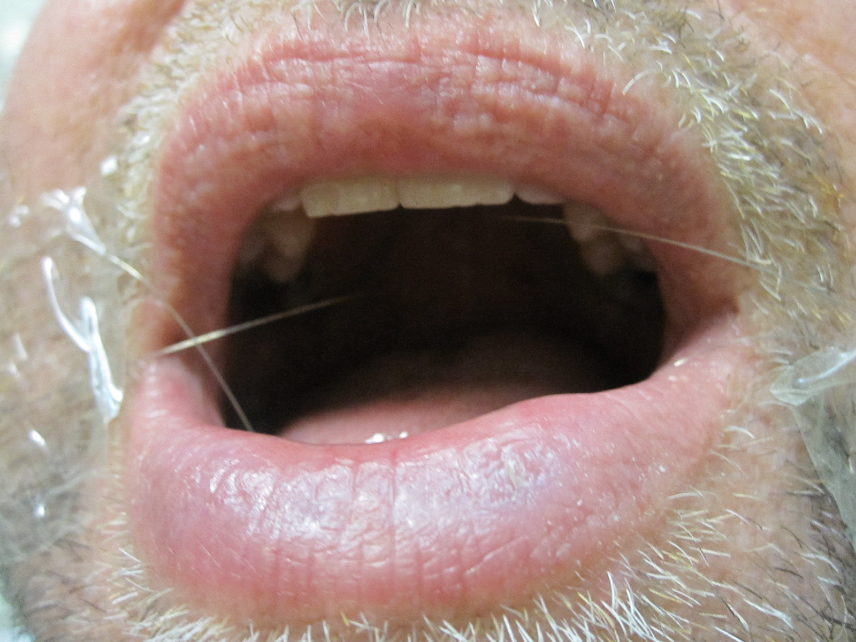
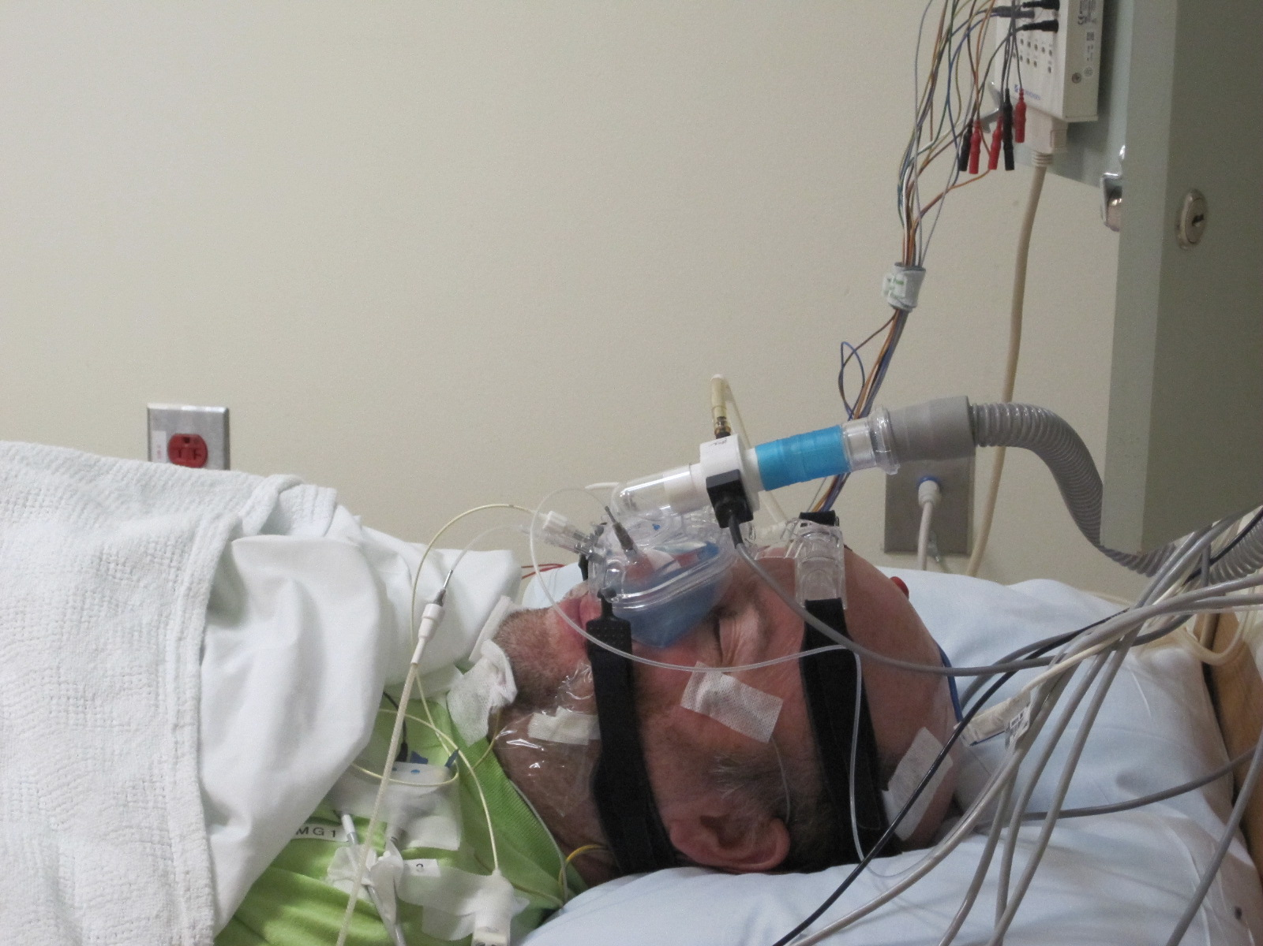
Anatomical and non-anatomical contributors to OSA
Adapted from Aishah and Eckert, Curr Opin Pulm Med (2019) and Carberry et al, Chest (2018)

Slide 9
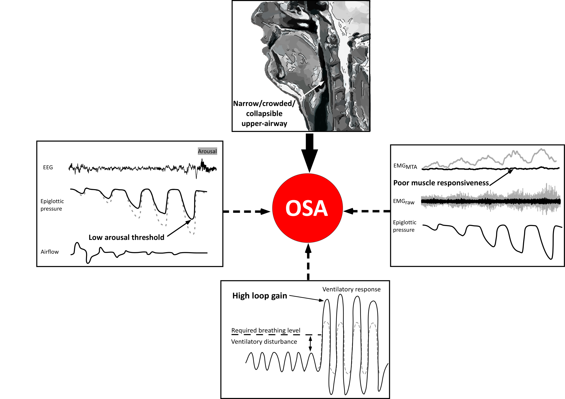
100% anatomical compromise
(but of variable magnitude)
37% low arousal threshold
36% poor muscle responsiveness
70% have 1 or more non-anatomical factors that contribute to their sleep apnoea
36% unstable respiratory control (high loop gain)
Eckert et al, Am J Resp Crit Care Med (2013) Carberry et al, Chest (2018)

Slide 10
Mechanisms of apnoea- common links between central and obstructive apnoea and the sleep disordered breathing spectrum
Reduced central respiratory drive can cause both central apnoea and upper airway closure
Eckert & Yaggi, Am J Resp Crit Care Med (2022)
Eckert, Malhotra & Jordan, Prog CV Dis (2009)

Slide 11
Outline
Overview of the 4 key pathophysiological traits/endotypes that contribute to sleep apnoea
    Role of ventilatory control instability (high loop gain) in central and obstructive apnoea
Implications for targeted personalised therapy
    Non-CPAP interventions to reduce ventilatory control instability and sleep disordered breathing severity
Unique translational research trial- Australia’s Sleep Revolution

Slide 12
Application of OSA endotype knowledge to deliver precision medicine for OSA
(Pcrit ~3-6cmH₂O)
(Pcrit ~3cmH₂O)
(Pcrit ~2-4cmH₂O)
(Pcrit dose-dependent)
/CBTi
/Sulthiame
Eckert et al, AJRCCM (2013)
Eckert, Sleep Med Rev (2018)

Slide 13
The carbonic anhydrase inhibitor acetazolamide lowers loop gain and the AHI in people with OSA
Edwards et al, J Physiol (2012)

Slide 14
Acetazolamide reduces AHI by ~40% in people with sleep disordered breathing
Schmickl et al, Chest (2020)

Slide 15
Carbonic anhydrase inhibition with 1 month of daily sulthiame reduces the AHI in people with OSA
Hedner et al, Am J Respir Crit Care Med (2022)
Hoff et al, Chest (2024)

Slide 16
Oxygen reduces loop gain in people with high loop gain
p < 0.001
p = ns
0.69
0.34
0.29
0.24
High Loop Gain
Low Loop Gain
Wellman et al, Resp Phys Neurobiol (2008)

Slide 17
Oxygen lowers the AHI in people with a high loop gain
*
Improvement
Wellman et al, Resp Phys Neurobiol (2008)

Slide 18
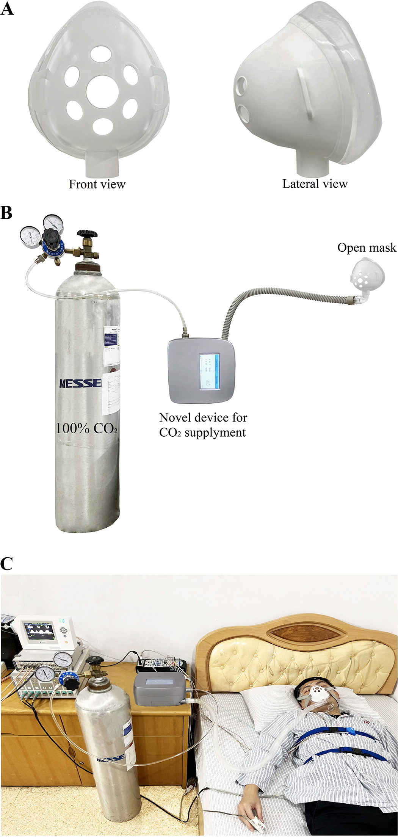
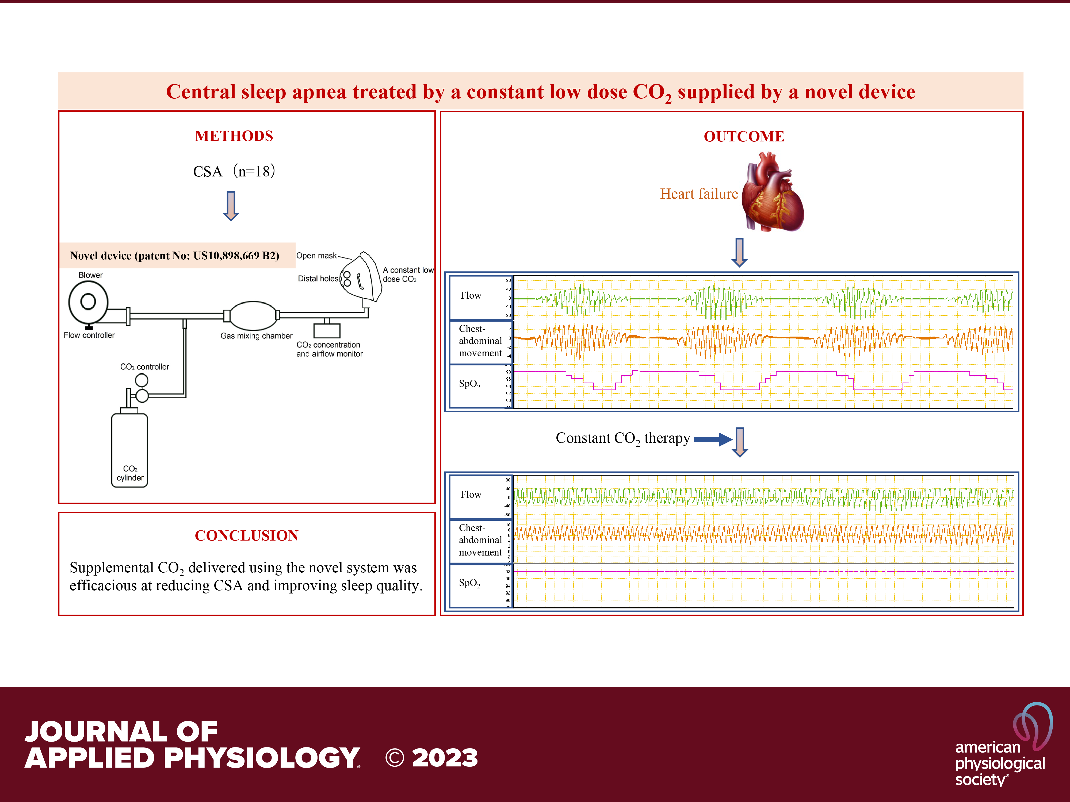
Central sleep apnoea treated by a constant low-dose CO₂ via a novel device
Central apnoea index reduced from:
18±13 to 1±1 events/h
AHI reduced from:
31±14 to 6±3 events/h
Sleep efficiency improved from:
71±18 to 80±11%
Luo et al, J Appl Physiol (2023)

Slide 19
Examples of combination therapy targeted at non-anatomical endotypes
O₂ to reduce loop gain plus a hypnotic (eszopiclone) to increase arousal threshold reduces OSA severity
Atomoxetine to increase pharyngeal muscle activity & reduce loop gain plus a hypnotic (trazodone) to increase arousal threshold reduces OSA severity
Edwards et al, Sleep (2016)
Corser et al, J Clin Sleep Med (2023)

Slide 20
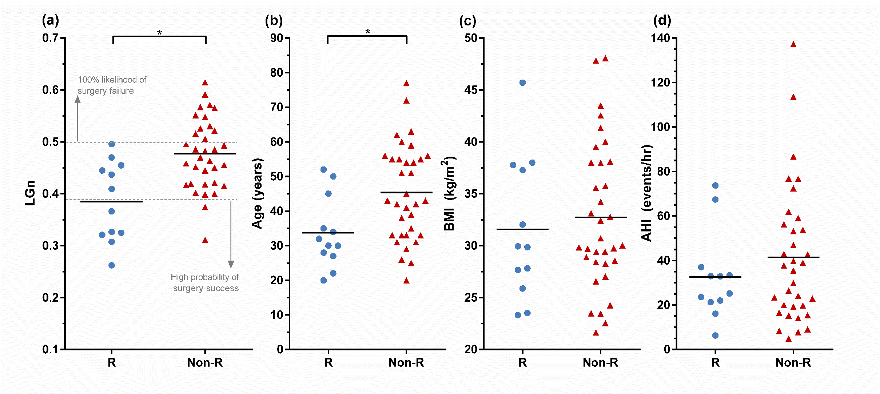
Application of OSA pathophysiology knowledge to predict treatment response to non-CPAP therapies- Role of high loop gain
Oral appliance therapy
Upper airway surgery
Emerging pharmacotherapy
Am J Resp Crit Care Med (2016)
Joosten et al, Sleep (2017)
Ann Am Thorac Soc (2021)
Ann Am Thorac Soc (2019)

Slide 21
Outline
Overview of the 4 key pathophysiological traits/endotypes that contribute to sleep apnoea
    Role of ventilatory control instability (high loop gain) in central and obstructive apnoea
Implications for targeted personalised therapy
    Non-CPAP interventions to reduce ventilatory control instability and sleep disordered breathing severity
Unique translational research trial- Australia’s Sleep Revolution

Slide 22
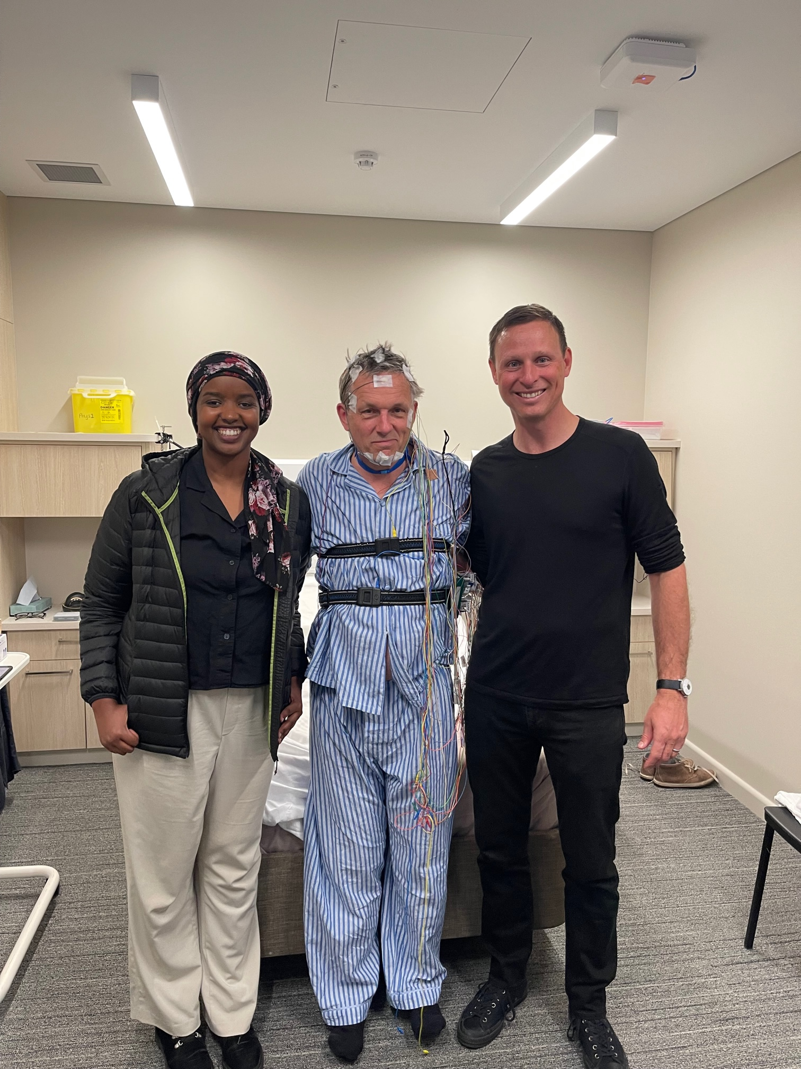
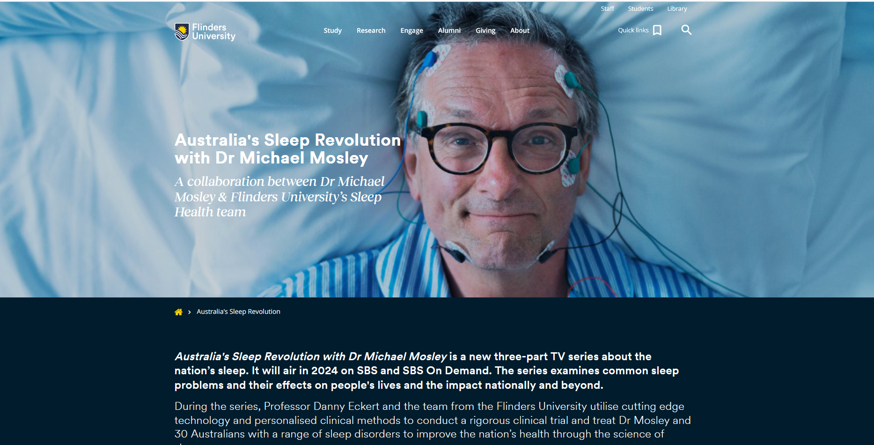




Background: Australia’s sleep revolution with Dr Michael Mosley
3x1h television series
https://www.flinders.edu.au/sleep-revolution
Thank you, Dr Michael Mosley (1957-2024)

Slide 23
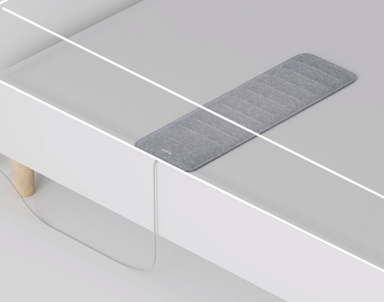
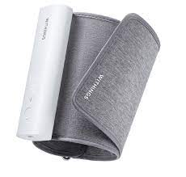
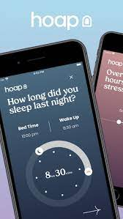

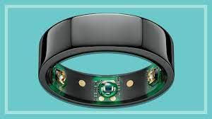
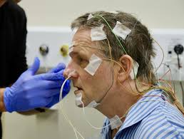
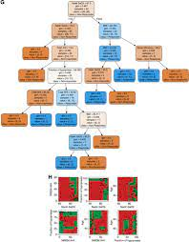
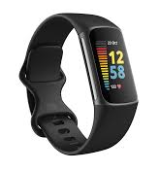
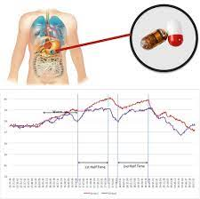

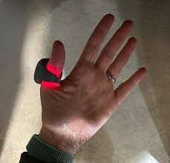
Novel diagnostic approaches and monitoring equipment

Slide 24
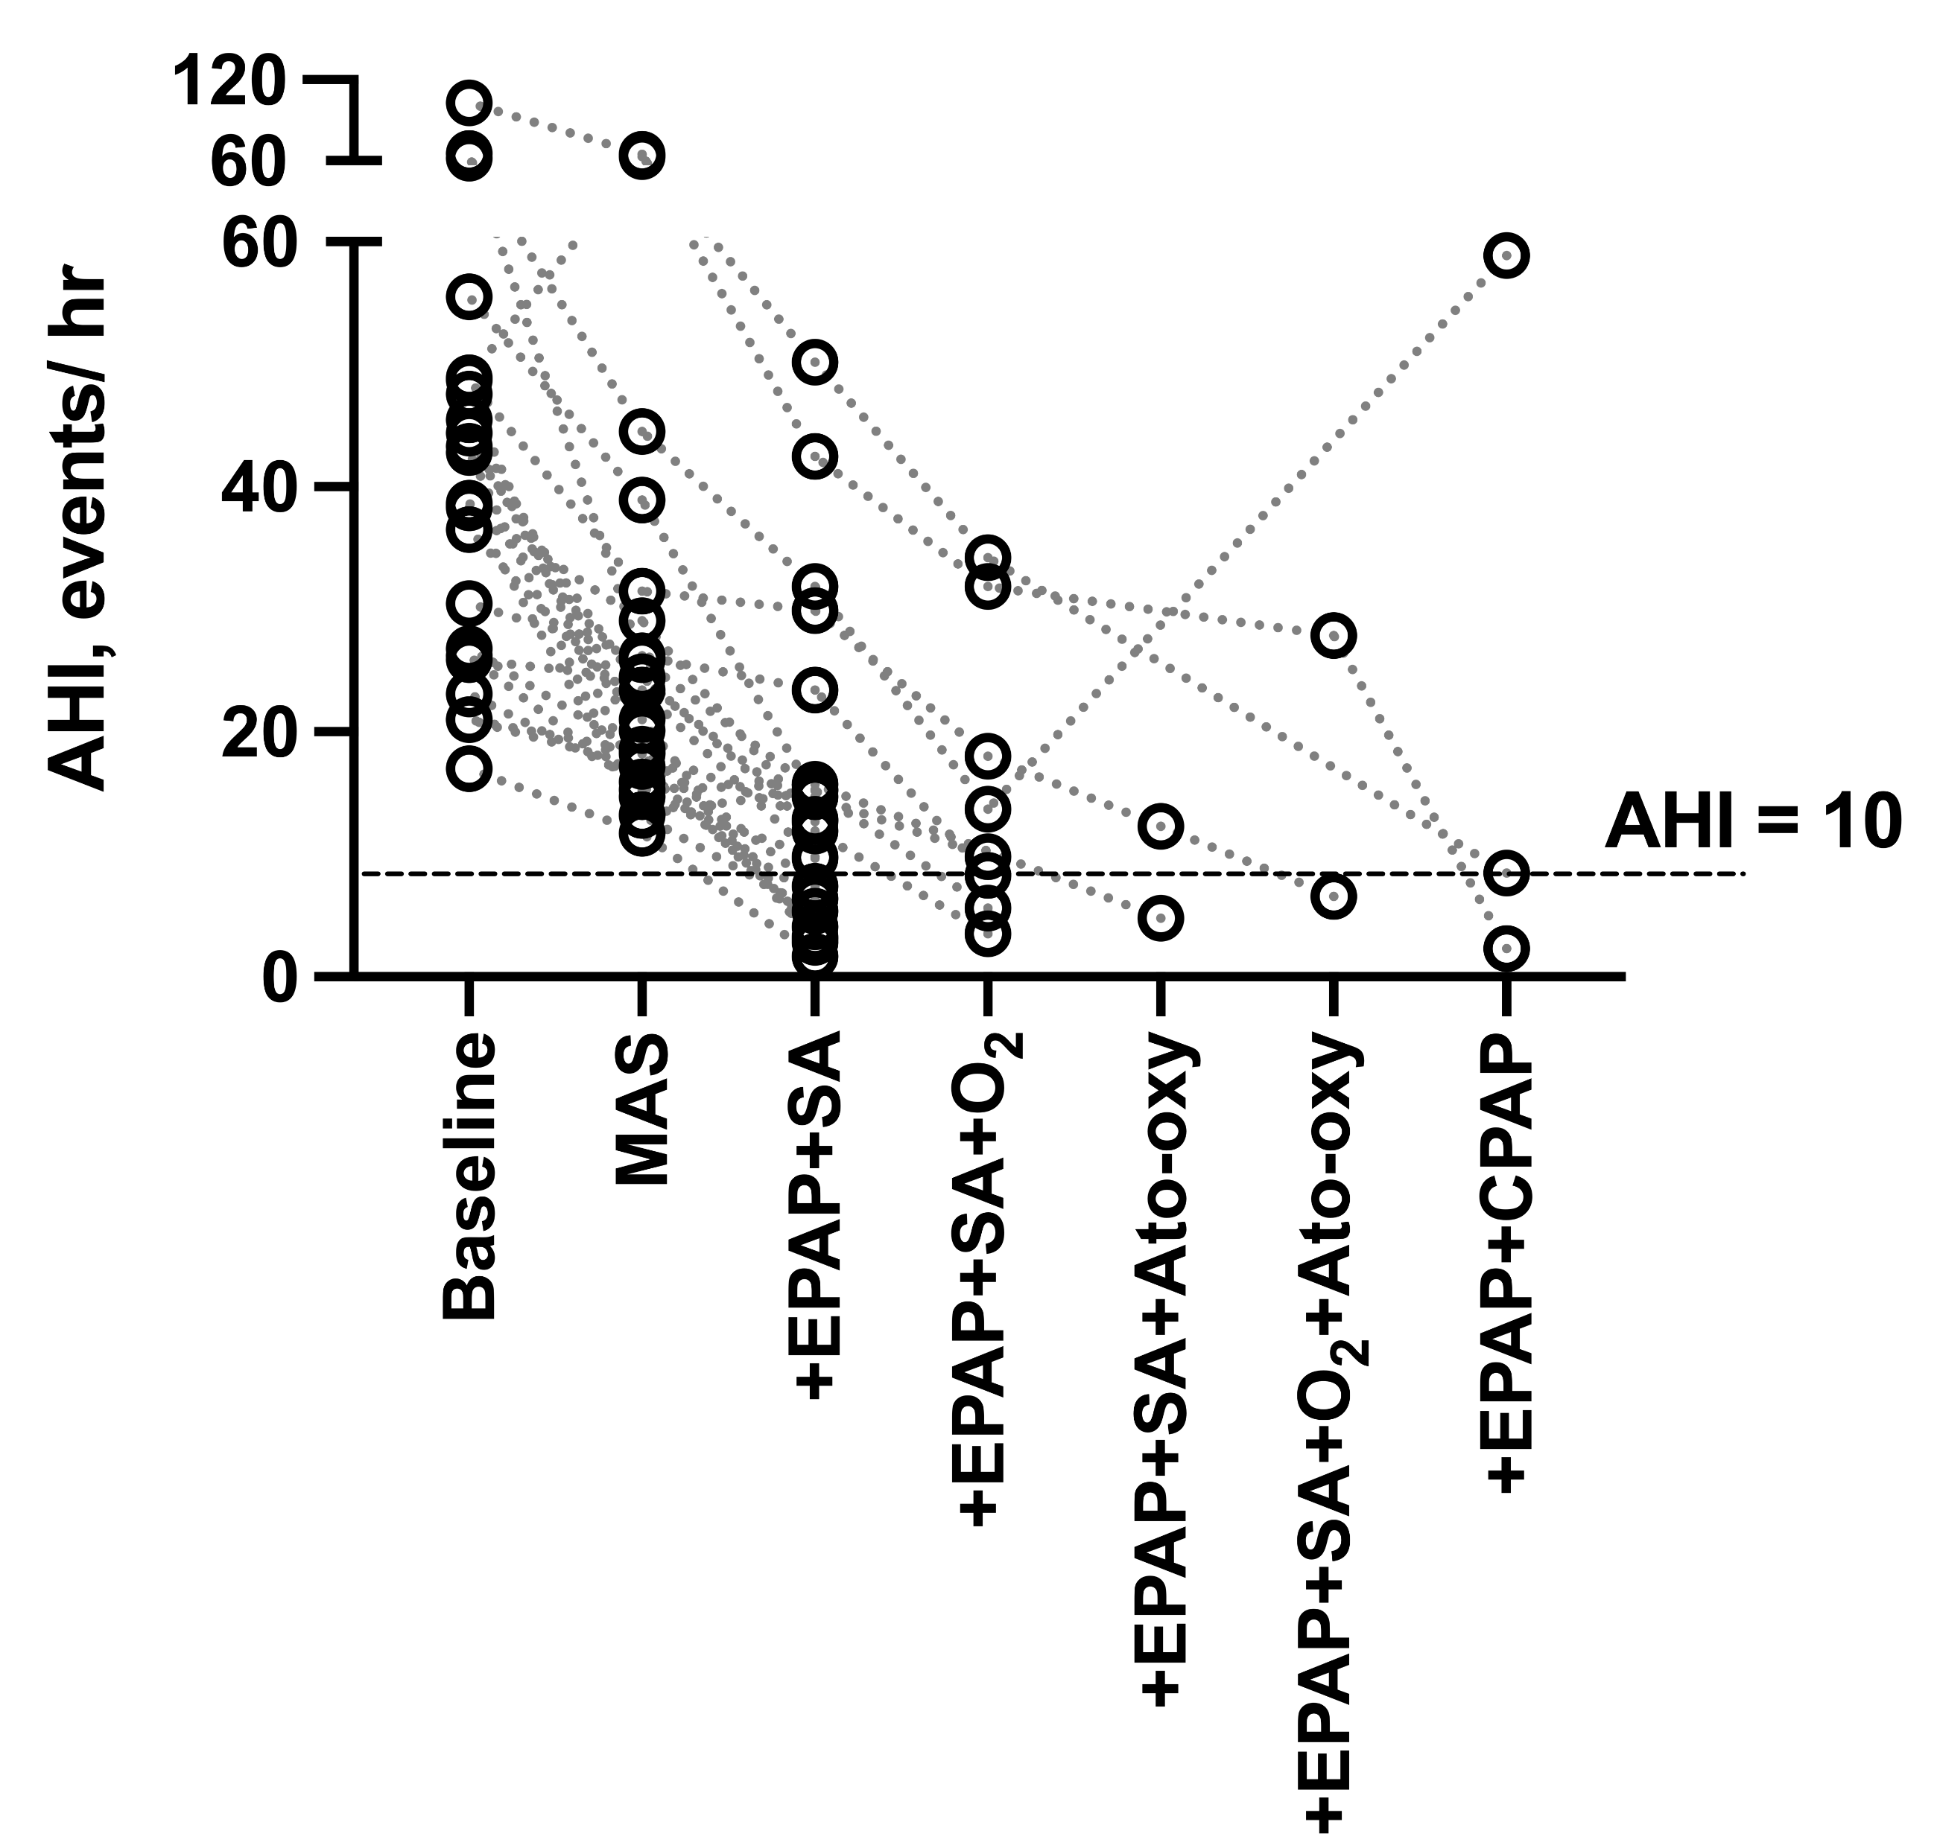
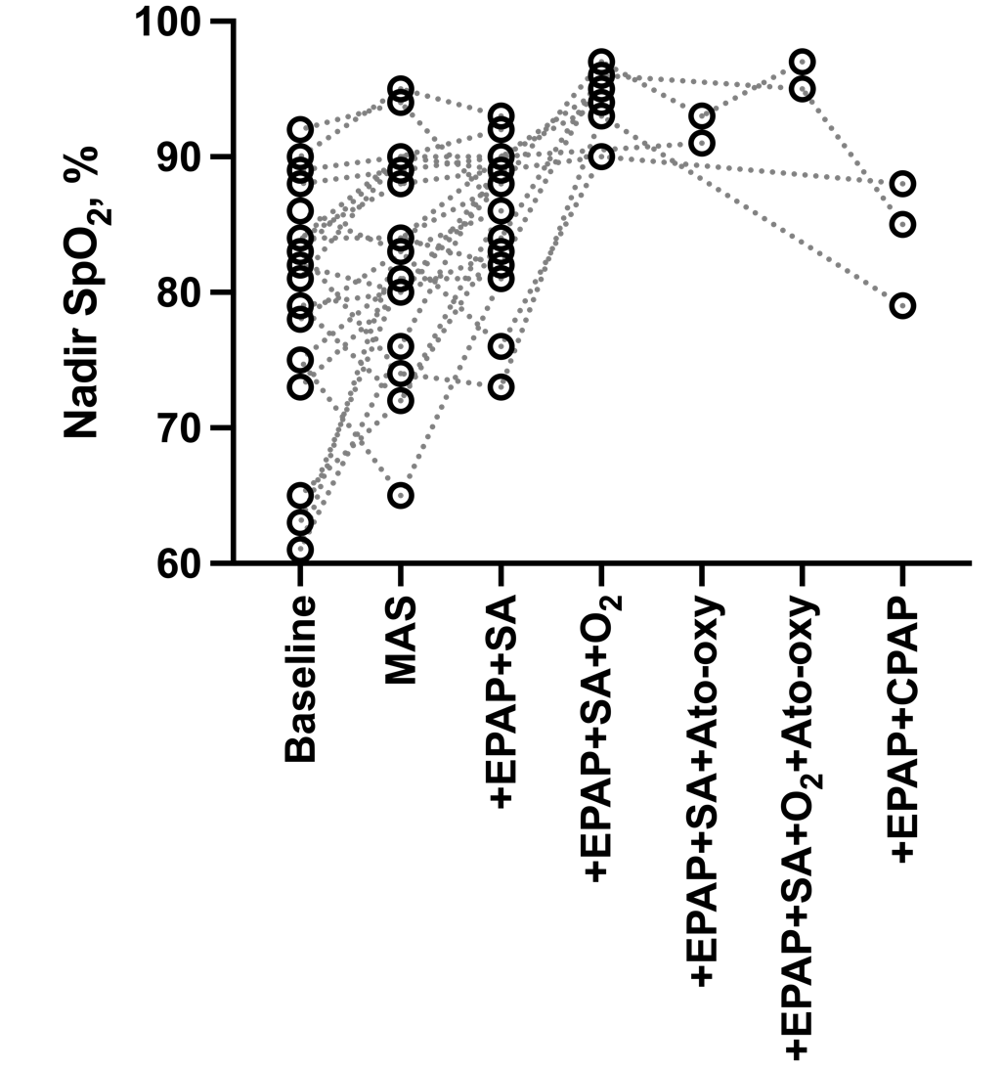
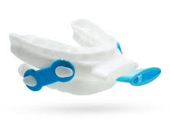
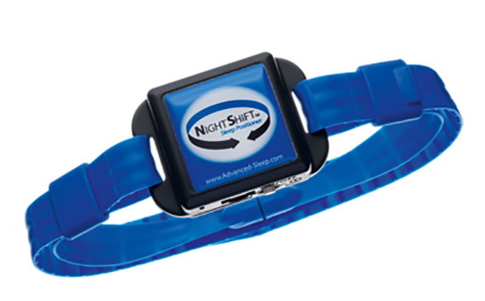
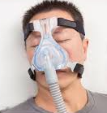

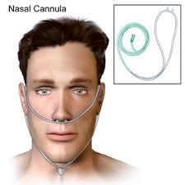

Stepwise add-on and endotype-informed targeted combination therapy to treat OSA
Aishah et al., Annals Am Thor Soc (2023)

Slide 25

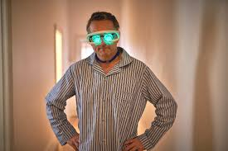
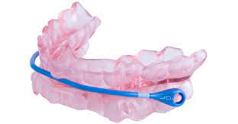
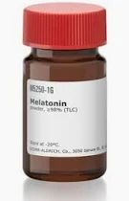
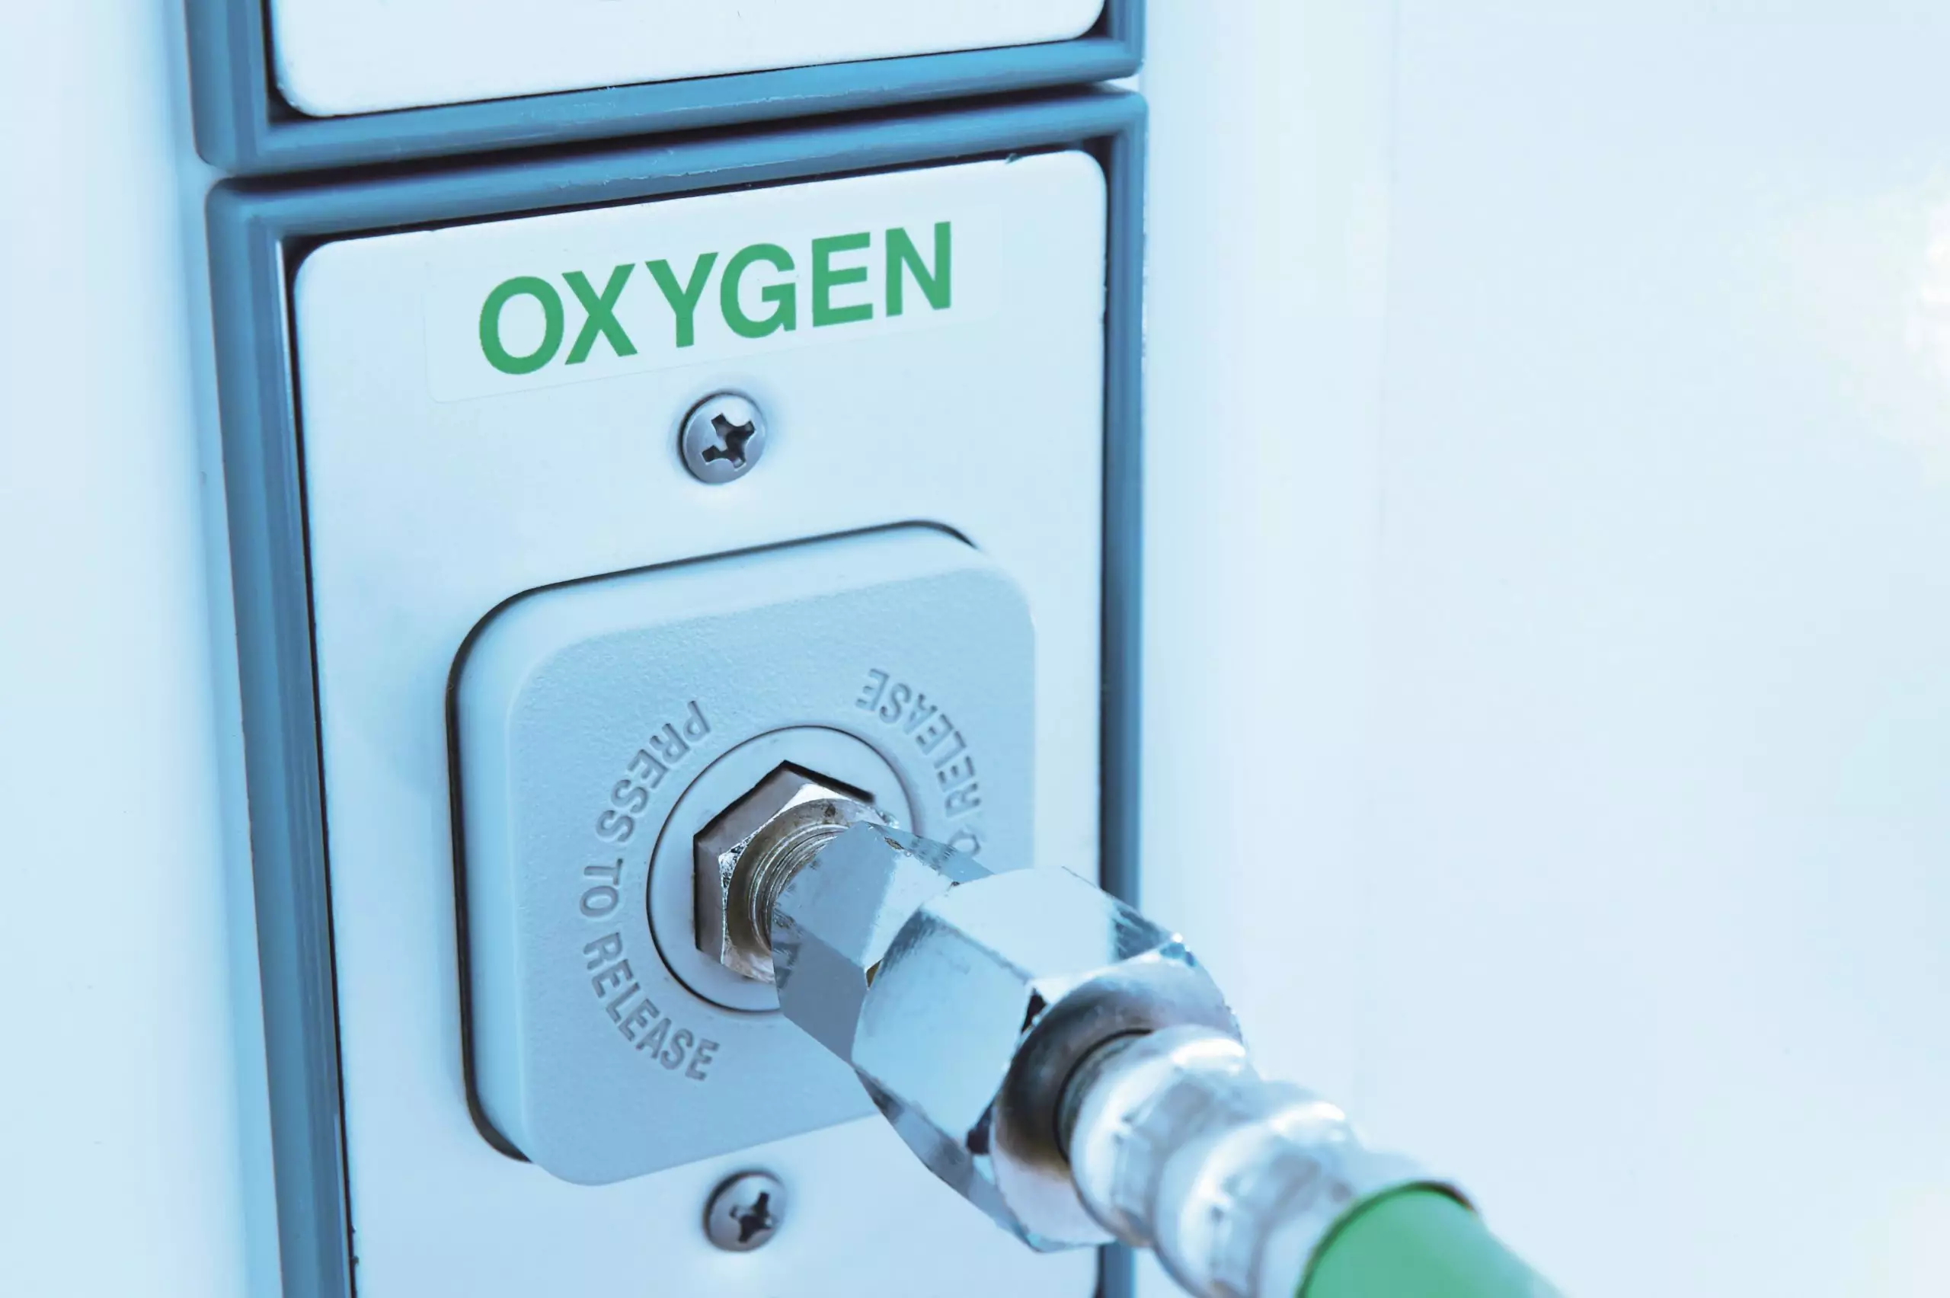

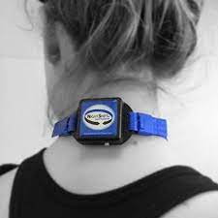
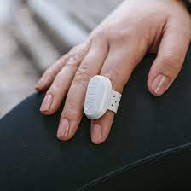
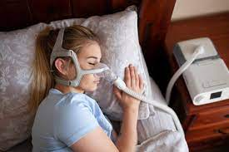
Targeted treatment options

Slide 26
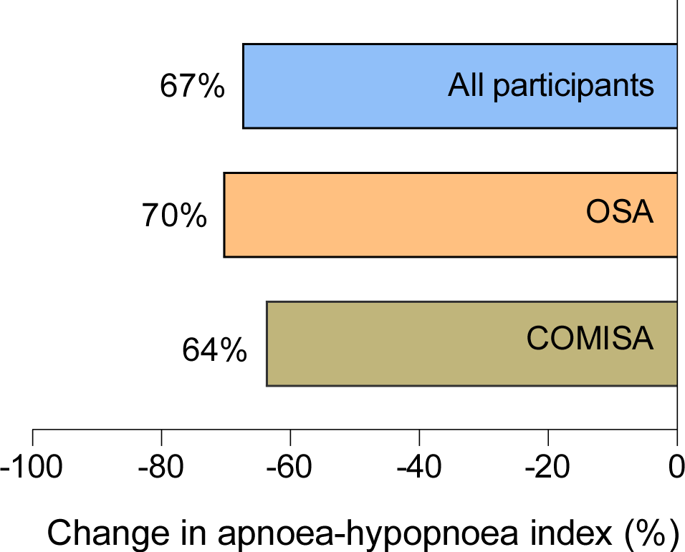
Endotype-directed targeted therapy reduced OSA severity
improvement
Eckert et al, (unpublished findings)

Slide 27

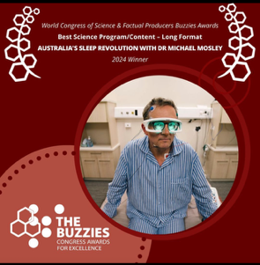
Australia’s sleep revolution: Outcomes to date
South Australian Excellence in Science and Industry Collaboration Award 2024
  South Australian Government, Department of State Development
Screen Producers Association 2025
  Finalist Documentary Series of the Year (winners yet to be announced)
Realscreen 2025
  Best Presenter or Narrator, Non-Fiction – Winner
  Award of Excellence for Talent – Winner
AACTA AWARD
  Best Documentary or Factual Program – Finalist
Buzzies - World Congress of Science & Factual Producers
  Best Science Program Long Format – Winner
  Best Host/Presenter in a Science, History or Wildlife Program - Finalist
Asian Television Awards
  Best Documentary Series – Winner
Asian Academy Creative Awards
  National Winner Best Direction (Non-Fiction),
  National Winner Best Documentary Series
AIB (Association for International Broadcasting)
  Health & Social Category – Finalist
West Australian Screen Culture Awards
  Innovation in Television - Finalist

Slide 28

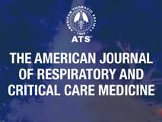
In press

Slide 29
