Slide 1


The future of targeted therapy for sleep apnoea
Danny J. Eckert
Matthew Flinders Professor
Director- FHMRI Sleep Health, Flinders University, Australia
Lead Investigator- Brigham and Women’s Hospital, Boston (part-time)
The future of sleep apnoea treatment: weight loss, the heart and beyond, scientific exchange meeting April 29th, 2025- National Wine Centre, Adelaide

Slide 2
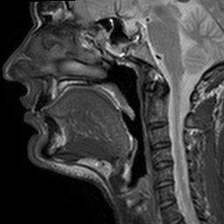
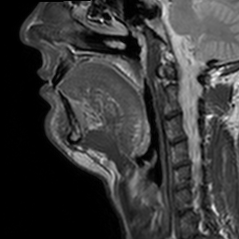
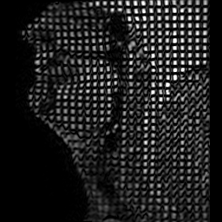
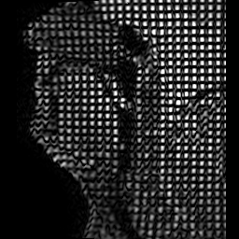
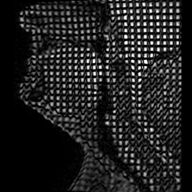

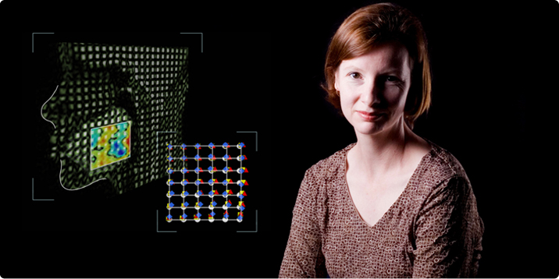
Interaction between upper airway anatomy and non-anatomical traits is crucial in determining the presence or absence of OSA
Eckert, Sleep Med Rev (2018) & Brown et al, Sleep, (2013)

Slide 3
Anatomical and non-anatomical contributors to OSA
Adapted from Aishah and Eckert, Curr Opin Pulm Med (2019) and Carberry et al, Chest (2018)

Slide 4
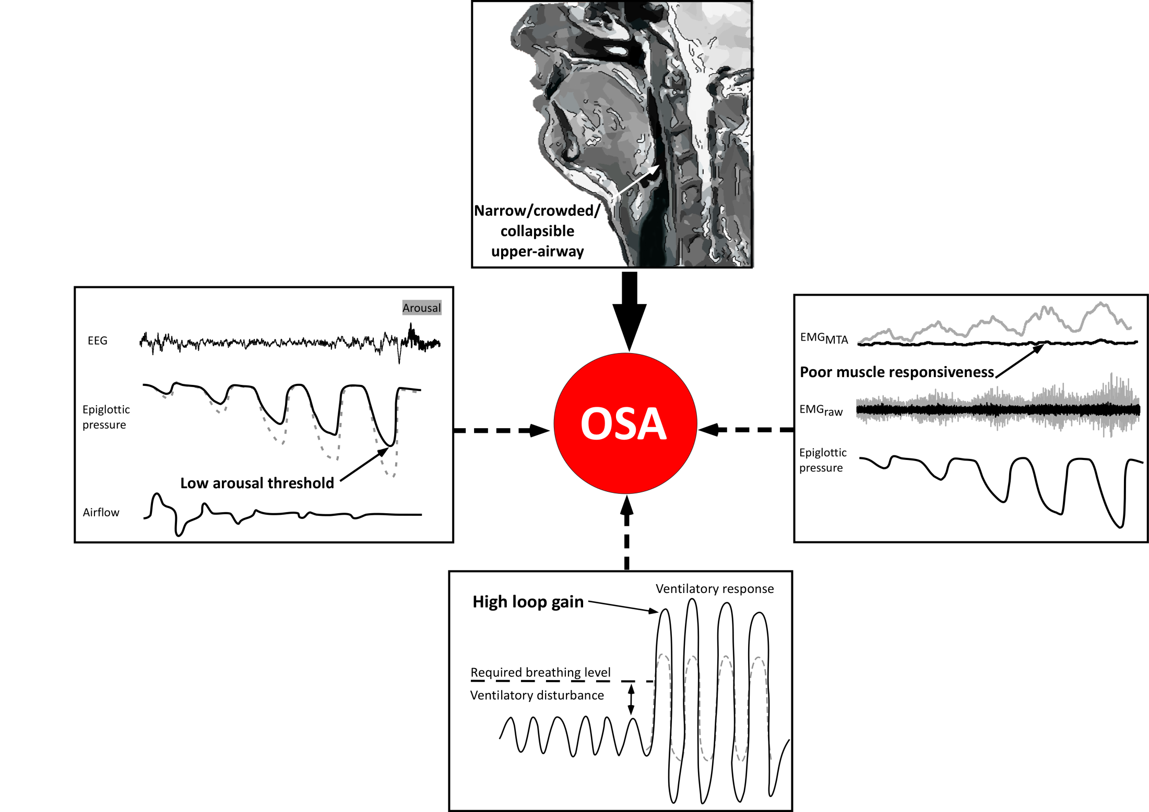
100% anatomical compromise
(but of variable magnitude)
37% low arousal threshold
36% poor muscle responsiveness
70% have 1 or more non-anatomical factors that contribute to their sleep apnoea
36% unstable respiratory control (high loop gain)
Eckert et al, Am J Resp Crit Care Med (2013) & Carberry et al, Chest (2018)

Slide 5
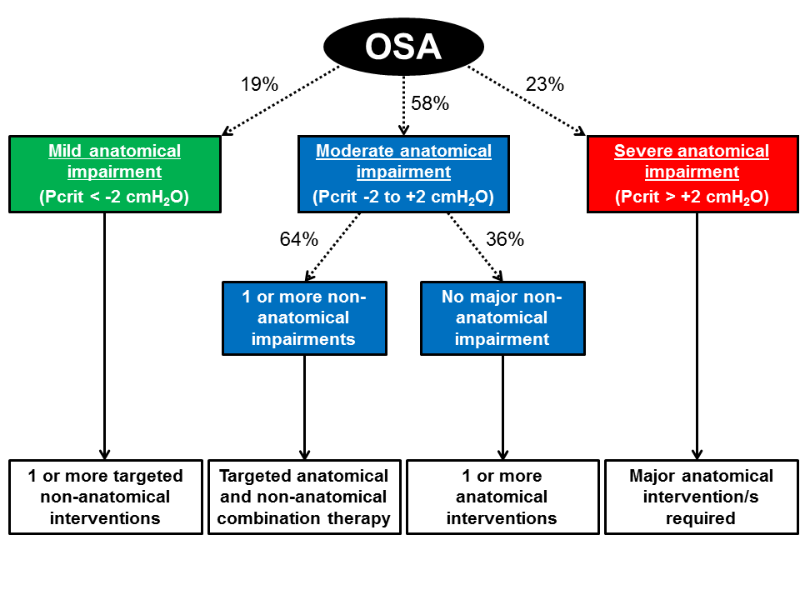
“PALM” scale concept to deliver targeted therapy
Pcrit
Arousal threshold
Loop gain &
Muscle response
Eckert, Sleep Med Rev (2018); Carberry et al, Chest (2018)

Slide 6
Application of OSA endotype knowledge to deliver precision medicine for OSA
(Pcrit ~3-6cmH₂O)
(Pcrit ~3cmH₂O)
(Pcrit ~2-4cmH₂O)
(Pcrit dose-dependent)
/CBTi
/Sulthiame
Eckert et al, AJRCCM (2013) and Eckert, Sleep Med Rev (2018)

Slide 7
Weight loss improves upper airway collapsibility (Pcrit)- Dose dependent
Usual care
Weight loss group (diet and behaviour modification)
Schwartz et al., Am Rev Resp Dis (1991)

Slide 8
Tirzepatide for the treatment of OSA and obesity
Malhotra et al. New Engl J Med (2024)

Slide 9
Functional anatomy: Critical closing pressure (Pcrit) and implications for targeted therapy
Non-REM Supine AHI (events/h)
Non-anatomical
Anatomical
Passive Pcrit (cmH₂O)
Non-anatomical targets
Controls
Increased Upper-Airway Collapsibility
OSA
Eckert et al, Am J Resp Crit Care Med (2013)

Slide 10


