Slide 1
Quando lʼinsonnia è causata da DRS
Francesco Fanfulla
Unità Operativa di Medicina del Sonno
Servizio di Fisiopatologia Respiratoria
ICS Maugeri Pavia e Montescano IRCCS

Slide 2
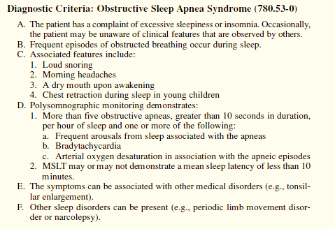
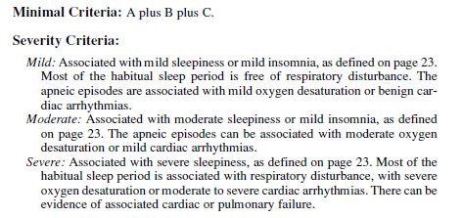
ICSD (1° edition)
Dyssomnias
The dyssomnias are the disorders that produce either difficulty initiating or maintaining sleep or excessive sleepiness.

Slide 3
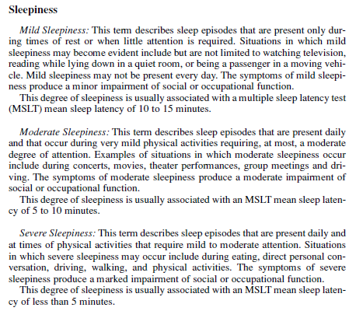
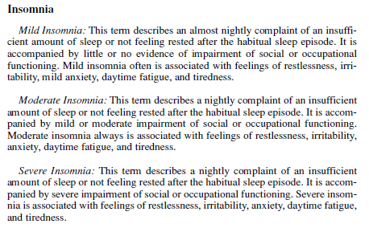

Slide 4
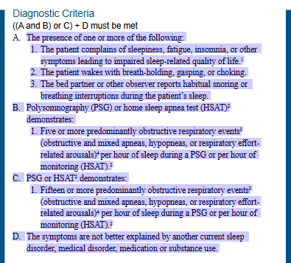
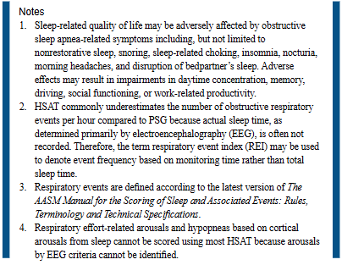
ICSD 3° edition - TR

Slide 5
Definition of Chronic Insomnia ICSD-3 tr
Chronic insomnia is characterized by difficulty initiating sleep, maintaining sleep, or experiencing poor sleep quality for at least three months. These sleep difficulties occur despite adequate opportunity for sleep and result in daytime dysfunction.
Difficulty initiating sleep: This refers to having trouble falling asleep when you intend to.
Difficulty maintaining sleep: This involves frequent awakenings or a difficulty returning to sleep after awakenings.
Poor sleep quality: This encompasses feelings of being unrefreshed or not sleeping deeply, even if you have been asleep for a sufficient amount of time
Daytime dysfunction: This refers to the negative impact on daily life due to the poor sleep, which can include fatigue, impaired concentration, malaise, and mood disturbances.
Chronic duration: The sleep difficulties must persist for at least three months to be classified as chronic insomnia.

Slide 6
Definition of Chronic Insomnia DSM-V (tr)
Insomnia disorder (i.e., clinical insomnia) as difficulty initiating sleep, difficulty maintaining sleep, or early-morning awakening despite adequate opportunity for sleep; leading to clinically significant distress or impairments in functioning; and with a frequency of 3 or more nights per week and a duration of 3 months or longer.
Insomnia is not explained by the presence of mental disorders or medical conditions and is not associated with another sleep-wake disorder.

Slide 7
Criterio | Descrizione
A. Disturbo del sonno | Difficoltà nell'iniziare o mantenere il sonno, oppure sonno non ristoratore per almeno 1 mese.
A1.1. Difficoltà nell'iniziare il sonno | Problemi ad addormentarsi per ≥3 e ≤7 notti a settimana, con un tempo di addormentamento ≥30 minuti.
A1.2. Difficoltà nel mantenere il sonno | Risvegli multipli (≥3 volte a notte) o difficoltà a riaddormentarsi (≥30 minuti ).
A1.2c. Risveglio precoce | Risveglio ≥30 minuti prima dell'orario desiderato per ≥3 e ≤7 giorni a settimana.
A1.3. Sonno non ristoratore | Sensazione di non essere riposati al mattino per ≥3 e ≤7 giorni a settimana, con gravità moderata, severa o molto severa.
A2. Durata del disturbo | Il problema persiste per almeno un mese.
B. Impatto sulla vita quotidiana | Il disturbo causa stress clinicamente significativo o compromissione in ambiti sociali, lavorativi o altre aree importanti.
C. Esclusione di altri disturbi del sonno | Il disturbo non è attribuibile a narcolessia, disturbi respiratori del sonno, disturbi del ritmo circadiano o parasonnie.
D. Esclusione di disturbi mentali | Il disturbo non è esclusivamente legato a condizioni come depressione maggiore, ansia generalizzata o delirio.
E. Esclusione di cause fisiologiche | Il disturbo non è dovuto agli effetti diretti di una sostanza (farmaci, droghe, ecc.).

Slide 8
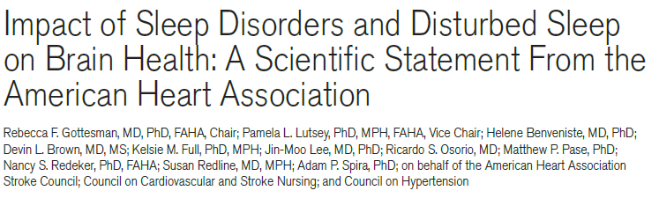
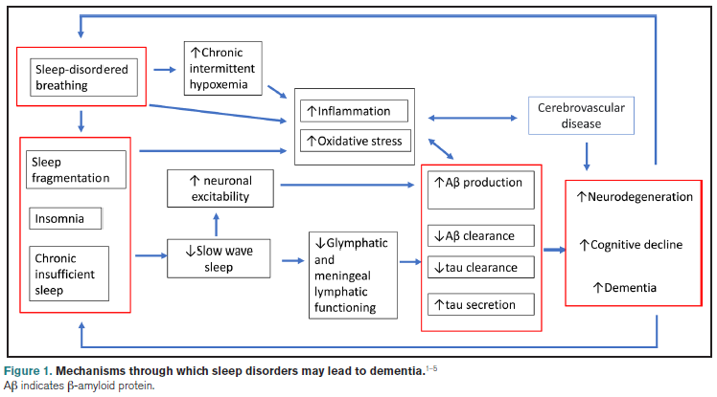

Slide 9
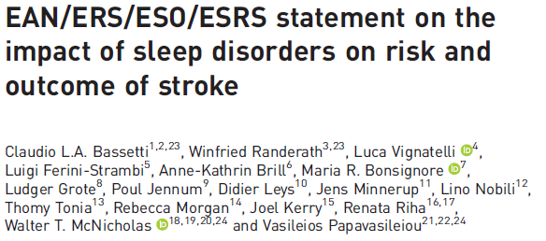
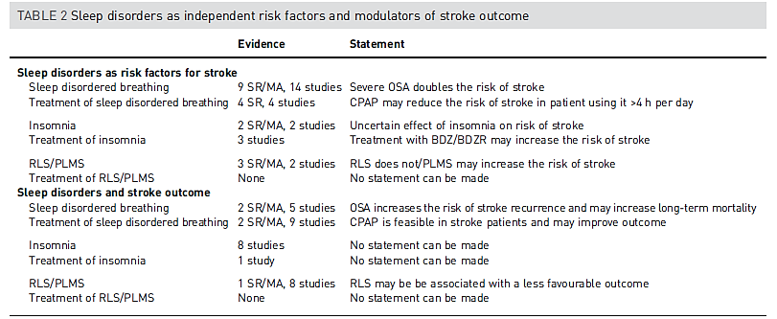

Slide 10
OSA Phenotype
A category of patients with OSA distinguished from others by a single or combination of disease features, in relation to clinically meaningful attributes (symptoms, response to therapy, health outcomes, quality of life).

Slide 11
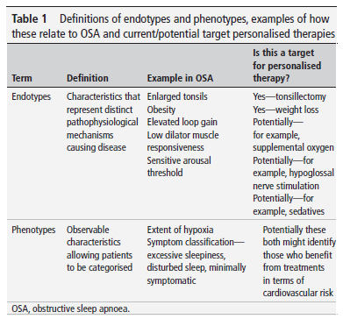
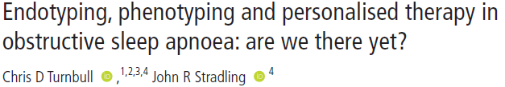
Potenziali Target
Stratificazione clinica/Triage
Peso specifico della sintomatologia (Patient-centered care vs Goal-oriented care)
Stratificazione rischio di Mortalità
Stratificazione rischio sviluppo di comorbilità (CV – neoplasie – respiratorie – declino cognitivo)
Stratificazione rischio incidenti stradali/lavorativi/malattia lavoratore turnista
Stratificazione sociale (accesso alle cure – sostenibilità – rinuncia – impatto lavorativo)
Risposta alla terapia
Problematica gestione paziente minimamente sintomatico

Slide 12
Uno sguardo…..sui dati disponibili

Slide 13
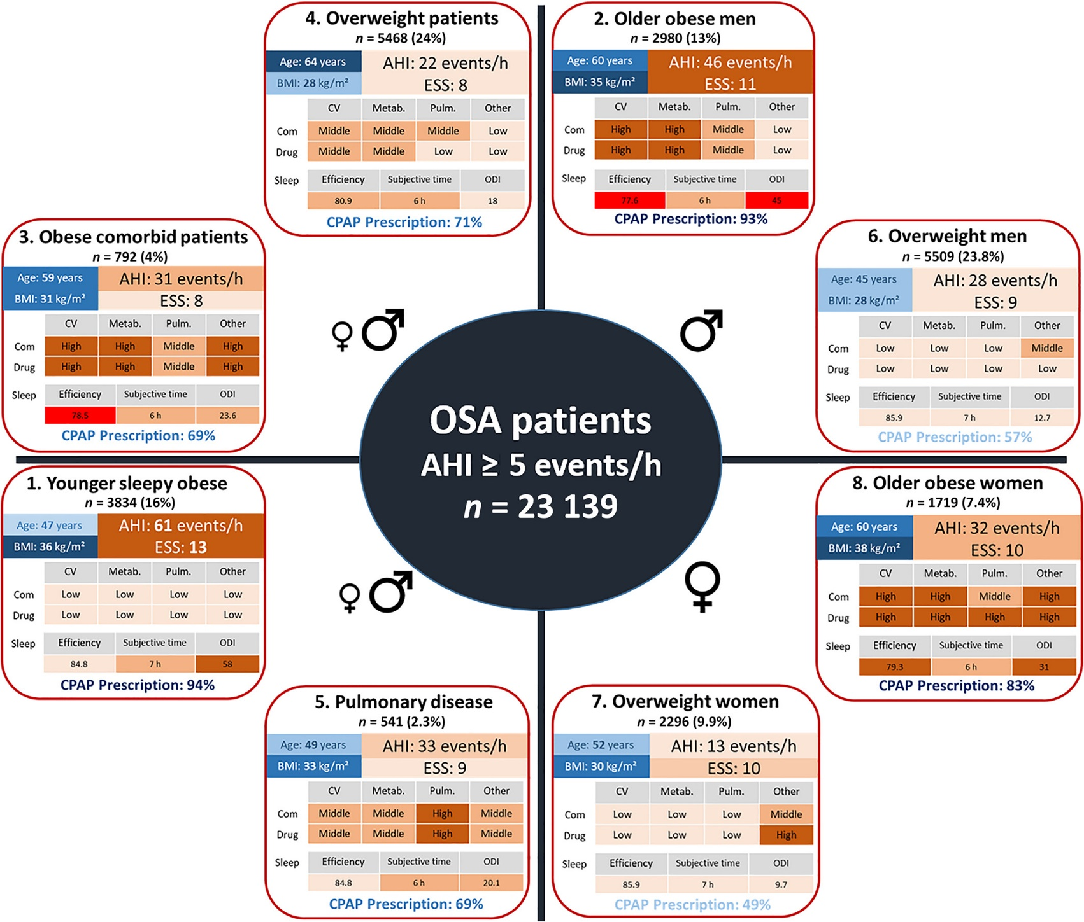
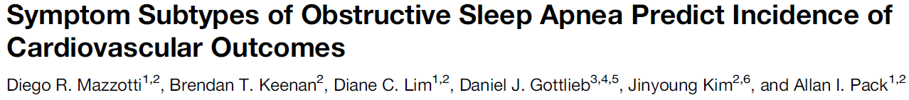
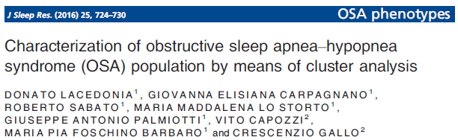
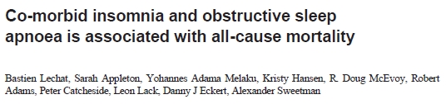
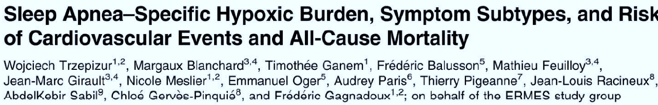

Slide 15
Clusters of sleep apnoea phenotypes:
A large pan‐European study from the European Sleep Apnoea Database (ESADA)
Respirology, Volume: 26, Issue: 4, Pages: 378-387, First published: 02 November 2020, DOI: (10.1111/resp.13969)
Notes:
Summary of the eight OSA phenotype clusters. Darker backgrounds indicate more severe disease. AHI, apnoea–hypopnoea index; BMI, body mass index; Com, comorbidities; CPAP, continuous positive airway pressure; CV, cardiovascular diseases; ESS, Epworth sleepiness scale; Metab, metabolic disease; OSA, obstructive sleep apnoea; Pulm, pulmonary disease.
IF THIS IMAGE HAS BEEN PROVIDED BY OR IS OWNED BY A THIRD PARTY, AS INDICATED IN THE CAPTION LINE, THEN FURTHER PERMISSION MAY BE NEEDED BEFORE ANY FURTHER USE. PLEASE CONTACT WILEY'S PERMISSIONS DEPARTMENT ON PERMISSIONS@WILEY.COM OR USE THE RIGHTSLINK SERVICE BY CLICKING ON THE 'REQUEST PERMISSIONS' LINK ACCOMPANYING THIS ARTICLE. WILEY OR AUTHOR OWNED IMAGES MAY BE USED FOR NON-COMMERCIAL PURPOSES, SUBJECT TO PROPER CITATION OF THE ARTICLE, AUTHOR, AND PUBLISHER.

Slide 16
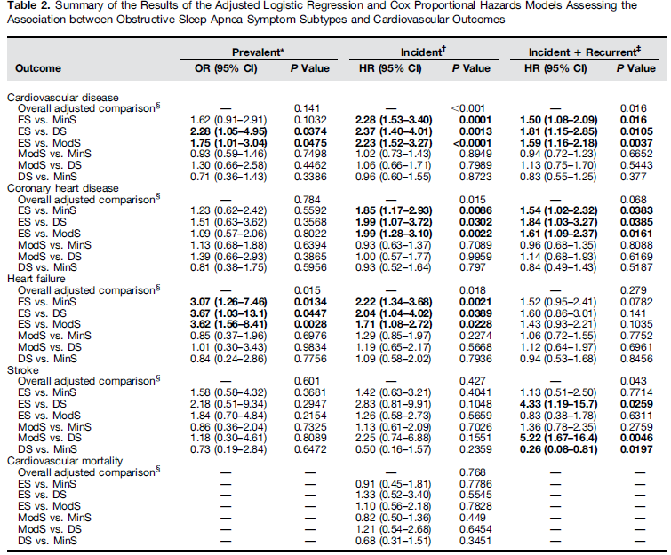
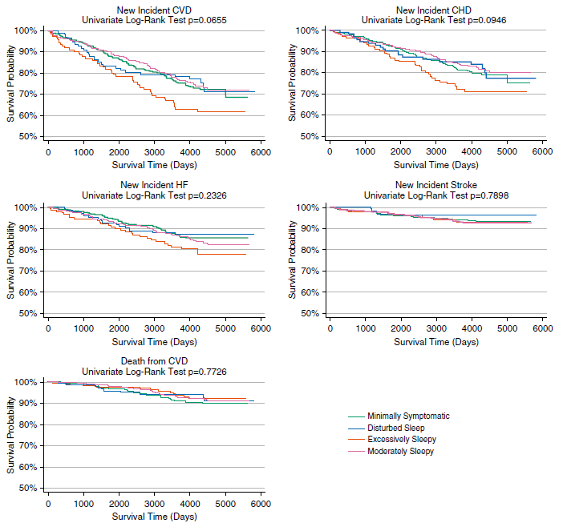
unadjusted

Slide 17
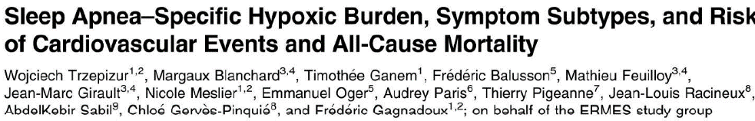
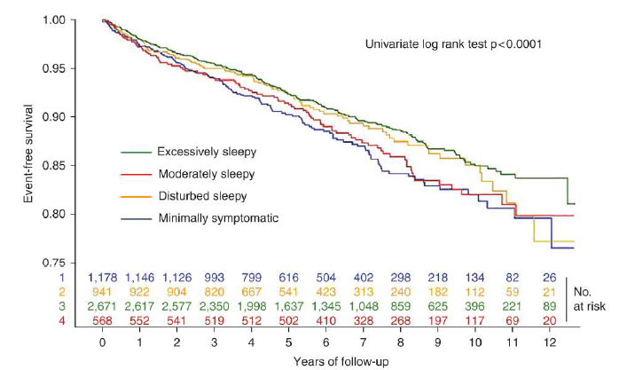
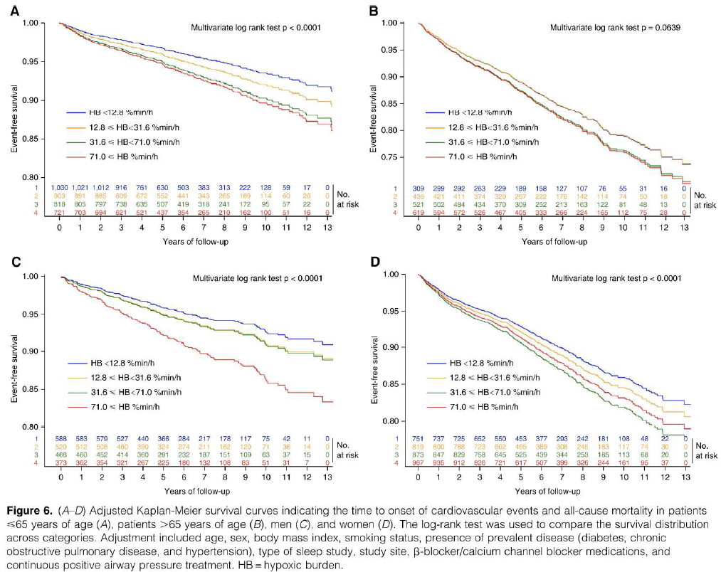
CV-disease free

Slide 18
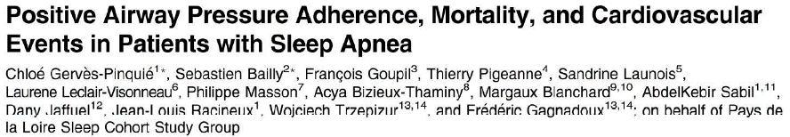
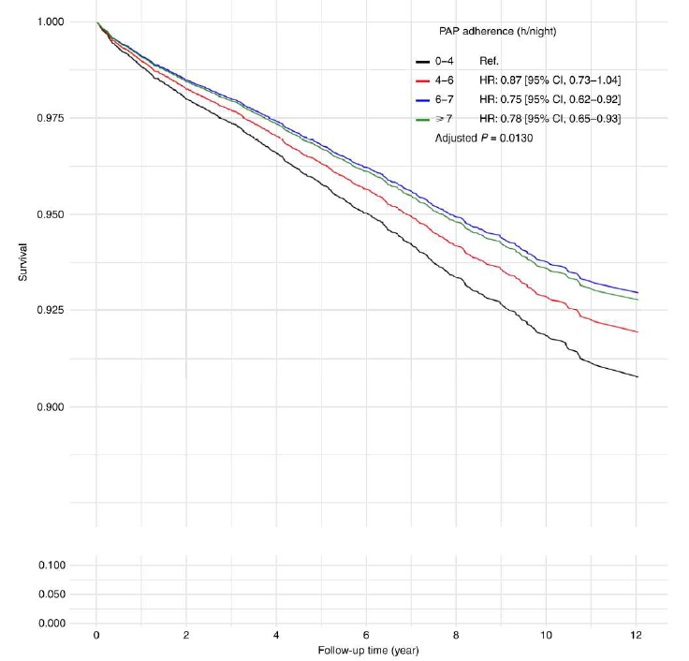
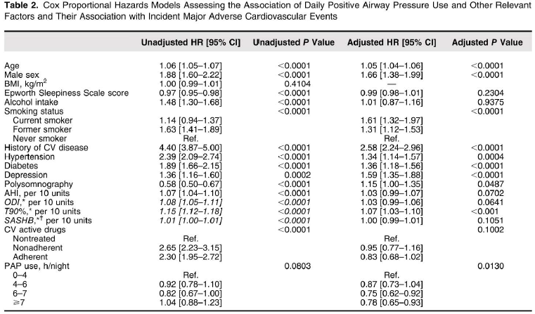

Slide 19

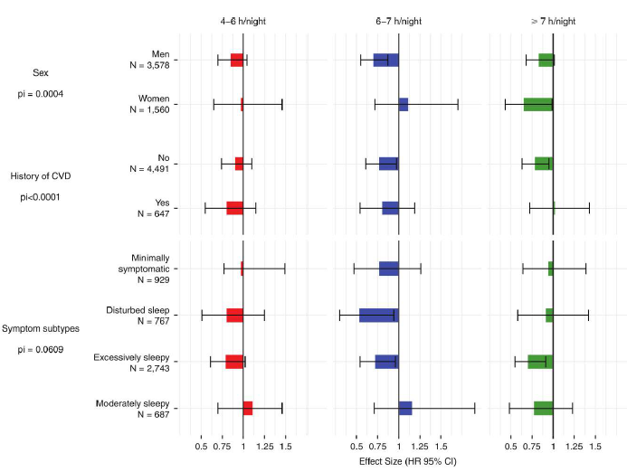

Slide 20


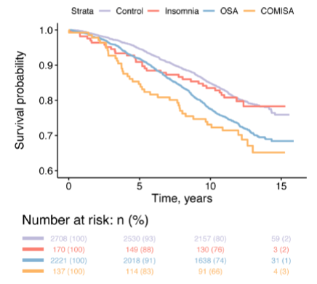
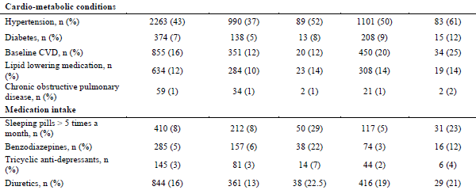

Sleep Heart Health Study (SHHS)

Slide 21
Insomnia was defined according to the presence of self-reported nocturnal symptoms (difficulties falling asleep, waking up in the middle of the night and having difficulty returning to sleep, and/or waking up too early and being unable to resume sleep, on 16-30 times per month) and daytime impairments including having little to no energy in the past 4 weeks, and/or feeling unrested at least 5 times a month and/or feeling tired most/all of the time.
Alternative definitions of insomnia, such as insomnia symptom frequency reduced to ≥5 times a month and presence/absence of sleep medication use were also explored in sensitivity analyses.

Slide 22
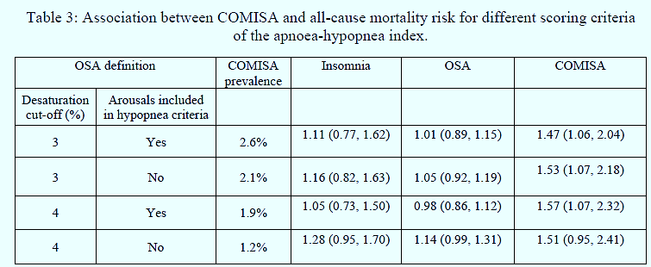
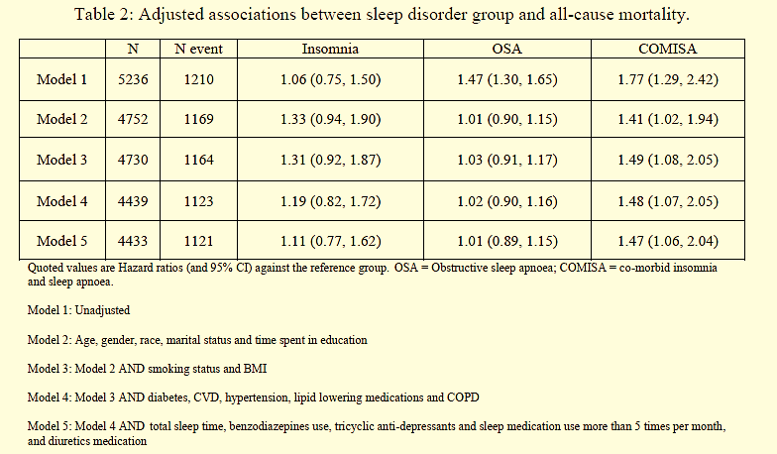
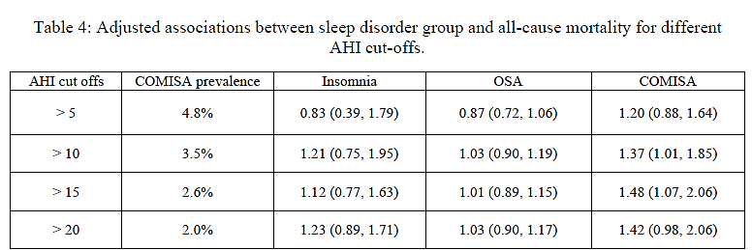

Slide 23
CPAP treatment success: CPAP use >4 h and either ⬇ in Epworth sleepiness score <4 points in patients with a baseline value >11 and/or an increase of at least 7 points in the energy/vitality component score of the SF36.
After adjustment for socioeconomic status, baseline apnea-hypopnea index, and ESS, patients from clusters “female OSA,” “mildly symptomatic OSA,” and “comorbid OSA,” had a lower likelihood of CPAP treatment success than patients with “severe OSA syndrome” from cluster 3.

Slide 24
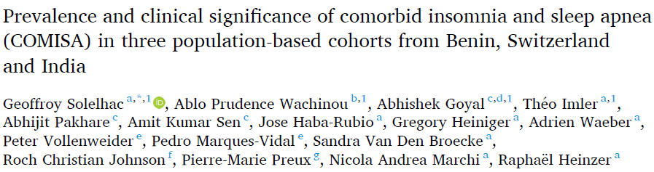
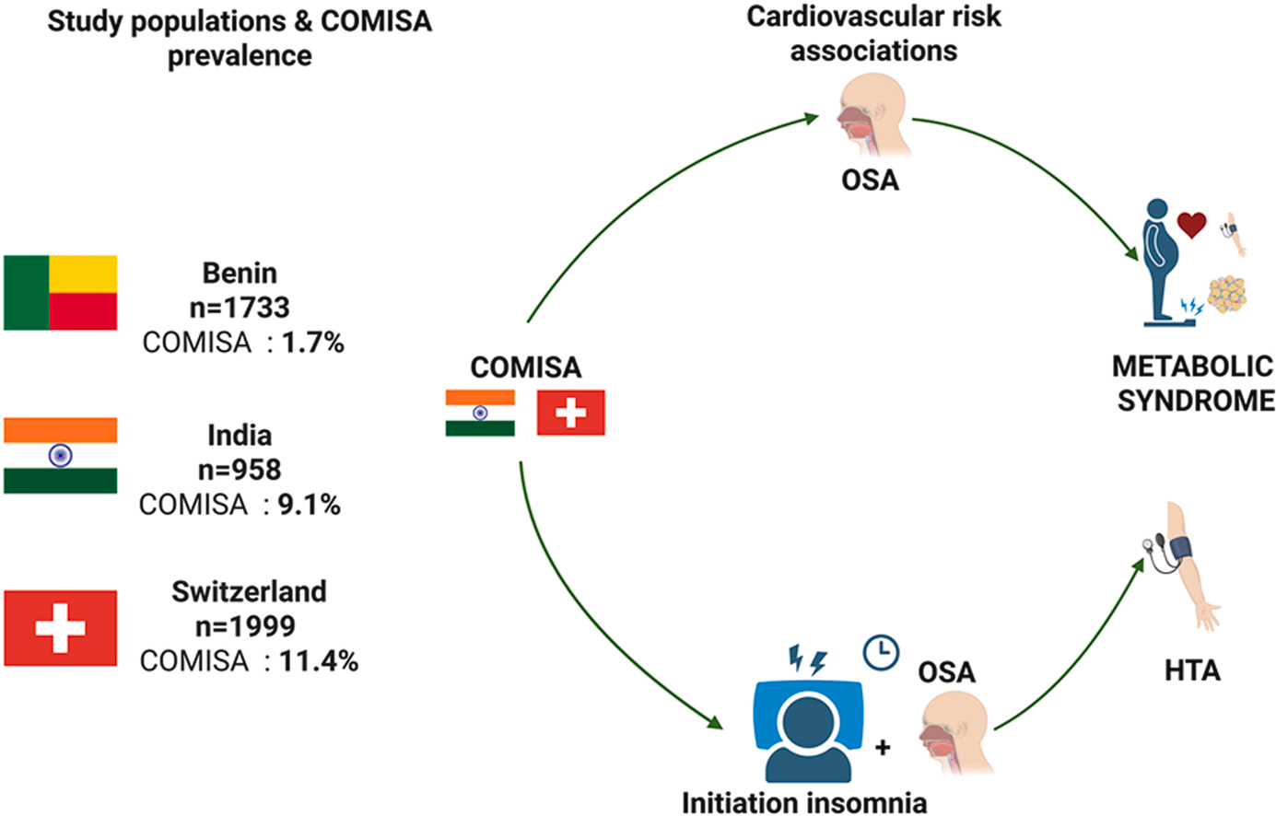

Slide 25
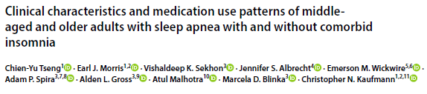
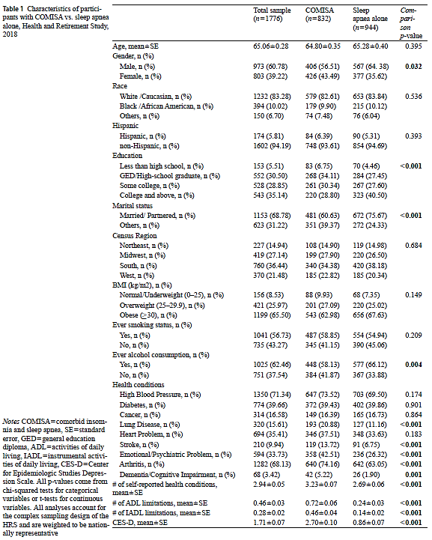
Insomnia symptoms were assessed using the Jenkins Sleep Scale, on which participants were asked to report on the frequency of trouble with “falling asleep,” “waking during the night,” and “waking too early,” as well as how often they “felt rested in the morning.”
The presence of an insomnia symptom was defined as answering “most of the time” for the first three symptoms or “rarely or never” for “felt rested in the morning.”

Slide 26
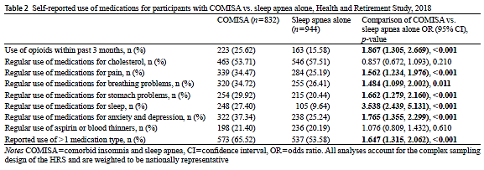

Slide 27
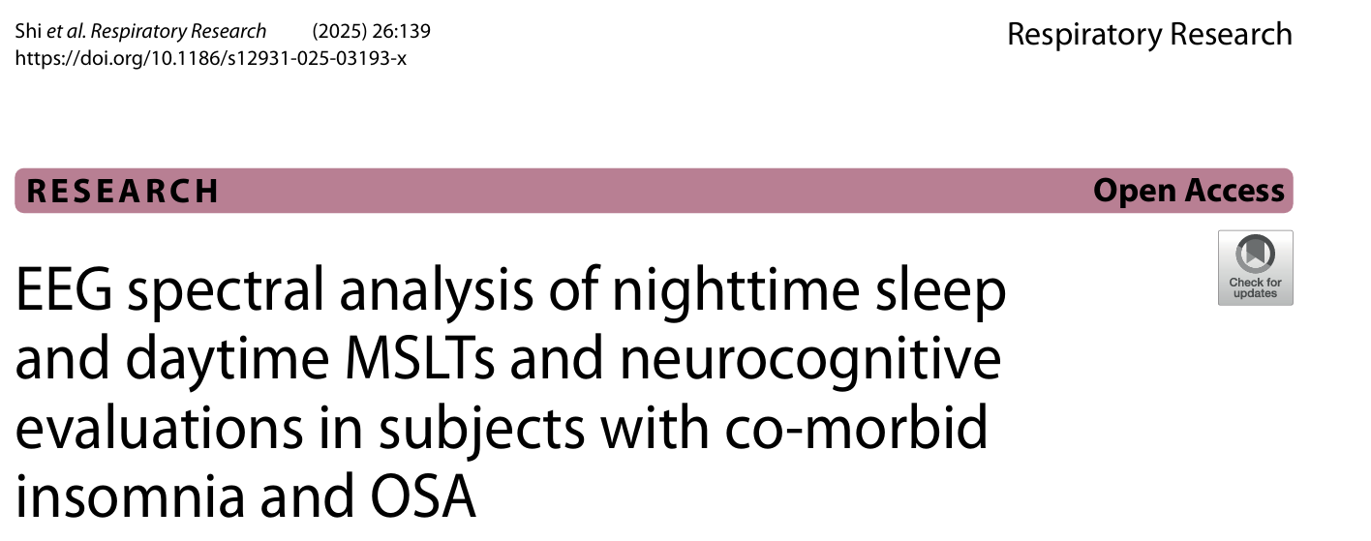

Slide 28
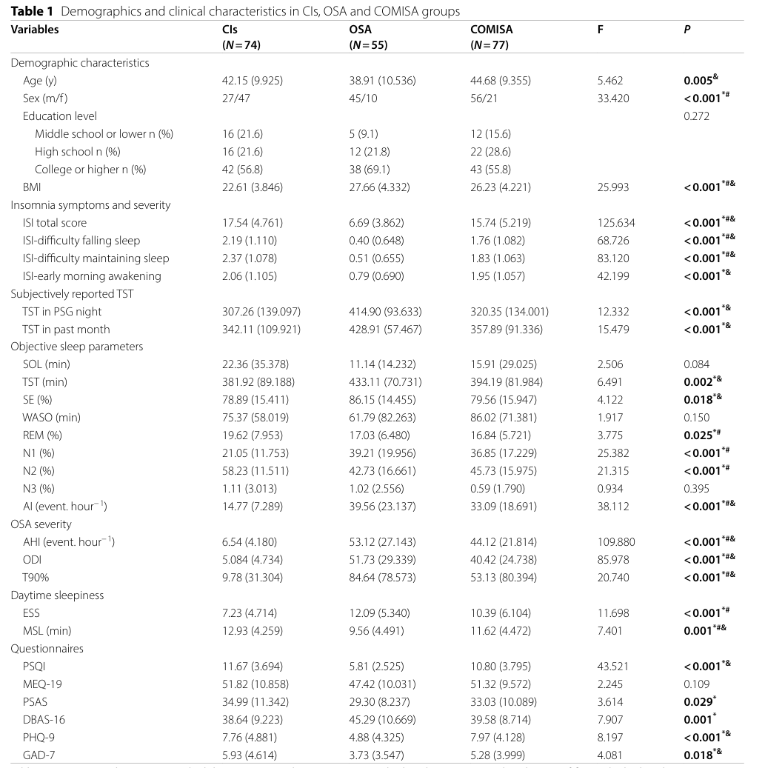

Slide 29
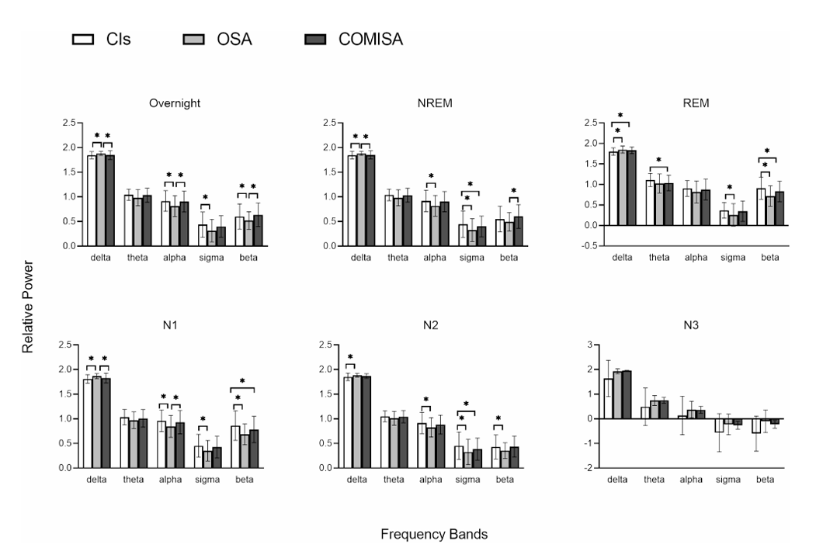
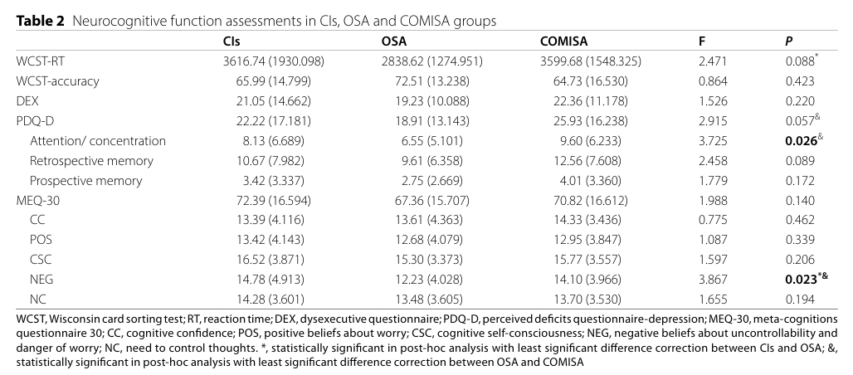

Slide 30
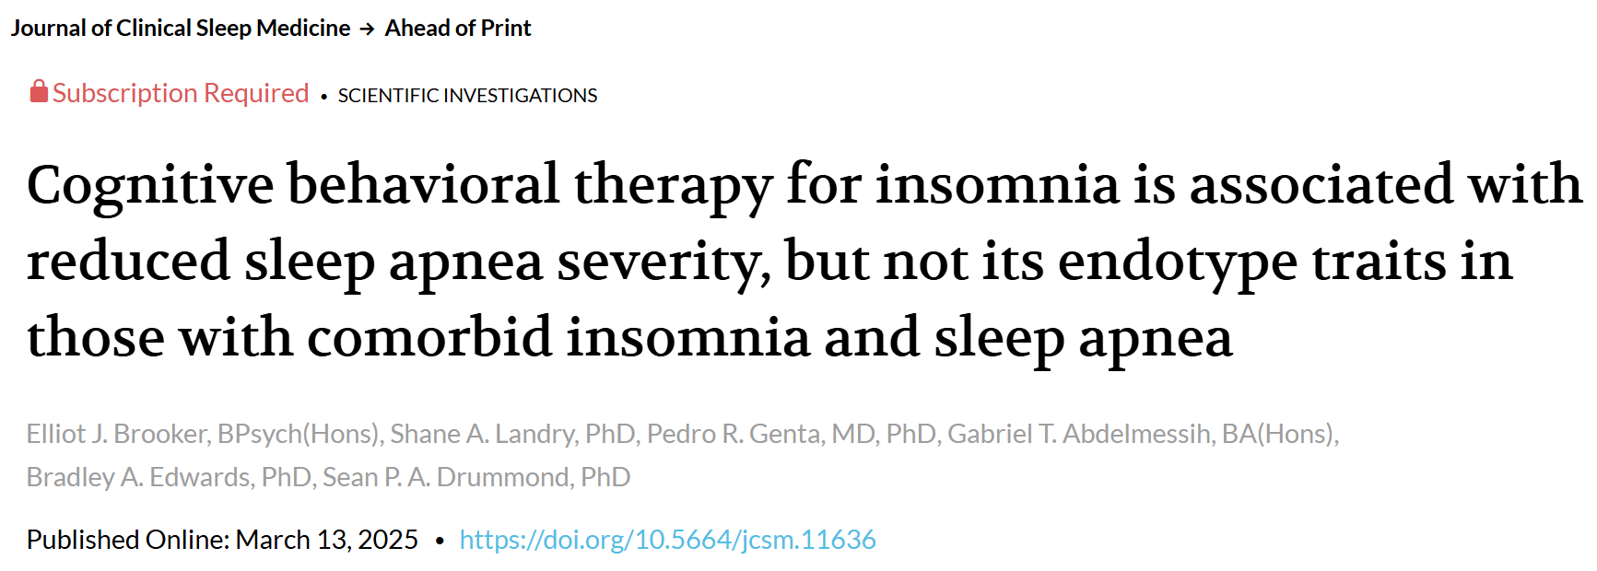
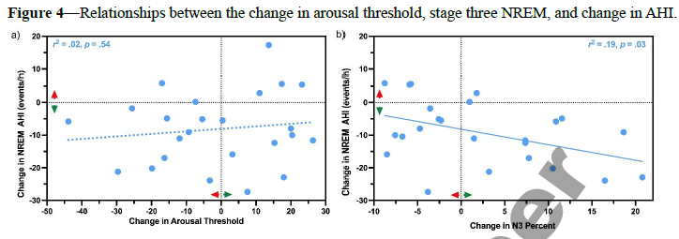
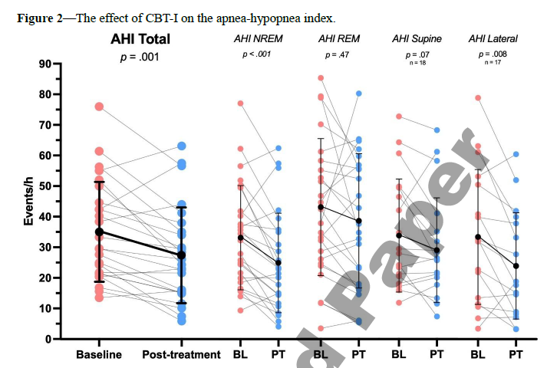

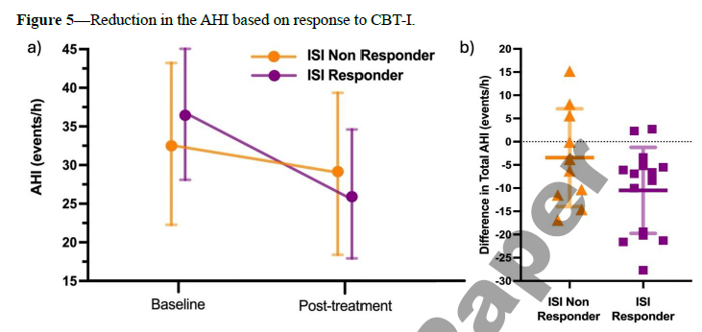

Slide 31
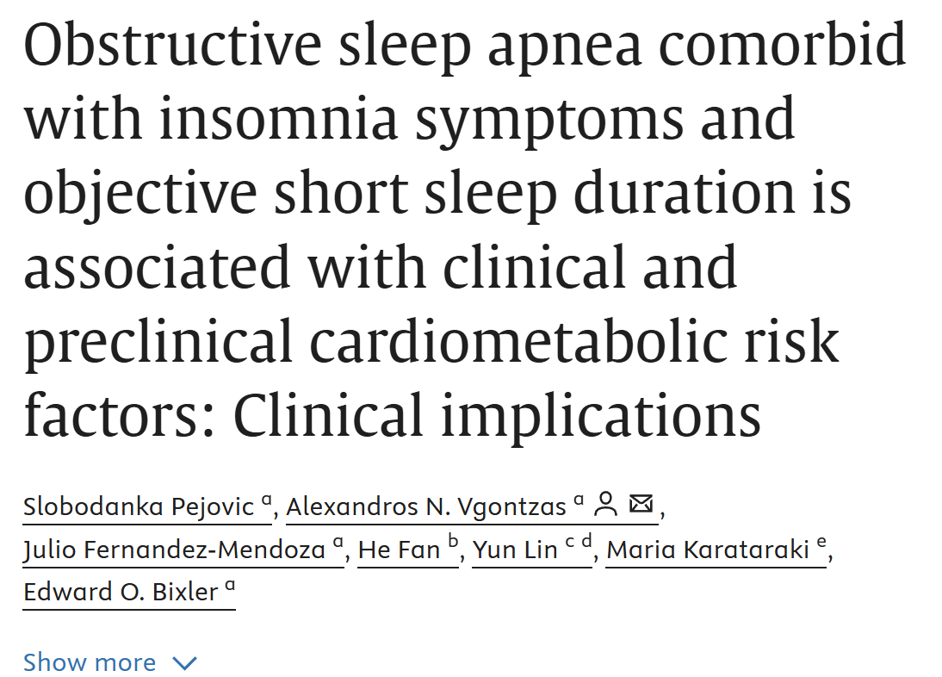
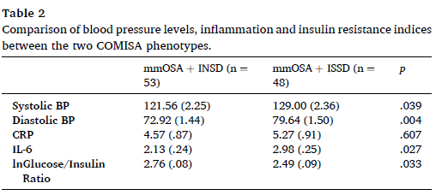
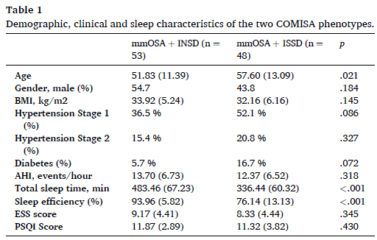

Slide 32
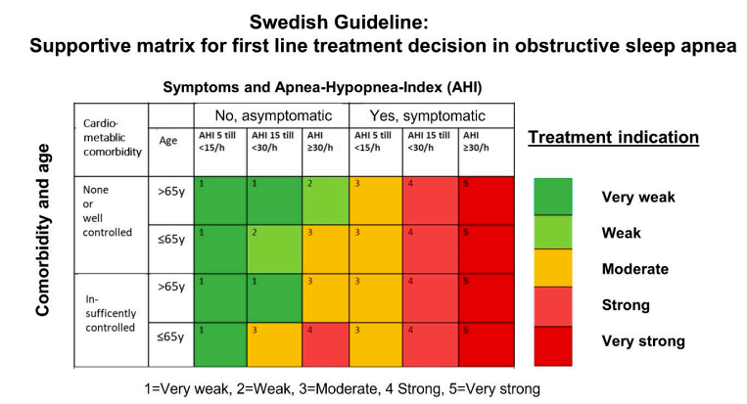
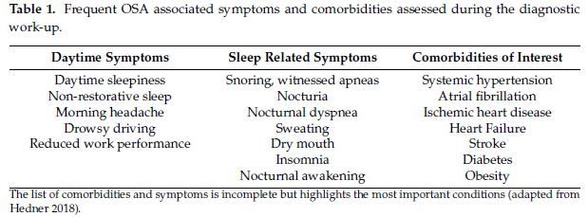

Slide 33
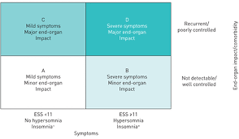

Slide 34


