Slide 1

Respiratory Oscillometry
Chiara Veneroni
Department of Electronics, Informatics and Biomedical Engineering
(chiara.veneroni@polimi.it)
Notes:
Come si esegue la oscillometria step-by-step - 30min
La oscillometria nel paziente stabile ed acuto - 20 min
Esercitazioni oscillometria e interpretazione risultati - 1h??

Slide 2
Outline
1. What is Oscillometry
Understanding the fundamental principles
Interpretation of results
How to perform an oscillometry test
Oscillometry in research and clinics
2. Main clinical applications of oscillometry
Detection of airway obstruction
Bronchial reversibility and Bronchial provocation test
Detection of Tidal Expiratory Flow limitation –EFLt
Other applications
Come si esegue la oscillometria step-by-step
La oscillometria nel paziente stabile ed acuto

Slide 3
Section 1
What is Oscillometry?
Understanding the fundamental principles

Slide 4
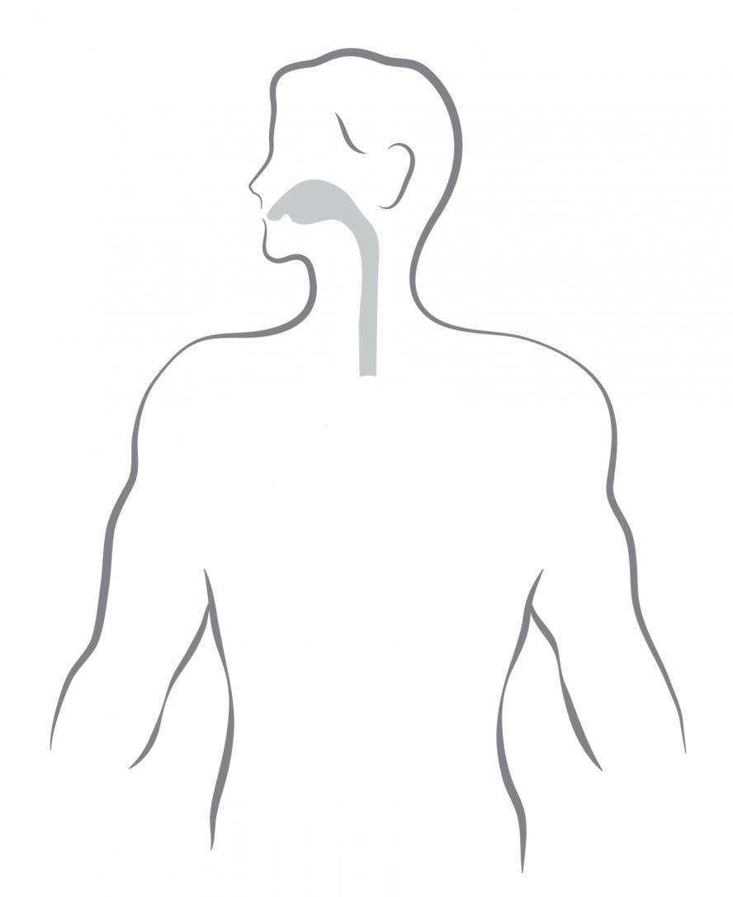
Measuring mechanical properties of the respiratory system
Pressure acting on the lung during spontaneous breathing:
Pressure generated by muscles
Plung = Pmus
??? ???
Flow
Respiratory mechanics: the determination of the relationships between pressure and flow in the respiratory system
respiratory muscles
pressure

Slide 5
Forced Oscillation Technique or Oscillometry
Flow
Pressure
Oscillometry allows the determination of the lung mechanical properties by looking at the flow response to small amplitude, high frequency pressure oscillations
respiratory muscles
pressure
DuBois AB, Brody AW, Lewis DH, Burgess BF. Oscillation mechanics of lungs and chest in man. J Appl Physiol 1956; 8: 587-94
DuBois AB, Brody AW, Lewis DH, Burgess BF. Oscillation mechanics of lungs and chest in man. J Appl Physiol 1956; 8: 587-94

Slide 6
Forced Oscillation Technique or Oscillometry
Flow
Pressure
Oscillometry allows the determination of the lung mechanical properties by looking at the flow response to small amplitude, high frequency pressure oscillations
respiratory muscles
pressure
DuBois AB, Brody AW, Lewis DH, Burgess BF. Oscillation mechanics of lungs and chest in man. J Appl Physiol 1956; 8: 587-94
DuBois AB, Brody AW, Lewis DH, Burgess BF. Oscillation mechanics of lungs and chest in man. J Appl Physiol 1956; 8: 587-94

Slide 7
Forced Oscillation Technique or Oscillometry
Flow
Pressure
Oscillometry allows the determination of the lung mechanical properties by looking at the flow response to small amplitude, high frequency pressure oscillations
respiratory muscles
pressure
DuBois AB, Brody AW, Lewis DH, Burgess BF. Oscillation mechanics of lungs and chest in man. J Appl Physiol 1956; 8: 587-94
DuBois AB, Brody AW, Lewis DH, Burgess BF. Oscillation mechanics of lungs and chest in man. J Appl Physiol 1956; 8: 587-94

Slide 8
Oscillometry: principles
Pressure acting on the lung during spontaneous breathing:
Pressure generated by muscles AND device
Plung = Pmus + Pdevice
Flow
Pressure
Oscillometry allows the determination of the lung mechanical properties by looking at the flow response to small amplitude, high frequency pressure oscillations
??? ???
respiratory muscles
pressure
DuBois AB, Brody AW, Lewis DH, Burgess BF. Oscillation mechanics of lungs and chest in man. J Appl Physiol 1956; 8: 587-94
DuBois AB, Brody AW, Lewis DH, Burgess BF. Oscillation mechanics of lungs and chest in man. J Appl Physiol 1956; 8: 587-94

Slide 9
Oscillometry: principles
Forced Oscillation Technique or Oscillometry
+
If the oscillations are faster than muscles (=higher frequency) it is possible to split the two components and consider the flow resulting from the oscillatory pressure only.
Hz:
the number of times pressure oscillates in a second.

Slide 10
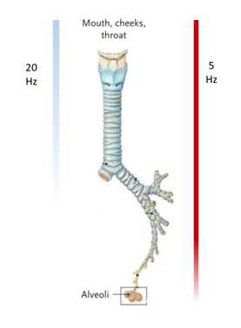
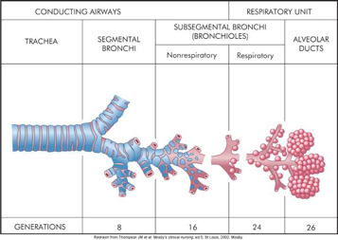
OPTIMAL STIMULATION FREQUENCY: SPEED VS DEPTH
6 Hz
12 Hz
Airway opening
Large airways
Alveoli
The proportion of the oscillatory pressure applied at the airway opening that is transmitted to the alveolus is higher at low frequencies than at higher frequencies.

Slide 11
OPTIMAL STIMULATION FREQUENCY: SPEED VS DEPTH
Which forcing frequencies should we use?
The optimal stimulation frequency is a trade-off between being faster than the breathing but not too fast, in order to reach the deepest parts of the lung.
For spontaneous breathing:
Adults: Frequency ≥ 5 Hz
Preschool children: Frequency ≥ 8 Hz
Newborns: Frequency ≥ 10 Hz

Slide 12
What is Oscillometry?
Understanding the fundamental principles
Interpretation of results

Slide 13
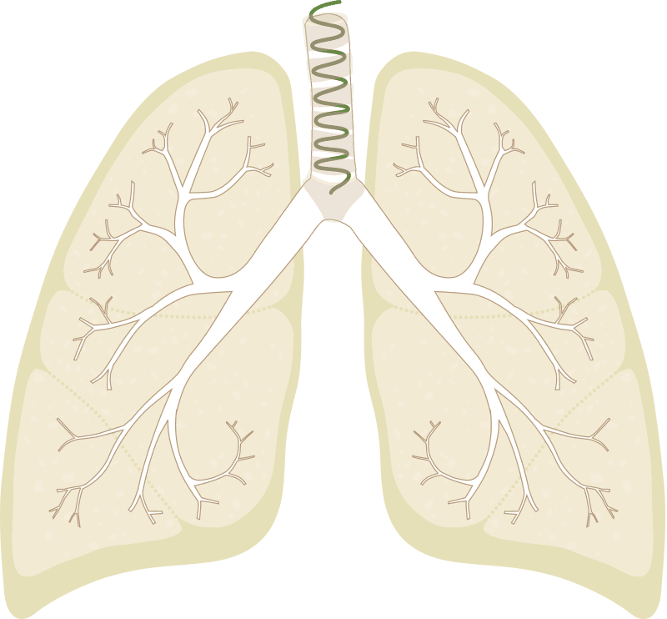
Respiratory impedance: INTERPRETATION
The oscillatory pressure moves air in and out of the lung, generating an airflow through the airways that is measured and used to calculate the respiratory impedance (Zrs).
Impedance (Zrs) tells us how easy or difficult it is for air to flow in and out of the lungs.
Impedance has 2 components:
Resistance (Rrs) and Reactance (Xrs)
for each frequency (f) used for testing.
Respiratory Impedance
(Zrs)
Resistance
Rrs
Reactance
Xrs

Slide 14
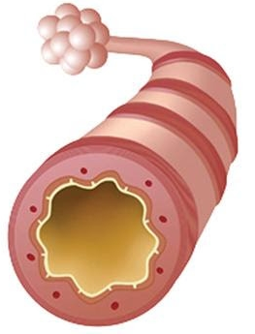
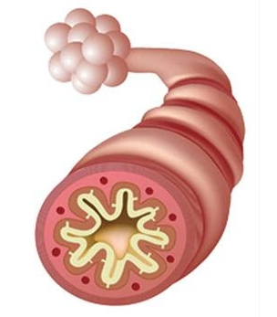
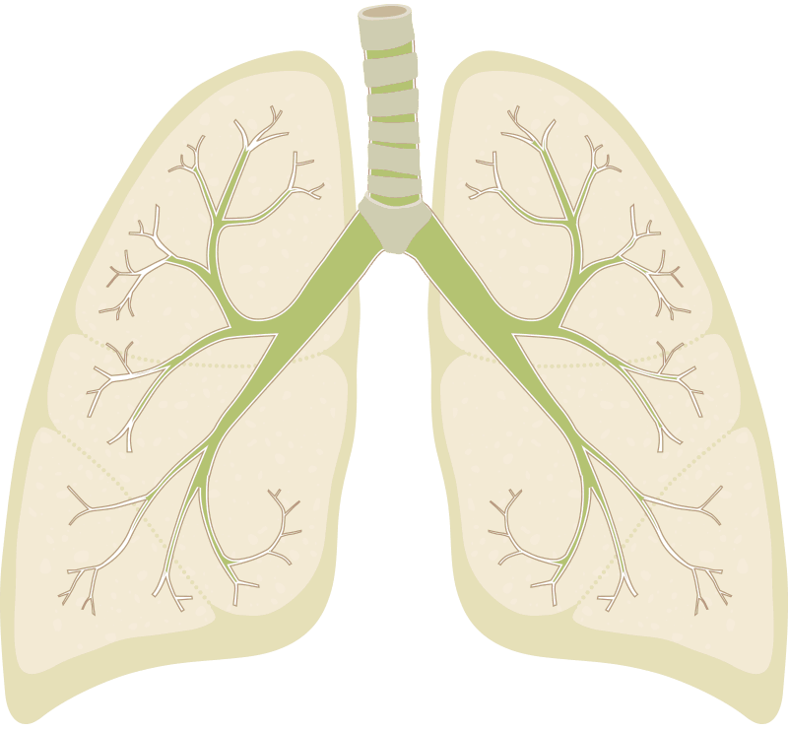
RESISTANCE (Rrs): CLINICAL INTERPRETATION
Resistance (Rrs) provides information related to the caliber of the larger airways, measured at tidal volume.
Rrs increases in situations such as:
  during bronchoconstriction,
  the presence of excessive mucous,
  airway inflammation,
  other causes of airway narrowing or obstruction¹
Resistance (Rrs) accounts for obstruction of the central (larger) airways
Rrs becomes bigger in obstructive diseases
¹Kaminsky, D. A., et al. (2022). Clinical significance and applications of oscillometry. European Respiratory Review, 31(163), 1–19.
²Mead, J. (1970). The Lung’s Quiet Zone. New England Journal of Medicine, 282(23), 1318–1319.

Slide 15
Small airways and airway resistance
Small airways
F. Thien. Measuring and imaging small airways dysfunction in asthma. http://dx.doi.org/10.5415/apallergy.2013.3.4.224

Slide 16
Oscillometry: the oscillogram
Example: Rrs in a normal lung
R_{rs}

Slide 17
Oscillometry: the oscillogram
Example: Rrs in a patient with central airway obstruction
Rrs

Slide 18
Oscillometry: the oscillogram
Example: Rrs in a patient with peripheral AND/OR heterogeneous airway obstruction

Slide 19
Oscillometry: the oscillogram
Example: Rrs in a patient with peripheral AND/OR heterogeneous airway obstruction
Rrs increases more at low frequencies:
«frequency dependence of Rrs»
Warning: frequency dependence is a sensitive but not specific marker of peripheral airway obstruction! Central heterogeneous obstruction and upper airway shunt also increase frequency dependence.

Slide 20
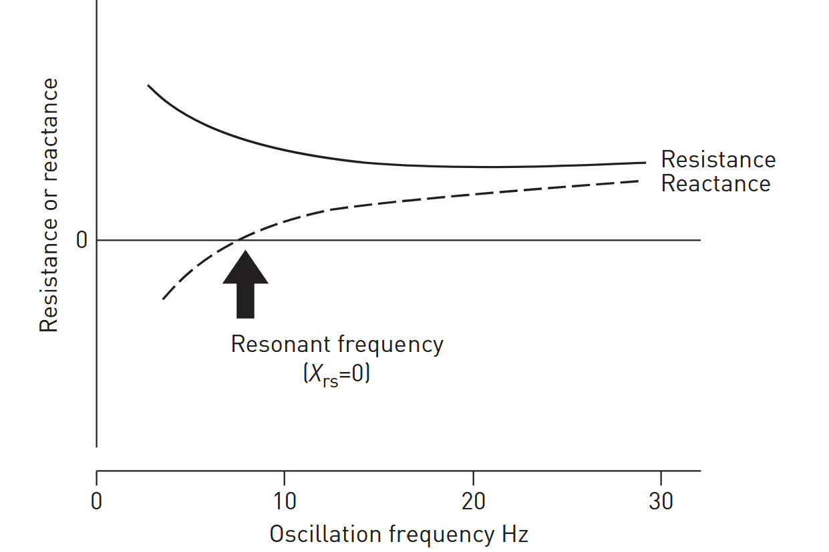
REACTANCE(Xrs): CLINICAL MEANINGS
At low stimulating frequencies (f < Fres), Xrs is a negative number and dominated by the dynamic compliance of the respiratory system
At higher stimulating frequencies (f > Fres), Xrs is a positive number and dominated by inertial properties of respiratory system
«low frequency Xrs:
important for clinical
evaluation

Slide 21
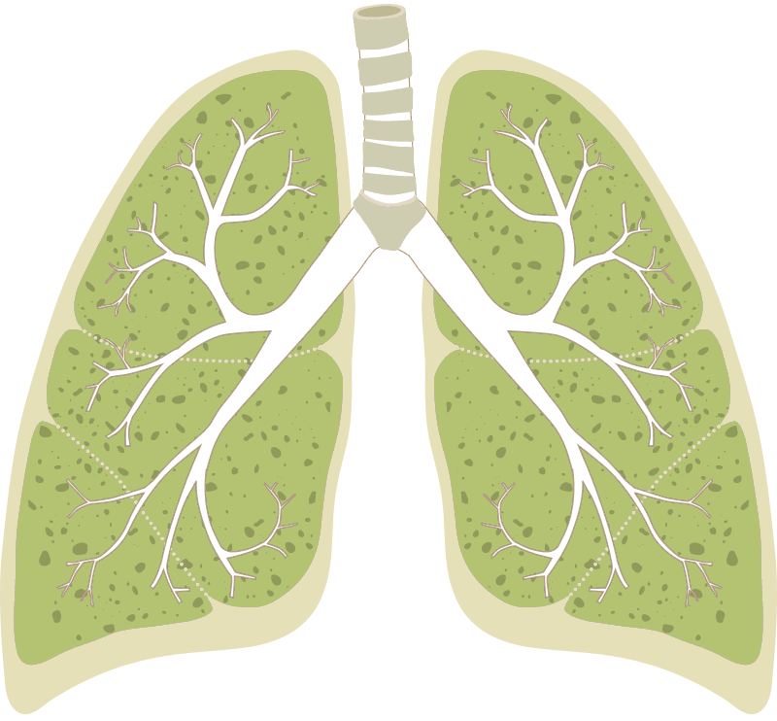
REACTANCE(Xrs): CLINICAL MEANINGS
At low FOT frequencies (5 Hz – 8 Hz), Xrs is related to the amount of alveoli in communication with the airway opening.
Xrs enables to determine how effectively the lung is being ventilated in its distal areas or how well air reaches the peripheral areas⁴.
Xrs falls below predicted values at low oscillating frequencies in the following conditions:
  peripheral obstruction¹
  presence of tidal expiratory flow limitation (during expiration only)²
  alveolar gas trapping and/or closing of alveolar units^{3,4}
Reactance reflects how easily the air reaches the lung periphery
Xrs becomes more negative in the presence of small airway disease or reduced lung/chest wall compliance
SIMPLIFYING THE CONCEPT:
¹Downie, S. R. et al(2013). Journal of Applied Physiology (Bethesda, Md. : 1985), 114(6), 770–777.
²Dellacà, R. L. et al. (2004). The European Respiratory Journal, 23(2), 232–240.
³Dellacà, R. L. et al (2009). Intensive Care Medicine, 35(12), 2164–2172.
⁴Milne, S. et al (2019). Journal of Applied Physiology (Bethesda, Md. : 1985), 126(5),1223–1231

Slide 22
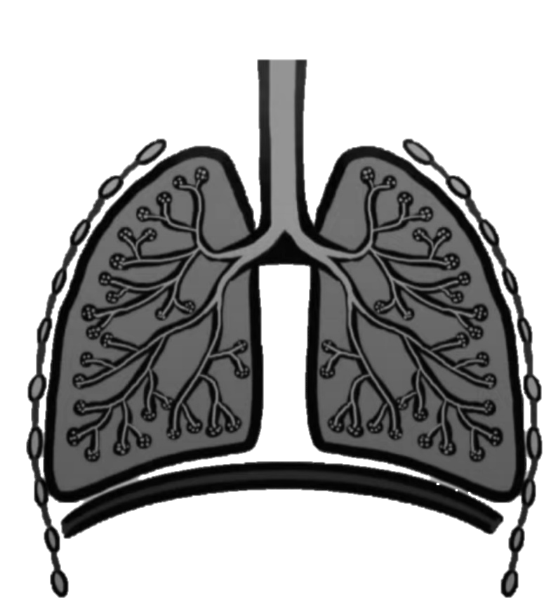
REACTANCE(Xrs): CLINICAL MEANINGS
Low-frequency Xrs (i.e., 5-8 Hz) becomes ABNORMAL when the measurable part of the respiratory system, including the lungs and chest wall, becomes “stiffer” (i.e., dynamic compliance is reduced).
Factors Contributing to a Reduction in Dynamic Compliance:
PERIPHERAL ʺROADBLOCKSʺ
STIFFER TISSUE
When oscillations cannot reach the periphery, such as in cases of small airway obstruction/collapse, or alveolar derecruitment.
When there is an increase in the stiffness of the lung parenchyma, as seen in Interstitial lung diseases
STIFFER WALLS
When there is an increase in the stiffness of the chest wall, which can occur in disorders such as osteogenesis imperfecta or amyotrophic lateral sclerosis (ALS).

Slide 23
Oscillometry: the oscillogram
Example: Rrs in a patient with lung volume de-recruitment (gas trapping, atelectasis, etc)
Rrs
Xrs

Slide 24
Oscillometry: the oscillogram
Example: Rrs and Xrs in a patient with peripheral airway obstruction (eventually associated with lung volume de-recruitment and heterogeneous obstruction)

Slide 25
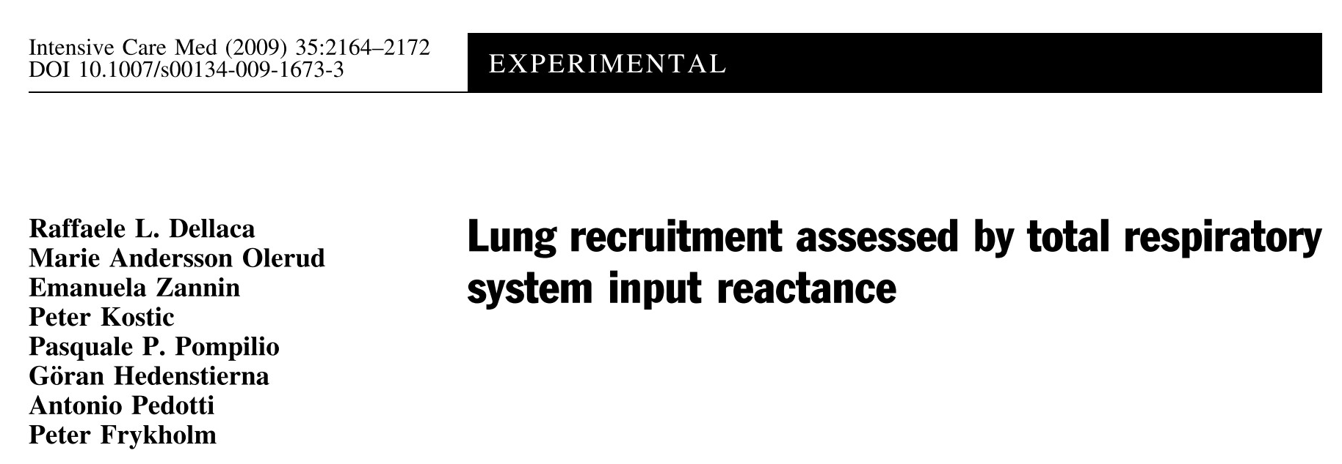

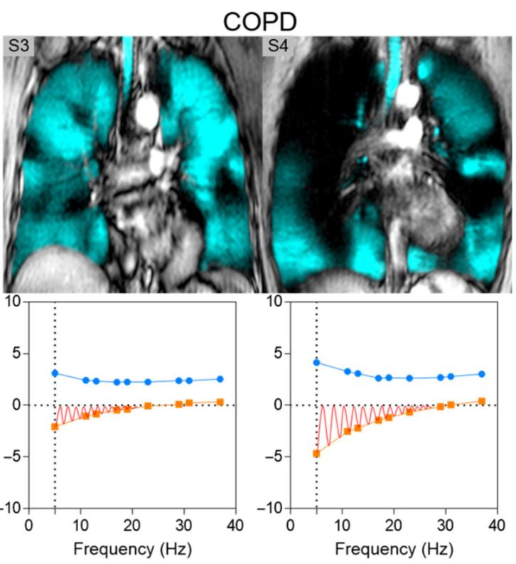
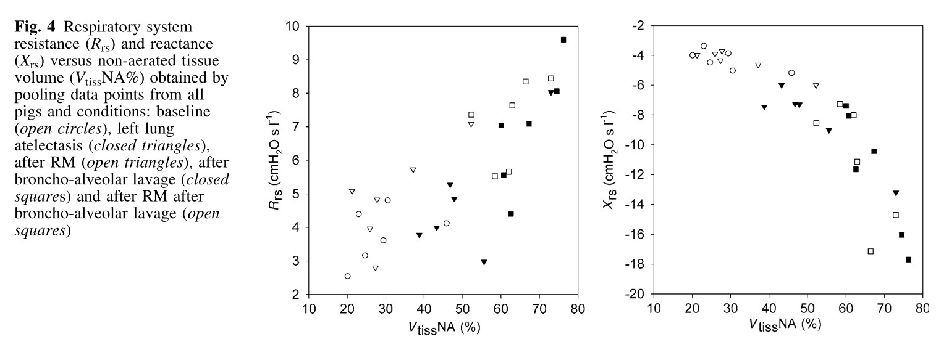
REACTANCE(Xrs): CLINICAL INTERPRETATION
SIMPLIFYING THE CONCEPT:
¹Downie, S. R. et al(2013). Journal of Applied Physiology (Bethesda, Md. : 1985), 114(6), 770–777.
²Dellacà, R. L. et al. (2004). The European Respiratory Journal, 23(2), 232–240.
³Dellacà, R. L. et al (2009). Intensive Care Medicine, 35(12), 2164–2172.
⁴Milne, S. et al (2019). Journal of Applied Physiology (Bethesda, Md. : 1985), 126(5),1223–1231

Slide 26
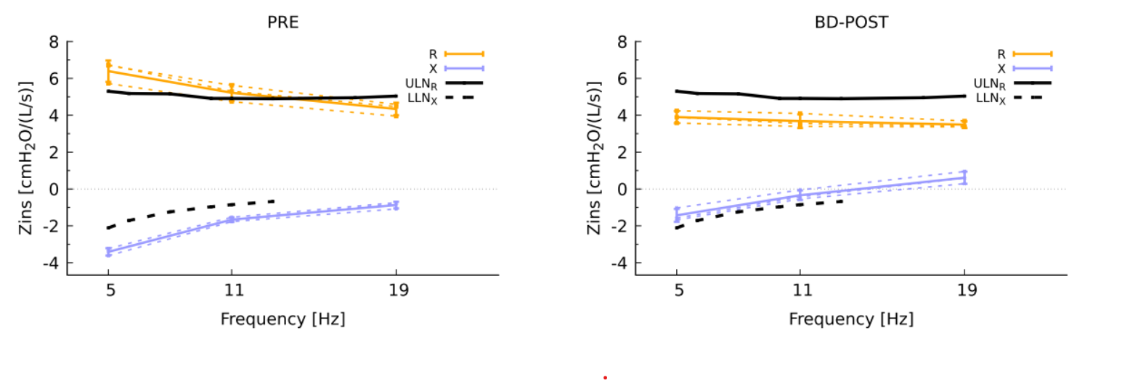
OSCILLOMETRY: KEY PARAMETERS
R5-19
R5
is always a positive number!
is «flat» on healthy subjects
shows a frequency dependence in disease
Rrs:
Ax
Commonly used parameters:
R5: Rrs at 5 Hz (or R8, 8 Hz, in preschooler)
R5-19: difference between Rrs at 5 Hz and 19 Hz, named also ‘frequency dependance of Rrs’
X5
Fres
PRACTICAL HINT: USE only a single Xrs parameter to describe lung periphery
X5, Ax and Fres provide equivalent information related to peripheral airway disease¹
Xrs:
usually negative at low frequencies
positive at higher frequencies
  Commonly used parameters:
  X5: Xrs at 5 Hz (or X8, 8 Hz, in preschooler)
  Fres: frequency where Xrs=0
  Ax: area of Xrs between 5 Hz and Fres
  Rrs and Xrs are usually expressed as cmH₂O/(L/s) or hPa/(L/s)
¹Veneroni C et al. Diagnostic Potential of Oscillometry: A Population-based Approach. Am J Respir Crit Care Med. 2024;209(4):444-453.

Slide 27
Oscillometry: within breath changes
oscillatory signal
insp
Flow (ml/s)
Time (s)
With FOT

Slide 28
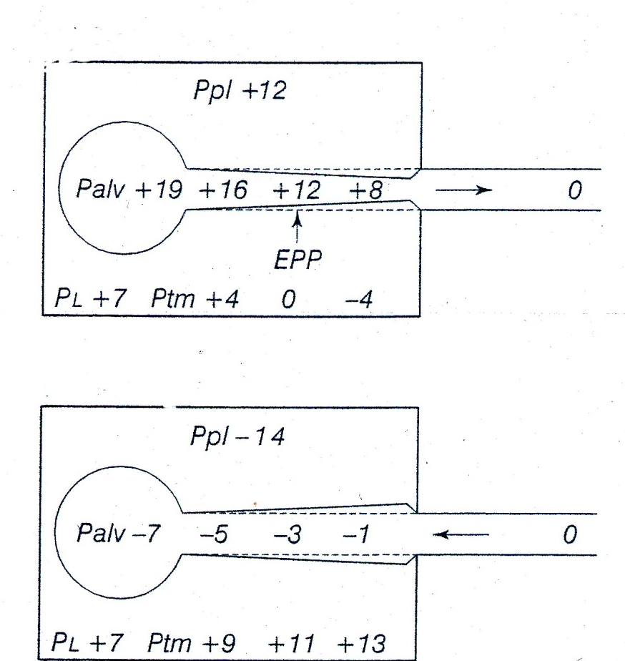
Airway dynamics during inspiration and expiration
During expiration, the elastic recoil of the lung and rib cage (and, during exercise, the expiratory muscular activity) increases alveolar pressure to move the air from the alveoli to the airway opening. During this phase, airway transmural pressure compresses the airways (“dynamic airway compression”).
Expiration
Inspiration
During inspiration, respiratory muscles expand the lung to reduce the alveolar pressure and initiate a flow of fresh air from the airway opening to the alveoli. During this phase, airway transmural pressure dilates the airways.
Notes:
Cambiano I volume… cambiano le prop meccanchie
Ma non solo I volume sono anche diverse le forze che agiscono sulle vie aeree durante insp/esp

Slide 29
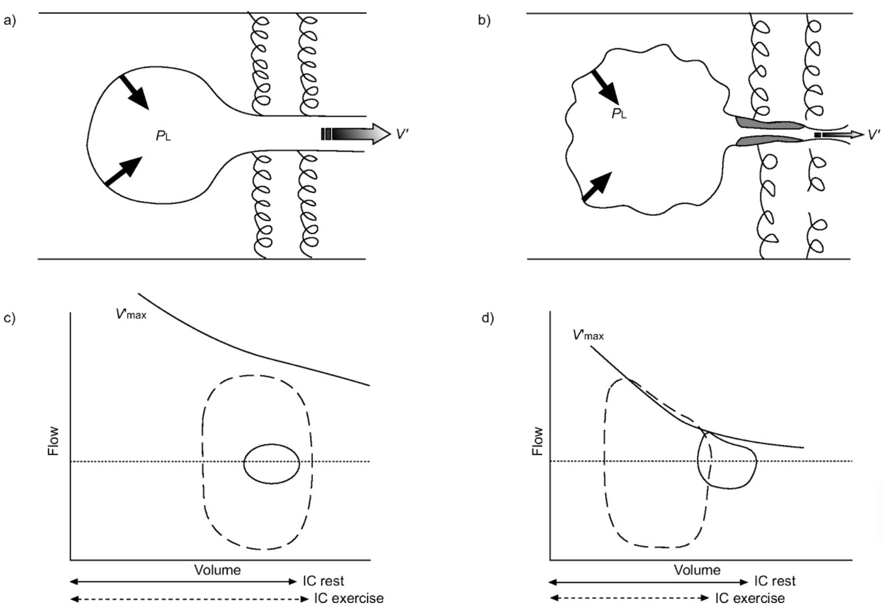
Tidal EFL (EFL_{t}): physiology
Normal
COPD
Physiology and consequences of lung hyperinflation in COPD.
D. E. O'Donnell, P. Laveneziana
European Respiratory Review 2006 15: 61-67;
TIDAL EFL: the expiratory flows are so reduced that the lung cannot empty before the beginning of a new breath
“Expiratory flow limitation (EFL) is the pathophysiological hallmark of chronic obstructive pulmonary disease (COPD) and arises because of the dual effects of permanent parenchymal destruction (emphysema) and airway dysfunction, which in turn reflect the effects of small airway inflammation (mucosal oedema, airway remodelling and mucous impaction) and possibly increased cholinergic airway smooth muscle tone”
Notes:
1- enfisema,.. Riduzione delle forze di richiamo eleastico
2- infiammazione, edema, smoth muscle.. La forza non si trasmette sul diametro interno la perdo sulle pareti

Slide 30
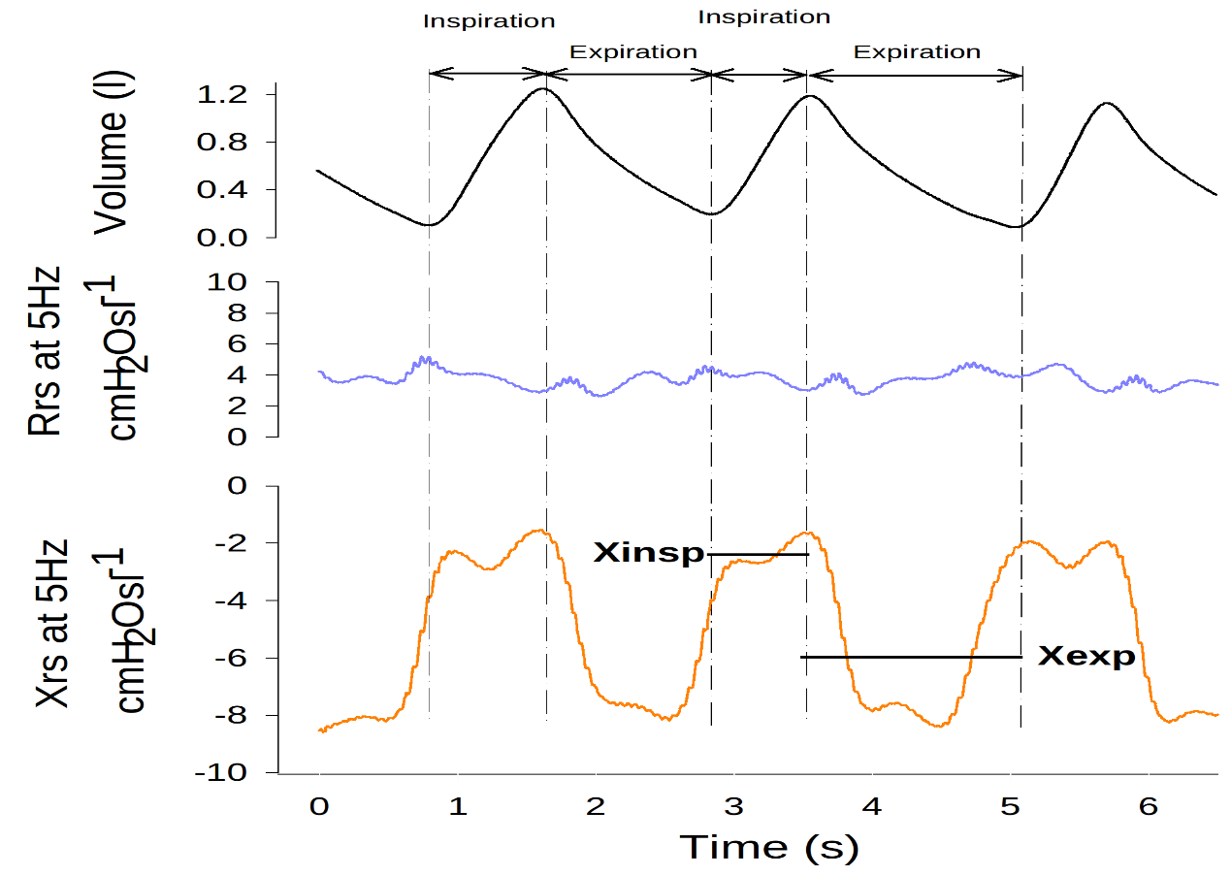
Within breath Oscillometry: KEY PARAMETERS
Respiratory diseases produce specific within-breath changes in the mechanical properties of the lung.
In within-breath oscillometry, Rrs and Xrs are studied in their temporal changes during the breathing cycle
Inspiration
Expiration
Common parameters used in within-breath oscillometry (calculated at the lowest available frequency):
Rinsp: average Rrs during inspiration
Xinsp: average Xrs during inspiration
Rexp: average Rrs during expiration
Xexp: average Xrs during expiration
ΔXrs: Xinsp-Xexp
Rinsp
Rexp
ΔXrs

Slide 31
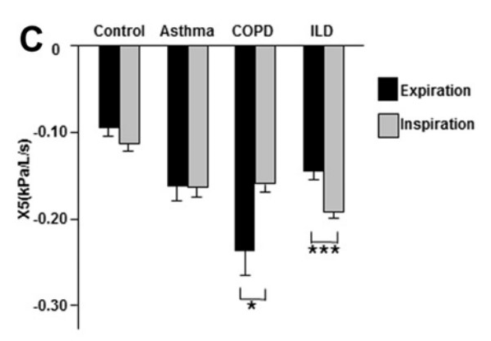
Within breath Oscillometry: ADVANTAGES
Whole-breath analyses show increased R5 and decreased X5 in the asthma, COPD and ILD groups.
Changes in within breath measurement results, particularly X5 can show specific patterns in asthma, COPD, and ILD.
Sugiyama A, Hattori N, Haruta Y, et al. Characteristics of inspiratory and expiratory reactance in interstitial lung disease. Respir Med. 2013;107(6):875-882.
KEY MESSAGE
Within-breath oscillometry can measure alterations that are more evident during a specific breathing phase.

Slide 32
What is Oscillometry?
Understanding the fundamental principles
Interpretation of results
How to perform an oscillometry test

Slide 34
Oscillometry: measurement protocol
What is an oscillometry evaluation?
average of at least 2 measurements with within-session coefficient of variability (CoV) of Rtot <10%(adults) or < 15% (children)
Measurement 1
Measurement 2
Measurement 3
> 3 artifacts free breaths
rest
> 3 artifacts free breaths
rest
> 3 artifacts free breaths
60-90 s
30 s
60-90 s
30 s
60-90 s
Average duration of a spirometry test: 30 minutes
(Am J Respir Crit Care Med, Vol. 189, P17-P18, 2014)
For maximum sensitivity, it's essential to conduct oscillometry testing BEFORE other Pulmonary Function Tests (PFTs) that necessitate the performance of Deep Inhalation.
Source: Technical standards for respiratory oscillometry. Eur Respir J. 2020;
Notes:
Ancora meglio su numero di respire interi

Slide 35
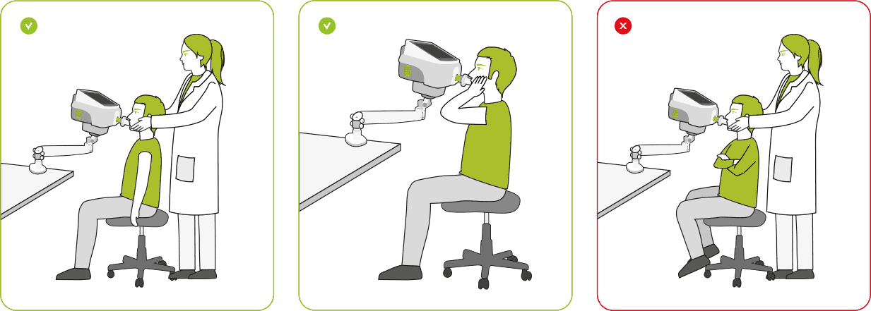
Running the test
Anticipate they may experience a “gentle vibration” or “fluttering” during the test
Anticipate that the test will last approximately the time required to record 5 to 10 quiet breaths and that it will be repeated 3 times
Encourage the patient to stay relaxed and breathe as normal
Perform the test with the patient correctly seated, with an upright posture with a slight “chin-up” position.
Instruct the patient to grip the mouthpiece with teeth and lips firmly to avoid leaks and to keep the tongue relaxed and below the mouthpiece, avoiding blockage.
Support the patient cheeks, and the floor of the mouth with palm and fingers or demonstrate to the patient how to do it by himself

Slide 36
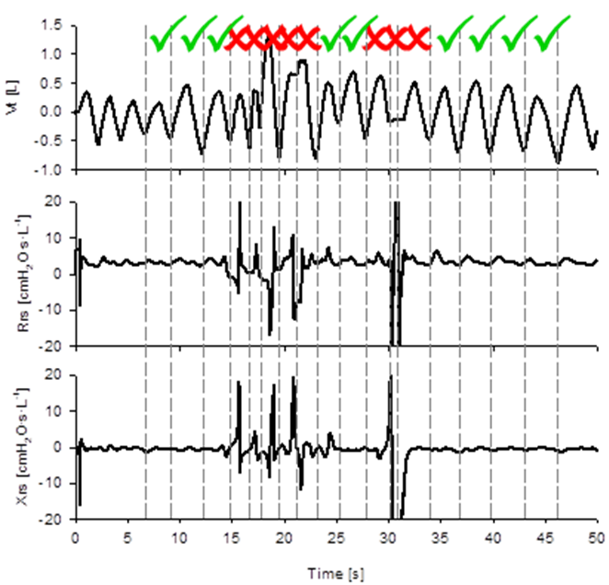
Evaluating possible measurement artifacts
Oscillometry may be affected by some measurement artifacts such as:
RELATED TO UPPER AIRWAYS
Missing cheek support
coughing
glottis closure
swallowing,
tongue obstruction of the filter (especially in children)
POSTURE RELATED
Leaks around the filter
Leaks around the mouthpiece/forget to use the noseclip
Incorrect measurement position
BREATHING PATTERN RELATED
Hyperventilation
High tidal volumes (i.e. > 2x resting tidal volume)
Only artifact-free portions of the measurements should be used for the processing of final results.
- Marchal F, et al.. Filtering artifacts in measurements of forced oscillation respiratory impedance in young children. Physiol Meas. 2004;25(5):1153-1166.
- King GG, et al.. Technical standards for respiratory oscillometry. Eur Respir J. 2020;55(2):1900753.
Aitken CR, et al. Reproducibility and responsiveness of airway impedance measures derived from the forced oscillation technique across different operating lung volumes. Respir Physiol Neurobiol. 2024;320(September 2023):104200.

Slide 37
What is Oscillometry?
Understanding the fundamental principles
Interpretation of results
How to perform an oscillometry test
Oscillometry in research and clinics

Slide 38
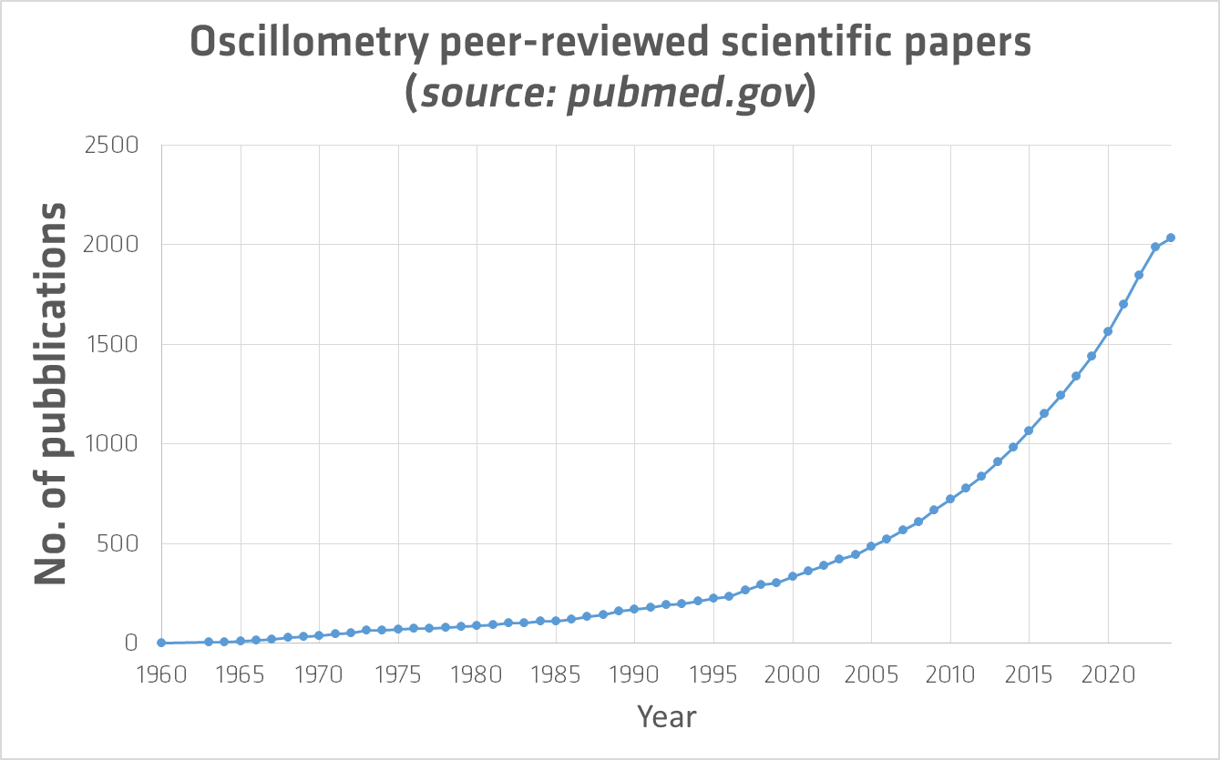
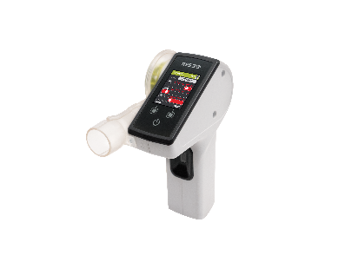
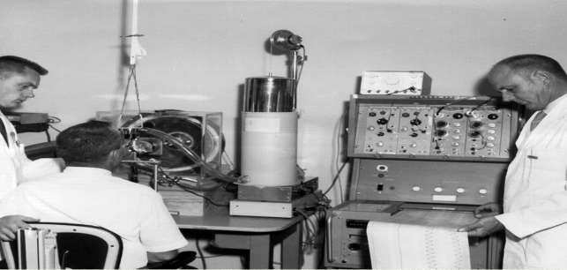
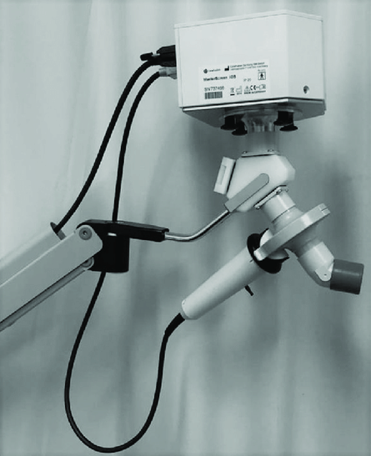
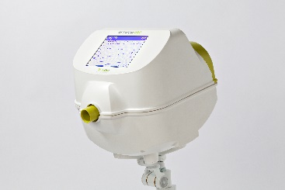
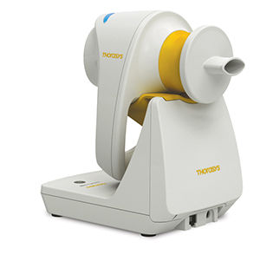
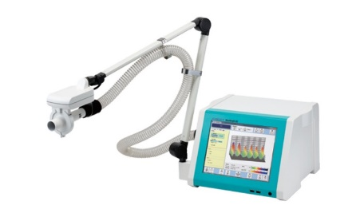
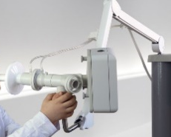
Oscillometry: development
ERS task force guideline document
Eur Respir J 2003; 22: 1026–1041
ATS/ERS statement document (preschooler)
Am J Respir Crit Care Med. 2007;175(12):1304-1345.
ERS technical standard
Eur Respir J. 2020;55(2):1900753.
New publications that demonstrate the clinical utility of oscillometry
Pubblication of technical standard documents
Development of simpler and commercially available FOT devices
Prof. Arthur Dubois introduced FOT.
(Journal of Applied Physiology 1956)

Slide 39
Advantages of oscillometry in clinical practice
Faster testing
Oscillometry testing requires 3 measurements of 5-10 breaths each for a total of about 5 minutes.
Less effort required by patients
Oscillometry requires less effort from the patient, making it more suitable for children and elderly patients.
Very sensitive to changes in lung function
Oscillometry is more sensitive to subtle changes in lung function, making it better for detecting early signs of respiratory disease.
Comprehensive
Oscillometry provides a comprehensive assessment of lung function, including small airway function, that spirometry may miss.

Slide 40

Conclusions
“.. oscillometry has gained considerable attention in the last two decades with the introduction of commercially available instruments, the publication of updated technical standards, and renewed enthusiasm for an old technique. ”
“… validating oscillometry as an important complementary, and advantageous, tool to spirometry in the assessment of respiratory symptoms and diagnosis of lung disease.”

Slide 41
Outline
1. What is Oscillometry
Understanding the fundamental principles
Interpretation of results
How to perform an oscillometry test
Oscillometry in research and clinics
2. Main clinical applications of oscillometry
Detection of airway obstruction
Bronchial reversibility and Bronchial provocation test
Detection of Tidal Expiratory Flow limitation –EFLt
Other applications
Come si esegue la oscillometria step-by-step
La oscillometria nel paziente stabile ed acuto

Slide 42
Outline
2. Main clinical applications of oscillometry
Detection of airway obstruction
Bronchial reversibility and Bronchial provocation test
Detection of Tidal Expiratory Flow limitation (EFLt)
Other applications

Slide 43

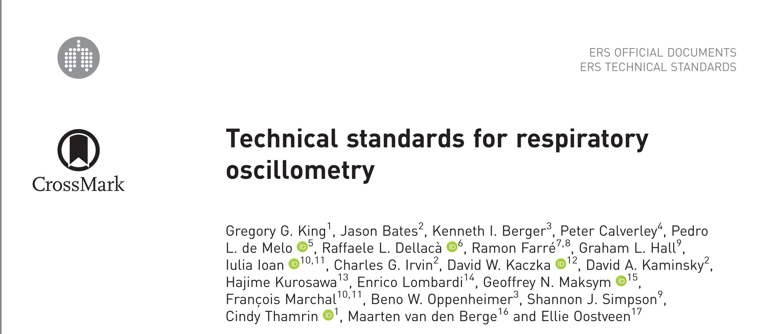

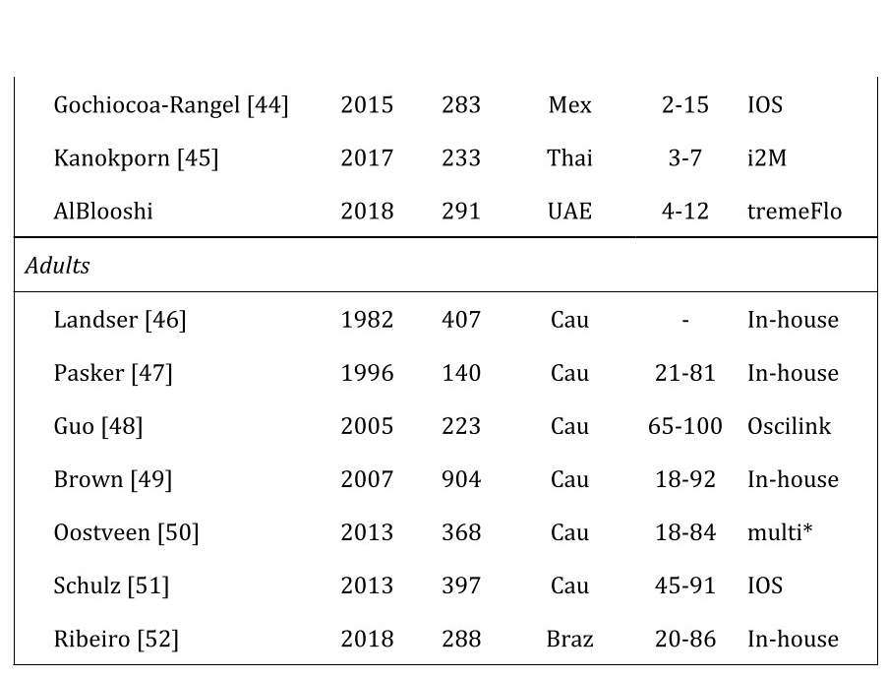
Detection of central and peripheral obstruction
A number of normative ranges have been published for Rrs and Xrs parameters
Eur Respir J. 2020;55(2):1900753.
GLI is currently working to the difinition of global reference equation for oscillometry
Notes:
Problema di quale scegliere e ai 18 anni
.. Sulla popolazione poco impatto.. Sul singolo sì..
Lettera ricevuta..
Non possiamo trascurare le differenze anatomiche.. Xrs volume, Rrs diametric… se il polmone è più grande sono più belle.

Slide 44
Clinical interpretation of an oscillometry test
↔ : Within normal range
↗: above ULN
↘: below LLN
R5 | X5 | Interpretation:
↔ | ↔ | Normal respiratory mechanics
↗ | ↔ | Central (upper?) airway obstruction
↔ | ↘ | Peripheral airway obstruction and/or lung volume de-recrutment / gas trapping
↗ | ↘ | Heterogeneous (mixed) obstruction

Slide 45
Clinical interpretation of an oscillometry test
↔ : Within normal range
↗: above ULN
↘: below LLN
Correlated variables
R5 | X5 | Ax | Fres | Interpretation:
↔ | ↔ | ↔ | ↔ | Normal respiratory mechanics
↗ | ↔ | ↔ | ↔ | Central (upper?) airway obstruction
↔ | ↘ | ↗ | ↗ | Peripheral airway obstruction and/or lung volume de-recrutment / gas trapping
↗ | ↘ | ↗ | ↗ | Heterogeneous (mixed) obstruction
References:
- Veneroni et al - Diagnostic potential of forced oscillometry technique : a population-based approach American Journal of Respiratory and Critical Care Medicine, Volume 209 Number 4 | February 15 2024
- Neeraj Gupta - Can oscillometry be a substitute to spirometry in the indigent? - Lung India 2022;39:74-6.

Slide 46

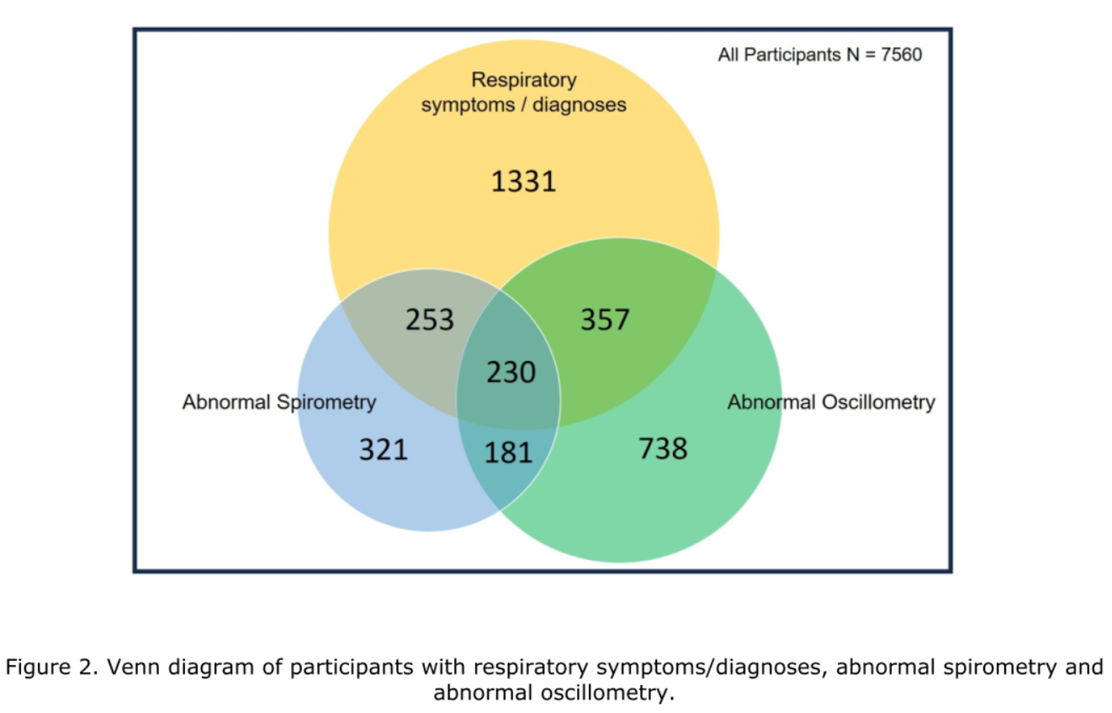
Am J Respir Crit Care Med. 2024;209(4):444-453.
General unselected population 18-90 years: 7.560 subjects
Abnormalities in oscillometry parameters are significantly related to the presence of respiratory symptoms and previous diagnosis of respiratory disease.
20% the adult population have abnormal oscillometry parameters, 13% of the adult population have abnormal spirometry
Abnormalities in oscillometry parameters are related to symptoms and previous respiratory diagnosis even in subjects with normal spirometry

Slide 47
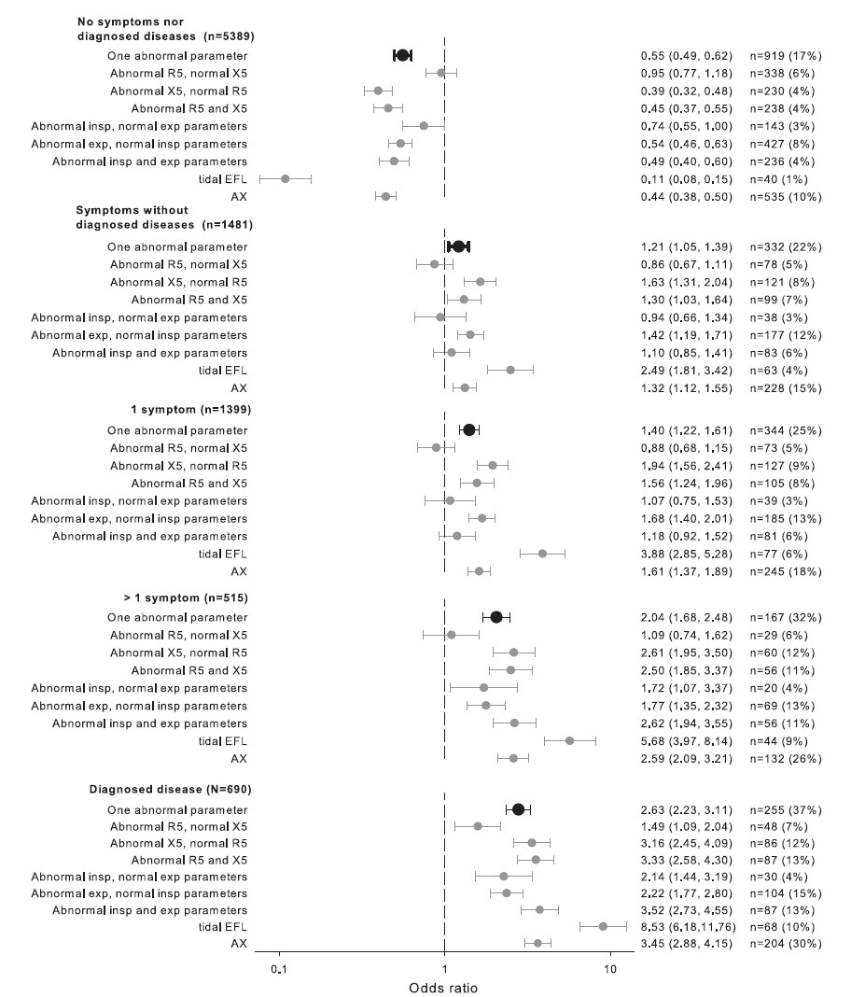
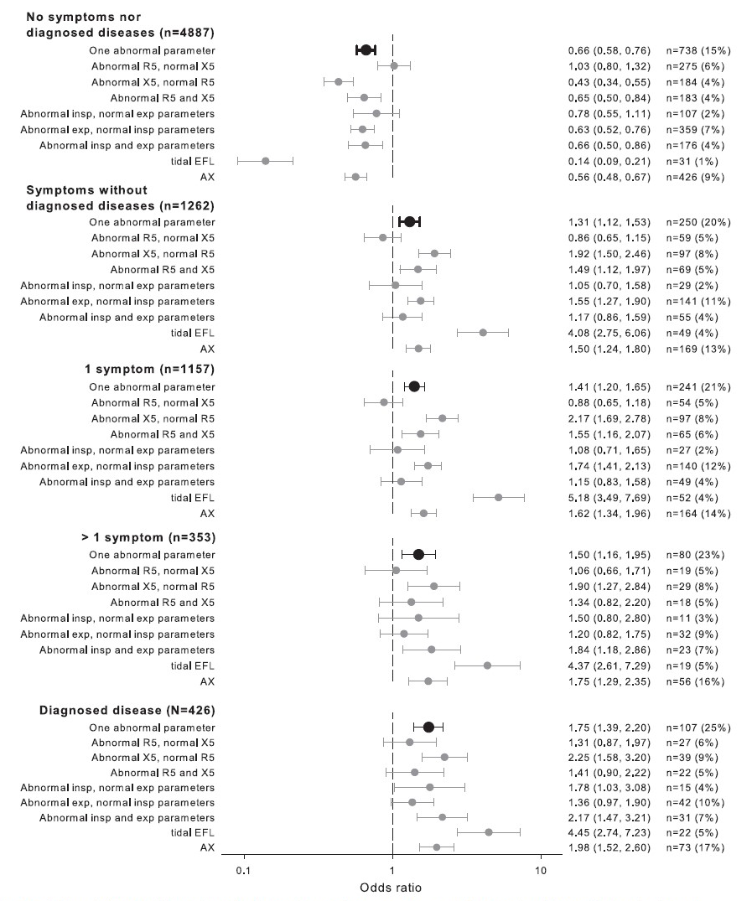
COMPLETE STUDY POPULATION
FEV1/FVC >LLN or FVC >LLN

Slide 48
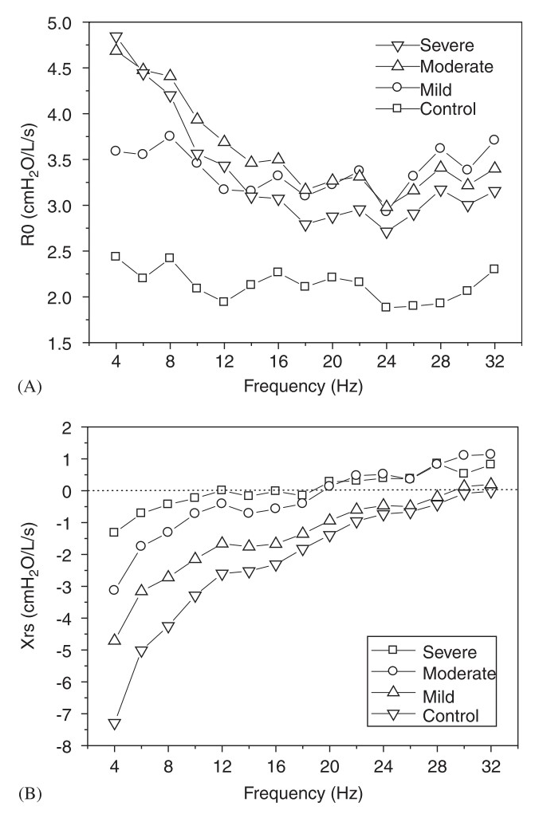
Oscillometry and disease progression
severe obstruction
OSCILLOGRAM:
Rrs and Xrs values measured at different oscillatory “frequencies”
KEY MESSAGE:
Rrs and Xrs can be used as indicators of changes in the level of obstructions in both the larger and smaller airways, which occur as the disease progresses.¹
As the disease worsens:
Rrs at 5 Hz become more POSITIVE
Xrs at 5 hz become more NEGATIVE
control
control
severe obstruction
¹ Di Mango et al. (2006). Changes in respiratory mechanics with increasing degrees of airway obstruction in COPD: detection by forced oscillation technique. Respiratory Medicine, 100(3), 399–410.
Notes:
Gruppi molto ben alliati per età, altezza e peso

Slide 49
Clinical applications of oscillometry
Main clinical applications of oscillometry
Detection of airway obstruction
Bronchial reversibility and Bronchial provocation test
Detection of Tidal Expiratory Flow limitation (EFLt)
Other applications

Slide 50
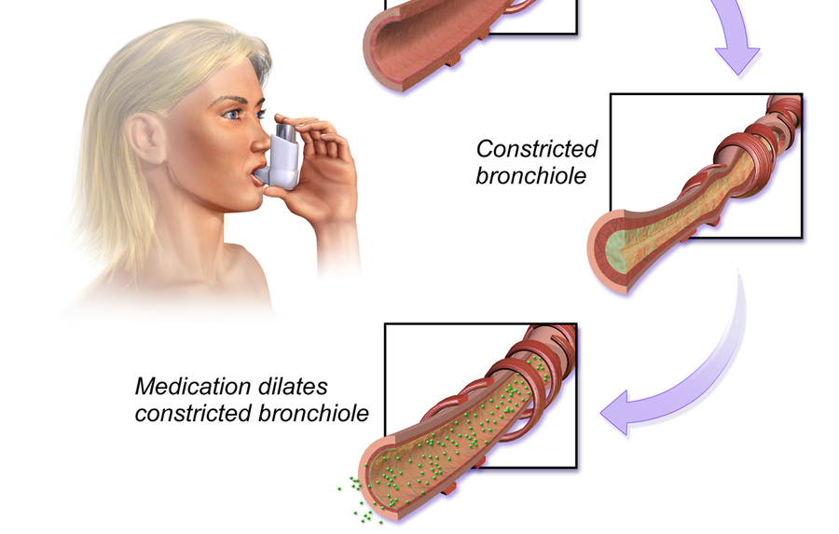
Bronchodilator reversibility testing
What is the purpose of a bronchodilator reversibility (BDR) test?
When an airway obstruction is detected, a BDR test aids physicians in understanding how obstructed airways react to the administration of a bronchodilator drug.
It is recommended^{1,2} to support diagnosis of Asthma and Chronic Obstructive Pulmonary Disease (COPD) and for evaluating the response to medication.
By BruceBlaus - Own work, CC BY-SA 4.0, https://commons.wikimedia.org/w/index.php?curid=44755052
PROCEDURE
Baseline assessment of airways obstruction*
Wait (15-20 minutes)
The test is POSITIVE if the BD has generated a change (or %change) or the level of airways obstruction above clinically defined thresholds
Administration of a bronchodilator agent
(usually 400 mg of Salbutamol)
Post BD assessment
of airways obstruction
*Historically perfomed using spirometry
¹European Respiratory Society clinical practice guidelines for the diagnosis of asthma in children aged 5–16 years, European Respiratory Journal 2021 58: 2004173;
²European Respiratory Society Guidelines for the Diagnosis of Asthma in Adults, European Respiratory Journal 2022;

Slide 51
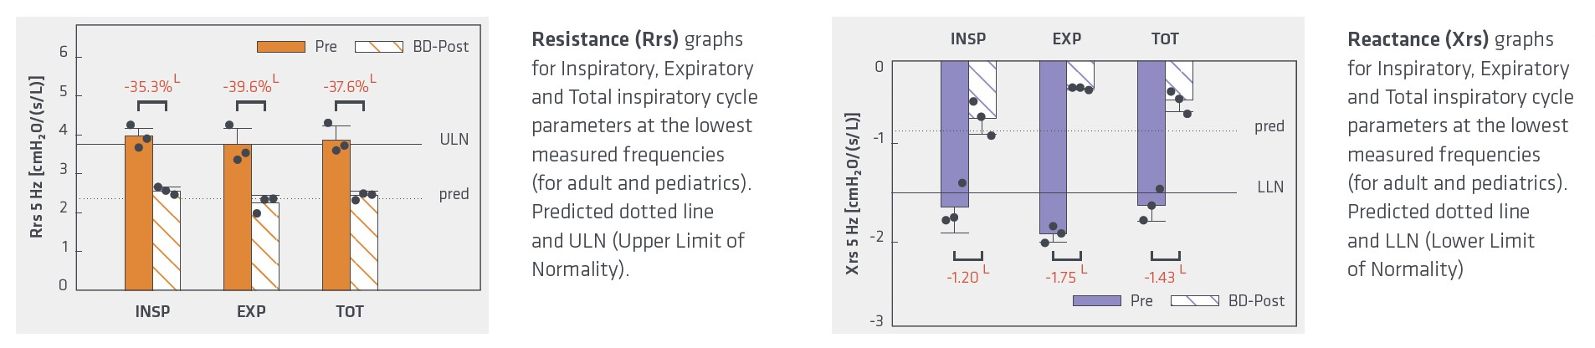
Central and peripheral obstruction pre and post BD
Rrs > ULN:
central airways obstruction
NORMAL RANGES
(pred, ULN, LLN)
Xrs < LLN:
peripheral obstruction

Slide 52

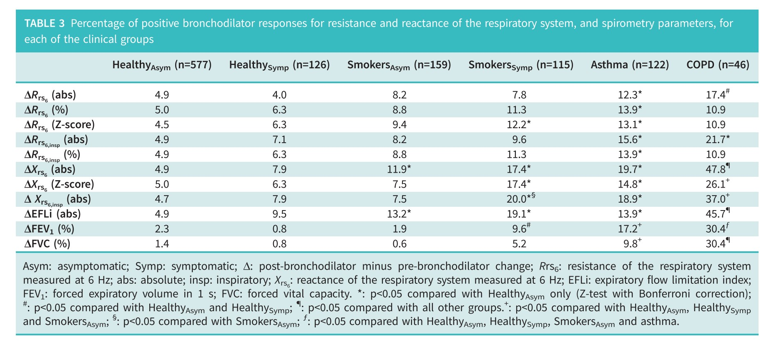
BDR testing using oscillometry
ERJ Open Res. 2021;7(4). 1

Slide 53

BDR testing using oscillometry: ERS technical standard
Eur Respir J 2022; 59: 2102663
Eur Respir J. 2020;55(2):1900753.
The recommended thresholds for positive bronchodilator responses are:
Param | Adults | Pediatric
ΔRrs% | -32% | -40%
ΔXrs% | +44% | +50%

Slide 54
Clinical applications of oscillometry
Main clinical applications of oscillometry
Detection of airway obstruction
Bronchial reversibility and Bronchial provocation test
Detection of Tidal Expiratory Flow limitation (EFLt)
Other applications

Slide 55
Tidal EFL (EFL_{t}): physiology
Normal
COPD
Physiology and consequences of lung hyperinflation in COPD.
D. E. O'Donnell, P. Laveneziana
European Respiratory Review 2006 15: 61-67;
TIDAL EFL: the expiratory flows are so reduced that the lung cannot empty before the beginning of a new breath
“Expiratory flow limitation (EFL) is the pathophysiological hallmark of chronic obstructive pulmonary disease (COPD) and arises because of the dual effects of permanent parenchymal destruction (emphysema) and airway dysfunction, which in turn reflect the effects of small airway inflammation (mucosal oedema, airway remodelling and mucous impaction) and possibly increased cholinergic airway smooth muscle tone”
Notes:
1- enfisema,.. Riduzione delle forze di richiamo eleastico
2- infiammazione, edema, smoth muscle.. La forza non si trasmette sul diametro interno la perdo sulle pareti

Slide 56
Detection of EFL by FOT
Inspiration
Expiration
EFL
ΔXrs
EFL ⇒ ΔXrs>2.8⁽⁴⁾
Dellacà RL et al. Eur Respir J. 2004;23(2):232-240.
Notes:
The measurements of within breath changes of input reactance been recently shown to be very effective for the detection of EFL in patients affected by COPD.
EFL is a fluidodinamic condition characterized by the development along the trechobronchial three of points in which flow is independent by the driving pressure. These points are called ccoke points.
The presence during expiration of the choke points prevents the stimulus from entering the alveoli, excluding them from the measurements. all that part of the lung that is downstream the flow limitnig sites.
Therefore during expiration reactance will be expression of the elastic propertyies of the whole respiratory system whiel during expiration reactance expresses the elastic properties of onle that parte of the lung that is upstream the flow-limiting sites
This woul d generate wide within-breath oscillation of the reactance and a paramenter called....
The presence of the choke points prevents the measurements of the whole system
The limiting case of the Venturi effect is when a fluid reaches the state of choked flow, where the fluid velocity approaches the local speed of sound. In choked flow the mass flow rate will not increase with a further decrease in the downstream pressure environment.
Dxrs therefore is a quantitative index of the amount of the airways that is chocked.

Slide 57
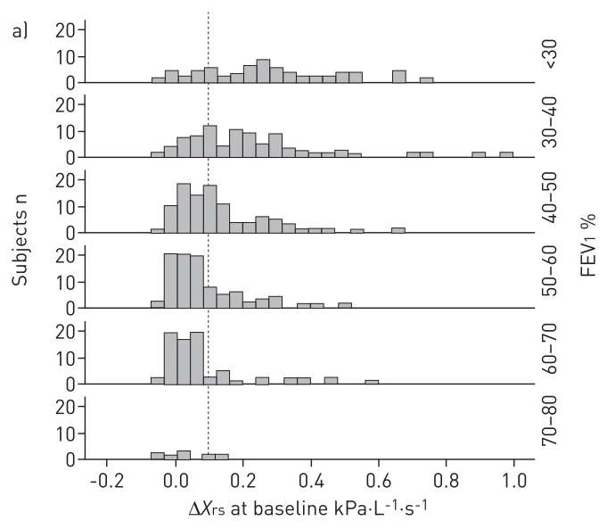
Detection of tidal EFL using oscillometry
Variability of within-breath reactance in COPD patients and its association with dyspnoea.
Aarli BB, Calverley PM a, Jensen RL, Eagan TML, Bakke PS, Hardie J a.
Eur Respir J. October 2014:1-10.
”ΔXrs was close to zero in healthy controls, with little within- and between-day variability. COPD patients tended to have higher DXrs values than the controls and more variation between measurements.
COPD patients with values exceeding those found in healthy individuals were prone to have higher mMRC scores at all GOLD grades.”
EFLt is an indicator of patient status that is relatively independent by the degree of obstruction measured with spirometry

Slide 58
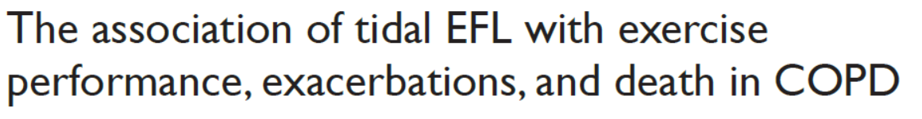
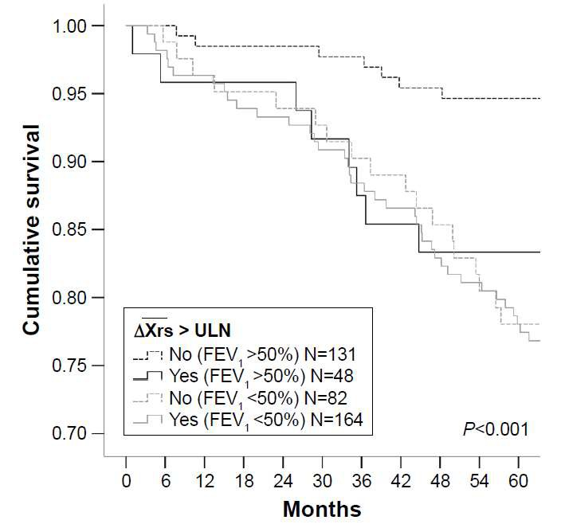
Aarli et al - International Journal of COPD 2017:12 2179–2188
NO EFL, FEV1 >50%
EFL, FEV1 >50% !!!
“The present study suggests that evidence of EFLt, measured during tidal breathing in an effort-independent fashion, can identify a subgroup of COPD patients with worse clinical outcomes.”

Slide 59
Main clinical applications of oscillometry
Detection of airway obstruction
Bronchial reversibility and Bronchial provocation test
Detection of Tidal Expiratory Flow limitation (EFLt)
Other applications
Mechanical ventilation
non-invasive ventilation
home-monitoring, longitudinal measurements
combination with slow vital capacity

Slide 60
Intubate acute patients: evidences in newborns
Optimize ventilation parameters
- CDP - PEEP
Impact of treatments (Pre-post measures)
  Suction
  Surfactant
  Steroids
  Bronchodilators
  Posture
  Resuscitation at birth
  Etc. …
Longitudinal monitoring
Diagnosis - phenotyping
- Identifying deviation from “normality”
Prognosis

Slide 61
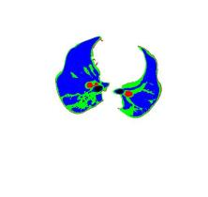
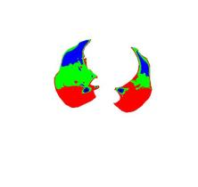

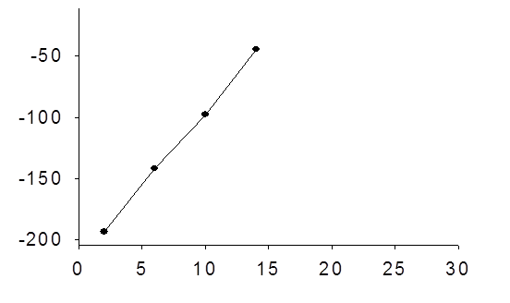
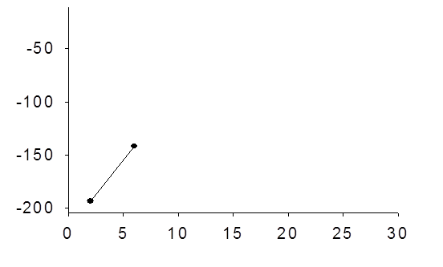
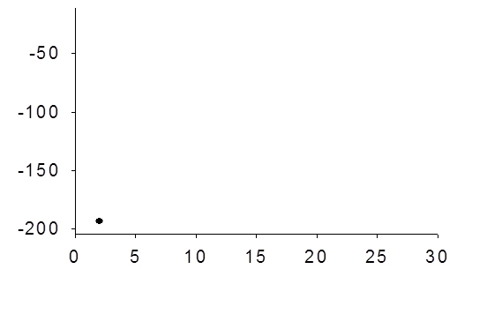
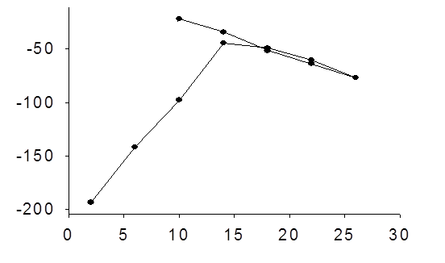
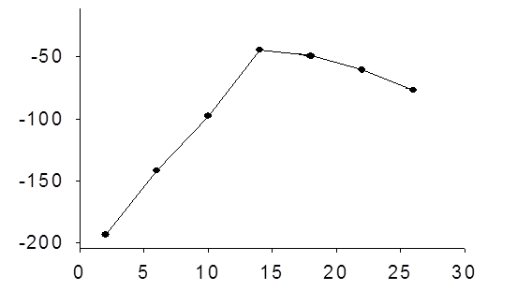
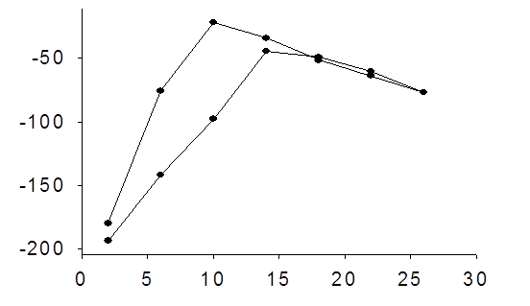
Intubate acute patients: PEEP optimization
OPEEP
X_{RS}(5Hz) allows the definition of an optimal PEEP in agreement with CT data in an animal model of RDS
recruitment
Xrs (cmH₂O*s/L)
PEEP (cmH₂O)
Dellacà et al 2011, Kostick et al 2011

Slide 62
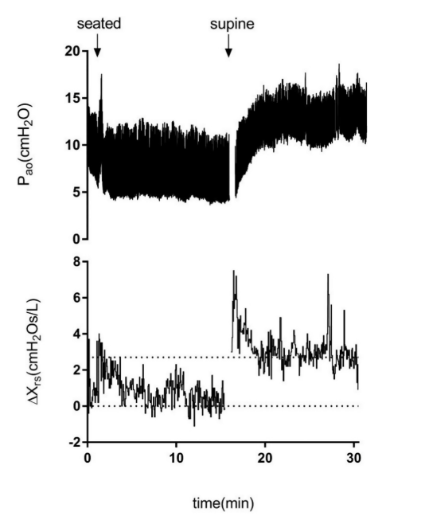
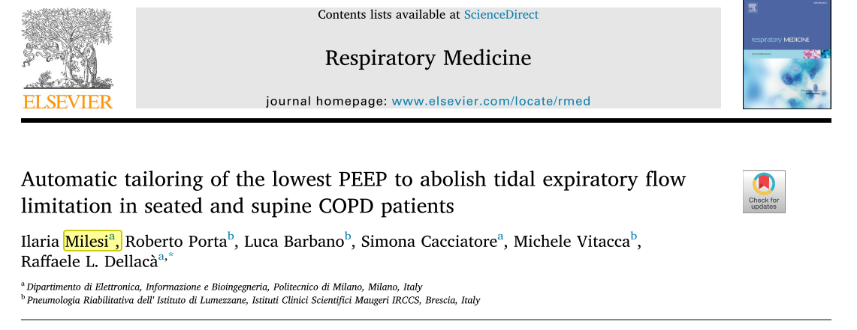
Automatic PEEP tailoring to abolish tidal expiratory flow limitation

Slide 63



Longitudinal monitoring in acute patients
patients with moderate–severe COVID-19 ARDS.
Notes:
Respiratory
Intensive Care Unit (RICU) COVID-19 of the Pulmonology Ward of the Azienda Sanitaria Universitaria Giuliano Isontina (Trieste, Italy) between

Slide 64


Longitudinal home monitoring
Room-air oxygen saturation (SpO2) dropped to 82% on 6 November.
Blood testing (11 November) confirmed severe inflammation with an increase of D-dimer index (2500 ng·mL−1; normal values <500 ng·mL−1).
Home thoracic chest ultrasounds on 11 and 16 November demonstrated diffuse bilateral B-lines compatible with COVID-19 interstitial pneumonia.
The disease severity was “severe” per World Health Organization classification.
Notes:
Impatto delle equazioni di riferimento

Slide 65




Beginning of symptoms
“In this study, we have shown that the variability of FOT impedance measures, specifically those of Xinsp (SDXinsp and CVXinsp), is related to symptoms in COPD and may be used to detect changes prior to an AECOPD as early as 3 days before symptoms manifest.”.
“Feasibility of COPD home telemonitoring with FOT was high, consistent with previous studies [14, 36], with high adherence (>95%) and low drop-out rates (<7%)”
Beginning FOT changes
Exacerbation

Slide 66

Longitudinal measurements
Monitoring the Temporal Changes of Respiratory Resistance: A Novel Test for the Management of Asthma. American journal of respiratory and critical care medicine. 2012

Slide 67


Oscillomety + slow vital capacity: Detection of Closing volume – Specific airway conductance
Picture from: https://derangedphysiology.com/

Slide 68
Oscillomety + slow vital capacity: Detection of Closing volume

Slide 69


Oscillomety + slow vital capacity
Specific airway conductance (sGrs)
Pediatric Pulmonology
“In our cohort, the sGrs outperformed the spirometric and the FOT indices Rrs5 and Xrs5 regarding their relationship with N2‐MBW outcomes.
Notably, the relationship between LCI and sGrs remained unaffected by lung hyperinflation, as opposed to that between LCI and FEF25‐ 75, Rrs5, or Xrs5, which was significantly reduced at higher RV/TLC values (Figure 4).”

Slide 70

Thank you!
chiara.veneroni@polimi.it

Slide 72
How should I integrate oscillometry in my clinical routine?
Integration into clinical practice of oscillometry testing should be similar to how one would use other lung function tests:
Oscillometry results:
1
“Consideration of the measurement error of the test, as well as the inherent biological variability of measurements both between individuals and between repeated measurements in the same individual.
Is Ve of the session ≤ 18 L/min?
Is CoV% of Rtot of the session ≤ 10% (adults) or ≤ 15% (children)?
Are Rrs parameters the ONLY abnormal ones?
(indicative of possible reduction of the caliber of the central airways)
Are Xrs parameters the ONLY abnormal ones?
(indicative of possible small, distal airways dysfunction/airway closure/lung
parenchymal diseases)
Are BOTH Rrs and Xrs abnormal?
(indicative of possible mixed reduction of the caliber of the central airways and small,
distal airways dysfunction)
Is EFLt present (i.e. ΔXrs ≥ 2.8)?
(indicative of the presence of dynamic hyperinflation
2
Integration of knowledge of physiological determinants of test results into a functional classification of the identified impairments.
3
Integration of the identified patterns with other clinical data to inform differential diagnosis and guide therapy.” ERS/ATS technical standard on interpretive strategies for routine lung function tests. 2021

