Slide 1
Come allenare i pazienti all’esercizio fisico
PANERONI MARA, PhD
ICS MAUGERI, PAVIA; LUMEZZANE

Slide 2
Come allenare i pazienti all’esercizio fisico
Agenda
Quale limitazione allo sforzo
Quale impatto sulla vita del paziente
Perchè trattare la limitazione allo sforzo
Come trattare la limitazione allo sforzo
Come personalizzare l’intervento
Conclusioni

Slide 3
Come allenare i pazienti all’esercizio fisico
Agenda
Quale limitazione allo sforzo
Quale impatto sulla vita del paziente
Perchè trattare la limitazione allo sforzo
Come trattare la limitazione allo sforzo
Come personalizzare l’intervento
Conclusioni

Slide 4
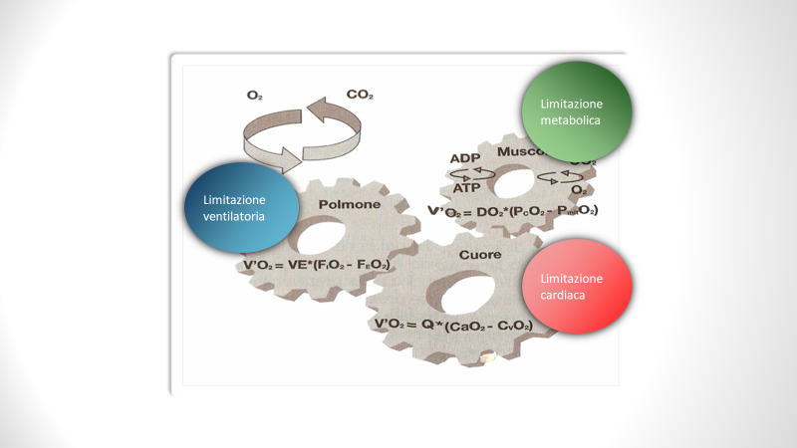
VO2 ⬇️

Slide 5
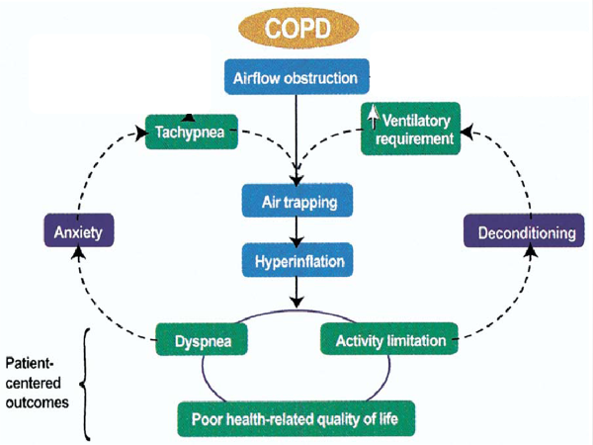
1

Slide 6
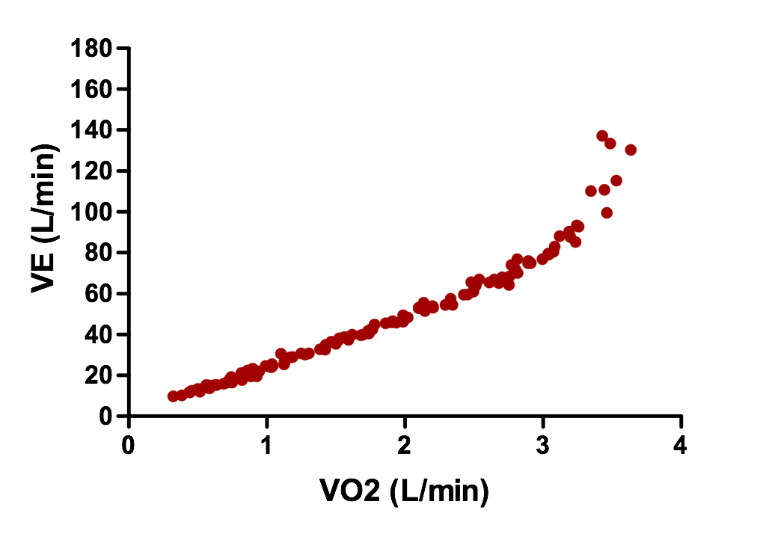
Soggetto sano, 45 anni: FEV₁ 4,71 L (124% pred.)
MVV: 188,4 L/min
VEmax raggiunta durante sforzo: 138 L/min → VEmax/MVV = 73%
Riserva ventilatoria

Slide 7
Soggetto con BPCO, 45 anni: FEV₁ 1,0 L (26% pred.)
MVV (FEV₁ x 40): 40 L/min
VEmax raggiunta durante sforzo: 40 L/min → VEmax/MVV = 100%
VEmax/MVV > 0.85
= presenza di un limite ventilatorio

Slide 8
1
2

Slide 9
Svantaggio meccanico dei muscoli inspiratori accessori in accorciamento
legge di Frank- Starling
Svantaggio meccanico del diaframma appiattito
legge di Laplace
P = T/r

Slide 10
1
2
3

Slide 11
Iperinsufflazione dinamica
Aumento temporaneo di EELV durante periodi di aumentata richiesta ventilatoria
(ad es. durante esercizio)
Gagnon et al, Int J COPD 2014

Slide 12
VO2 ⬇️
Lung Obstruction
Static hyperinflation
Dynamic hyperinflation
+
Diffusive
impairment
Exertional Dispnea
O2 bioavailability

Slide 13
VO2 ⬇️

Slide 14
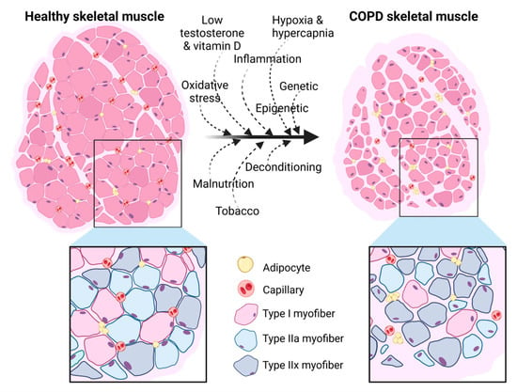
Tipizzazione delle fibre muscolari
CSA fibra ridotta
CSA muscolare ridotta
Shift verso IIA-IIX
L'infiltrazione di tessuto adiposo
Levine S J Appl Physiol (2012)
Notes:
Negli esseri umani, l’invecchiamento è associato ad una perdita di motoneuroni, soprattutto quelli più grandi con soglie di reclutamento più elevate ( 21 ). Ciò si traduce in una diminuzione del numero di fibre muscolari ( 21 ), molte delle quali perdono la loro innervazione, iniziano ad atrofizzarsi e cessano di funzionare insieme
https://www.mdpi.com/1422-0067/24/7/6454

Slide 15
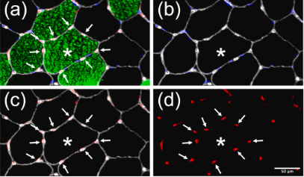
Capillarizzazione
Jobin, Jean Journal of Cardiopulmonary Rehabilitation 1998
Notes:
È interessante notare che i pazienti con BPCO che mostravano un significativo affaticamento muscolare indotto dall'esercizio fisico avevano una capillarizzazione muscolare inferiore rispetto ai "non affaticati" ( Saey et al., 2005 ), suggerendo un collegamento meccanicistico tra questi fenomeni.

Slide 16
VO2 ⬇️

Slide 17
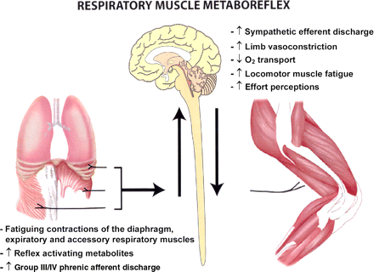
Dempsey et al. Respir Physiol Neurobiol 2006
Notes:
Moreover a “metaboreflex” able to reduce peripheral muscle activation in case of severe respiratory fatigue, has been more recently advocated as a contributor to exercise intolerance.
The metaboreflex is initiated by fatigue of the respiratory muscles, mediated supraspinally via group III/IV afferents, leading to sympathetically mediated vasoconstriction of limb locomotor muscle vasculature, exacerbating peripheral fatigue of working limb muscles and (via feedback) intensifying effort perceptions, thereby contributing to limitation of heavy-intensity endurance exercise performance

Slide 18
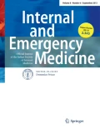
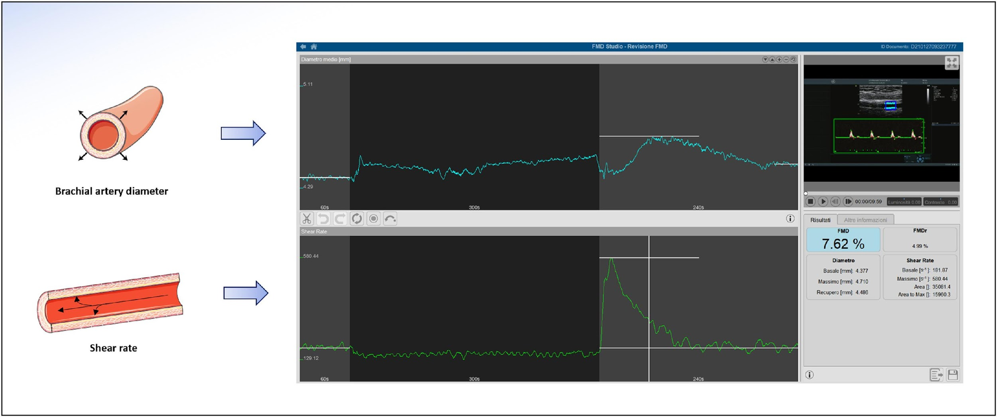
Forest plot of the difference in flow-mediated dilatation (FMD) among chronic obstructive pulmonary disease (COPD) patients and controls

Slide 19
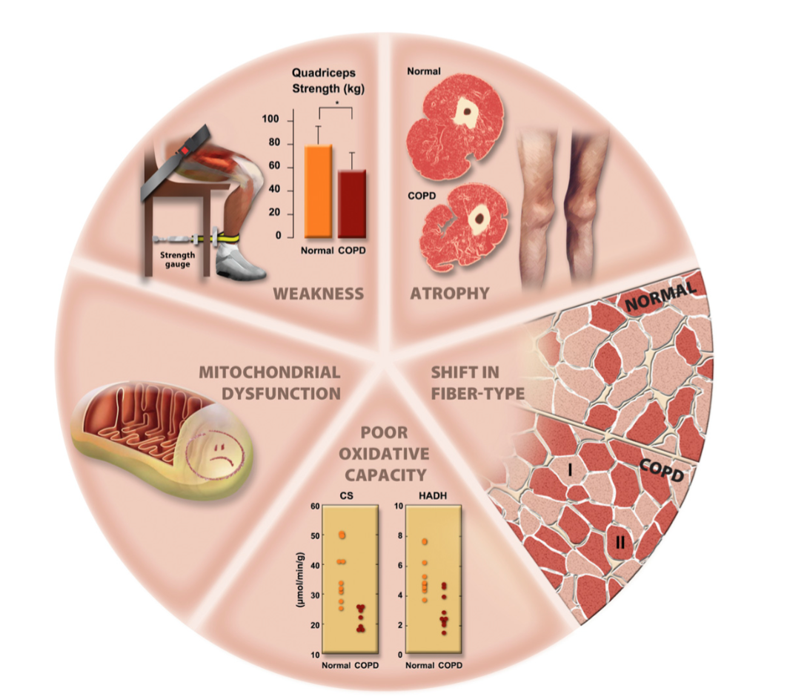
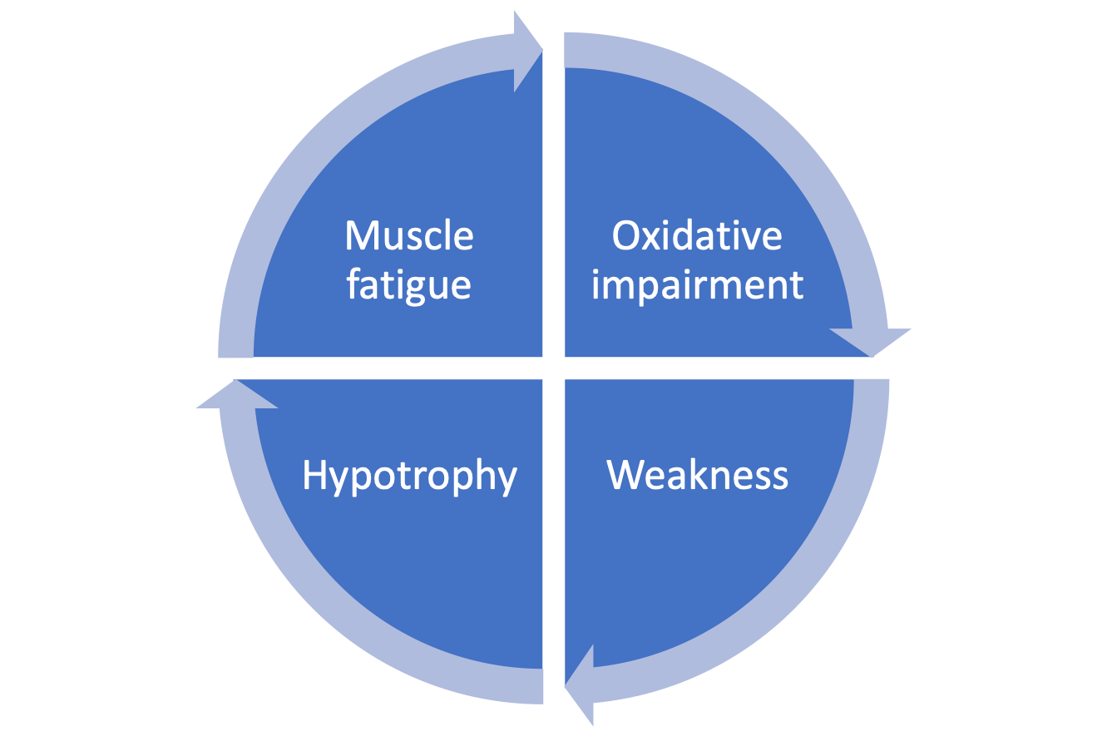
Maltais, Am J Respir Crit Care Med 2014

Slide 20
Come allenare i pazienti all’esercizio fisico
Agenda
Quale limitazione allo sforzo
Quale impatto sulla vita del paziente
Perchè trattare la limitazione allo sforzo
Come trattare la limitazione allo sforzo
Come personalizzare l’intervento
Conclusioni

Slide 21
N=126

Slide 22
A retrospective cohort analysis
data from adult UK Biobank COPD (2006–2010).
A cohort of 502,536 participants (age 37-73y
A muscle loss phenotype (MLP)
53.4% of subjects with chronic obstructive pulmonary disease (COPD) met at least one criterion for MLP.
Muscle loss phenotype was defined either as:
Low muscle mass (whole body). FFMI (fat free mass index): Whole body fat free mass / height (m)² <17.4 kg/m2 for male subjects and <15 kg/m² for female subjects as determined by bioelectric impedance¹. Low muscle mass (appendages). ASMI (appendicular skeletal muscle index): Sum of the muscle mass (fat free mass) of the 4 limbs / height (m)². ASMI < 8.90 kg/m² in men and < 6.37 kg/m² in women². Low muscle strength. HGS (handgrip strength): <30 kg for men and <20 kg for women³. Low muscle and fat mass. BMI (body mass index): <18.5 kg/m² ⁴. While low BMI has traditionally been considered as evidence for malnutrition⁵, it is the most common method that physicians consider muscle loss clinically and has been incorporated into COPD prognostication⁶, and therefore was included in our analysis.

Slide 24
rho=0.59, p=0.001
rho=0.43, p=0.001
rho= −0.47, p=0.002
rho=0.41, p=0.008
40 COPD patients, FEV1 49 ±17%predicted
Anne-Catherine, International Journal of Chronic Obstructive Pulmonary Disease 2020

Slide 25
57 stable COPD patients
(FEV1) of 36±9%
Two groups:
admitted at least twice in the last year (high medical consumption; n=23
not admitted in the last year (low medical consumption; n=34
Quality of life , costs

Slide 26
Come allenare i pazienti all’esercizio fisico
Agenda
Quale limitazione allo sforzo
Quale impatto sulla vita del paziente
Perchè trattare la limitazione allo sforzo
Come trattare la limitazione allo sforzo
Come personalizzare l’intervento
Conclusioni

Slide 28
Twenty-four patients with COPD (mean FEV1, 36.4 (8.5)% of predicted) underwent a high-intensity cycle ergometer exercise training program for 45 minutes, three times a week for 7 weeks.
CHEST 2005

Slide 29
Come allenare i pazienti all’esercizio fisico
Agenda
Quale limitazione allo sforzo
Quale impatto sulla vita del paziente
Perchè trattare la limitazione allo sforzo
Come trattare la limitazione allo sforzo
Come personalizzare l’intervento
Conclusioni

Slide 30
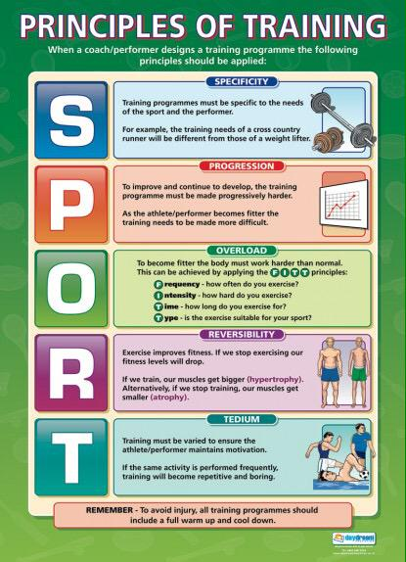
PR EXERCISE AREAs
Endurance
Strenght
Respiratory Muscle Training

Slide 31
Aerobic training
The American College of Sports Medicine (ACSM) defines aerobic exercise as “purposeful exercise that involves major muscle groups and is continuous and rhythmic in nature” . It includes activities such as cycling, walking, swimming, dancing and can also be performed using equipment such as a treadmill or stationary bike.
Garber CE, Med Sci Sports Exerc. 2011

Slide 32
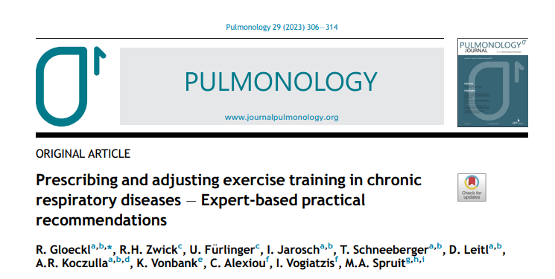
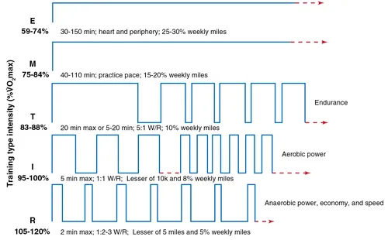
Pulmonology. 2023 29(4):306-314

Slide 33
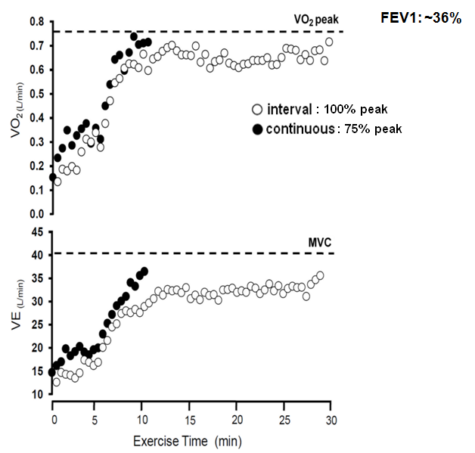
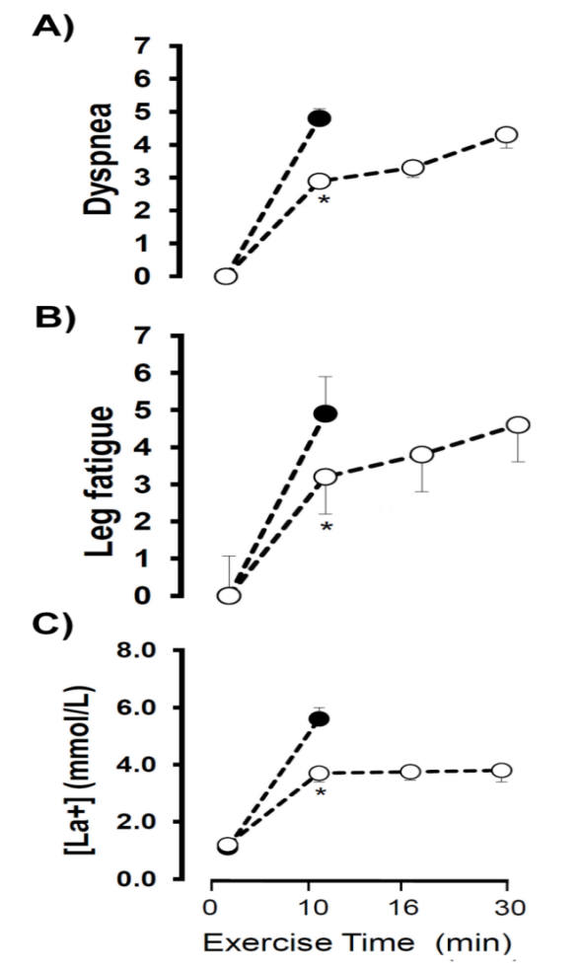
Crossover study
10 individuals with moderate COPD
Test 1: intermittent (1 min exercise and rest intervals)
Test 2: continuous test
70% of the W peak
Application of interval exercise in severe COPD
Troosters T, Eur Respir Rev 2023
Vogiatzis I. et al. ERJ 2004

Slide 34
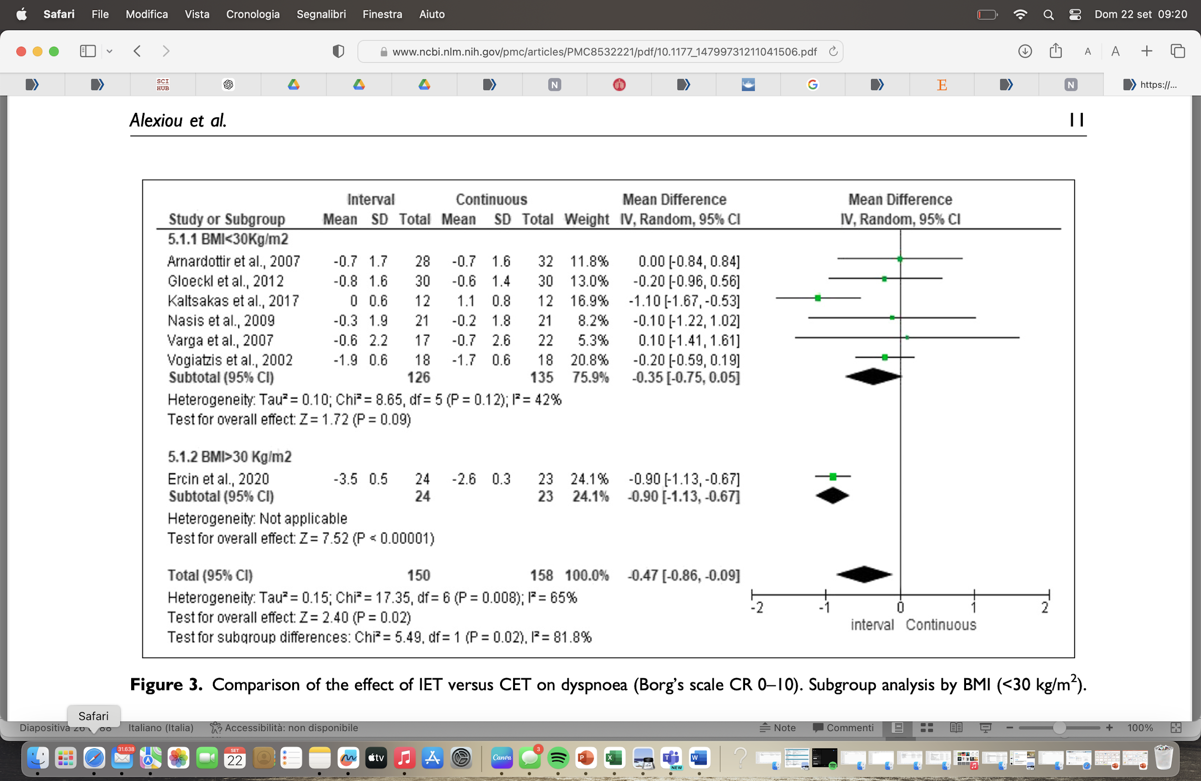
IET is superior to CET in improving exercise capacity and exercise-induced dyspnoea sensations in patients with CRDs; however, the extent of the clinical benefit is not considered clinically meaningful.

Slide 35
PR EXERCISE AREAs
Endurance
Strenght
Respiratory Muscle Training

Slide 36
Resistance training involves muscle contractions performed against a specific opposing force generated by a resistance such as body weight, free weights and weight machines. It is an umbrella term for training different aspects of muscle function such as strength and endurance.
Williams MA, Circulation. 2007

Slide 37
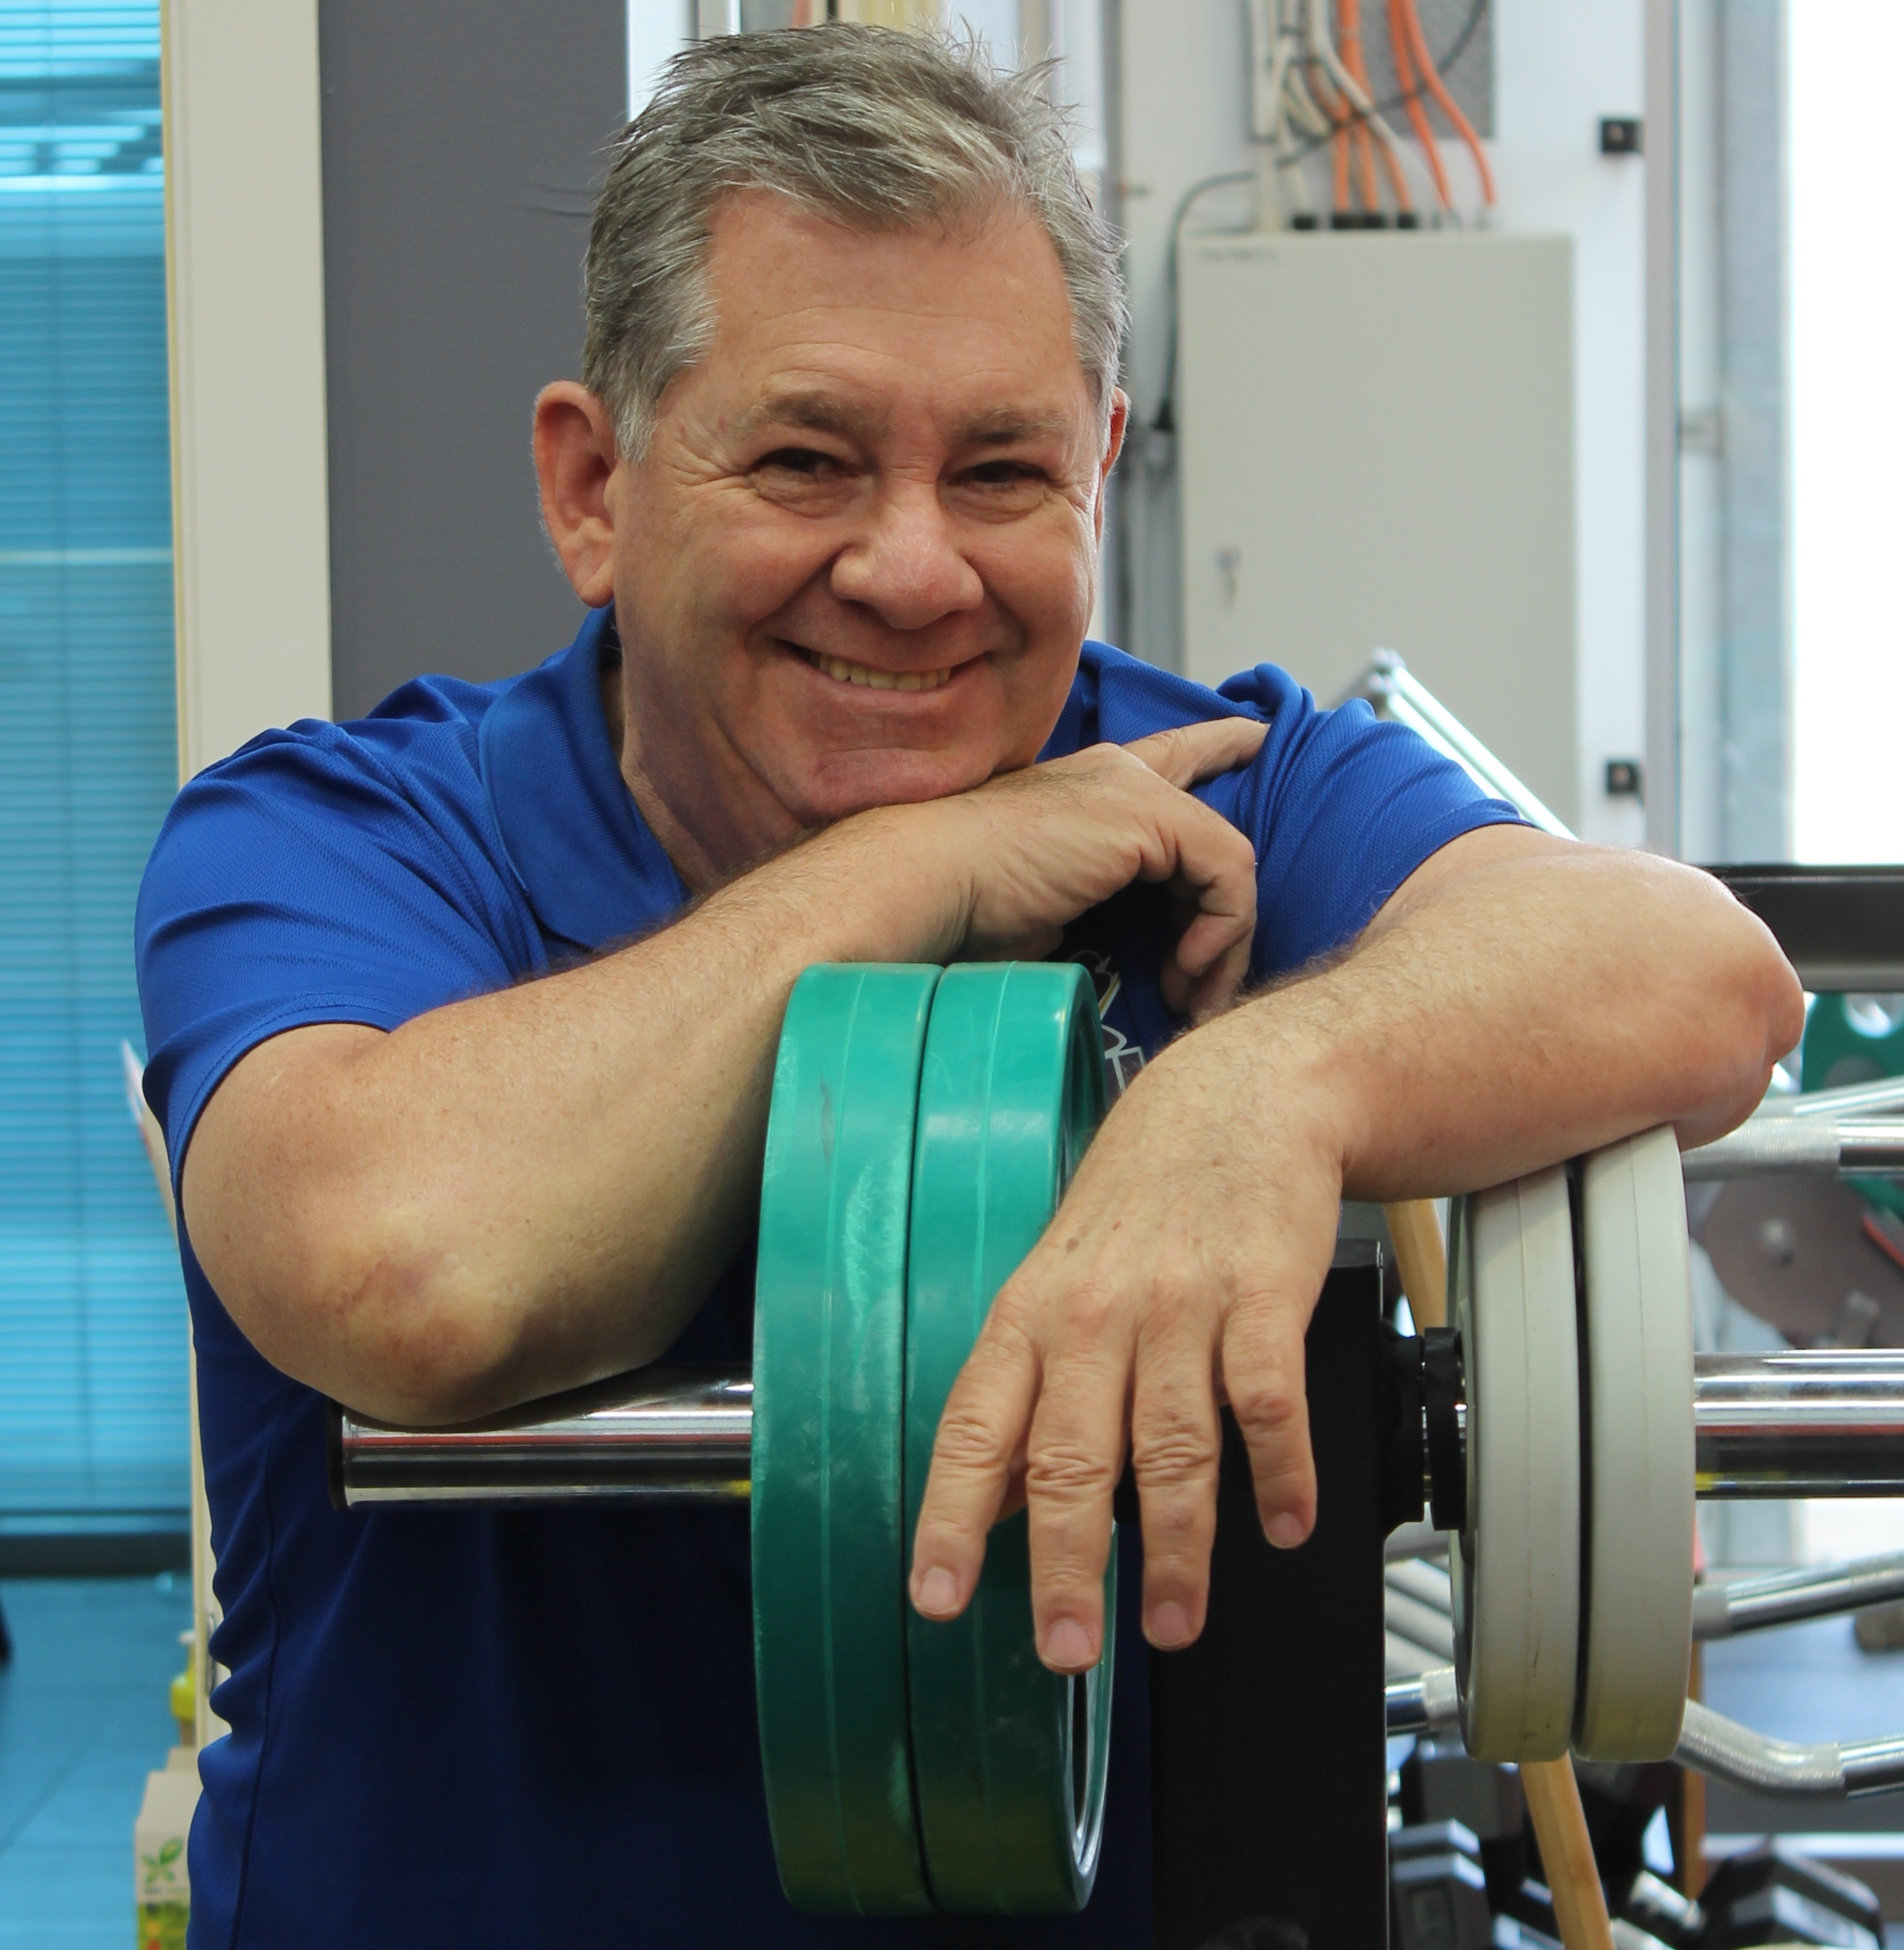
RESISTIVE TRAINING
Muscle weakness ranges from 20 to 40% depending on disease severity
Seymour Eur Respir J, 36 (2010)
Reduced limb muscle endurance and muscle fatigue occur in 30–80%
Mador Am J Respir Crit Care Med, 163 (2001)
Upper limbs stenght seems more preserved than those of lower limbs
Gosselink J Cardiopulmonary Rehabil (2000)

Slide 38
Pulmonology. 2023 29(4):306-314

Slide 39
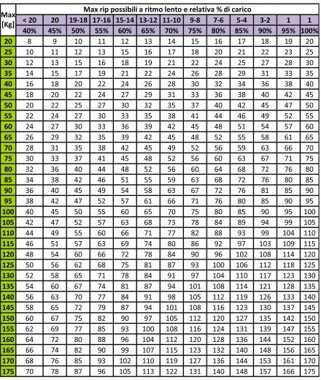
%1-RM | Massimo numero di ripetizioni possibili
100 | 1
90 | 5
80 | 8
70 | 12
60 | 17
2021

Slide 40
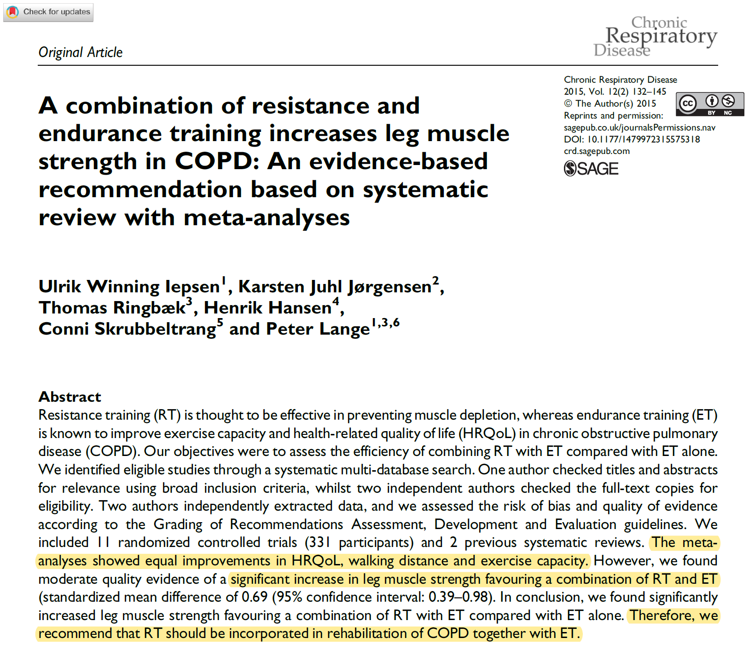
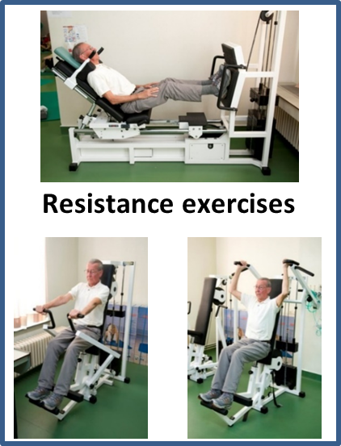

Slide 41
PR EXERCISE AREAs
Endurance
Strenght
Respiratory Muscle Training

Slide 42
Inspiratory muscle training is a resistive training uses devices that have differing levels of inspiratory flow resistance (eg. achieved by patient breathing through holes of sequentially smaller diameter , valves, or tapered flow resistive loading device).
Kkp M, J Pulm Respir Med. 2018

Slide 43
PR+IMT versus PR
22 trials (1446 participants)
probably makes little to no difference to breathlessness (measured with different scales);
has an unknown effect on physical fitness;
may make little to no difference to life quality (measured with different scales);
probably makes little to no difference to strength of breathing muscles.
IMT versus no training or sham device
37 studies with 1021 participants. • may reduce breathlessness measured with one scale, but it is unclear if it has an effect when measured with two other scales; • probably improves physical fitness; • probably improves life quality when measured with one scale, but it is unclear if it has a benefit when measured with another one;
• may make little to no difference to strength of breathing muscles.

Slide 44
Come allenare i pazienti all’esercizio fisico
Agenda
Quale limitazione allo sforzo
Quale impatto sulla vita del paziente
Perchè trattare la limitazione allo sforzo
Come trattare la limitazione allo sforzo
Come personalizzare l’intervento
Conclusioni

Slide 45
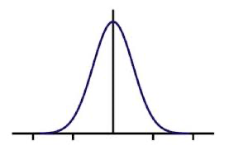
Despite the numerous benefits resulting from these conventional approaches for the ‘average’ person with COPD, individual variability remains concerning both the likelihood and magnitude of benefits from exercise training. No single best approach exists that caters to all such individual variability. However, several novel training modalities have emerged in recent years seeking to advance the benefits of exercise training in individuals with COPD
Bisca GW, EXPERT REVIEW OF RESPIRATORY MEDICINE, 2017

Slide 46
Dyspnoea, exercise performance, health status, mood status and problematic activities of daily life were assessed before and after a 40-session pulmonary rehabilitation programme in 2068 patients with COPD
Patients were clustered into four groups 18.3%;
“very good responder”, 35.9%; “good responder”, 35.4%; “moderate responder”, and 10.5%; “poor responder”
Eur Respir J 2015

Slide 47
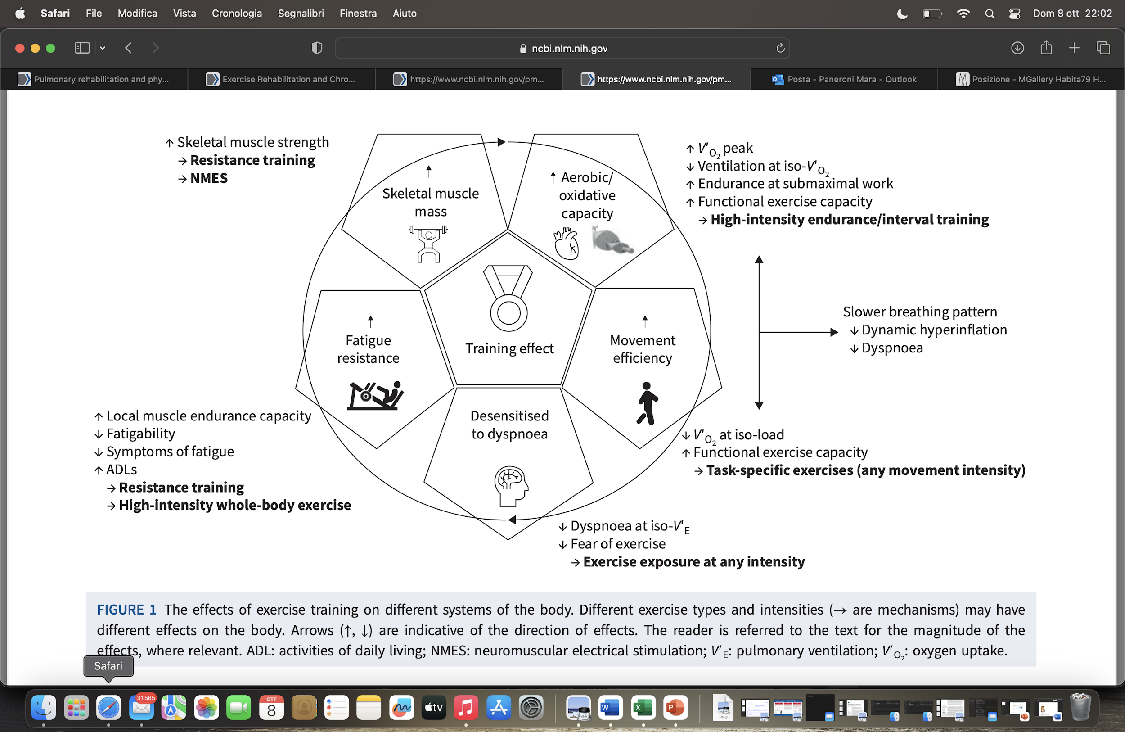
1° DEFINIRE I PROBLEMI
2019
Wounters EFM, Eur Respir Rev 2018

Slide 48
mac carla

Slide 49
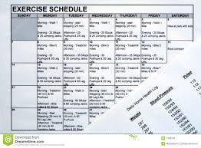
THE CHALLENGE:
BEST THE RECIPE
2°PERSONALIZZARE LA PRESCRIZIONE
Buchheit M, Sports Med (2013) 43:313–338

Slide 50
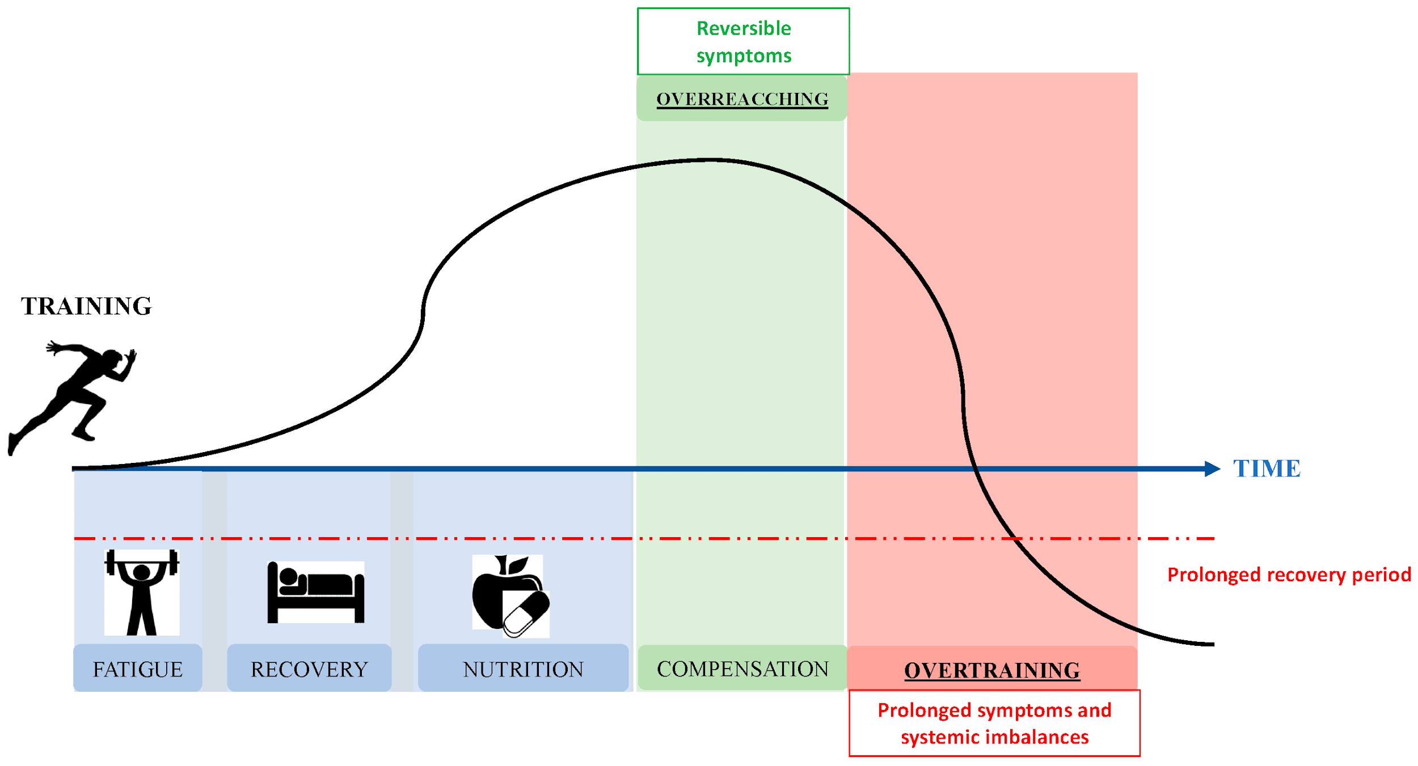
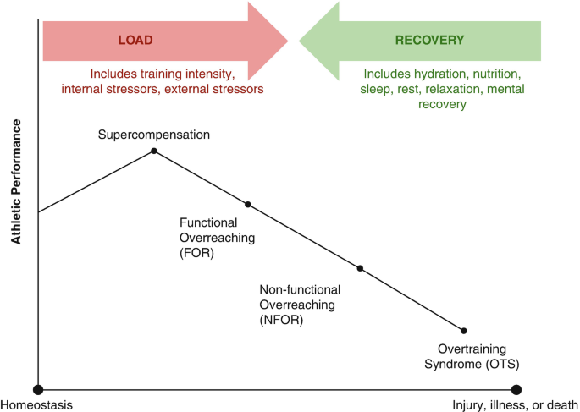
2021

Slide 51
Notes:
Our analysis included 15 studies with 979 participants. The results showed that HIIT led to the most significant improvements in exercise capac- ity, lung function, and breathlessness, and it also enhanced quality of life. MICT also produced notable benefits, particularly in exercise capacity and quality of life, similar to HICT. LICT was effective in improving exercise capacity but to a lesser extent. Overall, the evidence suggests that HIIT and MICT may be the most effective exercise approaches for patients with COPD. However, the quality of the evidence varied, so further research is needed to confirm these findings.

Slide 52
3°GESTIRE I TRATTAMENTI COMPLEMENTARI
J Thorac Dis 2016;8(11):3379-3400

Slide 53
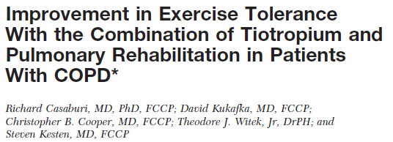
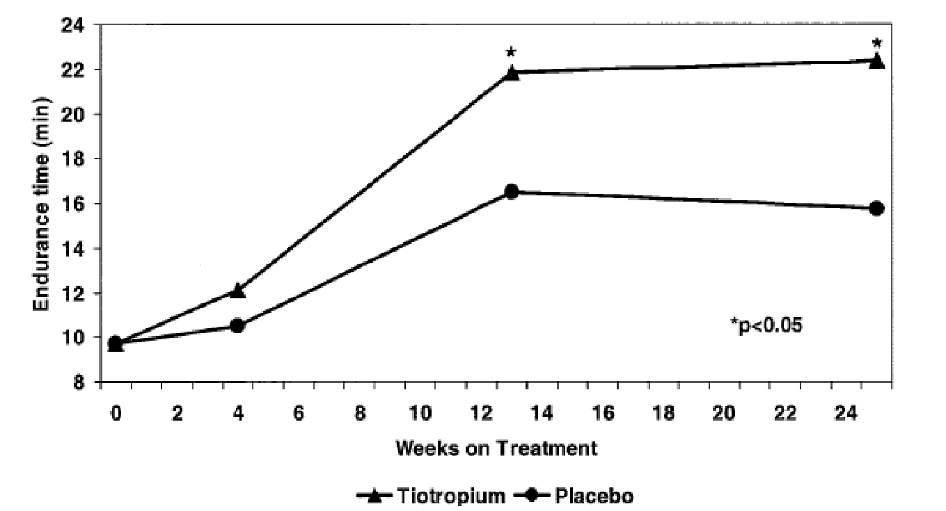
Tiotropium group n = 47
Placebo group n = 44
8 weeks of PR
treadmill training
3 times a week
> 30 min per session
+ 5,35 min
+ 6,60 min

Slide 54
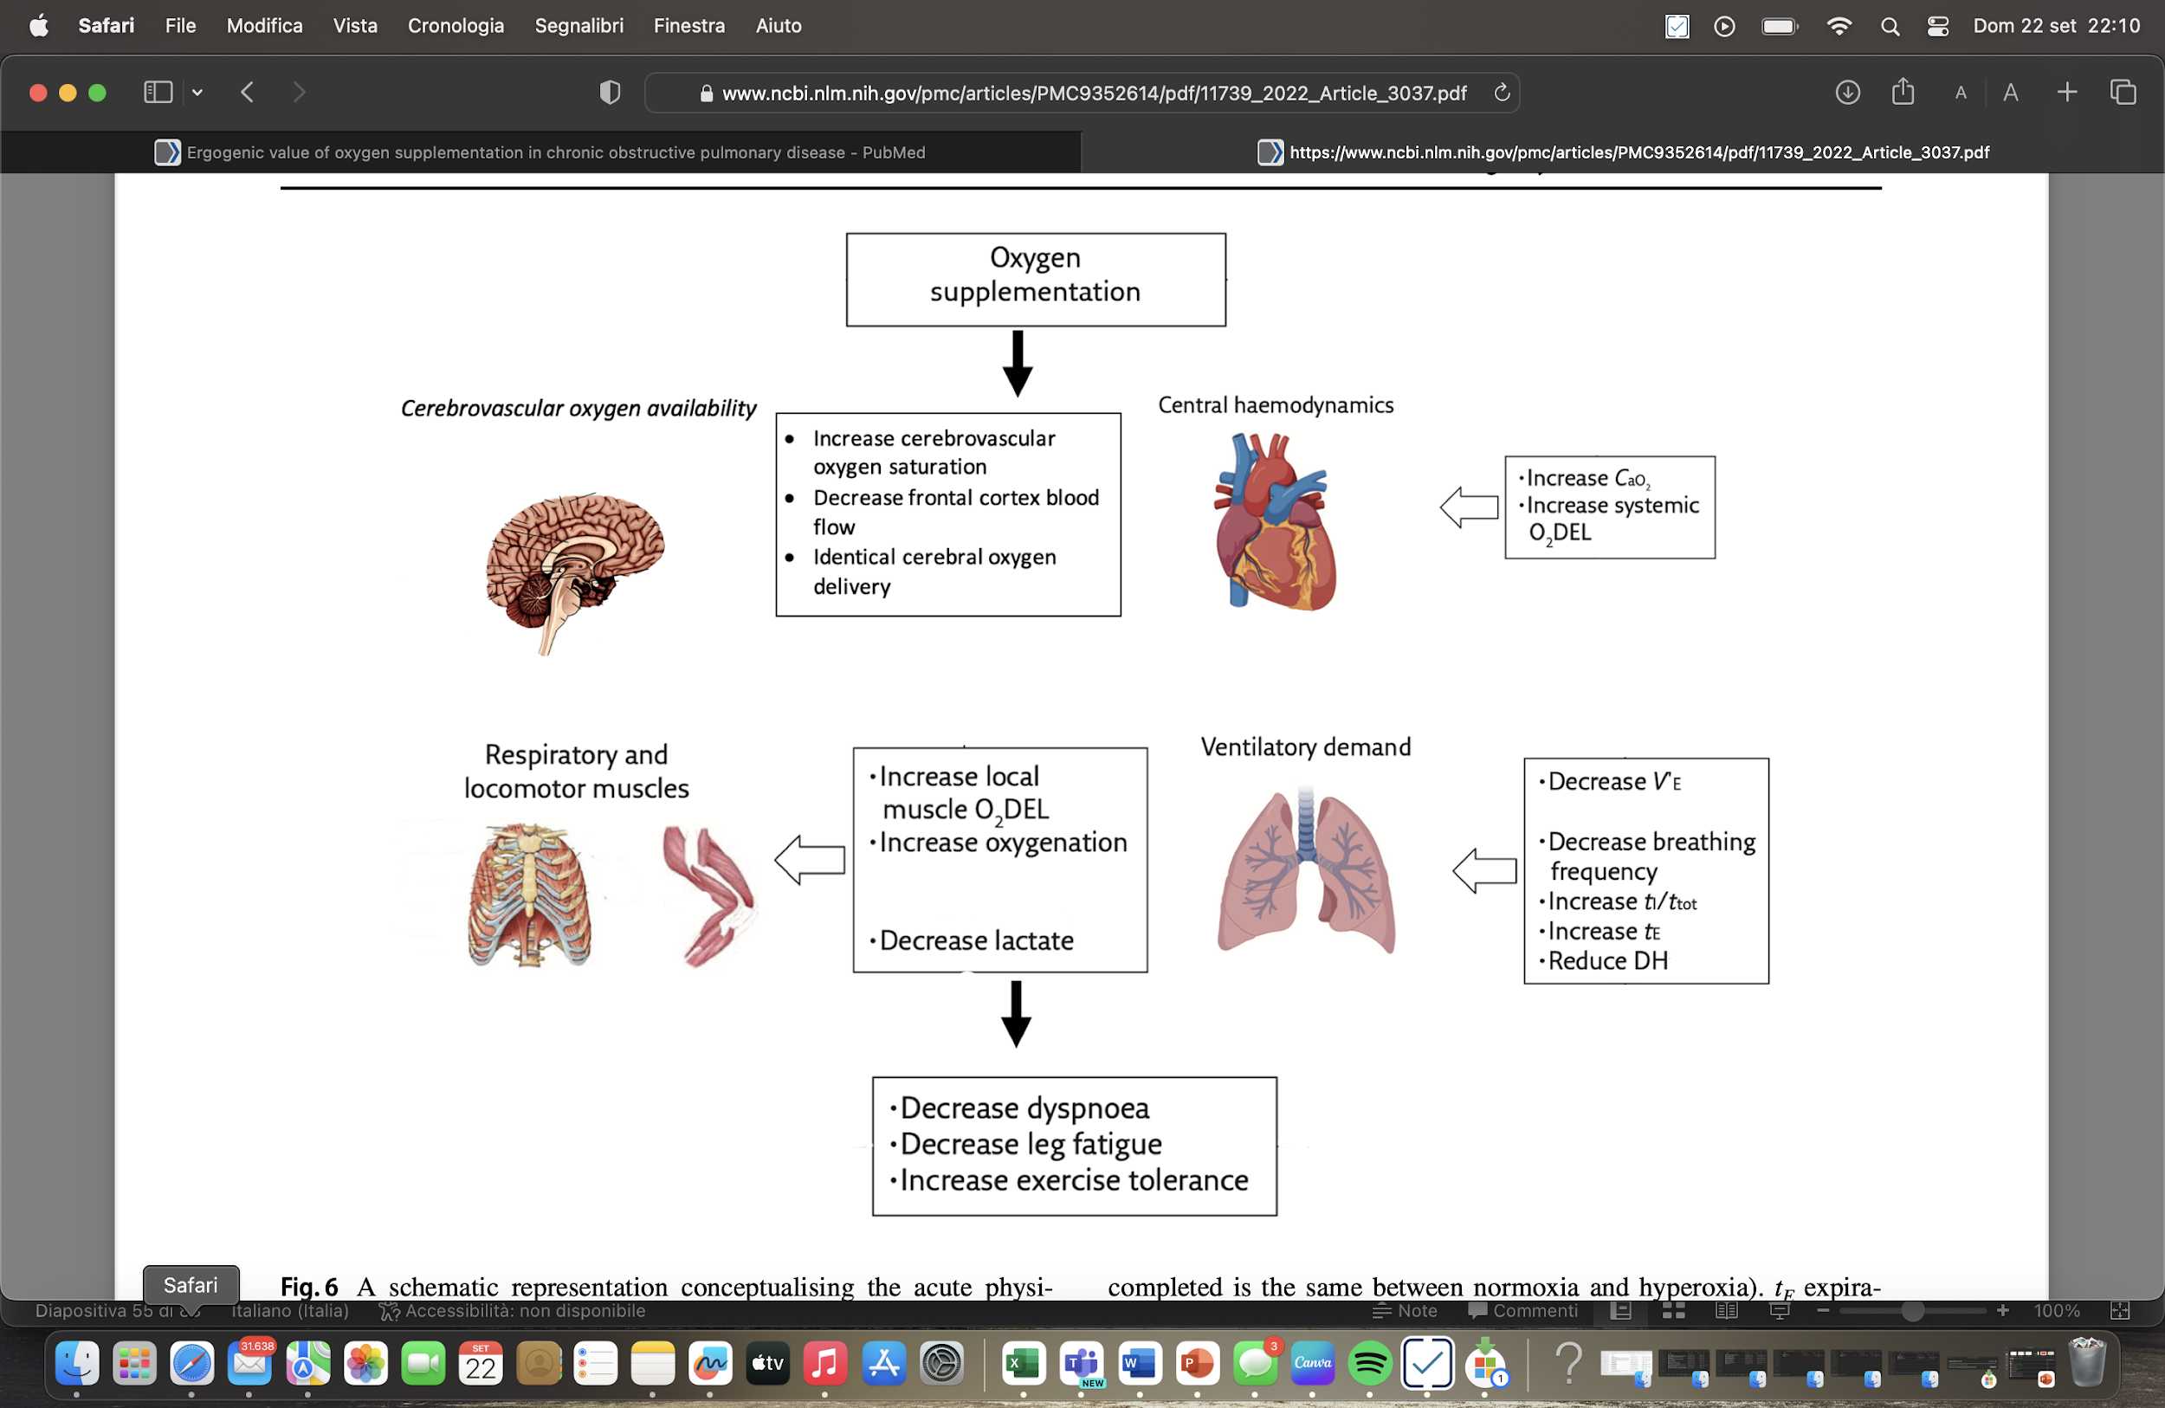

Slide 55
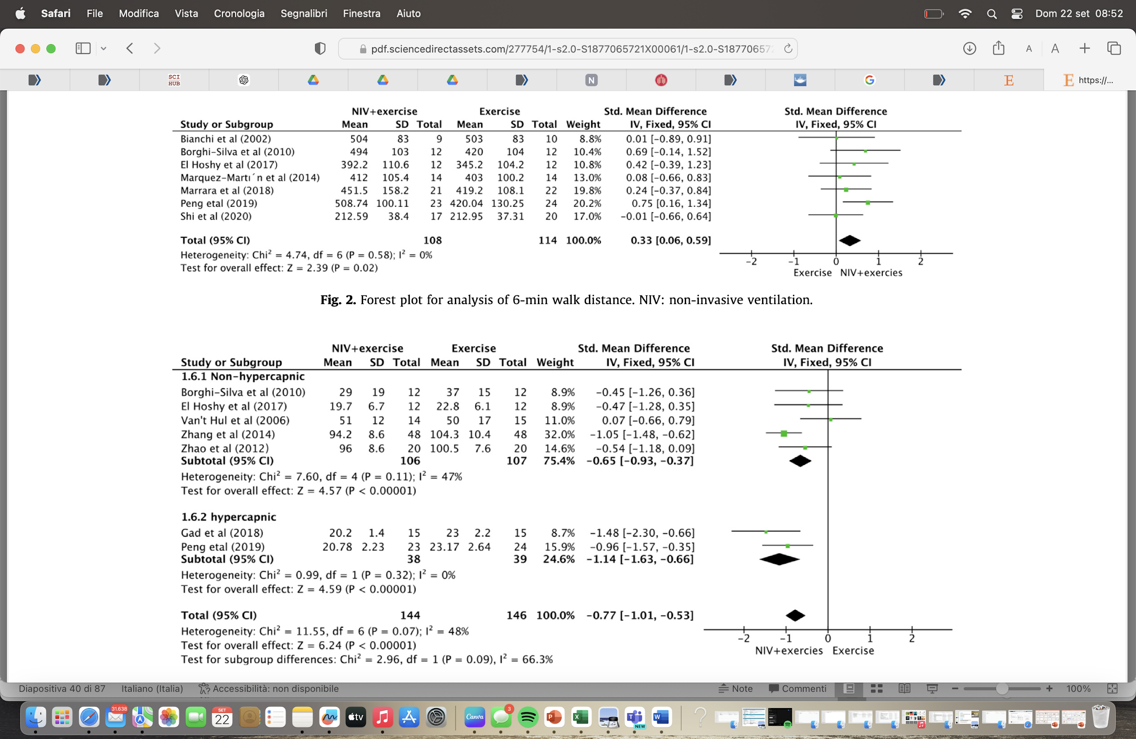
Our review reveals that NIV seems a relevant adjuvant for exercise training in COPD individuals because the intervention could improve exercise performance and QoL. We give recommendations for the development of NIV interventions during exercise training.
Annals of Physical and Rehabilitation Medicine 64 (2021) 101460

Slide 56
Macronutrients supplementation: as calorie-protein or aminoacids (AA) supplementation
Micronutrients supplementation: vitamins or bioactive compounds supplementation
Journal of the American Nutrition Association 2024

Slide 57
Come allenare i pazienti all’esercizio fisico
Agenda
Quale limitazione allo sforzo
Quale impatto sulla vita del paziente
Perchè trattare la limitazione allo sforzo
Come trattare la limitazione allo sforzo
Come personalizzare l’intervento
Conclusioni

Slide 58
Exercise training is safe and beneficial for the vast majority of patients with COPD, being combining endurance and strength the most valuable option to treat limb muscle dysfunction in stable patients with COPD.
Adaptations of the training regimen may allow selected patients to benefit from a training program that would not otherwise be possible in difficult situations such as exacerbation, or when comorbidities or disease severity compromise the ability of the patients to tolerate training.
Further work is necessary
to understand the short- and long-term clinical benefits in specific population,
To evaluate combination therapies consisting of classic and adjunct modalities
To evaluate how personalizing exercise training and optimizing its benefits.
Jatovich A, Am J Respir Crit Care Med 2018

Slide 59
WHAT IS THE AIM? WHICH ADAPTATIONS?
FUNZIONE
MUSCOLARE PERIFERICA
DISPNEA

Slide 60
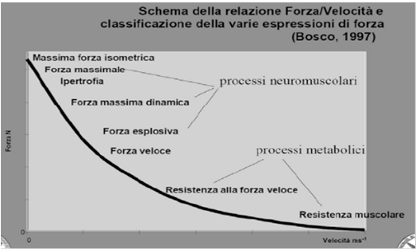
Simoes, J Thorac Dis. 2018

Slide 61
EXACERBATION / ICU
DISPNEA
FUNZIONE
MUSCOLARE PERIFERICA

Slide 62
STABLE SEVERE COPD
WEAKNESS?
WHICH
EXTERNAL HELPS
DISPNEA
FUNZIONE MUSCOLARE PERIFERICA

