Slide 1



La polmonite fulminante: una patologia tempo-dipendente in UTIR
Francesco Salton
SC Pneumologia, ASUGI
francesco.salton@units.it

Slide 2
Conflitti di interesse
Negli ultimi due anni ho avuto i seguenti rapporti economici e/o supporti Finanziari con soggetti portatori di interessi commerciali in campo sanitario:
Tipo di Rapporto Economico Azienda
Attività di Relatore GlaxoSmithKline, Insmed, Chiesi Farmaceutici, OrionPharma
Contributo Attività di Ricerca Vivisol
Attività di Consulenza GlaxoSmithKline, Chiesi Farmaceutici
Possesso di azioni o quote partecipative Gossamer Bio
Componente di Organi Direttivi
Rapporto di lavoro subordinato

Slide 3
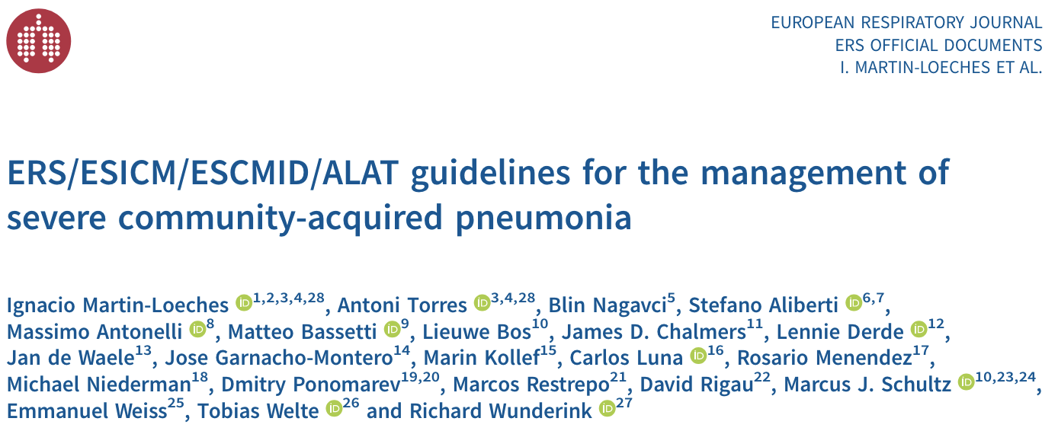
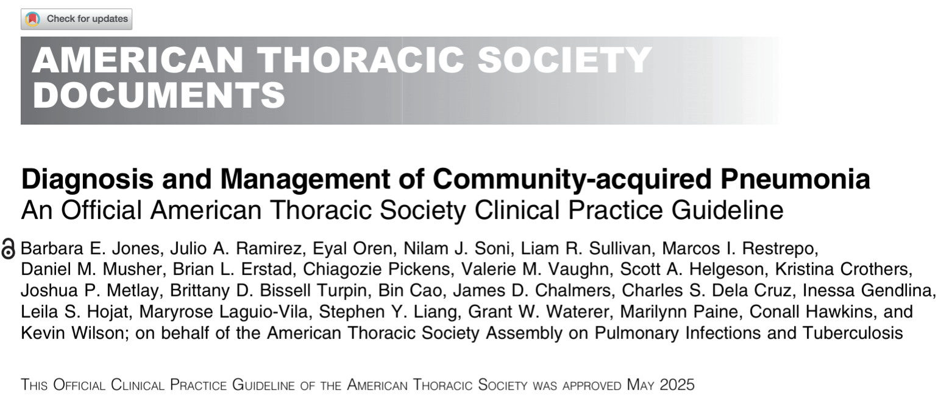
La polmonite “fulminante” non esiste nelle linee guida
Severe CAP (sCAP) is accepted terminology used to describe ICU-admitted patients with CAP as they might require organ support.
~ 40% of patients with CAP will require hospitalisation, and 5% of these patients will be admitted to the intensive care unit (ICU), primarily due to shock or the need for invasive or non-invasive mechanical ventilation.
Mortality +22% if shock is present, +25% if invasive mechanical ventilation is required, +30% if both conditions

Slide 4
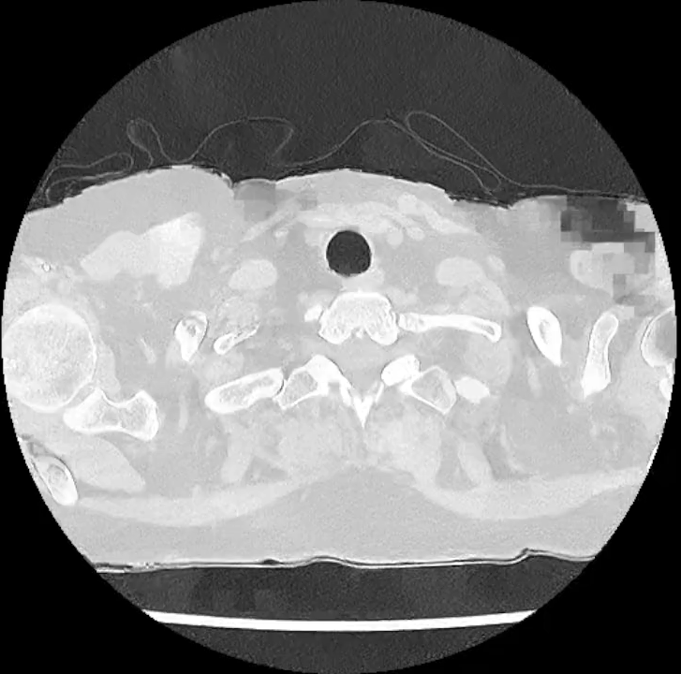
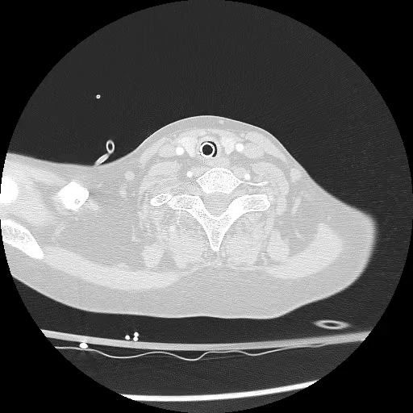
…ma esiste in “real life”
12/08/2025
13/08/2025

Slide 5
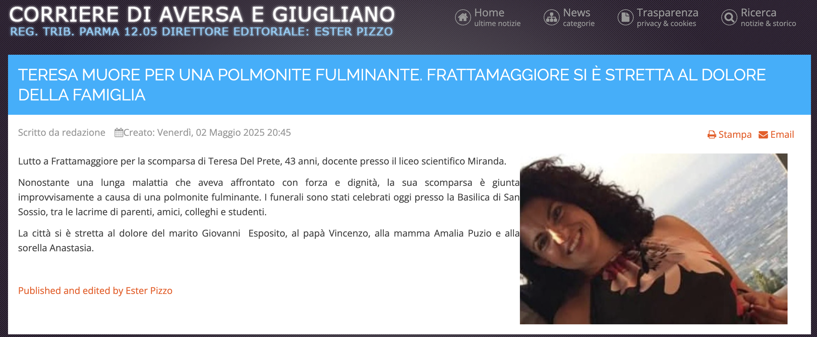

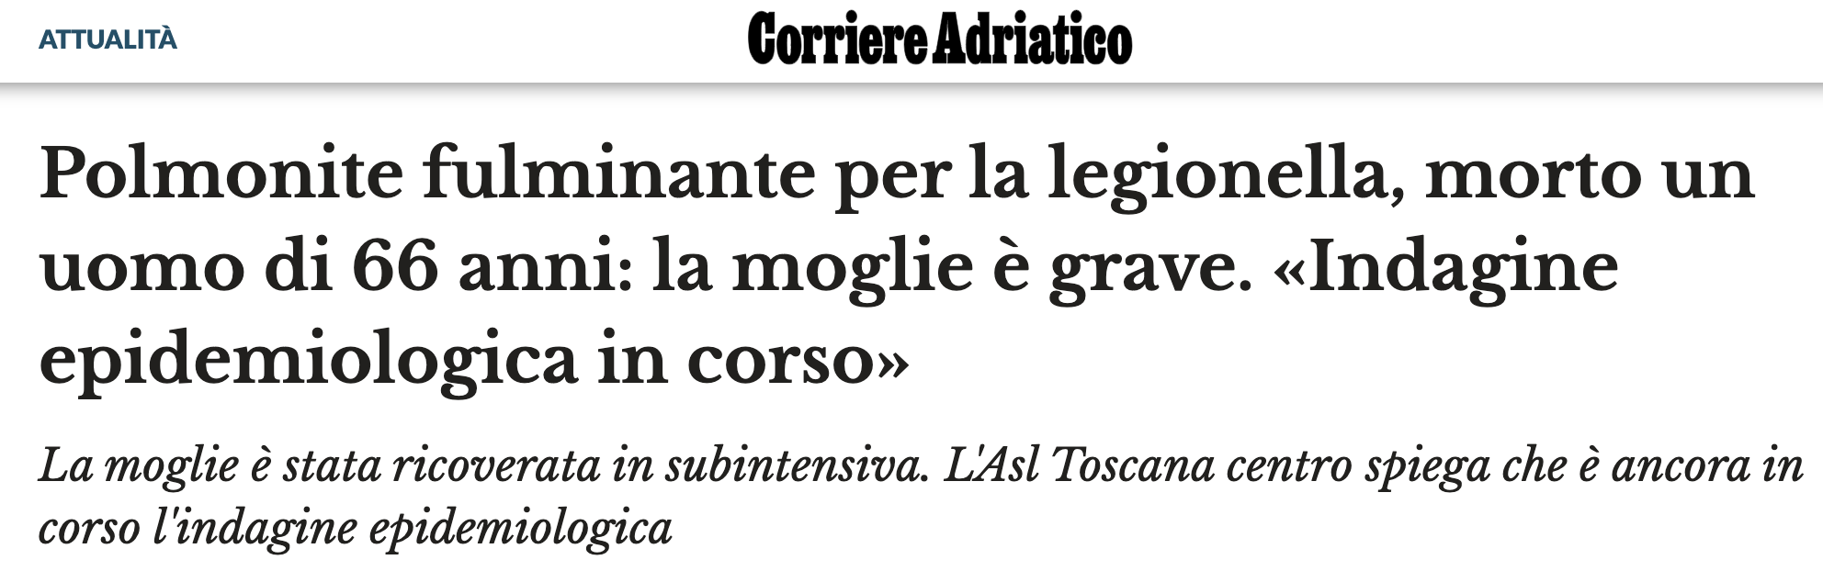

Slide 6
Perchè questa discrepanza?
I pazienti con polmonite “fulminante” sono spesso esclusi dai RCT
(es., “imminent death” nel REMAP-CAP trial)
► Le forme più gravi di polmonite rimangono sottorappresentate nelle raccomandazioni evidence-based
REMAP-CAP Investigators; Angus DC. Effect of hydrocortisone on mortality in patients with severe community-acquired pneumonia : The REMAP-CAP Corticosteroid Domain Randomized Clinical Trial. Intensive Care Med. 2025
Krueger WA et al. Influence of combined intravenous and topical antibiotic prophylaxis on the incidence of infections, organ dysfunctions, and mortality in critically ill surgical patients: a prospective, stratified, randomized, double-blind, placebo-controlled clinical trial. Am J Respir Crit Care Med. 2002

Slide 7
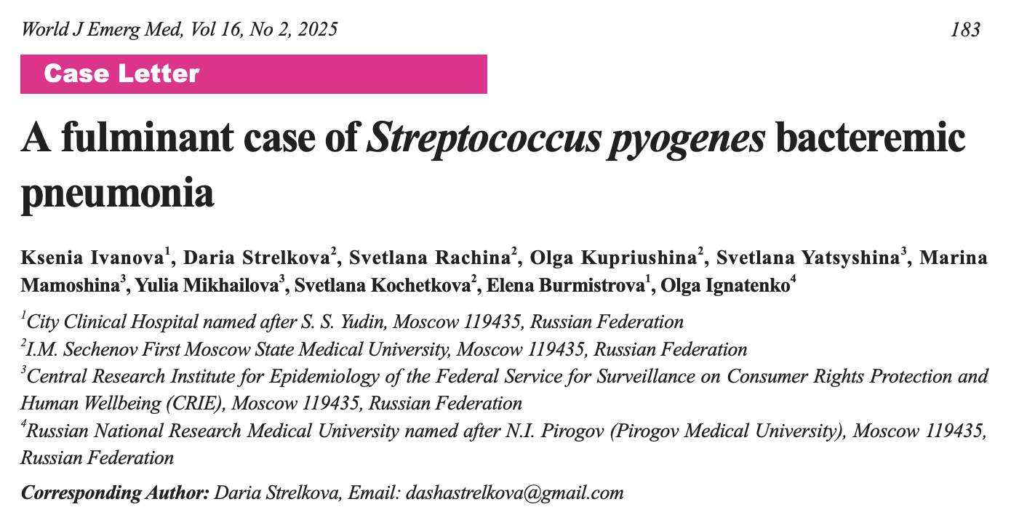
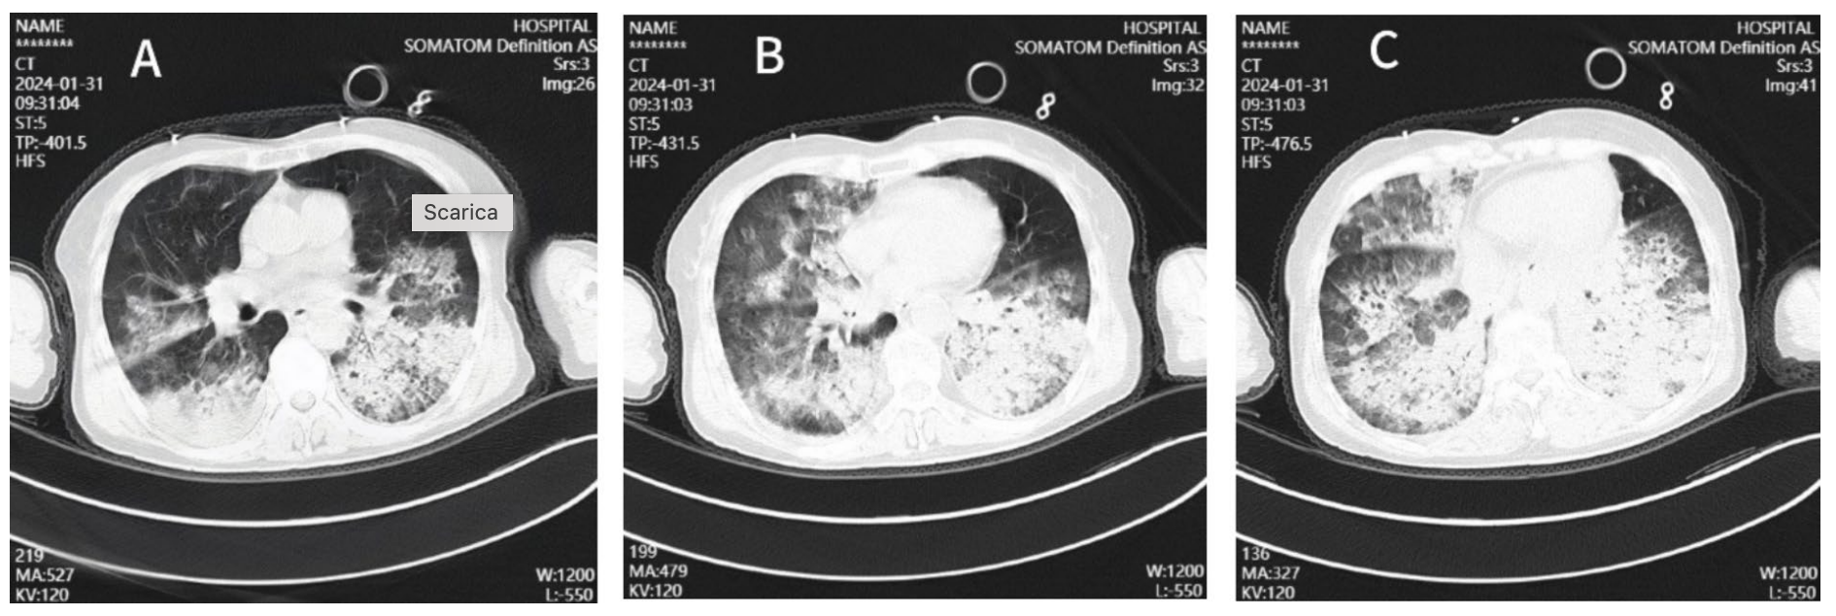
La letteratura sulle polmoniti “fulminanti”
[…] By the fourth hour of hospitalization, respiratory failure had progressed, with the PaO2/FiO2 dropping to 190 mmHg, and lactate levels increasing to 3.6 mmol/L. The patient was intubated, and required norepinephrine administration. Hemodiafiltration was performed for detoxication. Given the signs of septic shock and the positive S. pyogenes test, antibiotic therapy was switched to a combination of clindamycin and meropenem. Despite ongoing intensive therapy, the patient’s condition deteriorated […]

Slide 8
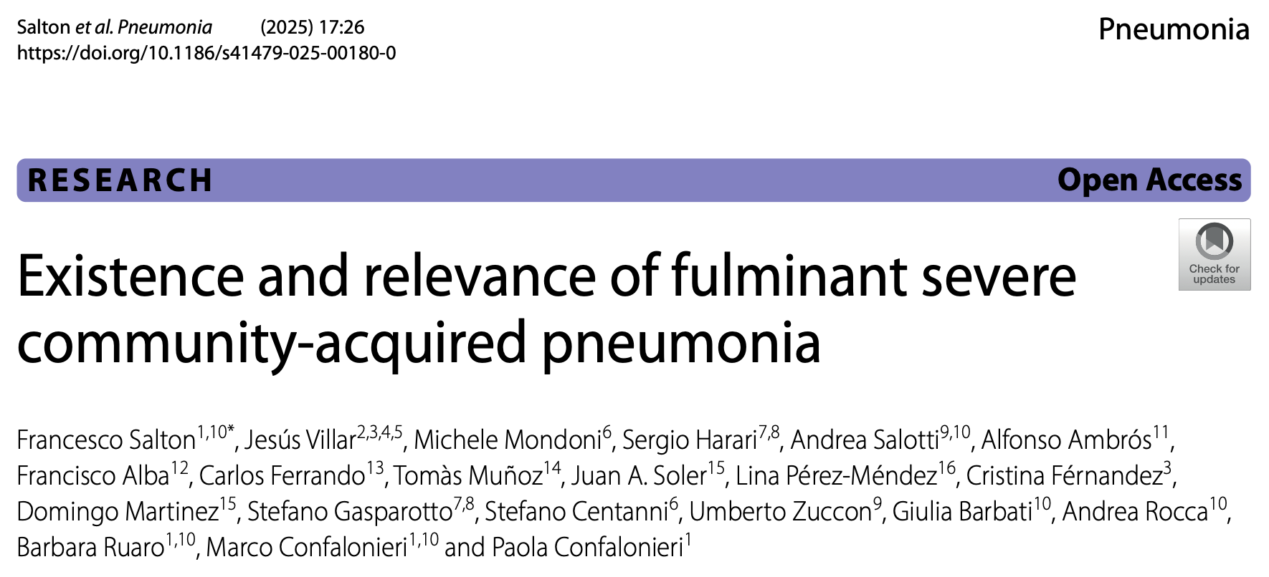
Eppur (qualcosa) si muove
Incidence 89/1517 (5.6%)
Death ≤ 48h = 19/1517 (1.3%)
sCAP leading to death in ≤ 7 days

Slide 9
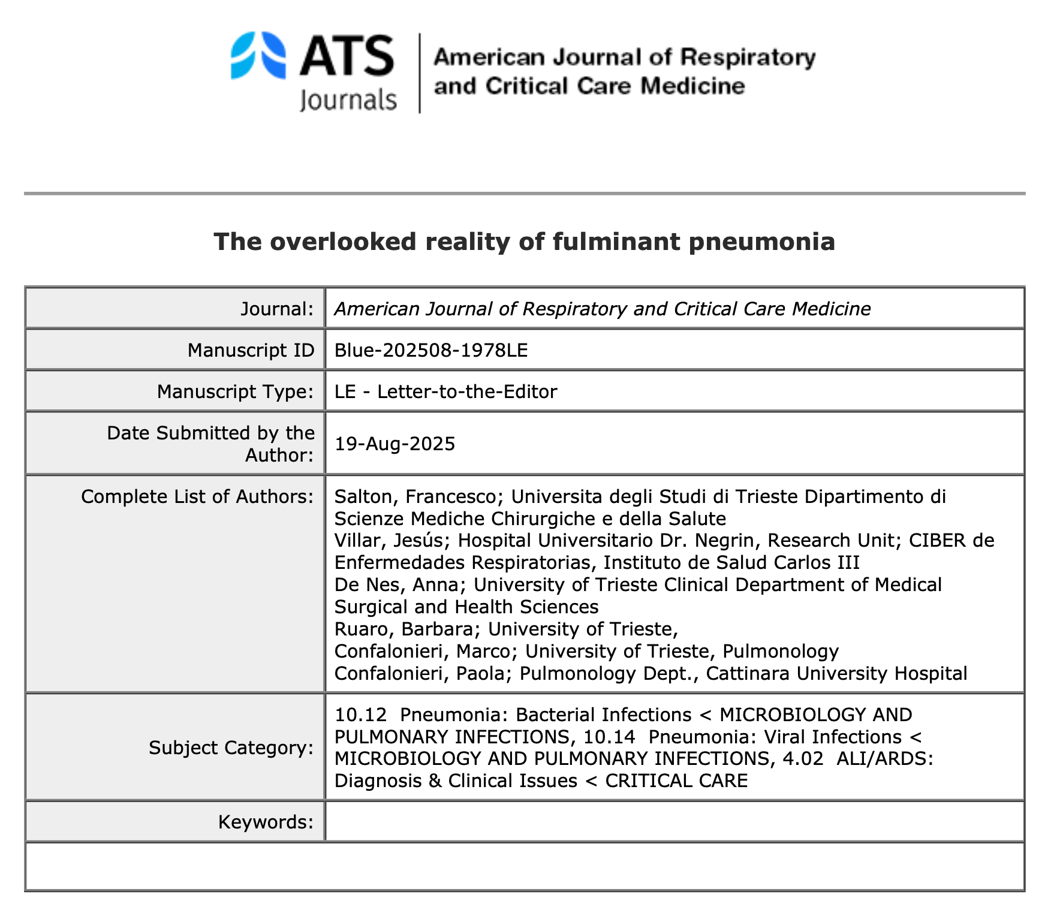
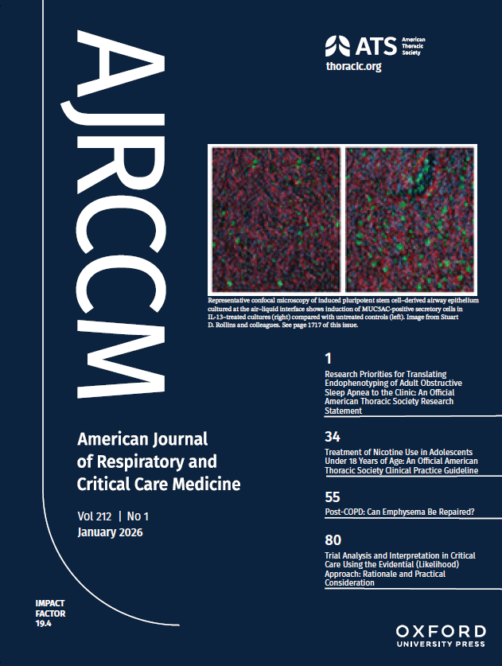
Eppur (qualcosa) si muove pt. 2

Slide 10
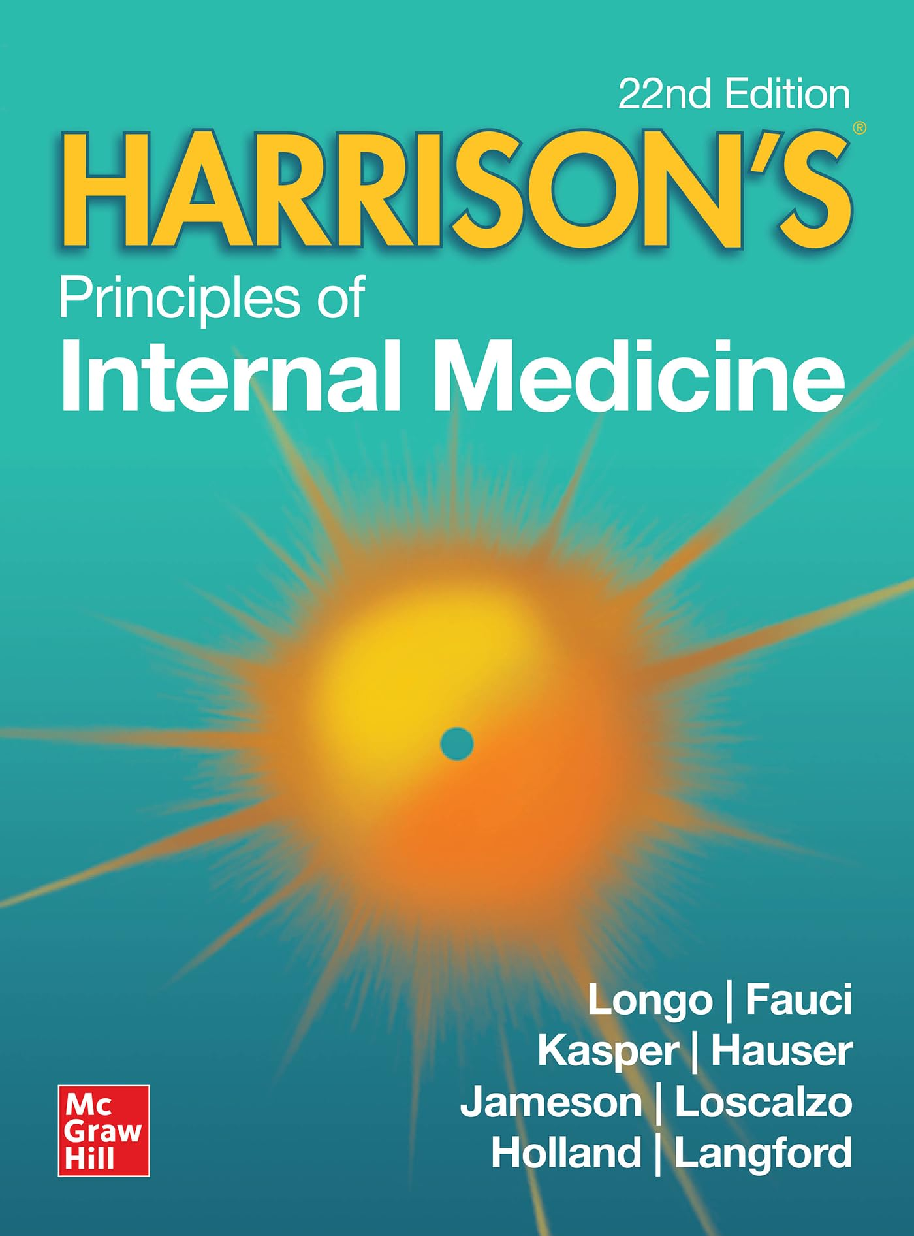
Eppur (qualcosa) si muove pt. 3
“the clinical presentation of CAP can vary from indolent to fulminant and from mild to fatal“

Slide 11



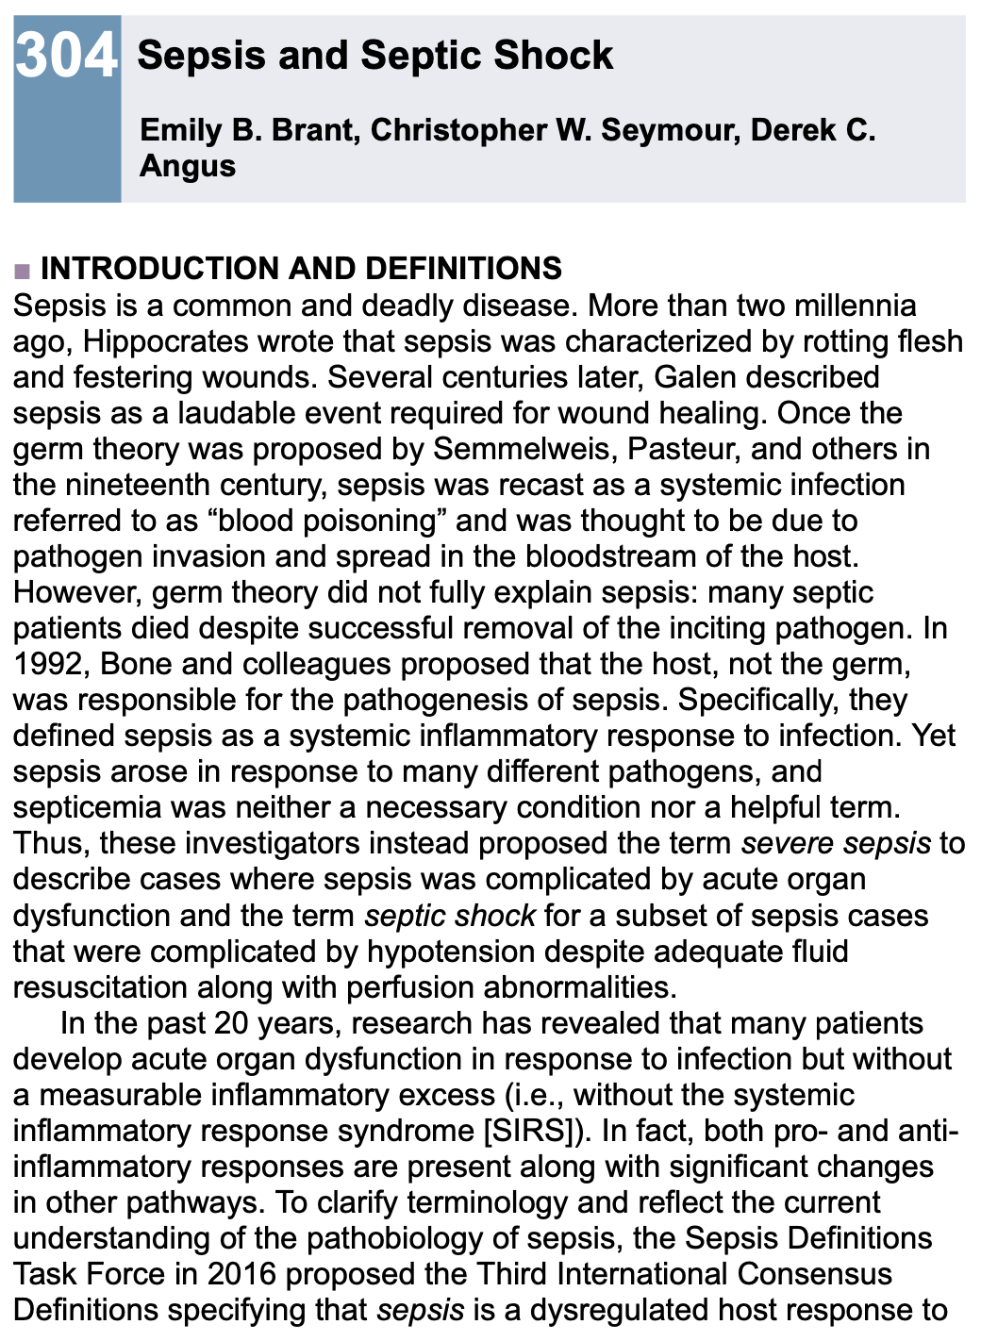
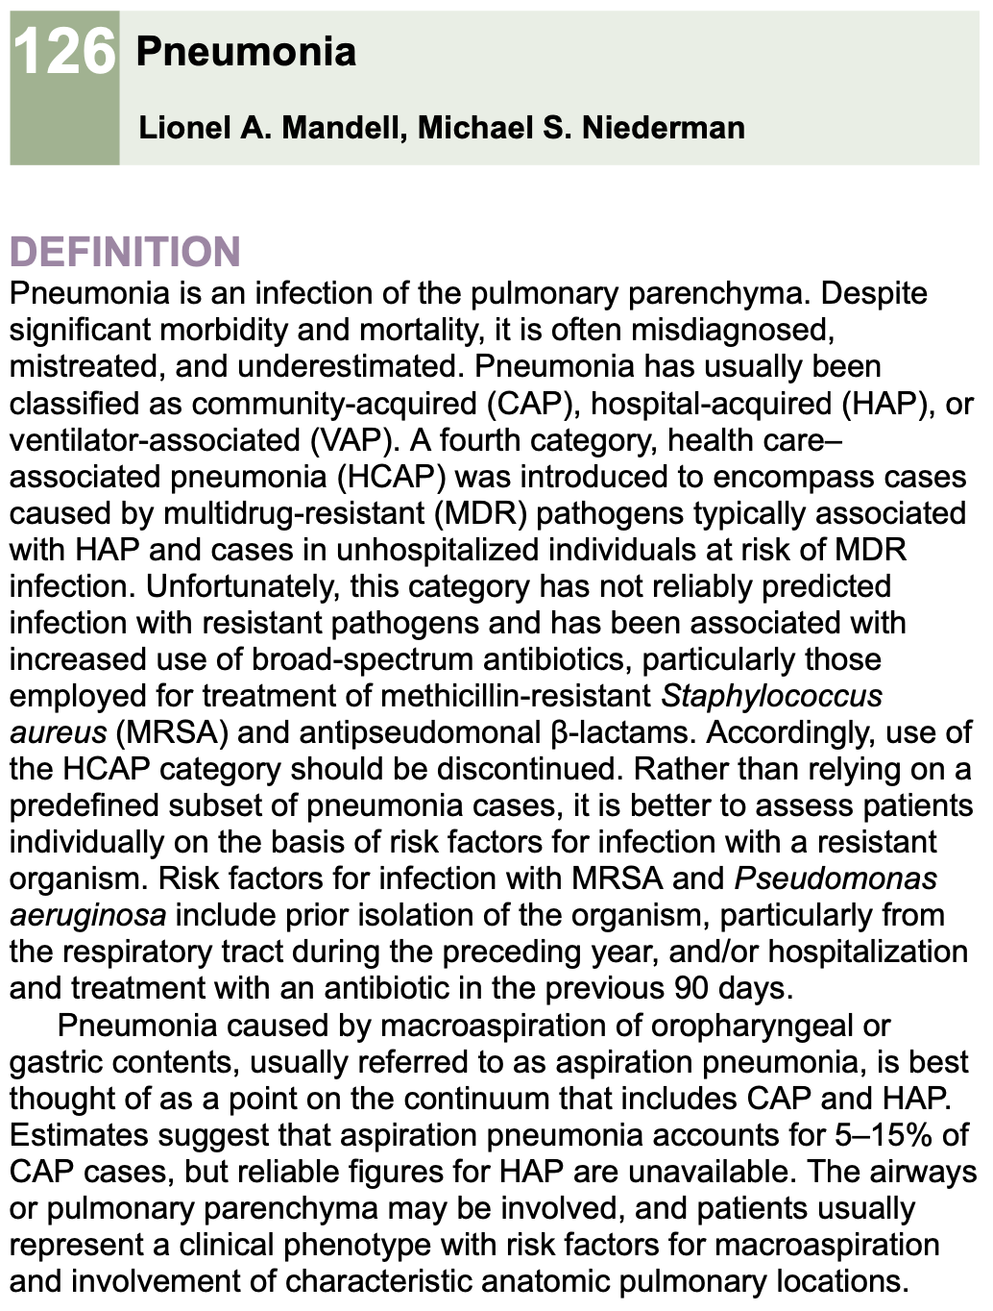
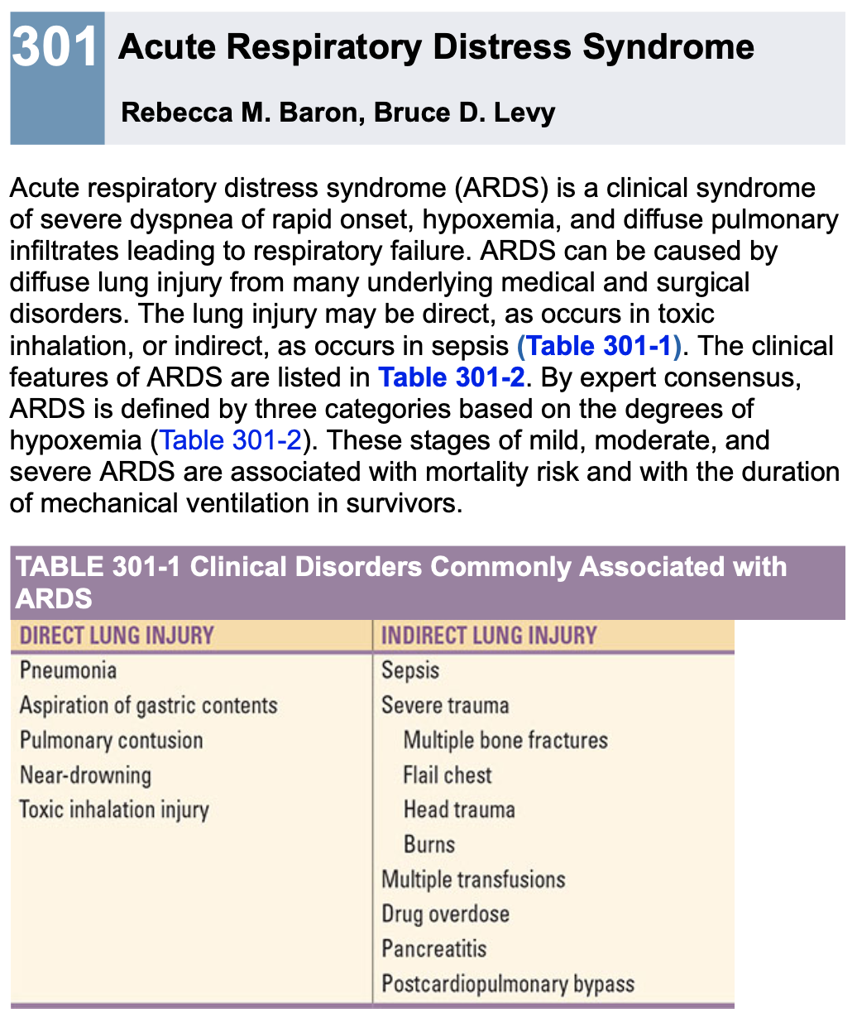
Una parte del problema è culturale
…but there is a substantial overlap/causality between conditions that we acknowledge as separate ones
Loscalzo J. et al. Harrison’s principles of internal medicine, 22nd ed. McGrawHill

Slide 12
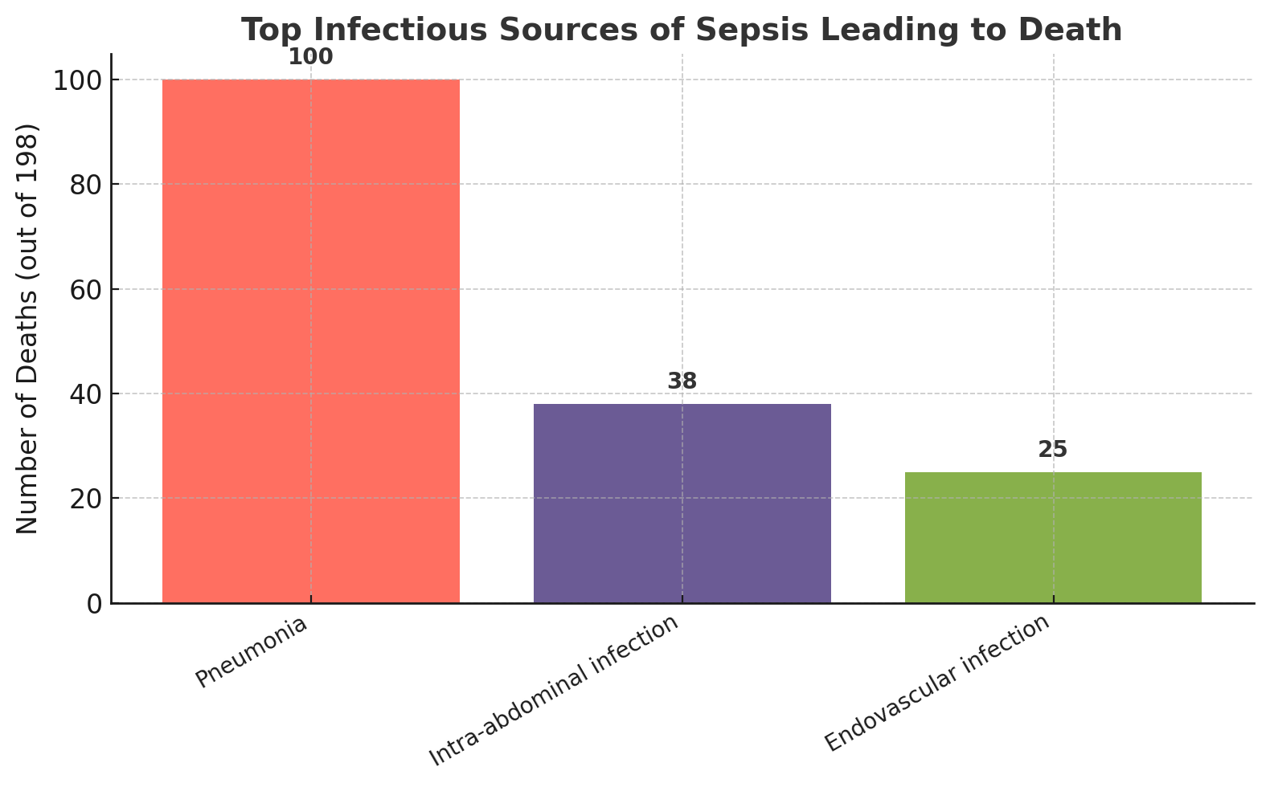
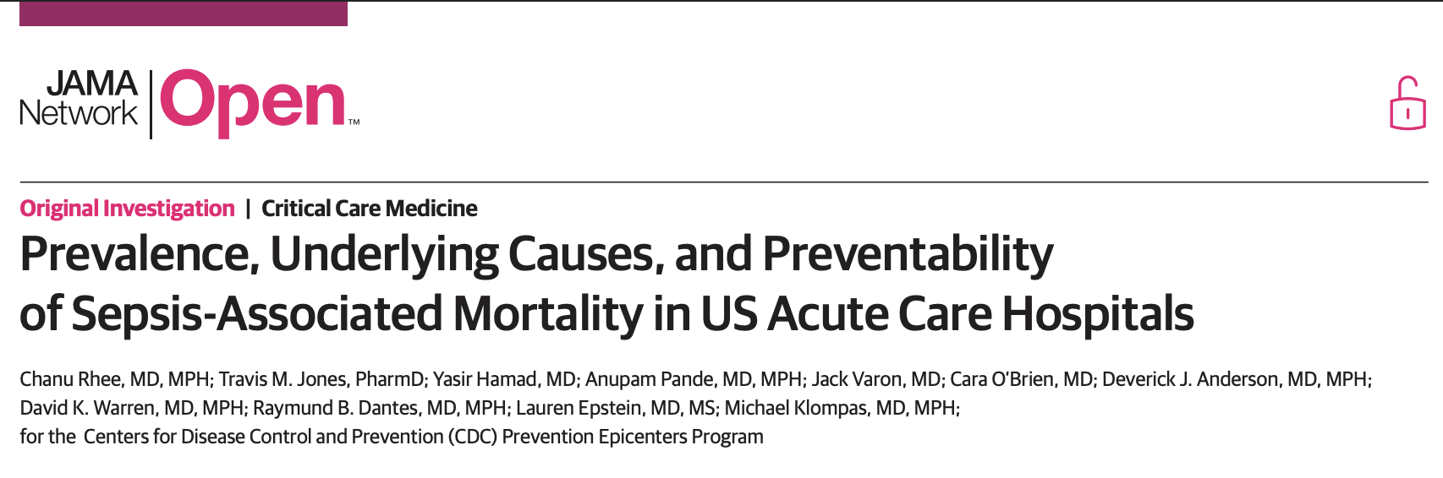
1. La polmonite è la causa più commune di sepsi
The most common infectious source of sepsis among patients in whom sepsis was the immediate cause of death was pneumonia (100 of 198, 50.5%), followed by intra-abdominal infections and endovascular infections.

Slide 13

2. La sepsi è la causa più commune di ARDS (e morte in ARDS)
Sepsis is an underlying cause for approximately 75% of patients with ARDS (59% pneumonia, 16% extrapulmonary sepsis)
Sepsis syndrome with multiple organ failure remains the most common cause of death in ARDS (30 to 50%), while respiratory failure causes a small percentage (13 to 19%) of deaths
26 to 44% of deaths occurred early (< 72 h after ARDS onset), and 56 to 74% occurred late (> 72 h)
1. Bellani G, et al. Epidemiology, patterns of care, and mortality for patients with acute respiratory distress syndrome in intensive care units in 50 countries. JAMA. 2016
2. Stapleton RD, Wang BM, Hudson LD, Rubenfeld GD, Caldwell ES, Steinberg KP. Causes and timing of death in patients with ARDS. Chest. 2005
3. Matthay, M.A et al. Acute respiratory distress syndrome. Nat Rev Dis Primers 2019
4. Bos, Lieuwe D J et al. Acute respiratory distress syndrome: causes, pathophysiology, and phenotypes. The Lancet 2022
Notes:
Of 29144 patients admitted to participating ICUs, 3022 (10.4%) fulfilled ARDS criteria. Of these, 2377 patients developed ARDS in the first 48 hours and whose respiratory failure was managed with invasive mechanical ventilation. The period prevalence of mild ARDS was 30.0% (95% CI, 28.2%-31.9%); of moderate ARDS, 46.6% (95% CI, 44.5%-48.6%); and of severe ARDS, 23.4% (95% CI, 21.7%-25.2%).

Slide 14
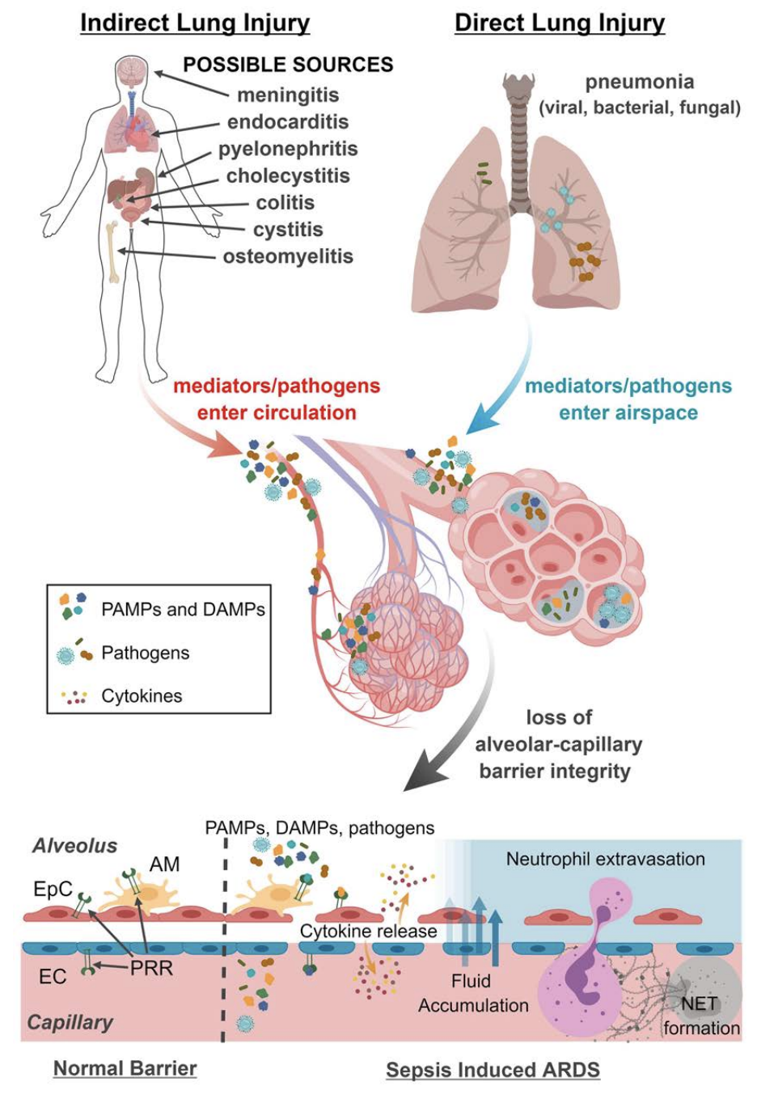
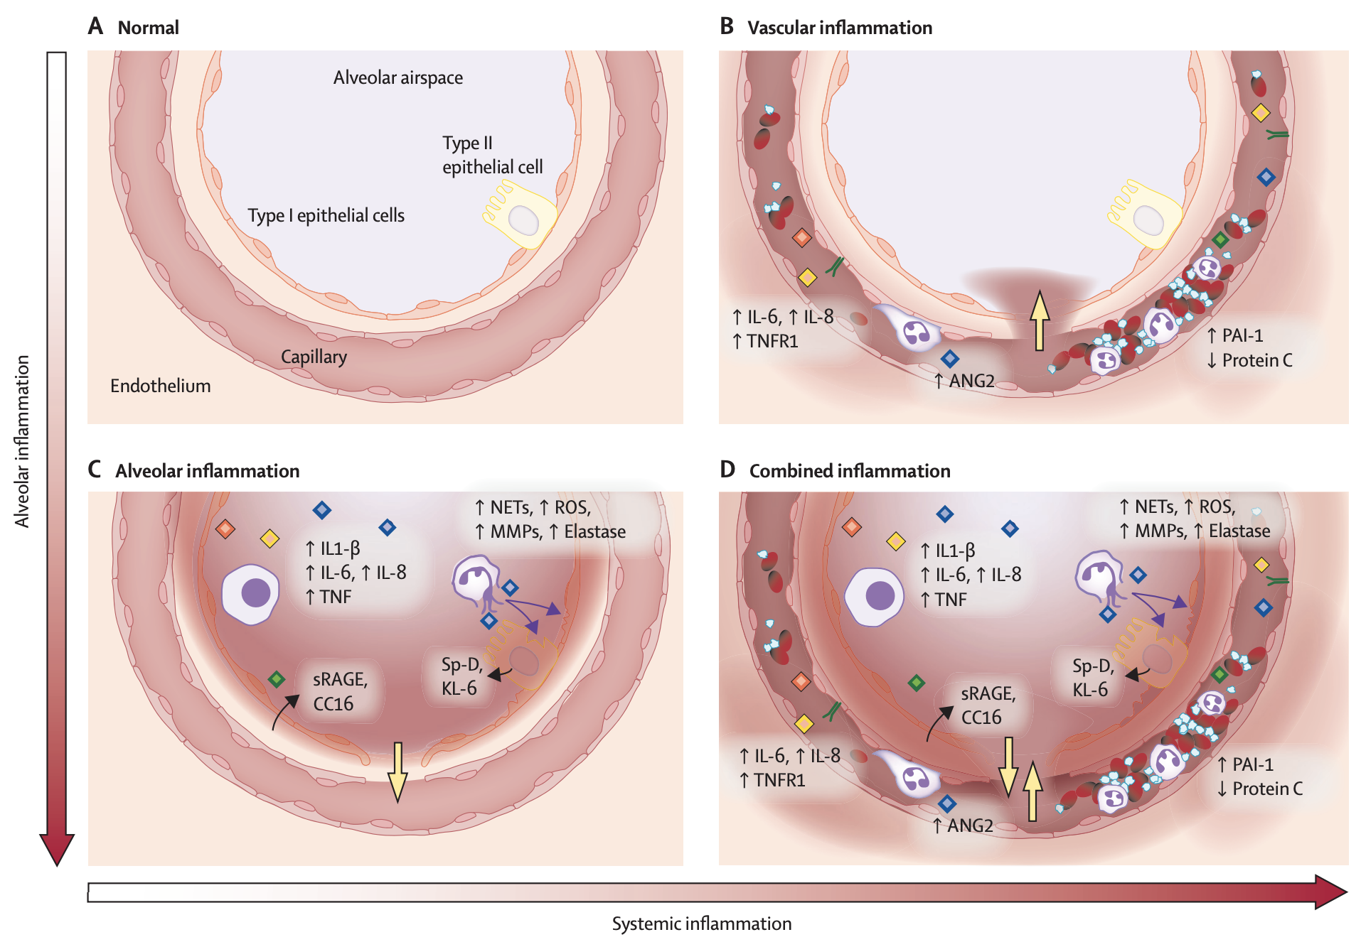
3. Meccanismi fisiopatologici condivisi
1. Bos, Lieuwe D J et al. Acute respiratory distress syndrome: causes, pathophysiology, and phenotypes. The Lancet 2022
2. Joshua A. Englert et al. Integrating molecular pathogenesis and clinical translation in sepsis-induced acute respiratory distress syndrome. JCI Insight 2019
Notes:
The normal alveolus, without inflammation or injury.
The changes observed in the hyperinflammatory subphenotype, which is characterised by systemic inflammation, endothelial dysfunction, and coagulation. Without alveolar inflammation, the injury caused by inflammation is driven from the systemic compartment towards the alveolar compartment (yellow arrow), resulting in increased permeability and alveolar oedema.
The changes in patients with alveolar hyperinflammation without a systemic hyperinflammatory subphenotype. Alveolar epithelial cells, alveolar macrophages, and neutrophils have a central role in proinflammatory cytokine production. Epithelial cells and macrophages are essential in production of proinflammatory molecules. Neutrophils produce various injurious molecules that damage type 1 and type 2 pneumocytes resulting in increased levels of pneumocyte injury markers. Without systemic inflammation, the injury caused by inflammation in this scenario is driven from the alveolar towards the systemic compartment (yellow arrow), also resulting in increased permeability and alveolar oedema.
The combined presence of systemic and alveolar hyperinflammation. Under these circumstances, inflammation induces lung injury, increased permeability, and alveolar oedema from both directions.
Although these panels illustrate the extreme situations, the severity of systemic and alveolar inflammation exists on a spectrum that probably varies considerably from patient to patient, contributing to heterogeneity.

Slide 15
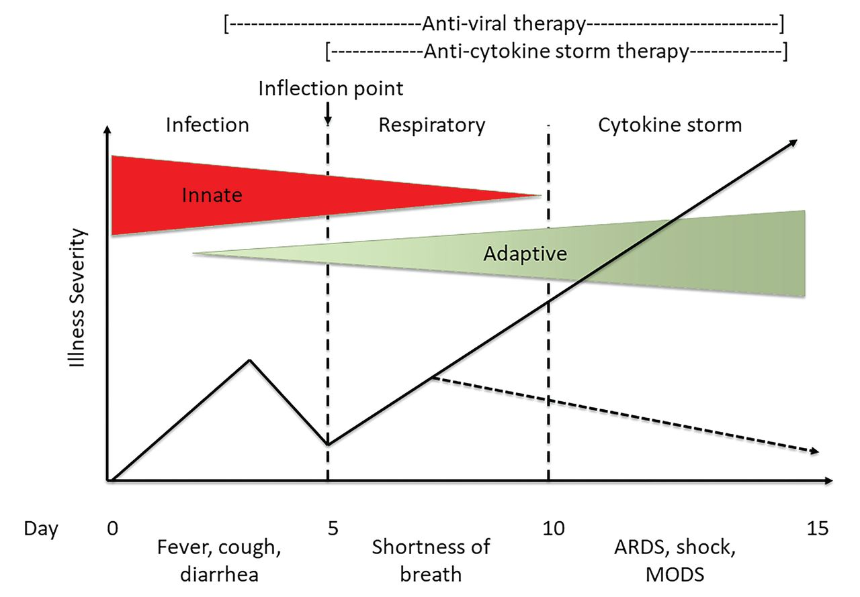

L’infiammazione come driver di danno
MOF
Antimicrobial therapy
Anti-cytokine storm therapy
Adapted from Chatham WW et al. The Journal of Rheumatology 2020

Slide 16
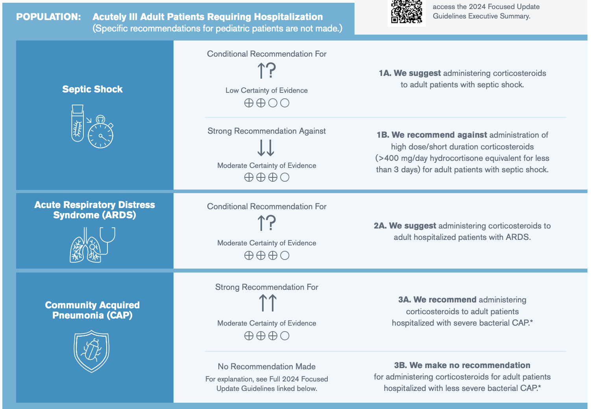
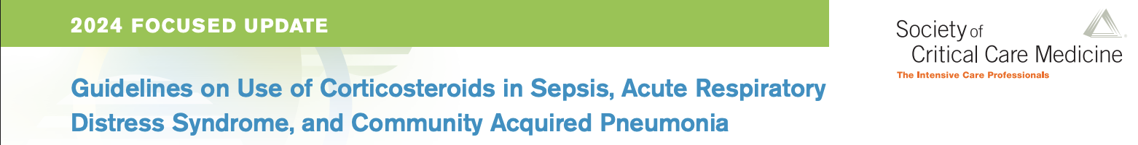
Glucocorticoidi in CAP/ARDS/shock settico
Notes:
Anti cytokine-storm

Slide 17
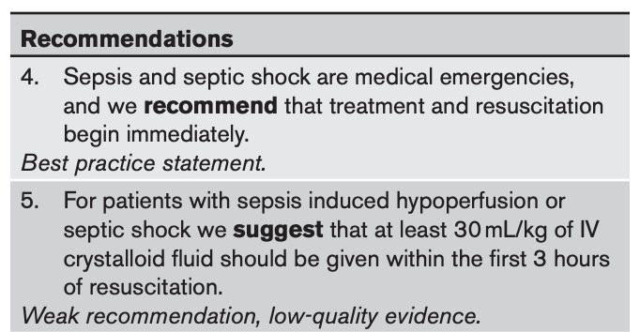
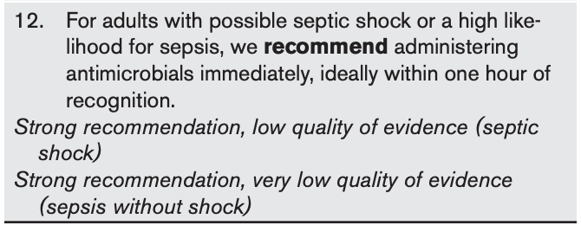

Sepsi e shock settico: prima è meglio
Sepsi e shock settico sono patologie tempo-dipendenti!
Each additional hour of time from ED arrival to administration of antimicrobials is associated with 1.04-1.19 increased odds of in-hospital mortality
Evans L. et al. Surviving Sepsis Campaign: International Guidelines for Management of Sepsis and Septic Shock 2021. Critical Care Medicine 2021
Notes:
In a study of 49,331 patients treated at 149 New York hospitals, each additional hour of time from ED arrival to administration of antimicrobials was associated with 1.04 increased odds of in-hospital mortality, p < 0.001 (1.07 (95% CI, 1.05−1.09) for patients receiving vasopressors vs. 1.01 (95% CI, 0.99−1.04) for patients not on vasopressors) (98). In a study of 35,000 patients treated at Kaiser Permanente Northern California, each additional hour of time from ER arrival to administration of antimicrobials was associated with 1.09 increased odds of in-hospital mortality (1.07 for patients with “severe” sepsis [lactate ≥ 2, at least one episode of hypotension, required noninvasive or invasive mechanical ventilation or has organ dysfunction] and 1.14 for patients with septic shock); which equated to a 0.4% absolute mortality increase for “severe” sepsis and a 1.8% absolute increase for septic shock (110). Finally, in a study of 10,811 patients treated in four Utah hospitals, each hour delay in time from ED arrival to administration of antimicrobials was associated with 1.16 increased odds of in-hospital and 1.10 increased odds of 1-year mortality (1.13 in patients with hypotension vs 1.09 in patients without hypotension) (111).

Slide 18
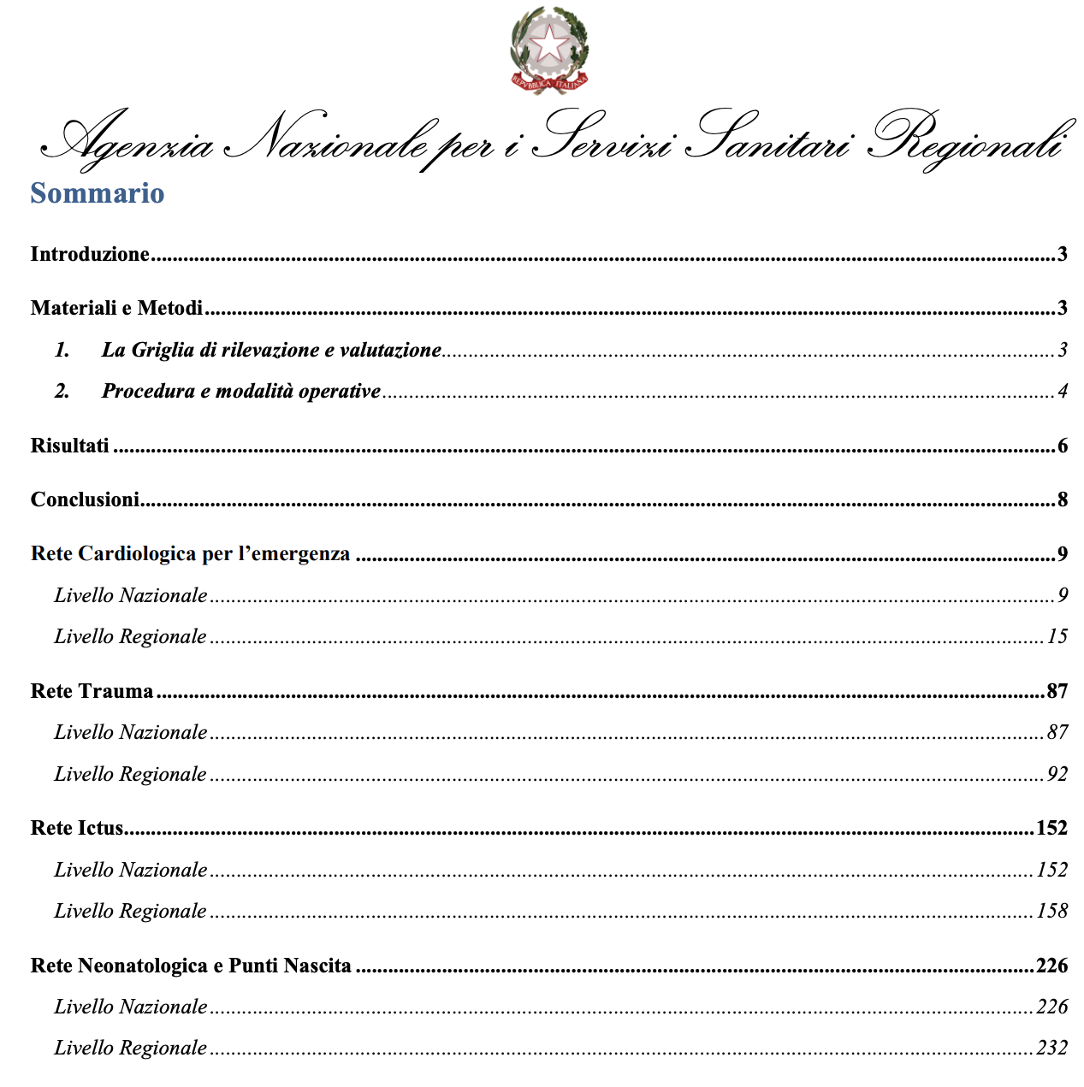

Patologie tempo-dipendenti (?)
Patologie che se non curate immediatamente portano il quadro clinico del paziente in una situazione che potrebbe essere irrecuperabile e di conseguenza alla morte o all'inabilità permanente.
Polmonite?
ARDS?
Sepsi?
Notes:
Per AGENAS non sono patologie tempo-dipendenti né polmoniti gravi, né sepsi, né ARDS

Slide 19
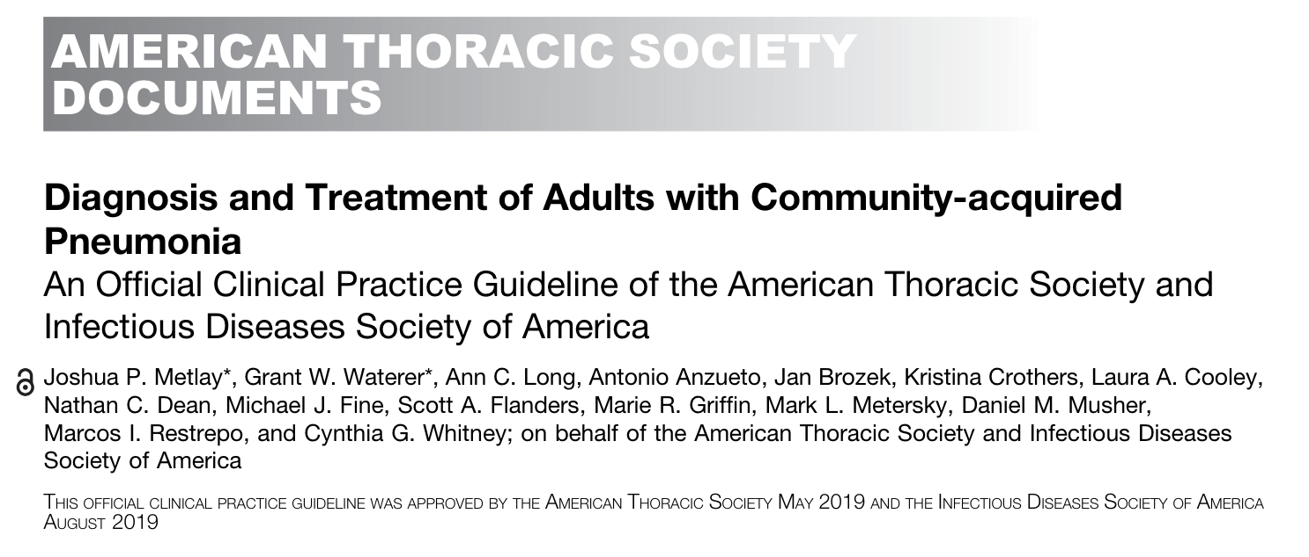
sCAP: stratificazione del rischio
«Severe CAP (sCAP) is accepted terminology used to describe ICU-admitted patients with CAP as they might require organ support»
Although historically site of care (outpatient, inpatient general ward, or ICU) has served as a severity surrogate, decisions about site of care may be based on considerations other than severity and can vary widely between hospitals and practice sites.
Notes:
Approximately 40% of patients with CAP will require hospitalisation, and 5% of these patients will be admitted to the intensive care unit (ICU), primarily due to shock or the need for invasive or non-invasive mechanical ventilation [2]. Severe CAP (sCAP) is accepted terminology used to describe ICU-admitted patients with CAP as they might require organ support. Data from a large cohort (CAPNETZ) have shown that the highest mortality is observed in patients who do not meet these criteria initially but deteriorate over the course of time (sCAP on admission: 17%; sCAP on day 4 to 7: 48%)

Slide 20
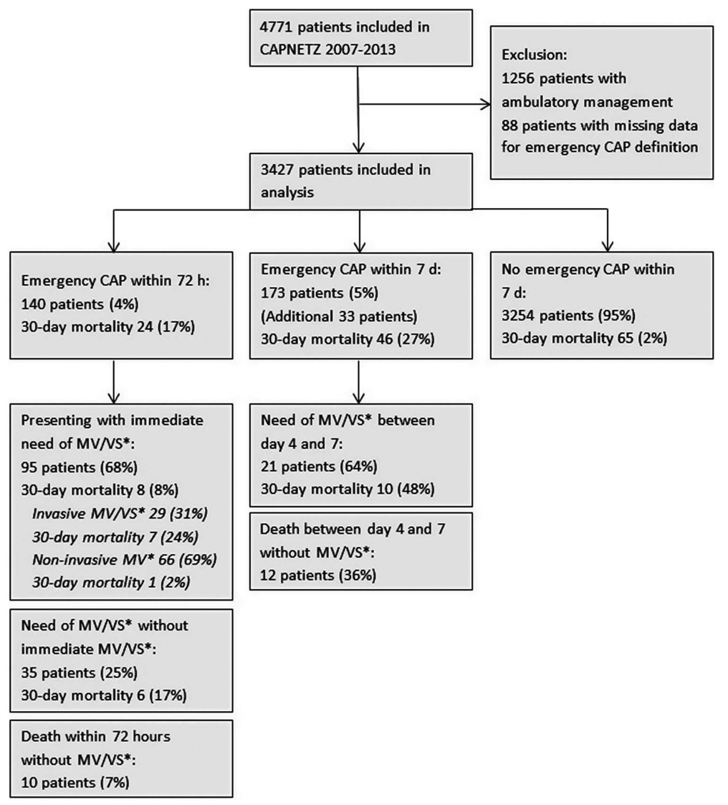

Perchè stratificare il rischio?
3427 hospitalized patients
Inclusion criteria:
Age ≥18 years
Pulmonary infiltrates
At least one of: fever, cough, sputum, focal chest signs on auscultation
Exclusion criteria:
Immune deficiency
Active TB
Nosocomial infection
Higher 30-day mortality is observed in patients who deteriorate over time:
Emergency CAP* on admission = 17%
Emergency CAP* on day 4 to 7 = 48%
▶︎ mis-triage” of patients with unrecognized severe pneumonia may lead to worse outcomes
*Emergency CAP =
IMV/NIV o vasopressori o morte
Kolditz M et al. Community-acquired pneumonia as medical emergency: predictors of early deterioration. Thorax 2015
Notes:
Data from a large cohort (CAPNETZ) have shown that the highest mortality is observed in patients who do not meet these criteria initially but deteriorate over the course of time (sCAP on admission: 17%; sCAP on day 4 to 7: 48%).
This may in part be attributable to progressive pneumonia, but “mis-triage” of patients with unrecognized severe pneumonia may be a contributing factor.
Rispetto a dati FulmisCAP: non criteri di gravità, non pandemia COVID-19.

Slide 21
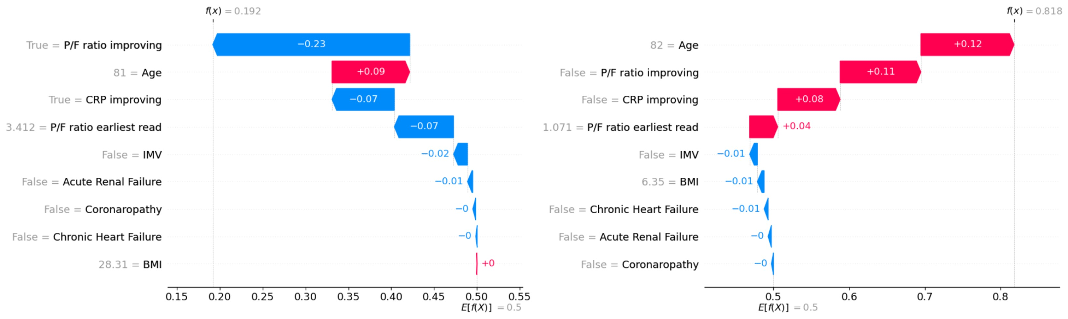
AI per la predizione dell’outcome
Paziente sopravvissuto
Paziente deceduto
Salton F et al., Int J Tuberc Lung Dis 2024
Notes:
Waterfall plots showing the SHAP values for all the features of two sample patients offer a local explanation of the model’s output, estimating the impact of each feature on the outcome predicted by the algorithm (RF). The color represents the sign of the SHAP contribution. Left Panel: Prediction for a survived patient; Right Panel: Prediction for a dead patient. The SHAP values attributed to the single features of the patients are sorted by the most influential factors for the individual prediction.

Slide 22
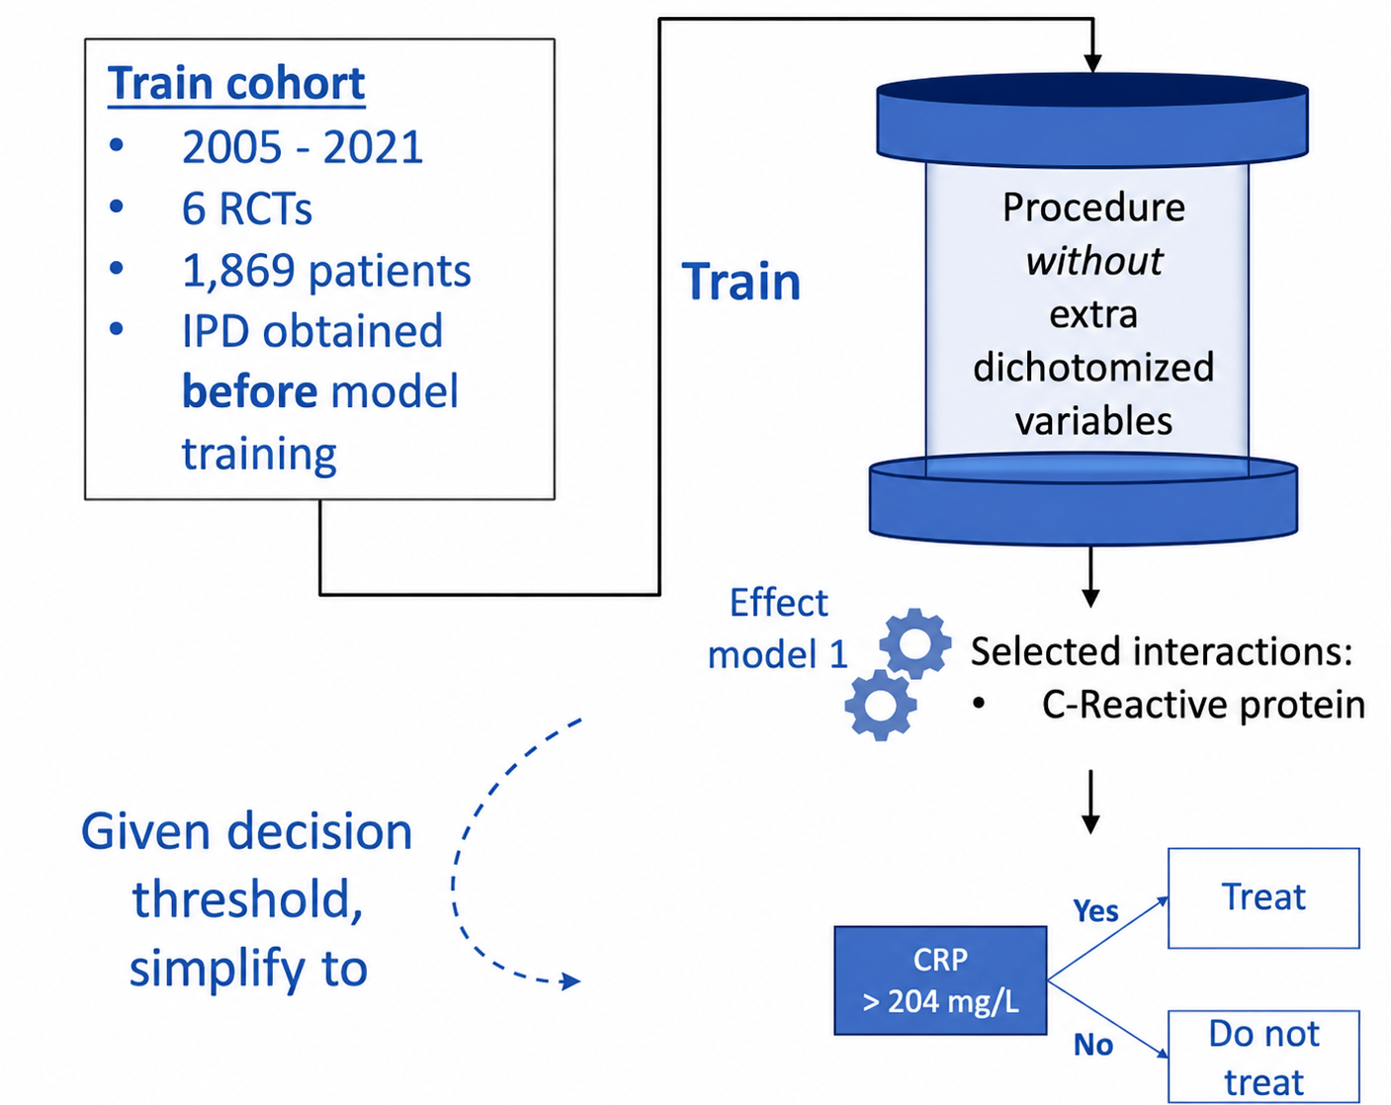
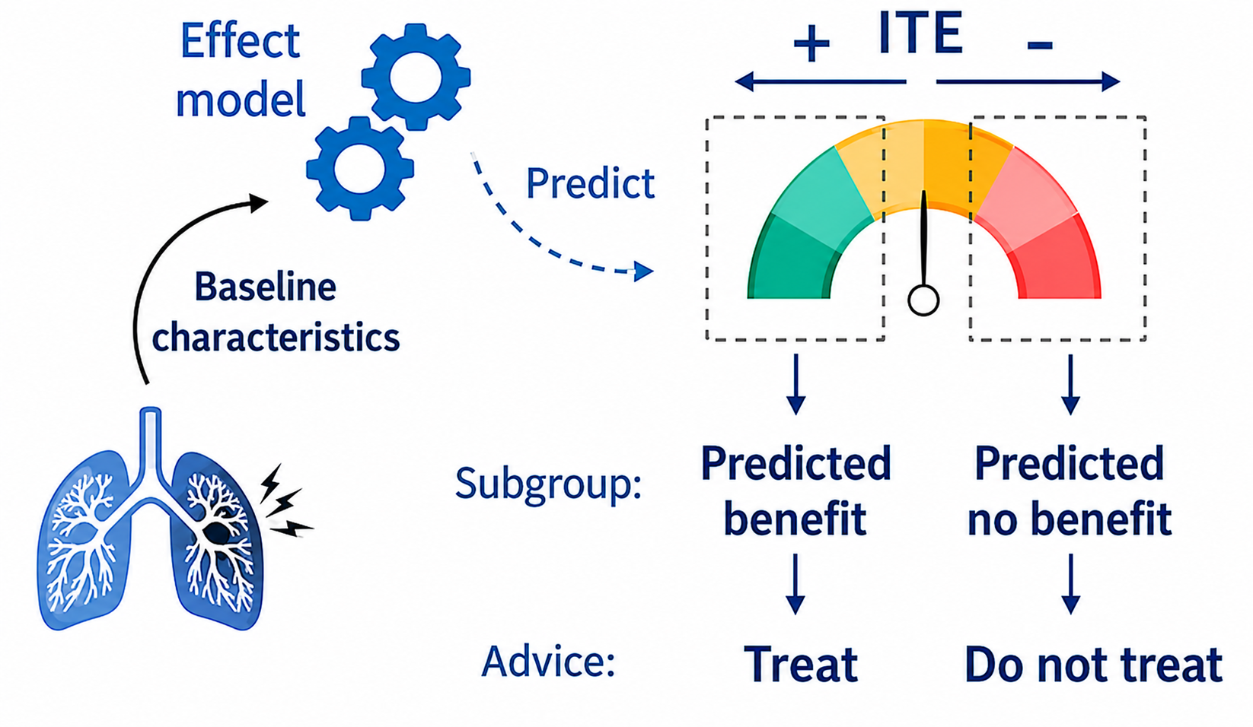

Actionable AI per l’ottimizzazione degli interventi
J.M. Smit, P.A. Van Der Zee, S.C.M. Stoof, M.E. Van Genderen, D. Snijders, W. G. Boersma, P. Confalonieri, F. Salton, M. Confalonieri et al. Lancet Respir Med 2025

Slide 23
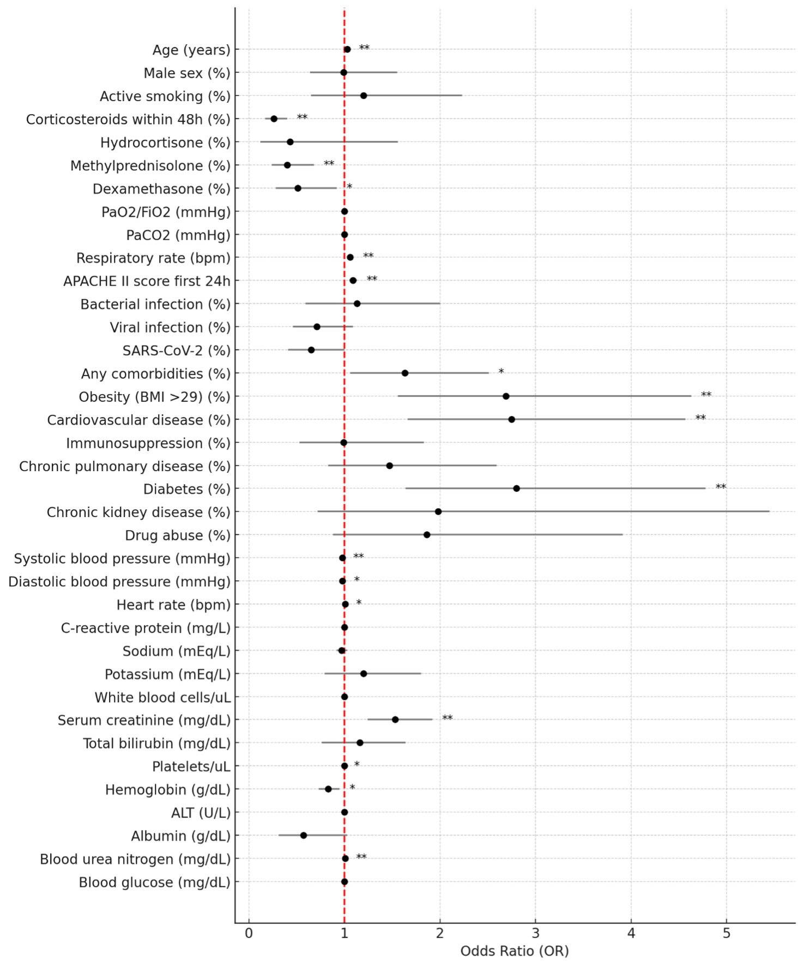
Fattori di rischio per polmonite fulminante
Population: 1517 hospitalized sCAP (ATS/IDSA 2007)
Risk factors: older age, obesity, diabetes, cardiovascular disease, chronic kidney disease
No association with SARS-CoV-2 infection
Glucocorticoids <48h are the strongest protective factor (OR 0.26, CI 95% 0.16-0.40, p<0.001)
93.4% had ARDS, 70.2% sepsis, and 72.7% MOF at the time of death
Salton F. et al. Existence and relevance of fulminant severe community-acquired pneumonia. Pneumonia. 2025

Slide 24

Le dimensioni del problema: what’s next?
Totale pazienti = 16.107
Ospedalizzati = 12.834
Non ospedalizzati = 3273
Deceduti entro 7 giorni dall’ospedalizzazione (qualsiasi gravità) = 262 (2.04%)
Deceduti entro 7 giorni da esordio sintomi (non ospedalizzati) = 3 (0.09%)
Salton F, CAPNETZ study team et al. Unpublished data

Slide 25
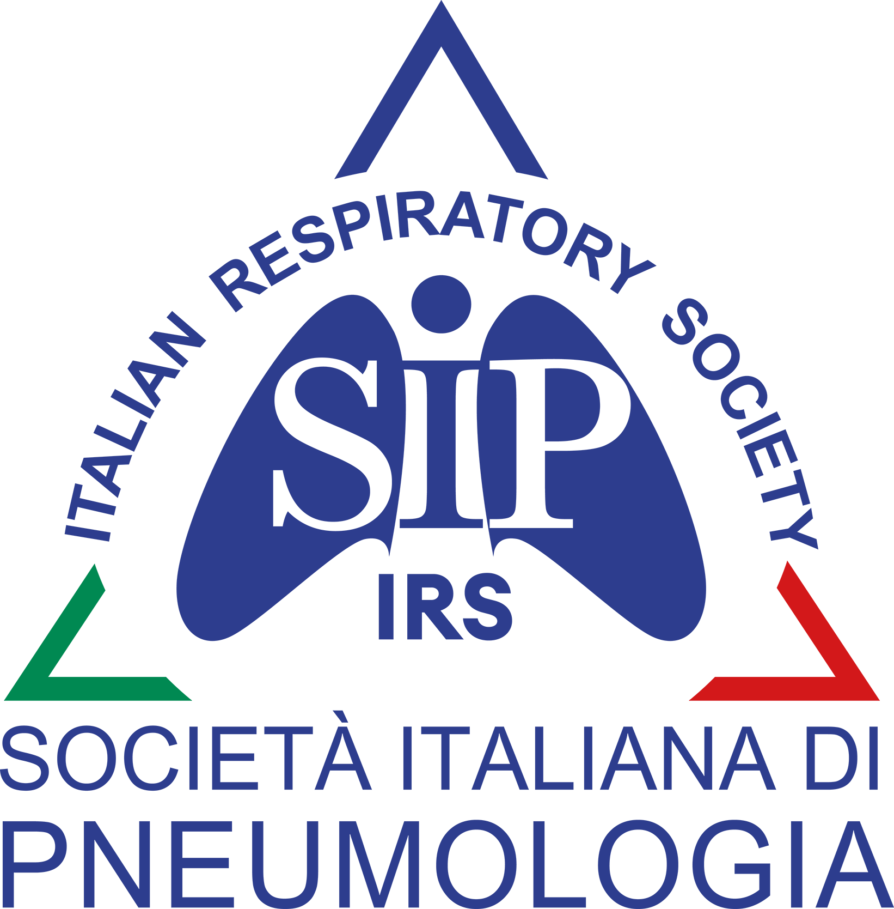

To be continued…

