Slide 1
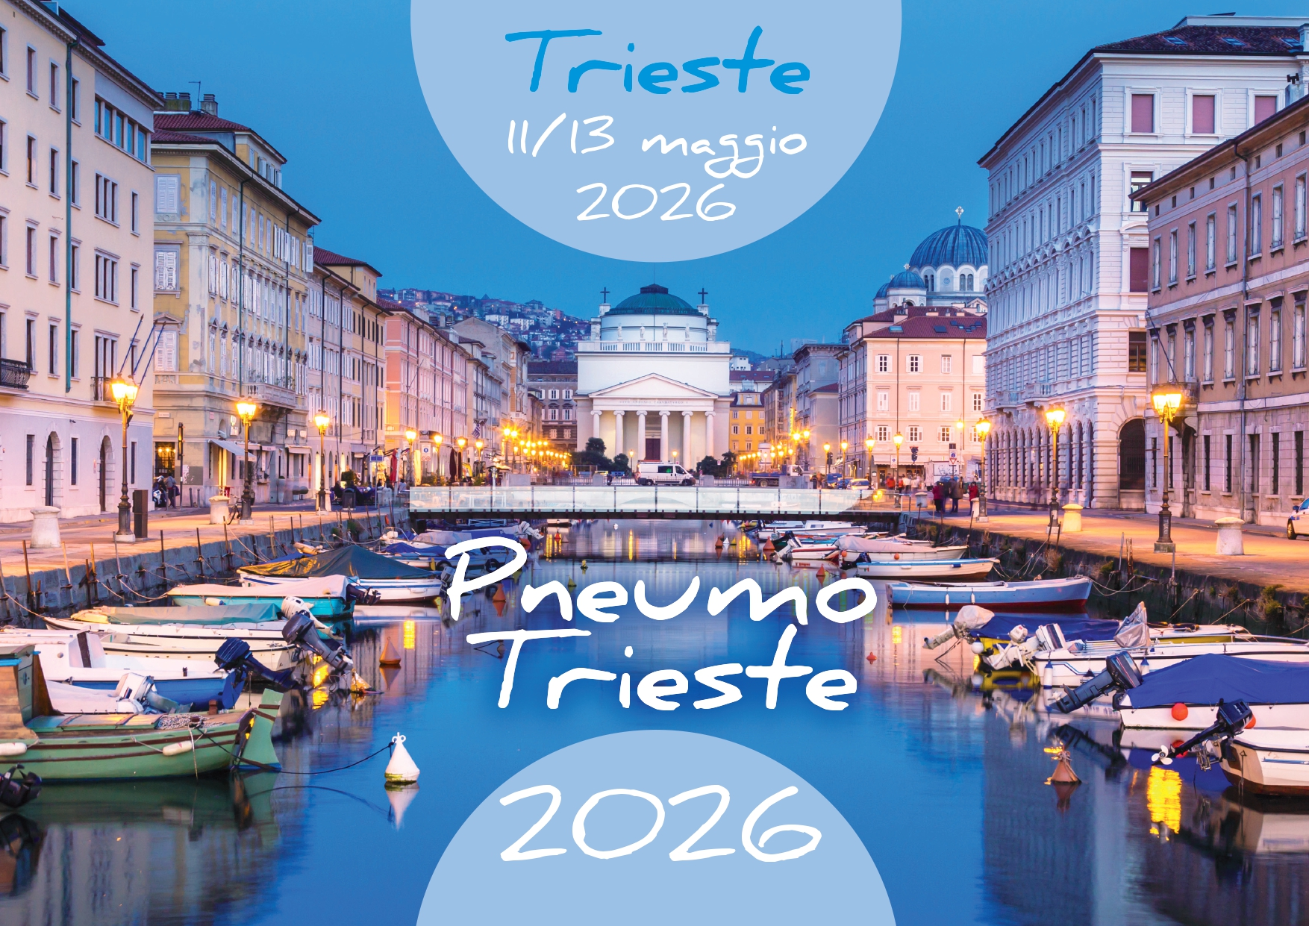
Diagnosis and Therapy of Pulmonary Complications of Systemic Sclerosis
Corrado Campochiaro, MD
Unit of Immunology, Rheumatology, Allergy and Rare Diseases
IRCCS San Raffaele Hospital Vita-Salute San Raffaele University

Slide 2
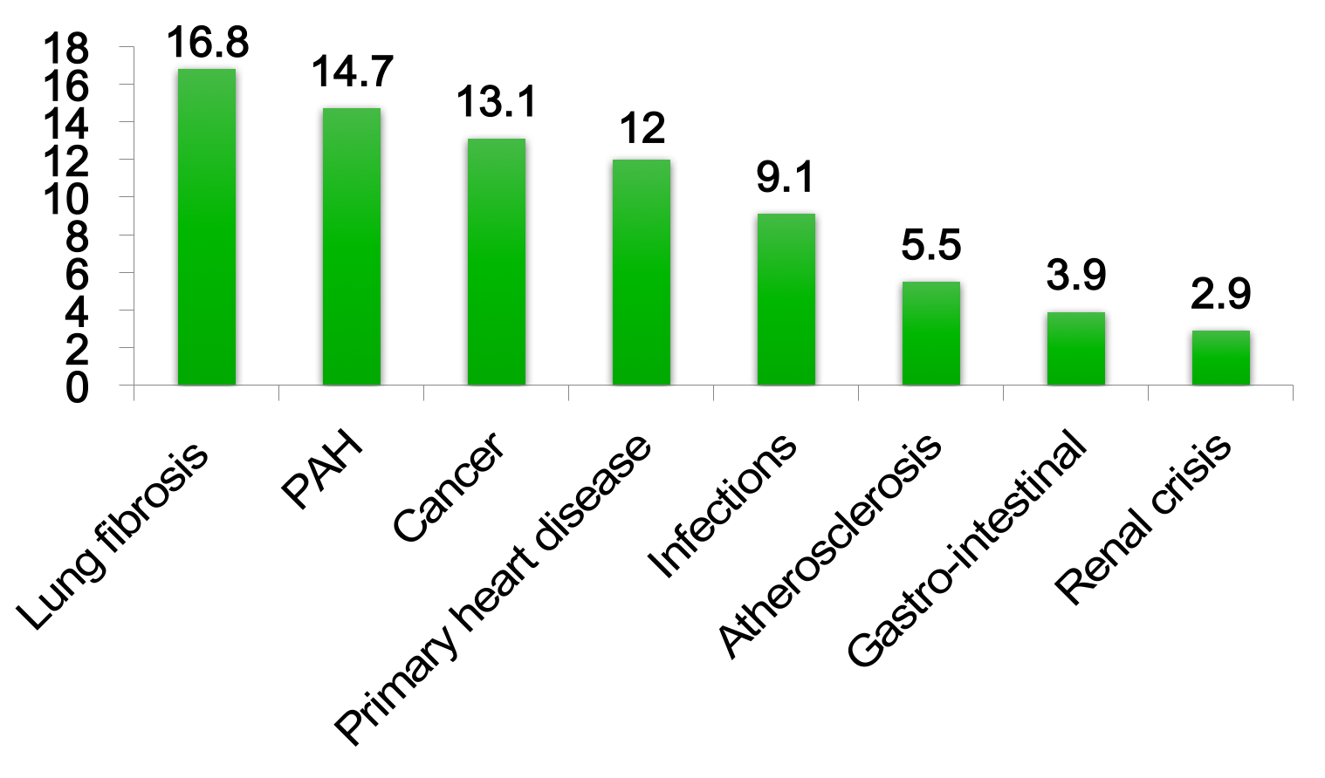
Why lung matters?
Causes of death from 1072 patients in EUSTAR
%
Elhai et al. Ann Rheum Dis. 2017;76:1897-1905

Slide 3
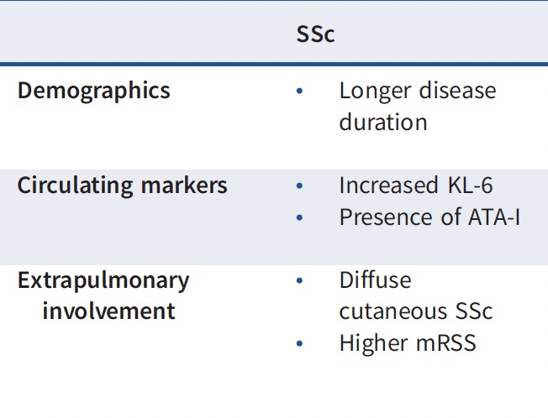
At risk population for ILD in SSc
Antoniou KM, Distler O, Gheorghiu A-M, et al. ERS/EULAR clinical practice guidelines for connective tissue disease-associated interstitial lung disease. Eur Respir J 2026; 67:2402533

Slide 4
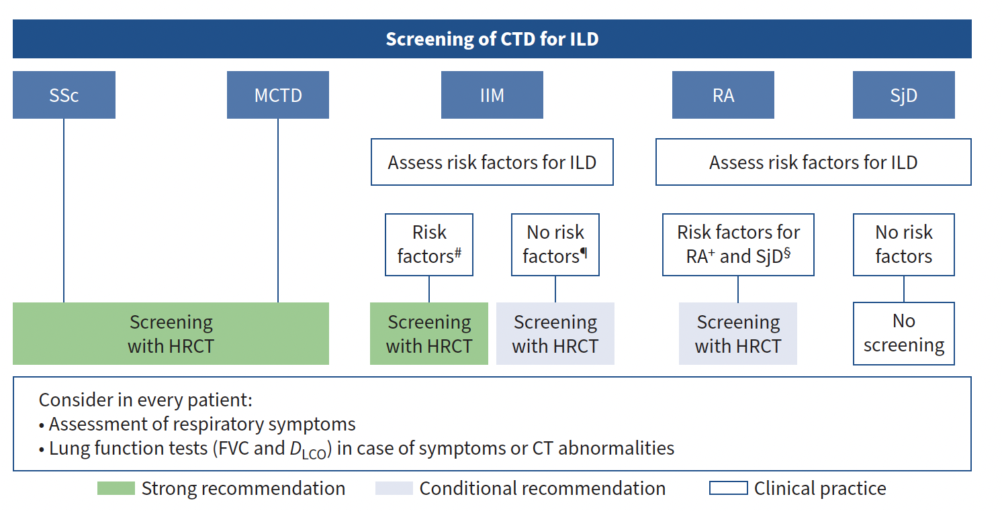
Screening of ILD in SSc
Antoniou KM, Distler O, Gheorghiu A-M, et al. ERS/EULAR clinical practice guidelines for connective tissue disease-associated interstitial lung disease. Eur Respir J 2026; 67:2402533

Slide 5
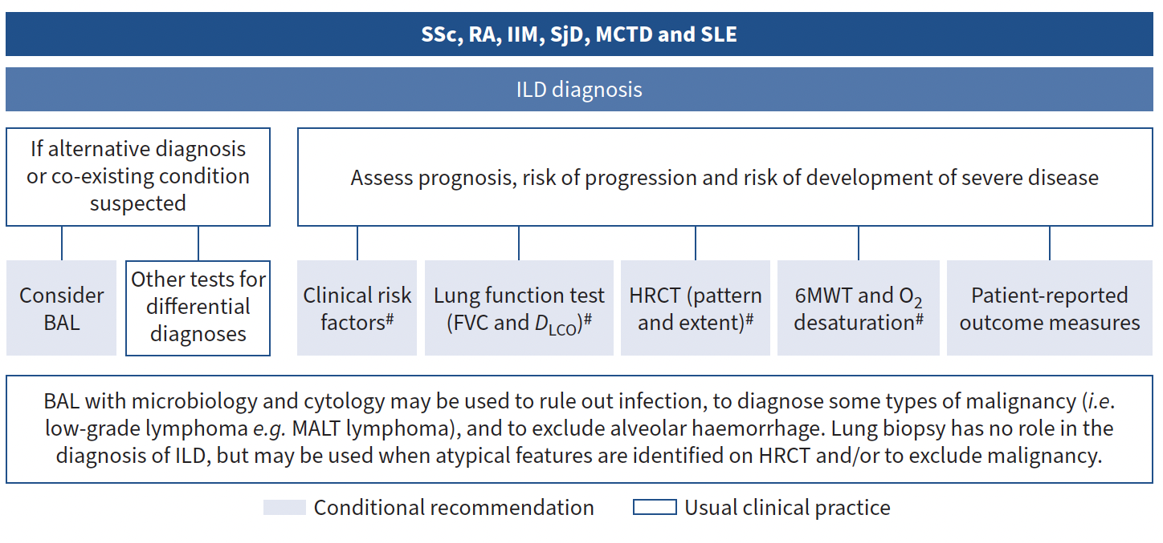
Work-up at Diagnosis of SSc-ILD

Slide 6
First thing First
Once we have diagnosed a patient with SSc-ILD
Where should we start? What should we assess?
Global Assessment
Disease Severity
Risk of progression
Antoniou KM, Distler O, Gheorghiu A-M, et al. ERS/EULAR clinical practice guidelines for connective tissue disease-associated interstitial lung disease. Eur Respir J 2026; 67:2402533

Slide 7
Global Assessment
High-resolution Chest Tomography (HRCT)
Pulmonary Function Tests (FVC and DLCO)
Skin Involvement (extent and progression)
Markers of inflammation (CRP and/or ESR)
Antoniou KM, Distler O, Gheorghiu A-M, et al. ERS/EULAR clinical practice guidelines for connective tissue disease-associated interstitial lung disease. Eur Respir J 2026; 67:2402533

Slide 8
Risk Factors for poor outcome
Demographics
  Older Age
  Male Sex
  African American Ethnicity
Circulating markers
  Elevated ESR, CRP
  Anti-topoisomerase I positivity
Pulmonary Function
  Baseline FVC and DLCO
  6MWT (low)
Imaging
  Higher extent of ILD on HRCT
Extrapulmonary Involvement
  Recent onset of SSc
  Rapid skin progression
  Higher mRSS
PROs
Still low evidence
Antoniou KM, Distler O, Gheorghiu A-M, et al. ERS/EULAR clinical practice guidelines for connective tissue disease-associated interstitial lung disease. Eur Respir J 2026; 67:2402533

Slide 9
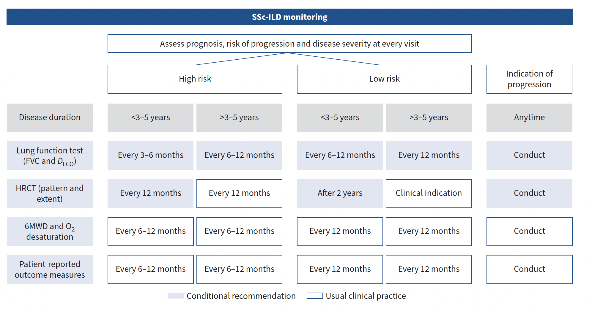
Monitoring

Slide 10
Why do we treat SSc-ILD patients? What are our aims?
Prevent disease progression
Improve symptoms
Improve QoL
Improve survival

Slide 11
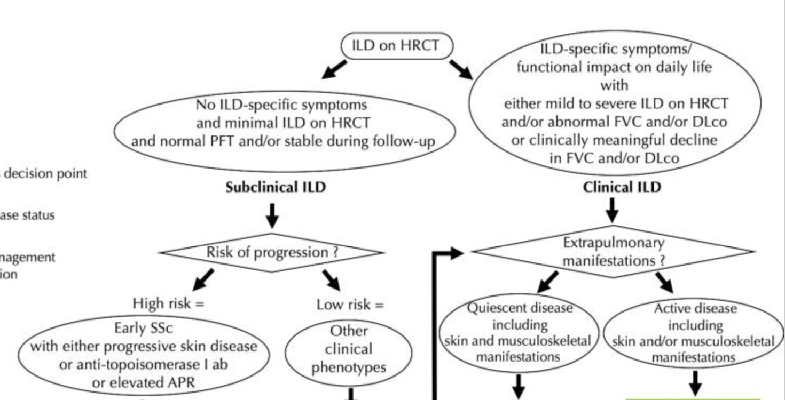
Who to treat
Khanna D, Lescoat A et al. SYSTEMIC SCLEROSIS-ASSOCIATED INTERSTITIAL LUNG DISEASE. Arthritis Rheumatol. 2021 Nov 10;74(1):13–27.

Slide 12
Approach to Treatment
Multidisciplinary discussions between pulmonologists and rheumatologists
Reimbursement, availability and patient preferences need to be considered
No head-to-head clinical trials are present
Inclusion criteria of the trials may be applied to choose the right therapeutic agent for the individual patient
Choice of therapy should consider extrapulmonary organ manifestations
Early and/or aggressive treatment for patients at risk of progressive or at risk of developing severe ILD

Slide 13
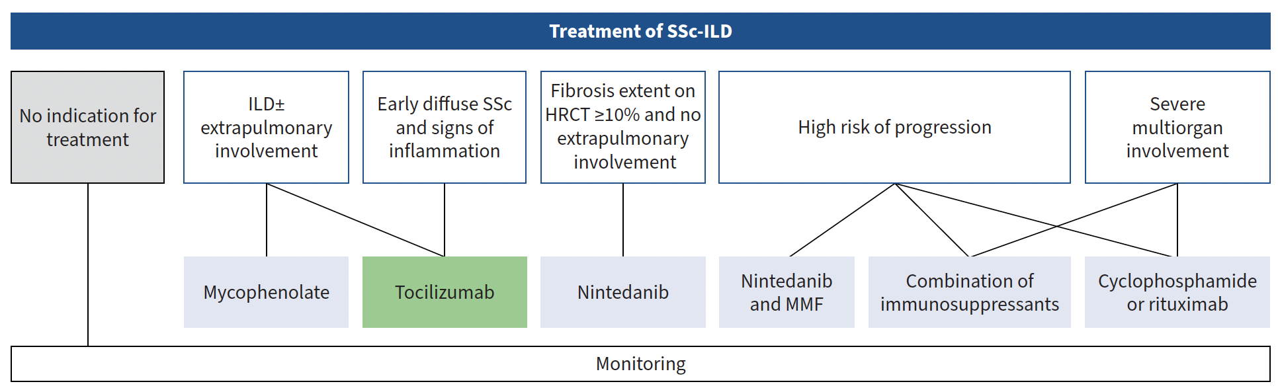
How To Treat
Antoniou KM, Distler O, Gheorghiu A-M, et al. ERS/EULAR clinical practice guidelines for connective tissue disease-associated interstitial lung disease. Eur Respir J 2026; 67:2402533

Slide 14
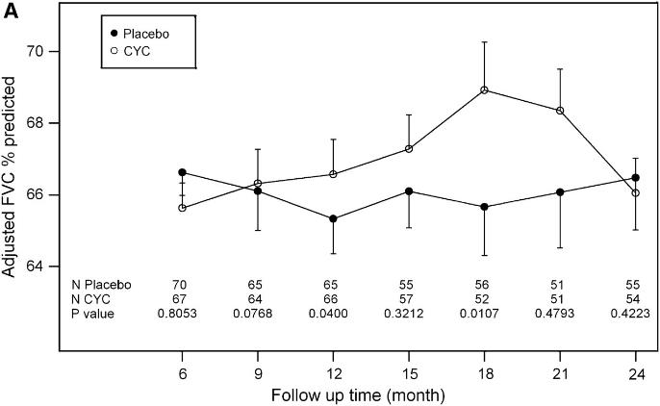
The efficacy of cyclophosphamide in SSc-ILD was shown in 2006
24 month follow-up data suggest maximum treatment effect on FVC at 18 months then benefit diminishes but improved dyspnoea score remains
  ¹Tashkin et al NEJM 2006
  ²Tashkin et al Am J Respir Crit Care Med 2007

Slide 15
Cyclophosphamide
Improvement or stabilisation of %pFVC
Improvement in the extent of ILD on imaging
Improvement of breathlessness and cough
Improvement in QoL
Benefit on skin
Concerns about side-effects and the limited treatment duration due to cumulative toxicity
Conditional recommendation, low certainty of evidence

Slide 16
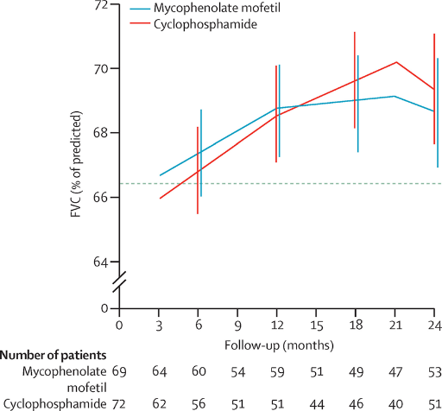
The efficacy of MMF in SSc-ILD was shown in 2016
2 years of MMF at a target dose of 1.500 mg twice daily or with 1 year of oral CYC In both arms improvement in LFTs
MMF extremely better tolerated then CYC (fewer haematological adverse events)
  Tashkin DP, et al. . Lancet Respir Med. 2016 Jul 25. pii: S2213-2600(16)30152-7

Slide 17
Mycophenolate Mofetil
Improvement or stabilisation of %pFVC
Improvement or stabilisation of ILD on HRCT
Improvement of breathlessness
Improvement of cough
Improvement of QoL
Improvement in skin scores
Manageable side-effects
The recommendation is conditional based on the very low certainty of evidence due to risk of bias and imprecision and the lack of data on other important outcomes.

Slide 18
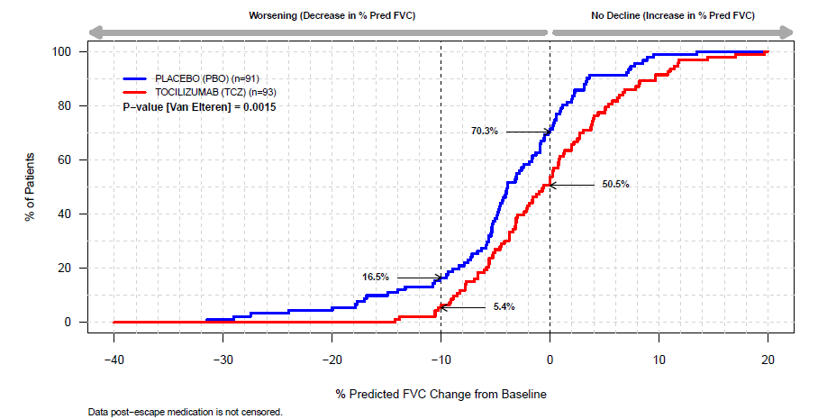
The efficacy of Tocilizumab in SSc-ILD was shown in 2020
Worsening (decrease in %pFVC relative to baseline)
No decline (increase in %pFVC relative to baseline)
Nominal p value (Van Elteren) = 0.0015
%pFVC | PBO n=106 | TCZ n=104 | Difference (95% CI); nominal p value
LSM change from BL at week 48 | -4.6 | -0.4 | 4.2 (2.0, 6.4); p = 0.0002
  Pulmonary function was preserved during 48 weeks of TCZ treatment compared with PBO. Proportion of patients with FVC decline >10% was lower with TCZ treatment compared with PBO
  Khanna D et al. Lancet Respir Med 2020 Tocilizumab in systemic sclerosis: a randomised, double-blind, placebo-controlled, phase 3 trial

Slide 19
Tocilizumab
SSc-ILD
  Early diffuse cutaneous SSc
  Elevated inflammatory markers
  Recent progression of skin fibrosis
Stabilization in FVC
Improvement of extrapulmonary manifestations
  Skin fibrosis
  Fatigue
Tolerable side-effect profile
In population with a high probability for severe and rapidly progressing ILD
Strong Recommendation

Slide 20
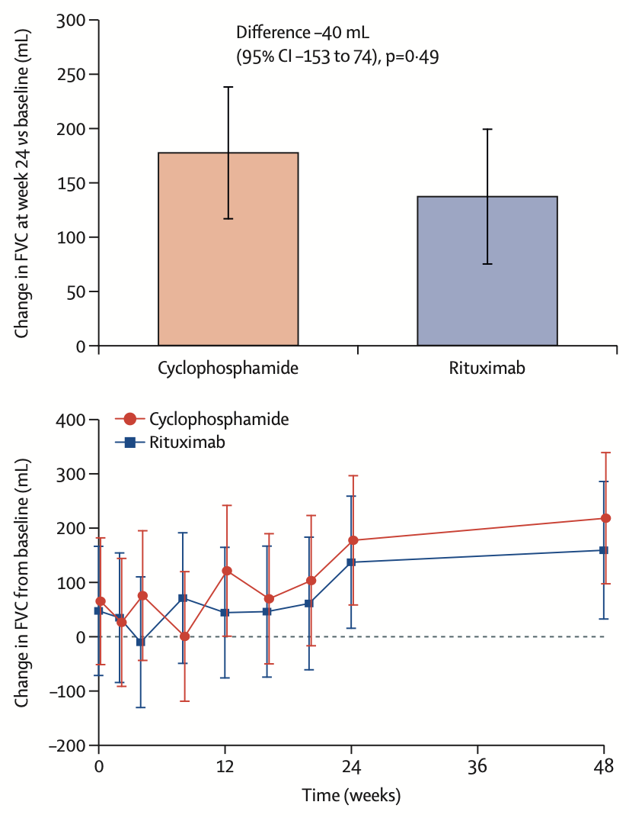
RTX versus CTX in 2023
CYC versus RTX in patients with ILD
RTX not superior to CYC
In both groups
  Increased FVC at 24 weeks
  Clinically important improvements in PROs
  RTX fewer adverse events
Maher TM et al. Rituximab versus intravenous cyclophosphamide in patients with connective tissue disease-associated interstitial lung disease in the UK (RECITAL): a double-blind, double-dummy, randomised, controlled, phase 2b trial. Lancet Respir Med 2023

Slide 21
Rituximab
Improvement or stabilisation of %pFVC
Treatment efficacy on skin
  Cumulative indirect evidence from other studies
Manageable side-effects
Conditional recommendation, very low certainty of evidence

Slide 22
The efficacy of Nintedanib in SSc-ILD has been shown in 2019
Annual rate of decline in FVC (mL/yr) (primary endpoint)
Change from baseline in FVC (mL) over 52 weeks
Adjusted annual rate (SE) of decline in FVC (mL/yr)
Mean (SE) absolute change from baseline in FVC (mL)
Difference: 41.0 mL/yr
(95% CI: 2.9, 79.0); p=0.04
Relative reduction: 44%
Week
Primary endpoint analyzed using random coefficient regression model (with random slopes and intercepts) including ATA status, age, height, gender and baseline FVC (mL) as covariates
  Distler O et al. N Engl J Med. 2019

Slide 23
Nintedanib
In SSc-ILD with >10% fibrosis extent
  reduces FVC decline
Effective only in FVC, but not on extrapulmonary organ involvement, other pulmonary outcomes, QoL and symptom burden.
Conditional recommendation, moderate certainty of evidence

Slide 24
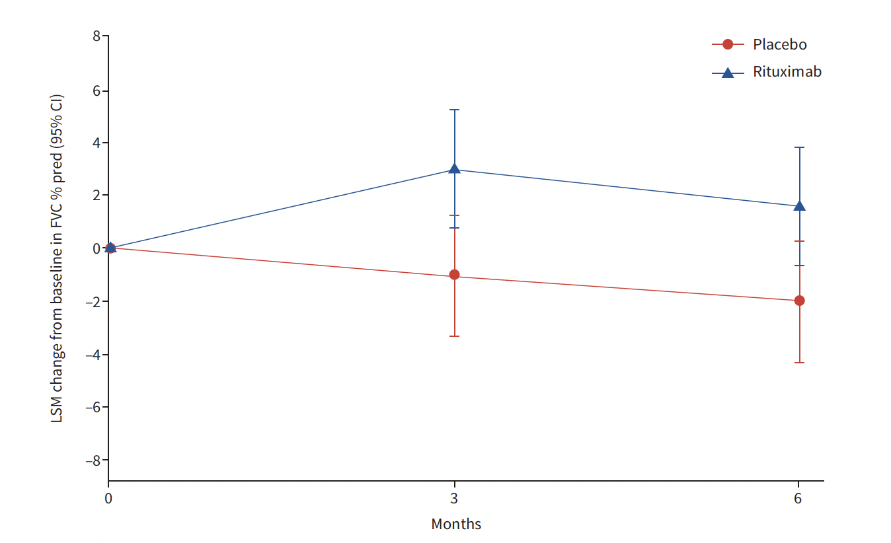
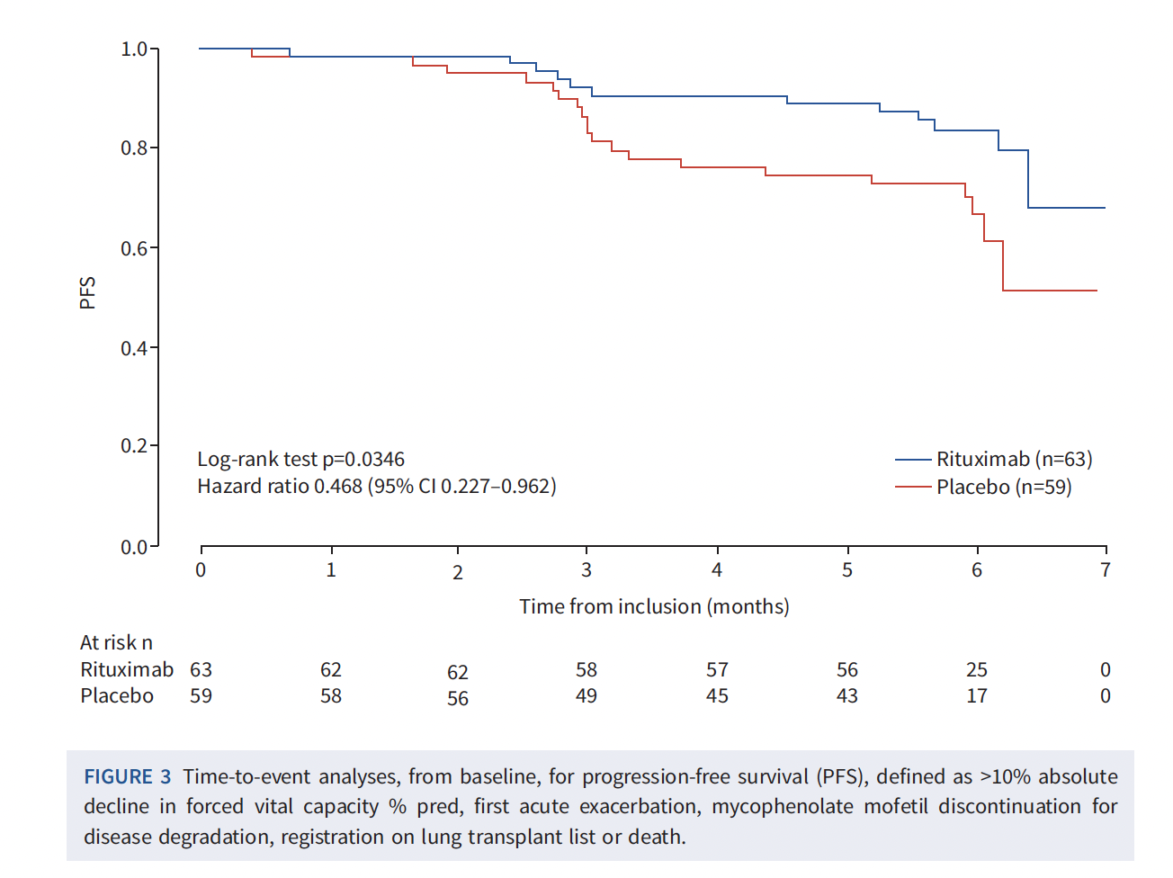
RTX + MMF (EVER-ILD) in 2023
Population
CTD-associated ILD
NSIP pattern (by pathology or HRCT)
Rituximab 1000 mg (day 1 and 15) vs placebo
Background MMF 2 g/day for 6 months
Results
Least-squares mean change from baseline to 6 months in %pFVC +1.60 in the RTX+MMF group versus −2.01 in the placebo+MMF group (p=0.0273)
PFS was better in the RTX+ MMF group (crude hazard ratio 0.47, 95% CI 0.23–0.96; p=0.03)
Mankikian J al. EUROPEAN RESPIRATORY JOURNAL 2022

Slide 25
Combination Therapy
MMF + NTD, supported by SENSCIS
  No increased harm compared to monotherapy
  Conditional recommendation, low certainty of evidence
Other combinations of immunosuppressants or, in the presence of progressive pulmonary fibrosis, with a combination of an immunosuppressant and nintedanib
  Conditional recommendation, very low certainty of evidence

Slide 26
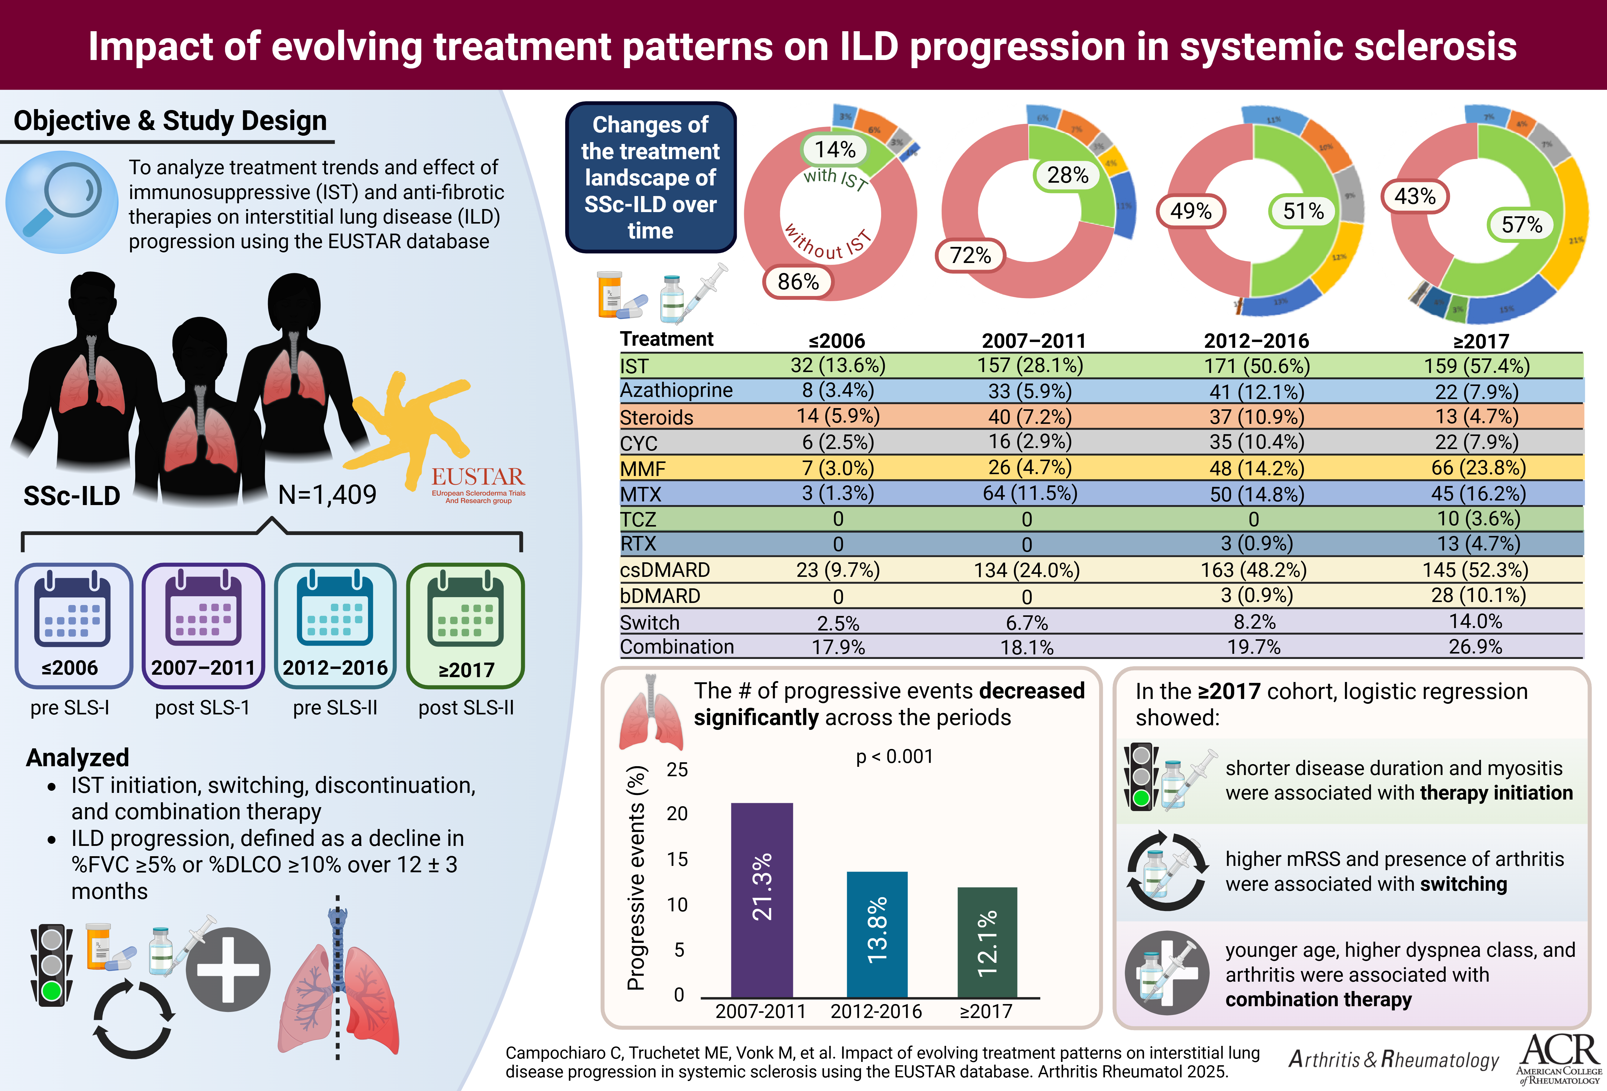
Real-World Evidence

Slide 27
14% of patients with SSc-ILD were treated with IST before 2006

Slide 28
28% of patients with SSc-ILD were treated with IST in 2007-2011

Slide 29
51% of patients with SSc-ILD were treated with IST in 2012-2016

Slide 30
The number of patients on ISTs changed significantly from 14 % to 57%

Slide 31
Specific Treatments
MMF increased from 7% in the ≤2006 cohort to 57% in the ≥2017 cohort (p <0.001)
CYC decreased from 67.5% in the ≤2006 cohort to 43% in the ≥2017 cohort (p <0.001)
Azathioprine decreased from 14% in the ≤2006 to 8% in the ≥2017 cohort (p <0.001)
Among csDMARDs: MMF most common
Among bDMARDs: RTX most common
Switching therapies increased from 2.5% to14% in the ≥2017 cohort (p <0.001)
Combination treatments increased from 17.9% to 26.9% in the ≥2017 cohort (p<0.001)

Slide 32
MMF-Based Regimens
NTD
(139)
TCZ
(122)
MMF
(377)
RTX
(257)
14
12
24
(6.4%)
61
(16%)
6
(1.6%)
37
(9.8%)
143
(38%)
Monotherapy: 166 (44%) treatment courses Combination:
Rituximab in 143 (38%)
Nintedanib in 61 (16%)
Tocilizumab in 37 (10%)
Triple Combination in 24 (6.4%)

Slide 33
NTD
(139)
TCZ
(122)
MTX
(186)
RTX
(257)
MTX-Based Regimens
14
8
(4.3%)
12
11
(5.9%)
45
(24%)
ABT
4 (3.5%)
40
(21.5%)
Monotherapy: 86 (46%) treatment courses
Combination:
Tocilizumab 45 (24%)
Rituximab 40 (21.5%)
Nintedanib 11 (5.9%)
Triple combination 8 (4.3%)

Slide 34
RTX-Based Regimens
NTD
(139)
MTX
(186)
MMF
(377)
AZA
(98)
RTX
(257)
61
24
(9.3%)
11
14
(5.4%)
8
(3.1%)
40
(15.6%)
143
(55.6%)
Monotherapy: 50 (19%) treatment courses
Combination:
MMF in 143 (56%)
MTX in 40 (16%)
NTD in 24 (9%)
Triple combination 32 (12%)
10
(3.9%)

Slide 35
TCZ-Based Regimens
NTD
(139)
MTX
(186)
MMF
(377)
AZA
(98)
TCZ
(122)
61
24
(9.3%)
12
(9.8%)
11
37
(30.3%)
45
(36.9%)
Monotherapy: 22 (18%) treatment courses Combination:
MTX in 45 (37%)
MMF in 37 (30%
NTD in 12 (10%)
Triple combination in 24 (9%)
6
(4.9%)

Slide 36
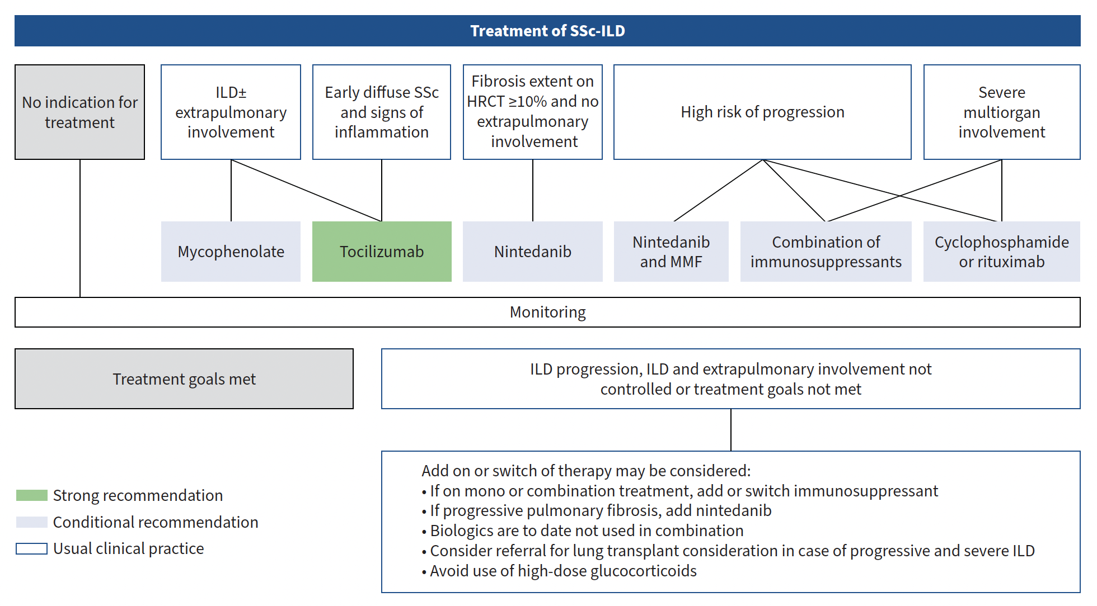
How To Treat

Slide 37
FIBRONEER-ILD: the primary endpoint (change in FVC [mL] at Week 52) was met for both doses of nerandomilast
43.7% of patients received background nintedanib
–84.6 mL
–98.6 mL
–165.8 mL
Difference: 81.1 mL
(95% CI: 46.0, 116.3); P<0.001
Relative reduction: 49%
Difference: 67.2 mL
(95% CI: 31.9, 102.5); P<0.001
Relative reduction: 41%
Maher TM et al. N Engl J Med 2025;392:2203–14

Slide 38
SSc-ILD in 2026
Treatment of SSc-ILD has dramatically changed over the past few years with new drugs now available
These are exciting times and precision medicine might better redefine WHO, WHAT and WHEN
An increasing number of SSc-ILD patients is currently started on IST/anti-fibrotic and combination therapies are frequently used

Slide 39

Thank you
San Raffaele Scleroderma Unit
Prof. Marco Matucci-Cerinic
Dr. Giacomo De Luca
Dr. Claudia Iannone
San Raffaele Radiology Department
Prof. Anna Palmisano
Prof. Antonio Esposito
EUSTAR
SCTC
World Sclederma Foundation
International Collaborations
Prof. Yannick Allanore
Prof. Anna-Maria Hoffmann-Vold

