Slide 1


Sarcoidosis - novel therapeutic strategies for patient benefit
Prof Elena Bargagli
Siena University

Slide 2
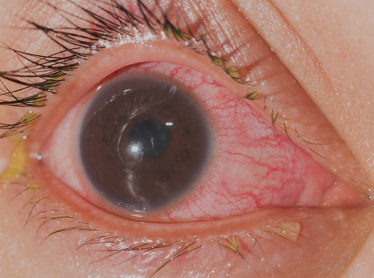
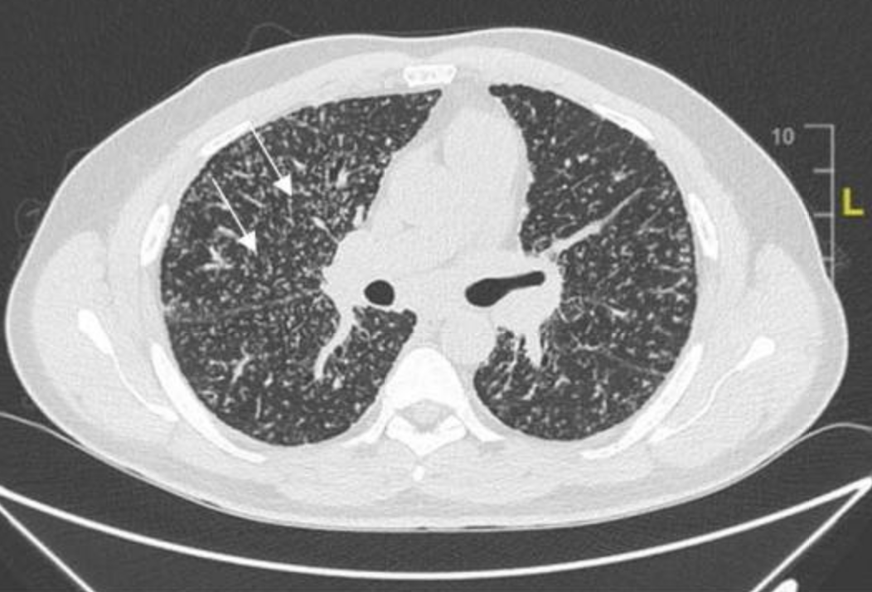
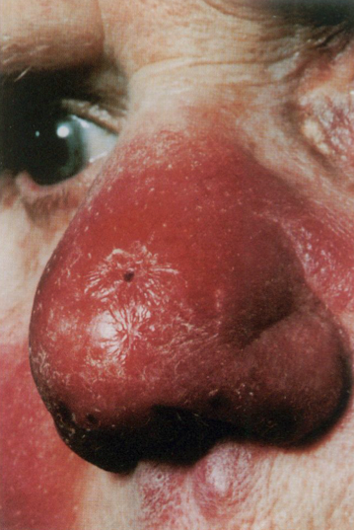
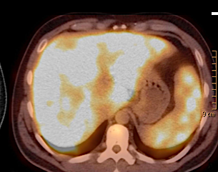
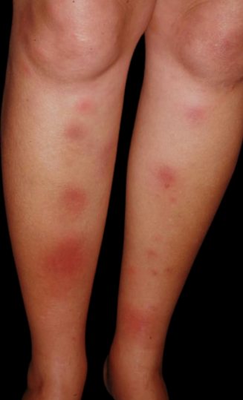
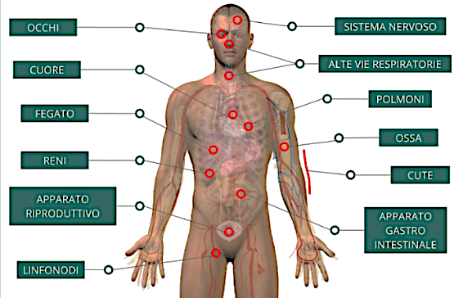

SARCOIDOSIS

Slide 3
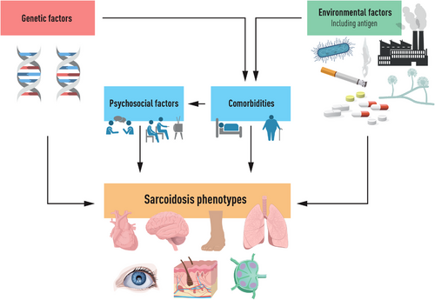

Slide 4


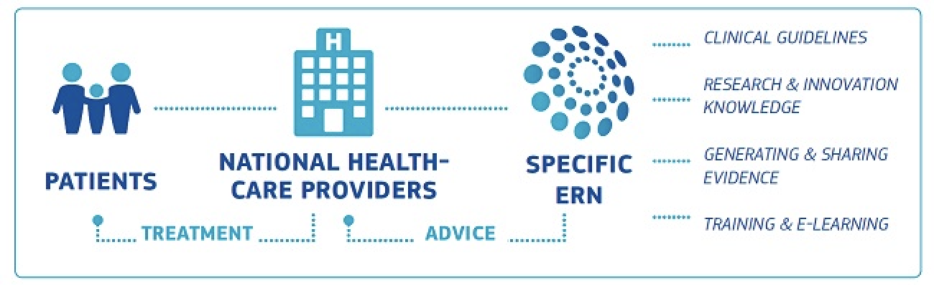
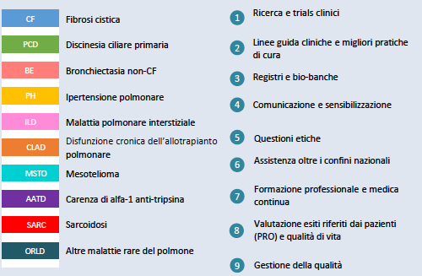
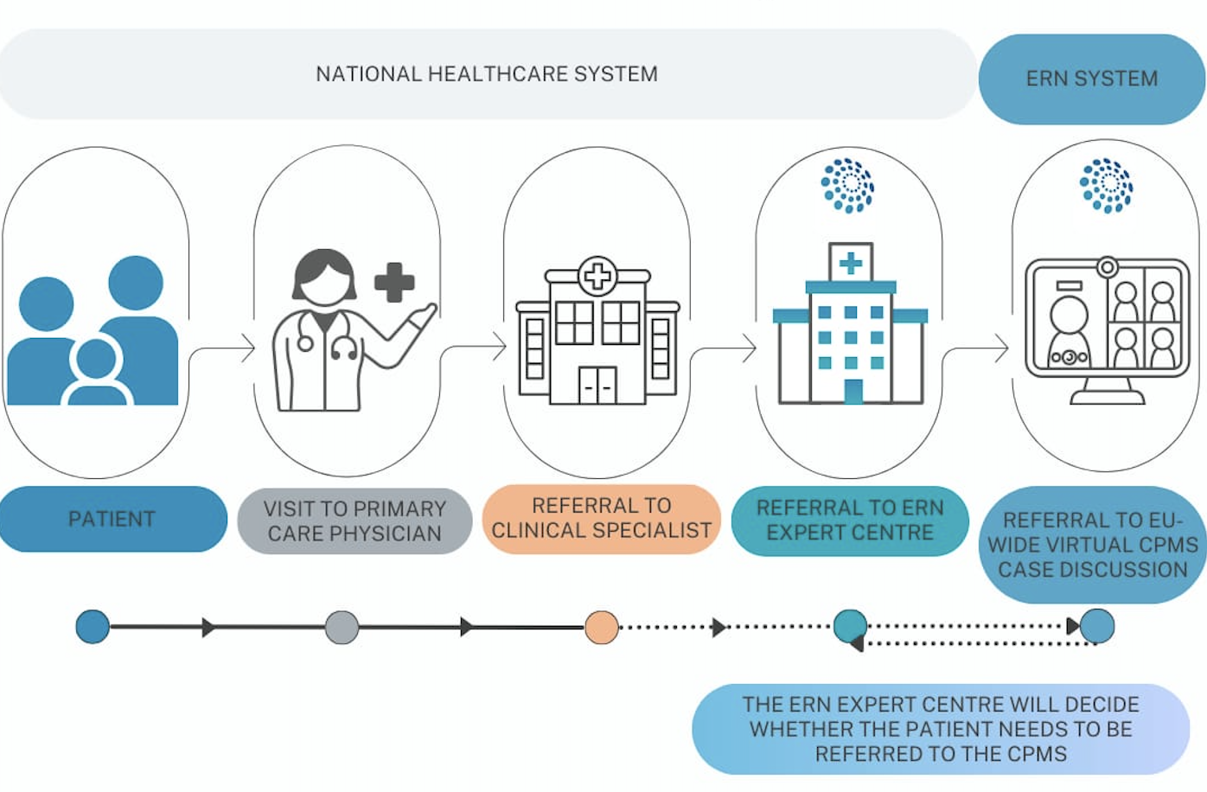
EUROPEAN REFERENCE NETWORKS (ERNs)

Slide 5
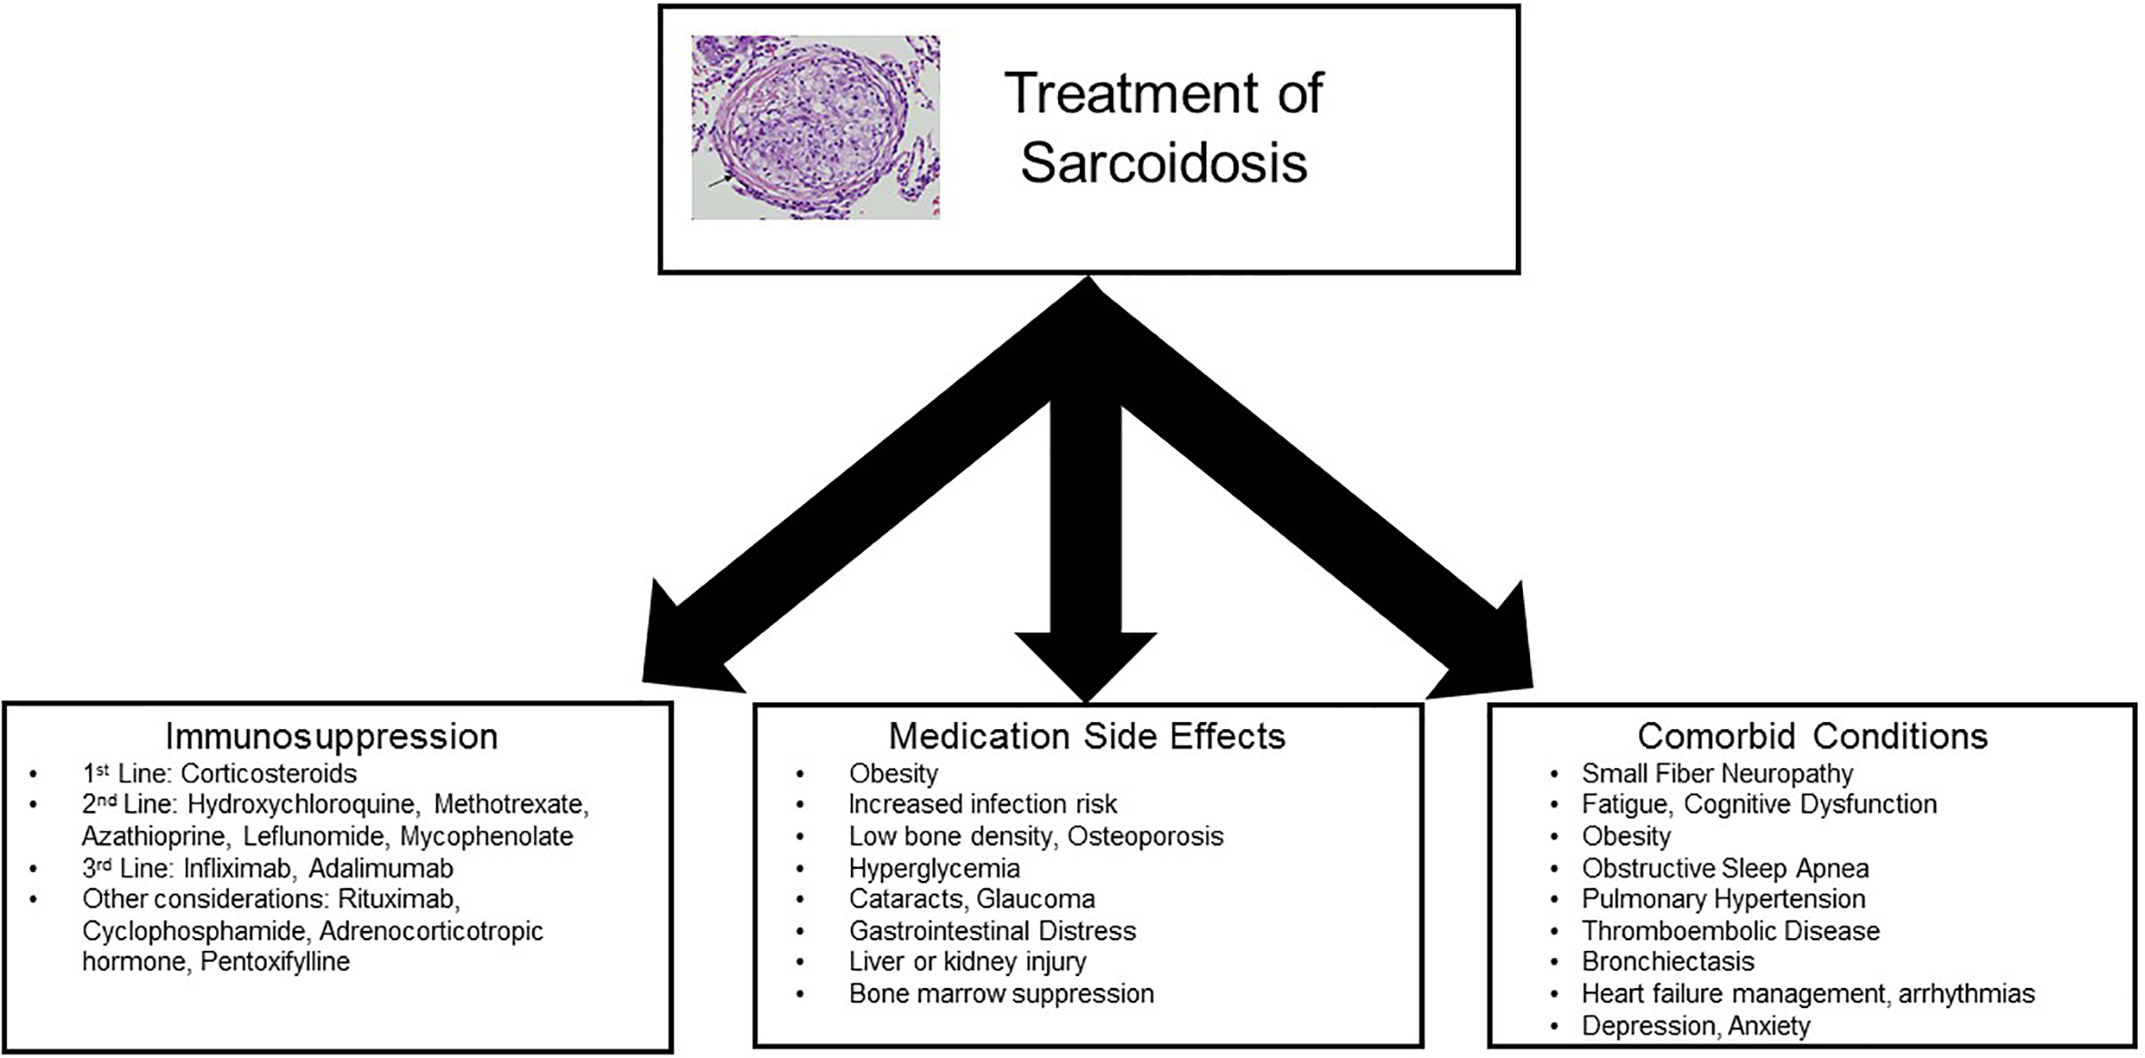

Slide 6
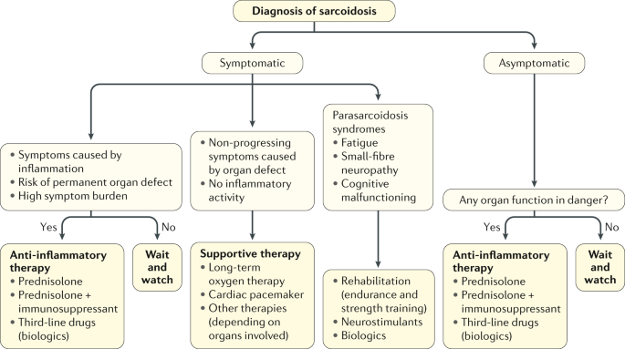

Slide 7
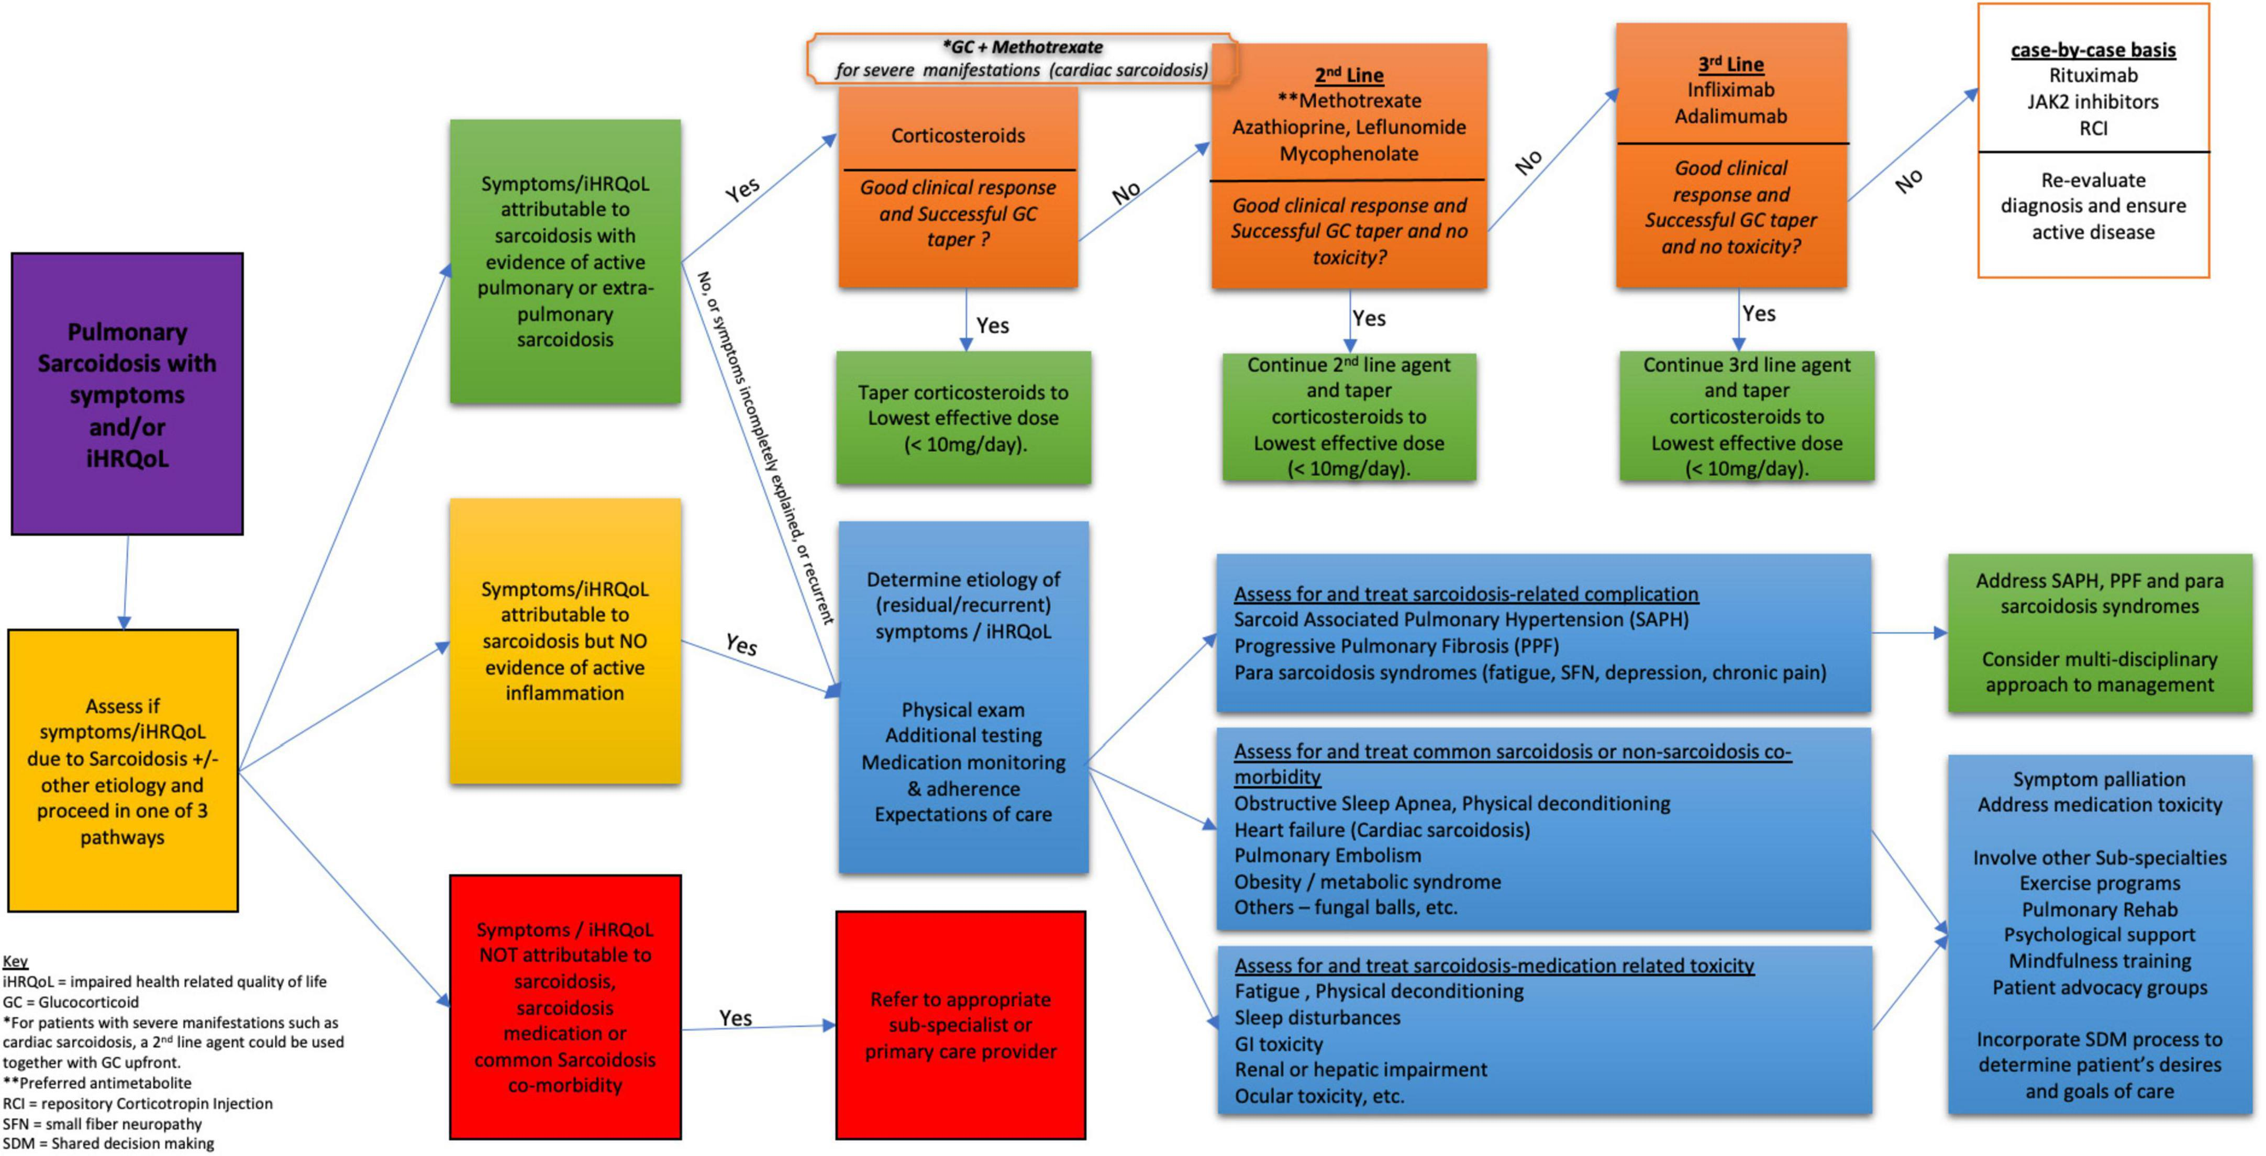

Slide 8
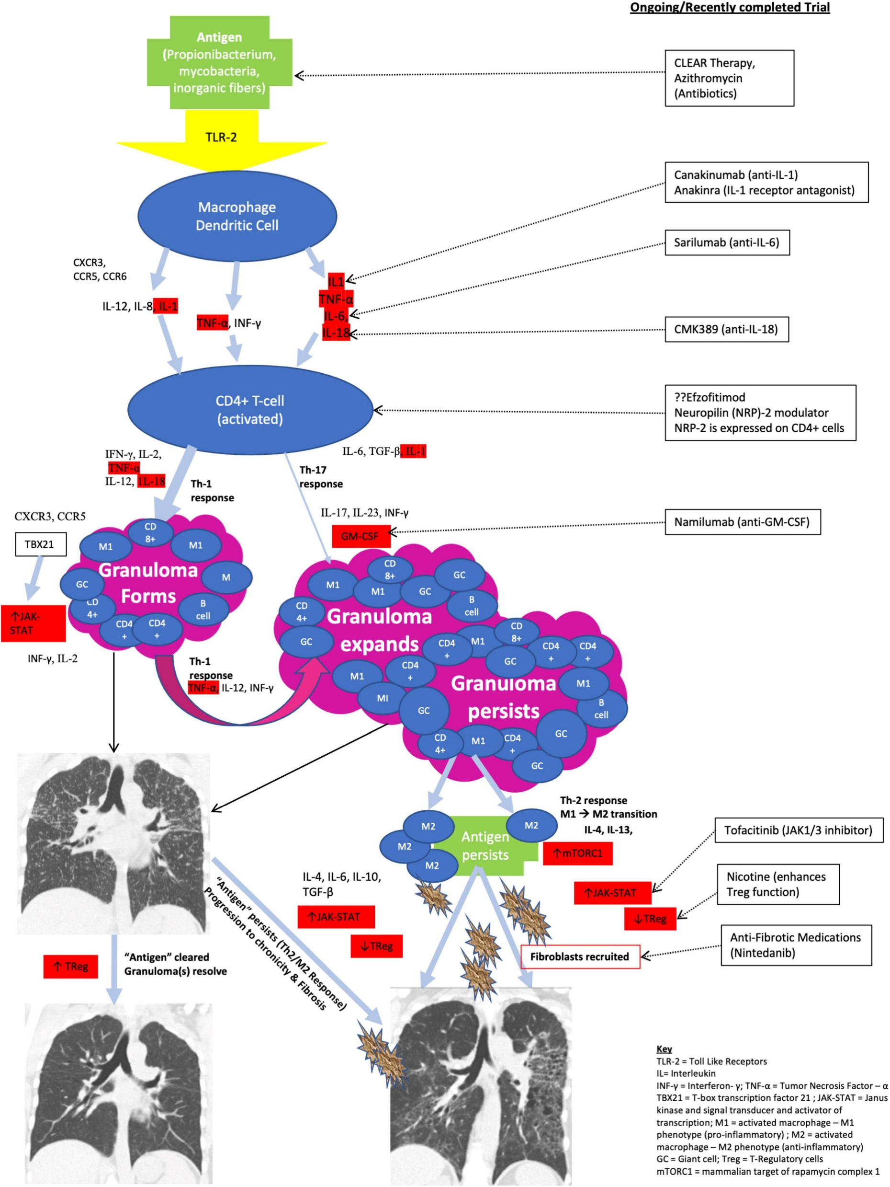

Slide 9

CLINICAL TRIALS
QUIDOSE Study: A Phase 3 randomized controlled trial evaluating the
efficacy of hydroxychloroquine combined with low-dose corticosteroids
The primary endpoint is the change in Forced Vital Capacity (FVC) at 26 weeks
2. Xentria Trial: A Phase 1b/2 study investigating XTMAB-16,
a monoclonal antibody targeting inflammatory pathways in pulmonary sarcoidosis
KITE Study: A Phase II trial evaluating OATD-01, a novel small molecule
targeting chitotriosidase 1 (CHIT1), in patients with active pulmonary sarcoidosis.
The study aims to assess its impact on inflammation and disease progression.
EFZO-FIT Study: A Phase III trial examining the efficacy of efzofitimod,
a protein designed to reduce lung inflammation, in patients with pulmonary sarcoidosis.
The study evaluates its potential to allow steroid dose reduction

Slide 10
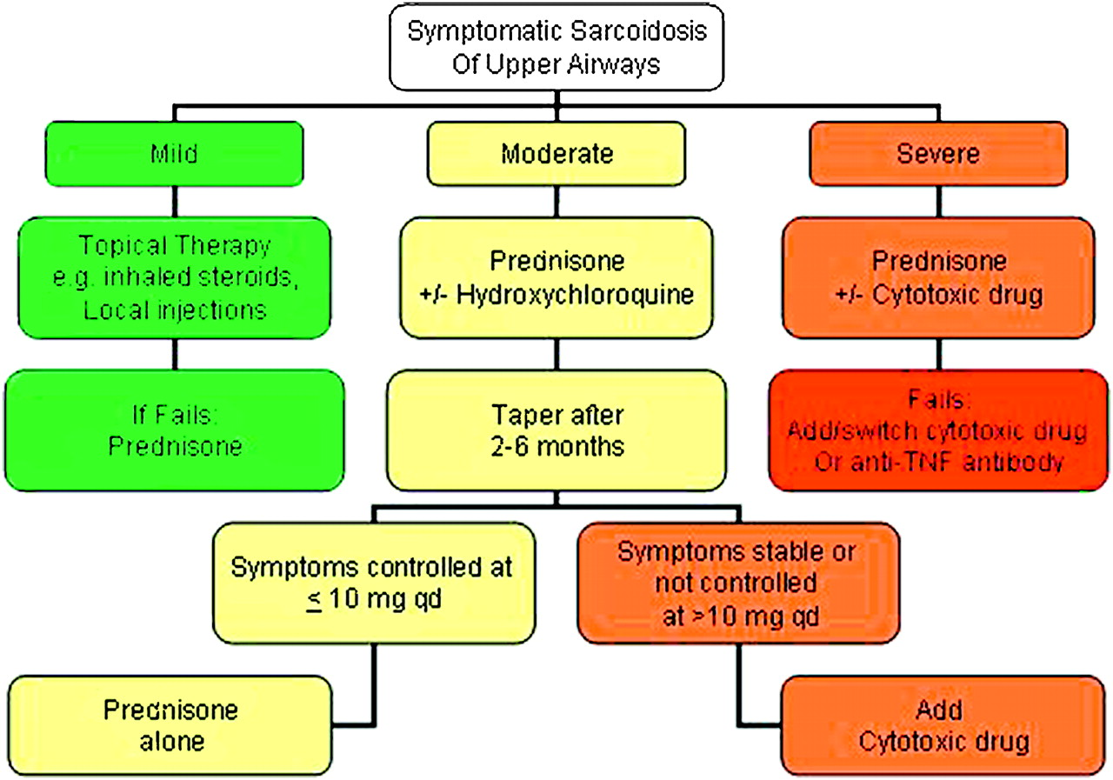
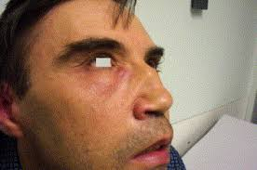
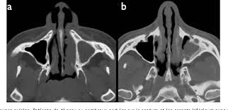
SURT
Sarcoidosis of the upper respiratory tract.
Bargagli E Resp Med

Slide 11
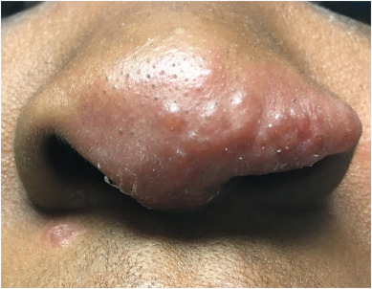
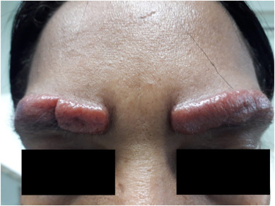
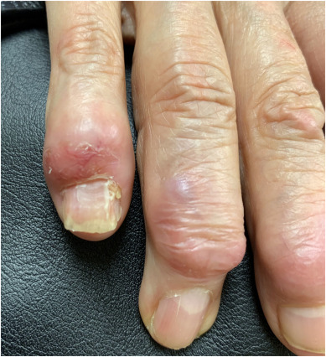
CUTANEOUS SARCOIDOSI

Slide 12
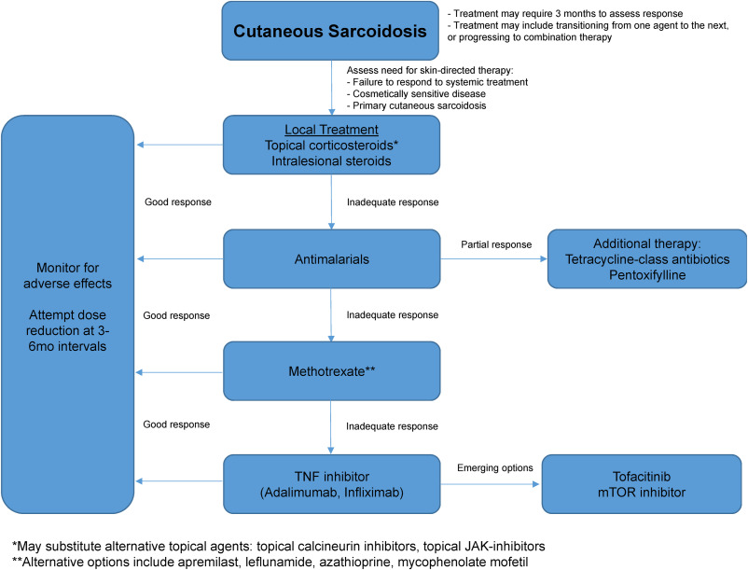

Slide 13
Priovant Announces Positive Phase 2 Results for Brepocitinib in Cutaneous Sarcoidosis (CS)
February 2026
Brepocitinib 45 mg significantly improved cutaneous sarcoidosis disease activity, achieving a 22.3-point improvement in mean CSAMI-A at Week 16 versus a 0.7-point improvement in placebo (Δ 21.6 P<0.0001)

Slide 14
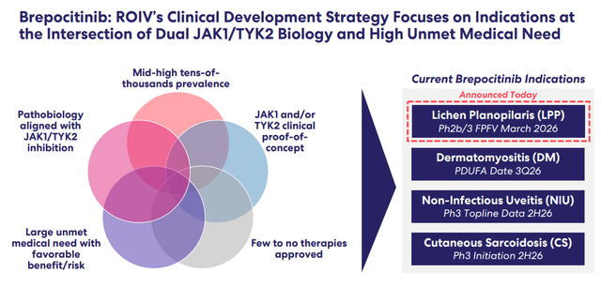

Slide 15
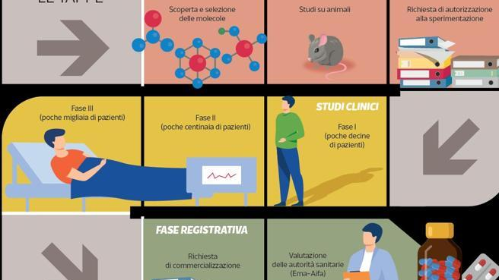

Slide 16

VANTAGG
PARTECIPAZIONE TRIAL CLINICI

Slide 17
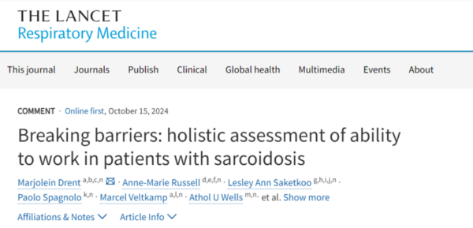

Slide 18
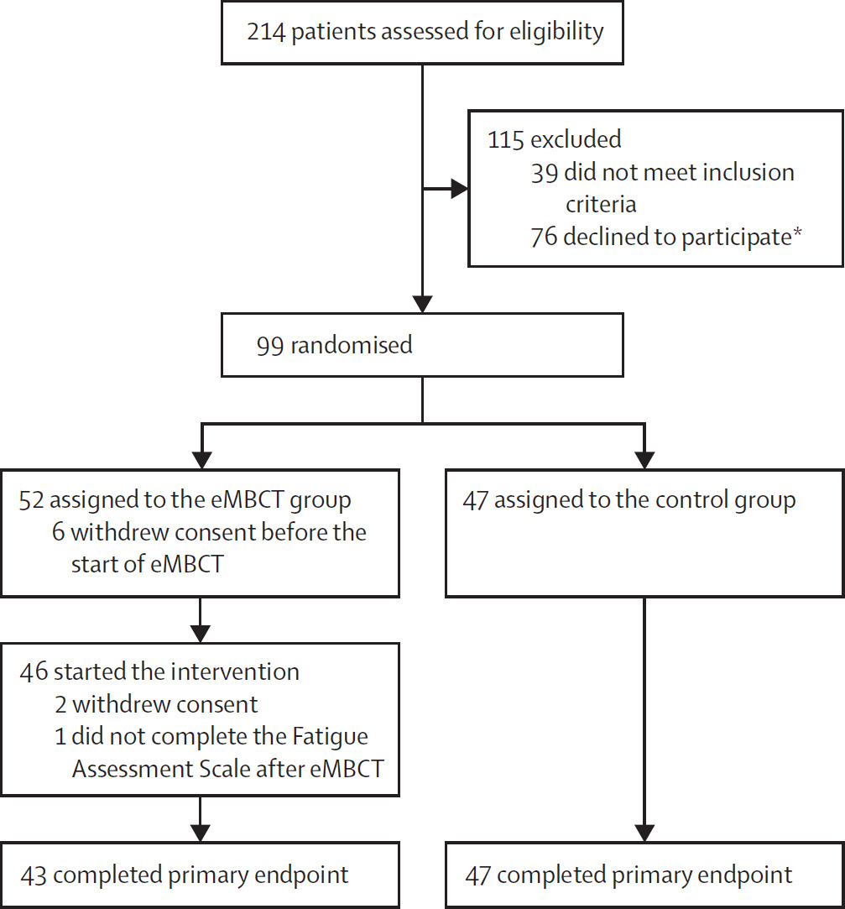
Online mindfulness-based cognitive therapy for fatigue in patients with sarcoidosis (TIRED): a randomised controlled trial. The Lancet 2023

Slide 19
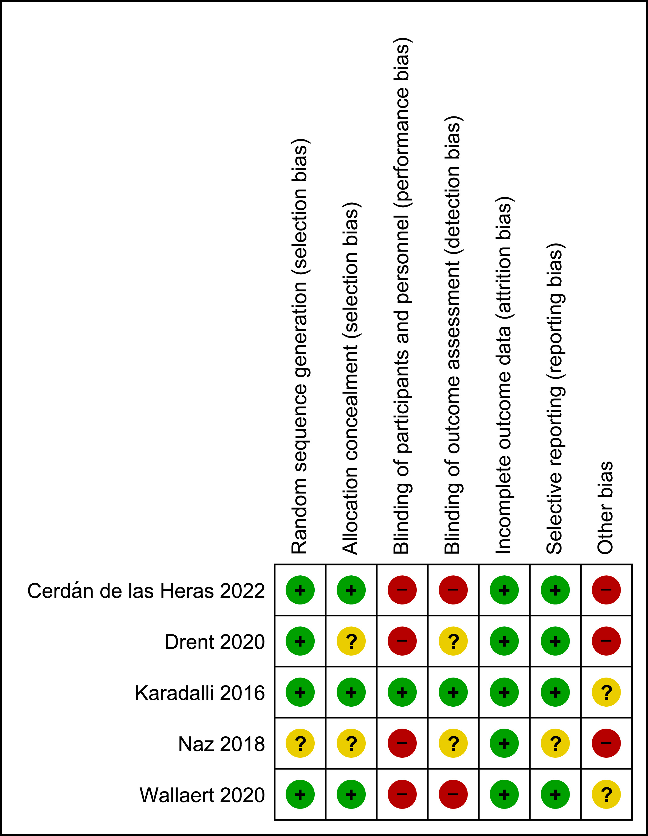

Pulmonary rehabilitation in sarcoidosis: A systematic review and meta-analysis

Slide 20

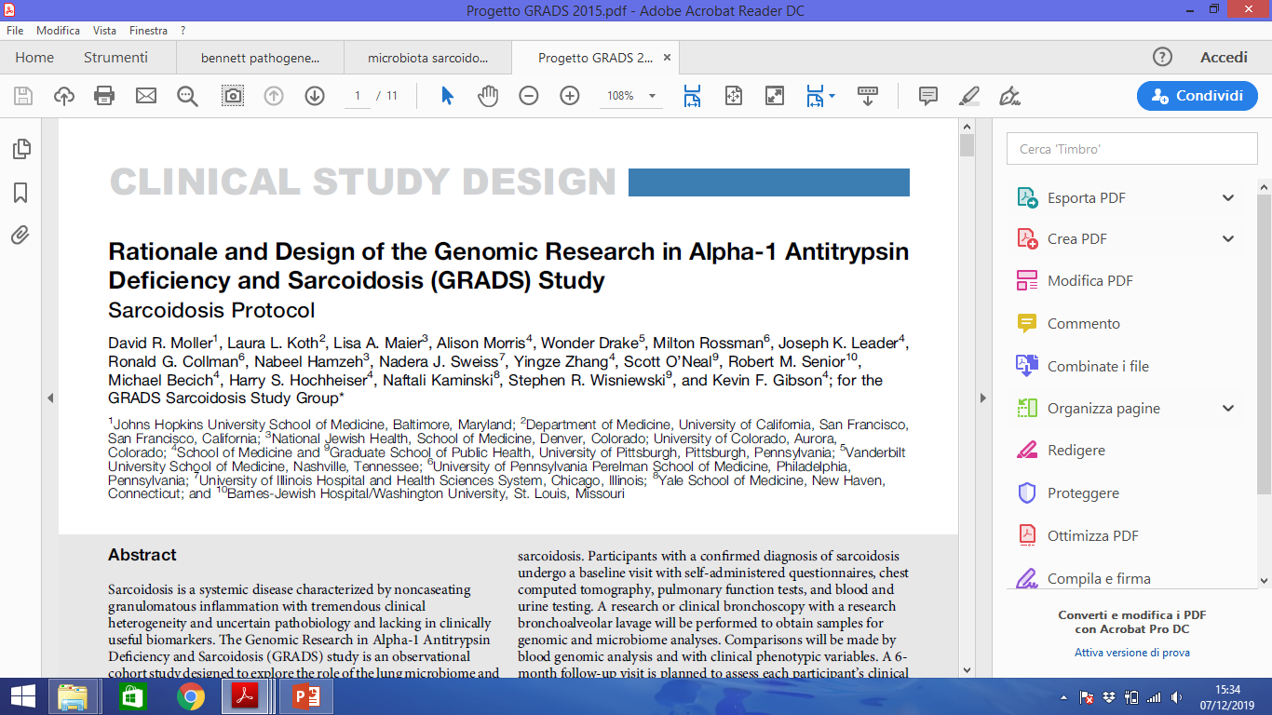


Omics sciences
«…GRADS is a observational cohort study designed to explore the role of lung microbiome and genome in these two diseases…»

Slide 21
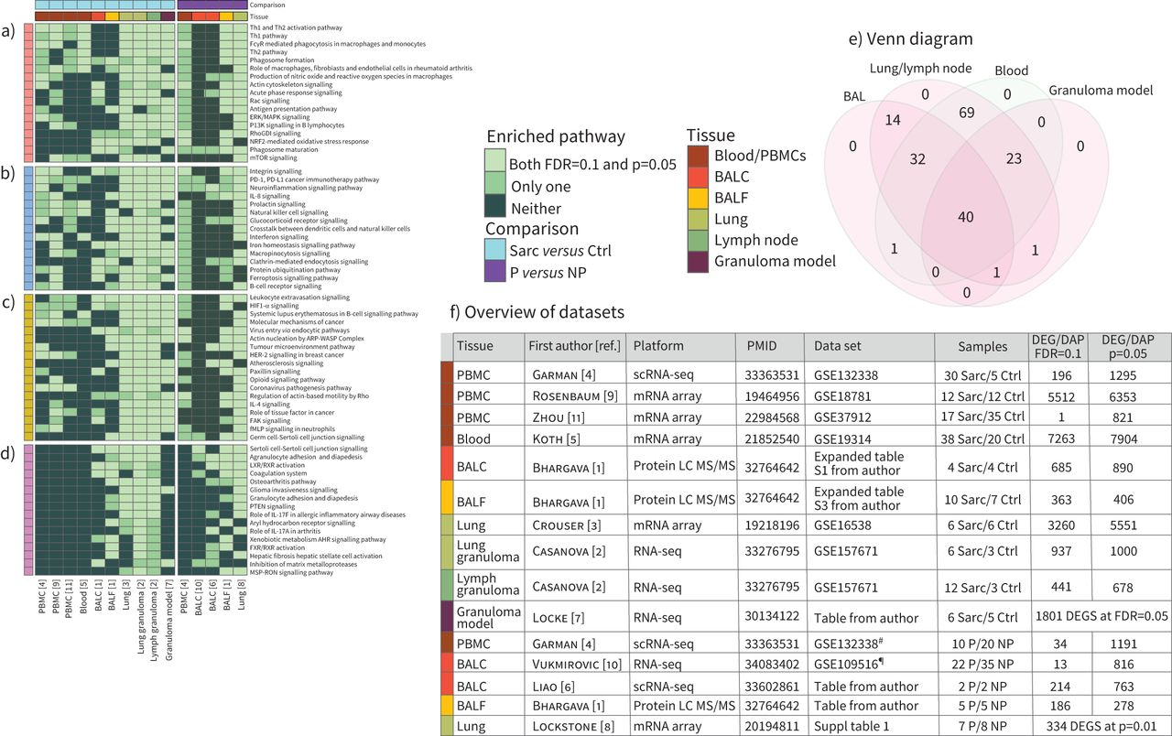
Summary of existing transcriptional and proteomic studies in sarcoidosis

Slide 22

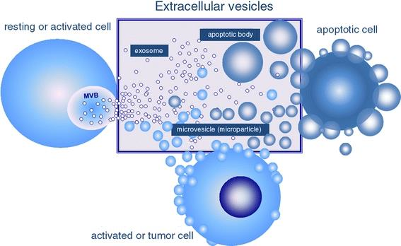
When does the laboratory come into play?
Bronchoalveolar lavage is a biological fluid representative of the alveolar compartment useful for searching inflammatory cellular infiltrates and as a source of biomarkers in interstitial lung diseases
Thorax, 2008

Slide 23
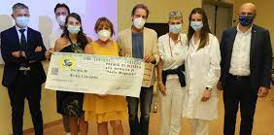
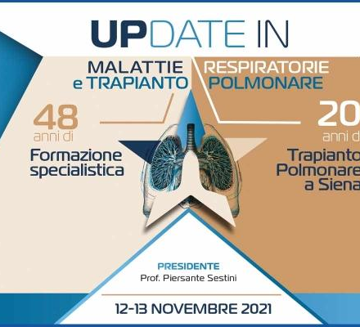

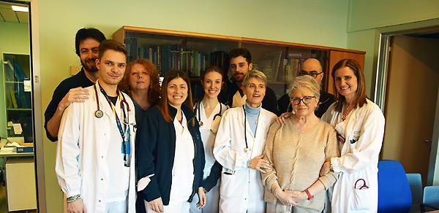
ASSOCIAZIONI PAZIENTI
…vicini nella ricerca, nell’assistenza e nella didattica

Slide 24
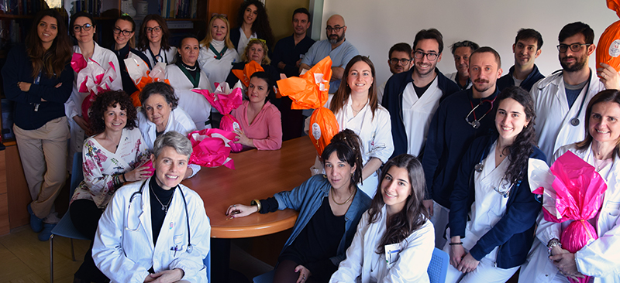
Science knows no country, because knowledge belongs to humanity, and is the torch which illuminates the world…

