Slide 1

Unclassifiable ILDs
Specific entity or just a set of cases with no diagnosis?
Claudia Ravaglia
Department of Medical and Surgical Sciences (DIMEC) - University of Bologna
Pulmonology Unit, G.B. Morgagni Hospital, Forlì - Italy
Notes:
Greetings

Slide 2
Why disease classification is so important? For utility …
For patients: guide management
  Guides therapy (immunosuppression, antifibrotics, exposure control, etc.)
  Defines prognosis/disease beahavior
For science: knowledge (reflecting the times)
  Provides cumulative evidence
  Reveals insights into pathogenesis
  Enables trial design and endpoints
For practitioner: shared language
  Structures multidisciplinary discussion (MDD)
  Reduces misclassification
Notes:
-Maybe, the first question we should àsk is why classification matters so mùch in medicine?
-First of all, disease classification may help (or should help) guiding clinical management and defining prognosis
-Second, it may help the understanding of pathogenesis of the diseases
-Finally, it offers a shared common language among clinicians

Slide 3
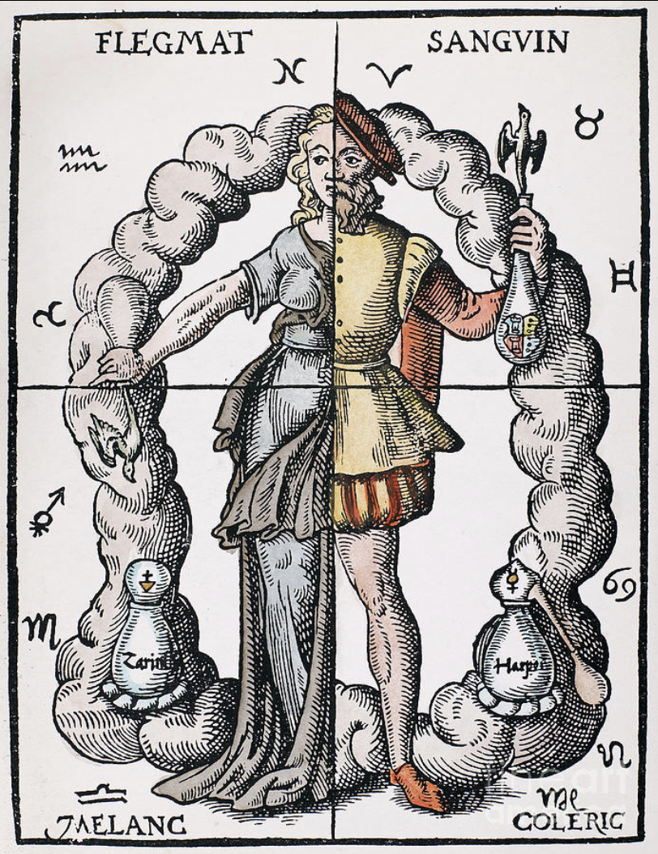

Ancient beginnings: Hippocrates and the 4 Humors
The fundamentally biological (body-based) approach of Hippocrates and his school
Four “humors”: black bile, yellow bile, phlegm, and blood
Impulse to classify diseases is old!
Early classifications based on very different scientific knowledge
Goal was the same: to bring order to disease and guide management
Notes:
The impulse to classify diseases is probably as old as medicine itself.
Even the ancient Hippocràtic theory of hùmors was an attempt to guide management.

Slide 4
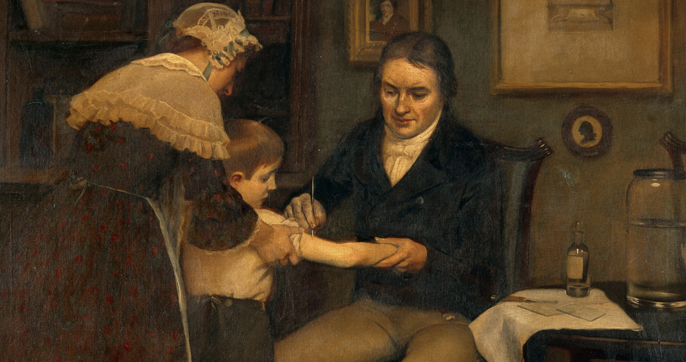

Age of Enlightenment: classification as a way to organize knowledge
Linnaeus “GENERA MORBORUM” Classification of Diseases
No pathology or microbiology
Classification: symptoms and clinical presentation
Focused on what clinicians could observe
Goal: organize and master knowledge
Notes:
-For centuries, classification systems were largely based on what clinicians could directly obsèrve: symptoms and clinical presentation.

Slide 5
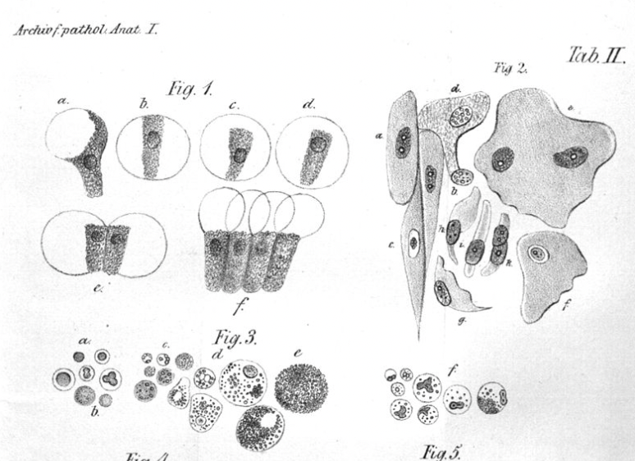
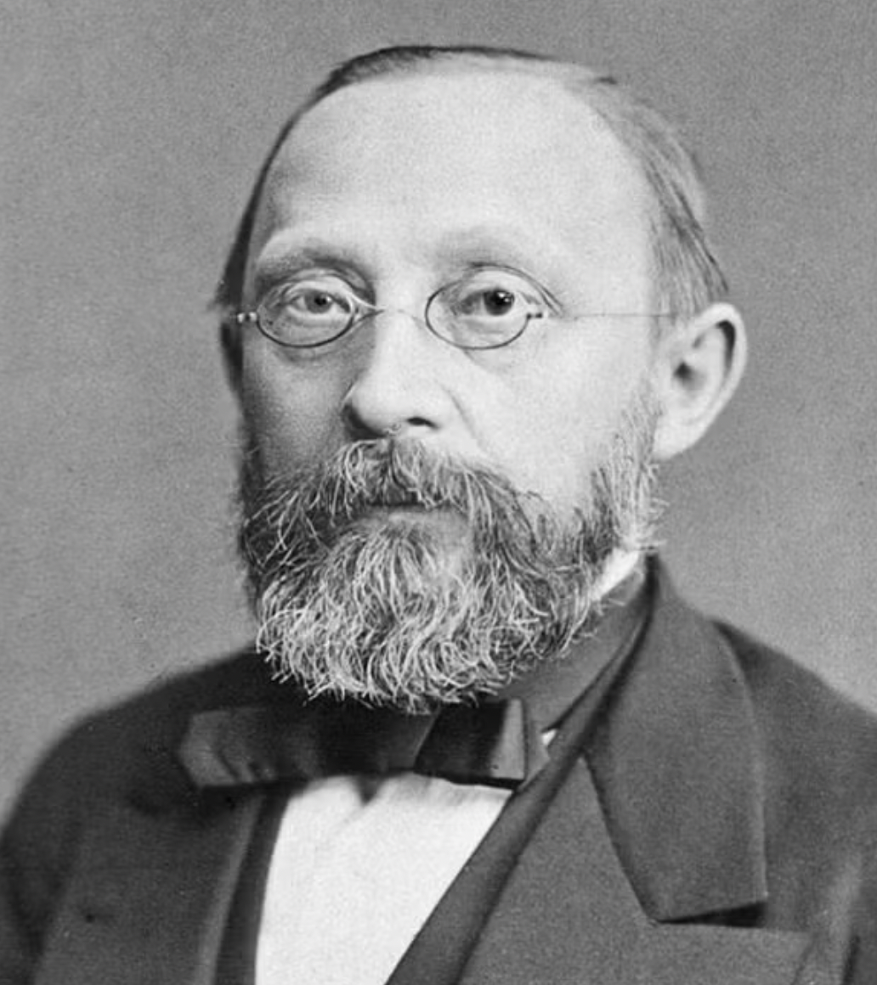
Virchow and the modern concept of cellular pathology
Classification anchored in visible structural changes
Virchow introduced the concept of cellular pathology
Diseases defined by structural cellular changes, not only symptoms
Foundation of modern disease classification
Link between clinical observation and underlying pathology
Notes:
-But was only with Vìrchow, with the concept of CELLULAR PATHOLOGY, that for the first time, diseases were no longer defined only by symptoms, but mainly by the STRUCTURAL CHANGES that could be observed at the cellular level.

Slide 6

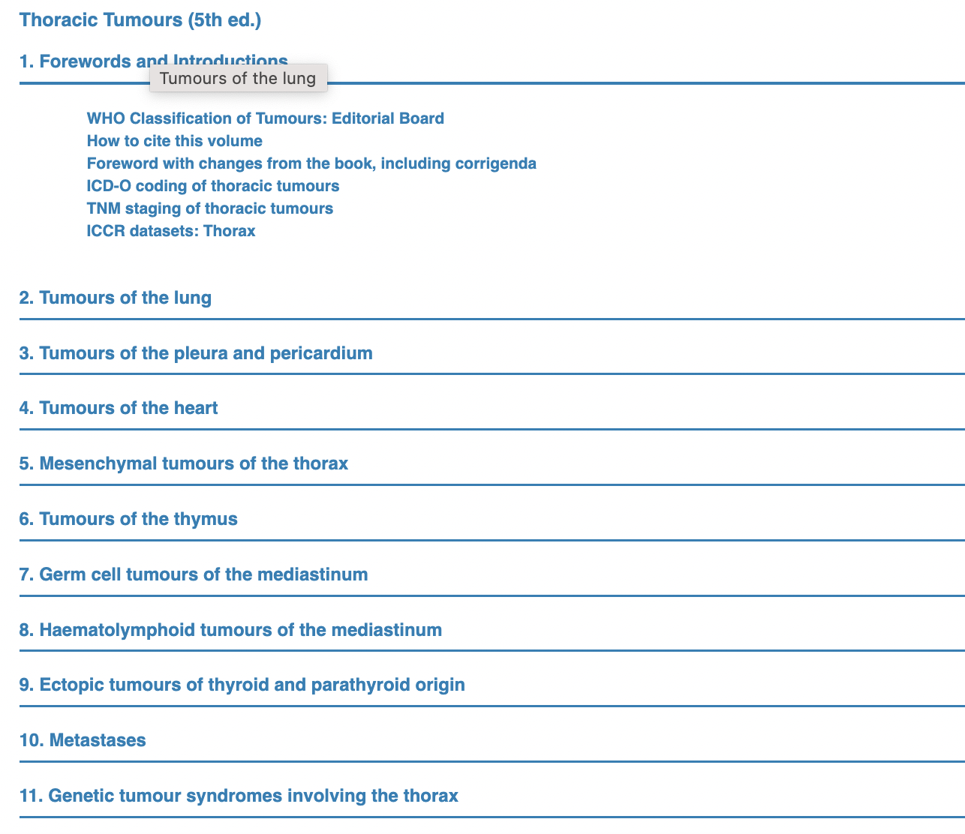
Notes:
-Perhaps the classification that best represents this còncept is the World Health Organization Classification of Thoracic Tumors, which includes tumours of the lung, but also tumours of the pleura and pericardium, tumours of the heart, tumours of the thymus, thyroid etc.

Slide 7
What happens when a patient cannot be classified?
Notes:
-And what happens when a patient cannot be classified?

Slide 8


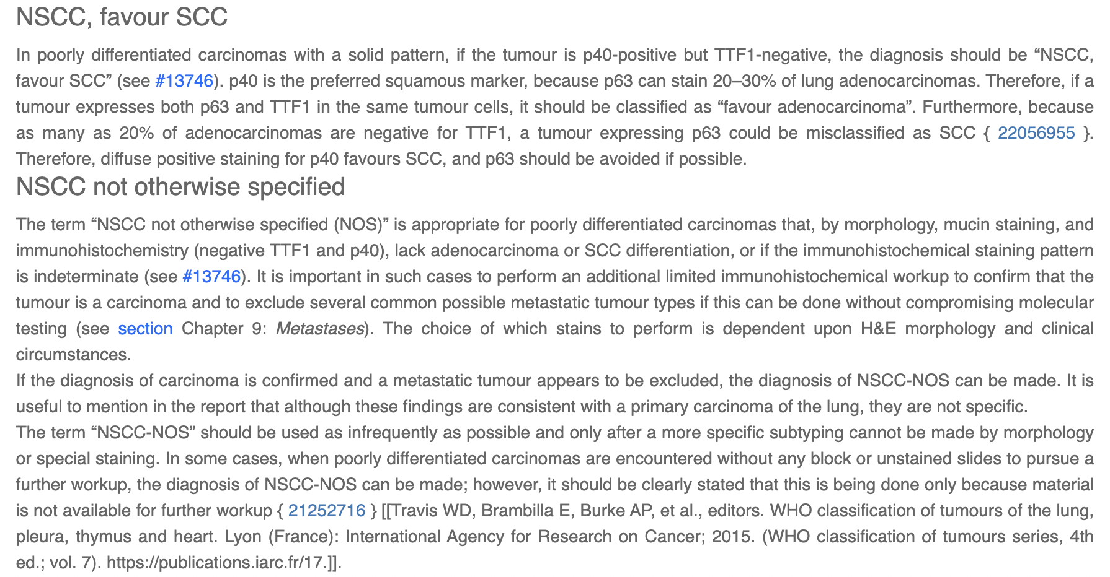
Notes:
-Even in the WHO Classification of Thoracic Tumors, it is stàndard to have an unclassifable catègory, because there àre cases where a specific pathologic diagnosis cannot be made
-Specifically, Tthe term “not otherwise specified (or NOS)” is considered appropriate for poorly differentiated carcinomas that, by morphology, mucin staining, and immunohistochemistry, lack Adenocarcinoma or Squamous Cell Carcinoma differentiation, or if the immunohistochemical staining pattern is indeterminate.
2) However, the document says that the term “NOS” should be used as infrequently as possible and only after a more specific subtyping cannot be made by morphology or special staining!!!

Slide 9
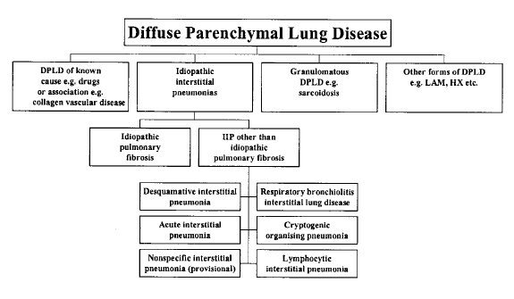
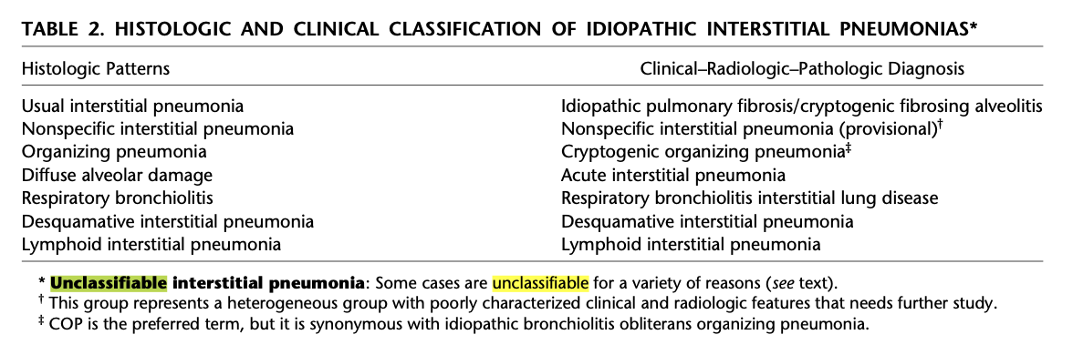
“Unclassifiable ILD” : patients with interstitial pneumonia that remained without a clear diagnosis on the basis of the available data, after extensive clinical, radiologic, and/or pathological examination.
Am J Respir Crit Care Med 2002
Notes:
-But coming to ILDs, in the 2002 classification of the idiopathic interstitial pneumonias (IIPs), the panelists have “resisted the creation of a non-classifiable category”, because this has been considered clinically unhelpful.
-However, the concept of “Unclassifiable ILD” was already introduced at that time and used to define “patients with interstitial pneumonia that remained without a clear diagnosis on the basis of the available data (extensive clinical, radiologic, and/or pathological examination)

Slide 10
Reasons for diagnostic uncertainty in ILD
Inadequate clinical information
Inadequate radiologic data
Inadequate biopsy (small size, poor sampling, artifacts, etc)
Major discrepancy between clinical, radiologic, and pathologic findings
Previous therapy resulting in alterations in radiologic or histologic findings
Discrepancy between histologic findings in different lobes that is not resolved after correlation with clinical and radiologic data
Am J Respir Crit Care Med 2002
Notes:
Some examples of reasons or circumstances under which a case may be unclassifiable include:
- Inadequate clinical information, radiologic data or biopsy (e.g., because of small size or poor sampling)
- existence of a major discrepancy between clinical, radiologic, and pathologic findings
- previous therapy resulting in alterations in the radiologic or histologic findings
- discrepancy between histologic findings in different lobes
…………….

Slide 11
Reasons for diagnostic uncertainty in ILD
- True unclassifiable disease vs incompletely evaluated disease
- Unclassifiable should not become a shortcut for incomplete diagnosis
Inadequate clinical information
Inadequate radiologic data
Inadequate biopsy (small size, poor sampling, artifacts, etc)
Major discrepancy between clinical, radiologic, and pathologic findings
Previous therapy resulting in alterations in radiologic or histologic findings
Discrepancy between histologic findings in different lobes that is not resolved after correlation with clinical and radiologic data
Am J Respir Crit Care Med 2002
Notes:
……
However, this definition really may depend on how complète the diagnostic work-up is !!
-And raises the concern that the term “unclassifiable ILD” might sometimes be used to justify stopping the evaluation too early in some patients.

Slide 12
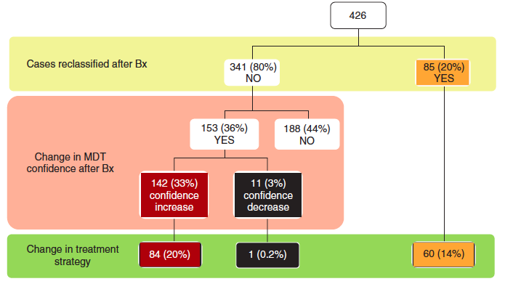
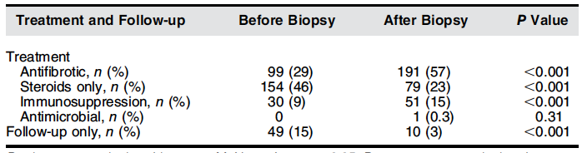
Can improved tissue sampling reduce unclassifiable ILD?
426 patients referred for suspected ILDs all biopsied (266 cryobiopsy, 160 SLB)
MDT
Treatment strategy changed:
-31.5% of cryobiopsy cases
-38% of SLB
Tomassetti S, et al Ann Am Thorac Soc 2022
Notes:
-Historically, many patients remained unclassified because surgical lung biopsy was not feasible due to age, comorbidities, or procedural risk.
-Today, with the increasing use of cryobiopsy and improved multidisciplinary evaluation, at least some of these patients may eventually become classifiable.

Slide 13
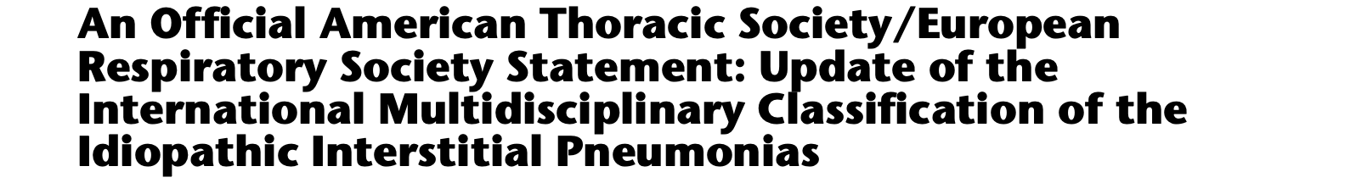
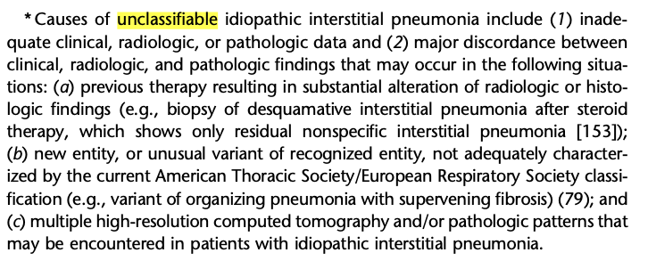
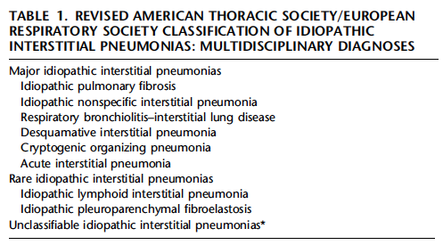
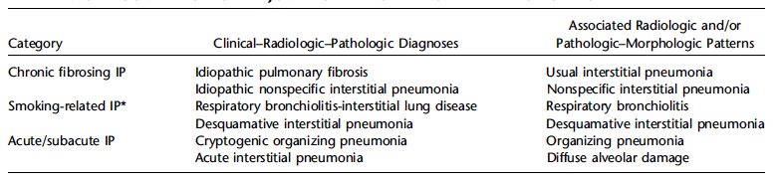
Travis WD, et al. Am J Respir Crit Care Med 2013
Notes:
-About 10 years later, in the 2013 revision of the IIPs classification, there were several important changes, such as major idiopathic interstitial pneumonias were grouped into chronic fibrosing, smoking-related and acute/subacute and, importantly, were distinguished from rare IIPs and unclassifiable IDIOPATHIC INTERSTITIAL PNEUMONIAs.

Slide 14
“Unclassifiable idiopathic IPs” may unintentionally restrict diagnostic thinking
Travis WD, et al. Am J Respir Crit Care Med 2013
Notes:
-So, UNCLASSIFIABLE and IDIOPATHIC. “Unclassifiable Idiopathic” may be problematic because it artificially narrows the differential diagnosis, while many patients may actually reflect occult CTD, HP, or other non-idiopathic diseases.

Slide 15
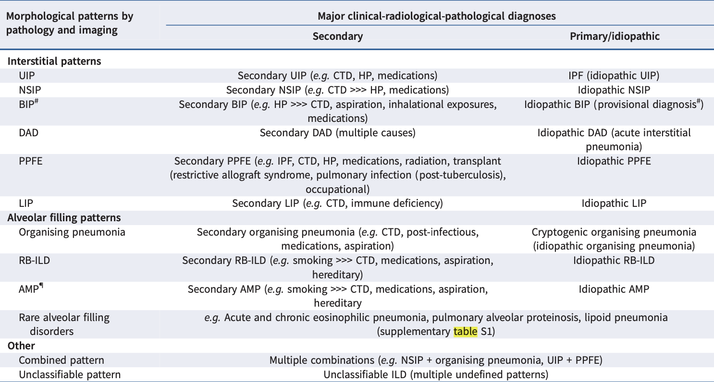



FOR A MORE COMPLETE AND FLEXIBLE SYSTEM:
IDIOPATHIC and SECONDARY IPs in the SAME CLASSIFICATION
BEYOND THE OLD “IDIOPATHIC-ONLY” APPROACH
Ryerson C, ERJ 2025
Patterns can be seen across different diseases
Notes:
-A MAJOR CONCEPTUAL SHIFT which made the NEW classification LESS BINARY and closer to reality, was the INCORPORATION of the IDIOPATHIC and SECONDARY interstitial pneumonias into the SAME CLASSIFICATION!
……

Slide 16
FOR A MORE COMPLETE AND FLEXIBLE SYSTEM:
IDIOPATHIC and SECONDARY IPs in the SAME CLASSIFICATION
BEYOND THE OLD “IDIOPATHIC-ONLY” APPROACH
Ryerson C, ERJ 2025
Cause may not be clear at the beginning. Some diseases are very rarely idiopathic. Evolving etiology
Notes:
….
-In many patients the underlying CAUSE IS NOT CLEAR AT THE BEGINNING………
-Some diseases are RARELY TRULY IDIOPATHIC (e.g. RB-ILD), or in some cases are INITIALLY LABELED AS IDIOPATHIC, but later may reveal a specific cause.

Slide 17

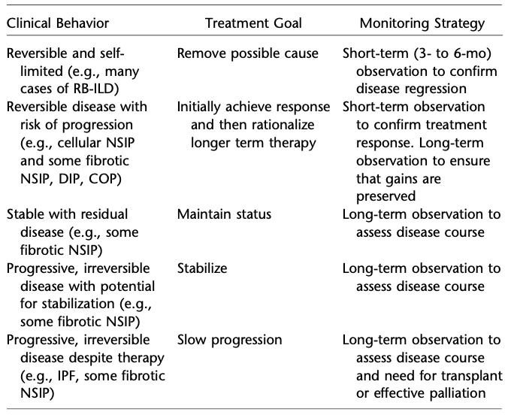
disease behavior classification
Travis WD, et al. Am J Respir Crit Care Med 2013
Notes:
-But one of the most pragmatic ideas introduced > 10 year ago by Athol Wells was that, when a precise label is not possible, we can still classify the patient according to disease behavior

Slide 18
The disease behavior classification
Behaviour defines not only how we treat, but also how closely and how long we need to monitor our patients
CLINICAL BEHAVIOR | TREATMENT GOAL | MONITORING STRATEGY
Reversible & self-limited | Remove possible cause | Short term (3-6 month) observation to confirm disease regression
Reversible disease with risk of progression | Initial response & then rationalize longer term therapy | Short term observation to confirm treatment response. Long term observation to ensure that gains are preserved
Stable with residual disease | Maintain status | Long term observation to assess disease course
Progressive, irreversible disease with potential for stabilization | To prevent progression | Long term observation to assess disease course
Progressive, irreversible disease despite therapy | To slow progression | Long-term observation to assess disease course, need for transplantation and effective palliation
some uILDs
some uILDs
some uILDs
some uILDs
some uILDs
Travis WD et al. Am J Respir Crit Care Med 2013
Notes:
And unclassifiable ILDs can be potentially associated with all 5 patterns of disease behavior: reversible and self-limited disease, reversible disease with risk of progression, stable with residual disease, progressive and irreversible but with potential for stabilization, and progressive irreversible despite therapy
In splitting ILDs by disease behàviour, the central distinction was between stàble and progressive disèase
Progrèssion (defined across clìnical, physiològical and radiològical domains) may predict òutcome regardless of the underlying làbel

Slide 19
Disease behavior is not disease biology!
Potential advantage | Potential limitation
Pragmatic management in uncertain cases | May oversimplify biologically complex diseases
Focus on progression and treatment response | Different diseases may share similar behaviors
Clinically actionable | Behavior may evolve over time
Useful in unclassifiable ILD | Risk of phenotype-driven rather than mechanism-driven medicine
Notes:
The disease behavior classification gives us a pragmatic framework when a precise diagnosis is not possible.
However, we also need to recognize that disease behavior is not the same as disease biology!
And ultimately, what really drives disease behavior is the underlying biology itself.

Slide 20
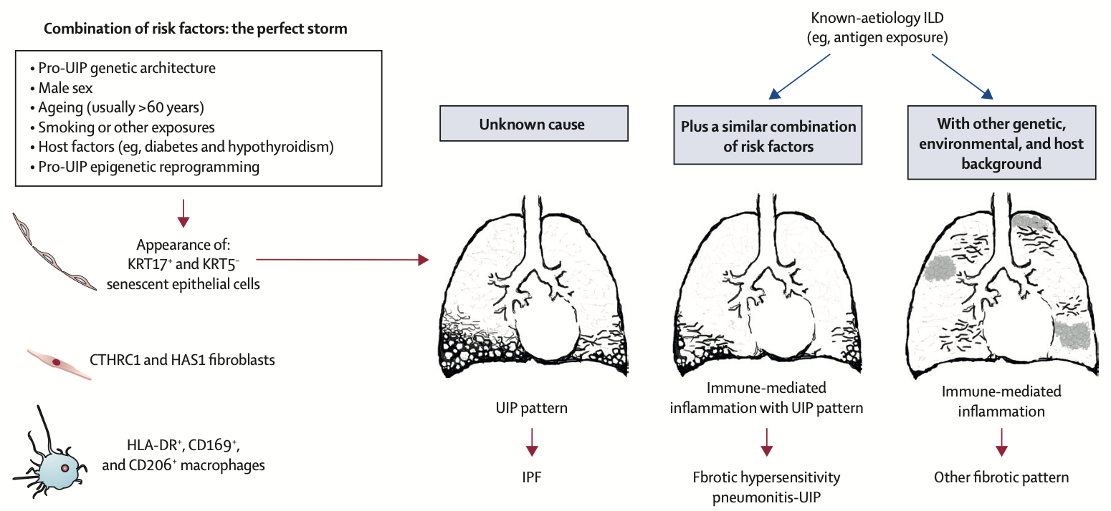
Usual interstitial pneumonia as a stand-alone diagnostic entity: the case for a paradigm shift?
Selman M, Pardo A, Wells AU. Lancet Respir Med 2023
Notes:
-As an example, UIP is now considered not just a morphologic pattern, but rather a distinct diagnostic and biological entity ……..

Slide 21

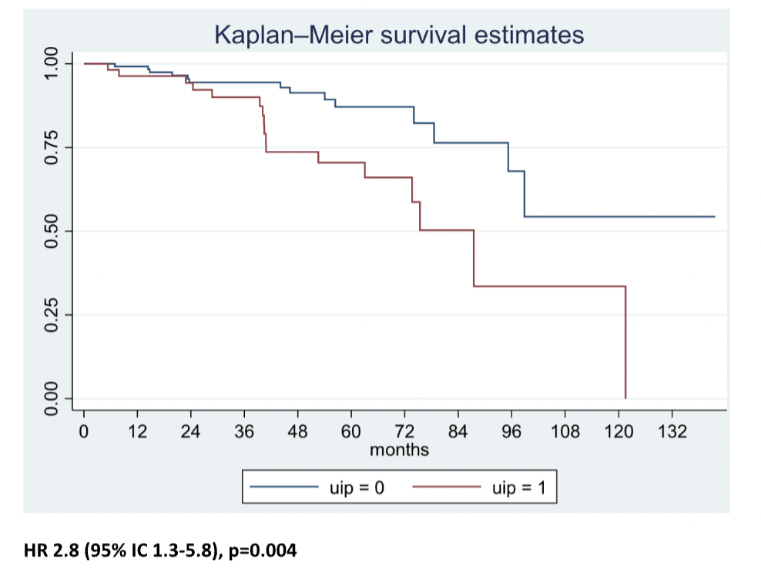
non UIP
non UIP fHP
UIP fHP
UIP
Petrarulo S, Pulmonology 2025
Notes:
…. associated with a distinct clinical disease behavior

Slide 22
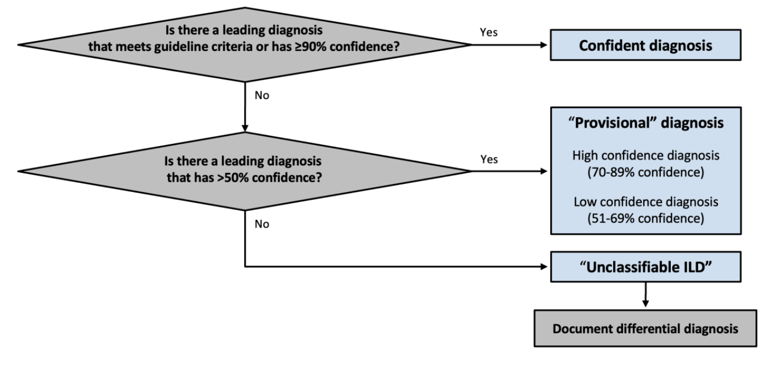
DIAGNOSTIC CONFIDENCE ALWAYS EXPLICITED
CLASSIFICATION LESS BINARY
EMPASIZE DIAGNOSTIC CONFIDENCE
-Diagnostic confidence approach (radiologically and histologically)
-Both for patterns and multidisciplinary diagnoses
Ryerson CJ, et al. Am J Respir Crit Care Med 2017
Ryerson CJ, Adegunsoye A, Piciucchi S, et al. Eur Respir J 2025
Notes:
-Another important CONCEPTUAL SHI’FT of the new classification was the VALIDATION of the DIAGNOSTIC CONFIDENCE as KEY ELEMENT
-We know that diagnostic confidence is structured in levels: ≥ 90% corresponds to a CONFIDENT diagnosis, 51–89% to a PROVISIONAL diagnosis and < 50% indicates the ABSENCE OF A LEADING DIAGNOSIS.
-Patients without a leading diagnosis that is considered more likely than not should be categorized as “unclassifiable ILD”

Slide 23
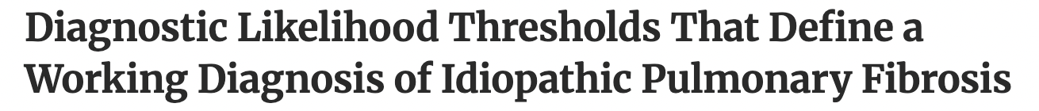
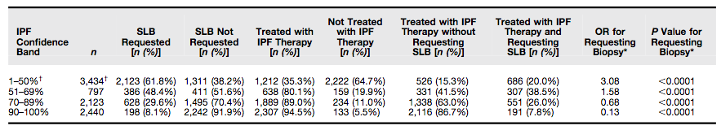
Walsh SLF, et al. Am J Respir Crit Care Med 2019; 200(9): 1146-1153
Notes:
-This “level of confidence” approach has potential clinical utility, based on an important study suggesting that clinicians often use a threshold of 70% confidence in a diagnosis of IPF as sufficient cèrtainty to support management decisions without pursuing further invasive testing

Slide 24
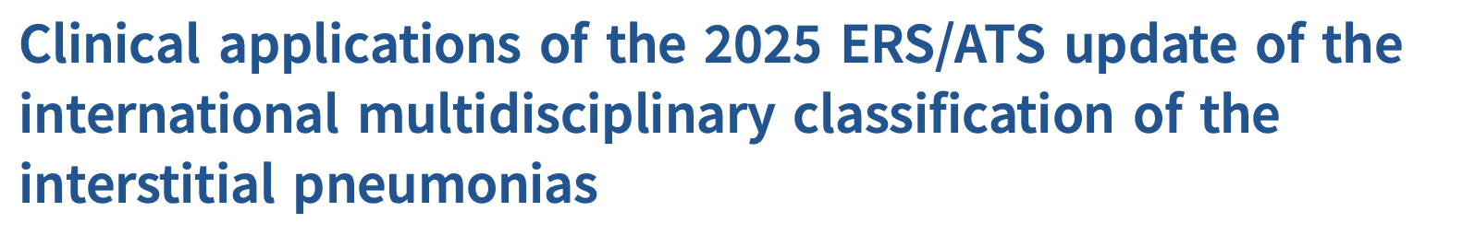
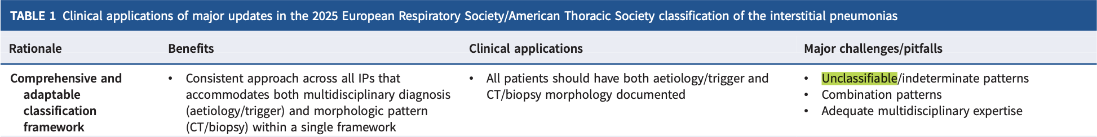
-Pathologists and radiologists SHOULD always STATE the LIKELIHOOD OF A DIAGNOSIS in their report and its KEY DIFFERENTIALS
Uncertainty should be acknowledged and documented
uILD ≠ end of the diagnostic process
Continuous reassessment during follow-up is essential. New clinical/radiological/biological data may redefine diagnosis
Goal: describe uncertainty more precisely. Not to classify more patients as “unclassifiable”
Ryerson C, et al. ERJ 2026
Notes:
-Pathologists and radiologists SHOULD always STATE the LIKELIHOOD OF A DIAGNOSIS in their report and its KEY DIFFERENTIALS (for example, “BIP pattern favouring HP”)
-This means that uncertainty should be explicitly acknowledged and documented!
-Labeling a patient as “unclassifiable” should never be considered the end of the diagnostic process. Quite the opposite: it should trigger continuous reassessment during follow-up

Slide 25

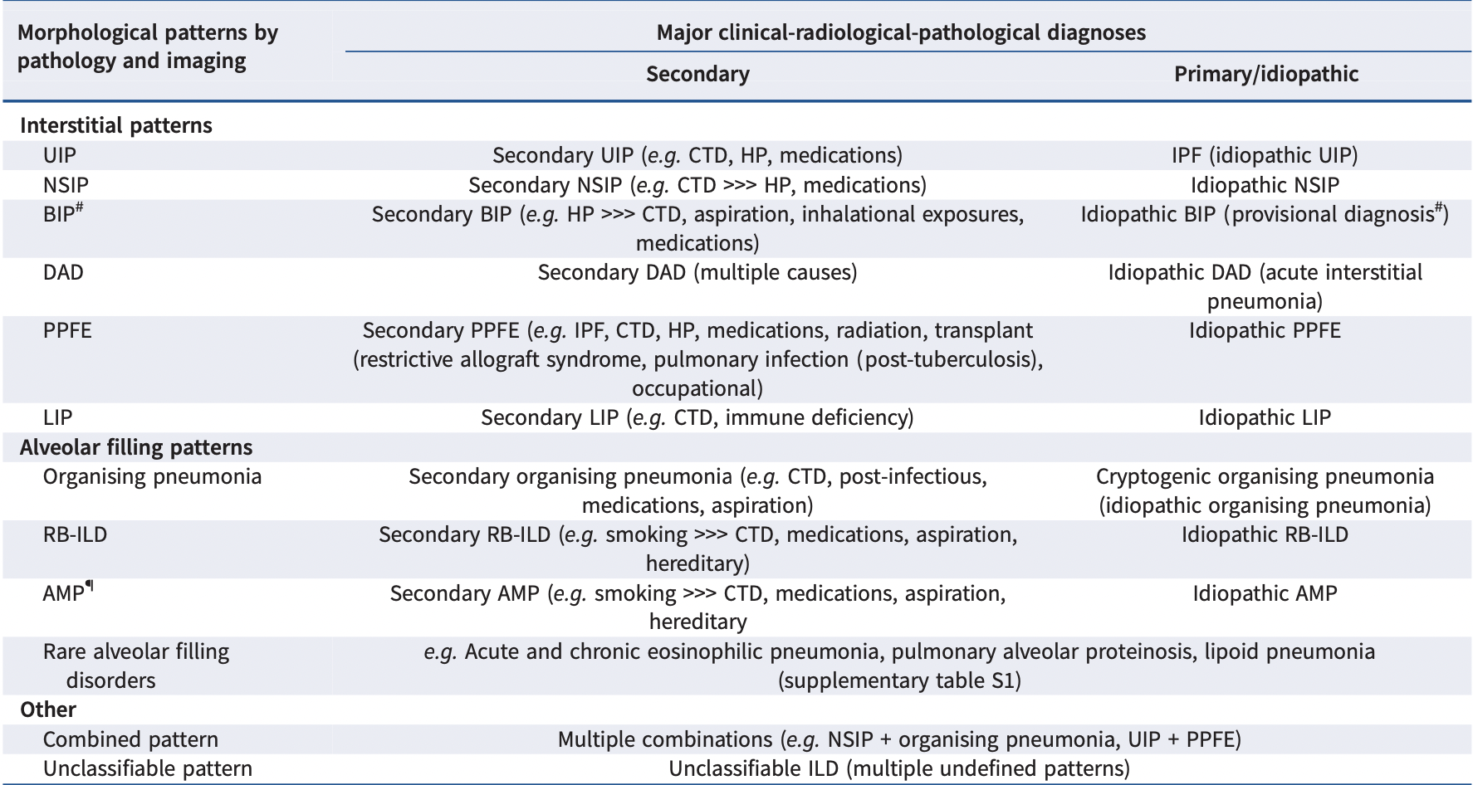
Ryerson C, ERJ 2025
Notes:
-Infact, unclassifiable ILDs are fully incorporated in the new ERS/ATS classification without being considered a diagnostic failure anymore, but rather a recognised category of patients

Slide 26
What are patients with unclassifiable ILD like?
uILD prevalence: 11.9% (95% CI 8.5–15.6). MDD associated with lower uILD prevalence: 9.5% vs 14.5%
Study | Years | MDD | uILD (N) | ILD (N) | uILD prevalence (%) | Biopsy (% ILDs) | Biopsy (% uILDs)
Alhamad 2011 | 2008-2013 | Yes | 6 | 263 | 2,3 | 16 | 82
Guler 2016 | 2012-2014 | No | 19,5 | 10 | 11,3 | 8,8 | 0
Holland 2014 | 2010-2013 | Yes | 105 | 431 | 24,4 | 22,7 | 43,3
Hyldgaard 2016 | 2003-2009 | Yes | 45 | 28 | 22 | 28,2 | 17,7
Jacob 2017 | 2007-2011 | Yes | 107 | 1080 | 9,9 | 82 | 13,4
Jo 2016 | 2014 | Yes | 82 | 623 | 13,2 | 623 | 11,1
Karakatsani 2009 | 2004 | No | 69 | 377 | 19,4 | 0 | 0
Lopez-Campos 2004 | 1998-2000 | No | 99 | 1426 | 6,9 | 422 | 13
Morell 2008 | 1995-2004 | No | 55 | 1370 | 9,6 | 999 | 0,2
Musellim 2014 | 2007-2009 | No | 132 | 178 | 25,8 | 228 | 12,7
Oldham 2016 | 2006-2014 | Yes | 28 | 174 | 16 | 0 | 0
Ryerson 2013 | 2000-2011 | Yes | 46 | 187 | 25,7 | 0 | 0
Singh 2017 | 2012-2015 | Yes | 48 | 218 | 7,8 | 63 | 1,6
Strambu 2013 | 2011 | No | 1 | 665 | 5,4 | 0 | 0
Thomeer 2004 | 1990-1999 | No | 17 | 0 | 0 | 0 | 0
Kondoh 2014 | 2012 | Yes | 36 | 0 | 0 | 0 | 0
Kreuter 2016 | 2014-2016 | No | 62 | 135 | 45,9 | 64 | 100
Low 2016 | 2012-2014 | No | 26 | 435 | 6 | 23 | 0
Reineck 2010 | 2006-2008 | Yes | 36 | 0 | 0 | 0 | 0
Wang 2015 | 2014 | No | 62 | 135 | 45,9 | 64 | 100
Xaubet 2004 | 2000-2001 | No | 26 | 435 | 6 | 23 | 0
Systematic review of 1060 patients from 88 studies
Guler SA, Ann Am Thorac Soc 2018; 15: 854–863)
Notes:
-But what àre patients with unclassifìable ILD lìke?
-First of all, prevalence of uILDs is estimated around 12%, but with a lower prevalence in centers that report the use of a formal multidisciplinary discussion of cases (9.5% vs. 14.5%)

Slide 27
What are patients with unclassifiable ILD like?
Baseline characteristics of patients are variable and similar to the general ILD population reported in each study
Study | uILD patients (N) | Mean age (y) | Male (%) | Ever smoker (%) | FVC (% pred) | DLCO (% pred)
Hyldgaard 2016 | 105 | 64.3 | 53 | 71 | 71.3 | 53.0
Jacob 2017 | 95 | 65 | 47 | 43 | 72.1 | 41.3
Lopez-Campos 2004 | 69 | 68 | 69
Morell 2008 | 73 | 66.7 | 46
Ryerson 2014 | 173 | 66.1 | 50 | 47 | 70.2 | 48.0
Siemienowicz 2015 | 28 | 75.3 | 50 | 58
Strambu 2013 | 46 | 58 |  | 25 | 79 | 55
Thomeer 2004 | 29 | 65 | 53 |  | 76 | 47
Drakopanagiotakis 2015 | 115 | 63.7 | 61 | 62,8 | 65.5 | 39.5
Kondoh 2014 | 28 | 62 | 54 | 57
Manfredi 2015 | 24 | 67.1 | 41,7
Reineck 2010 | 36 | 57 |  | 42
Weighted mean (95% CI) | 0 | 65.9 | 51.9 | 51.0 | 72.0 | 47.3
Notes:
-Baseline characteristics of patients are variable and similar to the general ILD population reported in each study.

Slide 28
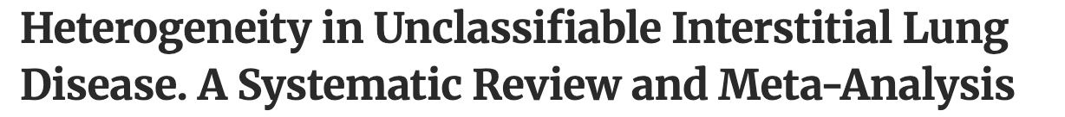
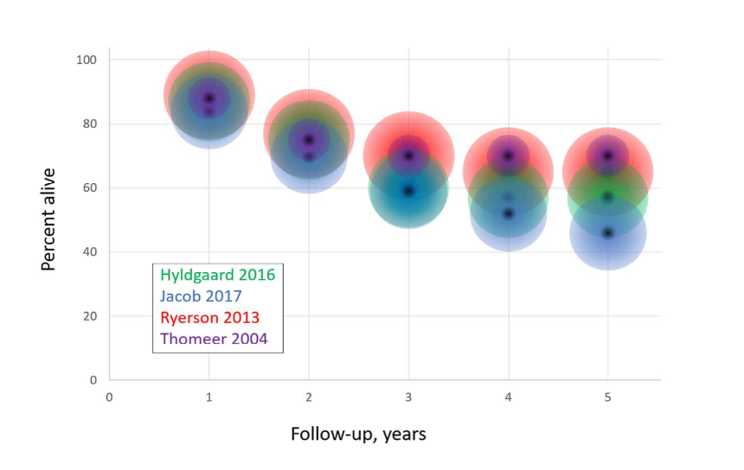
Table 1
Reported survival | in uILD
1-year survival: | ~84–89%
2-year survival: | ~70–76%
5-year survival: | ~46–70%
Guler SA, Ann Am Thorac Soc 2018; 15: 854–863)
Notes:
Reported survival of unclassifiable ILD from the literature is around 84-89% at 1-year, 70-76% at 2 years and 46-70% at 5 years

Slide 29
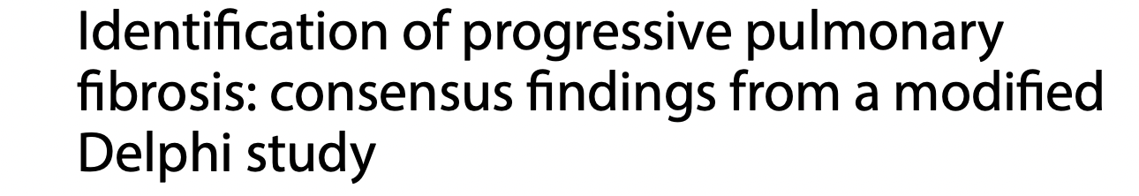
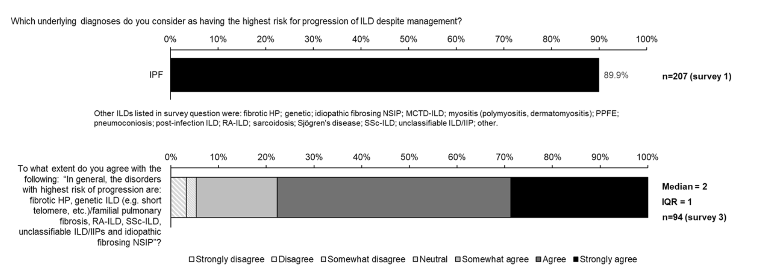
Strong agreement that unclassifiable ILDs (together with IPF) are among the ILDs most likely to progress.
Wells AU, Respir Res 2024
Notes:
-This expert consensus project was very interesting: expert clinicians discussed hòw they recognìze and follow progrèssion in fibrosing ILDs in everyday practice.
-Interestingly, there was a strong agreement that unclassifiable ILDs (together with IPF) are among the ILDs most likely to progress.

Slide 30
Do unclassifiable ILDs behave aggressively?
uILDs often include heterogeneous fibrotic phenotypes
Many patients already show “high-risk” features at presentation
Frequent presence of extensive fibrosis or UIP-like morphology
Functional impairment is often already significant
Diagnostic uncertainty does not necessarily mean biologically mild disease
Some uILDs may actually represent “occult” progressive fibrotic ILDs
Therefore, progression risk may be driven more by underlying fibrotic burden than by diagnostic label itself
Wells AU, Respir Res 2024
Notes:
-The authors did not provide a specific biological explanation for why unclassifiable ILDs are considered at high risk of progression, but probably reflects the fact that uILD often includes heterogeneous fibrotic cases with high-risk features, such as extensive fibrosis, UIP-like morphology, or impaired lung function.

Slide 31
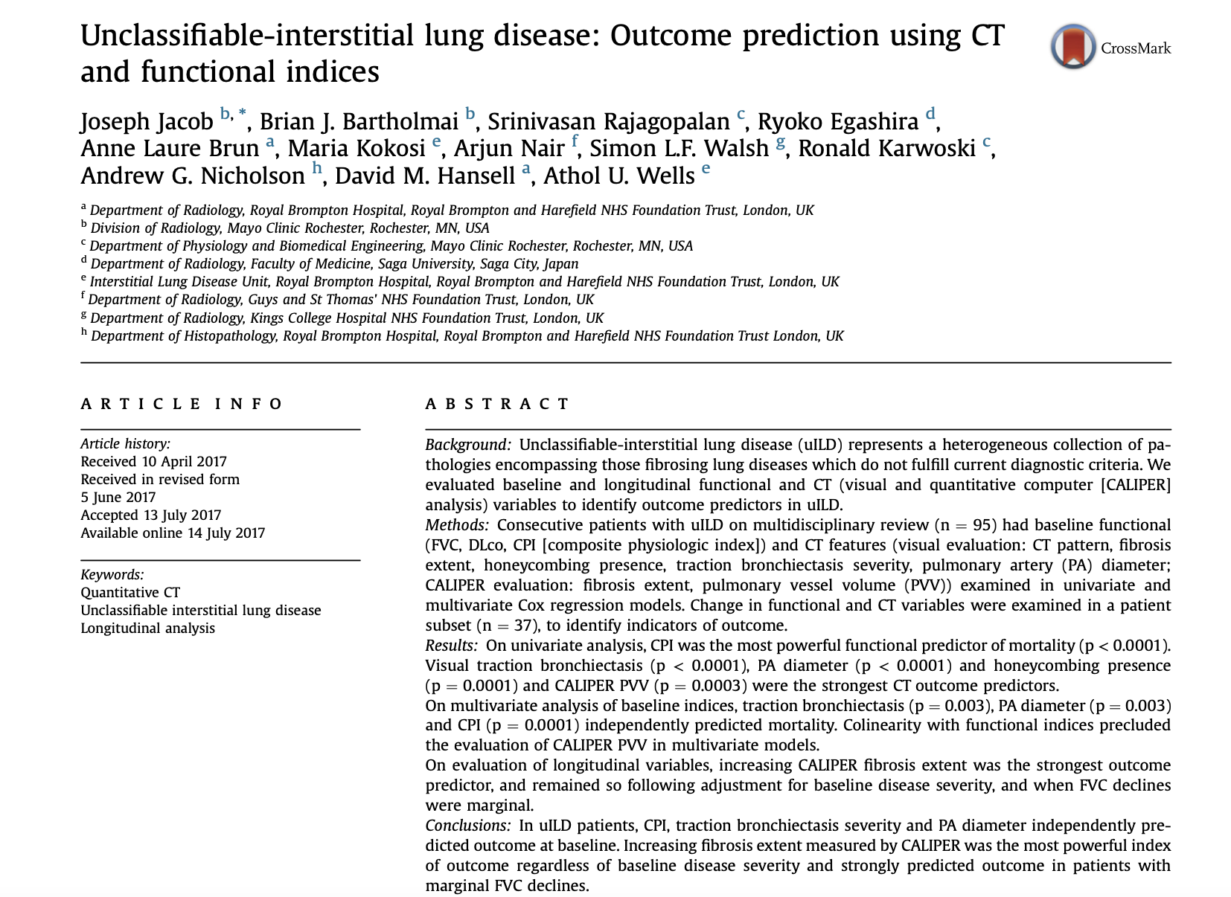

Notes:
-Regarding outcome prediction, this study has identified several new findings in patients with uILD:
Firstly, CPI, traction bronchiectasis severity and PA diameter independently predicted outcome at baseline
However, increasing fibrosis extent measured by CALIPER was the most powerful index of outcome regardless of baseline disease severity and strongly predicted outcome in patients with marginal FVC declines

Slide 32

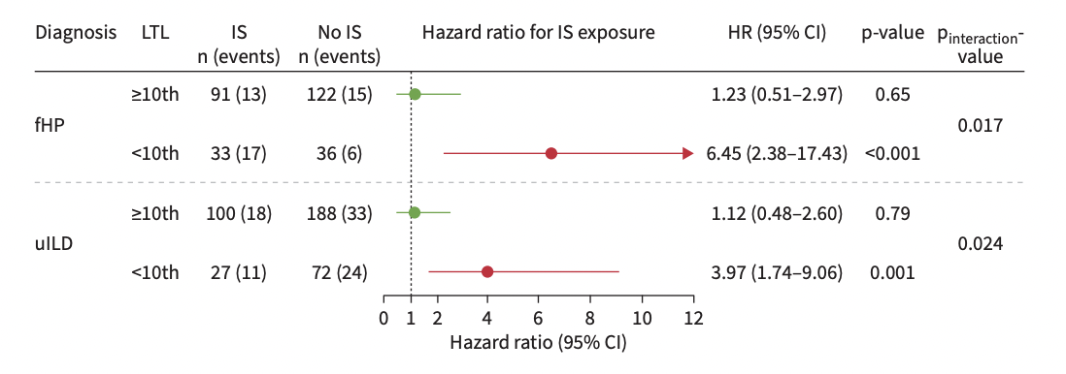
uILD patients with short telomeres showed poorer response to immunosuppression.
Markedly reduced transplant-free survival with MMF/AZA exposure
Suggested hidden biological endotypes beneath the “unclassifiable” label
Biology may influence treatment response more than morphology alone
Zhang D, Eur Respir J 2023
Notes:
-In this paper, the authors investigated whether a biological marker could identify a subgroup of unclassifiable ILD patients with a different therapeutic response.
-And interestingly, they found that uILD patients with markedly shortened leukocyte telomere length had significantly worse transplant-free survival when exposed to immunosuppressive therapy (MMF or azatioprine).
-Conceptually, this is extremely important, because it suggests that beneath the label of “unclassifiable” there may actually be distinct biological endotypes.

Slide 33
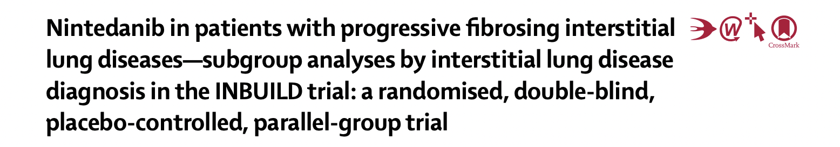
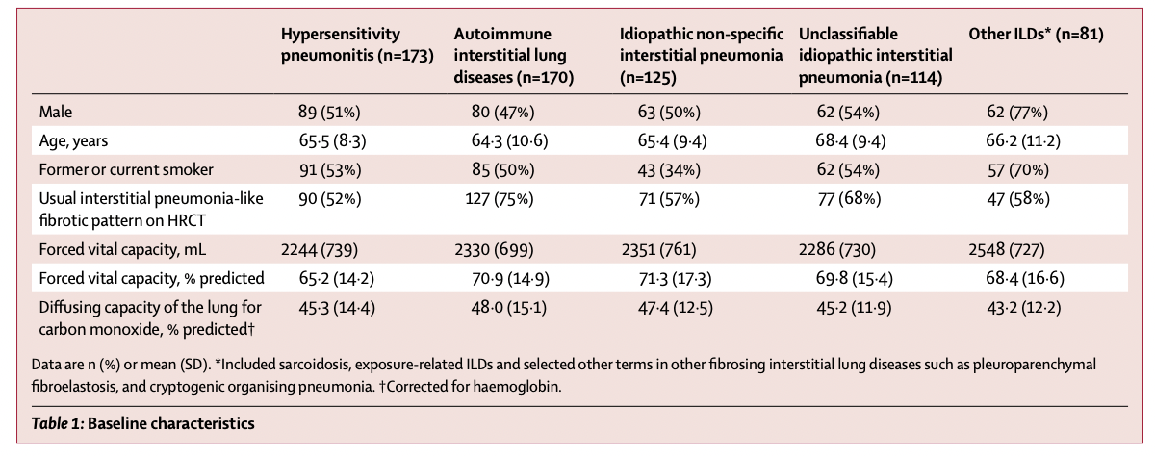
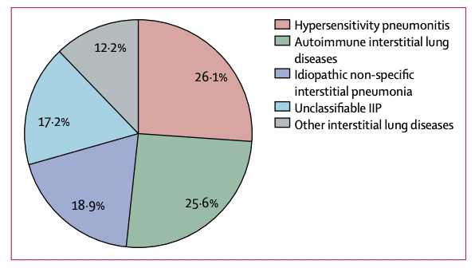
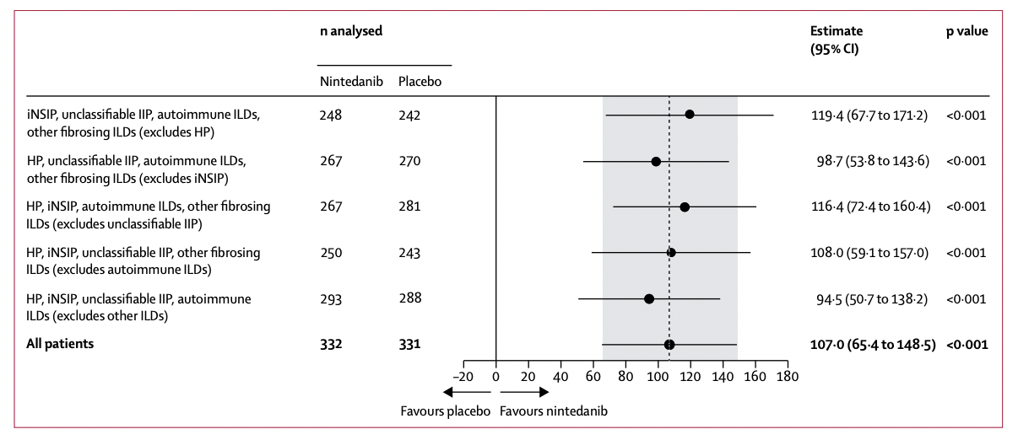
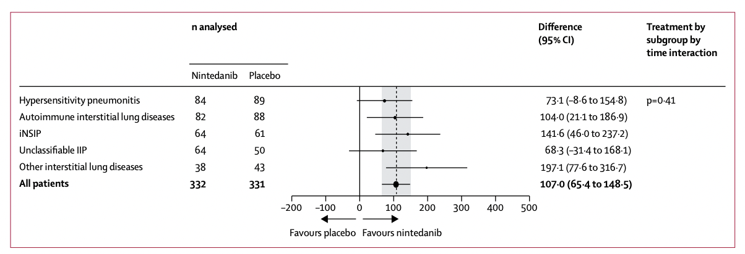
Even when the diagnosis is uncertain, progression is actionable
Wells AU, Lancet Respir Med 2020
Notes:
-On the other hand, the antifibrotic era has changed the meaning of unclassifiable ILD, as even when the diagnosis is uncertain, progression is actionable.
-In this subgroups analysis of INBUILD population, the effect of nintedanib vs placebo on reducing the rate of FVC decline was consistent across the 5 pre-specified subgroups based on the different ILD diagnoses, including unclassifiable ILDs (which were 17% of the total cohort)

Slide 34

ILDs diagnoses | UIP-like HRCT Nintedanib (n=206) | UIP-like HRCT Placebo (n=206) | non-UIP HRCT Nintedanib (n=126) | non-UIP HRCT Placebo (n=125)
HP | 44 (21.4) | 46 (22.3) | 40 (31.7) | 43 (34.4)
Autoimmune ILDs | 62 (30.1) | 65 (31.6) | 20 (15.9) | 23 (18.4)
RA-ILD | 36 (17.5) | 41 (19.9) | 6 (4.8) | 6 (4.8)
Ssc-ILD | 17 (8.3) | 7 (3.4) | 6 (4.8) | 9 (7.2)
Mixed CTD-ILD | 4 (1.9) | 8 (3.9) | 3 (2.4) | 4 (3.2)
Other autoimmune ILDs | 5 (2.4) | 9 (4.4) | 5 (4.0) | 4 (3.2)
Idiopathic NSIP | 34 (16.5) | 37 (18.0) | 30 (23.8) | 24 (19.2)
Unclassifiable IIPs | 43 (20.9) | 34 (16.5) | 21 (16.7) | 16 (12.8)
Other ILDs | 23 (11.2) | 24 (11.7) | 15 (11.9) | 19 (15.2)
114 patients with unclassifiable idiopathic interstitial pneumonia (uIIP) included
68% showed a UIP-like fibrotic pattern on HRCT
UIP-like morphology is common even in diagnostically unclassifiable disease
Radiologic overlap with the IPF spectrum is frequent in unclassifiable IIP
Flaherty KR, et al. N Engl J Med 2019
Notes:
-Interestingly, in the INBUILD study, a UIP-like fibrotic pattern was present in nearly 70% of patients with unclassifiable IIP, suggesting that many of these patients may actually lie biologically close to the IPF spectrum, despite the absence of a confident formal diagnosis.

Slide 35
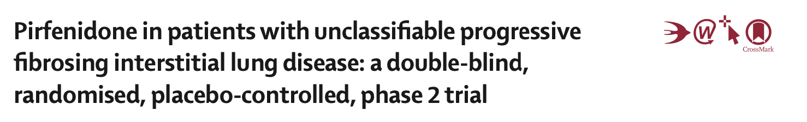
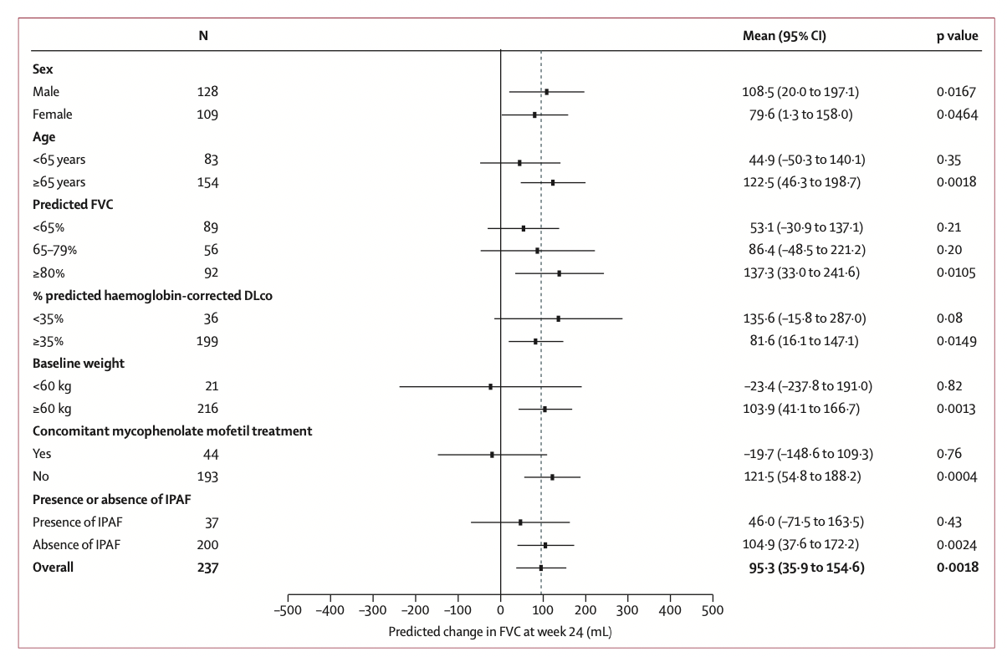
Maher TM, et al. Lancet Respir Med 2020
Notes:
-On the other hand, this was the first randomized controlled trial specifically designed for patients with progressive fibrosing unclassifiable ILDs.
-Although the primary endpoint based on home spirometry was affected by technical limitations, the key secondary endpoints consistently favored pirfenidone. In particular, pirfenidone reduced FVC decline and decreased the proportion of patients experiencing significant functional deterioration.

Slide 36
When facing unclassifiable ILD… ask the right questions
Unclassifiable ILD should not be viewed as a static label, but rather as a dynamic diagnostic state requiring continuous reassessment over time
Is it truly unclassifiable… or simply incompletely evaluated?
What is the dominant disease behavior?
  Is this disease stable? Predominantly inflammatory? Progressive fibrosing? Acute or subacute?
What biology is plausible?
Would additional testing actually change management?
Notes:
-How should we actually approach a patient with unclassifiable ILD in real life?
—-> Unclassifiable ILD should not be viewed as a static label, but rather as a dynamic diagnostic state requiring continuous reassessment over time
1) The first question is whether the disease is truly unclassifiable… or simply incompletely evaluated.
2) Second key point is understanding the dominant disease behavior: is this disease stable? predominantly inflammatory? progressive fibrosing? acute or subacute?
3) Then comes another crucial question: what biology is plausible beneath the unclassifiable label?
4) Furthermore, we should always ask whether additional testing would actually change management

Slide 37
Research priorities for unclassifiable ILD
What is the definition of unclassifiable ILD?
What workup is necessary prior to assigning a diagnosis of unclassifiable ILD?
How and how frequently should patients with unclassifiable ILD be re-screened for CTD?
What variables predict progression of unclassifiable ILD?
Ryerson C, et al. ERJ 2025
Notes:
-Finally, as suggested by the new classification, uILDs should be a major research priority
1) We still do not have a universally accepted definition: different centers may apply different thresholds of diagnostic confidence, different workups, or different interpretations during MDD.
2) We still do not know what is the minimum diagnostic evaluation required before concluding that an ILD is truly unclassifiable.
3) Another major issue is longitudinal reassessment: many patients initially considered unclassifiable may later evolve into a recognizable CTD-ILD or another defined entity, raising the question of how and when we should systematically re-screen these patients over time.
4) And finally, one of the most clinically relevant unmet needs is identifying predictors of progression

Slide 38
Thank you for your attention
Notes:
Thanks

