Slide 1

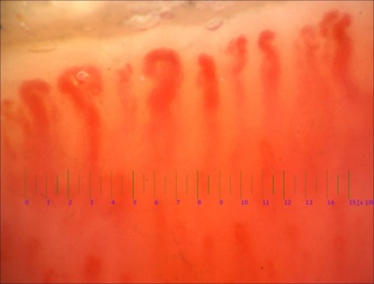
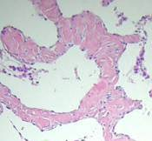
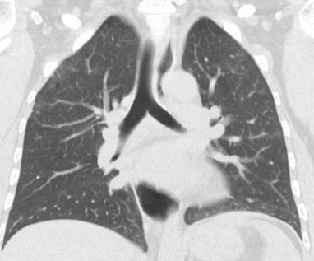


La videocapillaroscopia nella diagnosi e follow-up delle EGPA
Prof Barbara Ruaro, MD, EPhD,
SC Pneumologia, Università degli Studi di Trieste

Slide 2
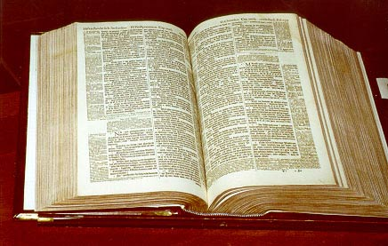
Agenda
I) Capillaroscopia ungueale (NVC). Che cos'è?
II) NVC nella valutazione
del danno microvascolare: fenomeno di Raynaud primario (PR)
vs PR secondario e pattern sclerodermico (Early, Active, Late)
III) NVC nella diagnosi e nel follow-up
IV) NVC nelle vasculiti
Notes:
NVC in scleroderma validated ma anche in altre patologie tra cui le vasculiti nostro lavoro

Slide 3
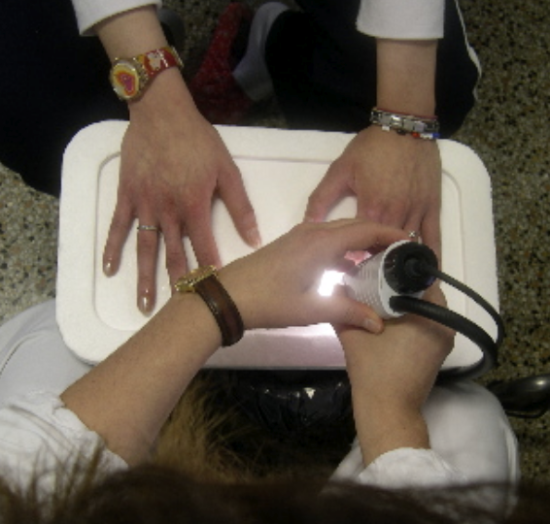
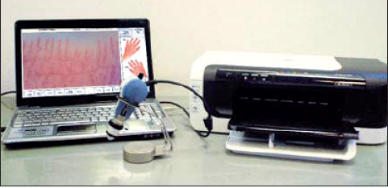
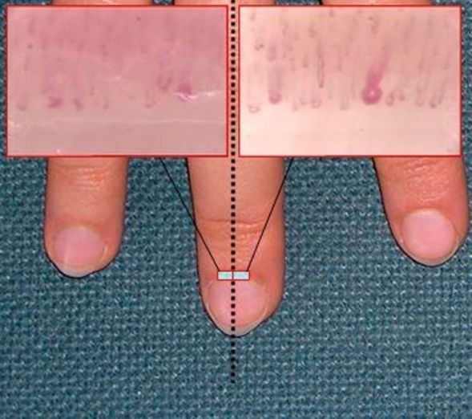
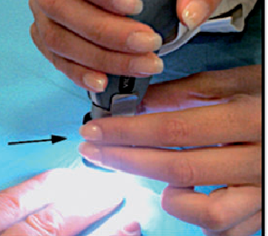
Videocapillaroscopia ungueale (NVC)
La videocapillaroscopia ungueale (NVC) è il metodo migliore, sicuro, non invasivo e validato per studiare le anomalie microvascolari morfologiche. La NVC consente di distinguere il fenomeno di Raynaud secondario (RP) sia dal RP primario che da soggetti sani, di identificare i pattern morfologici del danno microvascolare (pattern "Early", "Active" e "Late") e di calcolare il punteggio di evoluzione della microangiopatia (MES) per seguire l'evoluzione della malattia
Cutolo M, Smith V. State of the art on nailfold capillaroscopy: a reliable diagnostic tool and putative biomarker in rheumatology? Rheumatology (Oxford). 2013 Nov;52(11):1933-40.
Cutolo M, et al.. J Rheumatol 2010;37:1174-80
Sulli A, et al. Arthritis Rheum. 2012; 64:821-5.
Smith V, et al. Ann Rheum Dis. 2012; 71:1636-9.

Slide 4
Videocapillaroscopia ungueale (NVC)
Display
Software
Sonda
Camera
Lente d’ingrandimento
Letto ungueale
Sorgente di luce
Cutolo M, Smith V. State of the art on nailfold capillaroscopy: a reliable diagnostic tool and putative biomarker in rheumatology? Rheumatology (Oxford). 2013 Nov;52(11):1933-40.
Notes:
The main components of a nailfold capillaroscope typically include the following parts:
Light Source:
Often an LED or halogen light that illuminates the nailfold area to enhance visibility of the capillaries.
Magnifying Lens:
A high-power lens that allows for the detailed observation of capillary structures. This magnification is crucial for assessing capillary diameter, density, and other morphological features.
Camera:
A digital camera or a video camera that captures images or video of the nailfold capillary bed. This enables documentation and further analysis.
Display Screen:
A screen that shows real-time images captured by the camera. This helps in observing the capillaries during the procedure and allows for immediate assessment.
Stage or Imaging Platform:
A stable surface where the patient's hand is positioned and held in place for accurate imaging of the nailfold area.
Software for Analysis:
Computer software that aids in processing, analyzing, and interpreting the images, offering insights into capillary health and abnormalities.
Pressure Mechanism (if applicable):
Some devices incorporate a system to slightly press on the nail fold to enhance visibility and prevent movement during the examination.
Probe:
A tool used to gently retract the nail or press the cuticle area for better access and visualization of the capillaries.
Each component plays a crucial role in ensuring high-quality images and accurate assessments of capillary morphology.

Slide 5
Ruolo della videocapillaroscopia ungueale (NVC)
nel fenomeno di Raynaud primario e secondario
Primary RP:
Not related to any condition
Majority of cases:
manifestation of connective tissue disease
Secondary RP
Related to another condition
Many conditions:
Occupational factors: vibrations
Drugs: beta blockers
Oncologic and hematologic disorders
Hypotyroidism
Criteria for primary RP
Episodic attacks of acral pallor or cyanosis
Strong symmetrical pulses
No evidence of digital pitting scars, ulcerations or gangrene
A negative antinuclear antibody test
A normal erythrocyte sedimentation rate
Normal Nailfold capillaries
Criteria for secondary RP
age at onset of more than 30 years
episodes that appear intense, symmetric, painful and/or associated with ischemic
skin lesions
clinical aspects suggestive of a connective tissue disease
presence of specific autoantibodies
evidence of microvascular alterations as assessed by microscopy of nailfold capillaries
Cutolo M, Smith V. State of the art on nailfold capillaroscopy: a reliable diagnostic tool and putative biomarker in rheumatology? Rheumatology (Oxford). 2013 Nov;52(11):1933-40.

Slide 6
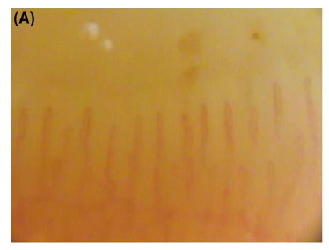
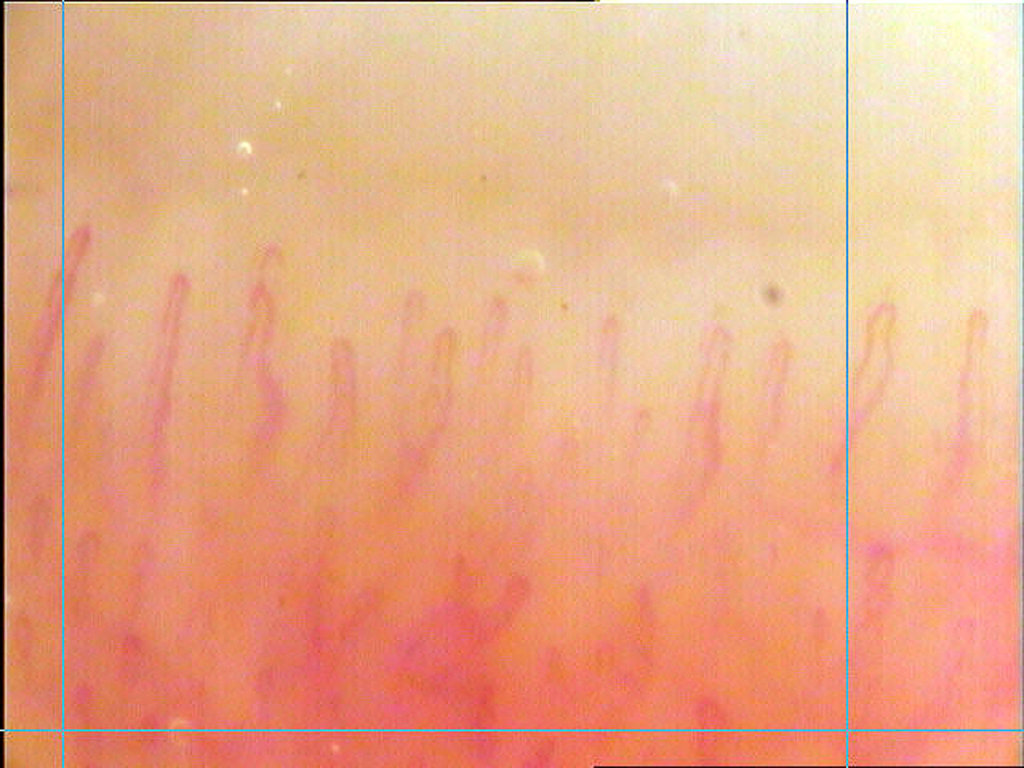

Videocapillaroscopia ungueale (NVC)
nel fenomeno di Raynaud primario
Characteristics of a normal capillaroscopy
Open hairpin shape
Regular arrangement
Numbers between 7-14
Constant morphological pattern
Across the population: wide variation in normal morphology
1mm
Smith V, Cutolo M. When and how to perform the capillaroscopy. Atlas of Capillaroscopy in Rheumatic diseases. Elsevier 2010
LeRoy and Medsger. Clin Exp Rheum.1992
Cutolo M, Smith V. Nailfold Capillaroscopy. In: Varga J, Denton C, Wigley F, editors. Scleroderma: From pathogenesis to comprehensive management. New York: Springer Science+Business Media, LLC; 2012.
Ruaro B, Nallino MG, et al Microcirculation. 2020;27(8):e12647.

Slide 7
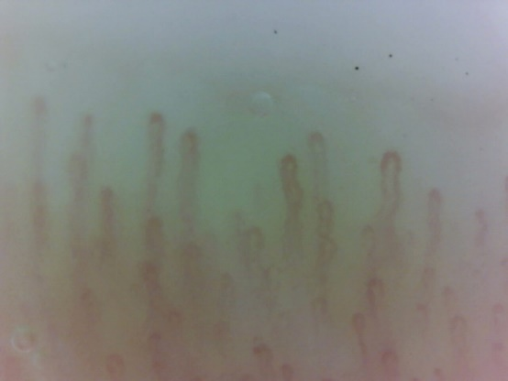
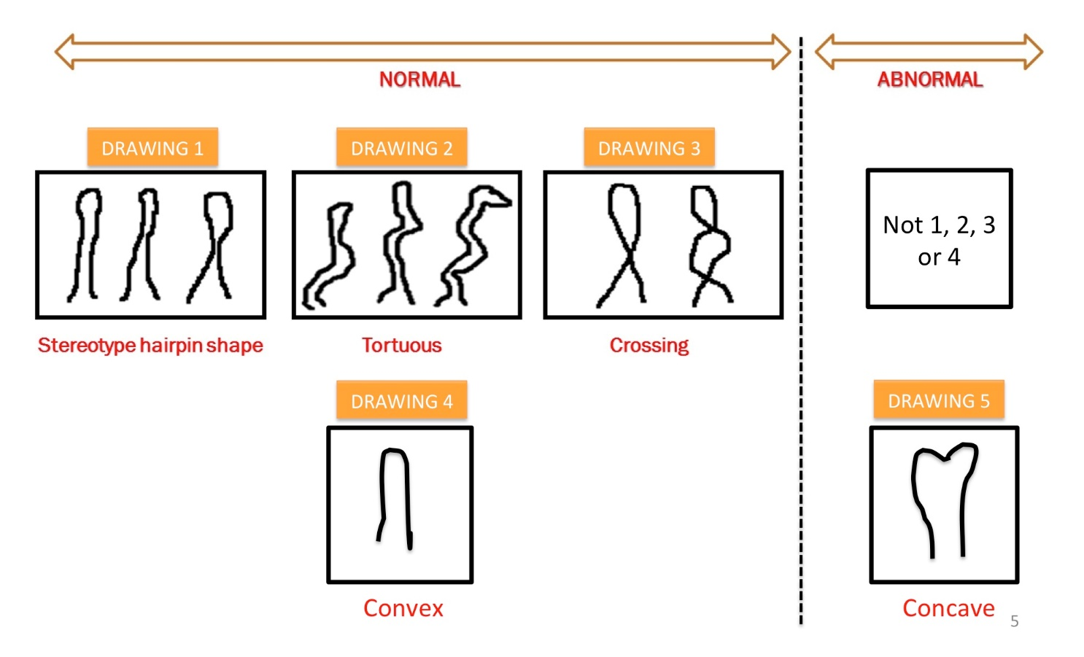
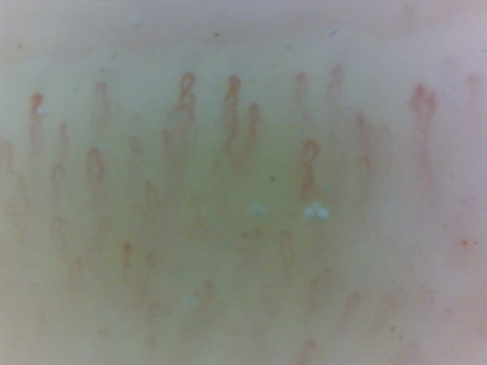
The EULAR study group on Microcirculation in Rheumatic Diseases
The most important capillaroscopic characteristics in PRP
Smith V et al. Rheumatology (Oxford) 2016;55(5):883-90.
Cutolo M et al. Rheumatology (Oxford) 2018;57(4):757-759.

Slide 8
Causes of secondary Raynaud phenomenon
Occlusive vascular disease
Haematologic
Neurologic
Pulmonary hypertension
Drugs
Vibration induced
Vascular trauma
Auto-immunity disease: 90%
(vasculitis, AR, PsA)
Systemic sclerosis > 90%

Slide 9
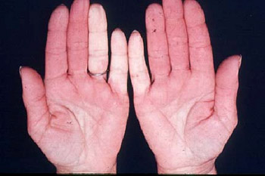
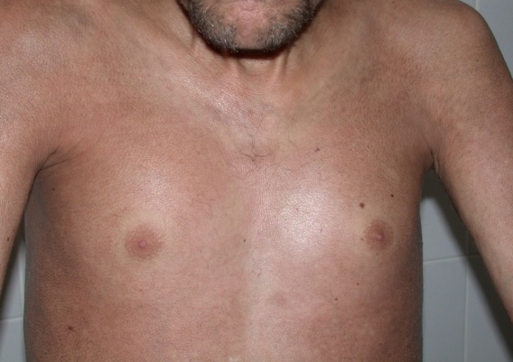
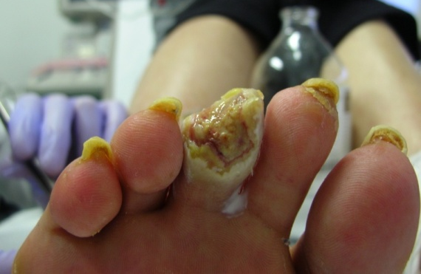
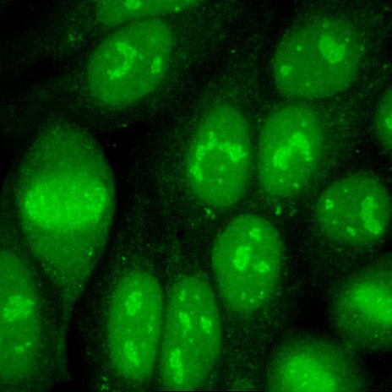
Definition of systemic sclerosis
Rare Systemic disorder:
Fibrosis
Generalised vasculopathy
Auto-Immunity
Antinuclear antibodies (ANA): 90%
SSc- specific antibodies:
Anti-centromere
Anti-topoisomersase I (scl-70)
Anti-RNA polymerase
Anti Th/To
Anti-fibrillarine
Smith V, De Keyser F. Advances in therapies for systemic sclerosis. In: Van Vollenhoven R, editor. Clinical Therapy Research in the Inflammatory Diseases. Singapore: World Scientific Publishing Co. Pte. Ltd; 2015. p. 165-98.
Bonroy C, Van Preat J et al. J Immunol Methods. 2012 May 31;379(1-2):53-60.
Gunther et al. Semin Immunopathol (2015) 37:529–542 Functional antibodis in SSc

Slide 10
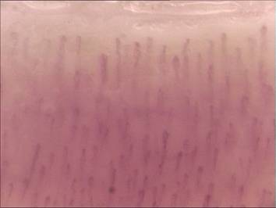
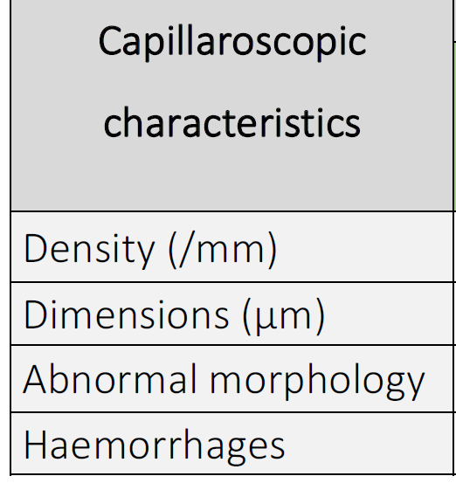
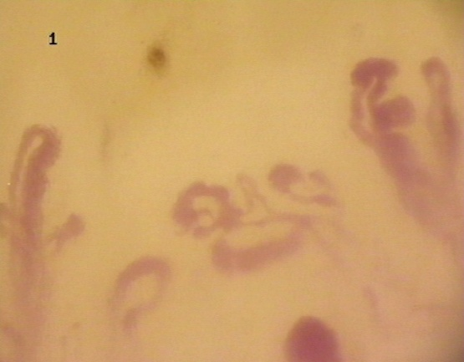

The EULAR study group on Microcirculation in Rheumatic Diseases
The most important capillaroscopic characteristics in PRP and SRP
Cutolo M, Smith V, et al. Autoimmun Rev. 2018 Apr;17(4):344-352. doi

Slide 11
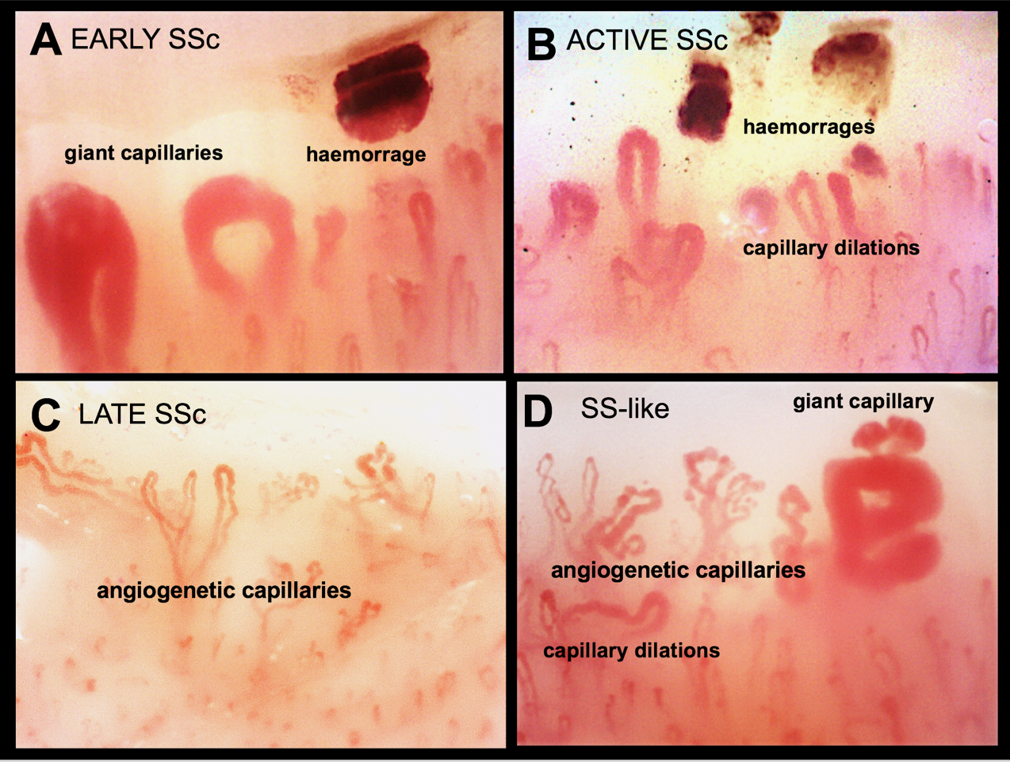
NVC in secondary RP
Specific combination of abnormalites
in scleroderma spectrum diseases: the patterns
Pizzorni et al. Long term follow-up of nailfold videocapillaroscopic changes in dermatomyositis
versus systemic sclerosis patients J Reumatol 2018

Slide 12
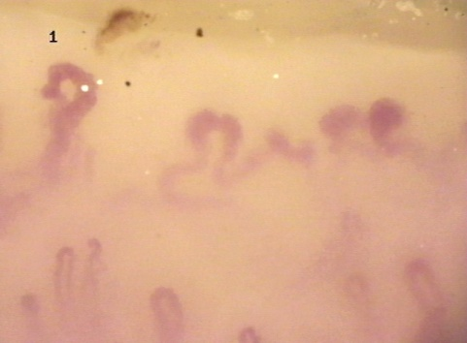
Qualitative assessment of capillaroscopic patterns
Evaluate the average of the eight fingers, from 2nd to 5th
" Early” NVC pattern:
few (< 33%) enlarged/giant capillaries,
few (< 33%) capillary haemorrhages,
relatively well-preserved capillary distribution,
no evident loss of capillaries.
"Active” NVC pattern:
frequent (> 33%) giant capillaries,
frequent (> 33%) capillary haemorrhages,
moderate (<67%) loss of capillaries,
moderate (<67%) disorganisation of the capillary architecture,
absent or few (< 33%) ramified capillaries.
"Late” NVC pattern:
irregular enlargement of the capillaries,
few (< 33%) or absent giant capillaries and haemorrhages,
severe (>66%) loss of capillaries with avascular areas,
disorganisation of the normal capillary array,
ramified/bushy capillaries.
Cutolo M, et al. Rheumatology 2004;43:719-26.
Cutolo M, et al. Nature Rev Rheumatol 2010; 6: 578-87.
Cutolo M. Atlas of capillaroscopy in rheumatic diseases. Elsevier 2010, Milan, Italy.
Notes:
Capillaroscopy, particularly nailfold capillaroscopy, is a diagnostic technique used to visualize the capillaries in the nail fold area. It is primarily employed in the assessment of microvascular pathology, especially in conditions such as systemic sclerosis, dermatomyositis, and other connective tissue diseases. In the context of lung involvement, capillaroscopy can play several roles:
Diagnostic Role
Assessment of Microvascular Damage: In diseases like systemic sclerosis, lung involvement often correlates with changes in microvasculature. Capillaroscopy can identify abnormal capillary patterns, which may indicate lung complications such as pulmonary fibrosis or pulmonary arterial hypertension.
Predictive Factor: Specific capillary patterns observed in capillaroscopy can help predict the likelihood of lung involvement in patients with connective tissue diseases. For instance, the presence of certain capillary abnormalities could indicate a higher risk for developing interstitial lung disease.

Slide 13
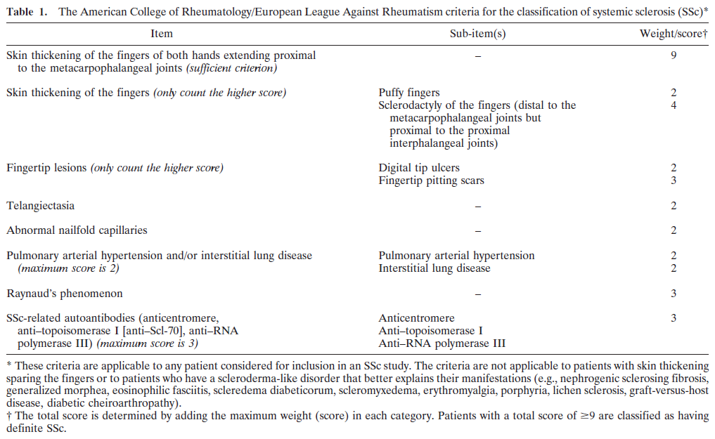
2013 classification criteria for systemic sclerosis: an American college of rheumatology/European league against rheumatism collaborative initiative.
van den Hoogen F et al Ann Rheum Dis. 2013 Nov;72(11):1747-55.

Slide 14
Capillaroscopy
and
organ involvements

Slide 15
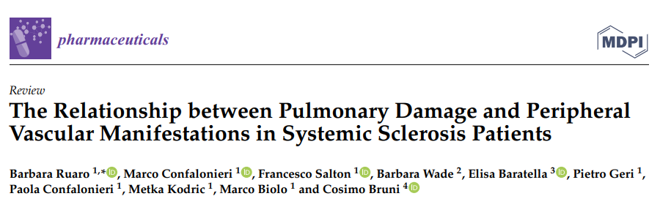
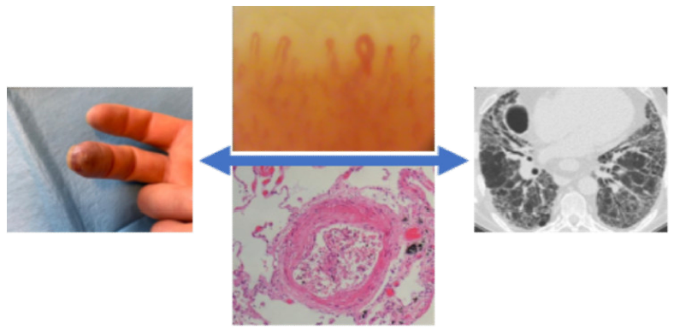
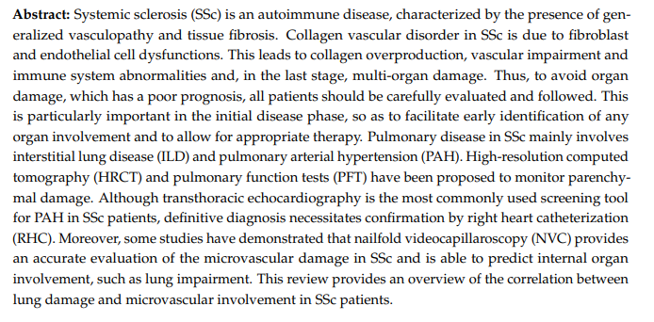
Correlations between peripheral vascular damage
and lung involvement: in connective tissue diseases
RuaroB, et al. Pharmaceuticals 2021, 14, 403.
Hofstee H.M.A., Ann Rheum Dis. 2019, 68:191-195

Slide 16
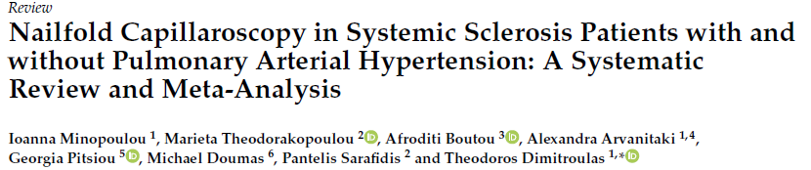
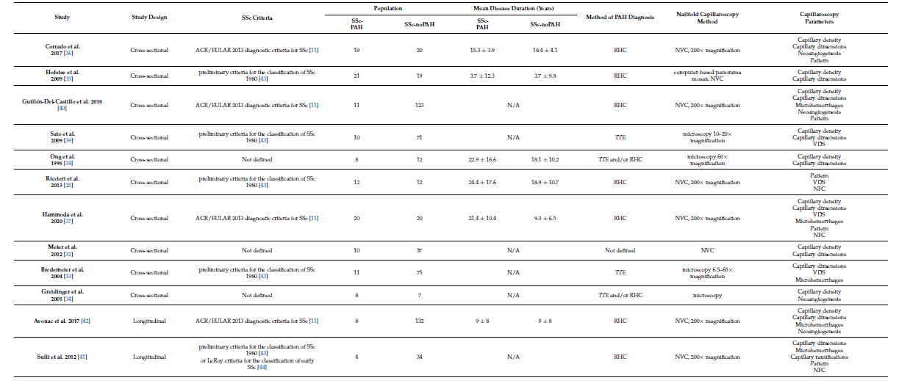
Reduction in capillary density is a MARKER of the presence and severity of PAH
PAH was found significantly more frequently in
patients with the "Active" and "Late“
scleroderma patterns
1. Corrado A, et al. Microvasc Res. 2017.
2. Hofstee HM, et al. Ann Rheum Dis. 2009.
3. Sulli A, et al. Arthritis Rheum. 2012.
4. Avouac J, et al. Semin Arthritis Rheum. 2017.

Slide 17
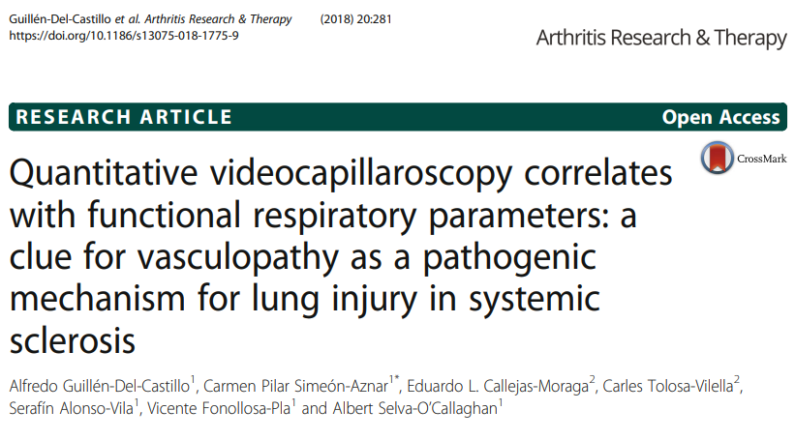
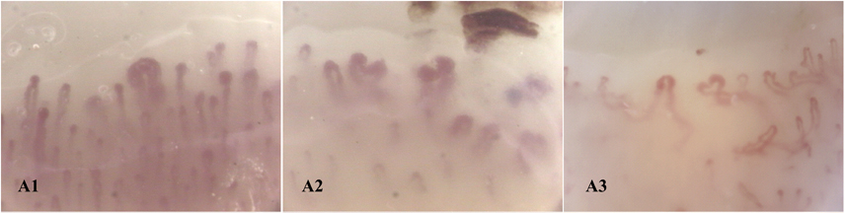
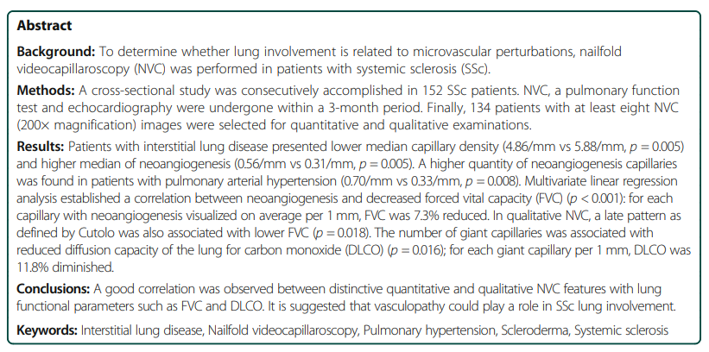
Neoangiogenesis and reduction in capillary density are correlated with ILD
ILD was found significantly more frequently in
patients with "Late” scleroderma patterns
The number of giant capillaries was
associated with reduced DLCO

Slide 18
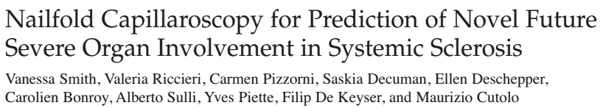
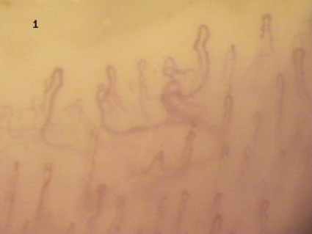
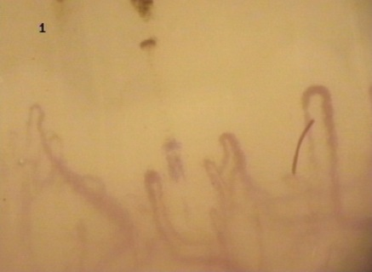
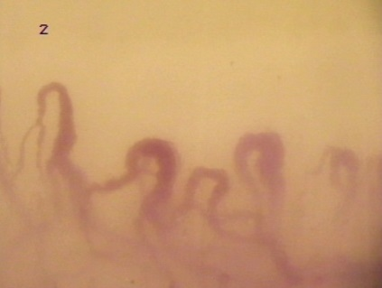
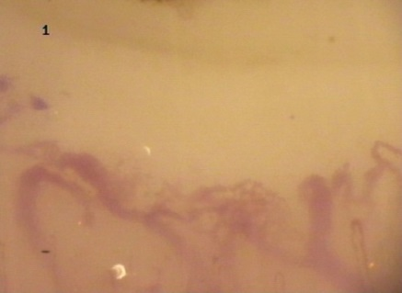
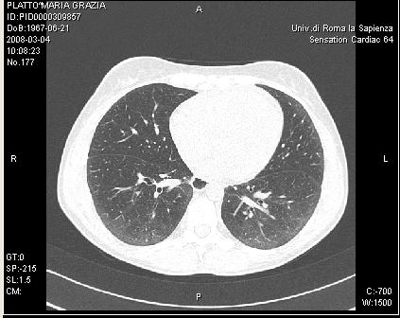
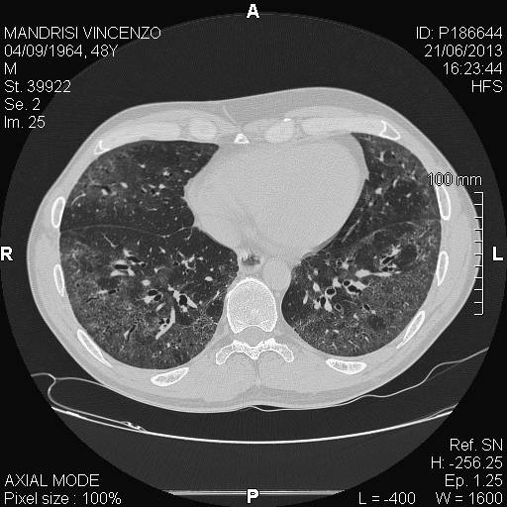
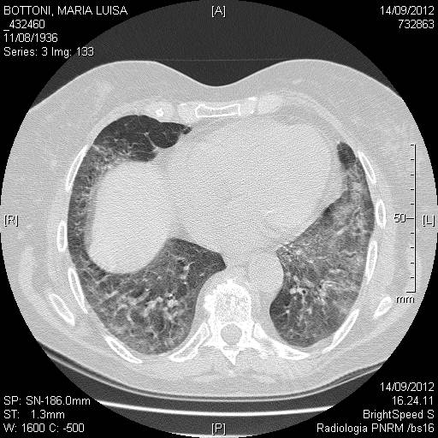
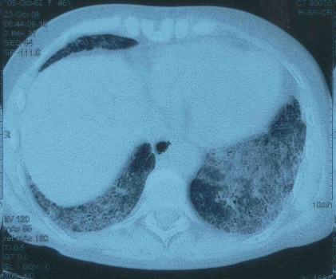
Correlation between NVC and the progression of ILD
The worsening of the capillaroscopy
correlates with the progression of ILD

Slide 19
Capillaroscopy to evaluate drug effect

Slide 20
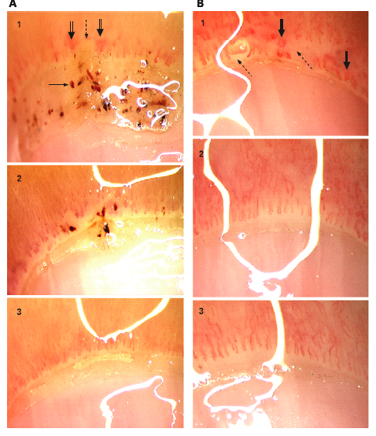
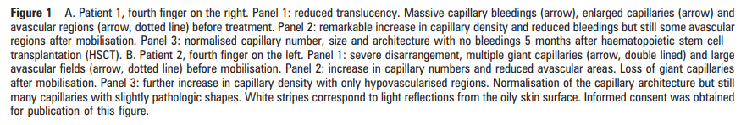
Ann Rheum Dis. 2008;67:1057-9
Rapid improvement of nailfold capillaroscopy after intense immunosuppression for systemic sclerosis and mixed connective tissue disease.
Aschwanden M, Daikeler T, Jaeger KA, Thalhammer C, Gratwohl A, Matucci-Cerinic M, Tyndall A.
The results support the reversibility of the microvascular changes in patients with SSc and MCTD on a short time interval.
Intense immunosuppression (cyclophosphamide) seems to have an impact on vascular remodelling in patients with SSc and MCTD.

Slide 21
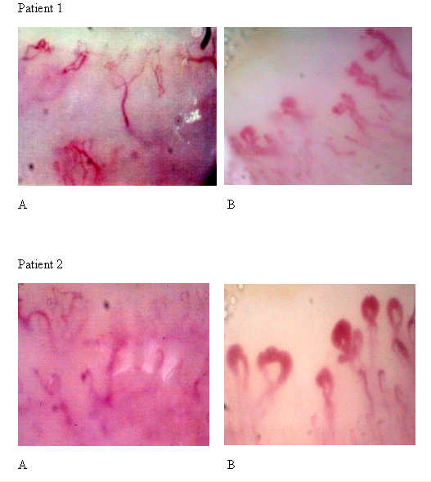
Guiducci S, Bellando Randone S, Bruni C, Carnesecchi G, Maresta A, Iannone F, Lapadula G, Matucci Cerinic M.
Bosentan fosters microvascular de-remodeling in systemic sclerosis
Clin Rheumatol 2012 Dec, 31(12):1723-5
The treatment with bosentan led to a shift from a late to an active pattern characterised by the disappearance of avascular areas. This event significantly improved the microcirculatory network and stabilised the microvasculature up to 1 year of treatment. These results suggest that Bosentan may modulate the structural microvascular modifications detected with NVC. In our patients, after Bosentan treatment, new capillaries and microhaemorrhages were found and occurrence of further ischemic ulcers was not seen.

Slide 22
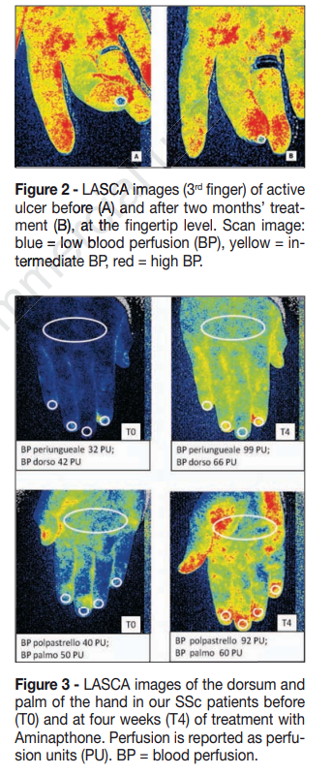
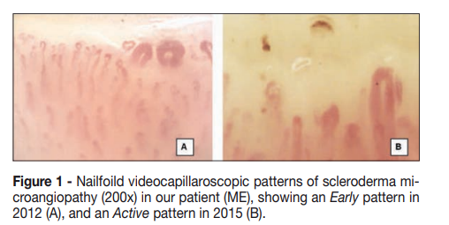
Ruaro B, Paolino S, Pizzorni C, Cutolo M, Sulli A. Assessment of treatment effects on digital ulcer and blood perfusion by laser speckle contrast analysis in a patient affected by systemic sclerosis. Reumatismo. 2017;69(3):134-136. Published 2017 Sep 21. doi:10.4081/reumatismo.2017.986
The patient was put on cyclic intravenous iloprost for Raynaud’s phenomenon, but in 2016, she was no longer able to continue the therapy prescribed due to problems at her workplace. Therefore, aminaphtone (75 mg twice daily) was started, in combination with her other treatments (bosentan, methotrexate and ramipril).

Slide 23
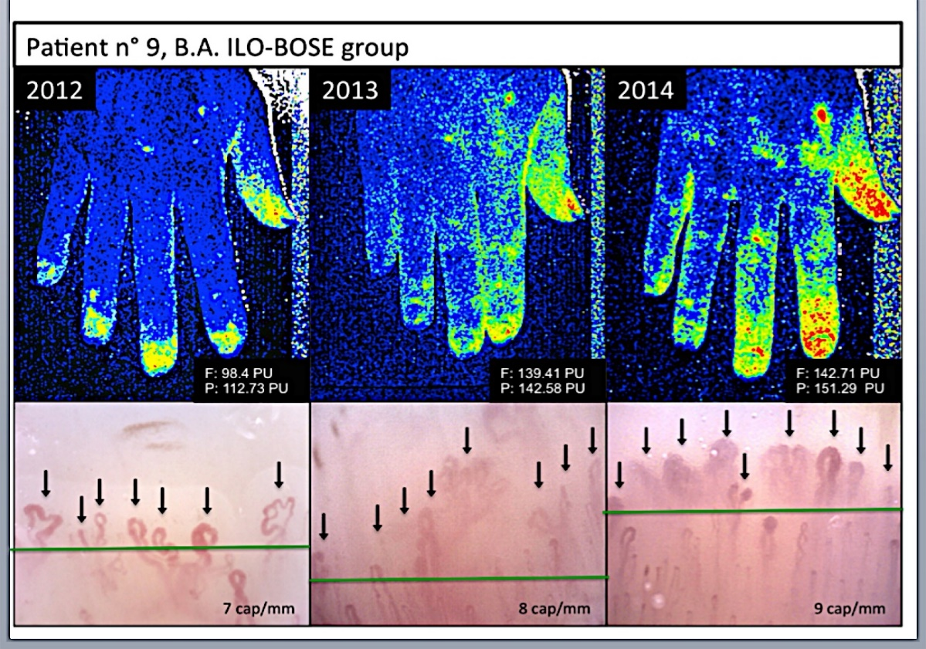
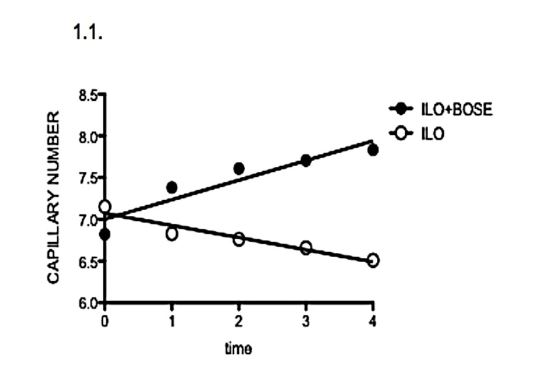
J Rheumatol 2016;43:2033-2041. Trombetta et al.
Effects of long-term treatment with bosentan and iloprost on nailfold absolute capillary number, fingertip blood perfusion and clinical status in systemic sclerosis patients
Results. Ten patients had current DU in the ILO+BOSE group at T0. At T0 ILO+BOSE group had slightly worse values (6.8±1.3 VS 7.1±0.5; p=0.41) for capillary absolute number, compared with ILO group. Values of sPAP (ILO+BOSE: 34.6±9 VS ILO: 29.3±3.4; p=0.01) and DLCO (ILO+BOSE: 64.3±16 VS ILO: 81.3±16; p=0.02) were significantly different between the two groups. No significant differences were observed for other parameters. There was a significant reduction (80%; p=0.0042) in the annual incidence of new DU in the ILO+BOSE group from T0 (10/15 patients) to T4 (2/15 patients).
In the ILO+BOSE group, capillary absolute number was found to have a 14.7% increase from 6.8±1.3 to 7.8±1.5 (p=0.01). On the other hand, in the ILO group, capillary number was found to have a 9.4% decrease from 7.18 ±0.5 to 6.5 ±1.1(p=0.29).
Conclusion. Long-term treatment with BOSE added to ILO in SSc patients, has an effect on structural microvascular alterations, in term of increased capillary number, and stabilizes lung function parameters, compared to ILO mono-therapy.

Slide 24
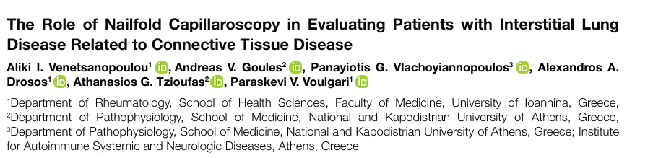
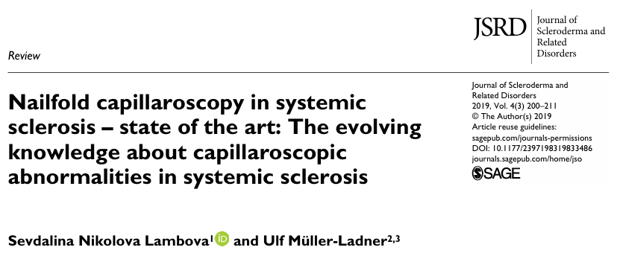
The evolving knowledge about nailfold capillaroscopy in systemic sclerosis will further spread its application from a mainly diagnostic tool to an established, reliable method for evaluation of disease activity, prognosis and therapeutic response.

Slide 25

The correlation between NVC and organ involvement in other rheumatic diseases
Patients with psoriasis have decreased capillary density and a greater presence of morphologically abnormal capillaries when compared to controls.
Several correlations between clinical and laboratory parameters in SLE and capillaroscopic parameters are identified in several articles. Disease activity is correlated with NVC score in seven studies, with abnormal morphology (i.e. "meandering") in one study and with haemorrhages in one study. Frequent attacks of Raynaud's phenomenon (RP) and gangrene are significantly correlated with dilated capillaries. In two studies a possible correlation between anti-SSA antibodies and lower density of capillaries is withheld.
Today, the presence of specific autoantibodies and capillaroscopic findings are generally accepted and emerge as a powerful diagnostic tool for detecting underlying CTD in patients with Raynaud's phenomenon.
Venetsanopoulou AI, et al. Mediterr J Rheumatol. 2023;34(4):588-591
Cutolo M, et al. Autoimmun Rev. 2018;17(4):344-352.
Ribeiro CF, et al. An Bras Dermatol. 2012;87(4):550-553.
Screm G, et al. Diagnostics (Basel). 2024;14(3):254.

Slide 26
Capillaroscopy
in vasculitis

Slide 27
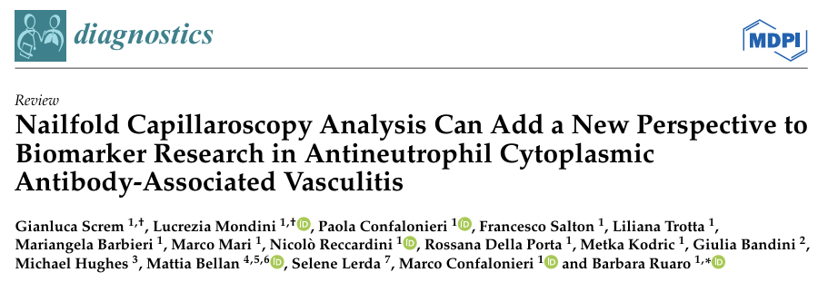


Capillaroscopy in vasculitis
Neoangiogenesis

Slide 28

The literature reported that capillaroscopy investigations documented several abnormalities (neoangiogenesis
and microhaemorrhages) in 70-80% of AAV patients

Slide 29




Capillaroscopy in vasculitis

Slide 30





In AAV common abnormalities were edema and tortuosity

Slide 31



The difference between active phase and non-active phase in AAV patients was clearly discernible. The active phase had higher rates of neoangiogenesis and capillary loss in comparison with non-active vasculitis

Slide 32
Capillaroscopy
in EGPA in our experience

Slide 33

Metodi del nostro studio pilota ..
Single centre
Retrospective case control
Weiss V, …, Ruaro B. OJRD 2026 (In indipendent review)

Slide 34







Risultati
*
Normal
Tortuous capillaries
*
*
1 Fisher’s exact test, Pearsons’s Chi squared test, Pairwise comparison
Pericapillary stippling
Crossed capillaries
**
*
*
Rolling, microhemorrhage
Angiogenesis
Weiss V, …, Ruaro B. OJRD 2026 (In indipendent review)

Slide 35



Capillaroscopy in vasculitis
Several patients showed neoangiogenesis, capillary loss
and microhaemorrhages as the most frequent findings.
Ampliamenti della ricerca …
Weiss V, …, Ruaro B. Frontiers 2026 (In indipendent review)

Slide 36


Capillaroscopy in vasculitis
The active phase showed different capillaroscopy alterations compared to the healthy subjects, such as and bushy and enlarged capillaries
Weiss V, …, Ruaro B. Frontiers 2026 (In indipendent review)

Slide 37




Capillaroscopy in vasculitis
Furthermore, the difference between active phase and non-active phase in AAV patients was clearly discernible. The non-active phase showed similar rates of capillaroscopy alterations compared to the healthy subjects, but the active phase had higher rates in almost all common abnormalities instead.
Weiss V, …, Ruaro B. Frontiers 2026 (In indipendent review)

Slide 38
In sintesi …
NVC rivela alterazioni microvascolari caratteristiche nel’EGPA - pericapillary stippling, rolling, apice rovesciato e microemorragie - reperti che appaiono specifici per l’EGPA e assenti nell’asma grave e negli individui sani
Capillaroscopia possa rappresentare uno strumento aggiuntivo per il rilevamento della microangiopatia vasculitica
Limitazioni
Campione limitato
Trattamento sistemico
Studi futuri
Valutare la relazione tra i reperti della NVC, l’attività clinica e la risposta al trattamento
Determinare se tali pattern morfologici possano funzionare come marcatori non invasivi in vasculite

Slide 39
Take home messages
L’NVC è uno strumento fondamentale per valutare i pazienti con RP
L’NVC può predire una grave vasculopatia periferica e il coinvolgimento viscerale in diverse malattie come la SSc
L’NVC può essere di supporto nel guidare la risposta ai trattamenti nelle connettiviti
L’ NVC rivela alterazioni microvascolari caratteristiche nel’EGPA - pericapillary stippling, rolling, apice rovesciato e microemorragie - reperti che appaiono specifici per l’EGPA e assenti nell’asma grave e negli individui sani
Ulteriori studi sono necessari per valutare se le anomalie osservate all’NVC nell’EGPA possono aiutare nella diagnosi e nel follow-up

Slide 40

Grazie per l’attenzione!

