Slide 1
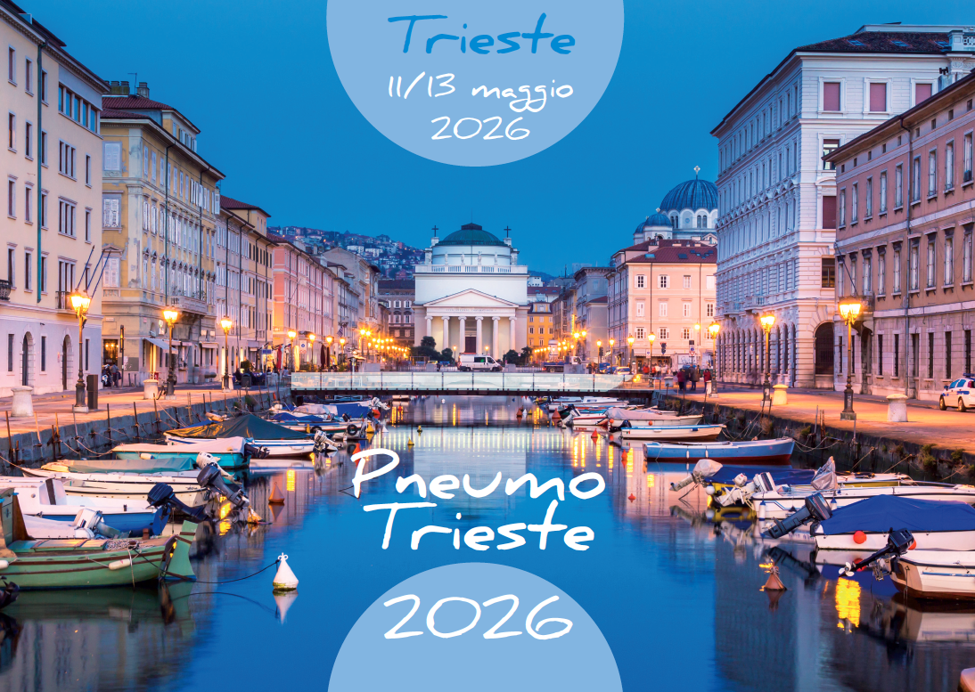
Dispositivi cardiaci impiantabili per il controllo del ritmo: quando e perché
M. Zecchin
SS Elettrofisiologia Diagnostica ed Interventistica
SC Cardiologia Trieste

Slide 2
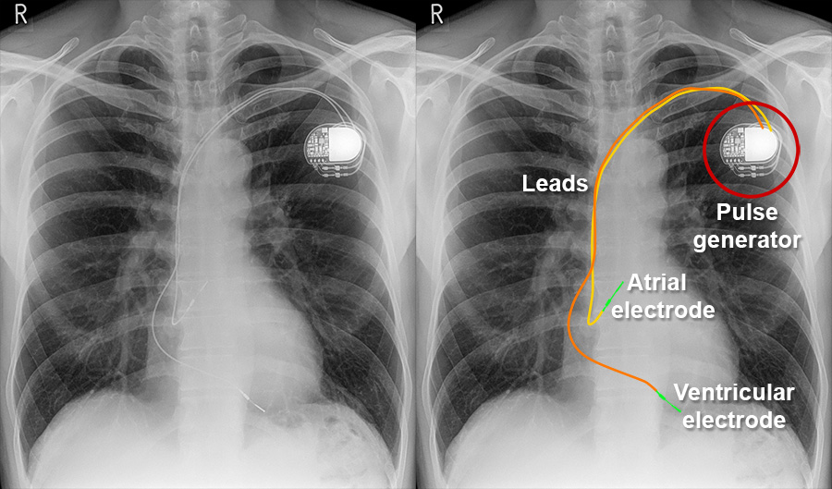
DISPOSITIVI CARDIACI ELETTRONICI IMPIANTABILI (CIED)
Terapia anti-brady
Pacemaker endocavitari (monocamerali, bicamerali)
Terapia per la resincronizzazione cardiaca
  Pacemaker biventricolari (CRT-P)
  Pacemaker con stimolazione della branca sinistra
Pacemaker «leadless» (ventricolari, ventricolari con sensing atrio-ventricolare, atriali)
Terapia anti-tachy
Defibrillatori impiantabili (ICD) endocavitari (monocamerali, bicamerali)
Defibrillatori impiantabili con possibilità di resincronizzazione
  ICD biventricolari (CRT-D)
  ICD con stimolazione della branca sinistra
ICD non endocavitari
  ICD interamente sottocutanei (S-ICD)
  ICD «extravascular (EV-ICD)

Slide 3
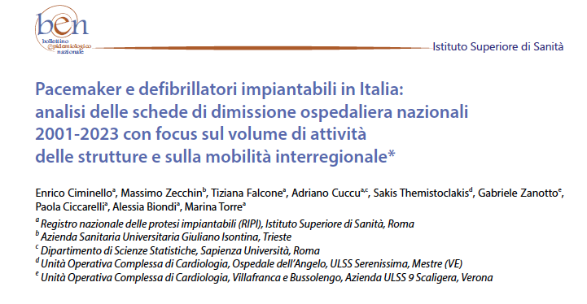
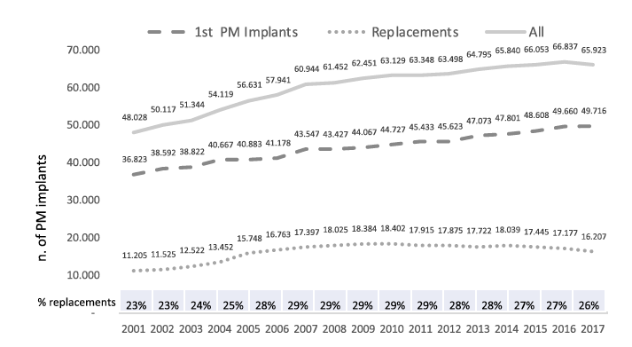
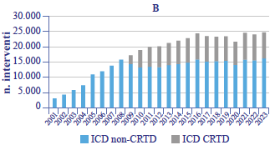
Impianti PM e ICD in Italia: dati SDO (ISS)
2001-2017
Zecchin et al , Eur J Int Med 2020, https://doi.org/10.1016/j.ejim.2020.09.003
Boll Epidemiol Naz 2025;6(1):30-37

Slide 4
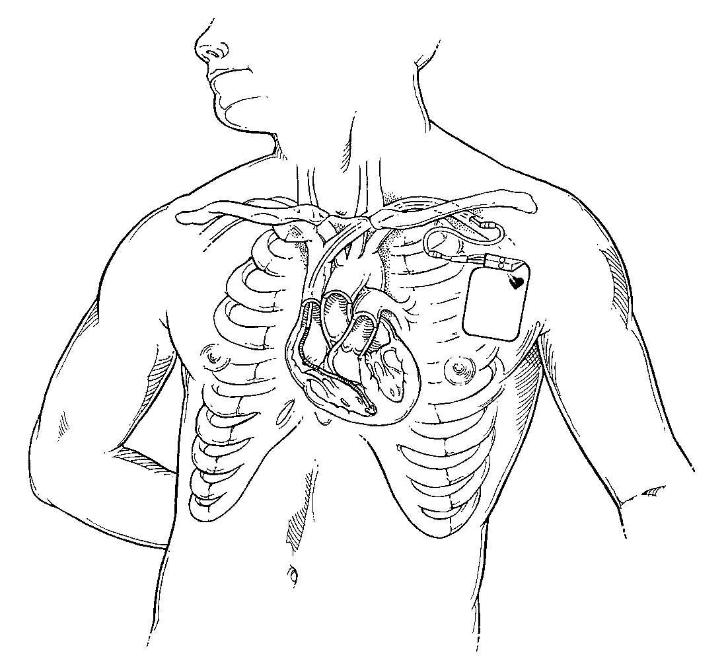
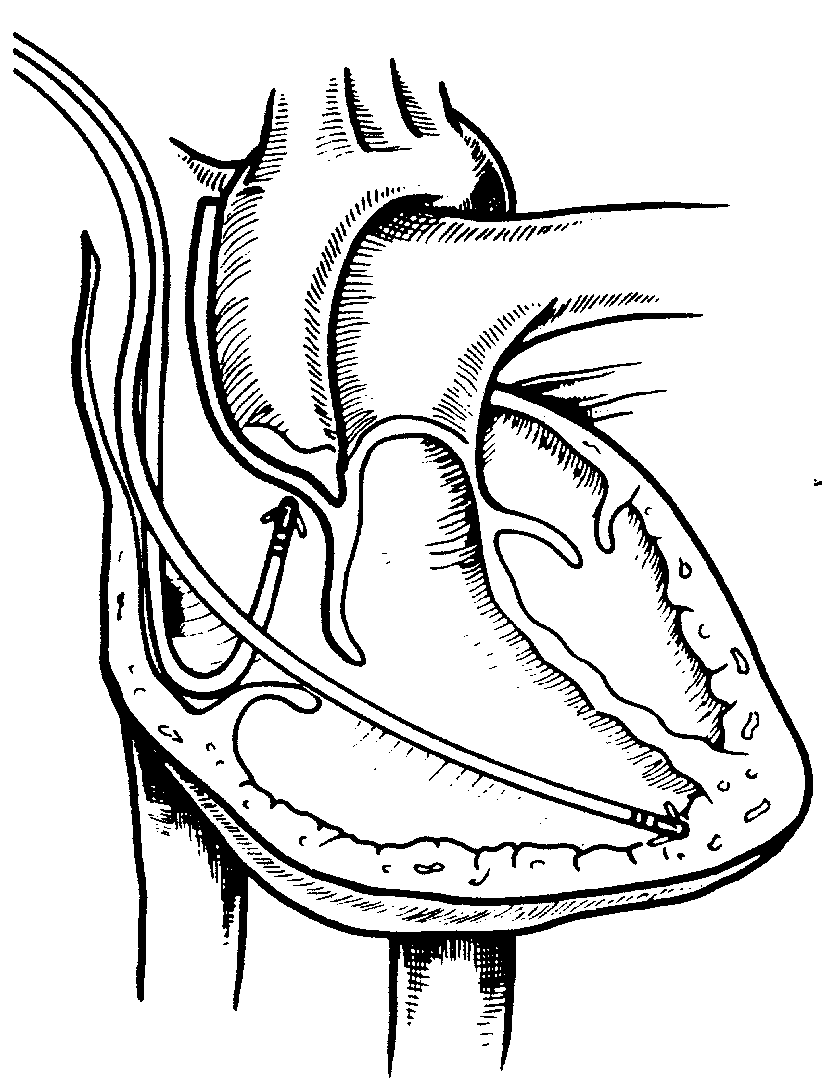
Pacemaker functions
Stimulate to achieve heart depolarization
Detect spontaneous heart activity
Modify pacing rate according to different metabolic demand
Give information
  on pacemaker function
  on heart function

Slide 5
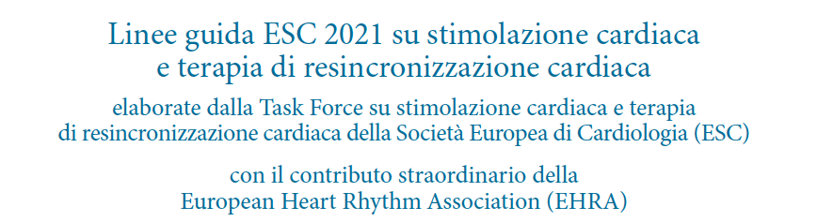


Slide 23
Pacemaker indications according to international guidelines (AHA/ACC/NASPE/ESC/ANMCO/AIAC)
SSS
  Symptomatic sinus bradycardia (HR < 40/min when awake)
  Symptomatic sinus pauses (> 3 sec when awake)
  Symptomatic chronotropic incompetence
AV block
  II degree AVB type 2
  Advanced AVB during SR or AFib
  Total AVB
Intraventricular block
  Trifascicular block (RBBB alternated with LBBB, RBBB + LAE alt. with RBBB + LPE)
  Bifascicular block (LBBB, RBBB + LAE, RBBB + LPE) with syncope

Slide 24
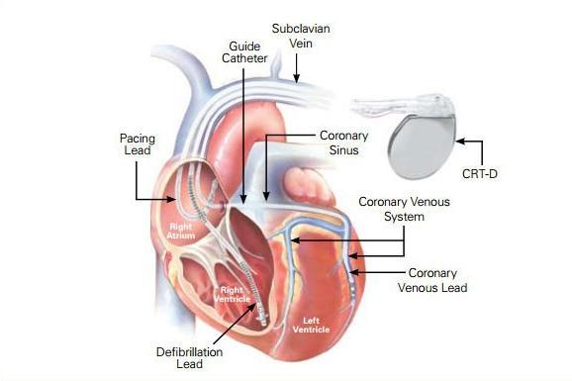
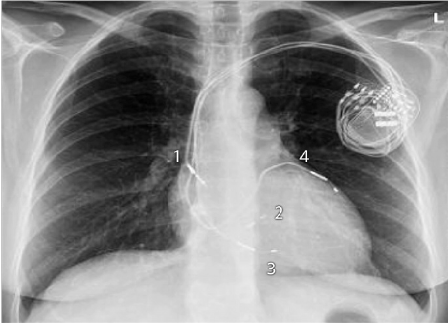
Terapia di resincronizzazione (CRT-P/CRT-D)

Slide 27
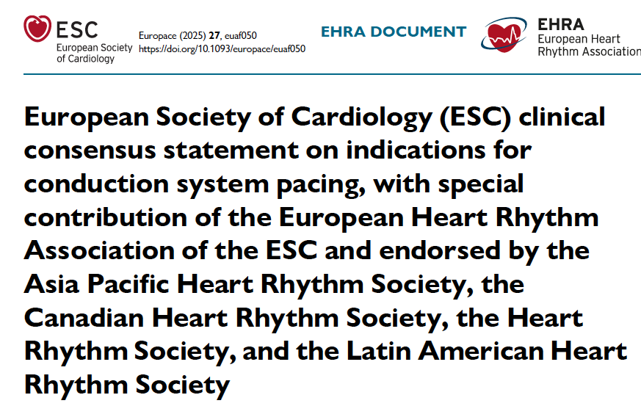
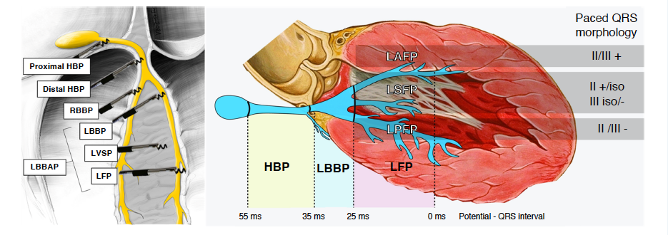
CONDUCTION PACING SYSTEM (CSP)

Slide 28
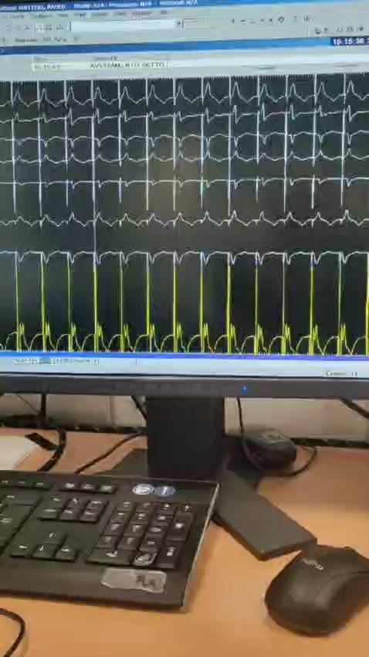
Stimolazione della branca sinistra
V6
V1

Slide 29
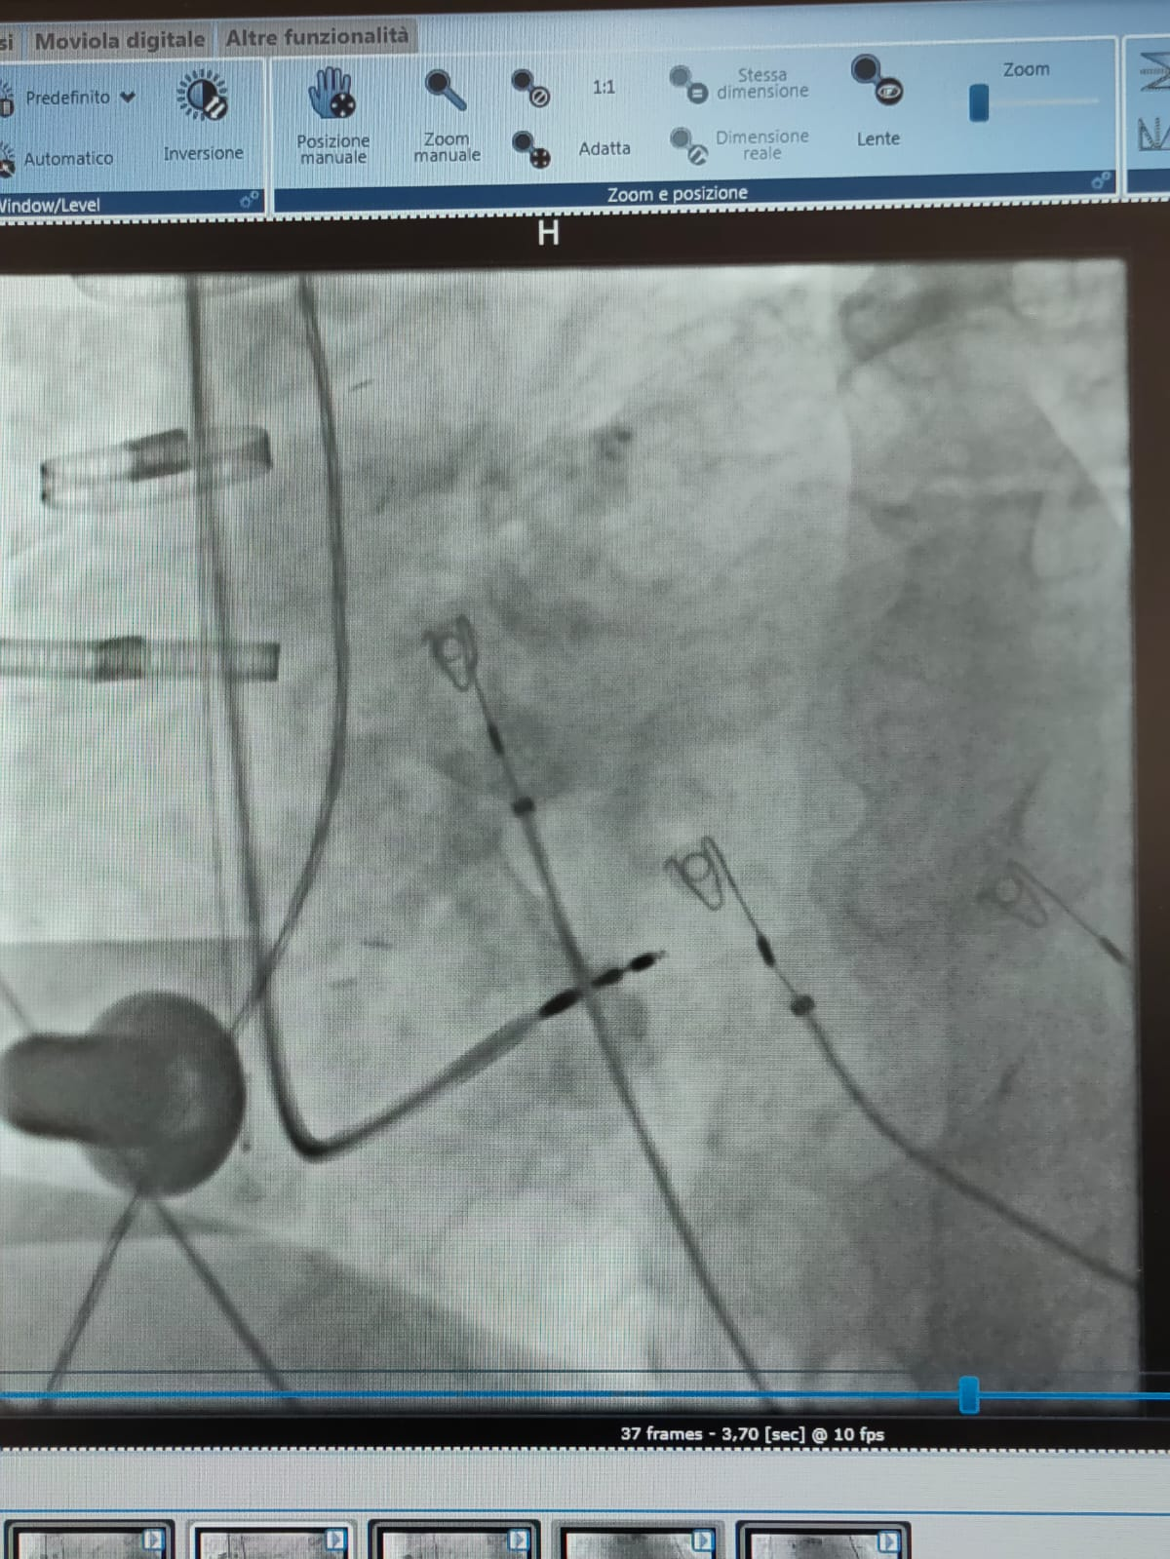
Stimolazione della branca sinistra

Slide 30
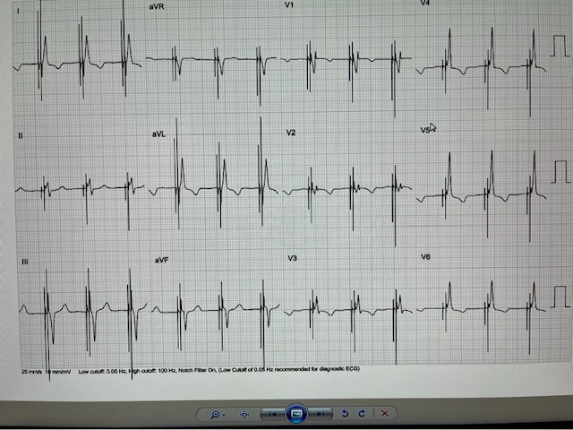
Stimolazione della branca sinistra

Slide 31
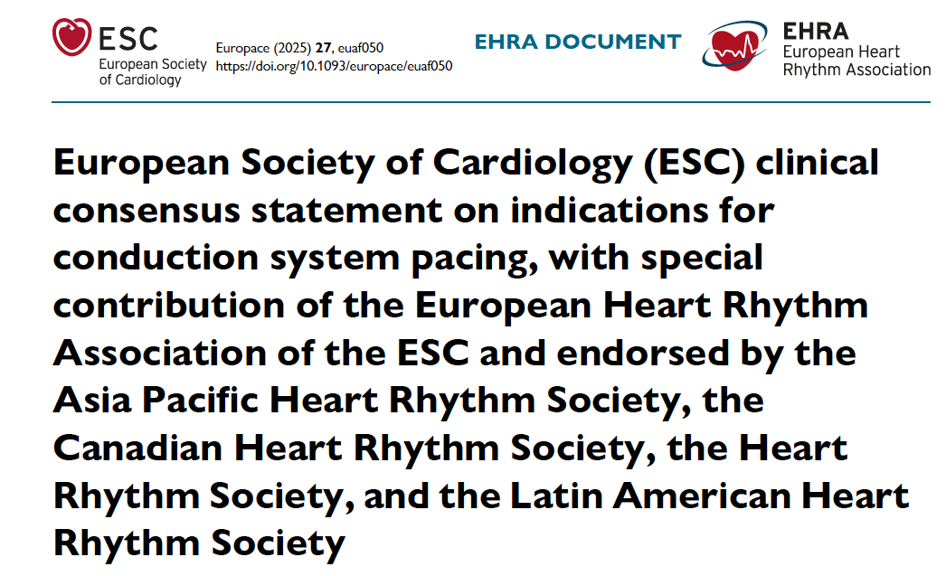
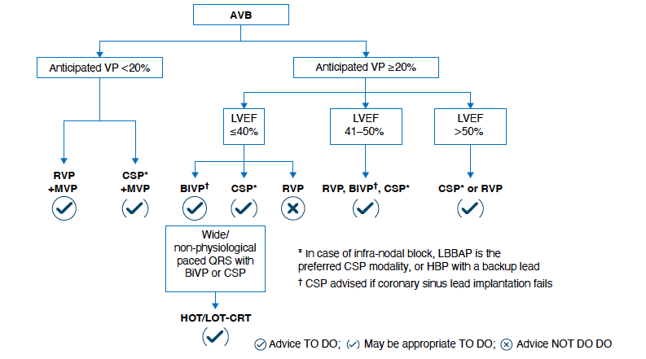
Summary of CSP indications
AVB, atrioventricular block;
BiVP, biventricular pacing;
CSP, conduction system pacing;
HBP, His bundle pacing;
HOT/LOT-CRT, His-optimized or left bundle-optimized cardiac resynchronization therapy;
LBBAP, left bundle branch area pacing
LVEF, left ventricular ejection fraction;
MVP, minimized ventricular pacing;
RVP, right ventricular pacing.

Slide 32
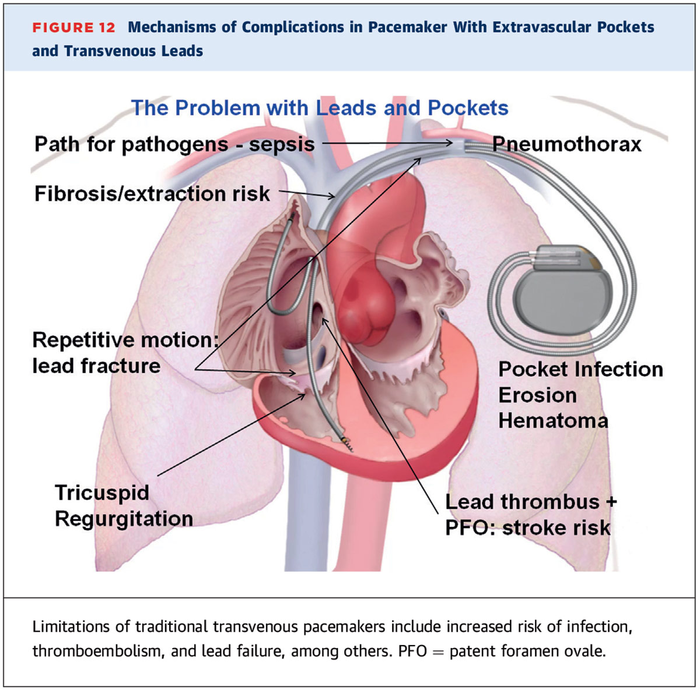

Slide 33
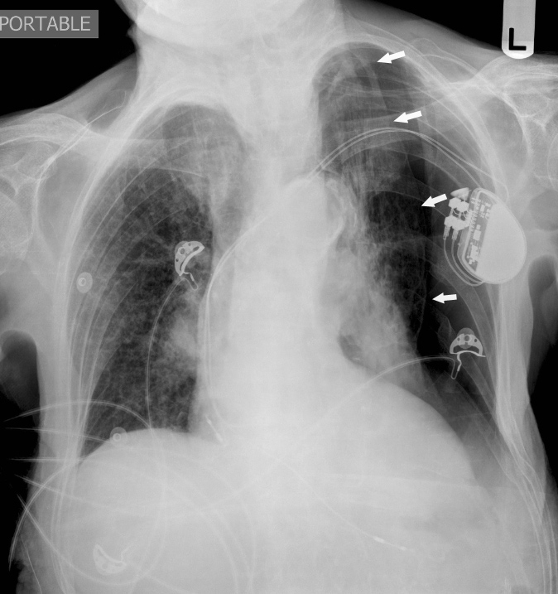
pnx

Slide 34
Curva di sopravvivenza libera da revisione degli elettrodi
Koneru et al J Am Heart Assoc. 2018;7:e007691. DOI: 10.1161/JAHA.117.007691

Slide 35
PACEMAKER «LEADLESS»
SISTEMA MEDTRONIC (MICRA)

Slide 36
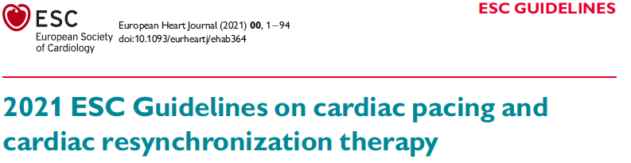
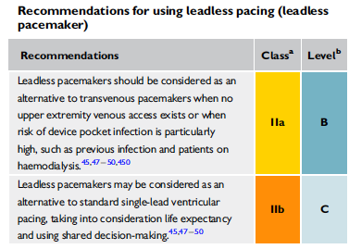
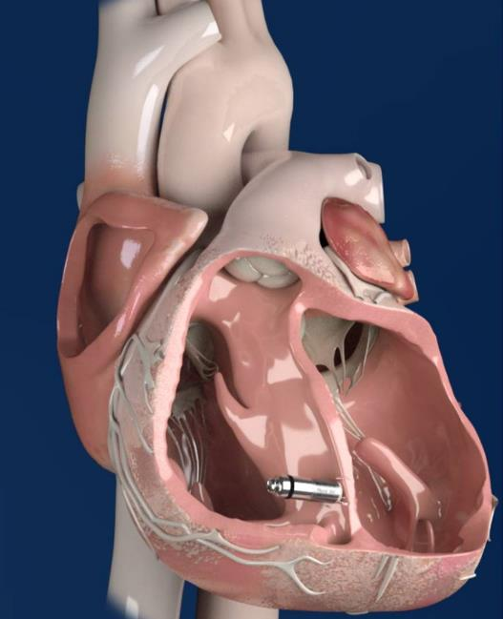
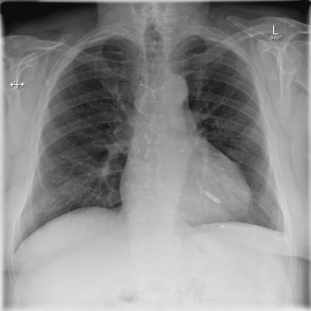

Slide 37
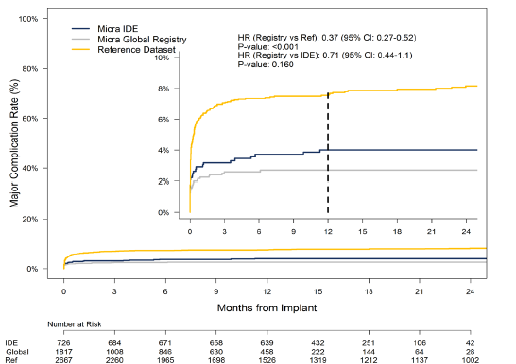
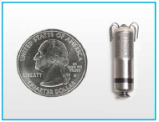
Reduced Major Complications with Micra
63% reduction in risk for major complications through 12 months relative to transvenous pacemakers
1El-Chami et al HRS Scientific Sessions 2018

Slide 38
The use of a leadless pacemaker for ventricular pacing may
serve as a feasible future alternative after tricuspid valve repair or replacement by a bioprosthesis.
However, experience is very limited, and no long-term data are available in this cohort. Crossing a mechanical tricuspid valve with the delivery sheath and a leadless pacemaker is contraindicated

Slide 39
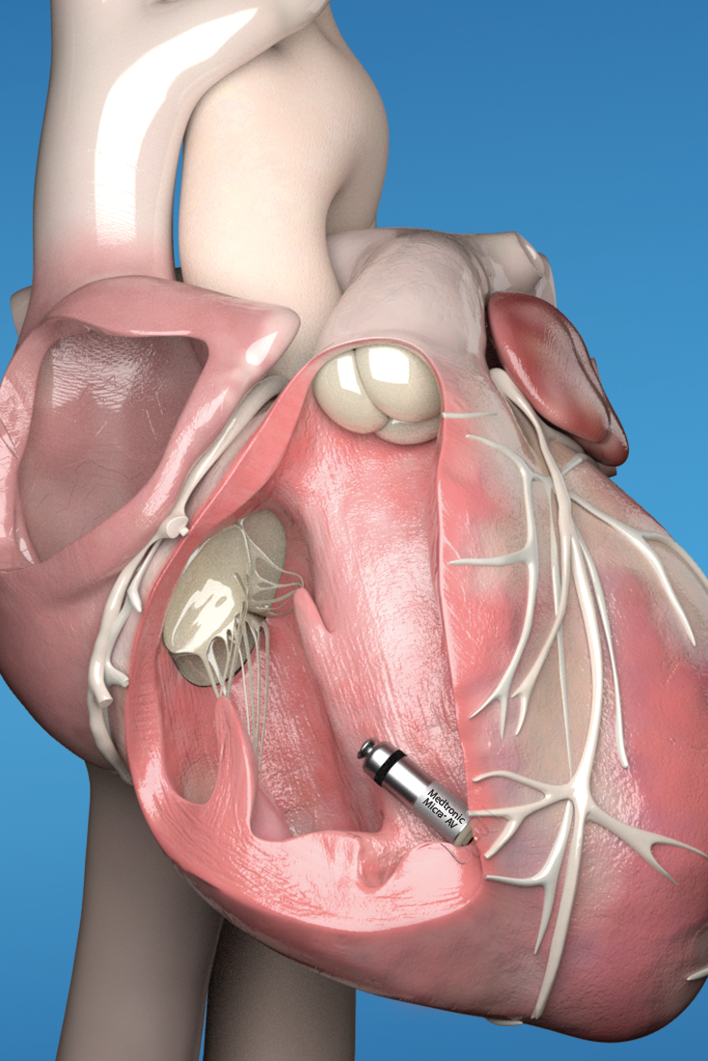
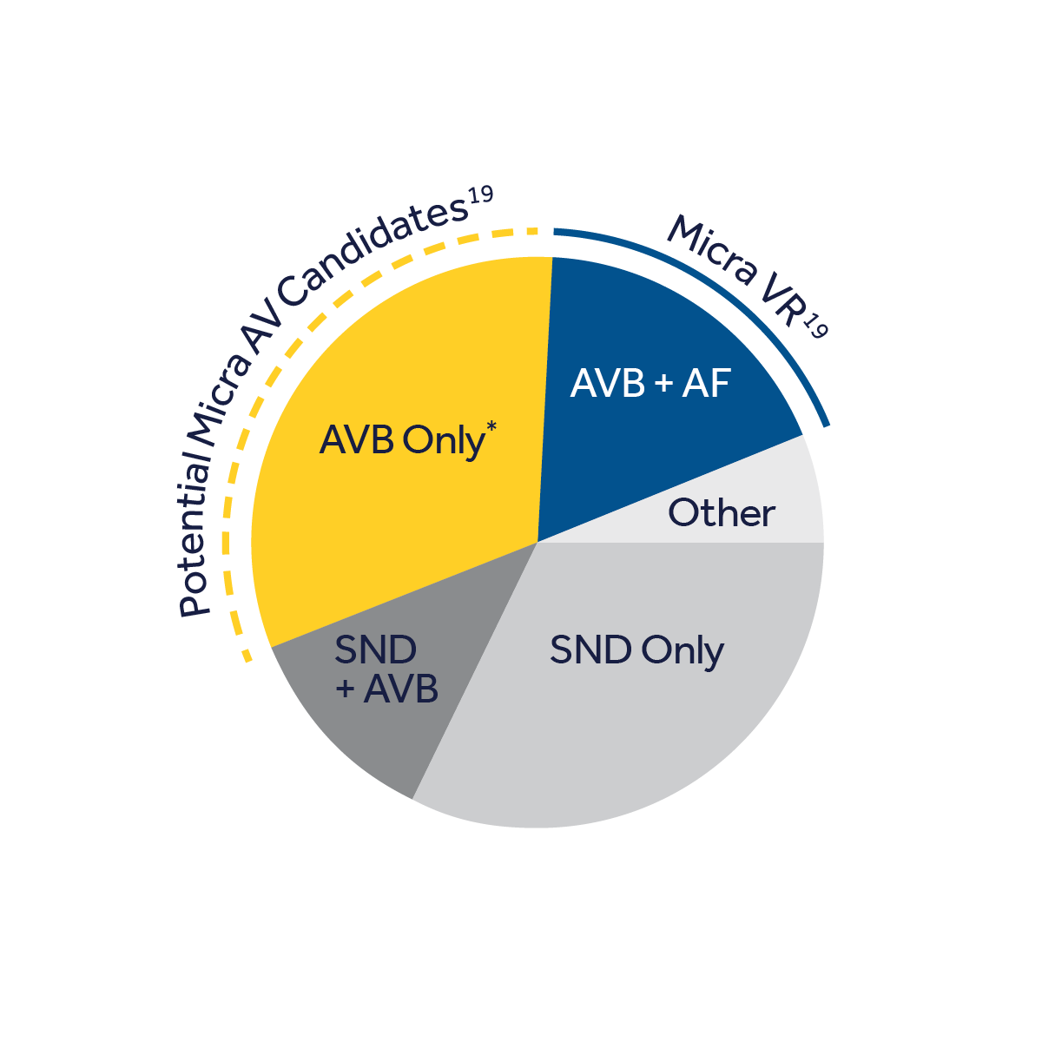
Sistema trans-catetere Micra™ AV
L’accelerometro incluso nel Micra AV’s consente di rilevare l’attività meccanica atriale ed utilizzare questa informazione per ottenere un pacing ventricolare atrio-sincronizzato¹⁶
Il dispositivo è dotato di un nuovo circuito integrato in grado di supportare questa nuova funzionalità di sincronia AV¹⁶
La stima della durata della batteria è di 8-13 anni a seconda del grado di blocco AV del paziente^{10,12}
17
17
*AVB-only patients who would benefit from leadless pacing per the indications for use.
Notes:
Possiamo dunque dire che i dati supportano favorevolmente la nuova tecnologia leadless…che negli ultimi mesi ha visto entrare sul mercato il Micra AV. Un dispositivo strutturalmente identico al Micra VR ma all’interno del quale l’elettronica è in grado di interpretare i dati provenienti dall’accelerometro di modo da consentire il rilevamento dell’attività meccanica atriale e dunque consentire un pacing atrio-sincronizzato.

Slide 40
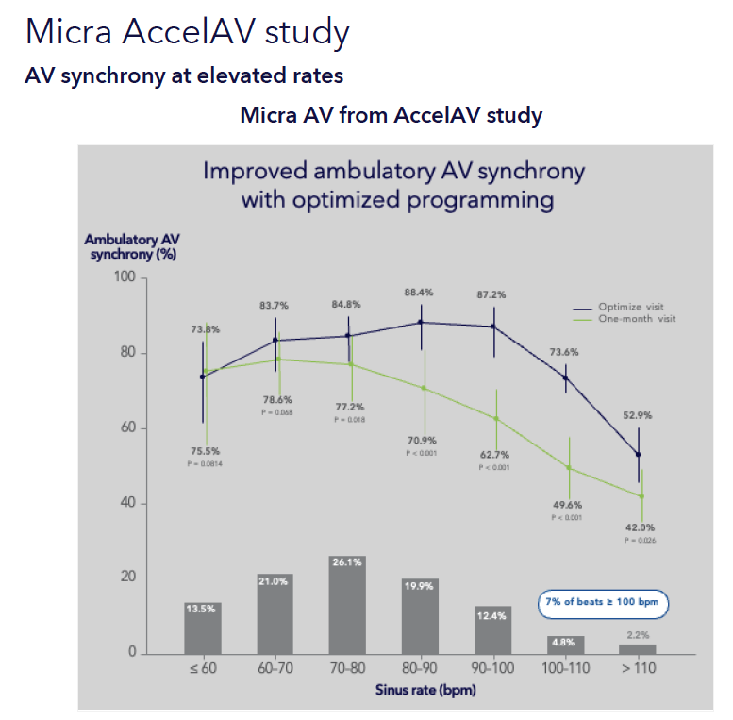

Slide 41
LEADLESS
SISTEMA ABBOTT (AVEIR)

Slide 42
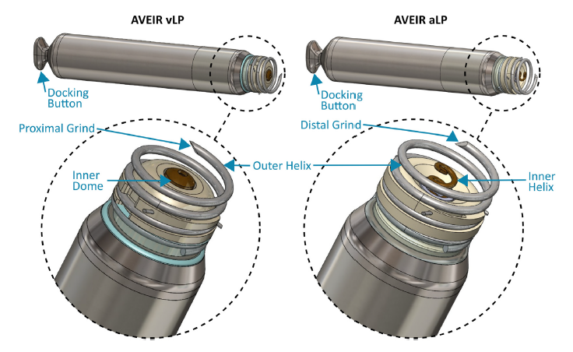

Slide 43
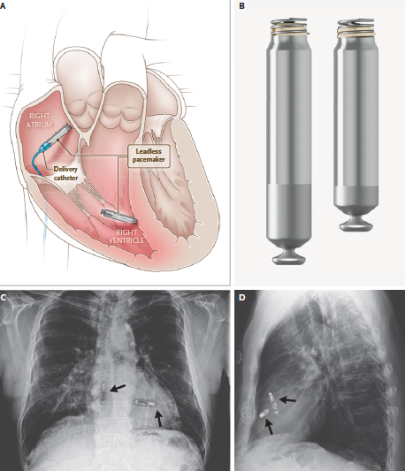
Dual chamber pacemaker

Slide 44
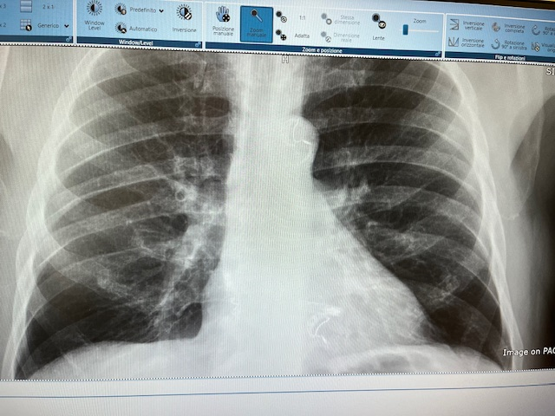
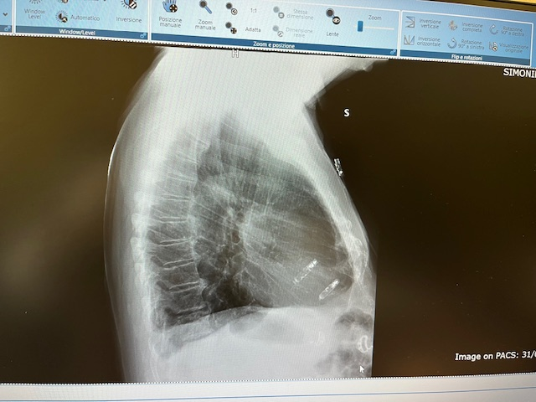
30/3/26
Primo impianto leadless bicamerale a Trieste

Slide 45
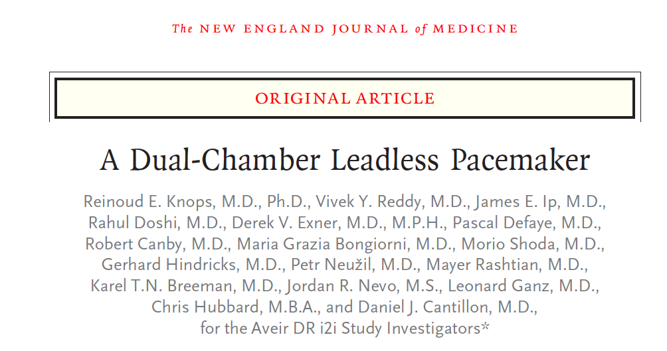
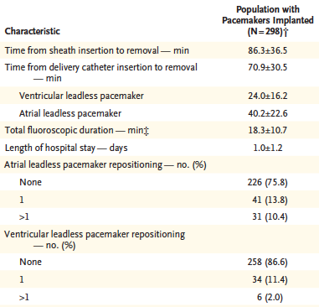
Procedural Characteristics
Knops et al N Engl J Med 2023;388:2360-70

Slide 46
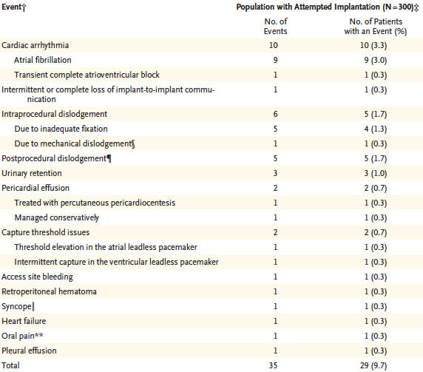
Complications within 90 Days
Knops et al N Engl J Med 2023;388:2360-70

Slide 47

Retrieval Success Rates Remained High, Regardless of Implant Duration¹
(n=27)
(n=49)
(n=54)
(n=39)
(n=31)
(n=20)
(n=20)
* Limited data is available for AVEIR leadless pacemakers
¹ Reddy, VY, et al. Worldwide Experience with Leadless Pacemaker Retrievals: A Worldwide Nanostim Experience out of 9y. Presented at: APHRS 2022; Nov 18-20, 2022; Singapore.

Slide 48
Obstructive Sleep Apnea and Arrhythmias
Long pauses and bradycardia are common in patientswith OSA.
58% of patients with implanted pacemakers for sick sinus syndrome had previously undiagnosed sleep apnea syndrome
An increased risk of sudden cardiac death has been reported in patients with severe OSA
In a study of 10 071 adults, OSA predicted incident sudden cardiac death, with the best predictors
being age >60 years, mean nocturnal oxygen saturation <78%, and AHI >20
Yeghiazarians et al Circulation. 2021;144:e56–e67. DOI: 10.1161/CIR.0000000000000988

Slide 49
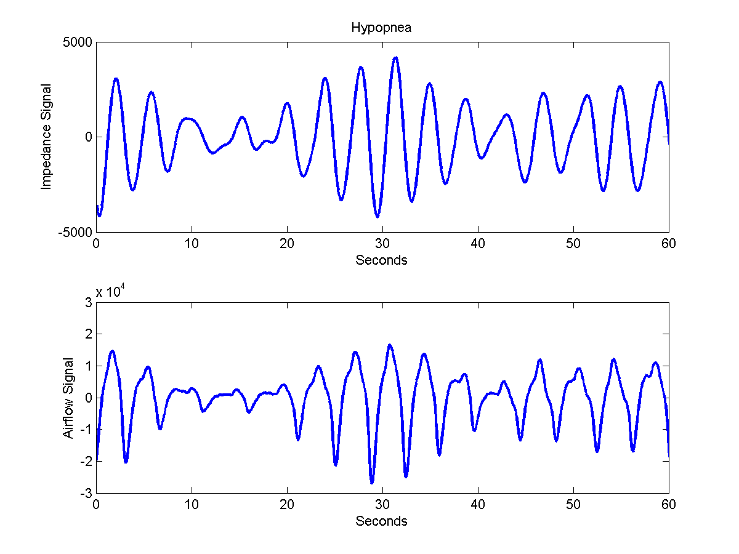
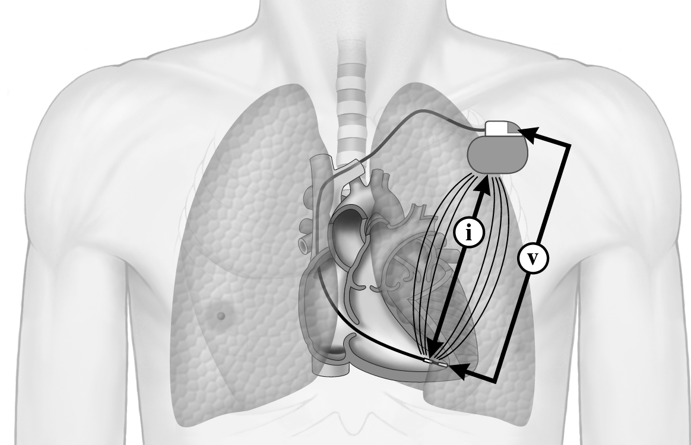
ApneaScan as screening tool
Breathing movements → Impedence variations
ApneaScan uses the Respiratory Sensor to monitor breathing patterns
Event: 26% reduction of breathing amplitude lasting 10 seconds or more (including full breathing pauses)
Implanted Impedance-based
Respiration Sensor
Apnea / Hypopnea Event Detection Example
Duration Threshold (10 s)
Amplitude Threshold (0.7)
Impedance
Airflow
Incepta ICD Reference Guide - 358431-014 EN Europe 06/11
Incepta CRTD Reference Guide - 358440-014 EN Europe 06/11
Notes:
Il dispositivo si calcola le variazioni di impedenza transtoracica e la frequenza degli atti respiratori.
49

Slide 50
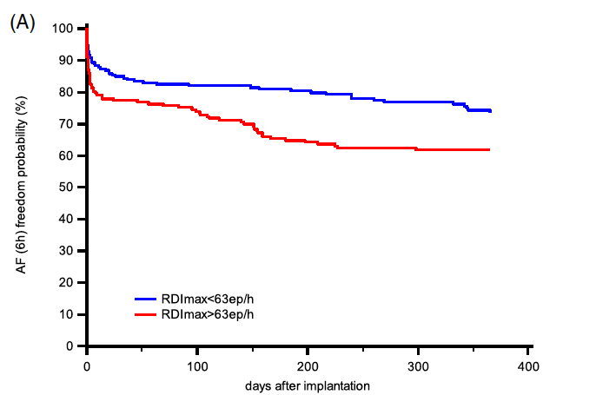
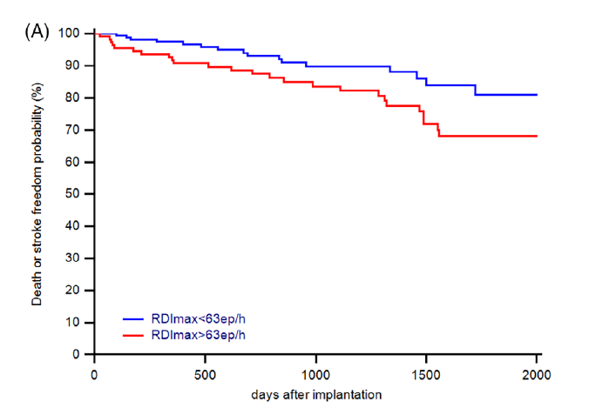
Obstructive Sleep Apnea Atrial Fibrillation and stroke
Mazza et al Clin Cardiol. 2020;43:1609–1615

Slide 51
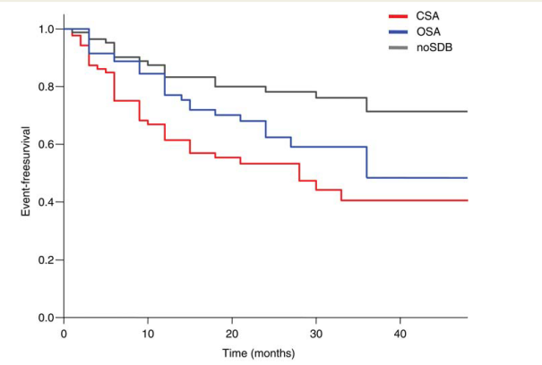
Kaplan–Meier plot on appropriate cardioverter-deﬁbrillator therapies
according to sleep disordered breathing (sleep apnoea: AHI ≥ 5 h⁻¹).
(central sleep apnoea)
(obstructive sleep apnoea)
(no sleep disordered breathing)
Bitter et al European Heart Journal 2011;32:61–74

Slide 52
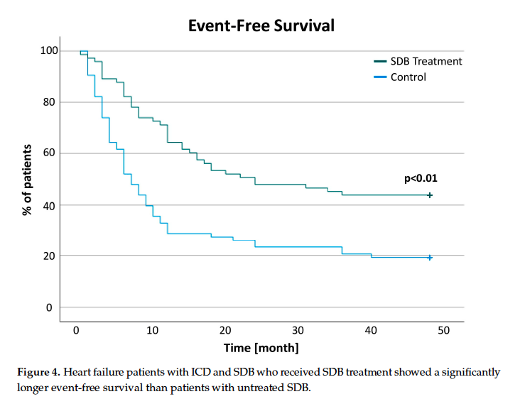
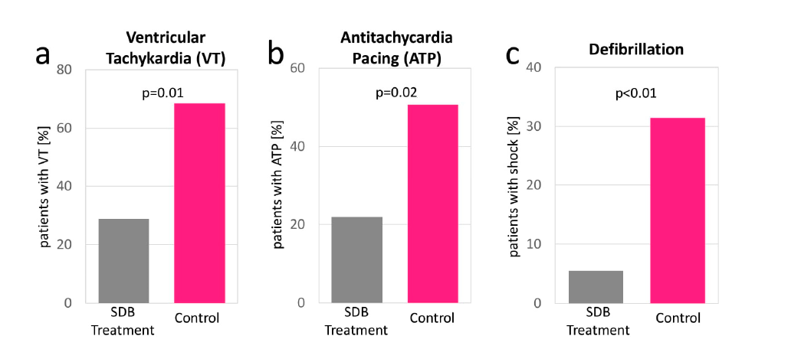
Impact of Sleep-Disordered Breathing Treatment on Ventricular
Tachycardia in Patients with Heart Failure
Gerçek et al J. Clin. Med. 2022, 11, 4567

Slide 53
DEFIBRILLATORE IMPIANTABILE
(ICD= Implantable Cardioverter Defibrillator)
Dispositivo in grado di riconoscere e trattare:
  le aritmie ipocinetiche (= pacemaker)
  Le aritmie ipercinetiche ventricolari
    Antitachycardia pacing (ATP)
    Shock intracavitario

Slide 54
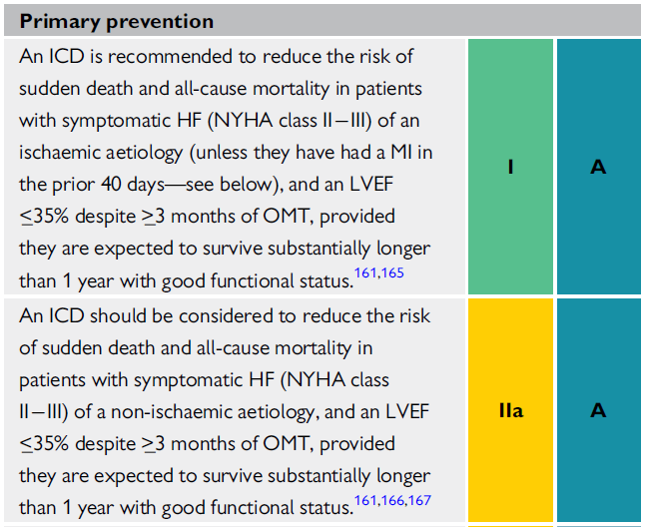
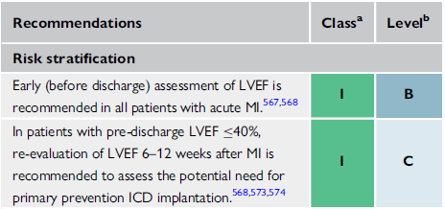
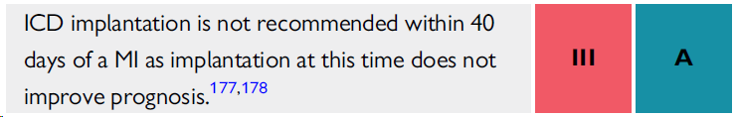
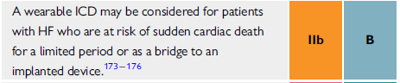

Pazienti con nuova diagnosi di HFrEF
Linee guida HF ESC 2021
Pazienti post IM
Linee guida
SCD e VA ESC 2022
Zeppenfeld K et al. Eur Heart J 2022;43:3997-4126
McDonagh TA et al. Eur Heart J 2021;42:3599-726

Slide 55
Interruzione delle TV con antitachycardia pacing
Modalità di interazione stimolo-circuito
*
*
tachycardia
ineffective
pacing
effective
pacing
Rosenqvist. in Am J Cardiol 1996; 78(5A): 92-97

Slide 56
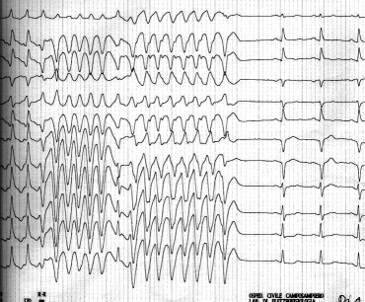
Interruzione di TV con ATP

Slide 57
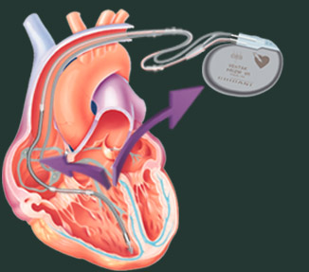
FIBRILLAZIONE VENTRICOLARE TRATTATA CON SHOCK

Slide 58
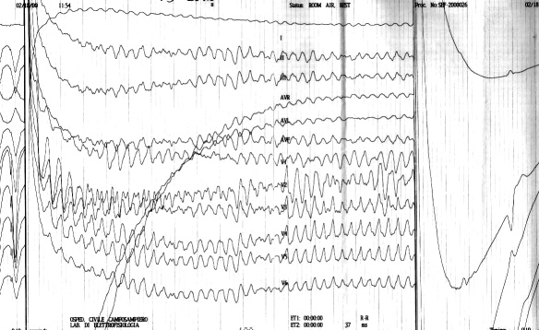
FIBRILLAZIONE VENTRICOLARE TRATTATA CON SHOCK

Slide 59
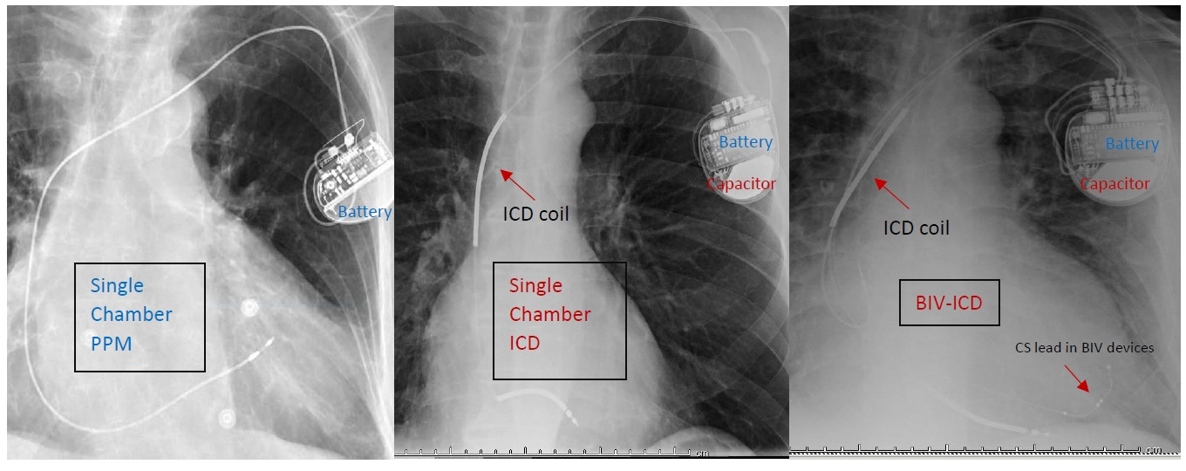

Slide 60

Concerns related to transvenous ICD
Indicate the level of concern you have, if any, regarding each of the following types of potential ICD complications
7 = Extremely Concerned
1 = Not at all Concerned

Slide 61

Annual rate of defibrillation lead defects versus time after lead implantation
Kleemann et al. Circulation. 2007;115:2474-2480
Notes:
Figure 2. Annual rate of defibrillation lead defects versus time after lead implantation. The annual rate of ICD lead defects increases with time (P<0.001, Cochran-Armitage test). *Failures per number at risk.

Slide 62



Subcutaneous ICD
(S-ICD)

Slide 63
Device-related complications in PRAETORIAN: prospective, randomized, trial comparing S-ICD and TV-ICD outcomes
In the first randomized S-ICD and TV-ICD trial, device-related complications requiring invasive intervention at 4 years for S-ICD patients was 4.3%, significantly lower than to 8.3% for TV-ICD patients.
Knops R.E., et al. Eur Heart J 2022; 43(47):4872-4883.
63
63

Slide 64



Slide 65



S-ICD
EV-ICD

Slide 66

TIMING DELL’ICD NELLA CARDIOPATIA ISCHEMICA

Slide 67
Rate of SD or Cardiac Arrest with Resuscitation over the Course of the Trial
Data from VALIANT study
Solomon et al Engl J Med 2005;352:2581-8.

Slide 68
ICD early after an MI
6-40 days after MI
LVEF≤35% SDNN/HRV <70 msec or HR>80 bpm
< 1 month after MI
LVEF<40%, HR > 90 bpm and/or NSVT
Hohnloser et al NEJM 2004;351:2481
Steinbeck G et al NEJM 2009;361:1427

Slide 69


N Engl J Med 2004;351:2481-2488
Notes:
> Mortalità cardiaca non improvvisa (> rischio di IMA fatali?): non effetto deteriore di stim v xd (prog VVI 40)

Slide 70
Pathogenesis of Sudden Unexpected Death in Patients With Myocardial Infarction and Left Ventricular Dysfunction, Heart Failure, or Both
Data from VALIANT study
Observed proportions of sudden unexpected death by
presumed arrhythmic death or by MI/myocardial rupture
Pouleur et al Circulation 2010;122:597-602

Slide 71




Il rischio acuto di SCD nei pazienti post-IM
2005 VALIANT TRIAL¹ -> SCD 1,4% a 30 giorni
2018 VEST TRIAL² -> SCD 2,4% a 90 giorni
Solomon et al. N Engl J Med. 2005 Jun 23;352(25):2581-8
Olgin et al. N Engl J Med. 2018;379(13):1205–1215.
Notes:
Rischio + conferma del rischio dal gruppo di controllo dello studio VEST

Slide 72
Time Dependence of Mortality Risk and Defibrillator Benefit After Myocardial Infarction
Data from the MADIT II study
Wilber et al Circulation 2004;109:1082-4

Slide 73
TIMING DELL’ICD NELLA CARDIOPATIA NONISCHEMICA

Slide 74


Study population and effect of medical treatment optimization on “SCD-HeFT criteria”
Zecchin et al Am J Cardiol 2012;109:729-35

Slide 75


Long-term survival
Long-term survival free from SD/MVA
A1 vs A2, p <0.001;
A1 vs B1, p=0.18
A2 vs B2, p=0.10
A1 vs A2, p=0.014
A1 vs B1, p=0.8
A2 vs B2, p=0.6.
A1: baseline “SCD-HeFT criteria” both at ﬁrst and second evaluation
A2: baseline “SCD-HeFT criteria” at ﬁrst but not at second evaluation
B1: patients developing “SCD-HeFT criteria” only at second evaluation
B2: patients without “SCD-HeFT criteria” at ﬁrst or second evaluation
Zecchin et al Am J Cardiol 2012;109:729-35

Slide 76

Il rischio acuto di SCD nei pazienti con nuova diagnosi di HFrEF
2018 ASCEND-HF TRIAL¹ -> SCD 2% a 30 giorni
2021 PROLONG TRIAL² -> SCD 4% a 90 giorni
Pokorney et al. Eur J Heart Fail . 2018 Mar;20(3):525-532
Mueller-Leisse J et al. 2021 Dec;8(6):5142-5148.

Slide 77
GRAZIE

