Slide 1
Contribution of the pulmonary
vasculature to lung repair and fibrosis
PneumoTrieste
Trieste, May 11th 2026
Giovanni Ligresti, PhD
Associate Professor of Medicine
Department of Medicine

Slide 2
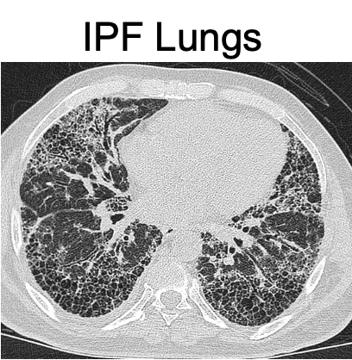
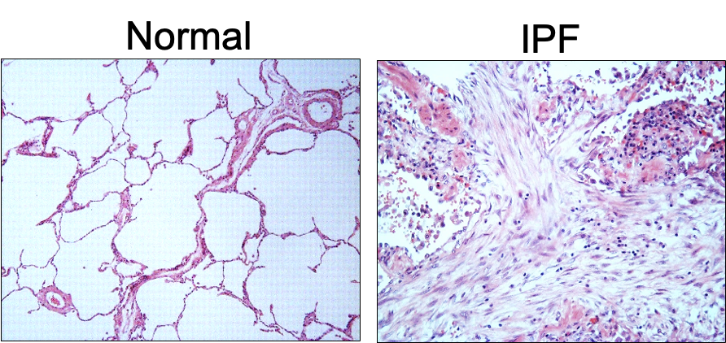
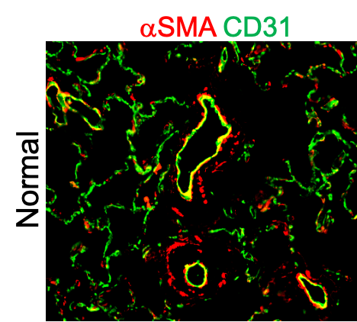
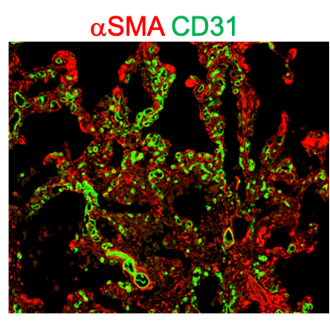
Idiopathic Pulmonary Fibrosis (IPF) is a chronic disease associated with aberrant vascular remodeling
IPF is a chronic lung disease characterized by alveolar damage and excessive matrix accumulation
resulting in loss of organ function. IPF is an aging-associated disease
αSMA CD31
IPF lungs

Slide 3
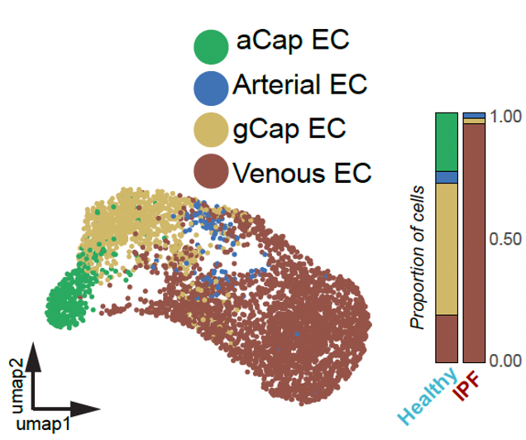
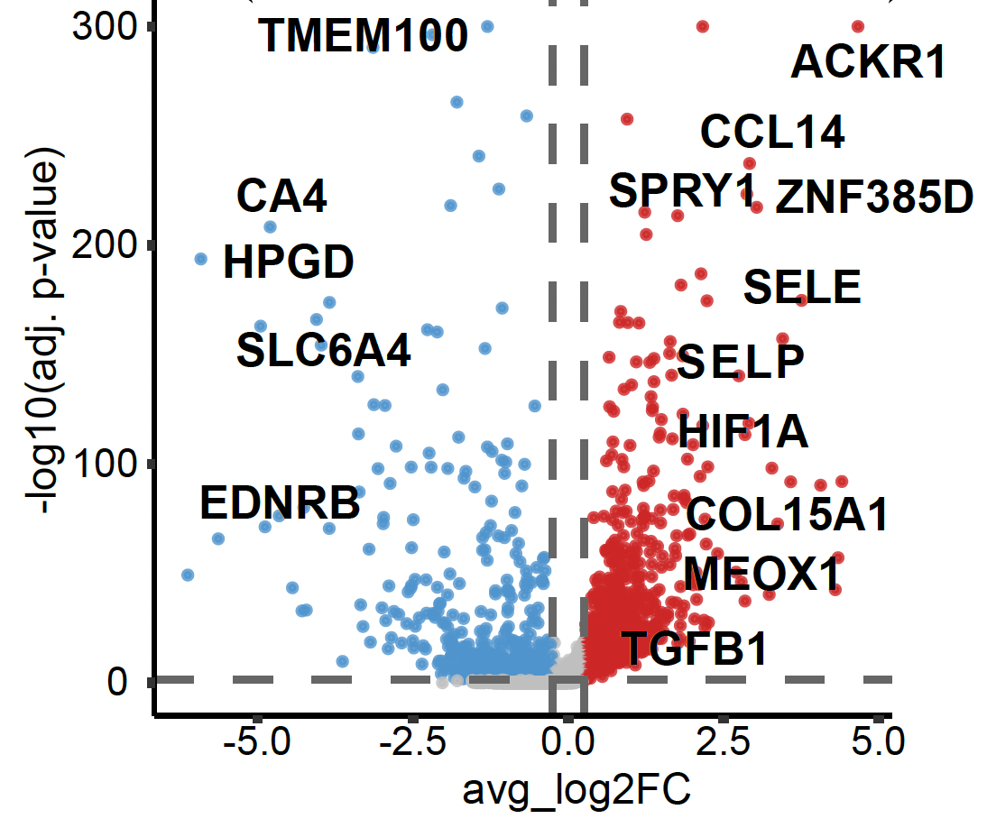
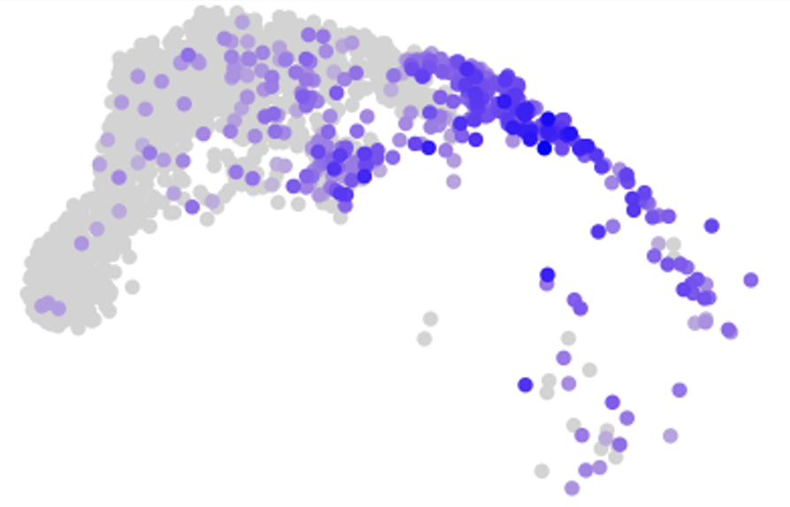
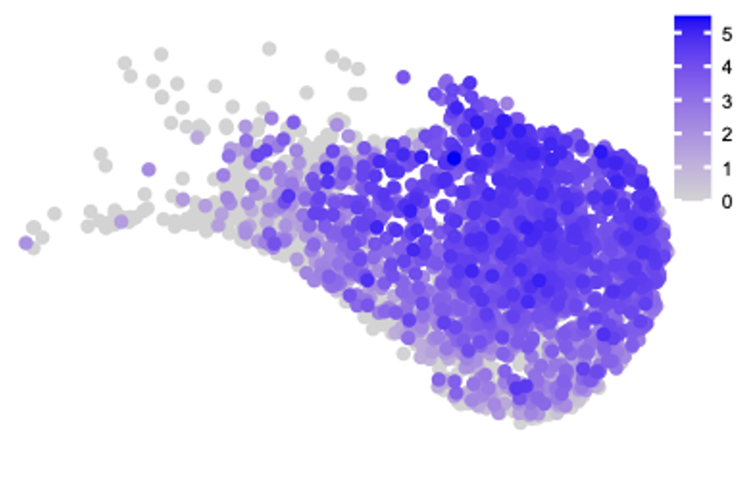
Single cell profiling identifies expansion
of ACKR1+ venous ECs in IPF
ALL ECs (Healthy vs IPF)
Tsukui et al., 2020
ACKR1 expression
Healthy
IPF

Slide 4
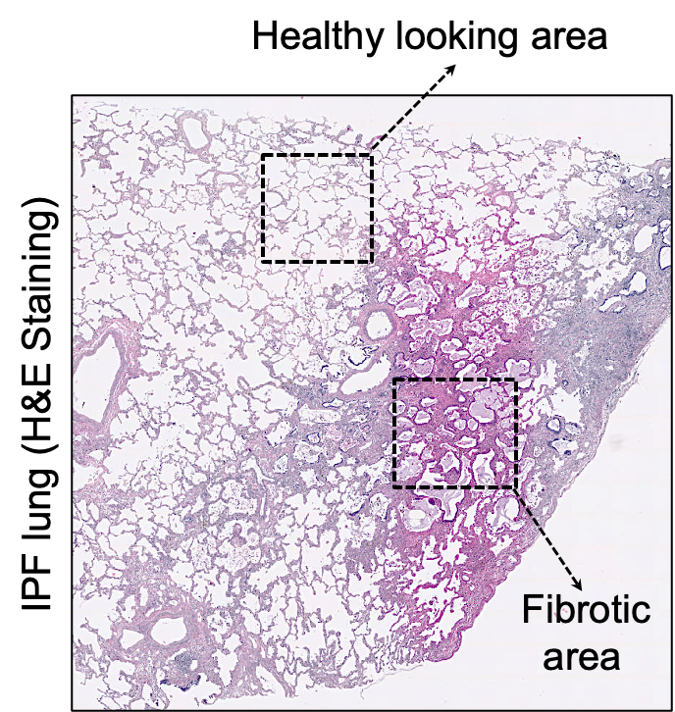
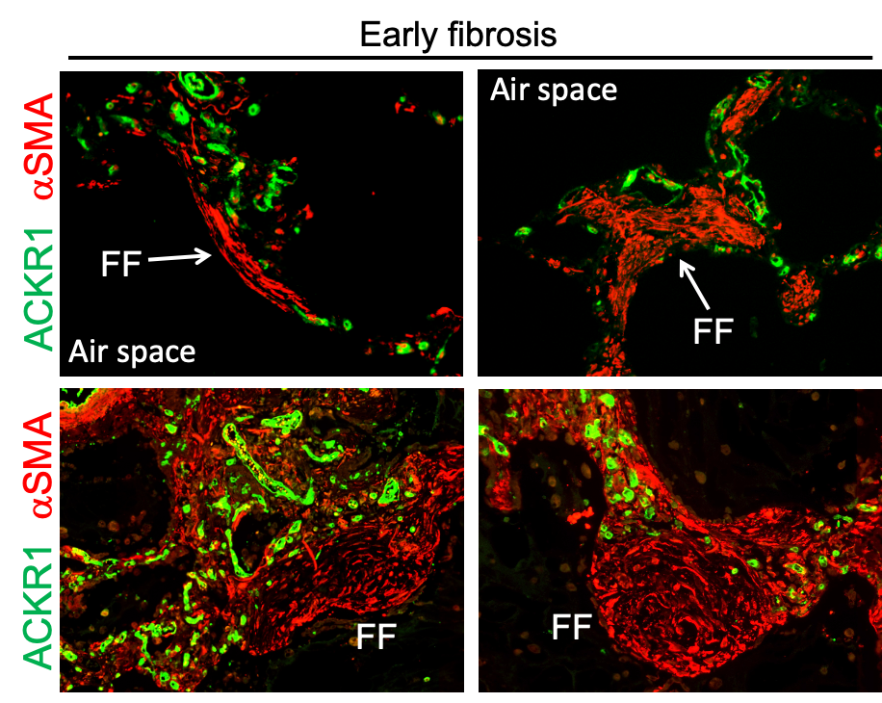
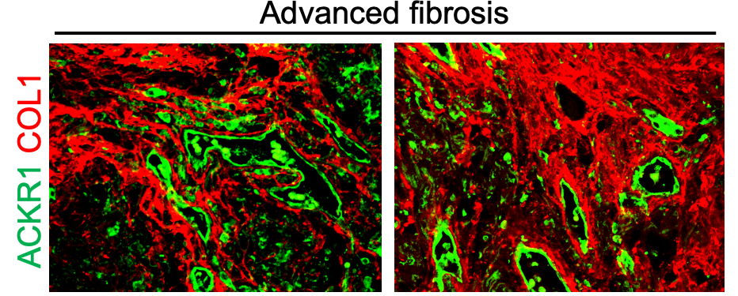
Do ACKR1+VECs contribute to early
stages of tissue remodeling in IPF lungs?
Do ACKR1+ VECs contribute to FF
formation and expansion?
Can ACKR1+ VECs be targeted to
restore normal vascular homeostasis

Slide 5
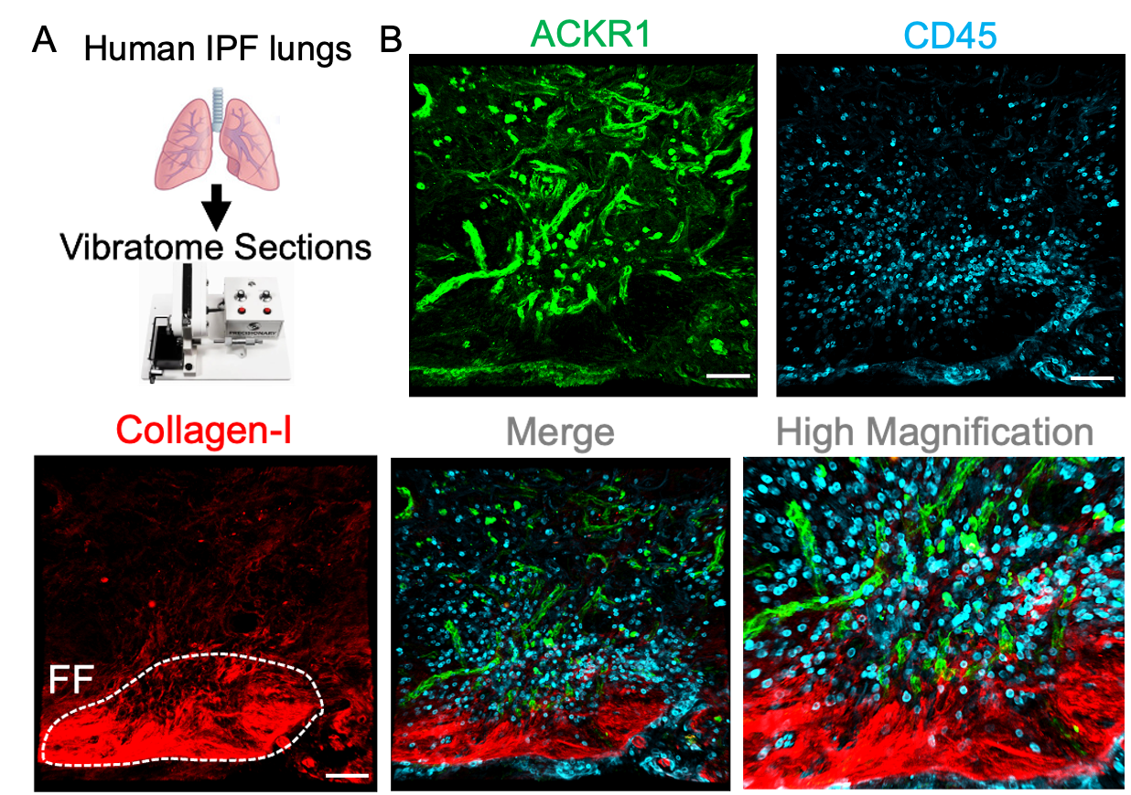
Immune cells are associated with ACKR1+ VECs
in lung areas of active fibrosis (FF)

Slide 6
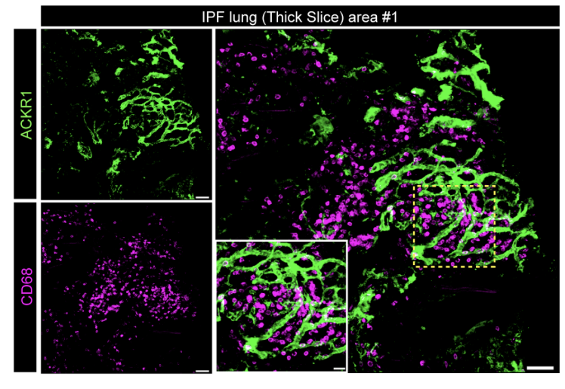
Macrophage aggregates are found nearby
distal ACKR1+ VECs in IPF lungs

Slide 7
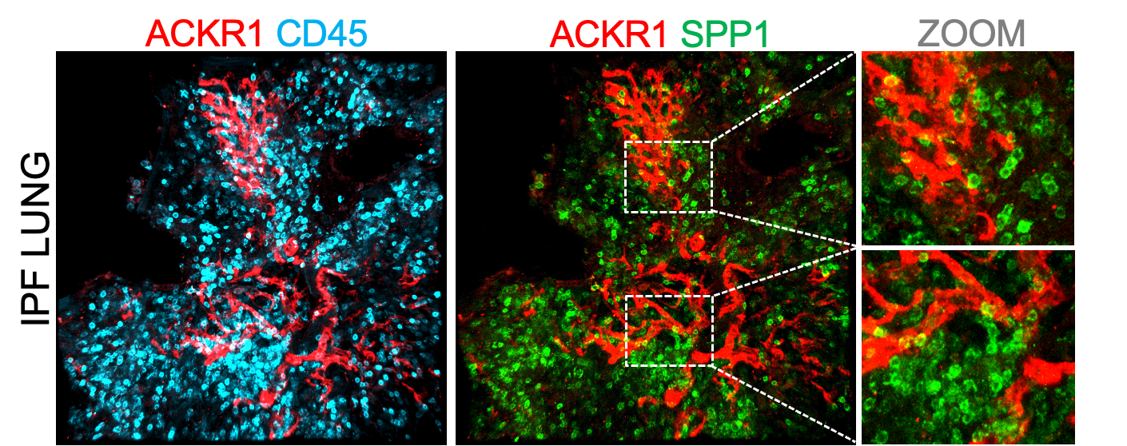
SPP1+ profibrotic macrophages closely associate
with ACKR1+ VECs in human IPF lungs
SPP1+ macrophages have been extensively reported as key mediators of the fibrotic process in IPF lungs.
Can ACKR1+ VECs influence SPP1+ macrophage differentiation and profibrotic function?
Is ACKR1 receptor implicated in this cellular crosstalk?

Slide 8
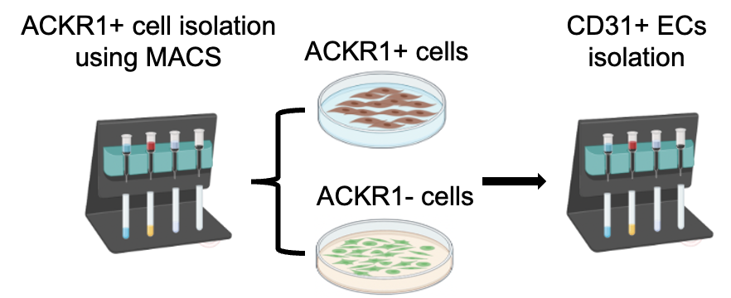
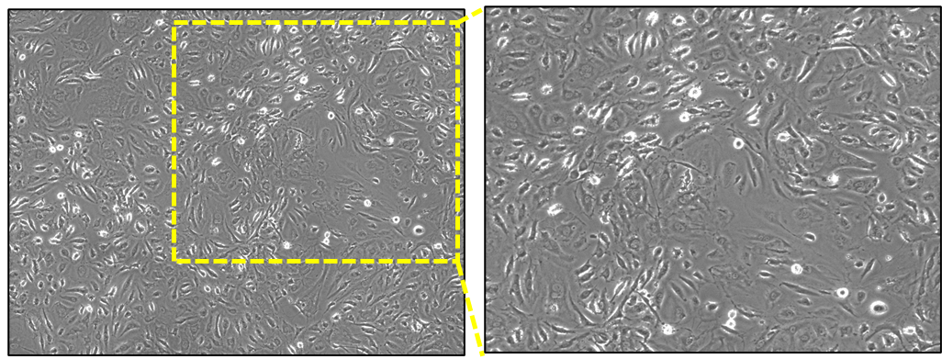
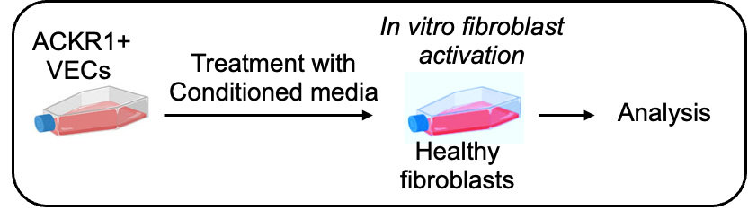
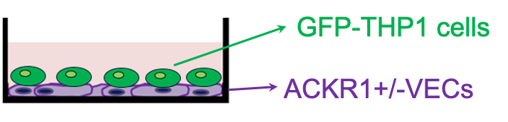
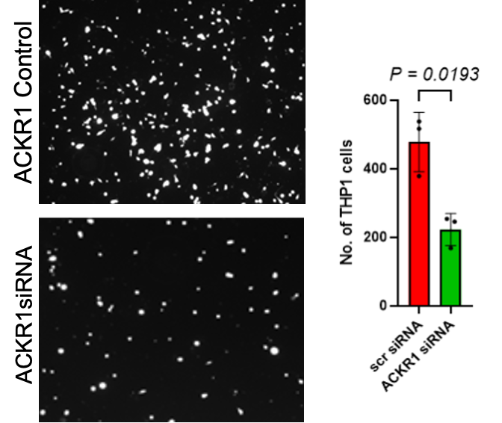
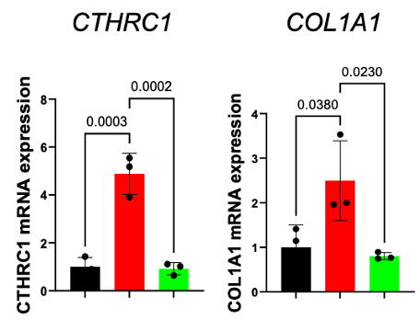
IPF-derived ACKR1+ VECs exhibit pro-fibrotic
activities that are dependent on ACKR1 receptor
ACKR1-Neg
ACKR1-Pos
ACKR1-Pos/siRNA

Slide 9
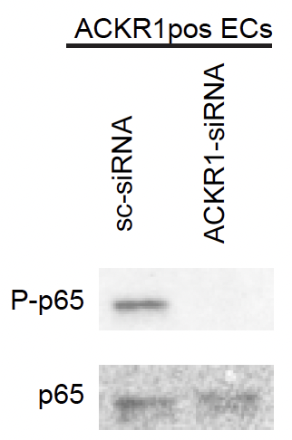
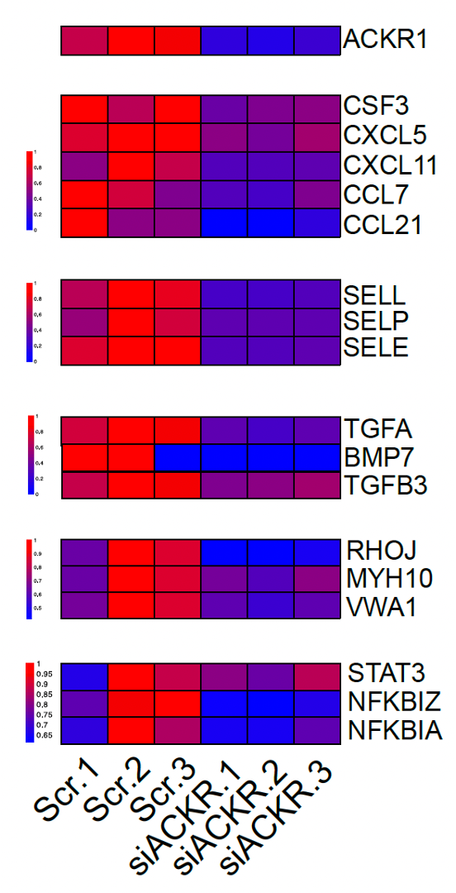
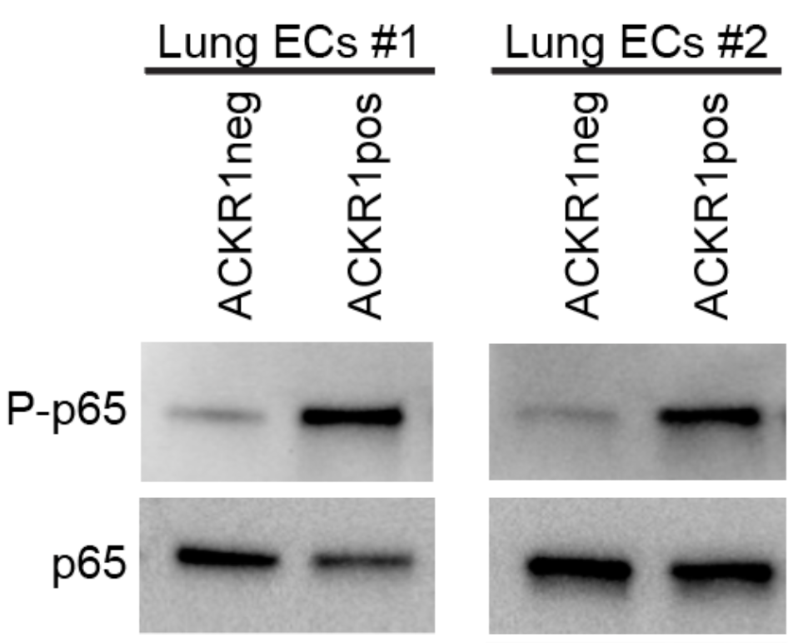
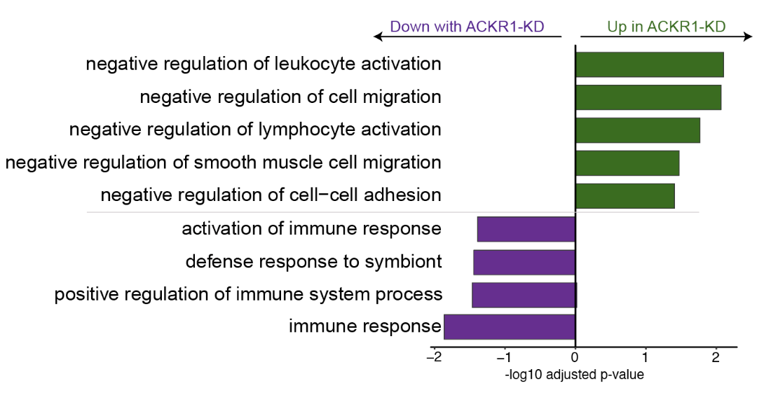
ACKR1+ VECs exhibit dependence on the
NF-κB signaling pathway
Bulk RNA-Sequencing (ACKR1 silencing)

Slide 10
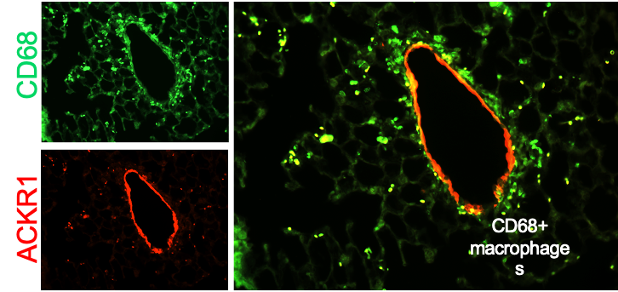
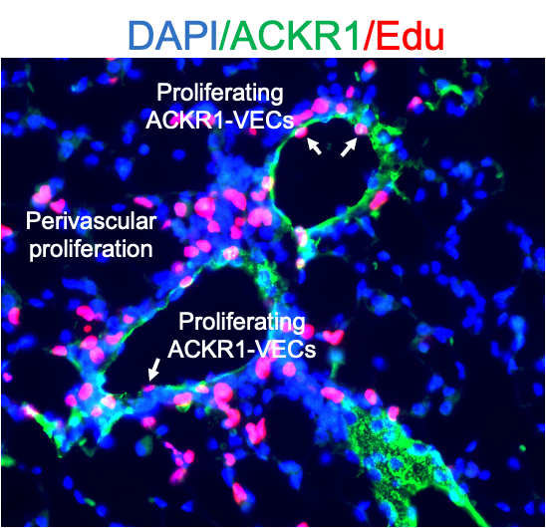
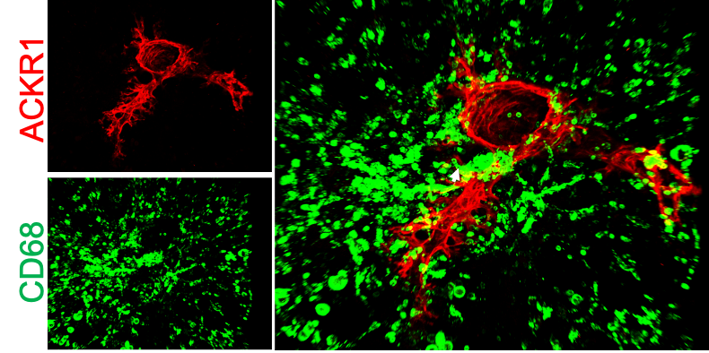
ACKR1+ VEC/macrophage interaction and ACKR1+ VEC proliferation are early events that precede fibrotic remodeling
Lungs were analyzed 3 days
post bleomycin delivery
DAPI ACKR1 EdU

Slide 11
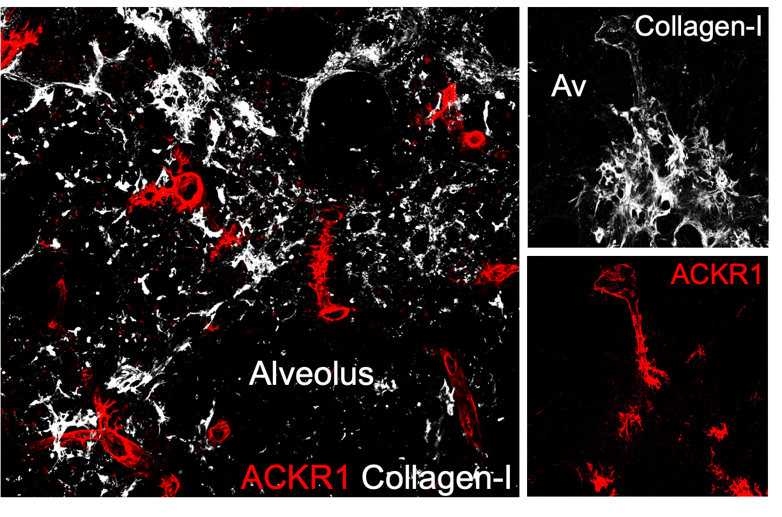
ACKR1+ VECs are spatially restricted
to collagen-enriched areas in injured lungs
Bleomycin (Day 21)

Slide 12
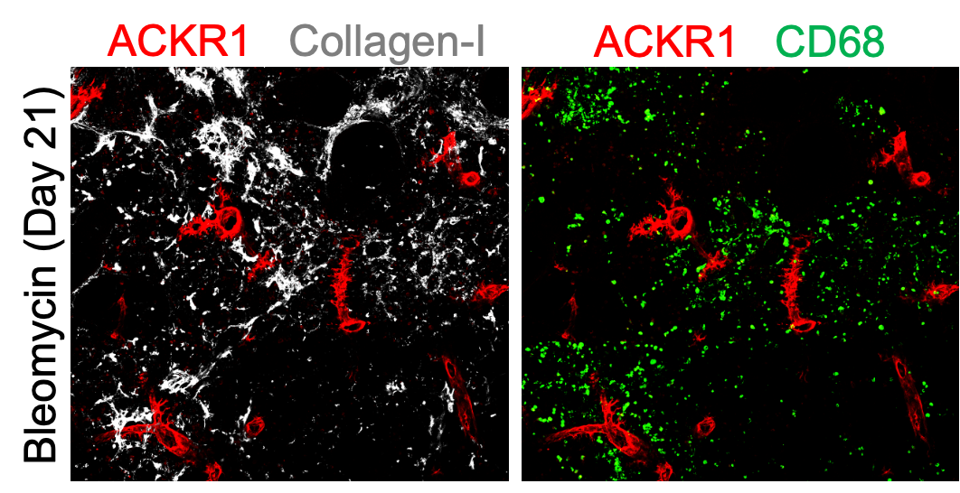
Macrophage aggregates are found nearby
ACKR1+ VECs in fibrotic mouse lungs

Slide 13
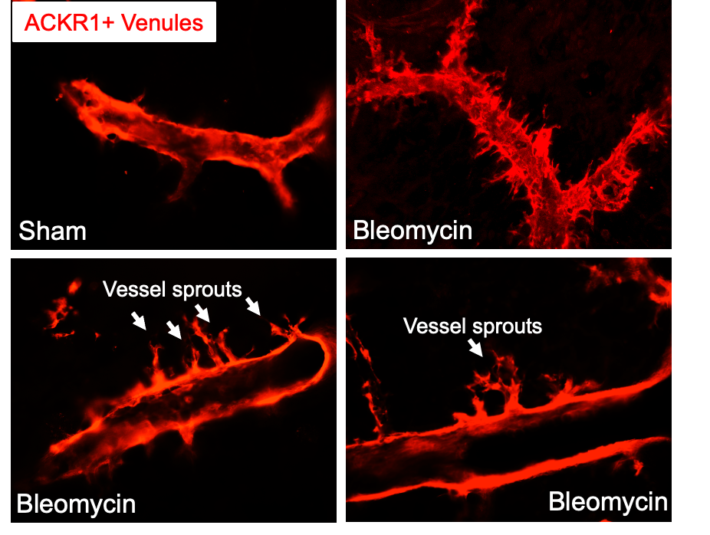
ACKR1+ venous ECs exhibit angiogenic
features under injury conditions
Mouse PCLS

Slide 14
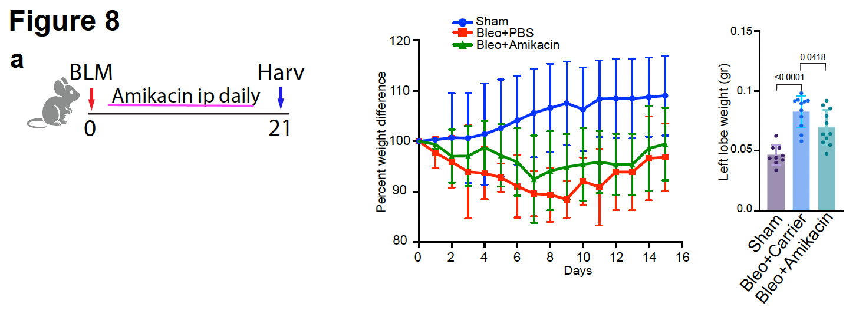
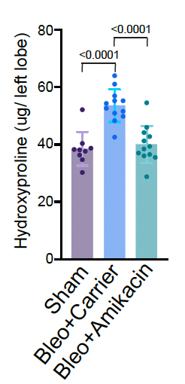
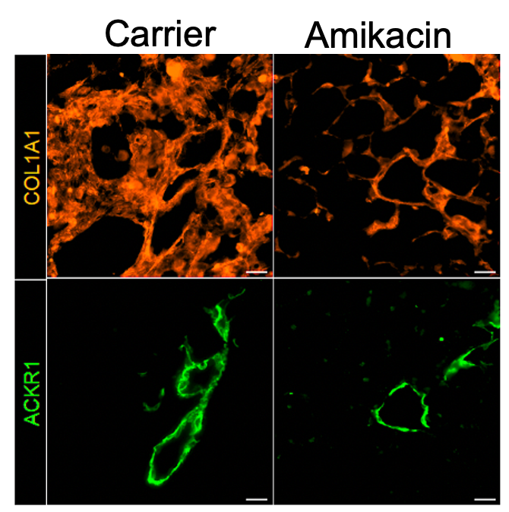
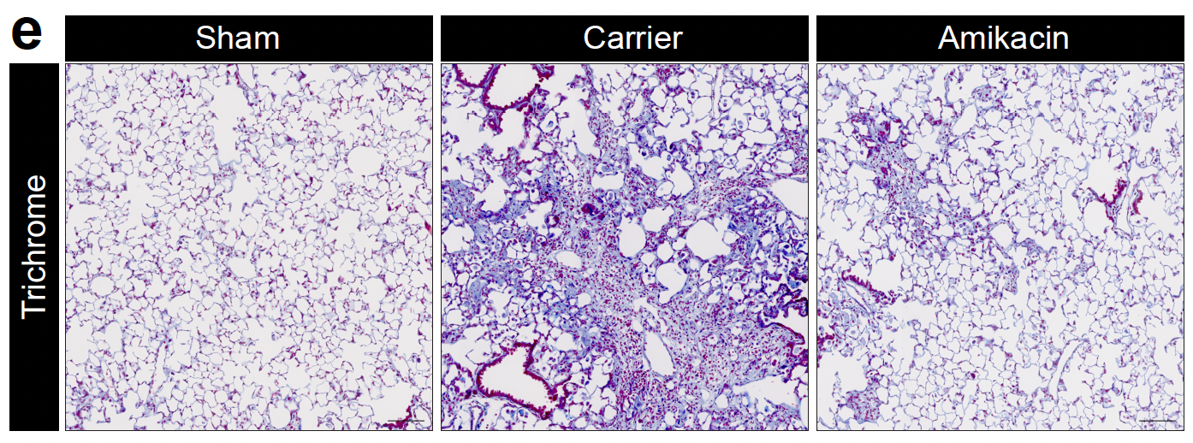
Pharmacological inhibition of ACKR1 using amikacin attenuates pulmonary fibrosis in mice.
Amikacin is an antibiotic medication used for a number of bacterial infection. It was recently identified as a potent ACKR1 antagonist

Slide 15
Final remarks
IPF is associated with vascular remodeling and endothelial dysfunction that actively contribute to fibrosis progression.
ACKR1+ VECs expand in IPF lungs and form a pathogenic vascular niche.
ACKR1+ VECs display distinct pro-fibrotic and pro-inflammatory programs influencing ECM remodeling and immune cell recruitment.
Pharmacologic inhibition of ACKR1 attenuates collagen deposition and immune cell recruitment in a bleomycin-induced lung fibrosis model.

Slide 16
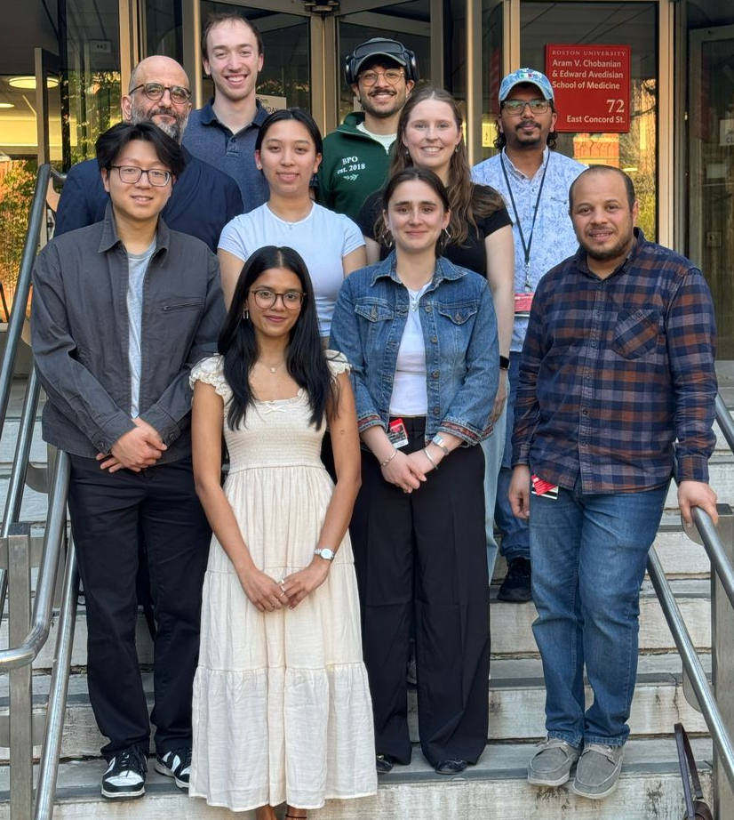
Acknowledgments
Current
Ahmed Raslan
Janardhan Karapurkar
Kristina Nicolas
Omar Elbasiony
Ria Shah
Maria Velikhovskaya
Uyen Chu
Chase Dietter
Tavon Mei
Former
Nunzia Caporarello
Jisu Lee
Tho Pham
Jiazhen Guan
Jeongmin Hong
Sona Eyvazova
Jillian Schmottlach
Collaborators
Bob Varelas
Maria Trojanowska
Hadi Nia
Steven Huang
Roberto Nicosia
Luca Braga
Marco Confalonieri
Contact Info:
ligresti@bu.edu

