Slide 1
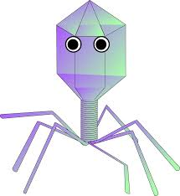

La terapia fagica per le infezioni difficili
Novella Cesta MD, PhD
Infectious Diseases Dep
Azienda Ospedaliera Universitaria Pisana (Pisa)
Chair of the Phage Therapy Study Group (SIMIT)
ESGNTA Executive Committee
novella.cesta@ao-pisa.toscana.it
Pneumotrieste 2026 – Trieste, 11-13 Maggio 2023

Slide 2

Antibiotic resistance is a slow-moving tsunami
Notes:
In the tsunami of the antibiotic resistance and the difficult to treat infections, what we probably need

Slide 3
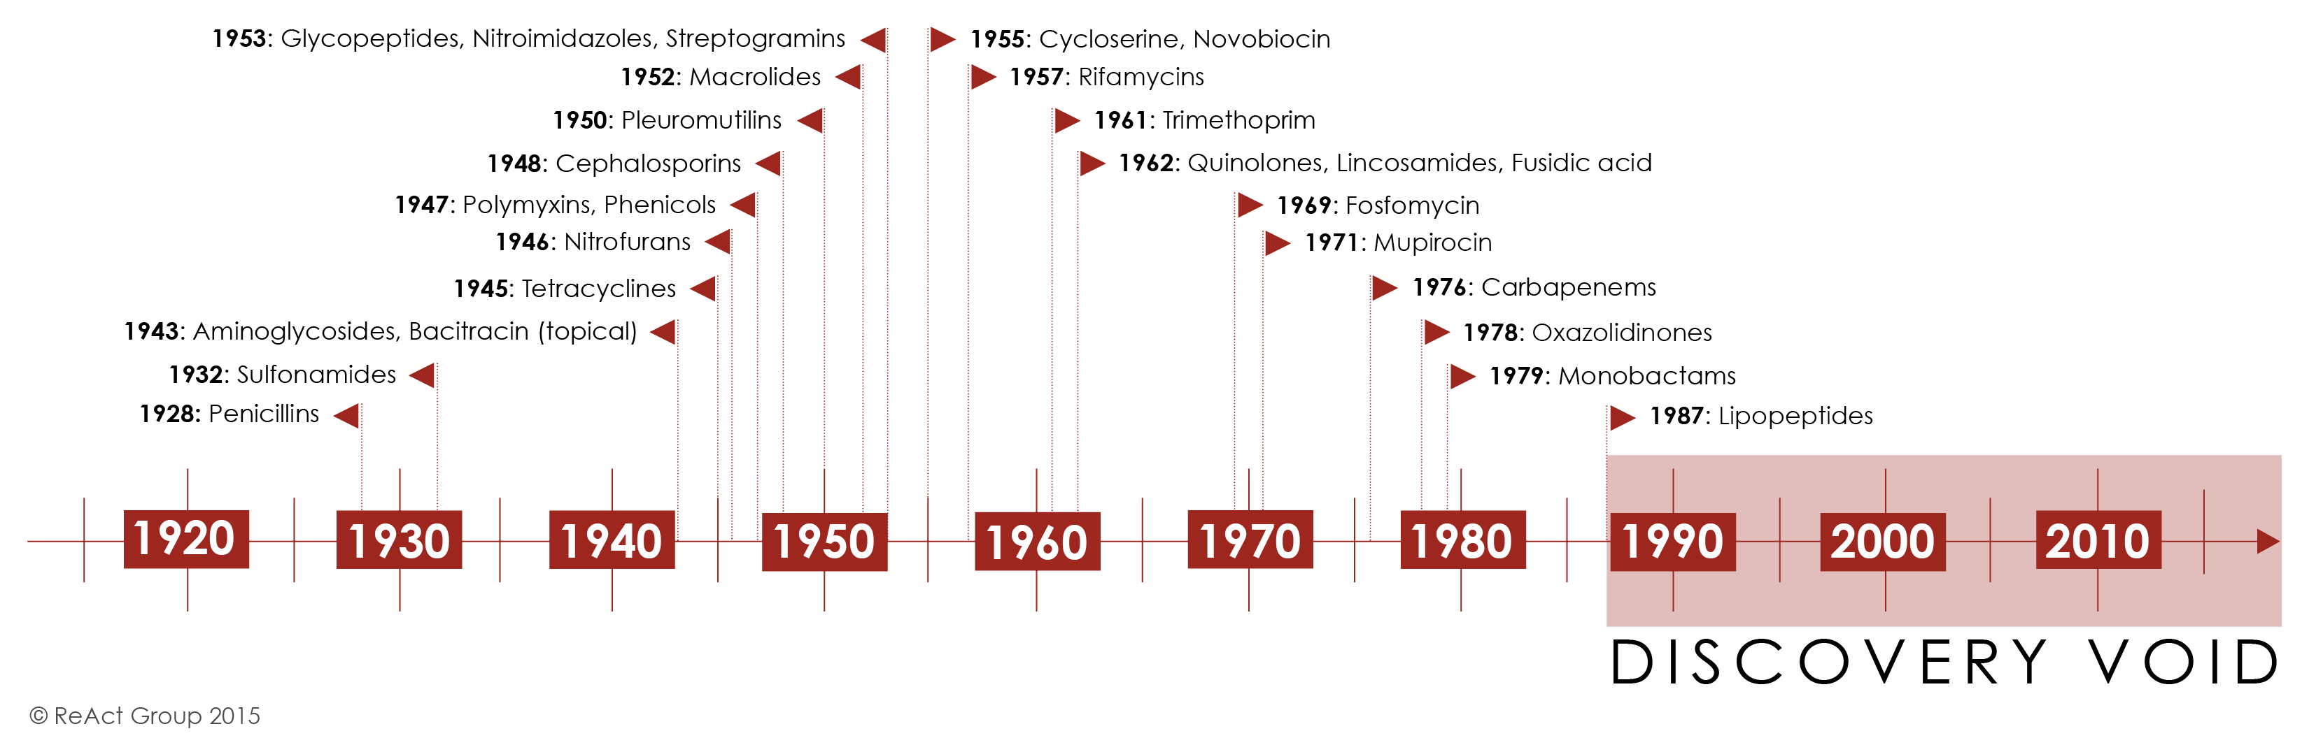
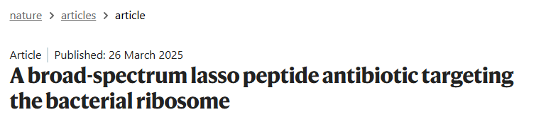
The lack of new antibiotics classes in pipeline
https://www.reactgroup.org/toolbox/understand/how-did-we-end-up-here/few-antibiotics-under-development/

Slide 4
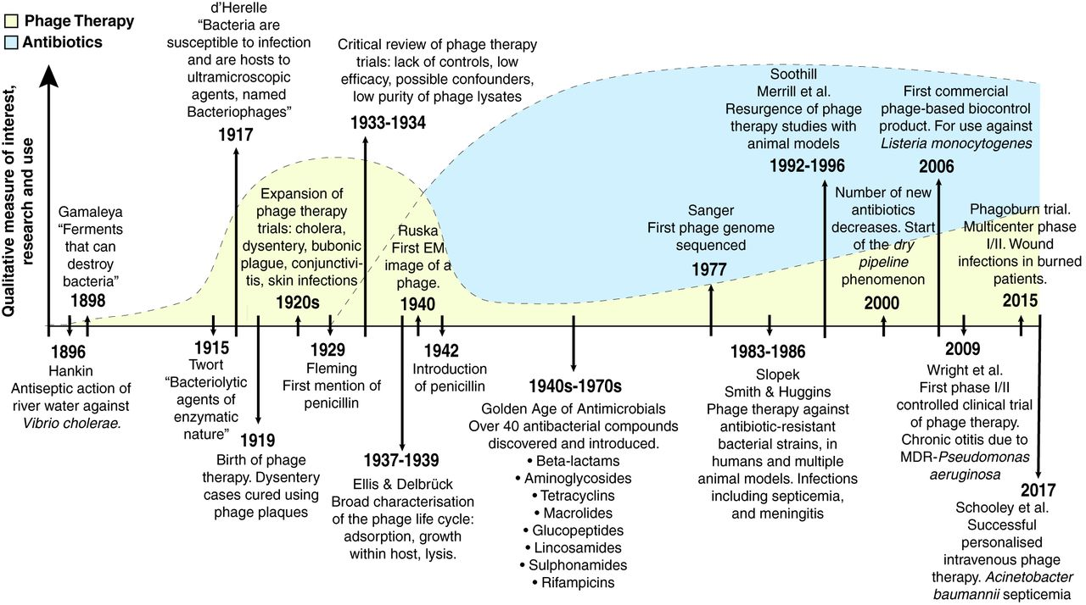
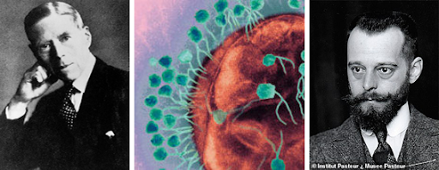
History of phage therapy
Alessandrini A e Doria R, Il batteriofago nella terapia del tifo addominale - ll policlinico sezione pratica anno 1924 parte 1
Gordillo Altamirano FL, Barr JJ. Clin Microbiol Rev. 2019 Jan 16;32(2)

Slide 5
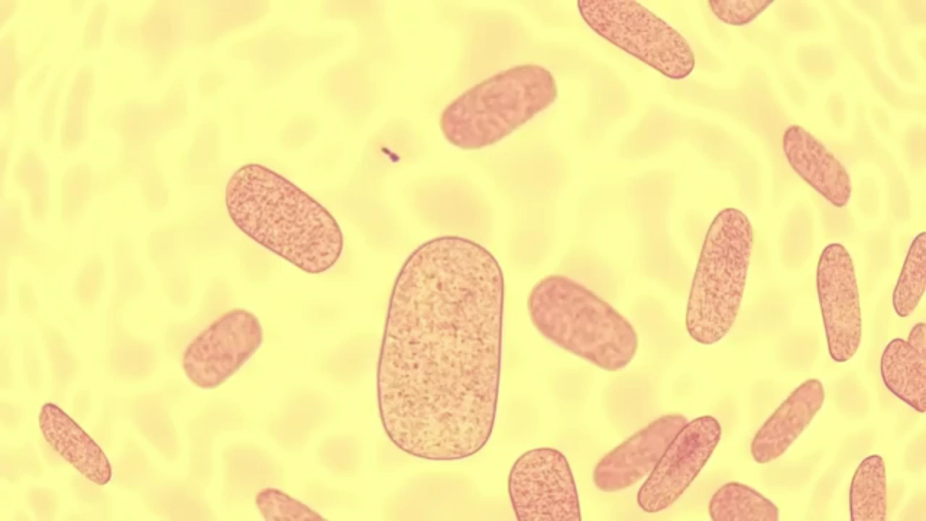
Bacteriophages: biological aspects
Bacteriophages (phages) are natural viruses of bacteria
Attack selectively and exclusively bacteria (at strain level)
They are the most abundant biological entities on Earth
(number of phage visions is estimated to 10³¹)
Phages can be defined as virulent or temperate, depending on their development cycles: lytic or lysogenic
No impact on human microbiome

Slide 6
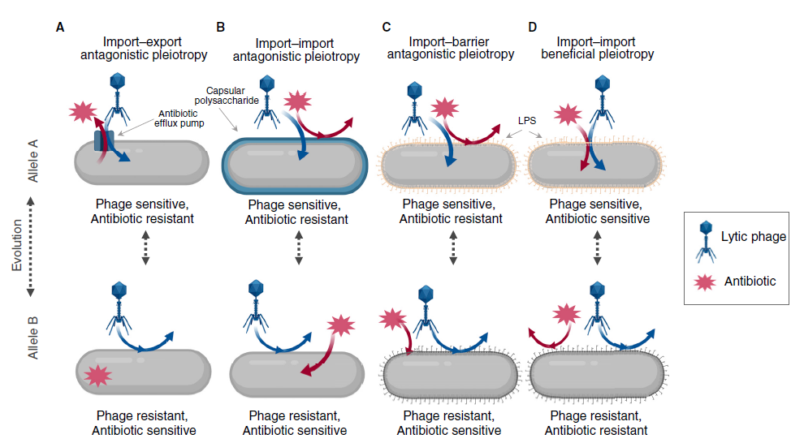
Bacteriophages as antimicrobial agents: characteristics
Fast lytic activity (including AMR strains)
Restoring antibiotic sensitivity
Synergism with antibiotics
Active against biofilm-embedded bacteria
No lysogenic phages or phages carrying toxins, virulence factors and antibiotic resistance genes should be used for therapy
TRADE OFF
TRADE ON
Current Biology 30, R1096–R1169, October 5, 2020
Notes:
We have to distinguish

Slide 7
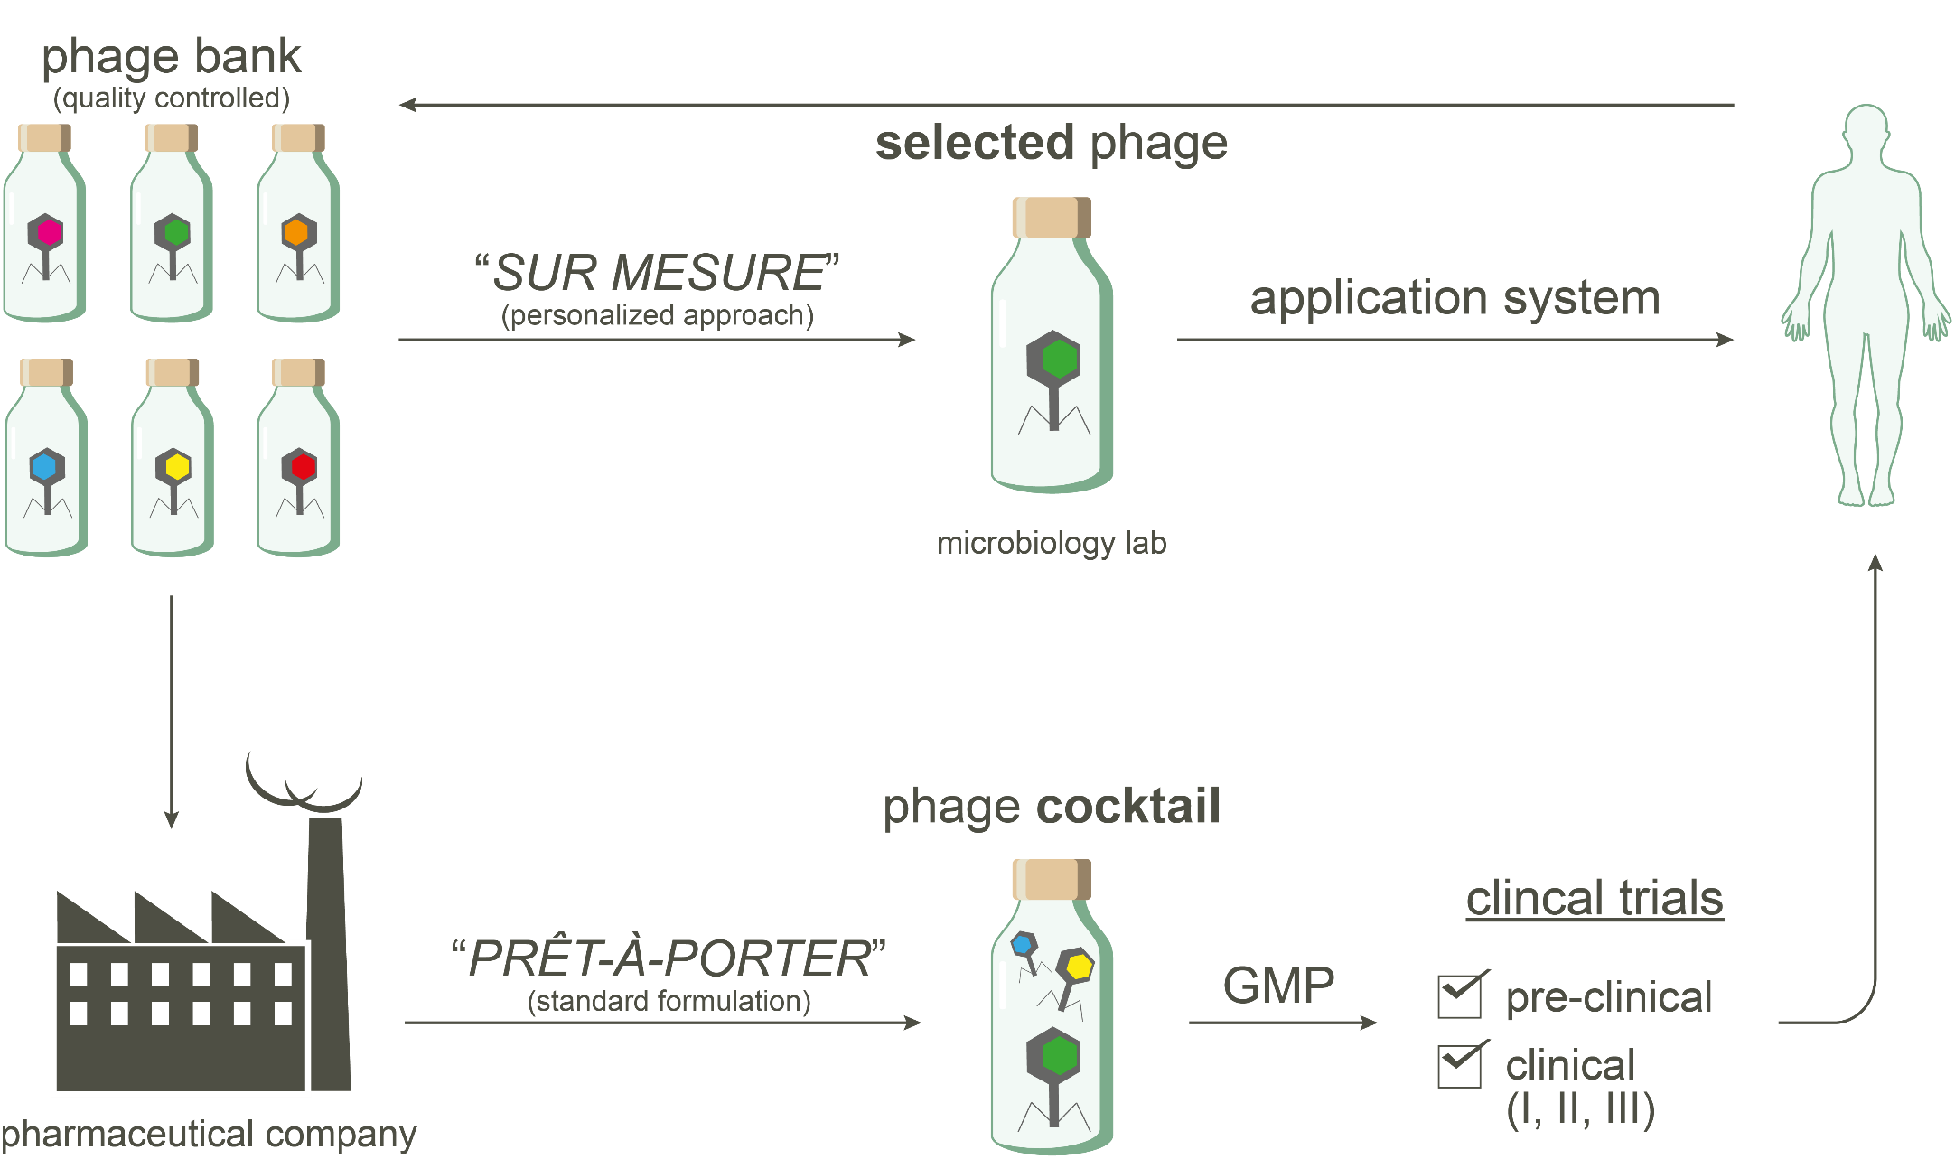

Therapeutic approaches for phage therapy

Slide 8
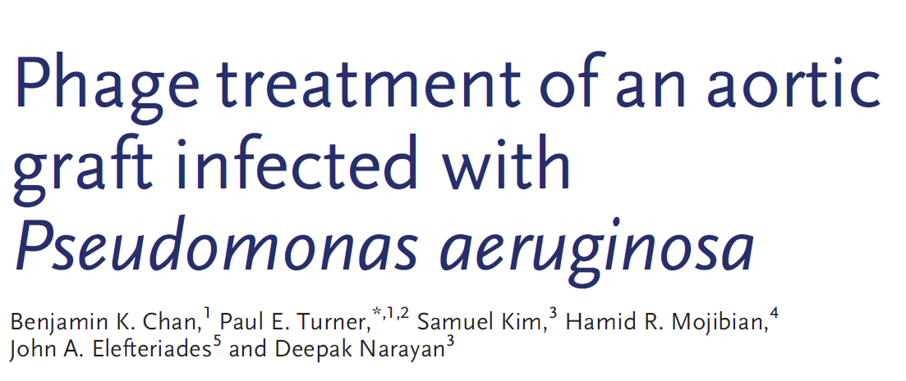
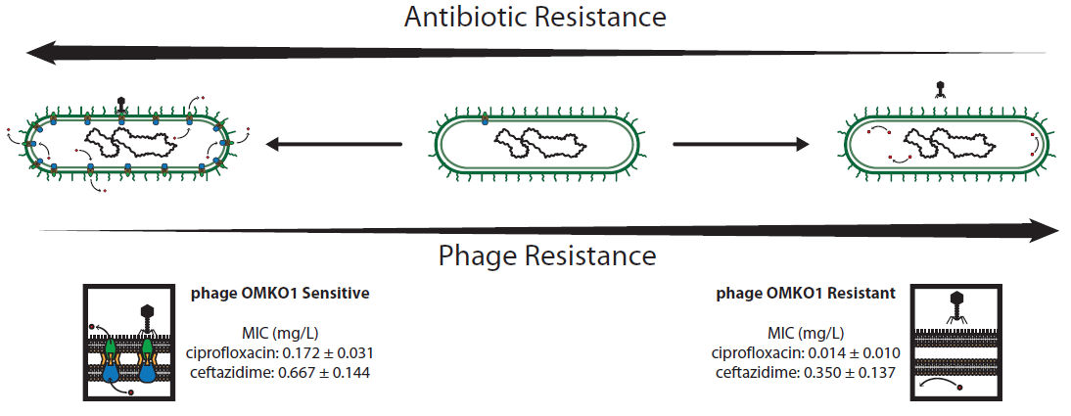
Mechanism of trade-off in clinical practice
Bacteriophage OMKO1 binding to efflux pump proteins in P. aeruginosa was consistent with an evolutionary trade-off: wildtype bacteria were killed by phage whereas evolution of phage-resistance led to increased antibiotic sensitivity.
Chan BK et al, Evolution, Medicine, and Public Health [2018] pp. 60–66

Slide 9
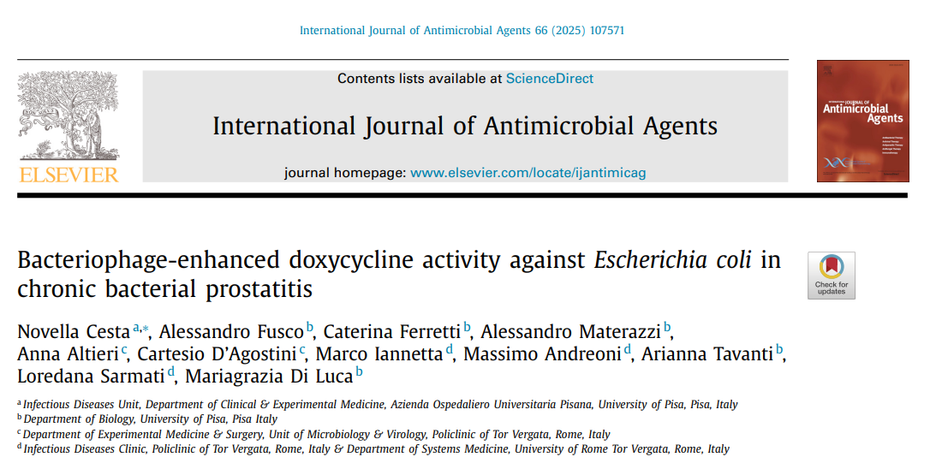
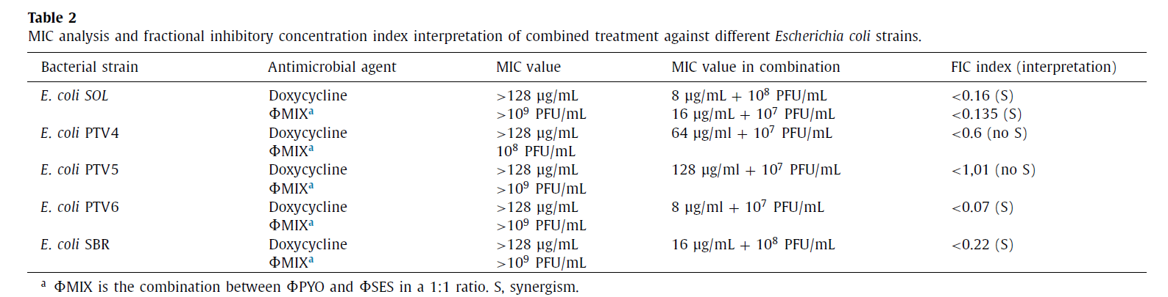
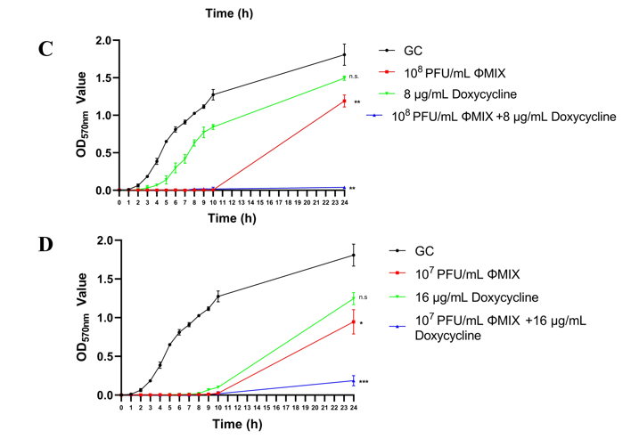
Antibiotic-phage synergism
The in vitro synergy effect between doxycycline and bacteriophages was observed in three of five E. coli isolates
*The commonly used fractional inhibitory concentration (FIC) index was adapted as Tkhilaishvili et al 2018.
If the FIC was ≤ 0.26, the concentrations of agent A and B used in the combination had a synergistic effect

Slide 10


Osteoarticular Infections: Italian experience
CEP, cephalosporin (dosage unknown); CIP, ciprofloxacin (500 mg q8h); CLZ/TAZ, ceftolozane/tazobactam (1.5 gr q8h); CPM, cefepime (2 gr q8h); CRP, C-reactive protein; DAIR, debridement, antibiotics and implant retention; DAP, daptomycin (500 mg q24h); MRP, meropenem (2 gr q12h); MSSE, methicillin-susceptible Staphylococcus epidermidis; MS-Staphylococcus hominis, methicillin-susceptible Staphylococcus hominis; THA, total hip arthroplasty; W, weeks; WBC, white blood cell
Cesta N et al. OFID 2023;10(2)

Slide 11
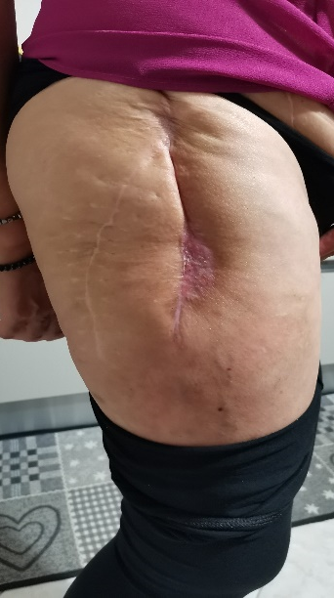
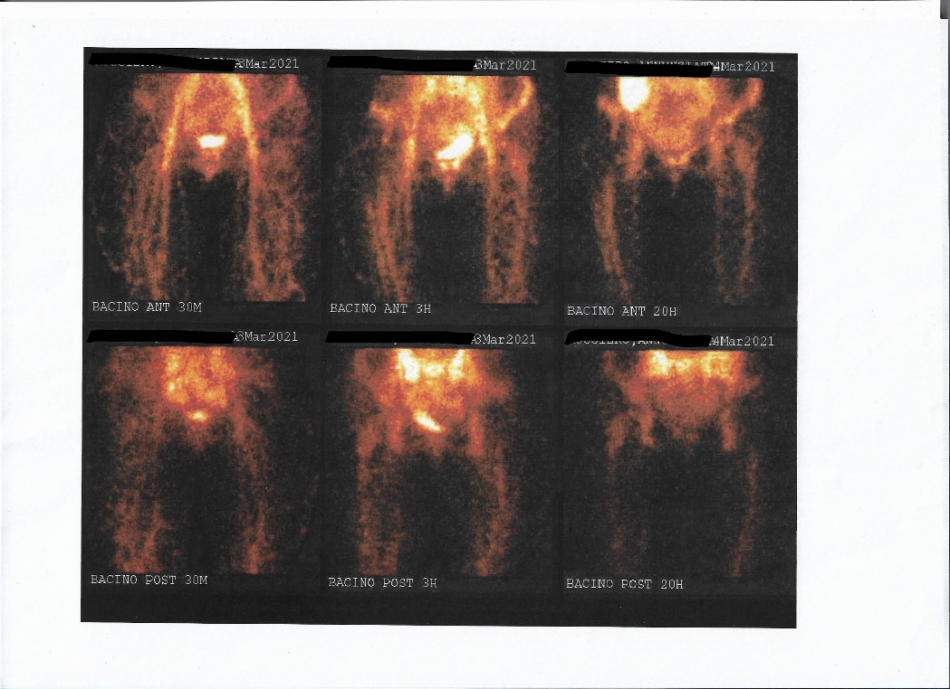
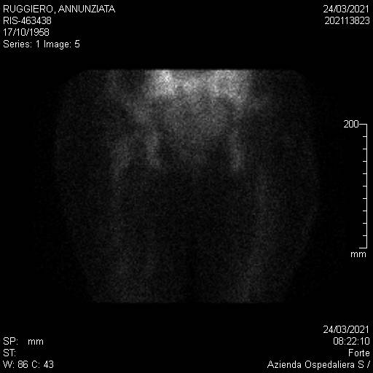
Results from clinical follow-up – 7 m and 2 Y after phage therapy
Images from the Tc-99m-labeled white blood cell scan were performed 7 months after phage therapy.
No leucocytic activity was detected in proximity of the right-hip prosthetic joint
Real-life picture of the patient right-hip in March 2022 (2 years after the end of phage-therapy)
Cesta N et al. OFID 2023;10(2)

Slide 12
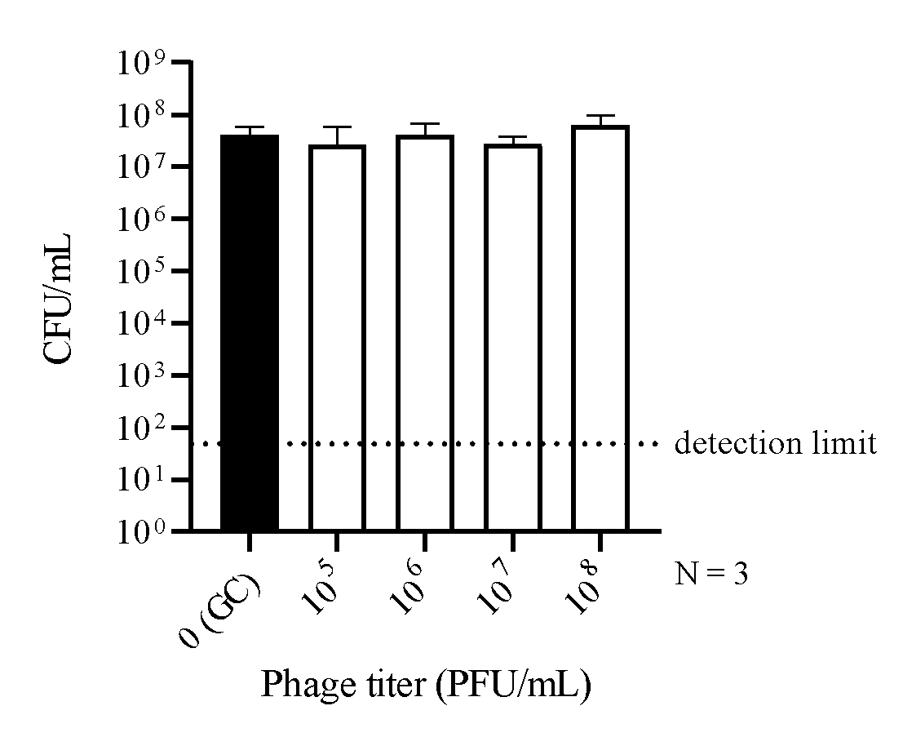
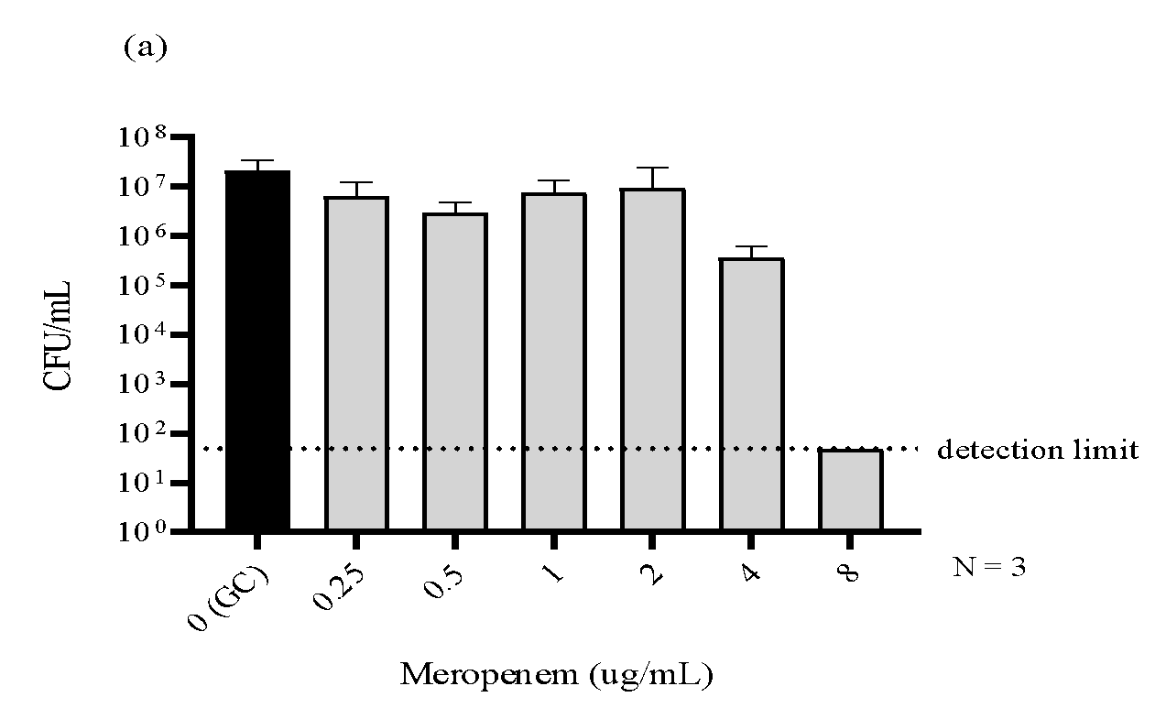
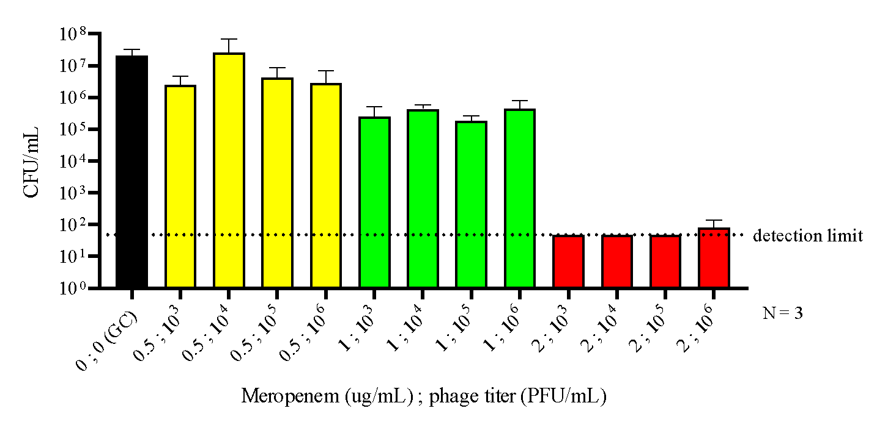
Meropenem-phage synergy in vitro on biofilm (24h)
Cesta N et al. OFID 2023;10(2)

Slide 13
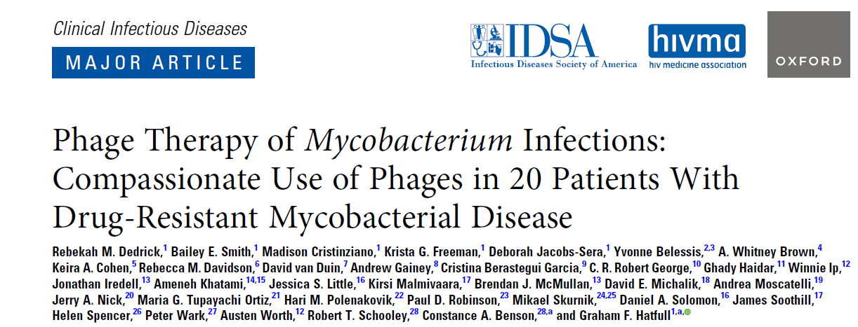
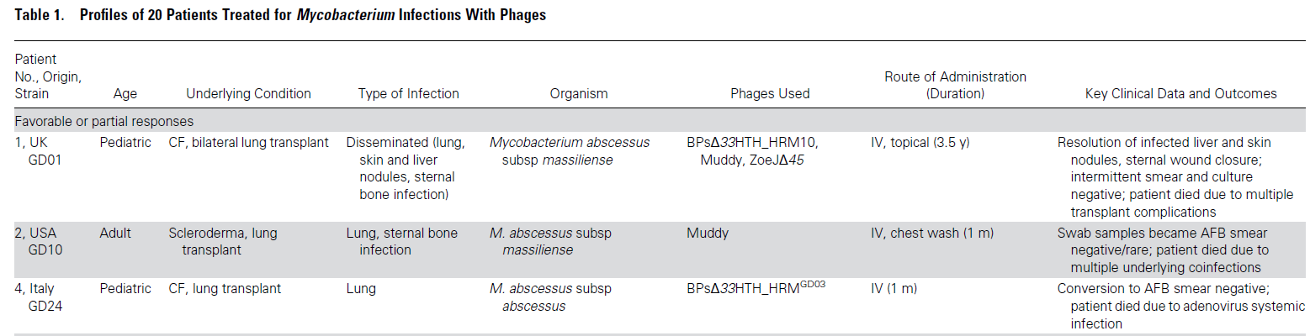
Lower Tract Respiratory Infections
Mycobacterium spp isolates from 200 culture-positive patients with symptomatic disease. One or more lytic phages were identified for 55 isolates.
Iv or aerosolization (or both) phages were administered to 20 patients on a compassionate use basis.
Patients were monitored for AE, clinical and microbiologic responses, the emergence of phage resistance, and phage neutralization in serum, sputum, or bronchoalveolar lavage fluid. All patients also received antimycobacterial treatment with at least 2 drugs.

Slide 14
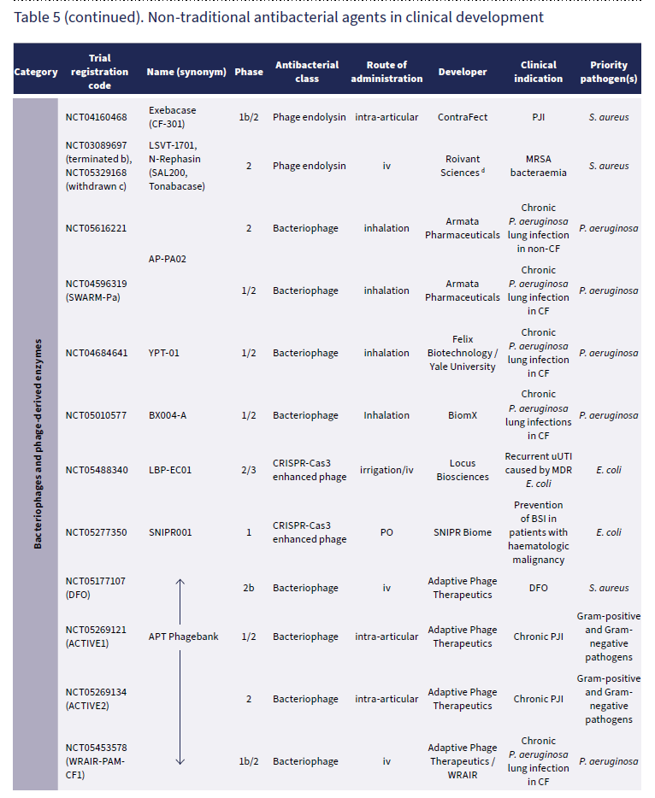
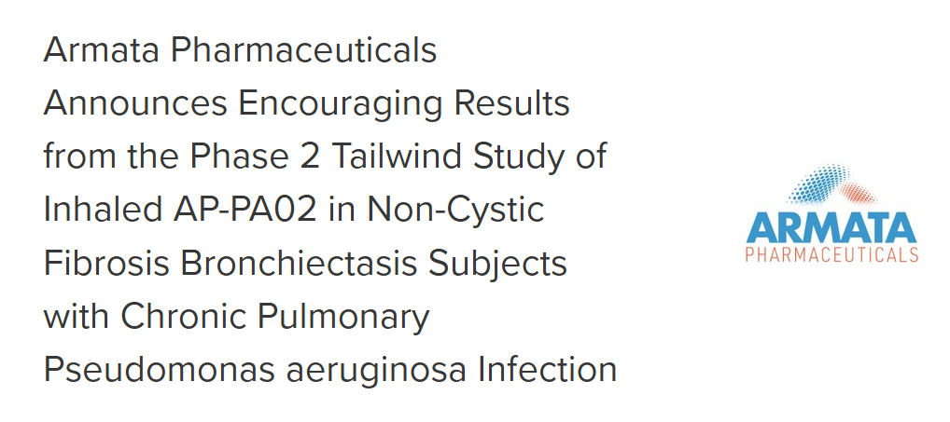
WHO - 2023 Antibacterial agents in clinical and preclinical development: an overview and analysis

Slide 15
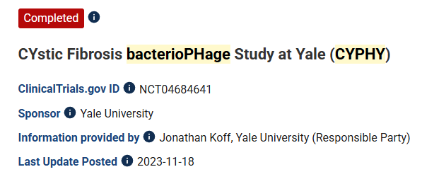
Lower Tract Respiratory Infections
Arm/Group Title | Phage Therapy | Placebo
Arm/Group Description | Participants will be randomized to receive 3mL phage therapy, nebulized daily for 7 days. Standard Dose YPT-01: Participants will be randomized to receive the standard dose of phage therapy YPT-01. | Participants will be randomized to receive the 3mL placebo, nebulized daily for 7 days. Placebo: Participants will be randomized to receive the placebo.
Overall Study
Started | 4 | 4
Completed | 4 | 2
Not Completed | 0 | 2
Primary Outcome: there was no difference between groups in sputum P. aeruginosa CFU/ml change from baseline to Day 14. There was no difference in safety outcomes between the two groups over the six months that patients were followed.
Secondary Outcomes: no difference between groups in lung function during the month following treatment (screening, day 14, day 21, day 28, and day 56)

Slide 16
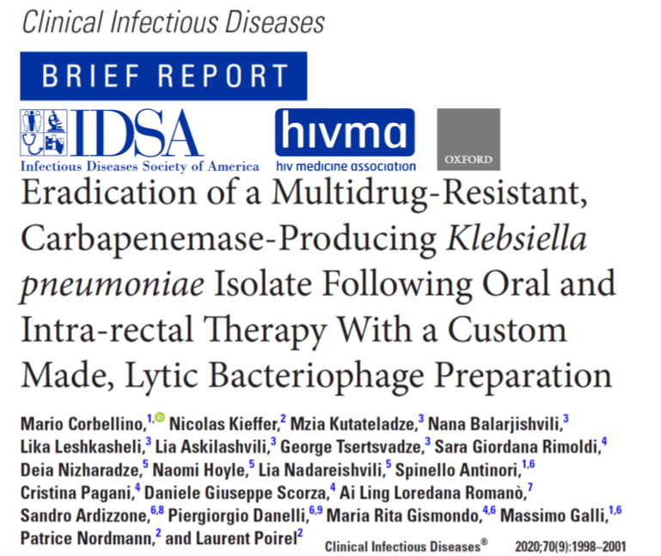





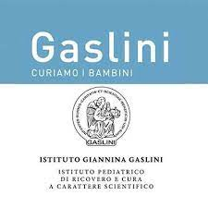

Italian Pathway…
2018
2019
2020
2021
First time Compassionate Use Approval

Slide 17





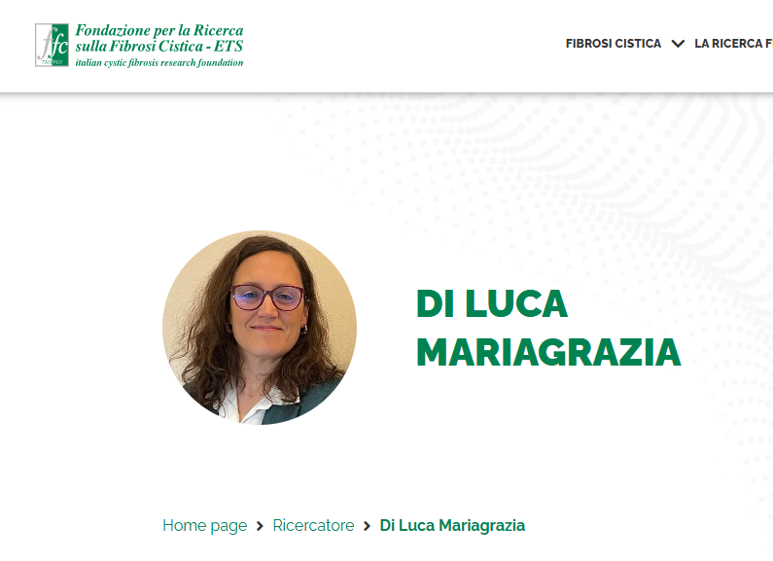




Italian Pathway…
PT Study Group (SIMIT)
Bacteriophages Study Group (SIM)
Bacteriophage Lab Centre (Pisa)
Compassionate Use Approval
Sternal prosthesis infection due to P. aeruginosa
2023
2024
2025
2026…
LVAD infection due to P. aeruginosa
MSSA chronic TKA infections
Wound infection due to P. aeruginosa
Lung infection due to P. aeruginosa in CF
Compassionate Use Approval
Genito-urinary infection due to E. coli
PT in Lungs Infections by MAB in CF patients – Funding by Italian Research Foundation for CF

Slide 18




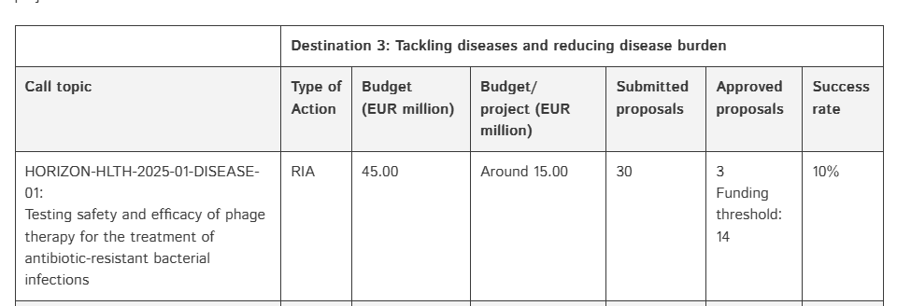
Call 2025
P-PEAKS: Personalized-Phage Against E. coli with IV Antibiotic to Knockout Stable Biofilms in Urinary Tract Infections
…Proposals should aim to develop phage-based therapies to treat bacterial infections that do not respond to conventional treatment options…
https://research-and-innovation.ec.europa.eu/funding/funding-opportunities/funding-programmes-and-open-calls/horizon-europe_en
https://accelopment.com/blog/funding/horizon-health-results-statistics-2025/

Slide 19



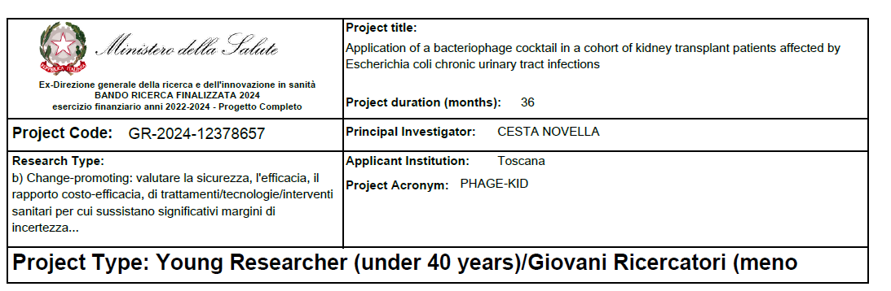
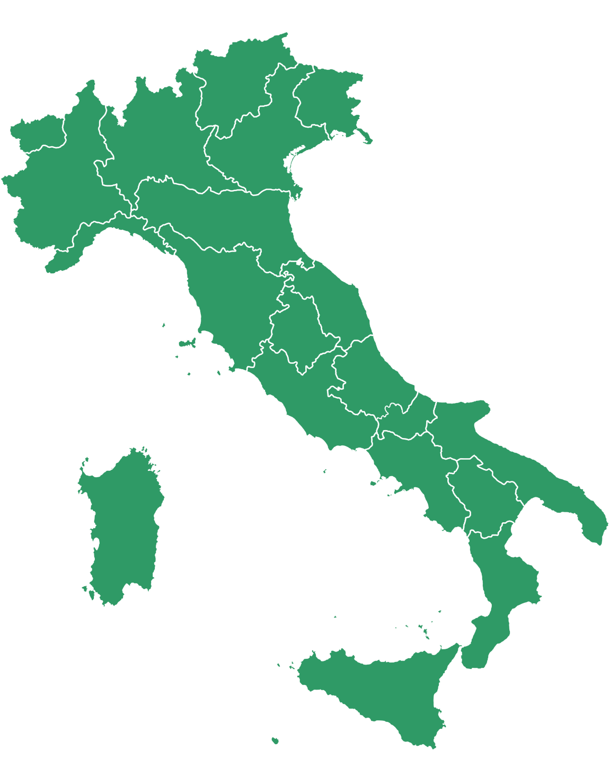

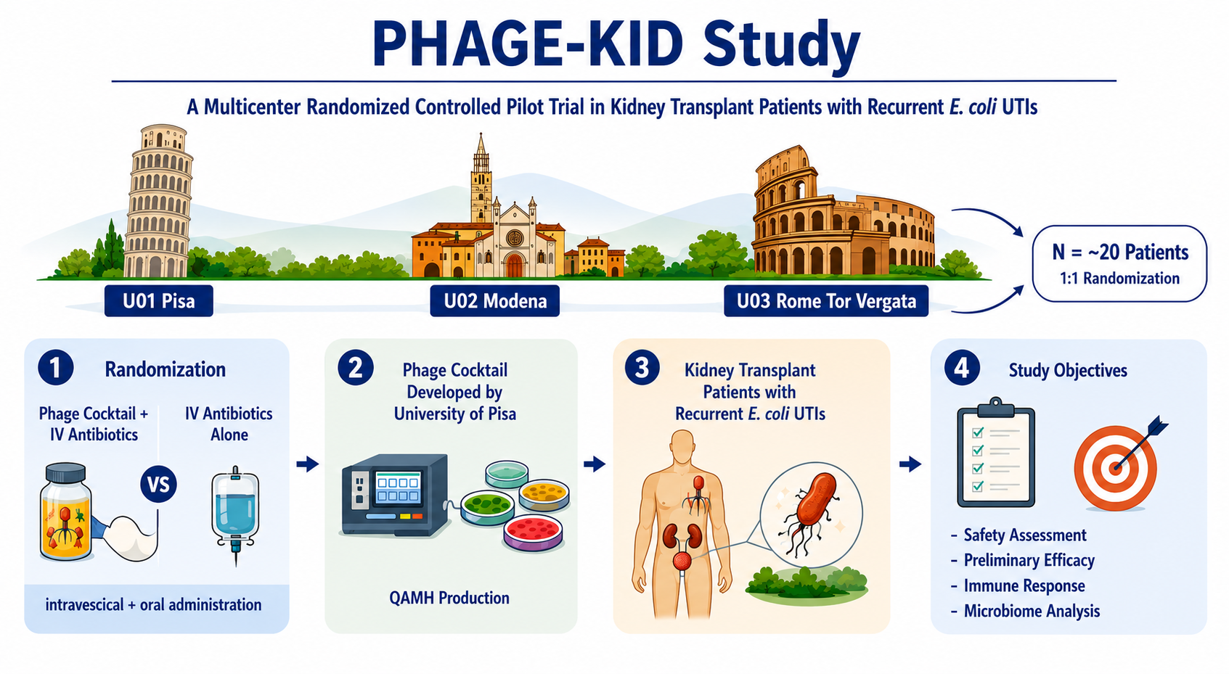

Slide 20
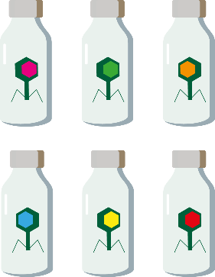

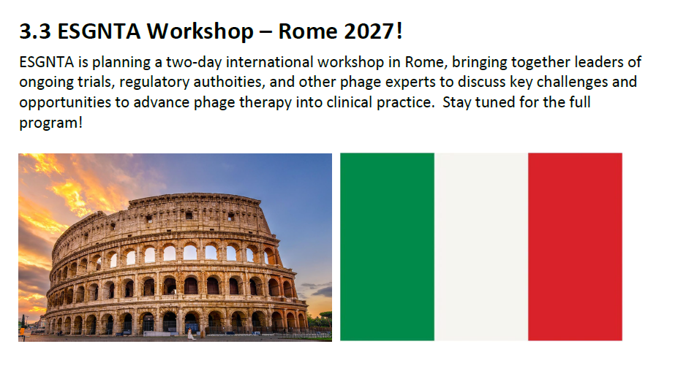

Future Perspective
1) Collaboration with the research laboratory of University of Pisa and the General Manager of Azienda Ospedaliera Universitaria Pisana to set up the Proof of Concept of the phage-based medical products manufacturing process (Magistral preparation)
(Magistral preparation in a referral clinical centre)
“Phage bank”
2) Starting a dialogue with the Italian Medicines Agency (AIFA) to discuss the approval of a linear and rapid pathway for the use of phage therapy in Italy.

Slide 21
Conclusions
Phage therapy (PT) is a reality (also in Italy!), the interests in it is widespread, and its therapeutic usefulness is widely recognised
Efficacy has been demonstrated in many clinical cases, but trials will help to obtain more information on it
One-fits-all approach (trials ongoing) will help to standardize the phage-based therapy
The implementation of personalized phages therapy might be a strategy to face bacterial outbreaks and treat chronic infections
A well-characterized and certified bank of therapeutic phages is needed
A dialogue with the regulatory authority remain a fundamental step to overcome the existing barriers and allowed an easier access to phage therapy (production-referral centres)
A multidisciplinary task force is required to develop phage therapy

Slide 22
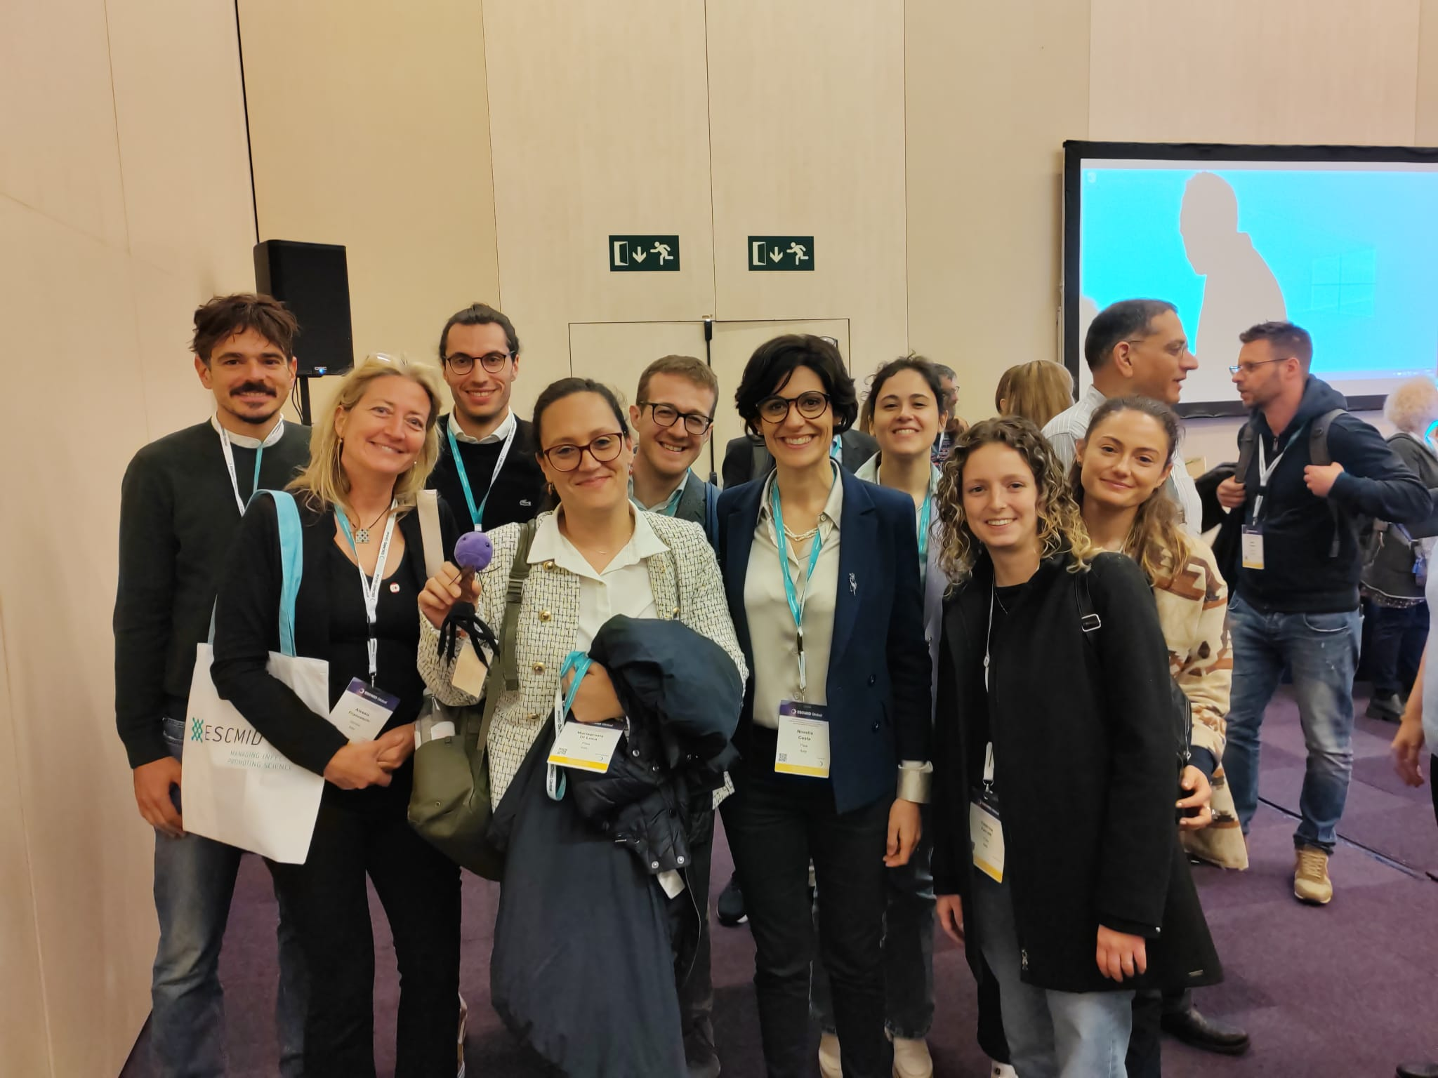
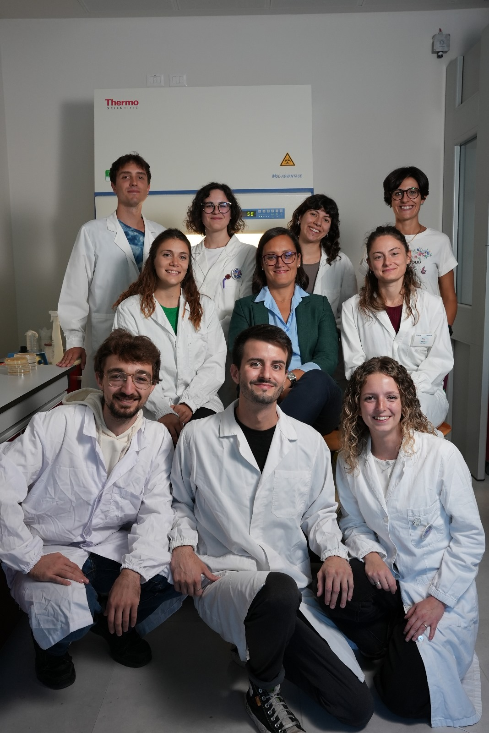

Slide 23

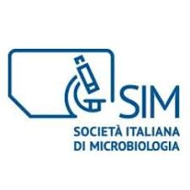

Acknowledgements
Phage Therapy Study Group
Dr. Matteo Passerini
Dr. Adriana Cervo
Prof. Carlo Tascini
Prof. Loredana Sarmati
Dr. Mzia Kutateladze and Collaborators
Prof. Mariagrazia Di Luca
Dr. Caterina Ferretti
Dr. Sarah Djebara
Dr. Maya Merabishvili
Dr. Benjamin Chan
Infectious Diseases Unit
Prof. Marco Falcone
Prof. Alberto Borghetti
Dr. Giusy Tiseo
Dr. Lorenzo Roberto Suardi
Dr. Manuela Pogliaghi
Microbiology Unit
Dr. Simona Barnini
Dr. Cesira Giordano
Dr. Alessandro Leonildi
Hospital Pharmacy Unit
Dr. Ielizza Desideri
Dr. Shawna McCallin
Dr. Gina Suh
Dr. Jean-Paul Pirnay
Prof. Ran Nir- Paz
Dr. Greg German
Dr. Lorenzo Andreani
Dr. Francesco Pecchia
Dr. Sara Occhineri
Dr. Alberto Bolletta
Prof. Paolo Parchi
Prof. Massimo Andreoni

Slide 24
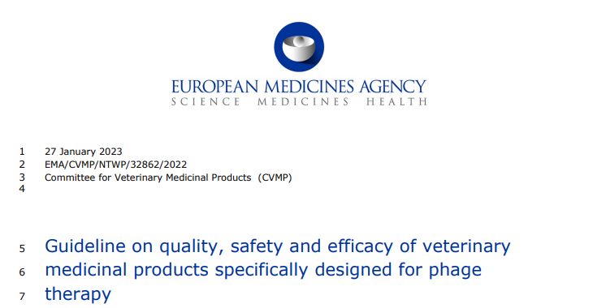
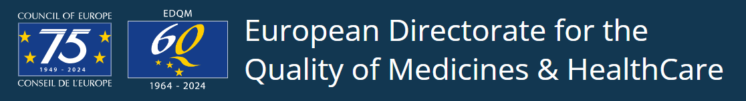
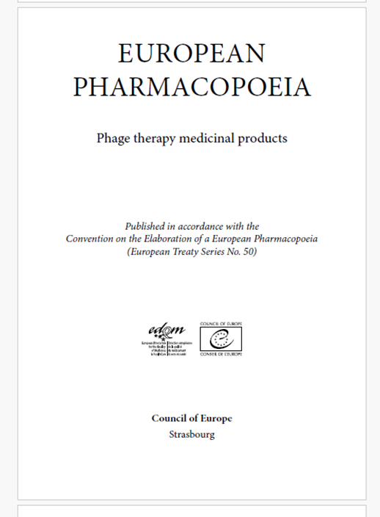
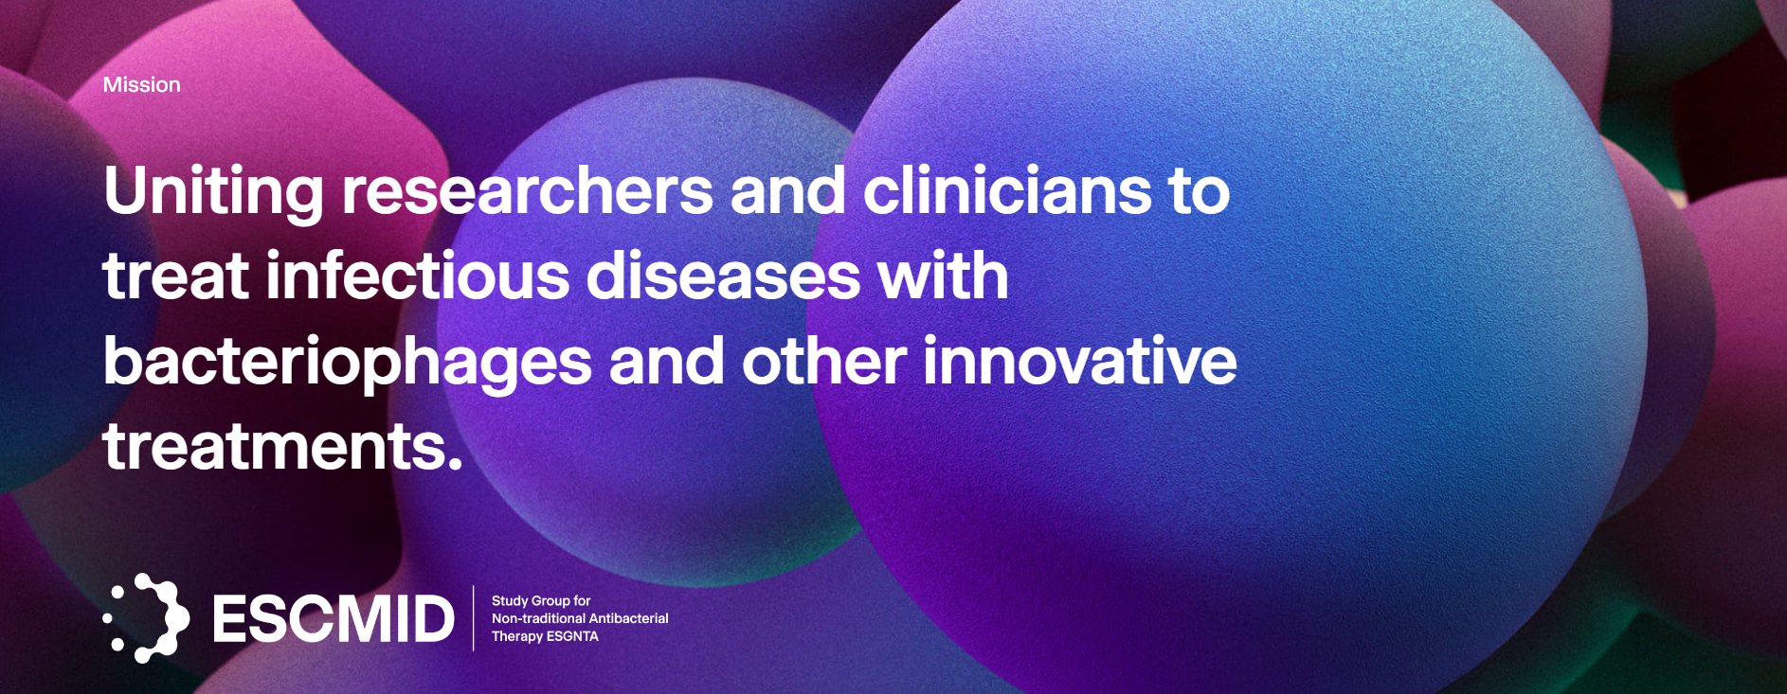
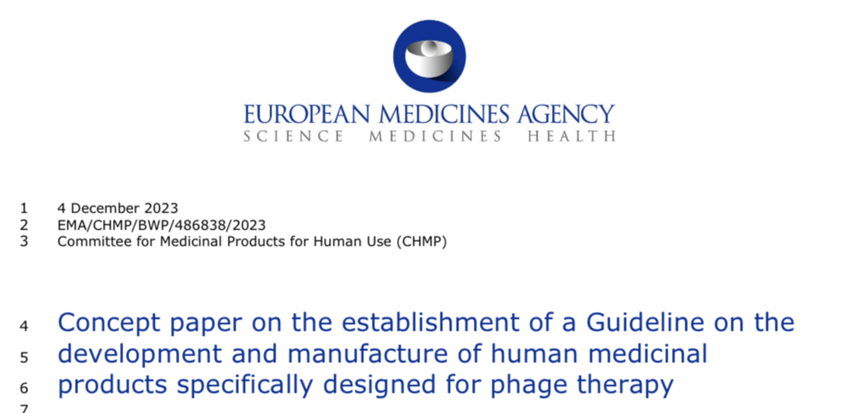

Regulatory framework in Europe (2025)
Natural bacteriophages used as therapeutics are considered by the European Medicines Agency (EMA) medicinal products, placing them under the Directive 2001/83/EC on the Community code relating to medicinal products for human use, under the category of biologicals
ESGNTA
ESCMID Study Group for Non-traditional Antibacterial Therapy
Phagogram

Slide 25
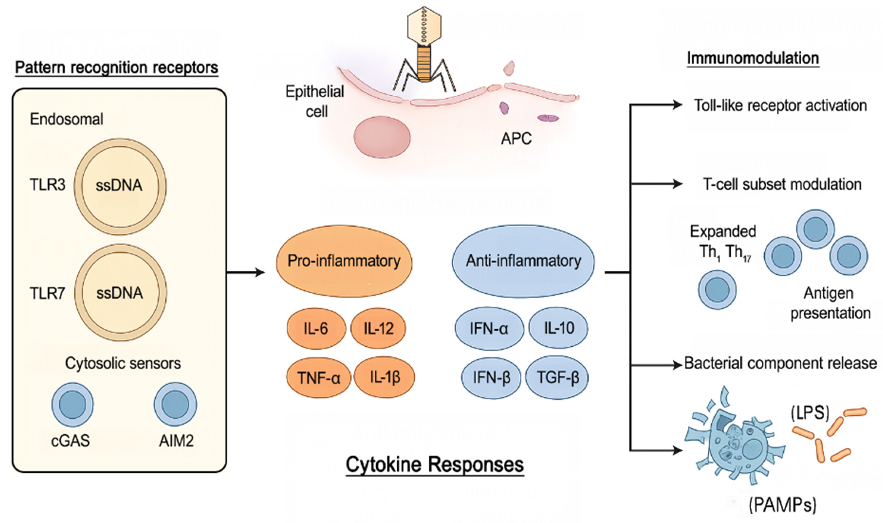
Immunomodulation of phages
Phages interact with immune receptors leading to cytokine responses: pro-inflammatory (IL-6, IL-12, IL-1β) and anti-inflammatory (IFN-α, IFN-β, IL-10, TGF-β). Immunomodulatory mechanisms include receptor activation, T-cell subset modulation (Th1, Th17), and bacterial component release (LPS, peptidoglycan) affecting immune homeostasis.

Slide 26
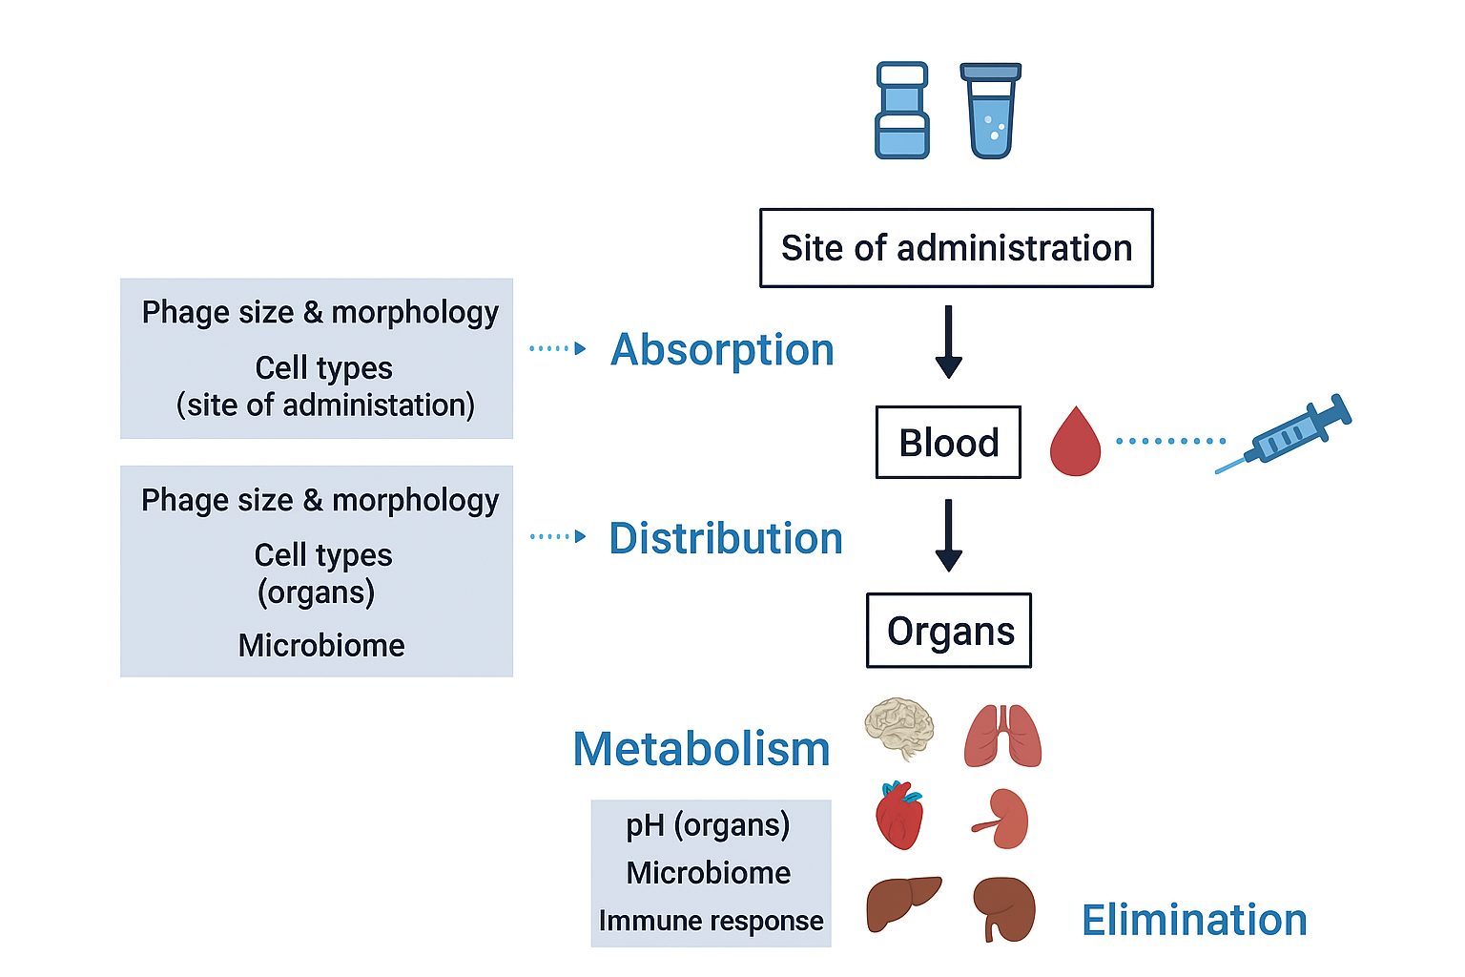
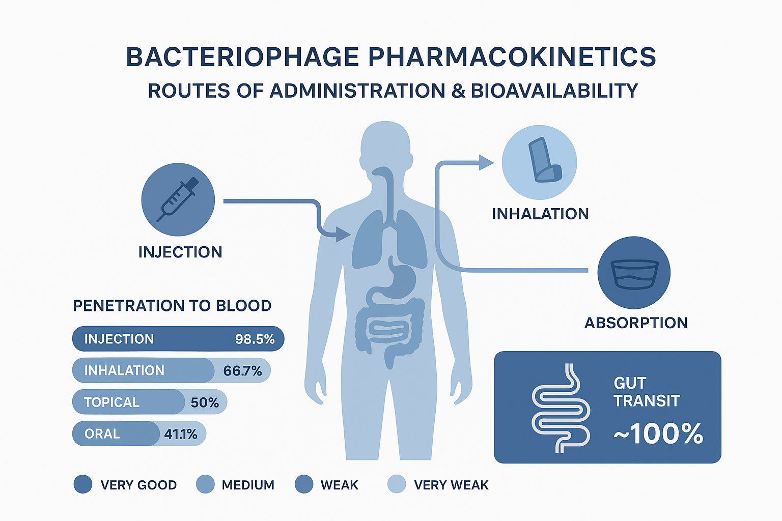
Pharmacokinetics of phages
D: highest phage accumulation detected in the spleen and liver after IV administration
D: Phages translocate in a bidirectional rather
than a unidirectional manner: monocyte/macrophages and cells
M: spleen and liver (>> Kupffer cells)
Adapted from Sue C. Nang, Clin Microbiol Infect 2023;29:702
Adapted from Dabrowska et al, Med Res Rev. 2019;1–26

Slide 27
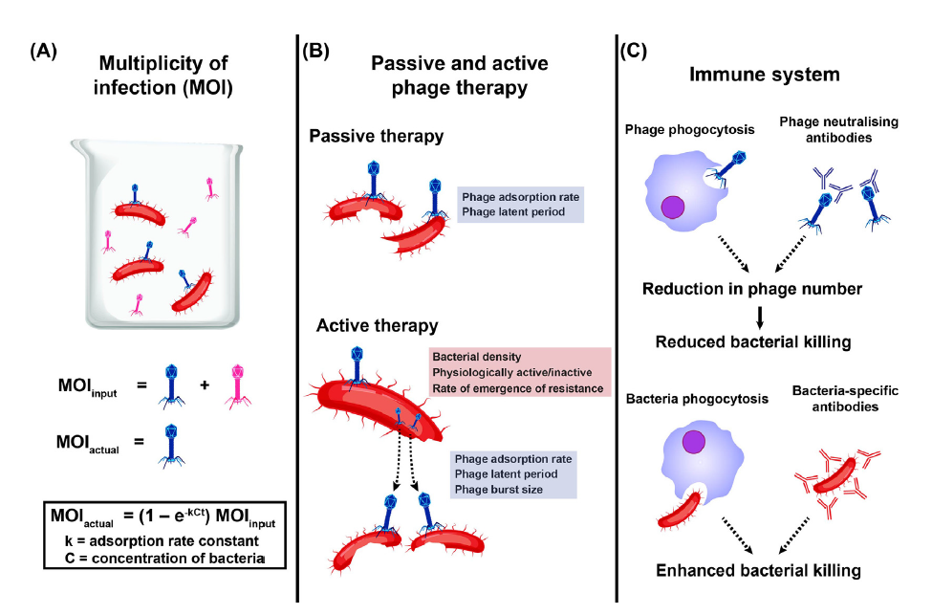
Pharmacodynamic of phages
The induction of phage-neutralizing antibodies is influenced by the route of phage administration, site of infection, host immune status, and duration of the therapy.
Adapted from Sue C. Nang, Clin Microbiol Infect 2023;29:702

